Slide 1
Managing Digital Records:
Administration Change Edition
Francesca Perez Evans
Records Management Consultant

Slide 2






G.S. 132: Public Records Law
§ 132
“made or received pursuant to law or ordinance in connection with the transaction of public business”

Slide 3









Public Records Can Be…
G.S. 132-1

Slide 4


Public Record?

Slide 5


Public Record Requests
§ 132-6. Inspection, examination
and copies of public records.
(a) Every custodian of public records shall permit any record in the custodian's custody to be inspected and examined at reasonable times and under reasonable supervision by any person, and shall, as promptly as possible, furnish copies thereof upon payment of any fees as may be prescribed by law. As used herein, "custodian" does not mean an agency that holds the public records of other agencies solely for purposes of storage or safekeeping or solely to provide data processing.
G.S. 132-6

Slide 6

NC GS § 143-318.10
NC G.S. § 125-19
20 USC § 1232g
NC G.S. § 132-1.7
CONFIDENTIAL
42 USC § 1320d-6
NC GS § 132-1.2(c)
01 NCAC 05B. 0103
NC G.S. § 115D-29
NC G.S. § 115C-174.13(a)
NC G.S. § 70-18
NC G.S. § 132-1.10 (b)(5)

Slide 7






Slide 8
Custodial Agency
§ 132-6. Inspection, examination
and copies of public records.
(a) Every custodian of public records shall permit any record in the custodian's custody to be inspected and examined at reasonable times and under reasonable supervision by any person, and shall, as promptly as possible, furnish copies thereof upon payment of any fees as may be prescribed by law. As used herein, "custodian" does not mean an agency that holds the public records of other agencies solely for purposes of storage or safekeeping or solely to provide data processing.

Slide 9


Record Copy?
Retention & Disposition Schedule?
Reference Copy?

Slide 10
Record Copy
Reference Copy
Transitory Record

Slide 11




Record
Reference
Transitory
  Original Or Official Copy
  Copy Intended For Easy Access To Information
  Minimal
  Intrinsic Value

Slide 12

Creation
Active Use
Retention
Disposition

Slide 13
What to Keep
For How Long
What to Keep
Community Colleges

Slide 14
G.S. 121: Archives & History Act
§ 121

Slide 15
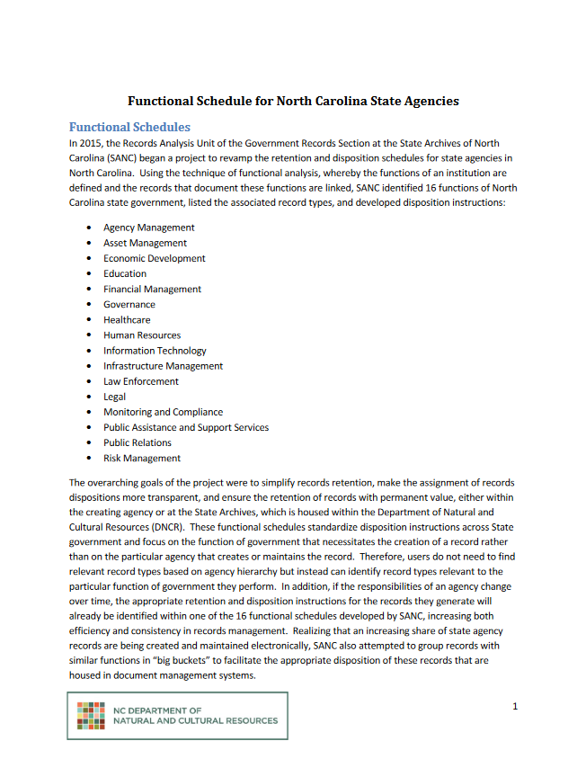
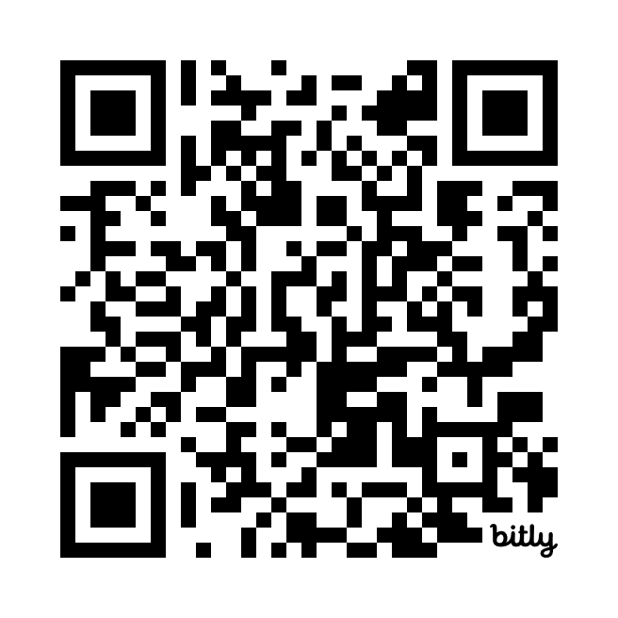
bit.ly/SANC-FS
Functional Schedule for North Carolina State Agencies

Slide 16
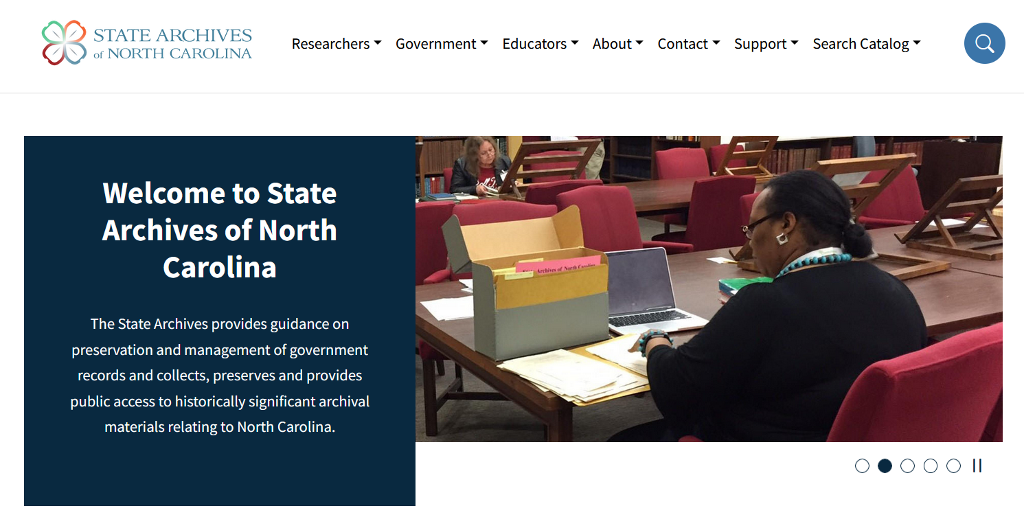


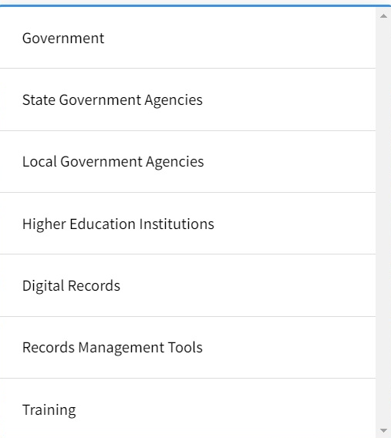

Slide 17
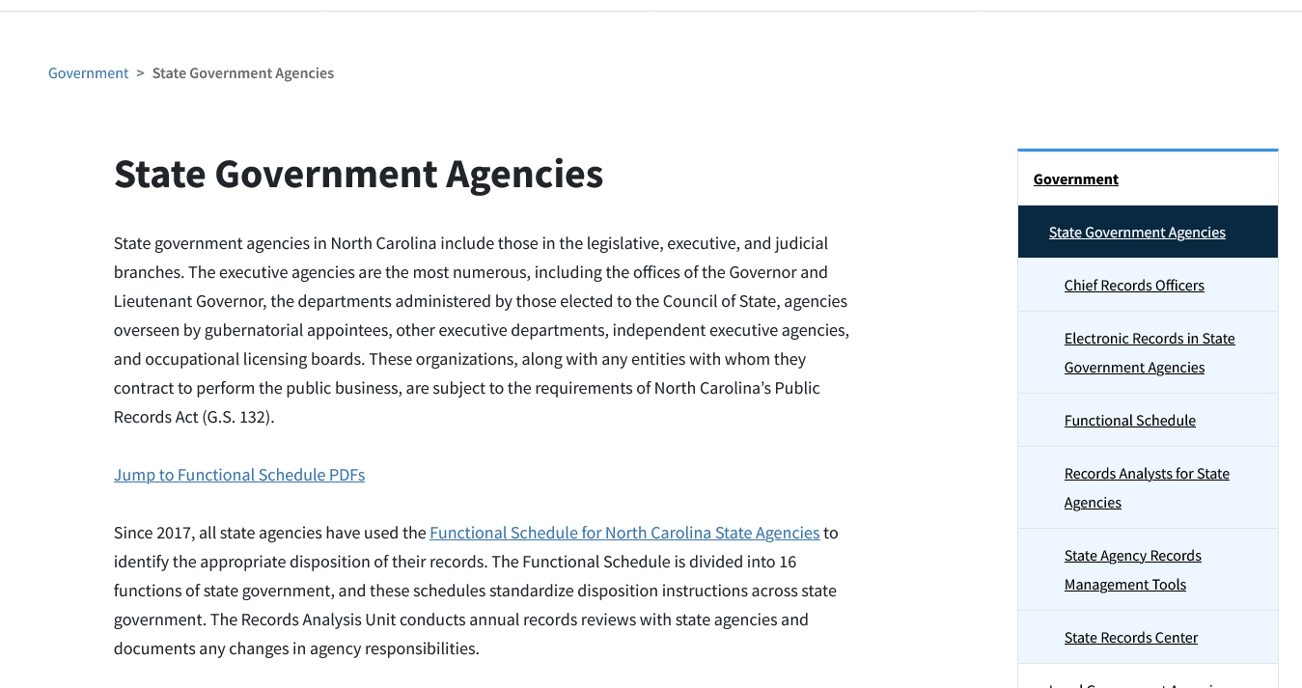

Slide 18
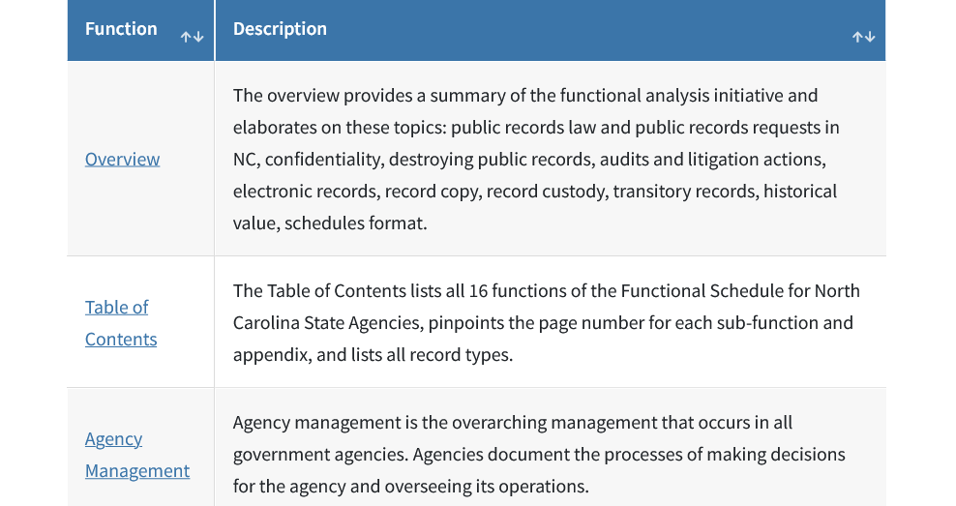

Slide 19
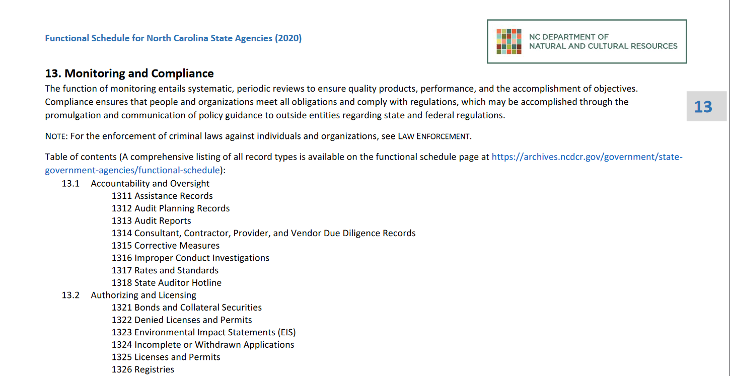

Slide 20
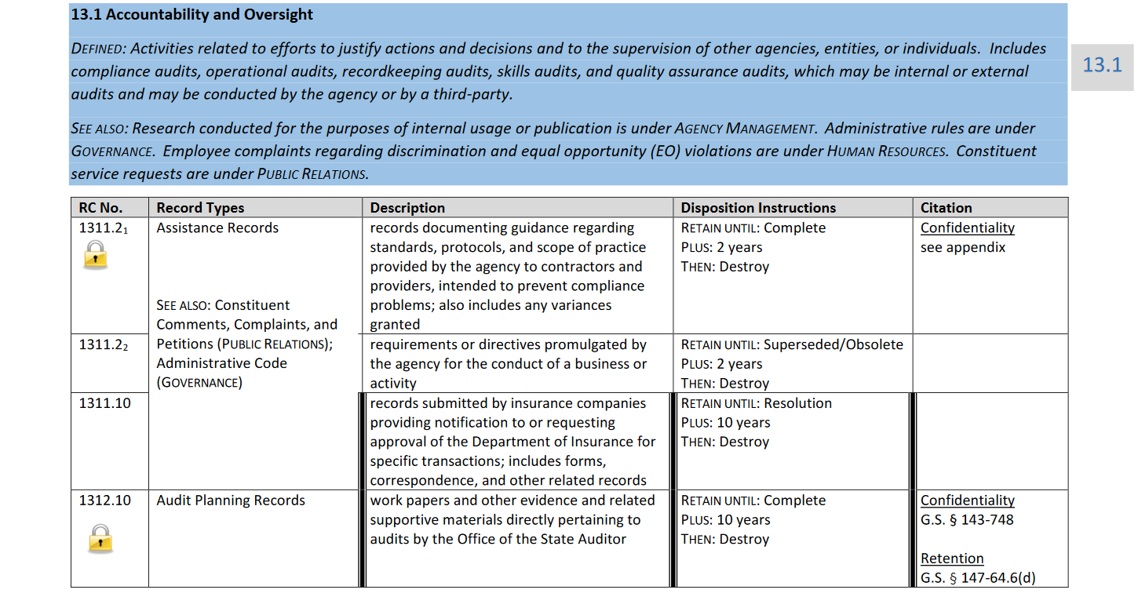

Slide 21

Audits, Litigation Holds, & Public Records Requests
Remember:
  If there’s an ongoing audit, a public records request, a lawsuit, or even a "reasonably anticipated" lawsuit, you may be required to retain records, including the metadata associated with electronic records, EVEN IF THEY COULD BE DESTROYED LEGALLY UNDER THE RETENTION RULES

Slide 22




State Archives Records Analysis Unit
?

Slide 23
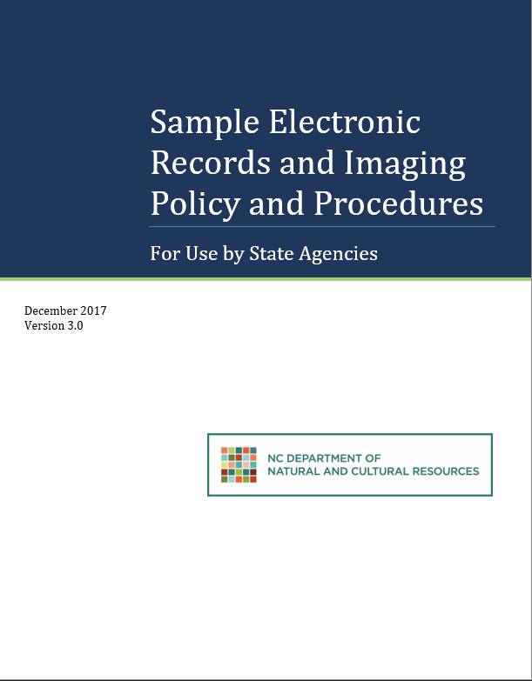
Digital Records Management
Electronic Records Policy
Specifies guidelines and best practices that the agency agrees to follow related to managing both born-digital and scanned electronic records.
bit.ly/SANC-Tools01

Slide 24
Responsible Parties
Agency Supervisor/Division Director
Managerial Staff
IT Department
Records Creators

Slide 25
Appropriate Storage Location
Networked servers with off-site backups are a preferred medium
for storage.
Consider who does and does not need access to a particular document when selecting a storage location.
Access rights should be managed by IT and assigned by a supervising authority within the agency to prevent unauthorized viewing of records.
Confidential records should utilize restrictions such as password protection or encryption.

Slide 26
Long-Term Maintenance
Because electronic records rely on technology to be accessible, they are vulnerable to obsolescence and corruption.
Ensure that storage drives are being backed up regularly by IT.
Periodically audit files for integrity and possible obsolescence.
  Follow procedures for restoring backups.
  Migrate files to updated hardware/software or convert to open-standard file formats that are more likely to be accessible in the future.

Slide 27
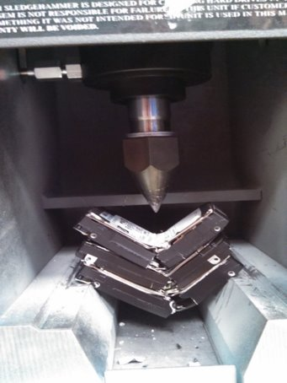
Destruction of Digital Records
The data, metadata, and physical media are destroyed in such a manner that the information cannot be read or reconstructed under any means.
  Purge hard drives from computers and copiers before surplussing
  Hitting “delete file” isn’t good enough

Slide 28







How Do I Manage All My Digital Files?

Slide 29
Records Management Tips: Digital Files
File Naming
Organization
Storage

Slide 30
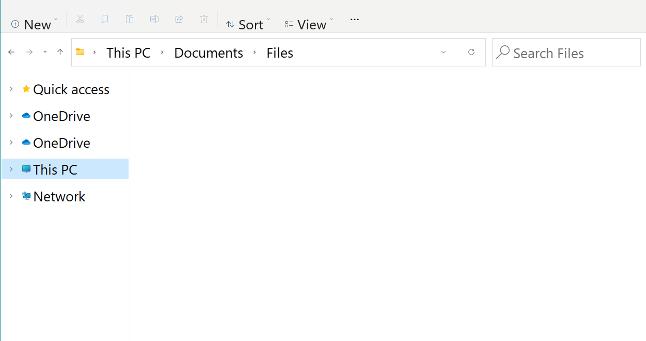



final report – Copy(2)
Form NEW
graphs.for.report
form data from last year
Meeting notes
slides.from.staff.meeting
final report #2 comments
report draft1

Slide 31
Report_v2_Final
Form_2024
Report_Graphs
Form-Data_2023
StaffMeeting_Notes_20240120
StaffMeeting_Slides_20240120
Report_v2_Comments
Report_v1_Draft

Slide 32
File-Naming Best Practices
Brief
Descriptive
Date
Version

Slide 33


Acceptable Special Characters
Special Characters To Avoid
\ / : ; * ^ # ? ! “ ” < > , .
Dashes ( - )
Underscores ( _ )
% | [ ] { } ( ) & $ ~ @ ` ‘

Slide 34
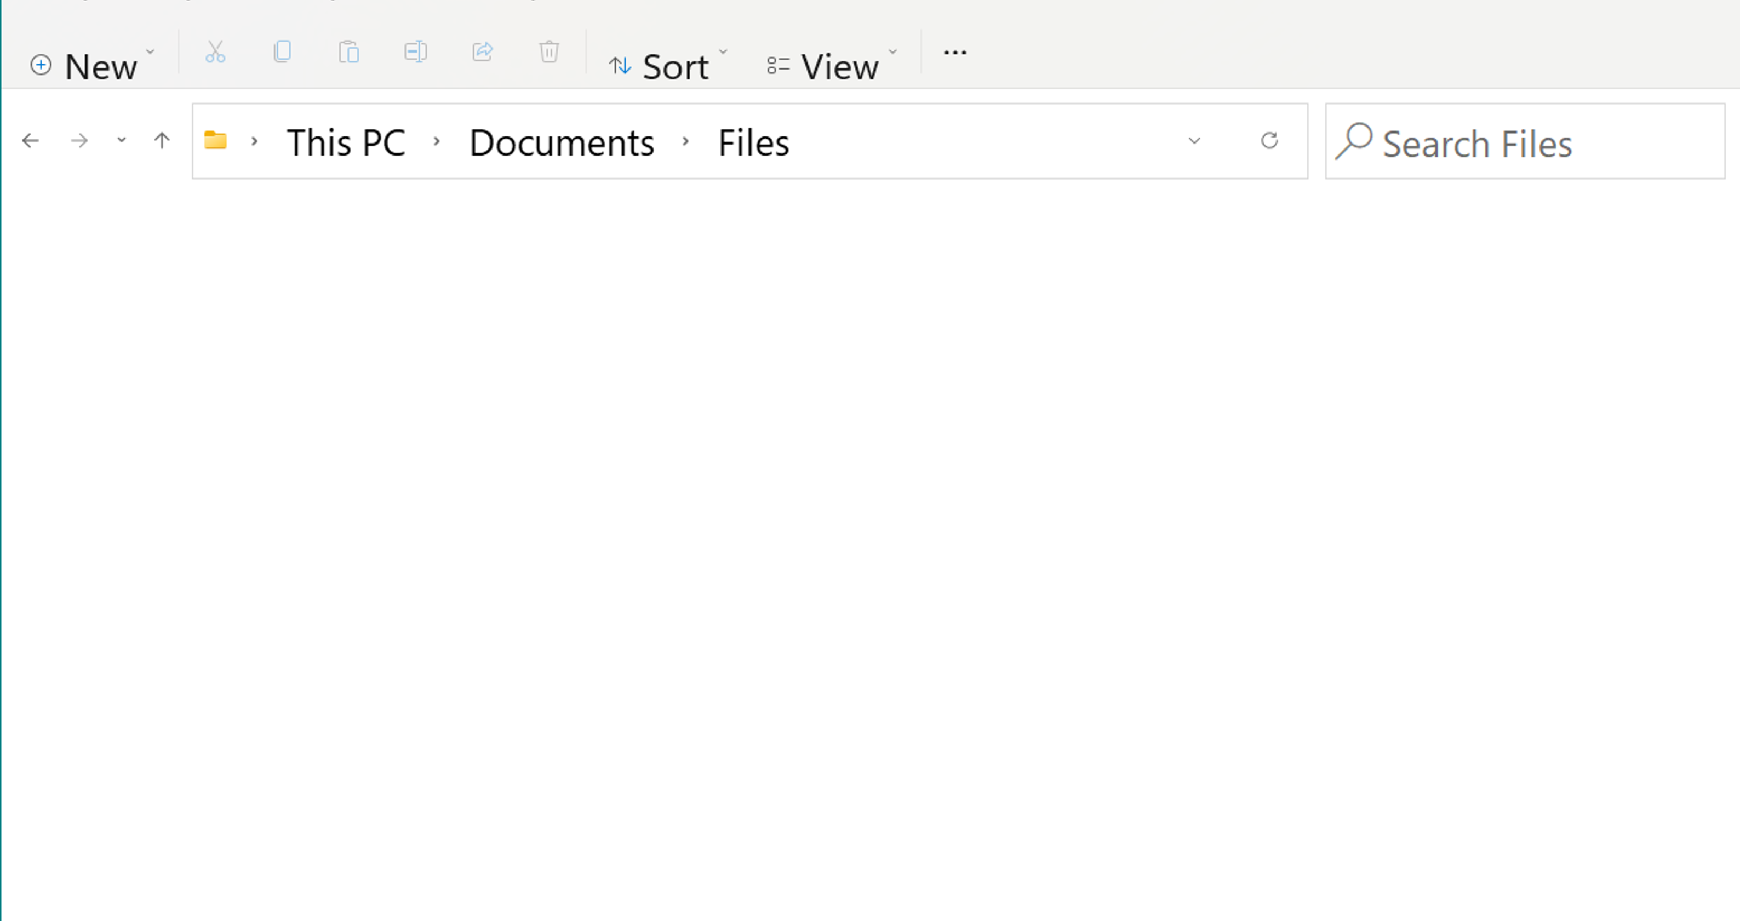




Documents
MonthlyReports
2020 Reports
2021 Reports
202301_Report
202302_Report
202303_Report
2022 Reports
2023 Reports
2024 Reports
Trainings
Presentations
202304_Report
202305_Report
202306_Report

Slide 35
C:\Users\user\Documents
\Folder
\Folder
\Folder
\Folder
\Folder
Folder
Folder
Folder

Slide 36

C:\Users\user\Documents
\Folder
\Folder
\Folder
\Folder
\Folder
\Folder
Folder
Folder
Folder
Error: Cannot Open File
C:\User\user\Documents\Folder\Folder\Folder\Folder\Folder\Folder\File

Slide 37
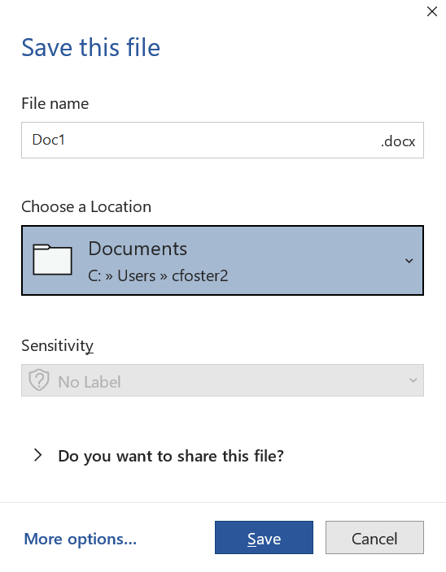


Slide 38




Slide 39



Personal
Workgroup
Organizational
  Relevant To
  You Only
  Can Be Shared With Workgroup
  Can Be Shared With Entire Organization

Slide 40
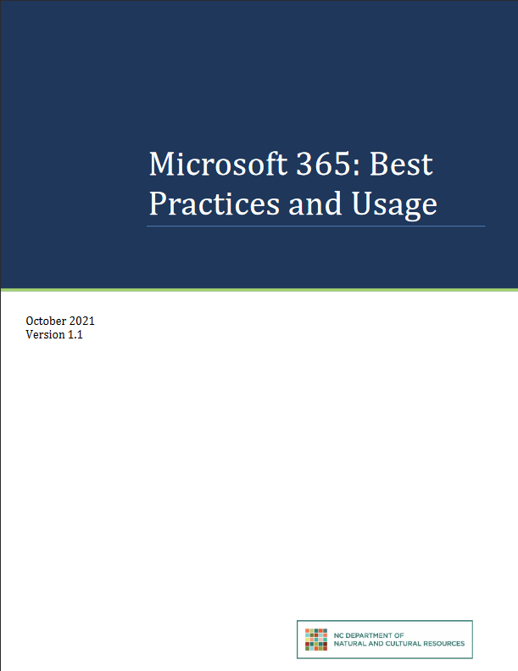


Microsoft 365: Best Practices and Usage
A technical overview of OneDrive, SharePoint, and related applications.
Records management best practices for using OneDrive and SharePoint in your agency.
bit.ly/SANC-BPFN

Slide 41
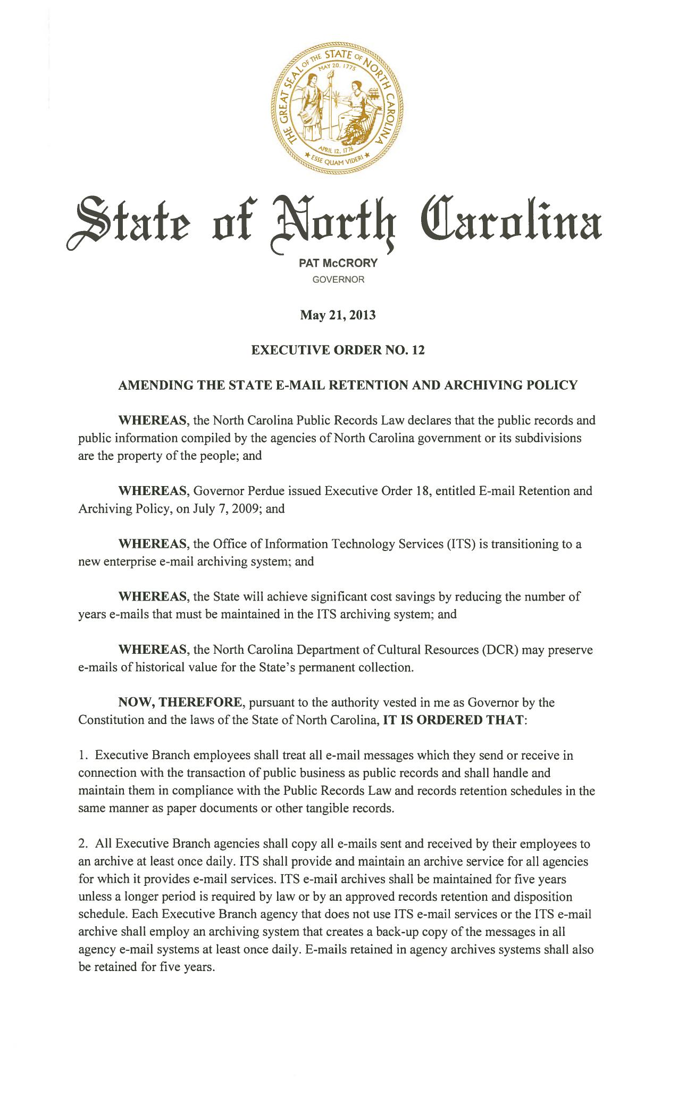
Digital Correspondence Management
State of North Carolina employees are responsible for the records management of content created and stored in Microsoft 365 applications including Outlook.

Slide 42
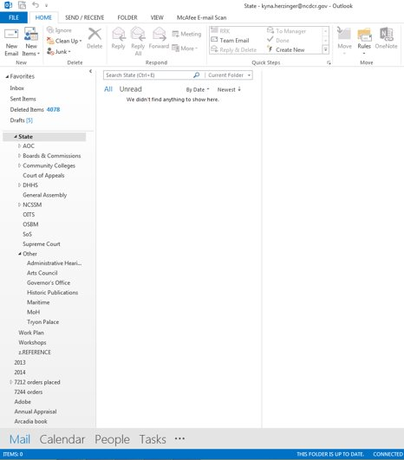

Microsoft Outlook
Few emails sit in your inbox
Emails are moved into an
organized system of folders

Slide 43
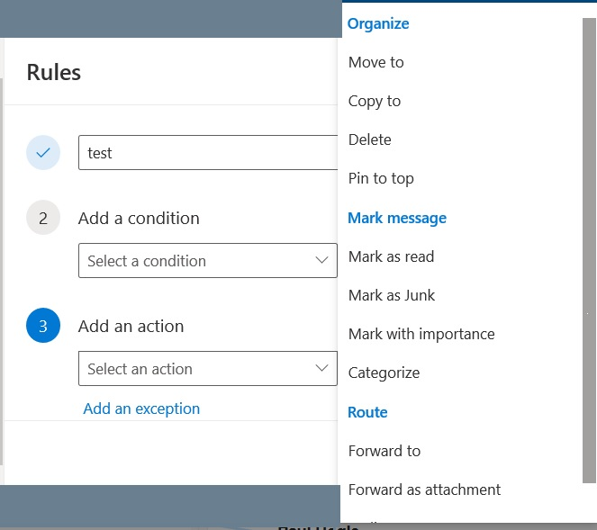
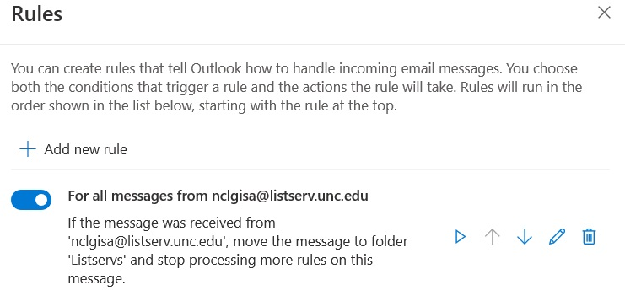
Microsoft Outlook

Slide 44
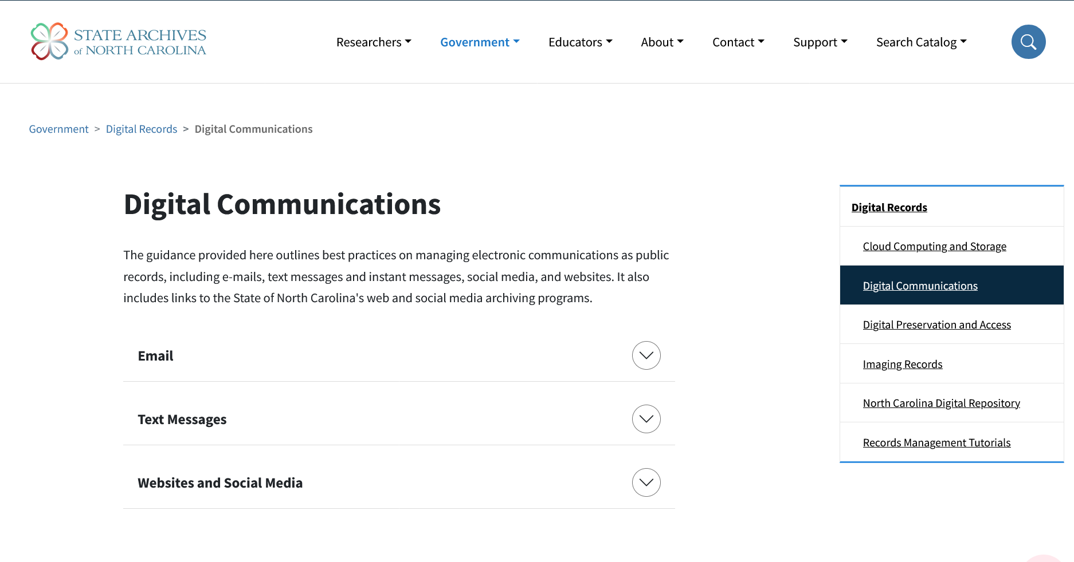
bit.ly/SANC-DC

Slide 45
Electronic Records Policy
Specifies guidelines and best practices that the agency agrees to follow related to managing both born-digital and scanned electronic records.
bit.ly/SANC-Tools01

Slide 46
Scanning-to-Destroy Paper Records
Identify Records to be Scanned
Locate on Functional Schedule
Non-Permanent Record
May Scan and Destroy
Permanent Record
May Scan but Must Keep Original
Target records according to frequency of agency use, access needs, space considerations, length of retention, etc.
  Non-permanent records: To be disposed of after indicated length of time
  Permanent records: Forever kept by the agency or transferred to the State Archives

Slide 47
Scanning Considerations
Costs
Scanning Equipment
Employee Time
Benefits
Easier Access
Reduces Physical Storage
Electronic Storage
Long-term Maintenance
While state agencies may scan any record, it is important to factor in the material, technological, and personnel costs when embarking on a scanning project.

Slide 48
Authorization to Destroy Paper Records
Documentation that agency followed all procedures and received authorization to destroy the paper copies of non-permanent records after scanning.
The destruction of original records is allowed only after quality assurance has been conducted on the imaged records, necessary corrections have been made, the electronic records system is audited for accuracy, and the destruction of records has been approved.
Records should be destroyed in accordance with 07 NCAC 04M .0510
Maintain a destructions log if you have an ongoing scanning project and do not include close-ended dates on the Authorization to Destroy form.
bit.ly/SANC-ADP

Slide 49
Retention for Scanned Records
When a digital image replaces the original record and assumes all legal authorities, the scanned record is considered the record copy and must be maintained for the retention period defined in the Functional Schedule.
The retention period begins when the original document was created, not when the electronic version was produced.
Any hard copies generated from scanned records will be considered reference copies.

Slide 50
Records Management: Employee Separation
CRO & State Archives Consultation
Sort & Organize Files
Identify Record Types
Complete Inventory & Destruction Log
Final
Walkthrough

Slide 51

THANK YOU!

Slide 52
For More Information
https://archives.ncdcr.gov/government

