Slide 1
Top 10 Most Frequently Cited Serious Violations in FFY 2022
General Industry
Presented by: ETTA, OSH Division, 919-707-7876
Notes:
Revised: 01/24
The information in this presentation is provided voluntarily by the N.C. Department of Labor, Education Training and Technical Assistance Bureau as a public service and is made available in good faith. This presentation is designed to assist trainers conducting OSHA outreach training for workers. Since workers are the target audience, this presentation emphasizes hazard identification, avoidance, and control – not standards. No attempt has been made to treat the topic exhaustively. It is essential that trainers tailor their presentations to the needs and understanding of their audience.
The information and advice provided on this Site and on Linked Sites is provided solely on the basis that users will be responsible for making their own assessment of the matters discussed herein and are advised to verify all relevant representations, statements, and information.
This presentation is not a substitute for any of the provisions of the Occupational Safety and Health Act of North Carolina or for any standards issued by the N.C. Department of Labor. Mention of trade names, commercial products, or organizations does not imply endorsement by the N.C. Department of Labor.

Slide 2
Objectives
In this course, we will discuss the Top Ten cited serious violations in General Industry for federal fiscal year (FFY) 2022.
- The Top Ten list includes data about citations issued 10/01/21 through 9/30/22 in North Carolina.

Slide 3
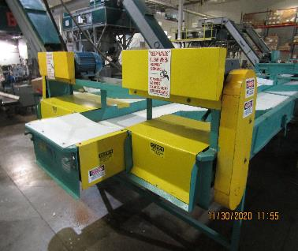
Machine Guarding
1910.212(a)(1)
Number 1: General Requirements
One or more methods of machine guarding must be provided to protect the operator and other employees in the machine area from hazards:
Point of operation
Ingoing nip points
Rotating parts
Flying chips and sparks
NCDOL Photo Library
Notes:
3
NCDOL Photo Library Closed Case File #318208360

Slide 4
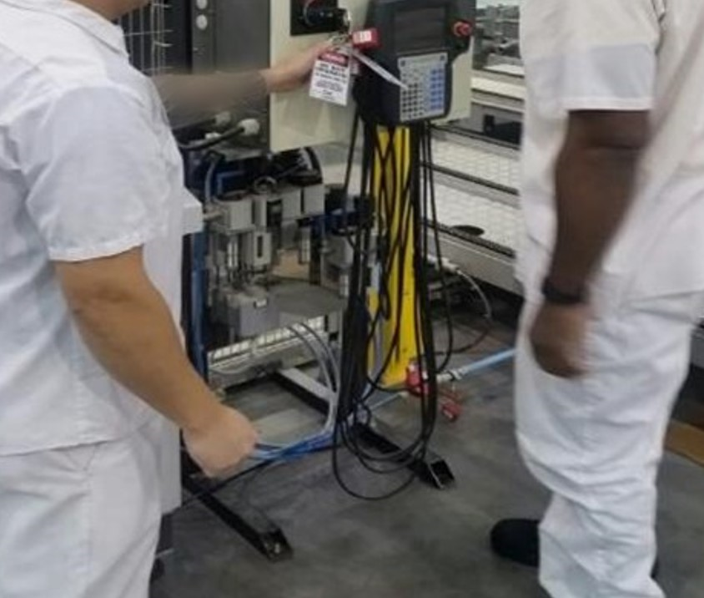
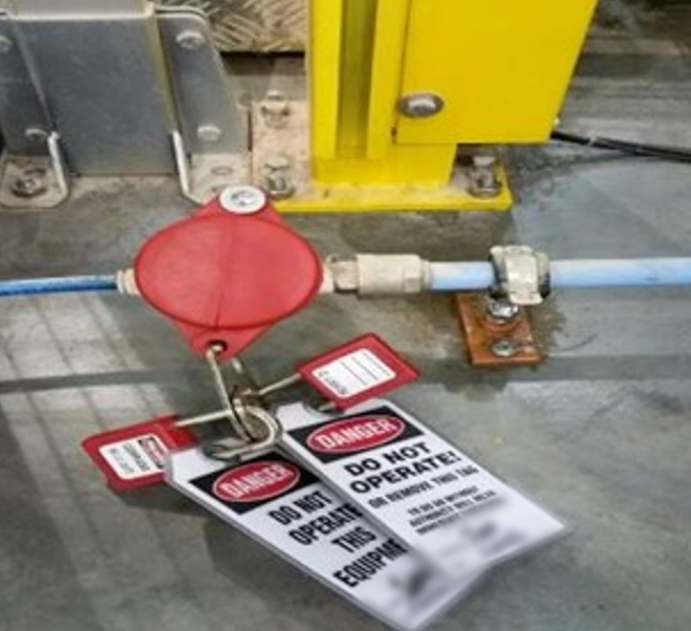
Lockout/Tagout
1910.147(c)(4)(i)
Number 2: Energy Control Procedures
Procedures shall be developed, documented and utilized for the control of potentially hazardous energy when employees are engaged in the activities covered by this section.
NCDOL Photo Library
NCDOL Photo Library
NCDOL Photo Library
Group LOTO: Electrical and Pneumatic
Notes:
NCDOL Photo Library Closed Case File #318118247

Slide 5
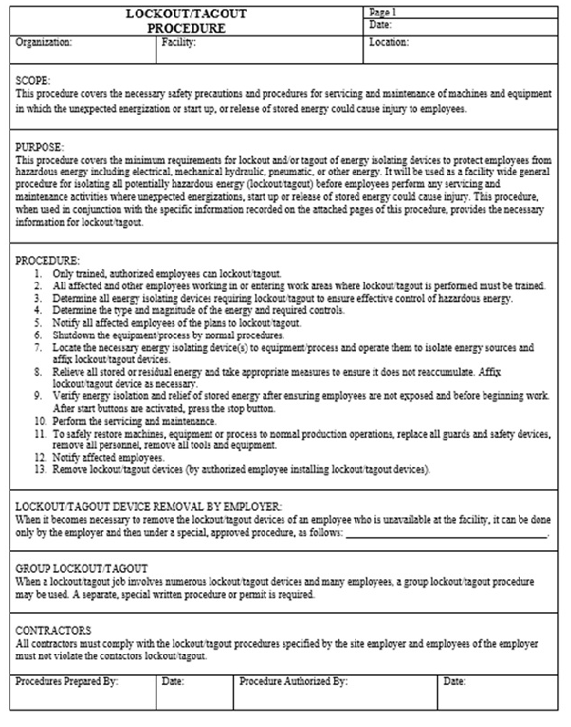
Lockout/Tagout
1910.147(c)(6)(i)
Number 3: Periodic Inspection
Employers are required to conduct an inspection of energy control procedures at least annually.
NCDOL Photo Library
NCDOL Photo Library
Notes:
NCDOL Photo Library Closed Case File #318118247

Slide 6
N.C. General Duty Clause
NCGS 95-129(1)
Number 4: N.C. General Duty Clause (GDC)
Elements necessary for a GDC violation:
Hazard to which employees were exposed.
Recognized hazard in the industry.
Hazard was causing or likely to cause. death or serious injury or physical harm.
There is a feasible and useful method to correct the hazard.
NCDOL Photo Library
North Carolina General Statutes (NCGS)
Notes:
Definition of the General Duty Clause
A statement within the OSH Act providing a requirement that employers furnish employment and places of employment which are free from recognized hazards to the health and safety of their employees. The clause covers situations for which there is no specific standard.
N.C. General Duty Clause: Each employer shall furnish to each of his employees conditions of employment and a place of employment free from recognized hazards that are causing or likely to cause death or serious injury or serious physical harm to his employees.
Conditions required to cite this standard:
1) a hazard to which employees were exposed
2) recognized hazard in the industry
3) hazard was causing or likely to cause death or serious injury or harm
4) there is a feasible and useful method to correct the hazard.

Slide 7
GDC Examples
Manual felling of a tree in a residential yard or area not involving timber harvesting or clearing land where the employer did not perform a hazard assessment to remove dead or snagged trees prior to cutting down other trees.
Landfill operations where the employer did not designate a safe barricaded area to protect employees servicing or repairing heavy equipment from customer vehicles.

Slide 8
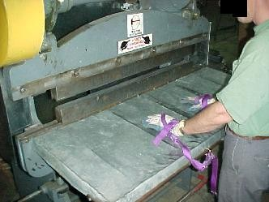
Machine Guarding
1910.212(a)(3)(ii)
Number 5: Point of Operation Guarding
The point of operation of machines whose operation expose employees to injury, shall be guarded.
NCDOL Photo Library
NCDOL Photo Library
Notes:
NCDOL Photo Library: OSHA Region 4 Photo Archive CD V1.0 (NCDOL has received written permission) – Photo identifies an employee using hand restraints to protect them from putting his hands in to the point of operation for this shear cutter.
This standard is cited when a SERIOUS machine guarding hazard exists for which an OSH specific requirement is not yet written.
Types of guarding.
One or more methods of machine guarding shall be provided to protect the operator and other employees in the machine area from hazards such as those created by point of operation, in-going nip points, rotating parts, flying chips and sparks.
Examples of guarding methods are barrier guards, two-hand tripping devices, electronic safety devices, etc.

Slide 9
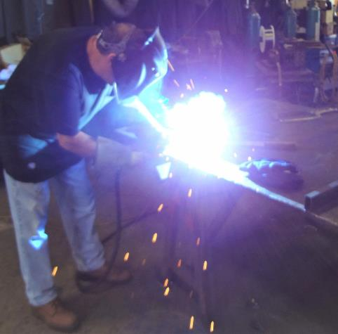
Personal Protective Equipment
1910.133(a)(1)
Number 6: Eye and Face Protection – General Requirements
Use appropriate eye or face protection when exposed to eye or face hazards.
Hazards from flying particles
Molten metal
Liquid chemicals
Acids or caustic liquids
Chemical gases or vapors
Potentially injurious light radiation
NCDOL Photo Library
Notes:
Slide 1 of 2: PPE 1910.133(a)(1)
NCDOL Photo Library: Taken by NCDOL Employee Robert O’Neal - NC Department of Transportation 07-07-15, Permission Letter Obtained – Photo identifies an employee not using PPE for the protection of his arm or neck areas from the harmful exposure of ultraviolet radiation (UV) radiation.
Welding arcs and flames emit intense visible, ultraviolet, and infrared radiation so employees must protect themselves from these type of radiation.
Long-term exposure to UV radiation can cause skin cancer.
The UV in a welding arc will burn unprotected skin just like UV radiation in sunlight. Burns are the most common injury to welders due to sparks landing on the skin.
Welding arcs are very intense and can cause burns to skin and eyes with just a few minutes of exposure.

Slide 10
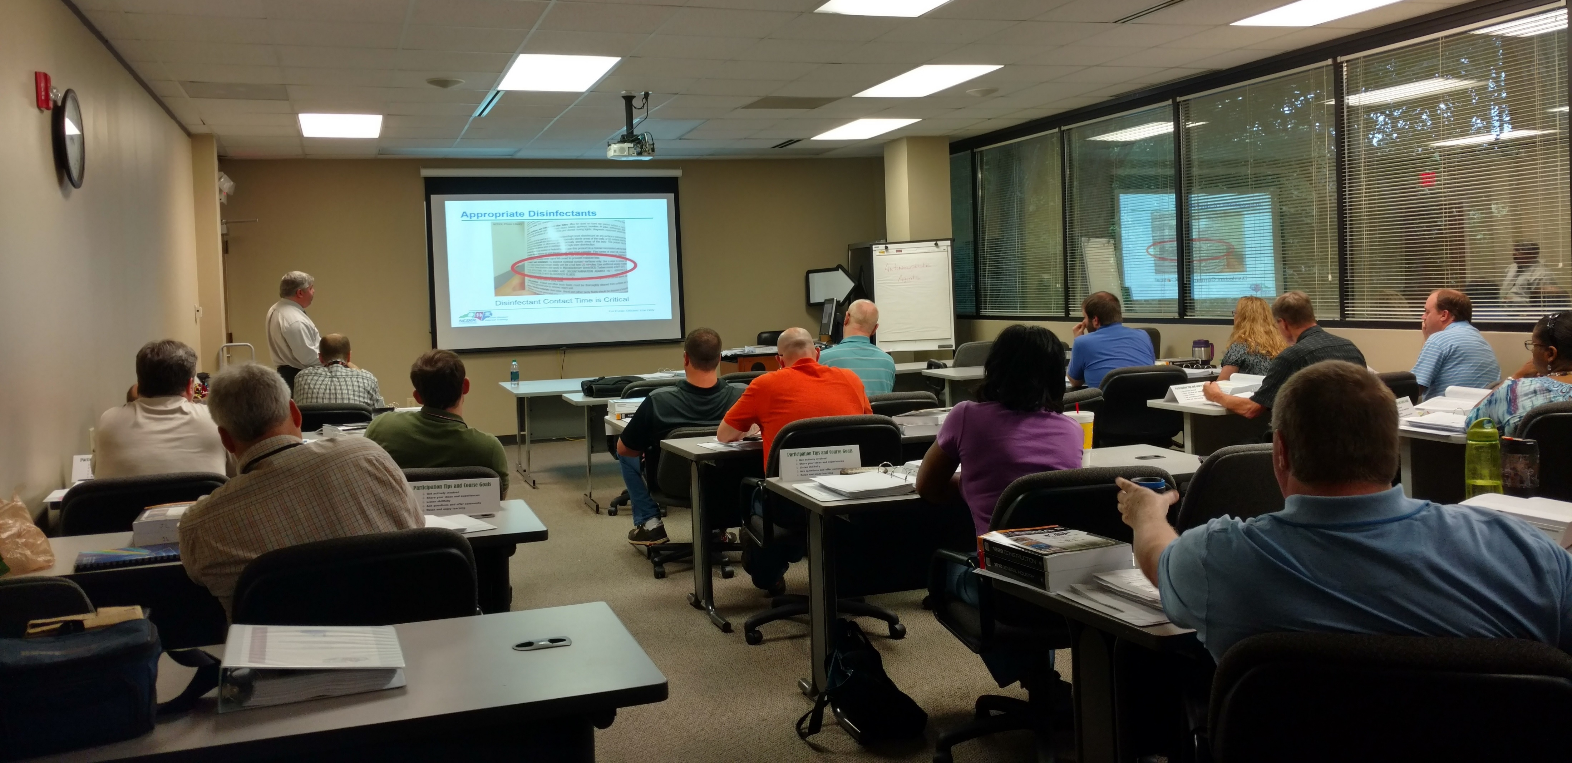
Lockout/Tagout
1910.147(c)(7)(i)(A)
Number 7: Training and Communication
- Each authorized employee shall receive training in the recognition of applicable hazardous energy sources, the type and magnitude of the energy available in the workplace, and the methods and means necessary for the energy isolation and control.
NCDOL Photo Library
NCDOL Photo Library
Notes:
Right Photograph-NCDOL Photo Library Closed Case File #318118247
Left Photograph – NCDOL classroom photograph taken at LBT by Marcy Collyer 2018

Slide 11
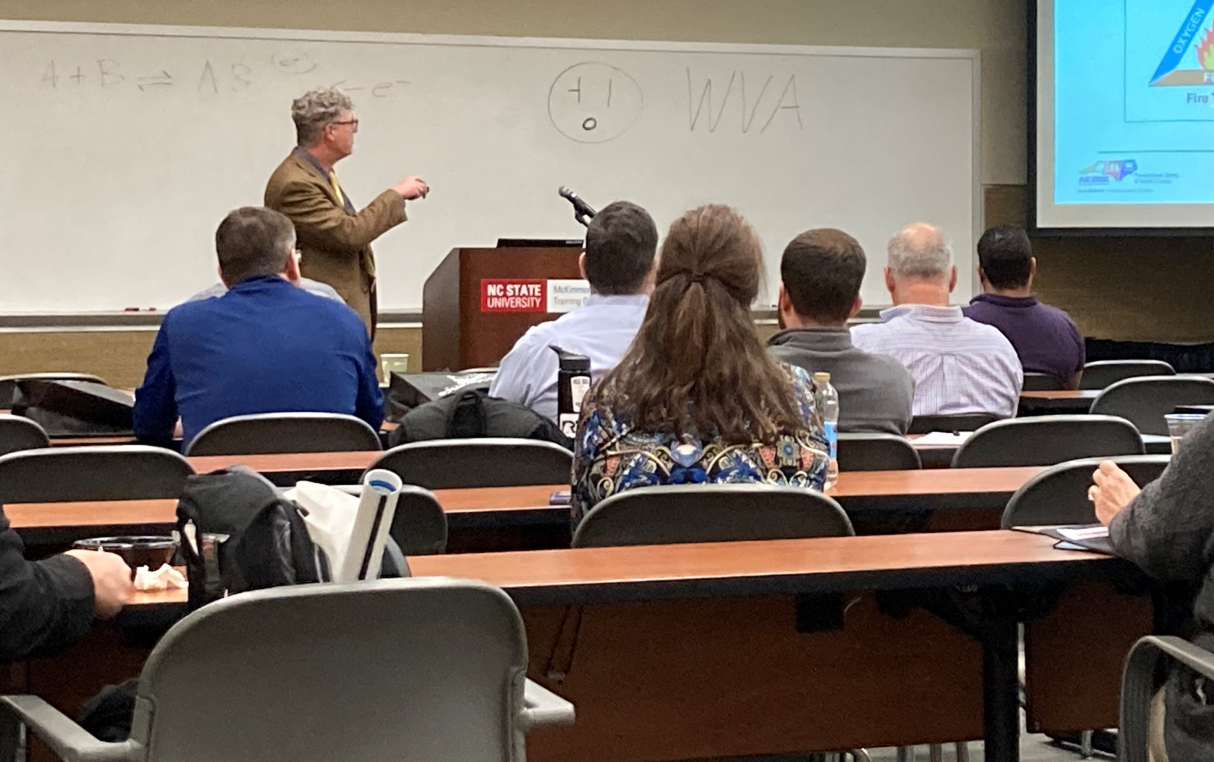
Hazard Communication 1910.1200(h)(1)
Number 8: Employee Information and Training
Employers shall provide employees with effective information and training on hazardous chemicals in their work area:
At the time of their initial assignment.
Whenever a new physical or health hazard is introduced into their work area.
NCDOL Photo Library
Notes:
NCDOL Photo Library: Taken by NCDOL Employee Wanda Lagoe of Andy Sterlen at the 2022 Best Conference.
Employers shall provide employees with effective information and training on hazardous chemicals in their work area at the time of their initial assignment, and whenever a new physical or health hazard the employees have not previously been trained about is introduced into their work area. Information and training may be designed to cover categories of hazards (e.g., flammability, carcinogenicity) or specific chemicals. Chemical-specific information must always be available through labels and safety data sheets.
While the standard does not state that annual, refresher or periodic training is required, employers should observe that employees must retain the information learned and that some continual training is expected. It is the employer’s responsibility to ensure that employees are adequately trained and equipped with the necessary knowledge.
Training can be conducted on each specific chemical or by categories (e.g., carcinogens, sensitizer, toxic agents) that are or may be encountered by employee during the course of his duties. Chemical specific information must always be available through labels and SDSs.
IAW Appendix A of the CPL 02-02-038 “The training provisions of this standard are not satisfied solely by giving employee the data sheets to read. An employer’s training program is to be a forum for explaining to employees not only the hazards of the chemicals in their work area, but also how to use the information generated the HAZCOM program. This can be accomplished in many ways (audiovisuals, classroom instruction, interactive video), and should include an opportunity for employees to ask questions to ensure that they understand the information presented to them. Furthermore, the training must be comprehensible. If the employees receive job instructions in a language other than English, then the training and information to be conveyed under this standard will also need to be conducted in a foreign language.”

Slide 12
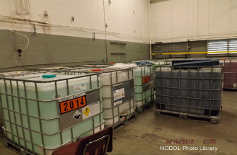
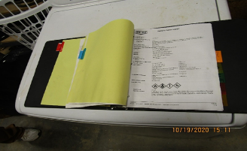
Hazard Communication 1910.1200(h)(1)
Number 8: Employee Information and Training
NCDOL Photo Library
Notes:
NCDOL Photo Library Closed Case File #318206000
OSHA Quick Card Hazard Communication Standard Pictogram, HCS Pictograms and Hazards

Slide 13
Fall Protection 1910.28(b)(1)(i)
Number 9: Duty to have Fall Protection
Except as provided elsewhere in this section, the employer must ensure that each employee on a walking-working surface with an unprotected side or edge that is 4 feet (1.2 m) or more above a lower level is protected from falling by one or more of the following:
(A) Guardrail systems;
(B) Safety net systems; or
(C) Personal fall protection systems: personal fall
arrest, travel restraint, or positioning systems.
Notes:
1926.501(a)
"General."
1926.501(a)(1)
This section sets forth requirements for employers to provide fall protection systems. All fall protection required by this section shall conform to the criteria set forth in 1926.502 of this subpart.
1926.501(a)(2)
The employer shall determine if the walking/working surfaces on which its employees are to work have the strength and structural integrity to support employees safely. Employees shall be allowed to work on those surfaces only when the surfaces have the requisite strength and structural integrity.
NOTE: The standard reference number is at the top right hand corner of many slides in this presentation. This is a quick reference for you to go directly to that number in the construction industry standards book.
As we saw in our previous slide, the duty to have fall protection in construction begins at the 6 foot level.
Walking/working surfaces must be inspected before work begins and they must be strong enough to support the weight of the employees and equipment that they are using.

Slide 14
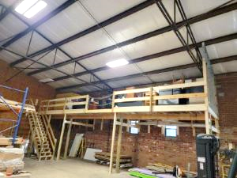
Fall Protection 1910.28(b)(1)(i)
Number 9: Duty to have Fall Protection
NCDOL Photo Library
Notes:
NCDOL Photo Library Closed Case File #318236239

Slide 15
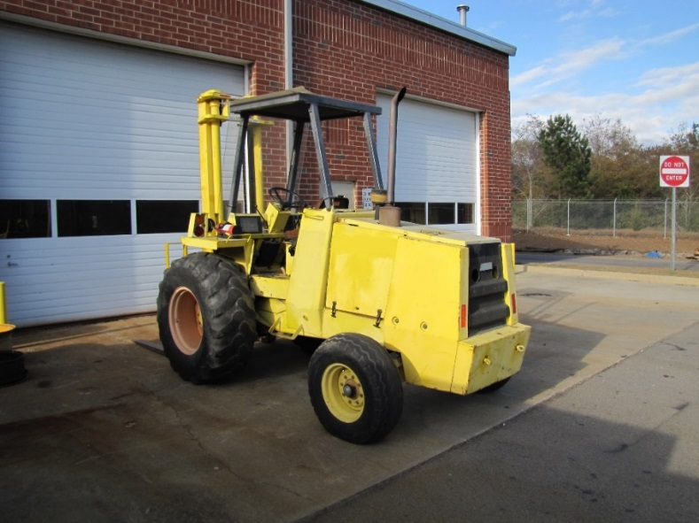
Powered Industrial Trucks 1910.178(I)(1)(i)
Number 10: Operator Training
Employer shall ensure that each powered industrial truck operator is competent to operate a powered industrial truck safely.
NCDOL Photo Library
Notes:
NCDOL Photo Library: Closed Case file #317355600
1910.178(l)(1)
Safe operation.
1910.178(l)(1)(i)
The employer shall ensure that each powered industrial truck operator is competent to operate a powered industrial truck safely, as demonstrated by the successful completion of the training and evaluation specified in this paragraph (l).
1910.178(l)(1)(ii)
Prior to permitting an employee to operate a powered industrial truck (except for training purposes), the employer shall ensure that each operator has successfully completed the training required by this paragraph (l), except as permitted by paragraph (l)(5).

Slide 16
Hazard Recognition in General Industry

Slide 17
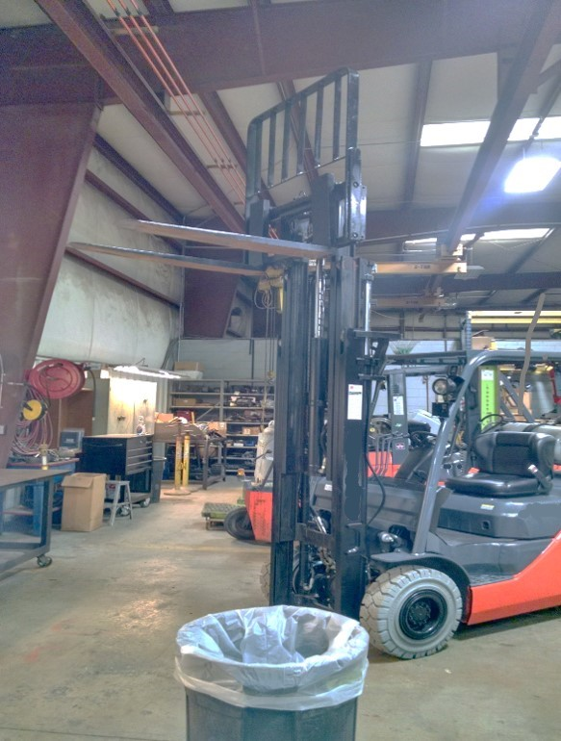
Hazard Recognition
1910.178(m)(2)
Struck-by hazards
NCDOL Photo Library
NCDOL Photo Library
Notes:
NCDOL Photo Library: Photo taken by NCDOL Employee Robert O’Neal – Southeast Industrial Equipment, Permission Letter Obtained – 9/22/2016 - Photo identifies a forklift carriage being suspended in the air while work was being performed on it. This was staged to identify hazards whenever this type of work is being preformed.
Ask the class: What are the hazards? Struck-by hazard!
Carriage can fall striking an employee. The overhead crane should have been used to support the carriage while work was being preformed.
1910.178(m)(2) No person shall be allowed to stand or pass under the elevated portion of any truck, whether loaded or empty.
1910.178(m)(5)(i)When a powered industrial truck is left unattended, load engaging means shall be fully lowered, controls shall be neutralized, power shall be shut off, and brakes set. Wheels shall be blocked if the truck is parked on an incline.
1910.178(m)(5)(ii)A powered industrial truck is unattended when the operator is 25 ft. or more away from the vehicle which remains in his view, or whenever the operator leaves the vehicle and it is not in his view.
1910.178(m)(5)(iii)When the operator of an industrial truck is dismounted and within 25 ft. of the truck still in his view, the load engaging means shall be fully lowered, controls neutralized, and the brakes set to prevent movement.

Slide 18
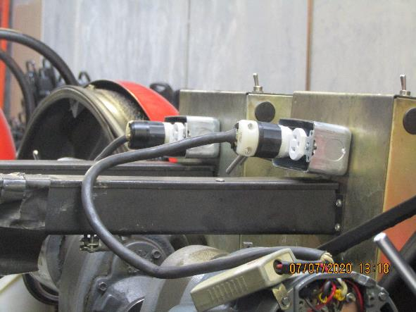
Hazard Recognition
1910.305(b)(2)(i)
1910.305(g)(2)(iii)
● Electrical shock hazards
NCDOL Photo Library
Notes:
NCDOL Photo Library Closed Case File #318198587
Upper circled area – (violation 02 004) – Pinspotter at a bowling alley, Strain relief was not provided to the flexible cord on the machines 110VAC back end (pit) motor.
1910.305(g)(2)(iii): Flexible cords and cables were not connected to devices and fittings so that strain relief was provided that would prevent pull from being directly transmitted to joints or terminal screws
Lower Rt – (Violation 02 003) – This is a Pinspotter, the 120-volt electrical receptacle is missing the faceplate, exposing the internal electrical wiring.
1910.305(b)(2)(i): Pull boxes, junction boxes, and fittings were not provided with covers identified for the purpose.

Slide 19
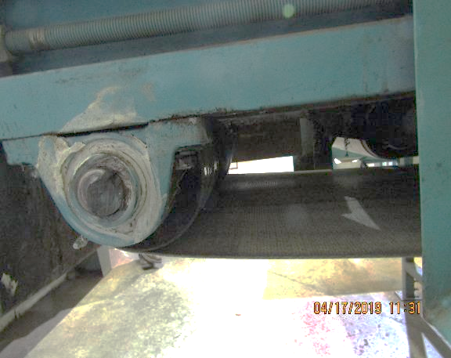
Hazard Recognition
1910.212(a)(1)
● Caught-in between hazards
NCDOL Photo Library
Unguarded Conveyor Pinch or Nip Point
Notes:
NCDOL Photo Library Closed Case File #318163383
Photo – (Violation 01 002) Haines 3-way distribution conveyor, where the drive ends of the #DB1 and #DB3 belts were not guarded, exposing employees to ingoing pinch point hazards between the belts and conveyor frames.
1910.212(a)(1): One or more methods of machine guarding was not provided to protect the operator and other employees in the machine area from hazards such as those created by point of operation, ingoing nip points, rotating parts, flying chips and sparks:

Slide 20
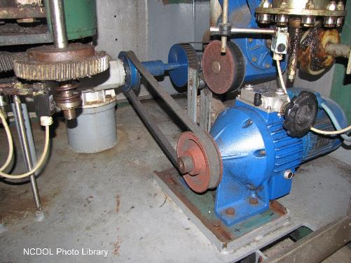
Hazard Recognition
1910.219
Caught-in between hazards: Gears, pulleys, belts must be guarded by complete enclosures or standard guard.
This does not comply
with the requirement.
Notes:
NCDOL Photo Library Closed Case File# 316782911
Mechanical Power-Transmission Apparatus 1910.219(f)(1)
Anyone working around stationary equipment should be able to identify potential amputation hazards. Understanding the mechanical components of machinery, the mechanical motion that occurs at or near these components, and specific worker activities performed in conjunction with machinery operation will help workers avoid injury.
In-Running Nip Points, also known as “pinch points,” develop when two parts move together and at least one moves in rotary or circular motion. In-running nip points occur whenever machine parts move toward each other or when one part moves past a stationary object. Typical nip points include gears, rollers, belt drives, and pulleys.
Gears, sprockets, and chains -1910.219(f)(1) Gears. Gears shall be guarded in accordance with one of the following methods:
1910.219(f)(1)(i) By a complete enclosure; or
1910.219(f)(1)(ii) By a standard guard as described in paragraph (o) of this section, at least seven (7) feet high extending six (6) inches above the mesh point of the gears; or
1910.219(f)(1)(iii) By a band guard covering the face of gear and having flanges extended inward beyond the root of the teeth on the exposed side or sides. Where any portion of the train of gears guarded by a band guard is less than six (6) feet from the floor a disk guard or a complete enclosure to the height of six (6) feet shall be required.

Slide 21
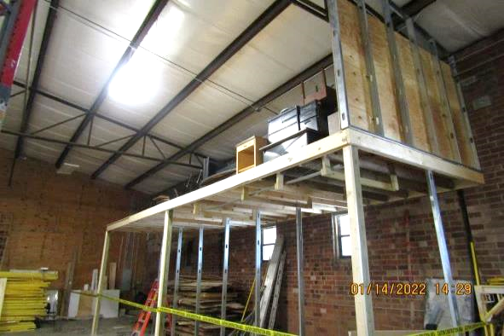
Hazard Recognition
1910.28(b)(1)(i)
● Fall hazards
NCDOL Photo Library
Notes:
NCDOL Photo Library Closed Case File #318236239 (violation 01 002 a)
Photo: Mezzanine 11 ft, 6 inches above lower level/concrete floor. No fall protection (such as a guardrail system) was provided by the employer. Employees were loading office furniture onto the mezzanine and were exposed to the hazard.
1910.28(b)(1)(i): The employer did not ensure each employee on a walking-working surface with an unprotected side or edge that is 4 feet (1.2 m) or more above a lower level was protected from falling by one or more of the following: guardrail systems; safety net systems; or personal fall protection systems:

Slide 22
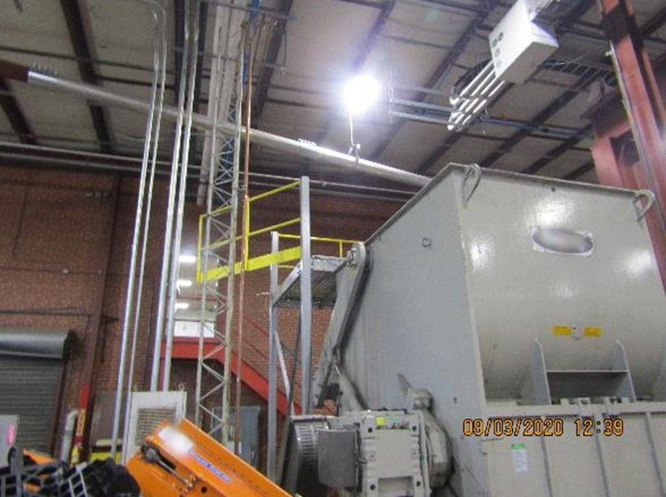
Hazard Recognition
1910.28
● Fall hazards
NCDOL Photo Library
Notes:
NCDOL Photo Library Closed Case File #318202900 –
Photo shows a Sterling Model SXS 1500 Extreme Duty Shredder; An employee could fall into the equipment/shredder due to unprotected side/edge of platform.
1910.28(b)(1)(i): The employer did not ensure each employee on a walking-working surface with an unprotected side or edge that is 4 feet (1.2 m) or more above a lower level was protected from falling by one or more of the following: guardrail systems; safety net systems; or personal fall protection systems:
1910.28(b)(5)Runways and similar walkways.
1910.28(b)(5)(i)The employer must ensure each employee on a runway or similar walkway is protected from falling 4 feet (1.2 m) or more to a lower level by a guardrail system.
1910.28(b)(5)(ii)When the employer can demonstrate that it is not feasible to have guardrails on both sides of a runway used exclusively for a special purpose, the employer may omit the guardrail on one side of the runway, provided the employer ensures:
1910.28(b)(5)(ii)(A)The runway is at least 18 inches (46 cm) wide; and
1910.28(b)(5)(ii)(B)Each employee is provided with and uses a personal fall arrest system or travel restraint system.

Slide 23
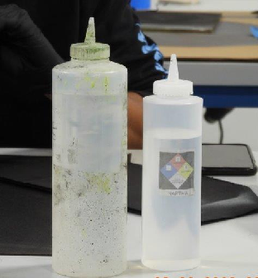
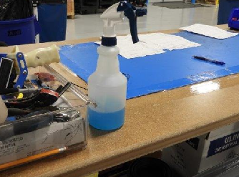
Hazard Recognition
1910.1200(f)(6)(ii)
Hazard communication – Chemical labeling
NCDOL Photo Library
NCDOL Photo Library
NCDOL Photo Library
Notes:
NCDOL Photo Library Closed Case File #318271392
Photo: There were secondary containers used by employees which contained isopropyl alcohol and glass cleaner. The containers were not labeled, tagged, or marked to identify the contents and the bottle was not labeled, tagged, or marked to provide employees with specific information regarding the physical and health hazards of the chemicals.
1910.1200(f)(6)(ii): Except as provided in 29 CFR 1910.1200(f)(7) and 29 CFR 1910.1200(f)(8), the employer did not ensure that each container of hazardous chemicals in the workplace was labeled, tagged or marked with the product identifier and words, pictures, symbols, or combination thereof, which provide at least general information regarding the hazards of the chemicals and which, in conjunction with the other information immediately available to employees under the hazard communication program, would provide employees with the specific information regarding the physical and health hazards of the hazardous chemical:

Slide 24
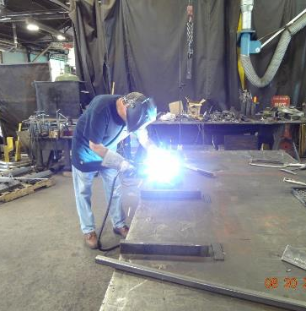
Hazard Recognition
1910.132; 1910.133
1910.134; 1910.138
Personal protective equipment
No protective screen between employee and other workers or persons to prevent flash burn eye injuries.
NCDOL Photo Library
Notes:
NCDOL Photo Library: Taken by NCDOL Employee Robert O’Neal - NC Department of Transportation 07-07-15, Permission Letter Obtained – Photo identifies an employee arc welding at his workstation without the proper PPE.
Ask the class; What type of PPE should he being wearing? Should he be using ventilation? Ventilation is provided! Notice the ventilation duct behind him next to the light curtain! It’s not use.
Skin protection - Wear tightly woven work-weight fabrics to keep UV radiation from reaching your skin. Such as welding gloves and Flame-resistanct Clothing.
Welding Gloves - are built to withstand sparks, high temperatures, and molten metal. They provide a welder’s hands with significant protection against the sparks and molten metal they deal with during welding operations. These gloves should be able to cover the hands and wrists while also being made of flame-resistant material.
Flame-Resistant Clothing - such as an apron, pants, and welding jackets are essential for welders. This is because there are many sparks during welding operations, so you need to shield your body from them. Typically, these clothing items are made of durable and flame-resistant fabrics and are designed to be used whenever you use welding equipment.
Respirator/Welders Mask: There are multiple types of respirators. Employers should buy the one that is made for welders and the type of projects you will be performing. If purchasing a mask with a filter, match the filter to the types of metals and coatings used.
Welding fumes can be hazardous to a person’s health. This is why respiratory protection is also necessary during welding operations. Whenever workers conduct welding operations, make sure they’re wearing masks or respirators, as this protects their lungs from debris and fumes that can be hazardous to their health.
Eye/face protection: welding eye protection protects against injuries from debris and from the effects of the ultraviolet light. Different types of helmets are made to protect you when performing different types of welding. These vary by shade number, having a passive or auto-darkening lens (automatically adjusts to welding rays) and comfort/fit.
Welding Helmet - You can’t weld without a welding helmet. This essential head protection equipment protects the worker’s eyes, face, and neck while also providing a shield against UV radiation. There are also modern welding helmets that automatically adjust the brightness to provide optimal vision during welding operations
Additional information:
Button up your shirt to protect the skin on the throat and neck.
Wear long sleeves and pant legs.
Cover your head with a fabric cap to protect the scalp from UV radiation.
Protect the back of your head by using a hood.
Protect your face from UV radiation by wearing a tight-fitting, opaque welder's helmet.
Make sure that all fabric garments are resistant to spark, heat and flame. Keep the fabrics clean and free of combustible materials that could be ignited by a spark.
General Standards:
1910.132 – PPE (general requirements)
1910.132(a) Application. Protective equipment, including personal protective equipment for eyes, face, head, and extremities, protective clothing, respiratory devices, and protective shields and barriers, shall be provided, used, and maintained in a sanitary and reliable condition wherever it is necessary by reason of hazards of processes or environment, chemical hazards, radiological hazards, or mechanical irritants encountered in a manner capable of causing injury or impairment in the function of any part of the body through absorption, inhalation or physical contact.
1910.133: PPE – Eye and Face Protection
1910.133(a)(1) The employer shall ensure that each affected employee uses appropriate eye or face protection when exposed to eye or face hazards from flying particles, molten metal, liquid chemicals, acids or caustic liquids, chemical gases or vapors, or potentially injurious light radiation.
1910.133(a)(5) The employer shall ensure that each affected employee uses equipment with filter lenses that have a shade number appropriate for the work being performed for protection from injurious light radiation. (listing of appropriate shade numbers for various operations in standard.)
1910.134 – Respiratory Protection
1910.134(a)(1)In the control of those occupational diseases caused by breathing air contaminated with harmful dusts, fogs, fumes, mists, gases, smokes, sprays, or vapors, the primary objective shall be to prevent atmospheric contamination. This shall be accomplished as far as feasible by accepted engineering control measures (for example, enclosure or confinement of the operation, general and local ventilation, and substitution of less toxic materials). When effective engineering controls are not feasible, or while they are being instituted, appropriate respirators shall be used pursuant to this section.
1910.138 – Hand Protection
1910.138(a)General requirements. Employers shall select and require employees to use appropriate hand protection when employees’ hands are exposed to hazards such as those from skin absorption of harmful substances; severe cuts or lacerations; severe abrasions; punctures; chemical burns; thermal burns; and harmful temperature extremes.
------------------------------------

Slide 25
Summary
In this course, we discussed the Top Ten most frequently cited serious General Industry violations for FFY 2022.
You should now understand and be able to identify hazards associated with the Top Ten most cited serious OSH violations in general industry.

Slide 26
Thank You For Attending!
Final Questions?
1-800-NC-LABOR
(1-800-625-2267)
www.labor.nc.gov

