Slide 1
North Carolina Department of Labor Occupational Safety and Health Division OSH Advisory Council Fall 2023*
Presented by:
Wanda Lagoe CSP ARM CPM
Education, Training and Technical Assistance
Occupational Safety and Health Division of North Carolina
*Preliminary Data
Notes:
The information in this presentation is provided voluntarily by the N.C. Department of Labor, Education Training and Technical Assistance Bureau as a public service and is made available in good faith. This presentation is designed to assist trainers conducting OSHA outreach training for workers. Since workers are the target audience, this presentation emphasizes hazard identification, avoidance, and control – not standards. No attempt has been made to treat the topic exhaustively. It is essential that trainers tailor their presentations to the needs and understanding of their audience.
The information and advice provided on this Site and on Linked Sites is provided solely on the basis that users will be responsible for making their own assessment of the matters discussed herein and are advised to verify all relevant representations, statements, and information.
This presentation is not a substitute for any of the provisions of the Occupational Safety and Health Act of North Carolina or for any standards issued by the N.C. Department of Labor. Mention of trade names, commercial products, or organizations does not imply endorsement by the N.C. Department of Labor.

Slide 2
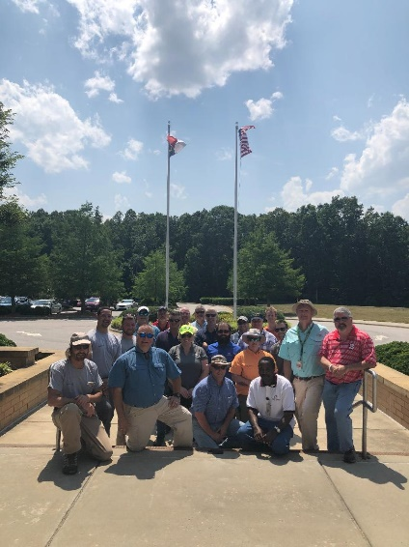
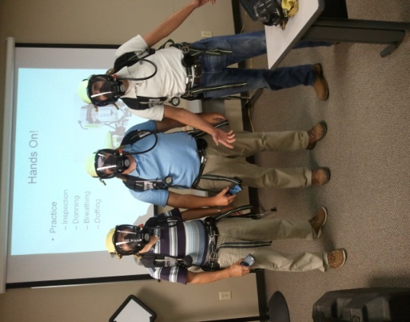
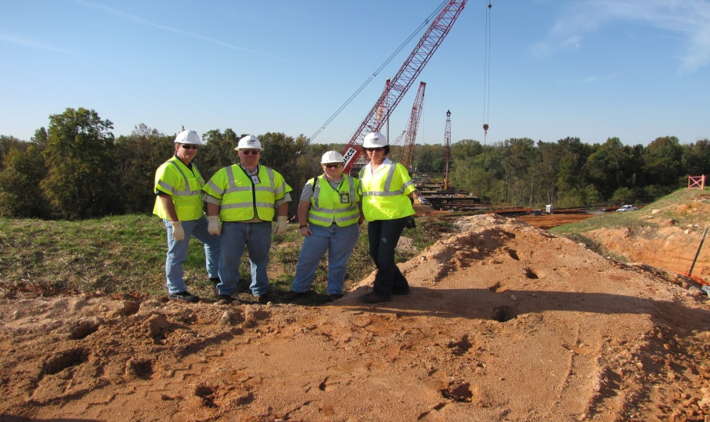
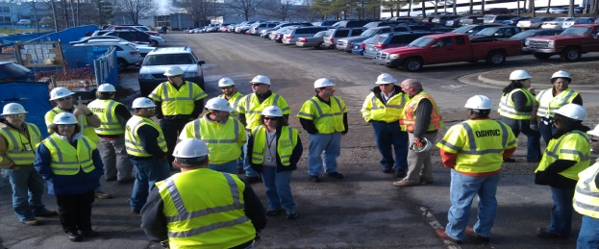
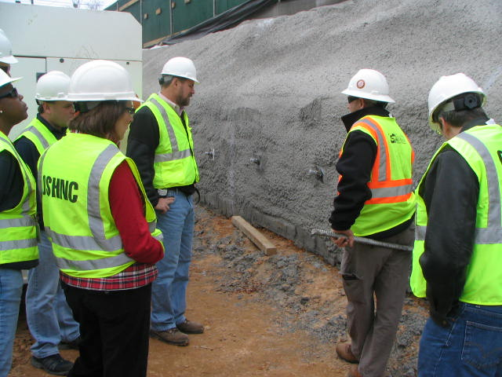
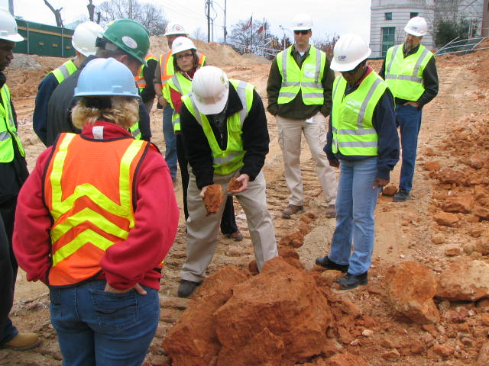
N.C. Workplace Safety and Health
OSH Division—Fatalities Inspected
FFY 2023—Fall
FATALITY TYPE | Total | FATALITY TYPE | Total
Struck By | 17 | Inhalation | 3
Caught In/Between | 10 | Ingestion | 0
Bite/Sting/Scratch | 0 | Absorption | 0
Fall (Same Level) | 2 | Repeated Motion/Pressure | 0
Fall (From Elevation) | 19 | Cardio/Respiratory | 0
Struck Against | 0 | Shock | 4
Rubbed/Abraded | 0 | Other | 12
COVID-19 | 0 | Criminal Activity | 4
Fatalities Under OSH Division Jurisdiction
FFY 2022 | Total | FFY 2023 | Total
Fatalities | 68 | Fatalities | 71
NCDOL Photo Library

Slide 3
N.C. Workplace Safety and Health
OSH Division—Strategic Plan Goals
FFY 2023—Fall
COMPLIANCE | Total | FFY Goal
Safety Inspections | 1,014 | 1,100
Health Inspections | 645 | 705
Serious Hazards Eliminated | 2,621 | 4,100
CONSULTATION | Total | FFY Goal
Serious Hazards Eliminated | 6,316 | 4,800
Private Sector and Public Sector Visits | 1,498 | 1,315
OSH DIVISION | Total | FFY Goal
Program Improvements | 2,120 | 2,060
People Trained in Special Emphasis Program Areas | 7,436 | 3,200
People Trained at OSH Division Sponsored Events | 9,361 | 5,350

Slide 4
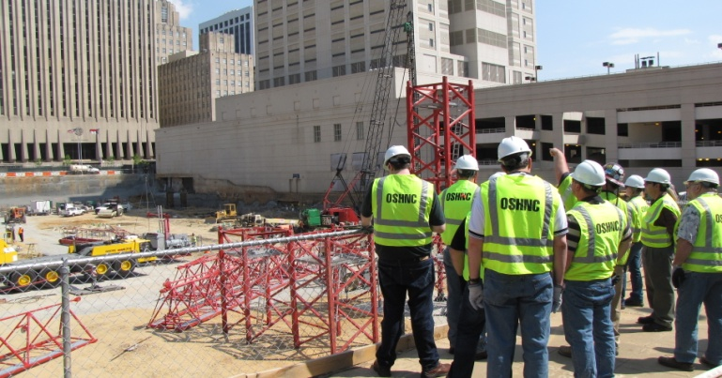
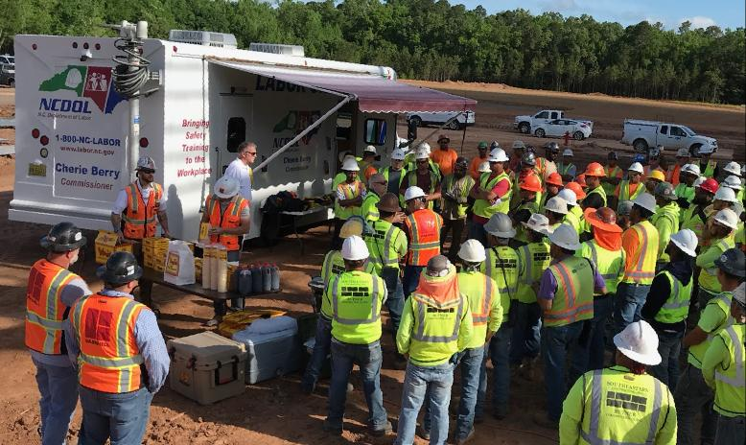
N.C. Workplace Safety and Health
OSH Division—Strategic Plan Goals
FFY 2023—Fall
EDUCATION, TRAINING AND TECHNICAL ASSISTANCE | Total | FFY Goal
Publications Distributed | 64,222 | 45,000
Standards Interpretations | 1,831 | N/A
AGRICULTURAL SAFETY AND HEALTH | Total | FFY Goal
Outreach Materials Distributed | 5,943 | 2,400
Compliance Inspections | 46 | 50
Certificates Issued | 2,061 | 1,750
Preoccupancy Inspections | 2,073 | 1,875
NCDOL Photo Library

Slide 5
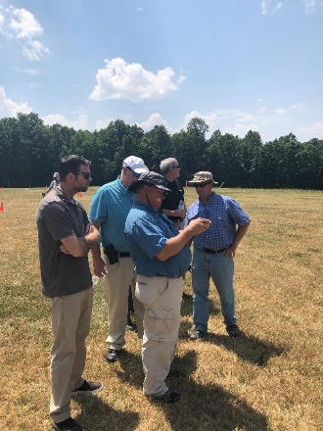
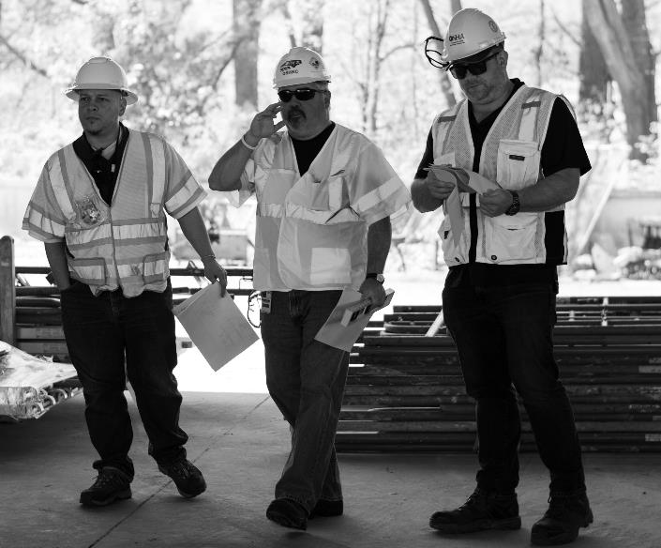
Strategic Plan
Special Emphasis Programs (SEP)
FFY 2023—Fall
NCDOL Photo Library
Construction
Logging and Arboriculture
Long Term Care Facilities
Health Hazards
Food Manufacturing
Grocery and Related Product Merchant Wholesalers
Amputations

Slide 6
Special Emphasis Program
Construction
FFY 2023—Fall
NAICS 23—CONSTRUCTION | FFY 2022 Total |  | FFY 2023 Total
Fatalities | 23 |  | 24
FATALITY TYPE | Total | FATALITY TYPE | Total
Struck By | 2 | Inhalation | 2
Caught In/Between | 1 | Ingestion | 0
Bite/Sting/Scratch | 0 | Absorption | 0
Fall (Same Level) | 0 | Repeated Motion/Pressure | 0
Fall (From Elevation) | 15 | Cardio/Respiratory | 0
Struck Against | 0 | Shock | 2
Rubbed/Abraded | 0 | Other | 2
Notes:
Will be posting a new billboard on the May 2022 fall prevention standdown and for heat stress.

Slide 7
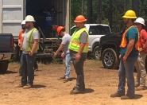
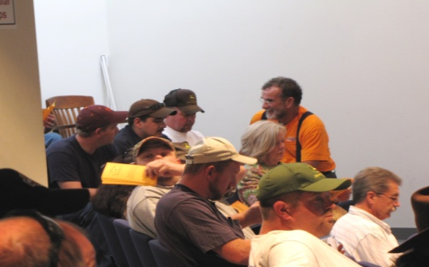
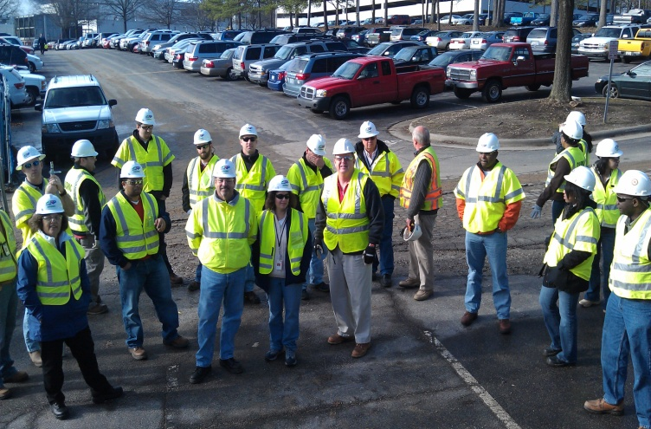
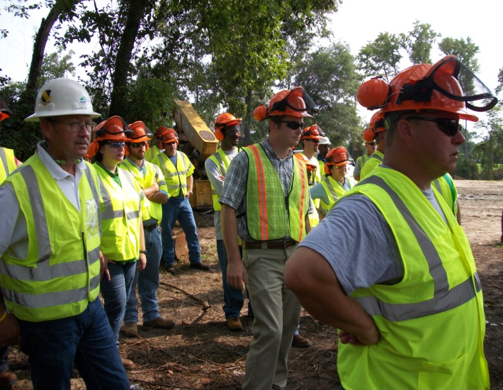
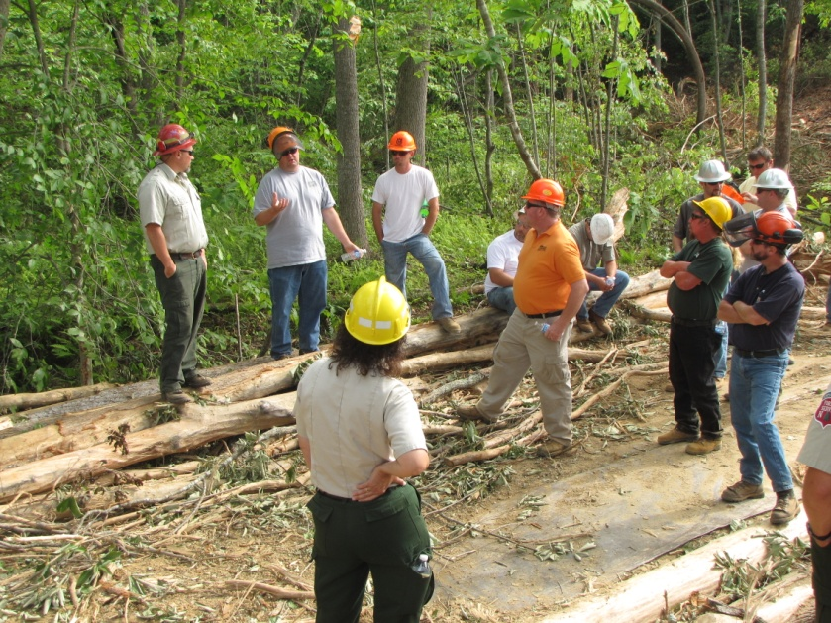
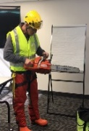
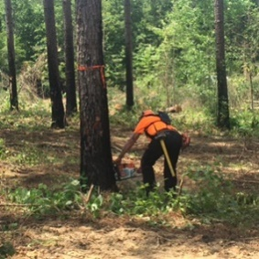

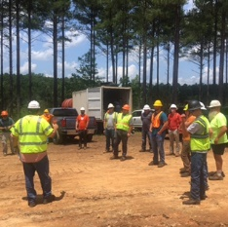
Special Emphasis Program
Construction
FFY 2023—Fall
23 | North Carolina |  |  |  | National Average |  |  |  | North Carolina vs. National Average
 | CY 2020 |  | CY 2021 |  | CY 2020 |  | CY 2021 |  | 2021 Comparison
TRC | 2.0 | 10% Decrease |  | 1.8 | 2.5 | No Change |  | 2.5 | 28% Lower
DART | 1.0 | 9% Increase |  | 1.1 | 1.6 | No Change |  | 1.6 | 31% Lower
SEP ACTIVITY | Total | FFY Goal
Compliance Inspections | 874 | 800
Consultative Visits | 463 | 290
OSH Outreach Events (10- and 30- Hour Construction) | 9 | 6
People Trained | 2,157 | 1,000

Slide 8
Special Emphasis Program
Logging and Arboriculture
FFY 2023—Fall
56173 | North Carolina |  |  |  | National Average |  |  |  | North Carolina vs. National Average
 | CY 2020 |  | CY 2021 |  | CY 2020 |  | CY 2021 |  | 2021 Comparison
TRC | 2.5 | 11% Increase |  | 2.8 | 3.0 | 6% Increase |  | 3.2 | 12% Lower
DART | 1.6 | 16% Increase |  | 1.9 | 2.0 | No Change |  | 2.0 | 5% Lower
SEP ACTIVITY | Total | FFY Goal
Compliance Inspections | 22 | 20
Consultative Visits | 15 | 15
OSH Training and Outreach Events | 13 | 5
People Trained | 470 | 150
NAICS 11331*—LOGGING | FFY 2022 Total |  | FFY 2023 Total
Fatalities | 1 |  | 1
NAICS 56173—ARBORICULTURE | FFY 2022 |  | FFY 2023 Total
NAICS 56173—ARBORICULTURE | FFY 2022 Total
Fatalities | 4 |  | 1
* TRC/DART Data not available

Slide 9
Special Emphasis Program
Long Term Care Facilities
FFY 2023—Fall
NAICS 623*—LONG TERM CARE
 | North Carolina |  |  |  | National Average |  |  |  | North Carolina vs. National Average
 | CY 2020 |  | CY 2021 |  | CY 2020 |  | CY 2021 |  | 2021 Comparison
TRC | 9.3 | 34% Decrease |  | 6.1 | 11.5 | 27% Decrease |  | 7.3 | 16% Lower
DART | 7.2 | 40% Decrease |  | 4.3 | 9.3 | 43% Decrease |  | 5.3 | 19% Lower
*TRC/DART rate based on the 3-digit NAICS code
SEP ACTIVITY | Total | FFY Goal
Compliance Inspections | 33 | 24
Consultative Visits | 38 | 30
OSH Outreach Events | 4 | 2
People Trained | 33 | 40

Slide 10
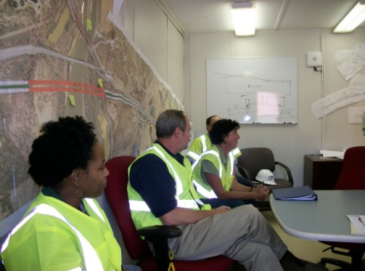
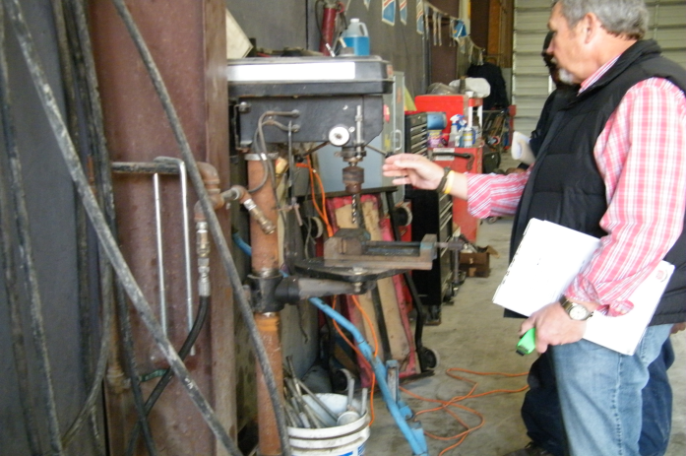
Special Emphasis Program
Health Hazards
FFY 2023—Fall
COMPLIANCE INSPECTIONS | Total | FFY Goal
Silica | 63 | 60
Asbestos | 9
Isocyanates | 20
Lead | 13
Hexavalent Chromium | 16
Total | 121
Program Improvements | 35 | 20
*Some inspections involved more than one health hazard and generally included a program improvement
NCDOL Photo Library

Slide 11
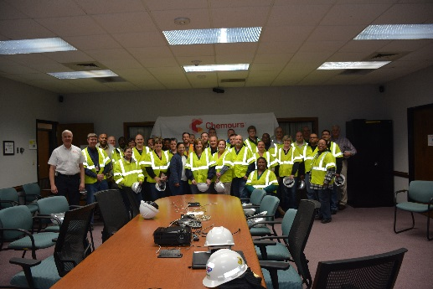
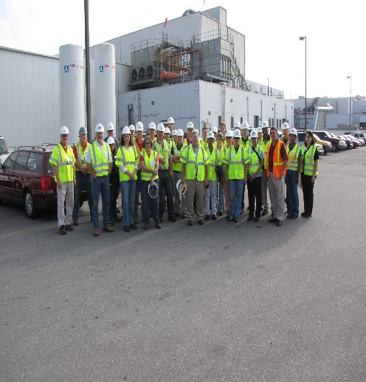
Special Emphasis Program
Health Hazards
FFY 2023—Fall
COMPLIANCE INSPECTION RESULTS
HEALTH HAZARDS | Number of Samples (Detectable Results) | Number With Overexposures | Average Severity Rate*
Silica | 14 | 5 | 0.73
Asbestos | 2 | 1 | 1.32
Isocyanates | 2 | 0 | 0.12
Lead | 10 | 2 | 0.60
Hexavalent Chromium | 8 | 0 | 0.07
Total | 36 | 8 | N/A
NCDOL Photo Library
* All Samples

Slide 12
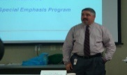
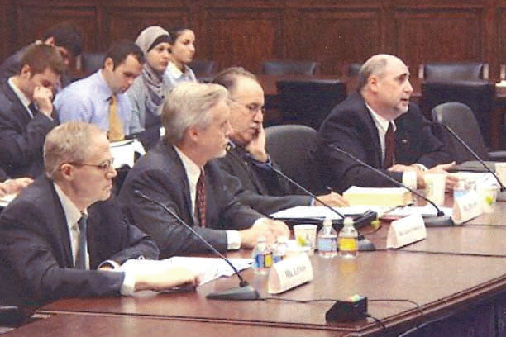
Special Emphasis Program
Health Hazards
FFY 2023—Fall
HEALTH HAZARDS | Consultative Surveys
 | 1st Qtr. | Total
Silica | 80 | 143
Asbestos |  | 14
Isocyanates |  | 13
Lead |  | 25
Hexavalent Chromium |  | 10
Total |  | 205
FFY Goal | 125 | 125
NCDOL Photo Library
NCDOL Photo Library
SEP ACTIVITY | Total | FFY Goal
OSH Outreach Events | 22 | 20
People Trained | 450 | 300

Slide 13
Special Emphasis Program
Food Manufacturing
FFY 2023—Fall
NAICS 311*—FOOD MANUFACTURING
 | North Carolina |  |  |  | National Average |  |  |  | North Carolina vs. National Average
 | CY 2020 |  | CY 2021 |  | CY 2020 |  | CY 2021 |  | 2021 Comparison
TRC | 3.8 | 11% Decrease |  | 3.4 | 5.1 | 6% Decrease |  | 4.8 | 25% Lower
DART | 3.0 | 13% Decrease |  | 2.6 | 3.9 | 8% Decrease |  | 3.6 | 23% Lower
*TRC/DART rate based on the 3-digit NAICS code
SEP ACTIVITY | Total | FFY Goal
Compliance Inspections | 29 | 25
Consultative Visits | 15 | 12
OSH Outreach Events | 4 | 2
People Trained | 47 | 40

Slide 14
Special Emphasis Program
Grocery and Related Product Wholesalers
FFY 2023—Fall
NAICS 4244*—GROCERY AND RELATED WHOLESALERS
 | North Carolina |  |  |  | National Average |  |  |  | North Carolina vs. National Average
 | CY 2020 |  | CY 2021 |  | CY 2020 |  | CY 2021 |  | 2021 Comparison
TRC | 4.1 | 2% Decrease |  | 4.0 | 4.9 | 9% Increase |  | 5.4 | 26% Lower
DART | 3.1 | 3% Increase |  | 3.2 | 4.0 | 2% Increase |  | 4.1 | 22% Lower
*DART/TRC rate based on the 4-digit NAICS code
SEP ACTIVITY | Total | FFY Goal
Compliance Inspections | 25 | 20
Consultative Visits | 12 | 3
OSH Outreach Events | 4 | 2
People Trained | 45 | 40

Slide 15
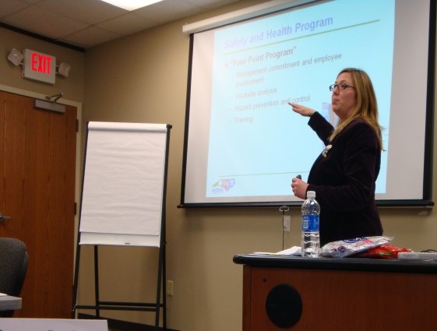
Special Emphasis Program
Amputations
FFY 2023—Fall
SEP ACTIVITY | Total | FFY Goal
Compliance Inspections | 169 | 150
Consultative Visits | 280 | 100
OSH Outreach Events | 54 | 15
People Trained | 1,217 | 400

Slide 16
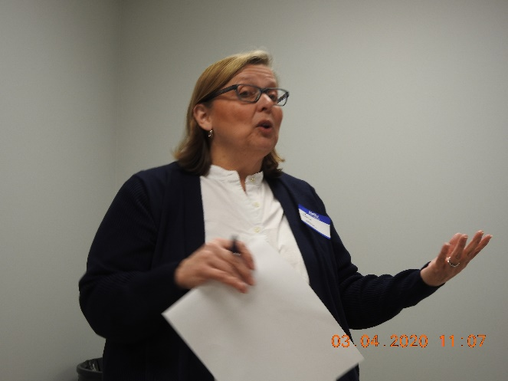
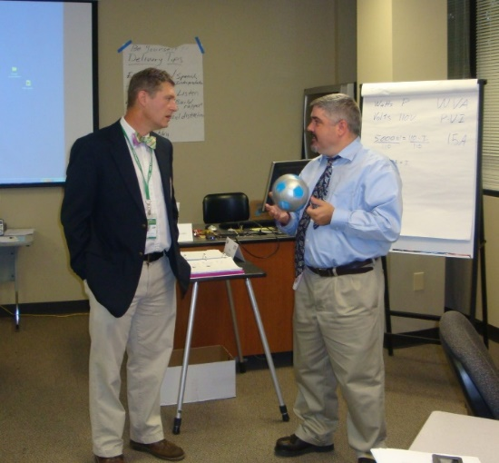
OSH Division
Public Sector
FFY 2023—Fall
 | CY 2020 |  | CY 2021
TRC | 4.2 | 12% Increase |  | 4.8
DART | 2.5 | 11% Increase |  | 2.8
ACTIVITY | Total | FFY Goal
Compliance Inspections | 120 | 95
Consultative Visits | 255 | 190
OSH Outreach Events/Booths | 25 | 6
Trained | 983 | 600

Slide 17
OSH Division
Complaint Desk*
FFY 2023—Fall
ACTIVITY | East Compliance | West Compliance | Agricultural Safety and Health | FFY 2023 Total | FFY 2022 Total
Complaints | 1,476 | 2,040 | 12 | 3,528 | 3,575
Referrals | 261 | 432 | 13 | 706 | 777
Fat/Cat | 100 | 118 | 10 | 228 | 228
Totals | 1,837 | 2,590 | 35 | 4,462* | 4,580*
*Includes calls that were processed but not necessarily inspected. Fat/Cat includes calls regarding heart attacks and other natural causes.
ACTIVITY | FFY 2023 Total | FFY 2022 Total
Complaints Not in OSH Jurisdiction* | 3,934 | 4,122
*Includes complaints related to wage and hour, discrimination, worker's compensation questions, beyond statute of limitation time frame, etc.

Slide 18
Strategic Management Plan
FFY 2024 - 2028
FFY 2023—Fall
New Five-Year Strategic Plan
SEP Team Leaders and OSH Management Meeting.
Reviewed National and North Carolina DART Rates.
Changes to Special Emphasis Programs
Removing Asbestos from Health Hazards; SEP Committee Discussing New Health Hazard Addition (Beryllium).
Expanding Grocery and Related Product Merchant Wholesalers SEP to Include Warehousing and Storage.*
*CPL 03-00-026 – NEP on Warehousing and Distribution Center Operations
Notes:
Due to DART rates in warehousing and storage, added their NAICS to Grocery.
HH SEP discussing which HH to add to replace asbestos.
All other SEPs will remain.

Slide 19
OSH Division
Education and Training Outreach
FFY 2023—Fall
OUTREACH EVENT | Total | FFY Goal
General Industry—10-Hour Course | 6 | 4
General Industry—30-Hour Course | 2 | 1
NC #500/502—Construction Train-the-Trainer Course/ NC #501/503—General Industry Train-the-Trainer Course | 1 | 1
Construction—10-Hour Course | 7 | 5
Construction—30-Hour Course | 2 | 1
Labor One/Booth Events | 18 | N/A
Speaker’s Bureau | 82 | N/A
Webinars | 93 | N/A
OSH Workshops | 5 | N/A
Technical Assistance | 0 | N/A
Spanish Training and Outreach Events | 1 | N/A
Train-the-Trainer Program (Construction/General Industry)—Events | 21 | N/A
Train-the-Trainer Program (Construction/General Industry)—Trained | 260 | N/A
Notes:
ETTA doesn’t have a Spanish Outreach trainer at this time.

Slide 20
OSH Division
Education and Training Outreach
FFY 2023—Fall
Stand Downs/Forums
Fall Prevention Stand-Down (May 1 - 5) (Webinars, Billboard, Special Events Page, Social Media, Labor One Events, Trained 1,709 Employees)
Heat Illness Prevention (All Summer) (Webinars, Billboards, Special Events Page, Social Media, Trained 105 Employees)
Trench Safety Stand-Down (June 19 - 23) (Webinars, Governor’s Proclamation, Billboards, Special Events Page, Social Media, Trained 37 Employees)
Safe + Sound (August 7 - 13) (Webinars, Governor’s Proclamation, Billboards, Special Events Page, Social Media, Trained 21 Employees)
Construction Forum (September 7) (Billboard, Special Events Page, Social Media and Labor One Events, Trained 78 Employees)

Slide 21
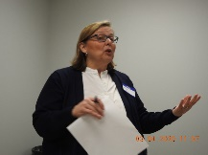
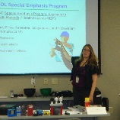
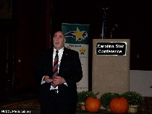
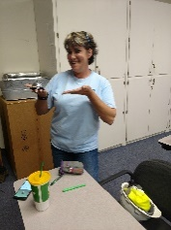
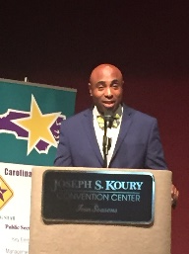
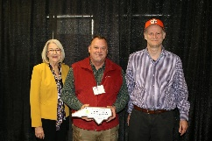
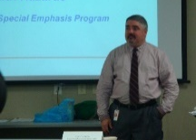

OSH Division
Recognition Programs
FFY 2023—Fall
*Cumulative Total
STAR SITES—New, Recertification, Promotion | Total | FFY Goal | Approved Star Sites*
Carolina Star | 22 |  | 104
Building Star | 7 |  | 23
Rising Star | 1 |  | 5
Public Sector Star | 1 |  | 18
Total | 31 | 20 | 150
NCDOL Photo Library
ACTIVITY | Total | FFY Goal
Star Sites—Termination/Withdrawn | 4
Star Booths | 9
Star Presentations | 21 | 10
Star Program Interventions | 147 | 100
Notes:
Withdrew: Emerson Automation Solutions – work site closed

Slide 22

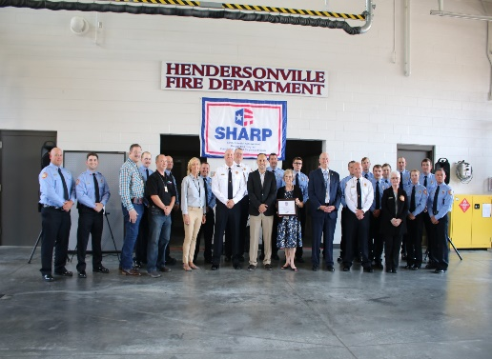
OSH Division
Recognition Programs
FFY 2023—Fall
SHARP SITES—New/Renewal | Total | FFY Goal | Approved SHARP Sites*
SHARP—Construction | 0 |  | 3
SHARP—General Industry | 41 |  | 104
SHARP—Public Sector | 19 |  | 45
Totals | 60 | 60 | 152
*Cumulative Total
GOLD STAR GROWERS—New
Total | 227
SAFETY AWARDS | Total
CY 2023 Safety Awards Season (291 – Silver; 1,860 – Gold) | 2,151 / 2,120*
 | Total
Million Hour Awards | 58
* Attendance
Notes:
2022 Safety Award Season reverting to normal schedule and may be a hybrid of virtual and in-person.

Slide 23


OSH Division
Alliances and Partnerships
FFY 2023—Fall
Alliances
Carolinas AGC
Lamar Advertising Company
Mexican Consulate
N.C. State – Industry Expansion Solutions
Safety and Health Council of NC
NUCA of the Carolinas
NCALGESO
Tree Care Industry Association
Plumbing-Heating-Cooling Contractor’s Association
N.C. Masonry Contractors Association (New! 11/16/2023)

Slide 24
OSH Division
Alliances and Partnerships
FFY 2023—Fall
Partnerships
Holder – Edison Foard – Leeper, A Joint Venture
Charlotte - Charlotte Douglas International Airport – Terminal Lobby Expansion – Phase 5 (New! 2023 – 2024)
Jacobs Engineering Group
Holly Springs - Biotech Manufacturing Facility and Campus (2022 – 2024)
Whiting – Turner Contracting Company (New! 11/6/2023)
Siler City – Wolfspeed Semi-conductor/Silicon Carbide Plant (2023 – 2025)

Slide 25
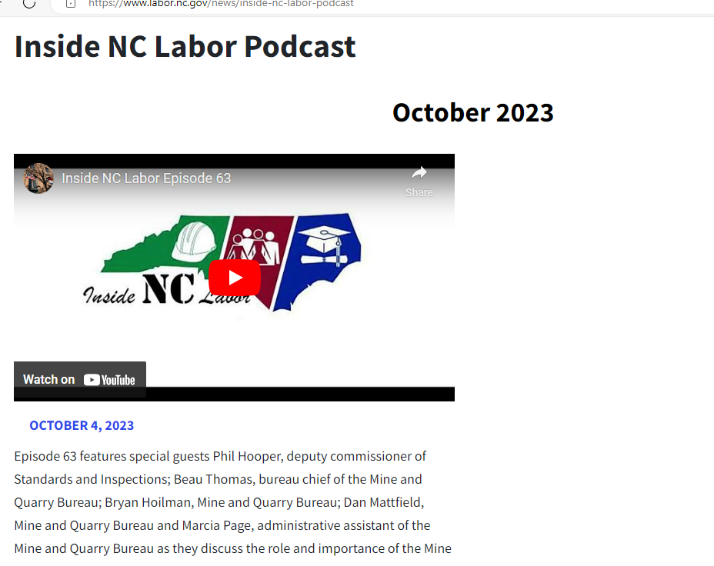
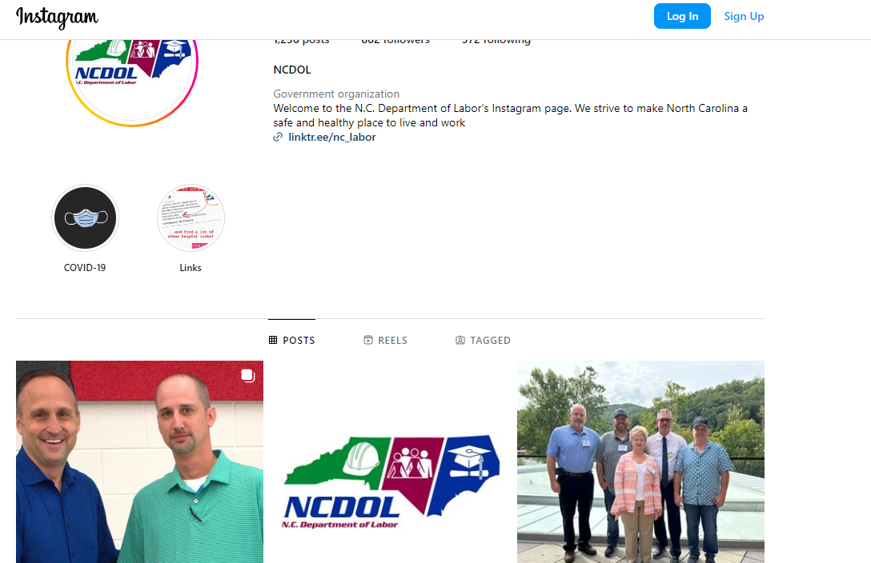
OSH Division
Social Media
FFY 2023—Fall
Inside NC Labor Podcasts
63 Episodes
Facebook
2,427 Followers
Instagram
862 Followers
X
2,227 Followers
LinkedIn
213 Followers

Slide 26
OSH Division
Standards Section—New/Revisions
FFY 2023—Fall
Compliance Directives (CPL)
CPL 02-01-064: Site-Specific Targeting
Updates the Site-specific Targeting Inspection Plan.
Receives highest priority among programmed inspections.
Based on injury and illness data (Form 300 Log Data 2019 – 2021); does not include construction worksites or NC public sector sites. Effective 8/6/2023.
CPL 03-00-008: Combustible Dust Explosion Prevention Program
Revised the CPL and continued the National Emphasis Program for Combustible Dust hazards. Effective 7/7/2023.

Slide 27
OSH Division
Standards Section—New
FFY 2023—Fall
Code of Federal Register (CFR)
CFR 127N – Tracking of Workplace Injuries and Illnesses
Requirement for employers in certain industries with 100 or more employees to submit information from their OSHA Form 300 - Log of Work-Related Injuries and Illnesses and OSHA Form 301 – Injury and Illness Incident Report.
Effective January 1, 2024.

Slide 28
OSH Division
Standards Section—New
FFY 2023—Fall
Memos
National Emphasis Program – Falls (CPL 03-00-025)
Implementing National Emphasis Program through existing procedures. Effective 9/27/2023.
OSH Division has Special Emphasis Programs, State-specific standard, and inspection procedures but will track related activities (Coding in OSHA Express).
Memo TC 1—Enforcement Inspection Guidance for Tree Care and Tree Removal Operations
Memo cancels CPL 02-01-045—Citation Guidance Related to Tree Care and Tree Removal Operations and provides enforcement guidance for inspecting employers engaged in tree care and tree removal operations. Effective 6/9/2023.

Slide 29
OSH Division
Cut-Loose, In-Training, Vacant
FFY 2023—Fall
West Compliance | Safety | % | Industrial Hygienist | %
Cut Loose | 21 | 68% | 16 | 59%
In-Training | 4 | 13% | 8 | 30%
Vacant | 6 | 19% | 3 | 4%
Total | 31 |  | 27
East Compliance | Safety | % | Industrial Hygienist | %
Cut Loose | 11 | 52% | 4 | 24%
In-Training | 3 | 14% | 5 | 29%
Vacant | 7 | 33% | 8 | 47%
Total | 21 |  | 17
Safety Cut Loose | 62% | Health Cut Loose | 45%
Safety In-Training | 13% | Health in-Training | 30%
Safety Vacant | 25% | Health Vacant | 25%

Slide 30
OSH Division
Cut-Loose, In-Training, Vacant
FFY 2023—Fall
Consultative Services | Safety | % | Industrial Hygienist | %
Cut Loose | 11 | 100% | 8 | 100%
In-Training | 0 | 0% | 0 | 0%
Vacant | 0 | 0% | 0 | 0%
Total | 11 |  | 8
Education, Training and Technical Assistance | Safety | % | Industrial Hygienist | %
Cut Loose | 8 | 73% | 6 | 100%
In-Training | 0 | 0% | 1 | 0%
Vacant | 3 | 27% | 0 | 9%
Total | 11 |  | 7
Agricultural Safety and Health | Safety | % | Industrial Hygienist
Cut Loose | 5 | 63% | N/A
In-Training | 3 | 37% | N/A
Vacant | 0 | 0% | N/A
Total | 8

Slide 31

Thank You For Attending!
FFY 2023—Fall
Questions?
1-800-NC-LABOR
(1-800-625-2267)
www.labor.nc.gov
Notes:
31

