Slide 1
North Carolina Department of Labor
Occupational Safety and Health Division
4th Quarter Report
Federal Fiscal Year 2023*
Presented by:
Wanda Lagoe CSP ARM CPM
Education, Training and Technical Assistance
Occupational Safety and Health Division of North Carolina
*Preliminary Data
Notes:
The information in this presentation is provided voluntarily by the N.C. Department of Labor, Education Training and Technical Assistance Bureau as a public service and is made available in good faith. This presentation is designed to assist trainers conducting OSHA outreach training for workers. Since workers are the target audience, this presentation emphasizes hazard identification, avoidance, and control – not standards. No attempt has been made to treat the topic exhaustively. It is essential that trainers tailor their presentations to the needs and understanding of their audience.
The information and advice provided on this Site and on Linked Sites is provided solely on the basis that users will be responsible for making their own assessment of the matters discussed herein and are advised to verify all relevant representations, statements, and information.
This presentation is not a substitute for any of the provisions of the Occupational Safety and Health Act of North Carolina or for any standards issued by the N.C. Department of Labor. Mention of trade names, commercial products, or organizations does not imply endorsement by the N.C. Department of Labor.

Slide 2
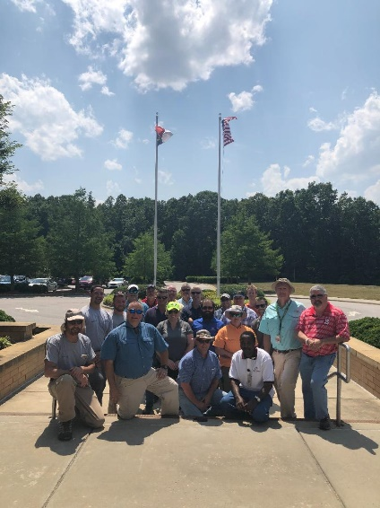
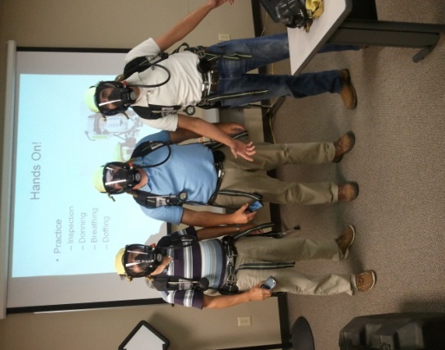
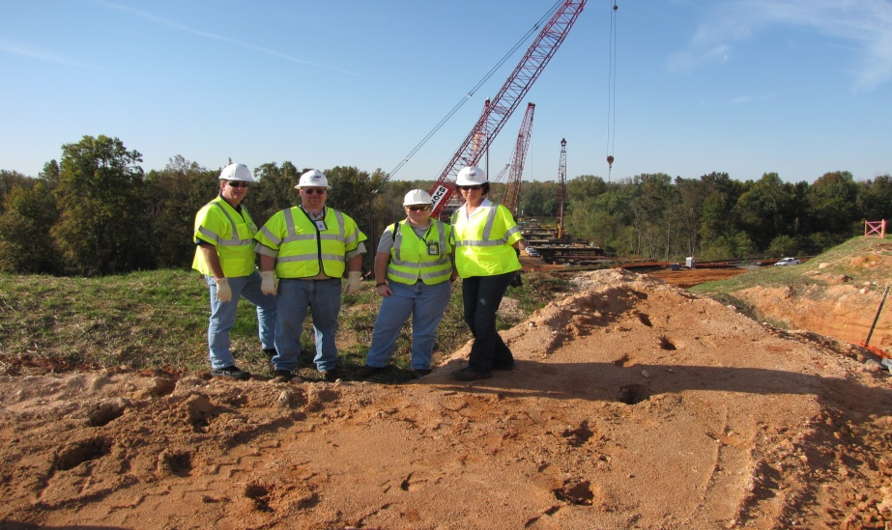
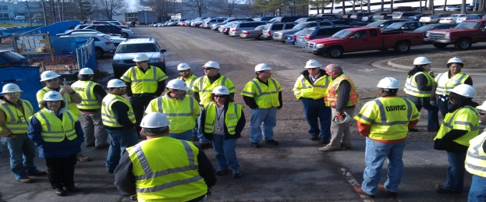
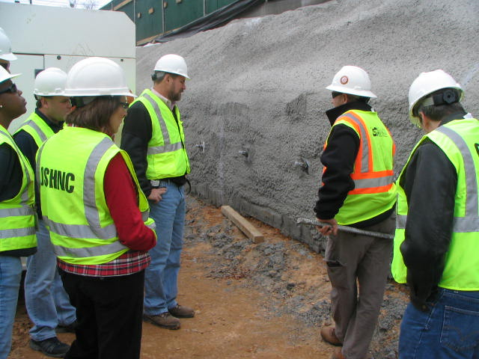
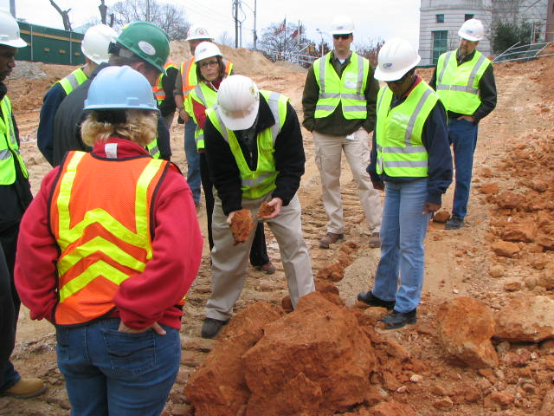
N.C. Workplace Safety and Health
OSH Division—Fatalities Inspected
FFY 2023—4th Qtr.
FATALITY TYPE | 1st Qtr. | 2nd Qtr. | 3rd Qtr. | 4th Qtr. | Total | FATALITY TYPE | 1st Qtr. | 2nd Qtr. | 3rd Qtr. | 4th Qtr. | Total
Struck By | 4 | 4 | 5 | 4 | 17 | Inhalation | 1 | 0 | 2 | 0 | 3
Caught In/Between | 1 | 2 | 2 | 5 | 10 | Ingestion | 0 | 0 | 0 | 0 | 0
Bite/Sting/Scratch | 0 | 0 | 0 | 0 | 0 | Absorption | 0 | 0 | 0 | 0 | 0
Fall (Same Level) | 2 | 0 | 0 | 0 | 2 | Repeated Motion/Pressure | 0 | 0 | 0 | 0 | 0
Fall (From Elevation) | 3 | 7 | 6 | 3 | 19 | Cardio/Respiratory | 0 | 0 | 0 | 0 | 0
Struck Against | 0 | 0 | 0 | 0 | 0 | Shock | 1 | 2 | 0 | 1 | 4
Rubbed/Abraded | 0 | 0 | 0 | 0 | 0 | Other | 5 | 2 | 3 | 2 | 12
COVID-19 | 0 | 0 | 0 | 0 | 0 | Criminal Activity | 0 | 0 | 2 | 2 | 4
Fatalities Under OSH Division Jurisdiction
FFY 2022 | Total | FFY 2023 | 1st Qtr. | 2nd Qtr. | 3rd Qtr. | 4th Qtr. | Total
Fatalities | 68 | Fatalities | 17 | 17 | 20 | 17 | 71
NCDOL Photo Library

Slide 3
N.C. Workplace Safety and Health
OSH Division—Strategic Plan Goals
FFY 2023—4th Qtr.
COMPLIANCE | 1st Qtr. | 2nd Qtr. | 3rd Qtr. | 4th Qtr. | Total | FFY Goal
Safety Inspections | 177 | 270 | 288 | 286 | 1,021 | 1,100
Health Inspections | 108 | 211 | 207 | 125 | 651 | 705
Serious Hazards Eliminated | 512 | 812 | 800 | 573 | 2,697 | 4,100
Training and/or Program Violations | 72 | 131 | 138 | 101 | 442 | 1,050
CONSULTATION | 1st Qtr. | 2nd Qtr. | 3rd Qtr. | 4th Qtr. | Total | FFY Goal
Serious Hazards Eliminated | 1,672 | 1,468 | 1,411 | 1,765 | 6,316 | 4,800
Private Sector and Public Sector Visits | 344 | 376 | 362 | 416 | 1,498 | 1,315
OSH DIVISION | 1st Qtr. | 2nd Qtr. | 3rd Qtr. | 4th Qtr. | Total | FFY Goal
Program Improvements | 419 | 550 | 586 | 565 | 2,120 | 2,060
People Trained in Special Emphasis Program Areas | 1,076 | 1,639 | 3,221 | 1,500 | 7,436 | 3,200
People Trained at OSH Division Sponsored Events | 1,530 | 1,827 | 4,149 | 1,855 | 9,361 | 5,350

Slide 4
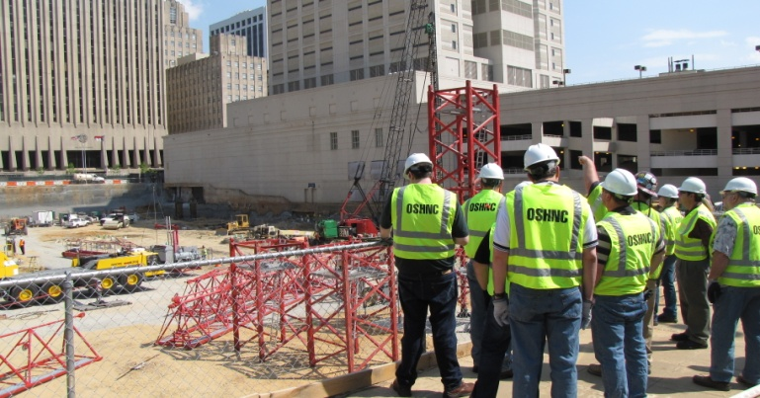
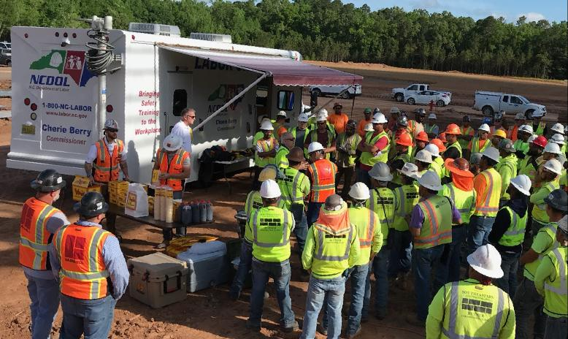
N.C. Workplace Safety and Health
OSH Division—Strategic Plan Goals
FFY 2023—4th Qtr.
EDUCATION, TRAINING AND TECHNICAL ASSISTANCE | 1st Qtr. | 2nd Qtr. | 3rd Qtr. | 4th Qtr. | Total | FFY Goal
Publications Distributed | 8,840 | 16,057 | 20,336 | 18,989 | 64,222 | 45,000
Standards Interpretations | 517 | 656 | 473 | 185 | 1,831 | NA
AGRICULTURAL SAFETY AND HEALTH | 1st Qtr. | 2nd Qtr. | 3rd Qtr. | 4th Qtr. | Total | FFY Goal
Outreach Materials Distributed | 1,018 | 3,630 | 1,109 | 186 | 5,943 | 2,400
Compliance Inspections | 10 | 0 | 3 | 33 | 46 | 50
Certificates Issued | 180 | 1,362 | 428 | 91 | 2,061 | 1,750
Preoccupancy Inspections | 270 | 1,436 | 295 | 72 | 2,073 | 1,875
NCDOL Photo Library

Slide 5
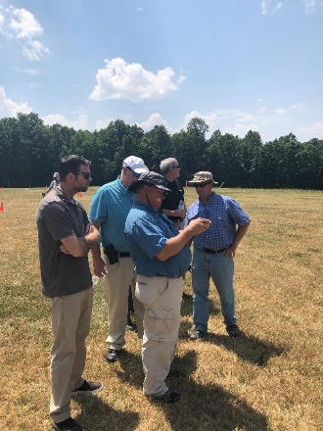

Strategic Plan
Special Emphasis Programs (SEP)
FFY 2023—4th Qtr.
NCDOL Photo Library
Construction
Logging and Arboriculture
Long Term Care Facilities
Health Hazards
Food Manufacturing
Grocery and Related Product Merchant Wholesalers
Amputations

Slide 6

Special Emphasis Program
Construction
FFY 2023—4th Qtr.
NAICS 23—CONSTRUCTION | FFY 2022 Total |  | 1st Qtr. | 2nd Qtr. | 3rd Qtr. | 4th Qtr. | FFY 2023 Total
Total Fatalities | 23 |  | 2 | 9 | 9 | 4 | 24
FATALITY TYPE | 1st Qtr. | 2nd Qtr. | 3rd Qtr. | 4th Qtr. | Total | FATALITY TYPE | 1st Qtr. | 2nd Qtr. | 3rd Qtr. | 4th Qtr. | Total
Struck By | 0 | 0 | 1 | 1 | 2 | Inhalation | 0 | 0 | 2 | 0 | 2
Caught In/Between | 0 | 1 | 0 | 0 | 1 | Ingestion | 0 | 0 | 0 | 0 | 0
Bite/Sting/Scratch | 0 | 0 | 0 | 0 | 0 | Absorption | 0 | 0 | 0 | 0 | 0
Fall (Same Level) | 0 | 0 | 0 | 0 | 0 | Repeated Motion/Pressure | 0 | 0 | 0 | 0 | 0
Fall (From Elevation) | 1 | 6 | 5 | 3 | 15 | Cardio/Respiratory | 0 | 0 | 0 | 0 | 0
Struck Against | 0 | 0 | 0 | 0 | 0 | Shock | 0 | 2 | 0 | 0 | 2
Rubbed/Abraded | 0 | 0 | 0 | 0 | 0 | Other | 1 | 0 | 1 | 0 | 2
Notes:
Will be posting a new billboard on the May 2022 fall prevention standdown and for heat stress.

Slide 7
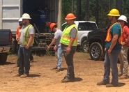
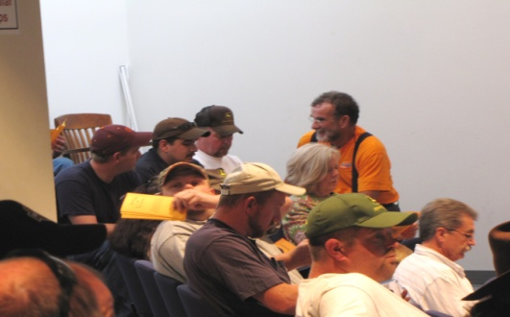
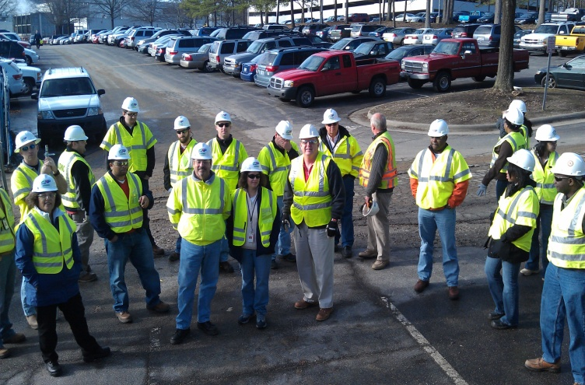
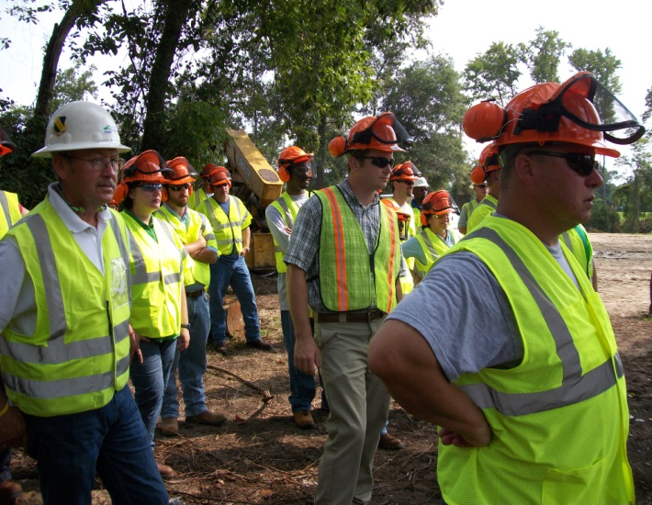
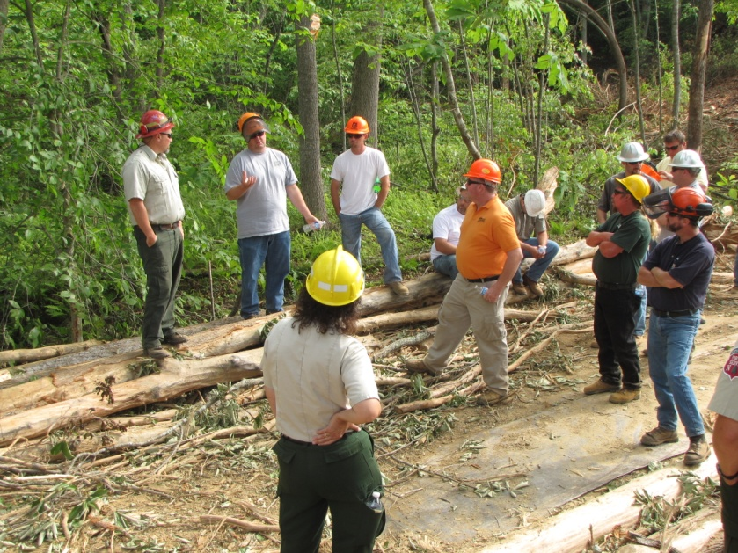
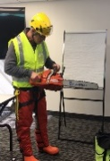
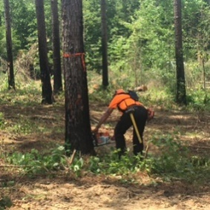

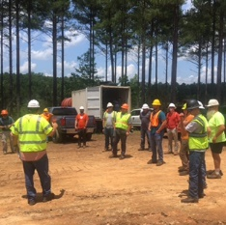
Special Emphasis Program
Construction
FFY 2023—4th Qtr.
 | North Carolina |  |  |  | National Average |  |  |  | North Carolina vs. National Average
 | CY 2020 |  | CY 2021 |  | CY 2020 |  | CY 2021 |  | 2021 Comparison
TRC | 2.0 | 10% Decrease |  | 1.8 | 2.5 | No Change |  | 2.5 | 28% Lower
DART | 1.0 | 9% Increase |  | 1.1 | 1.6 | No Change |  | 1.6 | 31% Lower
SEP ACTIVITY | 1st Qtr. | 2nd Qtr. | 3rd Qtr. | 4th Qtr. | Total | FFY Goal
Compliance Inspections | 133 | 252 | 238 | 253 | 876 | 800
Consultative Visits | 107 | 115 | 109 | 132 | 463 | 290
OSH Outreach Events (10- and 30- Hour Construction Courses) | 3 | 5 | 1 | 0 | 9 | 6
People Trained | 93 | 148 | 1,761 | 155 | 2,157 | 1,000

Slide 8
Special Emphasis Program
Logging and Arboriculture
FFY 2023—4th Qtr.
56173 | North Carolina |  |  |  | National Average |  |  |  | North Carolina vs. National Average
 | CY 2020 |  | CY 2021 |  | CY 2020 |  | CY 2021 |  | 2021 Comparison
TRC | 2.5 | 11% Increase |  | 2.8 | 3.0 | 6% Increase |  | 3.2 | 12% Lower
DART | 1.6 | 16% Increase |  | 1.9 | 2.0 | No Change |  | 2.0 | 5% Lower
SEP ACTIVITY | 1st Qtr. | 2nd Qtr. | 3rd Qtr. | 4th Qtr. | Total | FFY Goal
Compliance Inspections | 4 | 1 | 12 | 5 | 22 | 20
Consultative Visits | 5 | 4 | 5 | 1 | 15 | 15
OSH Training and Outreach Events | 2 | 4 | 2 | 5 | 13 | 5
People Trained | 26 | 158 | 164 | 122 | 470 | 150
NAICS 11331*—LOGGING | FFY 2022 Total |  | 1st Qtr. | 2nd Qtr. | 3rd Qtr. | 4th Qtr. | FFY 2023 Total
Fatalities | 1 |  | 0 | 1 | 0 | 0 | 1
NAICS 56173—ARBORICULTURE | FFY 2022 Total |  | 1st Qtr. | 2nd Qtr. | 3rd Qtr. | 4th Qtr. | FFY 2023 Total
Fatalities | 4 |  | 0 | 0 | 0 | 1 | 1
* TRC/DART Data not available

Slide 9
Special Emphasis Program
Long Term Care Facilities
FFY 2023—4th Qtr.
NAICS 623*—LONG TERM CARE
 | North Carolina |  |  |  | National Average |  |  |  | North Carolina vs. National Average
 | CY 2020 |  | CY 2021 |  | CY 2020 |  | CY 2021 |  | 2021 Comparison
TRC | 9.3 | 34% Decrease |  | 6.1 | 11.5 | 27% Decrease |  | 7.3 | 16% Lower
DART | 7.2 | 40% Decrease |  | 4.3 | 9.3 | 43% Decrease |  | 5.3 | 19% Lower
*TRC/DART rate based on the 3-digit NAICS code
SEP ACTIVITY | 1st Qtr. | 2nd Qtr. | 3rd Qtr. | 4th Qtr. | Total | FFY Goal
Compliance Inspections | 6 | 10 | 12 | 5 | 33 | 24
Consultative Visits | 9 | 14 | 8 | 7 | 38 | 30
OSH Outreach Events | 0 | 0 | 3 | 1 | 4 | 2
People Trained | 0 | 0 | 24 | 9 | 33 | 40

Slide 10
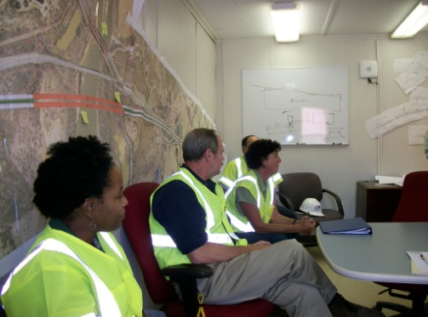
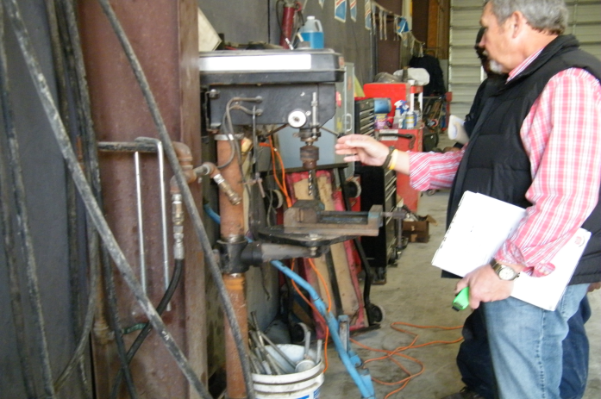
Special Emphasis Program
Health Hazards
FFY 2023—4th Qtr.
COMPLIANCE INSPECTIONS | 1st Qtr. | 2nd Qtr. | 3rd Qtr. | 4th Qtr. | Total | FFY Goal
Silica | 7 | 25 | 20 | 11 | 63 | 60
Asbestos | 2 | 3 | 3 | 1 | 9
Isocyanates | 4 | 6 | 7 | 3 | 20
Lead | 6 | 3 | 2 | 2 | 13
Hexavalent Chromium | 7 | 2 | 7 | 0 | 16
Total | 26 | 39 | 39 | 17 | 121
Program Improvements | 6 | 16 | 9 | 4 | 35 | 20
*Some inspections involved more than one health hazard and generally included a program improvement
NCDOL Photo Library

Slide 11
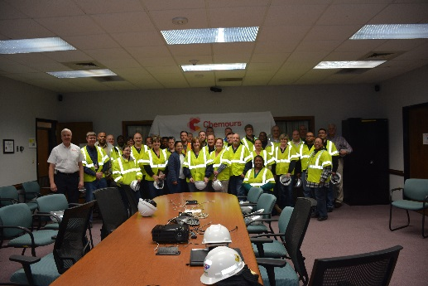
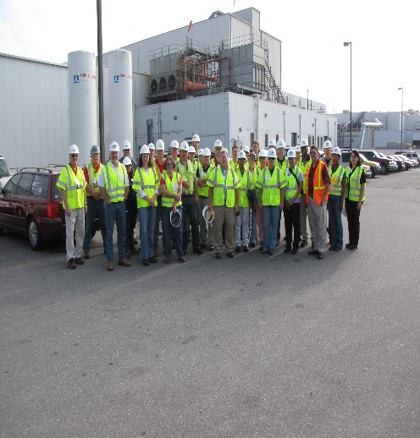
Special Emphasis Program
Health Hazards
FFY 2023—4th Qtr.
COMPLIANCE INSPECTION RESULTS
HEALTH HAZARDS | Number of Samples (Detectable Results) |  |  |  |  | Number With Overexposures |  |  |  |  | Average Severity Rate*
 | 1st Qtr. | 2nd Qtr. | 3rd Qtr. | 4th Qtr. | Total | 1st Qtr. | 2nd Qtr. | 3rd Qtr. | 4th Qtr. | Total | 1st Qtr. | 2nd Qtr. | 3rd Qtr. | 4th Qtr.
Silica | 2 | 6 | 3 | 3 | 14 | 1 | 2 | 1 | 1 | 5 | 1.18 | 0.68 | 0.84 | 0.57
Asbestos | 0 | 2 | 0 | 0 | 2 | 0 | 1 | 0 | 0 | 1 | 0.00 | 1.32 | 0.00 | 0.00
Isocyanates | 1 | 0 | 1 | 0 | 2 | 0 | 0 | 0 | 0 | 0 | 0.04 | 0.00 | 0.20 | 0.00
Lead | 3 | 6 | 0 | 1 | 10 | 1 | 1 | 0 | 0 | 2 | 1.41 | 0.29 | 0.00 | 0.07
Hexavalent Chromium | 1 | 5 | 2 | 0 | 8 | 0 | 0 | 0 | 0 | 0 | 0.12 | 0.03 | 0.20 | 0.00
Total | 7 | 13 | 3 | 4 | 36 | 2 | 4 | 1 | 1 | 8 | N/A | N/A | N/A | N/A
NCDOL Photo Library
* All Samples

Slide 12
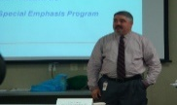
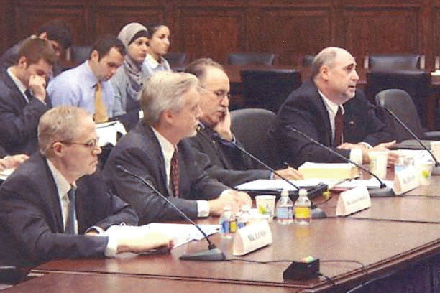
Special Emphasis Program
Health Hazards
FFY 2023—4th Qtr.
HEALTH HAZARDS | Consultative Surveys
 | 1st Qtr. | 2nd Qtr. | 3rd Qtr. | 4th Qtr. | Total
Silica | 39 | 40 | 38 | 26 | 143
Asbestos | 1 | 8 | 3 | 2 | 14
Isocyanates | 4 | 6 | 1 | 2 | 13
Lead | 4 | 15 | 4 | 2 | 25
Hexavalent Chromium | 3 | 1 | 3 | 3 | 10
Total | 51 | 70 | 49 | 35 | 205
FFY Goal | 125
NCDOL Photo Library
NCDOL Photo Library
SEP ACTIVITY | 1st Qtr. | 2nd Qtr. | 3rd Qtr. | 4th Qtr. | Total | FFY Goal
OSH Outreach Events | 5 | 7 | 4 | 6 | 22 | 20
People Trained | 105 | 125 | 75 | 145 | 450 | 300

Slide 13
Special Emphasis Program
Food Manufacturing
FFY 2023—4th Qtr.
NAICS 311*—FOOD MANUFACTURING
 | North Carolina |  |  |  | National Average |  |  |  | North Carolina vs. National Average
 | CY 2020 |  | CY 2021 |  | CY 2020 |  | CY 2021 |  | 2021 Comparison
TRC | 3.8 | 11% Decrease |  | 3.4 | 5.1 | 6% Decrease |  | 4.8 | 25% Lower
DART | 3.0 | 13% Decrease |  | 2.6 | 3.9 | 8% Decrease |  | 3.6 | 23% Lower
*TRC/DART rate based on the 3-digit NAICS code
SEP ACTIVITY | 1st Qtr. | 2nd Qtr. | 3rd Qtr. | 4th Qtr. | Total | FFY Goal
Compliance Inspections | 5 | 8 | 11 | 5 | 29 | 25
Consultative Visits | 7 | 3 | 3 | 2 | 15 | 12
OSH Outreach Events | 0 | 1 | 1 | 2 | 4 | 2
People Trained | 0 | 14 | 11 | 22 | 47 | 40

Slide 14
Special Emphasis Program
Grocery and Related Product Wholesalers
FFY 2023—4th Qtr.
NAICS 4244*—GROCERY AND RELATED WHOLESALERS
 | North Carolina |  |  |  | National Average |  |  |  | North Carolina vs. National Average
 | CY 2020 |  | CY 2021 |  | CY 2020 |  | CY 2021 |  | 2021 Comparison
TRC | 4.1 | 2% Decrease |  | 4.0 | 4.9 | 9% Increase |  | 5.4 | 26% Lower
DART | 3.1 | 3% Increase |  | 3.2 | 4.0 | 2% Increase |  | 4.1 | 22% Lower
*DART/TRC rate based on the 4-digit NAICS code
SEP ACTIVITY | 1st Qtr. | 2nd Qtr. | 3rd Qtr. | 4th Qtr. | Total | FFY Goal
Compliance Inspections | 2 | 8 | 10 | 5 | 25 | 20
Consultative Visits | 5 | 2 | 0 | 5 | 12 | 3
OSH Outreach Events | 1 | 0 | 2 | 1 | 4 | 2
People Trained | 11 | 0 | 18 | 16 | 45 | 40

Slide 15
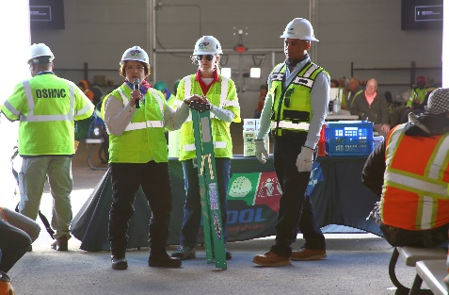
Special Emphasis Program
Amputations
FFY 2023—4th Qtr.
SEP ACTIVITY | 1st Qtr. | 2nd Qtr. | 3rd Qtr. | 4th Qtr. | Total | FFY Goal
Compliance Inspections | 44 | 48 | 56 | 30 | 178 | 150
Consultative Visits | 68 | 68 | 62 | 82 | 280 | 100
OSH Outreach Events | 13 | 16 | 13 | 12 | 54 | 15
People Trained | 286 | 424 | 255 | 252 | 1,217 | 400

Slide 16
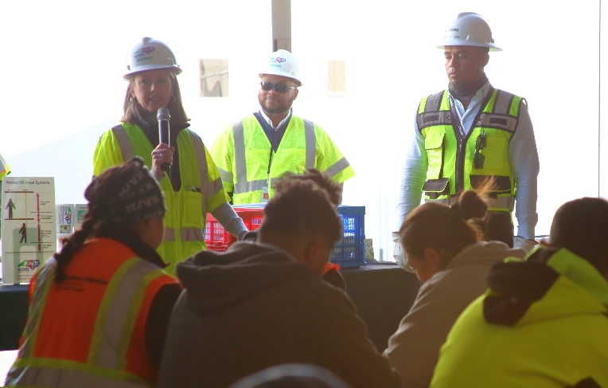
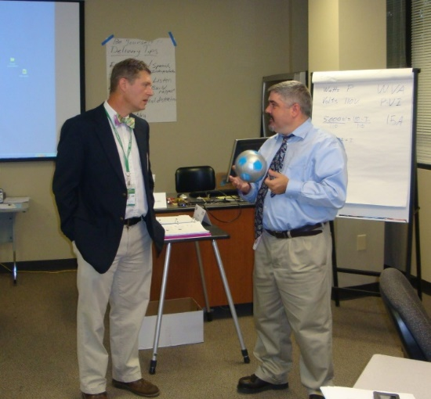
OSH Division
Public Sector
FFY 2023—4th Qtr.
 | CY 2020 |  | CY 2021
TRC | 4.2 | 12% Increase |  | 4.8
DART | 2.5 | 11% Increase |  | 2.8
ACTIVITY | 1st Qtr. | 2nd Qtr. | 3rd Qtr. | 4th Qtr. | Total | FFY Goal
Compliance Inspections | 21 | 49 | 38 | 12 | 120 | 95
Consultative Visits | 44 | 61 | 83 | 67 | 255 | 190
OSH Outreach Events/Booths | 2 | 7 | 7 | 9 | 25 | 6
Trained | 128 | 338 | 128 | 389 | 983 | 600

Slide 17
OSH Division
Education and Training Outreach
FFY 2023—4th Qtr.
OUTREACH EVENT | 1st Qtr. | 2nd Qtr. | 3rd Qtr. | 4th Qtr. | Total | FFY Goal
General Industry—10-Hour Course | 1 | 2 | 2 | 1 | 6 | 4
General Industry—30-Hour Course | 1 | 0 | 1 | 0 | 2 | 1
NC #500/502—Construction Train-the-Trainer Course/ NC #501/503—General Industry Train-the-Trainer Course | 1 | 0 | 0 | 0 | 1 | 1
Construction—10-Hour Course | 2 | 4 | 1 | 0 | 7 | 5
Construction—30-Hour Course | 1 | 1 | 0 | 0 | 2 | 1
Labor One/Booth Events | 0 | 4 | 12 | 2 | 18 | N/A
Speaker’s Bureau | 17 | 21 | 23 | 21 | 82 | N/A
Webinars | 22 | 13 | 27 | 31 | 93 | N/A
OSH Workshops | 0 | 0 | 3 | 2 | 5 | N/A
Technical Assistance | 0 | 0 | 0 | 0 | 0 | N/A
Spanish Training and Outreach Events | 0 | 0 | 0 | 1 | 1 | N/A
Train-the-Trainer Program (Construction/General Industry)—Events | 6 | 3 | 9 | 3 | 21 | N/A
Train-the-Trainer Program (Construction/General Industry)—Trained | 104 | 28 | 107 | 21 | 260 | N/A
Notes:
ETTA doesn’t have a Spanish Outreach trainer at this time.

Slide 18

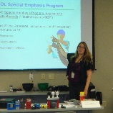
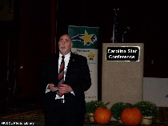
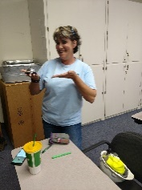
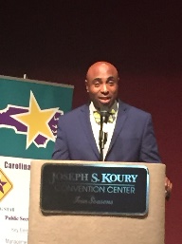
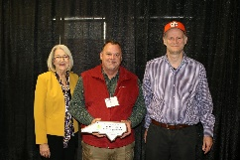
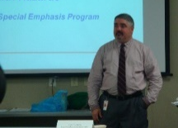

OSH Division
Recognition Programs
FFY 2023—4th Qtr.
*Cumulative Total
STAR SITES—New, Recertification, Promotion | 1st Qtr. | 2nd Qtr. | 3rd Qtr. | 4th Qtr. | Total | FFY Goal | Approved Star Sites*
Carolina Star | 3 | 2 | 11 | 6 | 22 |  | 104
Building Star | 1 | 1 | 3 | 2 | 7 |  | 23
Rising Star | 0 | 0 | 0 | 1 | 1 |  | 5
Public Sector Star | 0 | 0 | 1 | 0 | 1 |  | 18
Total | 4 | 3 | 15 | 9 | 31 | 20 | 150
NCDOL Photo Library
ACTIVITY | 1st Qtr. | 2nd Qtr. | 3rd Qtr. | 4th Qtr. | Total | FFY Goal
Star Sites—Termination/Withdrawn | 1 | 3 | 0 | 0 | 4
Star Booths | 4 | 0 | 1 | 4 | 9
Star Presentations | 4 | 8 | 4 | 5 | 21 | 10
Star Program Interventions | 28 | 53 | 41 | 25 | 147 | 100
Notes:
Withdrew: Emerson Automation Solutions – work site closed

Slide 19

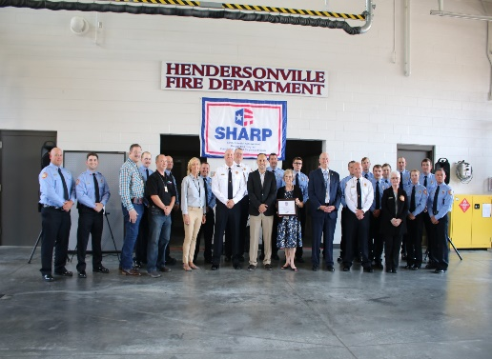
OSH Division
Recognition Programs
FFY 2023—4th Qtr.
SHARP SITES—New/Renewal | 1st Qtr. | 2nd Qtr. | 3rd Qtr. | 4th Qtr. | Total | FFY Goal | Approved SHARP Sites*
SHARP—Construction | 0 | 0 | 0 | 0 | 0 |  | 3
SHARP—General Industry | 12 | 8 | 8 | 13 | 41 |  | 104
SHARP—Public Sector | 7 | 1 | 11 | 0 | 19 |  | 45
Totals | 19 | 9 | 19 | 13 | 60 | 60 | 152
*Cumulative Total
GOLD STAR GROWERS—New | 1st Qtr. | 2nd Qtr. | 3rd Qtr. | 4th Qtr. | Total
 | 27 | 156 | 36 | 8 | 227
SAFETY AWARDS |  |  |  |  | Total
CY 2023 Safety Awards Season (271 – Silver; 1,881 – Gold) |  |  |  |  | 2,152 / 2,120*
 | 1st Qtr. | 2nd Qtr. | 3rd Qtr. | 4th Qtr. | Total
Million Hour Awards | 1 | 42 | 8 | 7 | 58
* Attendance

Slide 20


OSH Division
Alliances and Partnerships
FFY 2023—4th Qtr.
Alliances
  Carolinas AGC
  Lamar Advertising Company
  Mexican Consulate
  N.C. State – Industry Expansion Solutions
  Safety and Health Council of NC
  NUCA of the Carolinas
  NCALGESO
  Tree Care Industry Association
  Plumbing-Heating-Cooling Contractor’s Association
  N.C. Masonry Contractors Association (New! 11/16/2023)

Slide 21
OSH Division
Alliances and Partnerships
FFY 2023—4th Qtr.
Partnerships
  Holder – Edison Foard – Leeper, A Joint Venture
    Charlotte - Charlotte Douglas International Airport – Terminal Lobby Expansion – Phase 5 (New! 2023 – 2024)
  Jacobs Engineering Group
    Holly Springs - Biotech Manufacturing Facility and Campus (2022 – 2024)
  Whiting – Turner Contracting Company (New! 11/6/2023)
    Siler City – Wolfspeed Semi-conductor/Silicon Carbide Plant (2023 – 2025)

Slide 22
OSH Division
Complaint Desk*
FFY 2023—4th Qtr.
East Compliance | West Compliance | Agricultural Safety and Health
ACTIVITY | 1st Qtr. | 2nd Qtr. | 3rd Qtr. | 4th Qtr. | 1st Qtr. | 2nd Qtr. | 3rd Qtr. | 4th Qtr. | 1st Qtr. | 2nd Qtr. | 3rd Qtr. | 4th Qtr. | FFY 2023 Total | FFY 2022 Total
Complaints | 289 | 326 | 352 | 509 | 415 | 518 | 445 | 662 | 4 | 1 | 1 | 6 | 3,528 | 3,575
Referrals | 67 | 63 | 67 | 64 | 94 | 100 | 121 | 117 | 3 | 1 | 3 | 6 | 706 | 777
Fat/Cat | 36 | 17 | 19 | 30 | 27 | 38 | 29 | 21 | 4 | 0 | 1 | 5 | 228 | 228
Totals | 392 | 406 | 438 | 601 | 539 | 656 | 595 | 800 | 11 | 2 | 5 | 17 | 4,462 | 4,580*
*Includes calls that were processed but not necessarily inspected. Fat/Cat includes calls regarding heart attacks and other natural causes.
ACTIVITY | 1st Qtr. | 2nd Qtr. | 3rd Qtr. | 4th Qtr. | FFY 2023 Total | FFY 2022 Total
Complaints Not in OSH Jurisdiction* | 860 | 1,178 | 949 | 947 | 3,934 | 4,122
*Includes complaints related to wage and hour, discrimination, workers’ compensation questions, beyond statute of limitation time frame, etc.

Slide 23
OSH Division
Internal Training
FFY 2023—4th Qtr.
1st Qtr.—COURSES
In-Person | No. of Events | Trained
ASH Preoccupancy Inspection System | 1 | 8
CPR/AED | 1 | 8
How to Document A Willful Trench Violation in 5 Minutes or Less | 1 | 116
Machine Guarding and Lockout/Tagout | 1 | 61
Proposed Heat Standard | 1 | 121
Process Safety Management | 1 | 19
Using Toxicology and Physical Properties to Determine Sampling Priorities | 1 | 45
Significant Cases | 1 | 120
Webinars | No. of Events | Trained
Fall Protection, Hazard Communication, Powered Industrial Trucks, Office Ergonomics | 6 | 6
Total Trained |  | 504

Slide 24
OSH Division
Internal Training
FFY 2023—4th Qtr.
2nd Qtr.—COURSES
In-Person | No. of Events | Trained
OSH #100 Course – Initial Compliance | 1 | 13
Technical Writing/OSHA Express | 1 | 13
CPR/AED | 1 | 6
10-Hour General Industry Course | 1 | 1
Labor One Training | 2 | 2
Webinars | No. of Events | Trained
Food Manufacturing Special Emphasis Program (SEP) | 1 | 1
Logging Special Emphasis Program | 2 | 11
Occupational Noise | 1 | 2
Total Trained |  | 49

Slide 25
OSH Division
Internal Training
FFY 2023—4th Qtr.
3rd Qtr.—COURSES
In-Person | No. of Events | Trained
OSH #125 – Health Standards for Industrial Hygienists | 1 | 9
Webinars | No. of Events | Trained
Bloodborne Pathogens | 1 | 1
Confined Spaces (Construction) | 1 | 2
Electrical Safety (Construction) | 1 | 1
Ergonomics Awareness | 1 | 1
Fall Protection | 1 | 1
Food Manufacturing SEP | 1 | 11
Grocery and Related Wholesalers SEP | 1 | 8
Long Term Care | 1 | 6
Steel Erection | 1 | 1
Scaffolds | 1 | 1
Stairways and Ladders | 1 | 1
Struck-by/Caught Between | 1 | 1
Total Trained |  | 44

Slide 26
OSH Division
Internal Training
FFY 2023—4th Qtr.
4th Qtr.—COURSES
In-Person | No. of Events | Trained
OSH #100 – Initial Compliance | 1 | 15
OSH #105 – Introduction to Safety Standards | 1 | 21
Heat Stress | 1 | 1
Investigative Interviewing Techniques | 1 | 23
New Equipment Training | 2 | 42
OSH Construction Safety Specialist (OCSS) Excavation and Trenching | 1 | 16
OCSS Confined Space Entry | 1 | 14
Technical Writing | 1 | 16
CPR/AED/First Aid | 4 | 19
Webinars | No. of Events | Trained
Ergonomics, Exit Routes and Fire Prevention, Food Manufacturing SEP, Grocery and Related Products Wholesalers SEP, Food Manufacturing SEP, Logging SEP, Occupational Noise | 7 | 36
Total Trained |  | 203

Slide 27
OSH Division
Cut-Loose, In-Training, Vacant
FFY 2023—4th Qtr.
West Compliance | Safety | % | Industrial Hygienist | %
Cut Loose | 21 | 68% | 16 | 59%
In-Training | 4 | 13% | 8 | 30%
Vacant | 6 | 19% | 3 | 4%
Total | 31 |  | 27
East Compliance | Safety | % | Industrial Hygienist | %
Cut Loose | 11 | 52% | 4 | 24%
In-Training | 3 | 14% | 5 | 29%
Vacant | 7 | 33% | 8 | 47%
Total | 21 |  | 17
Safety Cut Loose | 62% | Health Cut Loose | 45%
Safety In-Training | 13% | Health in-Training | 30%
Safety Vacant | 25% | Health Vacant | 25%

Slide 28
OSH Division
Cut-Loose, In-Training, Vacant
FFY 2023—4th Qtr.
Consultative Services | Safety | % | Industrial Hygienist | %
Cut Loose | 11 | 100% | 8 | 100%
In-Training | 0 | 0% | 0 | 0%
Vacant | 0 | 0% | 0 | 0%
Total | 11 |  | 8
Education, Training and Technical Assistance | Safety | % | Industrial Hygienist | %
Cut Loose | 8 | 73% | 6 | 100%
In-Training | 0 | 0% | 1 | 0%
Vacant | 3 | 27% | 0 | 9%
Total | 11 |  | 7
Agricultural Safety and Health | Safety | % | Industrial Hygienist
Cut Loose | 5 | 63% | N/A
In-Training | 3 | 37% | N/A
Vacant | 0 | 0% | N/A
Total | 8

Slide 29
OSH Division
Standards Section—Revisions
FFY 2023—4th Qtr.
Compliance Directives (CPL)
  CPL 02-01-064: Site-Specific Targeting
    Updates the Site-specific Targeting Inspection Plan.
      Receives highest priority among programmed inspections.
      Based on injury and illness data (Form 300 Log Data 2019 – 2021); does not include construction worksites or NC public sector sites.
  CPL 03-00-008: Combustible Dust Explosion Prevention Program
    Revised the CPL and continued the National Emphasis Program for Combustible Dust hazards.

Slide 30
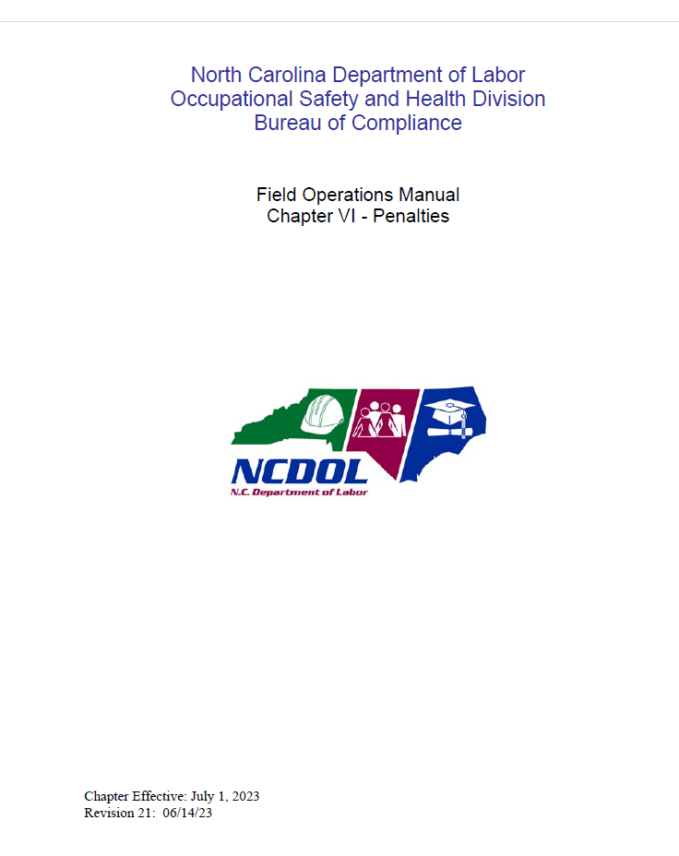
OSH Division
Standards Section—Revisions
FFY 2023—4th Qtr.
Field Operations Manual
  FOM Chapter 11 – Agricultural Safety and Health Inspections
    Updated penalties.
  FOM Chapter 6 – Penalties
    Updated penalties and adjustment factors.

Slide 31
OSH Division
Standards Section—New
FFY 2023—4th Qtr.
Memos
  National Emphasis Program – Falls (CPL 03-00-025)
    Implementing National Emphasis Program through existing procedures.
      OSH Division has Special Emphasis Programs, State-specific standard, and inspection procedures but will track related activities (Coding in OSHA Express).

Slide 32
OSH Division
Standards Section—New
FFY 2023—4th Qtr.
Code of Federal Register (CFR)
  CFR 127N – Tracking of Workplace Injuries and Illnesses
    Requirement for employers in certain industries with 100 or more employees to submit information from their OSHA Form 300 - Log of Work-Related Injuries and Illnesses and OSHA Form 301 – Injury and Illness Incident Report.
    Effective January 1, 2024.

Slide 33
OSH Division
Retaliatory Employment Discrimination
FFY 2023—4th Qtr.
OSH Complaint Statistics** | 1st Qtr. | 2nd Qtr. | 3rd Qtr. | 4th Qtr. | Total/ Average
# of New Docketed Cases | 43 Plus (19) 11(c) | 44 Plus (42) 11(c) | 46 Plus (34) 11(c) | 60 | 193
# of Administrative Closures (Included in Disposition Chart) | N/A | N/A | N/A | N/A | N/A
# of Cases Completed | 34 Plus (4) (11(c) | 42 Plus (36) 11(c) | 72 Plus (46) 11(c) | 65 | 213
# Completed Within 90 Days | 2 | 5 | 11 | 12 | 30
% Completed Within 90 Days – SAMM 14 | 6% | 12% | 15% | 18% | 14%
Average # Days to Complete – SAMM 16 | 294 | 294 | 280 | 291 | 289
# of Pending Cases at EOQ | 151 | 157 | 131 | 133 | 133
% Pending Over 90 Days | 68% | 80% | 70% | 82% | 75%
Average # of Days Pending | 163 | 191 | 180 | 167 | 168
** 4th Quarter statistics do not include referred Section 11(c) complaints that were not followed by Complainant filing a REDA complaint.

Slide 34
OSH Division
Retaliatory Employment Discrimination
FFY 2023—4th Qtr.
OSH Complaint Disposition | 1st Qtr. | 2nd Qtr. | 3rd Qtr. | 4th Qtr. | Total
Administrative Closure | 6 Plus (4) 11(c) | 10 Plus (36) 11(c) | 16 Plus (46) 11(c) | 12 | 44
Withdrawn (Includes Requested RTS Letters) | 13 | 9 | 19 | 13 | 54
Merit (Included in SAMM 15 Merit) | 4 | 4 | 6 | 8 | 22
Total SAMM 15 Merit | 7 | 7 | 14 | 12 | 40
Total SAMM 15 Percent Merit | 21% | 17% | 19% | 18% | 18%
Dismissal Right-to-Sue (Includes No Merit and Unresponsive) | 8 | 16 | 23 | 28 | 75
Settled Other (Included in SAMM 15) | 3 | 3 | 8 | 4 | 18
Total Cases Closed by Disposition | 34 | 42 | 72 | 65 | 213
Total Damages Paid This Quarter (Includes Settlements With Aid of the Bureau During Informal Discussions or Referral to Mediation Program.) | $40,000 | $10,000* | $15,100 | $90,460 | $155,560

Slide 35
OSH Division
Retaliatory Employment Discrimination
FFY 2023—4th Qtr.
Bureau Staffing
Jaleesa Thomas | Information Officer
Norma Velasco | Administrative Assistant II
James Agosto | Investigator
David Bailey | Investigator
Dianne Daniels | Investigator
Brian Lampe | Investigator
Erin Smith | Investigator
Theodore Place | Investigator
Alvin Vocalan | Investigator
Kevin Frye | Investigator
Harriet Hopkins | Administrator

Slide 36

Thank You For Attending!
FFY 2023—4th Qtr.
Questions?
1-800-NC-LABOR
(1-800-625-2267)
www.labor.nc.gov
Notes:
36

