Slide 1
Training Records Database Job Aid
Notes:
Updated October 2023

Slide 2
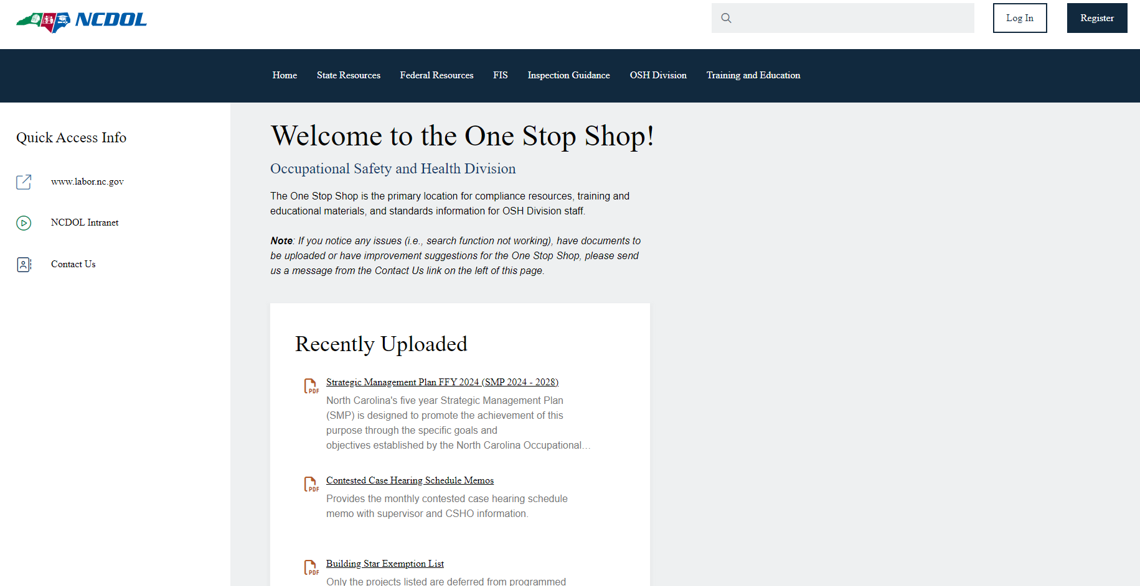
OSH Training Records Database
Select Training And Education

Slide 3
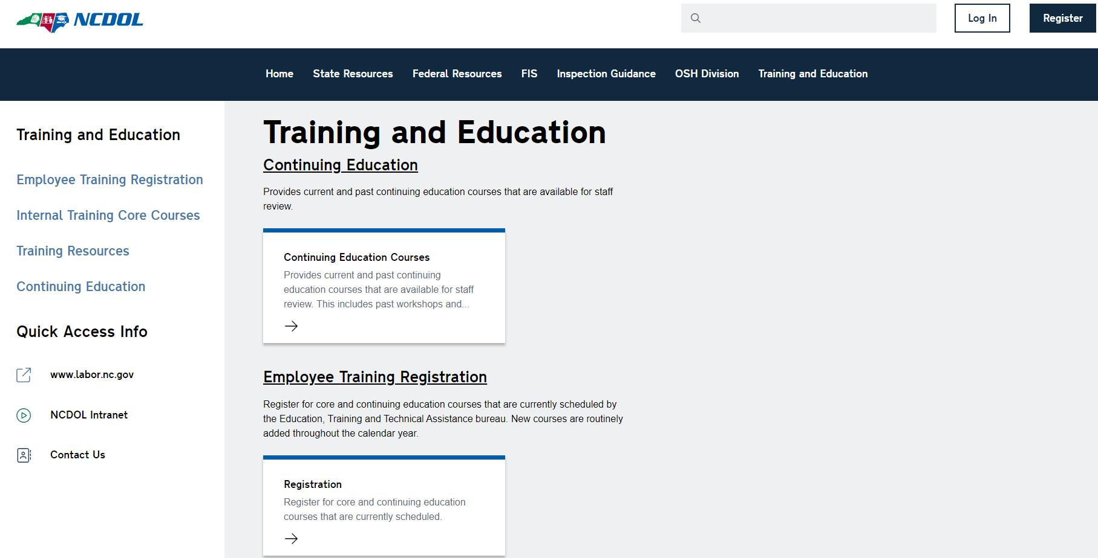
OSH Training Records Database
Select Training Resources

Slide 4
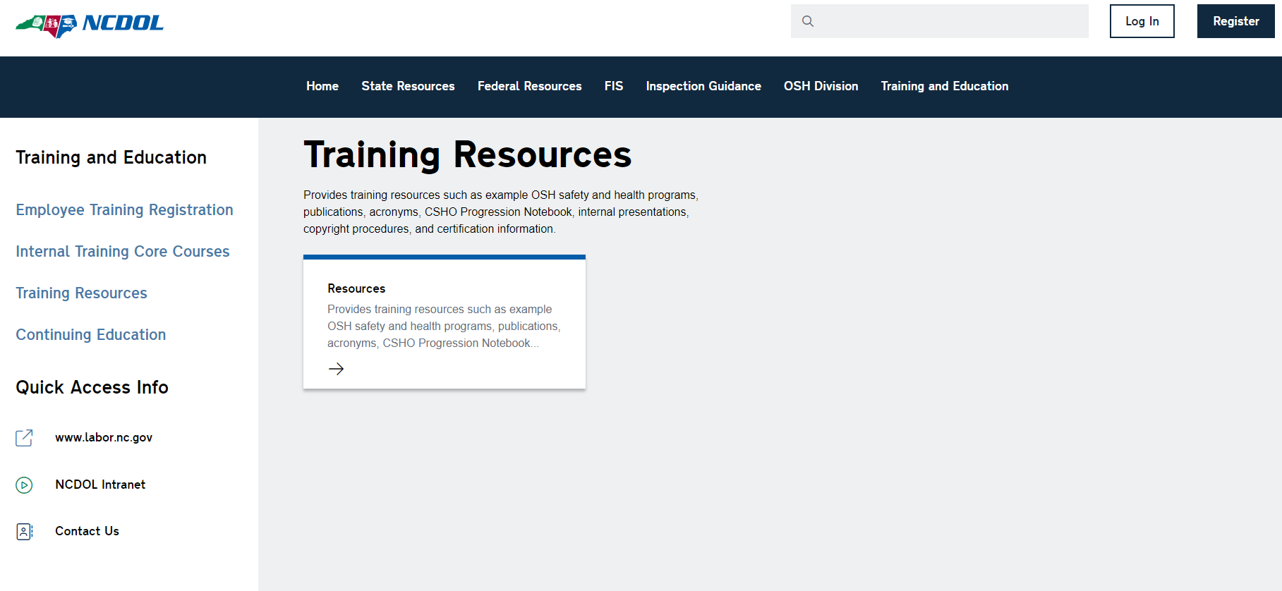
OSH Training Records Database
Select Resources

Slide 5
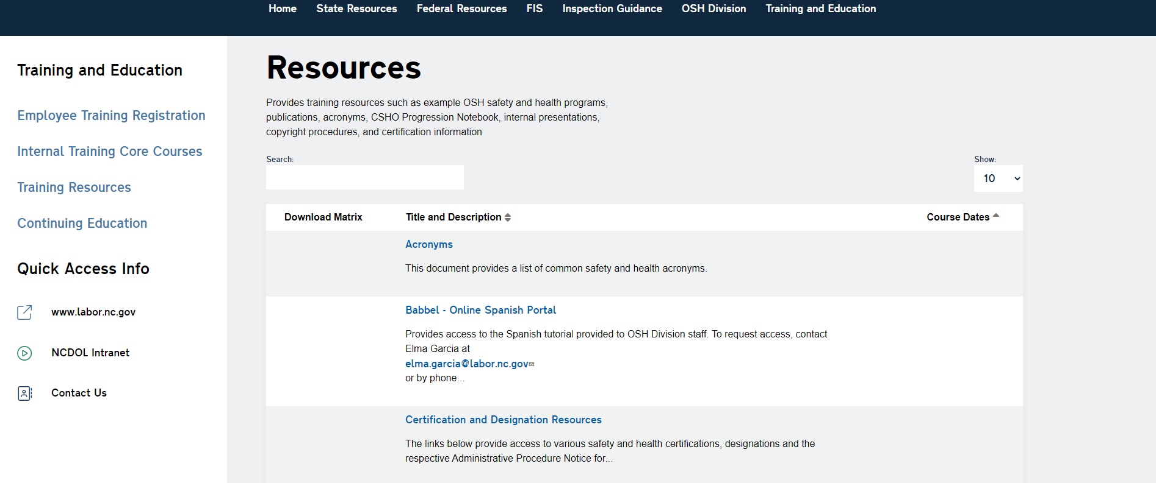
OSH Training Records Database
Scroll down to bottom of page. Go to page 2.

Slide 6
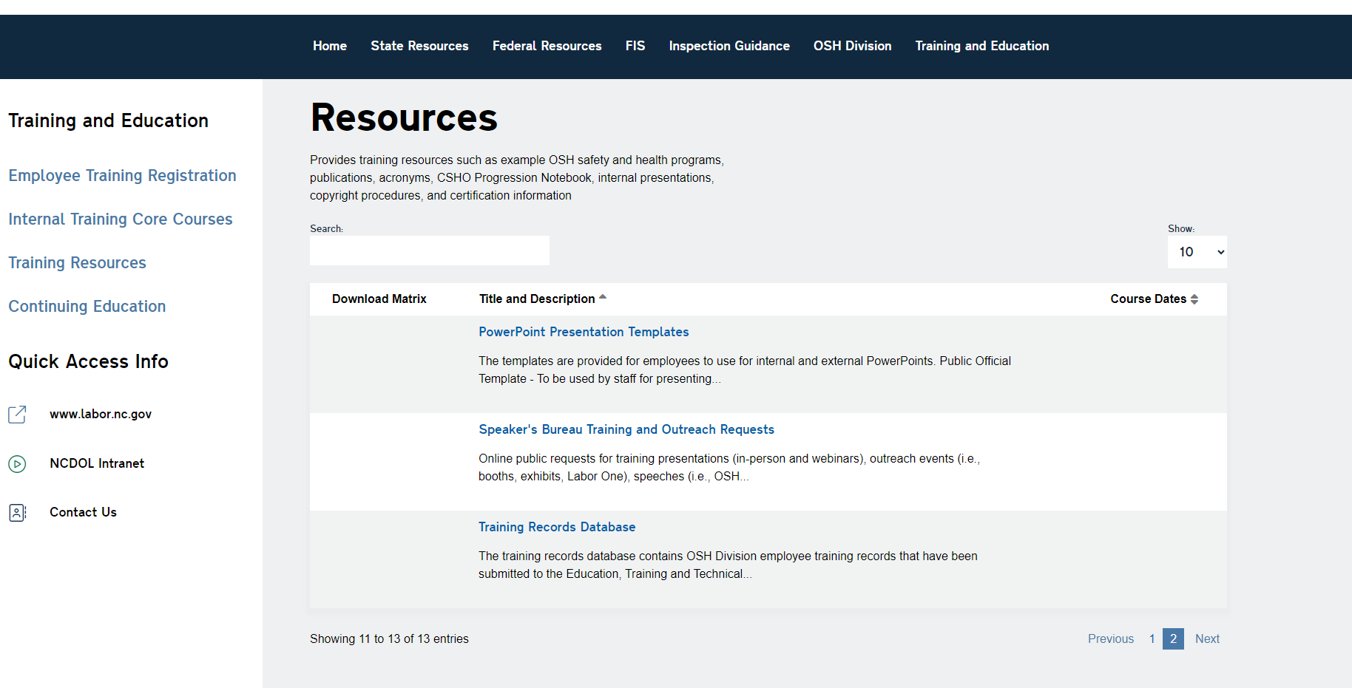
OSH Training Records Database
Page 2. Select Training Records Database

Slide 7
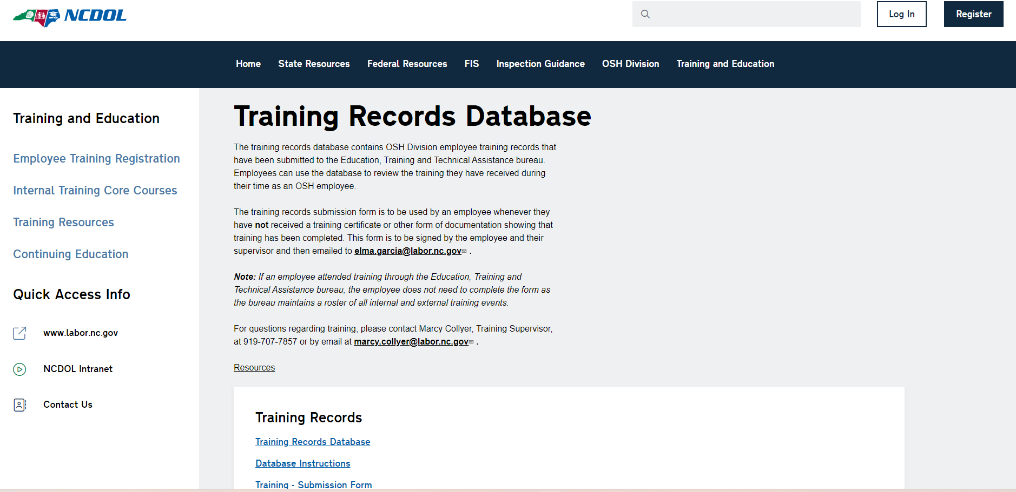
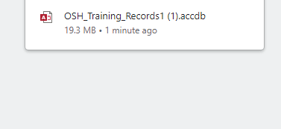
OSH Training Records Database
2. Click on download link
1. Select Training Records Database.

Slide 8
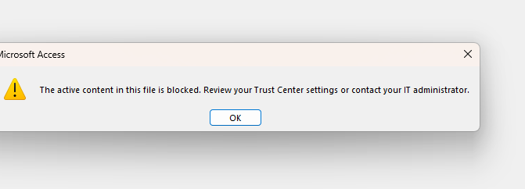
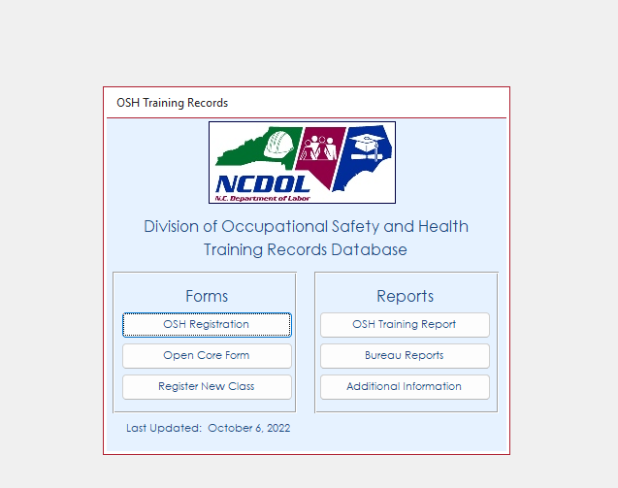
OSH Training Records Database
If you get this notification, just click Ok.
Will let you know the last time the database was updated, on the One Stop Shop

Slide 9
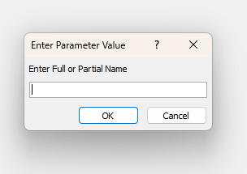
OSH Training Records Database
To Access Your Training Record
Enter first and/or last name. The more specific the better. The database is not case sensitive.

Slide 10
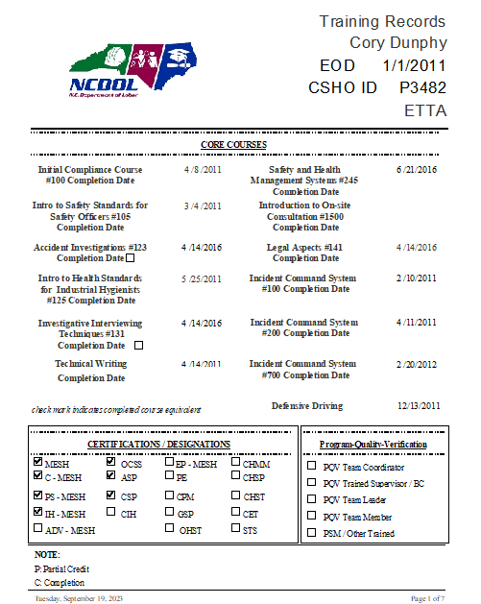
OSH Training Records Database
Your Name, Bureau and EOD Date (Entry Day of Duty) CSHO ID & Bureau
Core Courses
This section is when you’ve completed your core courses.
This section will have only the most recent Core Classes you’ve taken a core class more than once it will still show in your training records.
Certifications you’ve received

Slide 11
Training Documentation
Send Certificate
500/501
(Send Certificate and Card)
External Training
(Send Certificate and/or Card)
Safety Schools / Conferences
HAZWOPER
(Send Certificate and Card)
FEMA Courses
All USDOL/OSHA/OTI Training
Any and All Training
You Receive a Certificate For

Slide 12
Training Documentation
NCDOL Certificates you’ll receive.
Core Courses
100
105
123/131
125
141
345
Technical Writing
ETTA Webinars

Slide 13
Training Documentation
Do not send Certificate/Documentation
OSH Internal Training
(ie: Core, PSM., CPR, etc.)
Bureau Meetings
ETTA Webinars
District Meetings
Individual Training Topic
OSH Division Training

Slide 14
External Training (No Certificate Given)
Complete Training Submission Form, located on the One Stop Shop
This form in NOT needed
If you have a certificate
Needed if:
- National Safety Council
webinars
- Third party webinars
- Other third-party training

Slide 15
Your Name
Bureau (not district)
Training Event
Complete Course Title
Hour(s) Trained
Date(s) Trained
Location
Comments
Training Provided By
Supervisors Signature

Slide 16
FAQ’s
Q: What if I have old training from previous employers?
A: You can submit certificates; I will enter into your training records that are relevant to OSH.
Q: What if I am from another state plan or Federal OSHA and have previous OSHA training?
A: Please submit training certificates and/or cards.

Slide 17
FAQ’s
Q: What if I leave OSH and return, what about my training records from my previous employment here A: Great question, it happens all the time. I do not delete anyone from the database; however, you will need to complete another Student Data Form for OTI.
Q: What if there is an error?
A: Call me and we’ll get it sorted out.

Slide 18
Training Records Database Support
If you have any questions, please contact:
Elma Garcia at (919) 707-7858 elma.garcia@labor.nc.gov

