Slide 1
North Carolina Department of Labor Occupational Safety and Health Division 3rd Quarter Report Federal Fiscal Year 2023*
Presented by:
Wanda Lagoe CSP ARM CPM
Education, Training and Technical Assistance
Occupational Safety and Health Division of North Carolina
*Preliminary Data
Notes:
The information in this presentation is provided voluntarily by the N.C. Department of Labor, Education Training and Technical Assistance Bureau as a public service and is made available in good faith. This presentation is designed to assist trainers conducting OSHA outreach training for workers. Since workers are the target audience, this presentation emphasizes hazard identification, avoidance, and control – not standards. No attempt has been made to treat the topic exhaustively. It is essential that trainers tailor their presentations to the needs and understanding of their audience.
The information and advice provided on this Site and on Linked Sites is provided solely on the basis that users will be responsible for making their own assessment of the matters discussed herein and are advised to verify all relevant representations, statements, and information.
This presentation is not a substitute for any of the provisions of the Occupational Safety and Health Act of North Carolina or for any standards issued by the N.C. Department of Labor. Mention of trade names, commercial products, or organizations does not imply endorsement by the N.C. Department of Labor.

Slide 2
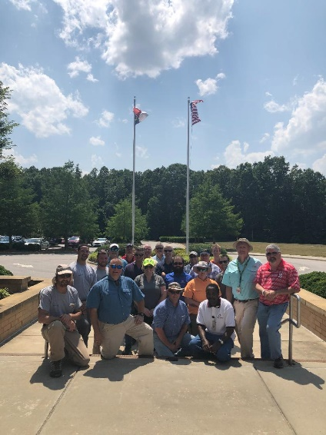
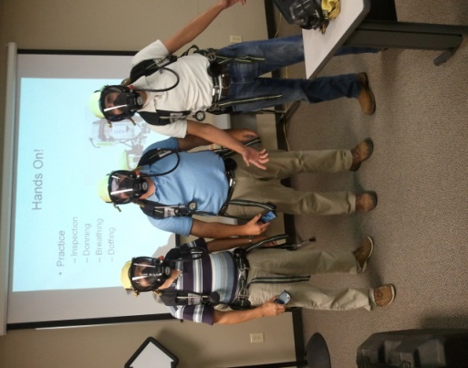
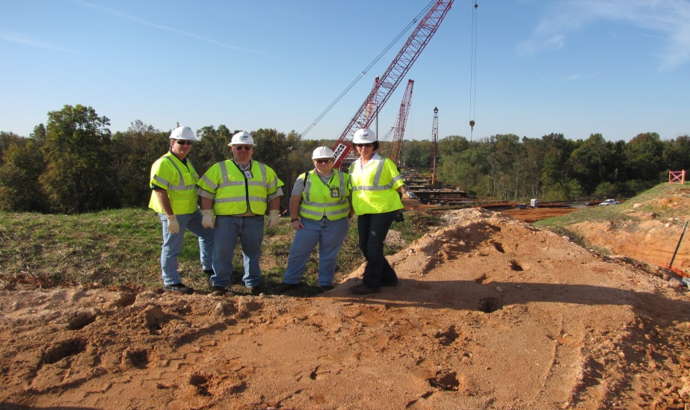
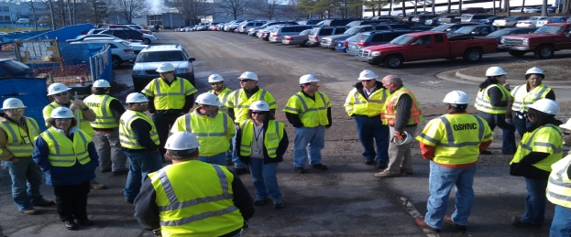
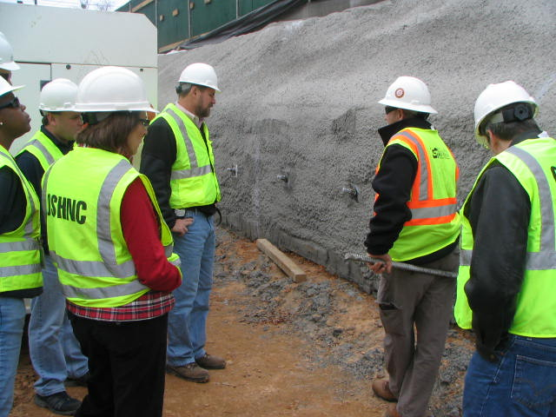
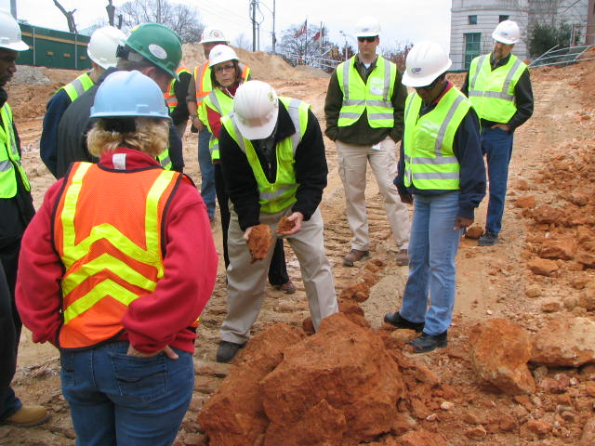
N.C. Workplace Safety and Health
OSH Division—Fatalities Inspected
FFY 2023—3rd Qtr.
FATALITY TYPE | 1st Qtr. | 2nd Qtr. | 3rd Qtr. | Total | FATALITY TYPE | 1st Qtr. | 2nd Qtr. | 3rd Qtr. | Total
Struck By | 3 | 4 | 6 | 13 | Inhalation | 1 | 0 | 2 | 3
Caught In/Between | 1 | 2 | 2 | 5 | Ingestion | 0 | 0 | 0 | 0
Bite/Sting/Scratch | 0 | 0 | 0 | 0 | Absorption | 0 | 0 | 0 | 0
Fall (Same Level) | 2 | 0 | 0 | 2 | Repeated Motion/Pressure | 0 | 0 | 0 | 0
Fall (From Elevation) | 3 | 7 | 5 | 15 | Cardio/Respiratory | 0 | 0 | 0 | 0
Struck Against | 0 | 0 | 0 | 0 | Shock | 1 | 2 | 0 | 3
Rubbed/Abraded | 0 | 0 | 0 | 0 | Other*** | 5 | 2 | 3 | 10
COVID-19 | 0 | 0 | 0 | 0 | Criminal Activity | 3 | 1 | 0 | 4
Fatalities Under OSH Division Jurisdiction
FFY 2022 |  | FFY 2023 | 1st Qtr. | 2nd Qtr. | 3rd Qtr. | Total
Total Fatalities | 68 | Fatalities | 16 | 17 | 18 | 51
NCDOL Photo Library
***"COVID-19" and "Criminal Activity" fatalities are included in the "Other” event category.

Slide 3
N.C. Workplace Safety and Health
OSH Division—Strategic Plan Goals
FFY 2023—3rd Qtr.
COMPLIANCE | 1st Qtr. | 2nd Qtr. | 3rd Qtr. | Total | FFY Goal
Safety Inspections | 205 | 265 | 307 | 777 | 1,100
Health Inspections | 114 | 202 | 188 | 504 | 705
Serious Hazards Eliminated | 377 | 608 | 582 | 1,567 | 4,100
Training and/or Program Violations | 72 | 129 | 132 | 333 | 1,050
CONSULTATION | 1st Qtr. | 2nd Qtr. | 3rd Qtr. | Total | FFY Goal
Serious Hazards Eliminated | 1,672 | 1,468 | 1,411 | 4,551 | 4,800
Private Sector and Public Sector Visits | 344 | 376 | 362 | 1,082 | 1,315
OSH DIVISION | 1st Qtr. | 2nd Qtr. | 3rd Qtr. | Total | FFY Goal
Program Improvements | 419 | 550 | 586 | 1,555 | 2,060
People Trained in Special Emphasis Program Areas | 1,076 | 1,639 | 3,221 | 5,936 | 3,200
People Trained at OSH Division Sponsored Events | 1,530 | 1,827 | 4,149 | 7,506 | 5,350

Slide 4
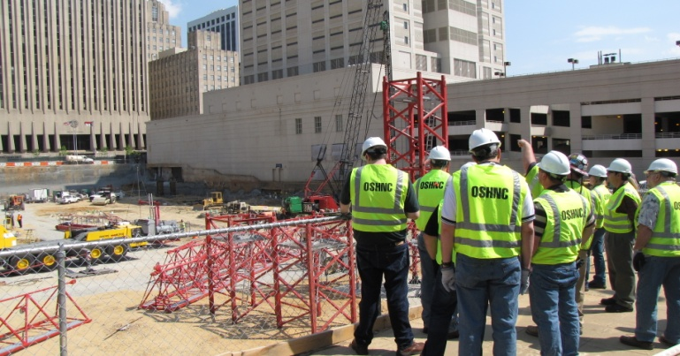
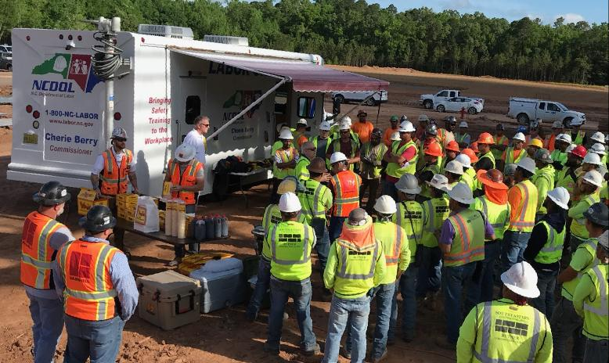
N.C. Workplace Safety and Health
OSH Division—Strategic Plan Goals
FFY 2023—3rd Qtr.
EDUCATION, TRAINING AND TECHNICAL ASSISTANCE | 1st Qtr. | 2nd Qtr. | 3rd Qtr. | Total | FFY Goal
Publications Distributed | 8,840 | 16,057 | 20,336 | 45,233 | 45,000
Standards Interpretations | 517 | 656 | 473 | 1,646 | NA
AGRICULTURAL SAFETY AND HEALTH | 1st Qtr. | 2nd Qtr. | 3rd Qtr. | Total | FFY Goal
Outreach Materials Distributed | 1,018 | 3,630 | 1,109 | 5,757 | 2,400
Compliance Inspections | 10 | 0 | 3 | 13 | 50
Certificates Issued | 180 | 1,362 | 428 | 1,970 | 1,750
Preoccupancy Inspections | 270 | 1,436 | 295 | 2,001 | 1,875
NCDOL Photo Library

Slide 5
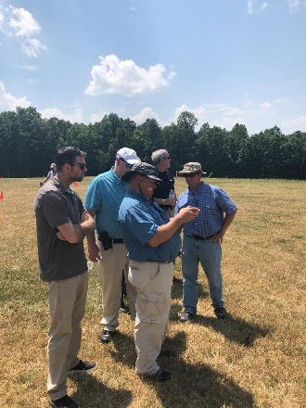

Strategic Plan
Special Emphasis Programs (SEP)
FFY 2023—3rd Qtr.
NCDOL Photo Library
Construction
Logging and Arboriculture
Long Term Care Facilities
Health Hazards
Food Manufacturing
Grocery and Related Product Wholesalers
Amputations

Slide 6
Special Emphasis Program
Construction
FFY 2023—3rd Qtr.
NAICS 23—CONSTRUCTION | FFY 2022 |  | 1st Qtr. | 2nd Qtr. | 3rd Qtr. | Total
Total Fatalities | 23 |  | 2 | 9 | 7 | 18
 |  |  | N/A | N/A | N/A | N/A
FFY 2022 3rd Qtr. Fatality Rate | 0.0020
FATALITY TYPE | 1st Qtr. | 2nd Qtr. | 3rd Qtr. | Total | FATALITY TYPE | 1st Qtr. | 2nd Qtr. | 3rd Qtr. | Total
Struck By | 0 | 0 | 1 | 1 | Inhalation | 0 | 0 | 2 | 2
Caught In/Between | 0 | 1 | 0 | 1 | Ingestion | 0 | 0 | 0 | 0
Bite/Sting/Scratch | 0 | 0 | 0 | 0 | Absorption | 0 | 0 | 0 | 0
Fall (Same Level) | 0 | 0 | 0 | 0 | Repeated Motion/Pressure | 0 | 0 | 0 | 0
Fall (From Elevation) | 1 | 6 | 4 | 11 | Cardio/Respiratory | 0 | 0 | 0 | 0
Struck Against | 0 | 0 | 0 | 0 | Shock | 0 | 2 | 0 | 2
Rubbed/Abraded | 0 | 0 | 0 | 0 | Other | 1 | 0 | 0 | 1
Notes:
Will be posting a new billboard on the May 2022 fall prevention standdown and for heat stress.

Slide 7
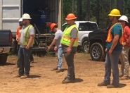
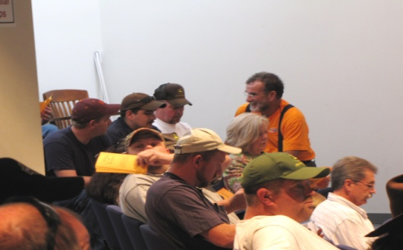
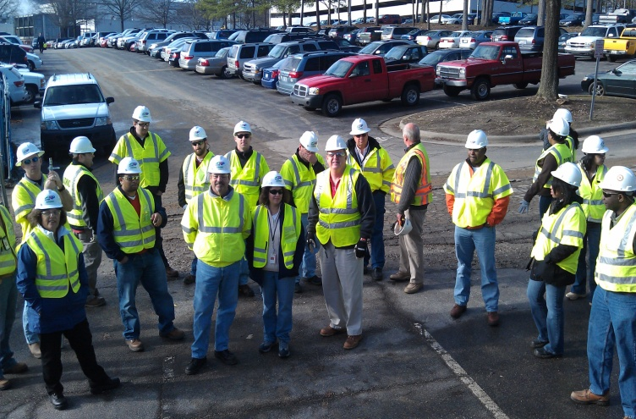
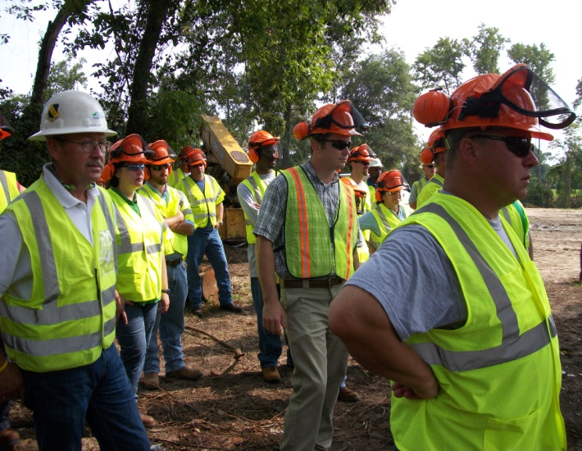
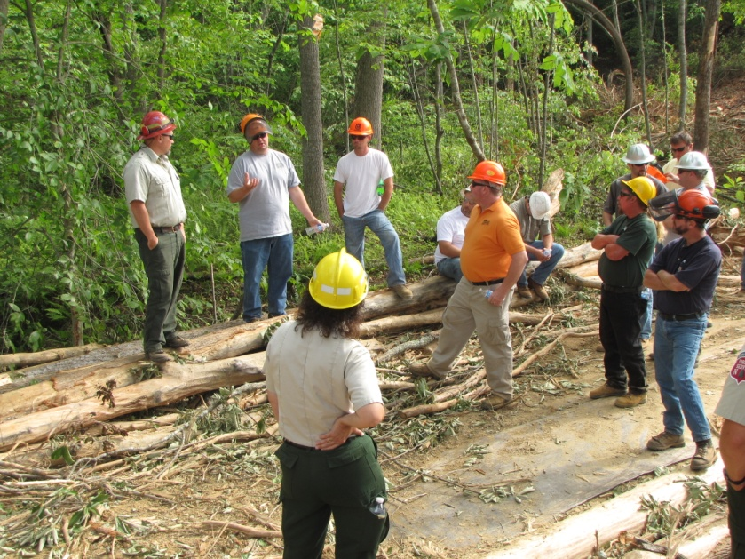
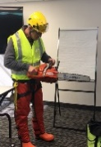
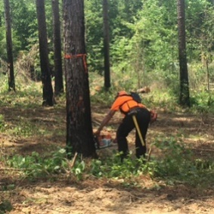

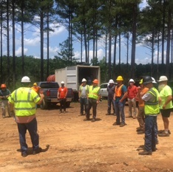
Special Emphasis Program
Construction
FFY 2023—3rd Qtr.
 | North Carolina |  |  |  | National Average |  |  |  | North Carolina vs. National Average
 | CY 2020 |  | CY 2021 |  | CY 2020 |  | CY 2021 |  | 2021 Comparison
TRC | 2.0 | 10% Decrease |  | 1.8 | 2.5 | No Change |  | 2.5 | 28% Lower
DART | 1.0 | 9% Increase |  | 1.1 | 1.6 | No Change |  | 1.6 | 31% Lower
SEP ACTIVITY | 1st Qtr. | 2nd Qtr. | 3rd Qtr. | Total | FFY Goal
Compliance Inspections | 133 | 252 | 238 | 623 | 800
Consultative Visits | 107 | 115 | 110 | 332 | 290
OSH Outreach Events (10- and 30- Hour Construction Courses) | 3 | 5 | 1 | 9 | 6
People Trained | 93 | 148 | 1,761 | 2,002 | 1,000

Slide 8
Special Emphasis Program
Logging and Arboriculture
FFY 2023—3rd Qtr.
56173 | North Carolina |  |  |  | National Average |  |  |  | North Carolina vs. National Average
 | CY 2020 |  | CY 2021 |  | CY 2020 |  | CY 2021 |  | 2021 Comparison
TRC | 2.5 | 11% Increase |  | 2.8 | 3.0 | 6% Increase |  | 3.2 | 12% Lower
DART | 1.6 | 16% Increase |  | 1.9 | 2.0 | No Change |  | 2.0 | 5% Lower
SEP ACTIVITY | 1st Qtr. | 2nd Qtr. | 3rd Qtr. | Total | FFY Goal
Compliance Inspections | 4 | 1 | 12 | 17 | 20
Consultative Visits | 5 | 4 | 5 | 14 | 15
OSH Training and Outreach Events | 2 | 4 | 2 | 8 | 5
People Trained | 26 | 158 | 164 | 348 | 150
NAICS 11331*—LOGGING | FFY 2022 |  | 1st Qtr. | 2nd Qtr. | 3rd Qtr. | Total
Total Fatalities | 1 |  | 0 | 1 | 0 | 1
NAICS 56173—ARBORICULTURE | FFY 2022 |  | 1st Qtr. | 2nd Qtr. | 3rd Qtr. | Total
Total Fatalities | 4 |  | 0 | 0 | 0 | 0
FFY 2022 3rd Qtr. Combined Fatality Rate |  |  | 0.0025
* TRC/DART Data not available

Slide 9
Special Emphasis Program
Long Term Care Facilities
FFY 2023—3rd Qtr.
NAICS 623*—LONG TERM CARE
 | North Carolina |  |  |  | National Average |  |  |  | North Carolina vs. National Average
 | CY 2020 |  | CY 2021 |  | CY 2020 |  | CY 2021 |  | 2021 Comparison
TRC | 9.3 | 34% Decrease |  | 6.1 | 11.5 | 27% Decrease |  | 7.3 | 16% Lower
DART | 7.2 | 40% Decrease |  | 4.3 | 9.3 | 43% Decrease |  | 5.3 | 19% Lower
*TRC/DART rate based on the 3-digit NAICS code
SEP ACTIVITY | 1st Qtr. | 2nd Qtr. | 3rd Qtr. | Total | FFY Goal
Compliance Inspections | 6 | 10 | 12 | 28 | 24
Consultative Visits | 9 | 14 | 8 | 31 | 30
OSH Outreach Events | 0 | 0 | 3 | 3 | 2
People Trained | 0 | 0 | 24 | 24 | 40

Slide 10
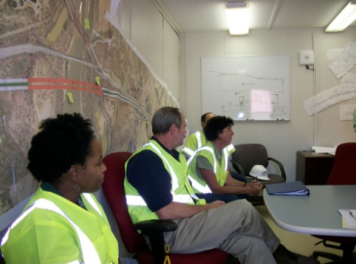
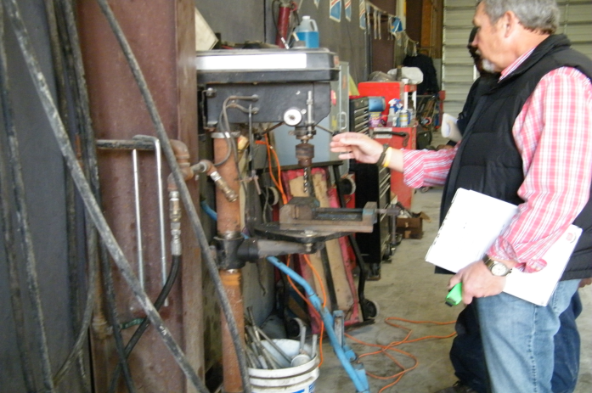
Special Emphasis Program
Health Hazards
FFY 2023—3rd Qtr.
COMPLIANCE INSPECTIONS | 1st Qtr. | 2nd Qtr. | 3rd Qtr. | Total | FFY Goal
Silica | 7 | 22 | 19 | 48 | 60
Asbestos | 2 | 3 | 3 | 8
Isocyanates | 4 | 6 | 7 | 17
Lead | 6 | 3 | 2 | 11
Hexavalent Chromium | 7 | 2 | 7 | 16
Total | 26 | 38 | 37 | 99
Program Improvements | 6 | 14 | 7 | 27 | 20
*Some inspections involved more than one health hazard and generally included a program improvement
NCDOL Photo Library

Slide 11
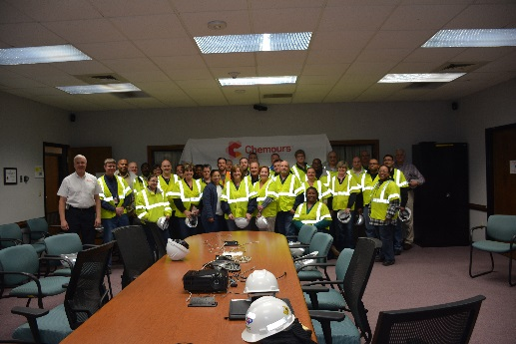
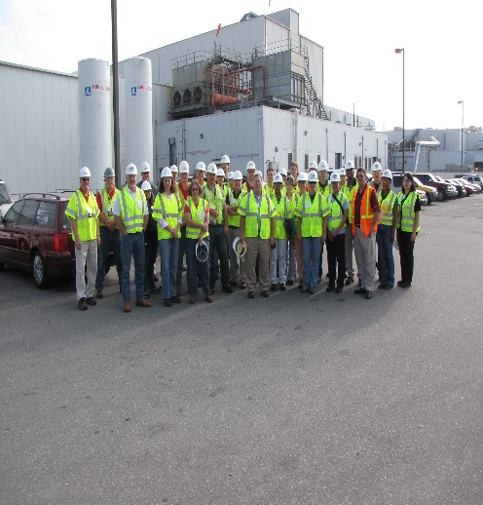
Special Emphasis Program
Health Hazards
FFY 2023—3rd Qtr.
COMPLIANCE INSPECTION RESULTS
HEALTH HAZARDS | Number of Samples (Detectable Results) |  |  |  | Number With Overexposures |  |  |  | Average Severity Rate*
 | 1st Qtr. | 2nd Qtr. | 3rd Qtr. | Total | 1st Qtr. | 2nd Qtr. | 3rd Qtr. | Total | 1st Qtr. | 2nd Qtr. | 3rd Qtr.
Silica | 2 | 2 | 0 | 4 | 1 | 0 | 0 | 1 | 1.18 | 0.15 | 0.00
Asbestos | 0 | 0 | 0 | 0 | 0 | 0 | 0 | 0 | 0.00 | 0.00 | 0.00
Isocyanates | 1 | 0 | 1 | 2 | 0 | 0 | 0 | 0 | 0.11 | 0.00 | 0.20
Lead | 3 | 6 | 0 | 9 | 1 | 1 | 0 | 2 | 1.41 | 0.29 | 0.00
Hexavalent Chromium | 1 | 5 | 2 | 8 | 0 | 0 | 0 | 0 | 0.12 | 0.03 | 0.16
Total | 7 | 13 | 3 | 23 | 2 | 1 | 0 | 3 | N/A | N/A | N/A
NCDOL Photo Library
* All Samples

Slide 12
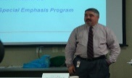
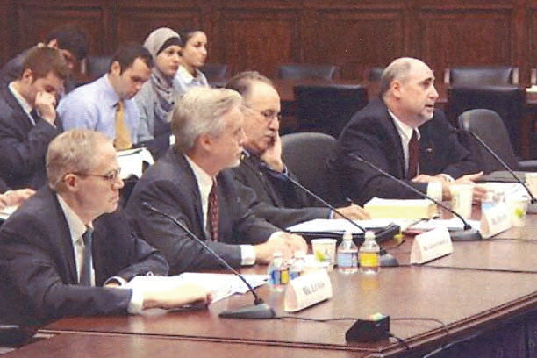
Special Emphasis Program
Health Hazards
FFY 2023—3rd Qtr.
HEALTH HAZARDS | Consultative Surveys
 | 1st Qtr. | 2nd Qtr. | 3rd Qtr. | Total
Silica | 39 | 40 | 38 | 117
Asbestos | 1 | 8 | 3 | 12
Isocyanates | 4 | 6 | 1 | 11
Lead | 4 | 15 | 4 | 23
Hexavalent Chromium | 3 | 1 | 3 | 7
Total | 51 | 70 | 49 | 170
FFY Goal | 125
NCDOL Photo Library
NCDOL Photo Library
SEP ACTIVITY | 1st Qtr. | 2nd Qtr. | 3rd Qtr. | Total | FFY Goal
OSH Outreach Events | 5 | 7 | 4 | 16 | 20
People Trained | 105 | 125 | 75 | 305 | 300

Slide 13
Special Emphasis Program
Food Manufacturing
FFY 2023—3rd Qtr.
NAICS 311*—FOOD MANUFACTURING
 | North Carolina |  |  |  | National Average |  |  |  | North Carolina vs. National Average
 | CY 2020 |  | CY 2021 |  | CY 2020 |  | CY 2021 |  | 2021 Comparison
TRC | 3.8 | 11% Decrease |  | 3.4 | 5.1 | 6% Decrease |  | 4.8 | 25% Lower
DART | 3.0 | 13% Decrease |  | 2.6 | 3.9 | 8% Decrease |  | 3.6 | 23% Lower
*TRC/DART rate based on the 3-digit NAICS code
SEP ACTIVITY | 1st Qtr. | 2nd Qtr. | 3rd Qtr. | Total | FFY Goal
Compliance Inspections | 5 | 8 | 11 | 24 | 25
Consultative Visits | 7 | 3 | 3 | 13 | 12
OSH Outreach Events | 0 | 1 | 1 | 2 | 2
People Trained | 0 | 14 | 11 | 25 | 40

Slide 14
Special Emphasis Program
Grocery and Related Product Wholesalers
FFY 2023—3rd Qtr.
NAICS 4244*—GROCERY AND RELATED WHOLESALERS
 | North Carolina |  |  |  | National Average |  |  |  | North Carolina vs. National Average
 | CY 2020 |  | CY 2021 |  | CY 2020 |  | CY 2021 |  | 2021 Comparison
TRC | 4.1 | 2% Decrease |  | 4.0 | 4.9 | 9% Increase |  | 5.4 | 26% Lower
DART | 3.1 | 3% Increase |  | 3.2 | 4.0 | 2% Increase |  | 4.1 | 22% Lower
*DART/TRC rate based on the 4-digit NAICS code
SEP ACTIVITY | 1st Qtr. | 2nd Qtr. | 3rd Qtr. | Total | FFY Goal
Compliance Inspections | 2 | 8 | 10 | 20 | 20
Consultative Visits | 5 | 2 | 0 | 7 | 3
OSH Outreach Events | 1 | 0 | 2 | 3 | 2
People Trained | 11 | 0 | 18 | 29 | 40

Slide 15
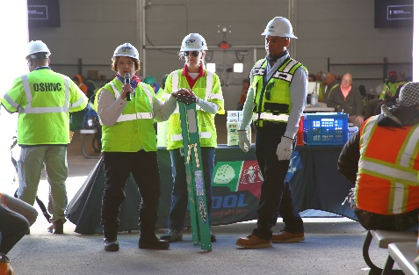
Special Emphasis Program
Amputations
FFY 2023—3rd Qtr.
SEP ACTIVITY | 1st Qtr. | 2nd Qtr. | 3rd Qtr. | Total | FFY Goal
Compliance Inspections | 44 | 48 | 56 | 148 | 150
Consultative Visits | 54 | 43 | 38 | 135 | 100
OSH Outreach Events | 13 | 16 | 13 | 42 | 15
People Trained | 286 | 424 | 255 | 965 | 400

Slide 16
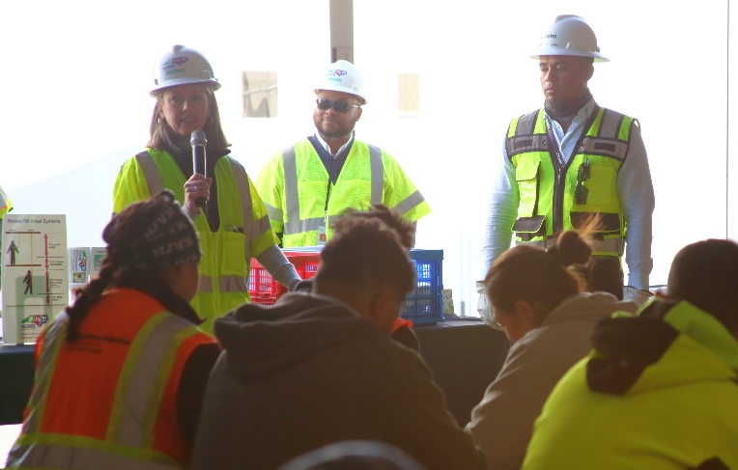
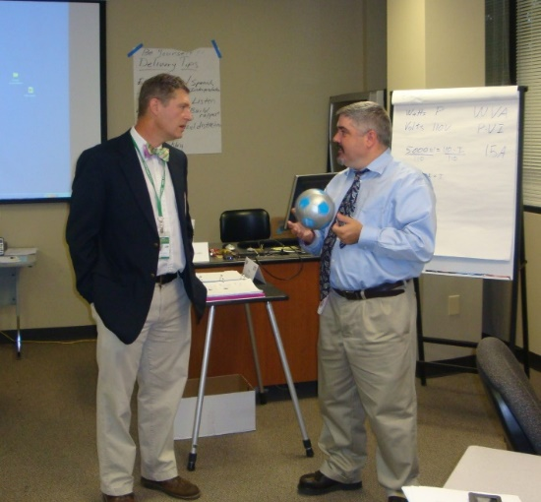
OSH Division
Public Sector
FFY 2023—3rd Qtr.
 | CY 2020 |  | CY 2021
TRC | 4.2 | 12% Increase |  | 4.8
DART | 2.5 | 11% Increase |  | 2.8
ACTIVITY | 1st Qtr. | 2nd Qtr. | 3rd Qtr. | Total | FFY Goal
Compliance Inspections | 21 | 49 | 38 | 108 | 95
Consultative Visits | 44 | 61 | 83 | 188 | 190
OSH Outreach Events/Booths | 2 | 7 | 7 | 16 | 6
Trained | 128 | 338 | 128 | 594 | 600

Slide 17
OSH Division
Education and Training Outreach
FFY 2023—3rd Qtr.
OUTREACH EVENT | 1st Qtr. | 2nd Qtr. | 3rd Qtr. | Total | FFY Goal
General Industry—10-Hour Course | 1 | 2 | 2 | 5 | 4
General Industry—30-Hour Course | 1 | 0 | 1 | 2 | 1
NC #500/502—Construction Train-the-Trainer Course/ NC #501/503—General Industry Train-the-Trainer Course | 1 | 0 | 0 | 1 | 1
Construction—10-Hour Course | 2 | 4 | 1 | 7 | 5
Construction—30-Hour Course | 1 | 1 | 0 | 2 | 1
Labor One/Booth Events | 0 | 4 | 12 | 16 | N/A
Speaker’s Bureau | 17 | 21 | 23 | 61 | N/A
Webinars | 22 | 13 | 27 | 62 | N/A
OSH Workshops | 0 | 0 | 3 | 3 | N/A
Technical Assistance | 0 | 0 | 0 | 0 | N/A
Spanish Training and Outreach Events | 0 | 0 | 0 | 0 | N/A
Train-the-Trainer Program (Construction/General Industry)—Events | 6 | 3 | 9 | 18 | N/A
Train-the-Trainer Program (Construction/General Industry)—Trained | 104 | 28 | 107 | 239 | N/A
Notes:
ETTA doesn’t have a Spanish Outreach trainer at this time.

Slide 18
OSH Division
Education and Training Outreach
FFY 2023—3rd Qtr.
Stand Downs/Forums
Fall Prevention Stand-Down (May 1 - 5) (Webinars, Billboard, Special Events Page, Social Media, Labor One Events, Trained 1,709 employees)
Heat Illness Prevention (All Summer) (Webinars, Billboards, Special Events Page, Social Media)
Trench Safety Stand-Down (June 19 - 23) (Webinars, Governor’s Proclamation, Billboards, Special Events Page, Social Media, Trained 37 employees)
Safe + Sound (August 7 - 13) (Webinars, Governor’s Proclamation, Billboards, Special Events Page, Social Media)
Construction Forum (September 7) (Billboard, Special Events Page, Social Media and Labor One Events)
Notes:
The stand downs and forums that we are involved in this year. All of them are a National Event except the construction forum. That is our own event that we do annually.

Slide 19

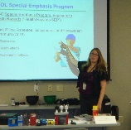
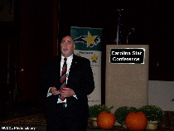
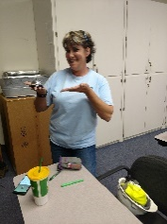
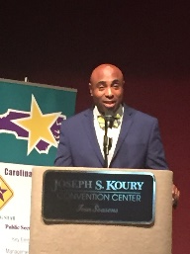
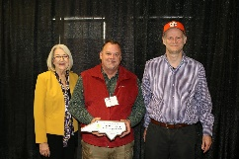
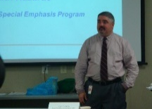

OSH Division
Recognition Programs
FFY 2023—3rd Qtr.
*Cumulative Total
STAR SITES—New, Recertification, Promotion | 1st Qtr. | 2nd Qtr. | 3rd Qtr. | Total | FFY Goal | Approved Star Sites*
Carolina Star | 3 | 3 | 11 | 17 |  | 100
Building Star | 1 | 1 | 3 | 5 |  | 23
Rising Star | 0 | 0 | 0 | 0 |  | 5
Public Sector Star | 0 | 0 | 1 | 1 |  | 18
Total | 4 | 4 | 15 | 23 | 20 | 146
NCDOL Photo Library
ACTIVITY | 1st Qtr. | 2nd Qtr. | 3rd Qtr. | Total | FFY Goal
Star Sites—Termination/Withdrawn | 1 | 3 | 0 | 4
Star Booths | 4 | 0 | 1 | 5
Star Presentations | 4 | 8 | 4 | 16 | 10
Star Program Interventions | 29 | 49 | 41 | 119 | 100
Notes:
Withdrew: Emerson Automation Solutions – work site closed

Slide 20

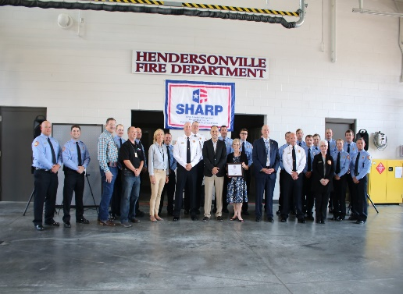
OSH Division
Recognition Programs
FFY 2023—3rd Qtr.
SHARP SITES—New/Renewal | 1st Qtr. | 2nd Qtr. | 3rd Qtr. | Total | FFY Goal | Approved SHARP Sites*
SHARP—Construction | 0 | 0 | 0 | 0 |  | 3
SHARP—General Industry | 12 | 8 | 8 | 28 |  | 104
SHARP—Public Sector | 7 | 1 | 11 | 19 |  | 45
Totals | 19 | 9 | 19 | 47 | 60 | 152
*Cumulative Total
GOLD STAR GROWERS—New | 1st Qtr. | 2nd Qtr. | 3rd Qtr. | Total
 | 27 | 156 | 36 | 219
SAFETY AWARDS |  |  |  | Total
CY 2022 Safety Awards Season* (Silver, Gold, Million Hour) |  |  |  | 2,132
 | 1st Qtr. | 2nd Qtr. | 3rd Qtr. | Total
Million Hour Awards | 1 | 42 | 8 | 51

Slide 21


OSH Division
Alliances and Partnerships
FFY 2023—3rd Qtr.
Alliances
Carolinas AGC
Lamar Advertising Company
Mexican Consulate
N.C. State – Industry Expansion Solutions
Safety and Health Council of NC
NUCA of the Carolinas
NCALGESO
Tree Care Industry Association
Plumbing-Heating-Cooling Contractor’s Association

Slide 22
OSH Division
Alliances and Partnerships
FFY 2023—3rd Qtr.
Partnerships
Holder – Edison Foard – Leeper, A Joint Venture
Charlotte - Charlotte Douglas International Airport – Terminal Lobby Expansion (2021 – 2023)
Jacobs Engineering Group
Holly Springs - Biotech Manufacturing Facility and Campus (2022 – 2024)

Slide 23
OSH Division
Complaint Desk*
FFY 2023—3rd Qtr.
East Compliance | West Compliance | Agricultural Safety and Health
ACTIVITY | 1st Qtr. | 2nd Qtr. | 3rd Qtr. | 1st Qtr. | 2nd Qtr. | 3rd Qtr. | 1st Qtr. | 2nd Qtr. | 3rd Qtr. | Cumulative Total | FFY 2022
Complaints | 289 | 326 | 352 | 415 | 518 | 445 | 4 | 1 | 1 | 2,351 | 3,575
Referrals | 67 | 63 | 67 | 94 | 100 | 121 | 3 | 1 | 3 | 519 | 777
Fat/Cat | 35 | 14 | 17 | 27 | 37 | 24 | 4 | 0 | 1 | 159 | 228
Totals | 391 | 403 | 436 | 536 | 655 | 590 | 11 | 2 | 5 | 3,029* | 4,580*
*Includes calls that were processed but not necessarily inspected. Fat/Cat includes calls regarding heart attacks and other natural causes.
ACTIVITY | 1st Qtr. | 2nd Qtr. | 3rd Qtr. | Cumulative Total | FFY 2022
Complaints Not in OSH Jurisdiction* | 860 | 1,178 | 947 | 2,985 | 4,122
*Includes complaints related to wage and hour, discrimination, workers’ compensation questions, beyond statute of limitation time frame, etc.

Slide 24
OSH Division
Internal Training
FFY 2023—3rd Qtr.
1st Qtr.—COURSES
In-Person | No. of Events | Trained
ASH Preoccupancy Inspection System | 1 | 8
CPR/AED | 1 | 8
How to Document A Willful Trench Violation in 5 Minutes or Less | 1 | 116
Machine Guarding and Lockout/Tagout | 1 | 61
Proposed Heat Standard | 1 | 121
Process Safety Management | 1 | 19
Using Toxicology and Physical Properties to Determine Sampling Priorities | 1 | 45
Significant Cases | 1 | 120
Webinars | No. of Events | Trained
Fall Protection, Hazard Communication, Powered Industrial Trucks, Office Ergonomics | 6 | 6
Total Trained |  | 504

Slide 25
OSH Division
Internal Training
FFY 2023—3rd Qtr.
2nd Qtr.—COURSES
In-Person | No. of Events | Trained
OSH NC #100 Course – Introduction to Safety Standards | 1 | 13
Technical Writing/OSHA Express | 1 | 13
CPR/AED | 1 | 6
10-Hour General Industry Course | 1 | 1
Labor One Training | 2 | 2
Webinars | No. of Events | Trained
Food Manufacturing Special Emphasis Program | 1 | 1
Logging Special Emphasis Program | 2 | 11
Occupational Noise | 1 | 2
Total Trained |  | 49

Slide 26
OSH Division
Internal Training
FFY 2023—3rd Qtr.
3rd Qtr.—COURSES
In-Person | No. of Events | Trained
OSH NC #125 – Health Standards for Industrial Hygienists | 1 | 9
Webinars | No. of Events | Trained
Bloodborne Pathogens | 1 | 1
Confined Spaces (Construction) | 1 | 2
Electrical Safety (Construction) | 1 | 1
Ergonomics Awareness | 1 | 1
Fall Protection | 1 | 1
Food Manufacturing Special Emphasis Program | 1 | 11
Grocery and Related Wholesalers Special Emphasis Program | 1 | 8
Long Term Care | 1 | 6
Steel Erection | 1 | 1
Scaffolds | 1 | 1
Stairways and Ladders | 1 | 1
Struck-by/Caught Between | 1 | 1
Total Trained |  | 44

Slide 27
OSH Division
Cut-Loose, In-Training, Vacant
FFY 2023—3rd Qtr.
West Compliance | Safety | % | Industrial Hygienist | %
Cut Loose | 21 | 68% | 19 | 70%
In-Training | 5 | 16% | 7 | 29%
Vacant | 5 | 16% | 1 | 4%
Total | 31 |  | 27
East Compliance | Safety | % | Industrial Hygienist | %
Cut Loose | 11 | 52% | 3 | 18%
In-Training | 4 | 19% | 5 | 29%
Vacant | 6 | 29% | 9 | 53%
Total | 21 |  | 17
Safety Cut Loose | 63% | Health Cut Loose | 50%
Safety In-Training | 17% | Health in-Training | 27%
Safety Vacant | 21% | Health Vacant | 23%

Slide 28
OSH Division
Cut-Loose, In-Training, Vacant
FFY 2023—3rd Qtr.
Consultative Services | Safety | % | Industrial Hygienist | %
Cut Loose | 9 | 82% | 8 | 100%
In-Training | 2 | 18% | 0 | 0%
Vacant | 0 | 0% | 0 | 0%
Total | 11 |  | 8
Education, Training and Technical Assistance | Safety | % | Industrial Hygienist | %
Cut Loose | 8 | 73% | 7 | 100%
In-Training | 0 | 0% | 0 | 0%
Vacant | 3 | 27% | 0 | 9%
Total | 11 |  | 7
Agricultural Safety and Health | Safety | % | Industrial Hygienist
Cut Loose | 5 | 63% | N/A
In-Training | 3 | 37% | N/A
Vacant | 0 | 0% | N/A
Total | 8

Slide 29
OSH Division
Standards Section—Revisions
FFY 2023—3rd Qtr.
Operational Procedure Notices (OPN)
OPN 149A—Special Emphasis Program (SEP): Amputations
SEP for amputation hazards on machinery. Revision included updated NAICS codes.
OPN 88K—SEP: Logging and Arboriculture
SEP for hazards associated with logging, tree harvesting, tree removal operations and arboriculture operations. Revision includes recent statistics and references to new tree care and tree removal operations.

Slide 30
OSH Division
Standards Section—New
FFY 2023—3rd Qtr.
Memos
Memo TC 1—Enforcement Inspection Guidance for Tree Care and Tree Removal Operations
Enforcement guidance for inspecting employers engaged in tree care and tree removal operations. This memo cancels CPL 02-01-045—Citation Guidance Related to Tree Care and Tree Removal Operations.
Memo TC 2—Davey Tree Ruling
Memo contains court decisions for cases between Davey Tree and OSHA for guidance in the application of the logging standard (1910.266) in tasks involving tree felling and line clearing work.

Slide 31
OSH Division
Retaliatory Employment Discrimination
FFY 2023—3rd Qtr.
OSH Complaint Statistics** | 1st Qtr. | 2nd Qtr. | 3rd Qtr. | Total
# of New Docketed Cases | 43 Plus (19) 11(c) | 44 Plus (42) 11(c) | 46 Plus (34) 11(c) | 133 Plus (95) 11(c)
# of Administrative Closures (Included in Disposition Chart) | N/A | N/A | N/A | N/A
# of Cases Completed | 34 Plus (4) (11(c) | 42 Plus (36) 11(c) | 72 Plus (46) 11(c) | 148 Plus (86) 11(c)
# Completed Within 90 Days | 2 | 5 | 11 | 18
% Completed Within 90 Days – SAMM 14 | 6% | 12% | 15% | N/A
Average # Days to Complete – SAMM 16 | 294 | 294 | 280 | N/A
# of Pending Cases at EOQ | 151 | 157 | 131 | N/A
% Pending Over 90 Days | 68% | 80% | 70% | N/A
Average # of Days Pending | 163 | 191 | 180 | N/A
** Please note that 11(c) cases are only included in the data where noted.

Slide 32
OSH Division
Retaliatory Employment Discrimination
FFY 2023—3rd Qtr.
OSH Complaint Disposition | 1st Qtr. | 2nd Qtr. | 3rd Qtr. | Total
Administrative Closure | 6 Plus (4) 11(c) | 10 Plus (36) 11(c) | 16 Plus (46) 11(c) | 32 Plus (82) 11(c)
Withdrawn (Includes Requested RTS Letters) | 13 | 9 | 19 | 41
Merit (Included in SAMM 15 Merit) | 4 | 4 | 6 | 14
Total SAMM 15 Merit | 7 | 7 | 14 | 28
Total SAMM 15 Percent Merit | 21% | 17% | 19% | N/A
Dismissal Right-to-Sue (Includes No Merit and Unresponsive) | 8 | 16 | 23 | 47
Settled Other (Included in SAMM 15) | 3 | 3 | 8 | 14
Total Cases Closed by Disposition | 34 | 42 | 72 | 148
Total Damages Paid This Quarter (Includes Settlements With Aid of the Bureau During Informal Discussions or Referral to Mediation Program.) | $40,000 | $10,000* | $15,100 | $65,100
*Corrected

Slide 33
OSH Division
Retaliatory Employment Discrimination
FFY 2023—3rd Qtr.
Bureau Staffing
Jaleesa Thomas | Information Officer
Norma Velasco | Administrative Assistant II
James Agosto | Investigator
David Bailey | Investigator
Dianne Daniels | Investigator
Brian Lampe (4-3-23) | Investigator
Erin Smith | Investigator
Theodore Place | Investigator
Alvin Vocalan | Investigator
Harriet Hopkins | Administrator

Slide 34

Thank You For Attending!
FFY 2023—3rd Qtr.
Questions?
1-800-NC-LABOR
(1-800-625-2267)
www.labor.nc.gov
Notes:
34

