Slide 1
Grocery and Related Product Merchant Wholesalers Special Emphasis Program
OPN 145
Presented by: ETTA Bureau, (919) 707-7876
Notes:
Revised: 09/01/22
The information in this presentation is provided voluntarily by the N.C. Department of Labor, Education Training and Technical Assistance Bureau as a public service and is made available in good faith. This presentation is designed to assist trainers conducting OSHA outreach training for workers. Since workers are the target audience, this presentation emphasizes hazard identification, avoidance, and control – not standards. No attempt has been made to treat the topic exhaustively. It is essential that trainers tailor their presentations to the needs and understanding of their audience.
The information and advice provided on this Site and on Linked Sites is provided solely on the basis that users will be responsible for making their own assessment of the matters discussed herein and are advised to verify all relevant representations, statements, and information.
This presentation is not a substitute for any of the provisions of the Occupational Safety and Health Act of North Carolina or for any standards issued by the N.C. Department of Labor. Mention of trade names, commercial products, or organizations does not imply endorsement by the N.C. Department of Labor.

Slide 2
Objectives
At the end of this course, students will be aware of:
  Details of OPN 145 - Grocery and Related Product Merchant Wholesalers Special Emphasis Program (SEP).
  Standards and hazards covered by this Operational Procedure Notice (OPN).
  General procedures for a compliance inspection under this OPN.

Slide 3
Scope
OPN 145 applies to NAICS Code 4244 - Grocery and Related Product Merchant Wholesalers.
This SEP covers all North Carolina employers and sites in NAICS 4244.
42411 – General Line Grocery Merchant Wholesalers | 42442 – Packaged Frozen Food Merchant Wholesalers | 42443 – Dairy Product Merchant Wholesalers
42444 – Poultry & Poultry Product Merchant Wholesalers | 42445 – Confectionery Merchant Wholesalers | 42446 – Fish and Seafood Merchant Wholesalers
42447 – Meat and Meat Product Merchant Wholesalers | 42448 – Fresh Fruit and Vegetable Merchant Wholesalers | 42449 – Other Grocery and Related Products Merchant Wholesalers

Slide 4
Why a Grocery Wholesaler SEP?
Significant numbers of NC Employers are covered by NAICS 4244.
Employees using more machinery in processes.
Work becoming more automated exposing employees to high-speed equipment.
  For example, conveyers
Increased automation has led to injury and illness rates higher than average for other sectors.

Slide 5
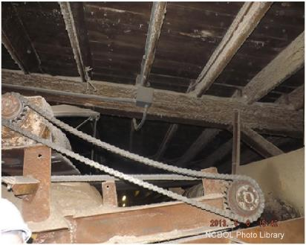
Why a Grocery Wholesaler SEP?
As high-speed automation increases, so does the need for proper machine maintenance and machine guarding and the safety programs that protect workers.
Violation: 1910.219(f)(3) Mechanical Power-Transmission Apparatus

Slide 6
Significant Hazards in Grocery
NCDOL’s injury and illness data for NAICS 4244 (calendar years, 2009 - 2011) identified significant hazards:
  Materials handling and storage
  Walking-working surfaces
  Ergonomics
  Powered industrial trucks
  Machine guarding
  Personal protective equipment (PPE)
  Eyewash equipment
  Hazard communication (HazCom)
  Process safety management (PSM)

Slide 7
Table 1: N.C. and National TRC and DART Rates Combined
Year | N.C. Average DART | National Average DART | N.C. Average TRC | National Average TRC
2014 | 1.5 | 1.8 | 2.9 | 3.4
2015 | 1.4 | 1.7 | 2.9 | 3.3
2016 | 1.4 | 1.7 | 2.7 | 3.2
2017 | 1.3 | 1.6 | 2.5 | 3.1
2018 | 1.4 | 1.7 | 2.6 | 3.1
2019 | 1.3 | 1.6 | 2.5 | 3.0
2020 | 1.3 | 1.8 | 2.2 | 2.9
N.C. and National Total Recordable Case (TRC) and Days Away, Restricted or Transferred (DART) rates for all industries combined.

Slide 8
Table 2: N.C. and National TRC and DART Rates for NAICS 4244
Year | N.C. DART | National DART | N.C. TRC | National TRC
2014 | 2.7 | 3.9 | 4.5 | 5.1
2015 | 3.3 | 4.2 | 4.3 | 5.3
2016 | 3.7 | 3.6 | 4.5 | 4.7
2017 | 3.0 | 4.2 | 4.1 | 5.2
2018 | 3.4 | 4.0 | 4.5 | 5.2
2019 | 3.3 | 3.7 | 4.6 | 4.8
2020 | 3.1 | 4.0 | 4.1 | 4.9
N.C. and National TRC and DART rates for NAICS 4244.

Slide 9
Goals of Grocery SEP
Federal Fiscal Year (FFY) 2019 - 2023 SEP goals include:
  5% reduction in workplace injuries and illnesses by the end of FFY 2023
  1% annual reduction in NC Bureau of Labor Statistics (BLS) DART rates for NAICS 4244 NC establishments

Slide 10
Goals of Grocery SEP
Goals will be accomplished through:
  Obtaining data
  Identifying types and trends of injuries
  Causes of fatalities
  Providing hazard identification through inspections
  Assisting employers using industry guides
  Forming alliances with NAICS 4244 North Carolina employers

Slide 11
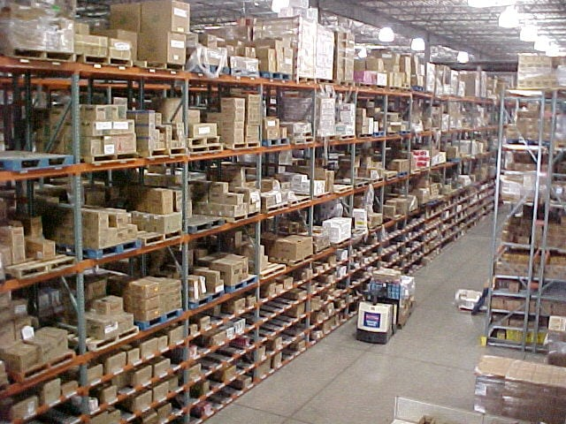
Inspection Priority
Inspections are generated and assigned according to priority.
  Imminent danger
  Fatality/catastrophe
  Complaints/referrals
  Follow-up/monitoring
  SEP programmed
Unprogrammed inspections can be expanded to cover the SEP.

Slide 12
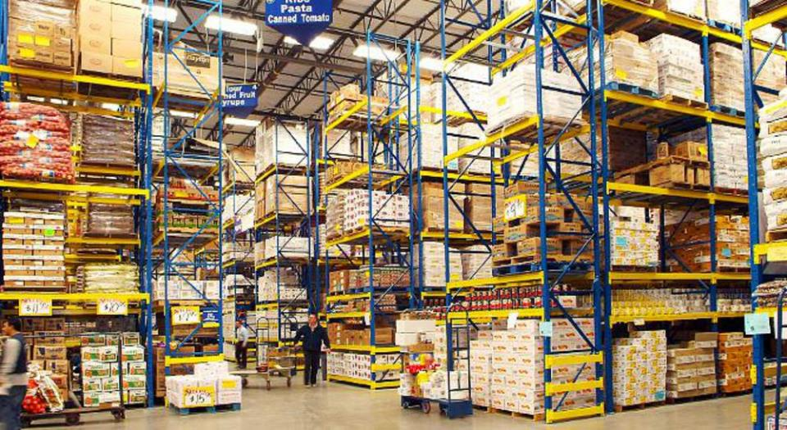
Pre-inspection Procedures
Verify that the SEP is applicable to employer/site
Review the site listing in Targeting System
  Are there…
    Consultative Services Surveys?
    Star Evaluations?
    SHARP Evaluations?

Slide 13

Inspection Exemptions
FOM Ch. III, D.3.h.
Deferrals:
  Consultation program surveys
    Full-service
    Limited service and scope
  SHARP participant
  Carolina Star Program

Slide 14
Pre-inspection Procedures
Read Industrial Data Report (IDR) for NAICS 4244.
Review documents in FOM, CPLs and OPNs based on SEP and potential site hazards.
  Example: Ergonomics, HazCom, Confined Space…

Slide 15
Pre-inspection Procedures
Normal compliance activities - programmed inspections
For complaints, referrals, or accidents – follow this OPN for guidance and FOM Chapter IX – “Complaints, Referrals and Accidents”.
For fatalities or catastrophes – follow this OPN for guidance and FOM Chapter VIII – “Fatality and Catastrophe Investigations”.

Slide 16
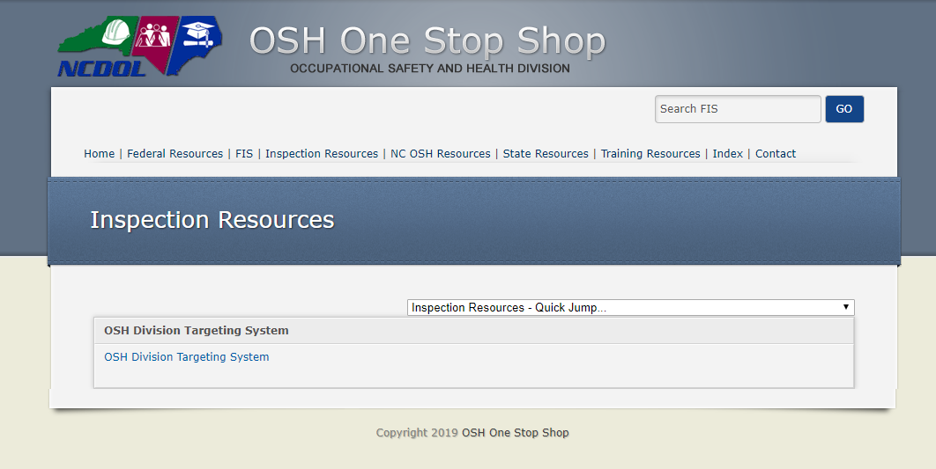
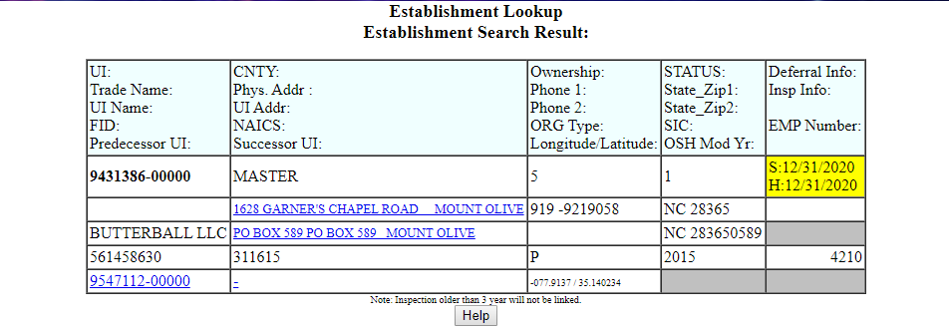
NC Site Lookup or “Targeting”

Slide 17
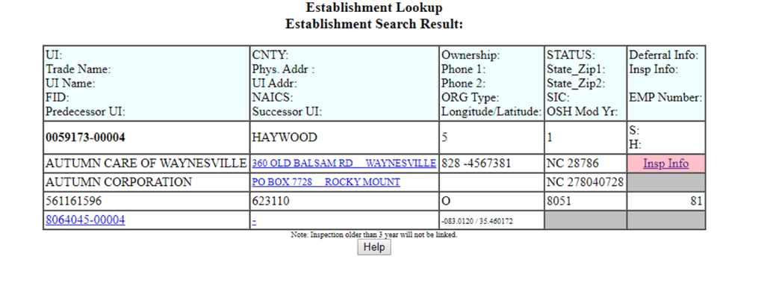
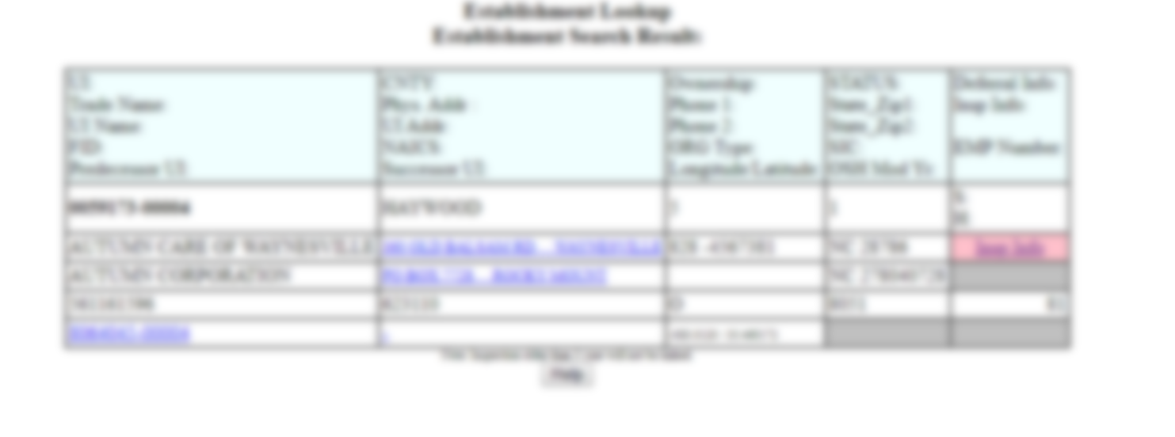
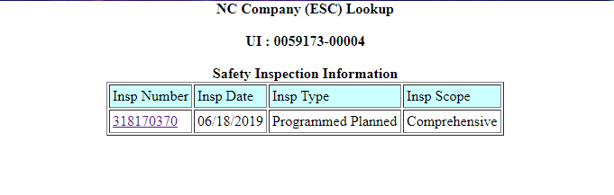
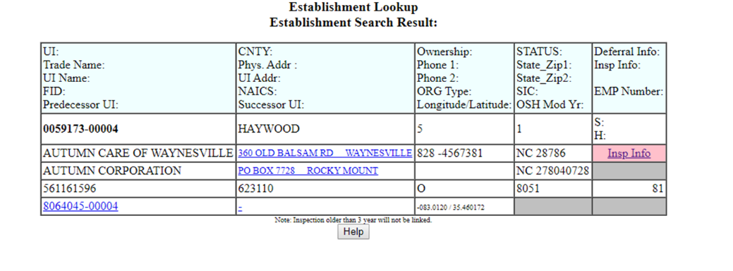
NC Site Lookup or “Targeting”

Slide 18

Inspection Procedures
Evaluate Health and Safety Program issues in the focus area listed in the SEP:
Recordkeeping
Powered industrial trucks
Electrical
Ergonomics
Hazard communication
Hexavalent chromium
Machine guarding
Process safety management (PSM)
Medical records

Slide 19
Recordkeeping
OPN 145 SEP
CPL 02-00-135
Presented by: ETTA Bureau, (919) 707-7876

Slide 20
Recordkeeping
29 CFR 1904
Review and evaluate OSHA 300 and 300A for preceding three years.
Review/evaluation current year-to-date OSHA 300 log.
Discuss any discrepancies with recordkeeper and management.
Record discrepancies in your narrative and inspection report.
NCDOL Photo Library

Slide 21
Recordkeeping
CPL 02-00-135
Follow requirements:
  29 CFR 1904: Recording and Reporting Occupational Injuries and Injuries
  CPL 02-00-135: Recordkeeping Policies and Procedures Manual
  Other applicable requirements

Slide 22

Recordkeeping - Interviews
Question employees regarding work-related injuries (past three years).
Ensure any incidents were properly recorded.
Discuss discrepancies with employer.

Slide 23
Employee Medical Records
CPL 02-00-135
Medical records not specifically required by OSHA:
  Medical exam results
  Laboratory tests
  Medical opinions and diagnoses
  First aid records
Obtain and maintain in accordance with:
  FOM Ch. III – Inspection Procedures
  FOM Ch. XIII – Fatality and Catastrophe Investigations
  FOM Ch. XVI – Administrative File Activities

Slide 24

Employee Medical Records
CPL 02-00-135
Legal justification for requesting medical records:
  45 CFR 164.512 (b)(1)(v):
    Health and Human Services Standards for Privacy of Individually Identifiable Health Information
This Photo by Unknown Author is licensed under CC BY-SA-NC

Slide 25

Recordkeeping - Privacy
Privacy and medical records
  Respect for employee privacy must be a priority.
  Obtain consent prior to reviewing medical records if possible.
This Photo by Unknown Author is licensed under CC BY-SA

Slide 26

Recordkeeping
Forward OSHA 300 and 300A forms from NAICS 4244 inspections to PSIM Bureau Chief.
  Required in order to track and trend illnesses and injuries for NAICS 4244.

Slide 27
Powered Industrial Trucks
OPN 145 SEP
Presented by: ETTA Bureau, (919) 707-7876

Slide 28
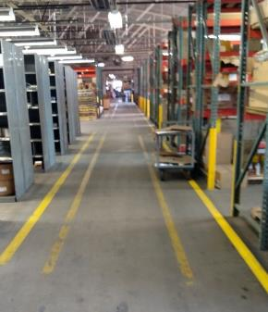
PITs - Handling Materials
Evaluate employers' policies, procedures, and work practices per 1910.176 and 1910.178.
Some areas of concern:
    Aisles
    Loading docks
    Through doorways
    Turns of passage
NCDOL Photo Library

Slide 29

Operator Training
Are employees competent to operate a powered industrial truck safely?

Slide 30
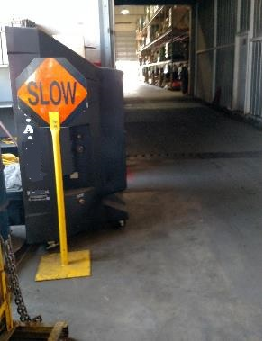
PITs - Handling Materials
1910.176(a)
Evaluate work processes:
  Both inside and outside warehouse and storage areas.
Look for:
  Struck-by hazards
  Use of chocks, dock locks, etc.
  Verify pedestrian walkways
NCDOL Photo Library
Notes:
30

Slide 31
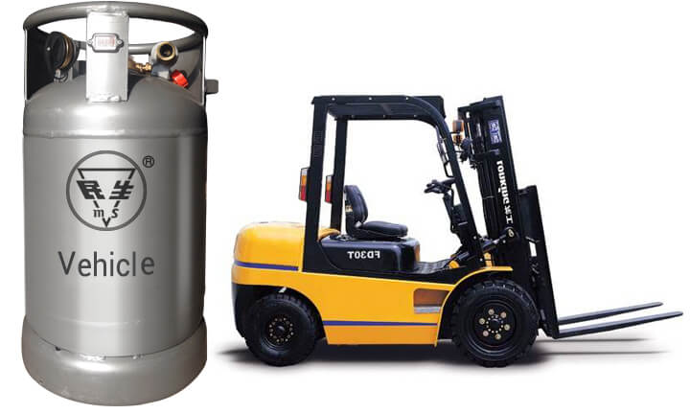
Powered Industrial Trucks
If PITs operate on hydrocarbon fuels:
  Evaluate employee exposure to carbon monoxide.

Slide 32

Powered Industrial Trucks
Are employees using seat belts while driving?
Are employees using Personal Fall Arrest Systems (PFAS) while on lifts for order picking?

Slide 33
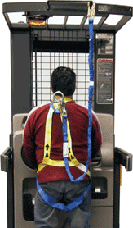
Powered Industrial Trucks
Are employees using PFAS while on lifts for order picking?

Slide 34
Electrical
OPN 145 SEP
Presented by: ETTA Bureau, (919) 707-7876

Slide 35
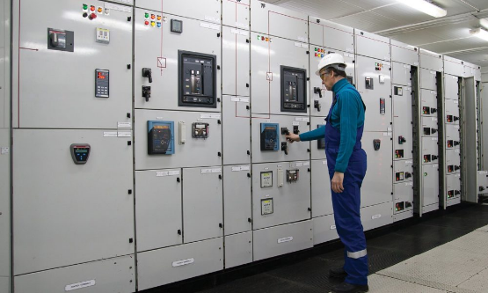
Electrical
Evaluate the condition of electrical equipment:
  Panels, cabinets, conduits, motor control centers, etc.

Slide 36


Electrical
Evaluate appropriate use of ground fault circuit interrupters (GFCI).
Evaluate the use of waterproof receptacles and enclosures.
Industrial GFCI
Industrial waterproof receptacle

Slide 37

Electrical
Evaluate electrical safe work practices
  Compliance with 1910.147 – Control of Hazardous Energy.

Slide 38
Ergonomics
OPN 145 SEP
FOM Chapter XVII
Presented by: ETTA Bureau, (919) 707-7876

Slide 39
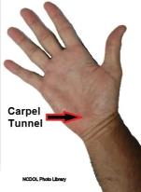
Ergonomics
NCGS 95-129(1)
Definition
  Ergonomics is defined as the “science related to man and his work, embodying the anatomic, physiologic, and mechanical principles affecting the efficient use of human energy”.
Injury examples
  Carpal tunnel syndrome; tendinitis; rotator cuff injuries (a shoulder problem); epicondylitis (an elbow problem); trigger finger; muscle strains and lower back injuries.

Slide 40

Are Ergonomic Hazards Present?
FOM Ch. XVII
Determine the presence of hazards:
  OSHA 300 logs, NCIC Form 19, OSHA 301
  Incident reports
  Ergonomics program
  Ergonomics training media and records
  Job hazard analyses (JHA) or similar
  Ergonomic record review checklist

Slide 41
Review Employer’s Ergonomics
Program
FOM Ch. XVII
Look for:
  Hazard identification and analysis
  Responsible and authorized personnel
  Employee input regarding lifting procedures
  Compliance to policies/procedures and deficiency follow-up
  Policy and procedure change(s) and injury and illness effect
  Medical treatment

Slide 42

Review Employer’s Ergonomics
Program
FOM Ch. XVII
Also check for:
  Management commitment
  Assessment of new lifting technologies and designs
  Employee education and training
  Program evaluation

Slide 43

Ergonomics Program/Health Management
Additionally, ensure employer:
  Evaluates workplace regularly
  Promotes early reporting
  Medical management
  Maintains safety commitment
Photo by Olga Kononenko on Unsplash

Slide 44
Ergonomics Program
FOM Ch. XVII
Calculate DART and severity rates
Review with Supervisor to determine course:
  Rates Improving + Effective Program
  Rates Improving + Deficient Program
  Rates Not Improving + Effective Program
LETTER

Slide 45
Ergonomics Program
FOM Ch. XVII
Review with Supervisor to determine course of action:
  Rates Not Improving + Deficient Ergonomics Program =
  Additionally, if clusters of Ergonomic injuries exist =
  INSPECTION
  INSPECTION

Slide 46

Conduct Interviews
FOM Ch. XVII
Verify employees are trained in:
  Hazard recognition
  Process for correcting hazards
  Requirement of reporting injuries
Ask about injuries/issues
Video employees performing tasks

Slide 47
Citation Guidance
FOM Ch. XVII
If ergonomic hazard(s) are found to exist,
  Evaluate elements of General Duty Clause:
    Hazard is present?
    Hazard recognized in the industry?
    Hazard likely to cause serious physical harm?
    Feasible method of abatement?

Slide 48
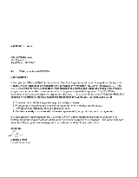
Citation Guidance
FOM Ch. XVII
Hazard Alerts
  Sent in lieu of a citation
  Describes observed deficiencies
  May include elements of an effective ergonomics program

Slide 49
Machine Guarding
OPN 145 SEP
Presented by: ETTA Bureau, (919) 707-7876

Slide 50

Machine Guarding
During the investigation:
Evaluate employer’s process of equipment inspection and evaluation.
  Are hazards identified and corrected?
  Is the equipment safe for routine operation?
This evaluation must include a review of the employer's documentation.

Slide 51
Machine Guarding
Evaluate the employer’s process for:
  Preventative maintenance
  Periodic self-inspection
Evaluation should cover production, facility, and shop machinery.
  Is the employer’s process identifying and correcting hazards?
Document review is also a part of this evaluation.
Notes:
This should also include a

Slide 52

Machine Guarding
Evaluate Lockout/Tagout Program (1910.147)
  Is the employer in compliance?

Slide 53

Machine Guarding
Conduct a focused walkthrough to evaluate machine guarding.
Include:
  Production areas
  Equipment rooms
  Maintenance areas
  Fabrication shops

Slide 54
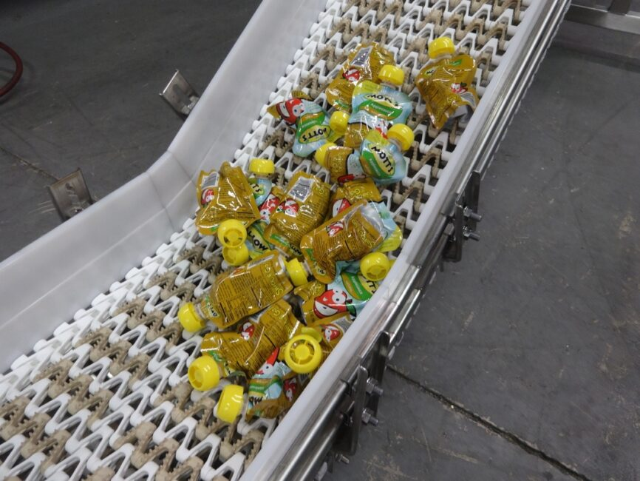
Machine Guarding
During walkaround, look for:
  Conveyors
  Point-of-operation guarding (in-running nip-points, cutters, shears, saws, presses, lathes, etc.)
  Mechanical transmission devices (gears, shafts, pulleys, and belts)
  Robotic equipment

Slide 55
Hazard Communication
OPN 145 SEP
CPL 02-02-079
Presented by: ETTA Bureau, (919) 707-7876

Slide 56
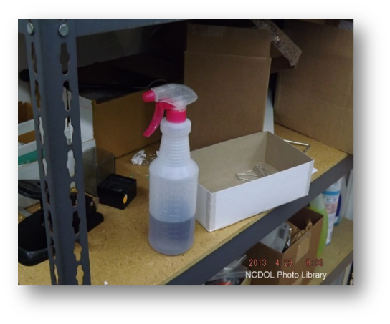
Hazard Communication
CPL 02-02-079
Hazardous chemicals often encountered…
  Sanitizers
  Disinfectants
  Gasoline
Unlabeled container

Slide 57

Hazard Communication
CPL 02-02-079
  Written program
  Worker training
  Employee exposure
  Hazard communication labels
  Access to Safety Data Sheets
This Photo by Unknown Author is licensed under CC BY-SA

Slide 58

Hazard Communication
CPL 02-02-079
Refer to CPL 02-02-079: Inspection Procedures for Hazard Communication (2012)
Image by Michael Tavrionov from Pixabay

Slide 59
Hexavalent Chromium
OPN 135 SEP
OPN 145 SEP
CPL 02-02-074
CPL 02-02-076
Presented by: ETTA Bureau, (919) 707-7876

Slide 60
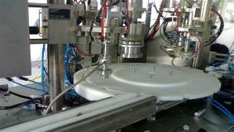
Hexavalent Chromium
During opening conference and employee interviews, verify if work activities and tasks may create an exposure.
  Example: welding on stainless steel equipment
If no activities are identified, document in the narrative portion of inspection.
Example of food packaging equipment

Slide 61

Hexavalent Chromium
If Hexavalent Chromium employee exposure is verified:
  Determine when these tasks creating exposure are performed.
  Request copies of initial exposure results and any subsequent.
  Evaluate results and discuss with District Supervisor.

Slide 62

Hexavalent Chromium
If employee exposure may have occurred and NO exposure monitoring has been performed…
  Conduct air monitoring or make a referral to a Health Compliance Officer (HCO).

Slide 63

Hexavalent Chromium
If sampling indicates work exposure at or above the Action Level (AL) or Permissible Exposure Limit (PEL) discuss with District Supervisor to determine next course of action.

Slide 64
Hexavalent Chromium
Review for more details:
  CPL 02-02-074: Inspection Procedures for Chromium (VI) Standard
  CPL 02-02-076: NEP – Hexavalent Chromium
  OPN 135: SEP – Exposure to Health Hazards

Slide 65
Process Safety Management
OPN 145 SEP
CPL 02-02-045
CPL 02-02-021
Presented by: ETTA Bureau, (919) 707-7876

Slide 66
Process Safety Management (PSM)
Prevent catastrophic releases of highly hazardous chemicals.
Grocery warehouse operations often require large scale industrial refrigeration.
  Volume of chemicals used can exceed PSM thresholds
  Examples include:
    Anhydrous ammonia (refrigerant)
    Chlorine (water treatment)

Slide 67
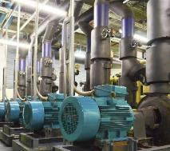
Process Safety Management
Interview appropriate management:
  Determine if any processes use hazardous chemicals at/above Threshold Quantities (TQ)
  Determine if any processes use flammable liquids or gas in quantities > 10,000 lbs.
  Remember to include all quantities in use, not just storage tanks.

Slide 68
Threshold Quantity 1910.119(a)
Threshold Quantity (TQ):
  Chemicals listed in appendix A (1910.119)
  Ammonia TQ = 10,000 Lbs.
  Chlorine TQ = 1,500 Lbs.
  Flammable liquids and gas TQ > 10,000 Lbs.
    Defined in 1910.119(a)

Slide 69
Process Safety Management
If highly hazardous chemicals are present > threshold quantities:
  Determine if employer has created/implemented a PSM program
  Consult with District Supervisor to determine if a referral must be made, etc.

Slide 70
Process Safety Management
If the CSHO has questions on 1910.119, contact:
  Program Quality Verification (PQV) team member
  Division PSM Coordinator
  District Supervisor or Bureau Chief

Slide 71
Process Safety Management
Review for more details:
  OPN 145, Appendix B, lists the process of evaluating if the PSM standard applies.
  CPL 02-02-045 – 29CFR 1910.119, Process Safety Management of Highly Hazardous Chemicals – Compliance Guidelines and Enforcement Procedures
  CPL 03-00-021 – Process Safety Management Covered Facilities

Slide 72
Additional Resources
OPN 145- SEP:
https://www.labor.nc.gov/documents/opn-145-special-emphasis-program-grocery-and-related-product-merchant-wholesalers
Industry Guides:
https://www.labor.nc.gov/safety-and-health/publications/osh-industry-guides
Sample Programs:
https://www.labor.nc.gov/safety-and-health/publications/example-programs

Slide 73
Summary
Students should now be aware of:
  The details of OPN 145 - Grocery and Related Product Merchant Wholesalers SEP.
  Standards and Hazards covered by this OPN.
  General procedures for a compliance inspection under this OPN.

Slide 74
Thank You For Attending!
Final Questions?
1-800-NC-LABOR
(1-800-625-2267)
www.labor.nc.gov

