Slide 1
North Carolina Department of Labor
Occupational Safety and Health Division
OSH Advisory Council
Spring 2023*
Presented by:
Wanda Lagoe CSP ARM CPM
Education, Training and Technical Assistance
Occupational Safety and Health Division of North Carolina
*Preliminary Data
Notes:
The information in this presentation is provided voluntarily by the N.C. Department of Labor, Education Training and Technical Assistance Bureau as a public service and is made available in good faith. This presentation is designed to assist trainers conducting OSHA outreach training for workers. Since workers are the target audience, this presentation emphasizes hazard identification, avoidance, and control – not standards. No attempt has been made to treat the topic exhaustively. It is essential that trainers tailor their presentations to the needs and understanding of their audience.
The information and advice provided on this Site and on Linked Sites is provided solely on the basis that users will be responsible for making their own assessment of the matters discussed herein and are advised to verify all relevant representations, statements, and information.
This presentation is not a substitute for any of the provisions of the Occupational Safety and Health Act of North Carolina or for any standards issued by the N.C. Department of Labor. Mention of trade names, commercial products, or organizations does not imply endorsement by the N.C. Department of Labor.

Slide 2
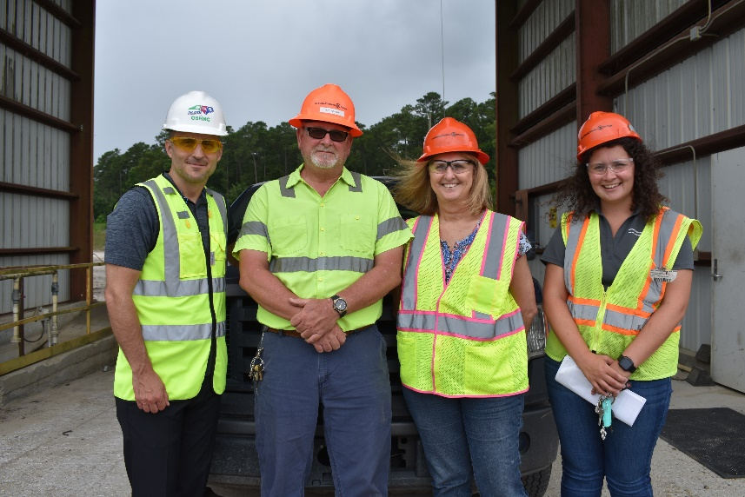
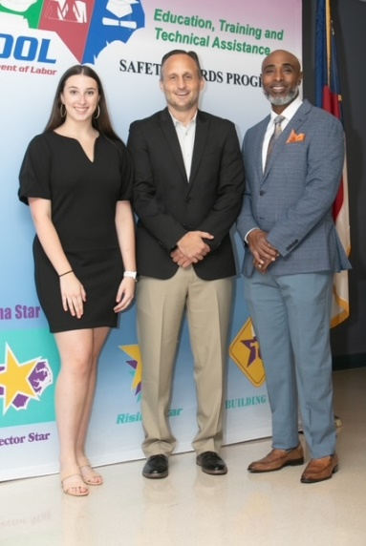
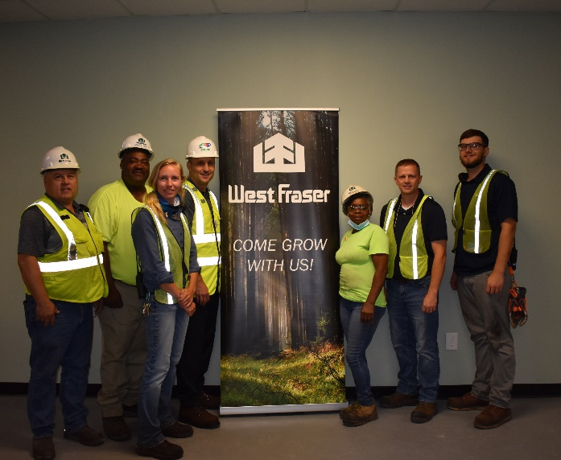
N.C. Workplace Safety and Health
TRC and DART Rate Comparison
FFY 2023—Spring
CY 2021 | North Carolina |  | National Average |  | Comparison
TRC Rate | 2.2 | 2.4* | 2.7 | 2.9* | 19% Lower/17% Lower*
DART Rate | 1.3 | 1.4* | 1.7 | 1.8* | 24% Lower/22% Lower*
*All industries including state and local government CY = Calendar Year
Notes:
North Carolina’s Total Recordable cases and DART rate continue to be lower that the National Average.
The DART rate stands for "Days Away, Restrictions and Transfers". This number is also based on trending over 200,000 hours but its not based on total injuries. Its based only on those injuries and illnesses severe enough to warrant "Days Away, Restrictions and Transfers".
The Total Recordable Case Rate (TRC) equals the division of all recordable cases by the hours worked, multiplied by 200'000 for standardization.

Slide 3
N.C. Workplace Safety and Health
Total Recordable Cases (TRC)
FFY 2023—Spring
4% Increase
11% Decrease
4% Decrease
8% Increase
12% Decrease
All Industries Including State and Local Government
Based on Calendar Year

Slide 4
N.C. Workplace Safety and Health
Days Away, Restricted or Transferred (DART)
FFY 2023—Spring
7% Increase
7% Increase
No Change
7% Increase
7% Decrease
7% Decrease
No Change
7% Decrease
7% Decrease
No Change
All Industries Including State and Local Government
Based on Calendar Year

Slide 5
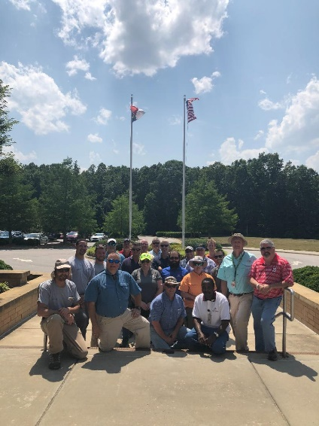
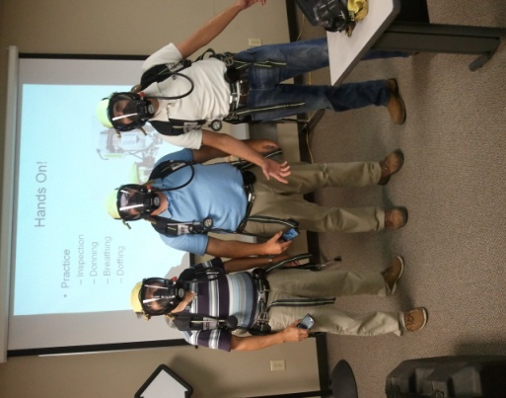
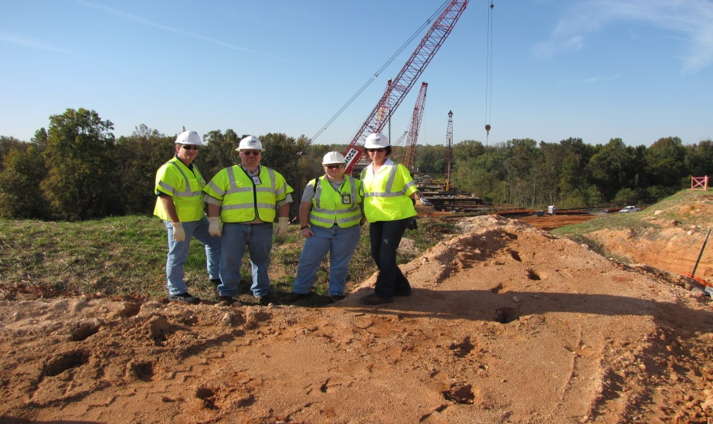
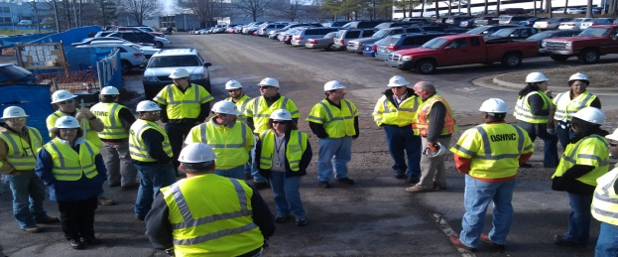
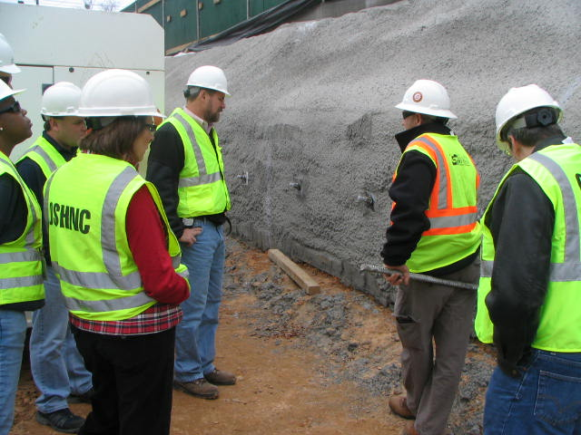
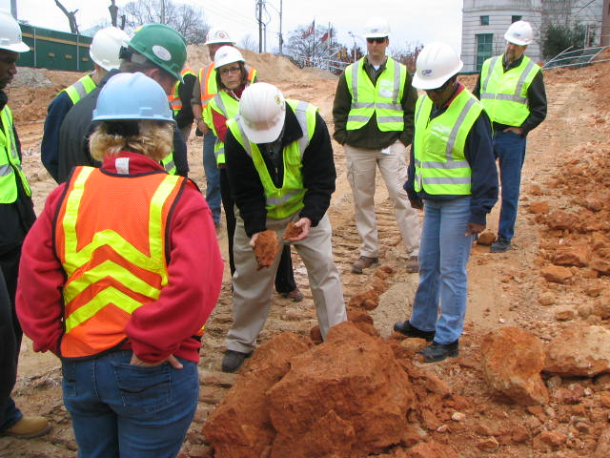
N.C. Workplace Safety and Health
OSH Division—Fatalities Inspected
FFY 2023—Spring
FATALITY TYPE | Total | FATALITY TYPE | Total
Struck By | 7 | Inhalation | 1
Caught In/Between | 3 | Ingestion | 0
Bite/Sting/Scratch | 0 | Absorption | 0
Fall (Same Level) | 1 | Repeated Motion/Pressure | 0
Fall (From Elevation) | 9 | Cardio/Respiratory | 0
Struck Against | 0 | Shock | 3
Rubbed/Abraded | 0 | Other | 7*
COVID-19 | 0 | Criminal Activity | 4*
Fatalities Under OSH Division Jurisdiction
FFY 2022 |  | FFY 2023 | Total
Total Fatalities | 68 | Fatalities | 31
NCDOL Photo Library
* Criminal Activity is also included in Other.

Slide 6
N.C. Workplace Safety and Health
OSH Division—Strategic Plan Goals
FFY 2023—Spring
COMPLIANCE | Total | FFY Goal
Safety Inspections | 492 | 1,100
Health Inspections | 346 | 705
Serious Hazards Eliminated | 3,381 | 4,100
Training and/or Program Violations | 175 | 1,050
CONSULTATION | Total | FFY Goal
Serious Hazards Eliminated | 3,123 | 4,800
Private Sector and Public Sector Visits | 720 | 1,315
OSH DIVISION | Total | FFY Goal
Program Improvements | 938 | 2,060
People Trained in Special Emphasis Program Areas | 2,715 | 3,200
People Trained at OSH Division Sponsored Events | 3,357 | 5,350

Slide 7
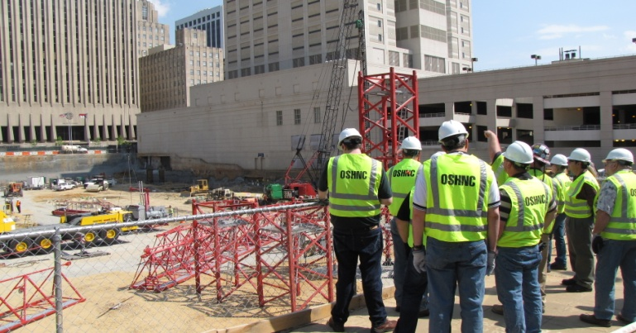
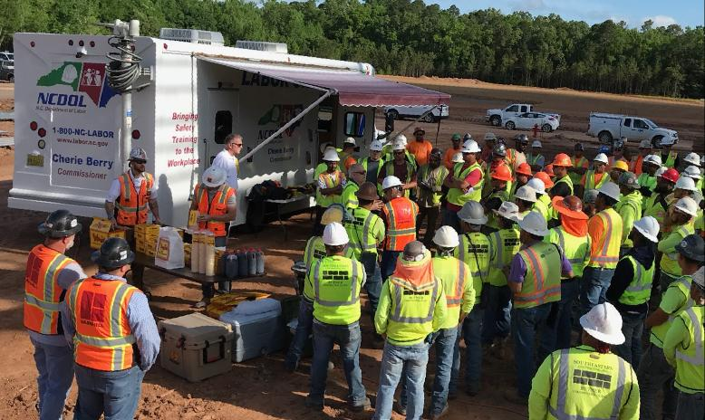
N.C. Workplace Safety and Health
OSH Division—Strategic Plan Goals
FFY 2023—Spring
EDUCATION, TRAINING AND TECHNICAL ASSISTANCE | Total | FFY Goal
Publications Distributed | 24,897 | 45,000
Standards Interpretations | 1,173 | N/A
AGRICULTURAL SAFETY AND HEALTH | Total | FFY Goal
Outreach Materials Distributed | 4,567 | 2,400
Compliance Inspections | 11 | 50
Certificates Issued | 1,542 | 1,750
Preoccupancy Inspections | 1,706 | 1,875
NCDOL Photo Library

Slide 8
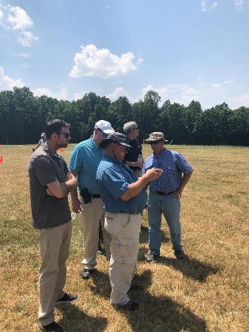

Strategic Plan
Special Emphasis Programs (SEP)
FFY 2023—Spring
NCDOL Photo Library
Construction
Logging and Arboriculture
Long Term Care Facilities
Health Hazards
Food Manufacturing
Grocery and Related Product Wholesalers
Amputations

Slide 9
Special Emphasis Program
Construction
FFY 2023—Spring
NAICS 23—CONSTRUCTION | FFY 2022 |  | Total
Total Fatalities | 23 |  | 12
 |  |  | N/A
FFY 2022 3rd Qtr. Fatality Rate | 0.0020
FATALITY TYPE | Total | FATALITY TYPE | Total
Struck By | 0 | Inhalation | 0
Caught In/Between | 1 | Ingestion | 0
Bite/Sting/Scratch | 0 | Absorption | 0
Fall (Same Level) | 0 | Repeated Motion/Pressure | 0
Fall (From Elevation) | 8 | Cardio/Respiratory | 0
Struck Against | 0 | Shock | 2
Rubbed/Abraded | 0 | Other | 1
Notes:
Will be posting a new billboard on the May 2022 fall prevention standdown and for heat stress.

Slide 10
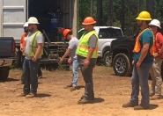
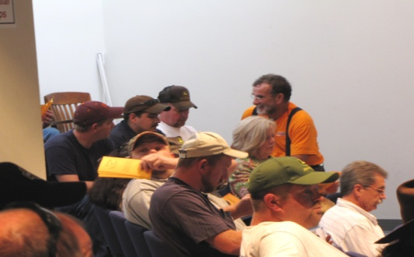
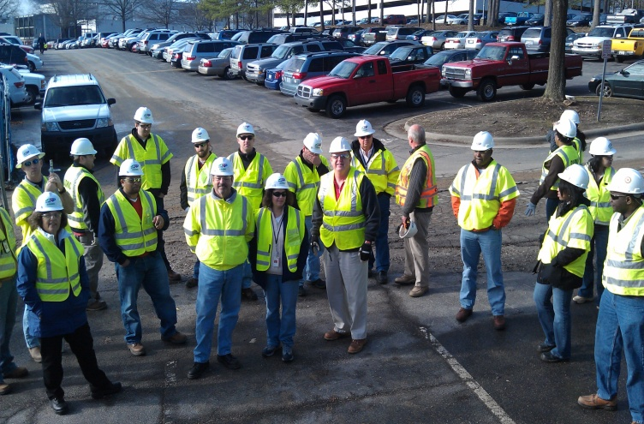
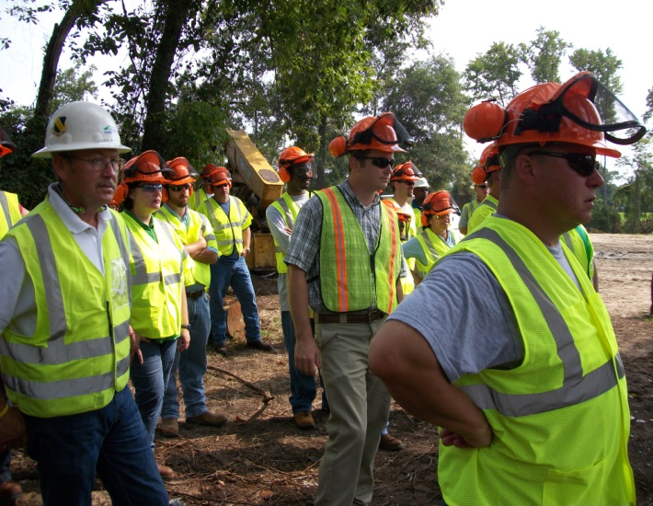
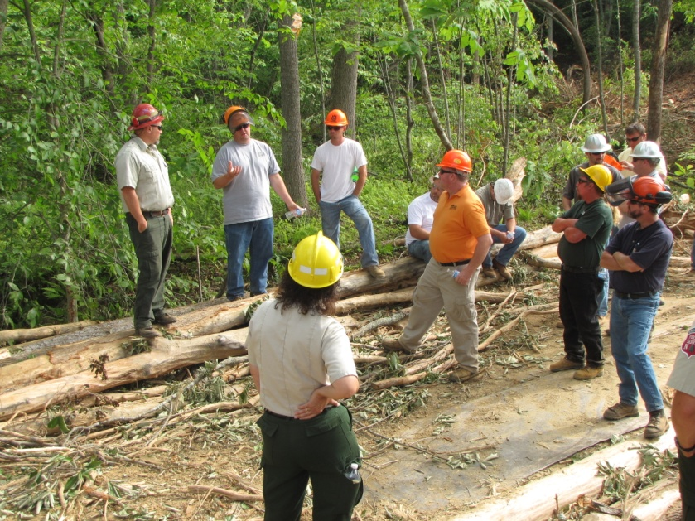
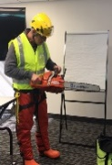
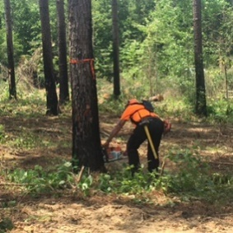

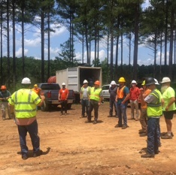
Special Emphasis Program
Construction
FFY 2023—Spring
23 | North Carolina |  |  |  | National Average |  |  |  | North Carolina vs. National Average
 | CY 2020 |  | CY 2021 |  | CY 2020 |  | CY 2021 |  | 2021 Comparison
TRC | 2.0 | 10% Decrease |  | 1.8 | 2.5 | No Change |  | 2.5 | 28% Lower
DART | 1.0 | 9% Increase |  | 1.1 | 1.6 | No Change |  | 1.6 | 31% Lower
SEP ACTIVITY | Total | FFY Goal
Compliance Inspections | 360 | 800
Consultative Visits | 216 | 290
OSH Outreach Events (10- and 30- Hour Construction Courses) | 8 | 6
People Trained | 241 | 1,000

Slide 11
Special Emphasis Program
Logging and Arboriculture
FFY 2023—Spring
56173 | North Carolina |  |  |  | National Average |  |  |  | North Carolina vs. National Average
 | CY 2020 |  | CY 2021 |  | CY 2020 |  | CY 2021 |  | 2021 Comparison
TRC | 2.5 | 11% Increase |  | 2.8 | 3.0 | 6% Increase |  | 3.2 | 12% Lower
DART | 1.6 | 16% Increase |  | 1.9 | 2.0 | No Change |  | 2.0 | 5% Lower
SEP ACTIVITY | Total | FFY Goal
Compliance Inspections | 5 | 20
Consultative Visits | 9 | 15
OSH Training and Outreach Events | 6 | 5
People Trained | 184 | 150
NAICS 11331*—LOGGING | FFY 2022 |  | Total
Total Fatalities | 1 |  | 1
NAICS 56173—ARBORICULTURE | FFY 2022 |  | Total
NAICS 56173—ARBORICULTURE | FFY 2022
Total Fatalities | 4 |  | 0
FFY 2022 3rd Qtr. Combined Fatality Rate |  |  | 0.0025
* TRC/DART Data not available

Slide 12
Special Emphasis Program
Long Term Care Facilities
FFY 2023—Spring
NAICS 623*—LONG TERM CARE
 | North Carolina |  |  |  | National Average |  |  |  | North Carolina vs. National Average
 | CY 2020 |  | CY 2021 |  | CY 2020 |  | CY 2021 |  | 2021 Comparison
TRC | 9.3 | 34% Decrease |  | 6.1 | 11.5 | 27% Decrease |  | 7.3 | 16% Lower
DART | 7.2 | 40% Decrease |  | 4.3 | 9.3 | 43% Decrease |  | 5.3 | 19% Lower
*TRC/DART rate based on the 3-digit NAICS code
SEP ACTIVITY | Total | FFY Goal
Compliance Inspections | 16 | 24
Consultative Visits | 23 | 30
OSH Outreach Events | 0 | 2
People Trained | 0 | 40

Slide 13
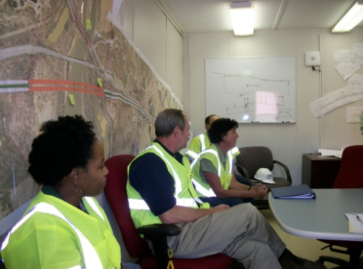
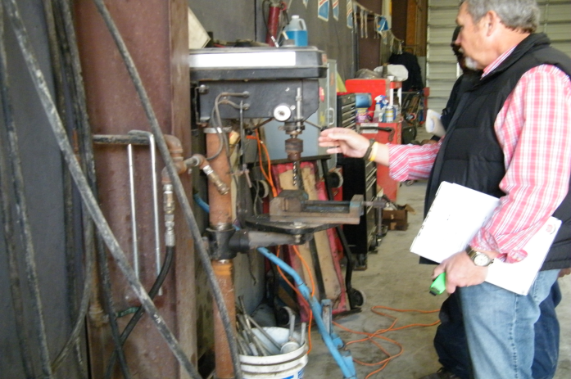
Special Emphasis Program
Health Hazards
FFY 2023—Spring
COMPLIANCE INSPECTIONS | Total | FFY Goal
Silica | 30 | 60
Asbestos | 5
Isocyanates | 8
Lead | 8
Hexavalent Chromium | 7
Total | 58
Program Improvements | 18 | 20
*Some inspections involved more than one health hazard and generally included a program improvement
NCDOL Photo Library

Slide 14
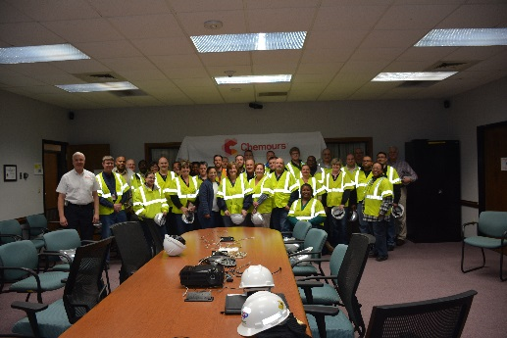
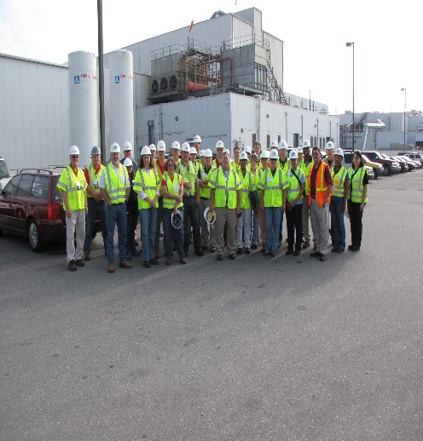
Special Emphasis Program
Health Hazards
FFY 2023—Spring
COMPLIANCE INSPECTION RESULTS
HEALTH HAZARDS | Number of Samples (Detectable Results) | Number With Overexposures | Average Severity Rate*
Silica | 4 | 1 | 0.60
Asbestos | 0 | 0 | 0.00
Isocyanates | 1 | 0 | 0.06
Lead | 9 | 2 | 0.85
Hexavalent Chromium | 6 | 0 | 0.08
Total | 20 | 3 | N/A
NCDOL Photo Library
* All Samples

Slide 15
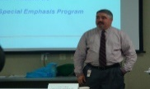
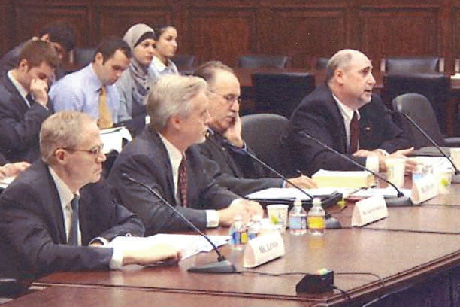
Special Emphasis Program
Health Hazards
FFY 2023—Spring
HEALTH HAZARDS | Consultative Surveys
 | 1st Qtr. | Total
Silica | 80 | 80
Asbestos |  | 9
Isocyanates |  | 10
Lead |  | 19
Hexavalent Chromium |  | 4
Total |  | 122
FFY Goal | 125 | 125
NCDOL Photo Library
NCDOL Photo Library
SEP ACTIVITY | Total | FFY Goal
OSH Outreach Events | 12 | 20
People Trained | 230 | 300

Slide 16
Special Emphasis Program
Food Manufacturing
FFY 2023—Spring
NAICS 311*—FOOD MANUFACTURING
 | North Carolina |  |  |  | National Average |  |  |  | North Carolina vs. National Average
 | CY 2020 |  | CY 2021 |  | CY 2020 |  | CY 2021 |  | 2021 Comparison
TRC | 3.8 | 11% Decrease |  | 3.4 | 5.1 | 6% Decrease |  | 4.8 | 25% Lower
DART | 3.0 | 13% Decrease |  | 2.6 | 3.9 | 8% Decrease |  | 3.6 | 23% Lower
*TRC/DART rate based on the 3-digit NAICS code
SEP ACTIVITY | Total | FFY Goal
Compliance Inspections | 9 | 25
Consultative Visits | 10 | 12
OSH Outreach Events | 1 | 2
People Trained | 14 | 40

Slide 17
Special Emphasis Program
Grocery and Related Product Wholesalers
FFY 2023—Spring
NAICS 4244*—GROCERY AND RELATED WHOLESALERS
 | North Carolina |  |  |  | National Average |  |  |  | North Carolina vs. National Average
 | CY 2020 |  | CY 2021 |  | CY 2020 |  | CY 2021 |  | 2021 Comparison
TRC | 4.1 | 2% Decrease |  | 4.0 | 4.9 | 9% Increase |  | 5.4 | 26% Lower
DART | 3.1 | 3% Increase |  | 3.2 | 4.0 | 2% Increase |  | 4.1 | 22% Lower
*DART/TRC rate based on the 4-digit NAICS code
SEP ACTIVITY | Total | FFY Goal
Compliance Inspections | 10 | 20
Consultative Visits | 7 | 3
OSH Outreach Events | 1 | 2
People Trained | 11 | 40

Slide 18
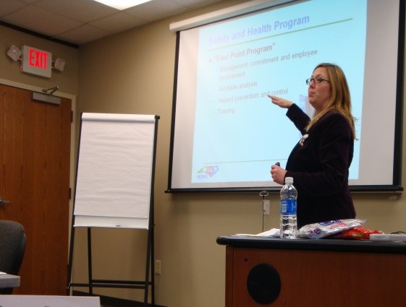
Special Emphasis Program
Amputations
FFY 2023—Spring
SEP ACTIVITY | Total | FFY Goal
Compliance Inspections | 81 | 150
Consultative Visits | 95 | 100
OSH Outreach Events | 29 | 15
People Trained | 710 | 400

Slide 19
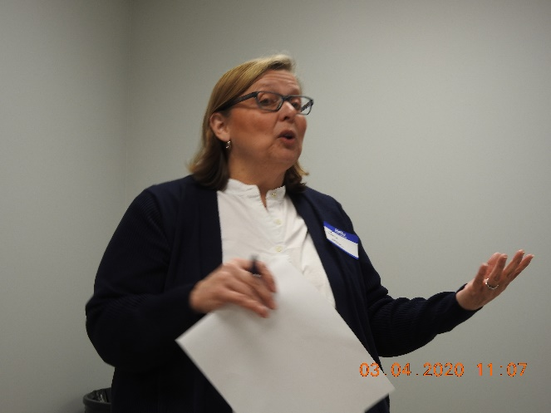
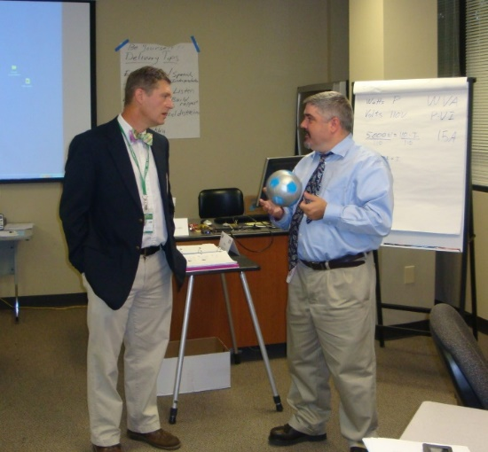
OSH Division
Public Sector
FFY 2023—Spring
 | CY 2020 |  | CY 2021
TRC | 4.2 | 12% Increase |  | 4.8
DART | 2.5 | 11% Increase |  | 2.8
ACTIVITY | Total | FFY Goal
Compliance Inspections | 68 | 95
Consultative Visits | 105 | 190
OSH Outreach Events/Booths | 7 | 6
Trained | 466 | 600

Slide 20
OSH Division
Complaint Desk*
FFY 2023—Spring
ACTIVITY | East Compliance | West Compliance | Agricultural Safety and Health | Cumulative Total | FFY 2022
Complaints | 615 | 933 | 5 | 1,553 | 3,575
Referrals | 130 | 194 | 4 | 328 | 777
Fat/Cat | 37 | 56 | 2 | 95 | 228
Totals | 782 | 1,183 | 11 | 1,976* | 4,580*
*Includes calls that were processed but not necessarily inspected. Fat/Cat includes calls regarding heart attacks and other natural causes.
ACTIVITY | Cumulative Total | FFY 2022
Complaints Not in OSH Jurisdiction* | 2,038 | 4,122
*Includes complaints related to wage and hour, discrimination, worker's compensation questions, beyond statute of limitation time frame, etc.

Slide 21
OSH Division
Education and Training Outreach
FFY 2023—Spring
OUTREACH EVENT | Total | FFY Goal
General Industry—10-Hour Course | 4 | 4
General Industry—30-Hour Course | 1 | 1
NC #500/502—Construction Train-the-Trainer Course/ NC #501/503—General Industry Train-the-Trainer Course | 1 | 1
Construction—10-Hour Course | 4 | 5
Construction—30-Hour Course | 2 | 1
Labor One/Booth Events | 4 | N/A
Speaker’s Bureau | 38 | N/A
Webinars | 35 | N/A
OSH Workshops | 0 | N/A
Technical Assistance | 0 | N/A
Spanish Training and Outreach Events | 0 | N/A
Train-the-Trainer Program (Construction/General Industry)—Events | 9 | N/A
Train-the-Trainer Program (Construction/General Industry)—Trained | 132 | N/A
Notes:
ETTA doesn’t have a Spanish Outreach trainer at this time.

Slide 22
OSH Division
Education and Training Outreach
FFY 2023—Spring
Stand Downs/Forums
  Stand Up 4 Grain Safety Week (March 27 - 31) (Special Events Page)
  Fall Prevention Stand-Down (May 1 - 5) (Webinars, Billboard, Special Events Page, Social Media, Labor One Events)
  Heat Illness Prevention (All Summer) (Webinars, Billboards, Special Events Page, Social Media)
  Trench Safety Stand-Down (June 19 - 23) (Webinars, Billboards, Special Events Page, Social Media)
  Safe + Sound (August 7 - 13) (Webinars, Billboards, Special Events Page, Social Media)
  Construction Forum (September 7) (Billboard, Special Events Page, Social Media and Labor One Events)

Slide 23
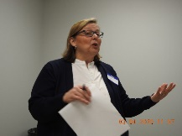
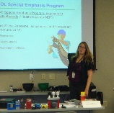
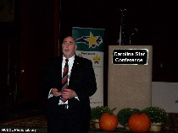
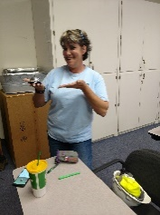
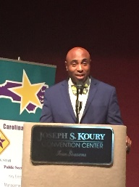
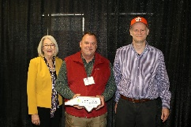
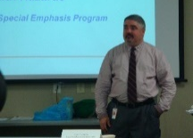

OSH Division
Recognition Programs
FFY 2023—Spring
*Cumulative Total
STAR SITES—New, Recertification, Promotion | Total | FFY Goal | Approved Star Sites*
Carolina Star | 6 |  | 100
Building Star | 2 |  | 23
Rising Star | 0 |  | 5
Public Sector Star | 0 |  | 18
Total | 8 | 20 | 146
NCDOL Photo Library
ACTIVITY | Total | FFY Goal
Star Sites—Termination/Withdrawn | 4
Star Booths | 4
Star Presentations | 12 | 10
Star Program Interventions | 78 | 100
Notes:
Withdrew: Emerson Automation Solutions – work site closed

Slide 24

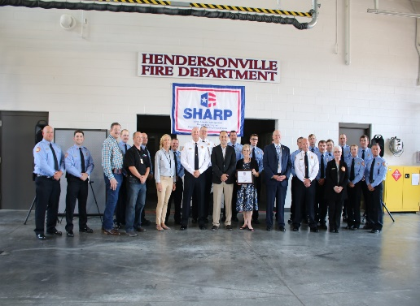
OSH Division
Recognition Programs
FFY 2023—Spring
SHARP SITES—New/Renewal | Total | FFY Goal | Approved SHARP Sites*
SHARP—Construction | 0 |  | 3
SHARP—General Industry | 20 |  | 104
SHARP—Public Sector | 8 |  | 45
Totals | 28 | 60 | 152
*Cumulative Total
GOLD STAR GROWERS—New
Total | 183
SAFETY AWARDS | Total
CY 2022 Safety Awards Season* (Silver, Gold, Million Hour) | 2,132
 | Total
Million Hour Awards | 43
Notes:
2022 Safety Award Season reverting to normal schedule and may be a hybrid of virtual and in-person.

Slide 25
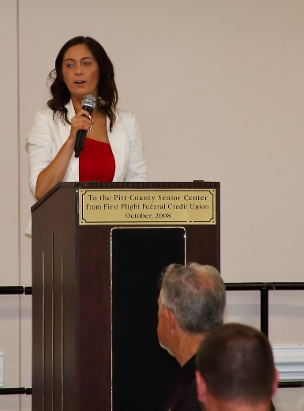
OSH Division
Safety Awards Program
FFY 2023—Spring
2023 Safety Award Banquet Season
  Kiley Willard –Safety Awards Coordinator
  28 Banquets (March – June)
  11 Banquets Completed
  One Cancelled – Statesville
  Attendance Up

Slide 26


OSH Division
Alliances and Partnerships
FFY 2023—Spring
Alliances
  Carolinas AGC
  Lamar Advertising Company
  Mexican Consulate
  N.C. State – Industry Expansion Solutions
  Safety and Health Council of NC
  NUCA of the Carolinas
  NCALGESO
  Tree Care Industry Association
  Plumbing-Heating-Cooling Contractor’s Association

Slide 27
OSH Division
Alliances and Partnerships
FFY 2023—Spring
Partnerships
  Barringer Construction
    Charlotte - Foundry Building Including Ancillary Buildings (2020 – 2023)
  Holder – Edison Foard – Leeper, A Joint Venture
    Charlotte - Charlotte Douglas International Airport – Terminal Lobby Expansion (2021 – 2023)
  Jacobs Engineering Group
    Holly Springs - Biotech Manufacturing Facility and Campus (2022 – 2024)

Slide 28
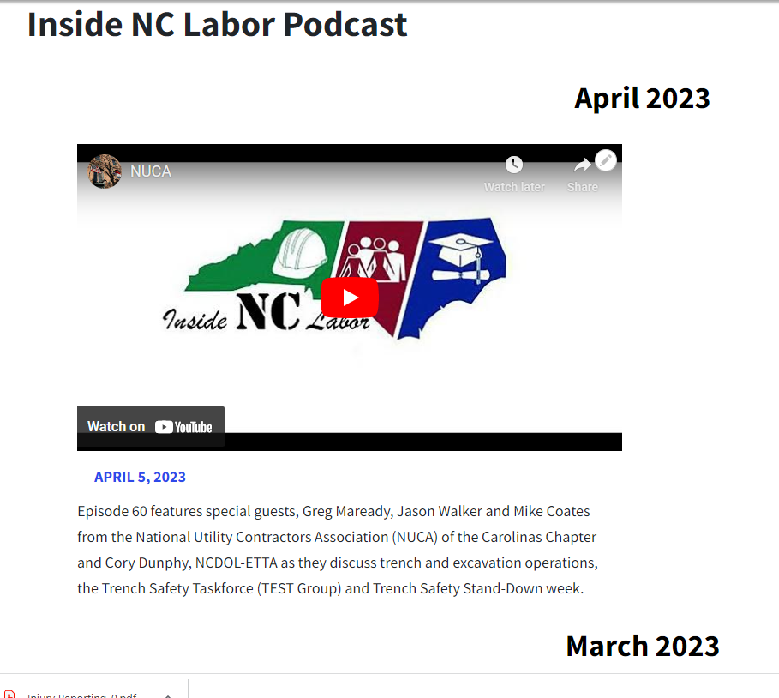
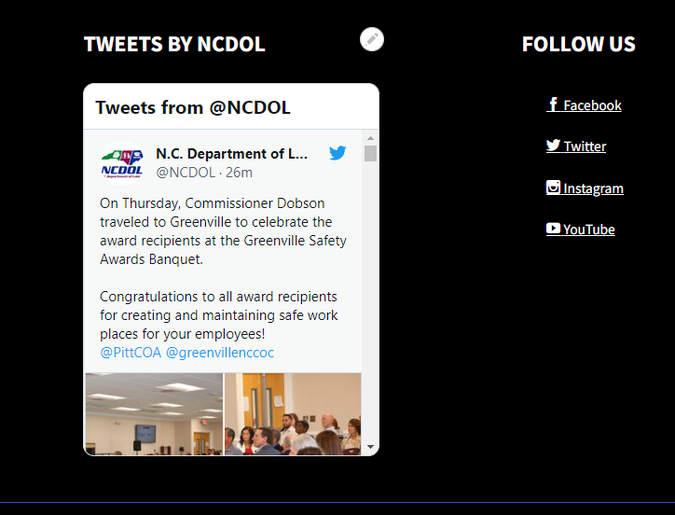
OSH Division
Social Media
FFY 2023—Spring
Inside NC Labor Podcasts
  60 episodes
Facebook
  2,294 followers
Instagram
  785 followers
Twitter
  2,177 followers
LinkedIn
  116 followers

Slide 29
OSH Division
Publications—New
FFY 2023—Spring
Quick Cards
  Forklift Safety
  Hazard Communication – Labels
  Hazard Communication – Pictograms
  Hazard Communication – Safety Data Sheets
Brochures
  Reporting Workplace Accidents
    Provides requirements for reporting workplace accidents.

Slide 30
OSH Division
Standards Section—New/Revisions
FFY 2023—Spring
Compliance Directive (CPL)
  CPL 02-01-063—Compliance Directive for Cranes and Derricks in Construction Standard
    Provides guidelines for enforcement procedures and inspection guidance conducted for equipment covered by Subpart CC.
  CPL 02-00-051—Enforcement Exemptions and Limitations Under the Appropriations Act
    Appendix A updated.
Standards Notice (SN)
  SN 78 —Pump Jack Scaffold Systems – Workbench Used as a Toprail
    Provides additional clarification on when the use of workbenches as toprails on pump jack scaffolds is acceptable.

Slide 31
OSH Division
Cut-Loose, In-Training, Vacant
FFY 2023—Spring
West Compliance | Safety | % | Industrial Hygienist | %
Cut Loose | 19 | 61% | 18 | 67%
In-Training | 7 | 23% | 0 | 0%
Vacant | 5 | 16% | 9 | 33%
Total | 31* |  | 27*
East Compliance | Safety | % | Industrial Hygienist | %
Cut Loose | 10 | 48% | 4 | 18%
In-Training | 4 | 19% | 4 | 13%
Vacant | 7 | 33% | 9 | 69%
Total | 21 |  | 17
Safety Cut Loose | 56% | Health Cut Loose | 50%
Safety In-Training | 21% | Health in-Training | 9%
Safety Vacant | 23% | Health Vacant | 41%

Slide 32
OSH Division
Cut-Loose, In-Training, Vacant
FFY 2023—Spring
Consultative Services | Safety | % | Industrial Hygienist | %
Cut Loose | 9 | 82% | 8 | 100%
In-Training | 2 | 18% | 0 | 0%
Vacant | 0 | 0% | 0 | 0%
Total | 11 |  | 8
Education, Training and Technical Assistance | Safety | % | Industrial Hygienist | %
Cut Loose | 11 | 100% | 6 | 91%
In-Training | 0 | 0% | 0 | 0%
Vacant | 0 | 0% | 1 | 9%
Total | 11 |  | 7
Agricultural Safety and Health | Safety | % | Industrial Hygienist
Cut Loose | 5 | 63% | NA
In-Training | 2 | 25% | NA
Vacant | 1 | 12% | NA
Total | 8

Slide 33
OSH Division
Certifications
FFY 2023—Spring
CERTIFICATIONS
Certified Safety Professional | 29
Associate Safety Professional | 7
Certified Industrial Hygienist | 11
Certified Hazardous Materials Manager | 4
Construction Health and Safety Technician | 6
Occupational Hygiene and Safety Technician | 2
Safety Management Specialist | 1
Safety Trained Supervisor - Construction | 1
Graduate Safety Professional | 4
Total | 65

Slide 34
OSH Division
Designations
FFY 2023—Spring
DESIGNATIONS
OSH Construction Safety Specialist | 67
Virtual Observer | 13
Remote Pilot | 10
Manager of Environmental Safety and Health | 69
Manager of Environmental Safety and Health – Construction | 44
Manager of Environmental Safety and Health – Industrial Hygiene | 53
Manager of Environmental Safety and Health – Public Sector | 19
Manager of Environmental Safety and Health – Environmental | 1
Advanced Manager of Environmental Safety and Health | 1
Total | 277

Slide 35

Thank You For Attending!
FFY 2023—Spring
Questions?
1-800-NC-LABOR
(1-800-625-2267)
www.labor.nc.gov
Notes:
35

