Slide 1

Entering an Inspection in the OSHA Express

Slide 2

QUEUE New Inspection Adding Violations
In this training module you have been assigned a Complaint number for Inspection thru your QUEUE.
Open a new Inspection based on this complaint in your QUEUE and forward a response to Deidre Duncan.
You will have 4 Violations associated with this complaint
2 Violations will be Grouped
1 Violation will be an Administrative Violation
This violation will be abated before citation issuance
1 Violation will be Serious with an “Override”

Slide 3

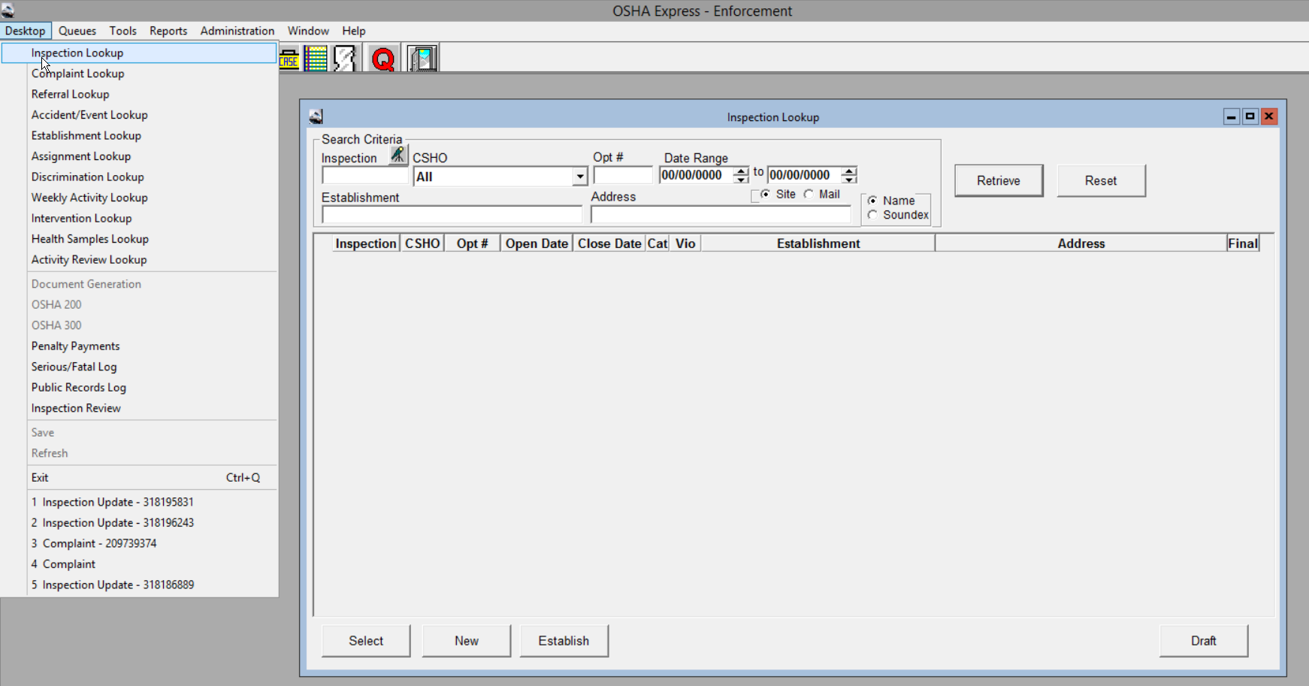
Click on the Desktop Icon then choose Inspection Lookup

Slide 4
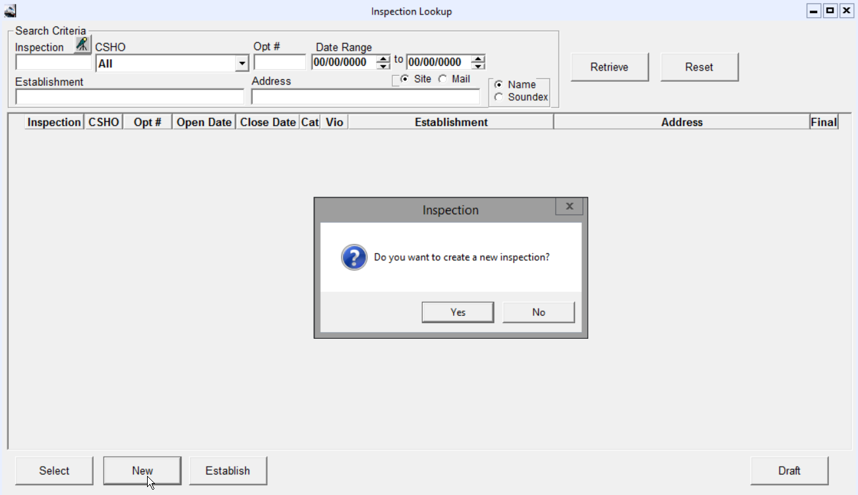

Click on New at the bottom of the lookup screen. Choose YES when the Question block appears.

Slide 5
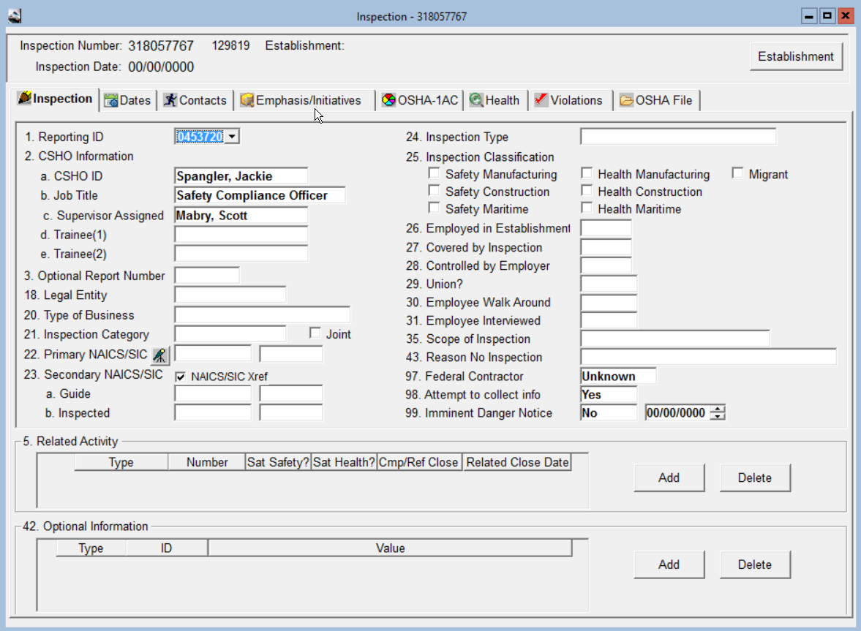


The inspection will be assigned a unique 9 digit OSHNC number with a unique 6 digit Activity number. The activity number is the ID that will transfer to the OIS (Federal System). The (1) Reporting ID will also be a unique 6 digit number pre-assigned based on your location, NEVER change this. Your CSHO ID, Job Title and Supervisor Assigned will also prefill.
OSH NC at this time does not use 97,98 and 99. Those are prefilled for you.

Slide 6
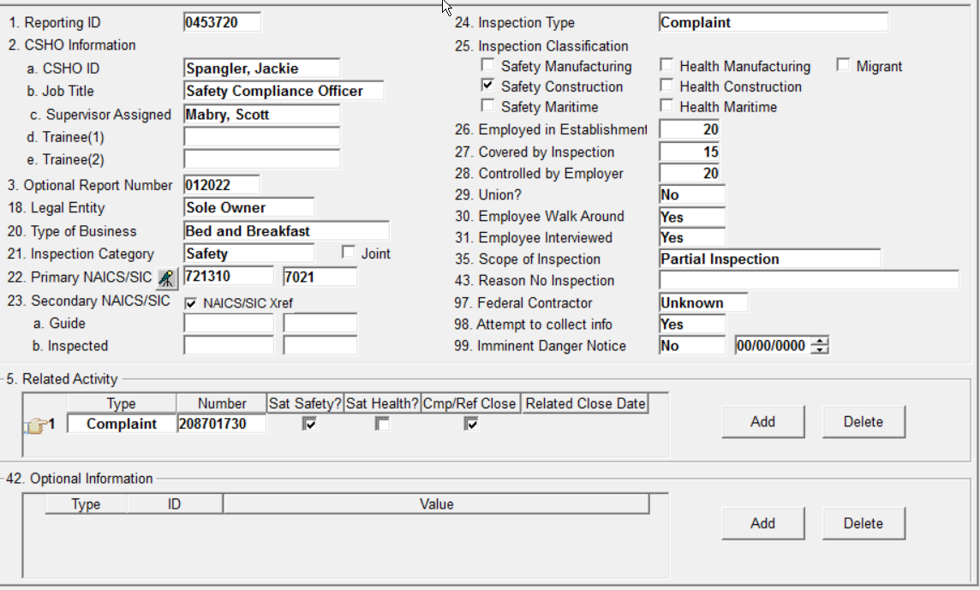

Once you have created the inspection you will then begin the process of filling out the OSHA1. For this training module your Inspection Type (24) will be “Complaint” that you will choose from the drop down box. Once you choose Complaint you will notice that the Related Activity Box (5) will prefill with the (1)Type “Complaint”, this is where you will place the complaint number. You will also satisfy the complaint and close it in this block. There will be occasions where the associated complaint will be used more than once if there are Temporary agencies, sub contractors etc. that are associated with the initial complaint (Unprogrammed Related), the Complaint/Referral will always be entered in the Related Activity box for these and it will ALWAYS have to be satisfied and closed in each one for Complaints and Referrals.

Slide 7
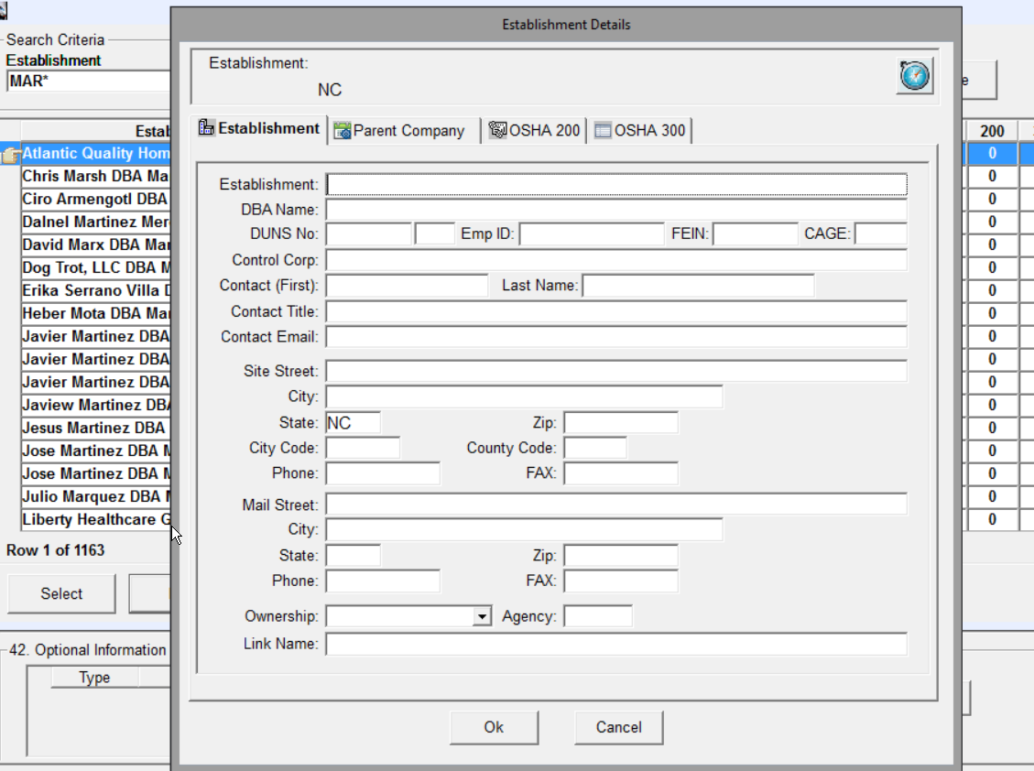
You will then enter the Establishment details. It is the practice of NCOSH to not “link” establishments in the OE unless you are 100% sure that no changes will be made to the Establishment details. Once you link an establishment any changes that you make will also change the prior establishment/inspection information. This can result in the new inspection being deleted and you will have to restart with a new inspection number. If you accidentally link an establishment and make change’s, please contact the OE System Administrator for direction.

Slide 8
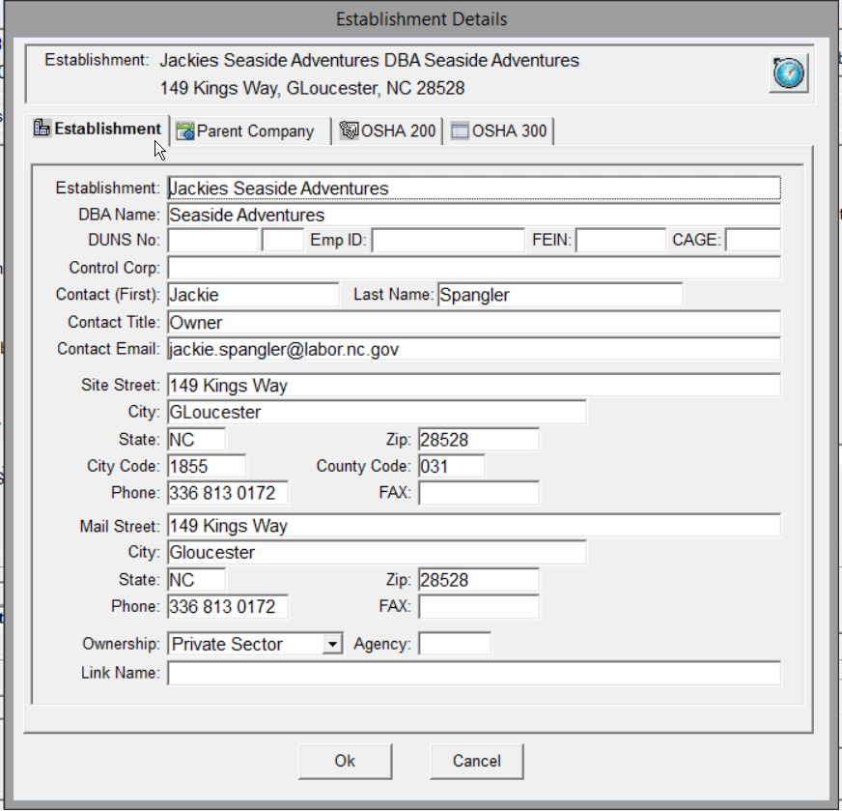
Completed Form This inspection had a DBA Site Street and Mail Street are the same

Slide 9
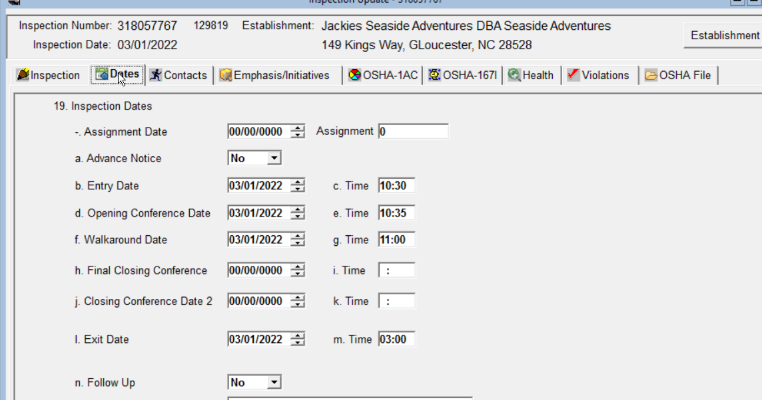

Slide 10
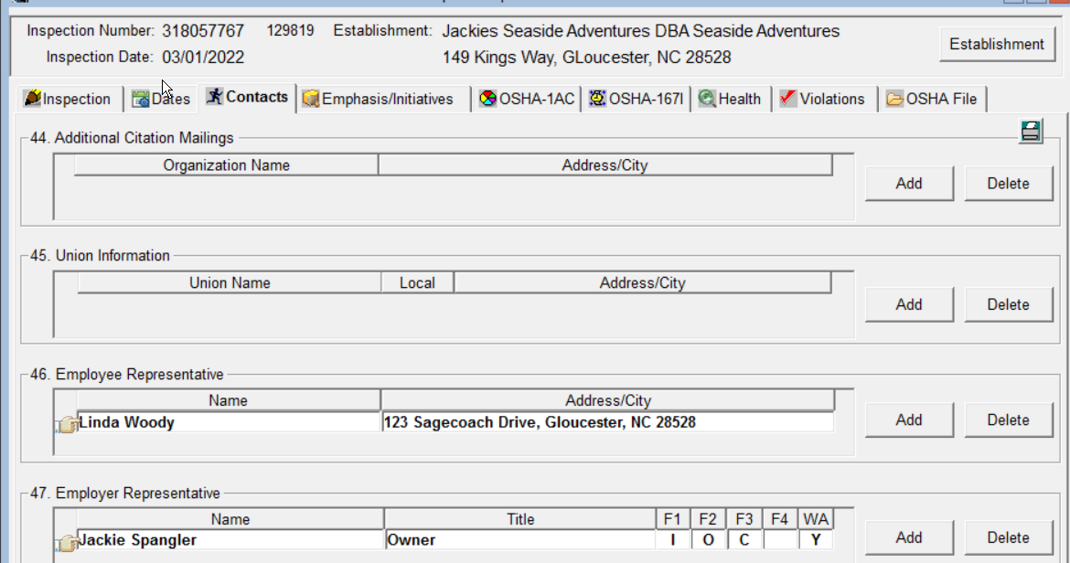

Slide 11
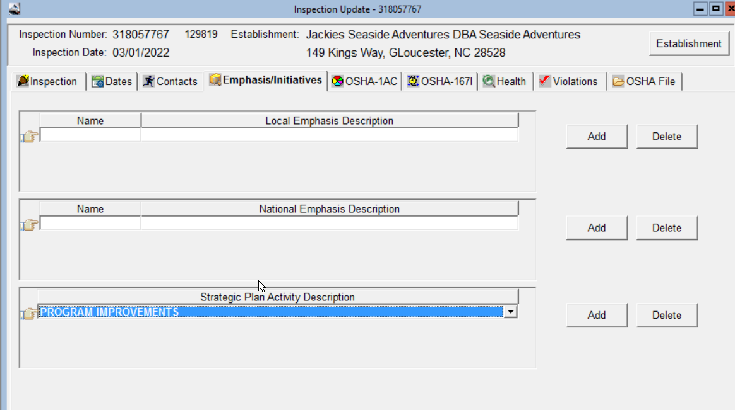

Slide 12
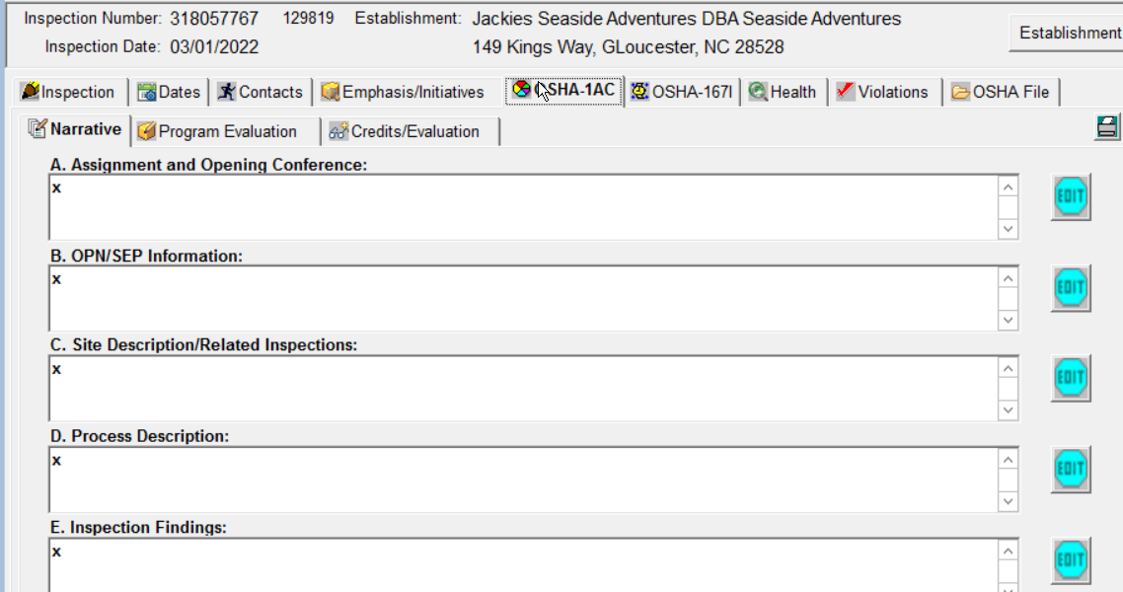

Slide 13
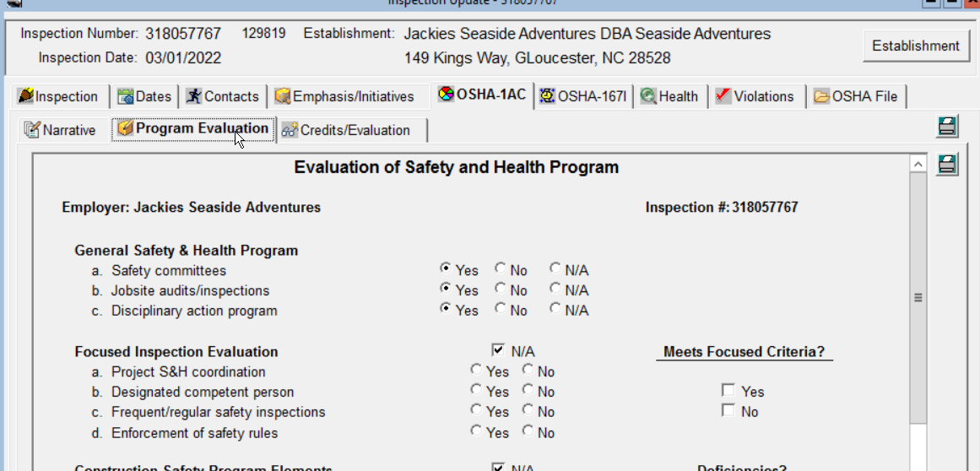

Slide 14
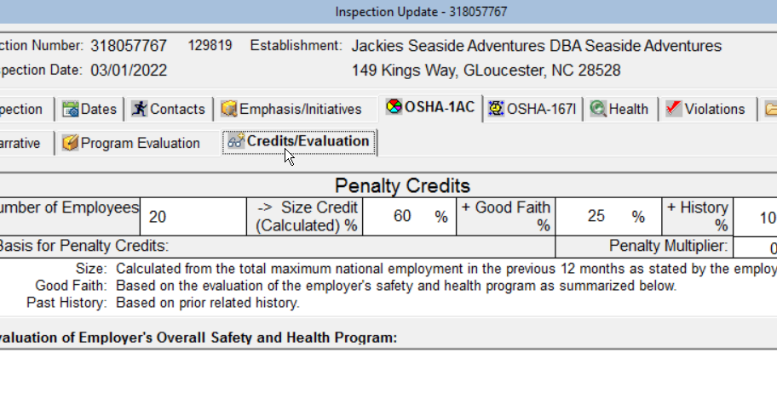

Slide 15
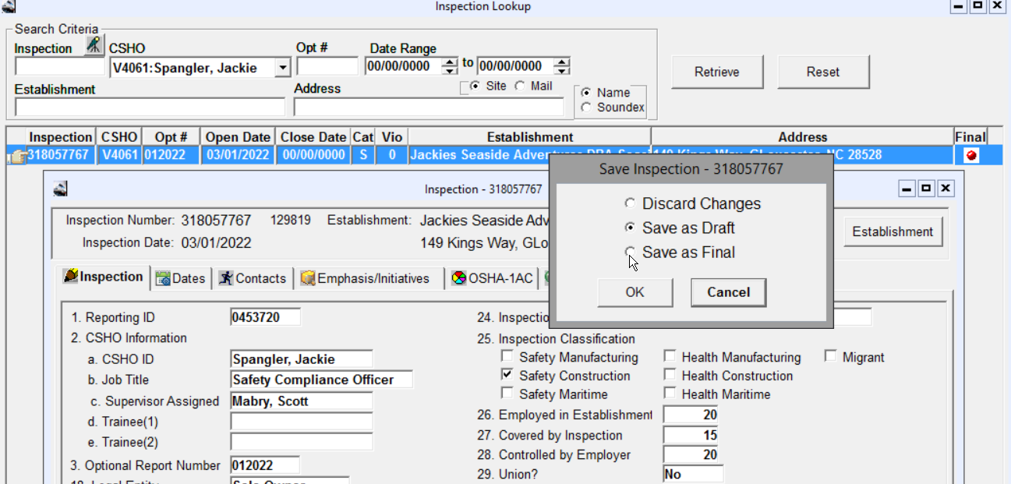

Slide 16
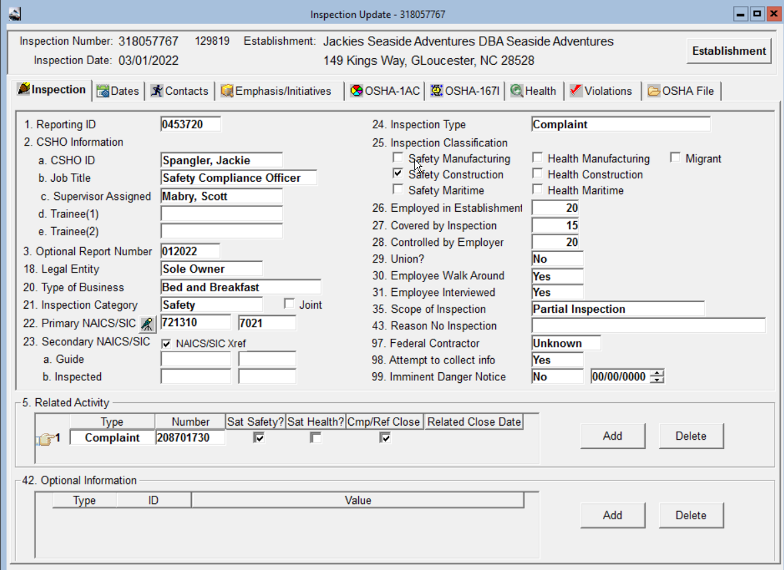

Slide 17
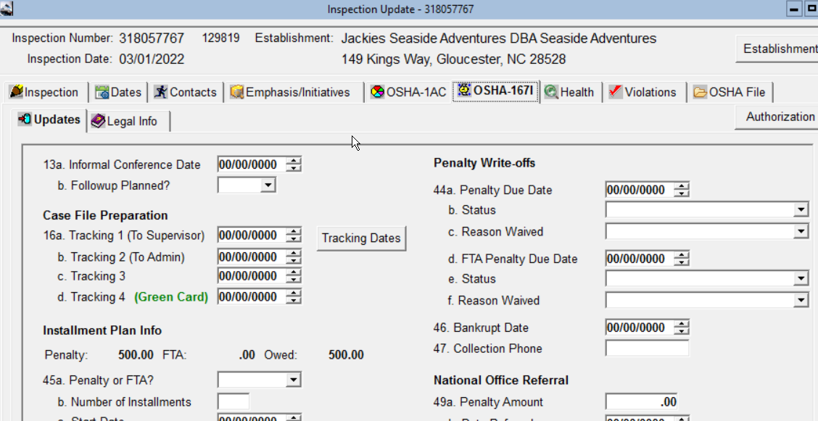

Slide 18
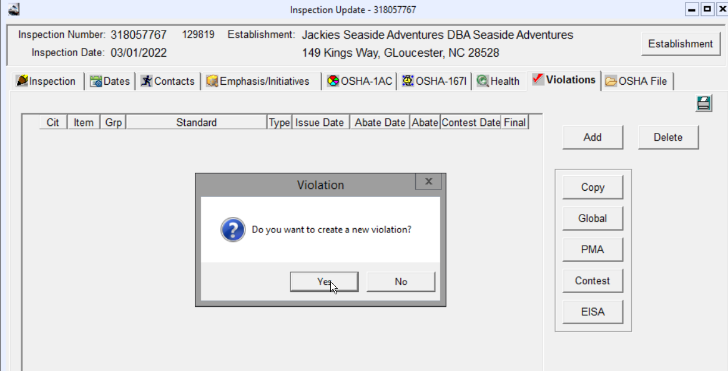

Slide 19
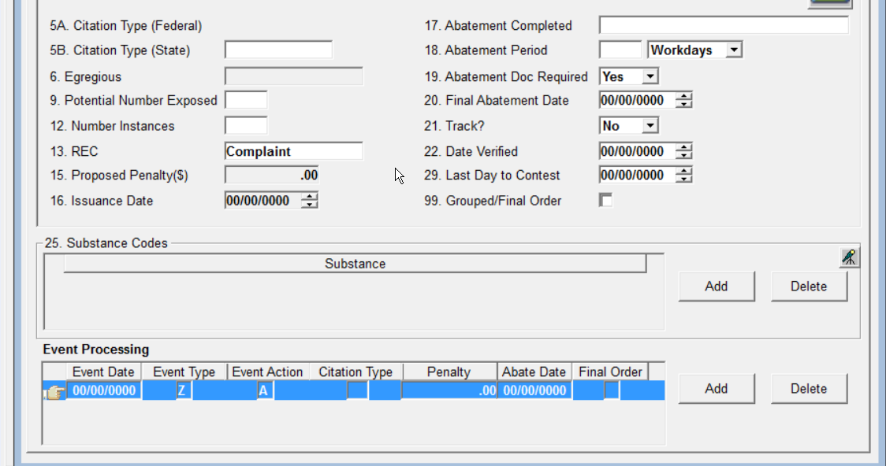

Slide 20
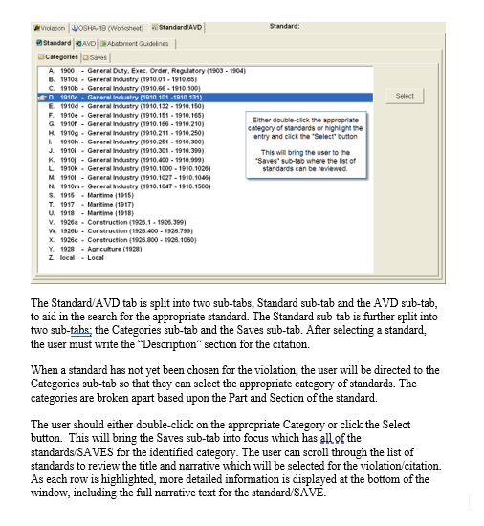
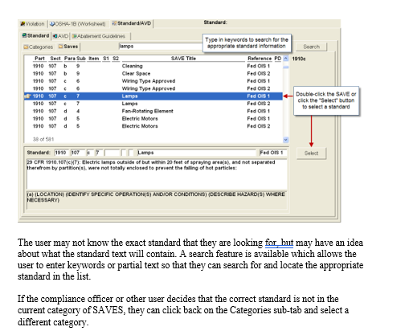

Slide 21
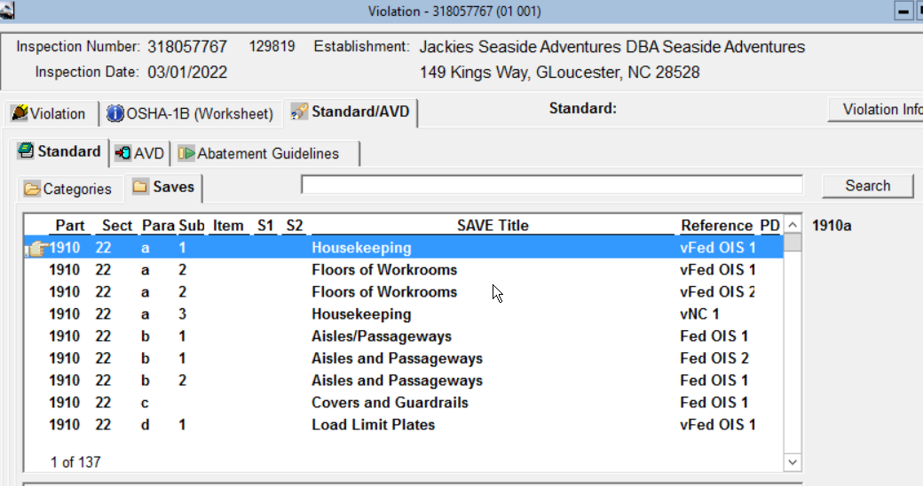

Slide 22
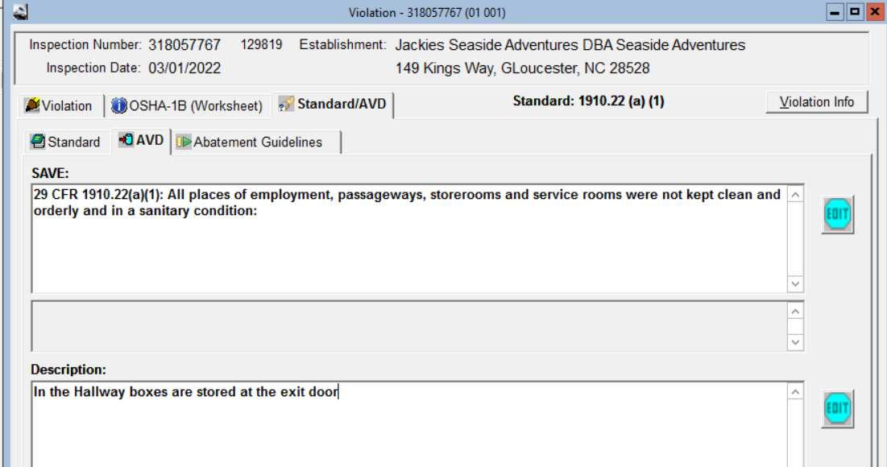

Slide 23
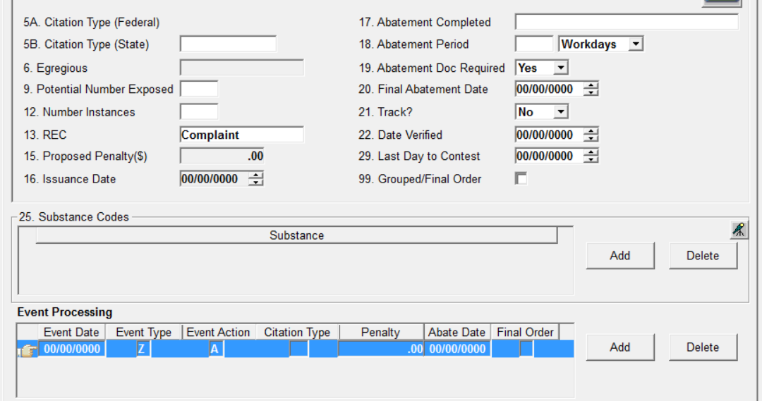

Slide 24
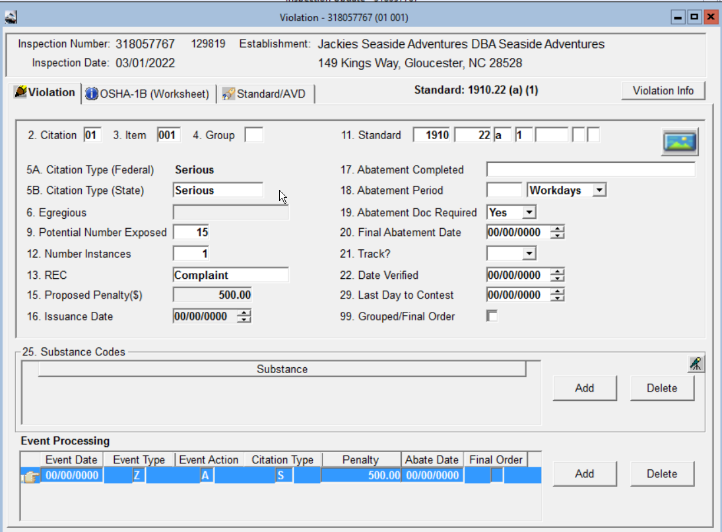

Slide 25
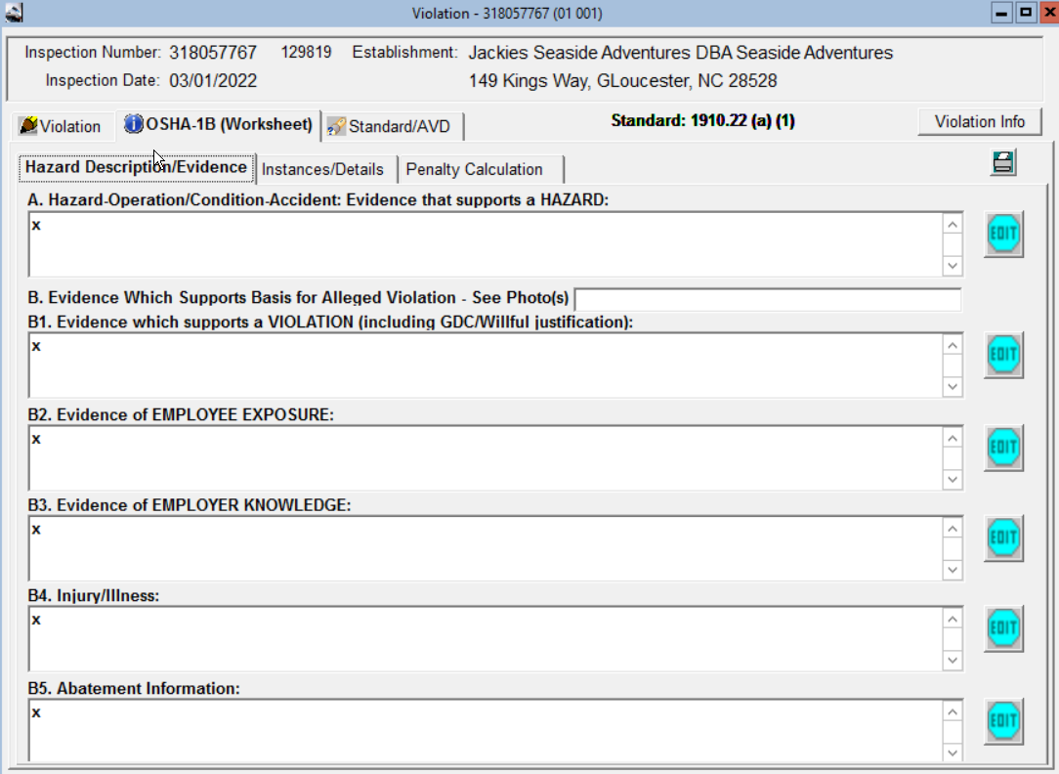

Slide 26
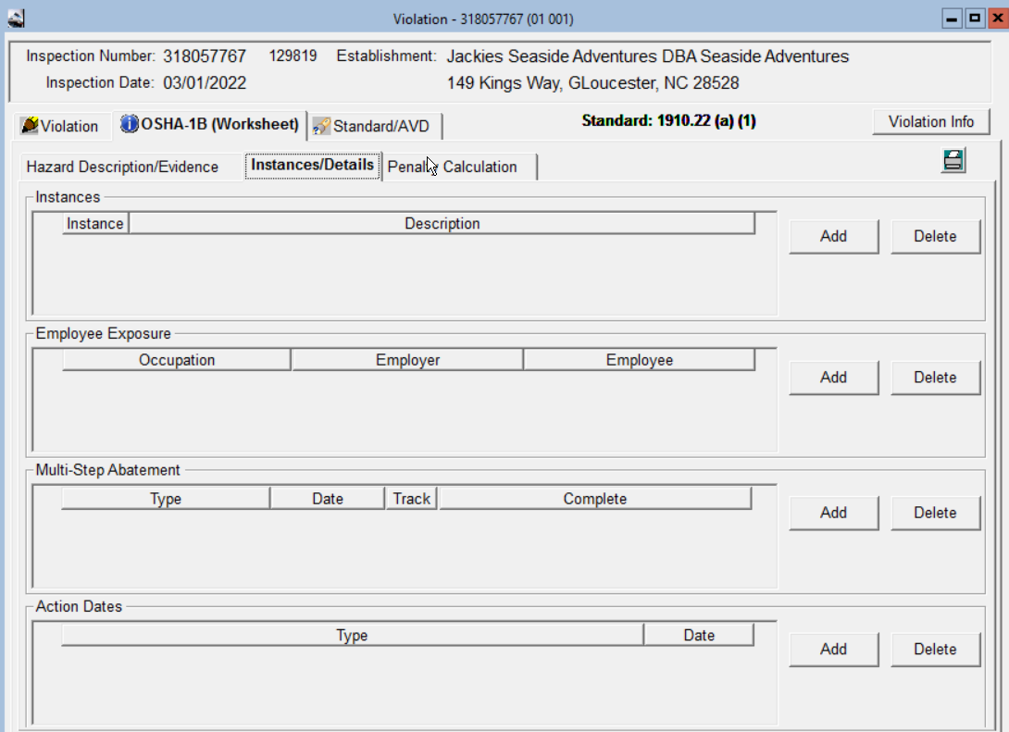

Slide 27
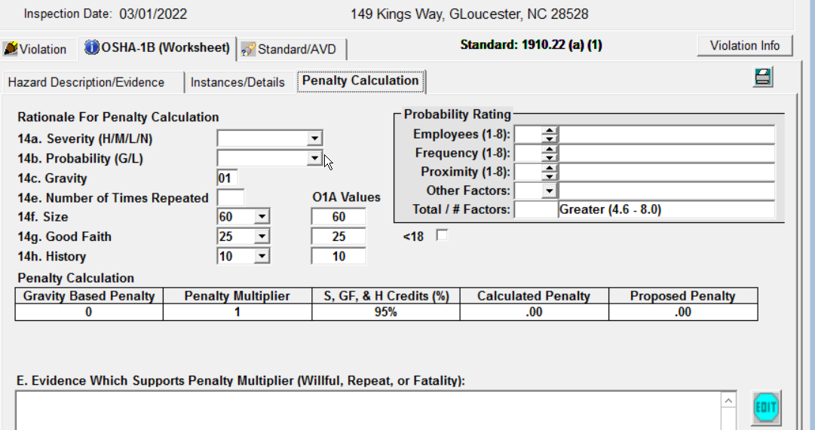

Slide 28
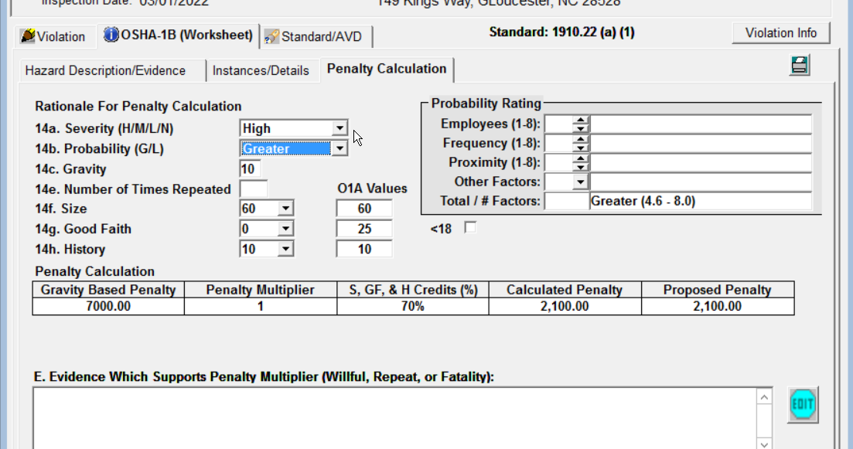

Slide 29
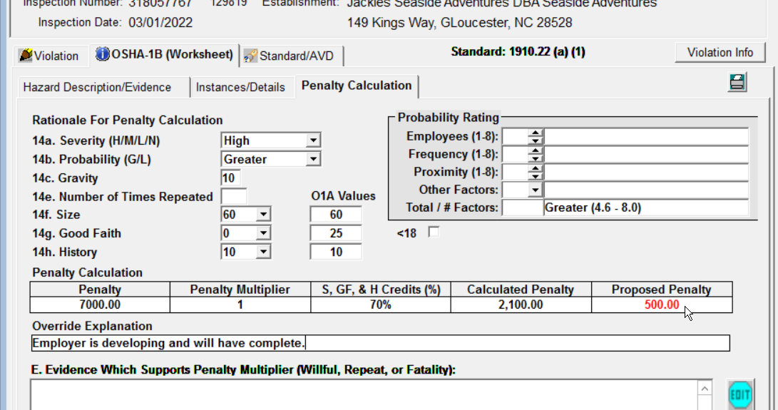

Slide 30
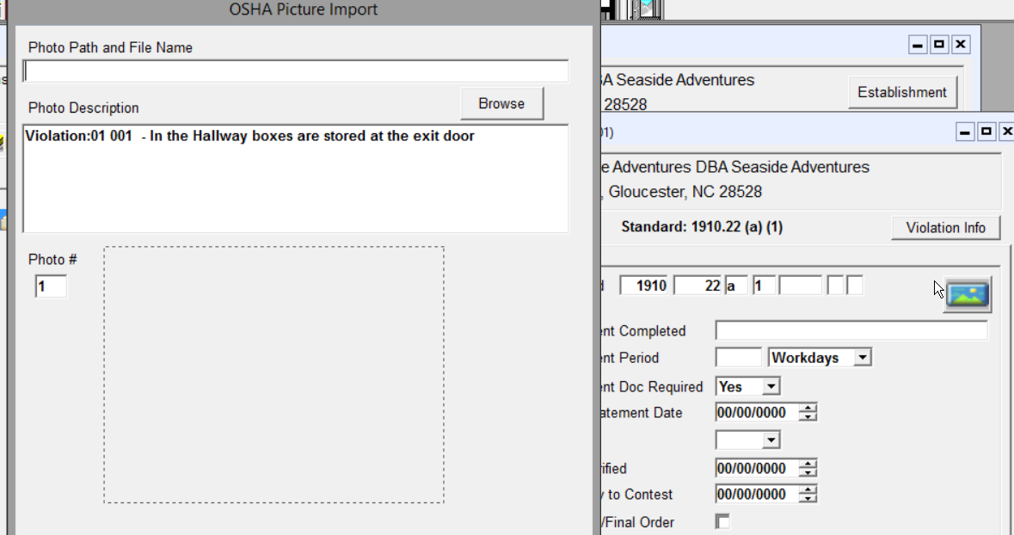

Slide 31
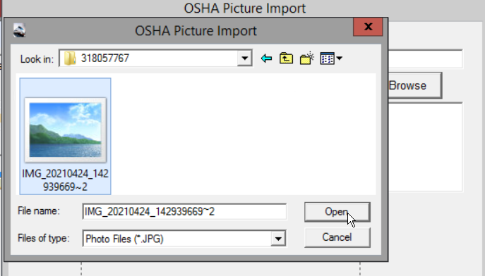

Slide 32
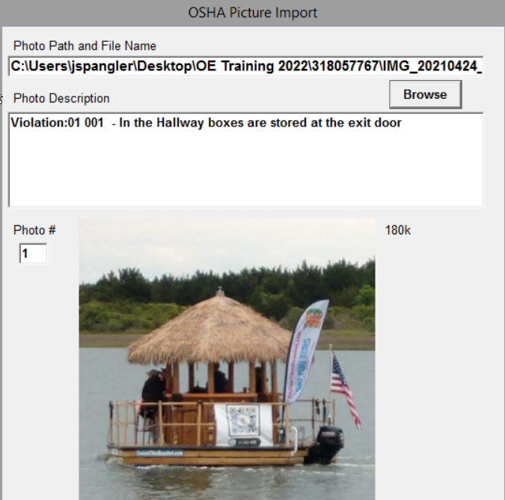

Slide 33
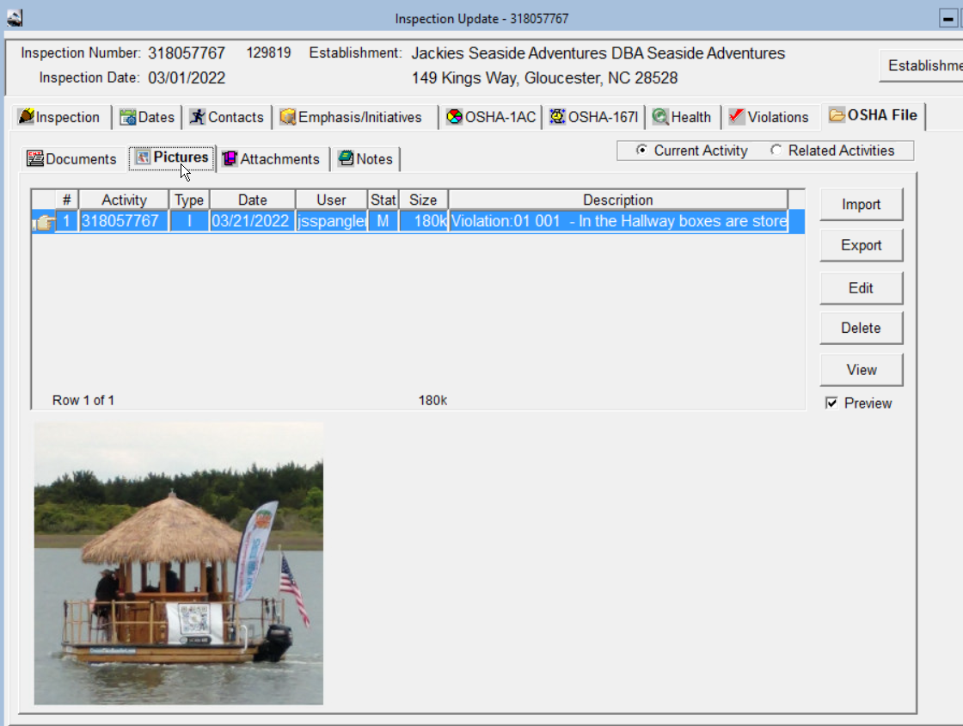

Slide 34
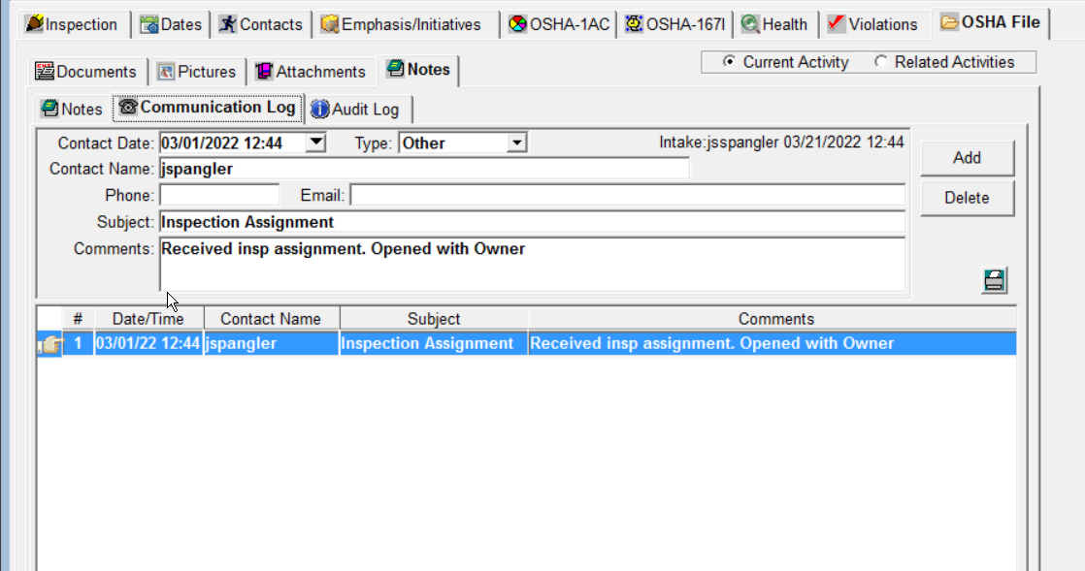

Slide 35
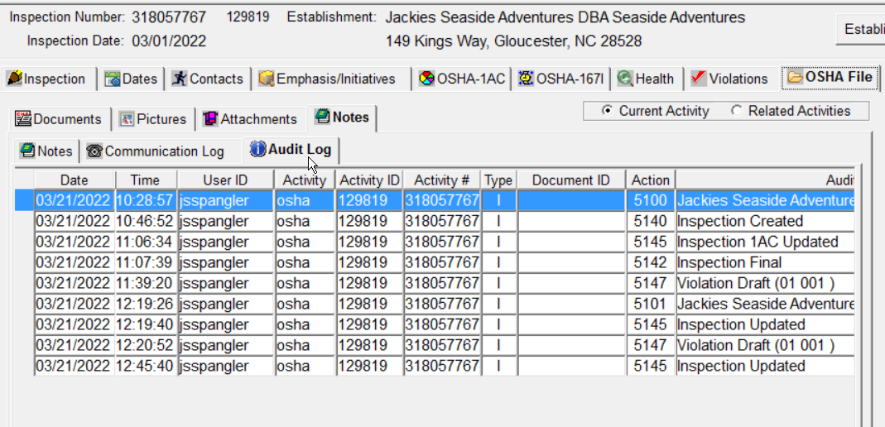

Slide 36
