Slide 1

OSHNC Updates
Five-Year Strategic Plan and Recruiting Efforts
Josh Dobson, Commissioner of Labor
State Advisory Council on Occupational Safety & Health
May 2, 2023
Presented by:
Paul M. Sullivan, CIH, CSP
Assistant Deputy Commissioner
NC Dept. of Labor/Occupational Safety & Health Division
Notes:
Created: March 2017
The information in this presentation is provided voluntarily by the N.C. Department of Labor, Education Training and Technical Assistance Bureau as a public service and is made available in good faith. This presentation is designed to assist trainers conducting OSHA outreach training for workers. Since workers are the target audience, this presentation emphasizes hazard identification, avoidance, and control – not standards. No attempt has been made to treat the topic exhaustively. It is essential that trainers tailor their presentations to the needs and understanding of their audience.
The information and advice provided on this Site and on Linked Sites is provided solely on the basis that users will be responsible for making their own assessment of the matters discussed herein and are advised to verify all relevant representations, statements, and information.
This presentation is not a substitute for any of the provisions of the Occupational Safety and Health Act of North Carolina or for any standards issued by the N.C. Department of Labor. Mention of trade names, commercial products, or organizations does not imply endorsement by the N.C. Department of Labor.

Slide 2
OSH Division Strategic Management Plan
Background. The Strategic Management Plan is a document utilized by the North Carolina Occupational Safety and Health (OSH) Division to provide guidance for allocating the division's limited resources in pursuit of established outcome goals. The strategic management planning process is designed to develop a five-year document that will best address the division goals of reducing injury and illness rates and the number of workplace fatalitjes in North Carolina.

Slide 3
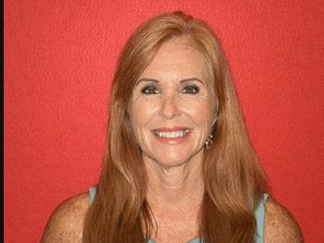
Strategic Plan Shout-Out
Sincere thanks to Targeting System Administrator Karen Padgett, who retired May 1, 2023, after 35.92 years of service to the State of NC.
Her outstanding work on the Strategic Plan, assignment targeting system, and OFIR report were invaluable to the OSHNC program and our efforts to ensure the safety and health of NC workers.
She will be missed!

Slide 4
Inspection Numbers FY18-22
Total Inspections: 11,651
Unprogrammed (Reactive) Inspections: 5344 (45.9%)
  Fatalities: 329 (2.8%)
  Complaints: 2442 (21%)
  ER Reported Referrals: 454 (3.9%)
  Referrals: 673 (5.8%)
  Follow-ups 394 (3.4%)
  Unprogrammed Related: 1034 (8.9%)
Programmed (Proactive) Inspections: 6305 (54.1%).
  FY2022 had only 973 programmed inspections (49.7%).

Slide 5
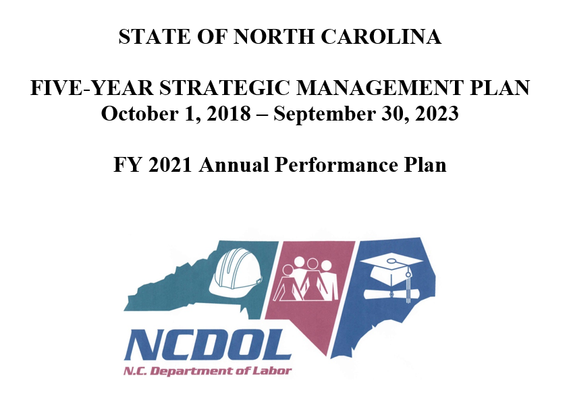

Slide 6
Outcome Goals (FY 19-23)

Slide 7
NCGS 95-136.1 – SEPs
The Department shall develop and implement a special emphasis inspection program that targets for special emphasis inspection employers who:
(1) Have a high rate of serious or willful violations of any standard, rule, order, or other requirement under this Article, or of regulations prescribed pursuant to the Federal Occupational Safety and Health Act of 1970, in a one-year period;
(2) Have a high rate of work-related deaths, or a high rate of work-related serious injuries or illnesses, in a one-year period; or
(3) Are engaged in a type of industry determined by the Department to be at high risk for serious or fatal work-related injuries or illnesses.

Slide 8
Reduction in Fatalities

Slide 9
Injury/Illness Reductions

Slide 10
Injury/Illness Reductions

Slide 11
Strategic Plan…Planning
While the Strategic Plan is reviewed annually and elements could be dropped or switched into a maintenance mode, a more detailed planning meeting is conducted prior to the next five-year cycle.
The meeting for the FY24-28 Strategic Plan was held on March 24, 2023, in Raleigh.
  Included all OSH upper management as well as the SEP team leaders.
  Looked closely at inspection data as well as National and NC DART rates.
  Made recommendations for the next five-year period.
  Inspection number goals are set year-by-year.

Slide 12
Inspection Data: FY18-22
The data shows how we find far more serious hazards/violations on programmed (proactive) vs. unprogrammed (reactive) inspections.

Slide 13
Construction & Tree Felling

Slide 14
Grocery & Long-Term Care SEPs

Slide 15
Health Hazards, Food, & Amputations

Slide 16
We Look at DART Rates

Slide 18
Decisions for FY24-28 Strategic Plan
Fatality Reduction
  1.1 Construction
  1.2 Logging/Arboriculture (Tree Felling)
Injury/Illness Reduction
  2.1 Grocery & Product Merchant Wholesalers
  2.2 Long-Term Care
  2.3 Health Hazards
  2.4 Food Manufacturing
  2.5 Amputations
✓
✓
?
✓
✓
✓
✓

Slide 19
Grocery & Product Merchant Wholesalers
DART rate is still relatively high, at 3.2 in NC and 4.0 for the US. The overall private sector rate is 1.3 for NC and 1.7 for the US.
While we’re finding less serious hazards on average than other programmed planned assignments, the hazards tend to be high gravity, such as those involving forklifts. There were also two fatalities in this NAICS code.
We decided to keep this industry in the FY24-28 Strategic Plan – and are adding Warehousing and Storage to it…due to the high DART rate (4.6) and hazard similarities.

Slide 20
Decisions for FY24-28 Strategic Plan
Fatality Reduction
  1.1 Construction
  1.2 Logging/Arboriculture (Tree Felling)
Injury/Illness Reduction
  2.1 Grocery & Product Merchant Wholesalers
  2.2 Long-Term Care
  2.3 Health Hazards
  2.4 Food Manufacturing
  2.5 Amputations
✓
✓
?
✓
✓
✓
✓

Slide 21
Decisions for FY24-28 Strategic Plan
Fatality Reduction
  1.1 Construction
  1.2 Logging/Arboriculture (Tree Felling)
Injury/Illness Reduction
  2.1 Grocery & Product Merchant Wholesalers
  2.2 Long-Term Care
  2.3 Health Hazards
  2.4 Food Manufacturing
  2.5 Amputations
✓
✓
✓
+
✓
✓
✓
✓

Slide 22
Recruitment Update
In Q2 of FY2022, 28 out of 95 CSHO positions in East and West Compliance (29.5%) were vacant.
In Q2 of FY2023, several CSHO positions were advertised as trainees. No experience is required…just an applicable four-year degree, excellent verbal and written communication skills, and a sincere interest in the job.

Slide 23
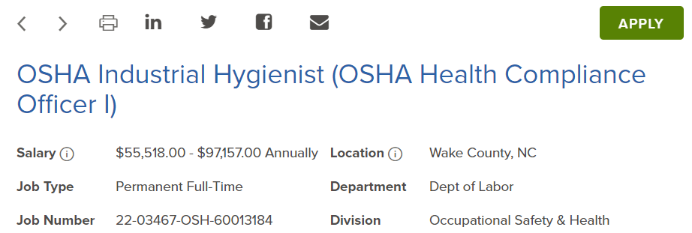
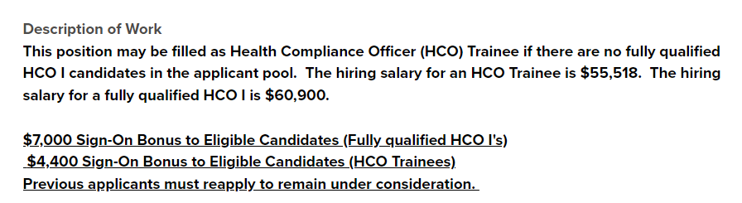
Industrial Hygiene Trainees

Slide 24


Safety Officer Trainees

Slide 25
So…how’s it going?
We’re moving in the right direction.
Trainee applicant pools are significantly better than the “fully qualified” pools from the past several years.
We’ve hired 11 new CSHOs since January 1st, including two or three who have accepted but not yet started.
We still have 24 vacancies out of 95 positions (25.3%), so the work continues.

Slide 26
Questions?
Josh Dobson, Commissioner of Labor

