Slide 1

OSHNC Fatality Investigation
Lake Phelps Grain, Inc.
Josh Dobson, Commissioner of Labor
State Advisory Council on Occupational Safety & Health
May 2, 2023
Presented by:
Paul M. Sullivan, CIH, CSP
Assistant Deputy Commissioner
NC Dept. of Labor/Occupational Safety & Health Division
Notes:
Created: March 2017
The information in this presentation is provided voluntarily by the N.C. Department of Labor, Education Training and Technical Assistance Bureau as a public service and is made available in good faith. This presentation is designed to assist trainers conducting OSHA outreach training for workers. Since workers are the target audience, this presentation emphasizes hazard identification, avoidance, and control – not standards. No attempt has been made to treat the topic exhaustively. It is essential that trainers tailor their presentations to the needs and understanding of their audience.
The information and advice provided on this Site and on Linked Sites is provided solely on the basis that users will be responsible for making their own assessment of the matters discussed herein and are advised to verify all relevant representations, statements, and information.
This presentation is not a substitute for any of the provisions of the Occupational Safety and Health Act of North Carolina or for any standards issued by the N.C. Department of Labor. Mention of trade names, commercial products, or organizations does not imply endorsement by the N.C. Department of Labor.

Slide 2
Objectives
Understand the elements of this OSHNC fatality investigation:
  Accident details
  CSHO investigative activities
  Identifying possible violations/citations
  Post-citation activities
  Abatement activities

Slide 3
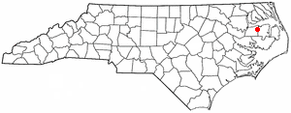
Fatality Event Details
The event occurred in July 2019 at Lake Phelps Grain, Inc. in Creswell, NC.
Elith Trinidad Sosa, a 49-year-old laborer, died when he entered grain bin #8 to prepare it for cleaning and was asphyxiated in corn that was 13-16 feet deep.
Creswell is located in Washington County, in the NC Inner Banks. The population in 2020 was 207.

Slide 4
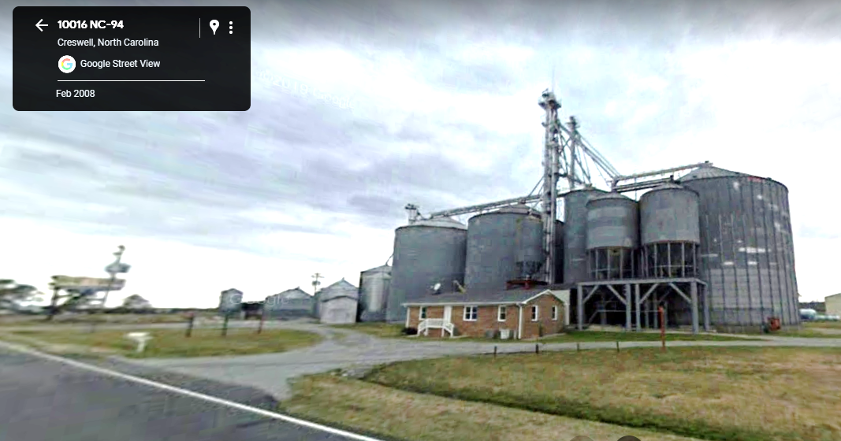
Street View

Slide 5
Site/Process Description
The establishment sits on three acres.
The facility is not a farm but falls under NAICS code 424510 for Grain and Field Bean Merchant Wholesalers.
They purchase and receive grains, including corn, soybeans and wheat, which are stored in one of 11 grain bins until purchased by customers.
  The grain arrives by truck and is unloaded over a pit.
  A system of bucket elevators and augers is used to transport the grain throughout the facility.

Slide 6
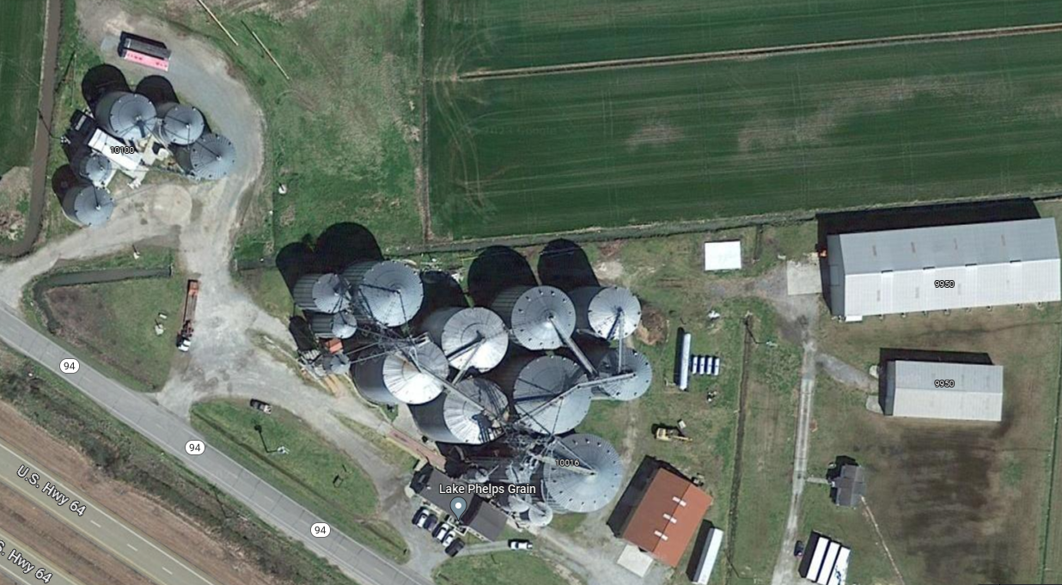
Aerial View

Slide 7
Site/Process Description
When the grain is sold, it is removed from the bottom of the bin through holes that lead to an auger. This is mainly done by gravity.
When the bins are at levels low enough that gravity alone cannot empty them, an employee will enter the bin to set a sweep auger in place to aid the flow of grain.

Slide 8
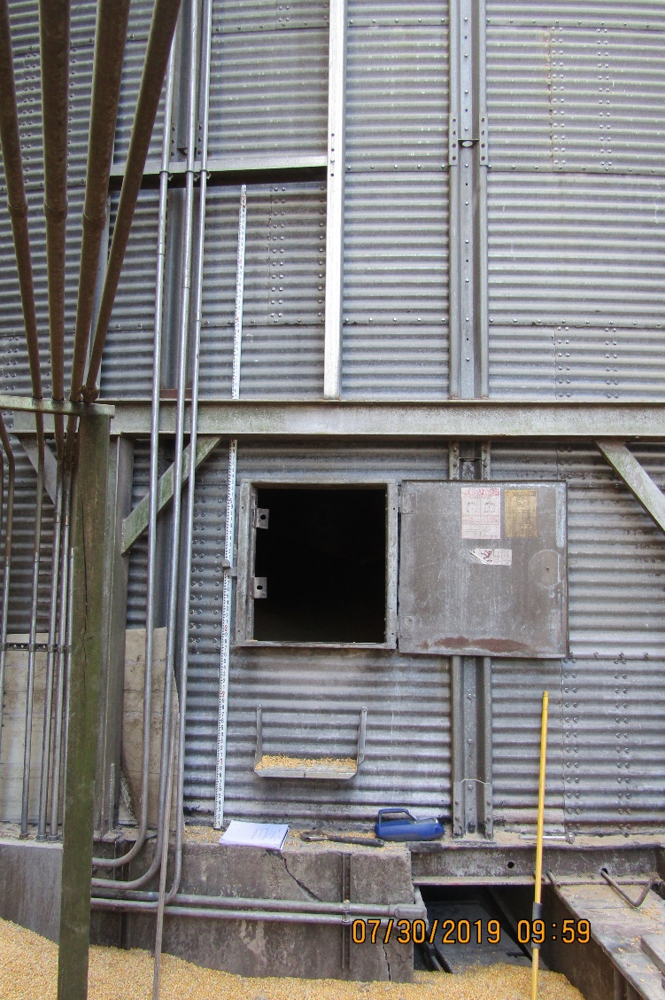
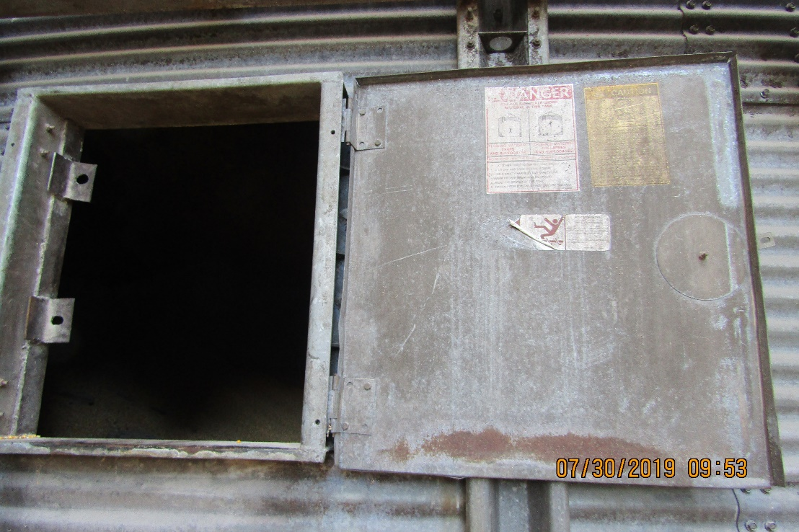
Entry Point into the Bin

Slide 9
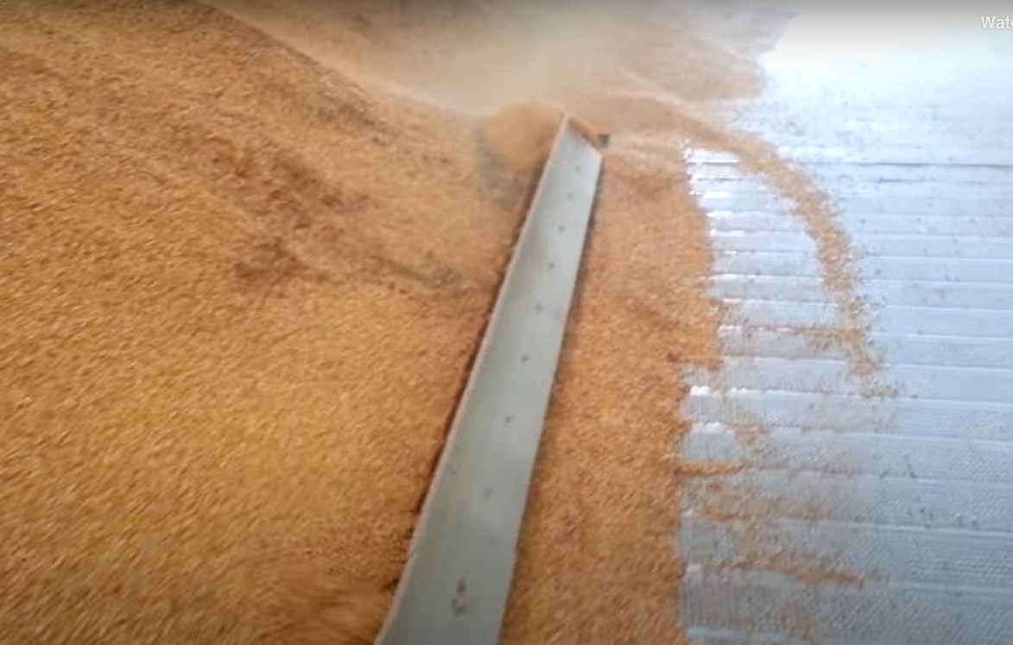
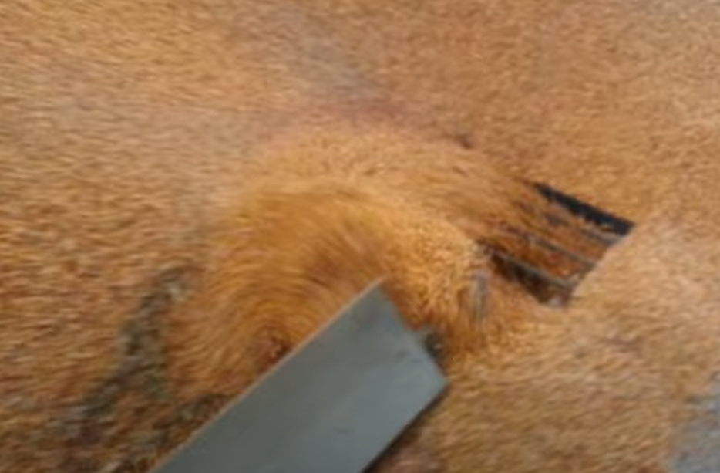
Sweep Auger Example

Slide 10
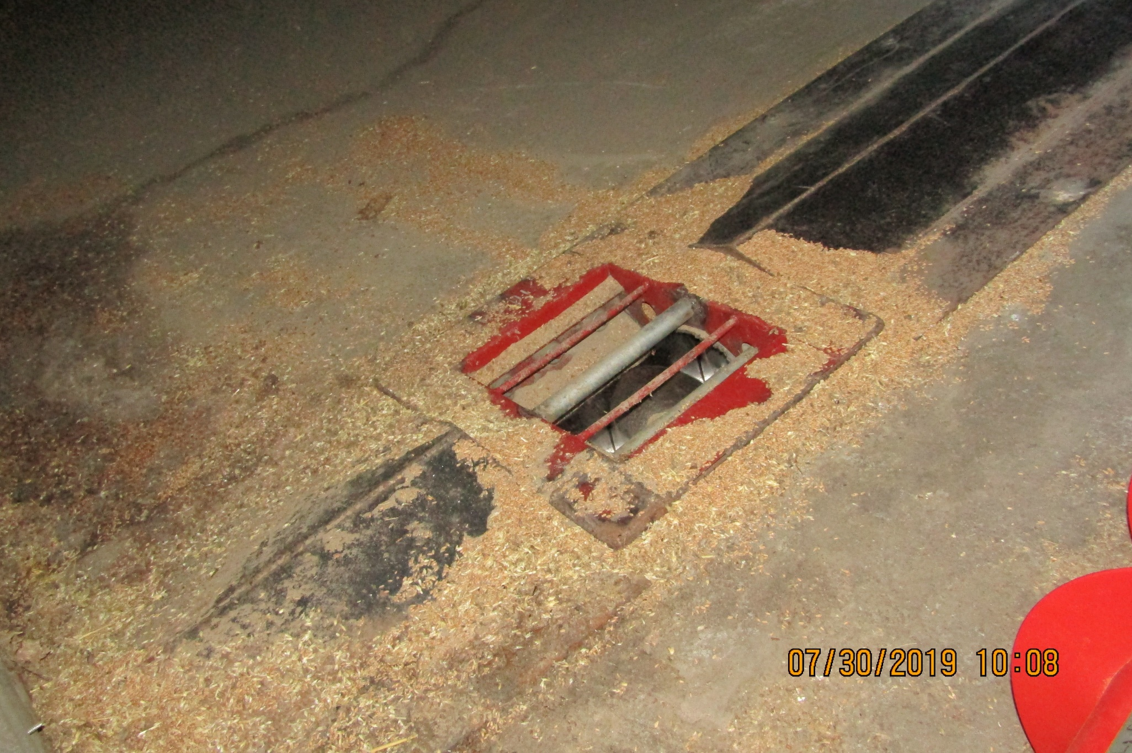
Reclaim Auger Underneath Bin Floor

Slide 11
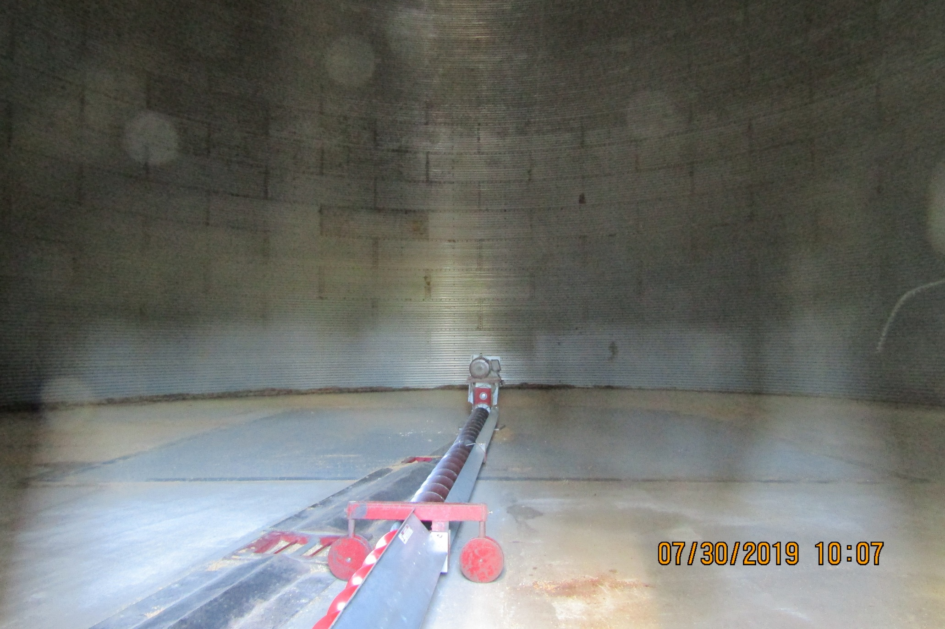
Empty Bin & Sweep Auger

Slide 12
Event Details
On July 29, 2019, at approximately 9:30 AM, three (3) employees were preparing to clean corn from a grain bin.
After opening holes in the floor of the bin using levers located outside, Employee #1 (Mr. Sosa) entered the bin from a hatch located two feet, seven inches from the floor of the bin. Employee #1 was preparing to start the sweep auger and was ensuring the holes were clear so the corn could flow through to the conveyor located underneath the bin.
According to the employer, Employee #1 walked to the "center peak" of the corn, which is believed to have had a depth of thirteen feet. This is when Employee #1 became engulfed in the corn.
Employee #2 ran to inform office personnel that Employee #1 was trapped inside the bin. Employees #2 and #3, accompanied by a member of management, attempted to rescue Employee #1 while emergency response personnel were en route. Approximately ten minutes after the initial call to 911, emergency personnel, including members of the Grain Bin Rescue Team, arrived on-site. The body of Employee #1 was recovered at approximately 3:35 PM on July 29, 2019.

Slide 13
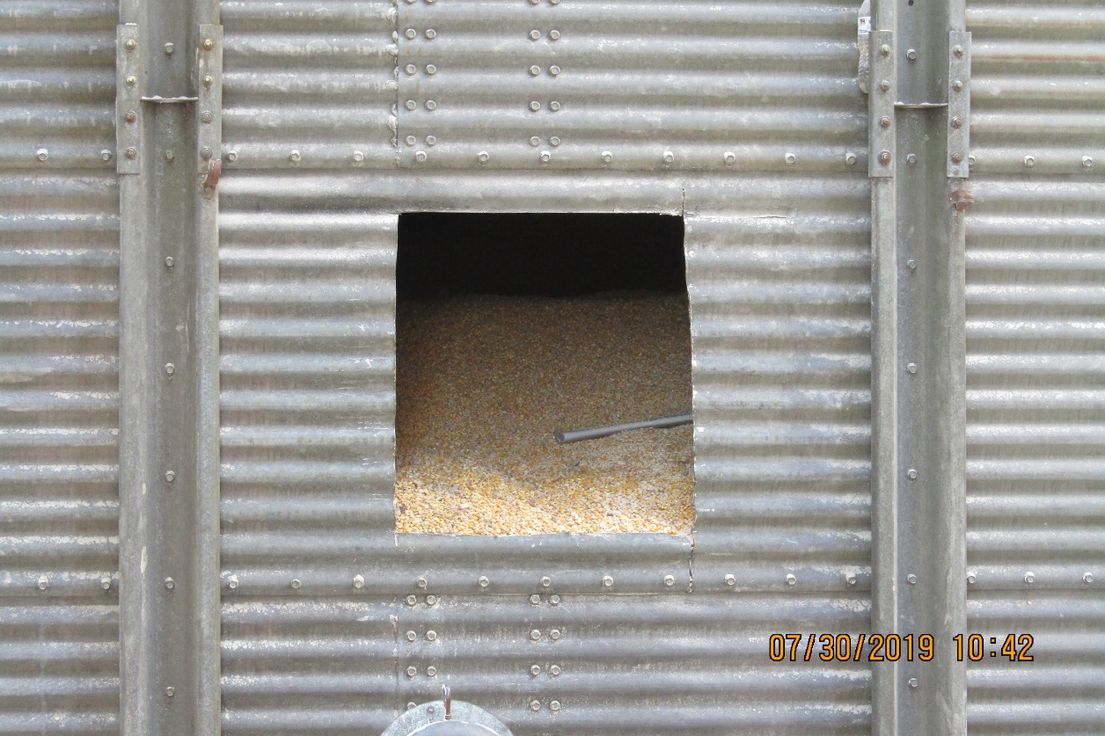
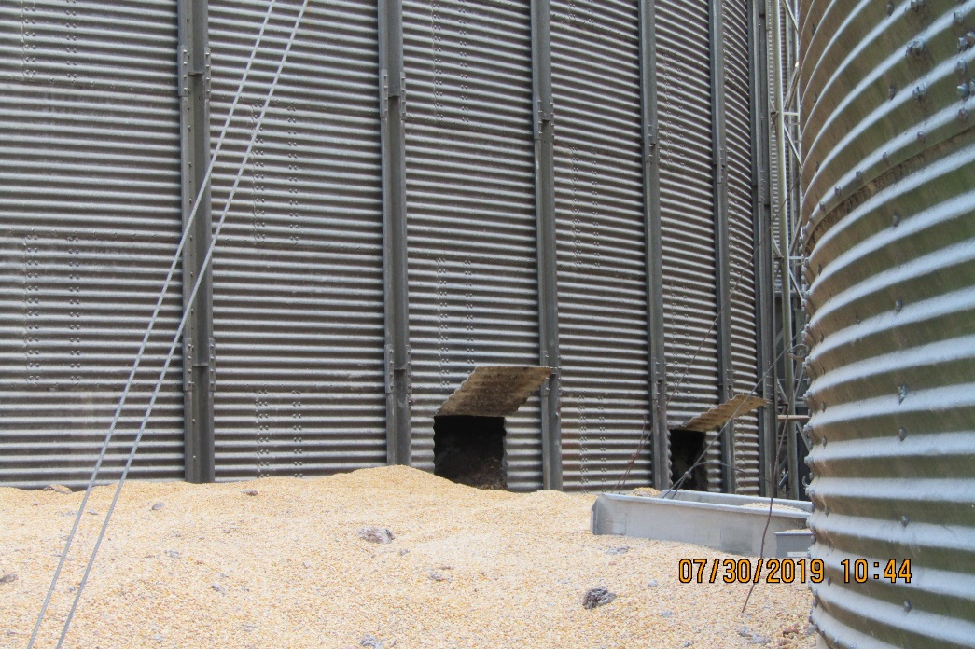
Holes Cut to Remove Grain

Slide 14
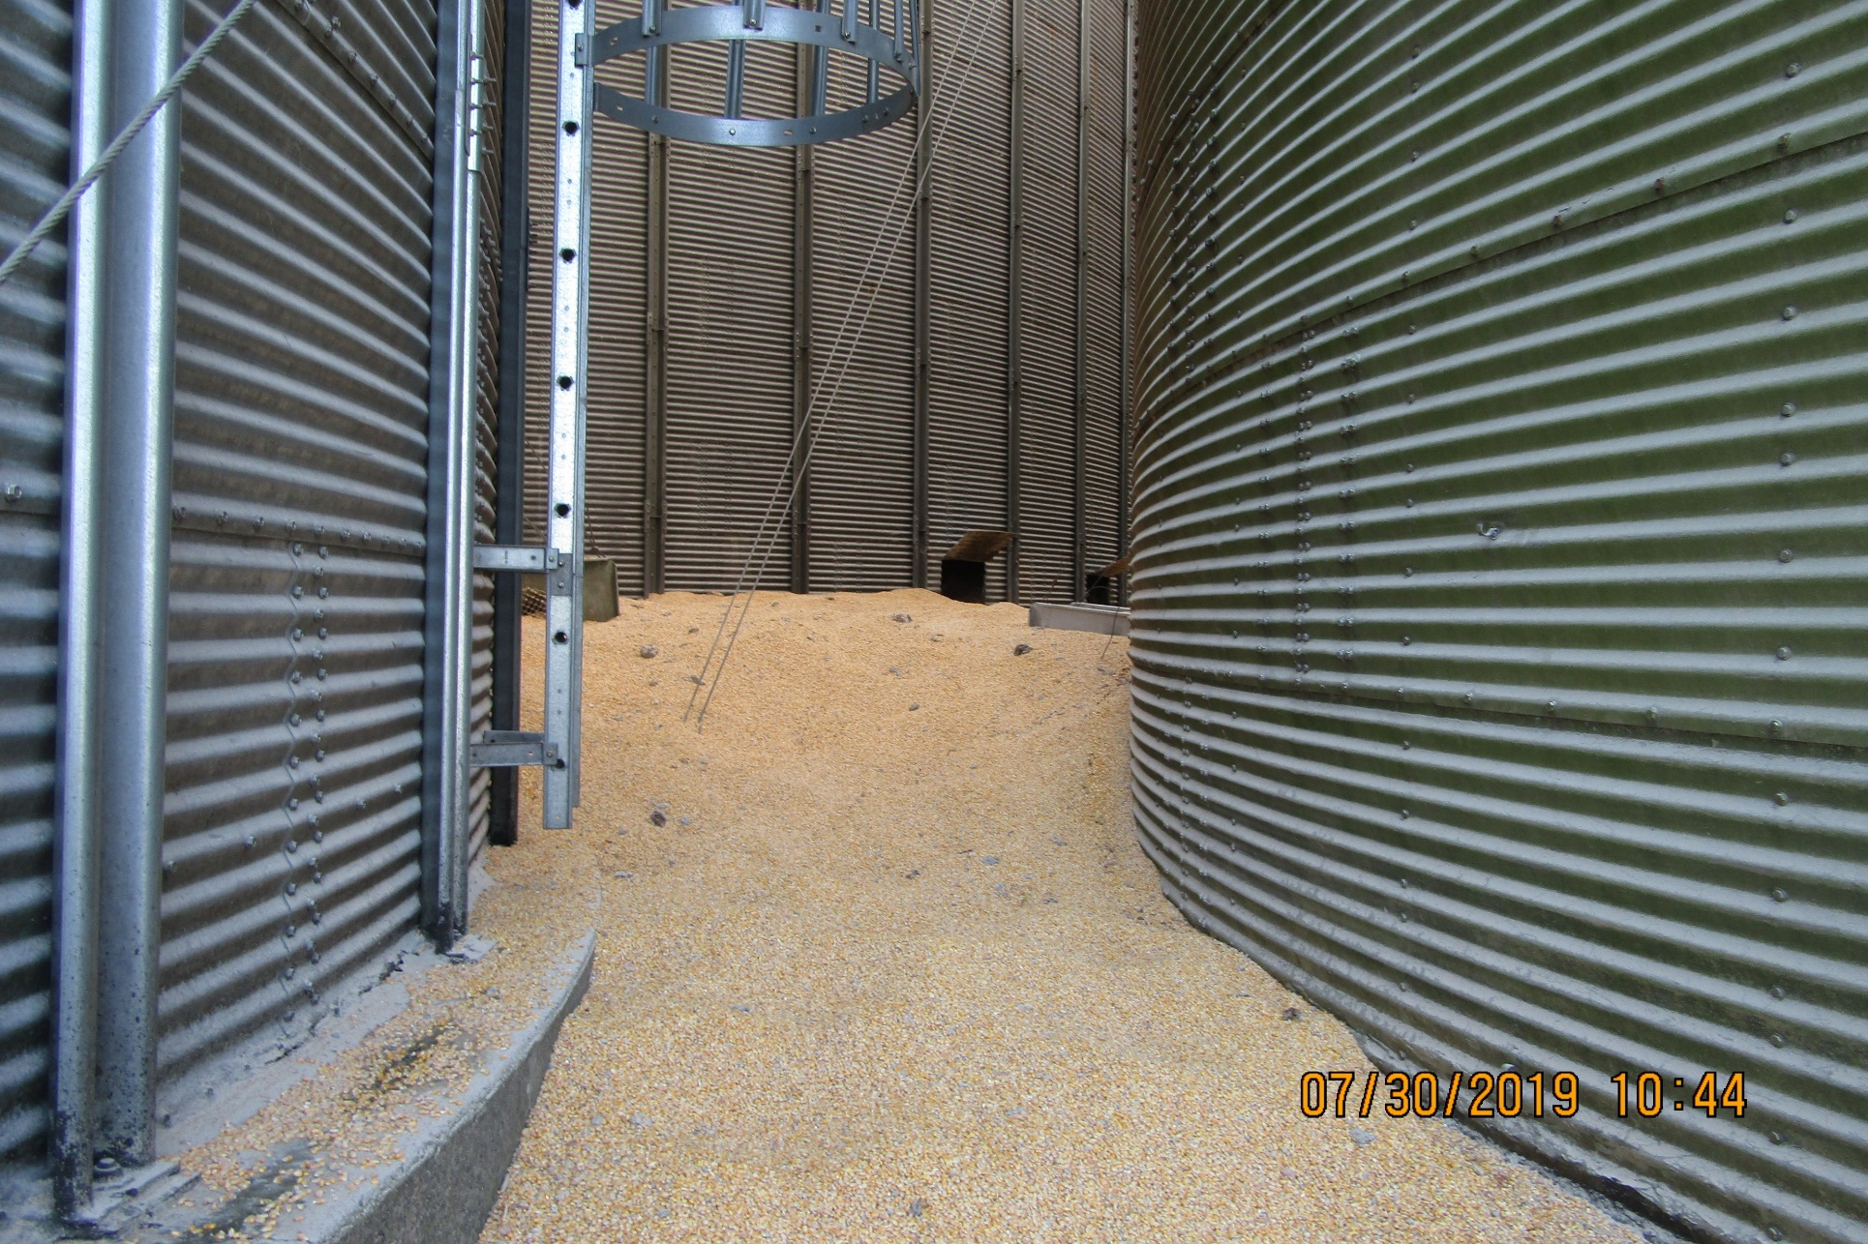
Significant Grain Removed

Slide 15
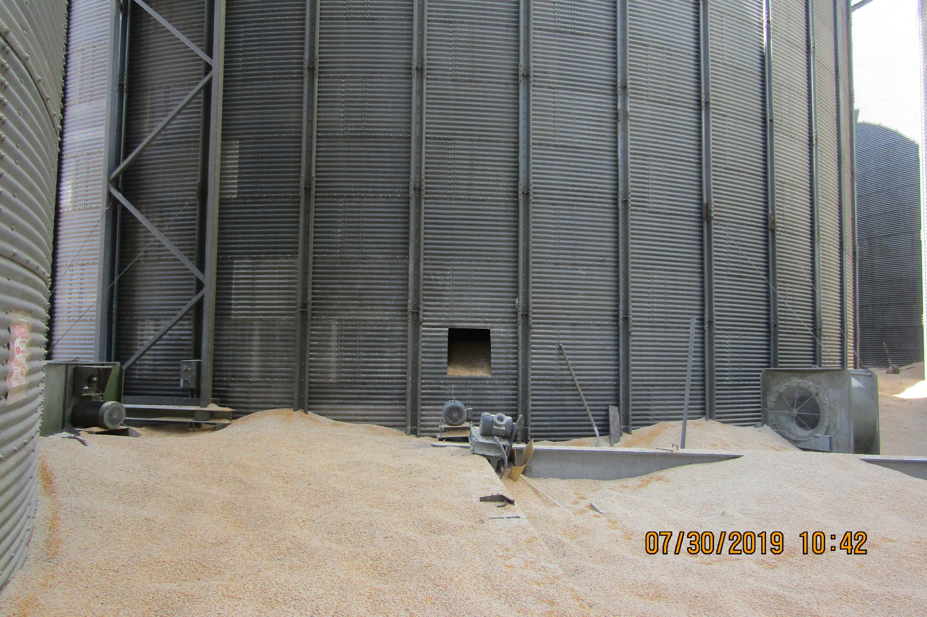
Significant Grain Removed

Slide 16
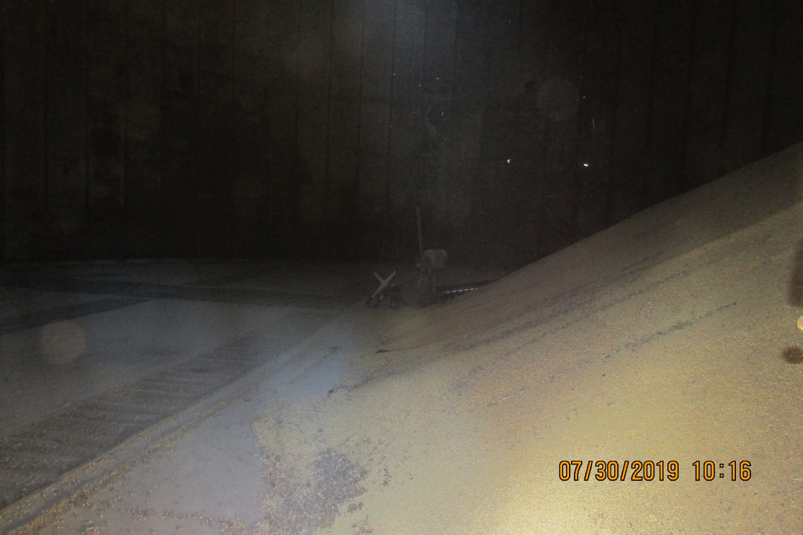
Inside View

Slide 17
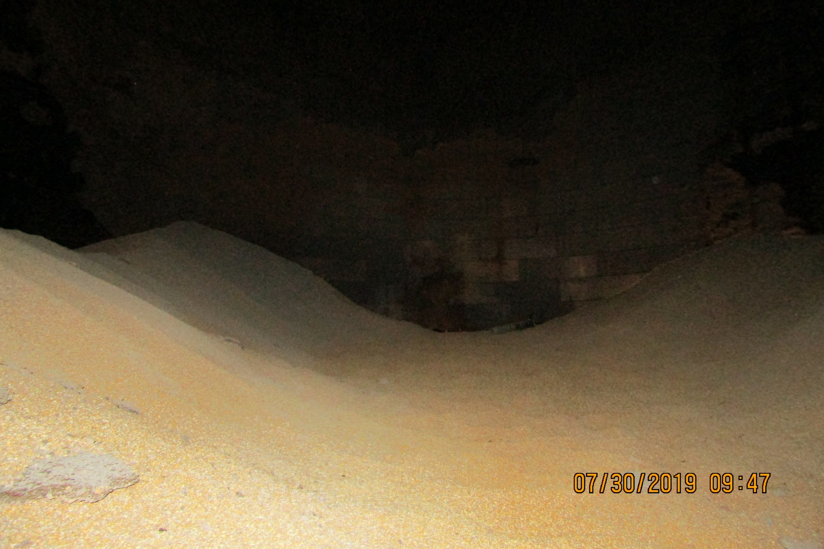
Inside View

Slide 18
Fatality Reporting Requirements
Basic requirement:
  1904.39(a)(1): Within eight (8) hours after the death of any employee as a result of a work-related incident, you must report the fatality to the Occupational Safety and Health Administration (OSHA), U.S. Department of Labor.

Slide 19
Notification in this Case
The Complaint Desk was notified by NCDOL Communications by email at 1319 of the WITN article. At the time, the article stated multiple agencies were responding to a rescue effort for a man trapped in a grain bin. The CSHO contacted the employer afterwards and was told that rescue efforts were still underway. The CSHO learned that evening, through a media report, that the employee had died, and his body was recovered.
While the employer didn’t report the event, our Field Operations Manual (FOM) specifies that no citations will be issued if we otherwise learn about the event during that eight-hour reporting window.

Slide 20
Fatality Investigation
The hazards of entering grain bins are certainly well known in the industry.
Grain being pulled out via the bottom auger creates a “quicksand-like” situation and engulfs the worker in seconds.
Source: OSHA Hazard Alert

Slide 24
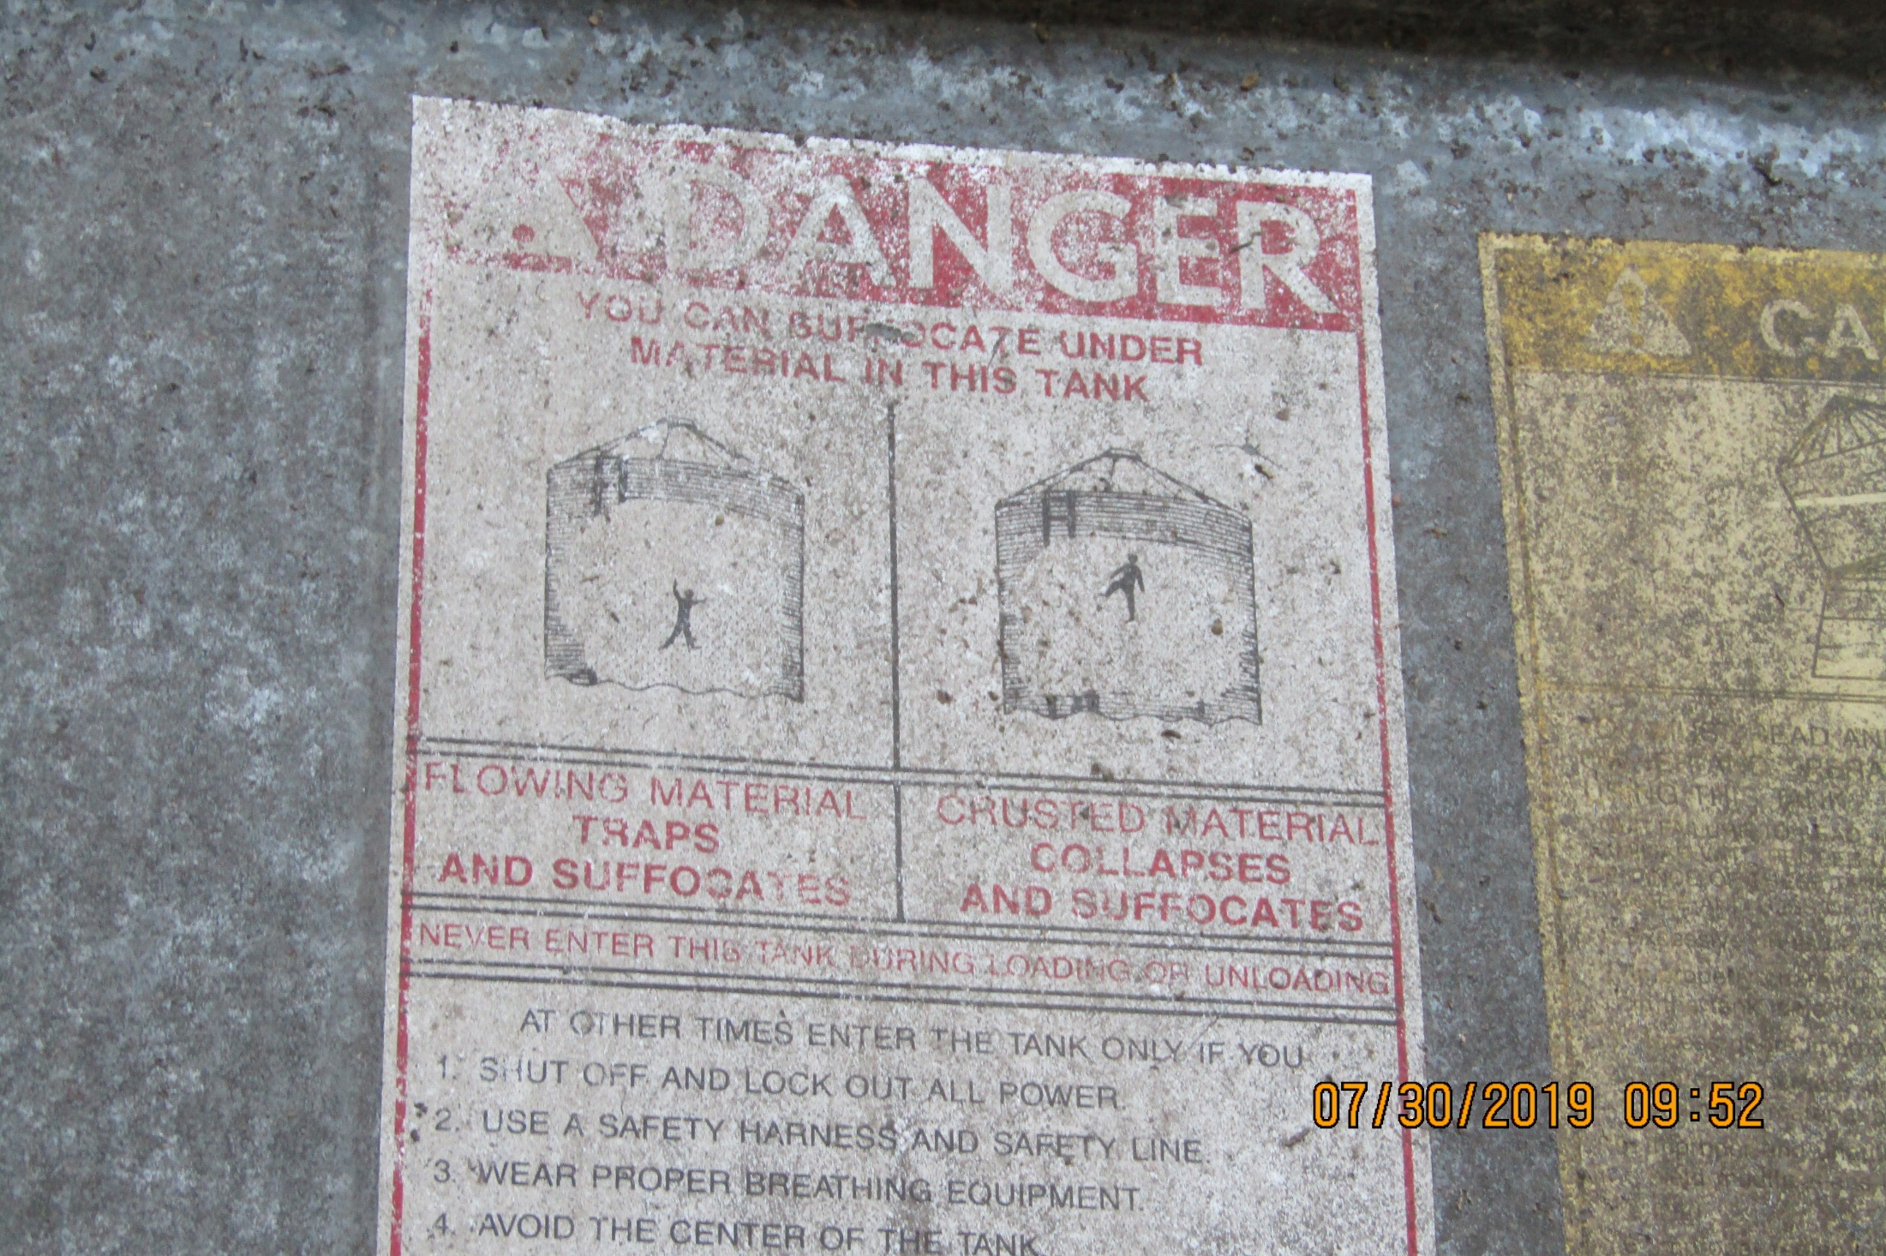

Slide 25

Permit-Required Confined Spaces
Addressed under 29 CFR 1910.146.
Must first be a confined space
  Able to enter & perform work
  Limited means of entry & egress
  Not designed for continuous occupancy
There must be an acute hazard for it to be a permit-required confined space.

Slide 26
Permit-Required Confined Spaces
In addition to the potential for a hazardous atmosphere (e.g., oxygen deficiency, acute chemical exposure, explosive dust/vapor), a hazard that causes a confined space to become a permit-required confined space is one that:
  “Contains a material that has the potential for engulfing an entrant.”

Slide 27
Requirements of 29 CFR 1910.146
Evaluation of spaces to determine if PRCS.
Notifying employees of any PRCS (such as with signs)
If entering a PRCS:
  Complete entry permit
  Air monitoring, ventilation
  Isolate/control hazards
  Attendant
  Training (entrant, attendant, etc.)
  Rescue provisions

Slide 28
Horizonal vs. Vertical Standards
The PRCS standard (29 CFR 1910.146) is a horizontal standard in that it applies to multiple industries.
The are several vertical standards (especially in Subpart R of 29 CFR 1910) that apply to a particular industry or to particular operations, practices, conditions, processes, means, methods, equipment, or installations.
One of those is 29 CFR 1910.272 for Grain Handling Facilities.

Slide 29
1910.146 vs. 1910.272
The Grain Handling Standard has two paragraphs addressing “entry into grain storage structures” and “entry into flat storage structures.”
So…which standard applies here?
  The newest standard (29 CFR 1910.146)?
  The industry standard (29 CFR 1910.272)?
  Both?
  Neither?

Slide 30
1910.146 vs. 1910.272
It always helps to look at the Scope & Application of each standard…especially the newer one.
1910.146(a): Scope and application. This section contains requirements for practices and procedures to protect employees in general industry from the hazards of entry into permit-required confined spaces. This section does not apply to agriculture, to construction, or to shipyard employment (parts 1928, 1926, and 1915 of this chapter, respectively).

Slide 31
Federal OSHA Interpretations
A 2005 interpretation says the following:
  Question 4: If employees enter grain bins under the requirements from the Grain Handling Standard, could the employer be cited for violations under the Permit-Required Confined Spaces Standard?
  Reply: Confined space work that is regulated under 29 CFR 1910.272, such as grain bin entry, is not subject to the provisions of 29 CFR 1910.146 as long as the provisions of 29 CFR 1910.272 protect against all of the hazards within the grain bins.

Slide 32

29 CFR 1910.272 Requirements
The bins at this establishment are considered flat storage structures:
  A grain storage building or structure that will not empty completely by gravity, has an unrestricted ground level opening for entry, and must be entered to reclaim the residual grain using powered equipment or manual means.

Slide 33
29 CFR 1910.272 Requirements
1910.272(g): Entry into grain storage structures. This paragraph applies to employee entry into bins, silos , tanks, and other grain storage structures. Exception: Entry through unrestricted ground level openings into flat storage structures in which there are no toxicity, flammability, oxygen-deficiency, or other atmospheric hazards is covered by paragraph (h) of this section. For the purposes of this paragraph (g), the term "grain" includes raw and processed grain and grain products in facilities within the scope of paragraph (b)(1) of this section.
While the exception could apply here, the employer had not taken steps to confirm the absence of atmospheric hazards.

Slide 34
Investigation Findings
Mr. Sosa and another employee entered the bin to retrieve and plug-in the sweep auger, which was already in the bin, but buried in the corn. Both employees had donned elastomeric respirators with N95 filters and organic vapor cartridges.
The reclaim auger continued to operate while they were in the bin. No permits were completed, no atmospheric testing was conducted, and no lifelines were used. Mr. Sosa walked onto a grain pile 13-16 feet in height and was engulfed.

Slide 42
Post-Citation Activities
The employer requested an informal conference. While they agreed with several of the citations and described significant safety & health program improvements, their position focused on two things:
  They disagreed with item 3, alleging the reclaim auger must be operating while they are in the bin to install the sweep auger.
  They contend the victim didn’t follow oral instructions to only stay in the area where the grain was two feet deep – and not climb on the tall grain piles.

Slide 43
Post-Citation Activities
The employer contested the citations. Settlement negotiations went back-and-forth several times, as the employer refused to accept items 3 and 5 regarding de-energizing the reclaim auger and the body harness & lifeline.
Final settlement terms included multiple serious violations and some specific abatement language.

Slide 44
Formal Settlement Terms
Citation 1 revisions:
  Item 1 (ID/evaluate respiratory hazards) – reclassified from S to NS with no penalty. Grouped with the other NS respirator citations.
  Item 2 (entry permit) – No changes. Remains a Serious violation with $3500 penalty.
  Item 3 (de-energize reclaim auger) – Remains a Serious violation, penalty increased from $2000 to $3500.
  Item 4 (testing the atmosphere) – No changes. Remains a Serious violation with a $2000 penalty.
  Item 5 (harness/lifeline) – deleted.

Slide 45
Formal Settlement Terms
No changes were made to the Non-serious 29 CFR 1910.134 respirator violations on Citation 2. One carried a $600 penalty.
Overall penalty was reduced from $14,400 to $9600.
Additionally, the “Respondent agrees to abide by and enforce provisions of OSHA’s Grain Handling Facility Sweep Auger Enforcement Policy dated May 3, 2013, including the following:”

Slide 46
Federal OSHA Enforcement Policy

Slide 47
Federal OSHA Enforcement Policy

Slide 48
Final Consent Order

Slide 49
Questions?
Josh Dobson, Commissioner of Labor

