Slide 1

Working in the OSHA Express
Fatality Inspections/Investigations
Accident/Event- Serious Fatal Log- NOK -Inspection

Slide 2
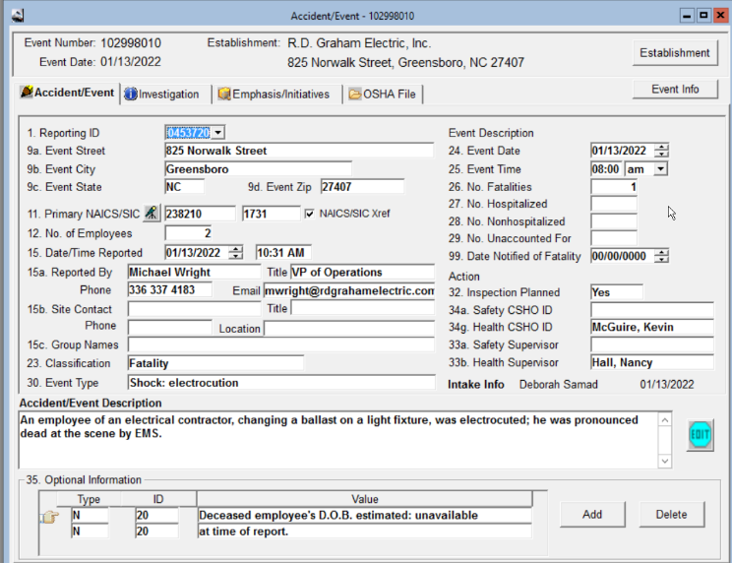
Fatality Inspections – Accident/Event- Serious Fatal Log- NOK -Inspection
All fatalities will have an Accident/Event form and number. Fatalities can also occur due to a prior Referral or a Complaint of accident/injury, but once the employee is deceased it will then become a fatality with an Accident/Event form. When this happens, the Supervisor will be notified thru the Complaint Desk, they will then review and make the decision to open an Inspection/Investigation and assign.
The Supervisor will assign the CSHO to the Accident/Investigation form and update the Serious Fatal Log with CSHO assigned, Date Assigned and Inspection Planned. The Inspection number will be blank until the CSHO creates an Inspection and at that time will initiate the Investigation from the Accident/Event notification. The CSHO will also go to the Serious Fatal Log and enter the assigned Inspection number.

Slide 3
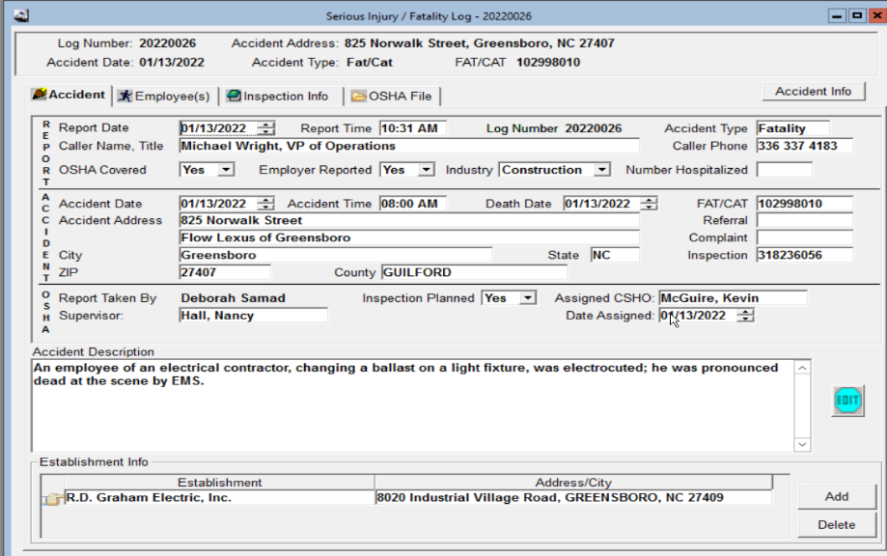
If the Fatality had a prior Referral or Complaint those numbers will be entered here also on the SF Log.
CSHO enters the Inspection number here.

Slide 4
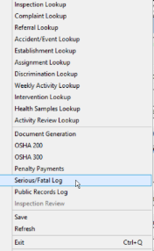

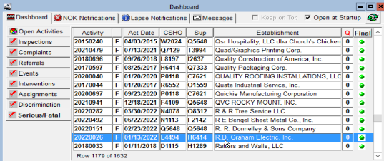
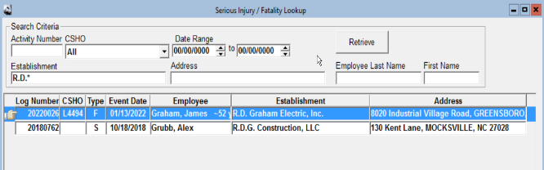
If you know the log number you can (1) Use the Serious/Fatal lookup and enter it there under Activity Number, (2) You can enter the name or portion of a name with a * sign (3) If the Supervisor has updated the Serious Fatal Log with your CSHO ID you can look it up under the CSHO drop down box. (4)Once the Inspection number has been entered on the Serious Fatal Log it will appear on the Serious/Fatal Dashboard, Serious Fatal Log report and will list with your CSHO ID and Supervisor ID and your individual Inspections list.
Dashboard
Establishment Name

Slide 5
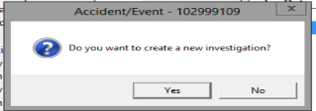
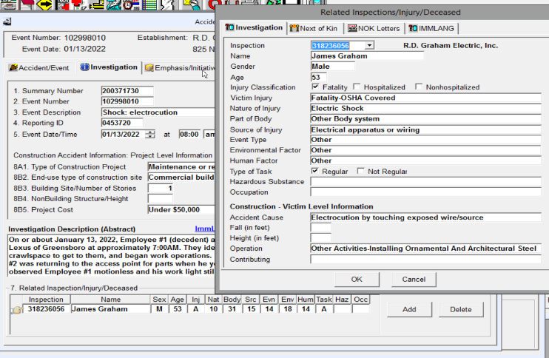
Entering the Investigation
Click on the ADD button and complete the required information.

Slide 6
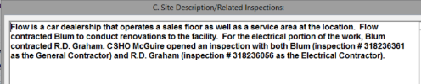
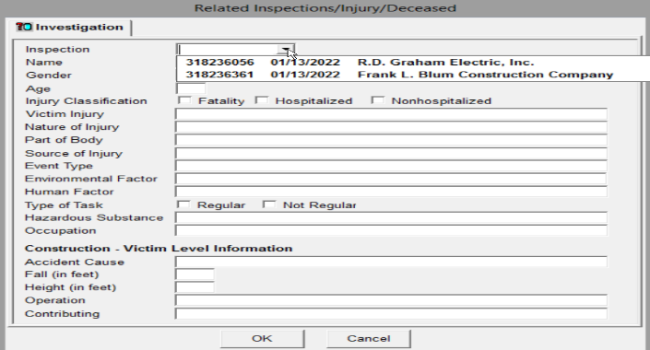
If there are multiple inspections that have been opened prior to the initial investigation being entered, you will see all associated with the Fatality. Make sure you chose the correct one.

Slide 7
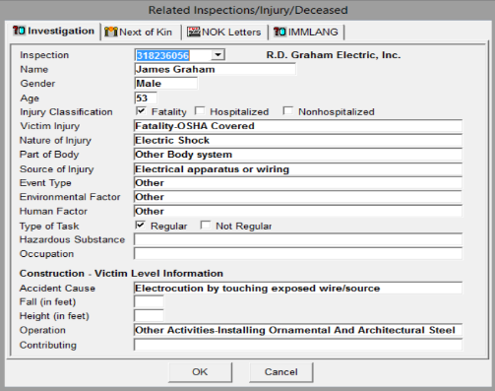
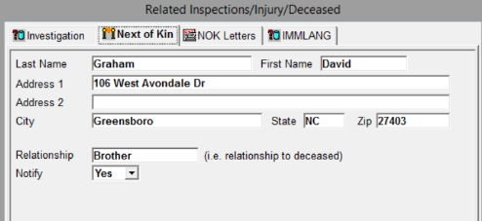
Once the information on the Investigation is filled out you will then continue to the Next of Kin tab to enter that information. You will always chose Notify – YES for tracking purposes. This will enable the Dashboard and when a letter is due or past due it will come up as a NOK notification reminder. Currently the administrative staff when queued to process a NOK letter will go in on the NOK letters side and enter the date the letter was mailed/sent
There will be letters that may appear on the Dashboard to be sent that are NOT associated with North Carolina OSH. The System Administrator will update those with a N/A and the date.

Slide 8

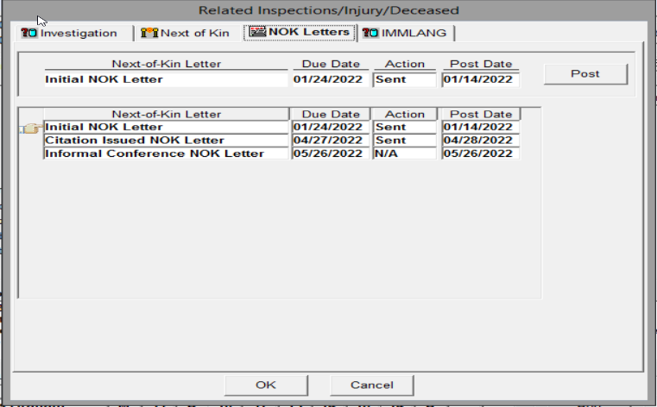
Why do I see these?
Other states that use the OE program send letters in some instances that NC does not use. These will be marked by the administrator as NA with a post date.

Slide 9
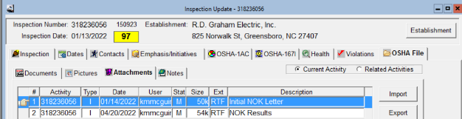
NOK- Next of Kin
NOK Letters are processed and mailed out by the administrative staff, but they are placed in the Attachments Section of the OE by the CSHO. The CSHO selects the correct letter to send and fills out any/all missing information “tags” concerning the NOK & deceased.
Once completed the CSHO “Imports” the letter into the Attachments and they will then queue to the admin staff that the letter is in the attachments and ready to send out.

Slide 10


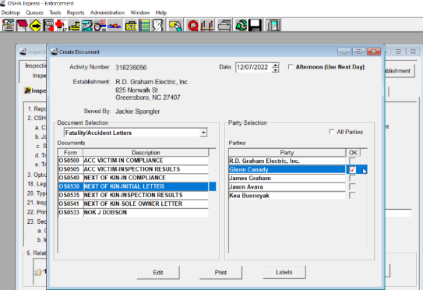
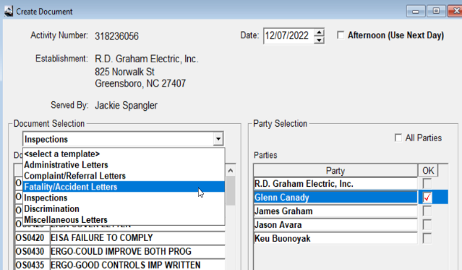
To process a letter in the OE you will go to the OE Desktop Icon and click on the mail/hand icon. This will open the create document function of the letter in the OE. You will use the drop down selection to chose Fatality/Accident Letters and chose the appropriate one. Once you have chosen the letter you will the click on EDIT.

Slide 11
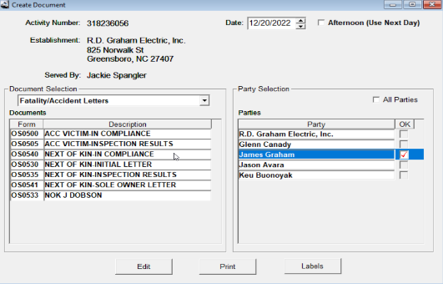
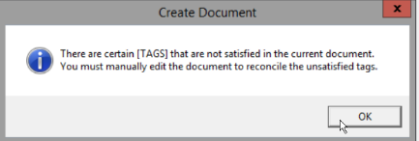
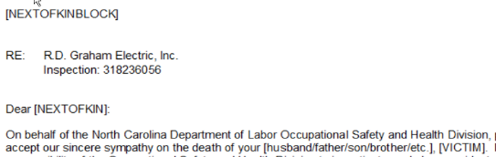
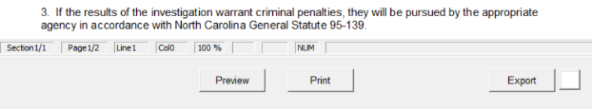
NOK Letter in OE prior to all “tags” being filled out correctly.
The letter should include all updated “tags” with correct information. DO NOT send a NOK letter to the admin to process without the correct information filled in.
RE: R&D Graham Enterprises LLC
Inspection: 318236056
Dear David Doe:
On behalf of the North Carolina Department of Labor Occupational Safety and Health Division, please accept our sincere sympathy on the death of your brother, James Doe.

Slide 12
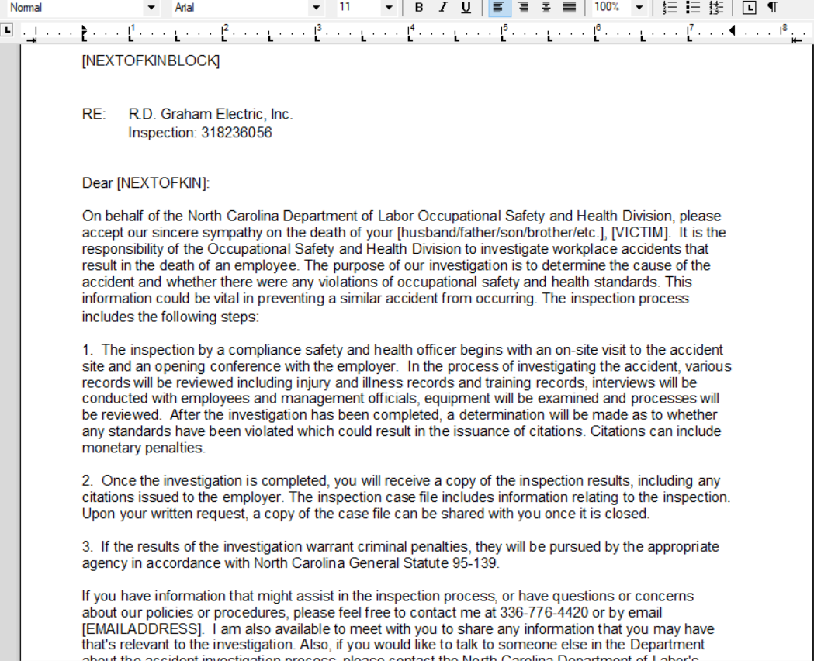






Slide 13
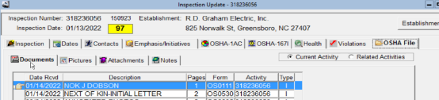
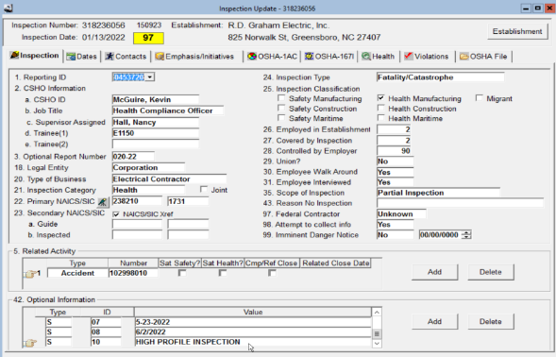
Once the letters are sent you will see the signed mailed copy in the Documents section of the Inspection in the OE.
*Note* - The Scope of Inspection (35.) for Fatality/Catastrophe Inspections will normally be Partial Inspections. However, the scope may be expanded in certain circumstances as outlined in the FOM, Chapter VIII – Fatality and Catastrophe Investigations, 2.a. with approval from the Supervisor/BC. This reminder is for report running.

Slide 14
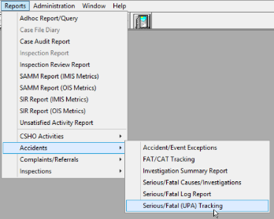

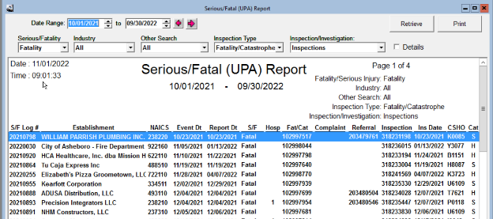
Serious/Fatal (UPA) Report
S/F Log – this log must match the monthly OFIR report from the PSIM’s division.

Slide 15

WAIT !!!
What is an OFIR?
Why does it affect my inspection ?

Slide 16
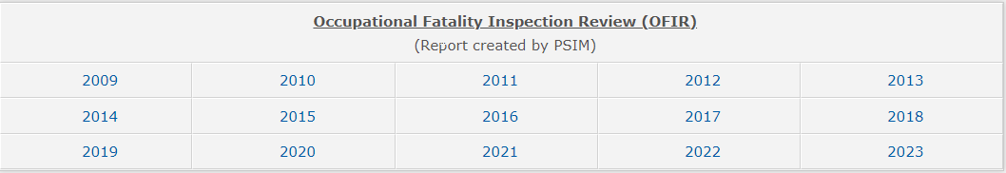
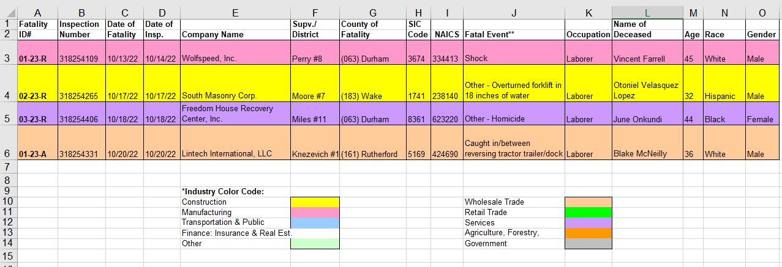
What is an OFIR?? I have heard of it but do not understand how it impacts my Fatality inspection?
The OFIR is a report created by the PSIM’s Division and can be found on the One Stop Shop. This report is sent out each month to Division Heads and the OE Administrator who must balance this report back to the OSHA Express Serious/Fatal UPA report. As you can see in this report there are four fatality inspections assigned and reported to the PSIM’s division for the Federal year 2023 (10-01-2022/11-30-2022) which begins October 1st of each year.

Slide 17
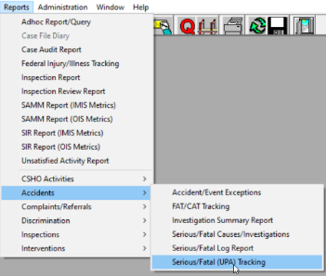
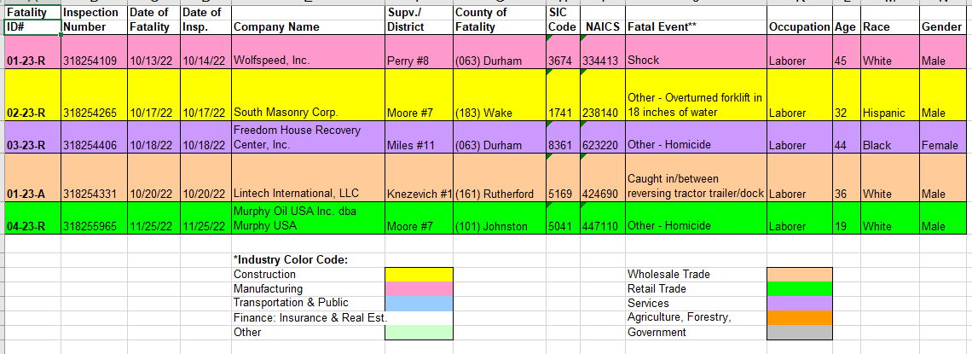
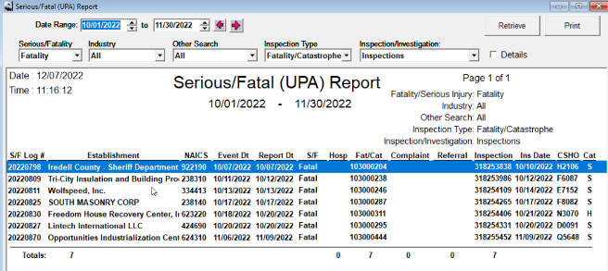

To review this report in the OE the administrator runs the Accidents-Serious/Fatal(UPA) Tracking. From this report using the same date range and the OFIR report, you can see that in the OE it is showing 7 fatality inspections vs the 5 on the OFIR. The administrator will review each inspection on the S/F report to ensure that it is a Fatality with the Scope of Partial or under certain approved instances Comprehensive.

Slide 18
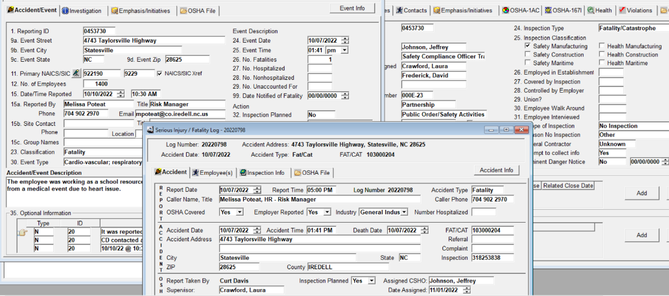
Here is what was found on the first inspection not on the OFIR. You will see that (1) the Scope of the inspection is “No Inspection” (2) the Serious Fatal Log still references this inspection as Assigned, Date Assigned and Inspection Planned as Yes. (3)The information on the Serious Fatal Log is incorrect and has not been updated. Once the fatality inspection has been updated to a No Inspection the CSHO should go into the Serious Fatal Log and remove the (1) Inspection number (2) Inspection Planned (NO) (3) CSHO Assigned should be right clicked out and Date Assigned should be right clicked out. Save your modifications. This will remove it from the Serious Fatal UPA report , Inspection Summary Report and the SAMM (OIS) report. This in essence will clear up 3 reports in the system that are incorrect due to the Serious Fatal Log not being updated correctly.

Slide 19
This concludes the training section for processing fatalities in the OE. Please feel free to contact the System Administrators for further guidance or questions on this section you may have.
For all actions there is always a reaction

