Slide 1
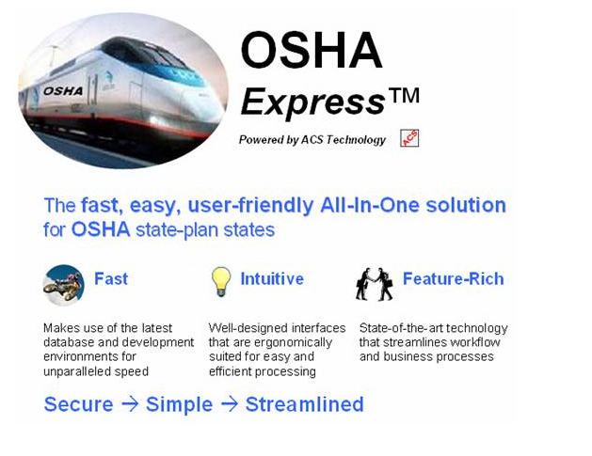


OSHA Express Workflow
The OSHA Express system provides a feature that facilitates the workflow within the OSHA Express environment.
· The workflow system employs a series of system defined queues which enable users to route and transfer work from one logical location to another.
· The workflow system can be envisioned as virtual in-boxes where work can be sent for the required processing.
One of the primary benefits of the OSHA Express workflow system is that it enables multiple users to view and process the workload at the same time.
Working in the QUEUE

Slide 2
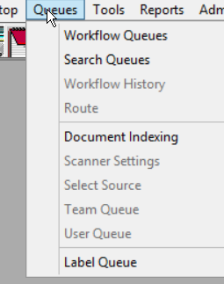
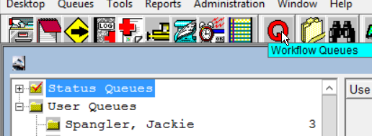
What is a QUEUE ?
The OSHA Express workflow system can be accessed by clicking on the Workflow Queues menu item under the Queues menu, or by clicking on the Workflow Queues toolbar icon.
There are two types of queues that are available within the workflow system: status queues and user queues.
All users will be able to route to any of the queues; however, the ability to retrieve and view the entries on a particular queue is controlled by the authority granted to each user. In other words, users will only see the queues that are pertinent for their work and job duties.
User queues are personal queues where users can store and track files while they are performing their work.
A user queue is only visible to the user to whom it is assigned and their managers and/or supervisor.

Slide 3
Workflow Routing
There is no limit to the number of times that a queue entry can be routed throughout the system. Think of it as the “OE email system”.
There are certain requirements for routing a queue entry that is the same as sending an email.
A status queue and user must be selected in the “Route To” section, and some narrative information is required in the route notes.
You can then click the Route button to route the queue entry.
A queue entry can also be routed with a different priority; High Priority, Normal Priority, or Low Priority, with the default being “Normal Priority.” Normal Priority is what you will use.
* Note*If you do not have anything in your Queue you will not have a Queue Folder when you access the QUEUE on the Dashboard.

Slide 4
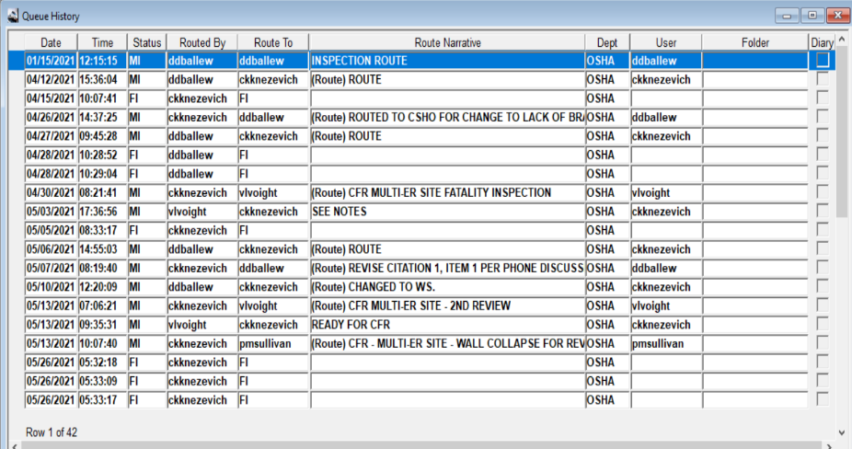
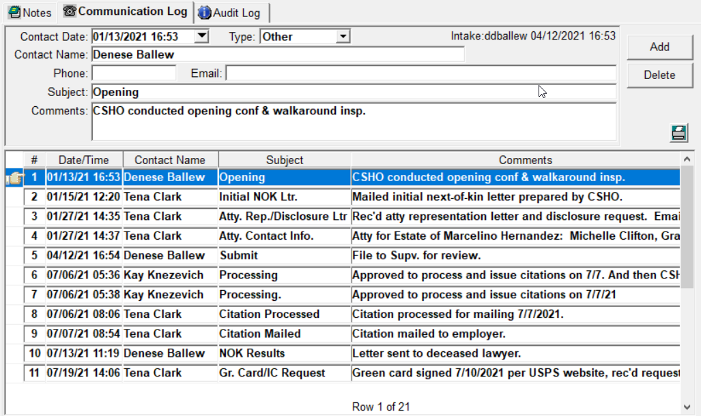
When routing in the Queue you are limited to what you can see in the route Narrative notes section in the OE and this section does not print out. For more comprehensive information that needs to be seen concerning the file always use the Communication Log. The Communication Log prints out in the OE.

Slide 5
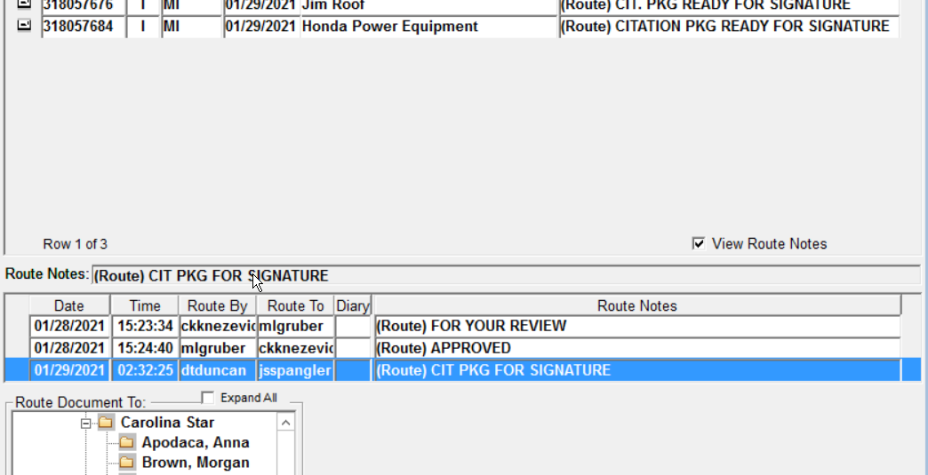
This is a QUEUE where routing has taken place. You will see the bottom section where all route notes associated with that particular file have taken place. Note also that the Mail folder is closed and not opened. This tells you that you have not opened the mail and addressed it and routed back to the sender if needed.

Slide 6
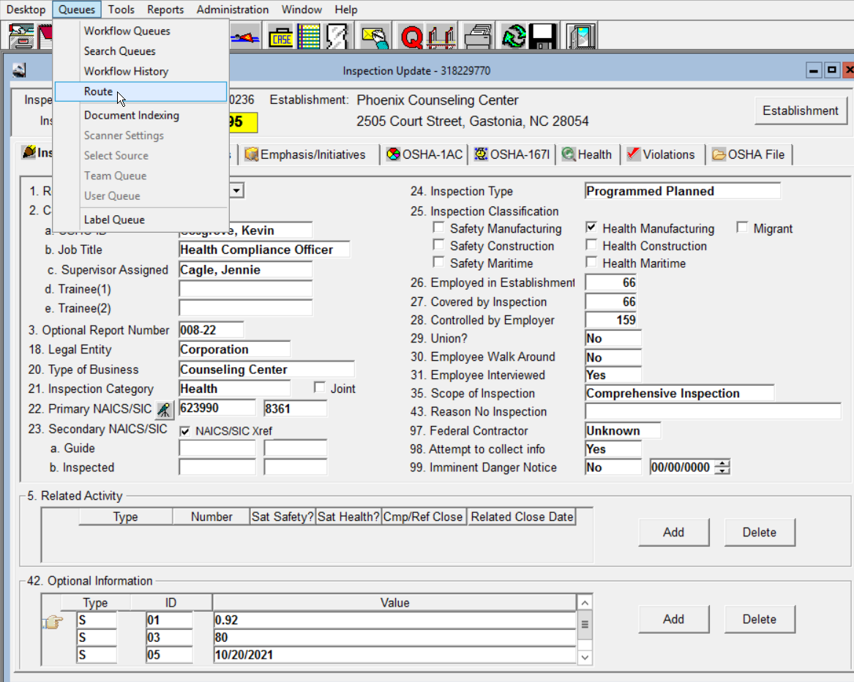
To “Queue” to someone you will have the item open, then click on QUEUE, then ROUTE or you can use the Route Activity Box on the Dashboard

Slide 7
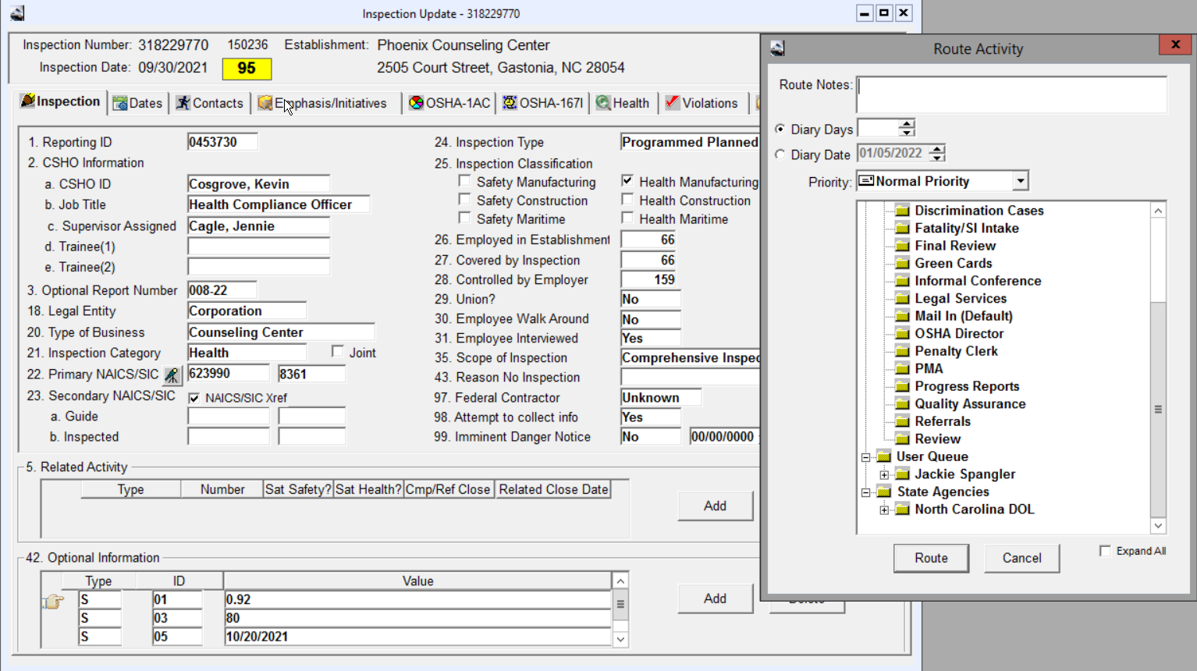
The Route Activity box will open up and this is where you will assign to the person you want to receive it,and place your route notes in the Route Note Box and tab off.

Slide 8
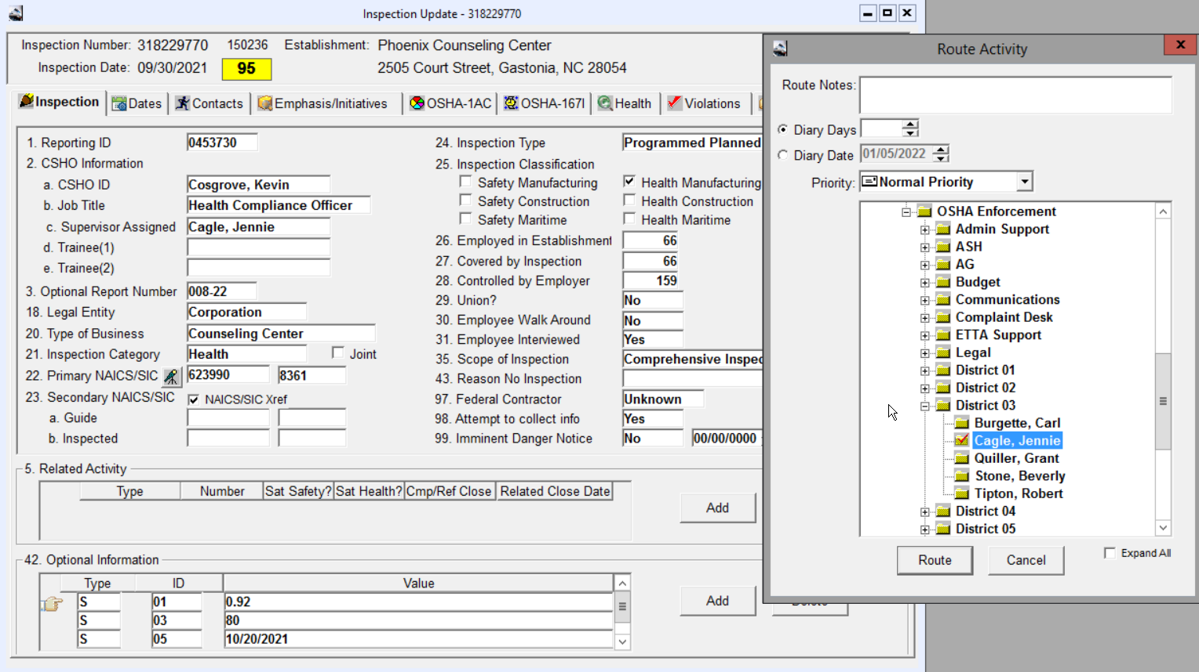
To find the person that you will be routing information and updates to you will have to click the PLUS (+) sign beside the folder that is labeled +North Carolina DOL-then +OSH Enforcement Folder-scroll down until you see the +District folder or division you will need and click the Plus (+) sign to open that group. Click on the folder beside the persons name you want to route to. A red check mark will appear on their folder name. You can also route and item to yourself by click on your name and it will be in your QUEUE.

Slide 9
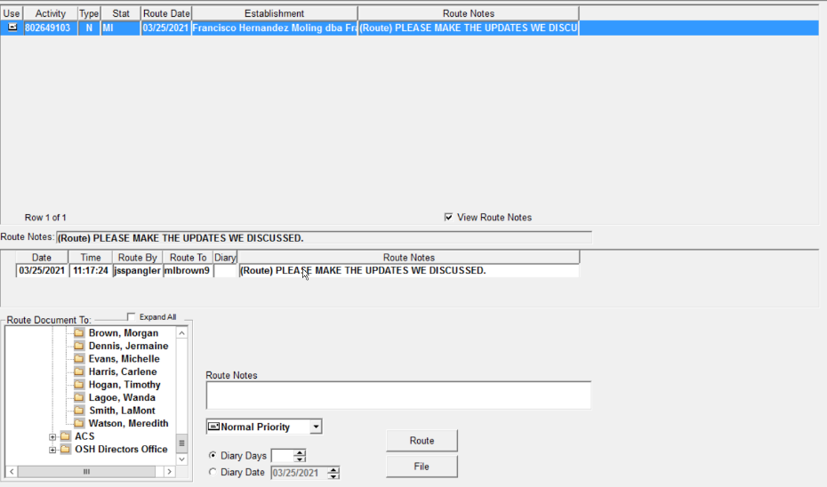
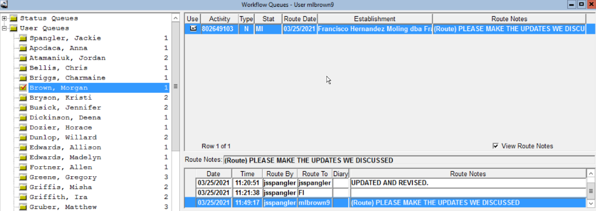
You will then see the Request in your Workflow QUEUE Folder. You will open, update, and respond back using the Queue, once you complete and Queue back to the requestor the file will “leave” your queue. *Note* it may appear to still be there, DO NOT file it. If you are uncertain that it went to the recipient, click on the Green refresh button, it will go away.

Slide 10
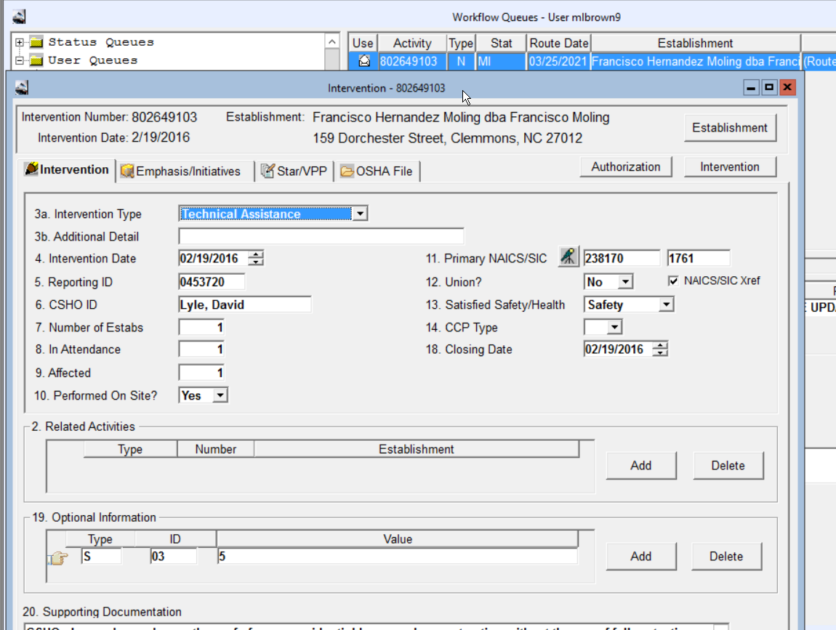
You will open the Activity/file in the top box area of the Workflow Queue user mailbox. Make you changes or update, Save your modifications and close it. To close and save your updates you can also click on the Red X in the upper right hand corner of the document. EXAMPLES

Slide 11
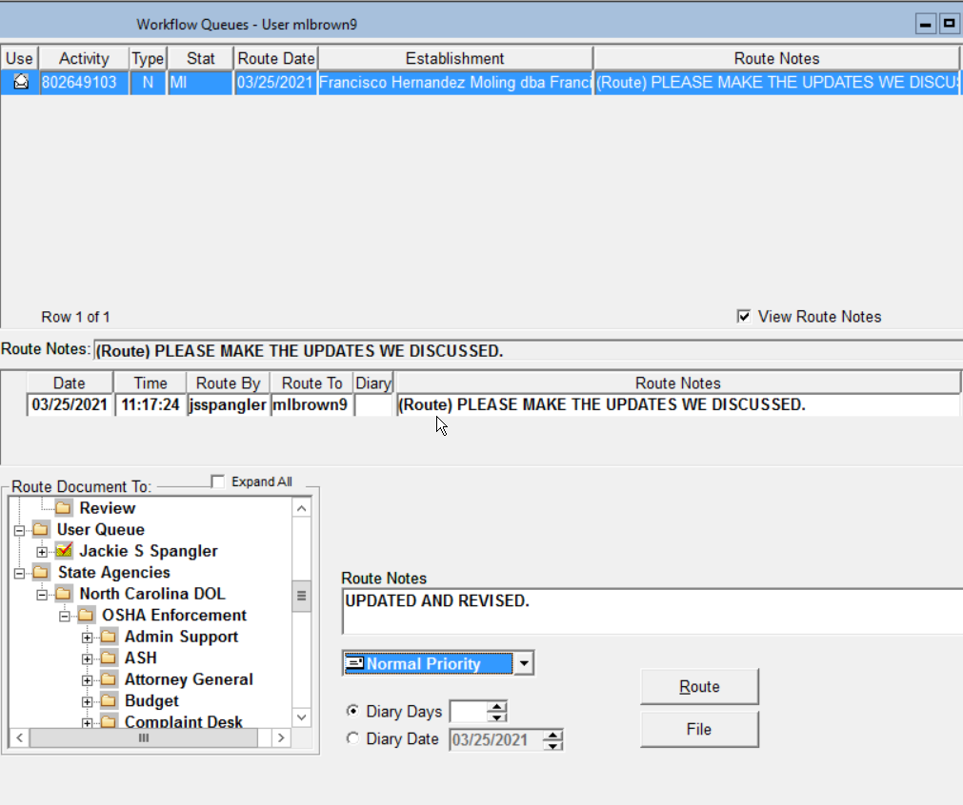

Slide 12
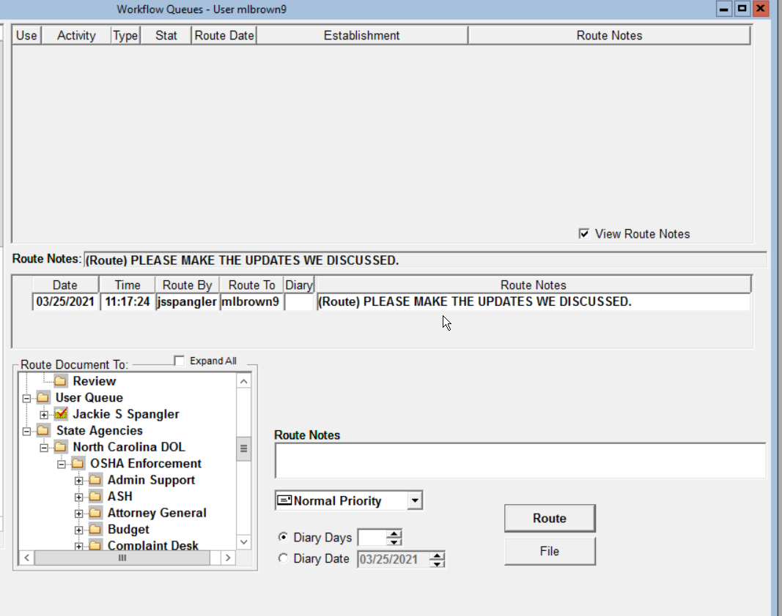



Slide 13
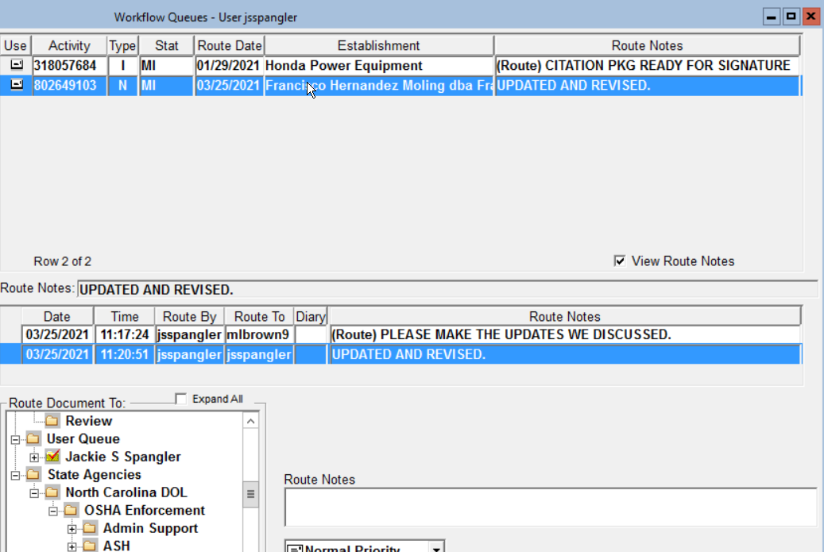

Slide 14
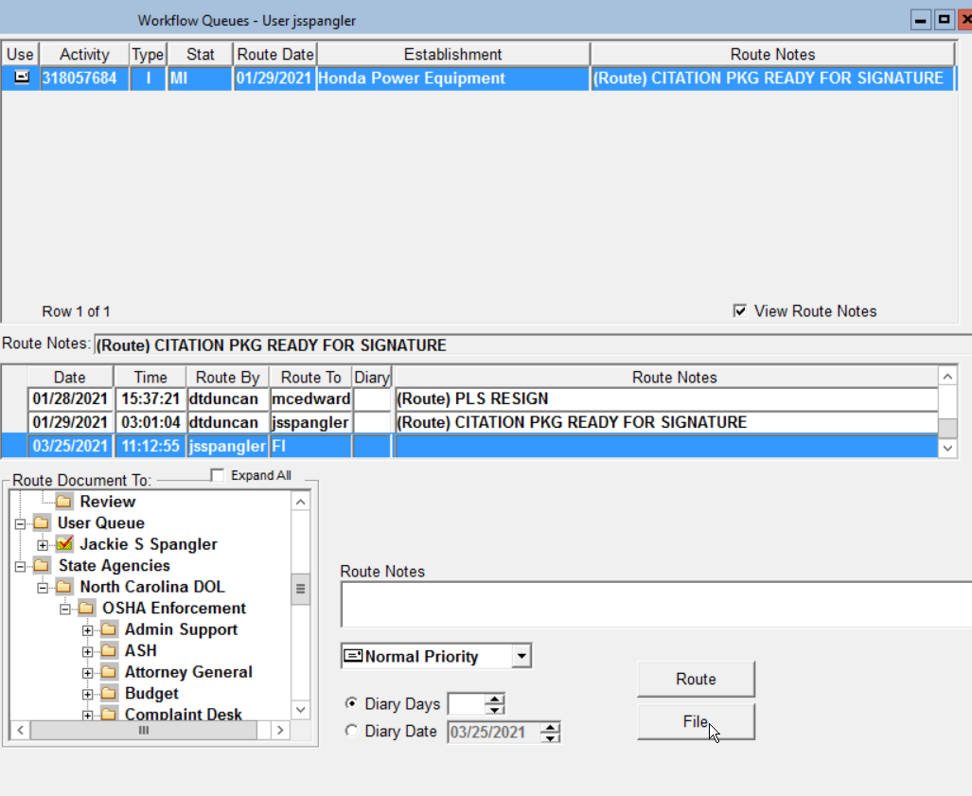


Slide 15
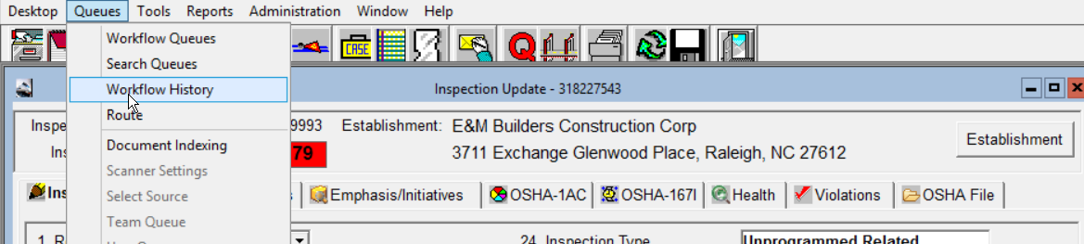
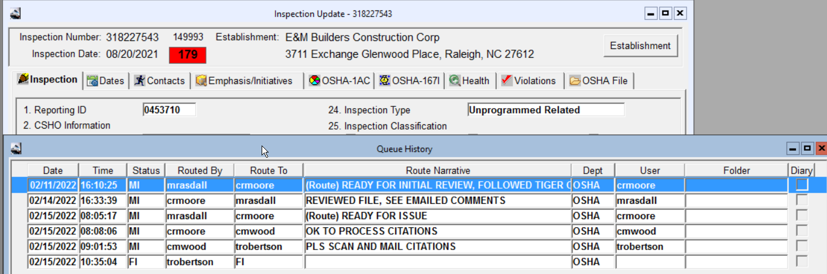
The inspection that you want to view must be opened in order to see the Workflow History.

Slide 16
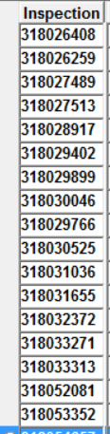

Choose any of the inspections here and queue to one of your class mates in attendance today. You will then open, retrieve and queue it back to the person that you received it from. You may queue more than one. Remember once you queue something in the OE the queued item then becomes part of the “Workflow” history associated with that item. Once you have completed this task, then go to your desktop QUEUE/Workflow History to review the queue and check the flow.

Slide 17

REVIEW
Routing
The OSHA Express workflow system provides several methods to create an entry on a queue.
Whenever an update is made to a file for which a queue entry does not already exist, you will be prompted to route the entry.
The mechanism for the automatic route can be slightly different depending on the activity. For example, an update to an inspection will prompt you to route to your user queue.
Other activities allow you to create/route the queue entry to any status queue or user. A queue entry can also be initiated into the workflow system at any time.
When a file that is “queue enabled” is open (i.e. an inspection, complaint, accident, intervention etc.), and the window has focus, the “Queues” – “Route” menu item or the “Route Activity” toolbar icon can be selected to create the workflow entry.
Note that the same file can exist in multiple queues at the same time (i.e. the equivalent of having a file in multiple in-boxes simultaneously).

Slide 18



What is a Diary? How do I use it?
The “diary” capabilities within the OSHA Express workflow system are available for when a “tickler” or reminder should pop up on your queue.at another point in time.
An example may be when the citations are issued for a particular inspection and the inspector wants to remind themselves to follow up on the case when the first abatement dates are due.
They would be allowed to set a diary date or a number of diary days for the queue entry so that it is “put to sleep” for a period of time. The queue entries that were routed with a diary date set will automatically activate when that specified date or number of days occurs and will appear in your queue along with all of your other queued items. diary date or number of days occurs. The queue entry will then be available along with all other queue
There may be times when you may wish to access your diary early or to see what you have listed there, and if they are resolved. If so you can FILE them from the Diary.ueue entry prior to the diary date or the number of days.
You can then click on the Diary View checkbox at the bottom of the queue selection interface.section of the interface.
The diary queue entries can be viewed, processed and routed just like any other queue entry. an then be viewed, processed, and routed just like any other queue entry
other queue entry.

Slide 19

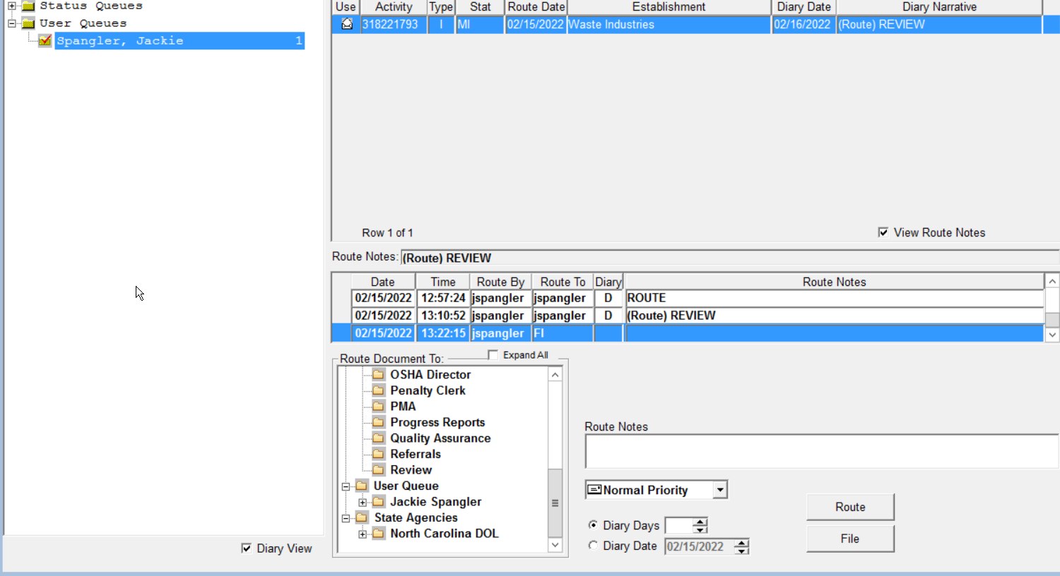

Slide 20

Questions?

Slide 21
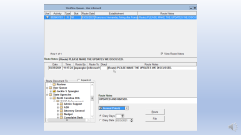
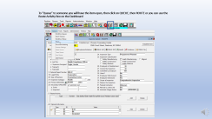
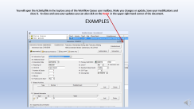
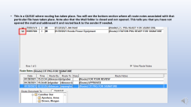
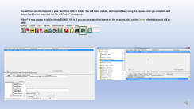
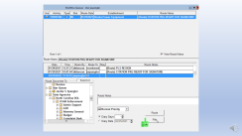
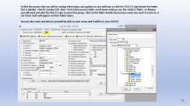
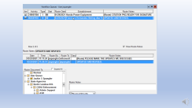
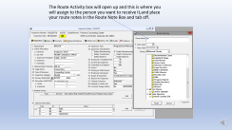
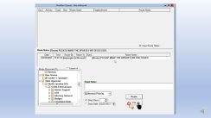
Summary of Slides

