Slide 1

OSHNC Civil Penalty Changes
Josh Dobson, Commissioner of Labor
September 2022
Presented by:
Paul Sullivan, CIH, CSP
Assistant Deputy Commissioner
NC Dept. of Labor/Occupational Safety & Health Division
Notes:
Created: March 2017
The information in this presentation is provided voluntarily by the N.C. Department of Labor, Education Training and Technical Assistance Bureau as a public service and is made available in good faith. This presentation is designed to assist trainers conducting OSHA outreach training for workers. Since workers are the target audience, this presentation emphasizes hazard identification, avoidance, and control – not standards. No attempt has been made to treat the topic exhaustively. It is essential that trainers tailor their presentations to the needs and understanding of their audience.
The information and advice provided on this Site and on Linked Sites is provided solely on the basis that users will be responsible for making their own assessment of the matters discussed herein and are advised to verify all relevant representations, statements, and information.
This presentation is not a substitute for any of the provisions of the Occupational Safety and Health Act of North Carolina or for any standards issued by the N.C. Department of Labor. Mention of trade names, commercial products, or organizations does not imply endorsement by the N.C. Department of Labor.

Slide 2
Objectives
Develop an understanding of the following:
  The reasons for the upcoming civil penalty increases for OSHNC Compliance.
  The changes to the maximum and minimum penalties, the new gravity-based penalties, and new recordkeeping penalties.
  The new Statute of Limitations language in NCGS 95-137.

Slide 3
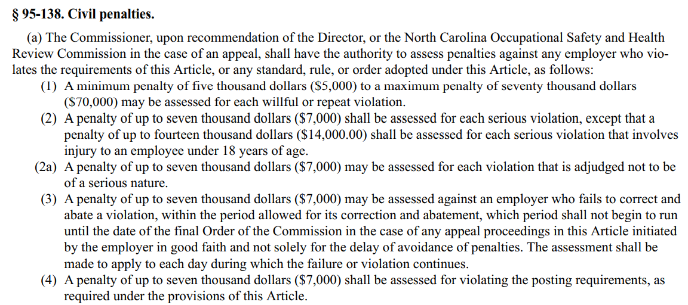
Current Penalties in the OSH Act of NC

Slide 4
Serious Violations
NCGS 95-127 defines a Serious violation:
  A violation that shall be deemed to exist in a place of employment if there is a substantial probability that death or serious physical harm could result from a condition which exists, or from one or more practices, means, methods, operations, or processes which have been adopted or are in use at such place of employment…
All violations are either Serious or Non-serious based on the observed conditions for this inspection. It doesn’t matter what was cited previously.
  Willful and Repeat designations are simply penalty multipliers that are added if applicable. They have nothing to do with the assessed severity.

Slide 5
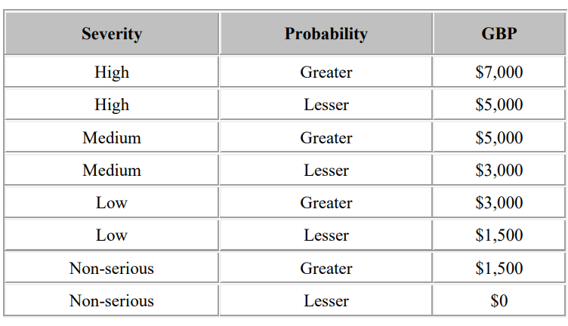
Current Penalties in FOM Chapter 6
Willful penalties are x10
Repeat penalties are x2, x5, or x10

Slide 6
Why the increase in penalties?
In November 2015, President Obama signed the Bipartisan Budget Act of 2015 into law. Title VII of the Budget Act, entitled the Federal Civil Penalties Inflation Adjustment Act Improvements Act of 2015, required mandatory upward adjustments of multiple civil penalties, including those proposed by OSHA.
Federal OSHA was required to issue an interim final rule containing a “catch up adjustment” to its civil penalties – and were not required to follow notice-and-comment rulemaking provisions. The changes to the penalty amounts depended upon the cost-of-living adjustments established by the Consumer Price Index (CPI). The initial catch-up adjustment amount was the percentage difference between the CPI in October 2015 and the CPI in October 1990, which was the year that OSHA penalties were last adjusted – which was approximately 78%.

Slide 7
Why does NC have to follow suit?
Section 18 of the Federal OSH Act states:
(c) The Secretary shall approve the plan submitted by a State under subsection (b), or any modification thereof, if such plan in his judgement:
(1) designates a State agency or agencies as the agency or agencies responsible for administering the plan throughout the State,
(2) provides for the development and enforcement of safety and health standards relating to one or more safety or health issues, which standards (and the enforcement of which standards) are or will be at least as effective in providing safe and healthful employment and places of employment as the standards promulgated under section 6 which relate to the same issues, and which standards, when applicable to products which are distributed or used in interstate commerce, are required by compelling local conditions and do not unduly burden interstate commerce.
OSHNC must be “at least as effective” as Federal OSHA with regard to enforcement procedures.

Slide 8
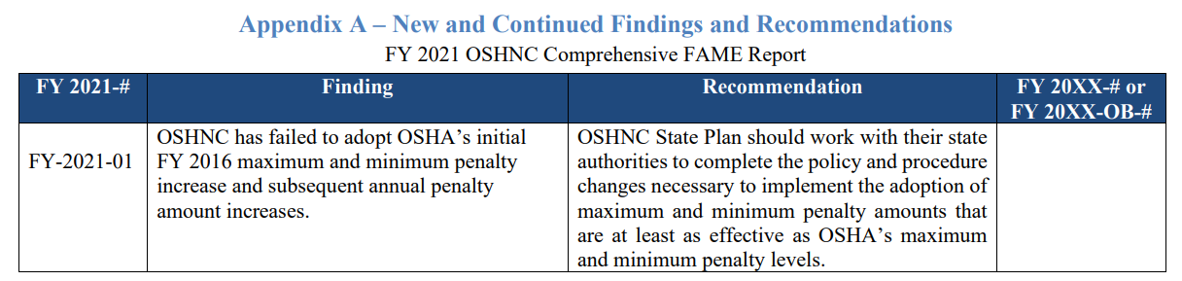
FY2021 FAME Report
Federal OSHA audits all State OSHA programs and issue a Federal Annual Monitoring and Evaluation (FAME) Report for each.
The recent FAME for OSHNC had only one “finding” and no “observations.”

Slide 9
State Plan Activity Mandated Measures (SAMMs)
The latest FAME has the following data about OSHNC penalties:
 | OSHNC Average | Evaluation Criteria
Average current serious penalty in private sector - total (1 to greater than 250 workers) | $1902.40 | +/- 25% of $3100.37 | The further review level is based on a three-year national average. The range of acceptable data not requiring further review is from $2325.28 to $3875.46.
Average current serious penalty in private sector (greater than 250 workers) | $4953.21 | +/- 25% of $6575.70 | The further review level is based on a three-year national average. The range of acceptable data not requiring further review is from $4931.78 to $8219.63.

Slide 10
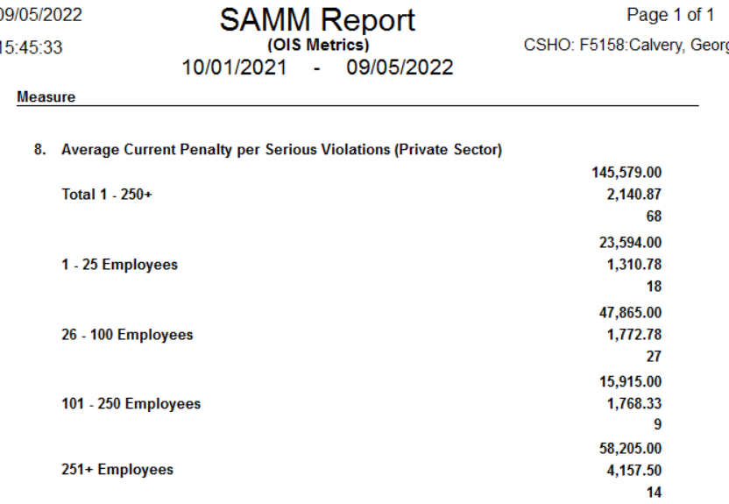
SAMM Report in OE
Any CSHO or supervisor can look up their penalty data in OSHA Express.

Slide 11
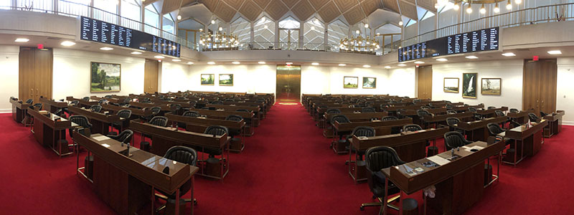
OSHNC Penalty Changes
Instead of possibly jeopardizing the OSHNC Section 18 state-plan approval, the Commissioner decided to request the penalty changes as part of our budget bill during the 2022 NC General Assembly short session.

Slide 12
OSHNC Penalty Changes
The penalty changes were passed by the General Assembly as part of the budget bill that was signed by Governor Roy Cooper.
Instead of setting specific new maximums and minimums, the new language revises NCGS 95-138 allow for future penalty changes based on the CPI.

Slide 13
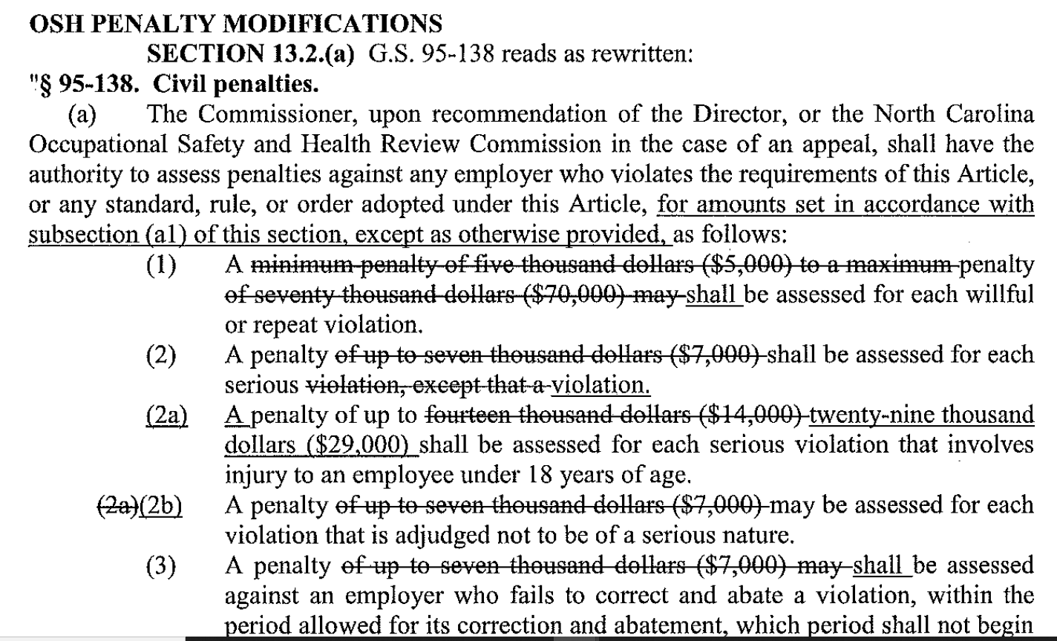
Revisions to NCGS 95-138

Slide 14
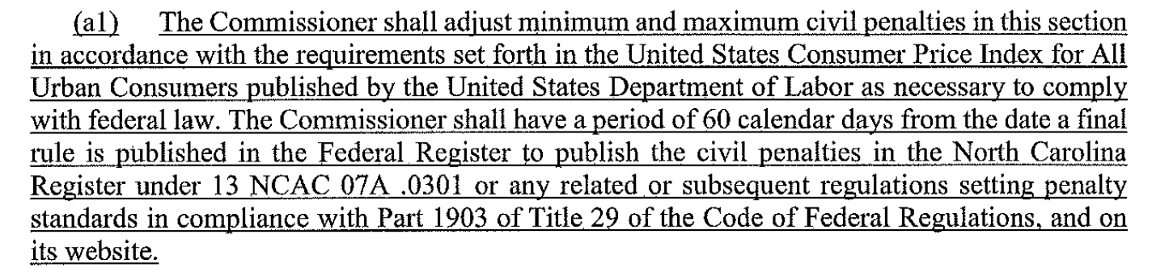
New language for NCGS 95-138(a)(1)
Federal OSHA sets new maximum and minimum penalties each year based on the CPI.
They are published in the Federal Register under 29 CFR 1903.15(d).
The penalties are then incorporated by reference into the NC Administrative Code.

Slide 15
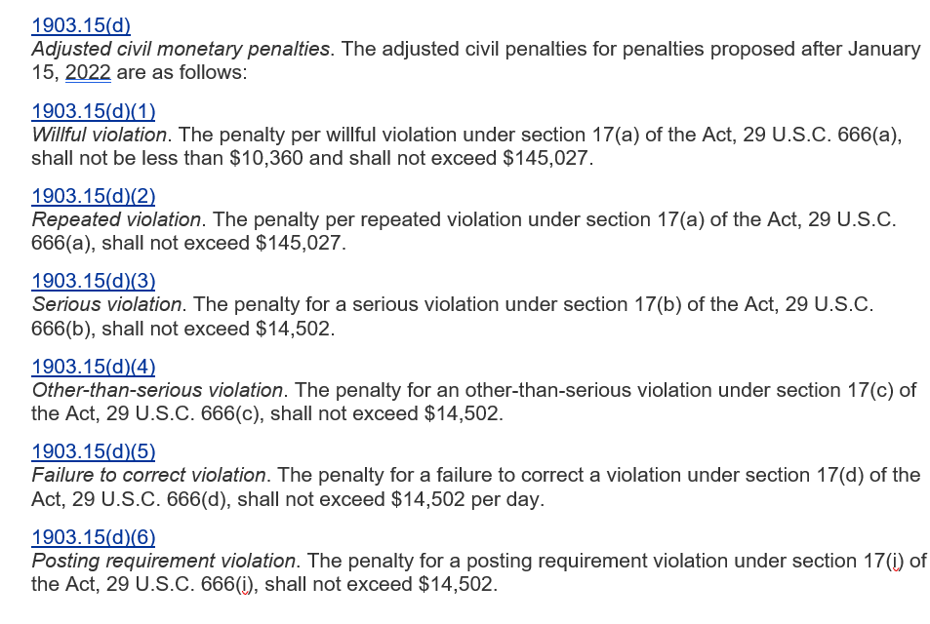
New Penalties under 1903.15(d)

Slide 16
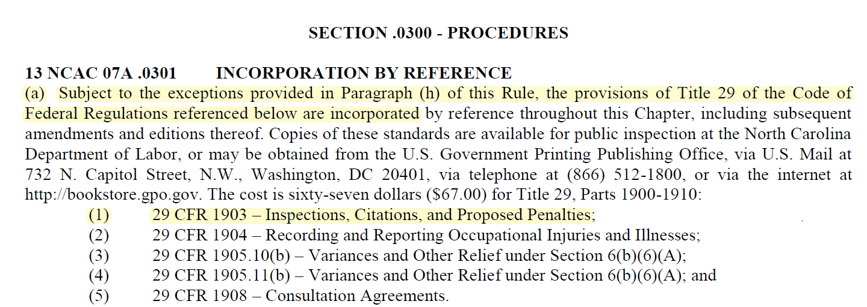
NC Administrative Code

Slide 17
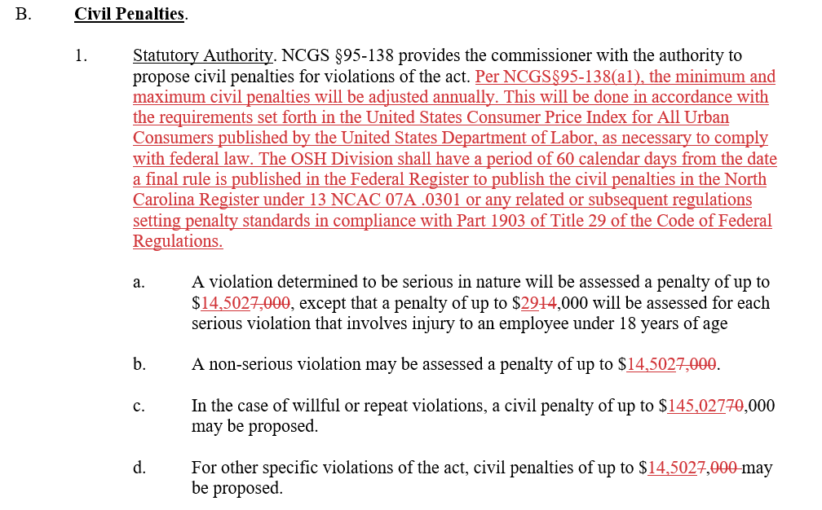
Effective October 1, 2022…
Changes to FOM Chapter VI will go into effect.

Slide 18

Very Important…
These penalty changes are effective for citations issued on or after October 1, 2022.
If you have any draft citations in OSHA Express that are not issued by COB on Friday, September 30, 2022, you will need to re-calculate the penalties in OE the next week prior to issuance.

Slide 19
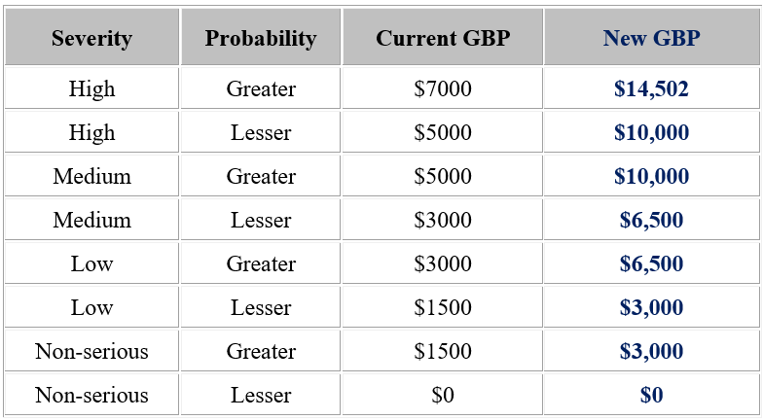
New Gravity-Based Penalties

Slide 20
New Gravity-Based Penalties
When the maximum penalty changes in future years based on the CPI, only the H/G GBP will change.

Slide 21
New Gravity-Based Penalties
The other GBPs will remain the same…at least for the foreseeable future.

Slide 22
Reporting & Recordkeeping Citations
The unadjusted penalties for all recordkeeping and reporting citations will be doubling.
Reporting violation increases:
  Fatality reporting: $5k to $10k (also includes more than one in-patient hospitalization, an amputation of more than one digit or the loss of an eye).
  Hospitalization, single-digit amputation reporting: $2.5k to $5k.

Slide 23
Reporting & Recordkeeping Citations
Migrant Housing Act
  NCGS §95-226(a) for failing to register migrant housing increases from $5k to $10k.
  NCGS §95-226(d) for occupying migrant housing without a certificate increases from $3k to $6k.

Slide 24
Reporting & Recordkeeping Citations
Citations for the following recordkeeping violations are increasing from $1k to $2k:
  Not maintaining OSHA 300/301 records
  OSHA 300 log recording violations
  Refusal to post an OSHA poster (must be approved by Director’s Office)
  Failure to create, certify, and post OSHA 300A summary.
  Failure to submit abatement certification docs

Slide 25
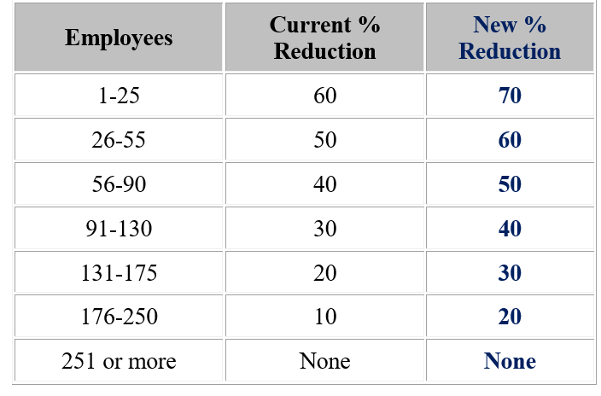
What else is changing?
The size credit will be increasing by 10%

Slide 26
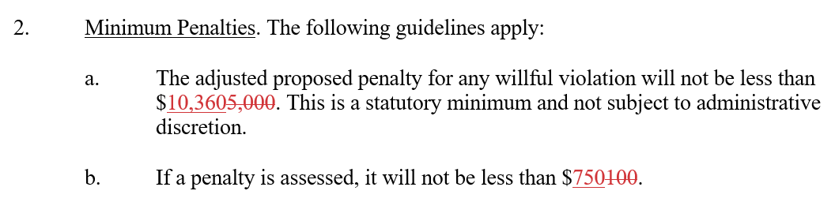
What else is changing?
If a penalty is assessed, it will not be less than $750.

Slide 27
Example Penalty Chart
Note that the H/G penalties will likely include cents.
Typical H/G penalties for small employers will change as follows:
  With history credit - $2100 to $2900.40
  W/o history credit - $2800 to $4350.60

Slide 28
Repeat Violations (FOM Ch. VI)
b. Penalty Increase Factors. NCGS §95-138(a) of the act provides that an employer who repeatedly violates the act may be assessed a civil penalty of up to $145,027, for each violation. In accordance with FOM Chapter IV.F.5, a multiplier of the amount of the penalty assessed for each repeat violation will be as follows: The GBP will be doubled for the first repeat violation, multiplied by 5 if the violation has been cited twice before, and multiplied by 10 if the violation has previously been cited three or more times.
c. Non-serious, No Initial Penalty. For a repeat non-serious violation that had no initial penalty, a $750 GBP will be assessed. This GBP will be reduced by the appropriate size factors. It will then be doubled for the first repeat violation, multiplied by 5 if the violation has been cited twice before, and multiplied by 10 if the violation has previously been cited three or more times. In no case will the final penalty be less than $750.

Slide 29
What else is changing?
That’s about it. All other penalty calculation procedures will remain the same.
Here is what will NOT change:
  Good faith credit (still 0%, 10%, 25% or 40%).
  History credit (still 0% or 10%)
  Grouping procedures. Just a reminder…two or more violations can be grouped, but they must be “so closely related as to constitute a single hazardous condition.”

Slide 30
Informal Conferences/Settlements
There will be no changes to the procedures in Chapter XIII regarding BC approval for informal or formal settlements:
    A case file that requires bureau chief approval for citation issuance or closing the case file also requires bureau chief approval for settlement. A settlement agreement with a penalty reduction greater than 35% requires bureau chief approval.
Most ISA penalty reductions have been in the 15-25% range. We’ll likely see more settlements in the 35%+ range with the higher penalties.
Try to avoid penalty-only contestments. If the ER agrees with the citations and penalty is the only issue, please discuss with the BC.

Slide 31
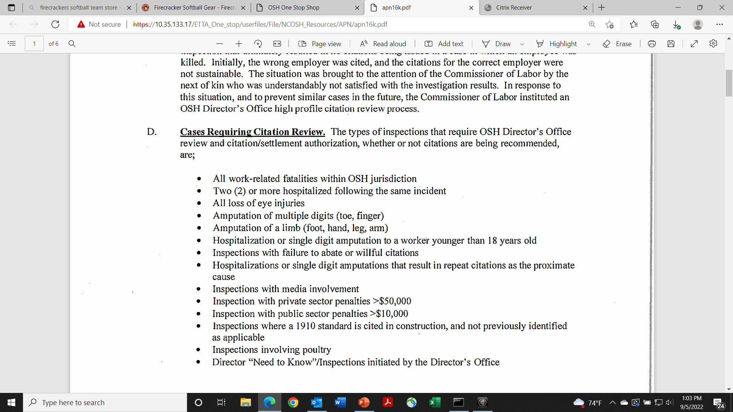
Penalty CFR Cases – APN 16K

Slide 32
Penalty CFR Cases – APN 16K
There will be no change to the private sector CFR threshold ($50k). We will likely increase the public sector threshold to $15,000.
  When citations are issued, public sector employers are more likely to contest than private sector employers (8.5% vs 5.6% since FY2021). That’s one reason CFR is important for these cases.

Slide 33
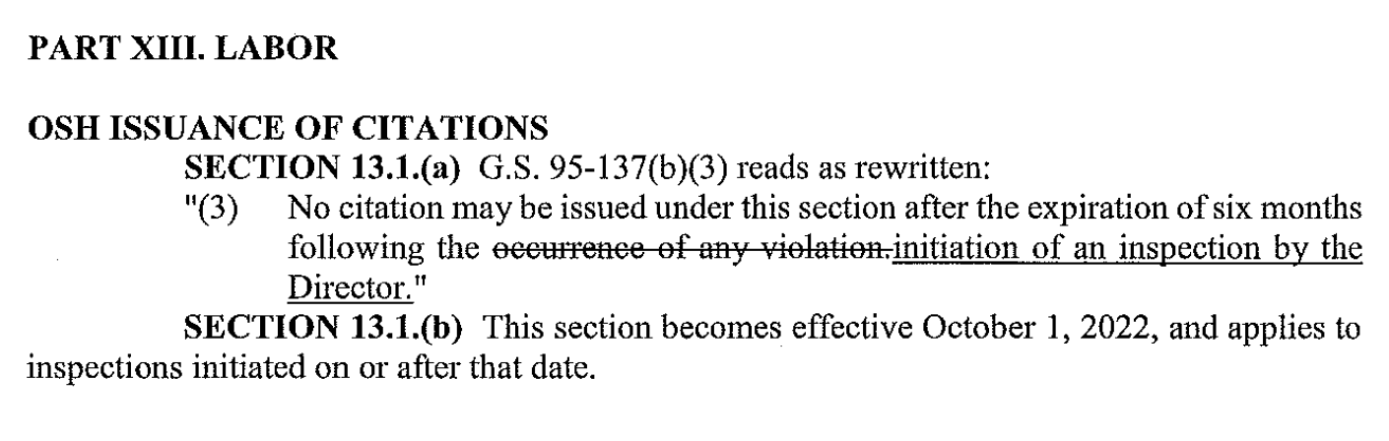
Change to Statute of Limitations

Slide 34
Questions?
Josh Dobson, Commissioner of Labor

