Slide 1


Part Three
Accident Investigation
Documenting Your Findings
Presented by: ETTA, OSH Division, (919) 707-7826
Notes:
Part Three Approx 1 hour
Materials needed: Laptop
Projector

Slide 2
Objectives
At the conclusion of this module, students will be able to:
  Recognize the benefits of properly documenting the accident investigation
  Identify strategies for photographing the accident investigation and developing diagrams and drawings
  Properly collect and document findings to support violations (Note: Documenting citations in OSHA Express is covered in Technical Writing).

Slide 3

Why Document?
  A complete and accurate record of investigation is necessary so that investigators can analyze the evidence, develop hypotheses, run tests, draw conclusions, and communicate observations at a later date.
  A complete and accurate documentation is essential if your opinions and conclusions are to withstand the test of critical review and cross-examination.

Slide 4
Investigation Photography
  Photos and digital images may be the most effective way of preserving an accident scene.
  Lighting is very important. Unless outdoors, most accident scenes have limited lighting.
  A good camera flash attachment is essential, and portable lighting may be required.
  Single-lens reflective digital camera is preferred by most investigators.
  The most important photo in the case may be the one that you failed to take, so always take as many images as necessary.

Slide 5

Diagrams, Drawings, and Plans
  Diagrams (freehand sketches) and drawings (formal renderings) can help document the accident scene only if clear, concise and accurate.
  Diagrams and drawings can be used to enhance the understanding of the investigators’ photographs.
  Diagrams and drawings should always include a north arrow, legend, and scale.
Show details and mark positions relative to each other with approximate measurements on diagrams and drawings.

Slide 6
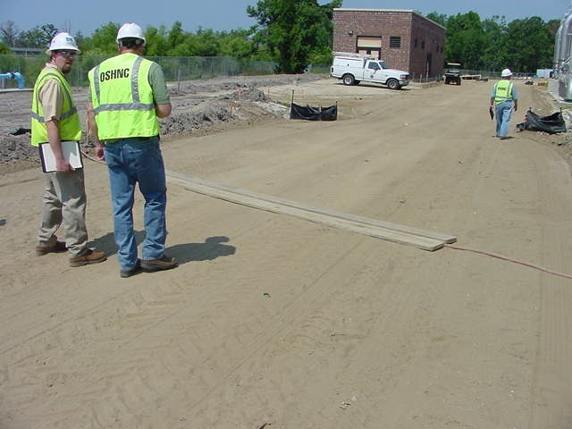
What Other Information is Needed?
  Police and fire reports, photos and videos
  Weather reports
  Interview notes
  Personal observations
  Medical Examiner reports
  EMS records
  Medical Records
  Security camera footage

Slide 7

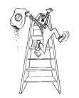
Accident Investigation Findings
  Chronology of events
  Report and obtain facts (not opinions)
    Phil is a painter.
    Phil stands on a ladder while painting the ceiling.
    Phil overextends himself and falls to the floor.
    Phil broke his leg.

Slide 8
Accident Investigation Findings
  What will prevent a reoccurrence?
  What could be done differently?
  Will it be adequate to prevent recurrences?
  Will it address the violation and citations?
  Does it properly identify all parties involved?
  Ensure completeness. DETAILS!!!!

Slide 9
Accident Investigation Findings
Interviews – managers/supervisors/employees/next of kin/witnesses
Material conditions – maintenance records/chain of custody.
Documentation – procedures/training records/coroner/law enforcement/medical.
Present facts in the written report not opinions

Slide 10
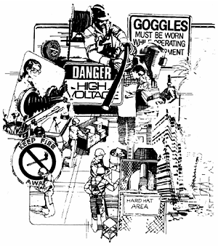
Accident Investigation Findings
Narrative should cover:
  Background – who, what, where, why, when, and how
  Description of accident – sequence of events
  Findings – causes
  Corrective measures
Notes:
Background:
This section contains background information that answers questions about who the victim is, and the time, date, location of the accident, as well as other necessary details. Make sure you obtain all of this information for possible later reference.
Description of the accident:
This section presents a descriptive narrative of the events leading up to, including and immediately after the accident. It's important that the narrative paint a vivid "word picture" so that someone unfamiliar with the accident can clearly see what happened.
Findings:
The findings section describes the hazardous conditions, unsafe behaviors and the system weaknesses your analysis has uncovered. Each description of surface and root cause will also include justification for the finding. The justification will explain how you came to your conclusion.
Unfortunately, the most common failure found in accident reports is that they address only surface causes. Consequently, similar accidents recur. These report forms may have a format that "forces" the investigator to list only surface causes for accidents. The form does not "report" the system weaknesses associated with each surface cause. Consequently, the investigator believes the job is done without ferreting out the system weaknesses representing the root causes.

Slide 11

Accident Investigation Findings
Properly collecting and documenting findings to
support OSHA violations:

Slide 12
Practice
Let’s practice the documentation techniques on our case study:
  Make a diagram (freehand sketch) of the case study, including a detailed sketch and approximate scale.
  List any safety plans you may need to collect.
  Note: Your job is purely documentation, not causation of the accident.

Slide 13
Summary
During this module, we discussed methods to:
  Identify the benefits of properly documenting the accident investigation
  Identify strategies for photographing the accident investigation and developing diagrams and drawings
  Properly collect and document findings to support violations.

Slide 14
Thank You For Attending!
Final Questions?

