Slide 1
North Carolina Department of Labor
Occupational Safety & Health Division
4th Quarter Report
Federal Fiscal Year 2022*
Presented by:
Wanda Lagoe CSP ARM CPM
Education, Training and Technical Assistance
Occupational Safety and Health Division of North Carolina
*Preliminary Data
Notes:
The information in this presentation is provided voluntarily by the N.C. Department of Labor, Education Training and Technical Assistance Bureau as a public service and is made available in good faith. This presentation is designed to assist trainers conducting OSHA outreach training for workers. Since workers are the target audience, this presentation emphasizes hazard identification, avoidance, and control – not standards. No attempt has been made to treat the topic exhaustively. It is essential that trainers tailor their presentations to the needs and understanding of their audience.
The information and advice provided on this Site and on Linked Sites is provided solely on the basis that users will be responsible for making their own assessment of the matters discussed herein and are advised to verify all relevant representations, statements, and information.
This presentation is not a substitute for any of the provisions of the Occupational Safety and Health Act of North Carolina or for any standards issued by the N.C. Department of Labor. Mention of trade names, commercial products, or organizations does not imply endorsement by the N.C. Department of Labor.

Slide 2
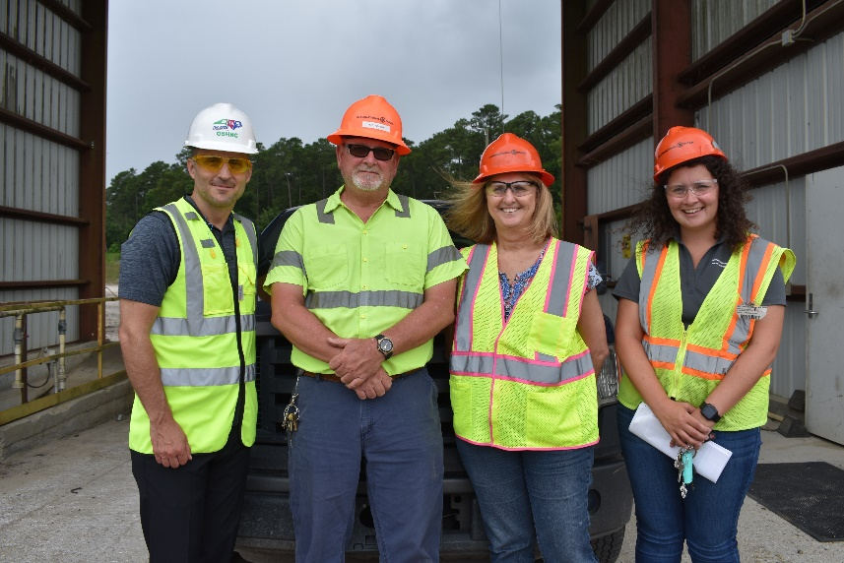
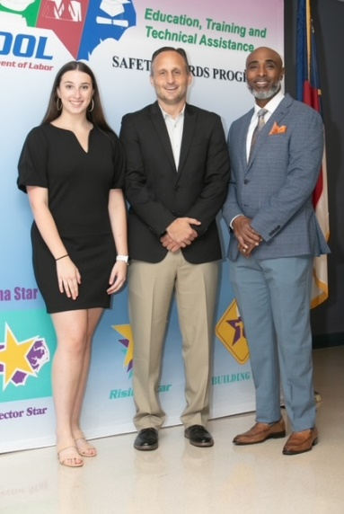
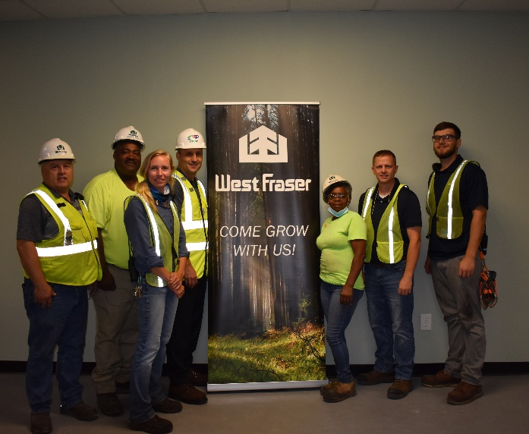
N.C. Workplace Safety and Health
TRC and DART Rate Comparison
FFY 2022—4th Qtr.
CY 2021 | North Carolina |  | National Average |  | Comparison
TRC Rate | 2.2 | 2.4* | 2.7 | 2.9* | 19% Lower/17% Lower*
DART Rate | 1.3 | 1.4* | 1.7 | 1.8* | 24% Lower/22% Lower*
*All industries including state and local government CY = Calendar Year
Notes:
North Carolina’s Total Recordable cases and DART rate continue to be lower that the National Average.
The DART rate stands for "Days Away, Restrictions and Transfers". This number is also based on trending over 200,000 hours but its not based on total injuries. Its based only on those injuries and illnesses severe enough to warrant "Days Away, Restrictions and Transfers".
The Total Recordable Case Rate (TRC) equals the division of all recordable cases by the hours worked, multiplied by 200'000 for standardization.

Slide 3
N.C. Workplace Safety and Health
Total Recordable Cases (TRC)
FFY 2022—4th Qtr.
4% Increase
11% Decrease
4% Decrease
8% Increase
12% Decrease
All Industries Including State and Local Government
Based on Calendar Year

Slide 4
N.C. Workplace Safety and Health
Days Away, Restricted or Transferred (DART)
FFY 2022—4th Qtr.
7% Increase
7% Increase
No Change
7% Increase
7% Decrease
7% Decrease
No Change
7% Decrease
7% Decrease
No Change
All Industries Including State and Local Government
Based on Calendar Year

Slide 5
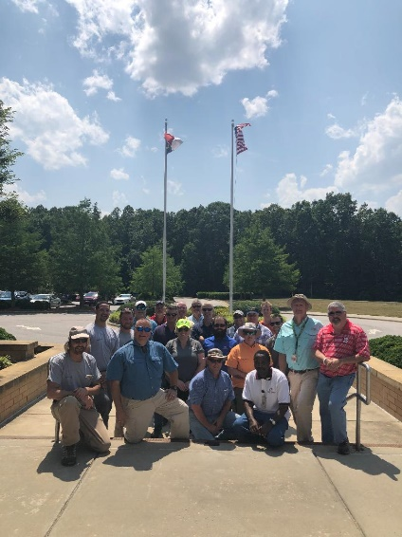
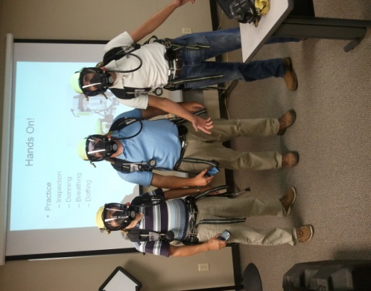
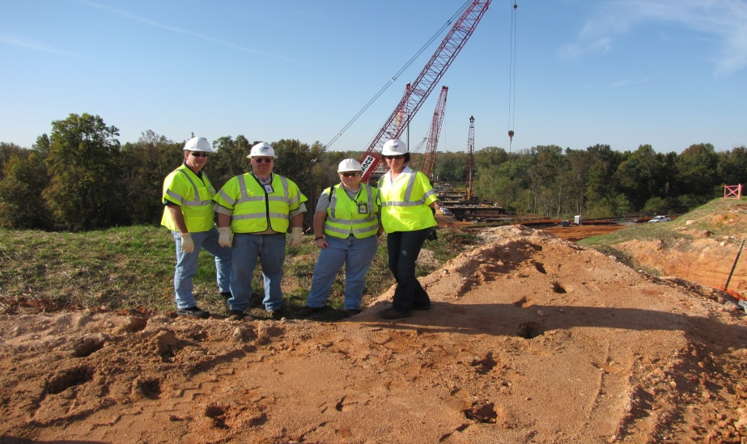
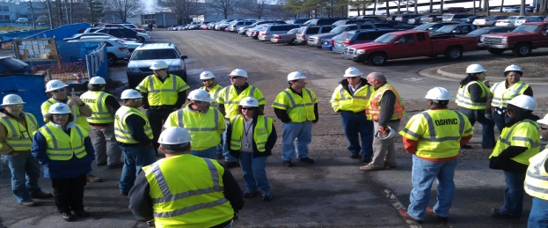
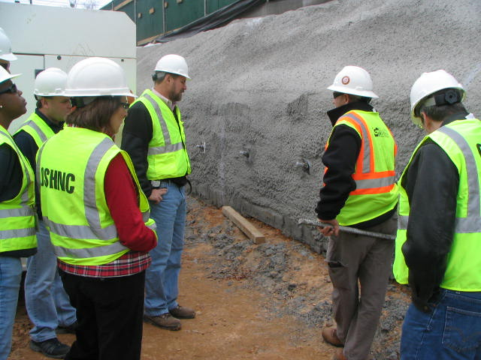
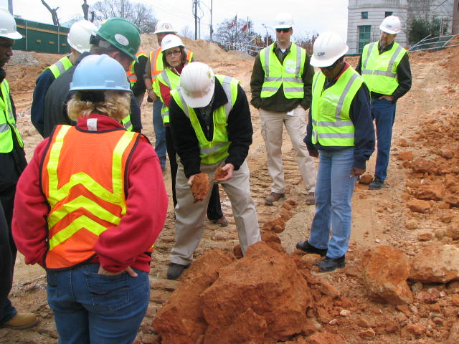
N.C. Workplace Safety and Health
OSH Division—Fatalities Inspected
FFY 2022—4th Qtr.
FATALITY TYPE | 1st Qtr. | 2nd Qtr. | 3rd Qtr. | 4th Qtr. | Total | FATALITY TYPE | 1st Qtr. | 2nd Qtr. | 3rd Qtr. | 4th Qtr. | Total
Struck By | 2 | 4 | 5 | 4 | 15 | Inhalation | 0 | 0 | 0 | 0 | 0
Caught In/Between | 2 | 1 | 4 | 2 | 9 | Ingestion | 0 | 0 | 0 | 0 | 0
Bite/Sting/Scratch | 0 | 0 | 0 | 0 | 0 | Absorption | 0 | 0 | 0 | 0 | 0
Fall (Same Level) | 0 | 0 | 0 | 0 | 0 | Repeated Motion/Pressure | 0 | 0 | 0 | 0 | 0
Fall (From Elevation) | 1 | 3 | 5 | 5 | 14 | Cardio/Respiratory | 0 | 0 | 0 | 0 | 0
Struck Against | 0 | 0 | 1 | 0 | 1 | Shock | 1 | 2 | 0 | 3 | 6
Rubbed/Abraded | 0 | 0 | 0 | 0 | 0 | Other | 2 | 3 | 0 | 5 | 10*
COVID-19 | 3 | 2 | 0 | 1 | 6 | Criminal Activity | 1 | 0 | 0 | 2 | 3*
Fatalities Under OSH Division Jurisdiction
FFY 2021 |  | FFY 2022 | 1st Qtr. | 2nd Qtr. | 3rd Qtr. | 4th Qtr. | Total
Total Fatalities | 91 | Fatalities | 11 | 15 | 15 | 20 | 61*
NCDOL Photo Library
* Criminal activity is also counted in another fatality type.

Slide 6
N.C. Workplace Safety and Health
OSH Division—Strategic Plan Goals
FFY 2022—4th Qtr.
Compliance | 1st Qtr. | 2nd Qtr. | 3rd Qtr. | 4th Qtr. | Total | FFY Goal
Safety Inspections | 315 | 256 | 314 | 298 | 1,173 | 1,145
Health Inspections | 154 | 234 | 167 | 190 | 780 | 755
Serious Hazards Eliminated | 715 | 679 | 779 | 779 | 2,952 | 4,100
Training and/or Program Violations | 136 | 133 | 113 | 133 | 507 | 1,050
Consultation | 1st Qtr. | 2nd Qtr. | 3rd Qtr. | 4th Qtr. | Total | FFY Goal
Serious Hazards Eliminated | 1,224 | 1,401 | 1,461 | 1,833 | 5,859 | 4,800
Private Sector and Public Sector Visits | 359 | 369 | 389 | 384 | 1,501 | 1,325
OSH Division | 1st Qtr. | 2nd Qtr. | 3rd Qtr. | 4th Qtr. | Total | FFY Goal
Program Improvements | 538 | 557 | 526 | 533 | 2,154 | 2,060
People Trained in Special Emphasis Program Areas | 1,161 | 1,385 | 1,557 | 1,530 | 5,633 | 3,200
People Trained at OSH Division Sponsored Events | 1,631 | 1,941 | 1,809 | 1,840 | 7,221 | 5,350

Slide 7
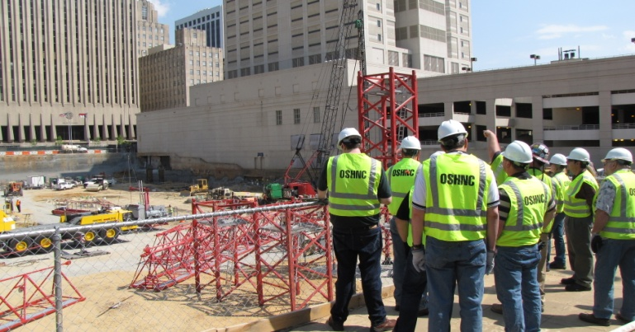
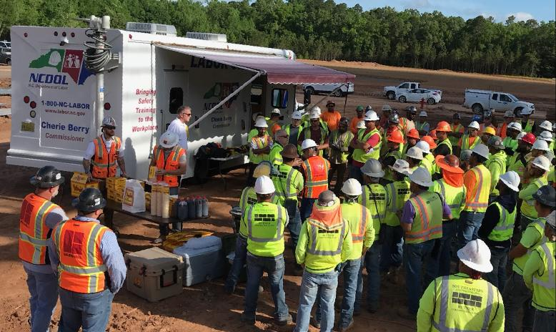
N.C. Workplace Safety and Health
OSH Division—Strategic Plan Goals
FFY 2022—4th Qtr.
Education, Training and Technical Assistance (ETTA) | 1st Qtr. | 2nd Qtr. | 3rd Qtr. | 4th Qtr. | Total | FFY Goal
Publications Distributed | 9,685 | 9,038 | 13,054 | 7,029 | 38,806 | 35,000
Standards Interpretations | 586 | 805 | 672 | 618 | 2,681 | NA
Agricultural Safety and Health (ASH) | 1st Qtr. | 2nd Qtr. | 3rd Qtr. | 4th Qtr. | Total | FFY Goal
Outreach Materials Distributed | 309 | 3,951 | 2,269 | 223 | 6,752 | 2,400
Compliance Inspections | 20 | 0 | 10 | 22 | 52 | 50
Certificates Issued | 143 | 1,227 | 493 | 89 | 1,952 | 1,600
Preoccupancy Inspections | 210 | 1,333 | 302 | 72 | 2,037 | 1,800
NCDOL Photo Library

Slide 8
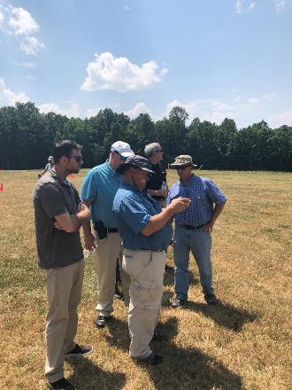

Strategic Plan
Special Emphasis Programs (SEP)
FFY 2022—4th Qtr.
NCDOL Photo Library
Construction
Logging and Arboriculture
Long Term Care Facilities
Health Hazards
Food Manufacturing
Grocery and Related Product Wholesalers
Amputations

Slide 9

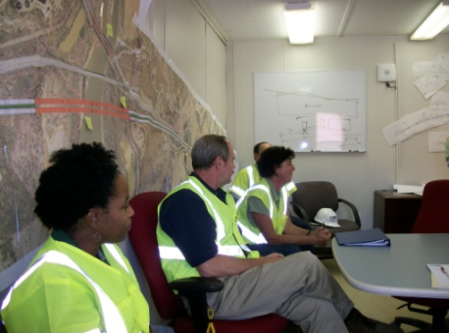
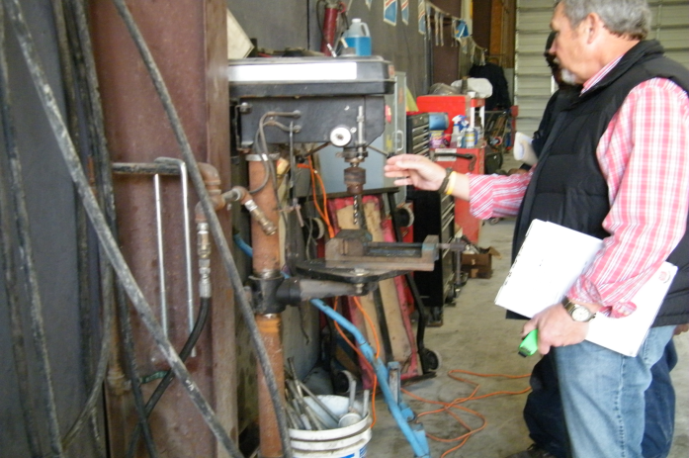
Special Emphasis Program
Construction
FFY 2022—4th Qtr.
NAICS 23—CONSTRUCTION | FFY 2021 |  | 1st Qtr. | 2nd Qtr. | 3rd Qtr. | 4th Qtr. | Total
Total Fatalities | 18 |  | 3 | 6 | 6 | 6 | 21
FFY 2022 2nd Qtr. Fatality Rate | 0.0025 |  | .0013 | .0025 | NA | NA | NA
Fatality Type | 1st Qtr. | 2nd Qtr. | 3rd Qtr. | 4th Qtr. | Total | Fatality Type | 1st Qtr. | 2nd Qtr. | 3rd Qtr. | 4th Qtr. | Total
Struck By | 1 | 2 | 1 | 1 | 5 | Inhalation | 0 | 0 | 0 | 0 | 0
Caught In/Between | 0 | 0 | 1 | 1 | 2 | Ingestion | 0 | 0 | 0 | 0 | 0
Bite/Sting/Scratch | 0 | 0 | 0 | 0 | 0 | Absorption | 0 | 0 | 0 | 0 | 0
Fall (Same Level) | 0 | 0 | 0 | 0 | 0 | Repeated Motion/Pressure | 0 | 0 | 0 | 0 | 0
Fall (From Elevation) | 0 | 2 | 3 | 2 | 7 | Cardio/Respiratory | 0 | 0 | 0 | 0 | 0
Struck Against | 0 | 0 | 1 | 0 | 1 | Shock | 1 | 2 | 0 | 2 | 5
Rubbed/Abraded | 0 | 0 | 0 | 0 | 0 | Other | 1 | 0 | 0 | 0 | 1
Notes:
s
Will be posting a new billboard on the May 2022 fall prevention standdown and for heat stress.

Slide 10
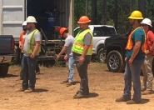
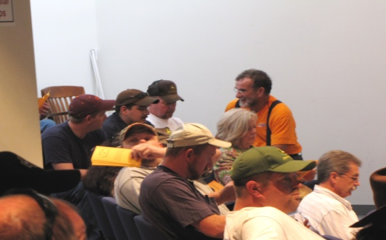
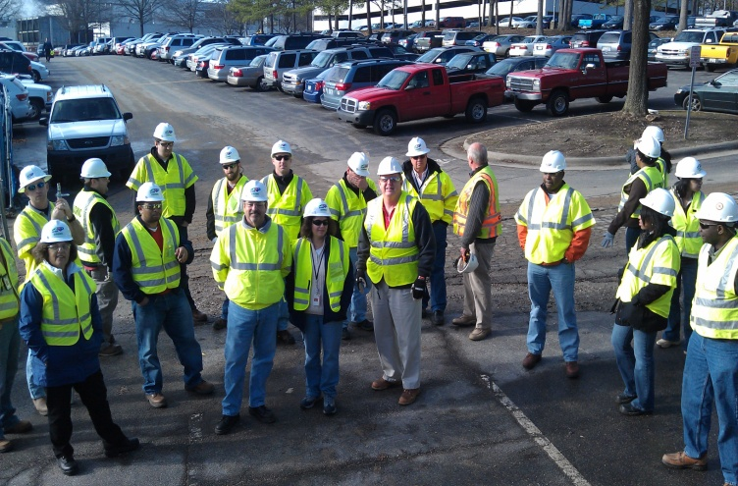
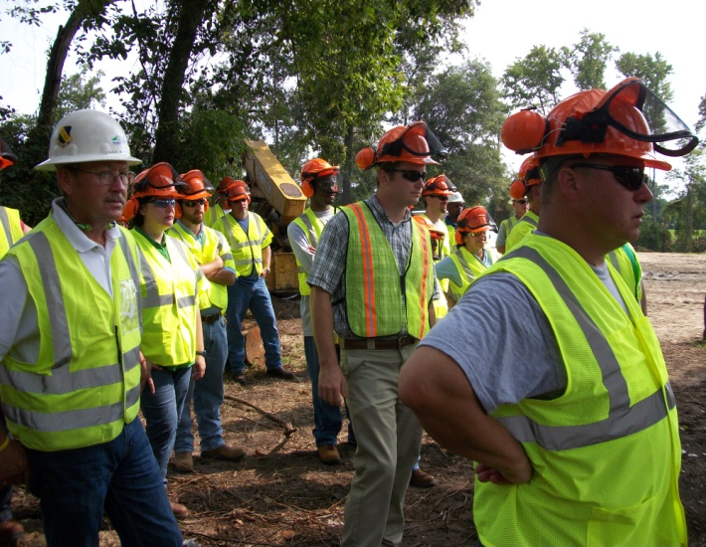
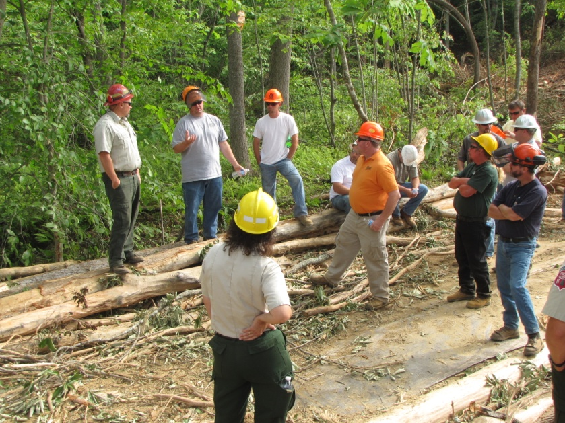
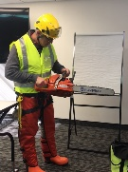
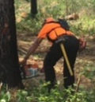
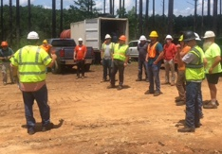
Special Emphasis Program
Construction
FFY 2022—4th Qtr.
 | North Carolina |  |  |  | National Average |  |  |  | North Carolina vs. National Average
 | CY 2020 |  | CY 2021 |  | CY 2020 |  | CY 2021 |  | 2021 Comparison
TRC | 2.0 | 10% Decrease |  | 1.8 | 2.5 | No Change |  | 2.5 | 28% Lower
DART | 1.0 | 9% Increase |  | 1.1 | 1.6 | No Change |  | 1.6 | 31% Lower
SEP ACTIVITY | 1st Qtr. | 2nd Qtr. | 3rd Qtr. | 4th Qtr. | Total | FFY Goal
Compliance Inspections | 253 | 269 | 244 | 253 | 1,019 | 1,050
Consultative Visits | 98 | 106 | 105 | 120 | 429 | 250
OSH Outreach Events (10- and 30- Hour Construction Courses) | 3 | 2 | 1 | 1 | 7 | 6
People Trained | 185 | 83 | 317 | 217 | 802 | 1,000

Slide 11
Special Emphasis Program
Logging and Arboriculture
FFY 2022—4th Qtr.
56173 | North Carolina |  |  |  | National Average |  |  |  | North Carolina vs. National Average
 | CY 2020 |  | CY 2021 |  | CY 2020 |  | CY 2021 |  | 2021 Comparison
TRC | 2.5 | 11% Increase |  | 2.8 | 3.0 | 6% Increase |  | 3.2 | 12% Lower
DART | 1.6 | 16% Increase |  | 1.9 | 2.0 | No Change |  | 2.0 | 5% Lower
SEP ACTIVITY | 1st Qtr. | 2nd Qtr. | 3rd Qtr. | 4th Qtr. | Total | FFY Goal
Compliance Inspections | 5 | 5 | 7 | 13 | 30 | 25
Consultative Visits | 3 | 1 | 10 | 3 | 17 | 15
OSH Training and Outreach Events | 1 | 5 | 3 | 2 | 11 | 3
People Trained | 9 | 125 | 122 | 18 | 264 | 75
NAICS 11331*—LOGGING | FFY 2021 |  | 1st Qtr. | 2nd Qtr. | 3rd Qtr. | 4th Qtr. | Total
Total Fatalities | 1 |  | 0 | 0 | 0 | 1 | 1
NAICS 56173—ARBORICULTURE | FFY 2021 |  | 1st Qtr. | 2nd Qtr. | 3rd Qtr. | 4th Qtr. | Total
Total Fatalities | 5 |  | 0 | 1 | 1 | 2 | 4
FFY 2021 4th Qtr. Combined Fatality Rate | .0028 |  | .0000 | .0028 | NA | NA | NA
* TRC/DART Data not available

Slide 12
Special Emphasis Program
Long Term Care Facilities
FFY 2022—4th Qtr.
NAICS 623*—LONG TERM CARE
 | North Carolina |  |  |  | National Average |  |  |  | North Carolina vs. National Average
 | CY 2020 |  | CY 2021 |  | CY 2020 |  | CY 2021 |  | 2021 Comparison
TRC | 9.3 | 34% Decrease |  | 6.1 | 11.5 | 27% Decrease |  | 7.3 | 16% Lower
DART | 7.2 | 40% Decrease |  | 4.3 | 9.3 | 43% Decrease |  | 5.3 | 19% Lower
*TRC/DART rate based on the 3-digit NAICS code
SEP ACTIVITY | 1st Qtr. | 2nd Qtr. | 3rd Qtr. | 4th Qtr. | Total | FFY Goal
Compliance Inspections | 10 | 18 | 9 | 5 | 33 | 24
Consultative Visits | 6 | 9 | 16 | 10 | 41 | 35
OSH Outreach Events | 0 | 0 | 1 | 2 | 3 | 2
People Trained | 0 | 0 | 8 | 19 | 27 | 40

Slide 13
Special Emphasis Program
Health Hazards
FFY 2022—4th Qtr.
COMPLIANCE INSPECTIONS | 1st Qtr. | 2nd Qtr. | 3rd Qtr. | 4th Qtr. | Total | FFY Goal
Silica | 6 | 18 | 13 | 17 | 54 | 60
Asbestos | 1 | 6 | 10 | 2 | 19
Isocyanates | 1 | 5 | 7 | 5 | 18
Lead | 1 | 3 | 3 | 3 | 10
Hexavalent Chromium | 1 | 2 | 1 | 0 | 4
Total | 10* | 34* | 34* | 27 | 105
Program Improvements | 4 | 12 | 7 | 18 | 41 | 20
*Some inspections involved more than one health hazard and generally included a program improvement
NCDOL Photo Library

Slide 14
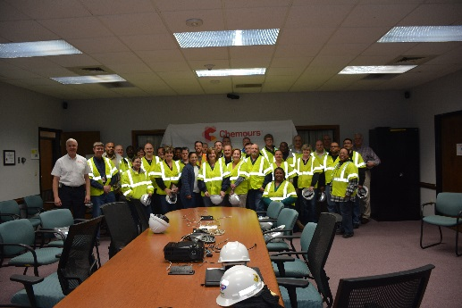
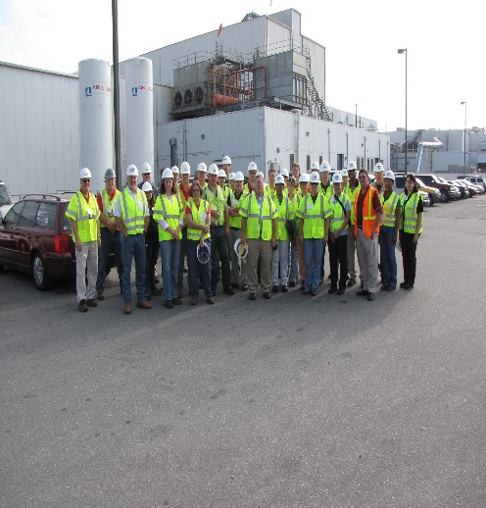
Special Emphasis Program
Health Hazards
FFY 2022—4th Qtr.
COMPLIANCE INSPECTION RESULTS
HEALTH HAZARDS | Number of Samples (Detectable Results) |  |  |  |  | Number With Overexposures |  |  |  |  | Average Severity Rate*
 | 1st Qtr. | 2nd Qtr. | 3rd Qtr. | 4th Qtr. | Total | 1st Qtr. | 2nd Qtr. | 3rd Qtr. | 4th Qtr. | Total | 1st Qtr. | 2nd Qtr. | 3rd Qtr. | 4th Qtr.
Silica | 1 | 20 | 7 | 2 | 30 | 0 | 0 | 1 | 1 | 2 | 0.79 | 0.18 | 0.99 | 0.37
Asbestos | 0 | 0 | 0 | 0 | 0 | 0 | 0 | 0 | 0 | 0 | 0 | 0 | 0 | 0
Isocyanates | 0 | 0 | 0 | 1 | 1 | 0 | 0 | 0 | 0 | 0 | 0 | 0 | 0 | 0.04
Lead | 0 | 0 | 0 | 3 | 3 | 0 | 0 | 0 | 0 | 0 | 0 | 0 | 0 | 0.13
Hexavalent Chromium | 1 | 0 | 2 | 0 | 3 | 0 | 0 | 0 | 0 | 0 | 0.01 | 0 | 0.03 | 0
Total | 2 | 20 | 9 | 6 | 37 | 0 | 0 | 1 | 1 | 2 | NA | NA | NA | NA
NCDOL Photo Library
* All Samples

Slide 15
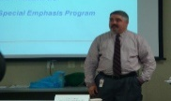
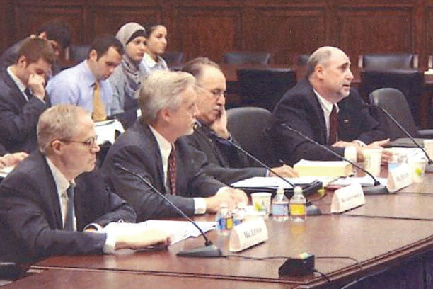
Special Emphasis Program
Health Hazards
FFY 2022—4th Qtr.
HEALTH HAZARDS | Consultative Surveys
 | 1st Qtr. | 2nd Qtr. | 3rd Qtr. | 4th Qtr. | Total
Silica | 30 | 30 | 25 | 43 | 128
Asbestos | 3 | 5 | 6 | 2 | 16
Isocyanates | 2 | 3 | 2 | 3 | 10
Lead | 12 | 4 | 7 | 5 | 28
Hexavalent Chromium | 3 | 3 | 2 | 5 | 13
Total | 50 | 45 | 42 | 58 | 195
FFY Goal | 125
NCDOL Photo Library
NCDOL Photo Library
SEP ACTIVITY | 1st Qtr. | 2nd Qtr. | 3rd Qtr. | 4th Qtr. | Total | FFY Goal
OSH Outreach Events | 7 | 3 | 3 | 13 | 26 | 20
People Trained | 76 | 59 | 41 | 224 | 400 | 300

Slide 16
Special Emphasis Program
Food Manufacturing
FFY 2022—4th Qtr.
NAICS 311*—FOOD MANUFACTURING
 | North Carolina |  |  |  | National Average |  |  |  | North Carolina vs. National Average
 | CY 2020 |  | CY 2021 |  | CY 2020 |  | CY 2021 |  | 2021 Comparison
TRC | 3.8 | 11% Decrease |  | 3.4 | 5.1 | 6% Decrease |  | 4.8 | 25% Lower
DART | 3.0 | 13% Decrease |  | 2.6 | 3.9 | 8% Decrease |  | 3.6 | 23% Lower
*TRC/DART rate based on the 3-digit NAICS code
SEP ACTIVITY | 1st Qtr. | 2nd Qtr. | 3rd Qtr. | 4th Qtr. | Total | FFY Goal
Compliance Inspections | 7 | 12 | 14 | 6 | 39 | 25
Consultative Visits | 4 | 9 | 5 | 6 | 24 | 12
OSH Outreach Events | 0 | 1 | 1 | 0 | 2 | 2
People Trained | 0 | 9 | 52 | 0 | 61 | 40

Slide 17
Special Emphasis Program
Grocery and Related Product Wholesalers
FFY 2022—4th Qtr.
NAICS 4244*—GROCERY AND RELATED WHOLESALERS
 | North Carolina |  |  |  | National Average |  |  |  | North Carolina vs. National Average
 | CY 2020 |  | CY 2021 |  | CY 2020 |  | CY 2021 |  | 2021 Comparison
TRC | 4.1 | 2% Decrease |  | 4.0 | 4.9 | 9% Increase |  | 5.4 | 26% Lower
DART | 3.1 | 3% Increase |  | 3.2 | 4.0 | 2% Increase |  | 4.1 | 22% Lower
*DART/TRC rate based on the 4-digit NAICS code
SEP ACTIVITY | 1st Qtr. | 2nd Qtr. | 3rd Qtr. | 4th Qtr. | Total | FFY Goal
Compliance Inspections | 7 | 6 | 4 | 4 | 21 | 20
Consultative Visits | 1 | 1 | 0 | 1 | 3 | 3
OSH Outreach Events | 0 | 1 | 0 | 2 | 3 | 2
People Trained | 0 | 9 | 0 | 6 | 15 | 40

Slide 18
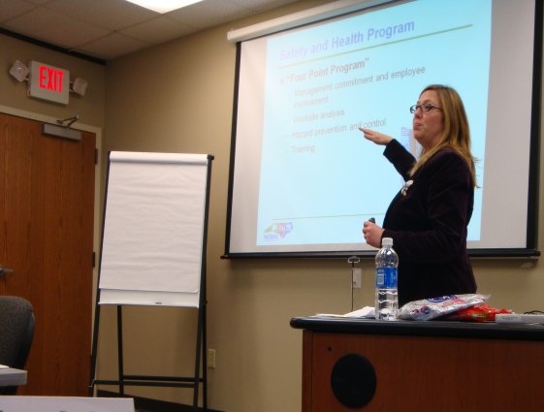
Special Emphasis Program
Amputations
FFY 2022—4th Qtr.
SEP ACTIVITY | 1st Qtr. | 2nd Qtr. | 3rd Qtr. | 4th Qtr. | Total | FFY Goal
Compliance Inspections | 50 | 30 | 40 | 44 | 168 | 150
Consultative Visits | 35 | 41 | 41 | 59 | 176 | 100
OSH Outreach Events | 11 | 15 | 6 | 7 | 39 | 15
People Trained | 139 | 296 | 118 | 128 | 681 | 400

Slide 19
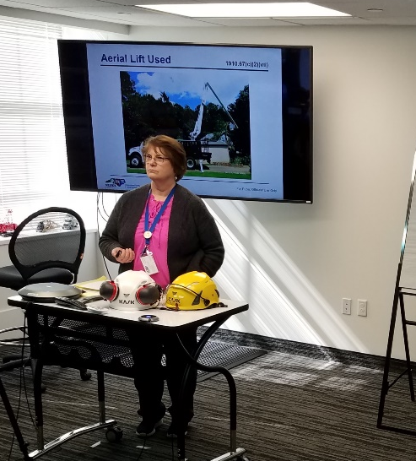
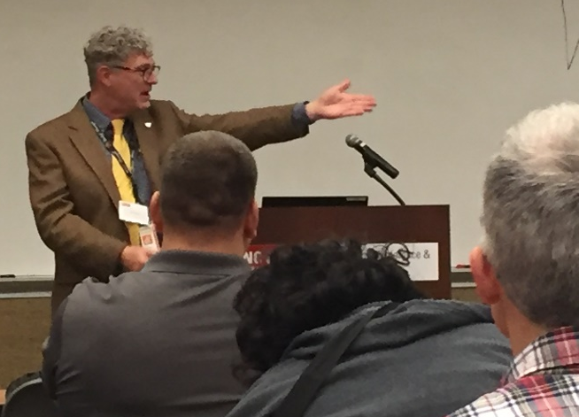
OSH Division
Public Sector
FFY 2022—4th Qtr.
 | CY 2020 |  | CY 2021
TRC | 4.2 | 12% Increase |  | 4.8
DART | 2.5 | 11% Increase |  | 2.8
ACTIVITY | 1st Qtr. | 2nd Qtr. | 3rd Qtr. | 4th Qtr. | Total | FFY Goal
Compliance Inspections | 17 | 24 | 37 | 16 | 94 | 100
Consultative Visits | 75 | 48 | 84 | 40 | 247 | 210
OSH Outreach Events/Booths | 1 | 11 | 7 | 7 | 26 | 6
Trained | 46 | 410 | 184 | 304 | 944 | 600

Slide 20
OSH Division
Education and Training Outreach
FFY 2022—4th Qtr.
OUTREACH EVENT | 1st Qtr. | 2nd Qtr. | 3rd Qtr. | 4th Qtr. | Total | FFY Goal
General Industry—10-Hour Course | 2 | 2 | 0 | 0 | 4 | 4
General Industry—30-Hour Course | 1 | 1 | 0 | 0 | 2 | 1
NC #500/502—Construction Train-the-Trainer Course/ NC #501/503—General Industry Train-the-Trainer Course | 0 | 0 | 0 | 1 | 1 | 1
Construction—10-Hour Course | 2 | 1 | 1 | 1 | 5 | 5
Construction—30-Hour Course | 1 | 1 | 0 | 0 | 2 | 1
Labor One/Booth Events | 2 | 1 | 2 | 1 | 6 | NA
Speaker’s Bureau | 19 | 23 | 22 | 20 | 84 | NA
Webinars | 7 | 20 | 27 | 32 | 86 | NA
OSH Workshops | 0 | 0 | 2 | 1 | 3 | NA
Technical Assistance | 6 | 9 | 4 | 0 | 4 | NA
Spanish Training and Outreach Events | 0 | 0 | 0 | 1 | 1 | NA
Train-the-Trainer Program (Construction/General Industry)—Events | 3 | 1 | 4 | 0 | 8 | NA
Train-the-Trainer Program (Construction/General Industry)—Trained | 35 | 5 | 37 | 0 | 77 | NA

Slide 21
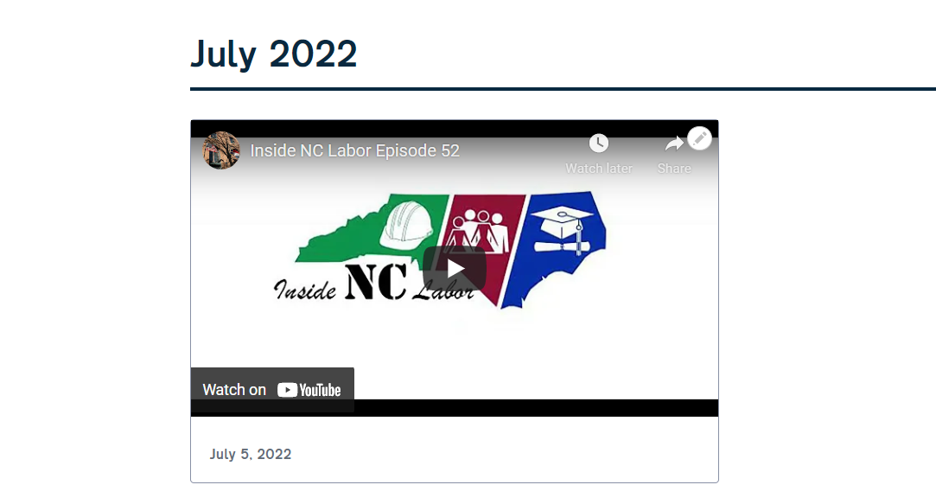



OSH Division
Social Media
FFY 2022—4th Qtr.
Inside NC Labor Podcasts
  57 episodes
Facebook
  2,176 followers
Instagram
  707 followers
Twitter
  2,177 followers

Slide 22
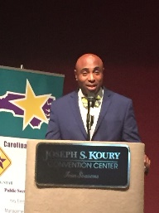
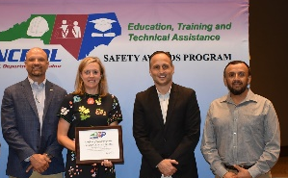
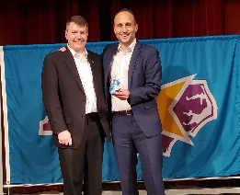
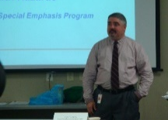

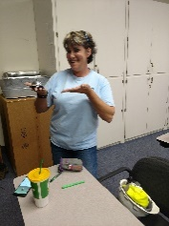
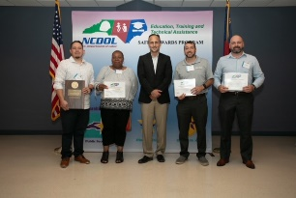
OSH Division
Recognition Programs
FFY 2022—4th Qtr.
*Cumulative Total
STAR SITES—New, Recertification, Promotion | 1st Qtr. | 2nd Qtr. | 3rd Qtr. | 4th Qtr. | Total | FFY Goal | Approved Star Sites
Carolina Star | 5 | 1 | 6 | 11 | 23 |  | 102
Building Star | 2 | 1 | 2 | 3 | 8 |  | 23
Rising Star | 0 | 0 | 1 | 0 | 1 |  | 4
Public Sector Star | 0 | 1 | 1 | 5 | 7 |  | 18
Total | 7 | 3 | 10 | 19 | 39 | 20 | 147
NCDOL Photo Library
 | 1st Qtr. | 2nd Qtr. | 3rd Qtr. | 4th Qtr. | Total | FFY Goal
Star Sites—Termination/Withdrawn | 1 | 0 | 2 | 1 | 4
Star Booths | 0 | 0 | 3 | 4 | 7
Star Presentations | 5 | 6 | 4 | 9 | 24 | 10
Star Program Interventions | 28 | 42 | 52 | 44 | 166 | 100
Notes:
Withdrew: Emerson Automation Solutions – work site closed

Slide 23


OSH Division
Recognition Programs
FFY 2022—4th Qtr.
SHARP SITES—New/Renewal | 1st Qtr. | 2nd Qtr. | 3rd Qtr. | 4th Qtr. | Total | FFY Goal | Approved SHARP Sites*
SHARP—Construction | 1 | 0 | 2 | 0 | 3 |  | 6
SHARP—General Industry | 15 | 14 | 19 | 16 | 64 |  | 105
SHARP—Public Sector | 9 | 9 | 0 | 3 | 21 |  | 49
Totals | 25 | 23 | 21 | 19 | 88 | 60 | 160
*Cumulative Total
GOLD STAR GROWERS—NEW | 1st Qtr. | 2nd Qtr. | 3rd Qtr. | 4th Qtr. | Total
 | 29 | 202 | 45 | 7 | 283
SAFETY AWARDS |  |  |  |  | Total
CY 2022 Safety Awards Season* (Silver, Gold, Million Hour) |  |  |  |  | 2,132
 | 1st Qtr. | 2nd Qtr. | 3rd Qtr. | 4th Qtr. | Total
Million Hour Awards | 9 | 36 | 3 | 2 | 50
*CY 2022 Preliminary numbers
Notes:
2022 Safety Award Season reverting to normal schedule and may be a hybrid of virtual and in-person.

Slide 24


OSH Division
Alliances and Partnerships
FFY 2022—4th Qtr.
Alliances
  Carolinas AGC
  Lamar Advertising Company
  Mexican Consulate
  N.C. State – Industry Expansion Solutions
  Safety and Health Council of NC
  NUCA of the Carolinas
  NCALGESO
  Tree Care Industry Association (Signing 11/10/2022)

Slide 25
OSH Division
Alliances and Partnerships
FFY 2022—4th Qtr.
Partnerships
  Barringer Construction
    Charlotte - Foundry Building Including Ancillary Buildings (2020 – 2023)
  Holder – Edison Foard – Leeper, A Joint Venture
    Charlotte - Charlotte Douglas International Airport – Terminal Lobby Expansion (2021 – 2023)
  Jacobs Engineering Group
    Holly Springs - Biotech Manufacturing Facility and Campus (2022 – 2024)

Slide 26
OSH Division
Complaint Desk*
FFY 2022—4th Qtr.
East Compliance | West Compliance | Agricultural Safety and Health
ACTIVITY | 1st Qtr. | 2nd Qtr. | 3rd Qtr. | 4th Qtr. | 1st Qtr. | 2nd Qtr. | 3rd Qtr. | 4th Qtr. | 1st Qtr. | 2nd Qtr. | 3rd Qtr. | 4th Qtr. | Cumulative Total | FFY 2021
Complaints | 319 | 395 | 419 | 506 | 365 | 521 | 437 | 590 | 3 | 7 | 6 | 7 | 3,575 | 4,321
Referrals | 79 | 77 | 94 | 324 | 98 | 91 | 117 | 120 | 8 | 0 | 10 | 9 | 777 | 743
Fat/Cat | 21 | 38 | 27 | 118 | 30 | 22 | 28 | 20 | 2 | 2 | 3 | 3 | 228 | 227
Totals | 419 | 510 | 540 | 612 | 493 | 634 | 582 | 730 | 13 | 9 | 19 | 19 | 4,580 | 5,291
*712 of the total were COVID-related.
**Includes calls that were processed but not necessarily inspected. Fat/Cat includes calls regarding heart attacks and other natural causes.
ACTIVITY | 1st Qtr. | 2nd Qtr. | 3rd Qtr. | 4th Qtr. | Cumulative Total | FFY 2021
Complaints Not in OSH Jurisdiction* | 824 | 919 | 1,078 | 1,301 | 4,122** | 3,232
*Includes complaints related to wage and hour, discrimination, worker's compensation questions, beyond statute of limitation time frame, etc.
**172 of the total were COVID-related.

Slide 27
OSH Division
Internal Training
FFY 2022—4th Qtr.
1st Qtr.—COURSE
In-Person | No. of Events | Trained
OCSS Confined Space Entry | 2 | 17
OCSS Excavation and Trenching | 1 | 9
Labor One Driver Training | 4 | 5
Virtual | No. of Events | Trained
Combustible Dust | 1 | 82
Engineering Controls | 1 | 47
10-Hour General Industry Awareness Course | 1 | 3
Total Trained |  | 163

Slide 28
OSH Division
Internal Training
FFY 2022—4th Qtr.
2nd Qtr.—COURSE
In Person | No. of Events | Trained
Labor One Training | 3 | 4
Virtual | No. of Events | Trained
OSH #100 Initial Compliance Course | 1 | 13
Technical Writing | 1 | 11
OSHA Express | 1 | 12
Legal Aspects | 1 | 11
Logging SEP | 1 | 16
Food Manufacturing SEP | 1 | 1
Grocery and Related Product Wholesalers | 1 | 2
Bloodborne Pathogens | 1 | 1
Total Trained |  | 71

Slide 29
OSH Division
Internal Training
FFY 2022—4th Qtr.
3rd Qtr.—COURSE
In Person | No. of Events | Trained
OSH #125 Health Standards Course | 1 | 7
OCSS Excavation and Trenching | 1 | 12
Labor One Training | 1 | 4
Virtual | No. of Events | Trained
Grocery SEP | 1 | 16
Electrical Safety | 1 | 39
Total Trained |  | 78

Slide 30
OSH Division
Internal Training
FFY 2022—4th Qtr.
4th Qtr.—COURSE
In Person | No. of Events | Trained
CPR/AED | 1 | 4
Virtual | No. of Events | Trained
OSH #105 Safety Standards Course | 1 | 9
Long Term Care SEP | 1 | 1
Grocery SEP | 1 | 4
Powered Industrial Trucks | 1 | 1
HAZCOM | 1 | 1
Fall Protection | 1 | 1
Total Trained |  | 21

Slide 31
OSH Division
Cut-Loose, In-Training, Vacant
FFY 2022—4th Qtr.
West Compliance | Safety | % | Industrial Hygienist | %
Cut Loose | 17 | 58% | 20 | 77%
In-Training | 8 | 28% | 1 | 4%
Vacant | 4 | 4% | 5 | 19%
Total | 29* |  | 26
East Compliance | Safety | % | Industrial Hygienist | %
Cut Loose | 10 | 43% | 3 | 17%
In-Training | 4 | 17% | 2 | 18%
Vacant | 9 | 39% | 12 | 71%
Total | 23 |  | 17
Safety Cut Loose | 52% | Health Cut Loose | 53%
Safety In-Training | 23% | Health in-Training | 7%
Safety Vacant | 25% | Health Vacant | 40%

Slide 32
OSH Division
Cut-Loose, In-Training, Vacant
FFY 2022—4th Qtr.
Consultative Services | Safety | % | Industrial Hygienist | %
Cut Loose | 9 | 82% | 8 | 100%
In-Training | 0 | 0% | 0 | 0%
Vacant | 2 | 18% | 0 | 0%
Total | 11 |  | 8
Education, Training and Technical Assistance | Safety | % | Industrial Hygienist | %
Cut Loose | 10 | 91% | 6 | 91%
In-Training | 1 | 9% | 0 | 0%
Vacant | 0 | 0% | 1 | 9%
Total | 11 |  | 6
Agricultural Safety and Health | Safety | % | Industrial Hygienist
Cut Loose | 5 | 63% | NA
In-Training | 1 | 13% | NA
Vacant | 2 | 25% | NA
Total | 8

Slide 33
OSH Division
Standards Update
FFY 2022—4th Qtr.
Alerts
  UV 1—Ultraviolet Wands
    FDA alert warning consumers about unsafe UV wands advertised to disinfect surfaces and kill germs. Wands may expose users and those nearby to unsafe levels of UV-C that may cause injury after a few seconds of use.
Compliance Directive
  CPL 02-00-042—Interagency Agreement Between MSHA and OSHA
    Provides guidelines for implementing the Interagency Agreement between the Mine Safety and Health Administration and the Occupational Safety and Health Administration – Jurisdictional issues.

Slide 34
OSH Division
Standards Update
FFY 2022—4th Qtr.
Code of Federal Regulation
  CFR 192—CFR Correction: Occupational Safety and Health Standards – Occupational Noise
    Amendment corrects an equation in Appendix A, 29 CFR 1910.95.
  CFR 193—CFR Correction: Safety and Health Regulations for Construction – Lead
    Amendment corrects 29 CFR 1926.62(d)(4)(ii) – Referenced paragraph (d)(10) instead of (d)(9).
  CFR 194—Correcting Amendment: Safety and Health Regulations for Construction – Lead
    Amendment corrects 29 CFR 1926.62(d)(2)(iv) – List of tasks had been removed.

Slide 35
OSH Division
Retaliatory Employment Discrimination
FFY 2022—4th Qtr.
Bureau Staffing
Jaleesa Thomas | Information Officer
Norma Velasco | Administrative Assistant II
James Agosto | Investigator
David Bailey | Investigator
Dianne Daniels | Investigator
Vacant | Investigator
Erin Smith | Investigator
Theodore Place | Investigator
Alvin Vocalan | Investigator
Harriet Hopkins | Administrator

Slide 36
OSH Division
Retaliatory Employment Discrimination
FFY 2022—4th Qtr.
OSH Complaint Statistics | 1st Qtr. | 2nd Qtr. | 3rd Qtr. | 4th Qtr. | Total
Total OSH Complaints Filed | 64 | 59* | 82¹ | 53⁶ | 258
Total OSH Complaints Closed | 68 | 75** | 65² | 22 | 230
Number of OSH Cases Closed Within 90 Days of File Date | 2 | 3*** | 0 | 1 | 6
Percentage of Cases Closed Within 90 Days of File Date | 4%* | 6%*** | 0% | 4.5% | NA
Of Cases Closed, Average Number of Elapsed Days Between File Date and Closed Date | 288* | 279 | 266³ | 219 | NA
Total Number of OSH Complaints Pending at End of Reporting Period | 103** | 100**** | 118⁴ | 143 | NA
Percentage of Pending OSH Complaints Over 90 Days Old (From Filing) | 69% | 71% (71/100) | 47% | 67% | NA
Average Number of Elapsed Days Since Filing Date of All OSH Cases Pending at End of the Reporting Period | 230* | 269 | 111⁵ | 147 | NA
¹Includes 28 Section 11(c) complaints (82-18=64
²Includes 38 OSH and 27 Administrative closures of Section 11(c) complaints
³WB State Report: 286
⁴WB State Report: 141
⁵WB State Report: 190
⁶Does not include Section 11(c)

Slide 37
OSH Division
Retaliatory Employment Discrimination
FFY 2022—4th Qtr.
OSH Complaint Disposition | 1st Qtr. | 2nd Qtr. | 3rd Qtr. | 4th Qtr. | Total
Administrative Closure (REDB Opened in OnBase and Docketed in IMIS) | 24 | 24 | 27 | 2 | 77
Withdrawn (Includes Requested RTS Letters) | 10 | 9 | 7 | 11 | 37
Merit (Included in SAMM 15 Merit) | 4 | 10 | 5 | 0 | 19
Total SAMM 15 Merit | 12 | 17 | 7 | 0 | 36
Total SAMM 15 Percent Merit (12/42) | 27% | 33% (17/51- No AC) | 18% | 0 | NA
Dismissal Right-to-Sue (Includes No Merit and Unresponsive) | 22 | 25 | 24 | 9 | 80
Settled Other (Included in SAMM 15) | 8 | 7 | 2 | 0 | 17
Total Cases Closed by Disposition | 68 | 75 (51 + 24 AC) | 65⁶ | 22 | 230
TOTAL DAMAGES PAID This Quarter (Includes Settlements With Aid of the Bureau During Informal Discussions or Mediation.) | $96,648 | $38,000 | $10,000⁷ | $0.00 | $144,648
⁶28 closures were administrative closures of Section 11(c) cases; Balance is 38 closures.
⁷I cannot find discrepancy with Onbase ($10,000) and WB State Summary Report ($18,000). It may have to do with a case that was closed in one quarter, but the settlement was paid in another.

Slide 38
OSH Division
Retaliatory Employment Discrimination
FFY 2022—4th Qtr.
OIS Report | 4th Qtr.
# of New Docketed Cases | 43
# of Administrative Closed Cases | 0
# of Cases Completed | 0
# Completed Within 90 Days | 0
% Completed Within 90 Days – SAMM 14 | 0%
Average # Days to Complete – SAMM 16 | 0
# of Pending Cases | 43
% Pending Over 90 Days | 2.33%
Average # of Days Pending | 48.95

Slide 39

Thank You For Attending!
FFY 2022—4th Qtr.
Questions?
1-800-NC-LABOR
(1-800-625-2267)
www.labor.nc.gov
Notes:
39

