Slide 1
North Carolina Department of Labor Occupational Safety & Health Division Director’s Office Update via Lifesize November 19, 2020
Presented by:
Kevin Beauregard, Deputy Commissioner of Labor/Director
Scott Mabry, Assistant Deputy Commissioner/ Assistant Director
Occupational Safety and Health Division of North Carolina

Slide 2
OSH Division HR/Budget Update
Budget
407 Certifications/Designations
State FY 2021 Budget
2.5% LI
COVID-19 Impact?
Fed FY2021 Budget
CR through 12/11/2020
FY 2020 NC’s 23g grant increased by $379,100
FY 2020 21d grant increased by $37,600
Charlotte Lease
Equipment Purchases
Over $500k since February
New computers/monitors
Additional Lifesize Equipment
COVID PPE/Supplies, Infrared Cameras, PAPRs, Other Field Equipment
23 CSP
12 CIH
14 ASP
2 CHMM
4 CHST
3 OHST
80 OCSS
10 CPM
227 Various MESH Designations
13 Remote Pilots
16 Virtual Observers
3 Other Designations
65 PARs processed, $131k

Slide 3
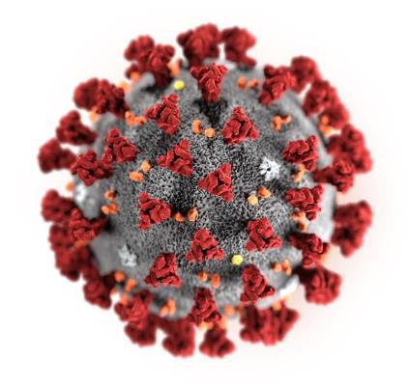
OSHNC Coronavirus Disease 2019 (COVID-19) Activities
Illustration: CDC / Alissa Eckert & Dan Higgins

Slide 4
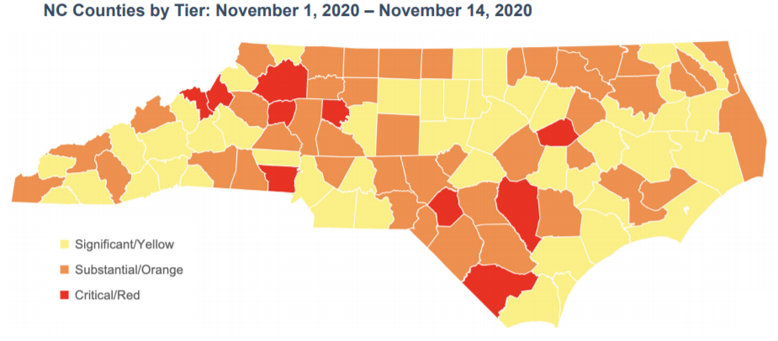
New NC DHHS County Alert System for levels of Community Spread of COVID-19
Notes:
Red > 10%
Orange 8-10%
Yellow < 8%

Slide 5
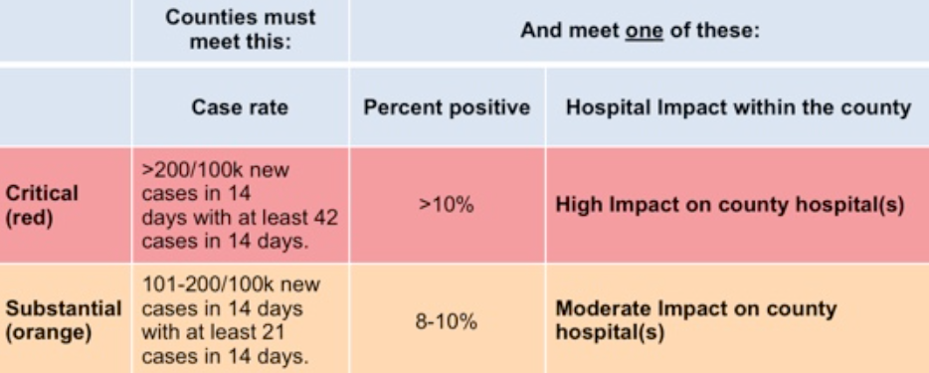
Coding Key and Criteria

Slide 6

OSH Division
COVID-19 Activities FFY20*
Calls/Emails | April* | May* | June* | July* | August* | September* | Total
OSH Director's Office | 217 | 436 | 397 | 390 | 397 | 306 | 2143
ETTA | 687 | 262 | 155 | 108 | 86 | 49 | 1347
ASH** | 45 | 45 | 32 | 56 | 74 | 89 | 705
PSIM | 0 | 2 | 2 | 4 | 3 | 0 | 22
CSB | 401 | 376 | 101 | 127 | 109 | 70 | 2177
Totals | 1350 | 1021 | 687 | 685 | 669 | 514 | 4926
*Monthly data as follows: April 2020 includes data through May 1, May 2020 includes data from May2- June 5,
June 2020 includes data from June 6-July 3, July 2020 includes data from July 4-July 31. August 2020 includes data from August 1 – August 28, September 2020 includes data from August 29-October 2
**Includes weekly conference calls with other Agencies.

Slide 7

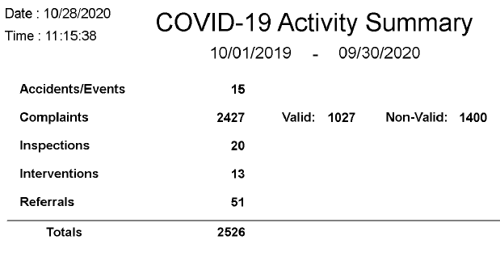
OSH Division
COVID-19 Compliance Activities FFY20*

Slide 8
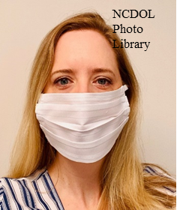
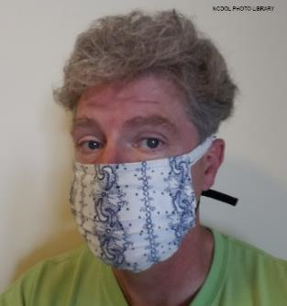
Top 10 NAICS OSHNC FY20 COVID-19 Related Complaints:
147 - NAICS 722310, Food Service Contractors
130 - NAICS 722511, Restaurants
66 - NAICS 445110, Supermarkets
62 - NAICS 621111, Physician Offices
57 - NAICS 311615, Poultry Processing
53 - NAICS 623110, Nursing Care Facilities
52 - NAICS 622110, Hospitals
49 - NAICS 452210, Department Stores
34 - NAICS 561422, Telemarketing Centers
33 - NAICS 713940, Fitness Centers

Slide 9
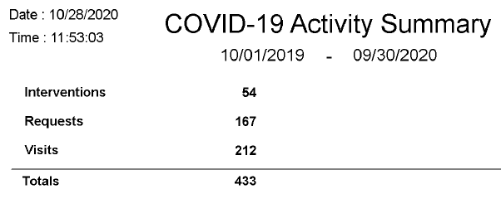
OSH Division
COVID-19 Consultation Activities FFY20*

Slide 10
OSH Division
COVID-19 Activities FFY20*
PSIM | March/April* | May* | June* | July* | August* | September* | Totals
COVID-19 Related Disclosure Requests | 0 | 194 | 8 | 153 | 1,228 | 44 | 1,627
ASH | March/April* | May* | June* | July* | August* | September* | Totals
Guidance Documents | 1 | 0 | 0 | 0 | 0 | 0 | 1
Director’s Office | March/April* | May* | June* | July* | August* | September* | Totals
Meetings | 10 | 26 | 25 | 16 | 4 | 21 | 102
*Monthly data as follows: April 2020 includes data through May 1: May 2020 includes data from May 2 - June 5: June 2020 includes data from June 6 - July 3: July 2020 includes data from July 4 - July 31. August 2020 includes data from August 1 – August 23.

Slide 11
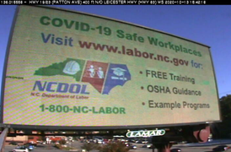
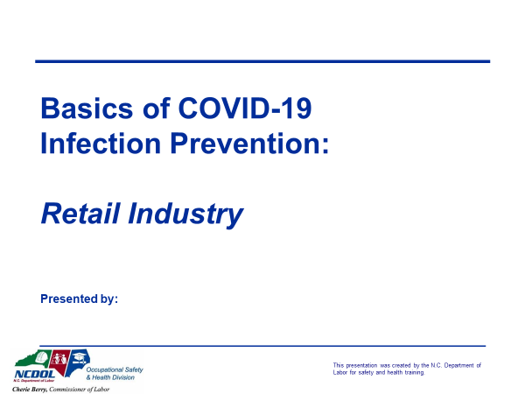
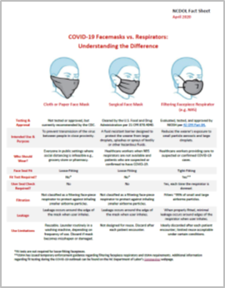
OSH Division
COVID-19 Activities FFY20*
ETTA | March/April* | May* | June* | July* | August* | September* | Totals
Live Webinars | 13 | 3 | 3 | 2 | 5 | 2 | 28
Pre-recorded Webinars | 4 | 0 | 0 | 0 | 2 | 0 | 6
PowerPoints | 4 | 1 | 2 | 0 | 14 | 4 | 25
Hazard Alerts | 6 | 0 | 0 | 0 | 0 | 1 | 7
Streaming Videos | 15 | 16 | 14 | 9 | 12 | 6 | 72
A-Z Topics Added/Updated | 4 | 5 | 5 | 3 | 4 | 3 | 24
Fact Sheets | 1 | 0 | 2 | 1 | 0 | 0 | 4
Example Programs | 0 | 0 | 1 | 0 | 0 | 0 | 1
Compliance Memos | 8 | 2 |  | 0 | 0 | 0 | 10
*Monthly data as follows: April 2020 includes data through May 1: May 2020 includes data from May 2 - June 5: June 2020 includes data from June 6 - July 3: July 2020 includes data from July 4 - July 31. August 2020 includes data from August 1 – August 30 and September 2020 includes data from August 31-September 27. .

Slide 12
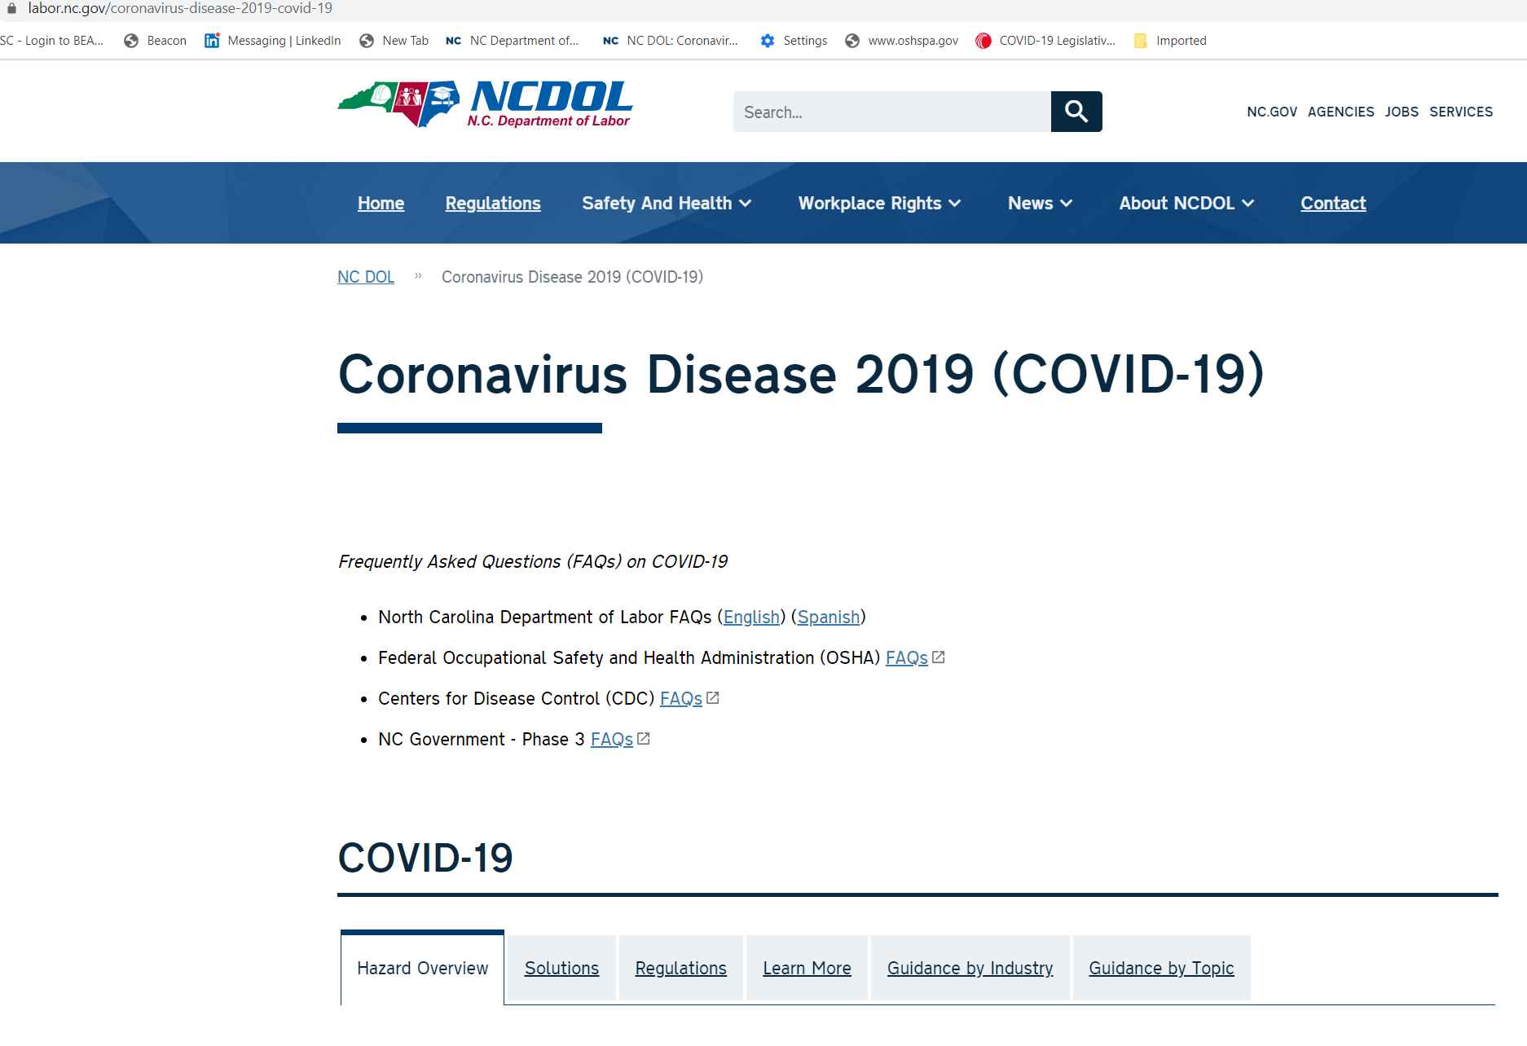
FAQ’s and Guidance Information

Slide 13

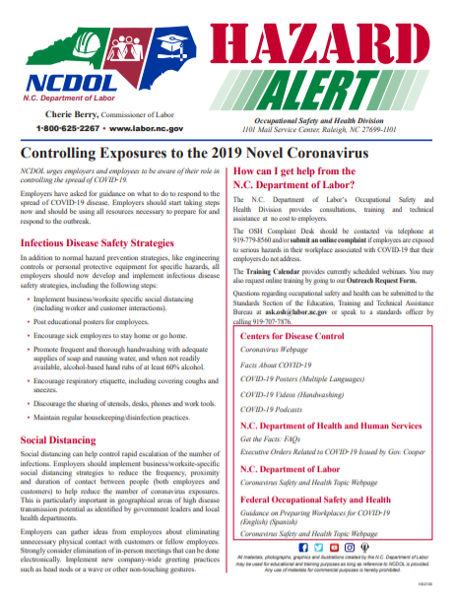
Guidance For All Employers

Slide 14
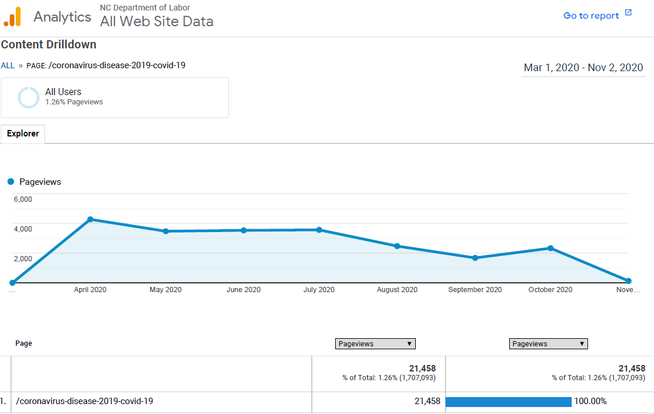
NCDOL COVID-19 Web Page Views

Slide 15
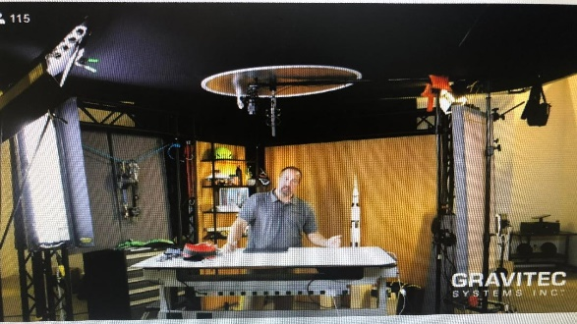
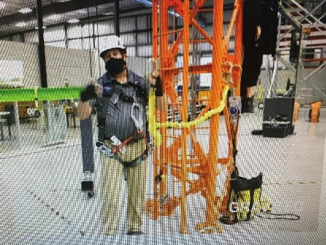
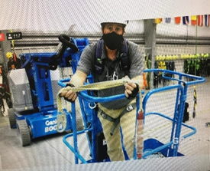
OSHA and OSHNC Migration to Virtual Training
Adobe Captivate
Used to create virtual training courses with interactive slides, videos, etc.
Software purchased for ETTA staff
Captivate Training for training staff held this past Summer/Fall
OSHA 125 virtual training held September 14th -24th
Gravitec virtual fall protection training held October 7th
ASH and IH virtual training being planned for December
Additional OSH Courses being planned for 2021
OSHA Training Institute began offering Virtual Courses in 2020 and will continue to do so in 2021
Notes:
10 hr (GI and Construction)
HAZWOPR 8 hr refresher

Slide 16
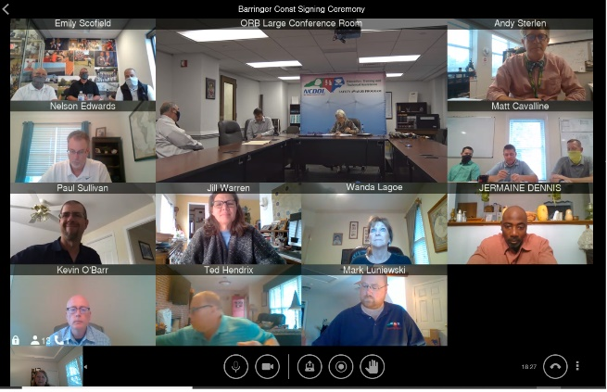
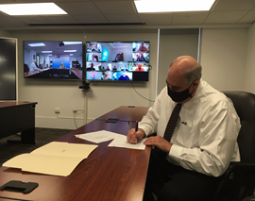
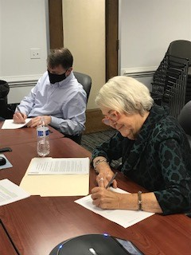
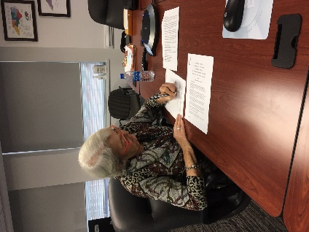
Other Virtual Activities During Ongoing Pandemic
OSH Review Commission Began Using OSH Lifesize System in Spring 2020 to Conduct Formal Hearings
Virtual Safety Awards, Service Awards and an OSH Advisory Board meeting
Many virtual meetings and conferences held on Lifesize, MS Teams and Zoom

Slide 17
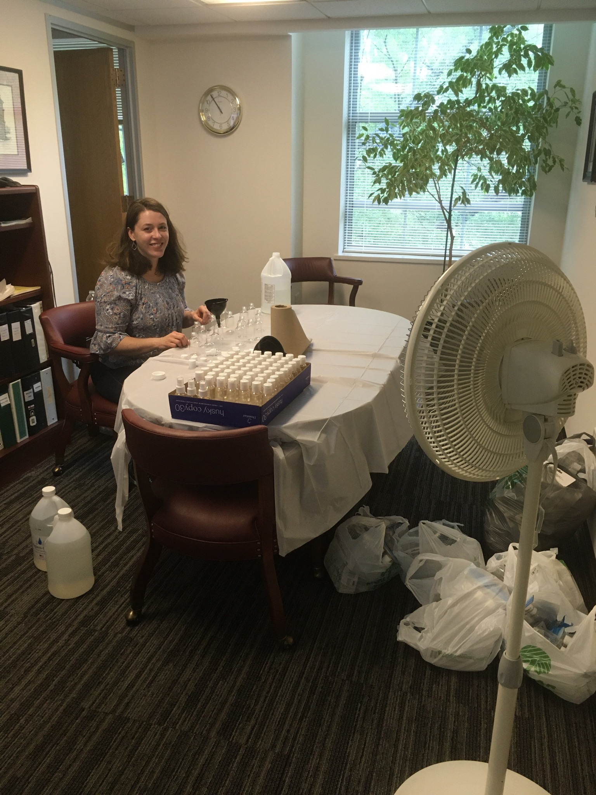
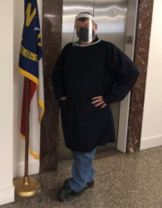
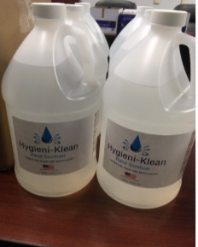
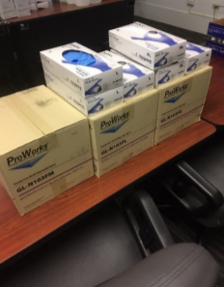
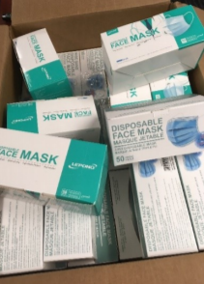
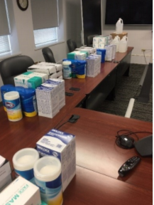
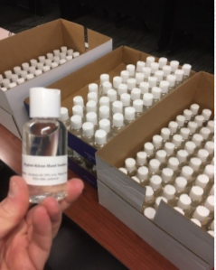
Thank-You For Adapting!

Slide 18

FFY 2019 Comprehensive FAME
No new findings or observations
Included review of 20 fatality files, 88 other unprogrammed files, 6 consultation files and 13 EDB files
Interviews, policy review, training, internal audits, AR,
SAMM, SIR, MARC, within acceptable parameters
NC penalties below the national average

Slide 19
2018 BLS Injury and Illness Rates Per 100 Full-Time Employees
Industry | NC Total Recordable Cases (TRC) | NC Days Away Restricted or Transferred (DART) | National Total Recordable Cases (TRC) | National Days Away Restricted or Transferred (DART)
All Industries | 2.5 | 1.3 | 3.0 | 1.6
Private Industry | 2.3 | 1.2 | 2.8 | 1.5

Slide 20
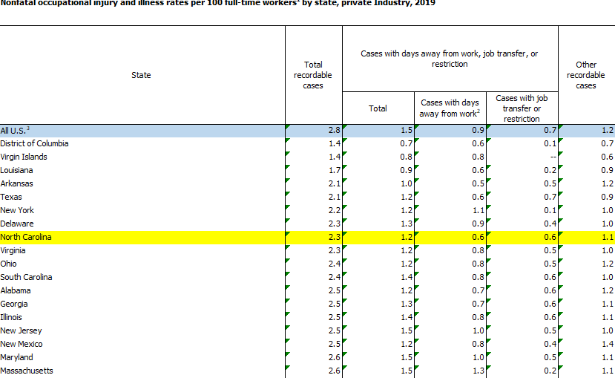
2019 BLS Private Sector TRC/DART NC 5th Lowest Rate in U.S.

Slide 21
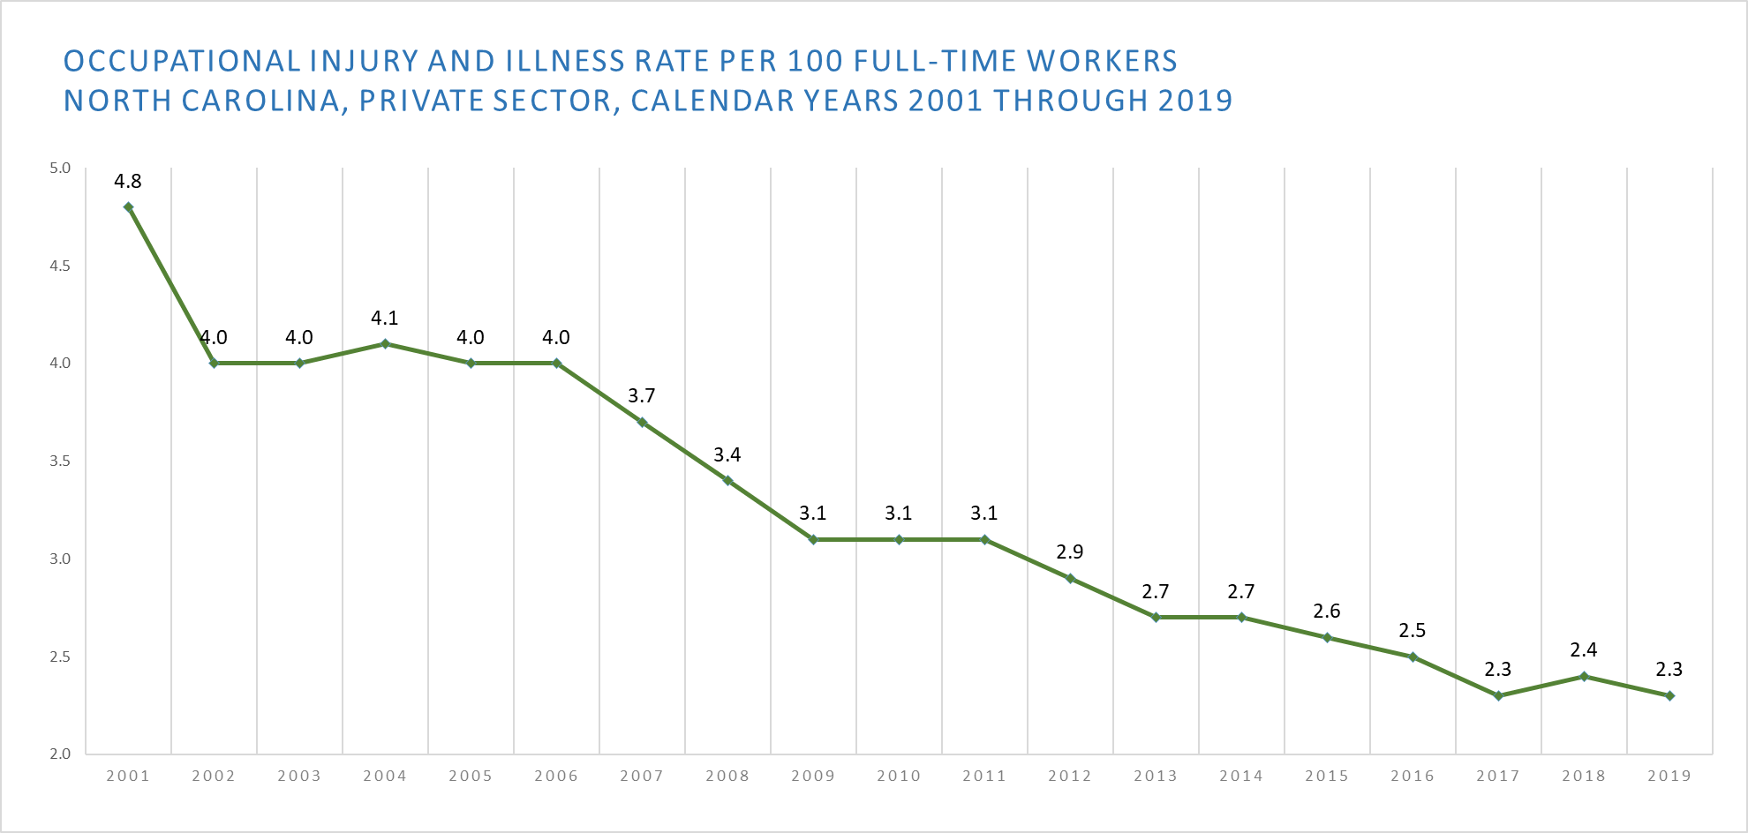
BLS Survey NC Data CY2001- CY2019 (Private Industry TRC)

Slide 22
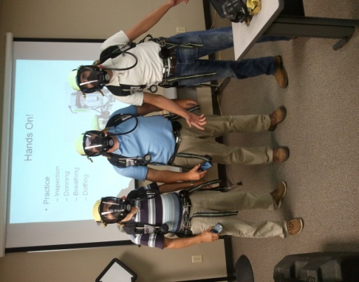
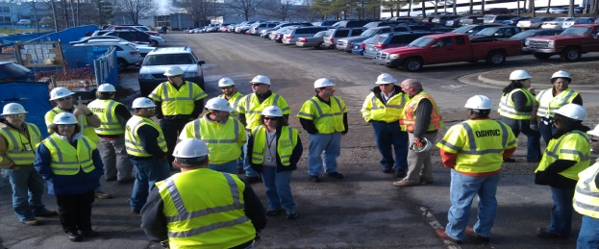

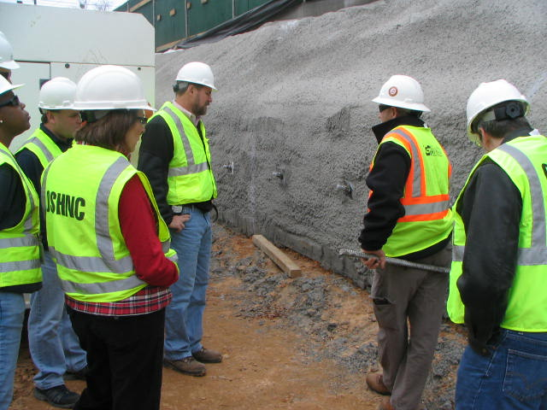
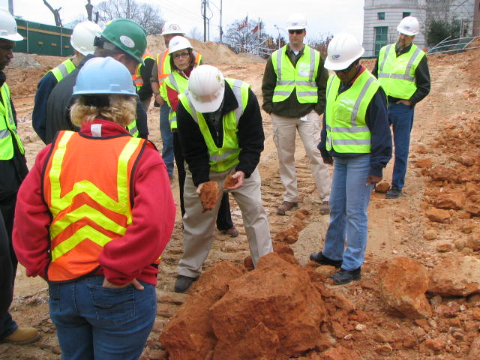
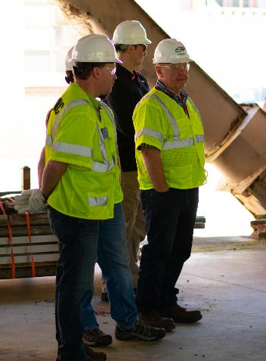
OSH Division
Fatalities Inspected
FFY 2020
FATALITY TYPE | Total | FATALITY TYPE | Total
Struck By | 21 | Inhalation | 1
Caught In/Between | 10 | Ingestion | 0
Bite/Sting/Scratch | 0 | Absorption | 0
Fall (Same Level) | 1 | Repeated Motion/Pressure | 0
Fall (From Elevation) | 18 | Cardio/Respiratory | 1
Struck Against | 0 | Shock | 2
Rubbed/Abraded | 0 | Other | 8
COVID-19 |  |  | 16
Fatalities Under OSH Division Jurisdiction
FFY 2019 |  | FFY 2020 | Total
Total Fatalities | 54 | Fatalities | 78
NCDOL Photo Library

Slide 23
OSH Division
Strategic Plan Goals
FFY 2020
COMPLIANCE | Total | FFY Goal
Safety Inspections | 1,259 | 1,193
Health Inspections | 813 | 755
CONSULTATION | Total | FFY Goal
Safety Visits Private Sector | 695 | 577
Safety Visits Public Sector Visits | 107 | 78
Health Visits Private Sector | 363 | 282
Health Visits Public Sector | 106 | 75
OSH DIVISION | Total | FFY Goal
Program Improvements | 2,166 | 2,060
People Trained in Special Emphasis Program Areas | 6,111 | 3,700
People Trained at OSH Division Sponsored Events | 8,572 | 7,350

Slide 24

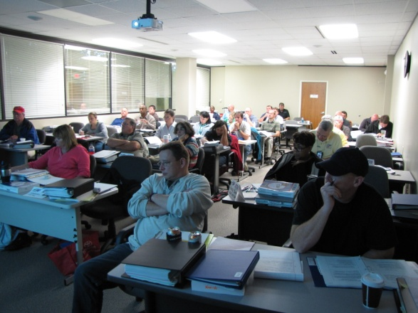
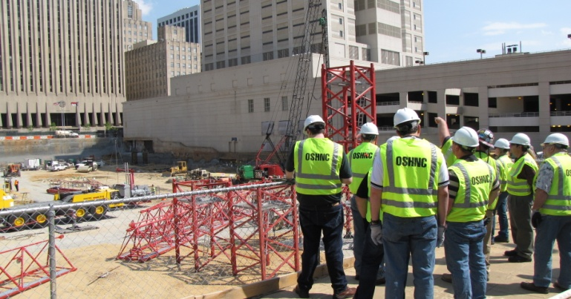

OSH Division
Strategic Plan Goals
FFY 2020
Education, Training and Technical Assistance (ETTA) | Total | FFY Goal
Publications Distributed | 20,678 | 20,000
Standards Interpretations | 3,379 | NA
Agricultural Safety and Health (ASH) | Total | FFY Goal
Outreach Materials Distributed | 2,472 | 3,500
Compliance Inspections | 39 | 80
Certificates Issued | 1,547 | 1,500
Preoccupancy Inspections | 1,631 | 1,700
NCDOL Photo Library

Slide 25
OSH Division
Complaint Desk*
FFY 2020—Fall
East Compliance | West Compliance | Agricultural Safety and Health
ACTIVITY | Total | Total | Total | Cumulative Total | FFY 2019
Complaints | 1,953 | 2,155 | 13 | 4,121 | 2,419
Referrals | 290 | 377 | 40 | 703 | 822
Fat/Cat | 99 | 134 | 13 | 246 | 123
Totals | 2,342 | 2,666 | 66 | 5,070 | 3,364
*Includes calls that were processed but not necessarily inspected. Fat/Cat includes calls regarding heart attacks and other natural causes.
ACTIVITY | Cumulative Total
Complaints Not in OSH Jurisdiction | 3,770
*Includes complaints related to wage and hour, discrimination, worker's compensation questions, beyond statute of limitation time frame, etc.
Notes:
Complaints, referrals, fatality and catastrophe inspections account for a significant amount of inspections that compliance does every year. This slide puts that into perspective.

Slide 26
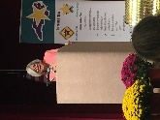
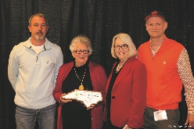
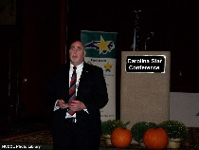
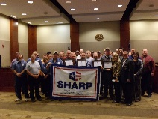
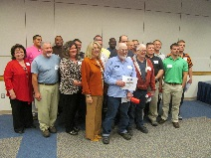
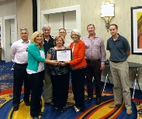
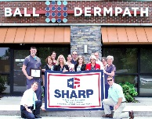
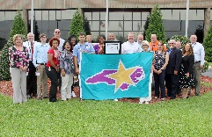
OSH Division
Recognition Programs
FFY 2020—Fall
STAR SITES—New, Recertification, Promotion | Total | FFY Goal | Approved Star Sites*
Carolina Star | 23 |  | 103
Building Star | 3 |  | 23
Rising Star | 3 |  | 4
Public Sector Star | 1 |  | 21
Total | 30 | 20 | 151
*Cumulative Total
NCDOL Photo Library
 | Total | FFY Goal
Star Sites—Termination/Withdrawn | 5
Star Booths | 2
Star Presentations | 9 | 20
Star Program Interventions | 134 | 100
Notes:
The Carolina Star Program is designed to recognize employers and employees who have implemented effective safety and health management systems and maintain injury and illness rates that meet the criteria for participation. Any size employer.
The SSTM Program is North Carolina’s version of federal OSHA’s Special Government Employee (SGE) Program. The SSTM Program allows industry employees and qualified independent private sector safety and health professionals the opportunity to work together in partnership with the NCDOL Carolina Star Program during onsite Star Program evaluations.
General industry, private sector participants must meet the following criteria: The most recent three-year average for both the total recordable case (TRC) rates and cases with days away from work, job transfer, or restriction (DART) rates must be at or below 50 percent of the most recent published federal BLS rates for the appropriate North American Industrial Classification System (NAICS) industry, preferably using a 6-digit NAICS rate, or highest digit available.
Building Star - The contractor participant must meet the following criteria: All injuries and illness rates for each worksite in North Carolina must be summarized on the OSHA 300 log each year, for the past three years. The most recent three-year average for both the total recordable case (TRC) rates and cases with days away from work, job transfer, or restriction (DART) rates must be at or below 50 percent of the most recent published Federal BLS rate for the appropriate North American Industrial Classification System (NAICS) preferably using a 6-digit NAICS rate, or highest digit available.

Slide 27
OSH Division
Recognition Programs
FFY 2020—Fall
SHARP SITES—New/Renewals | Total | FFY Goal | Approved SHARP Sites*
SHARP—Construction | 2 |  | 6
SHARP—General Industry | 3 |  | 121
SHARP—Public Sector | 18 |  | 40
SHARP—Logging | 0 |  | 0
SHARP—Renewals | 49 |  | N/A
Total | 72 | 55
*Cumulative Total
*Includes both general industry and public sector renewals
GOLD STAR GROWERS—New | Total
 | 277
SAFETY AWARDS | Total
CY 2020 Safety Awards Season (Silver, Gold, Million Hour) | 2,737
 | Total
Million Hour Awards | 96
Notes:
The SHARP (Safety and Health Achievement and Recognition Programs) Program is designed for small and mid-size employers that have established, implemented and maintained exceptional workplace safety standards.
The Gold Star Grower Housing Program recognizes growers who provide farmworker housing that meets and exceeds all of the requirements of the Migrant Housing Act of North Carolina.
The Gold Star Flag recognizes agricultural employers who have devised ways to continuously promote a culture of safety on their farms. Gold Star Flag recipients have identified hazards, trained their employees and completed farm safety inspections. They follow and exceed the regulations pertaining to the agricultural work place.
Safety Awards Program - In operation since 1946, the program now extends to more than 5,000 firms, and about 3,000 awards are presented annually. Two types of awards are administered through the program: Annual Safety Awards and Million-Hour Awards.
To qualify for an annual safety award, a firm must:
Have no fatalities during the calendar year at the site or location for which the award was given; and
Have maintained an incidence rate at least 50 percent below the average for its particular industry group.
Two Safety Award Levels - Gold and Silver
The Gold Award is based on the days away, restricted, transferred (DART) rate, which includes cases of days away from work, restricted activity or job transfer.
The Silver Award is based only on cases with days away from work. They are recorded when the worker misses at least one full day of work, not including the day of the injury.

Slide 28
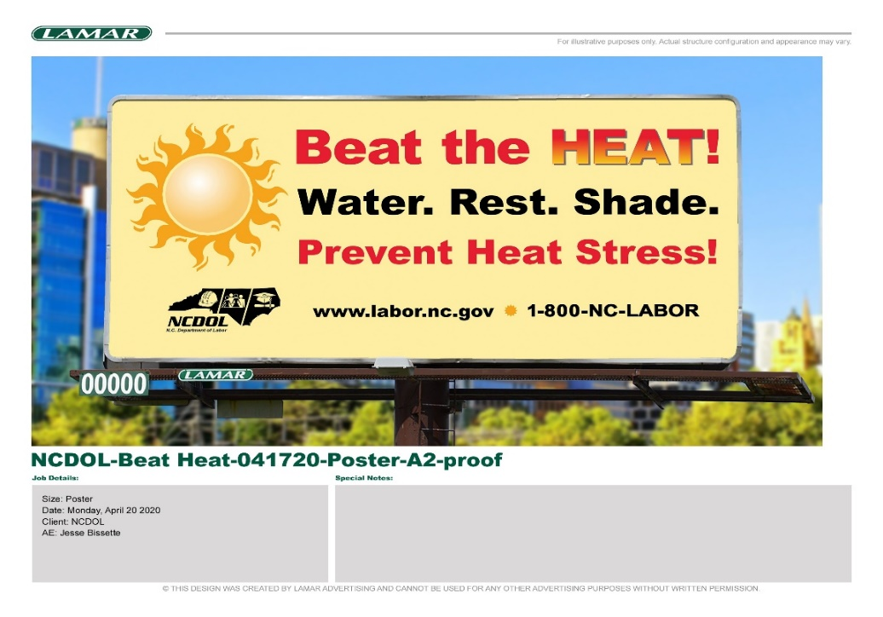

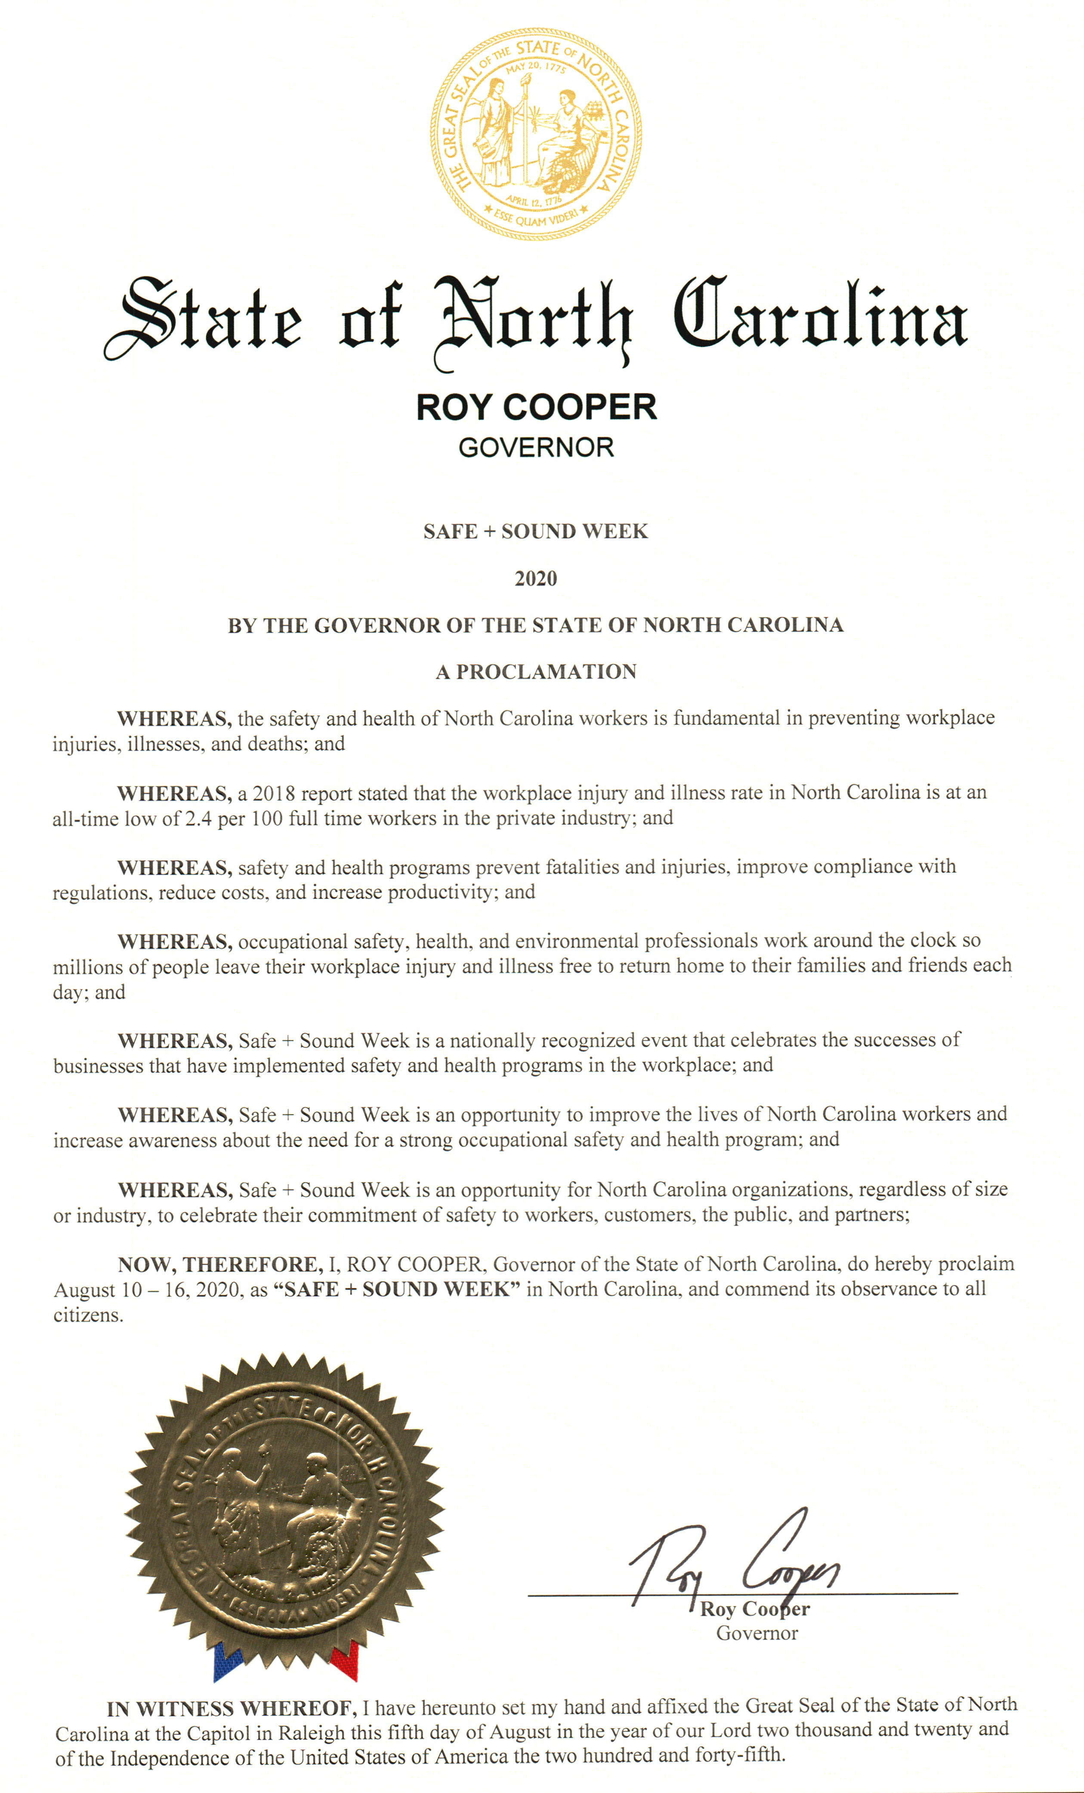
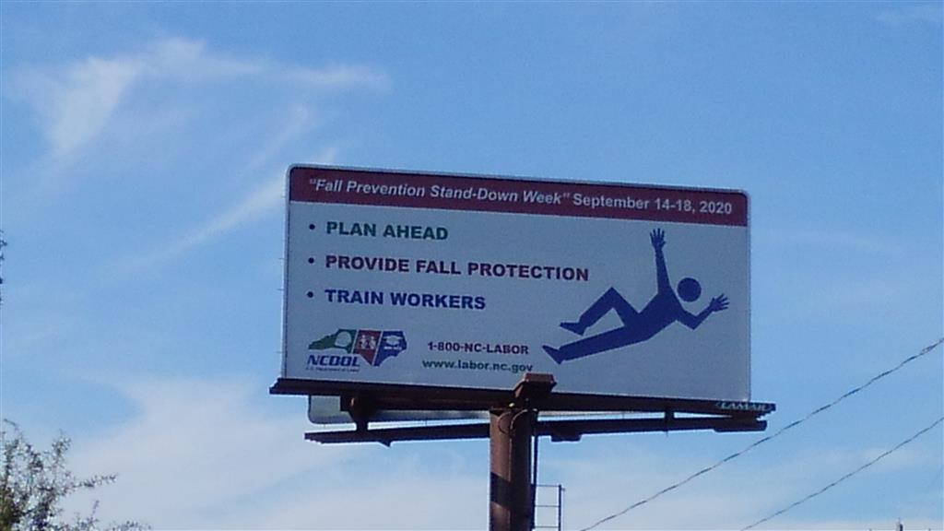
Stand Downs, Heat Stress Awareness and Safe & Sound
Trench Safety Stand Down - June 15-19, 2020
Safe + Sound Week - August 10-16th
55 Trained via Webinar
Fall Prevention Safety Stand Down – September 14-18, 2020
Four Webinars, 56 Trained
Billboard
Heat Stress
Seven Webinars, 154 trained
Billboard

Slide 29
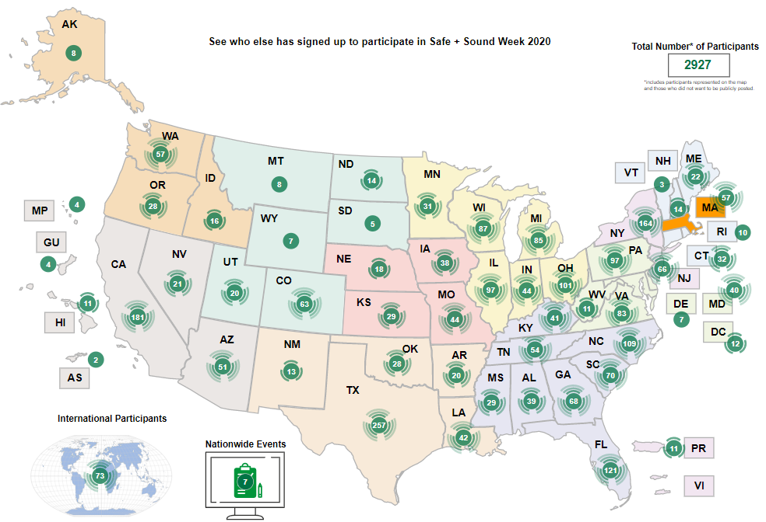
Safe & Sound Week 2020

Slide 30
Personnel Changes in NCDOL Effective 1/1/21
Commissioner of Labor Cherie Berry is retiring
Josh Dobson – New Commissioner of Labor
Dolores Quesenberry is retiring
Jennifer Haigwood will be the new NCDOL Communications Director
Julie Ryan will be the new Director of Administration & Governmental Affairs
Erin Wilson will be the new Special Assistant – Government & Constituent Affairs
Sarah Carr Barnes will become Art Britt’s Executive Assistant
Sandra Hamm & Wanda Smitherman will be retiring

Slide 31

OSH FY2021
FAME FY20
Activity Goals
Field Activities
PPE
Supplies
Virtual?
Continued Teleworking
New Computer Rollout
CH, LBT 11/30 Start
Webinars
Virtual Training
Video Based
On-Line Based
Virtual Meetings
This Photo by Unknown Author is licensed under CC BY-SA-NC. No changes made.

Slide 32

Questions?
1-800-NC-LABOR
(1-800-625-2267)
www.labor.nc.gov
Notes:
32

