Slide 1
North Carolina Department of Labor
Occupational Safety & Health Division
OSH Advisory Spring 2019
Federal Fiscal Year 2019*
Presented by:
Wanda Lagoe CSP CPM ARM
Bureau Chief
Education, Training and Technical Assistance
Occupational Safety and Health Division of North Carolina
*Preliminary Data
Notes:
The information in this presentation is provided voluntarily by the N.C. Department of Labor, Education Training and Technical Assistance Bureau as a public service and is made available in good faith. This presentation is designed to assist trainers conducting OSHA outreach training for workers. Since workers are the target audience, this presentation emphasizes hazard identification, avoidance, and control – not standards. No attempt has been made to treat the topic exhaustively. It is essential that trainers tailor their presentations to the needs and understanding of their audience.
The information and advice provided on this Site and on Linked Sites is provided solely on the basis that users will be responsible for making their own assessment of the matters discussed herein and are advised to verify all relevant representations, statements, and information.
This presentation is not a substitute for any of the provisions of the Occupational Safety and Health Act of North Carolina or for any standards issued by the N.C. Department of Labor. Mention of trade names, commercial products, or organizations does not imply endorsement by the N.C. Department of Labor.

Slide 2
OSH Division
Strategic Plan Goals
FFY 2019—Spring
COMPLIANCE | Total | FFY Goal
Safety Inspections | 825 | 1,907
Health Inspections | 422 | 1,087
Serious Hazards Eliminated | 3,275 | 4,100
CONSULTATION | Total | FFY Goal
Serious Hazards Eliminated | 3,811 | 5,250
Private Sector Visits | 717 | 1,165
Public Sector Visits | 146 | 205
OSH DIVISION | Total | FFY Goal
Program Improvements | 1,327 | 2,060
People Trained in Special Emphasis Program Areas | 4,290 | 3,700
People Trained at OSH Division Sponsored Events | 7,820 | 9,600

Slide 3
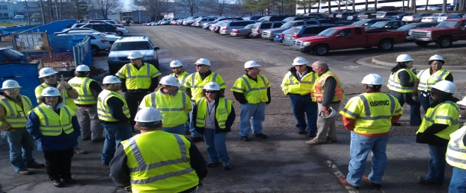

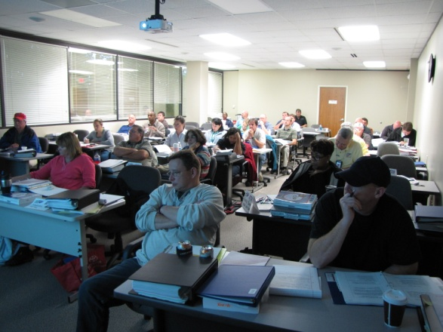
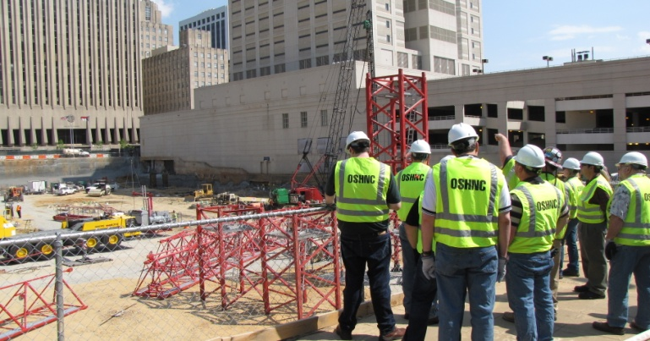
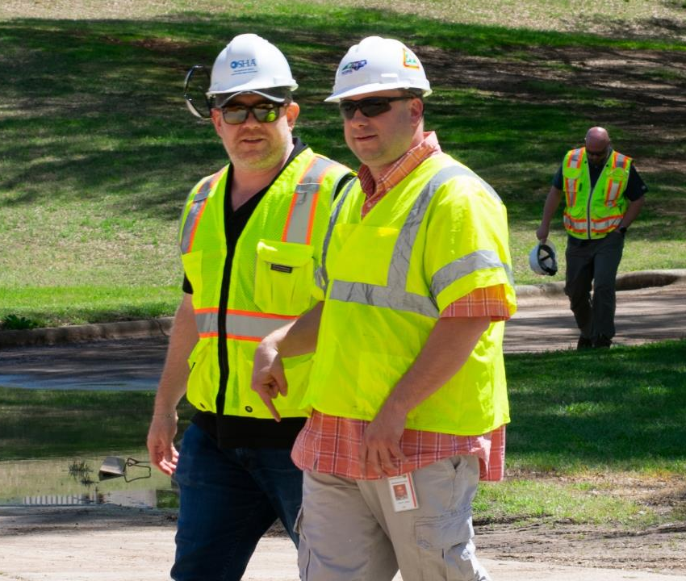
OSH Division
Strategic Plan Goals
FFY 2019—Spring
Education, Training and Technical Assistance (ETTA) | Total | FFY Goal
Publications Distributed | 45,709 | 45,000
Standards Interpretations | 1,566 | NA
Agricultural Safety and Health (ASH) | Total | FFY Goal
Outreach Materials Distributed | 2,692 | 3,500
Compliance Inspections | 31 | 80
Certificates Issued | 1,240 | 1,500
Preoccupancy Inspections | 1,457 | 1,700
NCDOL Photo Library

Slide 4
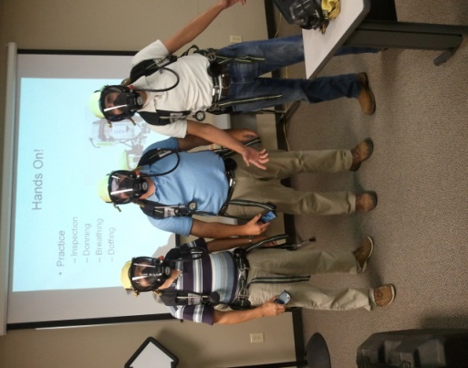

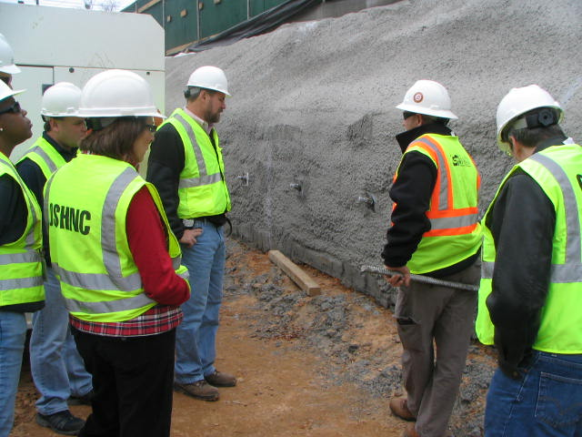
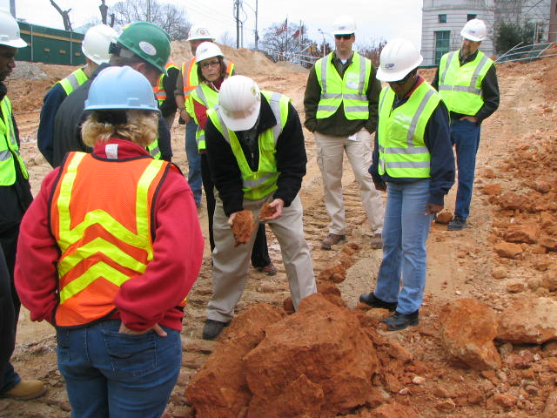
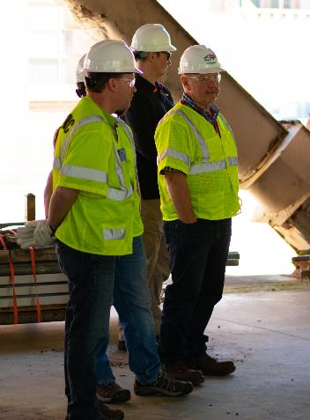
OSH Division
Fatalities Inspected
FFY 2019—Spring
FATALITY TYPE | Total | FATALITY TYPE | Total
Struck By | 6 | Inhalation | 1
Caught In/Between | 3 | Ingestion | 0
Bite/Sting/Scratch | 0 | Absorption | 0
Fall (Same Level) | 1 | Repeated Motion/Pressure | 0
Fall (From Elevation) | 6 | Cardio/Respiratory | 0
Struck Against | 0 | Shock | 0
Rubbed/Abraded | 0 | Other | 5
Fatalities Under OSH Division Jurisdiction
FFY 2018 |  | FFY 2019 | Total
Total Fatalities | 48 | Fatalities | 22
NCDOL Photo Library

Slide 5
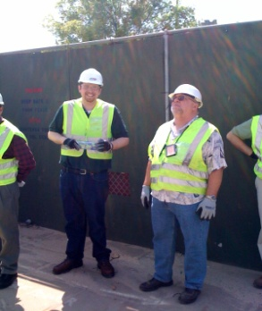
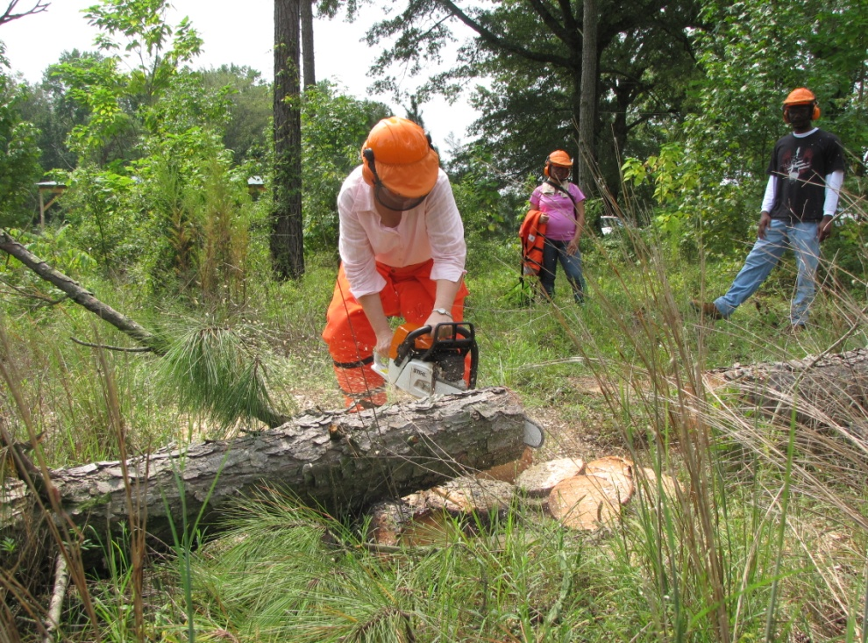
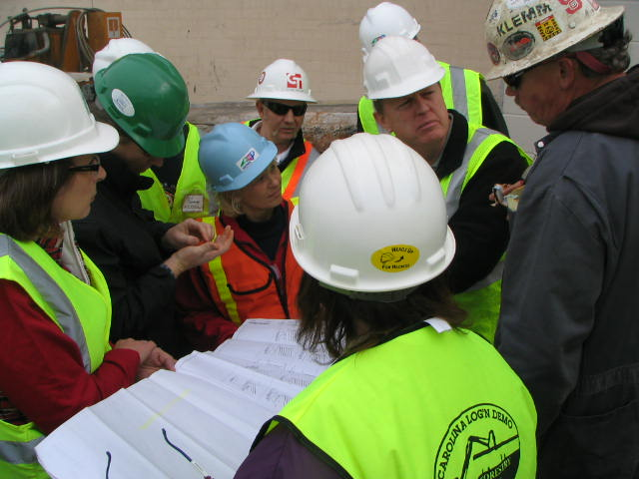
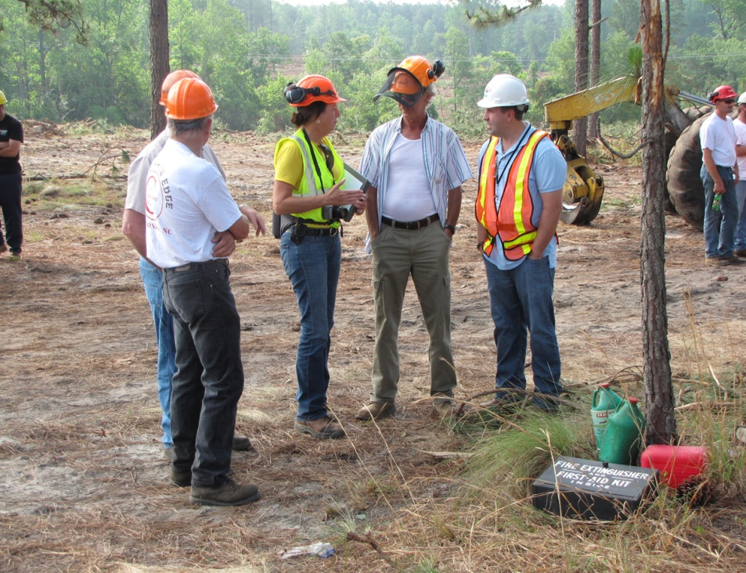
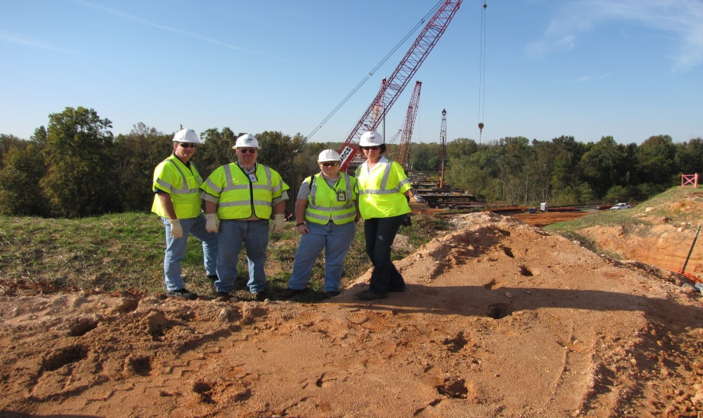
OSH Division
Complaint Desk*
FFY 2019—Spring
East Compliance | West Compliance | Agricultural Safety and Health
ACTIVITY | Total | Total | Total | Cumulative Total | FFY 2018
Complaints | 533 | 618 | 4 | 1,155 | 2,419
Referrals | 180 | 195 | 27 | 402 | 822
Fat/Cat | 42 | 38 | 0 | 80 | 123
Totals | 755 | 851 | 31 | 1,637 | 3,364
*Includes calls that were processed but not necessarily inspected. Fat/Cat includes calls regarding heart attacks and other natural causes.
Notes:
Complaints, referrals, fatality and catastrophe inspections account for a significant amount of inspections that compliance does every year. This slide puts that into perspective.

Slide 6

Strategic Plan
Special Emphasis Programs (SEP)
FFY 2019—Spring
Construction
Logging and Arboriculture
Long Term Care Facilities
Health Hazards
Food Manufacturing
Grocery and Related Product Wholesalers
Amputations
2019 – 2023 Strategic Management Plan
Goal #1 – Reduce fatalities by 2%
Goal #2 – Reduce injuries and illnesses by 5%
Notes:
FFY 2019 - 2023
OSHNC Outcome Goal #1 By the end of FY 2023, reduce the rate of workplace fatalities by 2% OSHNC Outcome Goal #2 By the end of FY 2023, reduce the rate of workplace injuries and illnesses by 5%

Slide 7
Special Emphasis Program
Construction
FFY 2019—Spring
NAICS 23—CONSTRUCTION | FFY 2018 |  | FFY 2019 Total
Total Fatalities | 24 |  | 8
Fatality Rate | 0.0118 |  | 0.0004
Fatality Type | Total | Fatality Type | Total
Struck By | 1 | Inhalation | 1
Caught In/Between | 0 | Ingestion | 0
Bite/Sting/Scratch | 0 | Absorption | 0
Fall (Same Level) | 0 | Repeated Motion/Pressure | 0
Fall (From Elevation) | 4 | Cardio/Respiratory | 0
Struck Against | 0 | Shock | 0
Rubbed/Abraded | 0 | Other | 2
Notes:
ETTA Events Total: 9 (4 Labor One, 4 Webinars, 1 Speaker Bureau )
Total Trained: 305
Consultation Events: 16
Total Trained: 1400
A total of 16 events were served by Rod Wilce. Activities included but are not limited to; event speakers, vendor demonstrations, fall protection training sessions, equipment inspections, distribution of Fed provided resource material, meals i.e. 700 Chic Filet sandwiches, countless doughnuts, full catered lunches. These 16 events provided the intended distribution of information and training to in excess 1400 employees within a 50 mile radius of Raleigh.
Used Billboards for Fall Stand Down, Safe and Sound Week, and Heat Stress.

Slide 8
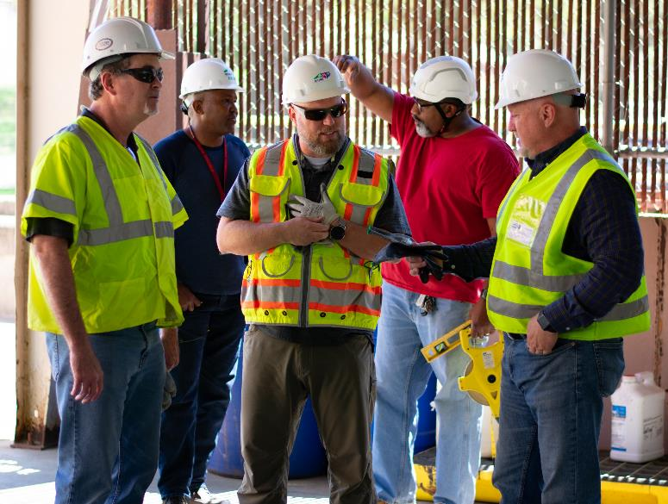
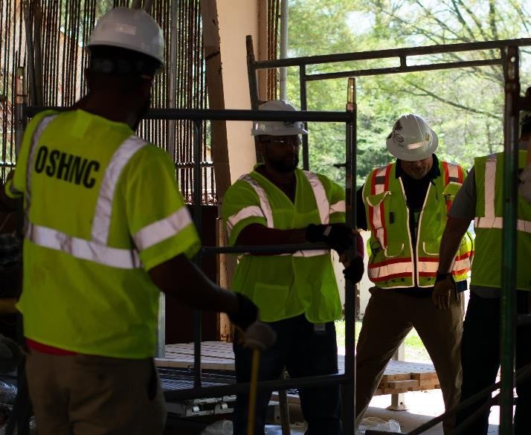

Special Emphasis Program
Construction
FFY 2019—Spring
SEP ACTIVITY | Total | FFY Goal
Compliance Inspections | 628 | 1,050
Consultative Visits | 223 | 200
OSH Outreach Events (10 and 30 Hour Construction Courses) | 2 | 8
People Trained | 1,481 | 2,500

Slide 9
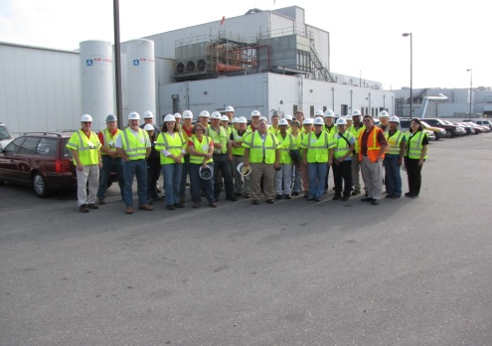
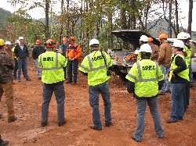
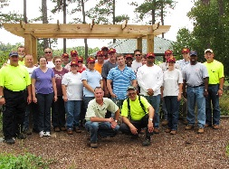
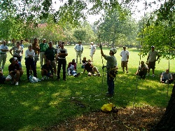
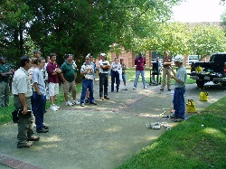
Special Emphasis Program
Logging and Arboriculture
FFY 2019—Spring
SEP ACTIVITY | Total | FFY Goal
Compliance Inspections | 23 | 60
Consultative Visits | 22 | 13
OSH Training and Outreach Events | 3 | 1
People Trained | 127 | 150
NAICS 11331*—LOGGING | FFY 2018 |  | Total
Total Fatalities | 0 |  | 1
NAICS 56173*—ARBORICULTURE | FFY 2017 |  | Total
Total Fatalities | 6 |  | 2
 |  |  | 0.0078
Combined Fatality Rate | 0.017
Notes:
NC TRC/DART rate not available for the 5 digit NAICS code
Logging fatalities went down but arboriculture went up.
Meeting minutes: Looking at alliances within the arboriculture industry. Encourage increased inspections in the SEP. Take a less experienced/confident CSHO out for familiarization. Continue to offer assistance and guidance where you/we can and provide referrals to Consultative or Compliance where appropriate. When conducting inspections on construction sites, public sector, or other activities where the employer/employees are conducting tree trimming/removal operations, please continue to mark the Emphasis/Initiatives blocks according to OPN 88I.

Slide 10
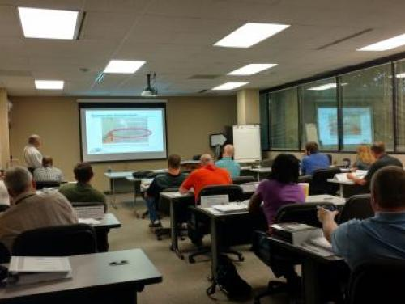
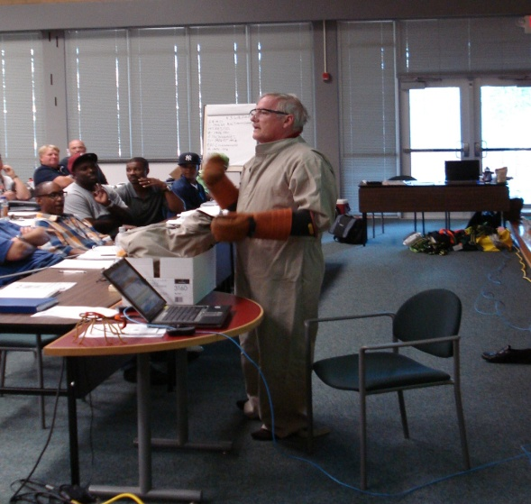
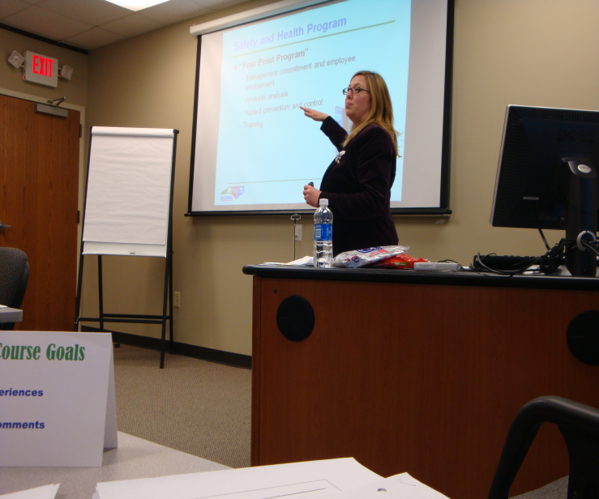
Special Emphasis Program
Long Term Care Facilities
FFY 2019—Spring
SEP ACTIVITY | Total | FFY Goal
Compliance Inspections | 25 | 48
Consultative Visits | 40 | 40
OSH Outreach Events | 1 | 2
People Trained | 400 | 50

Slide 11
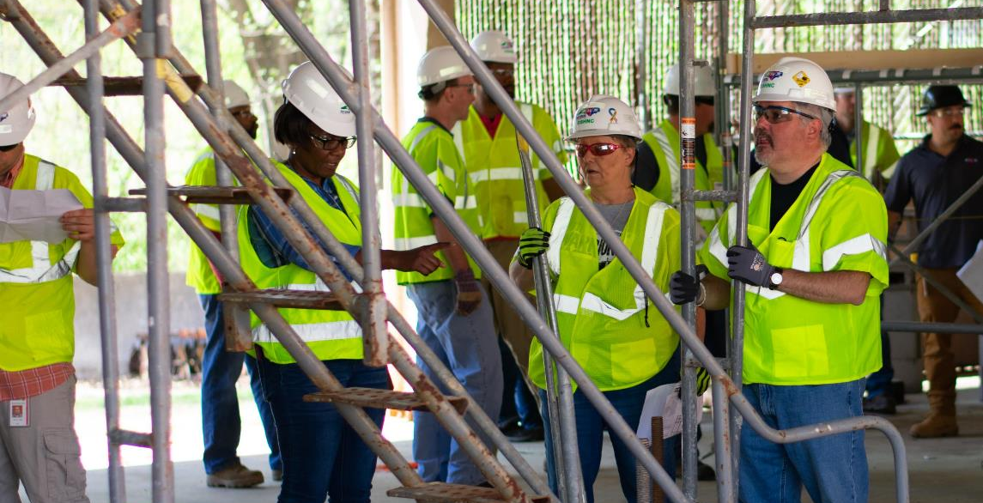

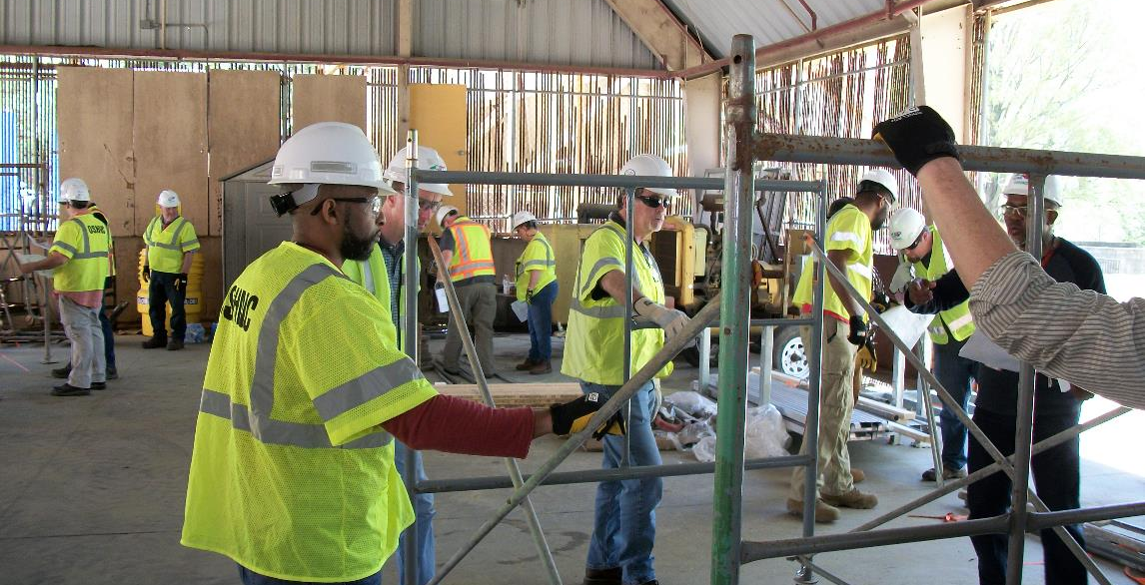
Special Emphasis Program
Health Hazards
FFY 2019—Spring
COMPLIANCE INSPECTIONS | Total | FFY Goal
Silica | 27 | 100
Asbestos | 11
Isocyanates | 8
Lead | 13
Hexavalent Chromium | 5
Total | 64*
Program Improvements | 21 | 20
*Some inspections involved more than one health hazard and generally included a program improvement

Slide 12

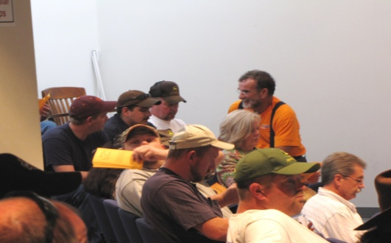
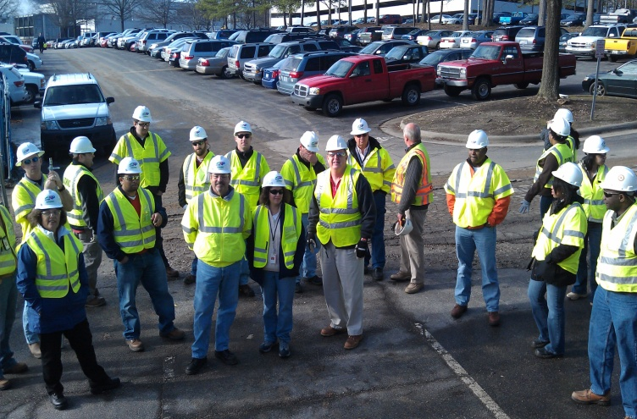
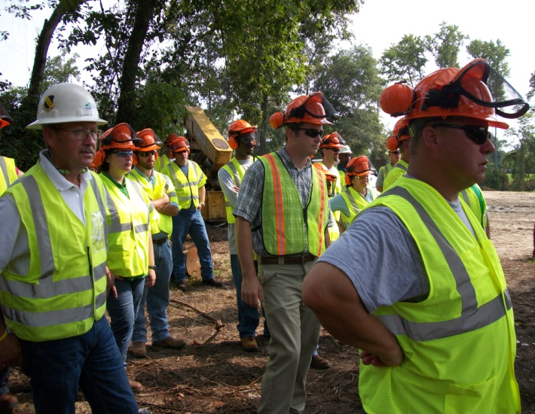

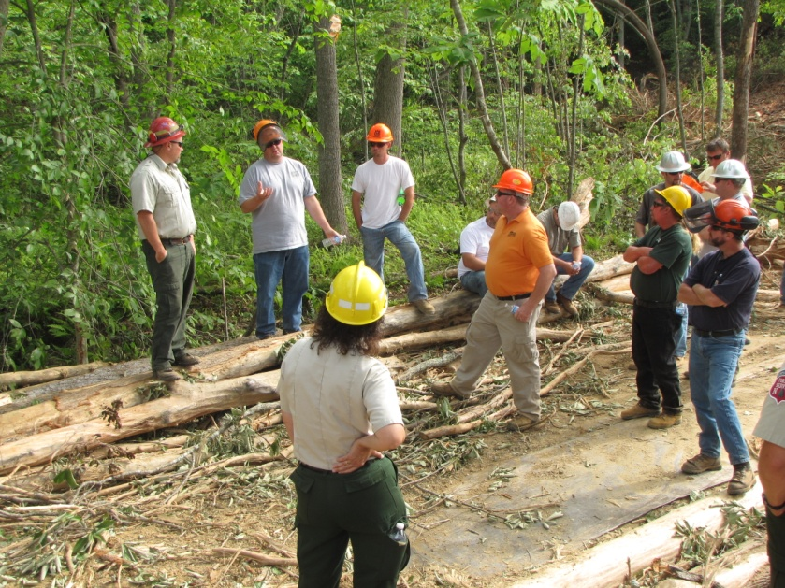
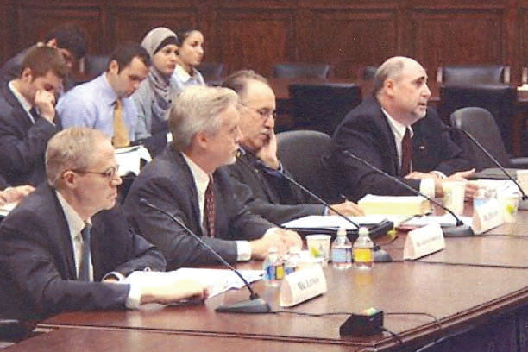

Special Emphasis Program
Health Hazards
FFY 2019—Spring
HEALTH HAZARDS | Consultative Surveys
 | Total
Silica | 79
Asbestos | 8
Isocyanates | 3
Lead | 12
Hexavalent Chromium | 10
Total | 112
FFY Goal | 200
NCDOL Photo Library
NCDOL Photo Library
SEP ACTIVITY | Total | FFY Goal
OSH Outreach Events | 13 | 18
People Trained | 401 | 400

Slide 13
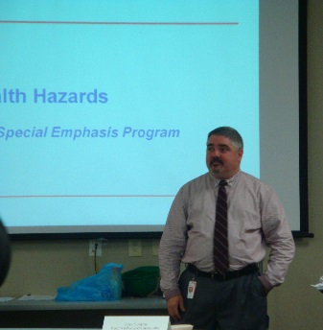
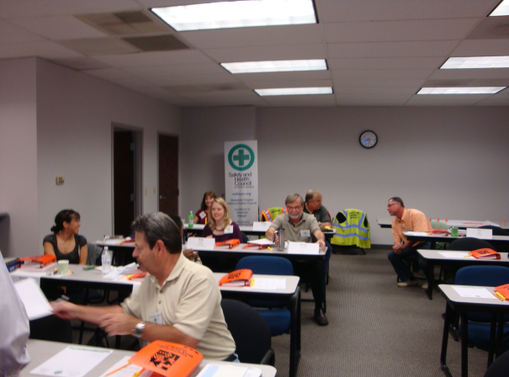
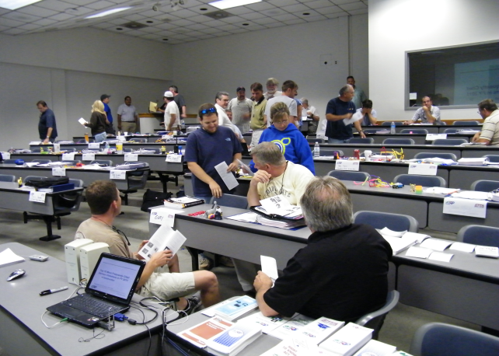
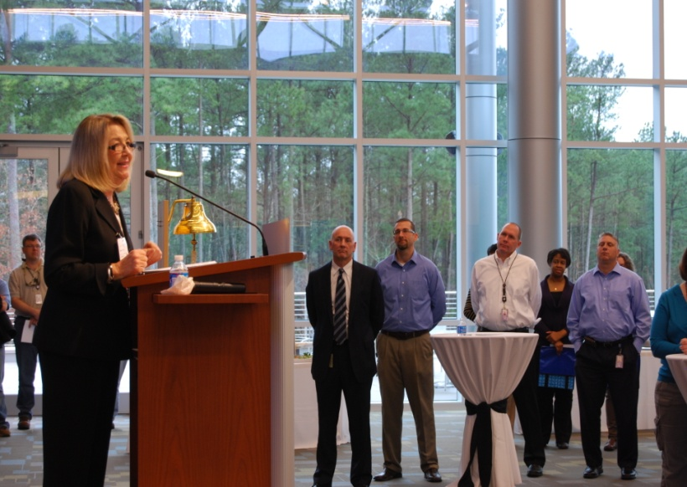
Special Emphasis Program
Food Manufacturing
FFY 2019—Spring
SEP ACTIVITY | Total | FFY Goal
Compliance Inspections | 18 | 40
Consultative Visits | 10 | 12
OSH Outreach Events | 0 | 1
People Trained | 0 | 25

Slide 14
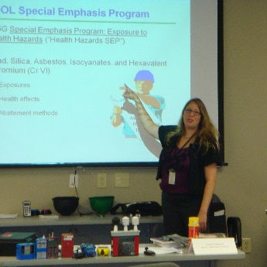
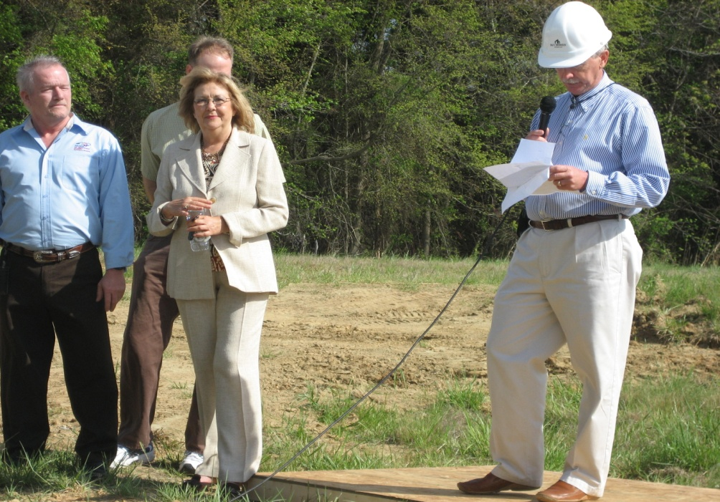
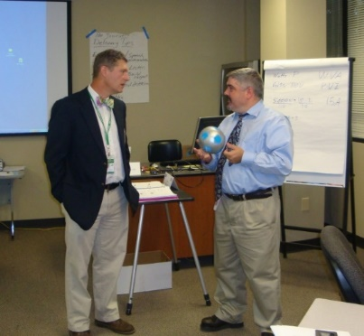
Special Emphasis Program
Grocery and Related Product Wholesalers
FFY 2019—Spring
SEP ACTIVITY | Total | FFY Goal
Compliance Inspections | 12 | 20
Consultative Visits | 2 | 3
OSH Outreach Events | 1 | 1
People Trained | 7 | 25

Slide 15
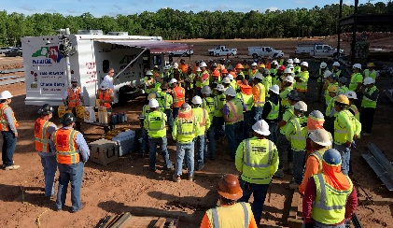
Special Emphasis Program
Amputations—New for FFY 2019
FFY 2019—Spring
FFY 2019 Planning Year
  Setting and Monitoring Goals
    Training Events (Internal and external)
    Compliance Inspections
    Consultation Visits
    Publications
  Developing an Operational Procedure Notice
Notes:
Added Amputations for our new 5 year SMP, and removed Accommodations.
Meeting Notes: Tara Payne and James Cook (co-chairs) presiding
The initial data compiled by Paul Sullivan spans from January 1, 2015 to current date.
Kevin Beauregard suggested using only full years (calendar, fiscal, etc.) for setting and monitoring goals. Targeting, data, etc. all needs to be based on consistent numbers for accurate results.
Paul’s 3 ½ years of data was tabulated to target companies with the highest amputations based on NAICS codes.
Paul suggested using data from fiscal years 2016, 17, and 18. This would address any concerns about under-reporting in 2015.
James and Tara asked what ETTA could do to help and whether the current Machine Guarding and Lockout/Tagout are sufficient. Andy said he thought that Lockout/Tagout was good, but that Machine Guarding was lacking photographs since the great photo purge of 2015. Paul and Tara suggested that they had plenty of photos from closed cases that they would be happy to share.
James and Tara suggested more advanced training for compliance officers. Injuries are primarily to ‘Affected’ employees rather than ‘Authorized’ employees. These are operators trying to clear jams or problems with machines rather than the maintenance people who are trained to deal these situations safely using safety protocols such as Lockout/Tagout.
Paul suggested a 1-day Internal Training workshop for Machine Guarding and a 1-day course in Lockout/Tagout. One in Charlotte for the West and a second in Raleigh for the East.
Andy said that this would be a good approach but would have to be coordinated with Marcy as ETTA had a very aggressive schedule in first quarter of 2019 regarding 10 and 30-hour classes as the hurricanes had wreaked havoc with our fourth quarter 2018 schedule for these classes.
Paul also suggested that they could supply COSHO’s with experience in individual pieces of equipment. Andy agreed and suggested that these could be done much like we do case studies in PSM training. Paul will seek volunteers for teaching subjects dealing with various manufacturing presses and equipment.
Kevin suggested talking to STAR and SHARP sites with this equipment about the possibility of scheduling field trips to these places.
It was agreed that these classes should be developed in first quarter 2019 for the SEP rollout in the fall of next year.

Slide 16
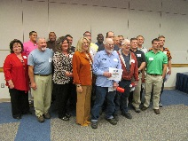
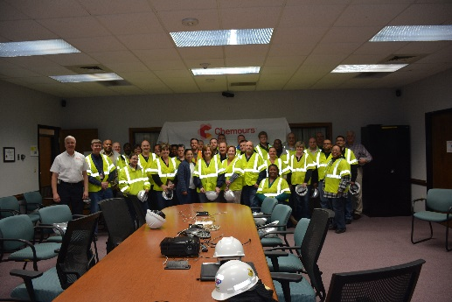

OSH Division
Public Sector
FFY 2019—Spring
ACTIVITY | Total | FFY Goal
Compliance Inspections | 108 | 151
Consultative Visits | 146 | 205
OSH Outreach Events/Booths | 19 | 22
Trained | 824 | 1,500

Slide 17
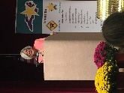
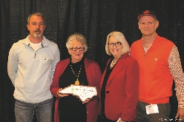
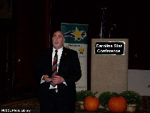
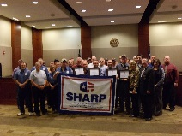
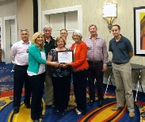
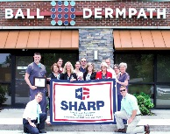
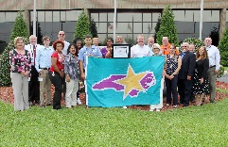
OSH Division
Recognition Programs
FFY 2019—Spring
STAR SITES—New, Recertification, Promotion | Total | FFY Goal | Approved Star Sites*
Carolina Star | 13 |  | 101
Building Star | 2 |  | 23
Rising Star | 0 |  | 6
Public Sector Star | 1 |  | 23
Total | 16 | 30 | 153
*Cumulative Total
NCDOL Photo Library
 | Total | FFY Goal
Star Sites—Termination/Withdrawn | 0
Star Booths | 2
Star Presentations | 18 | 30
Star Program Interventions | 84 | 150
Notes:
The Carolina Star Program is designed to recognize employers and employees who have implemented effective safety and health management systems and maintain injury and illness rates that meet the criteria for participation. Any size employer.
The SSTM Program is North Carolina’s version of federal OSHA’s Special Government Employee (SGE) Program. The SSTM Program allows industry employees and qualified independent private sector safety and health professionals the opportunity to work together in partnership with the NCDOL Carolina Star Program during onsite Star Program evaluations.
General industry, private sector participants must meet the following criteria: The most recent three-year average for both the total recordable case (TRC) rates and cases with days away from work, job transfer, or restriction (DART) rates must be at or below 50 percent of the most recent published federal BLS rates for the appropriate North American Industrial Classification System (NAICS) industry, preferably using a 6-digit NAICS rate, or highest digit available.
Building Star - The contractor participant must meet the following criteria: All injuries and illness rates for each worksite in North Carolina must be summarized on the OSHA 300 log each year, for the past three years. The most recent three-year average for both the total recordable case (TRC) rates and cases with days away from work, job transfer, or restriction (DART) rates must be at or below 50 percent of the most recent published Federal BLS rate for the appropriate North American Industrial Classification System (NAICS) preferably using a 6-digit NAICS rate, or highest digit available.

Slide 18
OSH Division
Recognition Programs
FFY 2019—Spring
SHARP SITES—NEW | Total | FFY Goal | Approved SHARP Sites*
SHARP—Construction | 1 |  | 7
SHARP—General Industry | 3 |  | 140
SHARP—Public Sector | 7 |  | 49
SHARP—Logging | 0 |  | 0
Total | 11 | 6 | 196
SHARP—Renewals | 32* | 55
*Cumulative Total
*Includes both general industry and public sector renewals
GOLD STAR GROWERS—NEW | Total
 | 225
SAFETY AWARDS | Total
CY 2018 Safety Awards Season | 3,327
 | Total
Million Hour Awards | 64
Notes:
The SHARP (Safety and Health Achievement and Recognition Programs) Program is designed for small and mid-size employers that have established, implemented and maintained exceptional workplace safety standards.
The Gold Star Grower Housing Program recognizes growers who provide farmworker housing that meets and exceeds all of the requirements of the Migrant Housing Act of North Carolina.
The Gold Star Flag recognizes agricultural employers who have devised ways to continuously promote a culture of safety on their farms. Gold Star Flag recipients have identified hazards, trained their employees and completed farm safety inspections. They follow and exceed the regulations pertaining to the agricultural work place.
Safety Awards Program - In operation since 1946, the program now extends to more than 5,000 firms, and about 3,000 awards are presented annually. Two types of awards are administered through the program: Annual Safety Awards and Million-Hour Awards.
To qualify for an annual safety award, a firm must:
Have no fatalities during the calendar year at the site or location for which the award was given; and
Have maintained an incidence rate at least 50 percent below the average for its particular industry group.
Two Safety Award Levels - Gold and Silver
The Gold Award is based on the days away, restricted, transferred (DART) rate, which includes cases of days away from work, restricted activity or job transfer.
The Silver Award is based only on cases with days away from work. They are recorded when the worker misses at least one full day of work, not including the day of the injury.

Slide 19
OSH Division
Cut-Loose, In-Training, Vacant
FFY 2019—Spring
West Compliance | Safety | % | Industrial Hygienist | %
Cut Loose | 26 | 84% | 21 | 81%
In-Training | 4 | 13% | 2 | 8%
Vacant | 1 | 3% | 3 | 11%
Total | 31 |  | 26
East Compliance | Safety | % | Industrial Hygienist | %
Cut Loose | 14 | 52% | 5 | 28%
In-Training | 9 | 33% | 7 | 39%
Vacant | 4 | 15% | 6 | 33%
Total | 27 |  | 18
Safety Cut Loose | 69% | Health Cut Loose | 59%
Safety In-Training | 22% | Health in-Training | 20%
Safety Vacant | 9% | Health Vacant | 20%

Slide 20
OSH Division
Cut-Loose, In-Training, Vacant
FFY 2019—Spring
Consultative Services | Safety | % | Industrial Hygienist | %
Cut Loose | 10 | 91% | 8 | 100%
In-Training | 0 | 0% | 0 | 0%
Vacant | 1 | 9% | 0 | 0%
Total | 11 |  | 8
Education, Training and Technical Assistance | Safety | % | Industrial Hygienist | %
Cut Loose | 8 | 73% | 6 | 100%
In-Training | 2 | 18% | 0 | 0%
Vacant | 1 | 9% | 0 | 0%
Total | 11 |  | 6
Agricultural Safety and Health | Safety | % | Industrial Hygienist
Cut Loose | 4 | 67% | NA
In-Training | 2 | 33% | NA
Vacant | 0 | 0% | NA
Total | 6

Slide 21
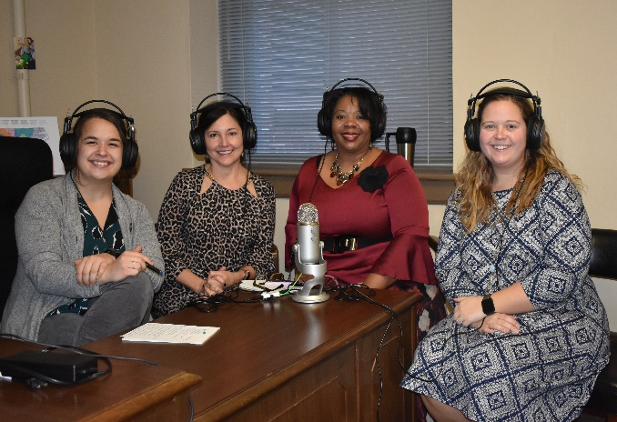
OSH Division
Social Media—New
FFY 2019—Spring
Inside NC Labor Podcasts
  Twice per month
  12 to date
  Topics
    Library Services
    Alliances
    Agricultural Safety and Health
    Safety Awards
    Mine Safety and Health
Notes:
We also do live webinars every week.

Slide 22
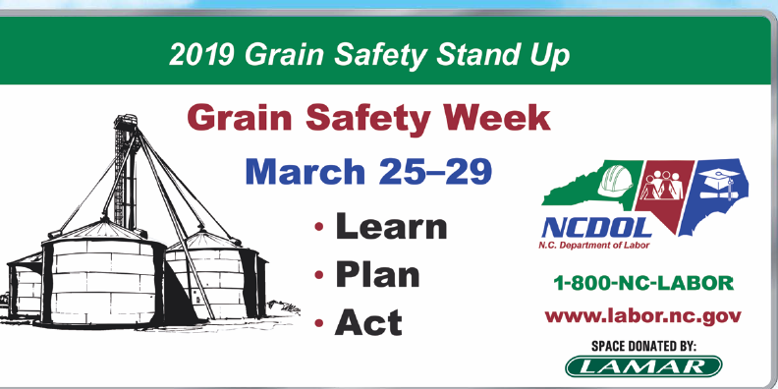
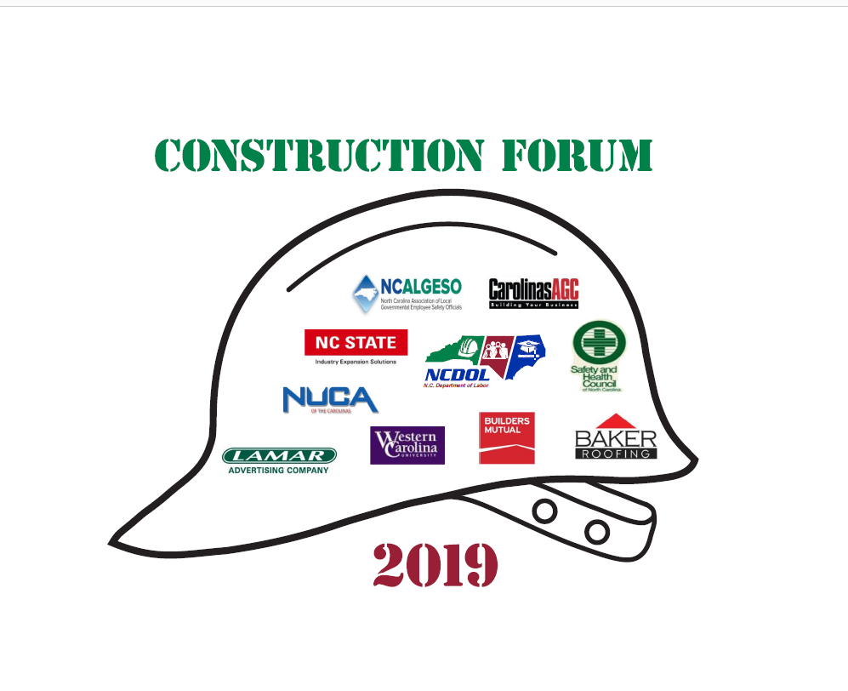

OSH Division
Training & Education Outreach
FFY 2019—Spring
Stand Up/Down
  Grain Safety Stand Up – March 25 - 29
  Fall Prevention Safety Stand Down – May 6 - 10
    Two Construction Forums
      Concord – May 7
      Raleigh – May 9
  Safe + Sound Week – August 12 - 18

Slide 23


OSH Division
Drone Program
FFY 2019—Spring
3 DJI Matrice 210 Drones
8 DJI Mavic Pro Drones
8 Teams/18 Pilots
  5 – Compliance
  1 – ETTA
  2 – Elevator and Amusement
6 Compliance Inspections
  Included a referral related to a massive mudslide in the western part of the state, a suspended scaffold failure, as well as accident investigations related to falls and excavation hazards
Notes:
With the teams, we have 2 under EAD, which totals 8 teams and a total of 18 pilots.
Compliance Inspections: 6; includes falls, suspended scaffold collapse, excavation/trench collapse, excavation equipment roll-over and mud slide.
Stats: From 1/2018 – 4/30/2019:
*550 flights
*54 locations
*55 hours
*Pilots have completed in excess of 40 hours of training
Additional Capabilities with the new Matrice 210 drones:
*System designed specifically for public safety agencies. The system is more robust, stable and is built with more technological safety systems, such as additional collision avoidance sensors.
*Multi-payload capability; this will allow operation of 2 cameras (ie., camera and thermal image camera) during same flight which will reduce the amount of time the drone will be flown and better life range of motors, batteries and equipment.
*Additional clearance from obstacles which will include better camera and zoom capabilities; camera has 30 optional zoom which will not require to fly close to the structure and prevent in-air collision.
*Interagency compatible and continuity. During large scale incidents, our agency will assist with various missions as part of the State Emergency Operations Plan and Contingency of Operations Plan.
*Contains built-in ADS-B receiver which will display manned aircraft in the flight path in real-time in an effort to prevent in-air collision.
*Weather resistant. With our agency’s mission, having a platform which is weather resistant will allow immediate response to collect critical evidence as part of accident/fatality investigations and weather will not interfere in the event a flight operation should be warranted.
*Longer Flight Time of 35 minutes.

Slide 24

OSH Division
NCDOL Library—Renewing
FFY 2019—Spring
The Training Network NOW!
  Streaming Video on Demand provides access to 500+ safety & health videos (350+ in Spanish) in The Training Network’s online library
  400+ registered patrons for access to The Training Network NOW streaming video service
Notes:
Streaming video service we subscribe too annually. Can have up to 499 users.

Slide 25

OSH Division
Standards Section—New
FFY 2019—Spring
A - Z Safety and Health Topics (>90 Topics)
  Excavations and Trenching
  Acids and Bases
  Abrasive Blasting
  Overhead and Gantry Cranes
  Organic Solvents
  Materials Handling and Storage
Notes:
We have almost 100 safety and health topics currently on our website. More to come!

Slide 26


OSH Division
Standards Section—Standards Tool
FFY 2019—Spring
Which Standards Apply
  Helps identify the standards that apply to your worksite
  Available for:
    General Industry
    Construction
    Recordkeeping
    Agriculture
    Shipyard Employment
    Marine Terminals
    NC State Specific Standards

Slide 27
OSH Division
Standards Section—New/Revisions
FFY 2019—Spring
Code of Federal Register (CFR)
  CFR 127M—Recording and Reporting Requirements
    Removes requirement for establishments with 250 or more employees to electronically submit information from OSHA Forms 300 and 301 (Effective 1/25/19)
Compliance Directive (CPL)
  CPL 02-18-01—Site-Specific Targeting 2016
    Directive implements a site-specific targeting inspection program using employer-submitted calendar year 2016 Form 300A data (Effective 3/8/19)
Notes:
Recording and Reporting Requirements 84 FR 380 (1/25/2019) 29 CFR1904.41 - final rule. Removes requirement for establishments with 250 or more employees to electronically submit information from OSHA Forms 300 and 301. Also requires covered employers to submit their Employer Identification Number (EIN) electronically along with their injury and illness data submission.
This directive implements a site-specific targeting (SST) inspection program using employer-submitted calendar year 2016 Form 300A data. Does not include construction worksites or PS sites; GI sites with 20 or more Ees. Effective 3/9/19

Slide 28

Thank You For Attending!
FFY 2019—Spring
Questions?
1-800-NC-LABOR
(1-800-625-2267)
www.labor.nc.gov
Notes:
28

