Slide 1
North Carolina Department of Labor Occupational Safety & Health Division OSH Advisory Spring 2018 Federal Fiscal Year 2018*
Presented by:
Wanda Lagoe CSP CPM ARM
Bureau Chief
Education, Training and Technical Assistance
Occupational Safety and Health Division of North Carolina
*Preliminary Data
Notes:
The information in this presentation is provided voluntarily by the N.C. Department of Labor, Education Training and Technical Assistance Bureau as a public service and is made available in good faith. This presentation is designed to assist trainers conducting OSHA outreach training for workers. Since workers are the target audience, this presentation emphasizes hazard identification, avoidance, and control – not standards. No attempt has been made to treat the topic exhaustively. It is essential that trainers tailor their presentations to the needs and understanding of their audience.
The information and advice provided on this Site and on Linked Sites is provided solely on the basis that users will be responsible for making their own assessment of the matters discussed herein and are advised to verify all relevant representations, statements, and information.
This presentation is not a substitute for any of the provisions of the Occupational Safety and Health Act of North Carolina or for any standards issued by the N.C. Department of Labor. Mention of trade names, commercial products, or organizations does not imply endorsement by the N.C. Department of Labor.

Slide 2
N.C. Workplace Safety and Health
Total Recordable Cases (TRC)
Spring 2018
6% Decrease
9% Decrease
No Change
3% Decrease
3% Decrease
All Industries Including State and Local Government
Based on Calendar Year

Slide 3
N.C. Workplace Safety and Health
Days Away, Restricted or Transferred (DART)
Spring 2018
No Change
7% Increase
9% Decrease
7% Decrease
No Change
All Industries Including State and Local Government
Based on Calendar Year

Slide 4
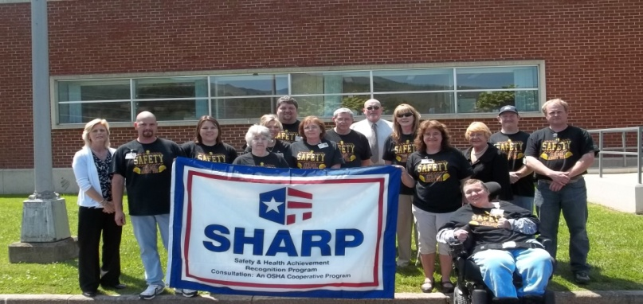
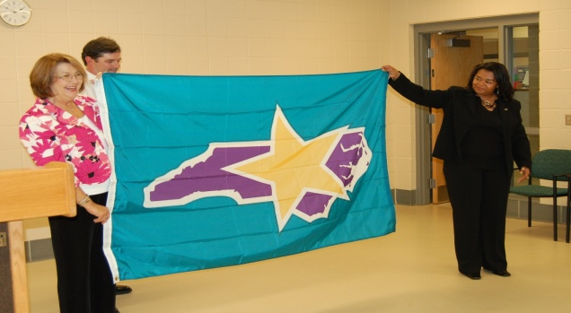
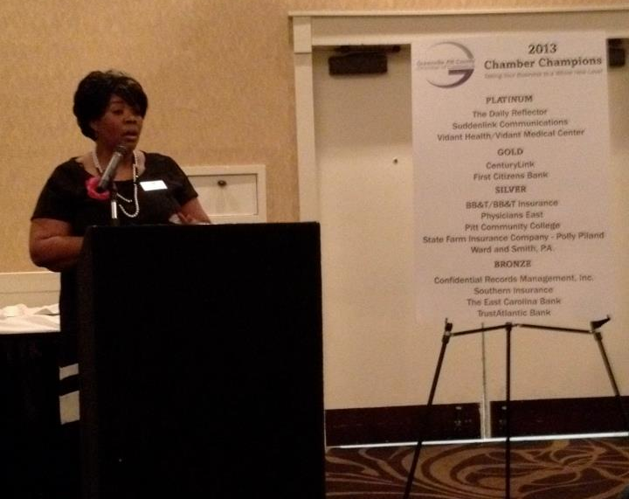
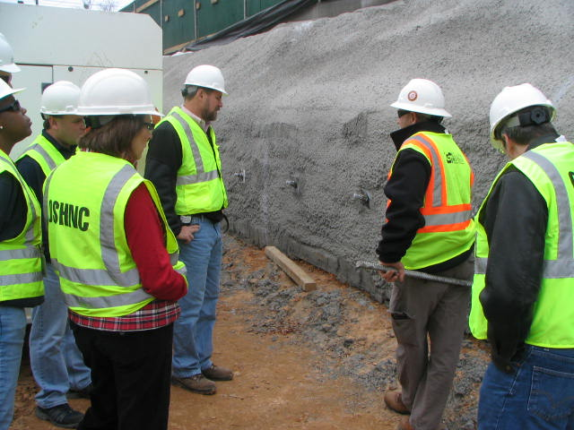
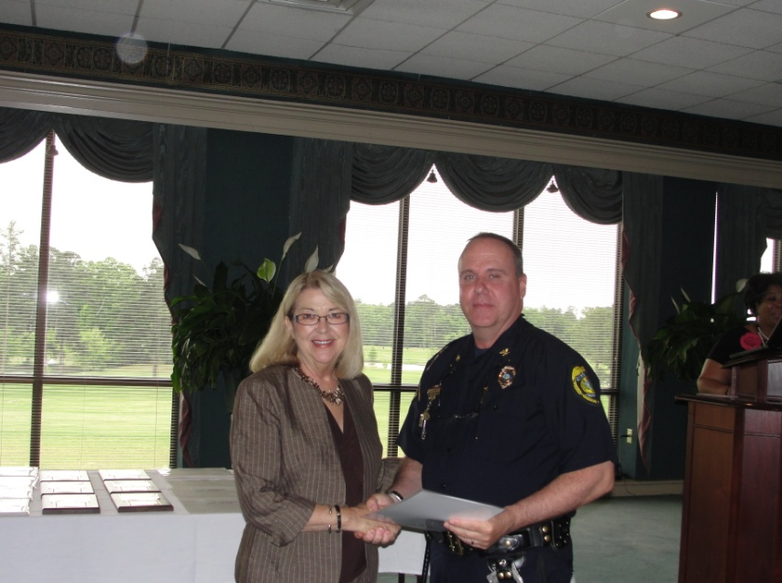
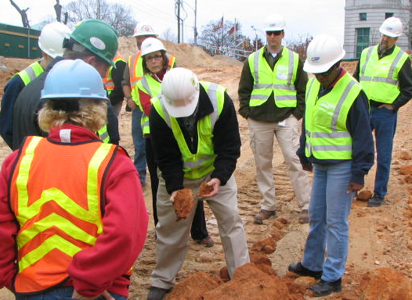
N.C. Workplace Safety and Health
TRC and DART Rate Comparison
Spring 2018
CY 2016 | North Carolina |  | National Average |  | Comparison
TRC Rate | 2.5 | 2.7* | 2.9 | 3.2* | 14% Lower/16% Lower*
DART Rate | 1.3 | 1.4* | 1.6 | 1.7* | 19% Lower/18% Lower*
*All industries including state and local government CY = Calendar Year
Notes:
North Carolina’s Total Recordable cases and DART rate continue to be lower that the National Average.
The DART rate stands for "Days Away, Restrictions and Transfers". This number is also based on trending over 200,000 hours but its not based on total injuries. Its based only on those injuries and illnesses severe enough to warrant "Days Away, Restrictions and Transfers".
The Total Recordable Case Rate (TRC) equals the division of all recordable cases by the hours worked, multiplied by 200'000 for standardization.

Slide 5
N.C. Workplace Safety and Health
Fatality Rate
Spring 2018
All Industries Including State and Local Government
Based on Calendar Year
Notes:
Baseline average:
Average of CY2010-CY2012
(The 200,000 figure in the formula represents the number of hours 100 employees working 40 hours per week, 50 weeks per year would work, and provides the standard base for calculating incidence rates. The 2,000 figure in the formula represents an estimate of the average number of hours a full time employee works annually, when actual hours are not available. 50 weeks x 40 hrs/wk = 2000 hrs/yr.)

Slide 6
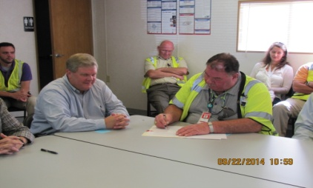
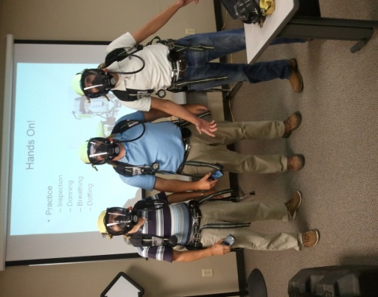
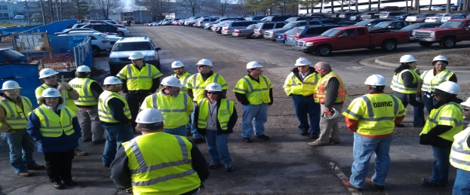
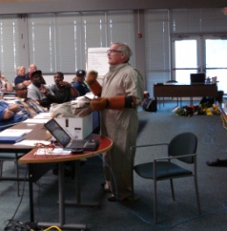
N.C. Workplace Safety and Health
OSH Division—Fatalities Inspected
Spring 2018
FATALITY TYPE | Total | FATALITY TYPE | Total
Struck By | 8 | Inhalation | 0
Caught In/Between | 1 | Ingestion | 0
Bite/Sting/Scratch | 0 | Absorption | 0
Fall (Same Level) | 0 | Repeated Motion/Pressure | 0
Fall (From Elevation) | 8 | Cardio/Respiratory | 0
Struck Against | 0 | Shock | 0
Rubbed/Abraded | 0 | Other | 8
Fatalities Under OSH Division Jurisdiction
FFY 2017 |  | FFY 2018 | Total
Total Fatalities | 35 | Fatalities | 25
NCDOL Photo Library

Slide 7
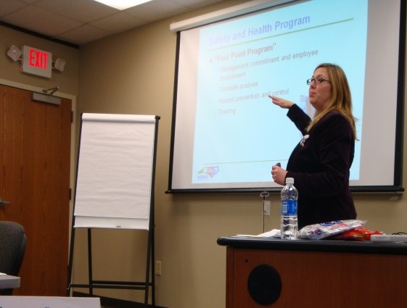
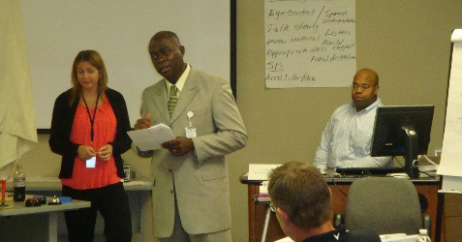
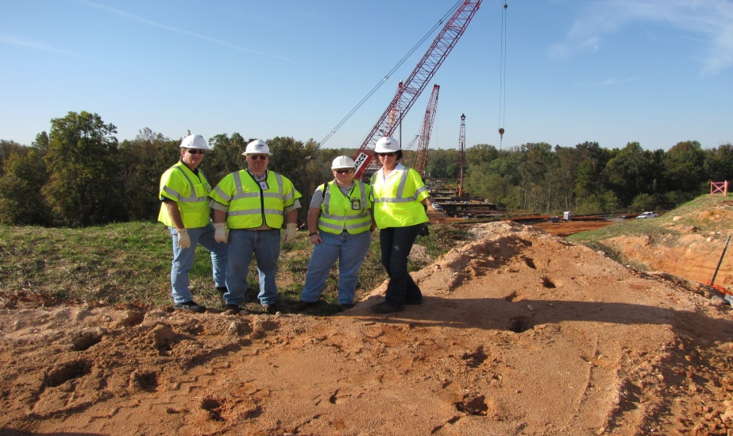
Strategic Plan
Special Emphasis Programs (SEP)
Spring 2018
NCDOL Photo Library
Construction
Logging and Arboriculture
Long Term Care Facilities
Health Hazards
Food Manufacturing
Grocery and Related Product Wholesalers

Slide 8
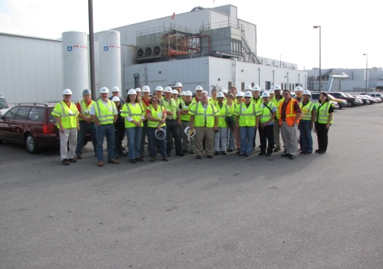

Special Emphasis Program
Construction
Spring 2018
NAICS 23*—CONSTRUCTION
 | North Carolina |  |  |  | National Average |  |  |  | North Carolina vs. National Average
 | CY 2015 |  | CY 2016 |  | CY 2015 |  | CY 2016 |  | 2016 Comparison
TRC | 2.7 | 19% Decrease |  | 2.2 | 3.5 | 9% Decrease |  | 3.2 | 31% Lower
DART | 1.5 | No Change |  | 1.5 | 2.0 | 5% Decrease |  | 1.9 | 21% Lower
*TRC/DART rate based on a 2 digit NAICS code

Slide 9
Special Emphasis Program
Construction
Spring 2018
NAICS 23—CONSTRUCTION | FFY 2017 |  | Total
Total Fatalities | 12 |  | 14
Fatality Rate | 0.0060 |  | 0.0066
Fatality Type | Total | Fatality Type | Total
Struck By | 5 | Inhalation | 0
Caught In/Between | 0 | Ingestion | 0
Bite/Sting/Scratch | 0 | Absorption | 0
Fall (Same Level) | 0 | Repeated Motion/Pressure | 0
Fall (From Elevation) | 8 | Cardio/Respiratory | 0
Struck Against | 0 | Shock | 0
Rubbed/Abraded | 0 | Other | 1

Slide 10
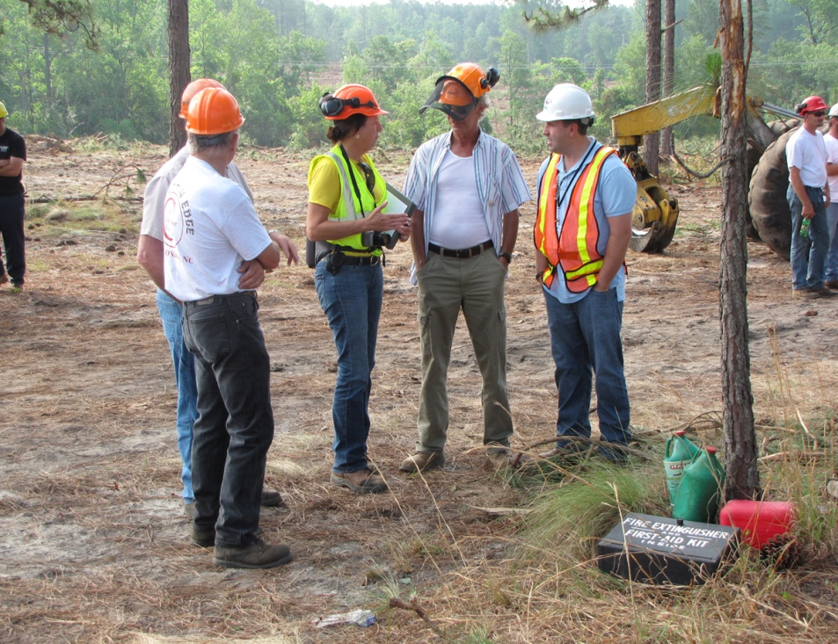
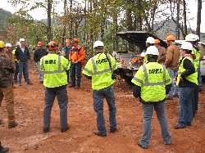
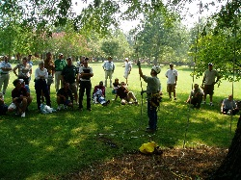
Special Emphasis Program
Logging and Arboriculture
Spring 2018
NAICS 11331*—LOGGING | FFY 2017 |  | Total
Total Fatalities | 3 |  | 0
NAICS 56173*—ARBORICULTURE | FFY 2017 |  | Total
Total Fatalities | 4 |  | 2
Combined Fatality Rate | 0.0225 |  | 0.0096
*NC TRC/DART rate not available for the 5 digit NAICS code

Slide 11
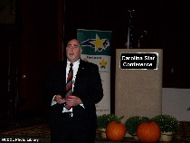
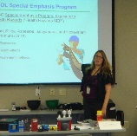
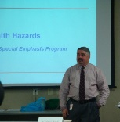
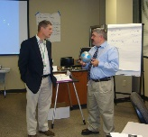
Special Emphasis Program
Long Term Care Facilities
Spring 2018
NAICS 623*—LONG TERM CARE
 | North Carolina |  |  |  | National Average |  |  |  | North Carolina vs. National Average
 | CY 2015 |  | CY 2016 |  | CY 2015 |  | CY 2016 |  | 2016 Comparison
TRC | 5.9 | 3% Decrease |  | 5.7 | 6.8 | 6% Decrease |  | 6.4 | 11% Lower
DART | 3.5 | 6% Decrease |  | 3.3 | 4.2 | 7% Decrease |  | 3.9 | 13% Lower
*TRC/DART rate based on the 3 digit NAICS code

Slide 12
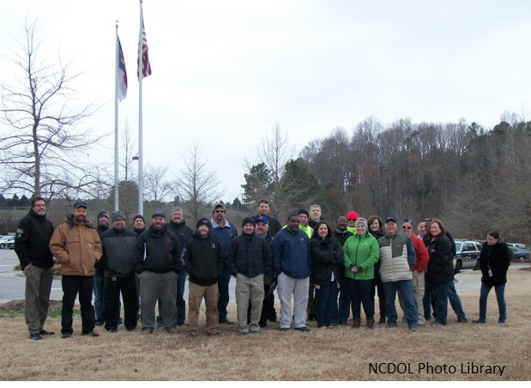
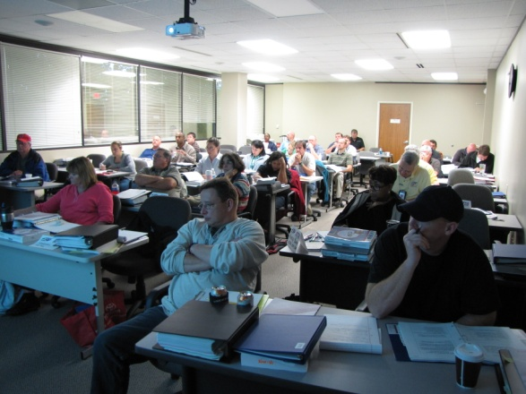
Special Emphasis Program
Food Manufacturing
Spring 2018
NAICS 311*—FOOD MANUFACTURING
 | North Carolina |  |  |  | National Average |  |  |  | North Carolina vs. National Average
 | CY 2015 |  | CY 2016 |  | CY 2015 |  | CY 2016 |  | 2016 Comparison
TRC | 4.2 | 12% Decrease |  | 3.7 | 4.7 | No Change |  | 4.7 | 21% Lower
DART | 2.8 | 4% Decrease |  | 2.7 | 3.1 | 3% Increase |  | 3.2 | 16% Lower
*TRC/DART rate based on the 3 digit NAICS code

Slide 13
Special Emphasis Program
Grocery and Related Product Wholesalers
Spring 2018
NAICS 4244*—GROCERY AND RELATED WHOLESALERS
 | North Carolina |  |  |  | National Average |  |  |  | North Carolina vs. National Average
 | CY 2015 |  | CY 2016 |  | CY 2015 |  | CY 2016 |  | 2016 Comparison
TRC | 4.3 | 4% Increase |  | 4.5 | 5.3 | 13% Decrease |  | 4.7 | 4% Lower
DART | 3.3 | 11% Increase |  | 3.7 | 4.2 | 14% Decrease |  | 3.6 | 3% Higher
*DART/TRC rate based on the 4 digit NAICS code

Slide 14

OSH Division
Public Sector
Spring 2018
Public Sector
 | North Carolina |  |  |  | National Average |  |  |  | North Carolina vs. National Average
 | CY 2015 |  | CY 2016 |  | CY 2015 |  | CY 2016 |  | 2016 Comparison
TRC | 3.9 | 8% Decrease |  | 3.6 | 5.1 | 8% Decrease |  | 4.7 | 23% Lower
DART | 1.9 | 11% Decrease |  | 1.7 | 2.4 | 8% Decrease |  | 2.2 | 23% Lower

Slide 15
OSH Division
FY 2019 – 2023 Strategic Management Plan
Spring 2018
Special Emphasis Programs
Removing accommodation
Adding amputations
First year – planning
Health hazards
May add
Noise
1-bromopropane

Slide 16
OSH Division
Recognition Programs
Spring 2018
STAR SITES—New, Recertification, Promotion | Approved Star Sites*
Carolina Star | 98
Building Star | 21
Rising Star | 3
Public Sector Star | 20
Total | 142
*Cumulative Total
SHARP SITES—New | Approved SHARP Sites*
SHARP—Construction | 8
SHARP—General Industry | 42
SHARP—Public Sector | 157
SHARP—Public Sector
SHARP—Logging | 0
Total | 207

Slide 17
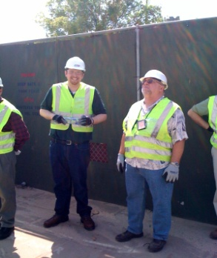
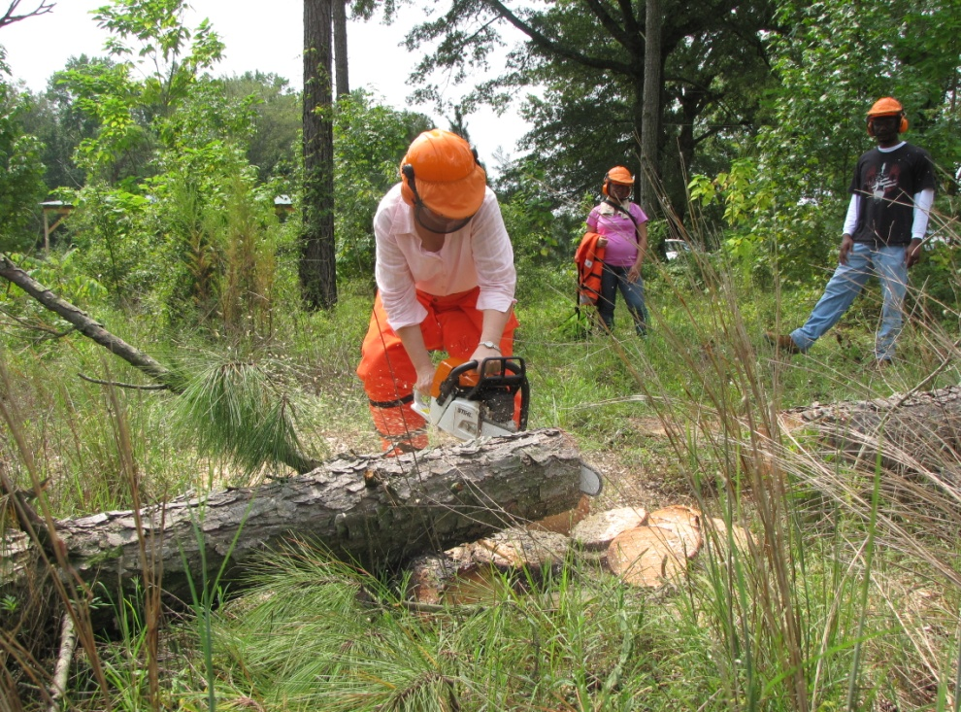
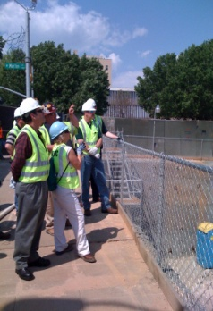
OSH Division
Complaint Desk*
Spring 2018
East Compliance | West Compliance | Agricultural Safety and Health
ACTIVITY | Total | Total | Total | Cumulative Total
Complaints | 503 | 605 | 7 | 1,115
Referrals | 165 | 204 | 13 | 382
Fat/Cat | 23 | 34 | 2 | 59
Totals | 691 | 843 | 22 | 1,556
*Includes calls that were processed but not necessarily inspected. Fat/Cat includes calls regarding heart attacks and other natural causes.
NCDOL Photo Library
Notes:
Complaints, referrals, fatality and catastrophe inspections account for a significant amount of inspections that compliance does every year. This slide puts that into perspective.

Slide 18
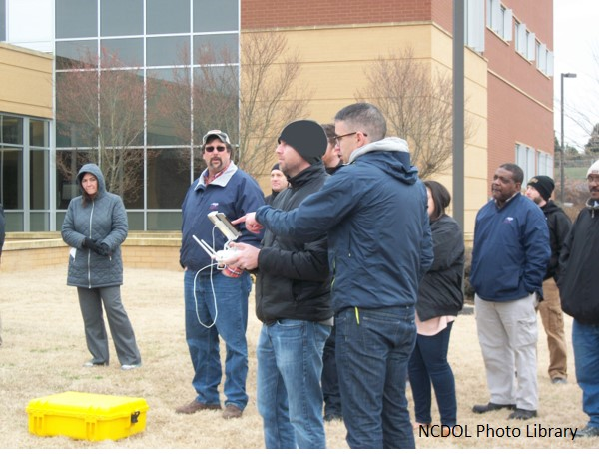
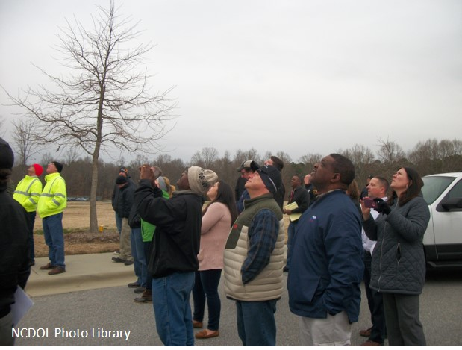
OSH Division
Internal Training
Spring 2018
COURSES | Number Trained
OCSS Trenching and Excavation OCSS—Raleigh | 20
Initial Compliance: OSH 100—Raleigh | 16
Technical Writing—Raleigh | 19
OSHA Express—Raleigh | 15
OCSS Trenching and Excavation OCSS—Charlotte | 16
Intro. to Safety Standards: OSH 105—Charlotte | 13
UAS Pilot Drone Training—Raleigh | 22
Introduction to Safety Standards: OSH 125—Charlotte | 7

Slide 19

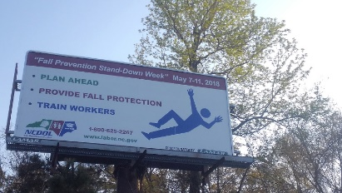
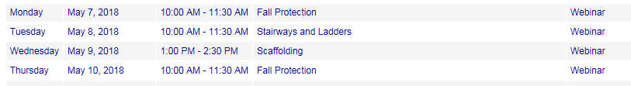

OSH Division
Training & Education Outreach
Spring 2018
Fall Stand Down—May 7-11
Builders Mutual (Labor One Events)
May 8—Raeford/Fayetteville
May 9—Belmont
Webinars
Safe + Sound Week—August 13-19
Activities TBD

Slide 20
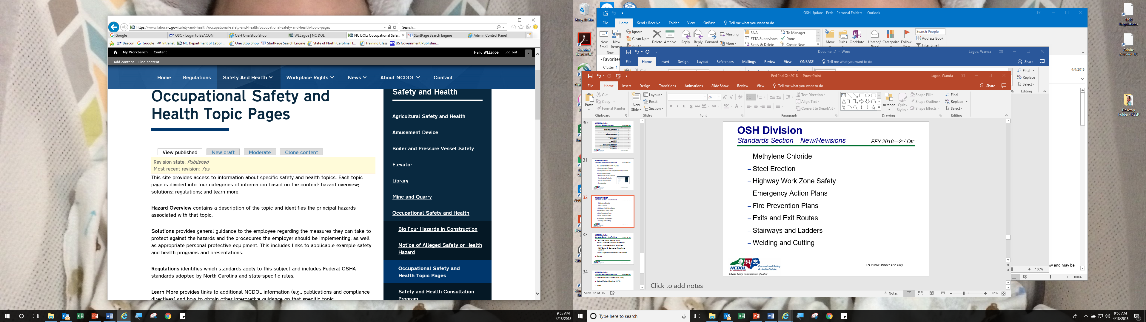
OSH Division
Standards Section—New to Website
Spring 2018
A - Z Safety and Health Topics
Communication Towers
Compressed Air and Compressed Air Equipment
Compressed Gases
Mechanical Power Presses
Non-ionizing Radiation
Power Press Brakes
Pyrotechnics

Slide 21
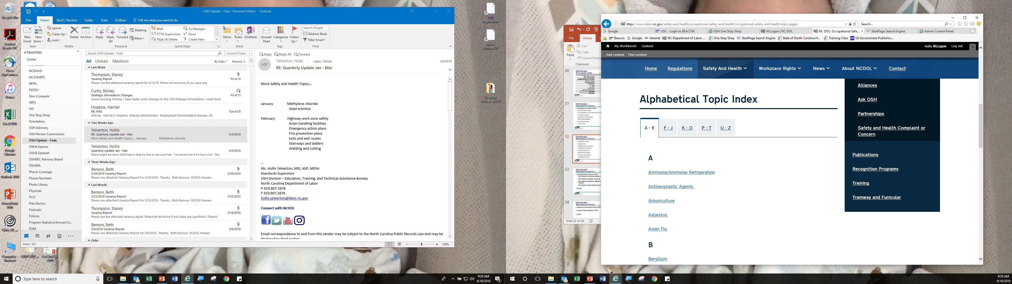
OSH Division
Standards Section—New to Website
Spring 2018
Methylene Chloride
Steel Erection
Highway Work Zone Safety
Emergency Action Plans
Fire Prevention Plans
Exits and Exit Routes
Stairways and Ladders
Welding and Cutting

Slide 22
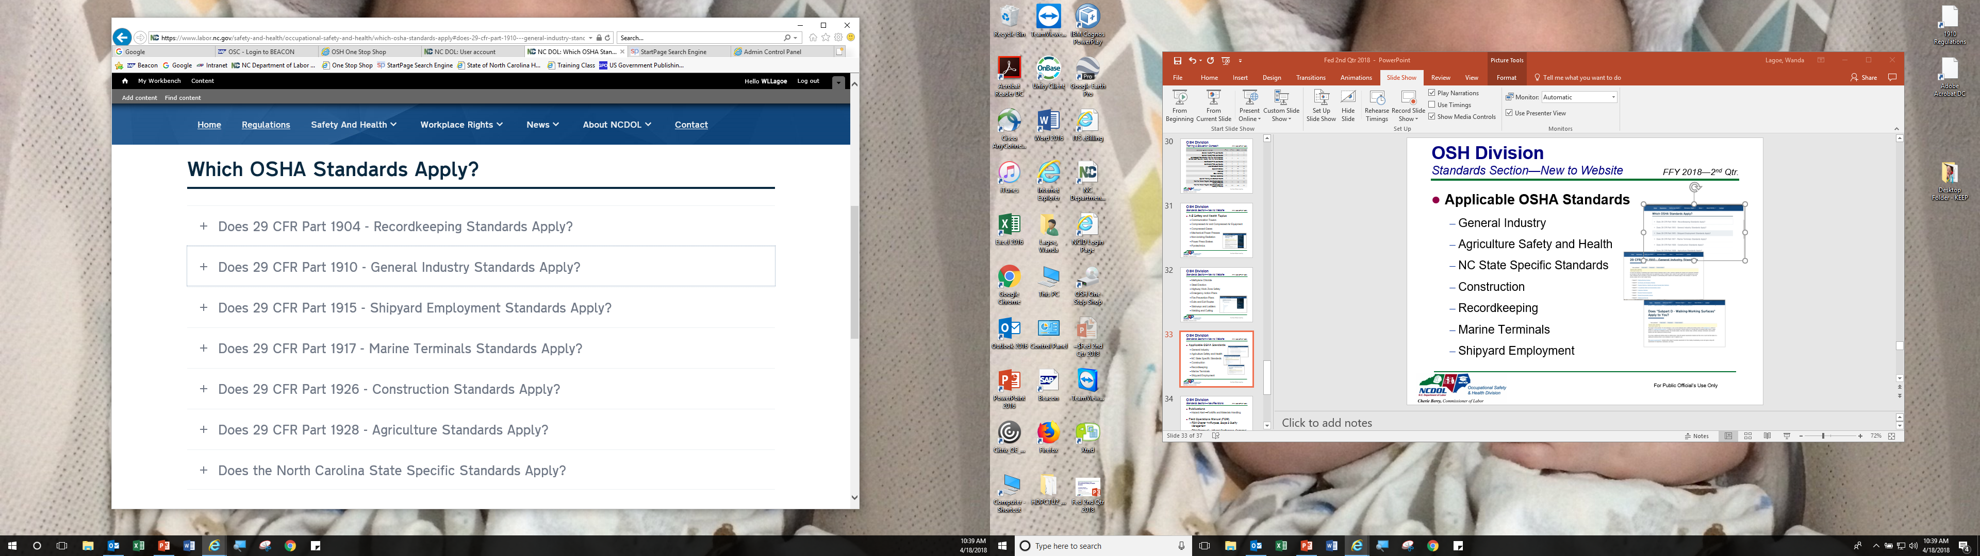
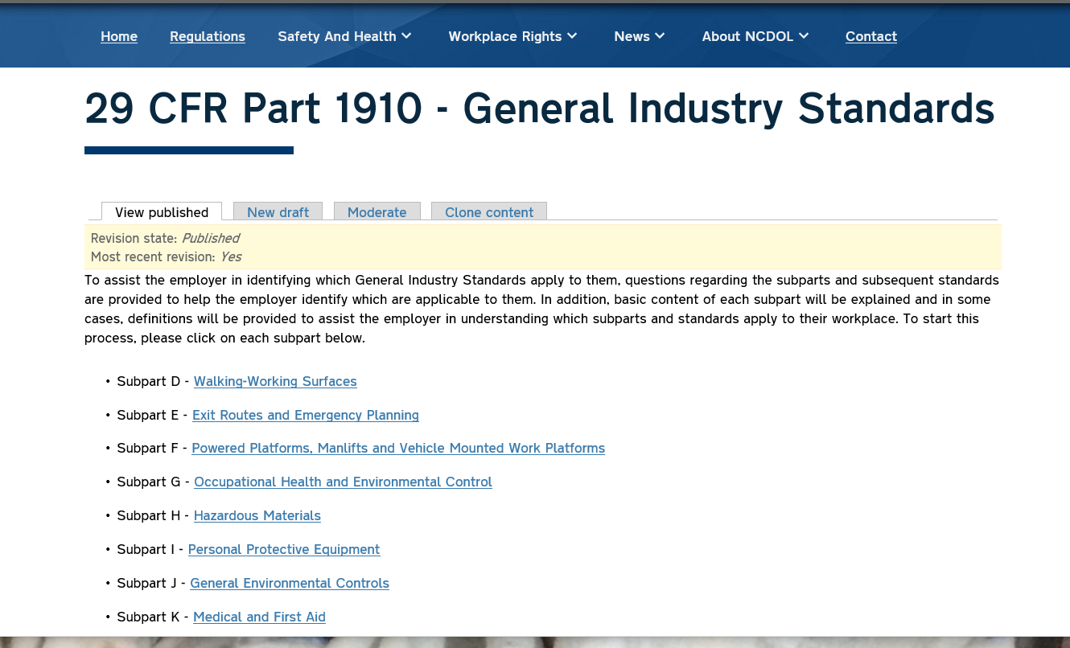
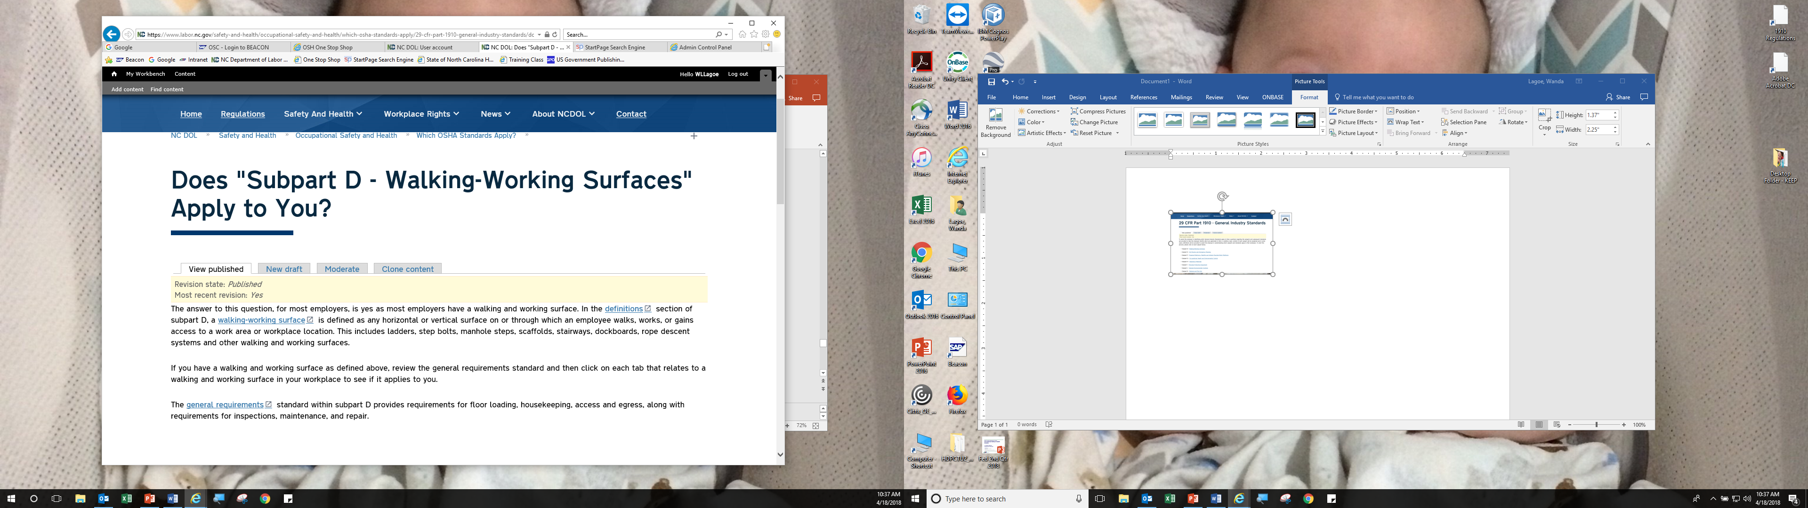
OSH Division
Standards Section—New to Website
Spring 2018
Applicable OSHA Standards
General Industry
Agriculture Safety and Health
NC State Specific Standards
Construction
Recordkeeping
Marine Terminals
Shipyard Employment

Slide 23
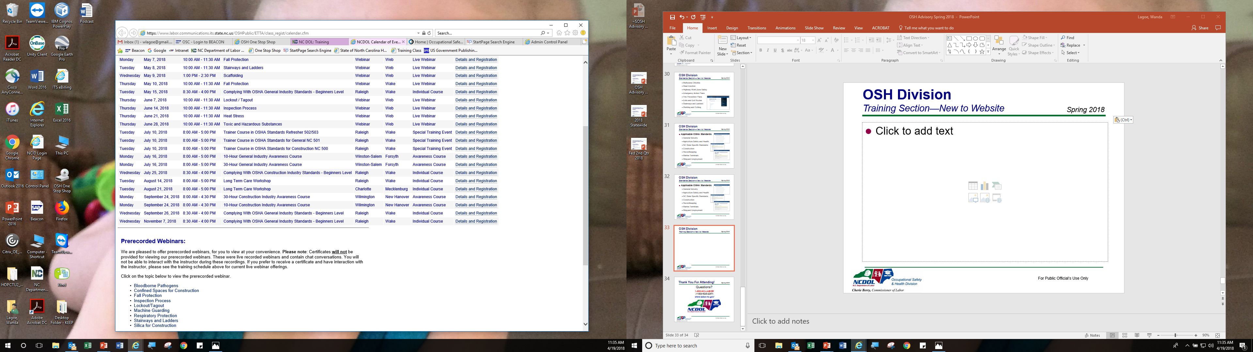
OSH Division
Training Section—New to Website
Spring 2018
Pre-recorded Webinars
Our webinar platform allows up to:
20 PPTs
600 hits per month

Slide 24
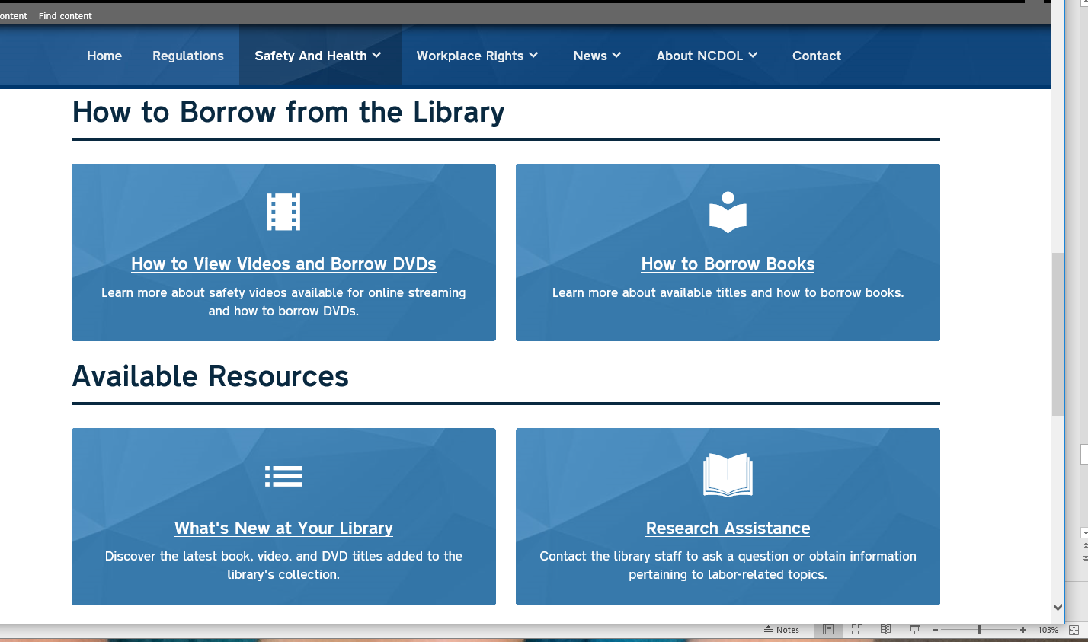
OSH Division
NCDOL Library
Spring 2018
The Training Network NOW!
Streaming Video on Demand provides access to 500+ safety & health videos (350+ in Spanish) in The Training Network’s online library
275+ registered patrons for access to The Training Network NOW streaming video service

Slide 25

OSH Division
Coming Soon—New to Website
Spring 2018
Pre-recorded Podcasts
Initial Podcast Aired April 30 with Dude Solutions
Topic – “Introduction to OSHA”
More Coming??

Slide 26

Thank You For Attending!
Spring 2018
Questions?
1-800-NC-LABOR
(1-800-625-2267)
www.labor.nc.gov
Notes:
26

