Slide 1
North Carolina Department of Labor Occupational Safety & Health Division OSH Advisory Fall 2021
Presented by:
Wanda Lagoe, Bureau Chief
Education, Training and Technical Assistance
Occupational Safety and Health Division of North Carolina
*Preliminary Data
Notes:
The information in this presentation is provided voluntarily by the N.C. Department of Labor, Education Training and Technical Assistance Bureau as a public service and is made available in good faith. This presentation is designed to assist trainers conducting OSHA outreach training for workers. Since workers are the target audience, this presentation emphasizes hazard identification, avoidance, and control – not standards. No attempt has been made to treat the topic exhaustively. It is essential that trainers tailor their presentations to the needs and understanding of their audience.
The information and advice provided on this Site and on Linked Sites is provided solely on the basis that users will be responsible for making their own assessment of the matters discussed herein and are advised to verify all relevant representations, statements, and information.
This presentation is not a substitute for any of the provisions of the Occupational Safety and Health Act of North Carolina or for any standards issued by the N.C. Department of Labor. Mention of trade names, commercial products, or organizations does not imply endorsement by the N.C. Department of Labor.

Slide 2
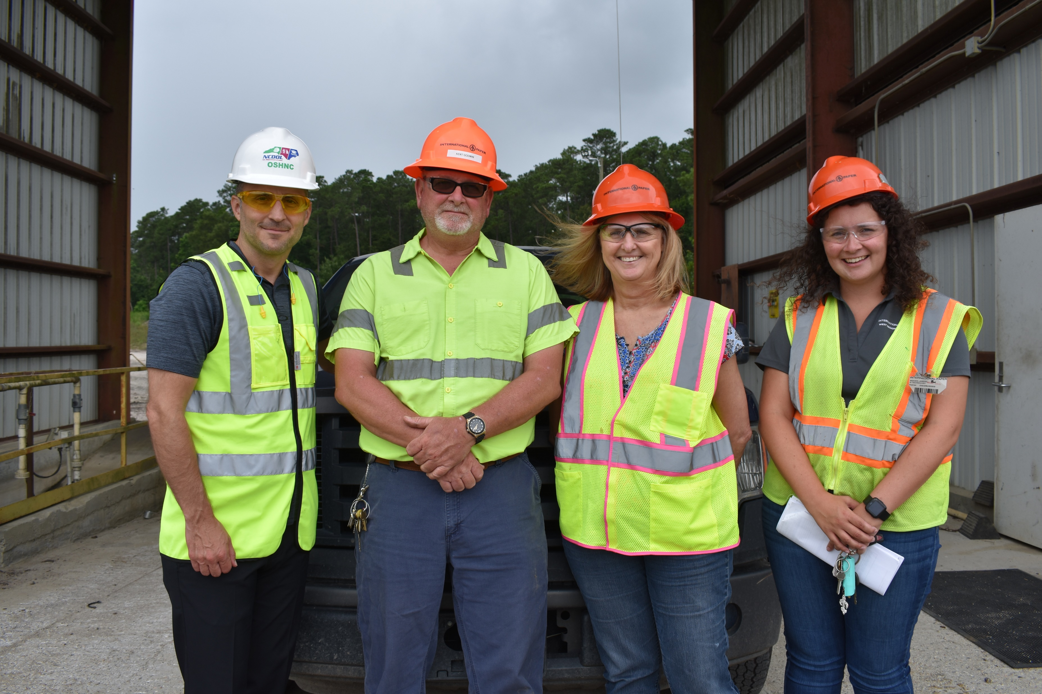
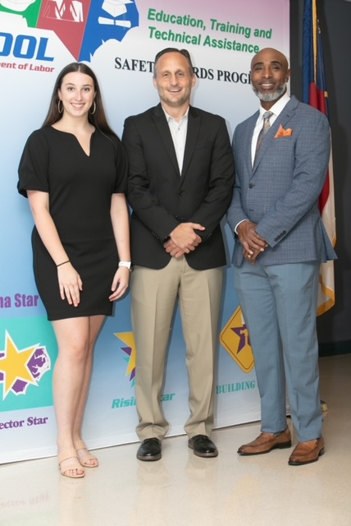
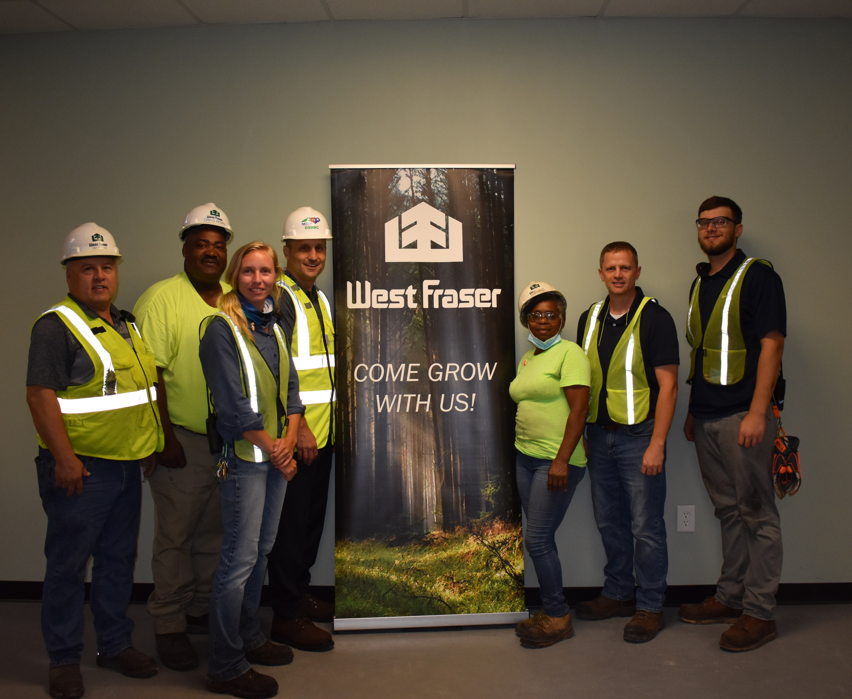
N.C. Workplace Safety and Health
TRC and DART Rate Comparison
FFY 2021—4th Qtr.
CY 2020 | North Carolina |  | National Average |  | Comparison
TRC Rate | 2.1 | 2.2* | 2.7 | 2.9* | 22% Lower/24% Lower*
DART Rate | 1.3 | 1.3* | 1.7 | 1.8* | 24% Lower/28% Lower*
*All industries including state and local government CY = Calendar Year
Notes:
North Carolina’s Total Recordable cases and DART rate continue to be lower that the National Average.
The DART rate stands for "Days Away, Restrictions and Transfers". This number is also based on trending over 200,000 hours but its not based on total injuries. Its based only on those injuries and illnesses severe enough to warrant "Days Away, Restrictions and Transfers".
The Total Recordable Case Rate (TRC) equals the division of all recordable cases by the hours worked, multiplied by 200'000 for standardization.

Slide 3
N.C. Workplace Safety and Health
Total Recordable Cases (TRC)
FFY 2021—4th Qtr.
4% Decrease
4% Increase
7% Decrease
4% Decrease
12% Decrease
All Industries Including State and Local Government
Based on Calendar Year

Slide 4
N.C. Workplace Safety and Health
Days Away, Restricted or Transferred (DART)
FFY 2021—4th Qtr.
No Change
7% Increase
7% Decrease
7% Decrease
No Change
All Industries Including State and Local Government
Based on Calendar Year

Slide 5
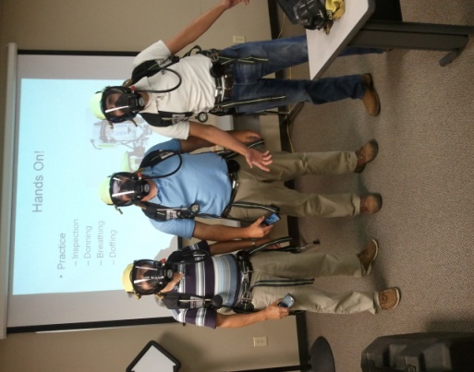
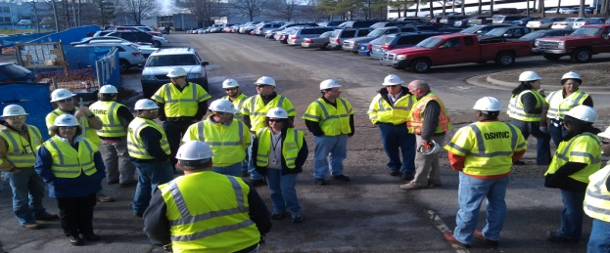

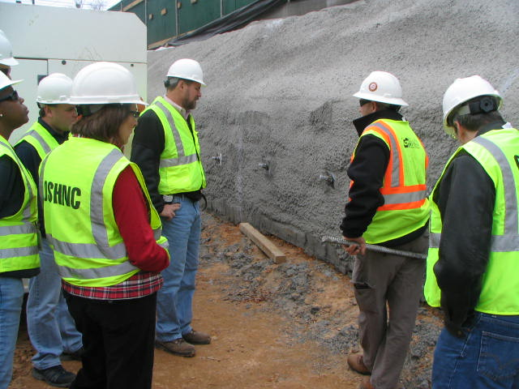
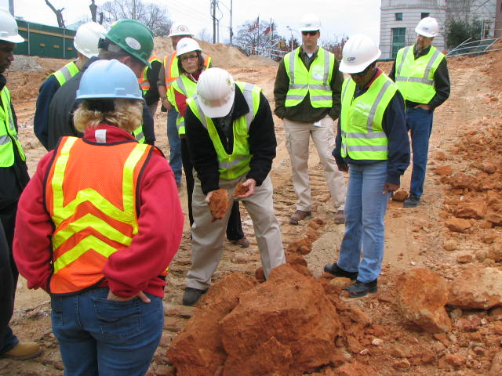
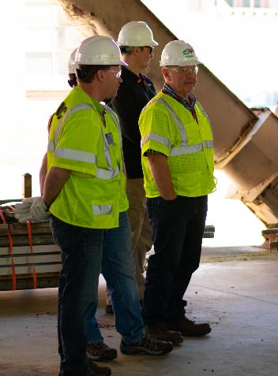
OSH Division
Fatalities Inspected
FFY 2021—Fall
FATALITY TYPE | Total | FATALITY TYPE | Total
Struck By | 16* | Inhalation | 3
Caught In/Between | 9 | Ingestion | 0
Bite/Sting/Scratch | 0 | Absorption | 0
Fall (Same Level) | 0 | Repeated Motion/Pressure | 0
Fall (From Elevation) | 10 | Cardio/Respiratory | 2
Struck Against | 1 | Shock | 5
Rubbed/Abraded | 0 | Other | 3
COVID-19 | 32 | Criminal Activity | 5
*One struck by is also a criminal activity.
Fatalities Under OSH Division Jurisdiction
FFY 2020 |  | FFY 2021 | Total
Total Fatalities | 79 | Total Fatalities | 86
NCDOL Photo Library

Slide 6
OSH Division
Strategic Plan Goals
FFY 2021—Fall
COMPLIANCE | Total | FFY Goal
Safety Inspections | 1,256 | 1,197
Health Inspections | 961 | 635
Serious Hazards Eliminated | 3,313 | 4,100
CONSULTATION | Total | FFY Goal
Serious Hazards Eliminated | 5,044 | 5,000
Private and Public Sector Visits | 1,425 | 925
OSH DIVISION | Total | FFY Goal
Program Improvements | 2,319 | 2,060
People Trained in Special Emphasis Program Areas | 5,510 | 3,700
People Trained at OSH Division Sponsored Events | 7,597 | 7,350

Slide 7

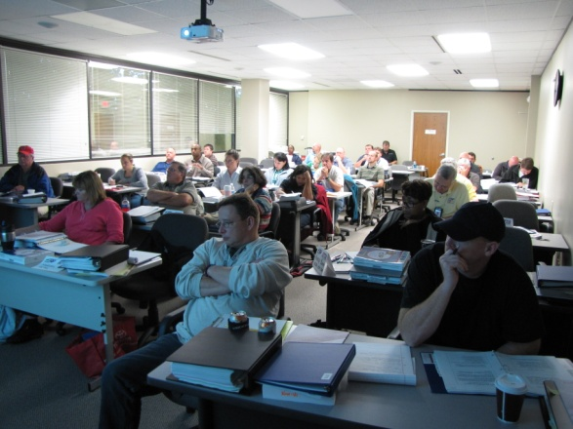
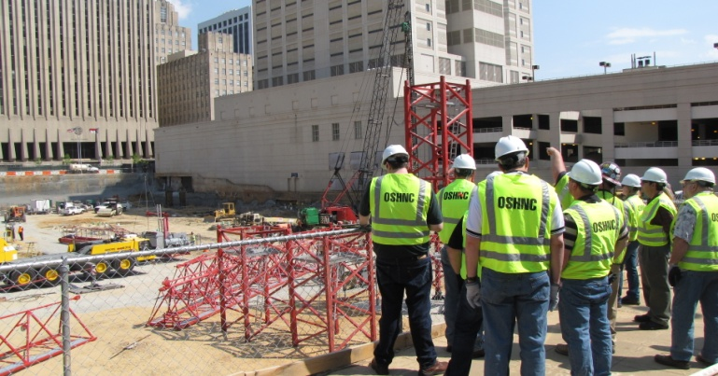

OSH Division
Strategic Plan Goals
FFY 2021—Fall
Education, Training and Technical Assistance (ETTA) | Total | FFY Goal
Publications Distributed | 21,286 | 23,000
Standards Interpretations | 2,147 | NA
Agricultural Safety and Health (ASH) | Total | FFY Goal
Outreach Materials Distributed | 4,752 | 3,500
Compliance Inspections | 52 | 80
Certificates Issued | 1,912 | 1,500
Preoccupancy Inspections | 1,964 | 1,700
NCDOL Photo Library

Slide 8
OSH Division
Complaint Desk*
FFY 2021—Fall
East Compliance | West Compliance | Agricultural Safety and Health
ACTIVITY | Total | Total | Total | Cumulative Total | FFY 2020
Complaints | 1,990 | 2,317 | 14 | 4,321 | 4,121
Referrals | 299 | 419 | 25 | 743 | 703
Fat/Cat | 94 | 122 | 11 | 227 | 246
Totals | 2,383 | 2,858 | 50 | 5,291 | 5,070
*Includes calls that were processed but not necessarily inspected. Fat/Cat includes calls regarding heart attacks and other natural causes.
ACTIVITY | Cumulative Total
Complaints Not in OSH Jurisdiction | 3,232
*Includes complaints related to wage and hour, discrimination, worker's compensation questions, beyond statute of limitation time frame, etc.
Notes:
Complaints, referrals, fatality and catastrophe inspections account for a significant amount of inspections that compliance does every year. This slide puts that into perspective.

Slide 9
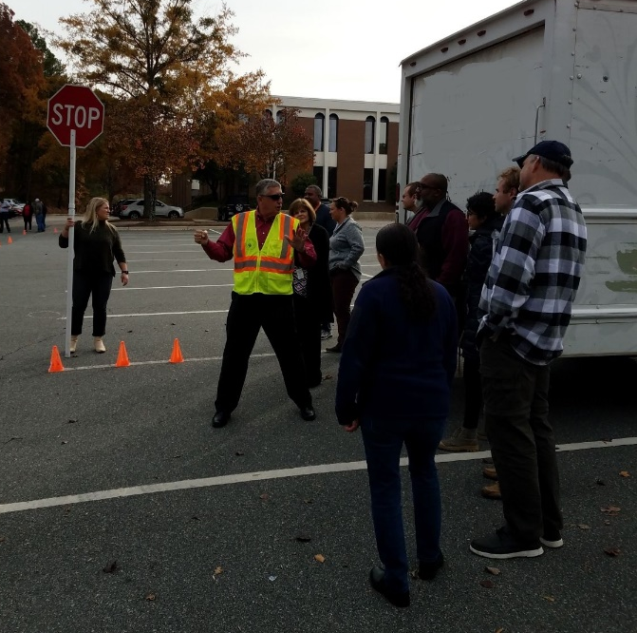
Strategic Plan
Special Emphasis Programs (SEP)
FFY 2021—Fall
Construction
Logging and Arboriculture
Long Term Care Facilities
Health Hazards
Food Manufacturing
Grocery and Related Product Wholesalers
Amputations
2019 – 2023 Strategic Management Plan
Goal #1 – Reduce fatalities by 2%
Goal #2 – Reduce injuries and illnesses by 5%
Notes:
FFY 2019 - 2023
OSHNC Outcome Goal #1 By the end of FY 2023, reduce the rate of workplace fatalities by 2% OSHNC Outcome Goal #2 By the end of FY 2023, reduce the rate of workplace injuries and illnesses by 5%

Slide 10

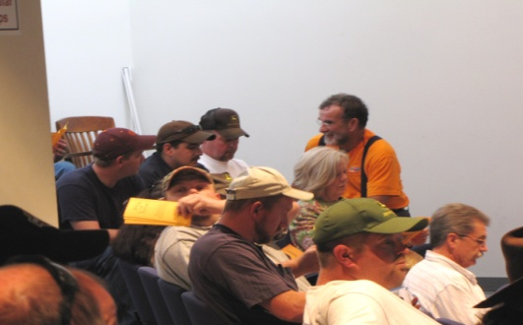
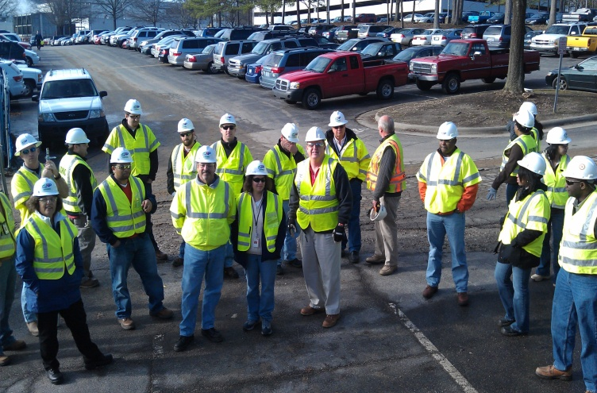
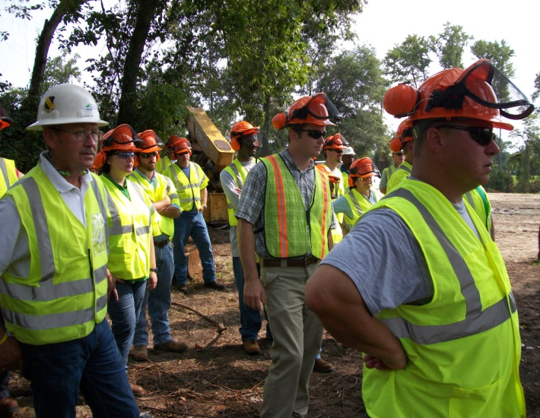

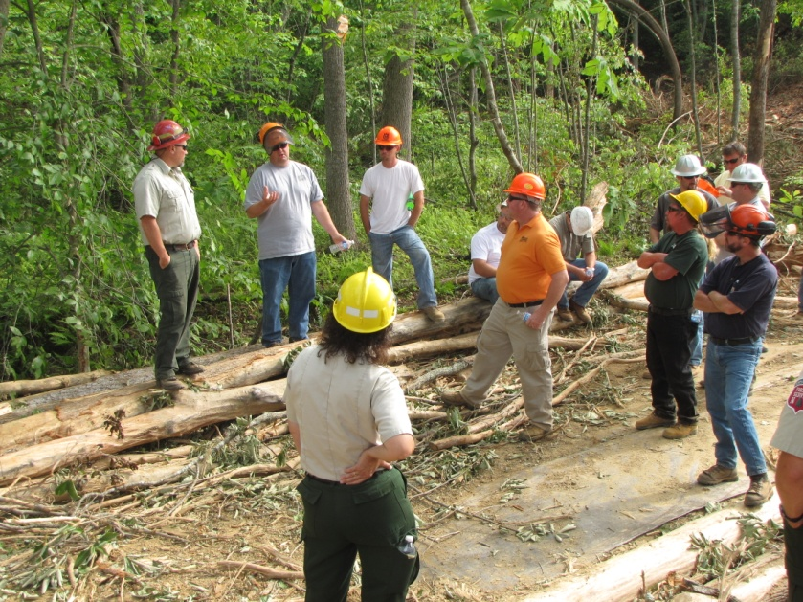
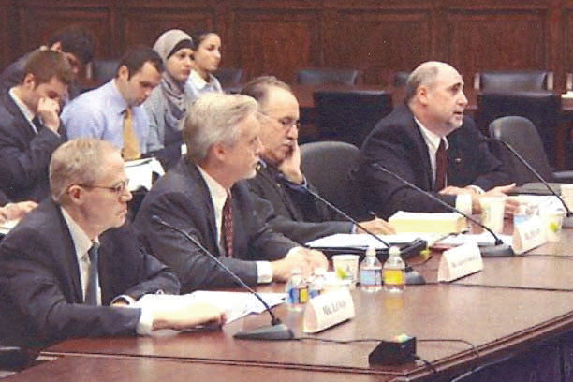

Special Emphasis Program
Construction
FFY 2021—Fall
 | North Carolina |  |  |  | National Average |  |  |  | North Carolina vs. National Average
 | CY 2019 |  | CY 2020 |  | CY 2019 |  | CY 2020 |  | 2020 Comparison
TRC | 1.6 | 20% Increase |  | 2.0 | 2.8 | 11% Decrease |  | 2.5 | 20% Lower
DART | 0.8 | 20% Increase |  | 1.0 | 1.7 | 6% Decrease |  | 1.6 | 37% Lower
SEP ACTIVITY | Total | FFY Goal
Compliance Inspections | 1,153 | 1,050
Consultative Visits | 437 | 250
OSH Outreach Events (10- and 30- Hour Construction Courses) | 6 | 6
People Trained | 814 | 1,750

Slide 11
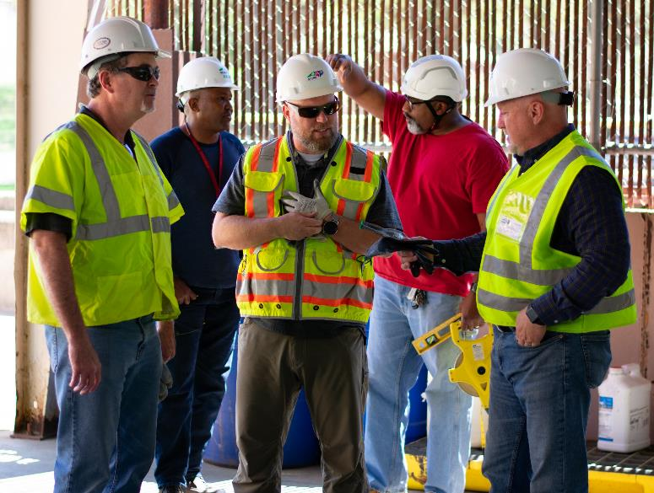
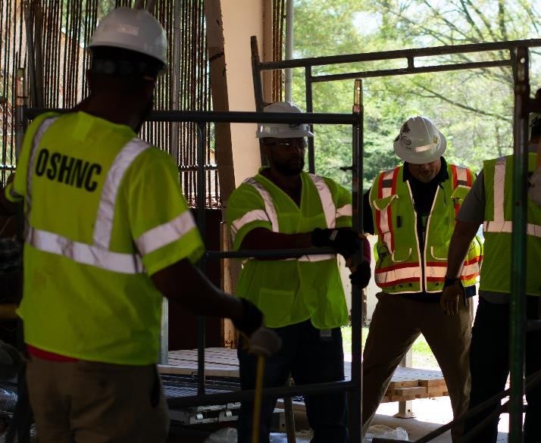

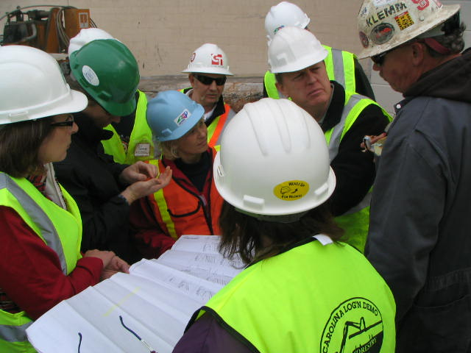
Special Emphasis Program
Construction
FFY 2021—Fall
NAICS 23—CONSTRUCTION | FFY 2020 |  | FFY 2021 Total
Total Fatalities | 26 |  | 17
FFY 2021 2nd Qtr. Fatality Rate |  |  | 0.0035
Fatality Type | Total | Fatality Type | Total
Struck By | 5 | Inhalation | 0
Caught In/Between | 3 | Ingestion | 0
Bite/Sting/Scratch | 0 | Absorption | 0
Fall (Same Level) | 0 | Repeated Motion/Pressure | 0
Fall (From Elevation) | 6 | Cardio/Respiratory | 0
Struck Against | 0 | Shock | 2
Rubbed/Abraded | 0 | Other | 1
Notes:
ETTA Events Total: 9 (4 Labor One, 4 Webinars, 1 Speaker Bureau )
Total Trained: 305
Consultation Events: 16
Total Trained: 1400
A total of 16 events were served by Rod Wilce. Activities included but are not limited to; event speakers, vendor demonstrations, fall protection training sessions, equipment inspections, distribution of Fed provided resource material, meals i.e. 700 Chic Filet sandwiches, countless doughnuts, full catered lunches. These 16 events provided the intended distribution of information and training to in excess 1400 employees within a 50 mile radius of Raleigh.
Used Billboards for Fall Stand Down, Safe and Sound Week, and Heat Stress.

Slide 12
Special Emphasis Program
Logging and Arboriculture
FFY 2021—Fall
56173 | North Carolina |  |  |  | National Average |  |  |  | North Carolina vs. National Average
 | CY 2019 |  | CY 2020 |  | CY 2019 |  | CY 2020 |  | 2020 Comparison
TRC | 3.9 | 36% Decrease |  | 2.5 | 3.9 | 23% Decrease |  | 3.0 | 17% Lower
DART | 1.6 | No Change |  | 1.6 | 2.5 | 20% Decrease |  | 2.0 | 20% Lower
SEP ACTIVITY | Total | FFY Goal
Compliance Inspections | 34 | 30
Consultative Visits | 17 | 13
OSH Training and Outreach Events | 7 | 3
People Trained | 180 | 75
NAICS 11331*—LOGGING | FFY 2020 |  | FFY 2021
Total Fatalities | 1 |  | 1
NAICS 56173—ARBORICULTURE | FFY 2020 |  | FFY 2021
Total Fatalities | 5 |  | 5
FFY 2021 2nd Qtr. Combined Fatality Rate |  |  | 0.0073
* TRC/DART Data not available
Notes:
NC TRC/DART rate not available for the 5 digit NAICS code
Logging fatalities went down but arboriculture went up.
Meeting minutes: Looking at alliances within the arboriculture industry. Encourage increased inspections in the SEP. Take a less experienced/confident CSHO out for familiarization. Continue to offer assistance and guidance where you/we can and provide referrals to Consultative or Compliance where appropriate. When conducting inspections on construction sites, public sector, or other activities where the employer/employees are conducting tree trimming/removal operations, please continue to mark the Emphasis/Initiatives blocks according to OPN 88I.

Slide 13
Special Emphasis Program
Long Term Care Facilities
FFY 2021—Fall
NAICS 623*—LONG TERM CARE
 | North Carolina |  |  |  | National Average |  |  |  | North Carolina vs. National Average
 | CY 2019 |  | CY 2020 |  | CY 2019 |  | CY 2020 |  | 2020 Comparison
TRC | 5.0 | 46% Increase |  | 9.3 | 5.9 | 49% Increase |  | 11.5 | 29% Lower
DART | 3.4 | 53% Increase |  | 7.2 | 3.5 | 62% Increase |  | 9.3 | 23% Lower
*TRC/DART rate based on the 3-digit NAICS code
SEP ACTIVITY | Total | FFY Goal
Compliance Inspections | 46 | 24
Consultative Visits | 44 | 10
OSH Outreach Events | 3 | 2
People Trained | 46 | 40

Slide 14
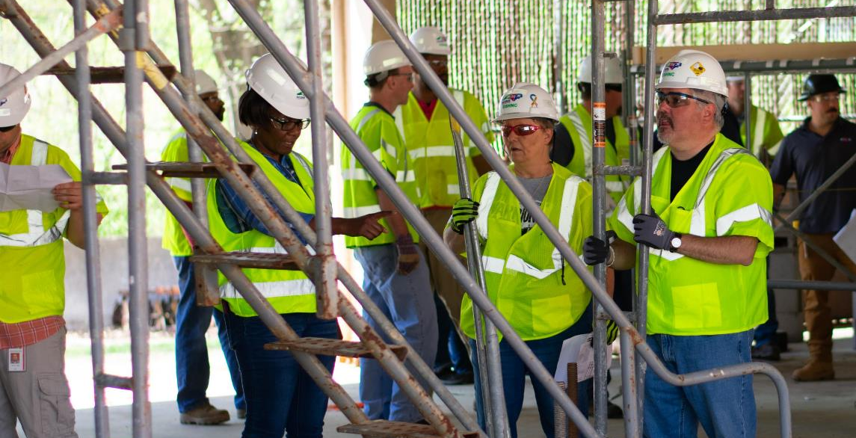

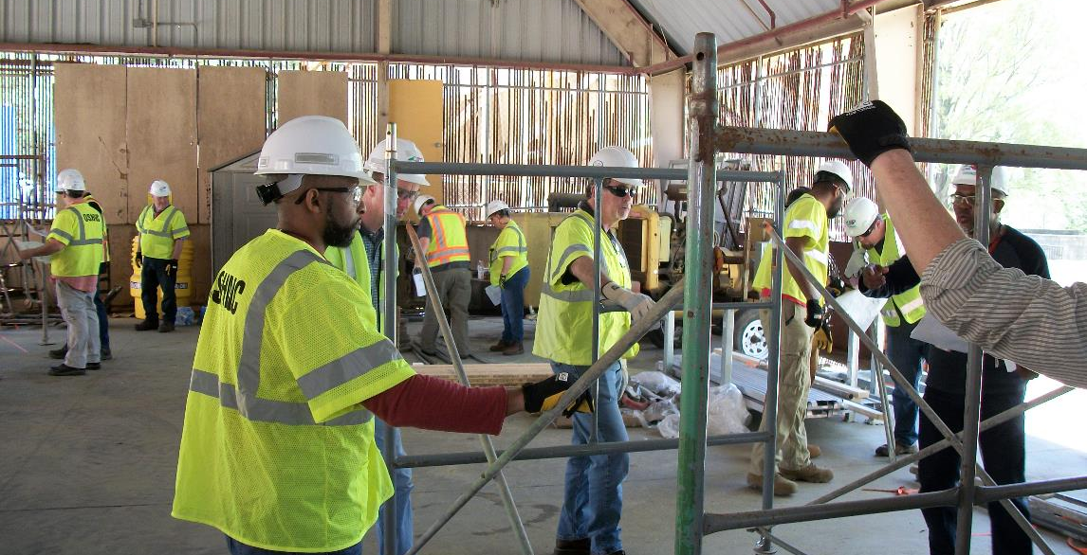
Special Emphasis Program
Health Hazards
FFY 2021—Fall
COMPLIANCE INSPECTIONS | Total | FFY Goal
Silica | 42 | 75
Asbestos | 21
Isocyanates | 21
Lead | 9
Hexavalent Chromium | 8
Total | 95
Program Improvements | 34 | 20
*Some inspections involved more than one health hazard and generally included a program improvement

Slide 15
Special Emphasis Program
Health Hazards
FFY 2021—Fall
HEALTH HAZARDS | Consultative Surveys
 | Total
Silica | 118
Asbestos | 19
Isocyanates | 9
Lead | 13
Hexavalent Chromium | 10
Total | 169
FFY Goal | 125
NCDOL Photo Library
NCDOL Photo Library
SEP ACTIVITY | Total | FFY Goal
OSH Outreach Events | 22 | 20
People Trained | 388 | 300

Slide 16
Special Emphasis Program
Food Manufacturing
FFY 2021—Fall
NAICS 311*—FOOD MANUFACTURING
 | North Carolina |  |  |  | National Average |  |  |  | North Carolina vs. National Average
 | CY 2019 |  | CY 2020 |  | CY 2019 |  | CY 2020 |  | 2020 Comparison
TRC | 2.9 | 24% Increase |  | 3.8 | 4.0 | 22% Increase |  | 5.1 | 25% Lower
DART | 2.1 | 30% Increase |  | 3.0 | 2.8 | 28% Increase |  | 3.9 | 23% Lower
*TRC/DART rate based on the 3-digit NAICS code
SEP ACTIVITY | Total | FFY Goal
Compliance Inspections | 51 | 20
Consultative Visits | 16 | 12
OSH Outreach Events | 3 | 2
People Trained | 32 | 40

Slide 17
Special Emphasis Program
Grocery and Related Product Wholesalers
FFY 2021—Fall
NAICS 4244*—GROCERY AND RELATED WHOLESALERS
 | North Carolina |  |  |  | National Average |  |  |  | North Carolina vs. National Average
 | CY 2019 |  | CY 2020 |  | CY 2019 |  | CY 2020 |  | 2020 Comparison
TRC | 5.2 | 23% Decrease |  | 4.1 | 4.8 | 2% Increase |  | 4.9 | 16% Lower
DART | 4.0 | 22% Decrease |  | 3.1 | 3.7 | 7% Increase |  | 4.0 | 22% Lower
*DART/TRC rate based on the 4-digit NAICS code
SEP ACTIVITY | Total | FFY Goal
Compliance Inspections | 27 | 24
Consultative Visits | 8 | 10
OSH Outreach Events | 2 | 2
People Trained | 16 | 40

Slide 18
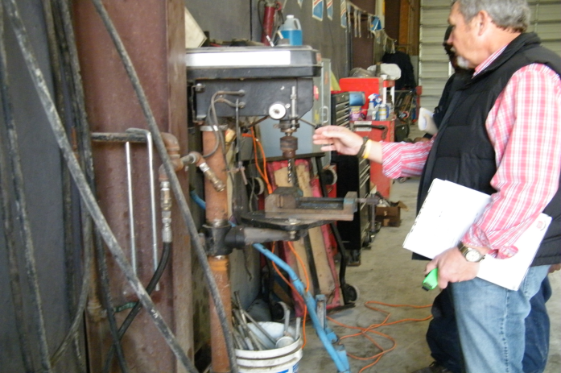
Special Emphasis Program
Amputations
FFY 2021—Fall
SEP ACTIVITY | Total | FFY Goal
Compliance Inspections | 161 | 100
Consultative Visits | 175 | 80
OSH Outreach Events | 37 | 15
People Trained | 690 | 400
Notes:
Added Amputations for our new 5 year SMP, and removed Accommodations.
Meeting Notes: Tara Payne and James Cook (co-chairs) presiding
The initial data compiled by Paul Sullivan spans from January 1, 2015 to current date.
Kevin Beauregard suggested using only full years (calendar, fiscal, etc.) for setting and monitoring goals. Targeting, data, etc. all needs to be based on consistent numbers for accurate results.
Paul’s 3 ½ years of data was tabulated to target companies with the highest amputations based on NAICS codes.
Paul suggested using data from fiscal years 2016, 17, and 18. This would address any concerns about under-reporting in 2015.
James and Tara asked what ETTA could do to help and whether the current Machine Guarding and Lockout/Tagout are sufficient. Andy said he thought that Lockout/Tagout was good, but that Machine Guarding was lacking photographs since the great photo purge of 2015. Paul and Tara suggested that they had plenty of photos from closed cases that they would be happy to share.
James and Tara suggested more advanced training for compliance officers. Injuries are primarily to ‘Affected’ employees rather than ‘Authorized’ employees. These are operators trying to clear jams or problems with machines rather than the maintenance people who are trained to deal these situations safely using safety protocols such as Lockout/Tagout.
Paul suggested a 1-day Internal Training workshop for Machine Guarding and a 1-day course in Lockout/Tagout. One in Charlotte for the West and a second in Raleigh for the East.
Andy said that this would be a good approach but would have to be coordinated with Marcy as ETTA had a very aggressive schedule in first quarter of 2019 regarding 10 and 30-hour classes as the hurricanes had wreaked havoc with our fourth quarter 2018 schedule for these classes.
Paul also suggested that they could supply COSHO’s with experience in individual pieces of equipment. Andy agreed and suggested that these could be done much like we do case studies in PSM training. Paul will seek volunteers for teaching subjects dealing with various manufacturing presses and equipment.
Kevin suggested talking to STAR and SHARP sites with this equipment about the possibility of scheduling field trips to these places.
It was agreed that these classes should be developed in first quarter 2019 for the SEP rollout in the fall of next year.

Slide 19
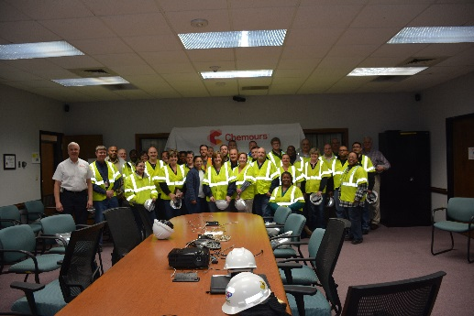
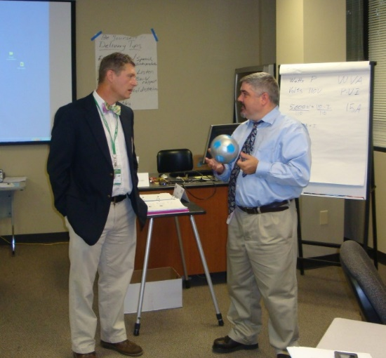
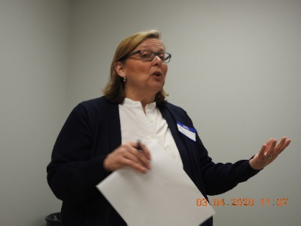
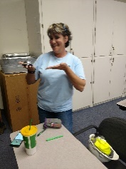
OSH Division
Public Sector
FFY 2021—Fall
 | CY 2019 |  | CY 2020
TRC | 3.6 | 14% Increase |  | 4.2
DART | 2.1 | 16% Increase |  | 2.5
ACTIVITY | Total | FFY Goal
Compliance Inspections | 127 | 63
Consultative Visits | 226 | 150
OSH Outreach Events/Booths | 3 | 22
Trained | 918 | 2,000

Slide 20
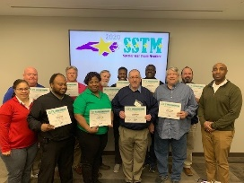
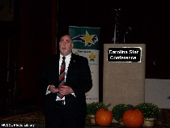
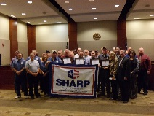
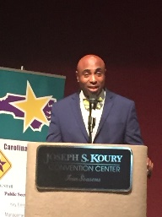
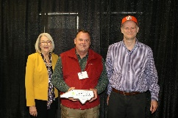
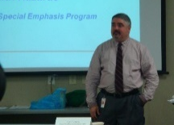

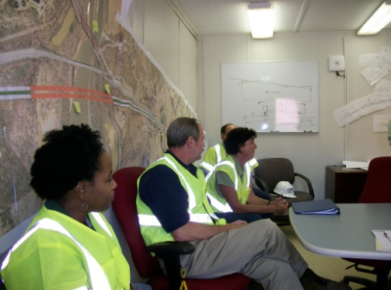
OSH Division
Recognition Programs
FFY 2021—Fall
STAR SITES—New, Recertification, Promotion | Total | FFY Goal | Approved Star Sites*
Carolina Star | 22 |  | 101
Building Star | 3 |  | 22
Rising Star | 0 |  | 4
Public Sector Star | 4 |  | 19
Total | 29 | 20 | 146
*Cumulative Total
NCDOL Photo Library
 | Total | FFY Goal
Star Sites—Termination/Withdrawn | 6
Star Conference Attendence | 305
Star Presentations | 18 | 20
Star Program Interventions | 134 | 100
Special Star Team Members/OSH Star Team Members | 108 | N/A
Notes:
The Carolina Star Program is designed to recognize employers and employees who have implemented effective safety and health management systems and maintain injury and illness rates that meet the criteria for participation. Any size employer.
The SSTM Program is North Carolina’s version of federal OSHA’s Special Government Employee (SGE) Program. The SSTM Program allows industry employees and qualified independent private sector safety and health professionals the opportunity to work together in partnership with the NCDOL Carolina Star Program during onsite Star Program evaluations.
General industry, private sector participants must meet the following criteria: The most recent three-year average for both the total recordable case (TRC) rates and cases with days away from work, job transfer, or restriction (DART) rates must be at or below 50 percent of the most recent published federal BLS rates for the appropriate North American Industrial Classification System (NAICS) industry, preferably using a 6-digit NAICS rate, or highest digit available.
Building Star - The contractor participant must meet the following criteria: All injuries and illness rates for each worksite in North Carolina must be summarized on the OSHA 300 log each year, for the past three years. The most recent three-year average for both the total recordable case (TRC) rates and cases with days away from work, job transfer, or restriction (DART) rates must be at or below 50 percent of the most recent published Federal BLS rate for the appropriate North American Industrial Classification System (NAICS) preferably using a 6-digit NAICS rate, or highest digit available.

Slide 21

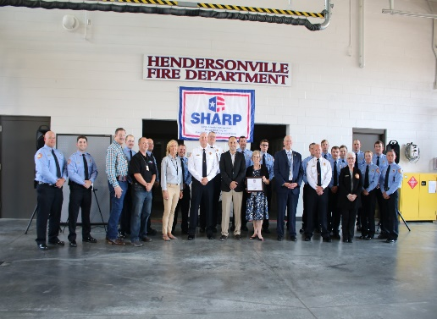
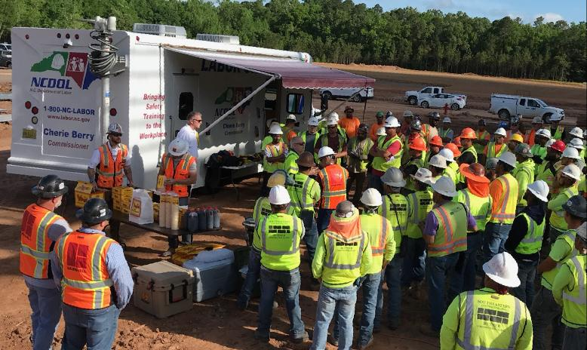
OSH Division
Recognition Programs
FFY 2021—Fall
SHARP SITES—New/Renewals | Total | FFY Goal | Approved SHARP Sites*
SHARP—Construction | 2 |  | 4
SHARP—General Industry | 55 |  | 115
SHARP—Public Sector | 19 |  | 41
Total | 76 |  | 160
*Cumulative Total
GOLD STAR GROWERS—New | Total
 | 212
SAFETY AWARDS | Total
CY 2020 Safety Awards Season (Silver, Gold, Million Hour) | 2,737
 | Total
Million Hour Awards | 45
Notes:
The SHARP (Safety and Health Achievement and Recognition Programs) Program is designed for small and mid-size employers that have established, implemented and maintained exceptional workplace safety standards.
The Gold Star Grower Housing Program recognizes growers who provide farmworker housing that meets and exceeds all of the requirements of the Migrant Housing Act of North Carolina.
The Gold Star Flag recognizes agricultural employers who have devised ways to continuously promote a culture of safety on their farms. Gold Star Flag recipients have identified hazards, trained their employees and completed farm safety inspections. They follow and exceed the regulations pertaining to the agricultural work place.
Safety Awards Program - In operation since 1946, the program now extends to more than 5,000 firms, and about 3,000 awards are presented annually. Two types of awards are administered through the program: Annual Safety Awards and Million-Hour Awards.
To qualify for an annual safety award, a firm must:
Have no fatalities during the calendar year at the site or location for which the award was given; and
Have maintained an incidence rate at least 50 percent below the average for its particular industry group.
Two Safety Award Levels - Gold and Silver
The Gold Award is based on the days away, restricted, transferred (DART) rate, which includes cases of days away from work, restricted activity or job transfer.
The Silver Award is based only on cases with days away from work. They are recorded when the worker misses at least one full day of work, not including the day of the injury.

Slide 22


OSH Division
Alliances and Partnerships
FFY 2021—Fall
Alliances
Carolinas AGC
Lamar Advertising Company
Mexican Consulate
N.C. State – Industry Expansion Solutions
Safety and Health Council of NC
NUCA of the Carolinas
NCALGESO

Slide 23
OSH Division
Alliances and Partnerships
FFY 2021—Fall
Partnerships
Sanders Utility Construction Company, Inc.
Charlotte – Irwin Creek Tributaries Sanitary Sewer Improvements (2020 – 2022)
Barringer Construction
Charlotte - Foundry Building Including Ancillary Buildings (2020 – 2023)
Holder – Edison Foard – Leeper, A Joint Venture
Charlotte - Charlotte Douglas International Airport – Terminal Lobby Expansion (2021 – 2023)

Slide 24
OSH Division
Education & Training
FFY 2021—Fall
OUTREACH EVENT | Total | FFY Goal
General Industry—10 Hour Course | 7 | 4
General Industry—30 Hour Course | 1 | 1
NC #500/502—Construction Train the Trainer Course NC #501/503—General Industry Train the Trainer Course | 1 | 1
Construction—10 Hour Course | 5 | 5
Construction—30 Hour Course | 1 | 1
Labor One/Booth Events | 5 | NA
Speaker’s Bureau | 35 | NA
Webinars | 104 | NA
OSH Workshops | 13 | NA
Technical Assistance | 28 | NA
Spanish Training and Outreach Events | 2 | NA
Train the Trainer Program (Construction/General Industry)—Events | 20 | NA
Train the Trainer Program (Construction/General Industry)—Trained | 126 | NA

Slide 25
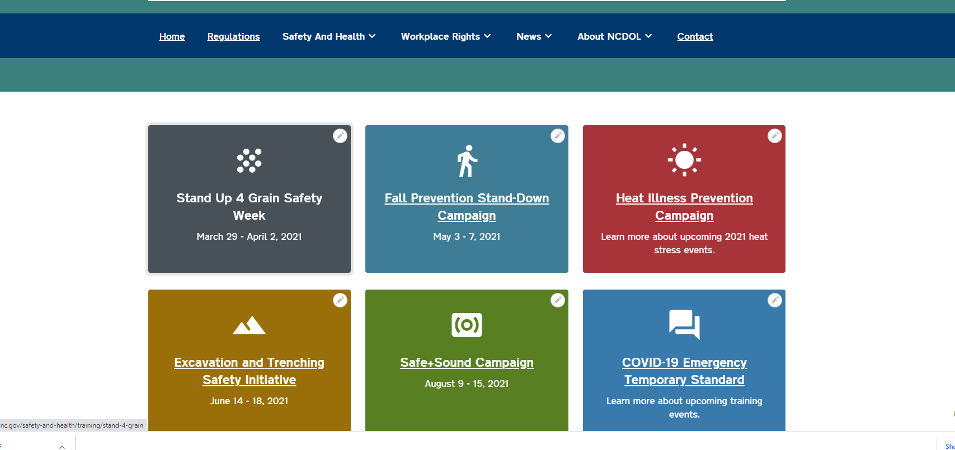
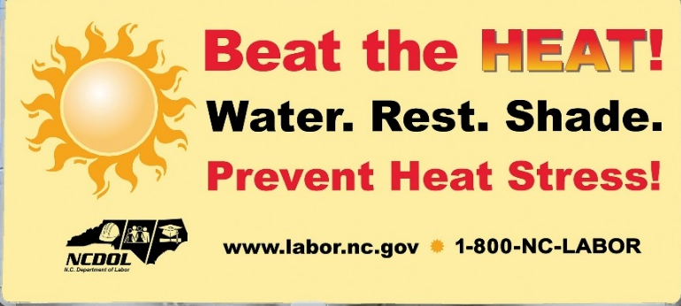
OSH Division
Education and Training Outreach
FFY 2021—Fall
Stand Downs/Forums
Fall Prevention
6 webinars, 76 trained
Construction Forum
48 trained
Excavation and Trenching
2 webinars, 22 trained
Heat Stress
3 webinars, 108 trained

Slide 26
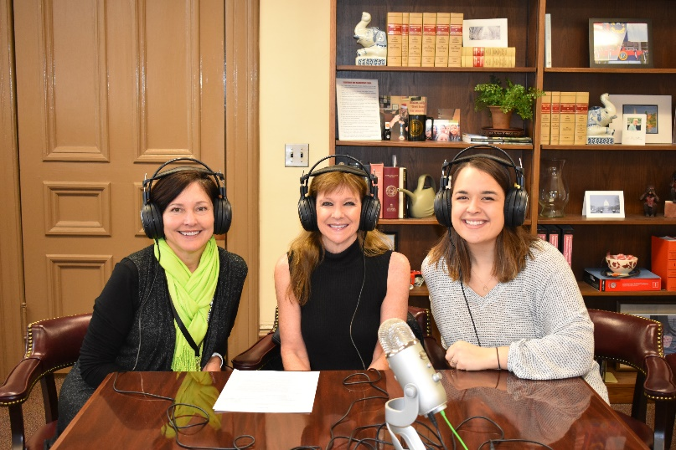
OSH Division
Social Media
FFY 2021—Fall
Inside NC Labor Podcasts
45 episodes
Facebook
1,866 followers
Instagram
572 followers
Twitter
2,057 followers

Slide 27
OSH Division
Standards Section—Revisions
FFY 2021—Fall
Compliance Directives (CPL)
CPL 02-00-051—Enforcement Exemptions and Limitations Under the Appropriations Act
Includes most recent listing of the North American Industry Classification System (NAICS) codes for industries with a DART occupational injury and illness rate below the national private sector rate of 1.5 for 2019.
CPL 02-01-062—Site-Specific Targeting (SST)
Implements OSHA's Site-Specific Targeting inspection plan. This program does not include construction worksites or North Carolina public sector sites.

Slide 28
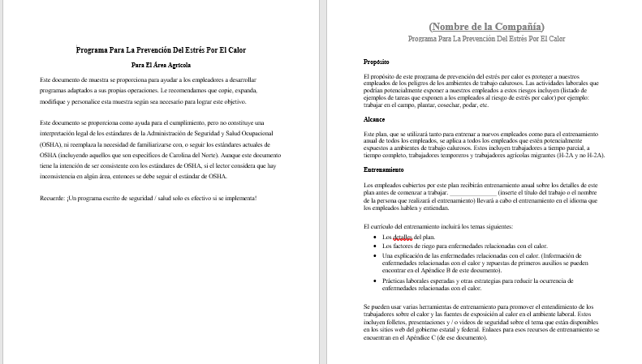
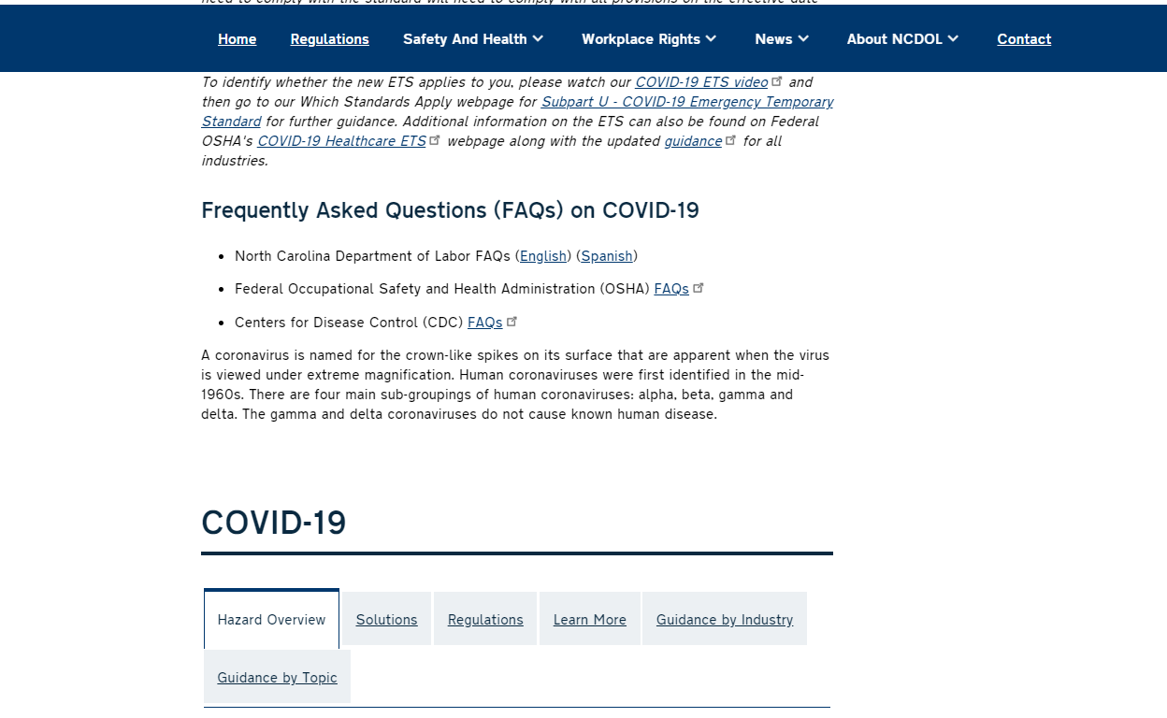
OSH Division
Standards Section—Publications
FFY 2021—Fall
Example Programs
Agriculture Heat Stress Prevention Program (Spanish)(English)
COVID-19 Frequently Asked Questions
Updated

Slide 29
OSH Division
Standards Section—Publications
FFY 2021—Fall
Brochures
Top Ten OSH Serious Violations
Safety Awards
Manager of Environmental, Safety and Health
Education, Training and Technical Assistance
Medical and Dental Offices
Public Sector Survey
Green Tobacco Sickness
Toolbox Talks (English)
Safety Briefings (English)

Slide 30
OSH Division
Cut-Loose, In-Training, Vacant
FFY 2021—Fall
West Compliance | Safety | % | Industrial Hygienist | %
Cut Loose | 19 | 61% | 23 | 88%
In-Training | 6 | 19% | 1 | 4%
Vacant | 6 | 19% | 2 | 8%
Total | 31 |  | 26
East Compliance | Safety | % | Industrial Hygienist | %
Cut Loose | 12 | 45% | 4 | 28%
In-Training | 5 | 19% | 3 | 17%
Vacant | 10 | 37% | 10 | 56%
Total | 27 |  | 18
Safety Cut Loose | 53% | Health Cut Loose | 61%
Safety In-Training | 19% | Health in-Training | 9%
Safety Vacant | 28% | Health Vacant | 30%

Slide 31
OSH Division
Cut-Loose, In-Training, Vacant
FFY 2021—Fall
Consultative Services | Safety | % | Industrial Hygienist | %
Cut Loose | 10 | 91% | 8 | 100%
In-Training | 0 | 0% | 0 | 0%
Vacant | 1 | 9% | 0 | 0%
Total | 11 |  | 8
Education, Training and Technical Assistance | Safety | % | Industrial Hygienist | %
Cut Loose | 8 | 73% | 4 | 67%
In-Training | 3 | 27% | 1 | 17%
Vacant | 0 | 0% | 1 | 17%
Total | 11 |  | 6
Agricultural Safety and Health | Safety | % | Industrial Hygienist
Cut Loose | 5 | 83% | NA
In-Training | 1 | 17% | NA
Vacant | 0 | 0% | NA
Total | 6

Slide 32
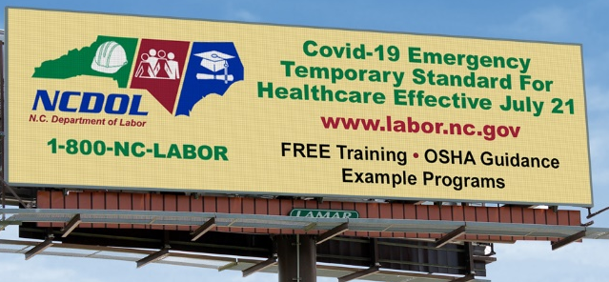
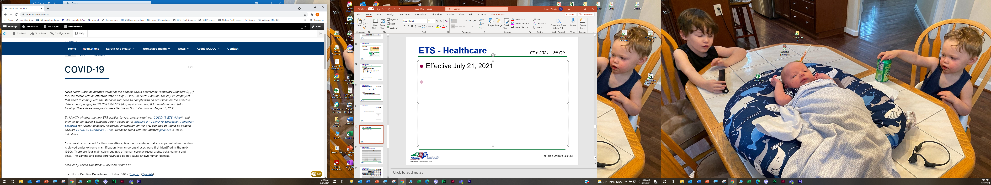
OSH Division
Standards Section—New Rule
FFY 2021—Fall
COVID-19 Emergency Temporary Standard
Effective July 21, 2021, in North Carolina
Paragraphs (i) - physical barriers, (k) - ventilation and (n) – training, effective August 5, 2021.
Outreach
COVID-19 Plan
PowerPoints and Webinars
“Which Standards Apply” Webpage
ETS Video – Application
Billboards
Industry Guide – Special Requirements

Slide 33
OSH Division
COVID-19 Activities
FFY 2021—Fall
Calls/Emails | FFY 2020* | FFY 2021** | October 2021*** | November 2021**** | FFY 2020-22
Director's Office | 2,143 | 1,581 | 126 | 98 | 3,948
ETTA | 1,347 | 623 | 49 | 24 | 2,043
ASH***** | 341 | 529 | 47 | 21 | 938
PSIM | 11 | 0 | 0 | 0 | 11
CSB | 1,084 | 440 | 16 | 34 | 1,574
Totals | 4,926 | 3,173 | 238 | 177 | 8,514
*FFY 2020 includes data from March 1 (estimated), 2020 through October 2, 2020.
**FFY 2021 includes data from October 2, 2020, through October 3, 2021.
***FFY October 2021 includes data from October 4, 2021, through October 31, 2021.
****FFY November 2021 includes data from November 1, 2021, through November 7, 2021.
*****Includes weekly conference calls with other Agencies.

Slide 34
OSH Division
COVID-19 Activities
FFY 2021—Fall
Director’s Office | FFY 2020* | FFY 2021** | October 2021*** | November2021**** | FFY 2020-22
Meetings | 102 | 93 | 7 | 4 | 206
Compliance | FFY 2020* | FFY 2021** | October 2021*** | November 2021**** | FFY 2020-22
Valid Complaints | 1,012 | 1,325 | 36 | 5 | 2,378
Non-Valid Complaints | 1,402 | 1,141 | 31 | 3 | 2,578
Inspections | 22 | 97 | 3 | 0 | 128
Referrals | 51 | 45 | 3 | 0 | 99
Unprocessed Complaints***** | 1,107 | 595 | 24 | 5 | 1,732
*FFY 2020 includes data from March 1 (estimated), 2020 through October 2, 2020.
**FFY 2021 includes data from October 2, 2020, through October 3, 2021.
***FFY October 2021 includes data from October 4, 2021, through October 31, 2021.
****FFY November 2021 includes data from November 1, 2021, through November 7, 2021.
*****This data is preliminary and subject to change as unprocessed complaints are moved to other categories. Many of these unprocessed complaints contain insufficient information to process and/or they cover complaint items that do not fall under OSH jurisdiction. Referrals to other Agencies are made, as appropriate.
.

Slide 35
OSH Division
COVID-19 Activities
FFY 2021—Fall
PSIM | FFY 2020* | FFY 2021** | October 2021*** | November2021**** | FFY 2020-22
Disclosure Requests | 1,627 | 1,418 | 0 | 0 | 3,045
CSB | FFY 2020* | FFY 2021** | October 2022*** | November 2022**** | FFY 2020-22
Interventions | 54 | 30 | 0 | 0 | 84
Visits | 157 | 367 | 25 | 5 | 554
ASH | FFY 2020* | FFY 2021** | October 2021*** | November2021**** | FFY 2020-22
Guidance Documents | 1 | 0 | 0 | 0 | 1
*FFY 2020 includes data from March 1 (estimated), 2020 through October 2, 2020.
**FFY 2021 includes data from October 2, 2020, through October 3, 2021.
***FFY October 2021 includes data from October 4, 2021, through October 31, 2021.
****FFY November 2021 includes data from November 1, 2021, through November 7, 2021.

Slide 36
OSH Division
COVID-19 Activities
FFY 2021—Fall
ETTA | FFY 2020* | FFY 2021** | October 2021*** | November2021**** | FFY 2020-22
Live Webinars | 28 | 19 | 1 | 0 | 48
Pre-recorded Webinars | 6 | 1 | 0 | 0 | 7
PowerPoints | 25 | 12 | 0 | 0 | 37
Hazard Alerts | 7 | 2 | 0 | 0 | 9
Streaming Videos | 72 | 62 | 3 | 0 | 137
A-Z Topics Added/Updated | 24 | 26 | 1 | 1 | 52
Fact Sheets | 4 | 9 | 0 | 0 | 13
Example Programs | 1 | 2 | 0 | 0 | 3
Compliance Memos | 10 | 3 | 1 | 0 | 14
Billboards | 0 | 4 | 0 | 0 | 4
*FFY 2020 includes data from March 1 (estimated), 2020 through October 2, 2020.
**FFY 2021 includes data from October 2, 2020, through October 3, 2021.
***FFY October 2021 includes data from October 4, 2021, through October 31, 2021.
****FFY November 2021 includes data from November 1, 2021, through November 7, 2021.

Slide 37
OSH Division
COVID-19 Activities
FFY 2021—Fall
COVID-19 Safety and Health Topic Page
FFY 2020
FFY 2020 - 2021 = 61,043
FFY 2021

Slide 38
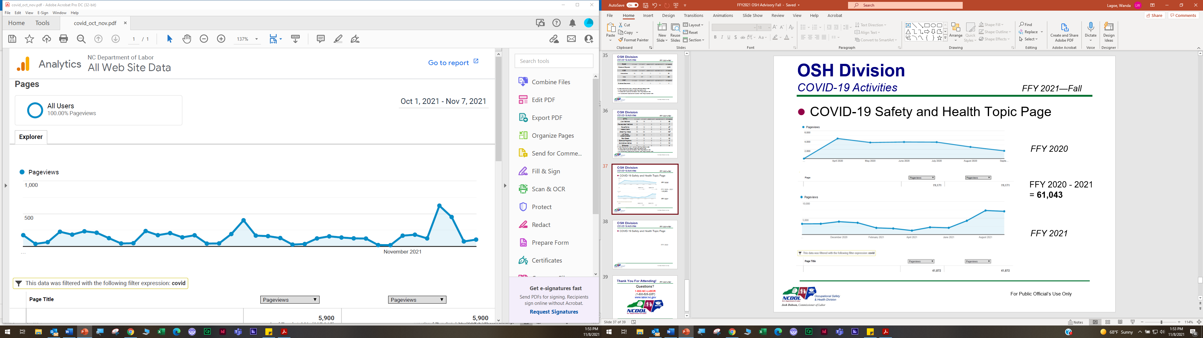
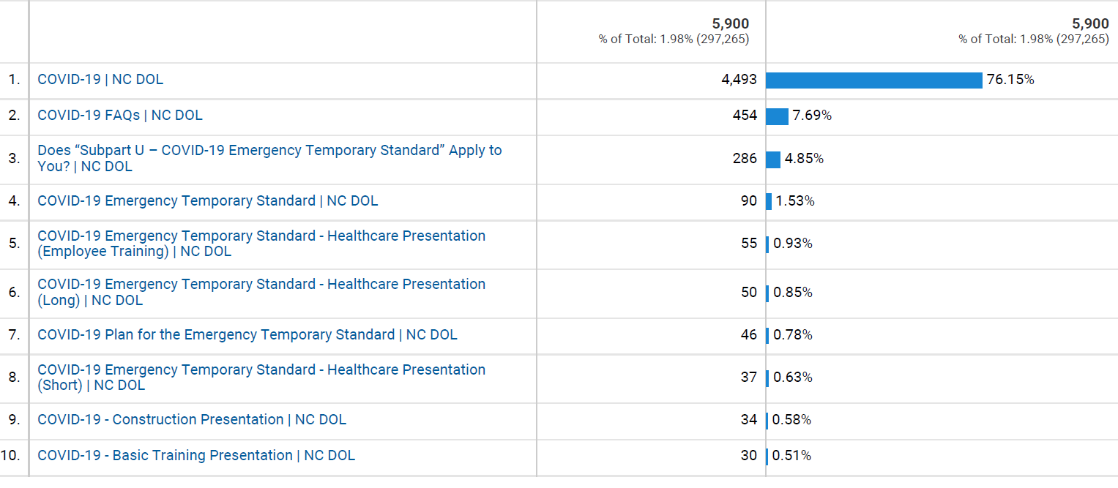
OSH Division
COVID-19 Activities
FFY 2021—Fall
COVID-19 Safety and Health Topic Page
October 1, 2021 – November 7, 2021

Slide 39

Thank You For Attending!
FFY 2021—Fall
Questions?
1-800-NC-LABOR
(1-800-625-2267)
www.labor.nc.gov
Notes:
39

