Slide 1
Hurricane Florence 2018
NCDOL Outreach Activities
Presented by: Cory Dunphy, ETTA 919-707-7859
Notes:
Revised: 11/2017
The information in this presentation is provided voluntarily by the N.C. Department of Labor, Education Training and Technical Assistance Bureau as a public service and is made available in good faith. This presentation is designed to assist trainers conducting OSHA outreach training for workers. Since workers are the target audience, this presentation emphasizes hazard identification, avoidance, and control – not standards. No attempt has been made to treat the topic exhaustively. It is essential that trainers tailor their presentations to the needs and understanding of their audience.
The information and advice provided on this Site and on Linked Sites is provided solely on the basis that users will be responsible for making their own assessment of the matters discussed herein and are advised to verify all relevant representations, statements, and information.
This presentation is not a substitute for any of the provisions of the Occupational Safety and Health Act of North Carolina or for any standards issued by the N.C. Department of Labor. Mention of trade names, commercial products, or organizations does not imply endorsement by the N.C. Department of Labor.

Slide 2
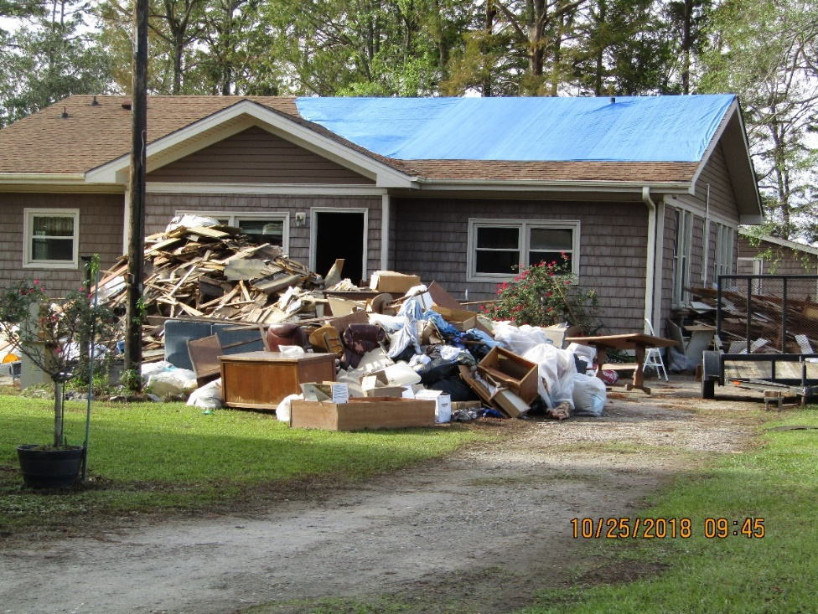
Objectives
We will go over the following:
Timeline of the storm
Our Preparations
Planning and
Coordination
Outreach Activity
Review (not
completed)
NCDOL Photo Library
Notes:
NCDOL Photo Library – This photo was taken by NCDOL Employee Warren Lutz during Hurricane Florence outreach activities near Lake Waccamaw, NC. Loss of interior due to flooding near Lake Waccamaw

Slide 3
Timeline
Aug 28, 2018 - National Hurricane Center identified a weather pattern that showed signs of possibly becoming a hurricane.
Sept 1, 2018 - the low pressure system developed into a Tropical Depression in the Atlantic off the coast of Africa
Sept 4, 2018 - developed into a Category 1 Hurricane named Florence

Slide 4
Timeline
Sept 5-6, 2018 - models indicated a strong possibility of landfall in the Carolinas
Sept 10, 2018 - Hurricane Florence developed into a Category 4
Sept 12 – 14, 2018 - Hurricane Florence downgraded to Category 1
Notes:
As late as Sunday Sept 9 several weather models showed the predicted path of Florence to track to the east of NC and stay off shore.
During the day on Sunday, the models shifted to indicate a landfall near Wilmington most likely.
On Monday Sept 10 majority of the models showed a major impact to NC
The speed of the hurricane drastically slowed as it approached the coast of NC.

Slide 5
Timeline
Sept 14, 2018 - Hurricane Florence made landfall south of Wrightsville Beach, NC
Sept 15, 2018 - Florence downgraded to a Tropical Storm moving over NC/SC line
Sept 16, 2018 - Florence downgraded to a Tropical Depression moving through SC and turning northward
Sept 17, 2018 - system absorbed by another front

Slide 6
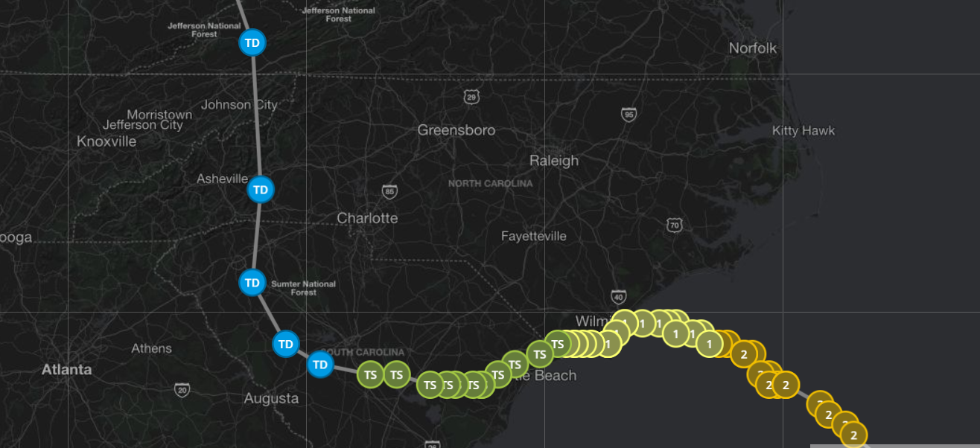
Timeline
Photo from www.weather.com tracking the path of Hurricane Florence.
Notes:
This photo taken from www.weather.com that shows the path of Hurricane Florence and its status as it passed through NC and SC.

Slide 7
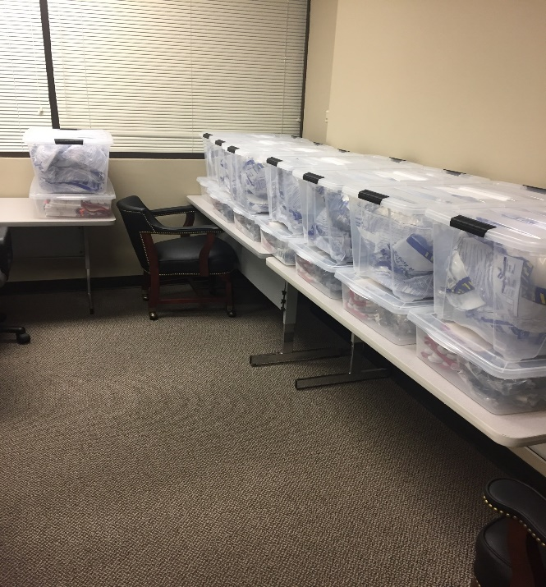
Preparations
Started preparations early in 2018
Review of previous hurricane outreach activities
Purchase of plastic totes
creation of “To Go Kits”
2018 COOP activity
Annual Training instructions
Planning
NCDOL Photo Library
Notes:
NCDOL Photo Library – This photo was taken by Hollis Yelverton, NCDOL Employee of the hurricane response totes that were prepared prior to Hurricane Florence in September 2018

Slide 8
Planning and Coordination
1st thing: checked on status of affected employees
Monday Sept 17 - starting checking on status of employees, especially Wilmington employees
by Tuesday Sept 18 all employees reported safe with 5 evacuated and 1 remained
Wednesday Sept 19 entered Wilmington office
Minimal damage – minor water damage in front of office
Roads to office still difficult to navigate

Slide 9
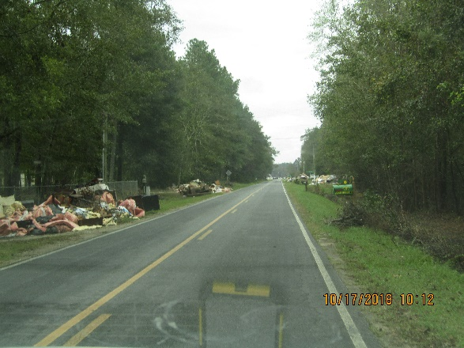
Planning and Coordination
Thursday Sept 19 initiated hurricane response activities
41 counties identified
Compliance activity suspended in identified counties
Employees acting in consultative role
Distributing personal protective
equipment to affected individuals
Teams from Compliance (Charlotte,
Winston, Raleigh), Consultative
Services, ETTA
NCDOL Photo Library
Notes:
NCDOL Photo Library – Photo taken by NCDOL employee Warren Lutz in Columbus County in November 2018.

Slide 10
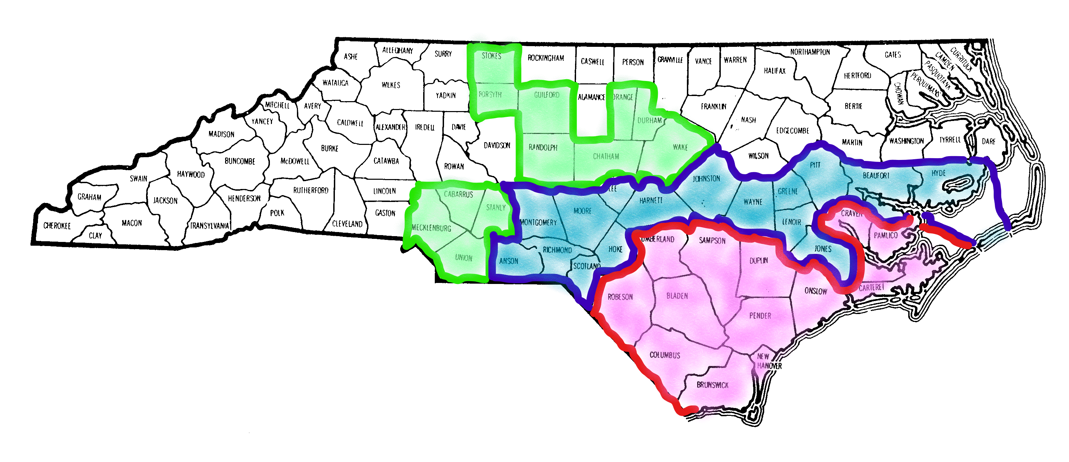
Outreach Activities
Initial Counties for Outreach Activities
Notes:
This map was created by Cory Dunphy to show the 41 counties that NCDOL initially determined as at least minimally affected by Hurricane Florence.

Slide 11
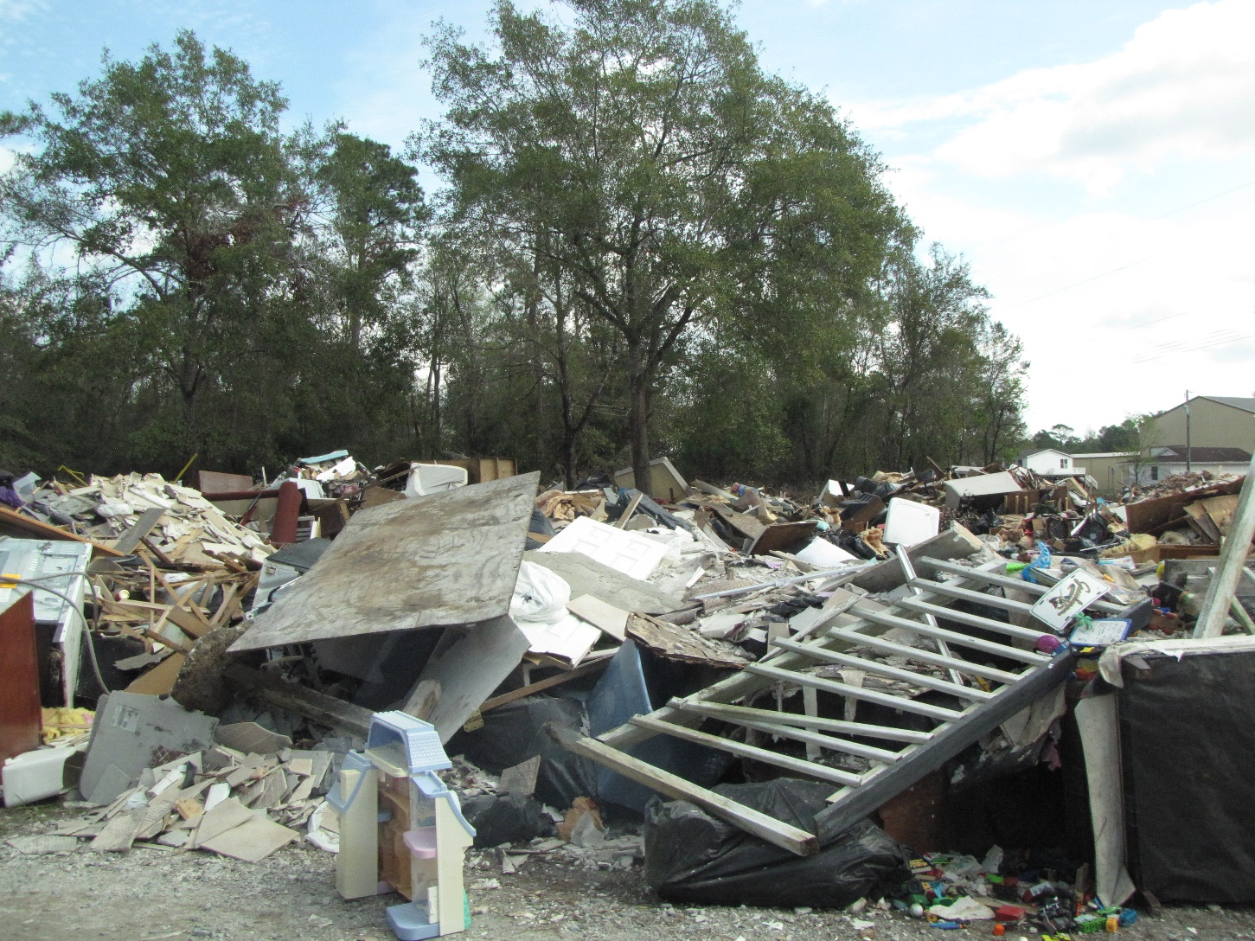
Outreach Activities
NCDOL Photo Library
Notes:
NCDOL Photo Library – Photo taken by NCDOL Employee Mia Pearson during Hurricane Outreach Activity in Pender County, NC. Debris from nearby houses piled up by the road awaiting pick up for disposal.

Slide 12
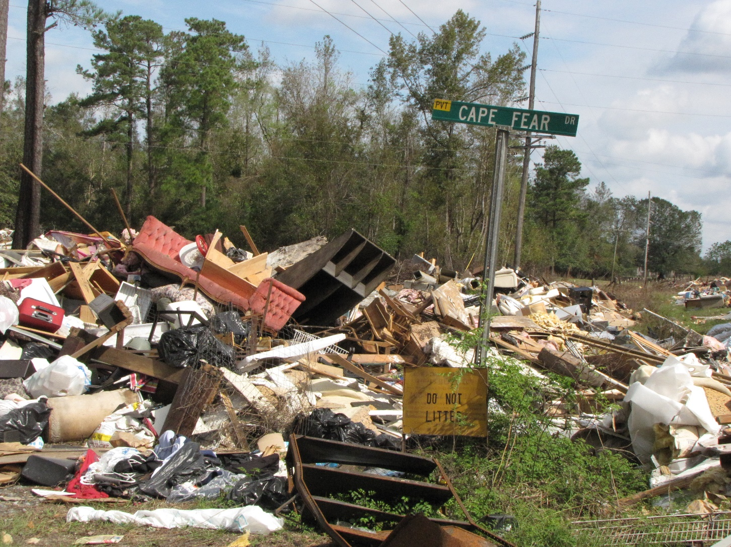
Outreach Activities
NCDOL Photo Library
Notes:
NCDOL Photo Library – Photo taken by NCDOL Employee Mia Pearson during Hurricane Outreach Activity in Pender County, NC. Debris from nearby houses piled up by the road awaiting pick up for disposal.

Slide 13
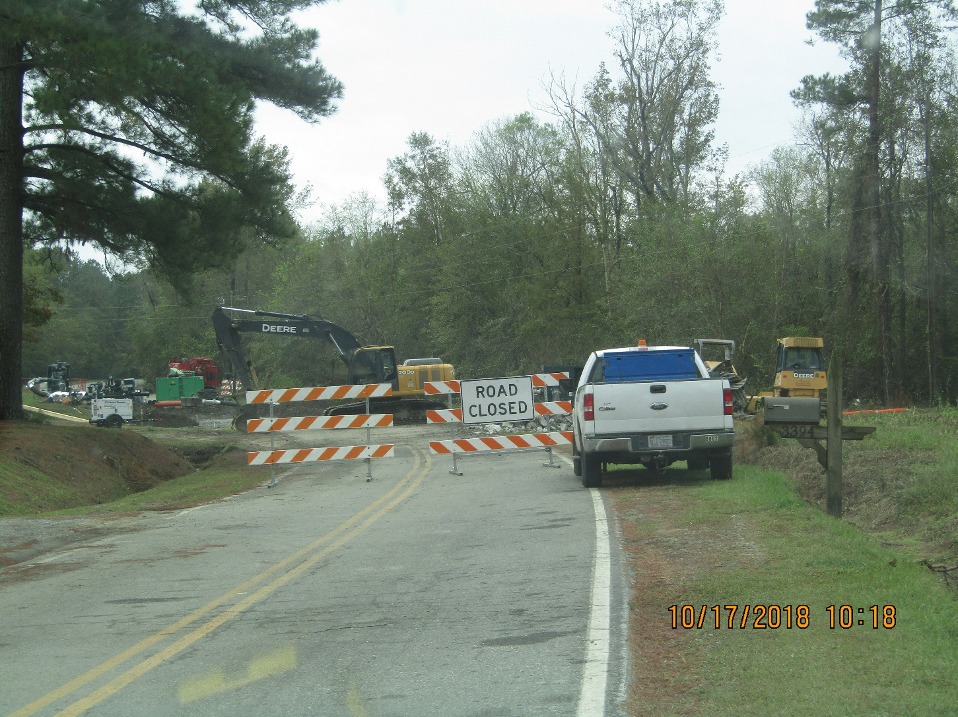
Outreach Activities
NCDOL Photo Library
Notes:
NCDOL Photo Library – Photo taken by NCDOL Employee Warren Lutz during Hurricane Outreach Activity in Columbus County, NC. One month after impact there are still roads that are closed due to being washed out from floods post- Florence.

Slide 14
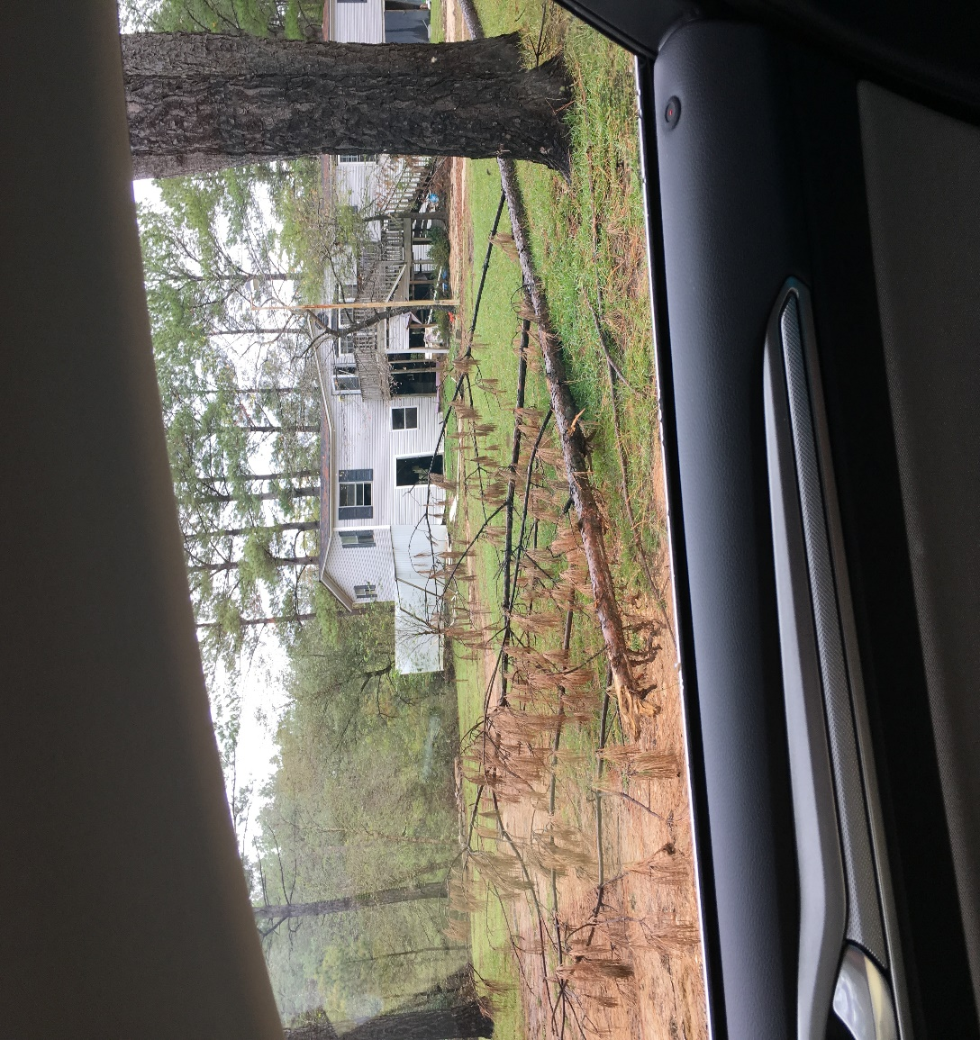
Outreach Activities
NCDOL Photo Library
Notes:
NCDOL Photo Library – Photo taken by NCDOL Employee Tara Payne during Hurricane Outreach Activity near Ivanhoe, NC. This photo shows damage to the trees, but also the washed out driveway to the house.

Slide 15
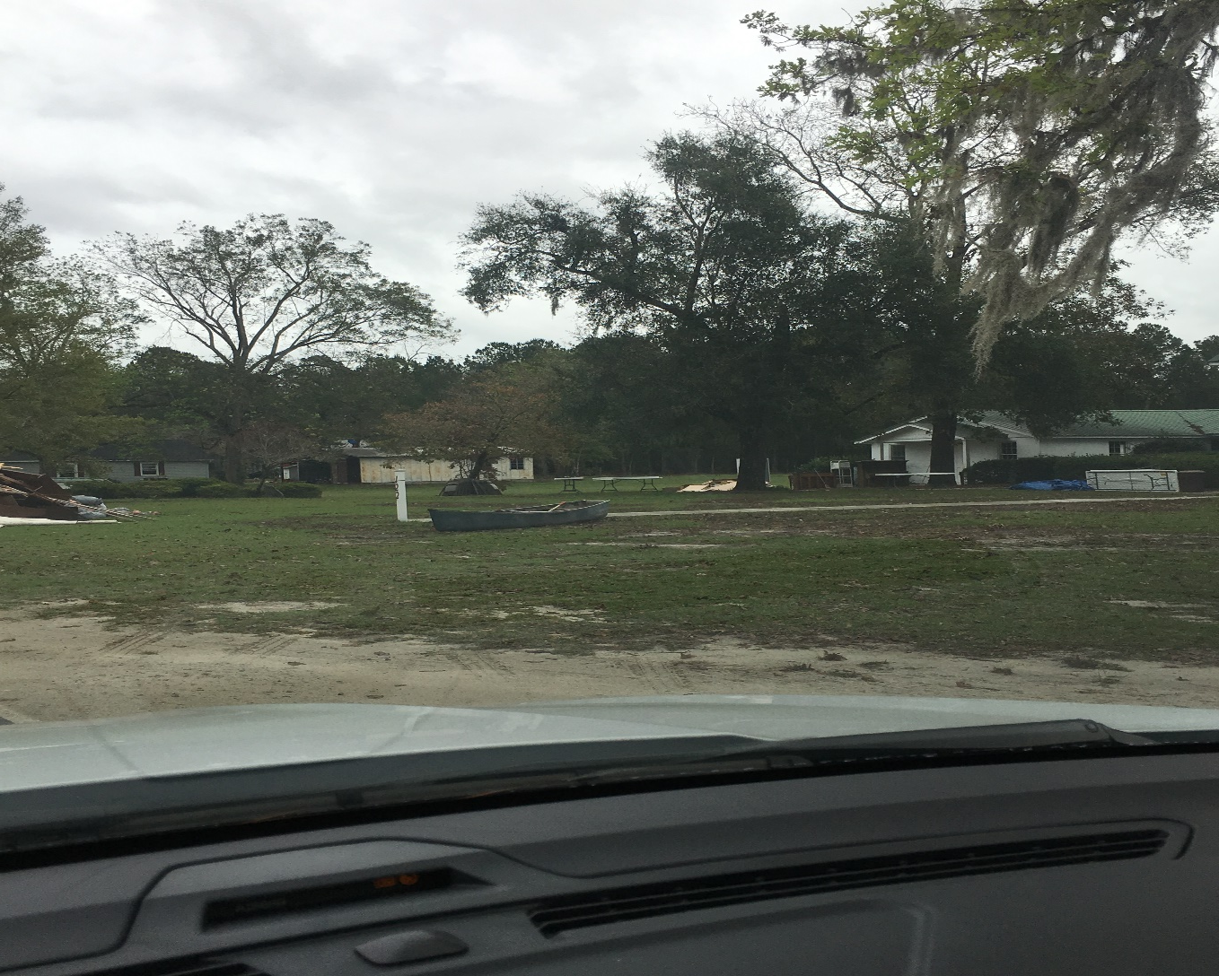
Outreach Activities
NCDOL Photo Library
Notes:
NCDOL Photo Library – Photo taken by NCDOL Employee Tara Payne during Hurricane Outreach Activity near Ivanhoe, NC. This photo shows a boat in the front yard of a house. Employees were told by residents that they tied boats to the front porch of the house so they were readily accessible in the event that they needed to evacuate.

Slide 16
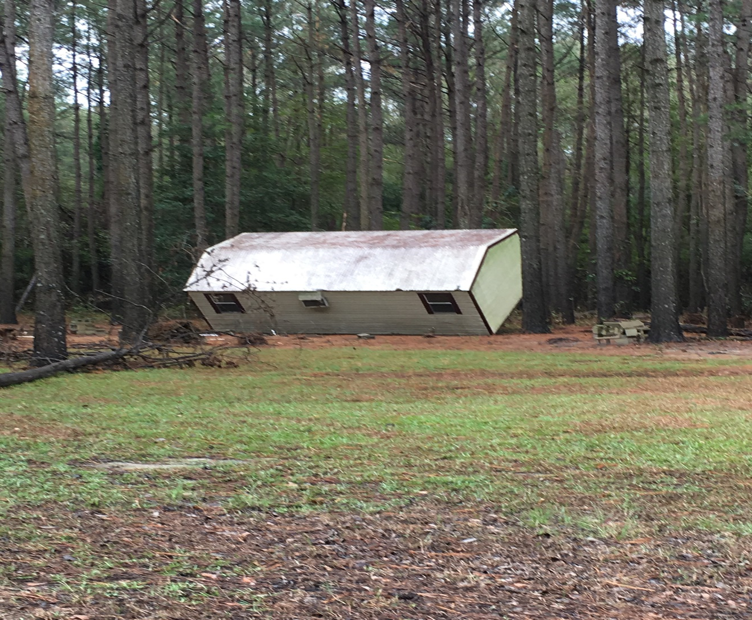
Outreach Activities
NCDOL Photo Library
Notes:
NCDOL Photo Library – Photo taken by NCDOL Employee Tara Payne during Hurricane Outreach Activity near Ivanhoe, NC. It shows a structure that was picked up by the flood waters and deposited in the woods at the edge of the property.

Slide 17
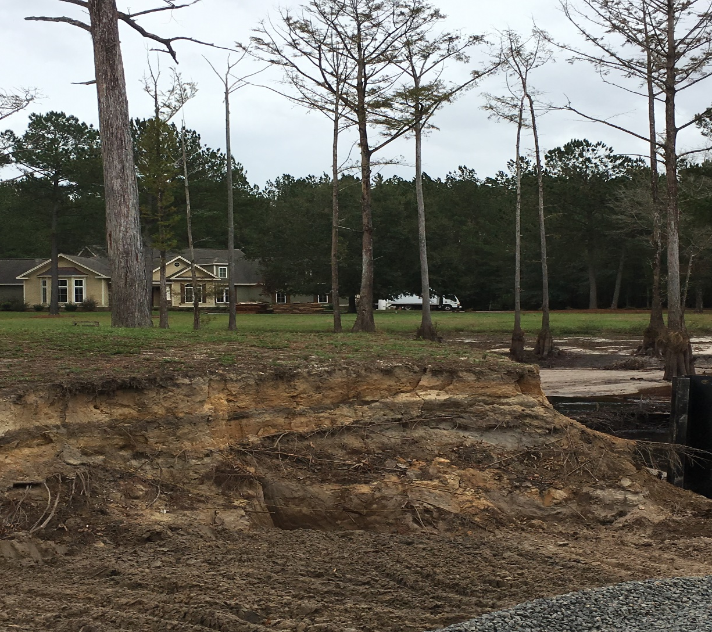
Outreach Activities
NCDOL Photo Library
Notes:
NCDOL Photo Library – Photo taken by NCDOL Employee Tara Payne during Hurricane Outreach Activity near Ivanhoe, NC. This photo shows a washed out stream/river that flooded up to the roof of the house when dams upstream were released.

Slide 18
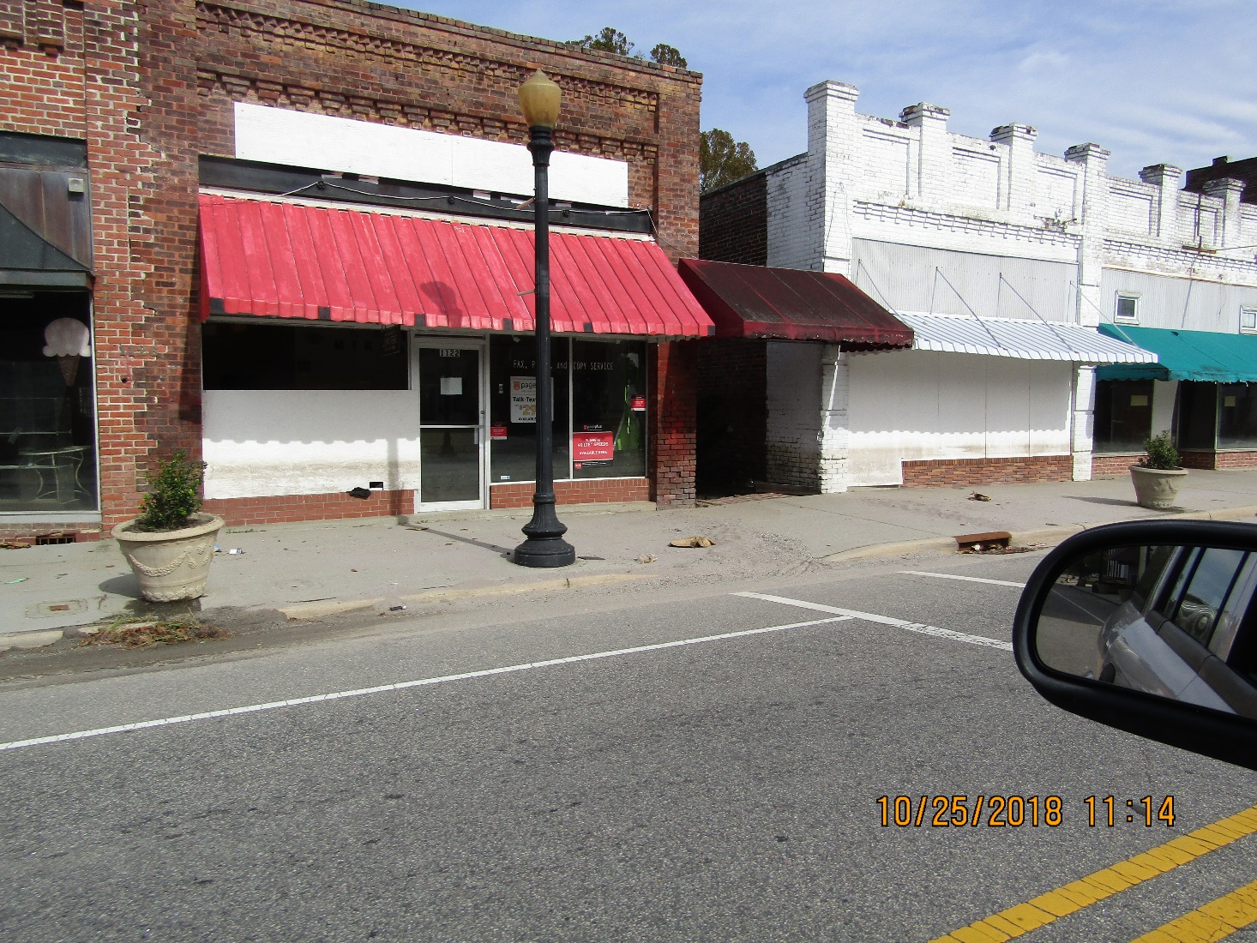
Outreach Activities
NCDOL Photo Library
Notes:
NCDOL Photo Library – Photo taken by NCDOL Employee Warren Lutz in Fair Bluff, NC. This photo shows downtown Fair Bluff abandoned with water level shown on buildings

Slide 19
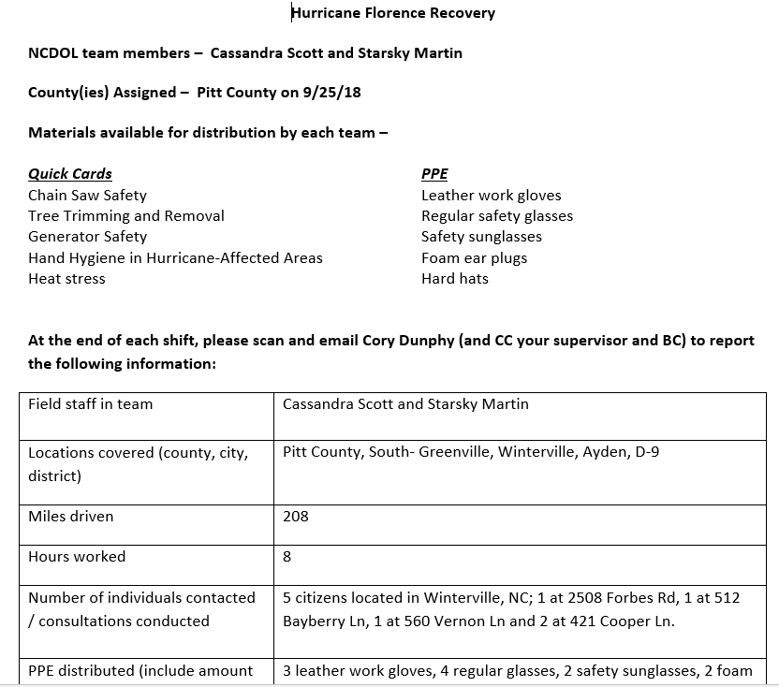
Outreach Activities
Activities
Daily recap
Record
activities
Track visits
Notes:
NCDOL Photo Library – screen shot of a Daily Recap Report form from 9/25/18.

Slide 20
Outreach Activities
As of Monday 11/5/2018 we have traveled approximately 20,785 miles and spent approximately 1,284 manhours on outreach activities
Distributed over 1,500 articles of personal protective equipment
137 hard hats 509 safety glasses
210 canvas gloves 185 nitrile gloves
225 pairs hearing protection 286 N95 respirators
Distributed over 900 safety publications

Slide 21
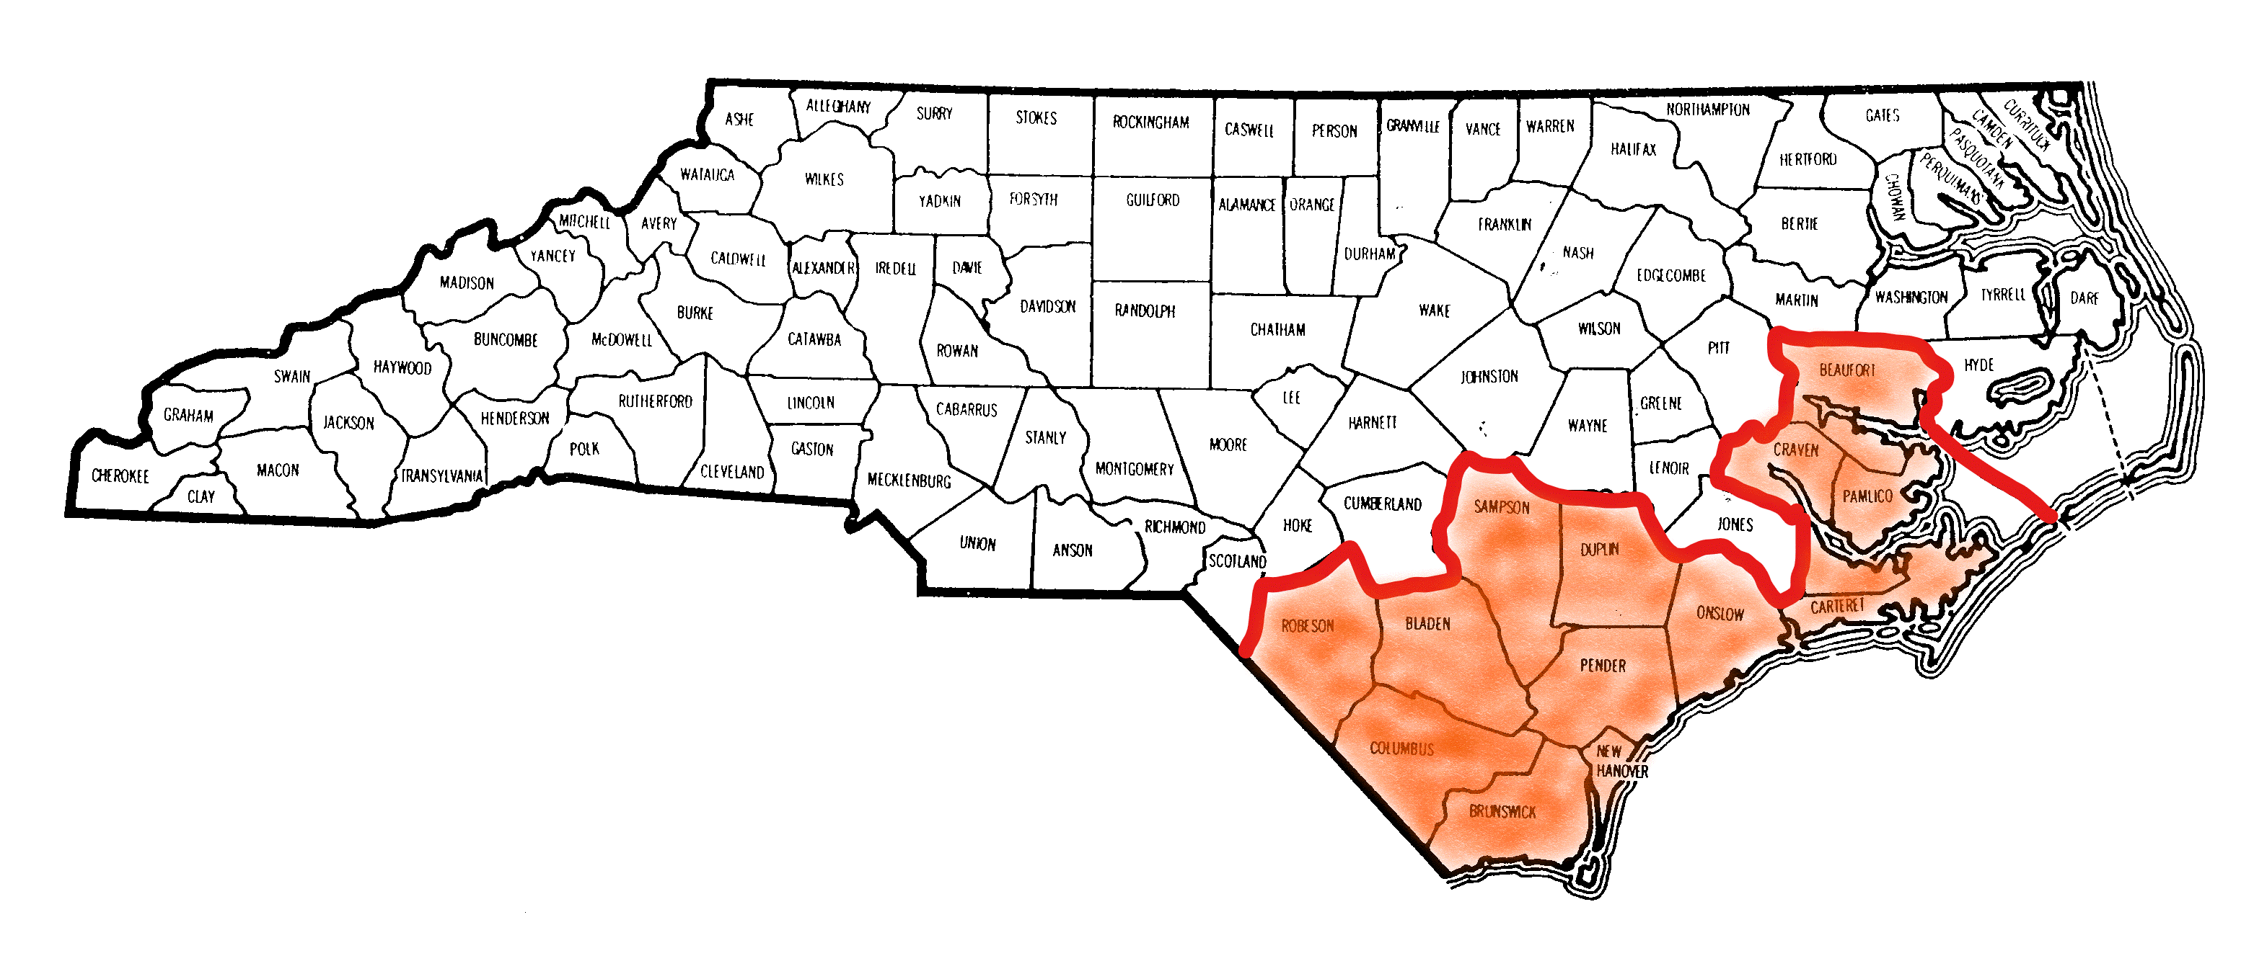
Outreach Activities
Current Counties for Outreach Activities
Notes:
This map was created by Cory Dunphy to show the 13 counties that NCDOL initially determined as at least minimally affected by Hurricane Florence as of 11/05/18.
Beaufort, Bladen, Brunswick, Carteret, Columbus, Craven, Duplin, New Hanover, Onslow, Pamlico, Pender, Robeson, and Sampson.

Slide 22
Assistance
Through Federal OSHA’s efforts we have received additional personal protective equipment to include with our supplies
canvas/leather gloves safety glasses
nitrile gloves hearing protection
rubber boots
Southeastern OTI Education Center at NCSU received grant for training outreach
training in NC, SC, Georgia (Hurricane Michael)

Slide 23
Review
Once the Outreach Activities are complete, we will meet to examine our actions
What worked
What didn’t work
Areas of improvement
Proposed changes for future events
Start of the preparations for the next storm

Slide 24

Summary
Today we reviewed:
Timeline of the storm
Our Preparations
Planning and
Coordination
Outreach Activity
Review (not
completed)
NCDOL Photo Library
Notes:
NCDOL Photo Library – This photo was taken by NCDOL Employee Warren Lutz during Hurricane Florence outreach activities near Lake Waccamaw, NC. Loss of interior due to flooding near Lake Waccamaw

