Slide 1
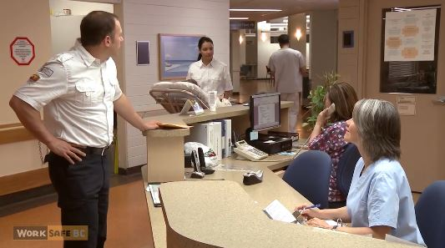
Introduction to
Long Term Care Inspections
WorkSafeBC
Notes:
Presentation was created with the new CSHO in mind or one new to LTC inspections.

Slide 2
Course Content
Ergonomics
Slips, Trips and Falls
Bloodborne Pathogens
Tuberculosis
Workplace Violence
MRSA
Hazard Communication
Recordkeeping
Tracking in OE
OPN 132 Appendices
Notes:
This is a list of the specific topics we are going to review in this course. These topics will be given a high level review. In other words we will touch on the big ideas and areas of these topics as they relate to Long Term Care.

Slide 3
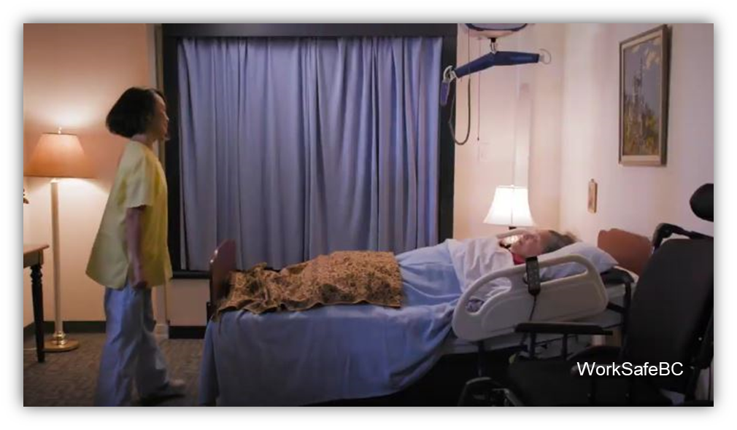
Objectives
At the end of this training participants should be familiar with…
The basic components and requirements of the OPN 132 SEP
The common hazards CSHOs can encounter during LTC inspections
The tools and guidance available to help assist CSHOs in LTC inspections
Notes:
At the end of this training participants should be familiar with…
The basic components and requirements of the OPN 132 SEP
The common hazards CSHOs can encounter during LTC inspections
The tools and guidance available to help assist CSHOs in LTC inspections

Slide 4
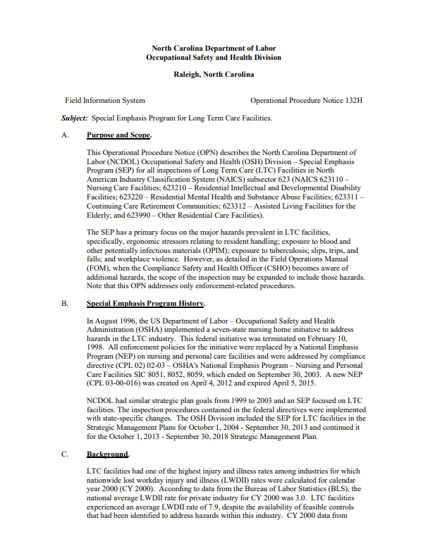
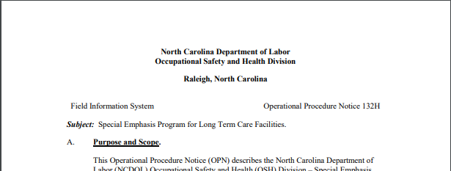
Presentation Scope/Purpose
Notes:
The purpose of this presentation is to clarify the use of Operational Procedure Notice (OPN) 132h. We will also briefly touch on other supplemental information available on the One Stop Shop and online. This presentation is intended to be helpful to compliance officers new to Long Term Care Inspections.
Photo/Screenshot of OPN 132H taken by Julie Martin on 11/4/19.

Slide 5
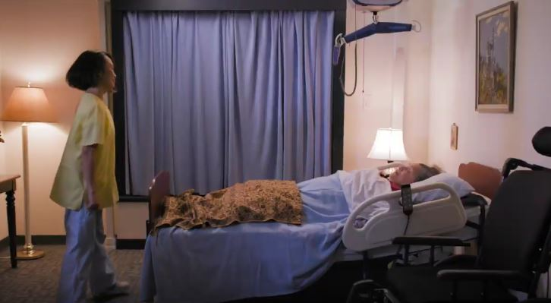
OPN 132 Purpose
Standardize Long Term Care (LTC) compliance inspections.
WorkSafeBC
Notes:
Purpose of the LTC SEP is to provide a standardized approach that CSHO’s can apply to the execution of Long Term Care facility compliance inspections

Slide 6
OPN 132 Purpose
Reduce injury/illness rates in LTC industry
Chart for illustration only
Notes:
And also to Focus NCDOL compliance, consultative and training activities in effort to systematically reduce injury and illness rates in the long term care industry.

Slide 7
OPN 132 Scope
NAICS Code | Description
623110 | Nursing Care Facilities
623210 | Residential Intellectual and Developmental Disability Facilities
623220 | Residential Mental Health and Substance Abuse Facilities
623311 | Continuing Care Retirement Communities
623312 | Assisted Living Facilities for the Elderly
623990 | Other Residential Care Facilities
Notes:
This SEP covers Establishments with the North American Industry Classification System (or NAICS) codes starting with 623 .
The applicable codes will be found on the LTC assignment lists for each compliance district.

Slide 8
Why a LTC SEP?
DART rates at least double the rates for the US workforce
North Carolina rates significantly higher than the NC average for all workers
Notes:
So, Why a LTC SEP?
The SEP came about because the DART rates, specifically the lost workday rates, for LTC employees were at least double the rates for the total US workforce. That is a troubling a figure.
This is also true of NC employees. LTC lost workday rates continue to be significantly higher than the average for all NC workers, and as along as this is the case, this SEP will remain in effect.

Slide 9
Why an LTC SEP?
NAICS 623 DART Rates
 | 2017 | 2016
National Average | 3.8 | 3.9
North Carolina | 3.7 | 3.3
Notes:
While our DART for LTC workers are higher than the total average DART rate for NC workers, According to the Bureau of Labor Statistics, the DART rates for NC within NAICS 623…. have been consistently lower than the national average within the last 4 years.

Slide 10
LTC Injury/Illness Data
Explosion or fire 0%
*www.bls.gov
Source: Annual Internal NCDOL Training Event
“OPN 132 , LTC Facilities” 09/12/16
Notes:
Now let’s take a look at this pie chart. This chart breaks down the non-fatal injuries with Days Away from Work.
_____________________________________________________________________________________________________________________________________________________
OVEREXERTION AND BODILY REACTION (ERGONOMICS) Codes in this division apply to cases, usually non-impact, in which injury or illness resulted from free bodily motion, from excessive physical effort, from repetition of a bodily motion, from the assumption of an unnatural position, or from remaining in the same position over a period of time.
Falls, slips, trips include falls on the same level, falls and jumps to lower levels, falls and jumps that were curtailed by a personal arrest device, and slips and trips that do not result in a fall. A trip is differentiated from a slip by the existence of a foreign object over which the injured worker stumbled. Slips are generally on flat, smooth, or slippery surfaces; trips occur when the injured worker makes contact with an uneven surface or an obstruction, such as a curb or box.
EXPOSURE TO HARMFUL SUBSTANCES OR ENVIRONMENTS Codes in this division apply to cases in which the injury or illness resulted from a condition or substance in the work environment. (This category applies to cases in which the injury or illness resulted from the inhalation, absorption, injection or needlestick, or ingestion of harmful substances. Codes in this major group should be used for instances of poisoning, allergic reactions, contagious and infectious diseases, and drug overdoses. This also covers exposure to electricity.
CONTACT WITH OBJECTS AND EQUIPMENT Codes in this division apply to injuries produced by contact between the injured person and the source of injury, except when the contact was due an event covered by one of the other divisions. (When the cut or puncture wound is the most severe injury or illness resulting from a needlestick, then use this event category.)(Also includes struck-by, caught-between.)
Violence and other injuries by persons or animals include all intentional injuries; injuries involving weapons (tools designed to be used as weapons, such as firearms and stun guns) regardless of intent; and injuries involving direct physical contact with persons, animals, or insects regardless of intent. Such injuries may be inflicted by another person, by oneself, or by an animal or insect. (Excluded from this division are injuries resulting from overexertion or bodily reaction, such as from lifting a patient)
EXPLOSION OR FIRE Codes in this division apply to cases in which the injury or illness resulted from an explosion or fire. Included are cases in which the person fell or jumped from a burning building, inhaled a harmful substance, or was struck by or struck against an object as a result of an explosion or fire. This division also includes incidents in which the worker was injured due to being trapped in a fire or whose respirator had run out of oxygen during a fire.
TRANSPORTATION INCIDENTS This division covers events involving transportation vehicles, animals used for transportation purposes, and powered industrial vehicles or powered mobile industrial equipment in which at least one vehicle (or mobile equipment) is in normal operation and the injury or illness was due to collision or other type of traffic incident; loss of control; or a sudden stop, start, or jolting of a vehicle regardless of the location where the event occurred.
Source of code explanations: http://www.bls.gov/iif/oiics_manual_2010.pdf

Slide 11
LTC – Areas of Emphasis
Approximately 84% of injuries/illness from:
  Bloodborne Pathogens
  Ergonomics
  Slips, Trips, and Falls
  Tuberculosis (TB)
  Workplace Violence
16%
84%
Source: Annual Internal NCDOL Training Event
“OPN 132 , LTC Facilities” 09/12/16
Notes:
simplify the previous slide, approximately 87% of injuries come from these listed areas. As a result these are the focus of the OPN 132 SEP known as Areas of Emphasis.

Slide 12
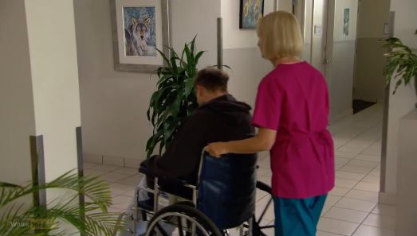
Priority Based LTC Assignments
Accidents
Complaints
Referrals
General Schedule
WorkSafeBC
Notes:
LTC Inspections are assigned based on the same priority system as other inspections., with Accidents and Complaints being a higher priority that general schedule inspections.
LTC inspections will continue to be prioritized per the FOM with goals set each year assuring increased focus on these SEP workplaces.
When at a LTC facility for an unprogrammed inspection, such as for a complaint, pay close attention to guidance within the FOM and OPN 132. In the past, CSHOs would expand un-programmed inspections to include the elements of a full LTC inspection. This is no longer the case. Currently, all CSHOs have to ask the employer for permission to expand into the scope of the LTC SEP. If they say no, you cannot expand beyond the bounds of unprogrammed activity that led to the inspection.
During comprehensive LTC inspections, each emphasis area should be addressed. Safety and Health officers should address each emphasis area and the inspection findings for each area should be documented in the narrative (OPN/SEP Information section). The narrative should include evaluations of written programs, observed hazards, and other pertinent observations. For example, an evaluation of an establishments exposure control plan for bloodborne pathogens should include any deficiencies that are observed during the inspection.

Slide 13


Pre-Inspection Preparation
Check for site inspection exemptions/deferrals
Are there…
  Consultative Services Surveys?
  Star Evaluations?
  SHARP Evaluations?
Microsoft Word Icons
Notes:
Very important for your LTC inspection…is your Pre-inspection preparation.
As well as reviewing any guidance related to the inspection, not the least of which is the SEP itself, you will need to review the facilities site listing on the Establishment Look-up or Targeting website prior to starting the onsite investigation.
Review the site listing to determine if an exemption has been issued for the employer/site by Consultative Services or ETTA (“Star” certification) (where can you find all this info, ask Jacopo)
Proceed according to exemption procedure (FOM Chapter III – Inspection Procedures, paragraph D.3.h - “Exemptions from Compliance Inspections” Let’s take a quick at each of these.

Slide 14

Inspection Exemptions
FOM Ch. III, D.3.h
Consultation Program Deferrals:
  Consultation Program Surveys
    Full-Service
    Limited Service/Scope
  SHARP participant
  Carolina Star Program
Photo by LinkedIn Sales Navigator on Unsplash
Notes:
Brief Review: Consultation Deferrals are available for ER’s who are participating in a compliance “survey” or “white hat inspection” OR in SHARP program, the Safety and Health Achievement Recognition Program.
You, the CSHO must determine if one of these deferrals applies to the facility prior to the opening conference.
If Consultation is conducting FULL-SERVICE safety AND health surveys, these ER’s will be located in the Targeting System. However, a limited scope survey or just a health or just a safety Full-Service survey will not show. You must call the appropriate Consultation Bureau District Supervisor to find out.
If a Consultation visit is still in-progress, it will take priority over a programmed planned inspection. However, a consultation visit will be terminated or superseded if an Imminent danger inspection, fatality/catastrophe inspection, a complaint inspection is required to take place.
If the facility is participating in SHARP, this information can be determined by checking in the OSH Targeting system. SHARP facilities are exempt from programmed planned inspection due their participation in the program. However, SHARP inspection deferrals do not apply to unprogrammed inspections, which should be conducted as usual.
Carolina Star deferrals, like SHARP, do not apply to unprogrammed inspection. When an ER has a STAR deferral, the scope of the unprogrammed inspection will be partial and limited in scope to cover only what is necessary to complete the purpose of the inspection and to address any serious plain sight hazards.
You should also call the Consultative or Carolina Star consultant and let them know of your unprogrammed inspection. It also gives you an opportunity to ask the consultant questions about the sight to better prepare for the inspection.
For more in depth information on this topic, refer to Chapter III,D.3.h
(example of targeting on next slide)

Slide 15
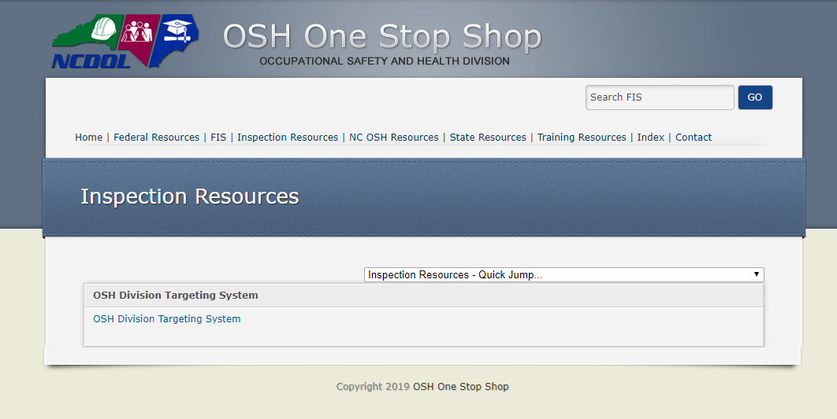
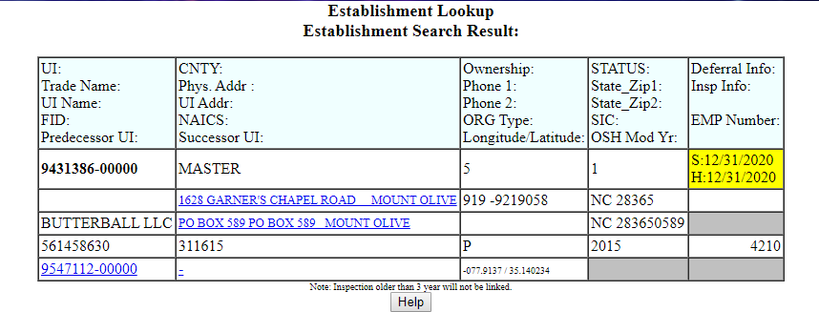
NC Site Lookup or “Targeting”
Notes:
I previously mentioned Targeting…I want to review quickly to make sure you all know what I am talking about. This is just going to be a very quick, high level review.
Lets take a quick look at the Targeting Program:
In One Stop Shop, under inspection Resources – access the OSH Division Targeting System., check to see if you find and exemption or deferment.
check to see if a Consultation Program Deferral is in effect (such as for participants in SHARP or from the Consultative Services Bureau or if they are currently working with a Star consultant.

Slide 16
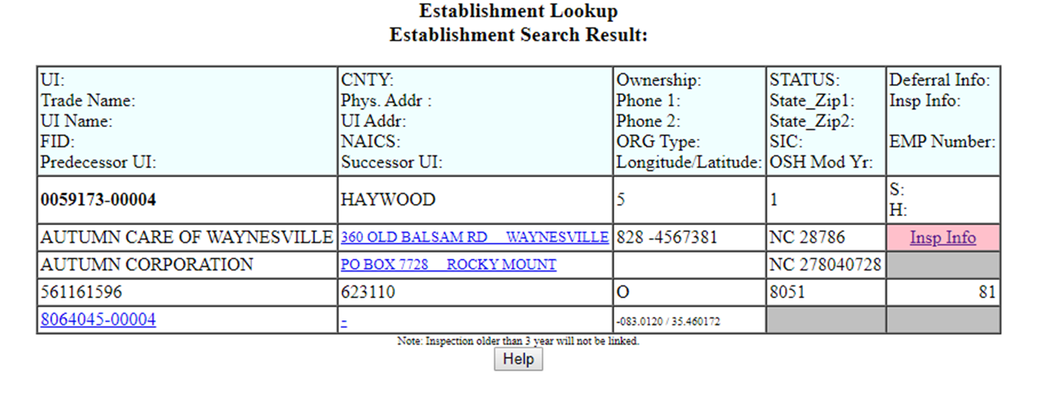
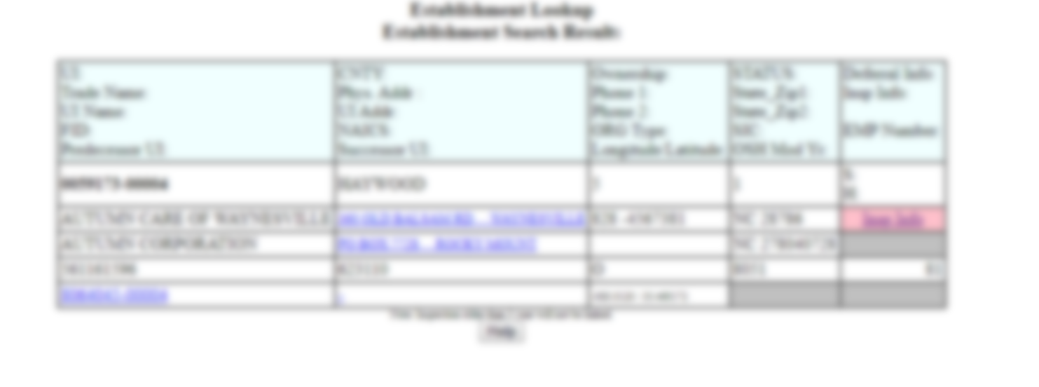
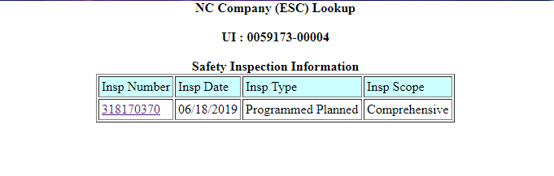
NC Site Lookup or “Targeting”
Notes:
verify that a comprehensive/programmed planned inspection has not been done recently,
If you are going to a site/facility for an unplanned activity (such as a complaint) and a programmed planned/general schedule inspection is due… Inform the employer during the opening conference that an LTC SEP inspection is due, inform them of the requirements of the SEP and ask them for permission to expand the scope of the inspection into a comprehensive inspection. Make sure you record the ER response to the request in the narrative.
If the employer denies the expansion of the scope, only proceed with the unplanned activity inspection unless there is also an official assignment for a comprehensive programmed inspection. Be sure to discuss the situation with your supervisor.
Even if you are there for a complaint or a referral, its still a good idea to review previous inspections to look for potential issues and repeat violations.

Slide 17
Compliance Inspection Procedures
Normal compliance activities - programmed inspections
For complaints, referrals, or accidents - follow this OPN for guidance and FOM Chapter IX – “Complaints, Referrals and Accidents”
For fatalities or catastrophes – follow this OPN for guidance and FOM Chapter VIII – “Fatality and Catastrophe Investigations”
Notes:
Make sure you are familiar with the inspection procedures for why you are at the LTC facility in the first place. Review relevant SEPS, OPNs, Memos, and the FOM to make sure you are following proper procedure. Appendix B of the SEP contains a list of many of helpful guidance documents.
During comprehensive LTC inspections, Safety and Health officers should address each emphasis area, which we will briefly review in this presentation. The inspection findings for each area should be documented in the narrative OPN/SEP Information section. This section of the narrative should include evaluations of written programs, observed hazards, and other pertinent observations. For example, an evaluation of an establishments exposure control plan for bloodborne pathogens should include any deficiencies that are observed during the inspection.
Another helpful tool, is the sample opening conference questionnaire and the LTC employee Questionnaire included at the end of OPN 132, in Appendices D and E, which you can use to help you during your investigation.

Slide 18
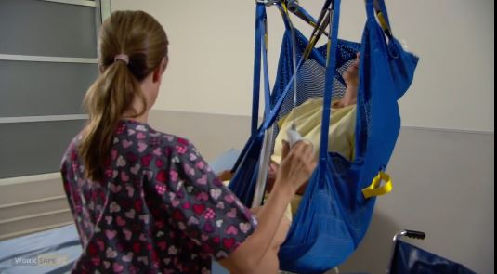
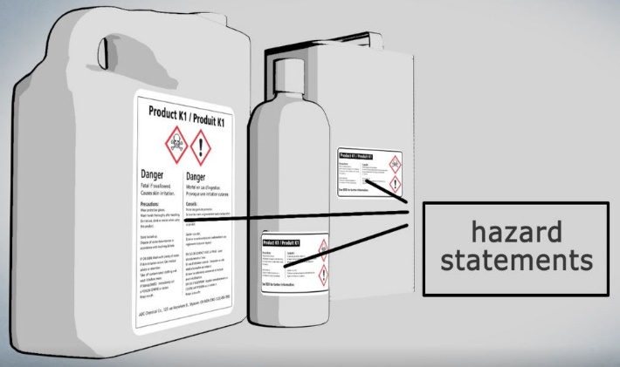
SEP Hazards and Related Concerns
Proceed with the inspection by following steps related to the following hazard categories:
  Ergonomic Risk Factors
  Slips, Trips and Falls
  Bloodborne Pathogens
  Tuberculosis (TB)
  Workplace Violence
Additional Concerns:
  MRSA
  Hazard Communication
  Recordkeeping
  Privacy
  Employee Medical Records
WorkSafeBC
WorkSafeBC
Notes:
Finally, to round out your pre-inspection preparation, make sure you are familiar with the common hazards and risks that are found in the LTC industry.
Listed in this slide are the major risk factors and concerns that are seen at LTC facilities. We will be going through each one as we go through this presentation.
These hazard categories or “elements” are to be addressed during general scheduled LTC inspections. OPN 132 provides inspection guidance for each element.

Slide 19
Ergonomics in LTC
OPN 132 SEP
FOM Ch. XVII
Notes:
Ergonomics in LTC. This is going to be a high level overview of this topic, refer to the LTC SEP and FOM Chapter 17: Ergonomic Inspection procedures for more details.

Slide 20
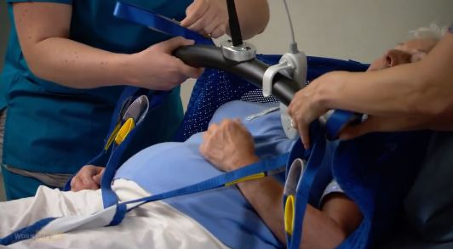
Ergonomics Injuries and Sources
Overexertion and bodily reaction: 39% of injuries with lost work time
  Muscle strains
  Low back injuries
  Rotator cuff injuries
  Tendonitis
Handling, transferring and repositioning patients/residents
  MSD rates for nursing assistants 4x average for all
WorkSafeBC
Source: Annual Internal NCDOL Training Event
“OPN 132 , LTC Facilities” 09/12/16
Notes:
39% of injuries in the LTC industry that result in lost time or time away from work are due to ergonomic issues. The most common ergonomic injuries being muscle strains, lower back injuries, rotator cuff injuries, and tendonitis. And most of these injuries are due to workers handling and moving patients.
Handling, transferring and repositioning patients/residents cause musculoskeletal Disorder injures at 4 times the average rate of other workers.
This is why the use of lifting equipment, and proper lifting procedures are so important . Potential ergonomic hazards should be closely examined in your inspection.

Slide 21

Are Ergo Hazards Present?
FOM Ch. XVII
Determine the presence of hazards:
  OSHA 300 logs, NC-19’s, OSHA 301’s
  Incident Reports
  Ergonomics Program
  Ergonomics Training Media and Records
  Job Hazard Analyses or similar
  Ergo Record Review Checklist
Image by Peggy und Marco Lachmann-Anke from Pixabay
Notes:
Determine the presence of hazards:
Request the OSHA 300 logs, the 301 forms or the NC-19’s, and incident reports for the previous 5 years.. A review of the establishments 300 logs should give you an indication of any trends in ergonomic related injuries. Evaluate them to identify possible Ergo cases, i.e. repetitive motion. Also look for any injuries related to patient handling.
Request any documentation related to ergonomics program and/or ergonomic hazards at the facility, such as job hazard analyses, the ER’s Ergonomics program,
In Appendix 17-B of FOM Chapter 17, there is an Ergonomics Record Review Checklist which you might find helpful.

Slide 22
Patient Handling/Ergo Program
FOM Ch. XVII
Review Employers Ergo Program
Look for:
  Hazard identification and analysis
  Responsible and authorized personnel
  Employee input regarding lifting procedures
  Compliance to policies/procedures and deficiency follow-up
  Policy/procedure change(s) and injury/illness effect
  Medical treatment
Notes:
Review and evaluate the ER’s Ergo Program:
Determine the extent of resident handling, related hazards and how the hazards are addressed by reviewing documentation and asking questions related to:
hazard identification and analysis – do they ID lifting tasks, list potential injuries, analyze how they could occur?
responsible and authorized compliance personnel – Is a person assigned who is responsible for the program? For ensuring it remains up to date, employees comply with it, etc.
employee input regarding lifting procedures: Do employee’s have input regarding the lifting equipment used for patient movement and lifting? The techniques and procedures that are followed?
Compliance to policies/procedures and deficiency follow-up – How is compliance with the program ensured or maintained? How are any issues, deficiencies, or non-compliances handled or followed up on?
Are policy/procedures changed in response to employee injury/illnesses? – If/When EE’s suffer ergonomic injuries, are they investigated? Are policies and procedures changed to help prevent future occurrences?

Slide 23
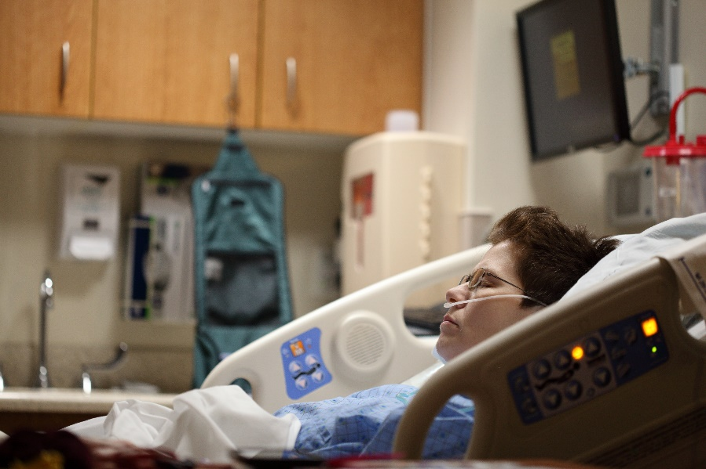
Patient Handling/Ergo Program
FOM Ch. XVII
Also check for:
  Management commitment
  Assessment of new lifting technologies/designs
  Employee education and training
  Program evaluation
Photo by Sharon McCutcheon on Unsplash
Notes:
Management commitment – Is top management enforcing compliance? Are they committed protecting the employees and implementing their program.
Assessment of new lifting technologies/designs – how often, if ever, are new lifting technologies and designs assessed or reviewed to see if EE exposure to these Ergo hazards could be further reduced?
Employee education and training – for example” Are Employees educated in the hazards of patient lifting and are they trained to lift patients safely?
Program evaluation – Evaluate the program per the guidelines listed in FOM Chapter XVII (17).

Slide 24

Ergo Program/Health Management
Additionally, ensure ER
  Evaluates workplace regularly
  Promotes early reporting
  Medical Management
  Maintains safety commitment
Photo by Olga Kononenko on Unsplash
Notes:
Additionally, make sure the ER is
Evaluating the workplace regularly, for example are they conducting Job Safety Analyses, how often?
Are they pro-actively addressing ergonomic health issues in order to prevent serious injuries and illnesses
Do they promote early reporting, even for seemingly minor ERGO injuries to prevent the occurrence of more serious problems? Do the EE’s concur with what the program states?
Do they have a Medical Management process which includes restricted or accommodated work assignments?
And Does the employer maintain and support Safety Commitment AT EVERY LEVEL. From the top, to middle management, to the workers on the floor. Do the EE’s feel that the ER is committed to their safety? This is a topic that interviews will give you some of the most valuable information.

Slide 25
Ergo Program
FOM Ch. XVII
Calculate DART and severity rates
Review with Supervisor to determine course:
  Rates Improving + Effective Program
  Rates Improving + Deficient Program
  Rates Not Improving + Effective Program
LETTER
Notes:
Calculate the DART and severity rates for the facility and employee job tasks as you review the 300 logs. Use to determine the areas you should focus on, your highest priorities and high risk jobs for your potential investigation. Use AT LEAST 3 years worth of data if available.
Review these calculated rates with your District supervisor to determine how the Ergonomic inspection is to continue as well as any other information you have gathered during your review of the 300 logs and relevant ER programs.
Where the DART and Severity rates are improving AND an EFFECTIVE ergo program has been implemented, the ergo inspection will be terminated and you will send the ER a letter. An example form letter can be found in Appendix C. (FOM Chapter 17)
Where the DART and Severity rates are improving BUT the ergo program has DEFICIENCIES, the ergo inspection will also be terminated. Again, you will send the ER a letter and include suggestions for improvement, sample form letter found in Appendix D.
Next scenario, we have either the DART or the Severity rates are not improving BUT the ER has an EFFECTIVE ergo program, the ergo inspection will be terminated, and send a letter again with program improvements and additional available resources. (a sample form letter for this scenario can be found in Appendix E, of Chapter 17)
So the big take away here is for these scenarios you send the ER an Ergo letter.

Slide 26
Ergo Program
FOM Ch. XVII
Review with Supervisor to determine course:
  Rates Not Improving + Deficient Ergo Program =
  Additionally, if clusters of Ergo injuries exist =
  INSPECTION
  INSPECTION
Notes:
If Neither the DART and Severity rates are improving nor does the ER have an effective Ergo program = consider continuing on with inspection
Additionally, even if the overall DART and/or severity rates are relatively low, but clusters of ergonomic injuries exist in one or more specific employee job tasks, and/or deficiencies in the ER’s ergo program exist, discuss with your district supervisor to determine if the situation is severe enough to warrant continuing on with the inspection.

Slide 27
Conduct Interviews
FOM Ch. XVII
Use LTC Questionnaire to determine:
  Resident mobility determination
  Use of equipment as related to manual lifts
  Decision on lifting approach
  Available lifting devices
  Availability and condition of slings, gait belts and other transfer devices
  Proper availability and use of policies and procedures
Notes:
We all know we have to interview EE’s. Interviews are vital in supporting a potential violation. As I mentioned before, use the LTC questionnaires in the SEP to help you stay focused, on topic and as an aid to memory. This questionnaire can be found in the One Stop Shop in the SEP or under “Compliance Aids”
These questionnaire can be very useful, and can help you gather needed information during your LTC inspection, but remember it is just an AID, not a requirement. It is not comprehensive and might lack the questions you need to ask depending on the specific circumstances or purpose of your visit. Don’t be afraid to write up your own questions ahead of time, that are more focused on the information you need to help you investigate the fatality, accident, or referral that sent you to the facility. Also let the employee’s responses in the interview process lead you to new questions or new potential lines of investigation.
In addition, as you are walking around the facility, look for employees wearing back belts, wrist splints or wraps which could indicate potential ergonomic stressors or problems. Also look for homemade workstation modifications or fixes. All of these indicators could help you zero in on potential employees to interview.

Slide 28
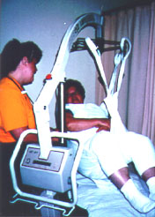
Conduct Interviews
FOM Ch. XVII
Verify EE’s are trained in:
  Hazard Recognition
  Process for Correcting Hazards
  Requirement of Reporting Injuries
Ask about injuries/issues
Video EE’s performing tasks
Photo from www.osha.gov
Notes:
During your interviews you also need to verify that employees have been Trained in:
hazard recognition regarding the Ergo hazards of their job duties, to include patient handling and are aware of how to prevent themselves from becoming injured.
that the EE’s know the Process for correcting and reporting hazards
And know of the Requirement for early reporting of injuries and why it is important.
While interviewing the EE’s make sure to ask them if they have been injured (even if only minor strains or sprains), whether they reported it or not, how did the injury or illness occur? What was done to prevent reoccurrence? Ask about awkward postures, does doing the task(s) cause discomfort? Have the EE’s jury-rigged their own modifications in order to make a job easier? ETC. Pretty much, anything and everything that might be relevant. Appendix G, of FOM CH. 17 – has a sample Ergonomic Assessment form which you can use if you discover any unreported or current injuries or to assess prior injuries.
As a part of the interview process video employees performing their job tasks. Video them actually lifting patients. If multiple methods are used, make sure to video and observe each method.
As you observe EE’s performing their job tasks, look for
Repetitive motions
Awkward work postures
Forceful exertions/heavy lifting
Vibrating tools or equipment
And any other risk factors you can identify that might lead to potential Ergo injuries

Slide 29
Citation Guidance
FOM Ch. XVII
If Ergo hazard(s) are found to exist:
  Evaluate elements of General Duty Clause
    Hazard is present?
    Hazard recognized in the industry?
    Hazard likely to cause serious physical harm?
    Feasible method of abatement?
Notes:
If you determine that ergonomic hazards exist,
Evaluate the hazard(s) relative to the requirements of the General Duty Clause:
Make sure you document the hazard well. Do you have photos? Written witness statements? Employer knowledge?
Is the hazard recognized in the industry? DO YOUR RESEARCH!! Make sure you can back up the violation with industry knowledge. For example, there are loads of industry materials out there on the dangers of patient handling, to include NIOSH and more. If lifting equipment is used, get a copy of the owners and/operator manual, the safety manual…anything from the manufacturer, even professional associations like the American Nursing Association can give you valuable information.
Is the hazard likely to cause serious physical harm? This is the difficult one. If at all possible you will need medical evidence that demonstrates an association between the employees injuries and their work. Again, research here is imperative.
Is there a feasible method of abatement? Industry guides and other research are good sources of information.
And of course, review these violations with your district supervisor.
One thing to keep in mind, if the employer is aware of the hazard and is ALREADY working to solve the issue incrementally, determine how much has been done prior to the inspection, and the time frame the actions the ER has taken occurred over. IF the ER is making a good faith effort to eliminate the hazard it is not likely the a GDC violation will be ok’d. Definitely discuss with your supervisor.
NCGS 95-129(1) General Duty Clause
Follow FOM Chapter XVII – “Ergonomics Inspection Procedures”

Slide 30
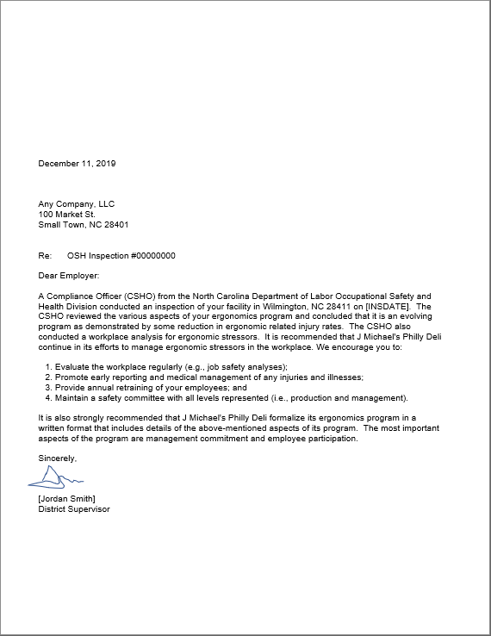
Citation Guidance
FOM Ch. XVII
Hazard alert letters
  Sent in lieu of a citation
  Describes observed deficiencies
  May include elements of an effective ergonomics program
Notes:
If after the hazards and supporting materials are reviewed and it is determined that there is insufficient evidence to support a violation…a hazard alert letter will be sent after the closing conference.
This letter will describe any specific deficiencies you observed, any possible or potential abatements, and mention available assistance such as consultative services. A suggested form letter for this purpose can be found in Chapter 17, Appendix F, you can also find the ergonomic hazard alert letter in OSHA Express under the letter tab. These letters are also available on OE under “Document Generation”.

Slide 31
Slips, Trips, & Falls in LTC
OPN 132 SEP
Notes:
Slips, trips and falls are another area of interest in LTC inspections. And should be treated the same as you would any other inspection where Slips, trips, and fall hazards present themselves.

Slide 32
Slips, Trips and Falls
OPN 132
Evaluate the general work environments and document hazards such as:
    Slippery or wet floors
    Tripping hazards
    Poor lighting
    Floor openings and holes
    Issues with stairs
    No fall prevention measures (elevated work surfaces w/o guardrails)
    Inadequate aisles
    Improper use of ladders and stepstools
    Use of improper equipment for elevated work
Notes:
As in any inspection, evaluate the general work environment (such as the kitchens, bathing areas, hallways, laundry) that have hard work surfaces that can become slippery when wet…document anything you see that might cause slips, trips, or falls.
Some other examples include inadequate aisles for moving patients and using improper equipment for an elevated work task. We’ve all seen someone stand on a stool to change a lightbulb because there wasn’t a ladder!
In addition to the examples listed, High slip, trip, and fall rates in the Long Term Care industry can also result when workers provide daily living assistance to residents with gait and balance problems who are at high risk of falling. If a worker is helping a patient walk and that patient begins to fall, they can trip the worker or take them down with them. This is a scenario where employee interviews will be vital.
Also, Activities of daily living include bathing, showering, and toileting; during these activities, workers are exposed to wet, slippery, and other hazardous floor conditions (Decker, Harris-Kojetin, & Bercovitz, 2009).
Ref: https://www.ncbi.nlm.nih.gov/pmc/articles/PMC4586109/pdf/nihms-717011.pdf

Slide 33
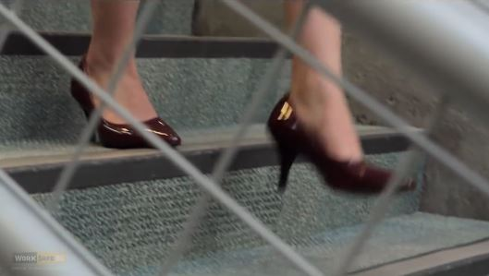
Slips, Trips and Falls
OPN 132
Check ER policies and procedures for:
  Reporting and clean-up of spills
  Posting of signs/barriers
  Good housekeeping
  Appropriate footwear
  Prevention of slick walking
  surfaces
WorkSafeBC
Notes:
Make sure you take note of any policies, procedures, and /or engineering controls used to deal with wet surfaces.
Are spills reported and cleaned up immediately?, Are signs and barriers posted to warn EE’s of wet floors?, Are good housekeeping practices followed and maintained? Are Aisles and hallways kept uncluttered?, Do employee’s wear non-slip footwear? What do the employees say during interviews? Do they back up what the policy and the ER say?
Also check to see how the floors are cleaned. Does the ER use no skid waxes or other types of coated surfaces to enhance surface friction to help prevent slips.
Another thing to consider is who is responsible for cleaning up spills? If it is the cleaning staff, are they there on every shift or do they just work during the day? If the cleaning staff isn’t there, does anybody else clean these spills up? How long does it take for the spills to be cleaned up if the cleaning staff isn’t there? Are there policies and procedures in place to handle this circumstance?

Slide 34
Slips, Trips and Falls
OPN 132
Citation Guidance
  29 CFR 1910 Subpart D – Walking-Working Surfaces
  Subpart J – General Environmental Controls
  29 CFR 1910.140 – Personal Fall Protection Systems
Notes:
When writing violations for slips, trips, and falls, you will pretty much be in …
1910 Subpart D – Walking-Working Surfaces
Subpart J – General Environmental Controls
Also, If employees are exposed to fall hazards, this include maintenance tasks from elevated surfaces, double check to see in 1910.142 – Personal Fall Protection Systems standards are applicable.

Slide 35
Bloodborne Pathogens in LTC
OPN 132 SEP
CPL 02-02-069
Notes:
Hopefully you are already familiar with Bloodborne Pathogens from other internal trainings. For LTC inspections make sure you review OPN 132 LTC SEP as well as The Compliance Directive 02-02-069 which is the Enforcement procedures for Occupational Exposure to Bloodborne Pathogens

Slide 36

Bloodborne Pathogens
CPL 02-02-069
Occupational exposure to blood and other potentially infectious materials (OPIM)
Photo by Chang Duong on Unsplash
Notes:
When dealing with Bloodborne pathogens we are focused on employee exposure to human blood and other materials that potentially contain human blood (called Other Potentially Infection Materials or OPIM)

Slide 37

Evaluate ECP
CPL 02-02-069
Evaluate the written Exposure Control Plan (ECP)
  Reviewed annually?
  Updated when employee tasks/procedures modified?
  Exposed employee tasks/procedures identified?
  Accessible to exposed employees?
  Procedure for documenting exposure incidents?
  And more…
Image by Arek Socha from Pixabay
Notes:
During the inspection you will need to evaluate the ER’s written Exposure Control Plan (ECP).
For example…
Is the plan reviewed at least annually and
Updated to reflect significant modifications in tasks or procedures?
Are exposed employees tasks/procedures identified?
Is the plan accessible to the exposed employees during their workshift? Can they easily access? Do they know where it is?
Are procedures listed for documenting employee exposure incidents?
While evaluating an establishment’s written exposure control plan, you need to determine which employees are covered under bloodborne pathogens standard and which employees have occupational exposure to blood. The written exposure control plan should include an “exposure determination” which should highlight the job titles and tasks that are expected to have occupational exposure to blood or OPIM. You should evaluate and review the ER’s exposure control plan while you’re onsite, this info can assist you in your employee interviews.
One area that often gets overlooked it the housekeeping or cleaning staff, It is important to evaluate whether employees who are responsible for the clean up of blood or other body fluids or are exposed to contaminated sharps are trained in bloodborne pathogens and are familiar with the establishments written exposure control plan.
More detailed information can be found in CPL 02-02-069

Slide 38

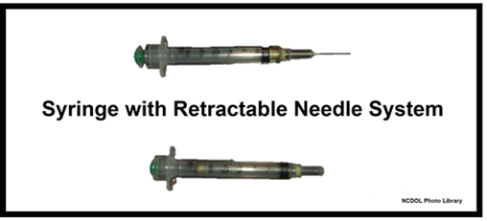
Evaluate ECP
CPL 02-02-069
Assess the implementation of engineering and work practice controls
  Use of sharps
  Types of sharps devices used
  Are safer devices considered?
  Is employee feedback solicited?
Image by Angelo Esslinger from Pixabay
Notes:
During the investigation you also need to assess the implementation of engineering and work practice controls
Evaluate the use of sharps and the types of sharps devices in use such as syringes
Evaluate the effort that the ER puts into considering safer devices such as SESIPS (Sharps with Engineered Sharps Injury Protections)
Verify that employer has considered safer devices to reflect changes in technology, to include engineering controls.
And is employee feedback solicited by the employer and is the process by which employee input is requested documented in the exposure control plan

Slide 39
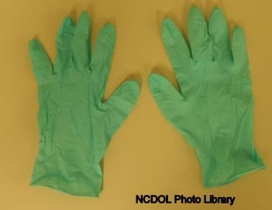
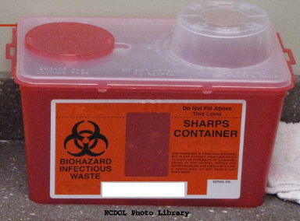
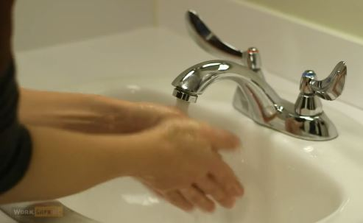
During the Walkaround
CPL 02-02-069
Are proper work practices/PPE in place?
Is biological waste handled properly?
Are adequate handwashing facilities available?
WorkSafeBC
Notes:
During the walkaround…
Ensure that proper work practices and PPE are in place for exposed employees
Are employees handling biological waste properly? Are proper waste containers provided? Etc.
Evaluate employee handwashing facilities…are they readily accessible to employees? Is soap and at least tepid water provided? Are alternative means used?, Are these alternative means adequate?
Make sure you observe employees using sharps containers, using the provided types of PPE, and the hand washing facilities.
Also, check to make sure Sharps containers are effectively closed and not overflowing.

Slide 40
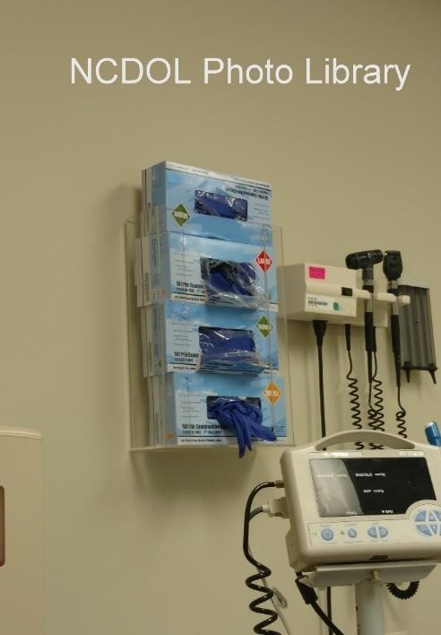
During the Walkaround
CPL 02-02-069
Is appropriate PPE provided?
Are procedures in place for clean-up of contaminated materials?
Notes:
Also,
EE PPE, Assess the use and availability of PPE. IS the PPE appropriate for the tasks used for? Is the PPE available in appropriate sizes for all employees? Will they actually fit?
Ensure that a program is in place for the immediate and proper clean-up of spills and disposal of any contaminated materials, specifically for spills of blood or other body fluids

Slide 41

During the Walkaround
CPL 02-02-069
Are EPA approved disinfectants used?
  List A: EPA’s registered antimicrobial products as sterilants
  List B: EPA registered tuberculocide products effective against Mycobacterium spp
  List C: EPA’s registered antimicrobial products effective against human HIV-1 Virus
  List D: EPA’s registered antimicrobial products effective against human HIV-1 and Hepatitis B virus
  List E: EPA’s registered antimicrobial products effective against Mycobacterium spp, human HIV-1 and Hepatitis B virus
  List F: EPA’s registered antimicrobial products against Hepatitis C virus
  List G: EPA’s registered antimicrobial products for medical waste treatment
  List H: EPA’s Registered Antimicrobial Products Effective Against Methicillin ResistantStaphylococcus aureus (MRSA) and Vancomycin Resistant Enterococcus faecalis or faecium (VRE)
  or
  Household bleach (5% NaOCl₂): at 1:10 - 1:100 in H2O
Notes:
When assessing employee clean up procedures make sure you verify that they are using an EPA approved disinfectant or equivalent.
As you can see on the list in the slide not all disinfectants will work against every pathogen so check what the EE’s are using against the lists found at www.EPA.gov.
Also ensure that the employees are using the disinfectants according to the products directions. If the product must be mixed, is it made fresh? In the proper ratios? Does the required surface contact time elapse before the employee wipes or cleans it up?
Lists A, B, C, and D EPA Registered Disinfectants, Sanitizers and Sterilants is provided as a service of the
National Antimicrobial Information Network and is based on the most recent information available from the EPA as of July, 2000. List C - Products Registered Effective Against HIV-1 are not appropriate disinfectants, unless they are also listed on List B, D, or E. In addition, sterilants and high level disinfectants cleared by the FDA are considered appropriate disinfectants. The disinfectant chosen must be used in accordance with the manufacturer’s instructions in order to ensure its efficacy.

Slide 42

Vaccination Requirements
Occupationally exposed employees
  HBV vaccine within 10 days of assignment
  Vaccine offered at no cost
  Declination forms are signed/maintained
  Antibody tests included with vaccination
CPL 02-02-069
Image by Peggy und Marco Lachmann-Anke from Pixabay
Notes:
As you know, vaccinations are required to be at least offered to occupationally exposed EE’s.
Check to make sure that these EE’s are:
Provided with the Hepatitis B (HBV) vaccine within 10 days of assignment to an exposure task
The Vaccine is offered at no cost to the employee and administered at a reasonable time and place
If the employees choose to wave the vaccine, verify the declination forms are signed by the employee and maintained.
That the Vaccinations performed also include an antibody test as directed by the US Public Health Service

Slide 43

Further Requirements
CPL 02-02-069
Bloodborne Pathogens Training
  Initial/annual
Sharps Injury Log
  Record of sharps injuries
  Lists type/brand of device
  Lists work area/department
  Lists how injury occurred
  EE confidentiality must be maintained
OSHA 300 Logs
Image by Corey Ryan Hanson from Pixabay
Notes:
Other requirements to check include…
Training
Affected employees receive initial and annual BBP training as detailed in the standard. Employee bloodborne pathogens training records should be requested for employees that have occupational exposure. The ER is required to maintain the records and the training must be offered annually.
Sharps Injury Log
Request the Sharps Injury log. Verify that sharps injuries are being recorded on the log. The log must include the type and brand of device involved in the injury, the work area or department the injury occurred in, and how the injury occurred. Remember, that employee confidentiality must be maintained for these injuries. If these sharps injuries require medical attention or result in a positive result of infection from the injury, the injuries will also need to be properly recorded on the OSHA 300 log as a “privacy case”. Be sure to note any deficiencies.
OSHA 300 Logs
Look for sharps or BBP exposure events. During your review of OSHA 300 logs, you should identify all instances of improper recording of contaminated sharp injuries. Again, ensure that Exposure related injuries are listed as a “privacy case” on the logs and do not list the employees name.

Slide 44

Lower Risk Tasks - BBP
CPL 02-02-069
Assisting with bathing or oral care
Handling incontinence pads, linens, and contaminated trash
Cleaning rooms, common areas, and equipment
Image by Peggy und Marco Lachmann-Anke from Pixabay
Notes:
There are many tasks performed at LTC facilities that might expose workers to contact with blood and body fluids.
Some of the activities that may be encountered on a daily basis that may pose lower risk for exposure to bloodborne pathogens include assisting with bathing or oral care; EEs handling incontinence pads, dirty linens, or contaminated trash, and EE’s cleaning rooms, common areas, and equipment.

Slide 45
Higher Risk Tasks - BBP
CPL 02-02-069
Assisting with wound care
Monitoring blood glucose
Giving an injection of medication
Cleaning blood/body fluid spills
Helping with nail or skin care
Providing first aid such as managing nose bleeds or abrasions
Notes:
Tasks that EE’s perform related to direct resident care pose the highest risk for exposure to bloodborne pathogens.
These tasks include assisting with wound care; monitoring blood glucose; performing an injection of medication such as insulin or blood thinner; cleaning blood or body fluid spills (this could be cleaning up the patient, not just from another surface); helping with nail or skin care. Additionally, performing first aid, such as managing nose bleeds or abrasions, are also potential exposure tasks.
That sums up our overview of BBP, please refer to the SEP and to the BBP CPL for more detail on the requirements and citation guidance for these inspections.

Slide 46
Tuberculosis in LTC
OPN 132 SEP
CPL 02-02-078
Notes:
Let’s take a break for about 15 minutes, get up and stretch, grab a coffee and we will start back at _______.
Tuberculosis is not something you necessarily inspect for often, make sure you are familiar with both the OPN and the CPL 02-02-78 for detailed information on how to conduct these inspections.

Slide 47
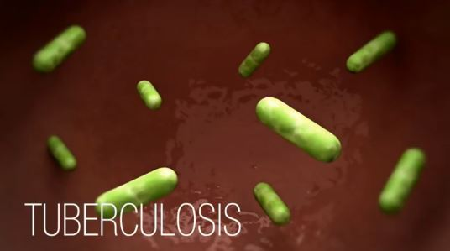
Tuberculosis (TB) Video
CPL 02-02-078
  “How TB Spreads”
CDC
http://www.cdc.gov/tb/topic/basics/howtbspreads.htm
Notes:
Since this is a hazard that is not often encountered, I have a quick video that reviews the basics.

Slide 48

Tuberculosis (TB) Inspection and Citation Guidance
CPL 02-02-078
Determine if a TB case is suspected or confirmed (w/in last 6 months)
  If “No”
    Suspend TB investigation
  If “Yes”
    proceed with CPL 02-02-078
http://www.cdc.gov/tb/topic/basics/howtbspreads.htm
Notes:
If you are conducting a LTC SEP inspection, you first must determine if a suspected or confirmed Tuberculosis case involving employees or patients has occurred within the previous six (6) months.
You should review the 300 logs and incident reports for confirmed cases of TB, conduct employee interviews to determine if there have been any potential or suspected cases. Also review any available infection control data the ER has. As soon as possible after the inspection has been initiated you should contact the local, or if necessary, the state health department to determine whether the facility has reported any TB cases within the previous year.
If after your investigation you cannot determine if a suspected or confirmed TB case has occurred then there is no need proceed, you can suspend the TB portion of the inspection.
However, it you do find evidence of TB, then proceed with the investigation according to requirements in CPL 02-02-078 “Inspection Procedures and Scheduling for Occupational Exposure to Tuberculosis”. Lets review some of these requirements…

Slide 49

If TB Cases Are Found…
CPL 02-02-078
Review plans for employee TB protection
Verify TB protection plans are in place/utilized
Assess appropriate areas of facility
Determine if Employer is in compliance!
Image by Arek Socha from Pixabay
Notes:
Verify implementation of the employer's plans for TB protection through employee interviews and, if possible, direct observations.
Use your professional judgement and assess the areas of the facility and determine which should be inspected during the walkthrough (for example, patient rooms, emergency departments, radiology departments, intensive care units, surgical suites, laboratories, laboratory procedure areas, bronchoscopy suites, sputum induction or inhalation/respiratory therapy rooms).
It’s through reviewing the ER’s plans for employee TB protection, EE interviews, and the inspection of appropriate areas of the facility that you’ll determine if the ER is in compliance.
Appendix C of the CPL has a CSHO checklist which is a great quick reference tool and can help you make sure that important considerations have not been overlooked.

Slide 50
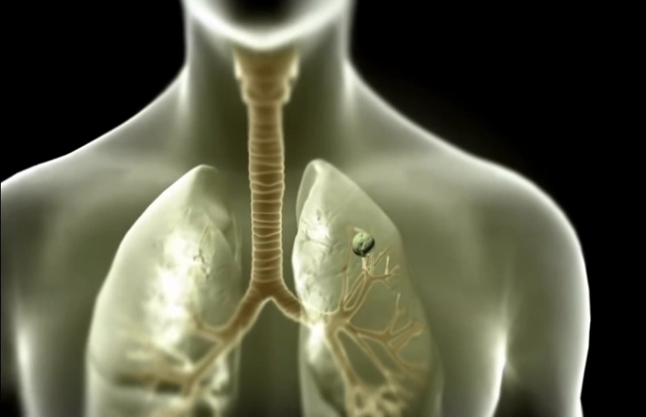
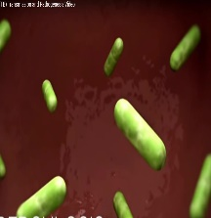
If TB Cases Are Found…
CPL 02-02-078
Protect yourself!
  2005 CDC Guidelines for Preventing the Transmission of Mycobacterium tuberculosis
  Ask for/Follow Employer and facility exposure control requirements
worksafeBC.com
Notes:
If you come across cases of TB in the field take proper precautions and Protect yourself!
Make sure you’re familiar with the 2005 CDC Guidelines for Preventing the Transmission of Mycobacterium tuberculosis
Ask the employer for any facility-imposed exposure control requirements you will need to adhere to during the inspection and during interviews. (topic cont. next slide)

Slide 51
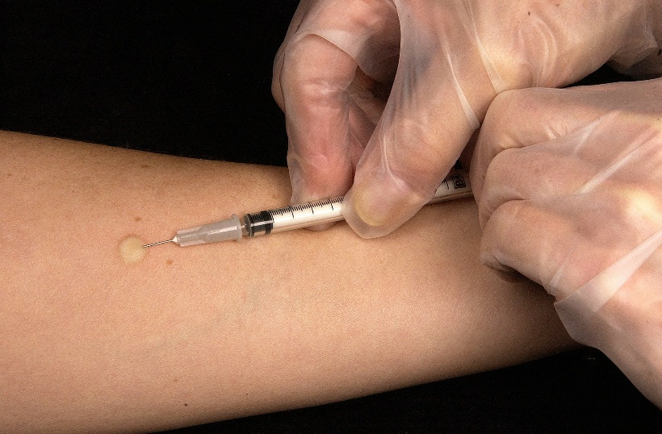
If TB Cases Are Found…
CPL 02-02-078
Protect yourself!
  Do not enter occupied Airborne Infection Isolation Room(s) (w/o authorization from District Supervisor)
  Wash your hands
  Tuberculin Skin Test (TST)
Image by WikiImages from Pixabay
Notes:
Do not enter occupied AIIR or Airborne Infection Isolation Rooms, or recently vacated AIIRs without discussing the need with your District Supervisor. If your supervisor determines that the entry is necessary, such as to perform air tests) you must comply with all facility PPE requirements which at a minimum must be a half-mask negative pressure respirator with at least an N95-rated filter.
At a minimum, wash your hands with soap and water after each TB inspection. If handwashing is not available, use hand sanitizers or antiseptic towelettes as a stopgap until you can wash your hands.
If you are exposed to any individuals with active TB, you can have a TST or Tuberculin Skin Test performed 8 to 10 weeks after the potential exposure.

Slide 52
Possible Citations for TB
CPL 02-02-078
NCGS 95-129(1) - General Duty Clause
29 CFR 1904 – Recording and Reporting Occupational Injuries and Illnesses
29 CFR 1910.132 – General Requirements for PPE
29 CFR 1910.134 – Respiratory Protection
29 CFR 1910.145 – Specifications for Accident Prevention Signs and Tags
29 CFR 1910.1020 – Access to Employee Exposure and Medical Records
Notes:
As with any inspection, read the relevant sections of the FOM and, of course, the CPL when investigating and preparing violations.
The standards listed here are ones that have commonly been cited for TB in a health care setting.
One thing to keep in mind, you will need to take pictures of the facility for case file documentation but do not video or photograph patients. You must protect patient confidentiality.

Slide 53
Workplace Violence in LTC
OPN 132 SEP
Memo 5/1/2017 (WPV3)/CPL 02-01-058
Notes:
Workplace Violence Memo (WPV3) dated 5/1/2017 which includes the federal CPL 02-01-058 – Enforcement Procedures and Scheduling for Occupational Exposure to Workplace Violence. North Carolina did not formally “adopt” this CPL but it is provided for CSHOs to use as general guidance and reference when conducting an inspection related to workplace violence, as neither OSHA nor NCDOL OSH have a promulgated standard that specifically addresses the hazard.
Please read the Memo at the beginning of the CPL as it contains NC specific guidance.

Slide 54
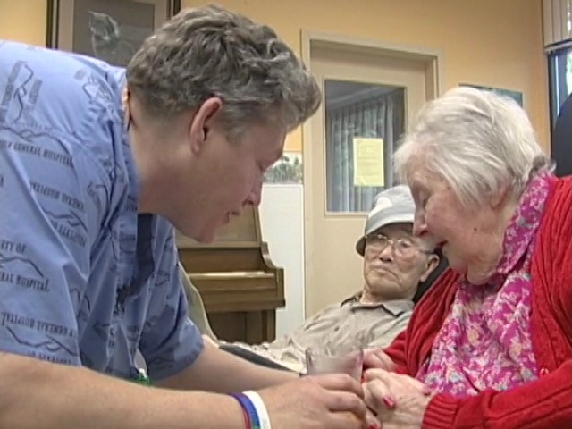
Workplace Violence (WPV)
CPL 02-01-058
Cause of 14% of lost work injuries
NIOSH defines: “violent acts directed toward persons at work or on duty.”
Notes:
As we observed previously, the BLS statistics showed that btw 2011 and 2014 approximately 14% of lost time injuries in LTC workers were due to Workplace Violence.
These workplace violence rates corroborated by the National Crime Victimization Survey (NCVS), which estimated that between 1993 and 2009 healthcare workers had a 20% (6.5 per 1,000) overall higher rate of workplace violence than all other workers (5.1 per 1,000).
NIOSH defines workplace violence as “violent acts (including physical assaults and threats of assaults) directed toward persons at work or on duty.”
2 minute video from WorkSafe BC (Canada). It give a glimpse into some examples of workplace violence in LTC facilities. In addition to the physical affects of WPV, what other effects does it have on the staff?
**Worksafe BC has a video that could be used in this section.

Slide 55
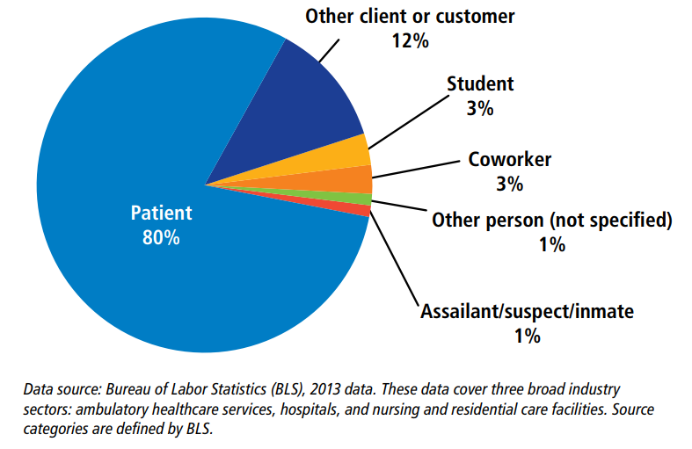
Workplace Violence in Health Care
Notes:
The Bureau of Labor Statistics (BLS) data shows that between 15,000 – 25,000 assaults, which result in days away from work, have been reported annually over the last 10 years. Two-thirds of these injuries were in the health-care setting each year.
Interactions with patients are by far the largest source of violence in healthcare settings.
This Violence is vastly underreported, the data listed in these BLS stats are only those that led to time away from work.
Reasons for underreporting are varied and can range from a lack of a reporting policy, lack of faith in the reporting system, or even a fear of retaliation.
Employee interviews are especially important when determining if there are workplace violence hazards. Asking the right questions might be the only way this issue can come to light in a LTC inspection.
(Play WorksafeBC – Workplace Violence video _ “Forever Changed”

Slide 56

WPV Documentation
CPL 02-01-058
Workplace Violence Prevention program
OSHA 300 logs & injury reports
Training records/program information
Workers Compensation records
Accident/incident/near-miss logs
Image by Ag Ku from Pixabay
Notes:
You will need to review the Employers Workplace Violence Prevention Program, if they have one. If one doesn’t exist, review policies and procedures, along with interviews and facility observations to determine what steps, if any, the ER has in place to protect EE’s.
Request and review the ER’s injury and illness records from at least 5 years prior to the inspection. Look for any recorded injuries associated with Workplace Violence and make note of any trends. Remember, workplace violence within LTC facilities usually refers to improper contact between employees and residents. Look for instances of physical abuse experienced by employees who are responsible for the direct care of residents.
Request information on any training EE’s receive on Workplace Violence, to include the contents of the training, when and how often the training occurs, who has received the training, etc.
Check other documents like workers compensations records, insurance records, security reports, first-aid logs, accident and near miss logs. These can provide information on incidents that were not documented in the OSHA log and give you additional information on the frequency and severity of any incidents.

Slide 57

WPV Documentation
CPL 02-01-058
Hazard Assessments
Health & Safety meeting minutes
Employee interviews
Medical records
Image by Pexels from Pixabay
Notes:
Review Hazard Assessments for Workplace Violence, are they adequate? These can also help support your employer knowledge of the hazard.
If the facility has a health and safety committee or meeting, request the meeting minutes…again you might find information concerning workplace violence incidents as well as knowledge of the hazard.
Evidence of workplace violence behavior can be identified during employee interviews, as well as during review of OSHA 300 logs.
Also when interviewing employees, make note of whether employees have experienced, or are aware of, any retaliation form the employer for complaining of workplace violence or potential workplace violence or for reporting an injury resulting from workplace violence. Acts you might identify can include workers having their hours reduced, denial of promotion, reassignment to a less desirable position or type of work, or even termination. The questionnaires in the LTC SEP could be very helpful in the interviewing process. I also highly recommend that you get written statements from all of your interviews, remember Workplace Violence would be a General Duty violation.
Also make sure you speak to the Individual(s) in charge of workplace Violence program at the facility as well as the trainers.
If the situation requires, request Medical Records for any identified EE incidents. This will necessitate you get a signed authorization form from the EE(s). Make sure you follow protocols to ensure privacy is maintained.

Slide 58

Written WPV Program
CPL 02-01-058
OSHA 3148-06R
Should contain:
  Management Commitment/Employee Participation
  Worksite Analysis
  Hazard Prevention and Control
  Safety and Health Training
  Recordkeeping
  Program evaluation
Image by Peggy und Marco Lachmann-Anke from Pixabay
Notes:
Workplace Violence Prevention Plan: To prevent workplace violence a written program should should incorporate these basic building blocks which include
Management Commitment/Employee Participation: for example: is there an effective reporting system? Is reporting encouraged? Is EE feedback sought after, etc?
Worksite Analysis: for example: How does the employer determined and identify the presence of or lack of workplace violence hazards? How do they assess? Do they use employee surveys? Other documentation? All should be reviewed.
Hazard Prevention and Control: for example: What hazard prevention methods or controls are in place? How were these determined to be sufficient? Do they appear to be working to prevent WPV incidents?
Safety and Health Training: for example: Are EE’s being trained in the methods of prevention and control that the ER has deemed appropriate? How is the training conducted? Is it effective?
Recordkeeping - for example: Records review is vital to identify patterns of assaults or near misses that could be prevent or reduced through the implementation of appropriate controls.
This review should include medical, safety , specific threat assessments, worker compensation reports, as well as OSHA 300 logs. Also ask if an incident/near miss log, the facilities daily log or general event log, and any police reports (if applicable). Is the ER reviewing this documentation?
Program evaluation – for example: Is the ER regularly investigating incidents and utilizing the information to update the program? How often? Is the ER measuring the rates of WPV occurrences to measure the programs performance, how well it is addressing the problem and protecting EE’s? Keeping abreast of new industry strategies to prevent or respond to workplace violence? Are they surveying EE’s periodically to learn if they are experiencing workplace violence?
The program should also state clear goals and objectives suitable to the size and complexity of the given workplace.
Overall, an effective violence prevention written plan:
Creates and disseminates a clear policy that violence, verbal and nonverbal threats, and related actions, will not be tolerated.
Ensures that no reprisals are taken against employees who report or experience workplace violence.
Encourages prompt reporting of all violent incidents and recordkeeping of incidents to assess risk and to measure progress.
Establishes a plan for maintaining security in the workplace which includes law enforcement officials and other specialists.

Slide 59

Signs of Concern
CPL 02-01-058
Lack of “good faith” to reduce hazards
Lack of procedural changes in response to related injuries
Lack of commitment from top management
Lack of medical or counseling programs for injured employees
Inadequate staffing
Failure to report violent incidents to police
Image by geralt from Pixabay
Notes:
Look for “Warning Signs” during your documentation review and interviews, some examples include…
Lack of “good faith” in actually reducing the workplace violence hazards that have occurred or employees have listed as a concern.
Lack of procedural changes in response to related employee injuries
Lack of commitment from top management,
Lack of medical or counseling programs available for injured employees
Inadequate staffing available to perform job tasks,
Failure to report violent incidents to the police

Slide 60

Inspection and Citation Guidance
CPL 02-01-058
General Duty Clause (GDC)
OSH Workplace Violence Memo dated 5/1/2017
(WPV 3), (OSHA directive CPL 02-01-058)
Image by StockSnap from Pixabay
Notes:
So you’ve Interviewed employees and reviewed OSHA 300 logs and other documentation and determined there is a workplace violence hazard issue.
Make sure you have the level of supporting evidence and supporting documentation required to build a General Duty Clause violation.
When constructing your violation refer back to the OSH Workplace Violence Memo dated 5/1/2017 (WPV 3), OSHA directive CPL 02-01-058 for guidance.
Lets do a quick review of information that could be helpful to you when building a Workplace Violence GDC violation

Slide 61
GDC: Death/Serious Hazard
CPL 02-01-058
Documented WPV injuries
  300 logs
  Injury reports
  Workers’ compensation records
  Medical records
  Police and security records
  Employee interviews (written)
Past complaints or grievances
Meeting minutes where WPV was discussed
Actual or potential employee exposure
Notes:
Remember with General Duty, the most likely injury to result must be serious physical harm or worse.
The easiest way to support this, is through injuries that have already occurred (if within the last 6 months) or show the injuries as a hazardous trend (injuries over the last 3 years).
Using the OSHA 300 logs, ER injury reports, medical records, written employee interviews, etc. you can show that the injuries and/or potential injuries constitute a serious hazard to the exposed employees. When interviewing EE’s also ask about near misses, where workplace violence incidents occurred but not injuries were reported. These might not be recorded.
Supplement this documentation with photographs if possible, if not create diagrams to show how prior incidents occurred. Create a visual picture, I personally used PowerPoint. I highly recommend, especially for cases that will go to the AG’s office or through Case File Review.
Look for past complaints and grievances. If the ER does not track or record, ask the EE’s what issues they have at the facility and get in writing.
Another good source of information is Meeting Minutes (could be for the safety committee or supervisor’s, etc.) where Workplace Violence was discussed. You might have to slog through quite a few to find what you need. You could always request the minutes around the time of a near miss or actual incident to help narrow it down.

Slide 62
GDC: Death/Serious Harm
CPL 02-01-058
Documentation that the WPV hazard caused or was likely to cause serious physical harm
  Employee interviews
  Injury/illness logs
  Police reports
Evidence of actual incidents
  Threats of physical harm
  Seriously injured or killed by WPV
Notes:
Just to drive this point home…
Make sure you document and reference in your violation the supporting evidence you discovered. Make sure you have a strong argument that death or serious harm is a likely result.

Slide 63
GDC: Employer Knowledge
CPL 02-01-058
Documentation of employees information
Employer awareness of prior incidents
Precautions taken by employer to prevent/minimize WPV
How employer currently addresses WPV including:
  Prevention plan
  Training plan
  Security plan
Management interviews including person responsible for certifying OSHA 300 logs
Notes:
2. With a General Duty violation you must also show that the employer had knowledge of the hazard.
Employer knowledge if often one of the most difficult requirements to prove.
Strong documentation is vital. As mentioned previously, look for documentation that shows/proves that the employer was aware that the problem existed.
IF the injuries were listed on the 300 log, a member of management has to certify that they have review it and it is accurate…that is knowledge! Look at hazard assessments, was the hazard identified? Who in management signed off on or reviewed the assessment? Again this could be use as support of knowledge. Of course, Interview the employer, ask them about their program, training, what precautions they have put in place to ensure EE safety. and if possible try to get a written statement.

Slide 64
GDC: Industry Recognition
CPL 02-01-058
Documentation from business groups/associations affiliated with the employer identifying WPV
Journal articles/research showing WPV in LTC
NIOSH and OSHA publications
National consensus standards
Notes:
3. Another requirement of General Duty is that the hazard must be recognized in the industry…
In general, these types of sources should be researched for any GDC violation, not just WPV.
Workplace Violence is a widespread problem in the healthcare industry and you should have not problem locating documentation. There are many sources out there not the least of which are from OSHA and NIOSH. You can also check out professional associations such as the American Nurses Association or similar which have also written articles on the subject which you can use as support.

Slide 65
GDC: Feasible Abatements
Reference:
  OSHA publication 3148: Guidelines for Preventing Workplace Violence for Healthcare and Social Service Workers
CPL 02-01-058
Notes:
4. And the final requirement of the General Duty Clause is that a Feasible Abatement must exist.
Refer to OSHA publication 3148: Guidelines for Preventing Workplace Violence for Healthcare and Social Service Workers. This document has a lot of information that would be useful for guidance on potential feasible abatements as well as guidance on implementing an effective WPV prevention program.

Slide 66
Potential Abatements
CPL 02-01-058
Implement WPV prevention program
Selected controls:
  Zero tolerance policy
  Ensure trained and qualified staff are available
  Determine behavioral history of new/transferred residents
  Establish system to identify patients with assaultive behavior problems
  Coworkers and supervisors jointly plan ways to effectively treat violent patients
Notes:
Some example potential abatements could include
-the employer implementing written WPV prevention program, if they currently lack one
-The employer could also establish controls in the facility such as:
Zero workplace violence tolerance policy
Ensure that trained and qualified staff are available to handle and interact with patients
Determine behavioral history of new/transferred residents to help pre-emptively identify potential issues.
Establish system (ex: chart tags) to identify patients with assaultive behavior problems
Use conferences with coworkers and supervisors to plan ways to effectively treat violent patients

Slide 67
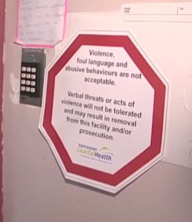
Employer Outreach
CPL 02-01-058
Hazard Alert Letter
Provide Outreach Materials
WorkSafeBC
Notes:
Consider issuing a hazard alert letter [Examples can be found in Memo WPV 3 (dated 5/1/17) – Workplace Violence Inspections (CPL 02-01-058) in OneStopShop]
If during the inspection you note Workplace violence hazards that do not rise to the level of a General Duty Clause violation, you should consider sending the ER a Hazard Alert Letter recommending the implementation of appropriate protective measures.
Also consider providing outreach materials such as OSHA’s “Guidelines for Preventing Workplace Violence for Healthcare and Social Service Workers” which I mentioned earlier. This document would give the employer valuable information on protecting their employees from workplace violence.

Slide 68
MRSA in LTC
OPN 132 SEP
Notes:
So now, lets take a look at MRSA...

Slide 69
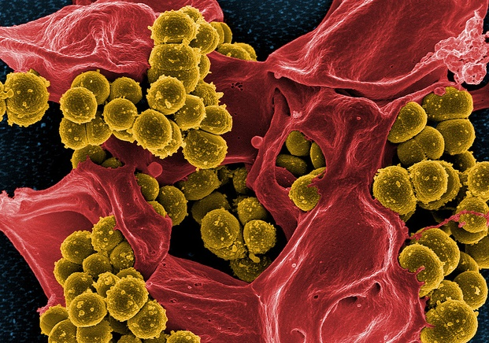
What is MRSA?
OPN 132 SEP
methicillin-resistant Staphylococcus aureus (MRSA)
  Antibiotic resistant bacteria
  5% of patients in U.S. hospitals carry MRSA
MRSA can cause severe problems:
  bloodstream infections
  pneumonia
  Sepsis
  death
(Image courtesy of the National Institute of Allergy and Infectious Diseases)
Notes:
So…What is MRSA anyway?
MRSA stands for methicillin-resistant Staphylococcus aureus, a type of bacteria that is resistant to several antibiotics.
How common is MRSA?
It’s pretty common, actually! Approximately 5% of patients in U.S. hospitals carry MRSA in their nose and/or on their skin. So you can see why it would be easy to transfer to another person.
In healthcare facilities, such as a LTC facility like a nursing home, MRSA can cause severe problems including:
bloodstream infections
pneumonia
sepsis
death

Slide 70
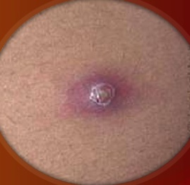
How is MRSA Spread?
OPN 132 SEP
Direct Contact:
  Skin-to-skin
  Skin to contaminated surface
  With infected wound/skin
  With asymptomatic carriers
www.cdc.gov/
Source: Annual Internal NCDOL Training Event
“OPN 132 , LTC Facilities” 09/12/16
Notes:
Staph infections (including MRSA) generally start as small red bumps that resemble pimples, boils, or spider bites. (an example is seen here on the slide)
Its important to think about how MRSA is spread in healthcare settings.
MRSA is usually spread by direct contact with an infected wound or from contaminated hands, usually those of healthcare providers. Also, people who carry MRSA but do not have signs of infection can spread the bacteria to others (i.e., people who are colonized can transfer the organism).
Skin contact with contaminated surface can also spread MRSA, this includes sharing personal items and equipment or supplies (such as towels or razors that have come into contact with an infected wound or infected skin)

Slide 71

MRSA Cases
OPN 132 SEP
CDC estimated in 2011
80,461
  Invasive (surgery, dialysis) MRSA Infections per year
11,285
  Deaths from MRSA per year
https://www.cdc.gov/mrsa/community/photos/photo-mrsa-1.html
Source: Annual Internal NCDOL Training Event
“OPN 132 , LTC Facilities” 09/12/16
Notes:
The CDC estimated in 2011 that approximately 80,461 cases of MRSA infection occur each year
As well as approximately 11,285 MRSA related deaths occur each year. So this is a serious issue.

Slide 72
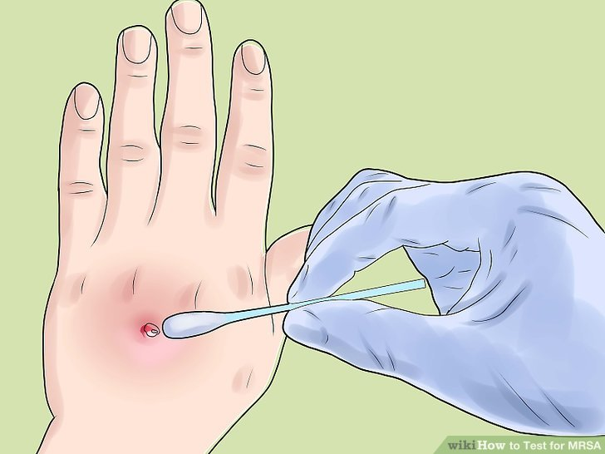
Diagnosis of MRSA
OPN 132 SEP
Tissue Sample or Nasal Secretions tested
Determine if drug-resistance
Determine if/which antibiotic will be effective
www.wikihow.com
Info Source: Annual Internal NCDOL Training Event
“OPN 132 , LTC Facilities” 09/12/16
Notes:
MRSA is diagnosed through checking a tissue sample or nasal secretion for signs of drug resistant bacteria. This sample is obtained from the infection site and sent to a microbiology laboratory
If the organism is confirmed, it is further tested for signs of drug-resistance, which bacteria is present, and it’s determined which antibiotic would be effective for treatment
Traditional tests take about 48 hours for the bacteria cultures to grow, however newer tests that can detect staph DNA in a matter of hours and are now becoming more widely available.

Slide 73

Potential Citations for MRSA
OPN 132 SEP
NCGS 95-129(1) - General Duty Clause
29 CFR 1904 – Recording and Reporting Occupational Injuries and Illnesses
29 CFR 1910.132 – General Requirements for PPE
29 CFR 1910.141 - Sanitation
29 CFR 1910.1030 – Bloodborne Pathogens
Source: Annual Internal NCDOL Training Event
“OPN 132 , LTC Facilities” 09/12/16
Image by DrawnByShaun from Pixabay
Notes:
These are some potential citations for MRSA,
For General Duty violations, check out OPN 132 Appendix C for example AVD language.
The other listed citations are pretty self explanatory, such as 1904 – recordkeeping, 1910.132 – PPE,
1910.141 – Sanitation and, 1910.1030 - Bloodborne Pathogens.

Slide 74
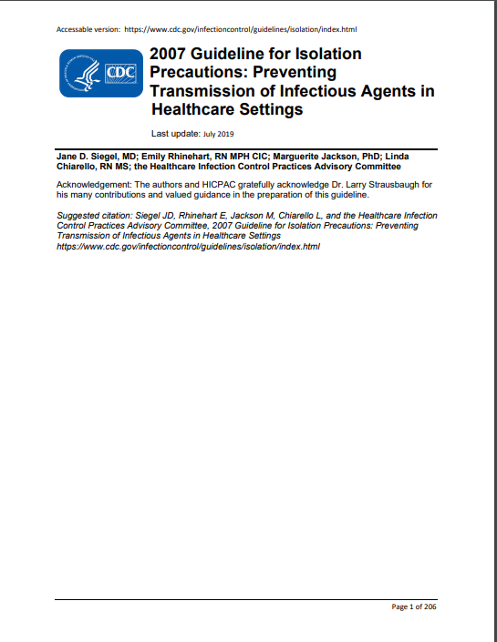
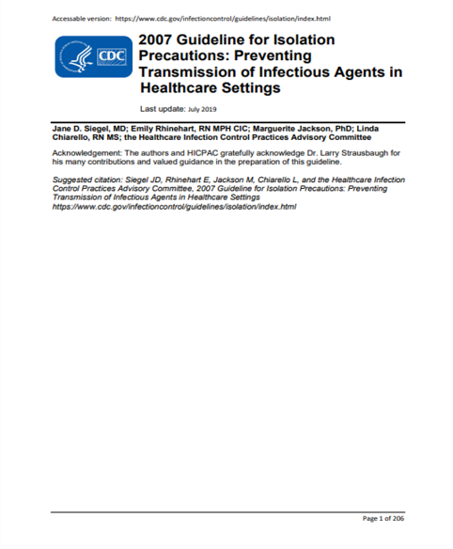
Recommended CDC Guidelines
OPN 132 SEP
Guidelines for Isolation Precautions: “Preventing Transmission of Infectious Agents in Healthcare Settings”, 2007
CDC.gov
Notes:
Recommendations for standard precautions and contact precautions to reduce or eliminate exposure to MRSA are outlined in CDC guidelines, including Guidelines for Isolation Precautions: “Preventing Transmission of Infectious Agents in Healthcare Settings”, 2007
Remember this one because it could serve as a good resource for a MRSA general duty violation.
That finishes off MRSA, on to the next area of emphasis!

Slide 75
Hazard Communication in LTC
OPN 132 SEP
CPL 02-02-079
Notes:
Haz Com! I think everyone here is familiar with hazard communication. This is going to be really high level.

Slide 76
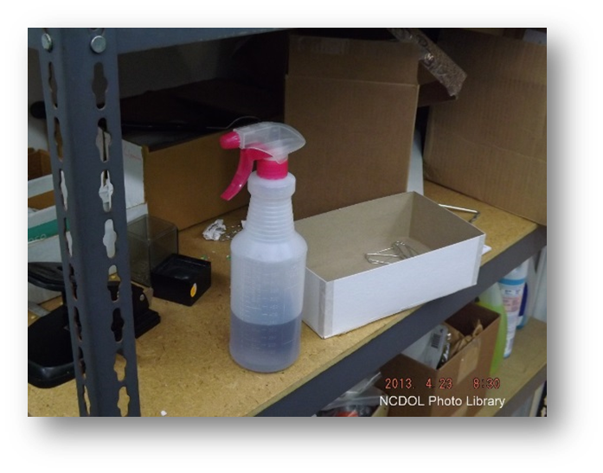
Hazard Communication
CPL 02-02-079
Hazardous chemicals often encountered…
  sanitizers
  disinfectants
  hazardous drugs
Unlabeled container
Notes:
Hazard Communication is an important element in LTC facilities due to the use of chemicals across multiple departments.
Check job descriptions and interview employees as well to determine what hazardous chemical exposures exist at the facility.
Nursing staff and housekeepers use substances for disinfecting, while maintenance staff might use chemical substances for general job duties that include painting, or lawn maintenance, which includes the use of gasoline.
Dietary staff also use degreasers and general cleaning substances within the kitchen. Employees that are responsible for these job duties would also be covered under haz com.

Slide 77

Hazard Communication
CPL 02-02-079
  Written program
  Worker training
  Employee exposure
  Hazard Communication labels
  Access to Safety Data Sheets
This Photo by Unknown Author is licensed under CC BY-SA
Notes:
As with any haz com related inspection…
Request and review the employer’s written Hazard Communication program. Find out where it is located. Ensure EE’s know where it is and how to access. Make sure it has all the required elements.
Ask ER if employee Haz Com training is performed and request/review training documentation. You will need this information for EE interviews.
Ask the ER how many hours a week employees are performing tasks that expose them to hazardous chemicals and find out what those tasks are. Interview EE’s and ask the same questions, look for inconsistencies and learn the details of the tasks the EE’s perform as well as how they protect themselves from contact, and anything else relevant.
Check chemical containers, how are they used by EE’s, are they properly labeled? Do EE’s refill?, etc.
Ask the employer where the Safety Data Sheets are located, not only will you need to review and observe the SDS’s to ensure they are being maintained properly, You will need to verify during interviews that employees can access and know how to use the SDS’s. In most portions of the investigation, remember ask EE’s “Show Me”. Direct observation is always preferred in an investigation and it give you the opportunity to take photographic proof or video!!

Slide 78

Hazard Communication
CPL 02-02-079
Refer to CPL 02-02-079: Inspection Procedures for Hazard Communication (2012)
Image by Michael Tavrionov from Pixabay
Notes:
If you need any more information or detail, refer to CPL 02-02-079: Inspection Procedures for Hazard Communication (it can be found at the one stop shop)
That’s it for Haz Com, on to the next topic!

Slide 79
Recordkeeping in LTC
OPN 132 SEP
CPL 02-00-135
Notes:
Let’s take a look at Recordkeeping…

Slide 80
Recordkeeping
CPL 02-00-135
Follow requirements:
  29 CFR 1904: Recording and Reporting Occupational Injuries and Injuries
  CPL 02-00-135: Recordkeeping Policies and Procedures Manual
  CPL 02-02-069: Enforcement Procedures Bloodborne Pathogens
  And other applicable requirements
Notes:
Recordkeeping issues must be handled in accordance with 29 CFR 1904, CPL 02-00-135 – Recordkeeping Policies and Procedures Manual,
CPL 02-02-069 (CPL 2-2.69) – Enforcement Procedures for the Occupational Exposure to Bloodborne Pathogens,
FOM Chapter 17 – Ergonomics Inspection Procedures (which requires review of at least the past three years of injury/illness data), and
any other relevant field guidance.

Slide 81

Privacy
CPL 02-00-135
Resident Privacy and Medical Records
  Respect for resident privacy must be a priority
  Obtain consent prior to reviewing medical records
This Photo by Unknown Author is licensed under CC BY-SA
Notes:
In Recordkeeping, respect for resident privacy must be a priority during each inspection. Under no circumstances may a CSHO enter resident rooms or other areas where resident privacy could be compromised without the consent of the resident or their next-of-kin guardian.
In evaluating resident handling or other hazards, do not review any resident records that include personally identifiable health information, including diagnoses, laboratory test results, etc., provided by the employer without the consent of the resident or their next-of-kin.

Slide 82

Privacy
CPL 02-00-135
Obtain family members or guardian consent prior to videotaping or photographing
  Appendix A: Resident Consent and Release
This Photo by Unknown Author is licensed under CC BY-NC-ND
Notes:
As mentioned before, Evaluations of workplace health and safety issues may involve assessment of resident handling. Resident handling activities may take place in resident rooms, restrooms, shower and bathing areas or other areas where the privacy of residents could be compromised.
Keep in mind, documenting resident handling activities by videotaping or taking photographs requires the resident's informed, written consent. Family members or guardians may give consent for those residents who are incapable of giving informed consent.
In Appendix A of the LTC SEP there is a Resident Consent and Release form for you to use.

Slide 83
Employee Medical Records
CPL 02-00-135
Medical Records not specifically required by OSHA
  medical exam results
  laboratory tests
  medical opinions/diagnoses,
  first aid records
Obtain and maintain in accordance with
  FOM Ch. III – Inspection Procedures,
  FOM Ch. XIII – Fatality and Catastrophe Investigations
  FOM Ch. XVI – Administrative File Activities.
Notes:
If you feel some employee medical records are needed that are not specifically required by an OSHA standard (e.g., the results of medical examinations, laboratory tests, medical opinions, diagnoses, first aid records, reports from physicians or other health care providers), they must be obtained and kept in accordance with FOM Chapter 3 – Inspection Procedures, Ch. 13 – Fatality and Catastrophe Investigations, and Ch. 16 – Administrative File Activities.

Slide 84

Employee Medical Records
CPL 02-00-135
Legal justification for requesting medical records:
  45 CFR 164.512 (b)(1)(v):
  Health and Human Services’ Standards for Privacy of Individually Identifiable Health Information
This Photo by Unknown Author is licensed under CC BY-SA-NC
Notes:
Health and Human Services’ Standards for Privacy of Individually Identifiable Health Information, 45 CFR 164.512 (b)(1)(v), states that an employer (or its health care provider) can disclose and use confidential employee health information when:
conducting or evaluating workplace medical surveillance;
When evaluating whether an employee has a work-related illness or injury;
To comply with OSHA requirements under 29 CFR parts 1904 through 1928, and 30 CFR parts 50 through 90,
And finally, this information can be disclosed under a state law having a similar purpose.
That finished our review of Recordkeeping for LTC, any questions?

Slide 85
Tracking in OE
Notes:
We all love OE, right? Well, there are specific requirements that must be followed for each LTC case file in OE to make sure that they are tracked correctly. So I thought I would touch on these really quickly.

Slide 86
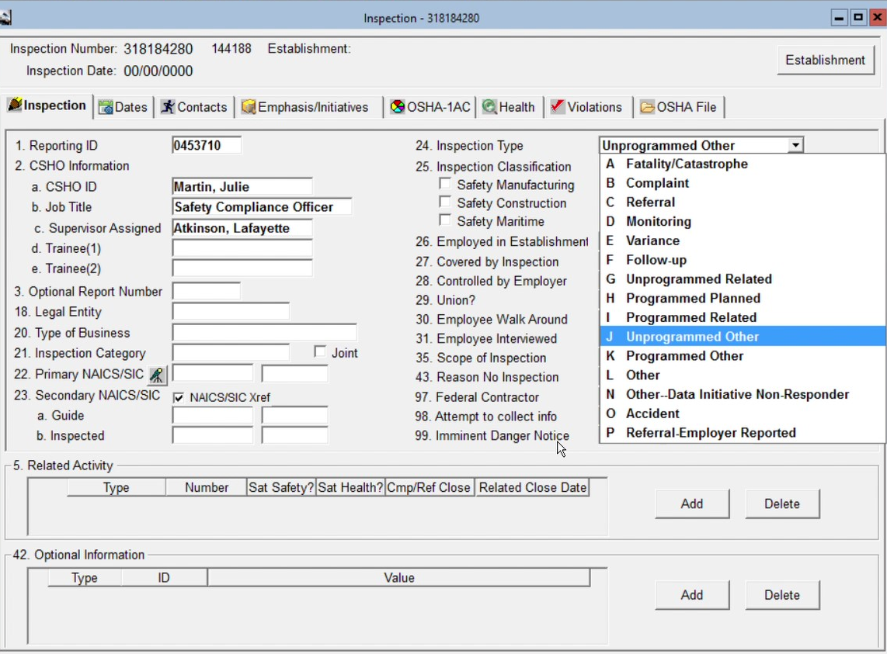
Recording and Tracking
Notes:
Shown here is an example OSHA 1 form from OE. For all unprogrammed inspection conducted in conjunction with an LTC SEP inspection, make sure you mark field 24: Inspection Type as an unprogrammed inspection.
In Field 5: Related activity. Record the appropriate associated unprogrammed activity (such as accident, complaint, or referral) and put in the corresponding activity ID number.

Slide 87
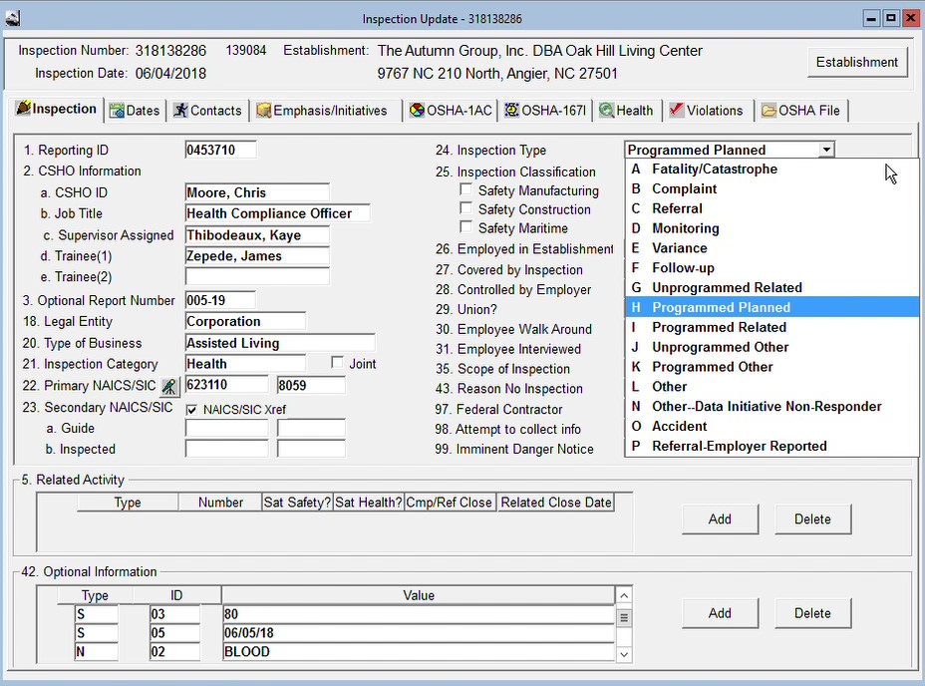
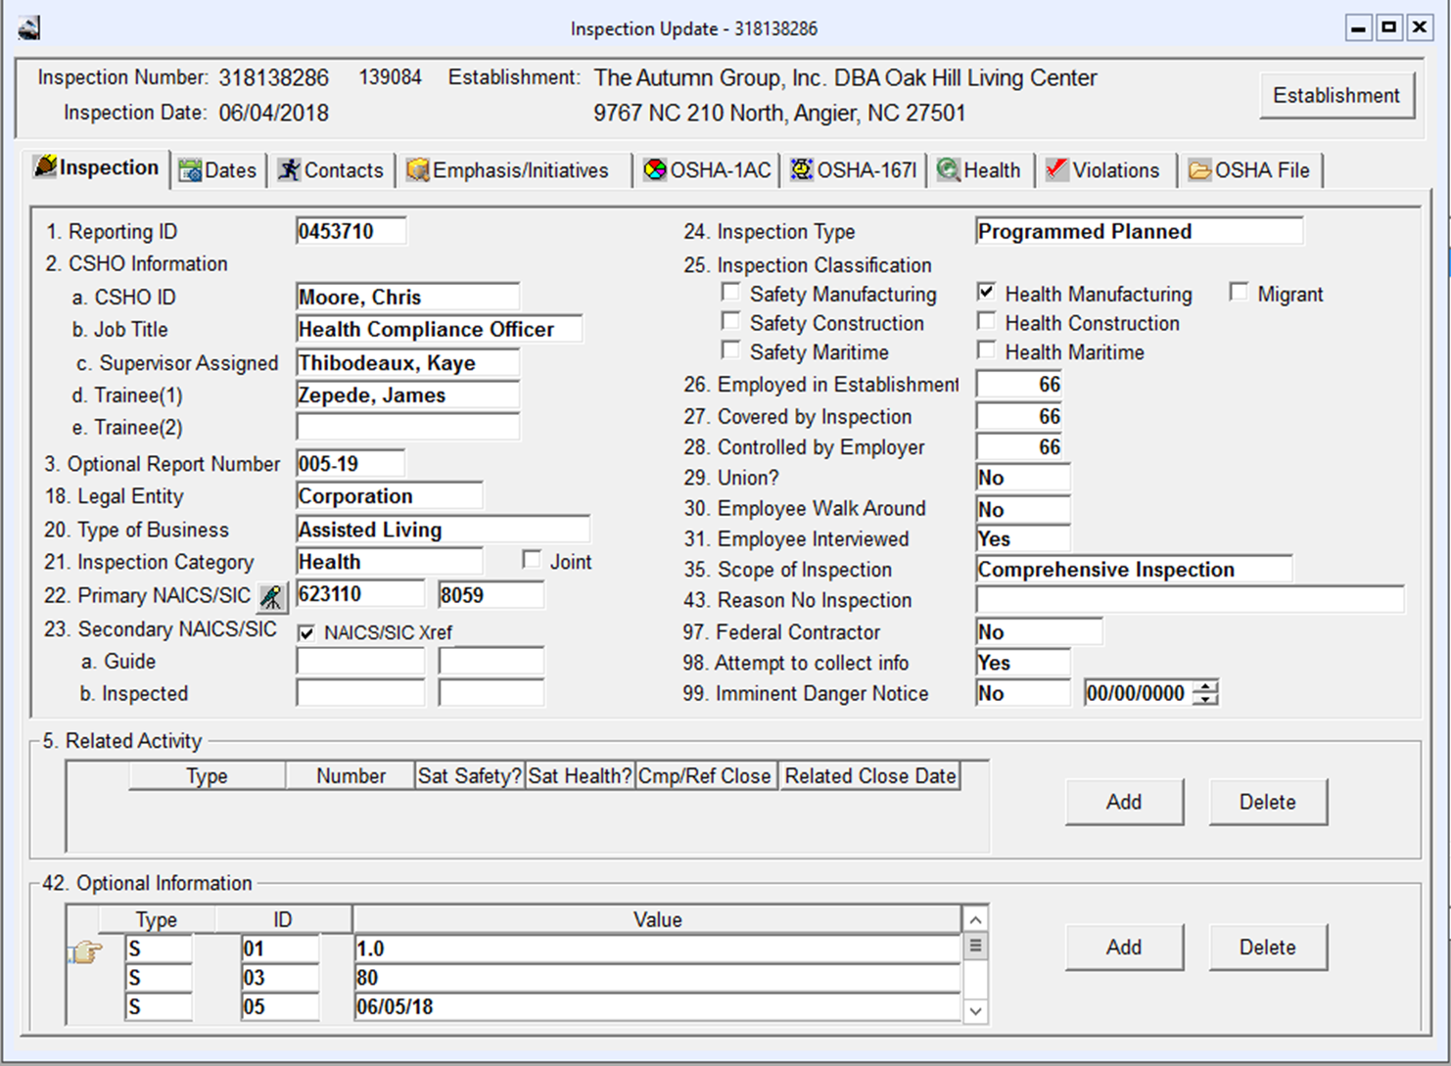

Recording and Tracking
Notes:
For Programmed inspections, the OSHA 1 forms must be marked Programmed Planned in field 24. Inspection Type…again Make sure you identify the scope of the inspection and the related activity, i.e., a Health General Schedule or a Safety General Schedule.

Slide 88
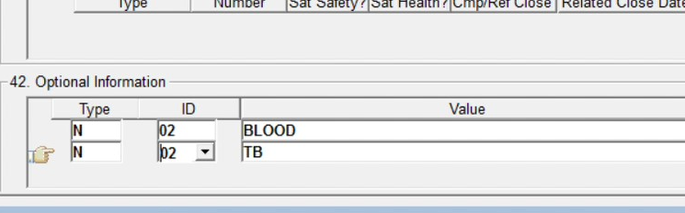
Recording and Tracking
OSHA Express
OSHA 1/Put in Item 42 Optional Codes
Example below:
Notes:
In the OSHA 1, you will also need to put in the correct Optional Codes into Item or field 42. Here’s an example.

Slide 89
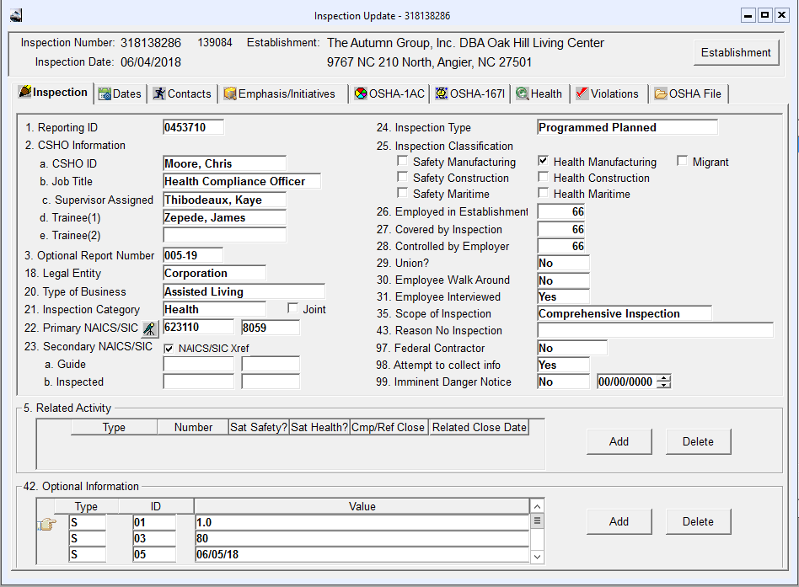
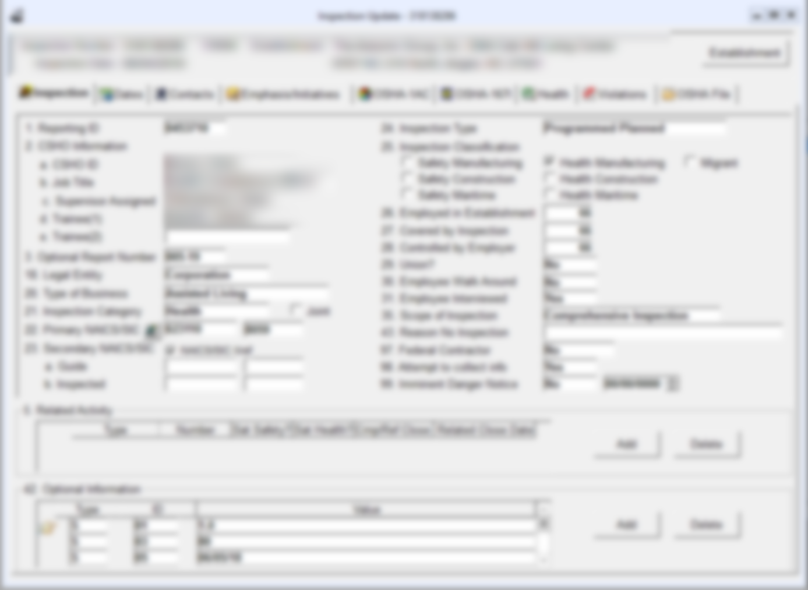
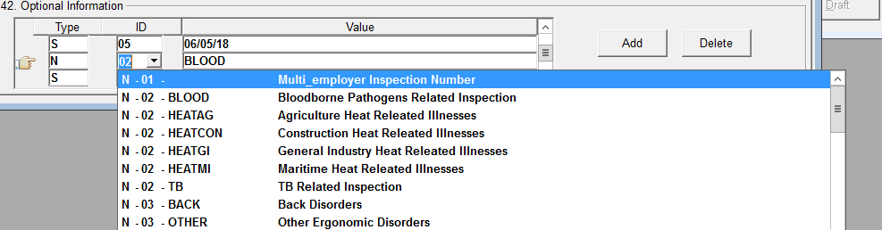
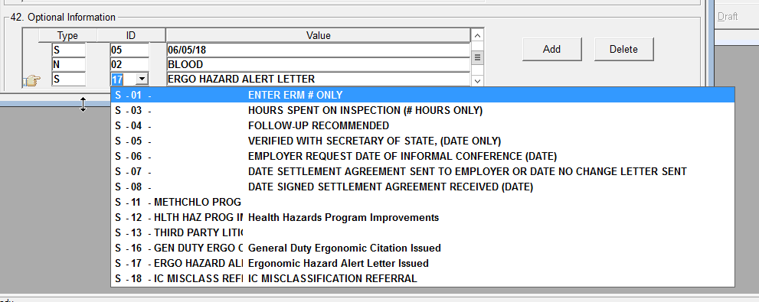
Recording and Tracking
Notes:
In Field 42: Optional Information, there are a lot of different options, under Type N, which are your national level codes, you havea Bloodborne Pathogens code, TB related inspection code, and more.
Under type S, your state level codes, you have options that Ergo hazard letters issues, Ergo GDC Citation issued, and many more.
Make sure you do a thorough search to make sure you choose all the codes applicable to your investigation.

Slide 90
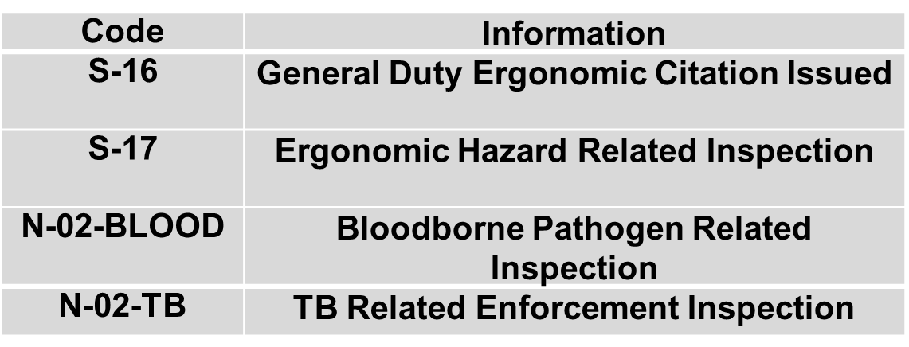
Recording and Tracking
OSHA Express
OSHA 1/Put in field 42 Optional Codes
Notes:
These are some of the most common Optional Codes used for a LTC file in OE.
Optional codes for workplace violence and slips, trips and falls are not necessary and haven’t been developed.

Slide 91
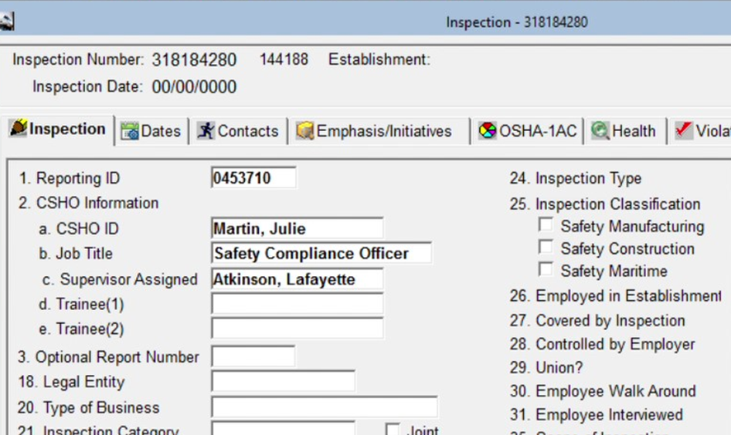
Recording and Tracking
OSHA Express
OSHA 1/Strategic Plan Activity
Notes:
And we can’t forget about Strategic plan activity…In the OSHA 1, click on the Emphasis and Initiatives tab,

Slide 92
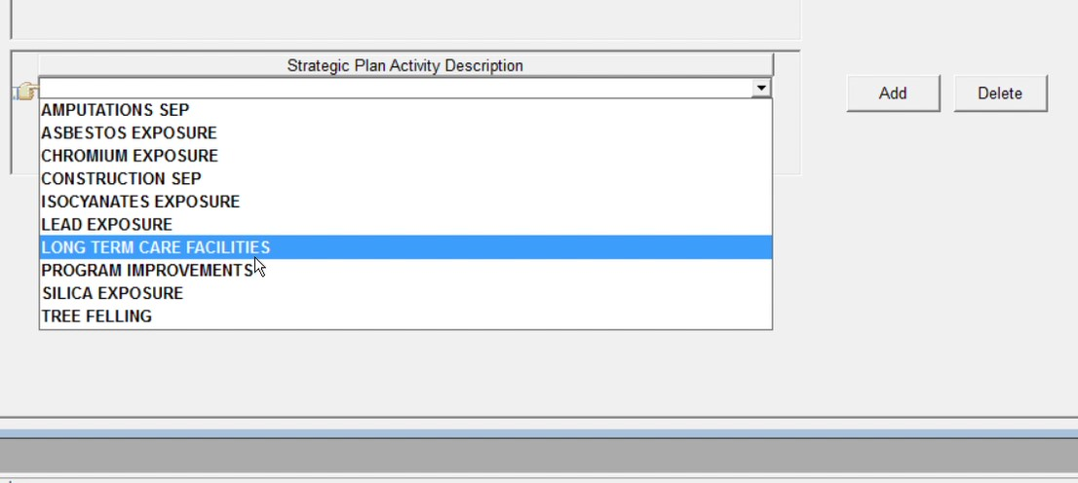
Recording and Tracking
OSHA Express
OSHA 1/Strategic Plan Activity
Notes:
Then Select ‘Strategic Plan Activity’ and choose the value “LONG TERM CARE FACILITIES” from the drop down menu. This is vital for tracking purposes. This helps identify the activity for SEP tracking and auditing purposes.
Just as an aside…I recommend reviewing closed LTC case files in OE. Ask your supervisor to recommend cases they feel are well written.

Slide 93
OPN 132 Appendices
Notes:
And now for a quick review of the appendices found in the LTC SEP

Slide 94

OPN 132 Appendices
Appendix A:
  Resident Consent and Release
This Photo by Unknown Author is licensed under CC BY-SA
Notes:
As mentioned previously, If during your inspection, you need evidence that includes photographs, videos that may infringe on the privacy of the resident; you must complete the Appendix A document and have it signed by the resident or their authorized person.

Slide 95
Appendix B
OPN 132
Resources:
  CPL 02-00-135, Recordkeeping
  CPL 02-02-069, Bloodborne Pathogens
  CPL 02-02-078, Tuberculosis
  CPL 02-02-079, Hazard Communication
Publications:
  NIOSH, Musculoskeletal Disorders and Workplace Factors, 2nd printing, US DHHS, CDC, NIOSH Pub No. 97-141.
  Back Injury Prevention Guide in the Health Care Industry for Health Care Providers, Cal OSHA (11/97).
Notes:
Appendix B contains useful resources, publications, and websites that provide guidance in conducting your inspection and/or supporting documentation for any violations that you may find. You can see some examples of the references listed in Appendix B in the slide.

Slide 96
Appendix C
OPN 132
Sample N.C. General Statute 95-129(1) AVD for MRSA Exposure
  General Duty Clause sample verbiage (AVD)
Notes:
Appendix C provides an example General Duty Clause AVD for MRSA.

Slide 97
Appendix D
OPN 132
Sample Opening Conference Questionnaire
Contains questions on:
  Ergonomics
  Slips, Trips, and Falls
  Bloodborne Pathogens
  Tuberculosis
  Workplace Violence
  MRSA
  Hazard Communication
Notes:
Appendix D contains a Sample Opening Conference Questionnaire.
This questionnaire can be very useful in ensuring that you ask the ER necessary questions to help aid your investigation and help you determine employer knowledge.
This Questionnaire is not required to be inserted into the case file and is not comprehensive of every question you might need to ask. But it is a very useful tool.
You can find an electronic version of this Questionnaire Form under Forms on the One Stop Shop
As you can see the form is modeled for use during a comprehensive inspections, however you can utilize the areas of the questionnaire that are applicable to your partial scope inspection or the sections that are relevant to any observed plain sight hazards.

Slide 98
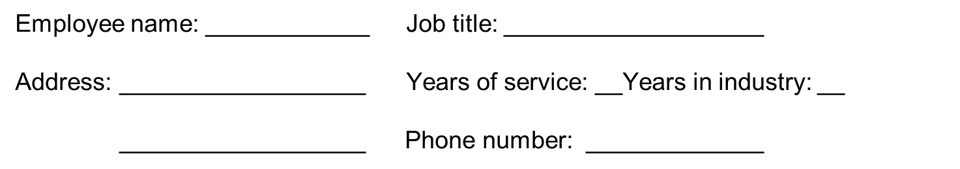
Appendix E
OPN 132
Sample Employee Interview Questionnaire
  Not required for case file
  Useful for interview process
  Questions cover gamut of SEP
Notes:
Appendix E contains a Sample Employee Interview Questionnaire
Just like the Opening Conference questionnaire, this in not a required for the case file or required that you use it, but it is a very useful tool that can help you ask important questions and lead you to further avenues of investigation into the SEP areas of interest.
An electronic copy of this questionnaire can be found on the One Stop Shop.

Slide 99
Summary
In this presentation we reviewed…
The basic components and requirements of the OPN 132 SEP
The common hazards CSHOs can encounter during LTC inspections
The tools and guidance available to help assist CSHOs in LTC inspections
Notes:
So today we reviewed the OPN 132 SEP for Long Term Care facilities
Some of the common hazards you might encounter at these facilities
And many of the tools and guidance available to help you during a LTC inspection.
I just want to say again, this was a quick, high level review to help you become familiar with the LTC SEP. I encourage you to read through the SEP and the other supporting documents yourself, if you have not already done so, to ensure your are well prepared for this type of inspection.

Slide 100
Thank You For Attending!
Final Questions?
1-800-NC-LABOR
(1-800-625-2267)
www.labor.nc.gov

