Slide 1
North Carolina Department of Labor Occupational Safety & Health Division 3rd Quarter Report Federal Fiscal Year 2022*
Presented by:
Wanda Lagoe CSP ARM CPM
Education, Training and Technical Assistance
Occupational Safety and Health Division of North Carolina
*Preliminary Data
Notes:
The information in this presentation is provided voluntarily by the N.C. Department of Labor, Education Training and Technical Assistance Bureau as a public service and is made available in good faith. This presentation is designed to assist trainers conducting OSHA outreach training for workers. Since workers are the target audience, this presentation emphasizes hazard identification, avoidance, and control – not standards. No attempt has been made to treat the topic exhaustively. It is essential that trainers tailor their presentations to the needs and understanding of their audience.
The information and advice provided on this Site and on Linked Sites is provided solely on the basis that users will be responsible for making their own assessment of the matters discussed herein and are advised to verify all relevant representations, statements, and information.
This presentation is not a substitute for any of the provisions of the Occupational Safety and Health Act of North Carolina or for any standards issued by the N.C. Department of Labor. Mention of trade names, commercial products, or organizations does not imply endorsement by the N.C. Department of Labor.

Slide 2
N.C. Workplace Safety and Health
Work-Related Fatalities in North Carolina
FFY 2022—3rd Qtr.
Note: CY 2022 is preliminary data through August 31, 2022.
Calendar Year

Slide 3
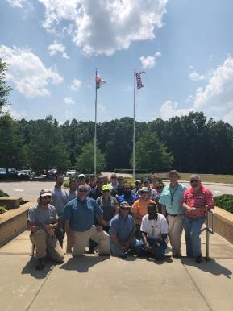
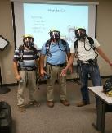
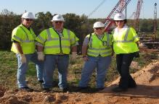
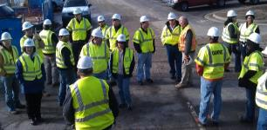
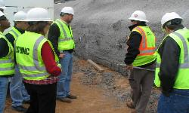
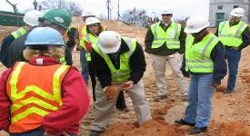
N.C. Workplace Safety and Health
OSH Division—Fatalities Inspected
FFY 2022—3rd Qtr.
FATALITY TYPE | 1st Qtr. | 2nd Qtr. | 3rd Qtr. | Total | FATALITY TYPE | 1st Qtr. | 2nd Qtr. | 3rd Qtr. | Total
Struck By | 2 | 4 | 4 | 10 | Inhalation | 0 | 0 | 0 | 0
Caught In/Between | 2 | 1 | 4 | 7 | Ingestion | 0 | 0 | 0 | 0
Bite/Sting/Scratch | 0 | 0 | 0 | 0 | Absorption | 0 | 0 | 0 | 0
Fall (Same Level) | 0 | 0 | 0 | 0 | Repeated Motion/Pressure | 0 | 0 | 0 | 0
Fall (From Elevation) | 1 | 2 | 5 | 8 | Cardio/Respiratory | 0 | 0 | 0 | 0
Struck Against | 0 | 0 | 1 | 1 | Shock | 1 | 2 | 0 | 3
Rubbed/Abraded | 0 | 0 | 0 | 0 | Other | 2 | 2 | 0 | 4
COVID-19 | 3 | 2 | 0 | 5 | Criminal Activity | 0 | 0 | 0 | 0
Fatalities Under OSH Division Jurisdiction
FFY 2021 |  | FFY 2022 | 1st Qtr. | 2nd Qtr. | 3rd Qtr. | Total
Total Fatalities | 90 | Fatalities | 11 | 13 | 14 | 38
NCDOL Photo Library

Slide 4
N.C. Workplace Safety and Health
OSH Division—Strategic Plan Goals
FFY 2022—3rd Qtr.
COMPLIANCE | 1st Qtr. | 2nd Qtr. | 3rd Qtr. | Total | FFY Goal
Safety Inspections | 315 | 258 | 285 | 858 | 1,145
Health Inspections | 154 | 234 | 167 | 555 | 755
Serious Hazards Eliminated | 554 | 690 | 468 | 1,712 | 4,100
Training and/or Program Violations | 136 | 133 | 113 | 371 | 1,050
CONSULTATION | 1st Qtr. | 2nd Qtr. | 3rd Qtr. | Total | FFY Goal
Serious Hazards Eliminated | 1,224 | 1,401 | 1,399 | 4,024 | 4,800
Private Sector and Public Sector Visits | 359 | 369 | 389 | 1,117 | 1,325
OSH DIVISION | 1st Qtr. | 2nd Qtr. | 3rd Qtr. | Total | FFY Goal
Program Improvements | 538 | 557 | 524 | 1,619 | 2,060
People Trained in Special Emphasis Program Areas | 1,161 | 1,385 | 1,557 | 4,103 | 3,200
People Trained at OSH Division Sponsored Events | 1,631 | 1,941 | 1,809 | 5,381 | 5,350

Slide 5

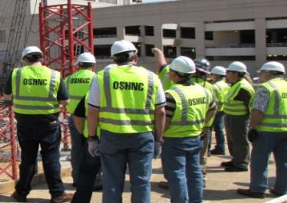
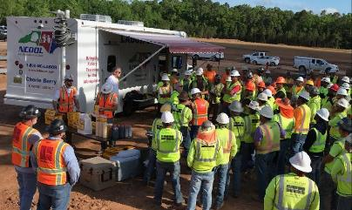
N.C. Workplace Safety and Health
OSH Division—Strategic Plan Goals
FFY 2022—3rd Qtr.
Education, Training and Technical Assistance (ETTA) | 1st Qtr. | 2nd Qtr. | 3rd Qtr. | Total | FFY Goal
Publications Distributed | 9,685 | 9,038 | 13,054 | 31,777 | 35,000
Standards Interpretations | 446 | 805 | 809 | 2,060 | NA
Agricultural Safety and Health (ASH) | 1st Qtr. | 2nd Qtr. | 3rd Qtr. | Total | FFY Goal
Outreach Materials Distributed | 309 | 3,951 | 2,269 | 6,529 | 2,400
Compliance Inspections | 20 | 0 | 10 | 30 | 50
Certificates Issued | 143 | 1,227 | 493 | 1,863 | 1,600
Preoccupancy Inspections | 210 | 1,333 | 302 | 1,965 | 1,800
NCDOL Photo Library

Slide 6
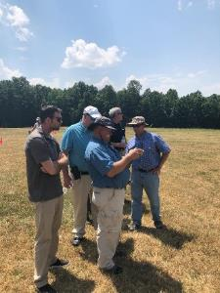
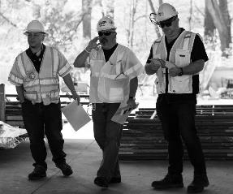
Strategic Plan
Special Emphasis Programs (SEP)
FFY 2022—3rd Qtr.
NCDOL Photo Library
Construction
Logging and Arboriculture
Long Term Care Facilities
Health Hazards
Food Manufacturing
Grocery and Related Product Wholesalers
Amputations

Slide 7
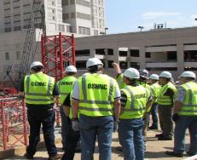
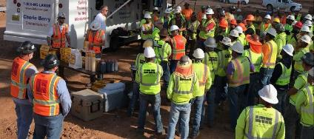
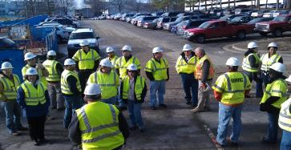
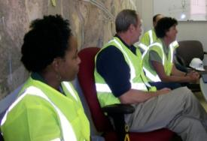
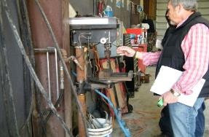
Special Emphasis Program
Construction
FFY 2022—3rd Qtr.
NAICS 23—CONSTRUCTION | FFY 2021 |  | 1st Qtr. | 2nd Qtr. | 3rd Qtr. | Total
Total Fatalities | 18 |  | 3 | 6 | 6 | 15
FFY 2021 4th Qtr. Fatality Rate | 0.0017
Fatality Type | 1st Qtr. | 2nd Qtr. | 3rd Qtr. | Total | Fatality Type | 1st Qtr. | 2nd Qtr. | 3rd Qtr. | Total
Struck By | 1 | 2 | 1 | 4 | Inhalation | 0 | 0 | 0 | 0
Caught In/Between | 0 | 0 | 1 | 1 | Ingestion | 0 | 0 | 0 | 0
Bite/Sting/Scratch | 0 | 0 | 0 | 0 | Absorption | 0 | 0 | 0 | 0
Fall (Same Level) | 0 | 0 | 0 | 0 | Repeated Motion/Pressure | 0 | 0 | 0 | 0
Fall (From Elevation) | 0 | 2 | 3 | 5 | Cardio/Respiratory | 0 | 0 | 0 | 0
Struck Against | 0 | 0 | 1 | 1 | Shock | 1 | 2 | 0 | 3
Rubbed/Abraded | 0 | 0 | 0 | 0 | Other | 1 | 0 | 0 | 1
Notes:
s
Will be posting a new billboard on the May 2022 fall prevention standdown and for heat stress.

Slide 8








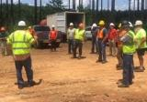
Special Emphasis Program
Construction
FFY 2022—3rd Qtr.
 | North Carolina |  |  |  | National Average |  |  |  | North Carolina vs. National Average
 | CY 2019 |  | CY 2020 |  | CY 2019 |  | CY 2020 |  | 2020 Comparison
TRC | 1.6 | 20% Increase |  | 2.0 | 2.8 | 11% Decrease |  | 2.5 | 20% Lower
DART | 0.8 | 20% Increase |  | 1.0 | 1.7 | 6% Decrease |  | 1.6 | 37% Lower
SEP ACTIVITY | 1st Qtr. | 2nd Qtr. | 3rd Qtr. | Total | FFY Goal
Compliance Inspections | 253 | 269 | 244 | 766 | 1,050
Consultative Visits | 99 | 107 | 107 | 313 | 250
OSH Outreach Events (10- and 30- Hour Construction Courses) | 3 | 2 | 1 | 6 | 6
People Trained | 185 | 83 | 317 | 585 | 1,000

Slide 9
Special Emphasis Program
Logging and Arboriculture
FFY 2022—3rd Qtr.
56173 | North Carolina |  |  |  | National Average |  |  |  | North Carolina vs. National Average
 | CY 2019 |  | CY 2020 |  | CY 2019 |  | CY 2020 |  | 2020 Comparison
TRC | 3.9 | 36% Decrease |  | 2.5 | 3.9 | 23% Decrease |  | 3.0 | 17% Lower
DART | 1.6 | No Change |  | 1.6 | 2.5 | 20% Decrease |  | 2.0 | 20% Lower
SEP ACTIVITY | 1st Qtr. | 2nd Qtr. | 3rd Qtr. | Total | FFY Goal
Compliance Inspections | 5 | 5 | 7 | 17 | 25
Consultative Visits | 3 | 1 | 10 | 14 | 15
OSH Training and Outreach Events | 1 | 5 | 3 | 9 | 3
People Trained | 9 | 125 | 121 | 246 | 75
NAICS 11331*—LOGGING | FFY 2021 |  | 1st Qtr. | 2nd Qtr. | 3rd Qtr. | Total
Total Fatalities | 1 |  | 0 | 0 | 0 | 0
NAICS 56173—ARBORICULTURE | FFY 2021 |  | 1st Qtr. | 2nd Qtr. | 3rd Qtr. | Total
Total Fatalities | 5 |  | 0 | 1 | 0 | 1
FFY 2021 4th Qtr. Combined Fatality Rate |  |  |  | 0.0070
* TRC/DART Data not available

Slide 10
Special Emphasis Program
Long Term Care Facilities
FFY 2022—3rd Qtr.
NAICS 623*—LONG TERM CARE
 | North Carolina |  |  |  | National Average |  |  |  | North Carolina vs. National Average
 | CY 2019 |  | CY 2020 |  | CY 2019 |  | CY 2020 |  | 2020 Comparison
TRC | 5.0 | 46% Increase |  | 9.3 | 5.9 | 49% Increase |  | 11.5 | 29% Lower
DART | 3.4 | 53% Increase |  | 7.2 | 3.5 | 62% Increase |  | 9.3 | 23% Lower
*TRC/DART rate based on the 3-digit NAICS code
SEP ACTIVITY | 1st Qtr. | 2nd Qtr. | 3rd Qtr. | Total | FFY Goal
Compliance Inspections | 15 | 4 | 9 | 28 | 24
Consultative Visits | 6 | 9 | 16 | 31 | 35
OSH Outreach Events | 0 | 0 | 1 | 1 | 2
People Trained | 0 | 0 | 8 | 8 | 40

Slide 11
Special Emphasis Program
Health Hazards
FFY 2022—3rd Qtr.
COMPLIANCE INSPECTIONS | 1st Qtr. | 2nd Qtr. | 3rd Qtr. | Total | FFY Goal
Silica | 6 | 18 | 12 | 36 | 60
Asbestos | 1 | 6 | 10 | 17
Isocyanates | 1 | 5 | 7 | 13
Lead | 1 | 3 | 2 | 6
Hexavalent Chromium | 1 | 2 | 1 | 4
Total | 9* | 34* | 33* | 69*
Program Improvements | 4 | 14 | 8 | 26 | 20
*Some inspections involved more than one health hazard and generally included a program improvement
NCDOL Photo Library

Slide 12

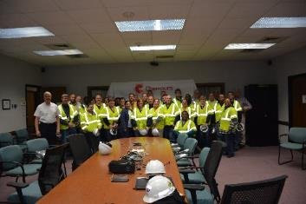
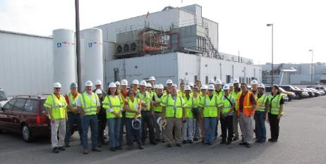
Special Emphasis Program
Health Hazards
FFY 2022—3rd Qtr.
COMPLIANCE INSPECTION RESULTS
HEALTH HAZARDS | Number of Samples (Detectable Results) |  |  |  | Number With Overexposures |  |  |  | Average Severity Rate*
 | 1st Qtr. | 2nd Qtr. | 3rd Qtr. | Total | 1st Qtr. | 2nd Qtr. | 3rd Qtr. | Total | 1st Qtr. | 2nd Qtr. | 3rd Qtr.
Silica | 1 | 14 | 3 | 18 | 0 | 0 | 1 | 1 | 0.79 | 0.28 | 0.91
Asbestos | 0 | 0 | 0 | 0 | 0 | 0 | 0 | 0 | 0 | 0 | 0
Isocyanates | 0 | 0 | 0 | 0 | 0 | 0 | 0 | 0 | 0 | 0 | 0
Lead | 0 | 0 | 0 | 0 | 0 | 0 | 0 | 0 | 0 | 0 | 0
Hexavalent Chromium | 1 | 0 | 2 | 3 | 0 | 0 | 0 | 0 | 0.01 | 0 | 0.03
Total | 2 | 14 | 5 | 21 | 0 | 0 | 1 | 1 | NA | NA | NA
NCDOL Photo Library
* All Samples

Slide 13








Special Emphasis Program
Health Hazards
FFY 2022—3rd Qtr.
HEALTH HAZARDS | Consultative Surveys
 | 1st Qtr. | 2nd Qtr. | 3rd Qtr. | Total
Silica | 30 | 30 | 24 | 84
Asbestos | 3 | 5 | 6 | 14
Isocyanates | 2 | 3 | 2 | 7
Lead | 12 | 3 | 7 | 22
Hexavalent Chromium | 3 | 3 | 2 | 8
Total | 50 | 44 | 41 | 135
FFY Goal | 125
NCDOL Photo Library
NCDOL Photo Library
SEP ACTIVITY | 1st Qtr. | 2nd Qtr. | 3rd Qtr. | Total | FFY Goal
OSH Outreach Events | 7 | 3 | 3 | 13 | 20
People Trained | 76 | 59 | 41 | 176 | 300

Slide 14
Special Emphasis Program
Food Manufacturing
FFY 2022—3rd Qtr.
NAICS 311*—FOOD MANUFACTURING
 | North Carolina |  |  |  | National Average |  |  |  | North Carolina vs. National Average
 | CY 2019 |  | CY 2020 |  | CY 2019 |  | CY 2020 |  | 2020 Comparison
TRC | 2.9 | 24% Increase |  | 3.8 | 4.0 | 22% Increase |  | 5.1 | 25% Lower
DART | 2.1 | 30% Increase |  | 3.0 | 2.8 | 28% Increase |  | 3.9 | 23% Lower
*TRC/DART rate based on the 3-digit NAICS code
SEP ACTIVITY | 1st Qtr. | 2nd Qtr. | 3rd Qtr. | Total | FFY Goal
Compliance Inspections | 7 | 9 | 14 | 33 | 25
Consultative Visits | 4 | 9 | 5 | 18 | 12
OSH Outreach Events | 0 | 1 | 1 | 2 | 2
People Trained | 0 | 9 | 52 | 61 | 40

Slide 15
Special Emphasis Program
Grocery and Related Product Wholesalers
FFY 2022—3rd Qtr.
NAICS 4244*—GROCERY AND RELATED WHOLESALERS
 | North Carolina |  |  |  | National Average |  |  |  | North Carolina vs. National Average
 | CY 2019 |  | CY 2020 |  | CY 2019 |  | CY 2020 |  | 2020 Comparison
TRC | 5.2 | 23% Decrease |  | 4.1 | 4.8 | 2% Increase |  | 4.9 | 16% Lower
DART | 4.0 | 22% Decrease |  | 3.1 | 3.7 | 7% Increase |  | 4.0 | 22% Lower
*DART/TRC rate based on the 4-digit NAICS code
SEP ACTIVITY | 1st Qtr. | 2nd Qtr. | 3RD Qtr. | Total | FFY Goal
Compliance Inspections | 7 | 6 | 4 | 17 | 20
Consultative Visits | 1 | 1 | 0 | 2 | 3
OSH Outreach Events | 0 | 1 | 0 | 1 | 2
People Trained | 0 | 9 | 0 | 9 | 40

Slide 16


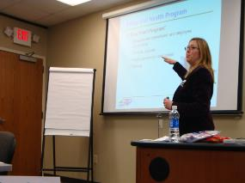
Special Emphasis Program
Amputations
FFY 2022—3rd Qtr.
SEP ACTIVITY | 1st Qtr. | 2nd Qtr. | 3rd Qtr. | Total | FFY Goal
Compliance Inspections | 50 | 34 | 38 | 122 | 150
Consultative Visits | 34 | 41 | 41 | 102 | 100
OSH Outreach Events | 11 | 15 | 6 | 32 | 15
People Trained | 139 | 296 | 118 | 563 | 400

Slide 17
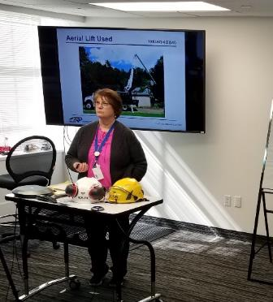
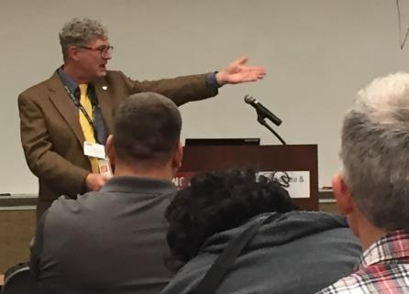

OSH Division
Public Sector
FFY 2022—3rd Qtr.
 | CY 2019 |  | CY 2020
TRC | 3.6 | 14% Increase |  | 4.2
DART | 2.1 | 16% Increase |  | 2.5
ACTIVITY | 1st Qtr. | 2nd Qtr. | 3rd Qtr. | Total | FFY Goal
Compliance Inspections | 17 | 24 | 34 | 75 | 100
Consultative Visits | 75 | 48 | 84 | 206 | 210
OSH Outreach Events/Booths | 1 | 11 | 7 | 19 | 6
Trained | 46 | 410 | 184 | 640 | 600

Slide 18
OSH Division
Education and Training Outreach
FFY 2022—3rd Qtr.
OUTREACH EVENT | 1st Qtr. | 2nd Qtr. | 3rd Qtr. | Total | FFY Goal
General Industry—10-Hour Course | 2 | 2 | 0 | 4 | 4
General Industry—30-Hour Course | 1 | 1 | 0 | 2 | 1
NC #500/502—Construction Train-the-Trainer Course/ NC #501/503—General Industry Train-the-Trainer Course | 0 | 0 | 0 | 0 | 1
Construction—10-Hour Course | 2 | 1 | 1 | 4 | 5
Construction—30-Hour Course | 1 | 1 | 0 | 2 | 1
Labor One/Booth Events | 2 | 1 | 2 | 5 | NA
Speaker’s Bureau | 19 | 23 | 22 | 64 | NA
Webinars | 7 | 20 | 27 | 54 | NA
OSH Workshops | 0 | 0 | 2 | 2 | NA
Technical Assistance | 6 | 9 | 4 | 19 | NA
Spanish Training and Outreach Events | 0 | 0 | 0 | 0 | NA
Train-the-Trainer Program (Construction/General Industry)—Events | 3 | 1 | 4 | 8 | NA
Train-the-Trainer Program (Construction/General Industry)—Trained | 35 | 5 | 37 | 77 | NA

Slide 19
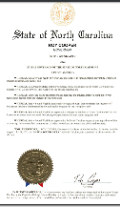
OSH Division
Education and Training Outreach
FFY 2022—3rd Qtr.
Stand Downs/Forums
Stand Up 4 Grain Safety Week (April 4 - 8)
Fall Prevention Stand-Down (May 2 - 6) – 452 Attendees (Webinars and Labor One Events)
Construction Forum (May 18) – 25 Attendees
Heat Illness Prevention (All Summer)
Trench Safety Stand-Down (June 13 - 17) – 15 Attendees (Webinars)
Safe + Sound (August 15 - 21) – 19 Attendees (Webinars)

Slide 20
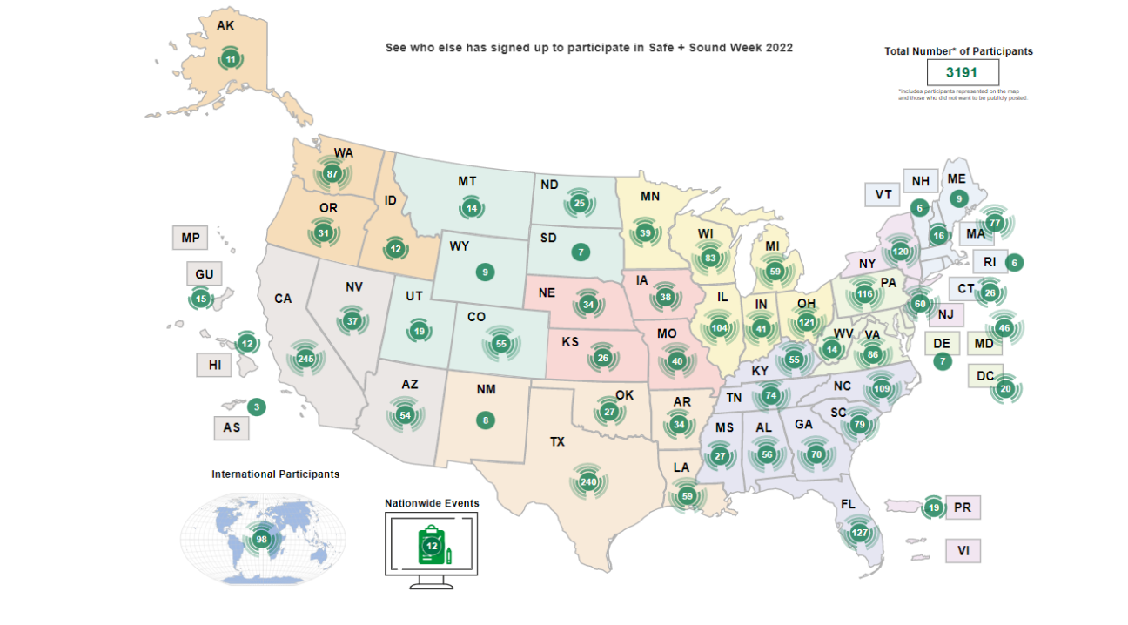
OSH Division
Education and Training Outreach
FFY 2022—3rd Qtr.

Slide 21
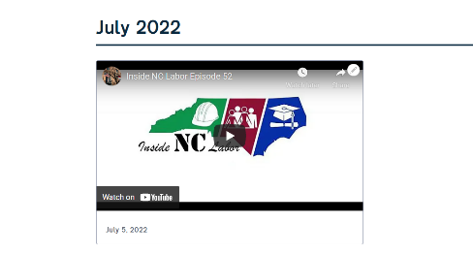


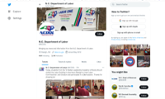
OSH Division
Social Media
FFY 2022—3rd Qtr.
Inside NC Labor Podcasts
52 episodes
Facebook
2,081 followers
Instagram
656 followers
Twitter
2,142 followers

Slide 22
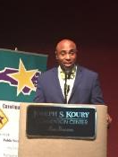

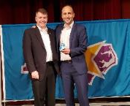
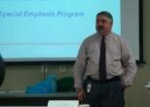

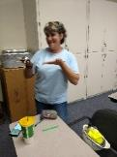

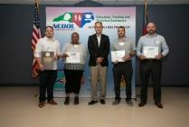
OSH Division
Recognition Programs
FFY 2022—3rd Qtr.
*Cumulative Total
STAR SITES—New, Recertification, Promotion | 1st Qtr. | 2nd Qtr. | 3rd Qtr. | Total | FFY Goal | Approved Star Sites*
Carolina Star | 5 | 1 | 6 | 12 |  | 102
Building Star | 2 | 1 | 2 | 5 |  | 24
Rising Star | 0 | 0 | 1 | 1 |  | 4
Public Sector Star | 0 | 1 | 1 | 2 |  | 19
Total | 7 | 3 | 10 | 20 | 20 | 149
NCDOL Photo Library
 | 1st Qtr. | 2nd Qtr. | 3rd Qtr. | Total | FFY Goal
Star Sites—Termination/Withdrawn | 1 | 0 | 1 | 2
Star Booths | 0 | 0 | 2 | 2
Star Presentations | 5 | 6 | 4 | 15 | 10
Star Program Interventions | 29 | 41 | 52 | 122 | 100
Notes:
Withdrew: Emerson Automation Solutions – work site closed

Slide 23



OSH Division
Recognition Programs
FFY 2022—3rd Qtr.
SHARP SITES—New/Renewal | 1st Qtr. | 2nd Qtr. | 3rd Qtr. | Total | FFY Goal | Approved SHARP Sites*
SHARP—Construction | 1 | 0 | 2 | 3 |  | 6
SHARP—General Industry | 15 | 14 | 19 | 48 |  | 103
SHARP—Public Sector | 9 | 9 | 0 | 18 |  | 49
Totals | 25 | 23 | 21 | 69 | 60 | 158
*Cumulative Total
GOLD STAR GROWERS—NEW | 1st Qtr. | 2nd Qtr. | 3rd Qtr. | Total
 | 29 | 202 | 45 | 276
SAFETY AWARDS |  |  |  | Total
CY 2022 Safety Awards Season* (Silver, Gold, Million Hour) |  |  |  | 2,132
 | 1st Qtr. | 2nd Qtr. | 3rd Qtr. | Total
Million Hour Awards | 9 | 36 | 3 | 48
*CY 2022 Preliminary numbers
Notes:
2022 Safety Award Season reverting to normal schedule and may be a hybrid of virtual and in-person.

Slide 24


OSH Division
Alliances and Partnerships
FFY 2022—3rd Qtr.
Alliances
Carolinas AGC
Lamar Advertising Company
Mexican Consulate
N.C. State – Industry Expansion Solutions
Safety and Health Council of NC
NUCA of the Carolinas
NCALGESO
Tree Care Industry Association (Signing 11/10/2022)

Slide 25
OSH Division
Alliances and Partnerships
FFY 2022—3rd Qtr.
Partnerships
Barringer Construction
Charlotte - Foundry Building Including Ancillary Buildings (2020 – 2023)
Holder – Edison Foard – Leeper, A Joint Venture
Charlotte - Charlotte Douglas International Airport – Terminal Lobby Expansion (2021 – 2023)
Jacobs Engineering Group
Holly Springs - Biotech Manufacturing Facility and Campus (2022 – 2024)

Slide 26
OSH Division
Complaint Desk*
FFY 2022—3rd Qtr.
East Compliance | West Compliance | Agricultural Safety and Health
ACTIVITY | 1st Qtr. | 2nd Qtr. | 3rd Qtr. | 1st Qtr. | 2nd Qtr. | 3rd Qtr. | 1st Qtr. | 2nd Qtr. | 3rd Qtr. | Cumulative Total | FFY 2021
Complaints | 319 | 395 | 419 | 365 | 521 | 437 | 3 | 7 | 6 | 2,472 | 4,321
Referrals | 79 | 77 | 94 | 98 | 91 | 117 | 8 | 0 | 10 | 574 | 743
Fat/Cat | 21 | 36 | 19 | 29 | 20 | 22 | 2 | 1 | 2 | 152 | 227
Totals | 419 | 508 | 532 | 492 | 632 | 576 | 13 | 8 | 18 | 3,198 | 5,291
*598 of the total were COVID-related.
**Includes calls that were processed but not necessarily inspected. Fat/Cat includes calls regarding heart attacks and other natural causes.
ACTIVITY | 1st Qtr. | 2nd Qtr. | 3rd Qtr. | Cumulative Total | FFY 2021
Complaints Not in OSH Jurisdiction* | 824 | 919 | 1,078 | 2,821 | 3,232
*Includes complaints related to wage and hour, discrimination, worker's compensation questions, beyond statute of limitation time frame, etc.

Slide 27
OSH Division
Cut-Loose, In-Training, Vacant
FFY 2022—3rd Qtr.
West Compliance | Safety | % | Industrial Hygienist | %
Cut Loose | 17 | 58% | 22 | 85%
In-Training | 4 | 14% | 1 | 4%
Vacant | 8 | 28% | 3 | 11%
Total | 29 |  | 26
East Compliance | Safety | % | Industrial Hygienist | %
Cut Loose | 11 | 48% | 4 | 24%
In-Training | 4 | 17% | 5 | 29%
Vacant | 8 | 35% | 8 | 47%
Total | 23 |  | 17
Safety Cut Loose | 54% | Health Cut Loose | 60%
Safety In-Training | 15% | Health in-Training | 14%
Safety Vacant | 31% | Health Vacant | 26%

Slide 28
OSH Division
Cut-Loose, In-Training, Vacant
FFY 2022—3rd Qtr.
Consultative Services | Safety | % | Industrial Hygienist | %
Cut Loose | 8 | 73% | 8 | 100%
In-Training | 1 | 9% | 0 | 0%
Vacant | 2 | 18% | 0 | 0%
Total | 11 |  | 8
Education, Training and Technical Assistance | Safety | % | Industrial Hygienist | %
Cut Loose | 10 | 91% | 5 | 83%
In-Training | 1 | 9% | 0 | 0%
Vacant | 0 | 0% | 1 | 17%
Total | 11 |  | 6
Agricultural Safety and Health | Safety | % | Industrial Hygienist
Cut Loose | 5 | 63% | NA
In-Training | 2 | 25% | NA
Vacant | 1 | 13% | NA
Total | 8

Slide 29
OSH Division
Internal Training
FFY 2022—3rd Qtr.
1st Qtr.—COURSE
In-Person | No. of Events | Trained
OCSS Confined Space Entry | 2 | 17
OCSS Excavation and Trenching | 1 | 9
Labor One Driver Training | 4 | 5
Virtual | No. of Events | Trained
Combustible Dust | 1 | 82
Engineering Controls | 1 | 47
10-Hour General Industry Awareness Course | 1 | 3
Total Trained |  | 163

Slide 30
OSH Division
Internal Training
FFY 2022—3rd Qtr.
2nd Qtr.—COURSE
In Person | No. of Events | Trained
Labor One Training | 3 | 4
Virtual | No. of Events | Trained
# 100 Initial Compliance Course | 1 | 13
Technical Writing | 1 | 11
OSHA Express | 1 | 12
Legal Aspects | 1 | 11
Logging SEP | 1 | 16
Food Manufacturing SEP | 1 | 1
Grocery and Related Product Wholesalers | 1 | 2
Bloodborne Pathogens | 1 | 1
Total Trained |  | 71

Slide 31


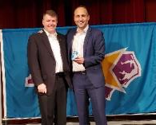
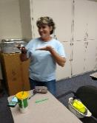
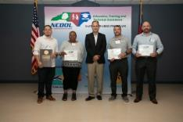



OSH Division
Internal Training
FFY 2022—3rd Qtr.
3rd Qtr.—COURSE
In Person | No. of Events | Trained
OSH #125 Health Standards Course | 1 | 7
OCSS Excavation and Trenching | 1 | 12
Labor One Training | 1 | 4
Virtual | No. of Events | Trained
Grocery SEP | 1 | 16
Electrical Safety | 1 | 39
Total Trained |  | 78

Slide 32
OSH Division
Standards Section—Revisions
FFY 2022—3rd Qtr.
Brochure
Labor One
Compliance Directive
CPL 02-00-051—Enforcement Exemptions and Limitations Under the Appropriations Act
Appendix A was updated and effective on the date of the memorandum until the next revision.

Slide 33
OSH Division
New Rules
FFY 2022—3rd Qtr.
Heat Stress
Working on a standard for General Industry and Construction, and a separate one for Agriculture.
Penalty Increases
Effective October 1, 2022.
Revised NCGS 95-138 – Penalties adjusted annually in accordance with Consumer Price Index.
Statute of Limitations
Effective October 1, 2022.
Revised NCGS 95-137(b)(3) – “No citation may be issued under this section after the expiration of six months following the initiation of an inspection by the Director.”
Notes:
Was “”occurrence of any violation”.

Slide 34
OSH Division
Management Changes
FFY 2022—3rd Qtr.
Scott Mabry – NCDOL Chief of Staff (8/1/22). Previously served as the Asst.
Deputy Commissioner/Asst. OSH Division: oversaw the Compliance Bureaus
including Agricultural Safety and Health.
Jennifer Haigwood – Deputy Commissioner / Director, OSH Division (10/1/22). Has
nearly 17 years of experience with the department; most recently as the Director
of Communications.
Paul Sullivan – Assistant Director, Occupational Safety and Health Division (8/1/22).
Paul has nearly 29 years of experience with NCDOL and previously served as the
OSH Division’s West Compliance Bureau Chief. Paul will be based in Charlotte.
Lee Peacock – OSH West Compliance Bureau Chief (8/1/22). Lee was a former CSHO
and most recently served as the District 2 Compliance Supervisor based out of
Charlotte.
Erin Wilson – Director of Communications (9/1/22). Erin started with NCDOL in
January 2021 as Legislative Liaison and later moved to the Communications Division
as a Public Information Officer.

Slide 35
OSH Division
Retaliatory Employment Discrimination
FFY 2022—3rd Qtr.
Bureau Staffing
Jaleesa Thomas | Information Officer
Norma Velasco | Administrative Assistant II
James Agosto | Investigator
David Bailey | Investigator
Dianne Daniels | Investigator
Vacant | Investigator
Erin Smith | Investigator
Theodore Place | Investigator
Alvin Vocalan | Investigator
Harriet Hopkins | Administrator

Slide 36
OSH Division
Retaliatory Employment Discrimination
FFY 2022—3rd Qtr.
OSH Complaint Statistics | 1st Qtr. | 2nd Qtr. | 3rd Qtr. | Total
Total OSH Complaints Filed | 64 | 59* | 82¹ | 205
Total OSH Complaints Closed | 68 | 75** | 65² | 208
Number of OSH Cases Closed Within 90 Days of File Date | 2 | 3*** | 0 | 5
Percentage of Cases Closed Within 90 Days of File Date | 4%* | 6%*** | 0% | NA
Of Cases Closed, Average Number of Elapsed Days Between File Date and Closed Date | 288* | 279 | 266³ | NA
Total Number of OSH Complaints Pending at End of Reporting Period | 103** | 100**** | 118⁴ | NA
Percentage of Pending OSH Complaints Over 90 Days Old (From Filing) | 69% | 71% (71/100) | 47% | NA
Average Number of Elapsed Days Since Filing Date of All OSH Cases Pending at End of the Reporting Period | 230* | 269 | 111⁵ | NA
¹Includes 28 Section 11(c) complaints (82-18=64
²Includes 38 OSH and 27 Administrative closures of Section 11(c) complaints
³WB State Report: 286
⁴WB State Report: 141
⁵WB State Report: 190

Slide 37
OSH Division
Retaliatory Employment Discrimination
FFY 2022—3rd Qtr.
OSH Complaint Disposition | 1st Qtr. | 2nd Qtr. | 3rd Qtr. | Total
Administrative Closure (REDB Opened in OnBase and Docketed in IMIS) | 24 | 24 | 27 | 75
Withdrawn (Includes Requested RTS Letters) | 10 | 9 | 7 | 26
Merit (Included in SAMM 15 Merit) | 4 | 10 | 5 | 19
Total SAMM 15 Merit | 12 | 17 | 7 | 36
Total SAMM 15 Percent Merit (12/42) | 27% | 33% (17/51- No AC) | 18% | NA
Dismissal Right-to-Sue (Includes No Merit and Unresponsive) | 22 | 25 | 24 | 71
Settled Other (Included in SAMM 15) | 8 | 7 | 2 | 17
Total Cases Closed by Disposition | 68 | 75 (51 + 24 AC) | 65⁶ | 208
TOTAL DAMAGES PAID This Quarter (Includes Settlements With Aid of the Bureau During Informal Discussions or Mediation.) | $96,648 | $38,000 | $10,000⁷ | $144,648
⁶28 closures were administrative closures of Section 11(c) cases; Balance is 38 closures.
⁷I cannot find discrepancy with Onbase ($10,000) and WB State Summary Report ($18,000). It may have to do with a case that was closed in one quarter, but the settlement was paid in another.

Slide 38
OSH Division
COVID-19 Activities
FFY 2020—2022
Calls/Emails | FFY 2020* | FFY 2021** | FFY 2022*** | FFY 2020-22
Director's Office | 2,143 | 1,581 | 986 | 4,710
ETTA | 1,347 | 623 | 515 | 2,720
ASH | 341 | 529 | 192 | 1,062
PSIM | 11 | 0 | 0 | 11
CSB | 1,084 | 440 | 241 | 1,765
Totals | 4,926 | 3,173 | 1,934 | 10,033
*FFY 2020 includes data from March 1 (estimated), 2020 through October 2, 2020.
**FFY 2021 includes data from October 2, 2020, through October 3, 2021.
***FFY 2022 includes data from October 4, 2021, through June 30, 2022..

Slide 39
OSH Division
COVID-19 Activities
FFY 2020—2022
Director’s Office | FFY 2020* | FFY 2021** | FFY 2022*** | FFY 2020-22
Meetings | 102 | 93 | 49 | 244
Compliance | FFY 2020* | FFY 2021** | FFY 2022*** | FFY 2020-22
Valid Complaints | 1,012 | 1,325 | 425 | 2,762
Non-Valid Complaints | 1,402 | 1,141 | 171 | 2,715
Inspections | 22 | 114 | 33 | 169
Referrals | 51 | 45 | 24 | 120
Unprocessed Complaints**** | 1,107 | 595 | 155 | 1,857
*FFY 2020 includes data from March 1 (estimated), 2020 through October 2, 2020.
**FFY 2021 includes data from October 2, 2020, through October 3, 2021.
***FFY 2022 includes data from October 4, 2021, through June 30, 2022..
****This data is preliminary and subject to change as unprocessed complaints are moved to other categories. Many of these unprocessed complaints contain insufficient information to process and/or they cover complaint items that do not fall under OSH jurisdiction. Referrals to other Agencies are made, as appropriate.
.

Slide 40
OSH Division
COVID-19 Activities
FFY 2020—2022
PSIM | FFY 2020* | FFY 2021** | FFY 2022*** | FFY 2020-22
Disclosure Requests | 1,627 | 1,418 | 50 | 3,095
CSB | FFY 2020* | FFY 2021** | FFY 2022*** | FFY 2020-22
Interventions | 54 | 30 | 9 | 93
Visits | 157 | 367 | 240 | 764
ASH | FFY 2020* | FFY 2021** | FFY 2022*** | FFY 2020-22
Guidance Documents | 1 | 0 | 0 | 1
*FFY 2020 includes data from March 1 (estimated), 2020 through October 2, 2020.
**FFY 2021 includes data from October 2, 2020, through October 3, 2021.
***FFY 2022 includes data from October 4, 2021, through June 30, 2022..

Slide 41
OSH Division
COVID-19 Activities
FFY 2020—2022
ETTA | FFY 2020* | FFY 2021** | FFY 2022*** | FFY 2020-22
Live Webinars | 28 | 19 | 1 | 48
Pre-recorded Webinars | 6 | 1 | 0 | 7
PowerPoints | 25 | 12 | 1 | 38
Hazard Alerts | 7 | 2 | 0 | 9
Streaming Videos | 72 | 62 | 14 | 148
A-Z Topics Added/Updated | 24 | 26 | 7 | 57
Fact Sheets | 4 | 9 | 0 | 13
Example Programs | 1 | 2 | 0 | 3
Compliance Memos | 10 | 3 | 3 | 16
Billboards | 0 | 5 | 0 | 5
*FFY 2020 includes data from March 1 (estimated), 2020 through October 2, 2020.
**FFY 2021 includes data from October 2, 2020, through October 3, 2021.
***FFY 2022 includes data from October 4, 2021, through June 30, 2022..

Slide 42
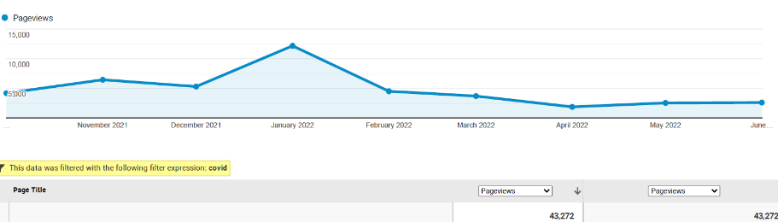
OSH Division
COVID-19 Activities
FFY 2020—2022
COVID-19 Safety and Health Topic Page
FFY 2020
FFY 2021
FFY 2022
Total: 104,315

Slide 43

Thank You For Attending!
FFY 2022—3rd Qtr.
Questions?
1-800-NC-LABOR
(1-800-625-2267)
www.labor.nc.gov
Notes:
43

