Slide 1
North Carolina Department of Labor
Occupational Safety & Health Division
2nd Quarter Report
Federal Fiscal Year 2022*
Presented by:
Wanda Lagoe
Education, Training and Technical Assistance
Occupational Safety and Health Division of North Carolina
*Preliminary Data
Notes:
The information in this presentation is provided voluntarily by the N.C. Department of Labor, Education Training and Technical Assistance Bureau as a public service and is made available in good faith. This presentation is designed to assist trainers conducting OSHA outreach training for workers. Since workers are the target audience, this presentation emphasizes hazard identification, avoidance, and control – not standards. No attempt has been made to treat the topic exhaustively. It is essential that trainers tailor their presentations to the needs and understanding of their audience.
The information and advice provided on this Site and on Linked Sites is provided solely on the basis that users will be responsible for making their own assessment of the matters discussed herein and are advised to verify all relevant representations, statements, and information.
This presentation is not a substitute for any of the provisions of the Occupational Safety and Health Act of North Carolina or for any standards issued by the N.C. Department of Labor. Mention of trade names, commercial products, or organizations does not imply endorsement by the N.C. Department of Labor.

Slide 2
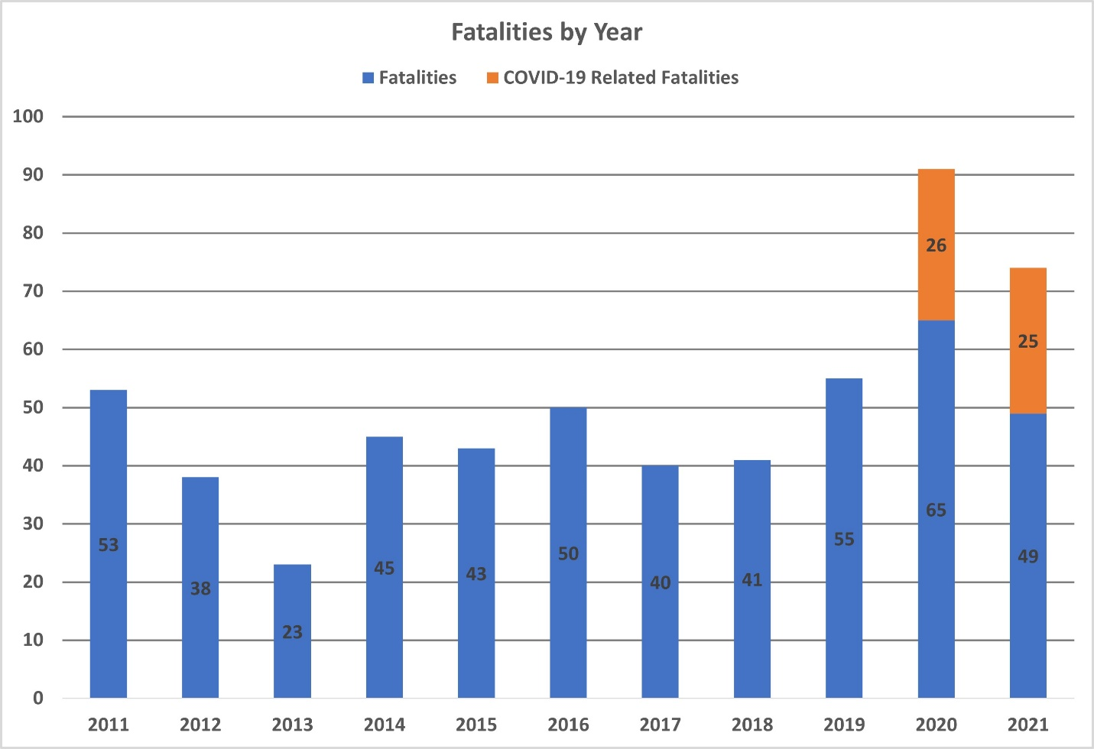
N.C. Workplace Safety and Health
Work-Related Fatalities in North Carolina
FFY 2022—2nd Qtr.
Calendar Year

Slide 3
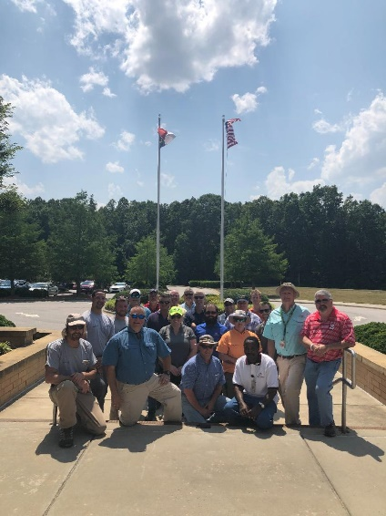
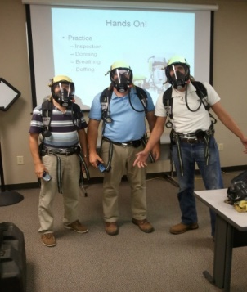
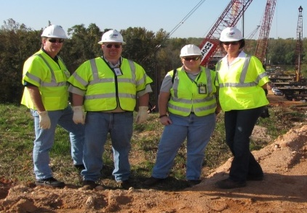
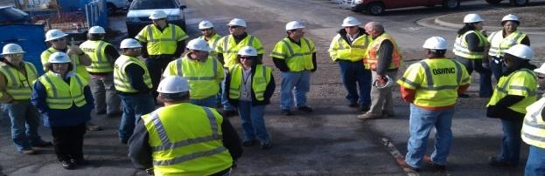
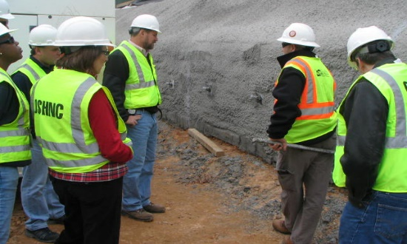
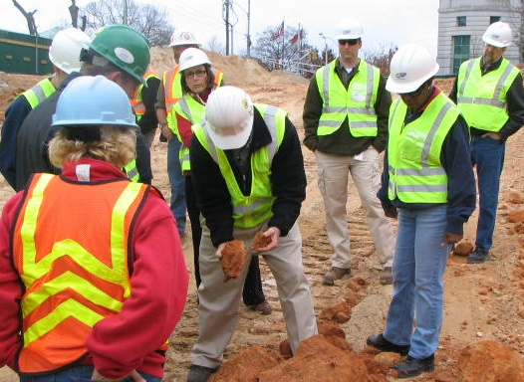
N.C. Workplace Safety and Health
OSH Division—Fatalities Inspected
FFY 2022—2nd Qtr.
FATALITY TYPE | 1st Qtr. | 2nd Qtr. | Total | FATALITY TYPE | 1st Qtr. | 2nd Qtr. | Total
Struck By | 2 | 4 | 6 | Inhalation | 0 | 0 | 0
Caught In/Between | 2 | 1 | 3 | Ingestion | 0 | 0 | 0
Bite/Sting/Scratch | 0 | 0 | 0 | Absorption | 0 | 0 | 0
Fall (Same Level) | 0 | 0 | 0 | Repeated Motion/Pressure | 0 | 0 | 0
Fall (From Elevation) | 1 | 2 | 3 | Cardio/Respiratory | 0 | 0 | 0
Struck Against | 0 | 0 | 0 | Shock | 1 | 2 | 3
Rubbed/Abraded | 0 | 0 | 0 | Other | 2 | 2 | 4
COVID-19 | 3 | 2 | 5 | Criminal Activity | 0 | 0 | 0
Fatalities Under OSH Division Jurisdiction
FFY 2021 |  | FFY 2022 | 1st Qtr. | 2nd Qtr. | Total
Total Fatalities | 90 | Fatalities | 11 | 13 | 24
NCDOL Photo Library

Slide 4
N.C. Workplace Safety and Health
OSH Division—Strategic Plan Goals
FFY 2022—2nd Qtr.
COMPLIANCE | 1st Qtr. | 2nd Qtr. | Total | FFY Goal
Safety Inspections | 315 | 256 | 571 | 1,145
Health Inspections | 154 | 217 | 371 | 755
Serious Hazards Eliminated | 715 | 662 | 1,377 | 4,100
Training and/or Program Violations | 136 | 133 | 269 | 1,050
CONSULTATION | 1st Qtr. | 2nd Qtr. | Total | FFY Goal
Serious Hazards Eliminated | 1,221 | 1,337 | 2,561 | 4,800
Private Sector and Public Sector Visits | 359 | 1,101 | 1,460 | 1,325
OSH DIVISION | 1st Qtr. | 2nd Qtr. | Total | FFY Goal
Program Improvements | 519 | 559 | 1,078 | 2,060
People Trained in Special Emphasis Program Areas | 1,161 | 1,385 | 2,546 | 3,200
People Trained at OSH Division Sponsored Events | 1,631 | 1,941 | 3,572 | 5,350

Slide 5
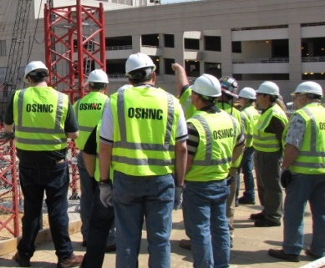
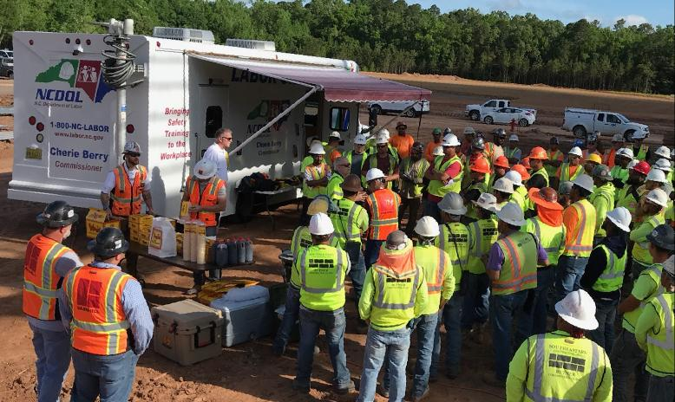
N.C. Workplace Safety and Health
OSH Division—Strategic Plan Goals
FFY 2022—2nd Qtr.
Education, Training and Technical Assistance (ETTA) | 1st Qtr. | 2nd Qtr. | Total | FFY Goal
Publications Distributed | 9,685 | 9,038 | 21,093 | 35,000
Standards Interpretations | 446 | 805 | 1,391 | NA
Agricultural Safety and Health (ASH) | 1st Qtr. | 2nd Qtr. | Total | FFY Goal
Outreach Materials Distributed | 309 | 3,951 | 4,260 | 2,400
Compliance Inspections | 20 | 0 | 20 | 50
Certificates Issued | 143 | 1,227 | 1,370 | 1,600
Preoccupancy Inspections | 210 | 1,333 | 1,543 | 1,800
NCDOL Photo Library

Slide 6
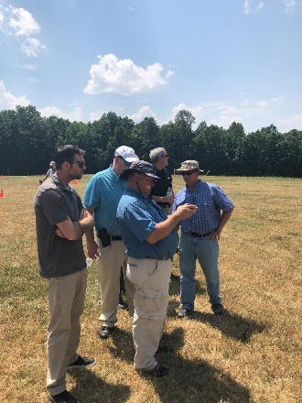
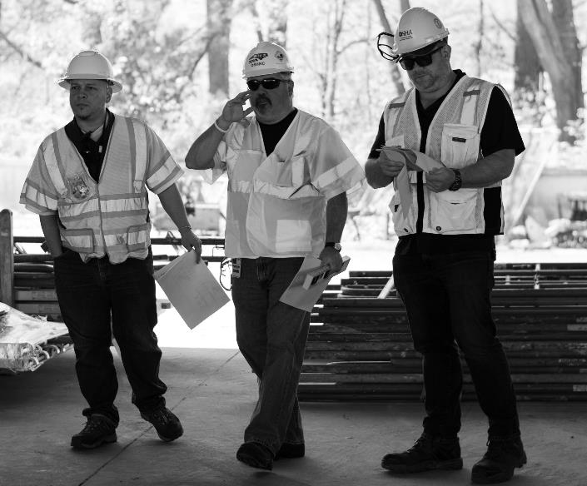
Strategic Plan
Special Emphasis Programs (SEP)
FFY 2022—2nd Qtr.
NCDOL Photo Library
Construction
Logging and Arboriculture
Long Term Care Facilities
Health Hazards
Food Manufacturing
Grocery and Related Product Wholesalers
Amputations

Slide 7
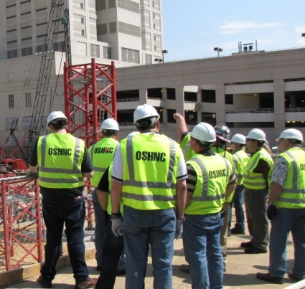
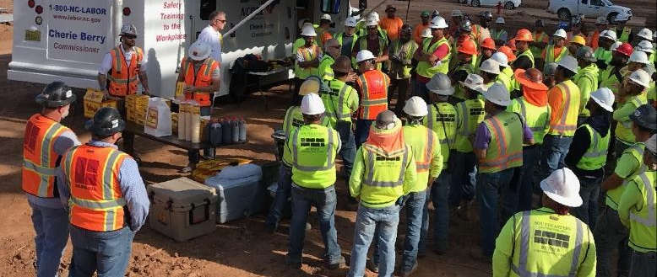
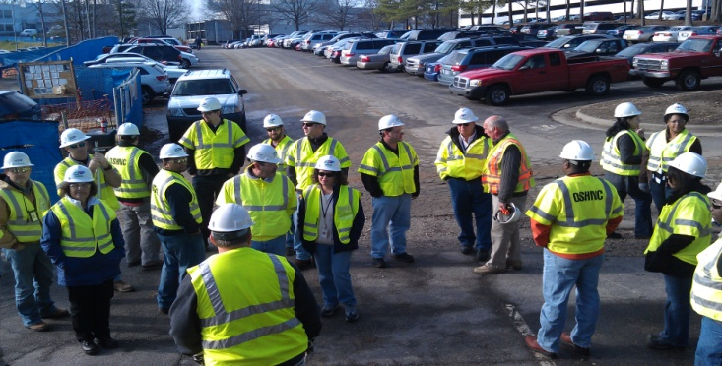
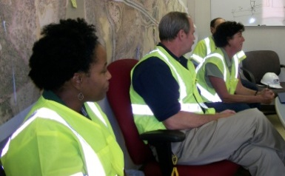
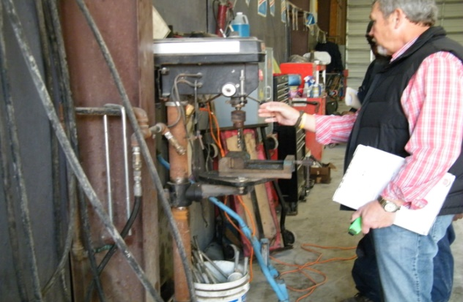
Special Emphasis Program
Construction
FFY 2022—2nd Qtr.
NAICS 23—CONSTRUCTION | FFY 2021 |  | 1st Qtr. | 2nd Qtr. | Total
Total Fatalities | 18 |  | 3 | 6 | 9
FFY 2021 4th Qtr. Fatality Rate | 0.0017
Fatality Type | 1st Qtr. | 2nd Qtr. | Total | Fatality Type | 1st Qtr. | 2nd Qtr. | Total
Struck By | 1 | 2 | 3 | Inhalation | 0 | 0 | 0
Caught In/Between | 0 | 0 | 0 | Ingestion | 0 | 0 | 0
Bite/Sting/Scratch | 0 | 0 | 0 | Absorption | 0 | 0 | 0
Fall (Same Level) | 0 | 0 | 0 | Repeated Motion/Pressure | 0 | 0 | 0
Fall (From Elevation) | 0 | 2 | 2 | Cardio/Respiratory | 0 | 0 | 0
Struck Against | 0 | 0 | 0 | Shock | 1 | 2 | 3
Rubbed/Abraded | 0 | 0 | 0 | Other | 1 | 0 | 1
Notes:
s
Will be posting a new billboard on the May 2022 fall prevention standdown and for heat stress.

Slide 8
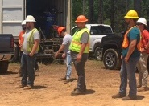
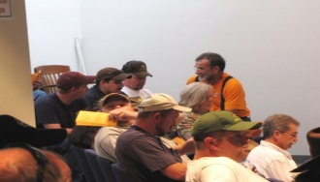
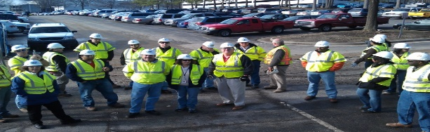
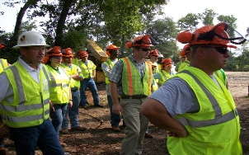
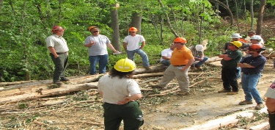
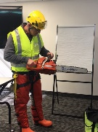
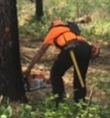

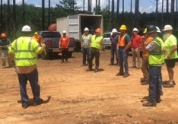
Special Emphasis Program
Construction
FFY 2022—2nd Qtr.
 | North Carolina |  |  |  | National Average |  |  |  | North Carolina vs. National Average
 | CY 2019 |  | CY 2020 |  | CY 2019 |  | CY 2020 |  | 2020 Comparison
TRC | 1.6 | 20% Increase |  | 2.0 | 2.8 | 11% Decrease |  | 2.5 | 20% Lower
DART | 0.8 | 20% Increase |  | 1.0 | 1.7 | 6% Decrease |  | 1.6 | 37% Lower
SEP ACTIVITY | 1st Qtr. | 2nd Qtr. | Total | FFY Goal
Compliance Inspections | 253 | 265 | 518 | 1,050
Consultative Visits | 98 | 105 | 203 | 250
OSH Outreach Events (10- and 30- Hour Construction Courses) | 3 | 2 | 5 | 6
People Trained | 185 | 83 | 268 | 1,000

Slide 9
Special Emphasis Program
Logging and Arboriculture
FFY 2022—2nd Qtr.
56173 | North Carolina |  |  |  | National Average |  |  |  | North Carolina vs. National Average
 | CY 2019 |  | CY 2020 |  | CY 2019 |  | CY 2020 |  | 2020 Comparison
TRC | 3.9 | 36% Decrease |  | 2.5 | 3.9 | 23% Decrease |  | 3.0 | 17% Lower
DART | 1.6 | No Change |  | 1.6 | 2.5 | 20% Decrease |  | 2.0 | 20% Lower
SEP ACTIVITY | 1st Qtr. | 2nd Qtr. | Total | FFY Goal
Compliance Inspections | 5 | 5 | 10 | 25
Consultative Visits | 3 | 1 | 4 | 15
OSH Training and Outreach Events | 1 | 5 | 6 | 3
People Trained | 9 | 125 | 134 | 75
NAICS 11331*—LOGGING | FFY 2021 |  | 1st Qtr. | 2nd Qtr. | Total
Total Fatalities | 1 |  | 0 | 0 | 0
NAICS 56173—ARBORICULTURE | FFY 2021 |  | 1st Qtr. | 2nd Qtr. | Total
Total Fatalities | 5 |  | 0 | 1 | 1
FFY 2021 4th Qtr. Combined Fatality Rate |  |  |  | 0.0070
* TRC/DART Data not available

Slide 10
Special Emphasis Program
Long Term Care Facilities
FFY 2022—2nd Qtr.
NAICS 623*—LONG TERM CARE
 | North Carolina |  |  |  | National Average |  |  |  | North Carolina vs. National Average
 | CY 2019 |  | CY 2020 |  | CY 2019 |  | CY 2020 |  | 2020 Comparison
TRC | 5.0 | 46% Increase |  | 9.3 | 5.9 | 49% Increase |  | 11.5 | 29% Lower
DART | 3.4 | 53% Increase |  | 7.2 | 3.5 | 62% Increase |  | 9.3 | 23% Lower
*TRC/DART rate based on the 3-digit NAICS code
SEP ACTIVITY | 1st Qtr. | 2nd Qtr. | Total | FFY Goal
Compliance Inspections | 15 | 4 | 19 | 24
Consultative Visits | 6 | 9 | 15 | 35
OSH Outreach Events | 0 | 0 | 0 | 2
People Trained | 0 | 0 | 0 | 40

Slide 11
Special Emphasis Program
Health Hazards
FFY 2022—2nd Qtr.
COMPLIANCE INSPECTIONS | 1st Qtr. | 2nd Qtr. | Total | FFY Goal
Silica | 6 | 17 | 23 | 60
Asbestos | 1 | 3 | 4
Isocyanates | 1 | 5 | 6
Lead | 1 | 3 | 4
Hexavalent Chromium | 1 | 2 | 3
Total | 10 | 30* | 40*
Program Improvements | 4 | 11 | 15 | 20
*Some inspections involved more than one health hazard and generally included a program improvement
NCDOL Photo Library

Slide 12
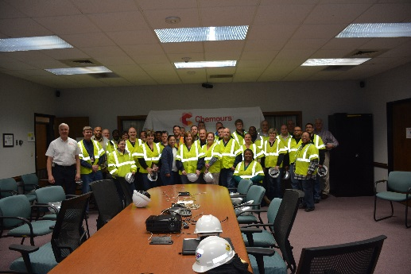
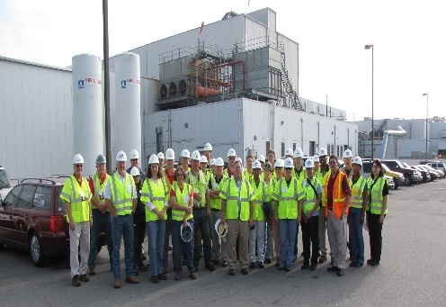
Special Emphasis Program
Health Hazards
FFY 2022—2nd Qtr.
COMPLIANCE INSPECTION RESULTS
HEALTH HAZARDS | Number of Samples (Detectable Results) |  |  | Number With Overexposures |  |  | Average Severity Rate*
 | 1st Qtr. | 2nd Qtr. | Total | 1st Qtr. | 2nd Qtr. | Total | 1st Qtr. | 2nd Qtr.
Silica | 1 | 14 | 15 | 0 | 0 | 0 | 0.79 | 0.28
Asbestos | 0 | 0 | 0 | 0 | 0 | 0 | 0 | 0
Isocyanates | 0 | 0 | 0 | 0 | 0 | 0 | 0 | 0
Lead | 0 | 0 | 0 | 0 | 0 | 0 | 0 | 0
Hexavalent Chromium | 1 | 0 | 1 | 0 | 0 | 0 | 0.01 | 0
Total | 2 | 14 | 16 | 0 | 0 | 0 | NA | NA
NCDOL Photo Library
* All Samples

Slide 13
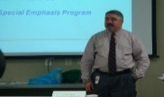

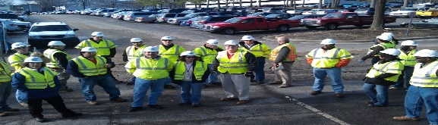

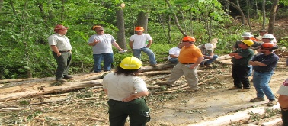
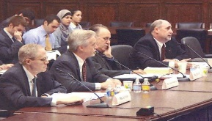


Special Emphasis Program
Health Hazards
FFY 2022—2nd Qtr.
HEALTH HAZARDS | Consultative Surveys
 | 1st Qtr. | 2nd Qtr. | Total
Silica | 30 | 23 | 53
Asbestos | 3 | 5 | 8
Isocyanates | 2 | 2 | 4
Lead | 12 | 3 | 15
Hexavalent Chromium | 3 | 3 | 6
Total | 50 | 36 | 86
FFY Goal | 125
NCDOL Photo Library
NCDOL Photo Library
SEP ACTIVITY | 1st Qtr. | 2nd Qtr. | Total | FFY Goal
OSH Outreach Events | 7 | 3 | 10 | 20
People Trained | 76 | 59 | 135 | 300

Slide 14
Special Emphasis Program
Food Manufacturing
FFY 2022—2nd Qtr.
NAICS 311*—FOOD MANUFACTURING
 | North Carolina |  |  |  | National Average |  |  |  | North Carolina vs. National Average
 | CY 2019 |  | CY 2020 |  | CY 2019 |  | CY 2020 |  | 2020 Comparison
TRC | 2.9 | 24% Increase |  | 3.8 | 4.0 | 22% Increase |  | 5.1 | 25% Lower
DART | 2.1 | 30% Increase |  | 3.0 | 2.8 | 28% Increase |  | 3.9 | 23% Lower
*TRC/DART rate based on the 3-digit NAICS code
SEP ACTIVITY | 1st Qtr. | 2nd Qtr. | Total | FFY Goal
Compliance Inspections | 7 | 9 | 16 | 25
Consultative Visits | 4 | 9 | 13 | 12
OSH Outreach Events | 0 | 1 | 1 | 2
People Trained | 0 | 9 | 9 | 40

Slide 15
Special Emphasis Program
Grocery and Related Product Wholesalers
FFY 2022—2nd Qtr.
NAICS 4244*—GROCERY AND RELATED WHOLESALERS
 | North Carolina |  |  |  | National Average |  |  |  | North Carolina vs. National Average
 | CY 2019 |  | CY 2020 |  | CY 2019 |  | CY 2020 |  | 2020 Comparison
TRC | 5.2 | 23% Decrease |  | 4.1 | 4.8 | 2% Increase |  | 4.9 | 16% Lower
DART | 4.0 | 22% Decrease |  | 3.1 | 3.7 | 7% Increase |  | 4.0 | 22% Lower
*DART/TRC rate based on the 4-digit NAICS code
SEP ACTIVITY | 1st Qtr. | 2nd Qtr. | Total | FFY Goal
Compliance Inspections | 7 | 8 | 18 | 20
Consultative Visits | 1 | 1 | 2 | 3
OSH Outreach Events | 0 | 1 | 1 | 2
People Trained | 0 | 9 | 9 | 40

Slide 16
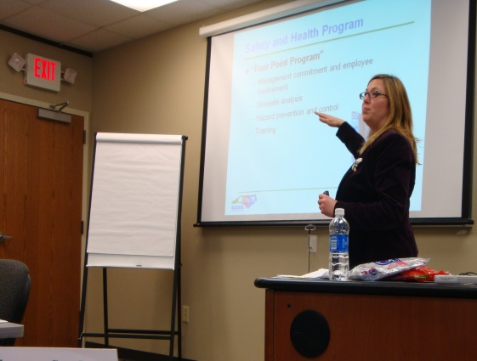
Special Emphasis Program
Amputations
FFY 2022—2nd Qtr.
SEP ACTIVITY | 1st Qtr. | 2nd Qtr. | Total | FFY Goal
Compliance Inspections | 50 | 34 | 84 | 150
Consultative Visits | 33 | 36 | 69 | 100
OSH Outreach Events | 11 | 15 | 26 | 15
People Trained | 139 | 296 | 435 | 400

Slide 17
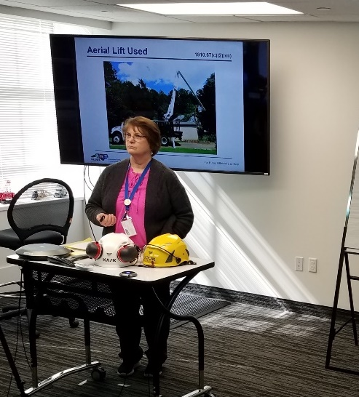
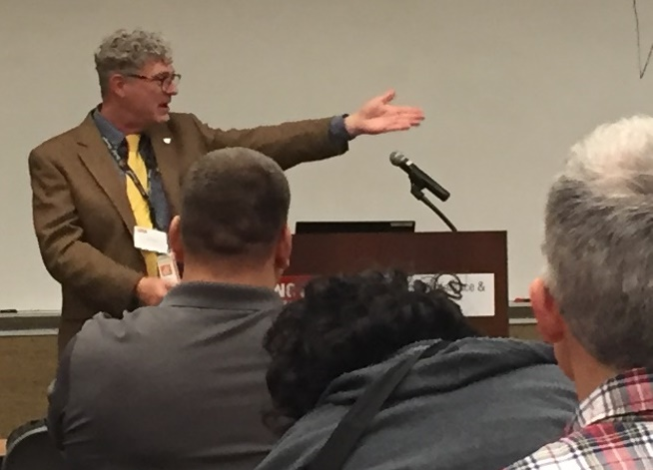
OSH Division
Public Sector
FFY 2022—2nd Qtr.
 | CY 2019 |  | CY 2020
TRC | 3.6 | 14% Increase |  | 4.2
DART | 2.1 | 16% Increase |  | 2.5
ACTIVITY | 1st Qtr. | 2nd Qtr. | Total | FFY Goal
Compliance Inspections | 17 | 25 | 42 | 100
Consultative Visits | 74 | 49 | 123 | 210
OSH Outreach Events/Booths | 1 | 11 | 12 | 6
Trained | 46 | 410 | 456 | 600

Slide 18
OSH Division
Education and Training Outreach
FFY 2022—2nd Qtr.
OUTREACH EVENT | 1st Qtr. | 2nd Qtr. | Total | FFY Goal
General Industry—10-Hour Course | 2 | 2 | 4 | 4
General Industry—30-Hour Course | 1 | 1 | 2 | 1
NC #500/502—Construction Train-the-Trainer Course/ NC #501/503—General Industry Train-the-Trainer Course | 0 | 0 | 0 | 1
Construction—10-Hour Course | 2 | 1 | 3 | 5
Construction—30-Hour Course | 1 | 1 | 2 | 1
Labor One/Booth Events | 2 | 2 | 4 | NA
Speaker’s Bureau | 19 | 23 | 42 | NA
Webinars | 7 | 20 | 27 | NA
OSH Workshops | 0 | 0 | 0 | NA
Technical Assistance | 0 | 0 | 0 | NA
Spanish Training and Outreach Events | 0 | 0 | 0 | NA
Train-the-Trainer Program (Construction/General Industry)—Events | 0 | 1 | 1 | NA
Train-the-Trainer Program (Construction/General Industry)—Trained | 0 | 5 | 5 | NA
Notes:
ETTA doesn’t have a Spanish Outreach trainer at this time.

Slide 19
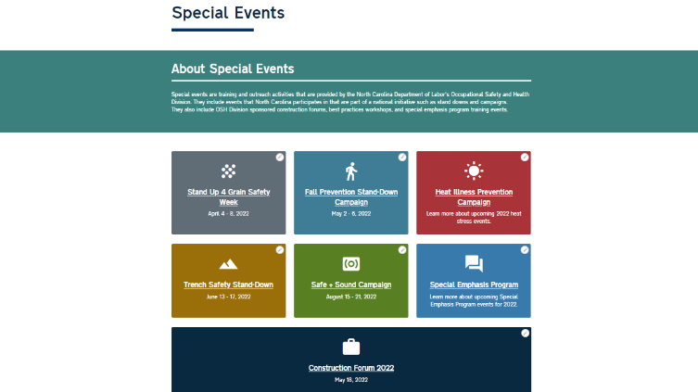
OSH Division
Education and Training Outreach
FFY 2022—2nd Qtr.
Stand Downs/Forums
  Stand Up 4 Grain Safety Week (April 4 - 8)
  Fall Prevention Stand-Down (May 2 - 6) – 452 Attendees (Webinars and Labor One Events)
  Construction Forum (May 18) – 25 Attendees
  Heat Illness Prevention (All Summer)
  Trench Safety Stand-Down (June 13 - 17)
  Safe + Sound (August 15 - 21)

Slide 20
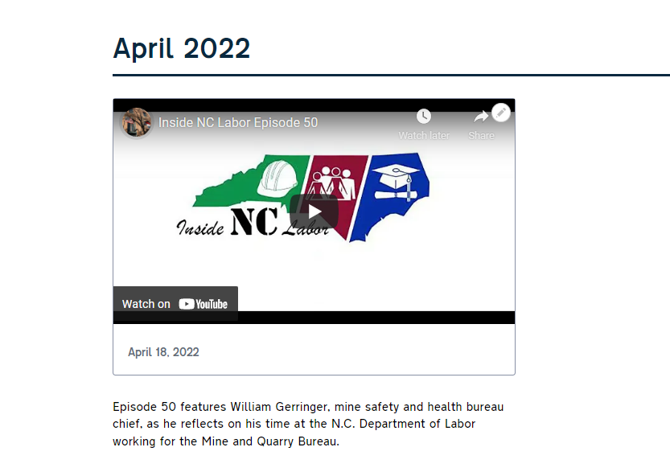
OSH Division
Social Media
FFY 2022—2nd Qtr.
Inside NC Labor Podcasts
  50 episodes
Facebook
  1,973 followers
Instagram
  641 followers
Twitter
  2,111 followers

Slide 21
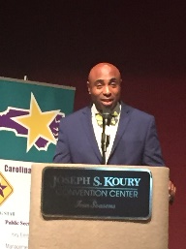

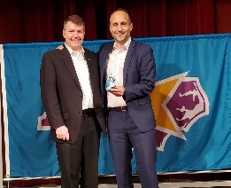


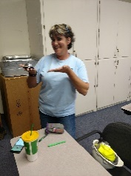

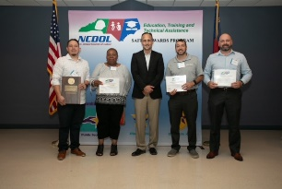
OSH Division
Recognition Programs
FFY 2022—2nd Qtr.
*Cumulative Total
STAR SITES—New, Recertification, Promotion | 1st Qtr. | 2nd Qtr. | Total | FFY Goal | Approved Star Sites*
Carolina Star | 4 | 1 | 5 |  | 102
Building Star | 2 | 1 | 3 |  | 24
Rising Star | 0 | 0 | 0 |  | 4
Public Sector Star | 0 | 1 | 1 |  | 19
Total | 6 | 3 | 9 | 20 | 149
NCDOL Photo Library
 | 1st Qtr. | 2nd Qtr. | Total | FFY Goal
Star Sites—Termination/Withdrawn | 1 | 0 | 1
Star Booths | 0 | 0 | 0
Star Presentations | 5 | 6 | 11 | 10
Star Program Interventions | 29 | 41 | 70 | 100
Notes:
Withdrew: Emerson Automation Solutions – work site closed

Slide 22


OSH Division
Recognition Programs
FFY 2022—2nd Qtr.
SHARP SITES—New/Renewal | 1st Qtr. | 2nd Qtr. | Total | FFY Goal | Approved SHARP Sites*
SHARP—Construction | 1 | 0 | 1 |  | 3
SHARP—General Industry | 15 | 14 | 29 |  | 104
SHARP—Public Sector | 9 | 9 | 18 |  | 49
Totals | 25 | 23 | 48 | 60 | 156
*Cumulative Total
GOLD STAR GROWERS—NEW | 1st Qtr. | 2nd Qtr. | Total
 | 29 | 202 | 231
SAFETY AWARDS |  |  | Total
CY 2021 Safety Awards Season (Silver, Gold, Million Hour) |  |  | 2,428
 | 1st Qtr. | 2nd Qtr. | Total
Million Hour Awards | 9 | 36 | 45
Notes:
2022 Safety Award Season reverting to normal schedule and may be a hybrid of virtual and in-person.

Slide 23


OSH Division
Alliances and Partnerships
FFY 2022—2nd Qtr.
Alliances
  Carolinas AGC
  Lamar Advertising Company
  Mexican Consulate
  N.C. State – Industry Expansion Solutions
  Safety and Health Council of NC
  NUCA of the Carolinas
  NCALGESO

Slide 24
OSH Division
Alliances and Partnerships
FFY 2022—2nd Qtr.
Partnerships
  Barringer Construction
    Charlotte - Foundry Building Including Ancillary Buildings (2020 – 2023)
  Holder – Edison Foard – Leeper, A Joint Venture
    Charlotte - Charlotte Douglas International Airport – Terminal Lobby Expansion (2021 – 2023)

Slide 25
OSH Division
Complaint Desk*
FFY 2022—2nd Qtr.
East Compliance | West Compliance | Agricultural Safety and Health
ACTIVITY | 1st Qtr. | 2nd Qtr. | 1st Qtr. | 2nd Qtr. | 1st Qtr. | 2nd Qtr. | Cumulative Total | FFY 2021
Complaints | 319 | 395 | 365 | 521 | 3 | 7 | 1,610* | 4,321
Referrals | 79 | 77 | 98 | 91 | 8 | 0 | 353 | 743
Fat/Cat | 17 | 28 | 28 | 20 | 2 | 6 | 95 | 227
Totals | 415 | 500 | 491 | 632 | 13 | 7 | 2,058 | 5,291
*552 of the total were COVID-related.
**Includes calls that were processed but not necessarily inspected. Fat/Cat includes calls regarding heart attacks and other natural causes.
ACTIVITY | 1st Qtr. | 2nd Qtr. | Cumulative Total | FFY 2021
Complaints Not in OSH Jurisdiction* | 813 | 920 | 1,733 | 3,232
*Includes complaints related to wage and hour, discrimination, worker's compensation questions, beyond statute of limitation time frame, etc.

Slide 26
OSH Division
Cut-Loose, In-Training, Vacant
FFY 2022—2nd Qtr.
West Compliance | Safety | % | Industrial Hygienist | %
Cut Loose | 17 | 58% | 21 | 81%
In-Training | 6 | 21% | 0 | 0%
Vacant | 6 | 21% | 5 | 19%
Total | 29* |  | 26
*One safety position eliminated.
East Compliance | Safety | % | Industrial Hygienist | %
Cut Loose | 10 | 43% | 4 | 24%
In-Training | 5 | 20% | 4 | 33%
Vacant | 8 | 35% | 9 | 53%
Total | 23** |  | 17**
**Two safety positions and one health position eliminated.
Safety Cut Loose | 52% | Health Cut Loose | 58%
Safety In-Training | 21% | Health in-Training | 9%
Safety Vacant | 27% | Health Vacant | 33%

Slide 27
OSH Division
Cut-Loose, In-Training, Vacant
FFY 2022—2nd Qtr.
Consultative Services | Safety | % | Industrial Hygienist | %
Cut Loose | 8 | 73% | 8 | 100%
In-Training | 1 | 9% | 0 | 0%
Vacant | 2 | 18% | 0 | 0%
Total | 11 |  | 8
Education, Training and Technical Assistance | Safety | % | Industrial Hygienist | %
Cut Loose | 10 | 91% | 6 | 100%
In-Training | 1 | 9% | 0 | 0%
Vacant | 0 | 0% | 0 | 0%
Total | 11 |  | 6
Agricultural Safety and Health | Safety | % | Industrial Hygienist
Cut Loose | 5 | 63% | NA
In-Training | 1 | 13% | NA
Vacant | 2 | 25% | NA
Total | 8

Slide 28
Recent Actions Taken to Attract/Retain Safety and Health Professionals
FFY 2022—2nd Qtr.
4/21 – $3,000 hiring bonus policy for CSHOs instituted
12/21 – State employees making less than $75k received $1,500; those making more than $75k, received $1,000 bonus
1/22 – State employees received 2.5% increase, retroactive to 7/1
2/22 – All NCDOL employees received $2,500 bonus related to working through the pandemic
4/22 – NCDOL/OSH established new minimum salaries for S&H professionals, resulting in increases for approx. 80% of positions
7/1 – 2.5% LI

Slide 29
OSH Division
Salary Increases
FFY 2022—2nd Qtr.
SCO I/Safety Trainer – min $58,000 ($8,004 above grade minimum)
HCO I/SCOII/Health Trainer – min $60,900 ($4,565 above grade minimum)
HCO II/Safety Consultant/ETTA Standards Officer/STAR Safety Consultant – min $63,945
Average increase of 133 S&H professionals was $5,493
Minimum salaries – entry levels, OSH tenure, certifications
Increases required $991,295 for salary/benefits
Funding sources – position cuts, reallocation, salary reserve

Slide 30
OSH Division
Internal Training
FFY 2022—2nd Qtr.
1st Qtr.—COURSE
In-Person | No. of Events | Trained
OCSS Confined Space Entry | 2 | 17
OCSS Excavation and Trenching | 1 | 9
Labor One Driver Training | 4 | 5
Virtual | No. of Events | Trained
Combustible Dust | 1 | 82
Engineering Controls | 1 | 47
10-Hour General Industry Awareness Course | 1 | 3
Total Trained |  | 163

Slide 31
OSH Division
Internal Training
FFY 2022—2nd Qtr.
2nd Qtr.—COURSE
In Person | No. of Events | Trained
Labor One Training | 3 | 4
Virtual | No. of Events | Trained
# 100 Initial Compliance Course | 1 | 13
Technical Writing | 1 | 11
OSHA Express | 1 | 12
Legal Aspects | 1 | 11
Logging SEP | 1 | 16
Food Manufacturing SEP | 1 | 1
Grocery and Related Product Wholesalers | 1 | 2
Bloodborne Pathogens | 1 | 1
Total Trained |  | 71

Slide 32
OSH Division
Standards Section—New/Revisions
FFY 2022—2nd Qtr.
Compliance Directive
  CPL 02-00-165—Compliance Directive for the Excavation Standard, 29 CFR 1926, Subpart P
    This instruction provides guidance and inspection procedures for the enforcement of Subpart P.
Memorandum of Understanding
  USDOL-MOU1 – USDOL Wage and Hour Division

Slide 33
OSH Division
Standards Section—New/Revisions
FFY 2022—2nd Qtr.
Operational Procedure Notice
  OPN 123X—Special Emphasis Program for Construction Activities
    Changes include updates to SEP counties and statistics.
  OPN 128W—Public Sector Surveys and Inspections
    Changed reference years for OSHA 300 logs and DART rates.
Memos
  COV 6—Repeal – Healthcare Emergency Temporary Standard on Occupational Exposure to COVID-19
    Repealed in NC effective March 4, 2022. This memo provides information and enforcement guidance related to the repeal.

Slide 34
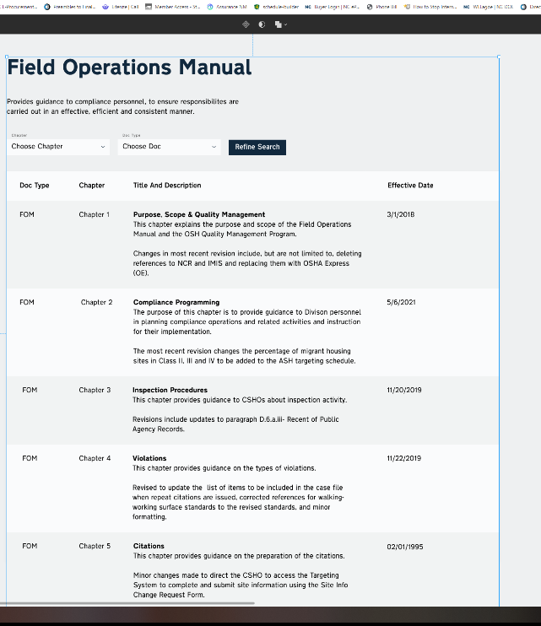
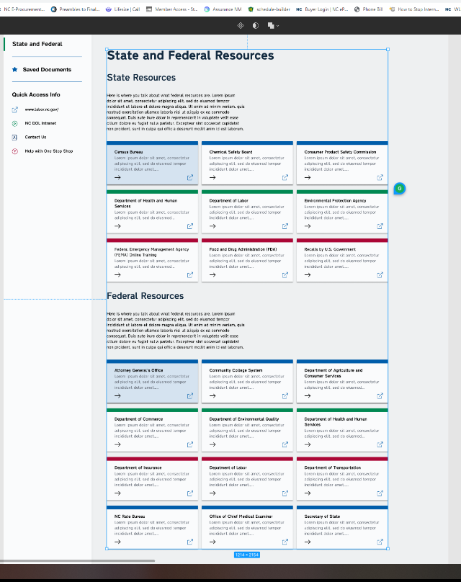
OSH Division
New Initiatives
FFY 2022—2nd Qtr.
Biznet - Online Registration System
  Internal and external training
Babbel - Online Spanish Training
  Thirty seats for internal staff
One Stop Shop Upgrade

Slide 35
OSH Division
Retaliatory Employment Discrimination
FFY 2022—2nd Qtr.
Bureau Staffing
Jaleesa Thomas | Information Officer
Norma Velasco | Administrative Assistant II
James Agosto | Investigator
Alexander Fowler | Investigator
Dianne Daniels | Investigator
Anitra Nalls | Investigator
Erin Smith | Investigator
Theodore Place | Investigator
Alvin Vocalan | Investigator
Harriet Hopkins | Administrator

Slide 36
OSH Division
Retaliatory Employment Discrimination
FFY 2022—2nd Qtr.
OSH Complaint Statistics | 1st Qtr. | 2nd Qtr. | Total
Total OSH Complaints Filed | 64 | 59* | 123
Total OSH Complaints Closed | 68 | 75** | 143
Number of OSH Cases Closed Within 90 Days of File Date | 2 | 3*** | 5
Percentage of Cases Closed Within 90 Days of File Date | 4%* | 6%*** | NA
Of Cases Closed, Average Number of Elapsed Days Between File Date and Closed Date | 288* | 279 | NA
Total Number of OSH Complaints Pending at End of Reporting Period | 103** | 100**** | NA
Percentage of Pending OSH Complaints Over 90 Days Old (From Filing) | 69% | 71% (71/100) | NA
Average Number of Elapsed Days Since Filing Date of All OSH Cases Pending at End of the Reporting Period | 230* | 269 | NA
*Includes 44 docketed and 15 IMIS undocketed.
**Includes 24 administrative closures (51+24).
***3/51; does not include administrative closures.
****WB pending case data includes complaints docketed after EOQ: 112-12.

Slide 37
OSH Division
Retaliatory Employment Discrimination
FFY 2022—2nd Qtr.
OSH Complaint Disposition | 1st Qtr. | 2nd Qtr. | Total
Administrative Closure (REDB Opened in OnBase and Docketed in IMIS) | 24 | 24 | 48
Withdrawn (Includes Requested RTS Letters) | 10 | 9 | 19
Merit (Included in SAMM 15 Merit) | 4 | 10 | 14
Total SAMM 15 Merit | 12 | 17 | 29
Total SAMM 15 Percent Merit (12/42) | 27% | 33% (17/51- No AC) | NA
Dismissal Right-to-Sue (Includes No Merit and Unresponsive) | 22 | 25 | 47
Settled Other (Included in SAMM 15) | 8 | 7 | 15
Total Cases Closed by Disposition | 68 | 75 (51 + 24 AC) | 143
TOTAL DAMAGES PAID This Quarter (Includes Settlements With Aid of the Bureau During Informal Discussions or Mediation.) | $96,648 | $38,000 | $134,648

Slide 38
OSH Division
COVID-19 Activities
FFY 2020—2022
Calls/Emails | FFY 2020* | FFY 2021** | 1st Qtr. FFY 2022*** | 2nd Qtr. FFY 2022**** | FFY 2020-22
Director's Office | 2,143 | 1,581 | 490 | 441 | 4,655
ETTA | 1,347 | 623 | 180 | 270 | 2,420
ASH***** | 341 | 529 | 117 | 52 | 1,039
PSIM | 11 | 0 | 0 | 0 | 11
CSB | 1,084 | 440 | 120 | 105 | 1,749
Totals | 4,926 | 3,173 | 907 | 868 | 9,874
*FFY 2020 includes data from March 1 (estimated), 2020 through October 2, 2020.
**FFY 2021 includes data from October 2, 2020, through October 3, 2021.
***1st Qtr. FFY 2022 includes data from October 4, 2021, through December 31, 2021.
**** 2nd Qtr. FFY 2022 includes data from January 1, 2022, through April 1, 2022.

Slide 39
OSH Division
COVID-19 Activities
FFY 2020—2022
Director’s Office | FFY 2020* | FFY 2021** | 1st Qtr. FFY 2022*** | 2nd Qtr. FFY 2022**** | FFY 2020-22
Meetings | 102 | 93 | 23 | 25 | 243
Compliance | FFY 2020* | FFY 2021** | 1st Qtr. FFY 2022*** | 2nd Qtr. FFY 2022**** | FFY 2020-22
Valid Complaints | 1,012 | 1,325 | 113 | 276 | 2,726
Non-Valid Complaints | 1,402 | 1,141 | 77 | 84 | 2,705
Inspections | 22 | 97 | 12 | 8 | 156
Referrals | 51 | 45 | 10 | 13 | 119
Unprocessed Complaints***** | 1,107 | 595 | 55 | 92 | 1,849
*FFY 2020 includes data from March 1 (estimated), 2020 through October 2, 2020.
**FFY 2021 includes data from October 2, 2020, through October 3, 2021.
***1st Qtr. FFY 2022 includes data from October 4, 2021, through December 31, 2021.
**** 2nd Qtr. FFY 2022 includes data from January 1, 2022, through April 1, 2022.
*****This data is preliminary and subject to change as unprocessed complaints are moved to other categories. Many of these unprocessed complaints contain insufficient information to process and/or they cover complaint items that do not fall under OSH jurisdiction. Referrals to other Agencies are made, as appropriate.
.

Slide 40
OSH Division
COVID-19 Activities
FFY 2020—2022
PSIM | FFY 2020* | FFY 2021** | 1st Qtr. FFY 2022*** | 2nd Qtr. FFY 2022**** | FFY 2020-22
Disclosure Requests | 1,627 | 1,418 | 5 | 39 | 3,089
CSB | FFY 2020* | FFY 2021** | 1st Qtr. FFY 2022*** | 2nd Qtr. FFY 2022**** | FFY 2020-22
Interventions | 54 | 30 | 0 | 1 | 85
Visits | 157 | 367 | 71 | 80 | 675
ASH | FFY 2020* | FFY 2021** | 1st Qtr. FFY 2022*** | 2nd Qtr. FFY 2022**** | FFY 2020-22
Guidance Documents | 1 | 0 | 0 | 0 | 1
*FFY 2020 includes data from March 1 (estimated), 2020 through October 2, 2020.
**FFY 2021 includes data from October 2, 2020, through October 3, 2021.
***1st Qtr. FFY 2022 includes data from October 4, 2021, through December 31, 2021.
**** 2nd Qtr. FFY 2022 includes data from January 1, 2022, through April 1, 2022.

Slide 41
OSH Division
COVID-19 Activities
FFY 2020—2022
ETTA | FFY 2020* | FFY 2021** | 1st Qtr. FFY 2022 | 2nd Qtr. FFY 2022 | FFY 2020-22
Live Webinars | 28 | 19 | 1 | 0 | 48
Pre-recorded Webinars | 6 | 1 | 0 | 0 | 7
PowerPoints | 25 | 12 | 0 | 1 | 38
Hazard Alerts | 7 | 2 | 0 | 0 | 9
Streaming Videos | 72 | 62 | 6 | 3 | 143
A-Z Topics Added/Updated | 24 | 26 | 4 | 3 | 57
Fact Sheets | 4 | 9 | 0 | 0 | 13
Example Programs | 1 | 2 | 0 | 0 | 3
Compliance Memos | 10 | 3 | 1 | 2 | 16
Billboards | 0 | 5 | 0 | 0 | 5
*FFY 2020 includes data from March 1 (estimated), 2020 through October 2, 2020.
**FFY 2021 includes data from October 2, 2020, through October 3, 2021.
***1st Qtr. FFY 2022 includes data from October 4, 2021, through December 31, 2021.
**** 2nd Qtr. FFY 2022 includes data from January 1, 2022, through April 29, 2022.

Slide 42
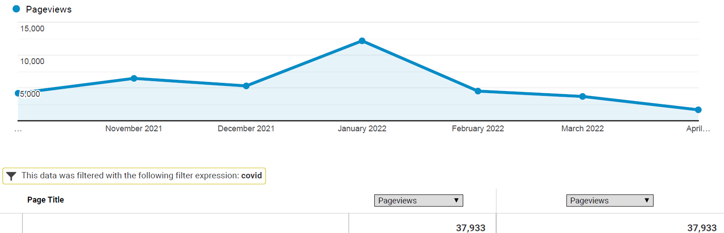
OSH Division
COVID-19 Activities
FFY 2020—2022
COVID-19 Safety and Health Topic Page
FFY 2020
FFY 2021
FFY 2022
Total: 98,976

Slide 43

Thank You For Attending!
FFY 2022—2nd Qtr.
Questions?
1-800-NC-LABOR
(1-800-625-2267)
www.labor.nc.gov
Notes:
43

