Slide 1
North Carolina Department of Labor Occupational Safety & Health Division 1st Quarter Report Federal Fiscal Year 2022*
Presented by:
Education, Training and Technical Assistance
Occupational Safety and Health Division of North Carolina
*Preliminary Data
Notes:
The information in this presentation is provided voluntarily by the N.C. Department of Labor, Education Training and Technical Assistance Bureau as a public service and is made available in good faith. This presentation is designed to assist trainers conducting OSHA outreach training for workers. Since workers are the target audience, this presentation emphasizes hazard identification, avoidance, and control – not standards. No attempt has been made to treat the topic exhaustively. It is essential that trainers tailor their presentations to the needs and understanding of their audience.
The information and advice provided on this Site and on Linked Sites is provided solely on the basis that users will be responsible for making their own assessment of the matters discussed herein and are advised to verify all relevant representations, statements, and information.
This presentation is not a substitute for any of the provisions of the Occupational Safety and Health Act of North Carolina or for any standards issued by the N.C. Department of Labor. Mention of trade names, commercial products, or organizations does not imply endorsement by the N.C. Department of Labor.

Slide 2
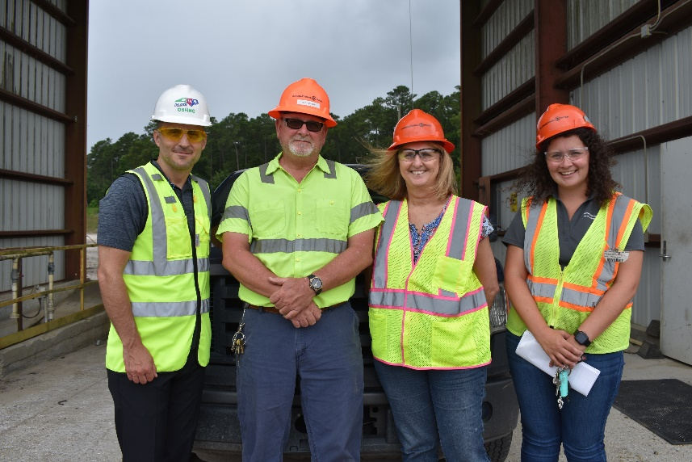
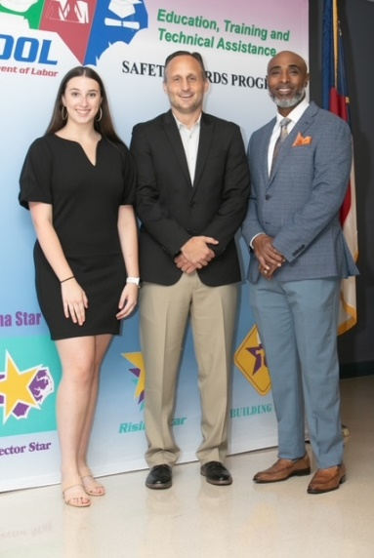
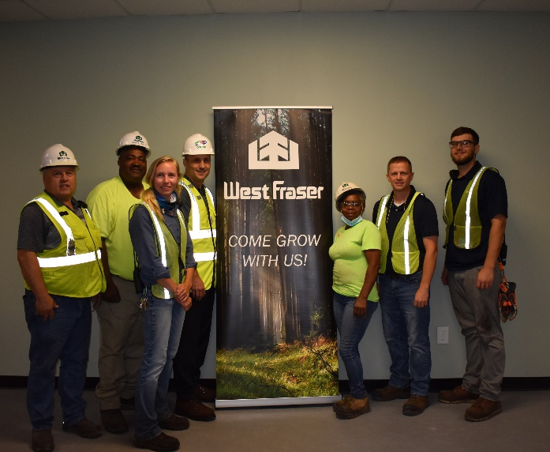
N.C. Workplace Safety and Health
TRC and DART Rate Comparison
FFY 2022—1st Qtr.
CY 2020 | North Carolina |  | National Average |  | Comparison
TRC Rate | 2.1 | 2.2* | 2.7 | 2.9* | 22% Lower/24% Lower*
DART Rate | 1.3 | 1.3* | 1.7 | 1.8* | 24% Lower/28% Lower*
*All industries including state and local government CY = Calendar Year
Notes:
North Carolina’s Total Recordable cases and DART rate continue to be lower that the National Average.
The DART rate stands for "Days Away, Restrictions and Transfers". This number is also based on trending over 200,000 hours but its not based on total injuries. Its based only on those injuries and illnesses severe enough to warrant "Days Away, Restrictions and Transfers".
The Total Recordable Case Rate (TRC) equals the division of all recordable cases by the hours worked, multiplied by 200'000 for standardization.

Slide 3
N.C. Workplace Safety and Health
Total Recordable Cases (TRC)
FFY 2022—1st Qtr.
4% Decrease
4% Increase
7% Decrease
4% Decrease
12% Decrease
All Industries Including State and Local Government
Based on Calendar Year

Slide 4
N.C. Workplace Safety and Health
Days Away, Restricted or Transferred (DART)
FFY 2022—1st Qtr.
No Change
7% Increase
7% Decrease
7% Decrease
No Change
All Industries Including State and Local Government
Based on Calendar Year

Slide 5
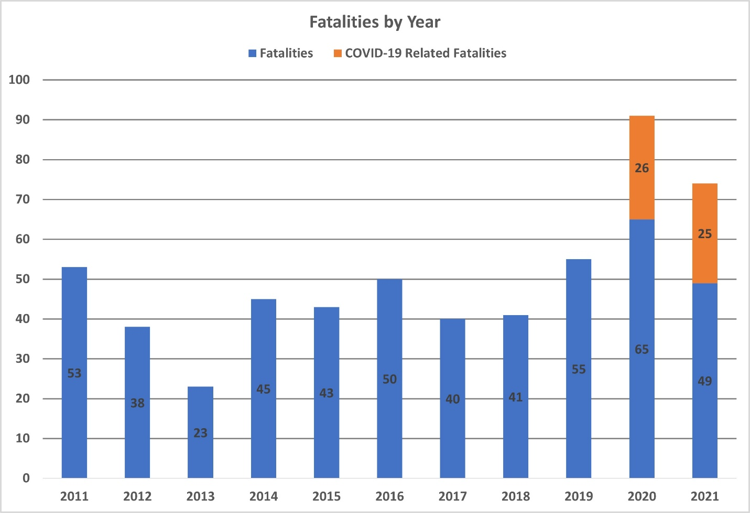
N.C. Workplace Safety and Health
Work-Related Fatalities in North Carolina
FFY 2022—1st Qtr.

Slide 6
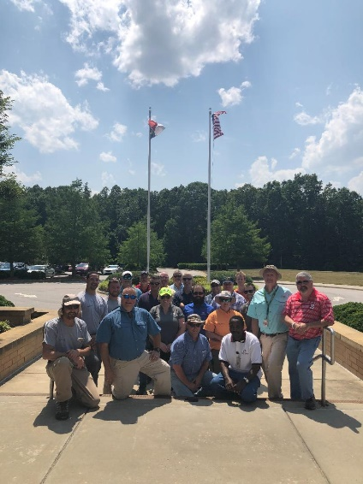
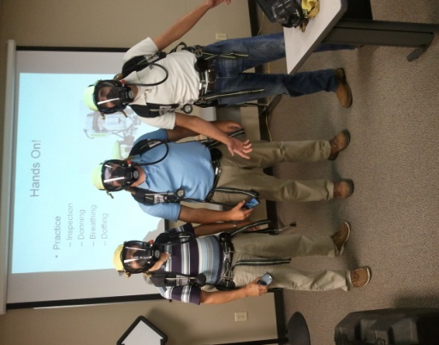
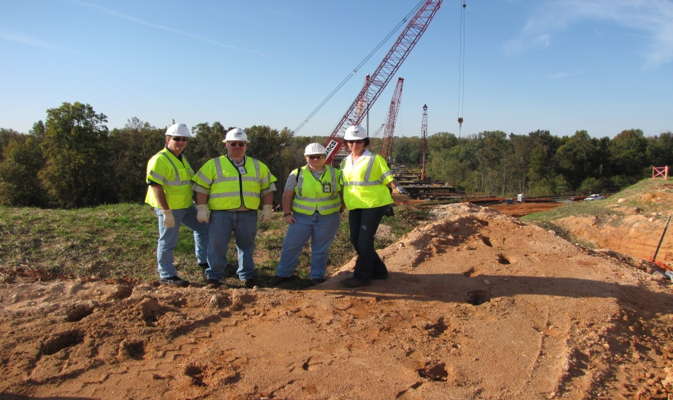
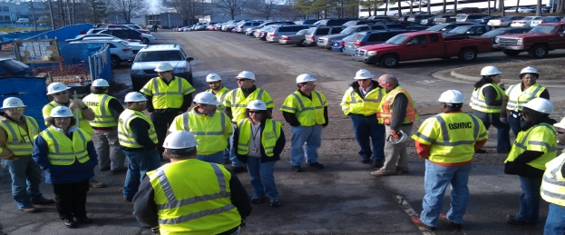
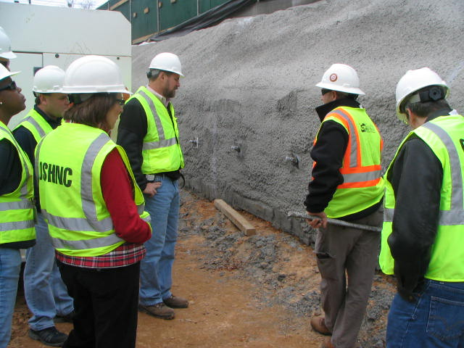
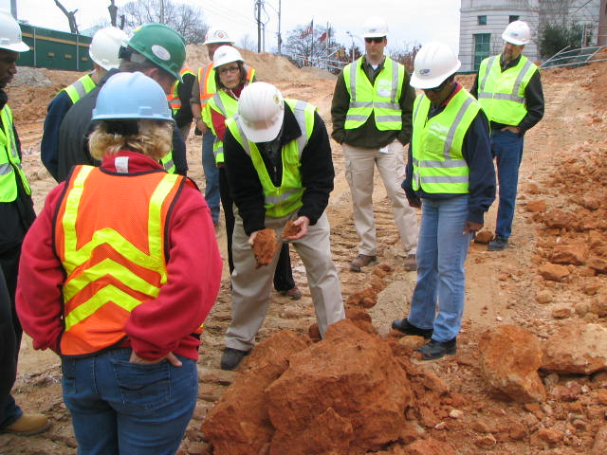
N.C. Workplace Safety and Health
OSH Division—Fatalities Inspected
FFY 2022—1st Qtr.
FATALITY TYPE | 1st Qtr. | Total | FATALITY TYPE | 1st Qtr. | Total
Struck By | 3 | 3 | Inhalation | 0 | 0
Caught In/Between | 2 | 2 | Ingestion | 0 | 0
Bite/Sting/Scratch | 0 | 0 | Absorption | 0 | 0
Fall (Same Level) | 0 | 0 | Repeated Motion/Pressure | 0 | 0
Fall (From Elevation) | 0 | 0 | Cardio/Respiratory | 0 | 0
Struck Against | 0 | 0 | Shock | 1 | 1
Rubbed/Abraded | 0 | 0 | Other | 2 | 2
COVID-19 | 2 | 2 | Criminal Activity | 0 | 0
Fatalities Under OSH Division Jurisdiction
FFY 2021 |  | FFY 2022 | 1st Qtr. | Total
Total Fatalities | 89 | Fatalities | 10 | 10
NCDOL Photo Library

Slide 7
N.C. Workplace Safety and Health
OSH Division—Strategic Plan Goals
FFY 2022—1st Qtr.
COMPLIANCE | 1st Qtr. | Total | FFY Goal
Safety Inspections | 306 | 306 | 1,638
Health Inspections | 161 | 161 | 962
Serious Hazards Eliminated | 553 | 553 | 4,100
Training and/or Program Violations | 112 | 112 | 1,050
CONSULTATION | 1st Qtr. | Total | FFY Goal
Serious Hazards Eliminated | 1,221 | 1,221 | 5,000
Private Sector and Public Sector Visits | 359 | 359 | 1,325
OSH DIVISION | 1st Qtr. | Total | FFY Goal
Program Improvements | 519 | 510 | 2,060
People Trained in Special Emphasis Program Areas | 1,161 | 1.161 | 3,200
People Trained at OSH Division Sponsored Events | 1,631 | 1,631 | 5,350

Slide 8
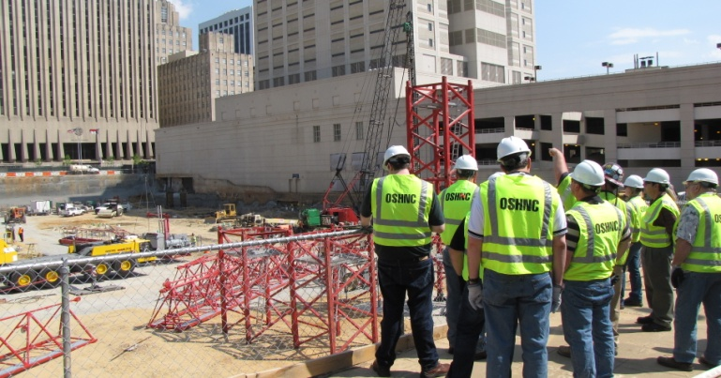
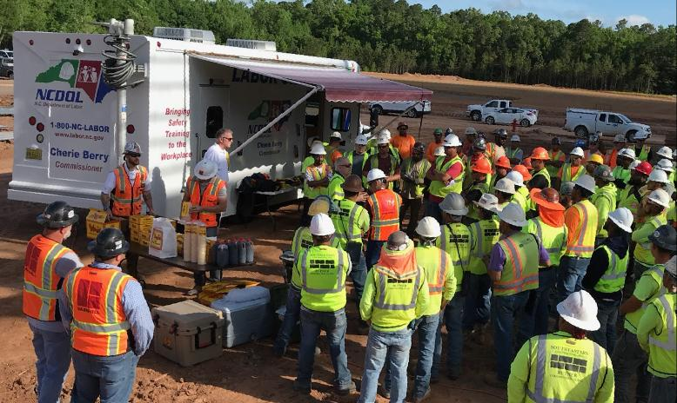
N.C. Workplace Safety and Health
OSH Division—Strategic Plan Goals
FFY 2022—1st Qtr.
Education, Training and Technical Assistance (ETTA) | 1st Qtr. | Total | FFY Goal
Publications Distributed | 9,685 | 9,685 | 23,000
Standards Interpretations | 446 | 446 | NA
Agricultural Safety and Health (ASH) | 1st Qtr. | Total | FFY Goal
Outreach Materials Distributed | 309 | 309 | 2,400
Compliance Inspections | 20 | 20 | 50
Certificates Issued | 143 | 143 | 1,600
Preoccupancy Inspections | 210 | 210 | 1,800
NCDOL Photo Library

Slide 9
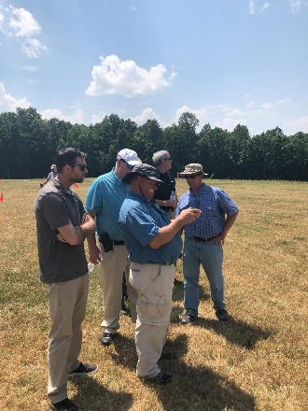

Strategic Plan
Special Emphasis Programs (SEP)
FFY 2022—1st Qtr.
NCDOL Photo Library
Construction
Logging and Arboriculture
Long Term Care Facilities
Health Hazards
Food Manufacturing
Grocery and Related Product Wholesalers
Amputations

Slide 10
Special Emphasis Program
Construction
FFY 2022—1st Qtr.
NAICS 23—CONSTRUCTION | FFY 2021 |  | 1st Qtr. | Total
Total Fatalities | 18 |  | 3 | 3
 |  |  | N/A | N/A
FFY 2021 3rd Qtr. Fatality Rate | 0.0017
Fatality Type | 1st Qtr. | Total | Fatality Type | 1st Qtr. | Total
Struck By | 1 | 1 | Inhalation | 0 | 0
Caught In/Between | 0 | 0 | Ingestion | 0 | 0
Bite/Sting/Scratch | 0 | 0 | Absorption | 0 | 0
Fall (Same Level) | 0 | 0 | Repeated Motion/Pressure | 0 | 0
Fall (From Elevation) | 0 | 0 | Cardio/Respiratory | 0 | 0
Struck Against | 0 | 0 | Shock | 1 | 1
Rubbed/Abraded | 0 | 0 | Other | 1 | 1
Notes:
s
Will be posting a new billboard on the May 2022 fall prevention standdown and for heat stress.

Slide 11
Special Emphasis Program
Construction
FFY 2022—1st Qtr.
 | North Carolina |  |  |  | National Average |  |  |  | North Carolina vs. National Average
 | CY 2019 |  | CY 2020 |  | CY 2019 |  | CY 2020 |  | 2020 Comparison
TRC | 1.6 | 20% Increase |  | 2.0 | 2.8 | 11% Decrease |  | 2.5 | 20% Lower
DART | 0.8 | 20% Increase |  | 1.0 | 1.7 | 6% Decrease |  | 1.6 | 37% Lower
SEP ACTIVITY | 1st Qtr. | Total | FFY Goal
Compliance Inspections | 253 | 253 | 1,050
Consultative Visits | 98 | 98 | 250
OSH Outreach Events (10- and 30- Hour Construction Courses) | 3 | 3 | 6
People Trained | 185 | 185 | 1,000

Slide 12
Special Emphasis Program
Logging and Arboriculture
FFY 2022—1st Qtr.
56173 | North Carolina |  |  |  | National Average |  |  |  | North Carolina vs. National Average
 | CY 2019 |  | CY 2020 |  | CY 2019 |  | CY 2020 |  | 2020 Comparison
TRC | 3.9 | 36% Decrease |  | 2.5 | 3.9 | 23% Decrease |  | 3.0 | 17% Lower
DART | 1.6 | No Change |  | 1.6 | 2.5 | 20% Decrease |  | 2.0 | 20% Lower
SEP ACTIVITY | 1st Qtr. | Total | FFY Goal
Compliance Inspections | 5 | 5 | 45
Consultative Visits | 3 | 3 | 15
OSH Training and Outreach Events | 1 | 1 | 3
People Trained | 9 | 9 | 75
NAICS 11331*—LOGGING | FFY 2021 |  | FFY 2022
Total Fatalities | 1 |  | 0
NAICS 56173—ARBORICULTURE | FFY 2021 |  | FFY 2022
Total Fatalities | 5 |  | 0
FFY 2021 3rd Qtr. Combined Fatality Rate |  |  | 0.0046
* TRC/DART Data not available

Slide 13
Special Emphasis Program
Long Term Care Facilities
FFY 2022—1st Qtr.
NAICS 623*—LONG TERM CARE
 | North Carolina |  |  |  | National Average |  |  |  | North Carolina vs. National Average
 | CY 2019 |  | CY 2020 |  | CY 2019 |  | CY 2020 |  | 2020 Comparison
TRC | 5.0 | 46% Increase |  | 9.3 | 5.9 | 49% Increase |  | 11.5 | 29% Lower
DART | 3.4 | 53% Increase |  | 7.2 | 3.5 | 62% Increase |  | 9.3 | 23% Lower
*TRC/DART rate based on the 3-digit NAICS code
SEP ACTIVITY | 1st Qtr. | Total | FFY Goal
Compliance Inspections | 9 | 9 | 48
Consultative Visits | 6 | 6 | 35
OSH Outreach Events | 0 | 0 | 2
People Trained | 0 | 0 | 40

Slide 14

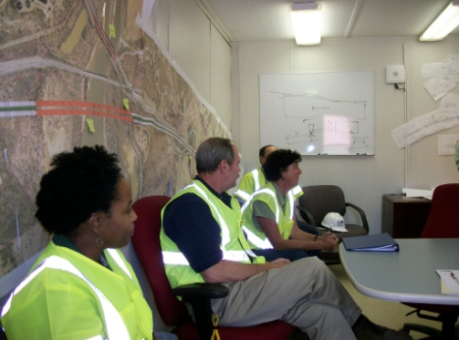
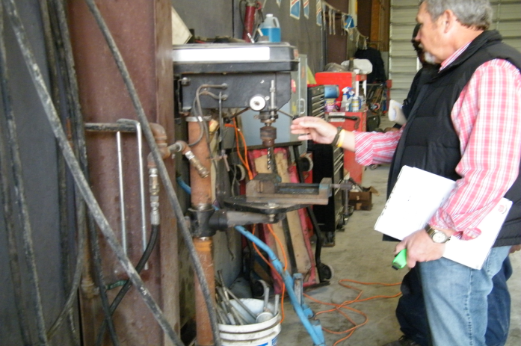
Special Emphasis Program
Health Hazards
FFY 2022—1st Qtr.
COMPLIANCE INSPECTIONS | 1st Qtr. | Total | FFY Goal
Silica | 4 | 4 | 100
Asbestos | 1 | 1
Isocyanates | 0 | 0
Lead | 1 | 1
Hexavalent Chromium | 1 | 1
Total | 7 | 7
Program Improvements | 2 | 2 | 20
*Some inspections involved more than one health hazard and generally included a program improvement
NCDOL Photo Library

Slide 15
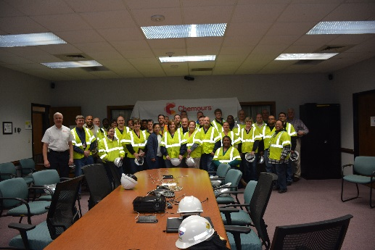
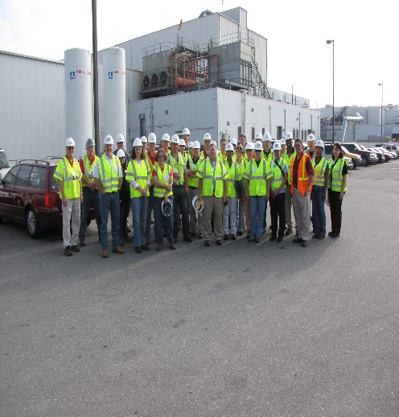
Special Emphasis Program
Health Hazards
FFY 2022—1st Qtr.
COMPLIANCE INSPECTION RESULTS
HEALTH HAZARDS | Number of Samples (Detectable Results) |  | Number With Overexposures |  | Average Severity Rate*
 | 1st Qtr. | Total | 1st Qtr. | Total | 1st Qtr.
Silica | 1 | 1 | 0 | 0 | 0.79
Asbestos | 0 | 0 | 0 | 0 | 0
Isocyanates | 0 | 0 | 0 | 0 | 0
Lead | 0 | 0 | 0 | 0 | 0
Hexavalent Chromium | 1 | 1 | 0 | 0 | 0.01
Total | 2 | 2 | 0 | 0 | NA
NCDOL Photo Library
* All Samples

Slide 16
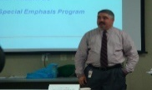
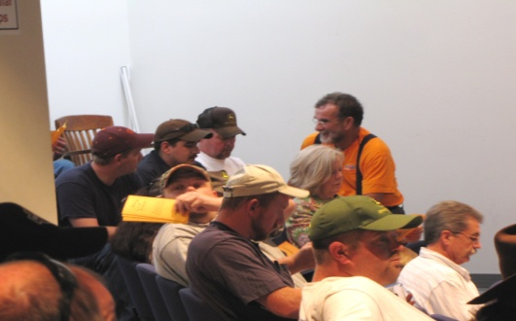
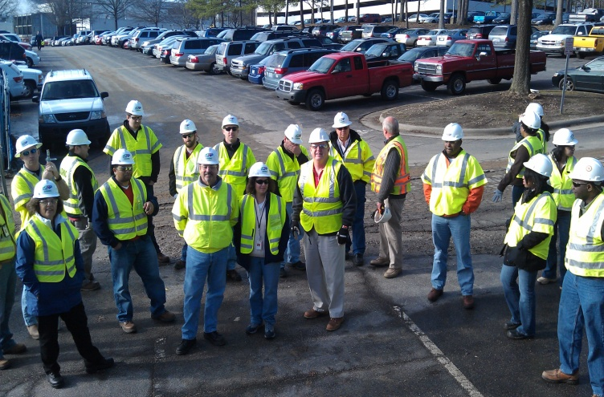
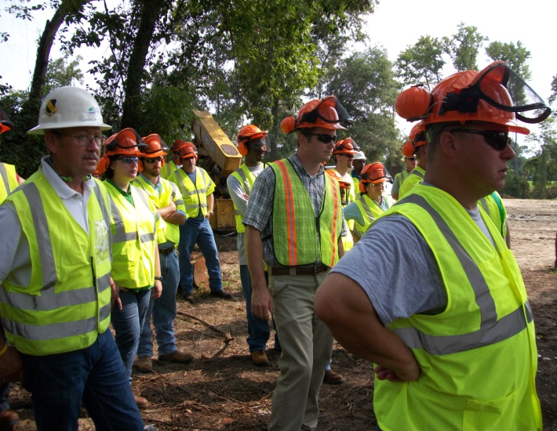
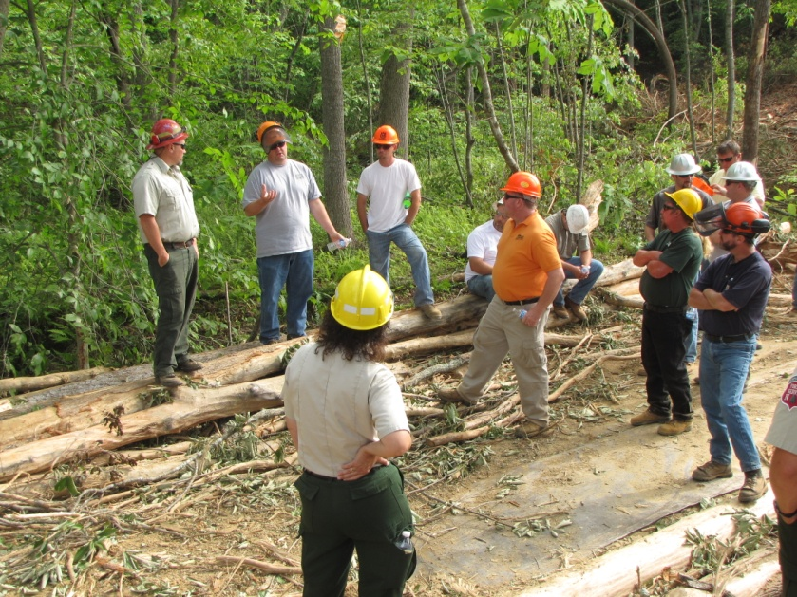
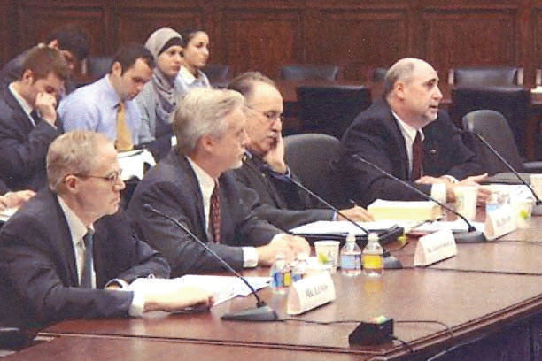
Special Emphasis Program
Health Hazards
FFY 2022—1st Qtr.
HEALTH HAZARDS | Consultative Surveys
 | 1st Qtr. | Total
Silica | 30 | 30
Asbestos | 3 | 3
Isocyanates | 2 | 2
Lead | 11 | 11
Hexavalent Chromium | 3 | 3
Total | 49 | 49
FFY Goal | 125
NCDOL Photo Library
NCDOL Photo Library
SEP ACTIVITY | 1st Qtr. | Total | FFY Goal
OSH Outreach Events | 7 | 7 | 20
People Trained | 76 | 76 | 300

Slide 17
Special Emphasis Program
Food Manufacturing
FFY 2022—1st Qtr.
NAICS 311*—FOOD MANUFACTURING
 | North Carolina |  |  |  | National Average |  |  |  | North Carolina vs. National Average
 | CY 2019 |  | CY 2020 |  | CY 2019 |  | CY 2020 |  | 2020 Comparison
TRC | 2.9 | 24% Increase |  | 3.8 | 4.0 | 22% Increase |  | 5.1 | 25% Lower
DART | 2.1 | 30% Increase |  | 3.0 | 2.8 | 28% Increase |  | 3.9 | 23% Lower
*TRC/DART rate based on the 3-digit NAICS code
SEP ACTIVITY | 1st Qtr. | Total | FFY Goal
Compliance Inspections | 7 | 7 | 40
Consultative Visits | 4 | 4 | 12
OSH Outreach Events | 0 | 0 | 2
People Trained | 0 | 0 | 40

Slide 18
Special Emphasis Program
Grocery and Related Product Wholesalers
FFY 2022—1st Qtr.
NAICS 4244*—GROCERY AND RELATED WHOLESALERS
 | North Carolina |  |  |  | National Average |  |  |  | North Carolina vs. National Average
 | CY 2019 |  | CY 2020 |  | CY 2019 |  | CY 2020 |  | 2020 Comparison
TRC | 5.2 | 23% Decrease |  | 4.1 | 4.8 | 2% Increase |  | 4.9 | 16% Lower
DART | 4.0 | 22% Decrease |  | 3.1 | 3.7 | 7% Increase |  | 4.0 | 22% Lower
*DART/TRC rate based on the 4-digit NAICS code
SEP ACTIVITY | 1st Qtr. | Total | FFY Goal
Compliance Inspections | 7 | 7 | 20
Consultative Visits | 1 | 1 | 3
OSH Outreach Events | 0 | 0 | 2
People Trained | 0 | 0 | 40

Slide 19
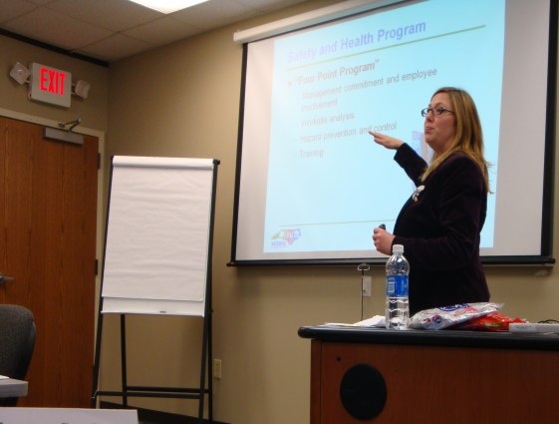
Special Emphasis Program
Amputations
FFY 2022—1st Qtr.
SEP ACTIVITY | 1st Qtr. | Total | FFY Goal
Compliance Inspections | 45 | 45 | 150
Consultative Visits | 33 | 33 | 100
OSH Outreach Events | 11 | 11 | 15
People Trained | 139 | 139 | 400

Slide 20
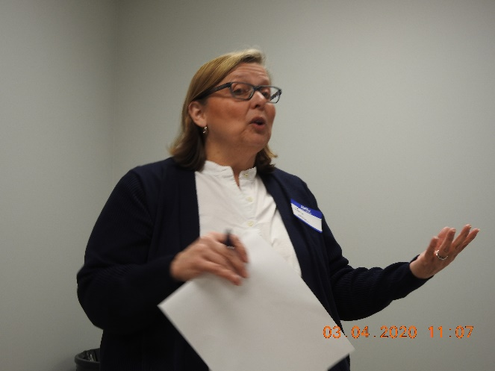
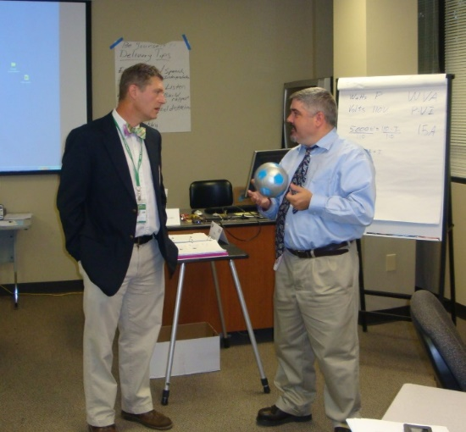
OSH Division
Public Sector
FFY 2022—1st Qtr.
 | CY 2019 |  | CY 2020
TRC | 3.6 | 14% Increase |  | 4.2
DART | 2.1 | 16% Increase |  | 2.5
ACTIVITY | 1st Qtr. | Total | FFY Goal
Compliance Inspections | 17 | 17 | 130
Consultative Visits | 74 | 74 | 210
OSH Outreach Events/Booths | 1 | 1 | 12
Trained | 46 | 46 | 1,000

Slide 21
OSH Division
Education and Training Outreach
FFY 2022—1st Qtr.
OUTREACH EVENT | 1st Qtr. | Total | FFY Goal
General Industry—10-Hour Course | 2 | 2 | 4
General Industry—30-Hour Course | 1 | 1 | 1
NC #500/502—Construction Train-the-Trainer Course/ NC #501/503—General Industry Train-the-Trainer Course | 0 | 0 | 1
Construction—10-Hour Course | 2 | 2 | 5
Construction—30-Hour Course | 1 | 1 | 1
Labor One/Booth Events | 2 | 2 | NA
Speaker’s Bureau | 19 | 19 | NA
Webinars | 7 | 7 | NA
OSH Workshops | 0 | 0 | NA
Technical Assistance | 0 | 0 | NA
Spanish Training and Outreach Events | 0 | 0 | NA
Train-the-Trainer Program (Construction/General Industry)—Events | 0 | 0 | NA
Train-the-Trainer Program (Construction/General Industry)—Trained | 0 | 0 | NA
Notes:
ETTA doesn’t have a Spanish Outreach trainer at this time.

Slide 22
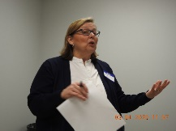
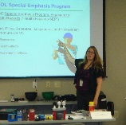
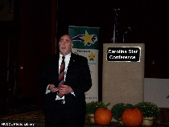
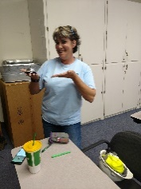
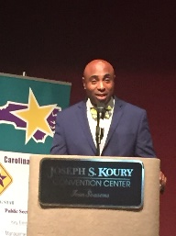
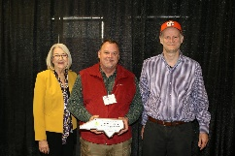
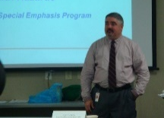

OSH Division
Recognition Programs
FFY 2022—1st Qtr.
*Cumulative Total
STAR SITES—New, Recertification, Promotion | 1st Qtr. | Total | FFY Goal | Approved Star Sites*
Carolina Star | 7 | 7 |  | 101
Building Star | 0 | 0 |  | 22
Rising Star | 0 | 0 |  | 4
Public Sector Star | 4 | 4 |  | 19
Total | 11 | 11 | 20 | 146
NCDOL Photo Library
 | 1st Qtr. | Total | FFY Goal
Star Sites—Termination/Withdrawn | 1 | 1
Star Booths | 0 | 0
Star Presentations | 3 | 3 | 20
Star Program Interventions | 29 | 29 | 100
Notes:
Withdrew: Emerson Automation Solutions – work site closed

Slide 23

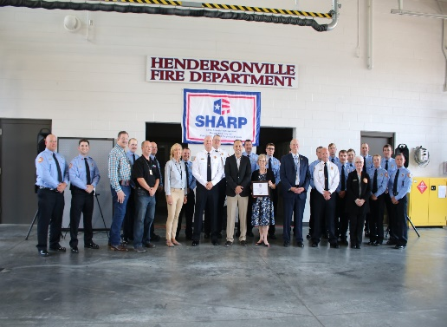
OSH Division
Recognition Programs
FFY 2022—1st Qtr.
SHARP SITES—New/Renewal | 1st Qtr. | Total | FFY Goal | Approved SHARP Sites*
SHARP—Construction | 1 | 1 |  | 5
SHARP—General Industry | 15 | 15 |  | 110
SHARP—Public Sector | 9 | 9 |  | 45
Totals | 25 | 25 | 44 | 160
*Cumulative Total
GOLD STAR GROWERS—NEW | 1st Qtr. | Total
 | 29 | 29
SAFETY AWARDS |  | Total
CY 2021 Safety Awards Season (Silver, Gold, Million Hour) |  | 2,428
 | 1st Qtr. | Total
Million Hour Awards | 0 | 0
Notes:
2022 Safety Award Season reverting to normal schedule and may be a hybrid of virtual and in-person.

Slide 24
OSH Division
Cut-Loose, In-Training, Vacant
FFY 2022—1st Qtr.
West Compliance | Safety | % | Industrial Hygienist | %
Cut Loose | 20 | 67% | 22 | 84%
In-Training | 6 | 20% | 1 | 4%
Vacant | 4 | 13% | 3 | 12%
Total | 30* |  | 26
*One safety position eliminated.
East Compliance | Safety | % | Industrial Hygienist | %
Cut Loose | 11 | 44% | 6 | 33%
In-Training | 5 | 20% | 4 | 33%
Vacant | 9 | 36% | 8 | 44%
Total | 25** |  | 18
**Two safety positions eliminated.
Safety Cut Loose | 56% | Health Cut Loose | 64%
Safety In-Training | 20% | Health in-Training | 11%
Safety Vacant | 24% | Health Vacant | 25%

Slide 25
OSH Division
Cut-Loose, In-Training, Vacant
FFY 2022—1st Qtr.
Consultative Services | Safety | % | Industrial Hygienist | %
Cut Loose | 9 | 82% | 8 | 100%
In-Training | 0 | 0% | 0 | 0%
Vacant | 2 | 18% | 0 | 0%
Total | 11 |  | 8
Education, Training and Technical Assistance | Safety | % | Industrial Hygienist | %
Cut Loose | 10 | 91% | 5 | 83%
In-Training | 1 | 9% | 0 | 0%
Vacant | 0 | 0% | 1 | 17%
Total | 11 |  | 6
Agricultural Safety and Health | Safety | % | Industrial Hygienist
Cut Loose | 5 | 83% | NA
In-Training | 1 | 17% | NA
Vacant | 0 | 0% | NA
Total | 6

Slide 26
OSH Division
Internal Training
FFY 2022—1st Qtr.
1st Qtr.—COURSE
In-Person | No. | Trained
OCSS Confined Space Entry | 2 | 17
OCSS Excavation and Trenching | 1 | 9
Labor One Driver Training | 4 | 5
Virtual | No. | Trained
Combustible Dust | 1 | 82
Engineering Controls | 1 | 47
10-Hour General Industry Awareness Course | 1 | 3
Total Trained |  | 163

Slide 27


OSH Division
Alliances and Partnerships
FFY 2022—1st Qtr.
Alliances
Carolinas AGC
Lamar Advertising Company
Mexican Consulate
N.C. State – Industry Expansion Solutions
Safety and Health Council of NC
NUCA of the Carolinas
NCALGESO

Slide 28
OSH Division
Alliances and Partnerships
FFY 2022—1st Qtr.
Partnerships
Barringer Construction
Charlotte - Foundry Building Including Ancillary Buildings (2020 – 2023)
Holder – Edison Foard – Leeper, A Joint Venture
Charlotte - Charlotte Douglas International Airport – Terminal Lobby Expansion (2021 – 2023)

Slide 29
OSH Division
Complaint Desk*
FFY 2022—1st Qtr.
East Compliance | West Compliance | Agricultural Safety and Health
ACTIVITY | 1st Qtr. | 1st Qtr. | 1st Qtr. | Cumulative Total | FFY 2021
Complaints | 319 | 365 | 3 | 687* | 4,321
Referrals | 79 | 98 | 8 | 185 | 743
Fat/Cat | 9 | 20 | 1 | 30 | 227
Totals | 407 | 483 | 12 | 902** | 5,291
*192 of the total were COVID-related.
**Includes calls that were processed but not necessarily inspected. Fat/Cat includes calls regarding heart attacks and other natural causes.
ACTIVITY | 1st Qtr. | Cumulative Total
Complaints Not in OSH Jurisdiction* | 813 | 813
*Includes complaints related to wage and hour, discrimination, worker's compensation questions, beyond statute of limitation time frame, etc.

Slide 30
OSH Division
Standards Section—Publications
FFY 2022—1st Qtr.
Brochures
Library
Example Programs
Heat Illness Prevention Program
Assured Equipment Grounding Conductor Program
Chemical Hygiene Plan
Fire Prevention Plan
HAZWOPER
Process Safety Management Program

Slide 31
OSH Division
Standards Section—Publications
FFY 2022—1st Qtr.
Outreach Materials
General Industry Standards that Require Inspections
Construction Standards that Require Inspections
General Industry Standards that Require Programs, Plans and Procedures
Construction Standards that Require Programs, Plans and Procedures
General Industry Standards that Require Training
Construction Standards that Require Training

Slide 32
OSH Division
Standards Section—Revisions
FFY 2022—1st Qtr.
Memorandums
COV 5—Updated Interim Enforcement Response Plan for Coronavirus Disease 2019
Updated instructions and guidance for handling COVID-19-related complaints, referrals, and severe illness reports in workplaces that are not covered by the June 21, 2021, Emergency Temporary Standard for COVID-19.

Slide 33
OSH Division
Standards Section—Revisions
FFY 2022—1st Qtr.
Operational Procedure Notice (OPN)
OPN 123W—Special Emphasis Program for Construction Activities
Latest revision included updates to SEP counties and statistics.
OPN 128W—Public Sector Surveys and Inspections
Changed reference years for OSHA 300 logs and DART rates.
Memorandum of Understanding
DHHS-MOU4—NCDHHS – Occupational Health Surveillance Program
Updated current procedures for referrals between agencies.

Slide 34
OSH Division
Standards Section—New
FFY 2022—1st Qtr.
Compliance Directive
CPL 02-00-165—Compliance Directive for the Excavation Standard, 29 CFR 1926, Subpart P
This instruction provides guidance and inspection procedures for the enforcement of Subpart P.
Alerts
Stihl Cut-Off Machines - Recall
Recall to repair certain TS 410 and TS 420 cut-off machines manufactured between January 2021 and April 2021.

Slide 35
OSH Division
Retaliatory Employment Discrimination
FFY 2022—1st Qtr.
Bureau Staffing
Jaleesa Thomas | Information Officer
Norma Velasco | Administrative Assistant II
James Agosto | Investigator
Alexander Fowler | Investigator
Dianne Daniels | Investigator
Anitra Nalls | Investigator
Erin Smith | Investigator
Theodore Place | Investigator
Alvin Vocalan | Investigator
Harriet Hopkins | Administrator

Slide 36
OSH Division
Retaliatory Employment Discrimination
FFY 2022—1st Qtr.
OSH Complaint Statistics | 1st Qtr. | Total
Total OSH Complaints Filed | 64 | 64
Total OSH Complaints Closed | 68 | 68
Number of OSH Cases Closed Within 90 Days of File Date | 2 | 2
Percentage of Cases Closed Within 90 Days of File Date | 4%* | 4%*
Of Cases Closed, Average Number of Elapsed Days Between File Date and Closed Date | 288* | 288*
Total Number of OSH Complaints Pending at End of Reporting Period | 103** | 103**
Percentage of Pending OSH Complaints Over 90 Days Old (From Filing) | 69% | 69%
Average Number of Elapsed Days Since Filing Date of All OSH Cases Pending at End of the Reporting Period | 230* | 230*
*All of these numbers are computed without including the 24 Admin Closures which would increase the number/percentage of cases closed within 90 days AND significantly decrease the days pending.
**The WB summary shows 114 cases pending but the Pending Cases report in IMIS includes 11 cases filed in January 2022.

Slide 37
OSH Division
Retaliatory Employment Discrimination
FFY 2022—1st Qtr.
OSH Complaint Disposition | 1st Qtr. | Total
Administrative Closure (REDB Opened in OnBase and Docketed in IMIS) | 24 | 24
Withdrawn (Includes Requested RTS Letters) | 10 | 10
Merit (Included in SAMM 15 Merit) | 4 | 4
Total SAMM 15 Merit | 12 | 12
Total SAMM 15 Percent Merit (12/42) | 27% | 27%
Dismissal Right-to-Sue (Includes No Merit and Unresponsive) | 22 | 22
Settled Other (Included in SAMM 15) | 8 | 8
Total Cases Closed by Disposition | 68 | 68
TOTAL DAMAGES PAID This Quarter (Includes Settlements With Aid of the Bureau During Informal Discussions or Mediation.) | $96,648 | $96,648

Slide 38
OSH Division
COVID-19 Activities
FFY 2020—2022
Calls/Emails | FFY 2020* | FFY 2021** | FFY 2022*** | FFY 2020-22
Director's Office | 2,143 | 1,581 | 762 | 4,486
ETTA | 1,347 | 623 | 397 | 2,367
ASH**** | 341 | 529 | 152 | 1,022
PSIM | 11 | 0 | 0 | 11
CSB | 1,084 | 440 | 205 | 1,729
Totals | 4,926 | 3,173 | 1,516 | 9,615
*FFY 2020 includes data from March 1 (estimated), 2020 through October 2, 2020.
**FFY 2021 includes data from October 2, 2020, through October 3, 2021.
***FFY 2022 includes data from October 4, 2021, through February 11, 2022.
****Includes weekly conference calls with other Agencies.

Slide 39
OSH Division
COVID-19 Activities
FFY 2020—2022
Director’s Office | FFY 2020* | FFY 2021** | FFY 2022*** | FFY 2020-22
Meetings | 102 | 93 | 39 | 234
Compliance | FFY 2020* | FFY 2021** | FFY 2022*** | FFY 2020-22
Valid Complaints | 1,012 | 1,325 | 373 | 2,710
Non-Valid Complaints | 1,402 | 1,141 | 154 | 2,698
Inspections | 22 | 97 | 13 | 148
Referrals | 51 | 45 | 22 | 118
Unprocessed Complaints**** | 1,107 | 595 | 138 | 1,840
*FFY 2020 includes data from March 1 (estimated), 2020 through October 2, 2020.
**FFY 2021 includes data from October 2, 2020, through October 3, 2021.
***FFY 2022 includes data from October 4, 2021, through February 11, 2022.
****This data is preliminary and subject to change as unprocessed complaints are moved to other categories. Many of these unprocessed complaints contain insufficient information to process and/or they cover complaint items that do not fall under OSH jurisdiction. Referrals to other Agencies are made, as appropriate.
.

Slide 40
OSH Division
COVID-19 Activities
FFY 2020—2022
PSIM | FFY 2020* | FFY 2021** | FFY 2022*** | FFY 2020-22
Disclosure Requests | 1,627 | 1,418 | 40 | 3,085
CSB | FFY 2020* | FFY 2021** | FFY 2022*** | FFY 2020-22
Interventions | 54 | 30 | 1 | 85
Visits | 157 | 367 | 107 | 631
ASH | FFY 2020* | FFY 2021** | FFY 2022*** | FFY 2020-22
Guidance Documents | 1 | 0 | 0 | 1
*FFY 2020 includes data from March 1 (estimated), 2020 through October 2, 2020.
**FFY 2021 includes data from October 2, 2020, through October 3, 2021.
***FFY 2022 includes data from October 4, 2021, through February 11, 2022.

Slide 41
OSH Division
COVID-19 Activities
FFY 2020—2022
ETTA | FFY 2020* | FFY 2021** | FFY 2022*** | FFY 2020-22
Live Webinars | 28 | 19 | 1 | 48
Pre-recorded Webinars | 6 | 1 | 0 | 7
PowerPoint Presentations | 25 | 12 | 1 | 38
Hazard Alerts | 7 | 2 | 0 | 9
Streaming Videos | 72 | 62 | 7 | 141
A-Z Topics Added/Updated | 24 | 26 | 4 | 54
Fact Sheets | 4 | 9 | 0 | 13
Example Programs | 1 | 2 | 0 | 3
Compliance Memos | 10 | 3 | 1 | 14
Billboards | 0 | 4 | 0 | 2
*FFY 2020 includes data from March 1 (estimated), 2020 through October 2, 2020.
**FFY 2021 includes data from October 2, 2020, through October 3, 2021.
***FFY 2022 includes data from October 4, 2021, through February 11, 2022.

Slide 42
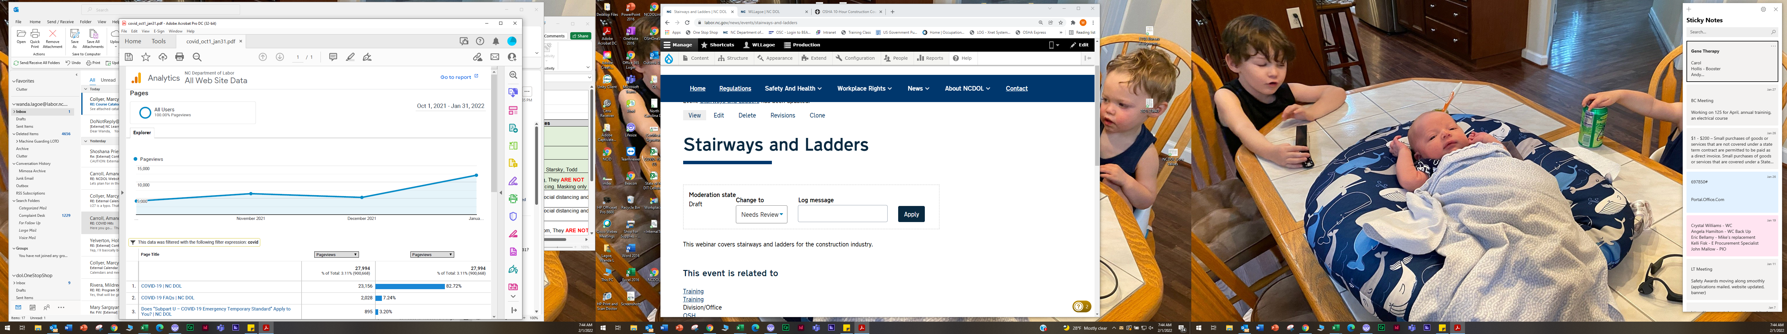
OSH Division
COVID-19 Activities
FFY 2020—2022
COVID-19 Safety and Health Topic Page
FFY 2020
FFY 2021
FFY 2022
Total: 89,037

Slide 43

Thank You For Attending!
FFY 2022—1st Qtr.
Questions?
1-800-NC-LABOR
(1-800-625-2267)
www.labor.nc.gov
Notes:
43

