Slide 1
North Carolina Department of Labor
Occupational Safety & Health Division
OSH Advisory Council
Spring 2022
Presented by:
Occupational Safety and Health Division of North Carolina
*Preliminary Data
Notes:
The information in this presentation is provided voluntarily by the N.C. Department of Labor, Education Training and Technical Assistance Bureau as a public service and is made available in good faith. This presentation is designed to assist trainers conducting OSHA outreach training for workers. Since workers are the target audience, this presentation emphasizes hazard identification, avoidance, and control – not standards. No attempt has been made to treat the topic exhaustively. It is essential that trainers tailor their presentations to the needs and understanding of their audience.
The information and advice provided on this Site and on Linked Sites is provided solely on the basis that users will be responsible for making their own assessment of the matters discussed herein and are advised to verify all relevant representations, statements, and information.
This presentation is not a substitute for any of the provisions of the Occupational Safety and Health Act of North Carolina or for any standards issued by the N.C. Department of Labor. Mention of trade names, commercial products, or organizations does not imply endorsement by the N.C. Department of Labor.

Slide 2
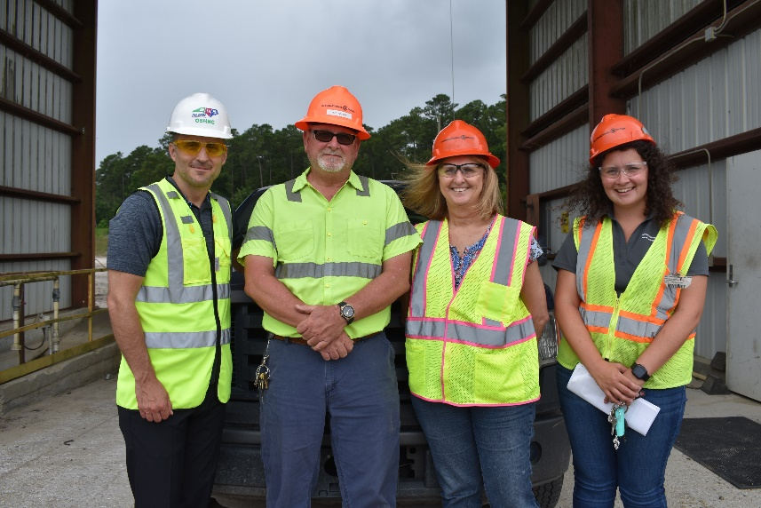
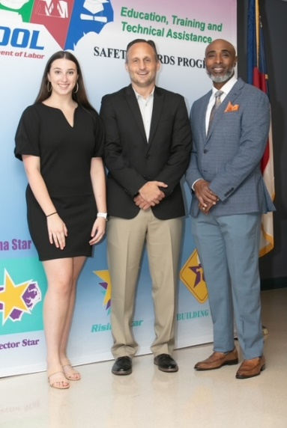
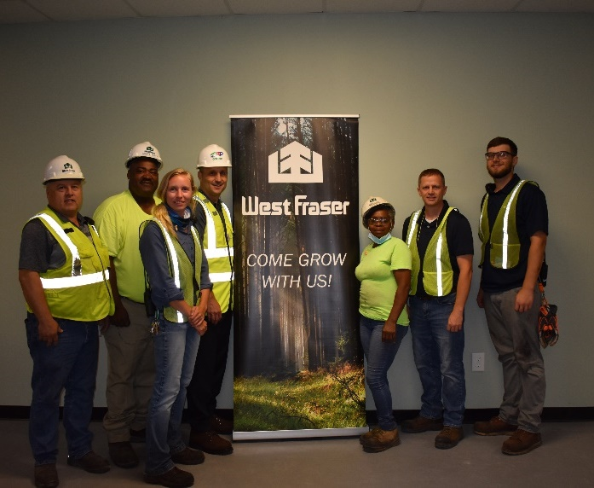
N.C. Workplace Safety and Health
TRC and DART Rate Comparison
FFY 2022—Spring
CY 2020 | North Carolina |  | National Average |  | Comparison
TRC Rate | 2.1 | 2.2* | 2.7 | 2.9* | 22% Lower/24% Lower*
DART Rate | 1.3 | 1.3* | 1.7 | 1.8* | 24% Lower/28% Lower*
*All industries including state and local government CY = Calendar Year
Notes:
North Carolina’s Total Recordable cases and DART rate continue to be lower that the National Average.
The DART rate stands for "Days Away, Restrictions and Transfers". This number is also based on trending over 200,000 hours but its not based on total injuries. Its based only on those injuries and illnesses severe enough to warrant "Days Away, Restrictions and Transfers".
The Total Recordable Case Rate (TRC) equals the division of all recordable cases by the hours worked, multiplied by 200'000 for standardization.

Slide 3
N.C. Workplace Safety and Health
Total Recordable Cases (TRC)
FFY 2022—Spring
4% Decrease
4% Increase
7% Decrease
4% Decrease
12% Decrease
All Industries Including State and Local Government
Based on Calendar Year

Slide 4
N.C. Workplace Safety and Health
Days Away, Restricted or Transferred (DART)
FFY 2022—Spring
No Change
7% Increase
7% Decrease
7% Decrease
No Change
All Industries Including State and Local Government
Based on Calendar Year

Slide 5
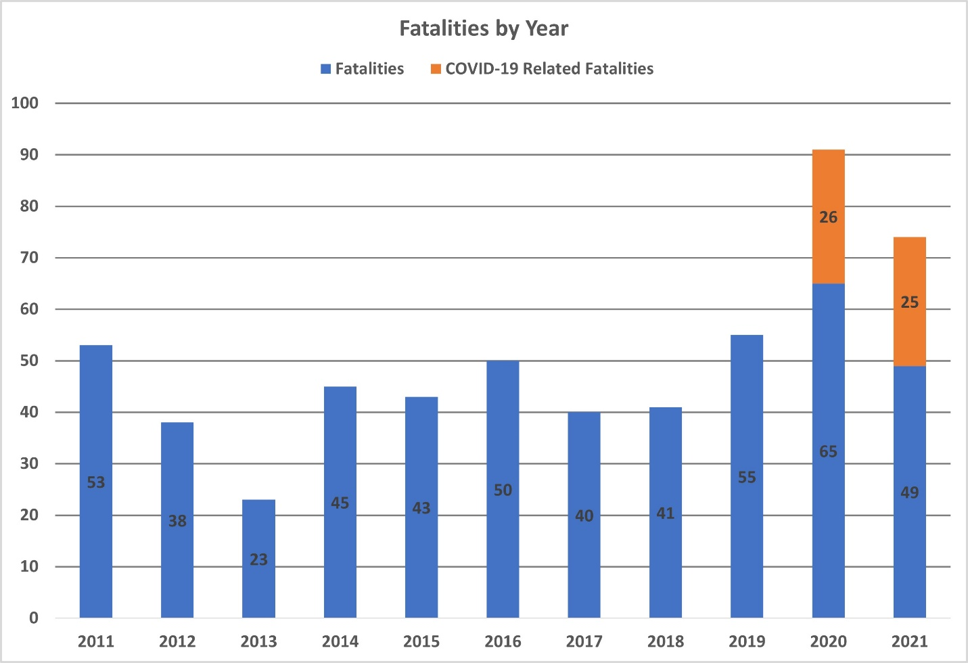
N.C. Workplace Safety and Health
Work-Related Fatalities in North Carolina
FFY 2022—Spring

Slide 6
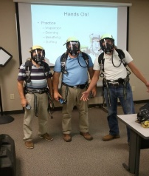
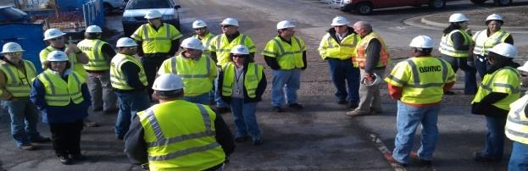

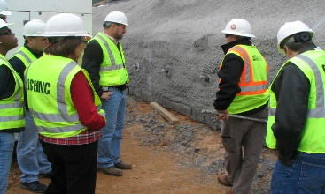
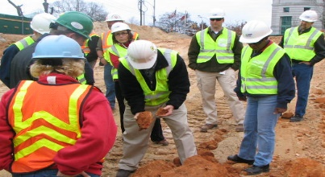
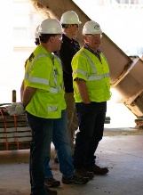
OSH Division
Fatalities Inspected
FFY 2022—Spring
FATALITY TYPE | Total | FATALITY TYPE | Total
Struck By | 5 | Inhalation | 0
Caught In/Between | 3 | Ingestion | 0
Bite/Sting/Scratch | 0 | Absorption | 0
Fall (Same Level) | 0 | Repeated Motion/Pressure | 0
Fall (From Elevation) | 2 | Cardio/Respiratory | 0
Struck Against | 0 | Shock | 3
Rubbed/Abraded | 0 | Other | 4
COVID-19 | 4 | Criminal Activity | 0
Fatalities Under OSH Division Jurisdiction
FFY 2021 |  | FFY 2022 | Total
Total Fatalities | 89 | Total Fatalities | 21
NCDOL Photo Library

Slide 7
OSH Division
Strategic Plan Goals
FFY 2022—Spring
COMPLIANCE | Total | FFY Goal
Safety Inspections | 535 | 1,145
Health Inspections | 386 | 755
Serious Hazards Eliminated | 1,211 | 4,100
CONSULTATION | Total | FFY Goal
Serious Hazards Eliminated | 2,561 | 5,000
Private and Public Sector Visits | 1,460 | 1,325
OSH DIVISION | Total | FFY Goal
Program Improvements | 1,078 | 2,060
People Trained in Special Emphasis Program Areas | 2,546 | 3,200
People Trained at OSH Division Sponsored Events | 3,572 | 5,350

Slide 8

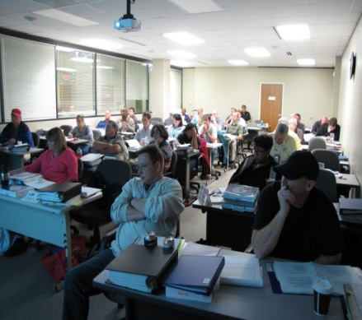
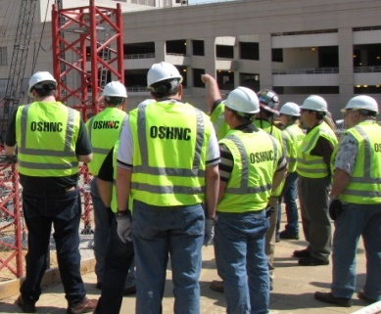

OSH Division
Strategic Plan Goals
FFY 2022—Spring
Education, Training and Technical Assistance (ETTA) | Total | FFY Goal
Publications Distributed | 21,093 | 35,000
Standards Interpretations | 1,391 | NA
Agricultural Safety and Health (ASH) | Total | FFY Goal
Outreach Materials Distributed | 4,260 | 2,400
Compliance Inspections | 20 | 50
Certificates Issued | 1,370 | 1,600
Preoccupancy Inspections | 1,543 | 1,800
NCDOL Photo Library

Slide 9
OSH Division
Complaint Desk*
FFY 2022—Spring
East Compliance | West Compliance | Agricultural Safety and Health
ACTIVITY | Total | Total | Total | Cumulative Total | FFY 2021
Complaints | 714 | 886 | 10 | 1,610** | 4,321
Referrals | 156 | 189 | 8 | 95 | 743
Fat/Cat | 45 | 48 | 2 | 95 | 227
Totals | 915 | 1,123 | 20 | 2,058 | 5,291
*Includes calls that were processed but not necessarily inspected. Fat/Cat includes calls regarding heart attacks and other natural causes.
**552 were COVID-19 related.
ACTIVITY | Cumulative Total
Complaints Not in OSH Jurisdiction | 1,733
*Includes complaints related to wage and hour, discrimination, worker's compensation questions, beyond statute of limitation time frame, etc.
Notes:
Complaints, referrals, fatality and catastrophe inspections account for a significant amount of inspections that compliance does every year. This slide puts that into perspective.

Slide 10
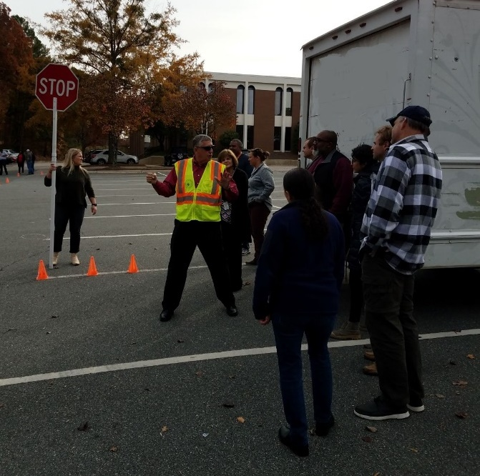
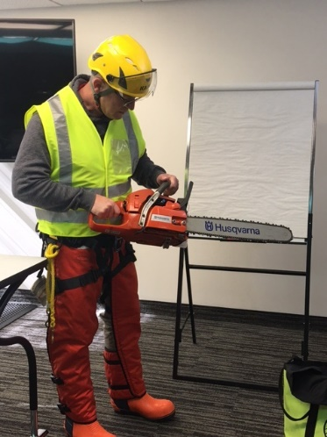
Strategic Plan
Special Emphasis Programs (SEP)
FFY 2022—Spring
Construction
Logging and Arboriculture
Long Term Care Facilities
Health Hazards
Food Manufacturing
Grocery and Related Product Wholesalers
Amputations
2019 – 2023 Strategic Management Plan
Goal #1 – Reduce fatalities by 2%
Goal #2 – Reduce injuries and illnesses by 5%
Notes:
FFY 2019 - 2023
OSHNC Outcome Goal #1 By the end of FY 2023, reduce the rate of workplace fatalities by 2% OSHNC Outcome Goal #2 By the end of FY 2023, reduce the rate of workplace injuries and illnesses by 5%

Slide 11

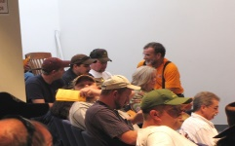
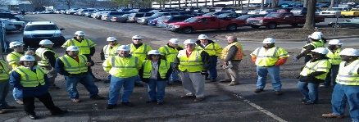
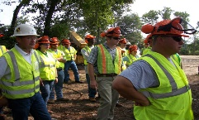

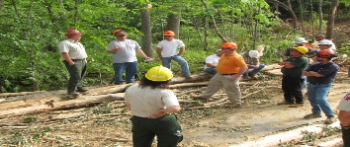
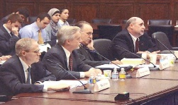

Special Emphasis Program
Construction
FFY 2022—Spring
 | North Carolina |  |  |  | National Average |  |  |  | North Carolina vs. National Average
 | CY 2019 |  | CY 2020 |  | CY 2019 |  | CY 2020 |  | 2020 Comparison
TRC | 1.6 | 20% Increase |  | 2.0 | 2.8 | 11% Decrease |  | 2.5 | 20% Lower
DART | 0.8 | 20% Increase |  | 1.0 | 1.7 | 6% Decrease |  | 1.6 | 37% Lower
SEP ACTIVITY | Total | FFY Goal
Compliance Inspections | 413 | 1,050
Consultative Visits | 203 | 250
OSH Outreach Events (10- and 30- Hour Construction Courses) | 5 | 6
People Trained | 268 | 1,000

Slide 12
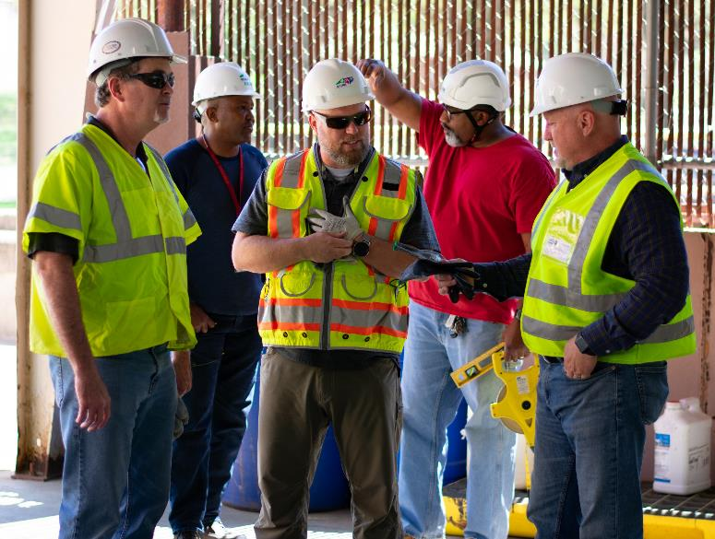
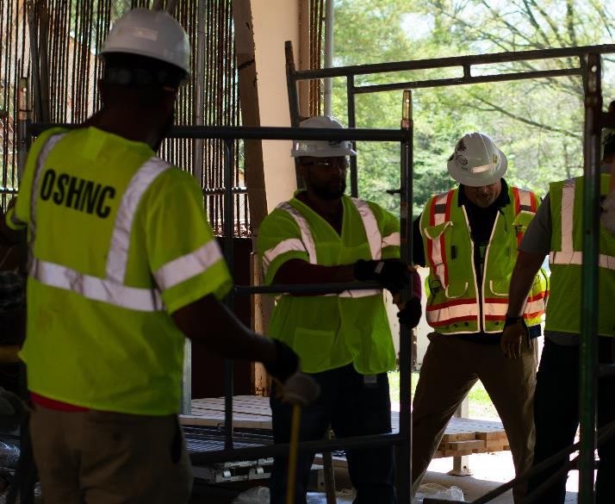

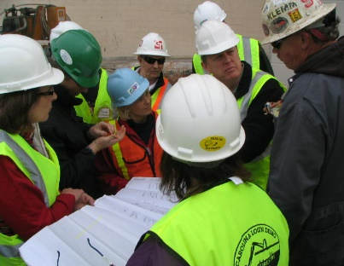
Special Emphasis Program
Construction
FFY 2022—Spring
NAICS 23—CONSTRUCTION | FFY 2021 |  | FFY 2022 Total
Total Fatalities | 18 |  | 9
FFY 2021 4th Qtr. Fatality Rate |  |  | 0.0017
Fatality Type | Total | Fatality Type | Total
Struck By | 3 | Inhalation | 0
Caught In/Between | 0 | Ingestion | 0
Bite/Sting/Scratch | 0 | Absorption | 0
Fall (Same Level) | 0 | Repeated Motion/Pressure | 0
Fall (From Elevation) | 2 | Cardio/Respiratory | 0
Struck Against | 0 | Shock | 3
Rubbed/Abraded | 0 | Other | 1
Notes:
ETTA Events Total: 9 (4 Labor One, 4 Webinars, 1 Speaker Bureau )
Total Trained: 305
Consultation Events: 16
Total Trained: 1400
A total of 16 events were served by Rod Wilce. Activities included but are not limited to; event speakers, vendor demonstrations, fall protection training sessions, equipment inspections, distribution of Fed provided resource material, meals i.e. 700 Chic Filet sandwiches, countless doughnuts, full catered lunches. These 16 events provided the intended distribution of information and training to in excess 1400 employees within a 50 mile radius of Raleigh.
Used Billboards for Fall Stand Down, Safe and Sound Week, and Heat Stress.

Slide 13
Special Emphasis Program
Logging and Arboriculture
FFY 2022—Spring
56173 | North Carolina |  |  |  | National Average |  |  |  | North Carolina vs. National Average
 | CY 2019 |  | CY 2020 |  | CY 2019 |  | CY 2020 |  | 2020 Comparison
TRC | 3.9 | 36% Decrease |  | 2.5 | 3.9 | 23% Decrease |  | 3.0 | 17% Lower
DART | 1.6 | No Change |  | 1.6 | 2.5 | 20% Decrease |  | 2.0 | 20% Lower
SEP ACTIVITY | Total | FFY Goal
Compliance Inspections | 6 | 25
Consultative Visits | 4 | 15
OSH Training and Outreach Events | 6 | 3
People Trained | 134 | 75
NAICS 11331*—LOGGING | FFY 2021 |  | FFY 2022
Total Fatalities | 1 |  | 0
NAICS 56173—ARBORICULTURE | FFY 2021 |  | FFY 2022
Total Fatalities | 5 |  | 0
FFY 2021 4th Qtr. Combined Fatality Rate |  |  | 0.0070
* TRC/DART Data not available
Notes:
NC TRC/DART rate not available for the 5 digit NAICS code
Logging fatalities went down but arboriculture went up.
Meeting minutes: Looking at alliances within the arboriculture industry. Encourage increased inspections in the SEP. Take a less experienced/confident CSHO out for familiarization. Continue to offer assistance and guidance where you/we can and provide referrals to Consultative or Compliance where appropriate. When conducting inspections on construction sites, public sector, or other activities where the employer/employees are conducting tree trimming/removal operations, please continue to mark the Emphasis/Initiatives blocks according to OPN 88I.

Slide 14
Special Emphasis Program
Long Term Care Facilities
FFY 2022—Spring
NAICS 623*—LONG TERM CARE
 | North Carolina |  |  |  | National Average |  |  |  | North Carolina vs. National Average
 | CY 2019 |  | CY 2020 |  | CY 2019 |  | CY 2020 |  | 2020 Comparison
TRC | 5.0 | 46% Increase |  | 9.3 | 5.9 | 49% Increase |  | 11.5 | 29% Lower
DART | 3.4 | 53% Increase |  | 7.2 | 3.5 | 62% Increase |  | 9.3 | 23% Lower
*TRC/DART rate based on the 3-digit NAICS code
SEP ACTIVITY | Total | FFY Goal
Compliance Inspections | 11 | 24
Consultative Visits | 15 | 35
OSH Outreach Events | 0 | 2
People Trained | 0 | 40

Slide 15

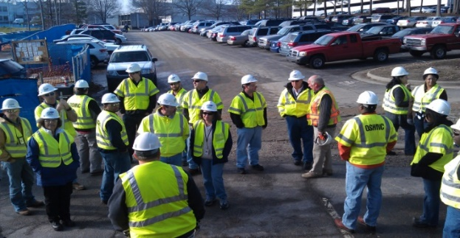
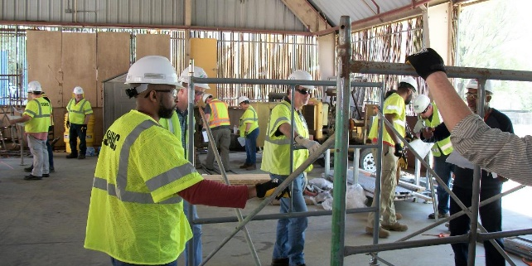
Special Emphasis Program
Health Hazards
FFY 2022—Spring
COMPLIANCE INSPECTIONS | Total | FFY Goal
Silica | 19 | 60
Asbestos | 4
Isocyanates | 5
Lead | 2
Hexavalent Chromium | 2
Total | 31*
Program Improvements | 9 | 20
*Some inspections involved more than one health hazard and generally included a program improvement

Slide 16


Special Emphasis Program
Health Hazards
FFY 2022—Spring
HEALTH HAZARDS | Consultative Surveys
 | Total
Silica | 53
Asbestos | 8
Isocyanates | 4
Lead | 15
Hexavalent Chromium | 6
Total | 86
FFY Goal | 125
NCDOL Photo Library
NCDOL Photo Library
SEP ACTIVITY | Total | FFY Goal
OSH Outreach Events | 10 | 20
People Trained | 135 | 300

Slide 17
Special Emphasis Program
Food Manufacturing
FFY 2022—Spring
NAICS 311*—FOOD MANUFACTURING
 | North Carolina |  |  |  | National Average |  |  |  | North Carolina vs. National Average
 | CY 2019 |  | CY 2020 |  | CY 2019 |  | CY 2020 |  | 2020 Comparison
TRC | 2.9 | 24% Increase |  | 3.8 | 4.0 | 22% Increase |  | 5.1 | 25% Lower
DART | 2.1 | 30% Increase |  | 3.0 | 2.8 | 28% Increase |  | 3.9 | 23% Lower
*TRC/DART rate based on the 3-digit NAICS code
SEP ACTIVITY | Total | FFY Goal
Compliance Inspections | 11 | 25
Consultative Visits | 13 | 12
OSH Outreach Events | 1 | 2
People Trained | 9 | 40

Slide 18
Special Emphasis Program
Grocery and Related Product Wholesalers
FFY 2022—Spring
NAICS 4244*—GROCERY AND RELATED WHOLESALERS
 | North Carolina |  |  |  | National Average |  |  |  | North Carolina vs. National Average
 | CY 2019 |  | CY 2020 |  | CY 2019 |  | CY 2020 |  | 2020 Comparison
TRC | 5.2 | 23% Decrease |  | 4.1 | 4.8 | 2% Increase |  | 4.9 | 16% Lower
DART | 4.0 | 22% Decrease |  | 3.1 | 3.7 | 7% Increase |  | 4.0 | 22% Lower
*DART/TRC rate based on the 4-digit NAICS code
SEP ACTIVITY | Total | FFY Goal
Compliance Inspections | 17 | 20
Consultative Visits | 2 | 3
OSH Outreach Events | 1 | 2
People Trained | 9 | 40

Slide 19

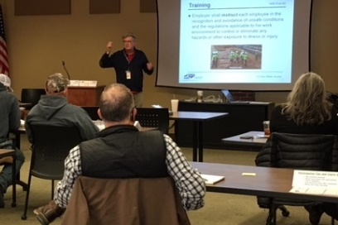
Special Emphasis Program
Amputations
FFY 2022—Spring
SEP ACTIVITY | Total | FFY Goal
Compliance Inspections | 69 | 150
Consultative Visits | 69 | 100
OSH Outreach Events | 26 | 15
People Trained | 435 | 400

Slide 20
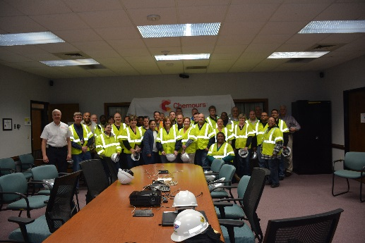
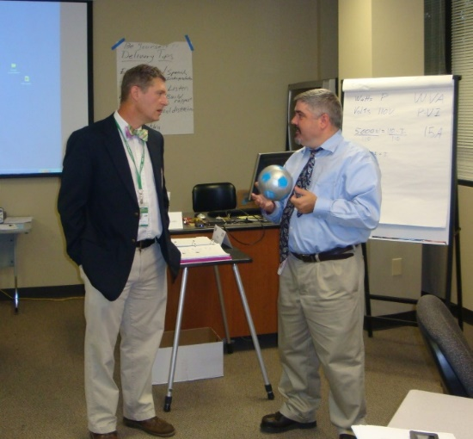
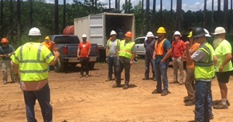
OSH Division
Public Sector
FFY 2022—Spring
 | CY 2019 |  | CY 2020
TRC | 3.6 | 14% Increase |  | 4.2
DART | 2.1 | 16% Increase |  | 2.5
ACTIVITY | Total | FFY Goal
Compliance Inspections | 41 | 100
Consultative Visits | 123 | 210
OSH Outreach Events/Booths | 11 | 6
Trained | 456 | 600

Slide 21
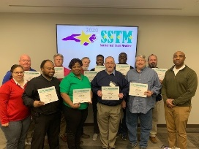
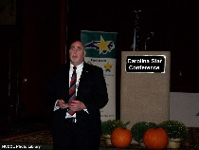
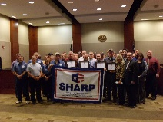
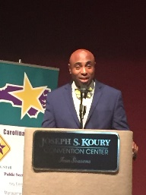
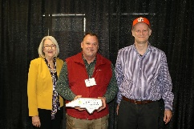
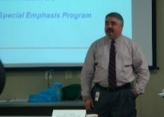
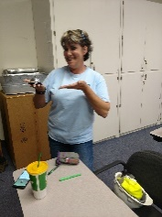

OSH Division
Recognition Programs
FFY 2022—Spring
STAR SITES—New, Recertification, Promotion | Total | FFY Goal | Approved Star Sites*
Carolina Star | 5 |  | 102
Building Star | 3 |  | 24
Rising Star | 0 |  | 4
Public Sector Star | 1 |  | 19
Total | 9 | 20 | 149
*Cumulative Total
NCDOL Photo Library
 | Total | FFY Goal
Star Sites—Termination/Withdrawn | 1 | NA
Star Presentations | 11 | 10
Star Program Interventions | 41 | 100
Star Booths | 0 | NA

Slide 22

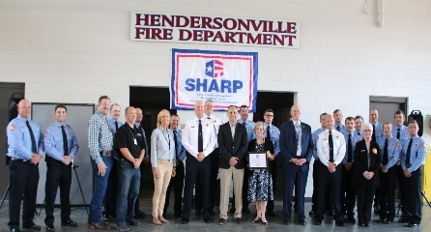
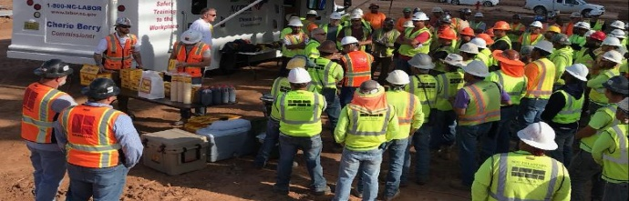
OSH Division
Recognition Programs
FFY 2022—Spring
SHARP SITES—New/Renewals | Total | FFY Goal | Approved SHARP Sites*
SHARP—Construction | 1 |  | 3
SHARP—General Industry | 29 |  | 104
SHARP—Public Sector | 18 |  | 49
Total | 48 | 60 | 156
*Cumulative Total
GOLD STAR GROWERS—New | Total
 | 231
SAFETY AWARDS | Total
CY 2021 Safety Awards Season (Silver, Gold, Million Hour) | 2,428
 | Total
Million Hour Awards | 45

Slide 23


OSH Division
Alliances and Partnerships
FFY 2022—Spring
Alliances
  Carolinas AGC
  Lamar Advertising Company
  Mexican Consulate
  N.C. State – Industry Expansion Solutions
  Safety and Health Council of NC
  NUCA of the Carolinas
  NCALGESO

Slide 24
OSH Division
Alliances and Partnerships
FFY 2022—Spring
Partnerships
  Barringer Construction
    Charlotte - Foundry Building Including Ancillary Buildings (2020 – 2023)
  Holder – Edison Foard – Leeper, A Joint Venture
    Charlotte - Charlotte Douglas International Airport – Terminal Lobby Expansion (2021 – 2023)
  Jacobs Engineering Group
    Holly Springs - Biotech Manufacturing Facility and Campus (2022 – 2024)

Slide 25
OSH Division
Education and Training Outreach
FFY 2022—Spring
OUTREACH EVENT | Total | FFY Goal
General Industry—10 Hour Course | 4 | 4
General Industry—30 Hour Course | 2 | 1
NC #500/502—Construction Train the Trainer Course NC #501/503—General Industry Train the Trainer Course | 0 | 1
Construction—10 Hour Course | 3 | 5
Construction—30 Hour Course | 2 | 1
Labor One/Booth Events | 4 | NA
Speaker’s Bureau | 42 | NA
Webinars | 27 | NA
OSH Workshops | 0 | NA
Technical Assistance | 0 | NA
Spanish Training and Outreach Events | 0 | NA
Train the Trainer Program (Construction/General Industry)—Events | 1 | NA
Train the Trainer Program (Construction/General Industry)—Trained | 5 | NA

Slide 26
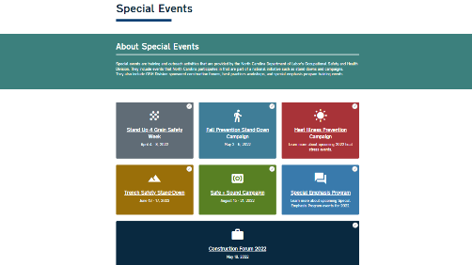
OSH Division
Education and Training Outreach
FFY 2022—Spring
Stand Downs/Forums
  Stand Up 4 Grain Safety Week (April 4 - 8)
  Fall Prevention Stand-Down (May 2 - 6)
  Construction Forum (May 18)
  Heat Illness Prevention (All Summer)
  Trench Safety Stand-Down (June 13 - 17)
  Safe + Sound (August 15 - 21)

Slide 27
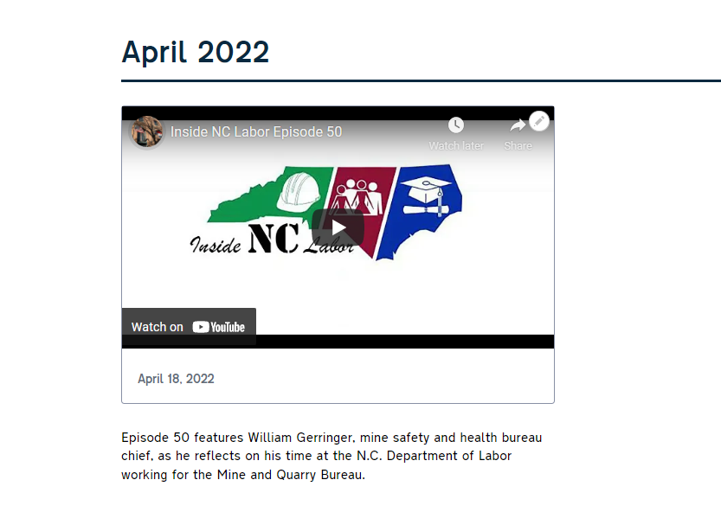
OSH Division
Social Media
FFY 2022—Spring
Inside NC Labor Podcasts
  50 episodes
Facebook
  1,973 followers
Instagram
  641 followers
Twitter
  2,111 followers

Slide 28
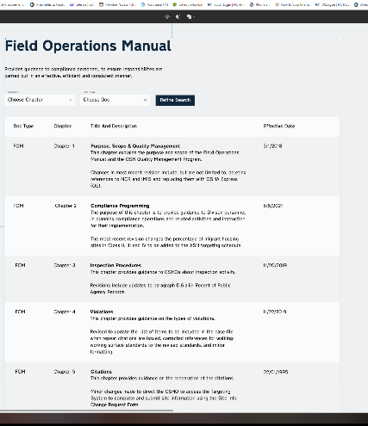
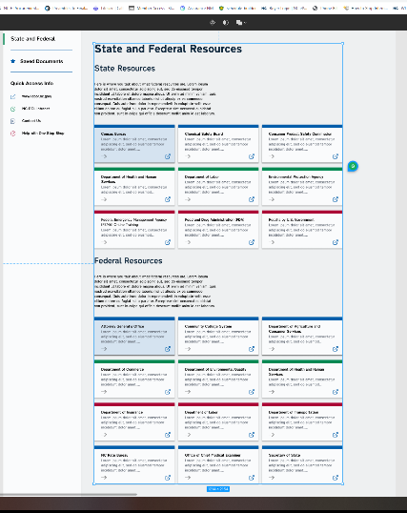
OSH Division
New Initiatives
FFY 2022—Spring
Biznet - Online Registration System
  Internal and external training
Babbel - Online Spanish Training
  Thirty seats for internal staff
One Stop Shop Upgrade

Slide 29
OSH Division
Standards Section—New/Revisions
FFY 2022—Spring
Compliance Directive
  CPL 02-00-165—Compliance Directive for the Excavation Standard, 29 CFR 1926, Subpart P
    This instruction provides guidance and inspection procedures for the enforcement of Subpart P.
Memorandum of Understanding
  DHHS-MOU4—NCDHHS – Occupational Health Surveillance Program
    Updated current procedures for referrals between agencies.
  USDOL-MOU1 – USDOL Wage and Hour Division

Slide 30
OSH Division
Standards Section—New/Revisions
FFY 2022—Spring
Operational Procedure Notice
  OPN 123X—Special Emphasis Program for Construction Activities
    Changes include updates to SEP counties and statistics.
  OPN 128W—Public Sector Surveys and Inspections
    Changed reference years for OSHA 300 logs and DART rates.
Memos
  COV 6—Repeal – Healthcare Emergency Temporary Standard on Occupational Exposure to COVID-19
    Repealed in NC effective March 4, 2022. This memo provides information and enforcement guidance related to the repeal.

Slide 31
OSH Division
Standards Section—New Publications
FFY 2022—Spring
Example Programs
  Heat Illness Prevention Program
  Assured Equipment Grounding Conductor Program
  Chemical Hygiene Plan
  Fire Prevention Plan
  HAZWOPER
  Process Safety Management Program

Slide 32
OSH Division
Cut-Loose, In-Training, Vacant
FFY 2022—Spring
West Compliance | Safety | % | Industrial Hygienist | %
Cut Loose | 17 | 58% | 21 | 81%
In-Training | 6 | 21% | 0 | 0%
Vacant | 6 | 21% | 5 | 19%
Total | 29* |  | 26
*One safety position eliminated.
East Compliance | Safety | % | Industrial Hygienist | %
Cut Loose | 10 | 43% | 4 | 24%
In-Training | 5 | 20% | 4 | 33%
Vacant | 8 | 35% | 9 | 53%
Total | 23** |  | 17**
**Two safety positions and one health position eliminated.
Safety Cut Loose | 52% | Health Cut Loose | 58%
Safety In-Training | 21% | Health in-Training | 9%
Safety Vacant | 27% | Health Vacant | 33%

Slide 33
OSH Division
Cut-Loose, In-Training, Vacant
FFY 2022—Spring
Consultative Services | Safety | % | Industrial Hygienist | %
Cut Loose | 8 | 73% | 8 | 100%
In-Training | 1 | 9% | 0 | 0%
Vacant | 2 | 18% | 0 | 0%
Total | 11 |  | 8
Education, Training and Technical Assistance | Safety | % | Industrial Hygienist | %
Cut Loose | 10 | 91% | 6 | 100%
In-Training | 1 | 9% | 0 | 0%
Vacant | 0 | 0% | 0 | 0%
Total | 11 |  | 6
Agricultural Safety and Health | Safety | % | Industrial Hygienist
Cut Loose | 5 | 63% | NA
In-Training | 1 | 13% | NA
Vacant | 2 | 25% | NA
Total | 8

Slide 34
Recent Actions Taken to Attract/Retain Safety and Health Professionals
FFY 2022—Spring
4/21 – $3,000 hiring bonus policy for CSHOs instituted
12/21 – State employees making less than $75k received $1,500; those making more than $75k, received $1,000 bonus
1/22 – State employees received 2.5% increase, retroactive to 7/1
2/22 – All NCDOL employees received $2500 bonus related to working through the pandemic
4/22 – NCDOL/OSH established new minimum salaries for S&H professionals, resulting in increases for approx. 80% of positions
7/1 – 2.5% LI

Slide 35
OSH Division
Salary Increases
FFY 2022—Spring
SCO I/Safety Trainer – min $58,000 ($8,004 above grade minimum)
HCO I/SCOII/Health Trainer – min $60,900 ($4,565 above grade minimum)
HCO II/Safety Consultant/ETTA Standards Officer/STAR Safety Consultant – min $63,945
Average increase of 133 S&H professionals was $5,493
Minimum salaries – entry levels, OSH tenure, certifications
Increases required $991,295 for salary/benefits
Funding sources – position cuts, reallocation, salary reserve

Slide 36
OSH Division
COVID-19
FFY 2022—Spring
COVID-19 ETS – Vaccination and Testing
  January 26, 2022 – Federal OSHA Repealed ETS2
COVID-19 ETS – Healthcare
  December 21, 2021 – Expired except 29 CFR 1910.502(q)(2)(ii), (q)(3)(ii)-(iv), and (r)]
  North Carolina repealed ETS1 – March 4, 2022
    North Carolina – Rule Making on the Recordkeeping Components
  OSHA working on COVID-19 Healthcare Rule

Slide 37
OSH Division
COVID-19 Activities
FFY 2022—Spring
Calls/Emails | FFY 2020* | FFY 2021** | FFY 2022*** | FFY 2020-22
Director's Office | 2,143 | 1,581 | 931 | 4,655
ETTA | 1,347 | 623 | 450 | 2,420
ASH***** | 341 | 529 | 169 | 1,039
PSIM | 11 | 0 | 0 | 11
CSB | 1,084 | 440 | 225 | 1,749
Totals | 4,926 | 3,173 | 1,775 | 9,874
*FFY 2020 includes data from March 1 (estimated), 2020 through October 2, 2020.
**FFY 2021 includes data from October 2, 2020, through October 3, 2021.
***FFY 2022 includes data from October 4, 2021, through April 1, 2021.

Slide 38
OSH Division
COVID-19 Activities
FFY 2022—Spring
Director’s Office | FFY 2020* | FFY 2021** | FFY 2022*** | FFY 2020-22
Meetings | 102 | 93 | 48 | 243
Compliance | FFY 2020* | FFY 2021** | FFY 2022*** | FFY 2020-22
Valid Complaints | 1,012 | 1,325 | 389 | 2,726
Non-Valid Complaints | 1,402 | 1,141 | 161 | 2,705
Inspections | 22 | 97 | 20 | 156
Referrals | 51 | 45 | 23 | 119
Unprocessed Complaints***** | 1,107 | 595 | 147 | 1,849
*FFY 2020 includes data from March 1 (estimated), 2020 through October 2, 2020.
**FFY 2021 includes data from October 2, 2020, through October 3, 2021.
***FFY 2022 includes data from October 4, 2021, through April 1, 2021.
*****This data is preliminary and subject to change as unprocessed complaints are moved to other categories. Many of these unprocessed complaints contain insufficient information to process and/or they cover complaint items that do not fall under OSH jurisdiction. Referrals to other Agencies are made, as appropriate.
.

Slide 39
OSH Division
COVID-19 Activities
FFY 2022—Spring
PSIM | FFY 2020* | FFY 2021** | FFY 2022*** | FFY 2020-22
Disclosure Requests | 1,627 | 1,418 | 44 | 3,089
CSB | FFY 2020* | FFY 2021** | FFY 2022*** | FFY 2020-22
Interventions | 54 | 30 | 1 | 85
Visits | 157 | 367 | 151 | 675
ASH | FFY 2020* | FFY 2021** | FFY 2022*** | FFY 2020-22
Guidance Documents | 1 | 0 | 0 | 1
*FFY 2020 includes data from March 1 (estimated), 2020 through October 2, 2020.
**FFY 2021 includes data from October 2, 2020, through October 3, 2021.
***FFY 2022 includes data from October 4, 2021, through April 1, 2021.

Slide 40
OSH Division
COVID-19 Activities
FFY 2022—Spring
ETTA | FFY 2020* | FFY 2021** | FFY 2022*** | FFY 2020-22
Live Webinars | 28 | 19 | 1 | 48
Pre-recorded Webinars | 6 | 1 | 0 | 7
PowerPoints | 25 | 12 | 1 | 38
Hazard Alerts | 7 | 2 | 0 | 9
Streaming Videos | 72 | 62 | 9 | 143
A-Z Topics Added/Updated | 24 | 26 | 7 | 57
Fact Sheets | 4 | 9 | 0 | 13
Example Programs | 1 | 2 | 0 | 3
Compliance Memos | 10 | 3 | 3 | 16
Billboards | 0 | 5 | 0 | 5
*FFY 2020 includes data from March 1 (estimated), 2020 through October 2, 2020.
**FFY 2021 includes data from October 2, 2020, through October 3, 2021.
***FFY 2022 includes data from October 4, 2021, through April 1, 2021.

Slide 41
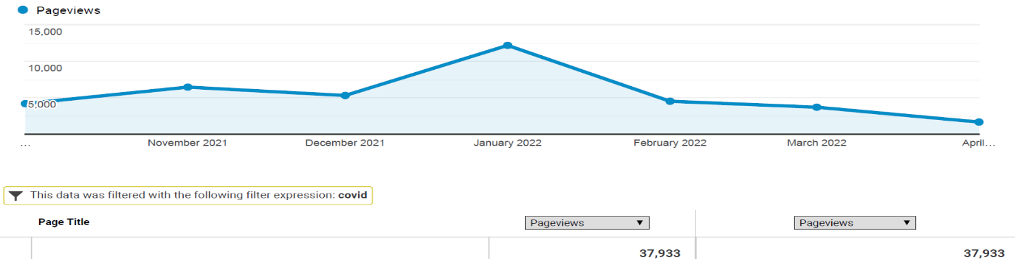
OSH Division
COVID-19 Activities
FFY 2022—Spring
COVID-19 Safety and Health Topic Page
FFY 2020
FFY 2021
FFY 2022
Total: 98,976

Slide 42
Other Federal OSHA News
Proposed Rulemaking - Heat Injury and Illness Prevention in Outdoor and Indoor Work Settings
Heat Related Hazards National Emphasis Program – Effective April 8, 2022
  North Carolina is reviewing for adoption
  OPN 141 – Enforcement Guidance for Conducting Heat-Related Illness Inspections and Issuing Citations

Slide 43

Thank You For Attending!
FFY 2022—Spring
Questions?
1-800-NC-LABOR
(1-800-625-2267)
www.labor.nc.gov
Notes:
43

