Slide 1
North Carolina Department of Labor Occupational Safety & Health Division OSH Advisory Council Fall 2022
Presented by:
Wanda Lagoe CSP ARM CPM
Education, Training and Technical Assistance
Occupational Safety and Health Division of North Carolina
*Preliminary Data
Notes:
The information in this presentation is provided voluntarily by the N.C. Department of Labor, Education Training and Technical Assistance Bureau as a public service and is made available in good faith. This presentation is designed to assist trainers conducting OSHA outreach training for workers. Since workers are the target audience, this presentation emphasizes hazard identification, avoidance, and control – not standards. No attempt has been made to treat the topic exhaustively. It is essential that trainers tailor their presentations to the needs and understanding of their audience.
The information and advice provided on this Site and on Linked Sites is provided solely on the basis that users will be responsible for making their own assessment of the matters discussed herein and are advised to verify all relevant representations, statements, and information.
This presentation is not a substitute for any of the provisions of the Occupational Safety and Health Act of North Carolina or for any standards issued by the N.C. Department of Labor. Mention of trade names, commercial products, or organizations does not imply endorsement by the N.C. Department of Labor.

Slide 2
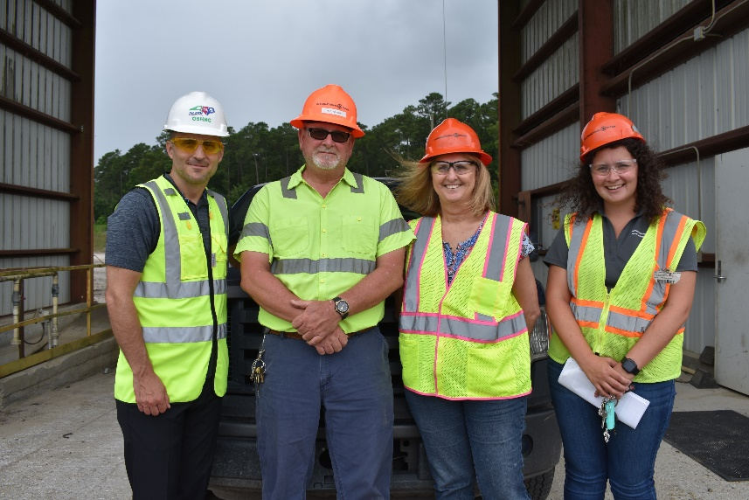
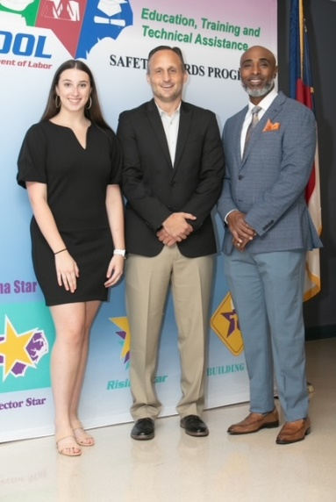
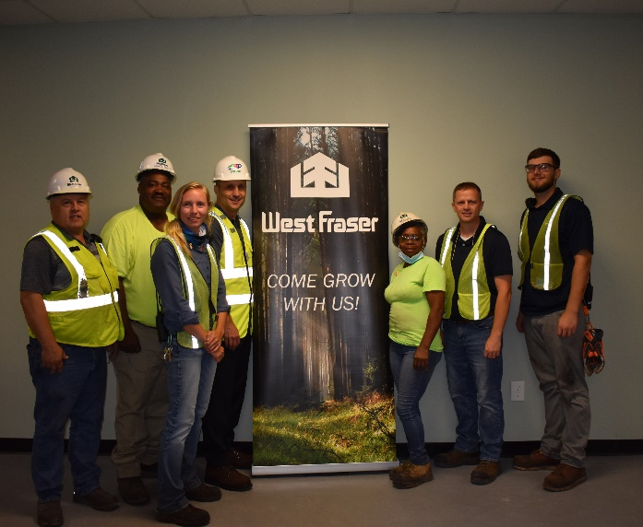
N.C. Workplace Safety and Health
TRC and DART Rate Comparison
FFY 2022—Fall
CY 2020 | North Carolina |  | National Average |  | Comparison
TRC Rate | 2.1 | 2.2* | 2.7 | 2.9* | 22% Lower/24% Lower*
DART Rate | 1.3 | 1.3* | 1.7 | 1.8* | 24% Lower/28% Lower*
*All industries including state and local government CY = Calendar Year
Notes:
North Carolina’s Total Recordable cases and DART rate continue to be lower that the National Average.
The DART rate stands for "Days Away, Restrictions and Transfers". This number is also based on trending over 200,000 hours but its not based on total injuries. Its based only on those injuries and illnesses severe enough to warrant "Days Away, Restrictions and Transfers".
The Total Recordable Case Rate (TRC) equals the division of all recordable cases by the hours worked, multiplied by 200'000 for standardization.

Slide 3
N.C. Workplace Safety and Health
Total Recordable Cases (TRC)
FFY 2022—Fall
4% Decrease
4% Increase
7% Decrease
4% Decrease
12% Decrease
All Industries Including State and Local Government
Based on Calendar Year

Slide 4
N.C. Workplace Safety and Health
Days Away, Restricted or Transferred (DART)
FFY 2022—Fall
No Change
7% Increase
7% Decrease
7% Decrease
No Change
All Industries Including State and Local Government
Based on Calendar Year

Slide 5
N.C. Workplace Safety and Health
Work-Related Fatalities in North Carolina
FFY 2022—Fall
Note: CY 2022 is preliminary data through August 31, 2022.
Calendar Year

Slide 6
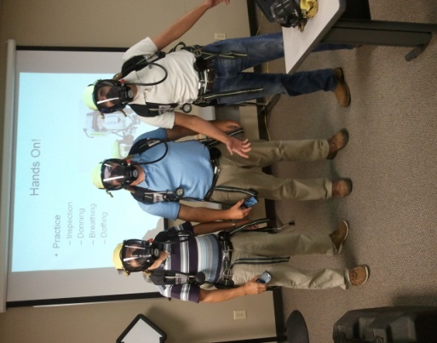
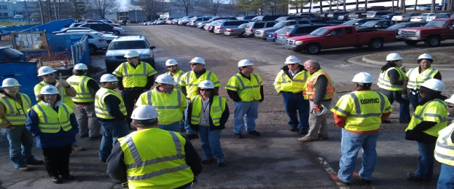

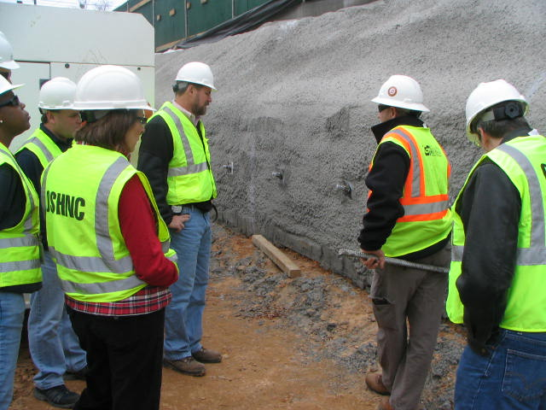
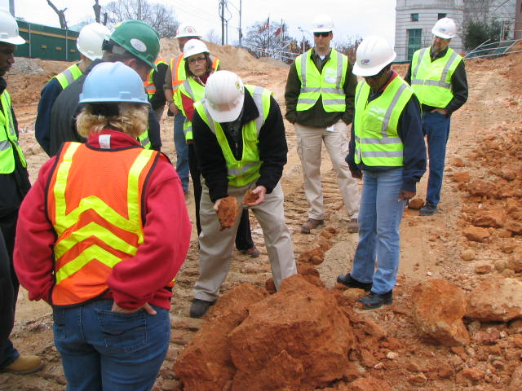
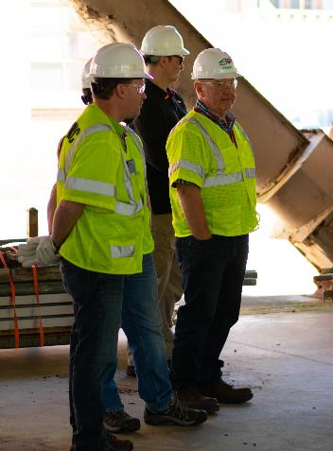
OSH Division
Fatalities Inspected
FFY 2022—Fall
FATALITY TYPE | Total | FATALITY TYPE | Total
Struck By | 15 | Inhalation | 0
Caught In/Between | 9 | Ingestion | 0
Bite/Sting/Scratch | 0 | Absorption | 0
Fall (Same Level) | 0 | Repeated Motion/Pressure | 0
Fall (From Elevation) | 15 | Cardio/Respiratory | 0
Struck Against | 1 | Shock | 6
Rubbed/Abraded | 0 | Other | 7
COVID-19 | 6 | Criminal Activity | 2*
Fatalities Under OSH Division Jurisdiction
FFY 2021 |  | FFY 2022 | Total
Total Fatalities | 90 | Total Fatalities | 61
NCDOL Photo Library
* Criminal activity is also counted in another fatality type.

Slide 7
OSH Division
Strategic Plan Goals
FFY 2022—Fall
COMPLIANCE | Total | FFY Goal
Safety Inspections | 1,113 | 1,145
Health Inspections | 780 | 755
Serious Hazards Eliminated | 3,472 | 4,100
CONSULTATION | Total | FFY Goal
Serious Hazards Eliminated | 5,839 | 4,800
Private and Public Sector Visits | 1,498 | 1,325
OSH DIVISION | Total | FFY Goal
Program Improvements | 2,154 | 2,060
People Trained in Special Emphasis Program Areas | 5,633 | 3,200
People Trained at OSH Division Sponsored Events | 7,221 | 5,350

Slide 8

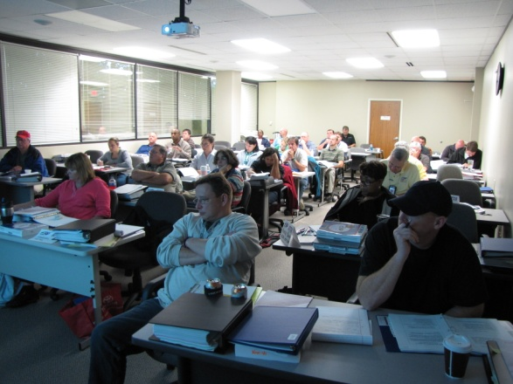
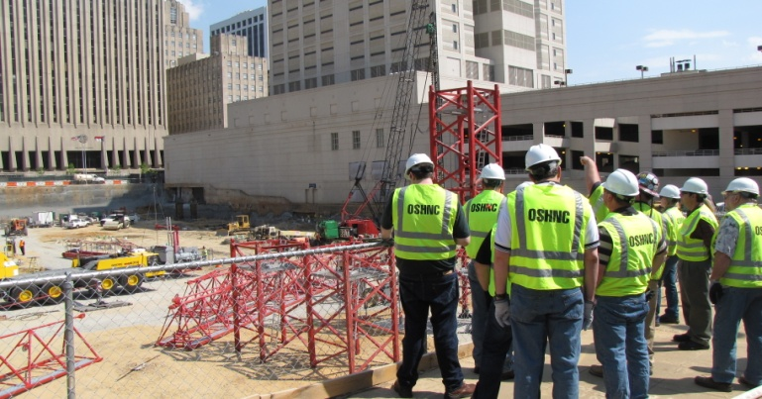

OSH Division
Strategic Plan Goals
FFY 2022—Fall
Education, Training and Technical Assistance (ETTA) | Total | FFY Goal
Publications Distributed | 38,806 | 35,000
Standards Interpretations | 2,681 | NA
Agricultural Safety and Health (ASH) | Total | FFY Goal
Outreach Materials Distributed | 6,752 | 2,400
Compliance Inspections | 52 | 50
Certificates Issued | 1,952 | 1,600
Preoccupancy Inspections | 2,037 | 1,800
NCDOL Photo Library

Slide 9
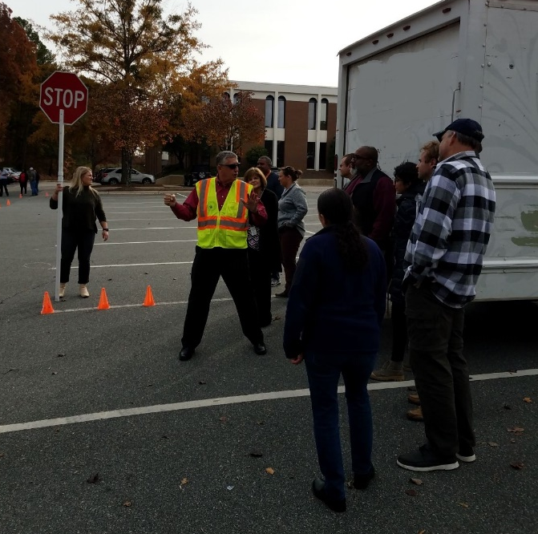
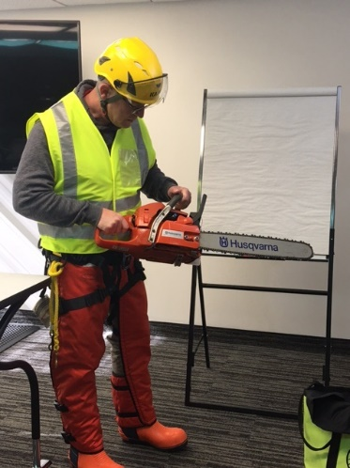
Strategic Plan
Special Emphasis Programs (SEP)
FFY 2022—Fall
Construction
Logging and Arboriculture
Long Term Care Facilities
Health Hazards
Food Manufacturing
Grocery and Related Product Wholesalers
Amputations
2019 – 2023 Strategic Management Plan
Goal #1 – Reduce fatalities by 2%
Goal #2 – Reduce injuries and illnesses by 5%
Notes:
FFY 2019 - 2023
OSHNC Outcome Goal #1 By the end of FY 2023, reduce the rate of workplace fatalities by 2% OSHNC Outcome Goal #2 By the end of FY 2023, reduce the rate of workplace injuries and illnesses by 5%

Slide 10

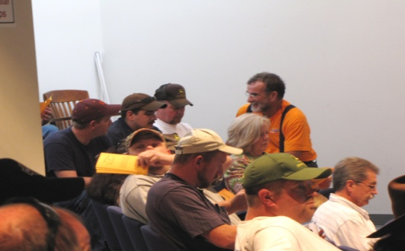
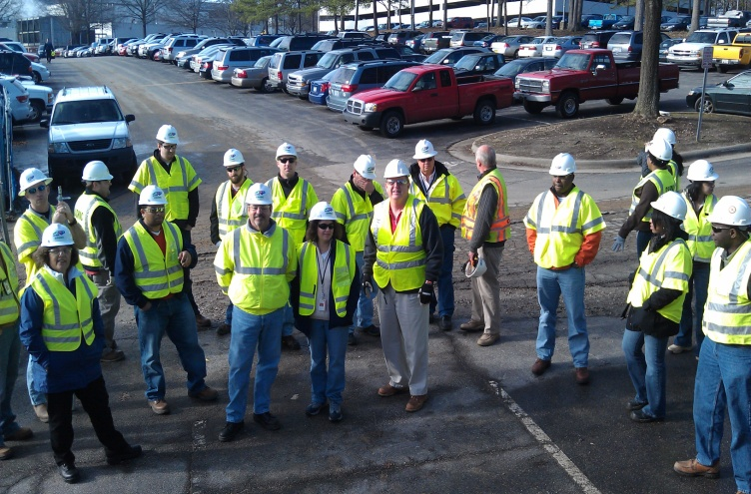
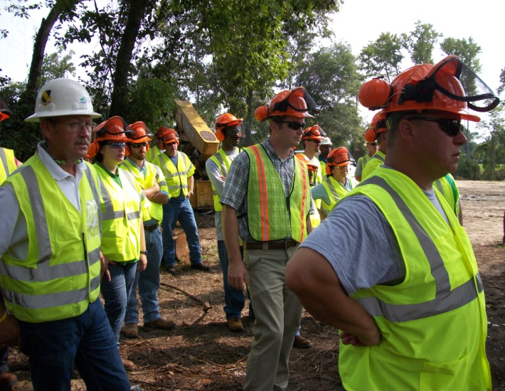

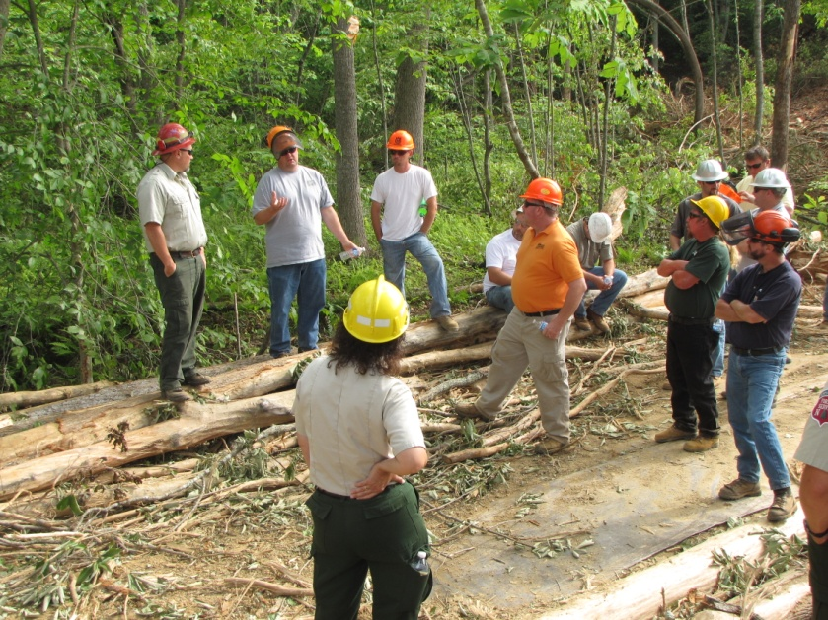
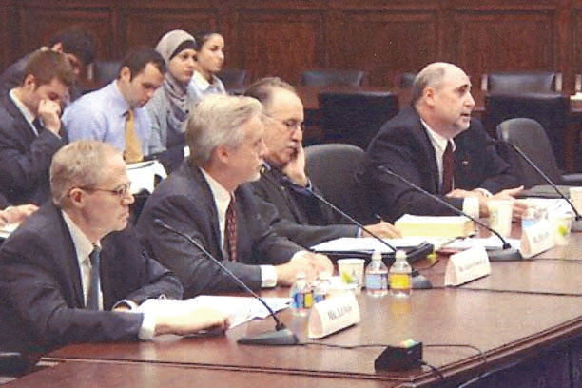

Special Emphasis Program
Construction
FFY 2022—Fall
 | North Carolina |  |  |  | National Average |  |  |  | North Carolina vs. National Average
 | CY 2019 |  | CY 2020 |  | CY 2019 |  | CY 2020 |  | 2020 Comparison
TRC | 1.6 | 20% Increase |  | 2.0 | 2.8 | 11% Decrease |  | 2.5 | 20% Lower
DART | 0.8 | 20% Increase |  | 1.0 | 1.7 | 6% Decrease |  | 1.6 | 37% Lower
SEP ACTIVITY | Total | FFY Goal
Compliance Inspections | 959 | 1,050
Consultative Visits | 435 | 250
OSH Outreach Events (10- and 30- Hour Construction Courses) | 7 | 6
People Trained | 802 | 1,000

Slide 11
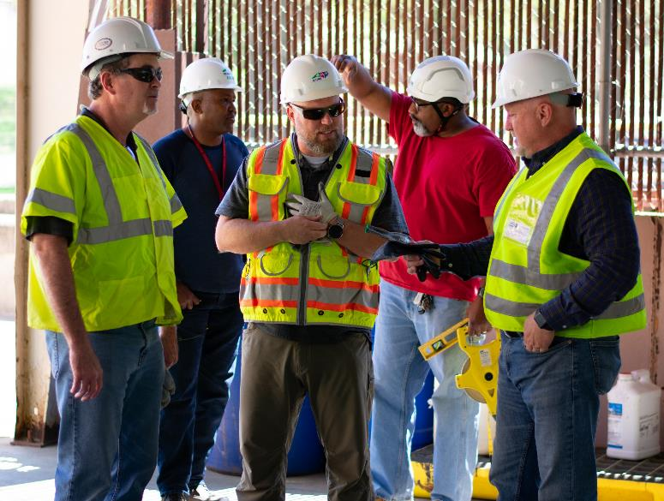
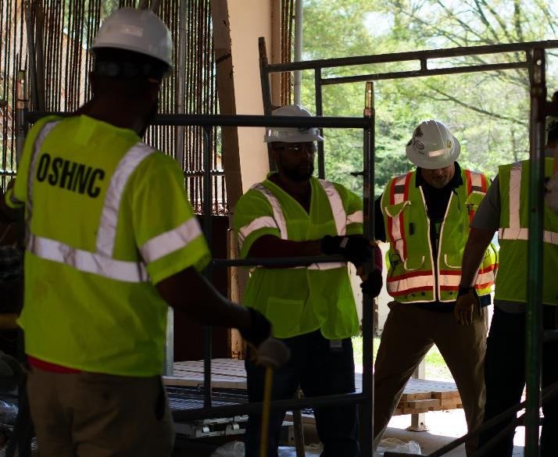

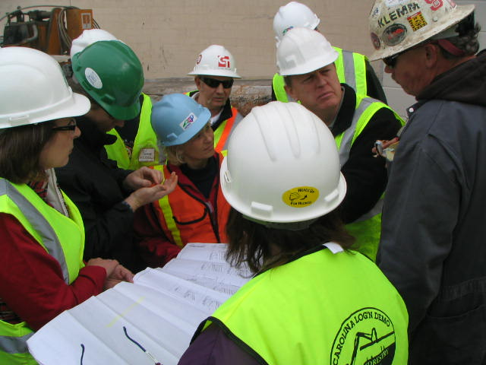
Special Emphasis Program
Construction
FFY 2022—Fall
NAICS 23—CONSTRUCTION | FFY 2021 |  | FFY 2022 Total
Total Fatalities | 18 |  | 22
Fatality Type | Total | Fatality Type | Total
Struck By | 5 | Inhalation | 0
Caught In/Between | 2 | Ingestion | 0
Bite/Sting/Scratch | 0 | Absorption | 0
Fall (Same Level) | 0 | Repeated Motion/Pressure | 0
Fall (From Elevation) | 8 | Cardio/Respiratory | 0
Struck Against | 1 | Shock | 5
Rubbed/Abraded | 0 | Other | 1
Notes:
ETTA Events Total: 9 (4 Labor One, 4 Webinars, 1 Speaker Bureau )
Total Trained: 305
Consultation Events: 16
Total Trained: 1400
A total of 16 events were served by Rod Wilce. Activities included but are not limited to; event speakers, vendor demonstrations, fall protection training sessions, equipment inspections, distribution of Fed provided resource material, meals i.e. 700 Chic Filet sandwiches, countless doughnuts, full catered lunches. These 16 events provided the intended distribution of information and training to in excess 1400 employees within a 50 mile radius of Raleigh.
Used Billboards for Fall Stand Down, Safe and Sound Week, and Heat Stress.

Slide 12
Special Emphasis Program
Logging and Arboriculture
FFY 2022—Fall
56173 | North Carolina |  |  |  | National Average |  |  |  | North Carolina vs. National Average
 | CY 2019 |  | CY 2020 |  | CY 2019 |  | CY 2020 |  | 2020 Comparison
TRC | 3.9 | 36% Decrease |  | 2.5 | 3.9 | 23% Decrease |  | 3.0 | 17% Lower
DART | 1.6 | No Change |  | 1.6 | 2.5 | 20% Decrease |  | 2.0 | 20% Lower
SEP ACTIVITY | Total | FFY Goal
Compliance Inspections | 29 | 25
Consultative Visits | 17 | 15
OSH Training and Outreach Events | 11 | 3
People Trained | 264 | 75
NAICS 11331*—LOGGING | FFY 2021 |  | FFY 2022
Total Fatalities | 1 |  | 1
NAICS 56173—ARBORICULTURE | FFY 2021 |  | FFY 2022
Total Fatalities | 5 |  | 4
* TRC/DART Data not available
Notes:
NC TRC/DART rate not available for the 5 digit NAICS code
Logging fatalities went down but arboriculture went up.
Meeting minutes: Looking at alliances within the arboriculture industry. Encourage increased inspections in the SEP. Take a less experienced/confident CSHO out for familiarization. Continue to offer assistance and guidance where you/we can and provide referrals to Consultative or Compliance where appropriate. When conducting inspections on construction sites, public sector, or other activities where the employer/employees are conducting tree trimming/removal operations, please continue to mark the Emphasis/Initiatives blocks according to OPN 88I.

Slide 13
Special Emphasis Program
Long Term Care Facilities
FFY 2022—Fall
NAICS 623*—LONG TERM CARE
 | North Carolina |  |  |  | National Average |  |  |  | North Carolina vs. National Average
 | CY 2019 |  | CY 2020 |  | CY 2019 |  | CY 2020 |  | 2020 Comparison
TRC | 5.0 | 46% Increase |  | 9.3 | 5.9 | 49% Increase |  | 11.5 | 29% Lower
DART | 3.4 | 53% Increase |  | 7.2 | 3.5 | 62% Increase |  | 9.3 | 23% Lower
*TRC/DART rate based on the 3-digit NAICS code
SEP ACTIVITY | Total | FFY Goal
Compliance Inspections | 29 | 24
Consultative Visits | 41 | 35
OSH Outreach Events | 3 | 2
People Trained | 27 | 40

Slide 14
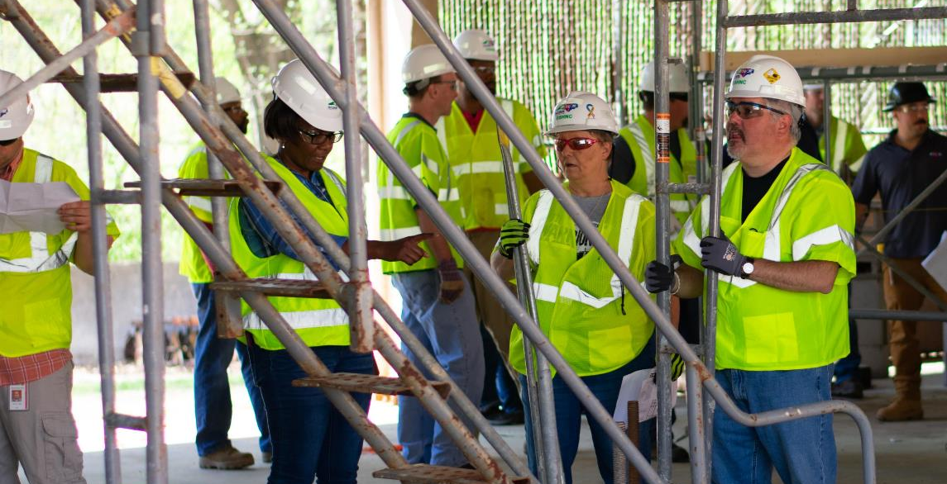

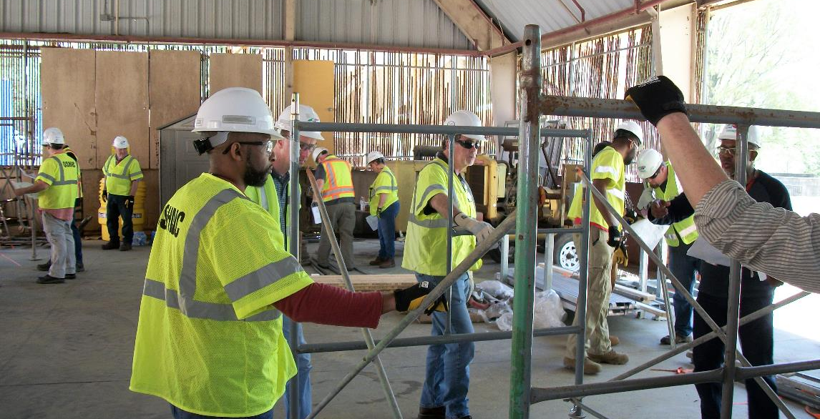
Special Emphasis Program
Health Hazards
FFY 2022—Fall
COMPLIANCE INSPECTIONS | Total | FFY Goal
Silica | 54 | 60
Asbestos | 19
Isocyanates | 18
Lead | 10
Hexavalent Chromium | 4
Total | 105
Program Improvements | 41 | 20
*Some inspections involved more than one health hazard and generally included a program improvement

Slide 15
Special Emphasis Program
Health Hazards
FFY 2022—Fall
HEALTH HAZARDS | Consultative Surveys
 | Total
Silica | 122
Asbestos | 16
Isocyanates | 9
Lead | 25
Hexavalent Chromium | 13
Total | 185
FFY Goal | 135
NCDOL Photo Library
NCDOL Photo Library
SEP ACTIVITY | Total | FFY Goal
OSH Outreach Events | 26 | 20
People Trained | 400 | 300

Slide 16
Special Emphasis Program
Food Manufacturing
FFY 2022—Fall
NAICS 311*—FOOD MANUFACTURING
 | North Carolina |  |  |  | National Average |  |  |  | North Carolina vs. National Average
 | CY 2019 |  | CY 2020 |  | CY 2019 |  | CY 2020 |  | 2020 Comparison
TRC | 2.9 | 24% Increase |  | 3.8 | 4.0 | 22% Increase |  | 5.1 | 25% Lower
DART | 2.1 | 30% Increase |  | 3.0 | 2.8 | 28% Increase |  | 3.9 | 23% Lower
*TRC/DART rate based on the 3-digit NAICS code
SEP ACTIVITY | Total | FFY Goal
Compliance Inspections | 39 | 25
Consultative Visits | 24 | 12
OSH Outreach Events | 2 | 2
People Trained | 61 | 40

Slide 17
Special Emphasis Program
Grocery and Related Product Wholesalers
FFY 2022—Fall
NAICS 4244*—GROCERY AND RELATED WHOLESALERS
 | North Carolina |  |  |  | National Average |  |  |  | North Carolina vs. National Average
 | CY 2019 |  | CY 2020 |  | CY 2019 |  | CY 2020 |  | 2020 Comparison
TRC | 5.2 | 23% Decrease |  | 4.1 | 4.8 | 2% Increase |  | 4.9 | 16% Lower
DART | 4.0 | 22% Decrease |  | 3.1 | 3.7 | 7% Increase |  | 4.0 | 22% Lower
*DART/TRC rate based on the 4-digit NAICS code
SEP ACTIVITY | Total | FFY Goal
Compliance Inspections | 21 | 20
Consultative Visits | 3 | 3
OSH Outreach Events | 3 | 2
People Trained | 15 | 40

Slide 18
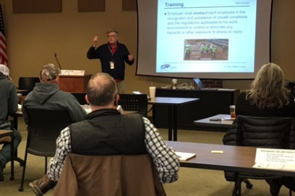
Special Emphasis Program
Amputations
FFY 2022—Fall
SEP ACTIVITY | Total | FFY Goal
Compliance Inspections | 169 | 150
Consultative Visits | 173 | 100
OSH Outreach Events | 39 | 15
People Trained | 681 | 400

Slide 19
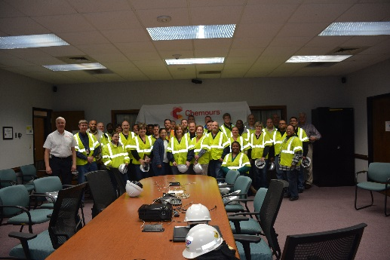
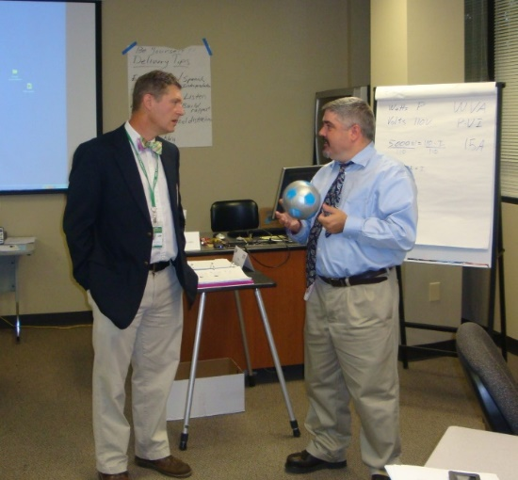
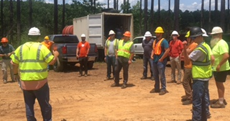
OSH Division
Public Sector
FFY 2022—Fall
 | CY 2019 |  | CY 2020
TRC | 3.6 | 14% Increase |  | 4.2
DART | 2.1 | 16% Increase |  | 2.5
ACTIVITY | Total | FFY Goal
Compliance Inspections | 94 | 100
Consultative Visits | 248 | 210
OSH Outreach Events/Booths | 26 | 6
Trained | 944 | 600

Slide 20
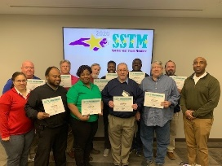
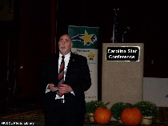
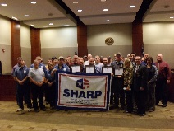
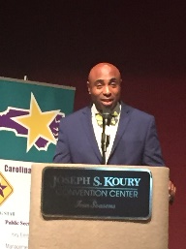
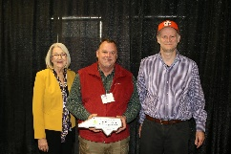
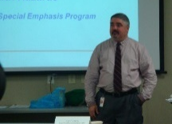
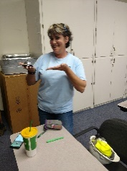
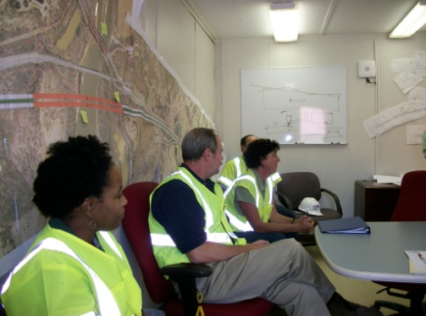
OSH Division
Recognition Programs
FFY 2022—Fall
STAR SITES—New, Recertification, Promotion | Total | FFY Goal | Approved Star Sites*
Carolina Star | 23 |  | 102
Building Star | 8 |  | 23
Rising Star | 1 |  | 4
Public Sector Star | 7 |  | 18
Total | 39 | 20 | 147
*Cumulative Total
NCDOL Photo Library
 | Total | FFY Goal
Star Sites—Termination/Withdrawn | 4 | NA
Star Presentations | 24 | 10
Star Program Interventions | 166 | 100
Star Booths | 7 | NA

Slide 21

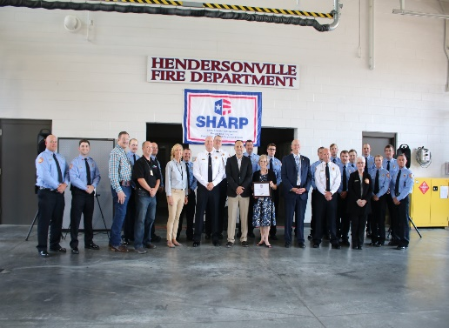
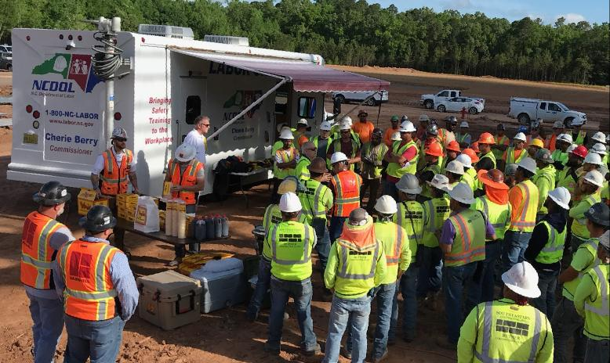
OSH Division
Recognition Programs
FFY 2022—Fall
SHARP SITES—New/Renewals | Total | FFY Goal | Approved SHARP Sites*
SHARP—Construction | 3 |  | 6
SHARP—General Industry | 64 |  | 105
SHARP—Public Sector | 18 |  | 49
Total | 85 | 60 | 160
*Cumulative Total
GOLD STAR GROWERS—New | Total
 | 283
SAFETY AWARDS | Total
CY 2022 Safety Awards Season (Silver, Gold, Million Hour) | 2,132
 | Total
Million Hour Awards | 50

Slide 22


OSH Division
Alliances and Partnerships
FFY 2022—Fall
Alliances
Carolinas AGC
Lamar Advertising Company
Mexican Consulate
N.C. State – Industry Expansion Solutions
Safety and Health Council of NC
NUCA of the Carolinas
NCALGESO
Tree Care Industry Association (Signing 11/10/2022)

Slide 23
OSH Division
Alliances and Partnerships
FFY 2022—Fall
Partnerships
Barringer Construction
Charlotte - Foundry Building Including Ancillary Buildings (2020 – 2023)
Holder – Edison Foard – Leeper, A Joint Venture
Charlotte - Charlotte Douglas International Airport – Terminal Lobby Expansion (2021 – 2023)
Jacobs Engineering Group
Holly Springs - Biotech Manufacturing Facility and Campus (2022 – 2024)

Slide 24
OSH Division
Education and Training Outreach
FFY 2022—Fall
OUTREACH EVENT | Total | FFY Goal
General Industry—10 Hour Course | 4 | 4
General Industry—30 Hour Course | 2 | 1
NC #500/502—Construction Train the Trainer Course NC #501/503—General Industry Train the Trainer Course | 1 | 1
Construction—10 Hour Course | 5 | 5
Construction—30 Hour Course | 2 | 1
Labor One/Booth Events | 6 | NA
Speaker’s Bureau | 84 | NA
Webinars | 86 | NA
OSH Workshops | 3 | NA
Technical Assistance | 4 | NA
Spanish Training and Outreach Events | 1 | NA
Train the Trainer Program (Construction/General Industry)—Events | 8 | NA
Train the Trainer Program (Construction/General Industry)—Trained | 77 | NA

Slide 25
OSH Division
Education and Training Outreach
FFY 2022—Fall
Stand Downs/Forums
Stand Up 4 Grain Safety Week (April 4 - 8)
Fall Prevention Stand-Down (May 2 - 6) – 452 Attendees (Webinars and Labor One Events)
Construction Forum (May 18) – 25 Attendees
Heat Illness Prevention (All Summer)
Trench Safety Stand-Down (June 13 - 17) – 15 Attendees (Webinars)
Safe + Sound (August 15 - 21) – 19 Attendees (Webinars)

Slide 26
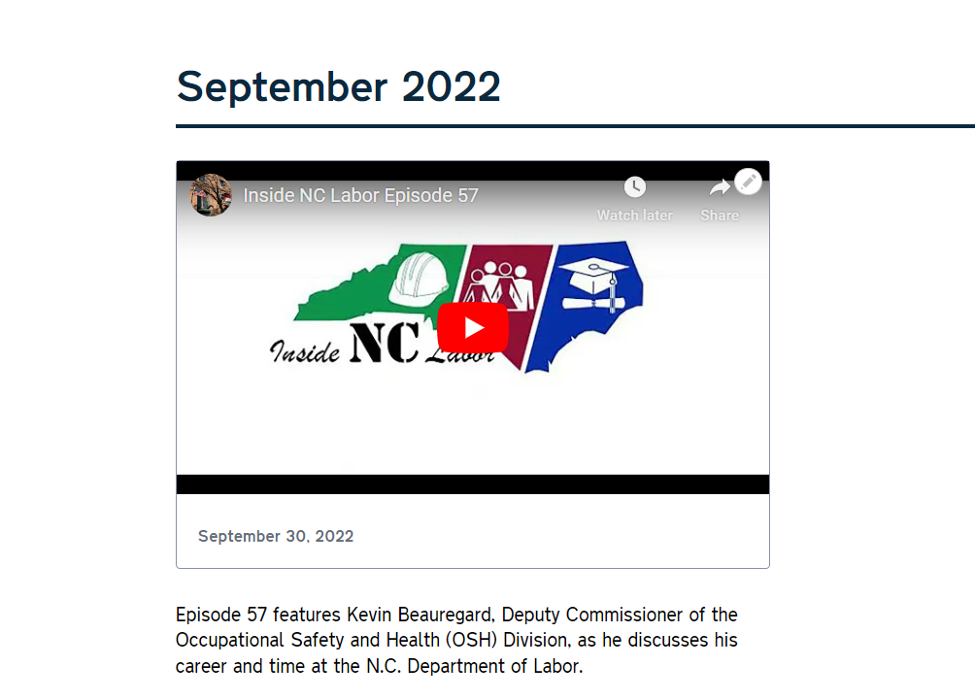
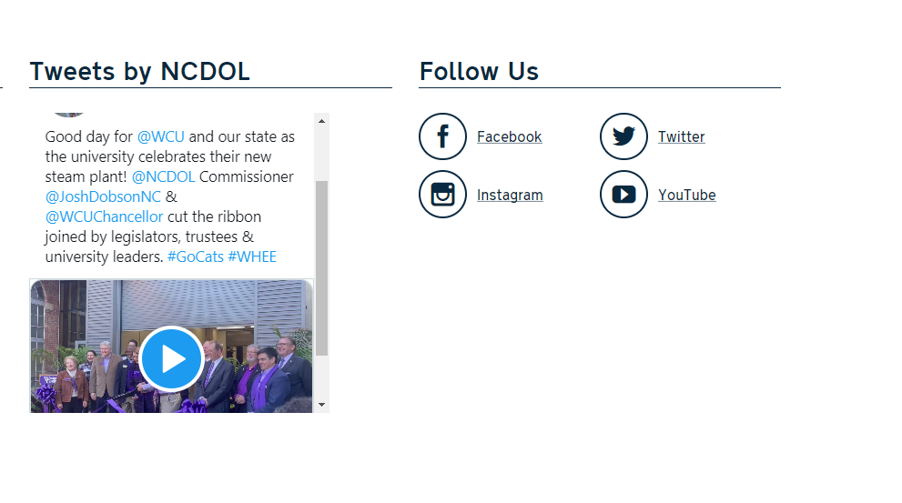
OSH Division
Social Media
FFY 2022—Fall
Inside NC Labor Podcasts
57 episodes
Facebook
2,176 followers
Instagram
707 followers
Twitter
2,177 followers

Slide 27
OSH Division
Standards Update
FFY 2022—Fall
Code of Federal Regulation
CFR 192—CFR Correction: Occupational Safety and Health Standards – Occupational Noise
Amendment corrects an equation in Appendix A, 29 CFR 1910.95.
CFR 193—CFR Correction: Safety and Health Regulations for Construction – Lead
Amendment corrects 29 CFR 1926.62(d)(4)(ii) – Referenced paragraph (d)(10) instead of (d)(9).
CFR 194—Correcting Amendment: Safety and Health Regulations for Construction – Lead
Amendment corrects 29 CFR 1926.62(d)(2)(iv) – List of tasks had been removed.

Slide 28
OSH Division
Standards Update
FFY 2022—Fall
Alerts
UV 1—Ultraviolet Wands
FDA alert warning consumers about unsafe UV wands advertised to disinfect surfaces and kill germs. Wands may expose users and those nearby to unsafe levels of UV-C that may cause injury after a few seconds of use.
Compliance Directive
CPL 02-00-042—Interagency Agreement Between MSHA and OSHA
Provides guidelines for implementing the Interagency Agreement between the Mine Safety and Health Administration and the Occupational Safety and Health Administration – Jurisdictional issues.

Slide 29
OSH Division
Complaint Desk
FFY 2022—Fall
East Compliance | West Compliance | Agricultural Safety and Health
ACTIVITY | Total | Total | Total | Cumulative Total | FFY 2021
Complaints | 1,639 | 1,913 | 23 | 3,575 | 4,321
Referrals | 324 | 426 | 27 | 777 | 743
Fat/Cat | 118 | 100 | 10 | 228 | 227
Totals | 2,081 | 2,439 | 60 | 4,580* | 5,291
Includes calls that were processed but not necessarily inspected. Fat/Cat includes calls regarding heart attacks and other natural causes.
*712 were COVID-19 related.
ACTIVITY | Cumulative Total
Complaints Not in OSH Jurisdiction | 4,122**
Includes complaints related to wage and hour, discrimination, worker's compensation questions, beyond statute of limitation time frame, etc.
**172 were COVID-19 related.
Notes:
Complaints, referrals, fatality and catastrophe inspections account for a significant amount of inspections that compliance does every year. This slide puts that into perspective.

Slide 30
OSH Division
Cut-Loose, In-Training, Vacant
FFY 2022—Fall
West Compliance | Safety | % | Industrial Hygienist | %
Cut Loose | 17 | 58% | 20 | 77%
In-Training | 8 | 28% | 1 | 4%
Vacant | 4 | 4% | 5 | 19%
Total | 29* |  | 26
East Compliance | Safety | % | Industrial Hygienist | %
Cut Loose | 10 | 43% | 3 | 17%
In-Training | 4 | 17% | 2 | 18%
Vacant | 9 | 39% | 12 | 71%
Total | 23 |  | 17
Safety Cut Loose | 52% | Health Cut Loose | 53%
Safety In-Training | 23% | Health in-Training | 7%
Safety Vacant | 25% | Health Vacant | 40%

Slide 31
OSH Division
Cut-Loose, In-Training, Vacant
FFY 2022—Fall
Consultative Services | Safety | % | Industrial Hygienist | %
Cut Loose | 9 | 82% | 8 | 100%
In-Training | 0 | 0% | 0 | 0%
Vacant | 2 | 18% | 0 | 0%
Total | 11 |  | 8
Education, Training and Technical Assistance | Safety | % | Industrial Hygienist | %
Cut Loose | 10 | 91% | 6 | 91%
In-Training | 1 | 9% | 0 | 0%
Vacant | 0 | 0% | 1 | 9%
Total | 11 |  | 6
Agricultural Safety and Health | Safety | % | Industrial Hygienist
Cut Loose | 5 | 63% | NA
In-Training | 1 | 13% | NA
Vacant | 2 | 25% | NA
Total | 8

Slide 32

Thank You For Attending!
FFY 2022—Fall
Questions?
1-800-NC-LABOR
(1-800-625-2267)
www.labor.nc.gov
Notes:
32

