Slide 1
North Carolina Department of Labor
Occupational Safety & Health Division
3rd Quarter Report
Federal Fiscal Year 2021*
Presented by:
Occupational Safety and Health Division of North Carolina
*Preliminary Data
Notes:
The information in this presentation is provided voluntarily by the N.C. Department of Labor, Education Training and Technical Assistance Bureau as a public service and is made available in good faith. This presentation is designed to assist trainers conducting OSHA outreach training for workers. Since workers are the target audience, this presentation emphasizes hazard identification, avoidance, and control – not standards. No attempt has been made to treat the topic exhaustively. It is essential that trainers tailor their presentations to the needs and understanding of their audience.
The information and advice provided on this Site and on Linked Sites is provided solely on the basis that users will be responsible for making their own assessment of the matters discussed herein and are advised to verify all relevant representations, statements, and information.
This presentation is not a substitute for any of the provisions of the Occupational Safety and Health Act of North Carolina or for any standards issued by the N.C. Department of Labor. Mention of trade names, commercial products, or organizations does not imply endorsement by the N.C. Department of Labor.

Slide 2
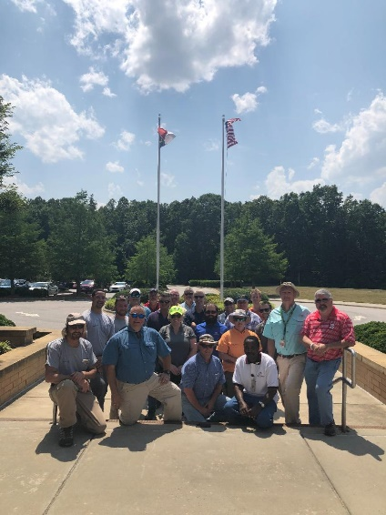
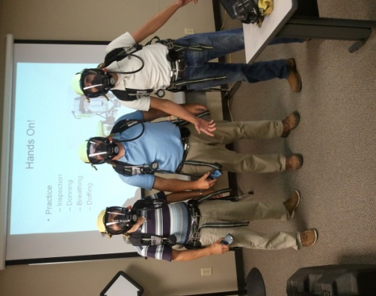
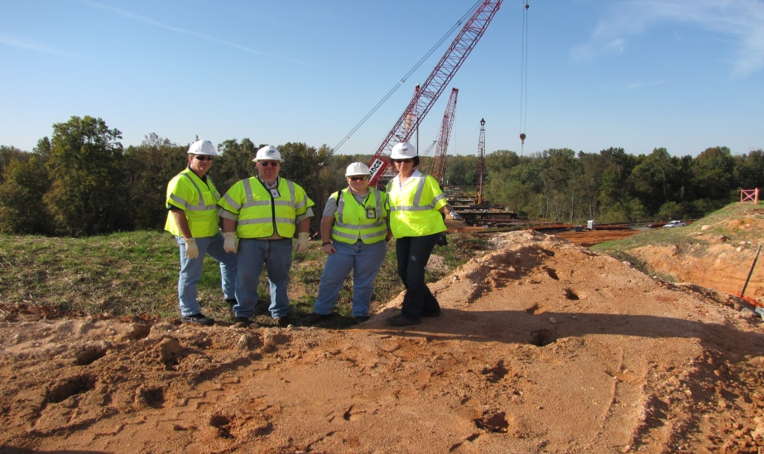
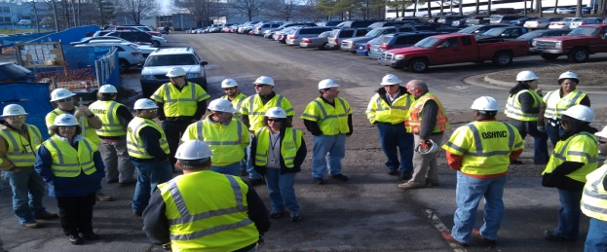
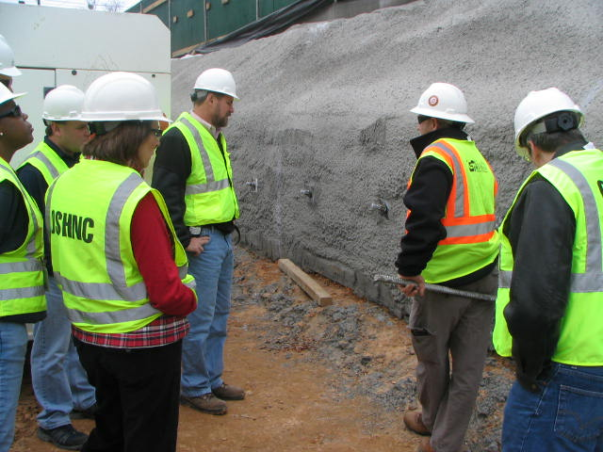
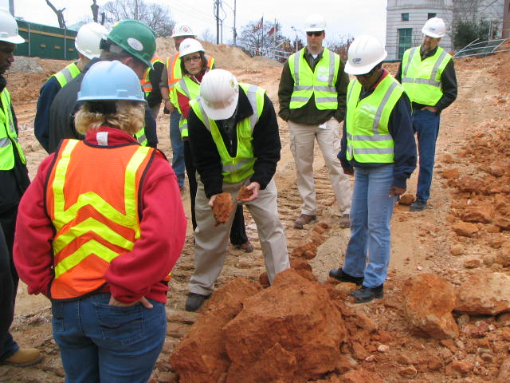
N.C. Workplace Safety and Health
OSH Division—Fatalities Inspected
FFY 2021—3rd Qtr.
FATALITY TYPE | 1ST Qtr. | 2nd Qtr. | 3rd Qtr. | Total | FATALITY TYPE | 1ST Qtr. | 2nd Qtr. | 3rd Qtr. | Total
Struck By | 7 | 3 | 4 | 14 | Inhalation | 0 | 0 | 0 | 0
Caught In/Between | 2 | 1 | 3 | 6 | Ingestion | 0 | 0 | 1 | 1
Bite/Sting/Scratch | 0 | 0 | 0 | 0 | Absorption | 0 | 0 | 0 | 0
Fall (Same Level) | 0 | 0 | 0 | 0 | Repeated Motion/Pressure | 0 | 0 | 0 | 0
Fall (From Elevation) | 2 | 3 | 4 | 9 | Cardio/Respiratory | 0 | 1 | 0 | 1
Struck Against | 1 | 0 | 0 | 1 | Shock | 0 | 0 | 2 | 2
Rubbed/Abraded | 0 | 0 | 0 | 0 | Other | 2 | 0 | 5 | 7
COVID-19 |  |  |  |  |  | 10 | 5 | 3 | 18
Fatalities Under OSH Division Jurisdiction
FFY 2020 |  | FFY 2021 | 1st Qtr. | 2nd Qtr. | 3rd Qtr. | Total
Total Fatalities | 79 | Fatalities | 24 | 13 | 16 | 59
NCDOL Photo Library

Slide 3
N.C. Workplace Safety and Health
OSH Division—Strategic Plan Goals
FFY 2021—3rd Qtr.
COMPLIANCE | 1ST Qtr. | 2nd Qtr. | 3rd Qtr. | Total | FFY Goal
Safety Inspections | 270 | 370 | 310 | 950 | 1,197
Health Inspections | 221 | 230 | 260 | 711 | 635
Serious Hazards Eliminated | 553 | 566 | 1,333 | 2,452 | 4,100
Training and/or Program Violations | 126 | 206 | 168 | 500 | 1,050
CONSULTATION | 1ST Qtr. | 2nd Qtr. | 3rd Qtr. | Total | FFY Goal
Serious Hazards Eliminated | 1,143 | 1,005 | 1,379 | 3,527 | 5,000
Private Sector and Public Sector Visits | 333 | 351 | 395 | 1,079 | 925
OSH DIVISION | 1ST Qtr. | 2nd Qtr. | 3rd Qtr. | Total | FFY Goal
Program Improvements | 486 | 595 | 608 | 1,689 | 2,060
People Trained in Special Emphasis Program Areas | 1,326 | 1,517 | 1,331 | 4,174 | 3,700
People Trained at OSH Division Sponsored Events | 1,942 | 2,257 | 1,640 | 5,839 | 7,350

Slide 4
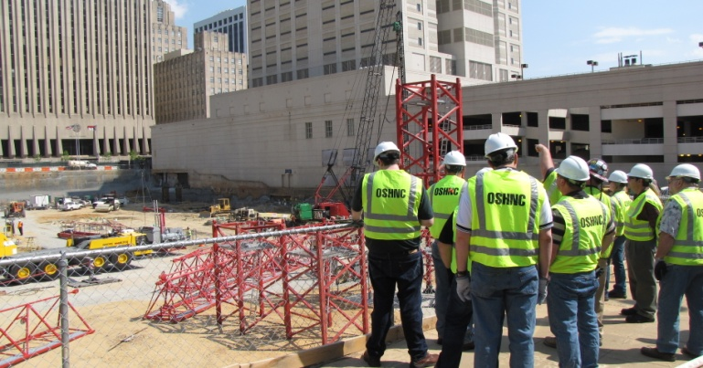
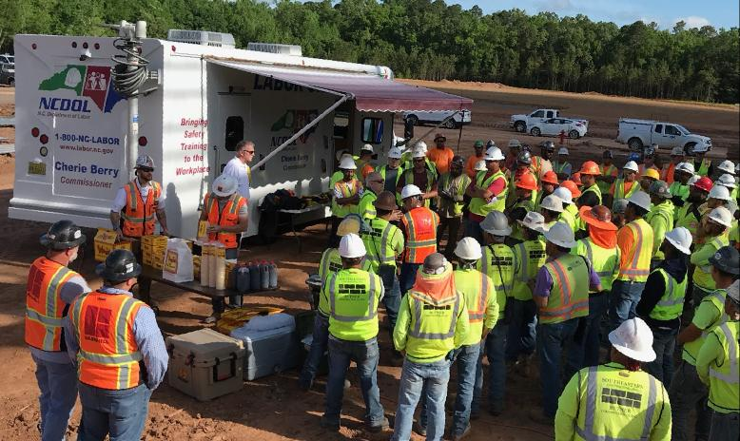
N.C. Workplace Safety and Health
OSH Division—Strategic Plan Goals
FFY 2021—3rd Qtr.
Education, Training and Technical Assistance (ETTA) | 1ST Qtr. | 2nd Qtr. | 3rd Qtr. | Total | FFY Goal
Publications Distributed | 3,618 | 5,616 | 4,475 | 13,709 | 23,000
Standards Interpretations | 589 | 695 | 572 | 1,856 | NA
Agricultural Safety and Health (ASH) | 1ST Qtr. | 2nd Qtr. | 3rd Qtr. | Total | FFY Goal
Outreach Materials Distributed | 240 | 3,430 | 912 | 4,582 | 3,500
Compliance Inspections | 11 | 0 | 4 | 15 | 80
Certificates Issued | 108 | 1,172 | 516 | 1,796 | 1,500
Preoccupancy Inspections | 168 | 1,368 | 344 | 1,880 | 1,700
NCDOL Photo Library

Slide 5
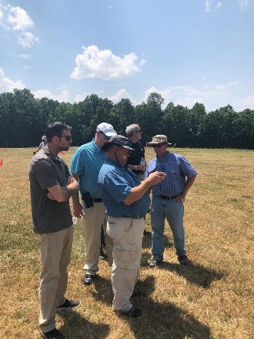

Strategic Plan
Special Emphasis Programs (SEP)
FFY 2021—3rd Qtr.
NCDOL Photo Library
Construction
Logging and Arboriculture
Long Term Care Facilities
Health Hazards
Food Manufacturing
Grocery and Related Product Wholesalers
Amputations

Slide 6
Special Emphasis Program
Construction
FFY 2021—3rd Qtr.
NAICS 23—CONSTRUCTION | FFY 2020 |  | 1st Qtr. | 2nd Qtr. | 3rd Qtr. | Total
Total Fatalities | 26 |  | 6 | 3 | 4 | 13
1st Qtr. Fatality Rate | 0.0022 |  | NA | NA | NA | NA
Fatality Type | 1st Qtr. | 2nd Qtr. | 3rd Qtr. | Total | Fatality Type | 1st Qtr. | 2nd Qtr. | 3rd Qtr. | Total
Struck By | 3 | 1 | 0 | 4 | Inhalation | 0 | 0 | 0 | 0
Caught In/Between | 1 | 0 | 1 | 2 | Ingestion | 0 | 0 | 0 | 0
Bite/Sting/Scratch | 0 | 0 | 0 | 0 | Absorption | 0 | 0 | 0 | 0
Fall (Same Level) | 0 | 0 | 0 | 0 | Repeated Motion/Pressure | 0 | 0 | 0 | 0
Fall (From Elevation) | 2 | 2 | 2 | 6 | Cardio/Respiratory | 0 | 0 | 0 | 0
Struck Against | 0 | 0 | 0 | 0 | Shock | 0 | 0 | 0 | 0
Rubbed/Abraded | 0 | 0 | 0 | 0 | Other | 0 | 0 | 1 | 1
Notes:
s
ETTA Events Total: 9 (4 Labor One, 4 Webinars, 1 Speaker Bureau )
Total Trained: 305
Consultation Events: 16
Total Trained: 1400
A total of 16 events were served by Rod Wilce. Activities included but are not limited to; event speakers, vendor demonstrations, fall protection training sessions, equipment inspections, distribution of Fed provided resource material, meals i.e. 700 Chic Filet sandwiches, countless doughnuts, full catered lunches. These 16 events provided the intended distribution of information and training to in excess 1400 employees within a 50 mile radius of Raleigh.
Used Billboards for Fall Stand Down, Safe and Sound Week, and Heat Stress.

Slide 7
Special Emphasis Program
Construction
FFY 2021—3rd Qtr.
 | North Carolina |  |  |  | National Average |  |  |  | North Carolina vs. National Average
 | CY 2018 |  | CY 2019 |  | CY 2018 |  | CY 2019 |  | 2019 Comparison
TRC | 2.5 | 36% Decrease |  | 1.6 | 3.1 | 10% Decrease |  | 2.8 | 43% Lower
DART | 1.6 | 50% Decrease |  | 0.8 | 1.7 | No Change |  | 1.7 | 53% Lower
SEP ACTIVITY | 1ST Qtr. | 2nd Qtr. | 3rd Qtr. | Total | FFY Goal
Compliance Inspections | 270 | 302 | 314 | 886 | 1,050
Consultative Visits | 115 | 118 | 117 | 350 | 200
OSH Outreach Events (10- and 30- Hour Construction Courses) | 1 | 2 | 1 | 4 | 6
People Trained | 241 | 275 | 171 | 687 | 1,750

Slide 8
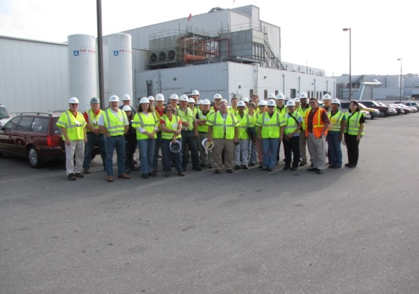
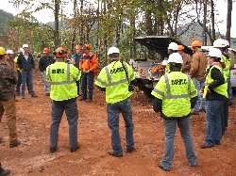
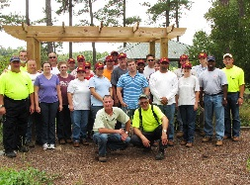
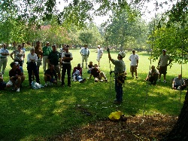
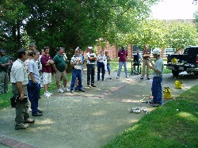
Special Emphasis Program
Logging and Arboriculture
FFY 2021—3rd Qtr.
SEP ACTIVITY | 1st Qtr. | 2nd Qtr. | 3rd Qtr. | Total | FFY Goal
Compliance Inspections | 13 | 10 | 8 | 31 | 30
Consultative Visits | 3 | 3 | 10 | 16 | 15
OSH Training and Outreach Events | 0 | 0 | 3 | 3 | 3
People Trained | 0 | 0 | 97 | 97 | 75
NAICS 11331*—LOGGING | FFY 2020 |  | 1st Qtr. | 2nd Qtr. | 3rd Qtr. | Total
Total Fatalities | 1 |  | 0 | 0 | 1 | 1
NAICS 56173*—ARBORICULTURE | FFY 2020 |  | 1st Qtr. | 2nd Qtr. | 3rd Qtr. | Total
Total Fatalities | 5 |  | 1 | 1 | 1 | 3
1st Qtr. Combined Fatality Rate | 0.0025 |  | NA | NA | NA | NA

Slide 9
Special Emphasis Program
Long Term Care Facilities
FFY 2021—3rd Qtr.
NAICS 623*—LONG TERM CARE
 | North Carolina |  |  |  | National Average |  |  |  | North Carolina vs. National Average
 | CY 2018 |  | CY 2019 |  | CY 2018 |  | CY 2019 |  | 2019 Comparison
TRC | 5.4 | 7% Decrease |  | 5.0 | 6.1 | 3% Decrease |  | 5.9 | 15% Lower
DART | 3.3 | 3% Increase |  | 3.4 | 3.7 | 5% Decrease |  | 3.5 | 3% Lower
SEP ACTIVITY | 1ST Qtr. | 2nd Qtr. | 3rd Qtr. | Total | FFY Goal
Compliance Inspections | 4 | 3 | 6 | 13 | 24
Consultative Visits | 8 | 17 | 11 | 36 | 10
OSH Outreach Events | 0 | 0 | 0 | 0 | 2
People Trained | 0 | 0 | 0 | 0 | 40

Slide 10

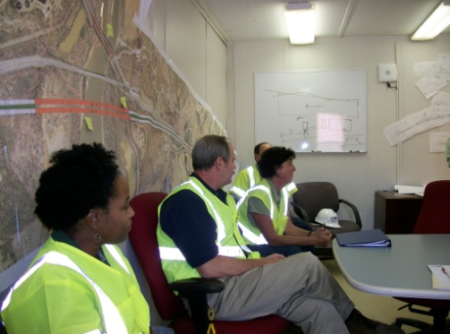
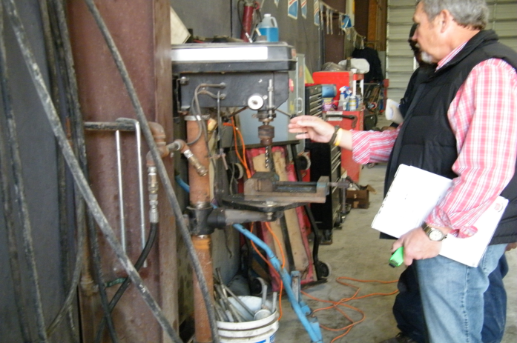
Special Emphasis Program
Health Hazards
FFY 2021—3rd Qtr.
COMPLIANCE INSPECTIONS | 1ST Qtr. | 2nd Qtr. | 3rd Qtr. | Total | FFY Goal
Silica | 10 | 11 | 6 | 27 | 75
Asbestos | 7 | 4 | 3 | 14
Isocyanates | 4 | 11 | 5 | 20
Lead | 3 | 4 | 3 | 10
Hexavalent Chromium | 5 | 2 | 1 | 8
Total | 29 | 32 | 18 | 79
Program Improvements | 10 | 11 | 6 | 27 | 20
*Some inspections involved more than one health hazard and generally included a program improvement
NCDOL Photo Library

Slide 11
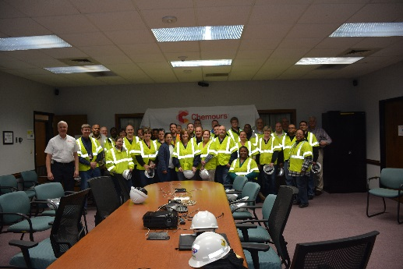
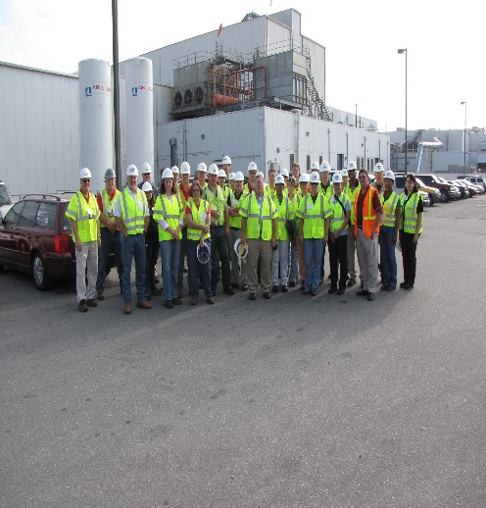
Special Emphasis Program
Health Hazards
FFY 2021—3rd Qtr.
COMPLIANCE INSPECTION RESULTS
HEALTH HAZARDS | Number of Samples (Detectable Results) |  |  |  | Number With Overexposures |  |  |  | Average Severity Rate*
 | 1st Qtr. | 2nd Qtr. | 3rd Qtr. | Total | 1st Qtr. | 2nd Qtr. | 3rd Qtr. | Total | 1st Qtr. | 2nd Qtr. | 3rd Qtr.
Silica | 1 | 9 | 4 | 15 | 0 | 3 | 1 | 4 | 0.56 | 0.99 | 1.19
Asbestos | 0 | 0 | 0 | 0 | 0 | 0 | 0 | 0 | 0 | 0 | 0
Isocyanates | 1 | 2 | 3 | 6 | 0 | 0 | 0 | 0 | 0.026 | 0.008 | 0.129
Lead | 0 | 0 | 0 | 0 | 0 | 0 | 0 | 0 | 0 | 0 | 0
Hexavalent Chromium | 0 | 1 | 0 | 1 | 0 | 0 | 0 | 0 | 0 | 0.01 | 0
Total | 2 | 12 | 7 | 22 | 0 | 3 | 1 | 4 | NA | NA | NA
NCDOL Photo Library
* All Samples

Slide 12
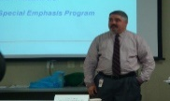
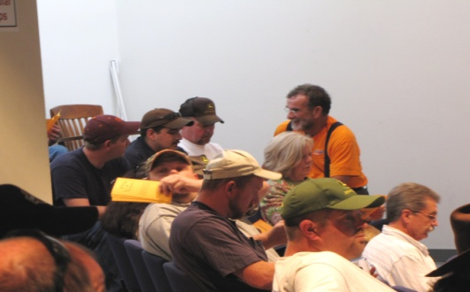
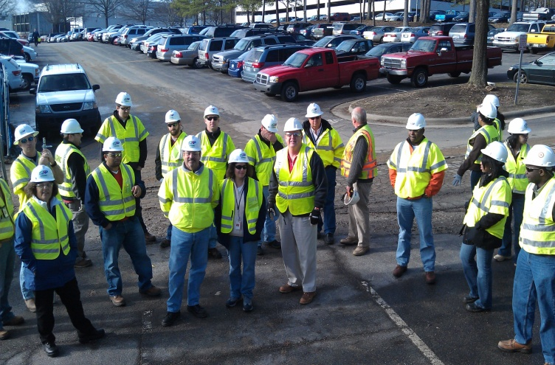
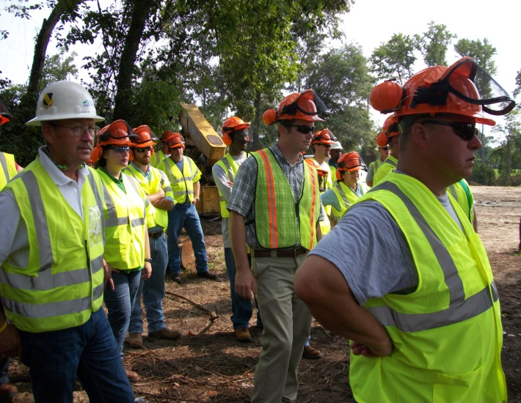
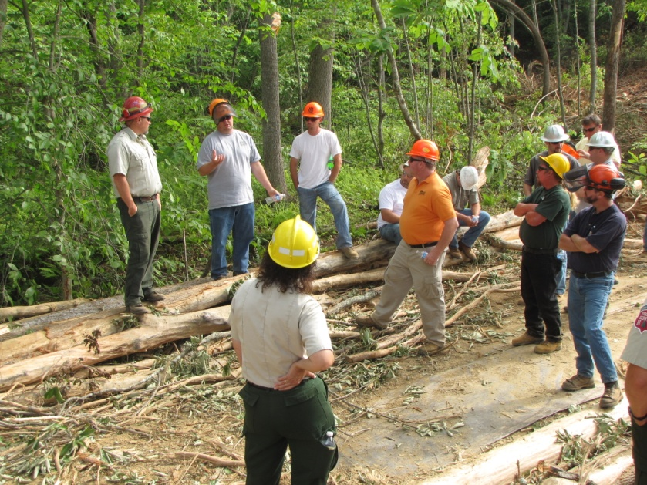
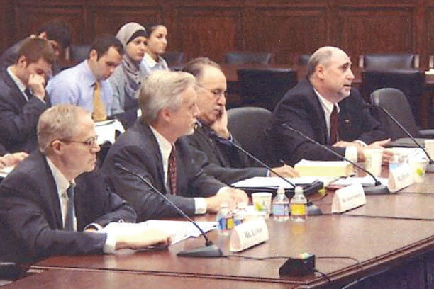
Special Emphasis Program
Health Hazards
FFY 2021—3rd Qtr.
HEALTH HAZARDS | Consultative Surveys
 | 1st Qtr. | 2nd Qtr. | 3rd Qtr. | Total
Silica | 21 | 26 | 38 | 85
Asbestos | 5 | 9 | 8 | 22
Isocyanates | 1 | 5 | 1 | 7
Lead | 7 | 0 | 2 | 9
Hexavalent Chromium | 4 | 0 | 6 | 10
Total | 38 | 40 | 55 | 133
FFY Goal | 125
NCDOL Photo Library
NCDOL Photo Library
SEP ACTIVITY | 1st Qtr. | 2nd Qtr. | 3rd Qtr. | Total | FFY Goal
OSH Outreach Events | 3 | 7 | 4 | 14 | 20
People Trained | 50 | 139 | 74 | 263 | 300

Slide 13
Special Emphasis Program
Food Manufacturing
FFY 2021—3rd Qtr.
NAICS 311*—FOOD MANUFACTURING
 | North Carolina |  |  |  | National Average |  |  |  | North Carolina vs. National Average
 | CY 2018 |  | CY 2019 |  | CY 2018 |  | CY 2019 |  | 2019 Comparison
TRC | 2.9 | No Change |  | 2.9 | 4.2 | 5% Decrease |  | 4.0 | 27% Lower
DART | 2.2 | 5% Decrease |  | 2.1 | 2.9 | 3% Decrease |  | 2.8 | 25% Lower
*TRC/DART rate based on the 3-digit NAICS code
SEP ACTIVITY | 1st Qtr. | 2nd Qtr. | 3rd Qtr. | Total | FFY Goal
Compliance Inspections | 10 | 10 | 15 | 35 | 20
Consultative Visits | 1 | 4 | 7 | 12 | 12
OSH Outreach Events | 0 | 1 | 0 | 1 | 2
People Trained | 0 | 9 | 0 | 9 | 40

Slide 14
Special Emphasis Program
Grocery and Related Product Wholesalers
FFY 2021—3rd Qtr.
NAICS 4244*—GROCERY AND RELATED WHOLESALERS
 | North Carolina |  |  |  | National Average |  |  |  | North Carolina vs. National Average
 | CY 2018 |  | CY 2019 |  | CY 2018 |  | CY 2019 |  | 2019 Comparison
TRC | 4.5 | 2% Increase |  | 4.6 | 5.2 | 8% Decrease |  | 4.8 | 4% Lower
DART | 3.4 | 3% Decrease |  | 3.3 | 4.0 | 7% Decrease |  | 3.7 | 11% Lower
*DART/TRC rate based on the 4-digit NAICS code
SEP ACTIVITY | 1st Qtr. | 2nd Qtr. | 3rd Qtr. | Total | FFY Goal
Compliance Inspections | 4 | 4 | 11 | 19 | 24
Consultative Visits | 4 | 0 | 4 | 8 | 10
OSH Outreach Events | 0 | 1 | 0 | 1 | 2
People Trained | 0 | 8 | 0 | 8 | 40

Slide 15
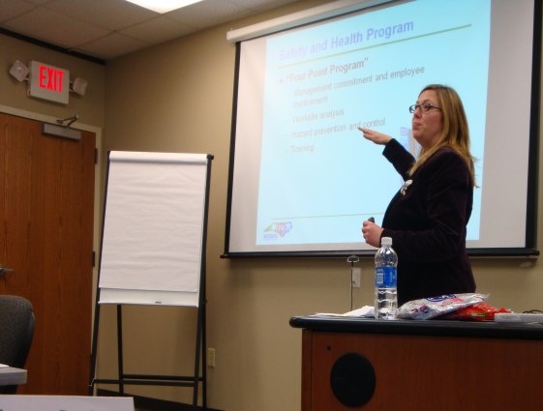
Special Emphasis Program
Amputations
FFY 2021—3rd Qtr.
SEP ACTIVITY | 1st Qtr. | 2nd Qtr. | 3rd Qtr. | Total | FFY Goal
Compliance Inspections | 28 | 43 | 47 | 118 | 100
Consultative Visits | 44 | 43 | 50 | 137 | 80
OSH Outreach Events | 7 | 5 | 6 | 18 | 15
People Trained | 123 | 79 | 41 | 243 | 400

Slide 16
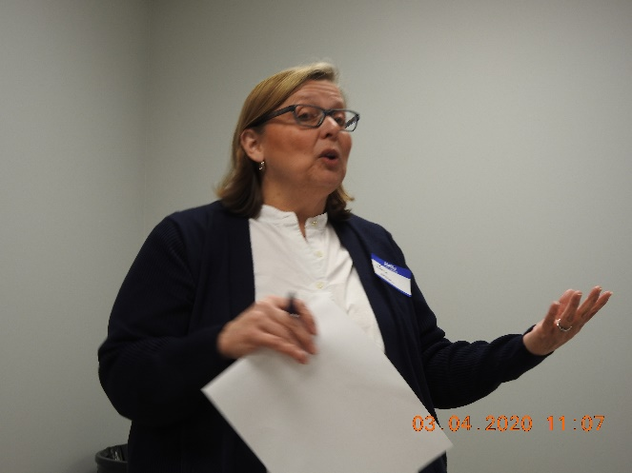
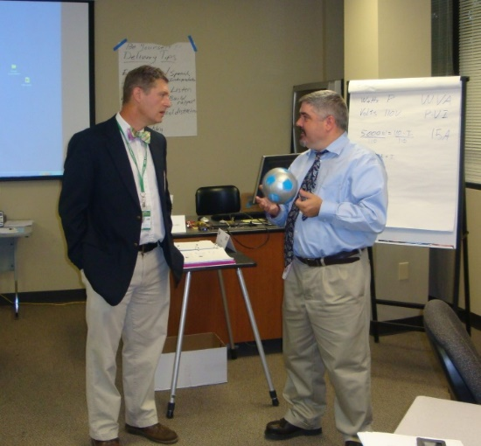
OSH Division
Public Sector
FFY 2021—3rd Qtr.
 | CY 2018 |  | CY 2019
TRC | 3.9 | 8% Decrease |  | 3.6
DART | 1.8 | 14% Increase |  | 2.1
ACTIVITY | 1ST Qtr. | 2nd Qtr. | 3rd Qtr. | Total | FFY Goal
Compliance Inspections | 16 | 36 | 24 | 76 | 63
Consultative Visits | 67 | 36 | 54 | 157 | 150
OSH Outreach Events/Booths | 0 | 1 | 1 | 2 | 22
Trained | 256 | 299 | 140 | 695 | 2,000

Slide 17
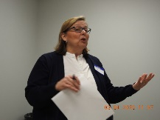
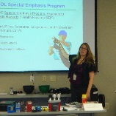
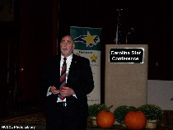
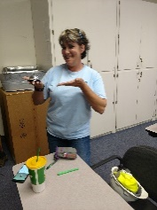
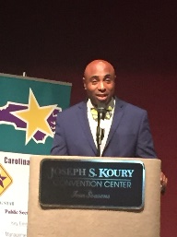
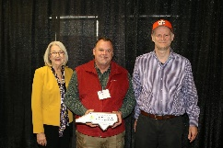
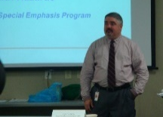

OSH Division
Recognition Programs
FFY 2021—3rd Qtr.
*Cumulative Total
STAR SITES—New, Recertification, Promotion | 1st Qtr. | 2nd Qtr. | 3rd Qtr. | Total | FFY Goal | Approved Star Sites*
Carolina Star | 2 | 2 | 5 | 9 |  | 103
Building Star | 0 | 1 | 0 | 1 |  | 23
Rising Star | 0 | 0 | 0 | 0 |  | 4
Public Sector Star | 1 | 1 | 2 | 4 |  | 20
Total | 3 | 4 | 7 | 14 | 20 | 150
NCDOL Photo Library
 | 1st Qtr. | 2nd Qtr. | 3rd Qtr. | Total | FFY Goal
Star Sites—Termination/Withdrawn | 2 | 0 | 0 | 2
Star Booths | 0 | 0 | 0 | 0
Star Presentations | 3 | 6 | 3 | 12 | 20
Star Program Interventions | 32 | 30 | 42 | 104 | 100

Slide 18

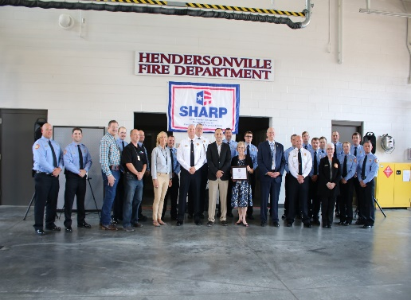
OSH Division
Recognition Programs
FFY 2021—3rd Qtr.
SHARP SITES—New/Renewal | 1st Qtr. | 2nd Qtr. | 3rd Qtr. | Total | FFY Goal | Approved SHARP Sites*
SHARP—Construction | 0 | 0 | 1 | 1 |  | 4
SHARP—General Industry | 9 | 20 | 11 | 40 |  | 115
SHARP—Public Sector | 5 | 2 | 8 | 15 |  | 41
Totals | 14 | 22 | 20 | 56 | 55 | 160
*Cumulative Total
GOLD STAR GROWERS—NEW | 1st Qtr. | 2nd Qtr. | 3rd Qtr. | Total
 | 1 | 178 | 30 | 209
SAFETY AWARDS |  |  |  | Total
CY 2020 Safety Awards Season (Silver, Gold, Million Hour) |  |  |  | 2,737
 | 1st Qtr. | 2nd Qtr. | 3rd Qtr. | Total
Million Hour Awards | 8 | 22 | 8 | 38

Slide 19


OSH Division
Alliances and Partnerships
FFY 2021—3rd Qtr.
Alliances
  Carolinas AGC
  Lamar Advertising Company
  Mexican Consulate
  N.C. State – Industry Expansion Solutions
  Safety and Health Council of NC
  NUCA of the Carolinas
  NCALGESO

Slide 20
OSH Division
Alliances and Partnerships
FFY 2021—3rd Qtr.
Partnerships
  Sanders Utility Construction Company, Inc.
    Charlotte - Irwin Creek Tributaries Sanitary Sewer Improvements (2020 – 2022)
  Barringer Construction
    Charlotte - Foundry Building Including Ancillary Buildings (2020 – 2023)
  Holder – Edison Foard – Leeper, A Joint Venture
    Charlotte - Charlotte Convention Center (2020 – 2021)

Slide 21
OSH Division
Complaint Desk*
FFY 2021—3rd Qtr.
East Compliance | West Compliance | Agricultural Safety and Health
ACTIVITY | 1st Qtr. | 2nd Qtr. | 3rd Qtr. | 1st Qtr. | 2nd Qtr. | 3rd Qtr. | 1st Qtr. | 2nd Qtr. | 3rd Qtr. | Cumulative Total | FFY 2020
Complaints | 604 | 614 | 299 | 744 | 655 | 338 | 3 | 1 | 2 | 3,260 | 4,121
Referrals | 65 | 72 | 70 | 101 | 102 | 109 | 10 | 3 | 1 | 533 | 703
Fat/Cat | 22 | 24 | 17 | 32 | 20 | 25 | 2 | 1 | 2 | 145 | 246
Totals | 691 | 710 | 386 | 877 | 777 | 472 | 15 | 5 | 5 | 3,938 | 5,070
*Includes calls that were processed but not necessarily inspected. Fat/Cat includes calls regarding heart attacks and other natural causes.
ACTIVITY | 1st Qtr. | 2nd Qtr. | 3rd Qtr. | Cumulative Total
Complaints Not in OSH Jurisdiction* | 764 | 688 | 744 | 2,196
*Includes complaints related to wage and hour, discrimination, worker's compensation questions, beyond statute of limitation time frame, etc.

Slide 22
OSH Division
Cut-Loose, In-Training, Vacant
FFY 2021—3rd Qtr.
West Compliance | Safety | % | Industrial Hygienist | %
Cut Loose | 18 | 58% | 22 | 84%
In-Training | 8 | 26% | 2 | 8%
Vacant | 5 | 16% | 2 | 8%
Total | 31 |  | 26
East Compliance | Safety | % | Industrial Hygienist | %
Cut Loose | 12 | 45% | 5 | 28%
In-Training | 6 | 22% | 2 | 11%
Vacant | 9 | 33% | 11 | 61%
Total | 27 |  | 18
Safety Cut Loose | 52% | Health Cut Loose | 61%
Safety In-Training | 24% | Health in-Training | 9%
Safety Vacant | 24% | Health Vacant | 30%

Slide 23
OSH Division
Cut-Loose, In-Training, Vacant
FFY 2021—3rd Qtr.
Consultative Services | Safety | % | Industrial Hygienist | %
Cut Loose | 9 | 82% | 8 | 100%
In-Training | 1 | 9% | 0 | 0%
Vacant | 1 | 9% | 0 | 0%
Total | 11 |  | 8
Education, Training and Technical Assistance | Safety | % | Industrial Hygienist | %
Cut Loose | 8 | 73% | 4 | 67%
In-Training | 2 | 18% | 2 | 33%
Vacant | 1 | 9% | 0 | 0%
Total | 11 |  | 6
Agricultural Safety and Health | Safety | % | Industrial Hygienist
Cut Loose | 5 | 83% | NA
In-Training | 1 | 17% | NA
Vacant | 0 | 0% | NA
Total | 6

Slide 24
OSH Division
Internal Training
FFY 2021—3rd Qtr.
1st Qtr.—COURSE
Webinars: | No. | Trained
Fall Protection (3), Steel Erection, Stairways and Ladders (2), Basic COVID-19, COVID-19 for Food Processing (2), Inspection Process (2), HAZCOM (3), Introduction to OSH, Toxic and Hazardous Substances, Bloodborne Pathogens, Lockout-Tagout (2), Concrete and Masonry, Scaffolding, Walking - Working Surfaces, Electrical Safety (4), Struck By-Caught Between, 1910 Subpart E – Exit Routes and Emergency Planning, Personal Protective Equipment, Hand and Portable Powered Tools (2), Excavation and Trenching (2), Cranes and Derricks, Welding and Cutting, Machine Guarding, Health Hazards - Special Emphasis Program. | 37 | 107
Virtual: | No. | Trained
Gravitec Fall Protection—Annual training | 1 | 144
8-Hour HAZWOPER Refresher | 1 | 14
Total Trained |  | 121

Slide 25
OSH Division
Internal Training
FFY 2021—3rd Qtr.
2nd Qtr.—COURSE
Webinars: | No. | Trained
Steel Erection, COVID-19 for Construction, HAZCOM (2), Toxic and Hazardous Substances, Bloodborne Pathogens, Lockout-Tagout, Electrical Safety (2), Hand and Portable Powered Tools, Excavation and Trenching, Cranes and Derricks, Machine Guarding (2), Confined Spaces in General Industry (2), Ergonomics Awareness (2), Recordkeeping (2), Food Manufacturing Special Emphasis Program, Respiratory Protection, Hearing Conservation, Safety and Health Committees, Powered Industrial Trucks, Silica (General Industry). | 26 | 49
Virtual: | No. | Trained
#100 Course – Initial Compliance | 1 | 15
Technical Writing/OSHA Express | 1 | 16
10-Hour General Industry Awareness Course | 1 | 1
Total Trained |  | 81

Slide 26
OSH Division
Internal Training
FFY 2021—3rd Qtr.
3rd Qtr.—COURSE
Webinars: | No. | Trained
Stairways and Ladders, Heat Stress | 2 | 2
Virtual: | No. | Trained
Fall Stand Down | 1 | 14
Construction Forum | 1 | 7
Fall Protection (Gravitec) | 1 | 18
#123/#131 – Accident Investigation and Interviewing Techniques | 2 | 29
#105 – Introduction to Safety Standards | 1 | 18
10-Hour Construction Awareness Course | 1 | 1
Total Trained |  | 87

Slide 27
OSH Division
Education and Training Outreach
FFY 2021—3rd Qtr.
OUTREACH EVENT | 1st Qtr. | 2nd Qtr. | 3rd Qtr. | Total | FFY Goal
General Industry—10-Hour Course | 1 | 2 | 2 | 5 | 4
General Industry—30-Hour Course | 0 | 0 | 0 | 0 | 1
NC #500/502—Construction Train-the-Trainer Course/ NC #501/503—General Industry Train-the-Trainer Course | 0 | 0 | 0 | 0 | 1
Construction—10-Hour Course | 1 | 2 | 1 | 4 | 5
Construction—30-Hour Course | 0 | 0 | 0 | 0 | 1
Labor One/Booth Events | 1 | 0 | 0 | 1 | NA
Speaker’s Bureau | 9 | 9 | 7 | 25 | NA
Webinars | 47 | 35 | 10 | 92 | NA
OSH Workshops | 4 | 0 | 7 | 11 | NA
Technical Assistance | 14 | 12 | 0 | 26 | NA
Spanish Training and Outreach Events | 1 | 0 | 1 | 2 | NA
Train-the-Trainer Program (Construction/General Industry)—Events | 4 | 3 | 11 | 18 | NA
Train-the-Trainer Program (Construction/General Industry)—Trained | 14 | 22 | 83 | 119 | NA

Slide 28
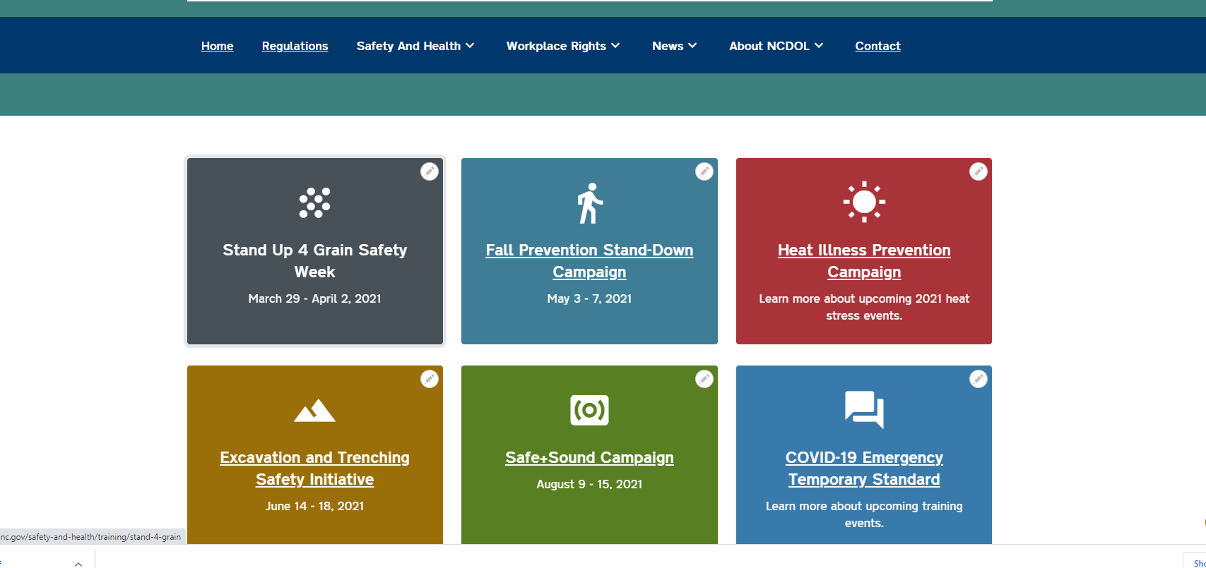
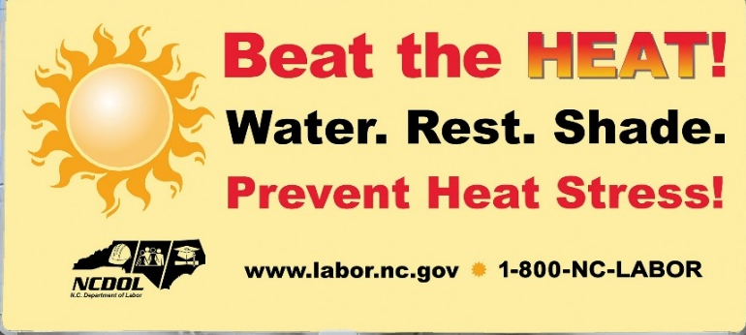
OSH Division
Education and Training Outreach
FFY 2021—3rd Qtr.
Stand Downs/Forums
  Fall Prevention
    6 webinars, 76 trained
  Construction Forum
    48 trained
  Excavation and Trenching
    2 webinars, 22 trained
  Heat Stress
    3 webinars, 108 trained

Slide 29
OSH Division
Standards Section—Publications
FFY 2021—3rd Qtr.
Brochures
  Top Ten OSH Serious Violations
  Safety Awards
  Manager of Environmental, Safety and Health
  Education, Training and Technical Assistance
  Medical and Dental Offices
  Public Sector Survey
  Green Tobacco Sickness
  Toolbox Talks (English)
  Safety Briefings (English)

Slide 30
OSH Division
Standards Section—Revisions
FFY 2021—3rd Qtr.
Operational Procedure Notice (OPN)
  OPN 64H—Mandatory Training Program for OSHA Compliance Personnel
    Annual review with minor edits.
Memos
  MRA 6—Medical Records Administrator
    Updated current OSH Division Medical Records Administrators.
Forms
  SAVE 3—SAVE Request Form
    For requesting SAVEs to be updated or added to OE.

Slide 31
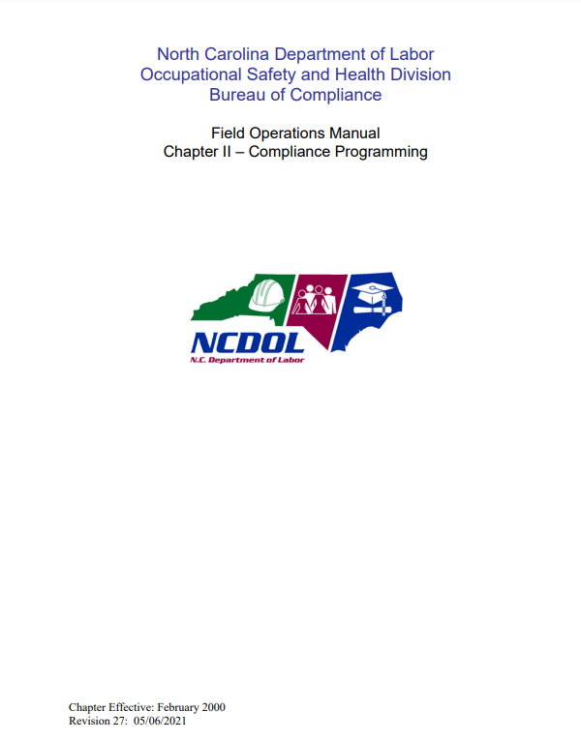
OSH Division
Standards Section—Revisions
FFY 2021—3rd Qtr.
Field Operations Manual (FOM)
  FOM Chapter 2—Compliance Programming
    New percentages of migrant housing sites in Class II, III and IV to be added to the ASH targeting schedule.

Slide 32
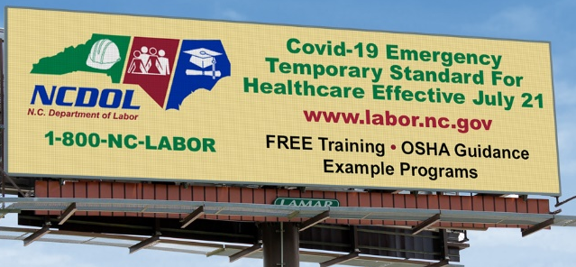
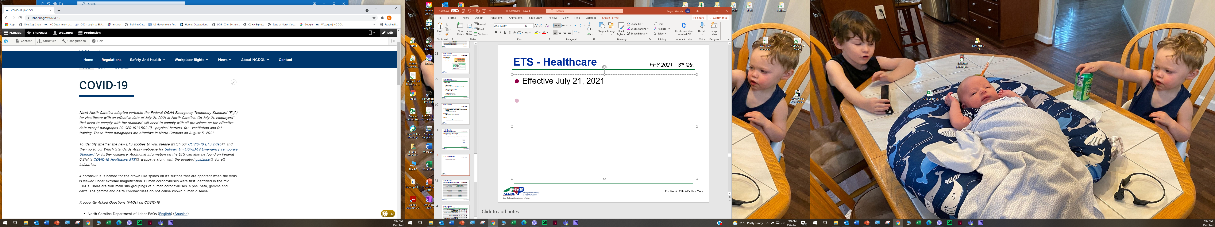
ETS - Healthcare
FFY 2021—3rd Qtr.
Effective July 21, 2021
  Paragraphs (i) - physical barriers, (k) - ventilation and (n) – training, effective August 5, 2021.
Outreach
  COVID-19 Plan
  PowerPoints and Webinars
  “Which Standards Apply” Webpage
  ETS Video – Application
  Billboards
  Industry Guide – Special Requirements

Slide 33
ETS - Healthcare
FFY 2021—3rd Qtr.
Memorandum
  Enforcement delay—Certain provisions of the ETS on Occupational Exposure to COVID-19.
    Delayed enforcement of paragraphs (i), (k), and (n) until August 5, 2021.
Direction
  DIR 2021-02 (CPL 02)—Inspection Procedures for the COVID-19 Emergency Temporary Standard.
    Established inspection procedures and enforcement policies for the COVID-19 ETS.

Slide 34
OSH Division
Retaliatory Employment Discrimination
FFY 2021—3rd Qtr.
Bureau Staffing
Jay Cronley | Information Officer
Celestine Chestnutt | Administrative Assistant II
James Agosto | Investigator
Alexander Fowler | Investigator
Dianne Daniels | Investigator
Anitra Nalls | Investigator
Erin Smith | Investigator
Theodore Place | Investigator
Alvin Vocalan | Investigator
Harriet Hopkins | Administrator

Slide 35
OSH Division
Retaliatory Employment Discrimination
FFY 2021—3rd Qtr.
OSH Complaint Statistics | 1st Qtr. | 2nd Qtr. | 3rd Qtr. | Total
Total OSH Complaints Filed | 37 | 36* | 39 | 112
Total OSH Complaints Closed | 54 | 27* | 44 | 125
Number of OSH Cases Closed Within 90 Days of File Date | 0 | 1 | 2 | 3
Percentage of Cases Closed Within 90 Days of File Date | 0% | 4% | 5% | NA
Of Cases Closed, Average Number of Elapsed Days Between File Date and Closed Date | 248 | 259 | 245 | NA
Total Number of OSH Complaints Pending at End of Reporting Period | 111 | 116* | 114 | NA
Percentage of Pending OSH Complaints Over 90 Days Old (From Filing) | 68% | 70% | 68% | NA
Average Number of Elapsed Days Since Filing Date of All OSH Cases Pending at End of the Reporting Period | 191 | 199 | 210 | NA
*During the quarter seven (7) complaints were open and administratively closed in IMIS and should have been closed as dismissals. This was corrected after the quarter ended (not able to backdate) and will be reflected in the next quarter’s numbers.

Slide 36
OSH Division
Retaliatory Employment Discrimination
FFY 2021—3rd Qtr.
OSH Complaint Disposition | 1st Qtr. | 2nd Qtr. | 3rd Qtr. | Total
Administrative Closure (IMIS: Not Docketed) | 0 | 0 | 0 | 0
Withdrawn (Includes Requested RTS Letters) | 13 | 5 | 10 | 28
Merit | 5* | 5* | 7 | 17
Total SAMM 15 Merit | 10 | 7 | 9 | 26
Total SAMM 15 Percent Merit | 19% | 26% | 20% | NA
Dismissal Right-to-Sue (Includes No Merit and Unresponsive) | 31 | 15 | 25 | 71
Settled (External and Internal) | 5* | 2* | 2 | 9
Total Cases Closed by Disposition | 54 | 27 | 44 | 125
TOTAL DAMAGES PAID (Includes Settlements With Aid of the Bureau During Informal Discussions or Mediation.) | $15,960 | $5,000 | $19,750 | $40,710
*Total of Merit and Settled is Total SAMM 15 Merit Finding.

Slide 37
REDA Complaints
COVID-19 Statistics
FFY 2021—3rd Qtr.
OSH Complaint COVID-19 Statistics | 1st Quarter FFY 2020 - 2021 | 2nd Quarter FFY 2020 - 2021 | 3rd Quarter FFY 2020 - 2021 | Total
OSH Cases Filed this Quarter | 37 | 36 | 39 | 112
COVID-19 Related Complaints Filed | 22 | 24 | 7 | 53
% of Filed OSH Cases that are COVID-19 Related | 59% | 67% | 18% | NA
% of Filed OSH Cases that are 11(c) Referrals | 13% | 28% | 3% | NA
COVID-19 Related Complaints Closed | 22 | 14 | 25 | 61
Disposition | DRTS: 7 (31%) Withdrawn:12 (55%) Settled: 3 (14%) | DRTS: 7 (50%) Withdrawn: 4 (29%) MRTS: 3 (21%) | DRTS: 11 (28%) Withdrawn: 2 (5%) Right to Sue Requested: 5 (13%) MRTS: 6 (15%) Settled: 1 (3%) | NA
% Change in Filed OSH Complaints Compared to 4th Qtr., 2020 (63) | -40% | -3% | -38% | NA
% Change in Filed COVID-19 Related Complaints Compared to 4th Qtr., 2020 (43) | -49% | +9% | -84% | NA
% of Calls to Helpline Related to COVID-19 | 22% | 23% (E) | 12% | NA

Slide 38
OSH Division
COVID-19 Activities
FFY 2020—2021
Calls/Emails | FFY 2020* | 1st Qtr. 2021** | 2nd Qtr. 2021** | 3rd Qtr. 2021** | July 2021*** | August 2021**** | FFY 2021 | FFY 2020-21
Director's Office | 2,143 | 543 | 452 | 215 | 21 | 74 | 1,305 | 3,448
ETTA | 1,347 | 163 | 124 | 86 | 57 | 57 | 487 | 1,834
ASH***** | 341 | 121 | 136 | 65 | 52 | 31 | 405 | 746
PSIM | 11 | 0 | 0 | 0 | 0 | 0 | 0 | 11
CSB | 1,084 | 138 | 152 | 44 | 17 | 35 | 386 | 1,470
Totals | 4,926 | 965 | 864 | 410 | 20 | 110 | 2,583 | 7,509
*FFY 2020 includes data from March 1 (estimated), 2020 through October 2, 2020.
**Quarterly data as follows: 1st quarter includes October data from October 3, 2020, to January 1, 2021. 2nd quarter data includes data from January 2, 2021, to April 2, 2021. 3rd quarter data includes data from April 3, 2021, to July 4, 2021.
***July 2021 includes data from July 5, 2021, through August 1, 2021.
****August 2021 includes data from August 2, 2021, through August 22, 2021.
*****Includes weekly conference calls with other Agencies.

Slide 39
OSH Division
COVID-19 Activities
FFY 2020—2021
Director’s Office | FFY 2020* | 1st Qtr. 2021** | 2nd Qtr. 2021** | 3rd Qtr. 2021** | July 2021*** | August 2021**** | FFY 2021 | FFY 2020-21
Meetings | 102 | 37 | 28 | 19 | 6 | 7 | 97 | 199
Compliance | FFY 2020* | 1st Qtr. 2021** | 2nd Qtr. 2021** | 3rd Qtr. 2021** | July 2021*** | August 2021**** | FFY 2021 | FFY 2020-21
Valid Complaints | 1,012 | 514 | 473 | 85 | 25 | 68 | 1,158 | 2,170
Non-Valid Complaints | 1,402 | 544 | 420 | 78 | 11 | 19 | 1,061 | 2,463
Inspections | 22 | 17 | 20 | 10 | 3 | 13 | 70 | 92
Referrals | 51 | 6 | 5 | 0 | 5 | 9 | 25 | 76
Unprocessed Complaints***** | 1,107 | 263 | 188 | 43 | 13 | 31 | 530 | 1,637
*FFY 2020 includes data from March 1 (estimated), 2020 through October 2, 2020.
**Quarterly data as follows: 1st quarter includes October data from October 3, 2020, to January 1, 2021. 2nd quarter data includes data from January 2, 2021, to April 2, 2021. 3rd quarter data includes data from April 3, 2021, to July 4, 2021.
***July 2021 includes data from July 5, 2021, through August 1, 2021.
****August 2021 includes data from August 2, 2021, through August 22, 2021.
*****This data is preliminary and subject to change as unprocessed complaints are moved to other categories. Many of these unprocessed complaints contain insufficient information to process and/or they cover complaint items that do not fall under OSH jurisdiction. Referrals to other Agencies are made, as appropriate.
.

Slide 40
OSH Division
COVID-19 Activities
FFY 2020—2021
PSIM | FFY 2020* | 1st Qtr. 2021** | 2nd Qtr. 2021** | 3rd Qtr. 2021** | July 2021*** | August 2021**** | FFY 2021 | FFY 2020-21
Disclosure Requests | 1,627 | 1,193 | 198 | 2 | 15 | 1 | 1,409 | 3,036
CSB | FFY 2020* | 1st Qtr. 2021** | 2nd Qtr. 2021** | 3rd Qtr. 2021** | July 2021*** | August 2021**** | FFY 2021 | FFY 2020-21
Interventions | 54 | 2 | 10 | 12 | 1 | 2 | 27 | 81
Visits | 157 | 90 | 111 | 93 | 31 | 21 | 336 | 493
ASH | FFY 2020* | 1st Qtr. 2021** | 2nd Qtr. 2021** | 3rd Qtr. 2021** | July 2021*** | August 2021**** | FFY 2021 | FFY 2020-21
Guidance Documents | 1 | 0 | 0 | 0 | 0 | 0 | 0 | 1
*FFY 2020 includes data from March 1 (estimated), 2020 through October 2, 2020.
**Quarterly data as follows: 1st quarter includes October data from October 3, 2020, to January 1, 2021. 2nd quarter data includes data from January 2, 2021, to April 2, 2021. 3rd quarter data includes data from April 3, 2021, to July 4, 2021.
***July 2021 includes data from July 5, 2021, through August 1, 2021.
****August 2021 includes data from August 2, 2021, through August 22, 2021.

Slide 41
OSH Division
COVID-19 Activities
FFY 2020—2021
ETTA | FFY 2020* | 1st Qtr. 2021** | 2nd Qtr. 2021** | 3rd Qtr. 2021** | July 2021*** | August 2021**** | FFY 2021 | FFY 2020-21
Live Webinars | 28 | 9 | 2 | 0 | 4 | 2 | 17 | 45
Pre-recorded Webinars | 6 | 1 | 0 | 0 | 0 | 1 | 1 | 7
PowerPoints | 5 | 5 | 0 | 2 | 4 | 1 | 12 | 17
Hazard Alerts | 7 | 2 | 0 | 0 | 0 | 0 | 2 | 9
Streaming Videos | 72 | 36 | 7 | 8 | 1 | 4 | 56 | 128
A-Z Topics Added/Updated | 24 | 8 | 6 | 0 | 7 | 2 | 23 | 47
Fact Sheets | 4 | 4 | 3 | 2 | 0 | 0 | 9 | 13
Example Programs | 1 | 1 | 0 | 0 | 1 | 0 | 2 | 3
Compliance Memos | 10 | 1 | 0 | 0 | 2 | 0 | 3 | 13
Billboards | 0 | 2 | 0 | 2 | 0 | 0 | 4 | 4
*FFY 2020 includes data from March 1 (estimated), 2020 through October 2, 2020.
**Quarterly data as follows: 1st quarter includes October data from October 3, 2020, to January 1, 2021. 2nd quarter data includes data from January 2, 2021, to April 2, 2021. 3rd quarter data includes data from April 3, 2021, to July 4, 2021.
***July 2021 includes data from July 5, 2021, through August 1, 2021.
****August 2021 includes data from August 2, 2021, through August 22, 2021.

Slide 42
OSH Division
COVID-19 Activities
FFY 2020—2021
COVID-19 Safety and Health Topic Page
FFY 2020
FFY 2020 - 2021 = 46,559
FFY 2021

Slide 43

Thank You For Attending!
FFY 2021—3rd Qtr.
Questions?
1-800-NC-LABOR
(1-800-625-2267)
www.labor.nc.gov
Notes:
43

