Slide 1
North Carolina Department of Labor
Occupational Safety & Health Division
1st Quarter Report
Federal Fiscal Year 2021*
Presented by:
Wanda Lagoe CSP CPM ARM
Bureau Chief
Education, Training and Technical Assistance
Occupational Safety and Health Division of North Carolina
*Preliminary Data
Notes:
The information in this presentation is provided voluntarily by the N.C. Department of Labor, Education Training and Technical Assistance Bureau as a public service and is made available in good faith. This presentation is designed to assist trainers conducting OSHA outreach training for workers. Since workers are the target audience, this presentation emphasizes hazard identification, avoidance, and control – not standards. No attempt has been made to treat the topic exhaustively. It is essential that trainers tailor their presentations to the needs and understanding of their audience.
The information and advice provided on this Site and on Linked Sites is provided solely on the basis that users will be responsible for making their own assessment of the matters discussed herein and are advised to verify all relevant representations, statements, and information.
This presentation is not a substitute for any of the provisions of the Occupational Safety and Health Act of North Carolina or for any standards issued by the N.C. Department of Labor. Mention of trade names, commercial products, or organizations does not imply endorsement by the N.C. Department of Labor.

Slide 2
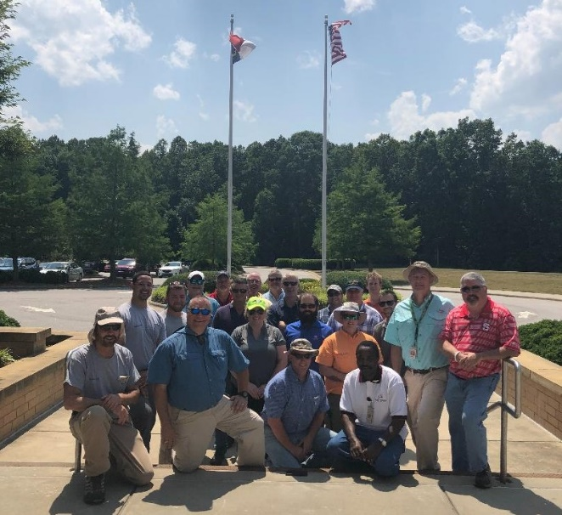


N.C. Workplace Safety and Health
TRC and DART Rate Comparison
FFY 2021—1st Qtr.
CY 2019 | North Carolina |  | National Average |  | Comparison
TRC Rate | 2.3 | 2.5* | 2.8 | 3.0* | 18% Lower/17% Lower*
DART Rate | 1.2 | 1.3* | 1.5 | 1.6* | 20% Lower/19% Lower*
*All industries including state and local government CY = Calendar Year
Notes:
North Carolina’s Total Recordable cases and DART rate continue to be lower that the National Average.
The DART rate stands for "Days Away, Restrictions and Transfers". This number is also based on trending over 200,000 hours but its not based on total injuries. Its based only on those injuries and illnesses severe enough to warrant "Days Away, Restrictions and Transfers".
The Total Recordable Case Rate (TRC) equals the division of all recordable cases by the hours worked, multiplied by 200'000 for standardization.

Slide 3
N.C. Workplace Safety and Health
Total Recordable Cases (TRC)
FFY 2021—1st Qtr.
3% Decrease
4% Decrease
4% Increase
7% Decrease
4% Decrease
All Industries Including State and Local Government
Based on Calendar Year

Slide 4
N.C. Workplace Safety and Health
Days Away, Restricted or Transferred (DART)
FFY 2021—1st Qtr.
7% Decrease
No Change
7% Increase
7% Decrease
7% Decrease
All Industries Including State and Local Government
Based on Calendar Year

Slide 5
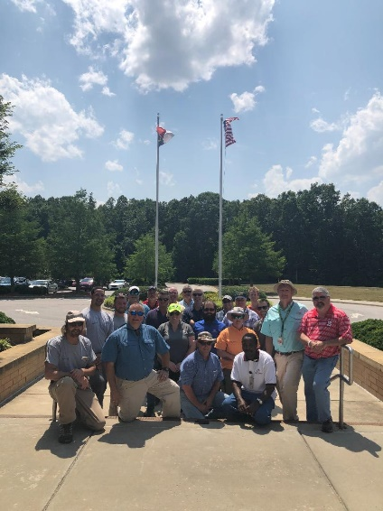
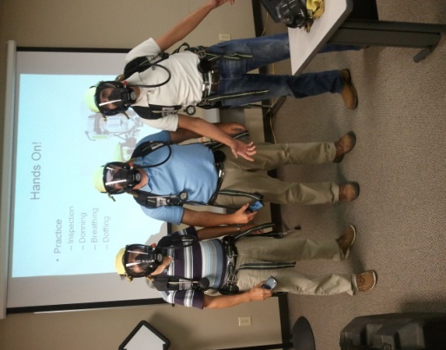
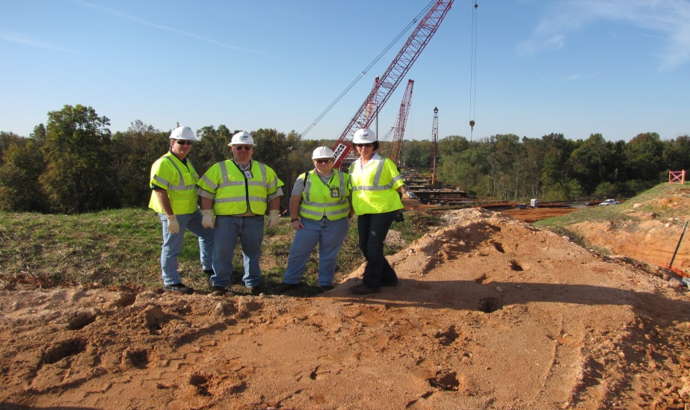
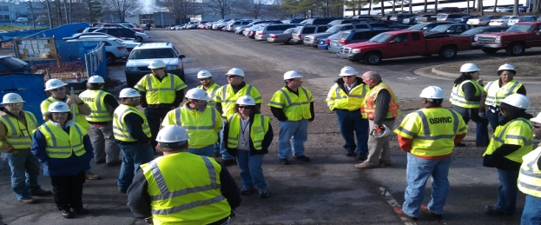
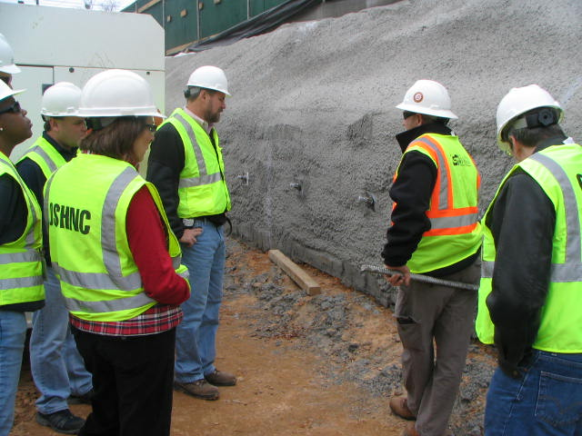
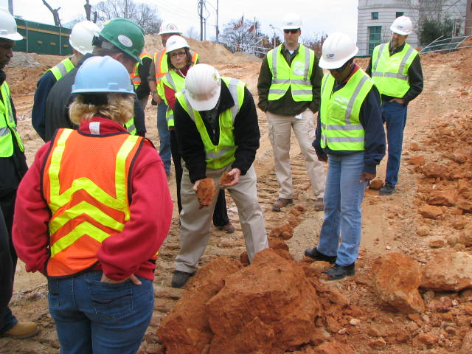
N.C. Workplace Safety and Health
OSH Division—Fatalities Inspected
FFY 2021—1st Qtr.
FATALITY TYPE | 1ST Qtr. | Total | FATALITY TYPE | 1ST Qtr. | Total
Struck By | 7 | 7 | Inhalation | 0 | 0
Caught In/Between | 1 | 1 | Ingestion | 0 | 0
Bite/Sting/Scratch | 0 | 0 | Absorption | 0 | 0
Fall (Same Level) | 0 | 0 | Repeated Motion/Pressure | 0 | 0
Fall (From Elevation) | 2 | 2 | Cardio/Respiratory | 0 | 0
Struck Against | 1 | 1 | Shock | 0 | 0
Rubbed/Abraded | 0 | 0 | Other | 2 | 2
COVID-19 |  |  |  | 10 | 10
Fatalities Under OSH Division Jurisdiction
FFY 2020 |  | FFY 2021 | 1st Qtr. | Total
Total Fatalities | 78 | Fatalities | 23 | 23
NCDOL Photo Library

Slide 6
N.C. Workplace Safety and Health
OSH Division—Strategic Plan Goals
FFY 2021—1st Qtr.
COMPLIANCE | 1ST Qtr. | Total | FFY Goal
Safety Inspections | 260 | 260 | 1,197
Health Inspections | 224 | 224 | 635
Serious Hazards Eliminated | 549 | 549 | 4,100
Training and/or Program Violations | 125 | 125 | 1,050
CONSULTATION | 1ST Qtr. | Total | FFY Goal
Serious Hazards Eliminated | 1,107 | 1,107 | 5,000
Private Sector and Public Sector Visits | 333 | 333 | 925
OSH DIVISION | 1ST Qtr. | Total | FFY Goal
Program Improvements | 472 | 472 | 2,060
People Trained in Special Emphasis Program Areas | 1,326 | 1,326 | 3,700
People Trained at OSH Division Sponsored Events | 1,942 | 1,942 | 7,350

Slide 7
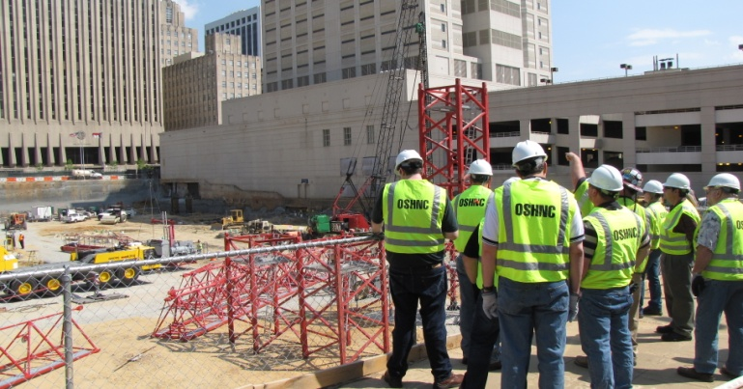
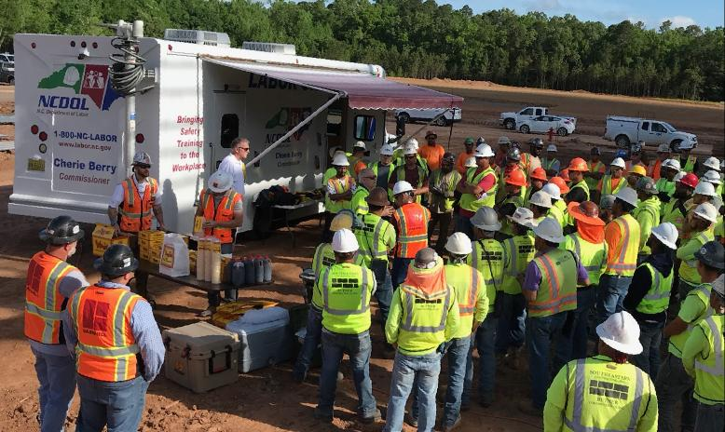
N.C. Workplace Safety and Health
OSH Division—Strategic Plan Goals
FFY 2021—1st Qtr.
Education, Training and Technical Assistance (ETTA) | 1ST Qtr. | Total | FFY Goal
Publications Distributed | 3,618 | 3,618 | 23,000
Standards Interpretations | 589 | 589 | NA
Agricultural Safety and Health (ASH) | 1ST Qtr. | Total | FFY Goal
Outreach Materials Distributed | 240 | 240 | 3,500
Compliance Inspections | 11 | 11 | 80
Certificates Issued | 108 | 108 | 1,500
Preoccupancy Inspections | 168 | 168 | 1,700
NCDOL Photo Library

Slide 8
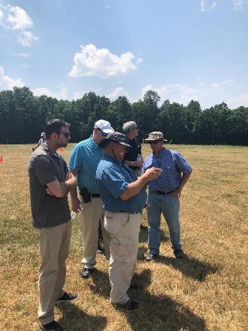
Strategic Plan
Special Emphasis Programs (SEP)
FFY 2021—1st Qtr.
NCDOL Photo Library
Construction
Logging and Arboriculture
Long Term Care Facilities
Health Hazards
Food Manufacturing
Grocery and Related Product Wholesalers
Amputations

Slide 9
Special Emphasis Program
Construction
FFY 2021—1st Qtr.
NAICS 23—CONSTRUCTION | FFY 2020 |  | 1st Qtr. | Total
Total Fatalities | 26 |  | 5 | 5
3rd Qtr. Fatality Rate | 0.0013 |  | N/A | N/A
Fatality Type | 1st Qtr. | Total | Fatality Type | 1st Qtr. | Total
Struck By | 3 | 3 | Inhalation | 0 | 0
Caught In/Between | 0 | 0 | Ingestion | 0 | 0
Bite/Sting/Scratch | 0 | 0 | Absorption | 0 | 0
Fall (Same Level) | 0 | 0 | Repeated Motion/Pressure | 0 | 0
Fall (From Elevation) | 2 | 2 | Cardio/Respiratory | 0 | 0
Struck Against | 0 | 0 | Shock | 0 | 0
Rubbed/Abraded | 0 | 0 | Other | 0 | 0
Notes:
ETTA Events Total: 9 (4 Labor One, 4 Webinars, 1 Speaker Bureau )
Total Trained: 305
Consultation Events: 16
Total Trained: 1400
A total of 16 events were served by Rod Wilce. Activities included but are not limited to; event speakers, vendor demonstrations, fall protection training sessions, equipment inspections, distribution of Fed provided resource material, meals i.e. 700 Chic Filet sandwiches, countless doughnuts, full catered lunches. These 16 events provided the intended distribution of information and training to in excess 1400 employees within a 50 mile radius of Raleigh.
Used Billboards for Fall Stand Down, Safe and Sound Week, and Heat Stress.

Slide 10
Special Emphasis Program
Construction
FFY 2021—1st Qtr.
 | North Carolina |  |  |  | National Average |  |  |  | North Carolina vs. National Average
 | CY 2018 |  | CY 2019 |  | CY 2018 |  | CY 2019 |  | 2019 Comparison
TRC | 2.5 | 36% Decrease |  | 1.6 | 3.1 | 10% Decrease |  | 2.8 | 43% Lower
DART | 1.6 | 50% Decrease |  | 0.8 | 1.7 | No Change |  | 1.7 | 53% Lower
SEP ACTIVITY | 1ST Qtr. | Total | FFY Goal
Compliance Inspections | 264 | 264 | 1,050
Consultative Visits | 115 | 115 | 200
OSH Outreach Events (10- and 30- Hour Construction Courses) | 1 | 1 | 6
People Trained | 241 | 241 | 1,750

Slide 11
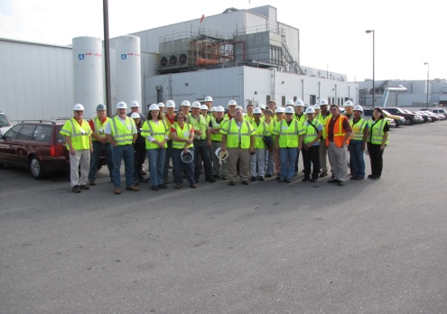
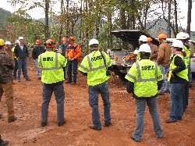
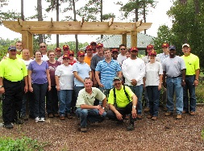
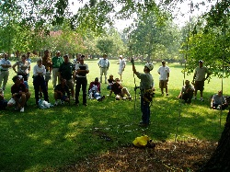
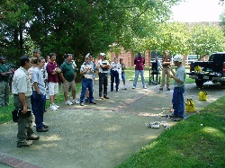
Special Emphasis Program
Logging and Arboriculture
FFY 2021—1st Qtr.
SEP ACTIVITY | 1st Qtr. | Total | FFY Goal
Compliance Inspections | 13 | 13 | 30
Consultative Visits | 3 | 3 | 15
OSH Training and Outreach Events | 0 | 0 | 3
People Trained | 0 | 0 | 75
NAICS 11331*—LOGGING | FFY 2020 |  | 1st Qtr. | Total
Total Fatalities | 1 |  | 0 | 0
NAICS 56173*—ARBORICULTURE | FFY 2020 |  | 1st Qtr. | Total
Total Fatalities | 5 |  | 1 | 1
3rd Qtr. Combined Fatality Rate | 0.0049 |  | N/A | N/A

Slide 12
Special Emphasis Program
Long Term Care Facilities
FFY 2021—1st Qtr.
NAICS 623*—LONG TERM CARE
 | North Carolina |  |  |  | National Average |  |  |  | North Carolina vs. National Average
 | CY 2018 |  | CY 2019 |  | CY 2018 |  | CY 2019 |  | 2019 Comparison
TRC | 5.4 | 7% Decrease |  | 5.0 | 6.1 | 3% Decrease |  | 5.9 | 15% Lower
DART | 3.3 | 3% Increase |  | 3.4 | 3.7 | 5% Decrease |  | 3.5 | 3% Lower
SEP ACTIVITY | 1ST Qtr. | Total | FFY Goal
Compliance Inspections | 2 | 2 | 24
Consultative Visits | 8 | 8 | 10
OSH Outreach Events | 0 | 0 | 2
People Trained | 0 | 0 | 40

Slide 13

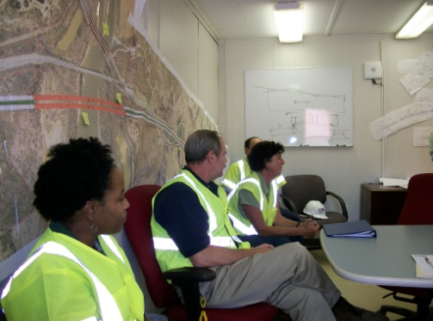
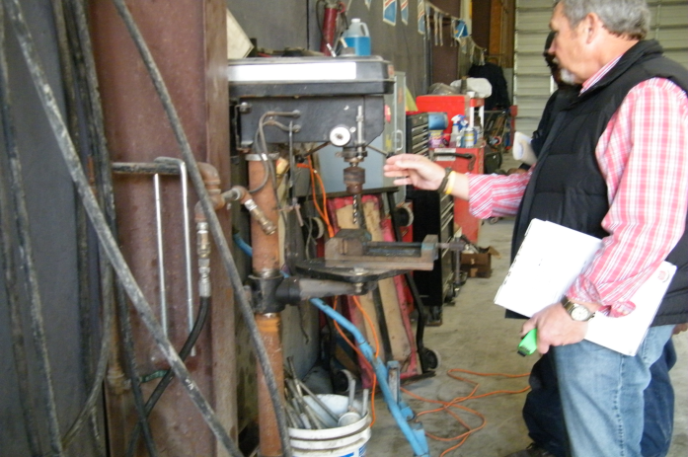
Special Emphasis Program
Health Hazards
FFY 2021—1st Qtr.
COMPLIANCE INSPECTIONS | 1ST Qtr. | Total | FFY Goal
Silica | 9 | 9 | 75
Asbestos | 7 | 7
Isocyanates | 3 | 3
Lead | 2 | 2
Hexavalent Chromium | 4 | 4
Total | 22 | 22
Program Improvements | 6 | 6 | 20
*Some inspections involved more than one health hazard and generally included a program improvement
NCDOL Photo Library

Slide 14
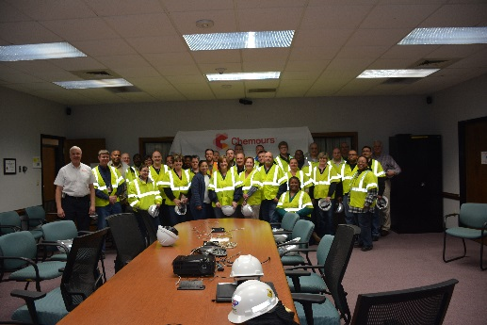
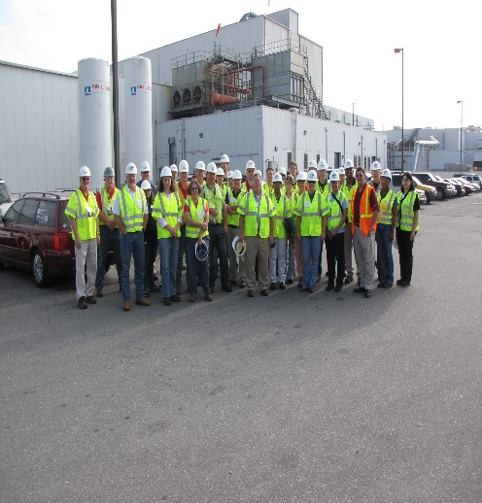
Special Emphasis Program
Health Hazards
FFY 2021—1st Qtr.
COMPLIANCE INSPECTION RESULTS
HEALTH HAZARDS | Number of Samples (Detectable Results) |  | Number With Overexposures |  | Average Severity Rate*
 | 1st Qtr. | Total | 1st Qtr. | Total | 1st Qtr. | Aver.
Silica | 1 | 1 | 0 | 0 | 0.56 | 0.56
Asbestos | 0 | 0 | 0 | 0 | 0 | 0
Isocyanates | 1 | 1 | 0 | 0 | 0.026 | 0.026
Lead | 0 | 0 | 0 | 0 | 0 | 0
Hexavalent Chromium | 0 | 0 | 0 | 0 | 0 | 0
Total | 2 | 2 | 0 | 0 | N/A | N/A
NCDOL Photo Library
* All Samples

Slide 15
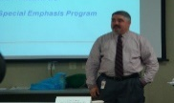
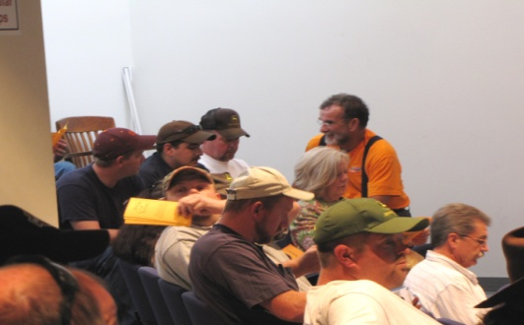
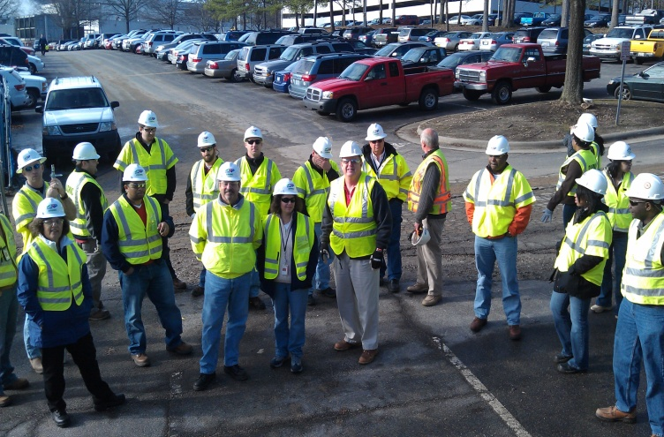
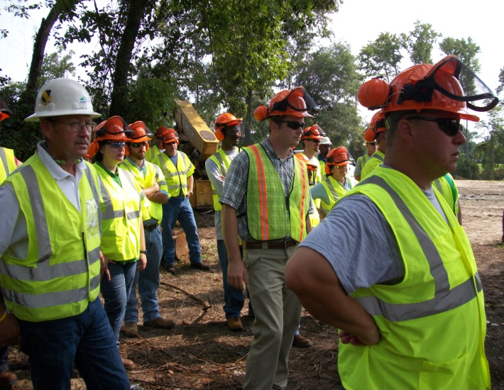
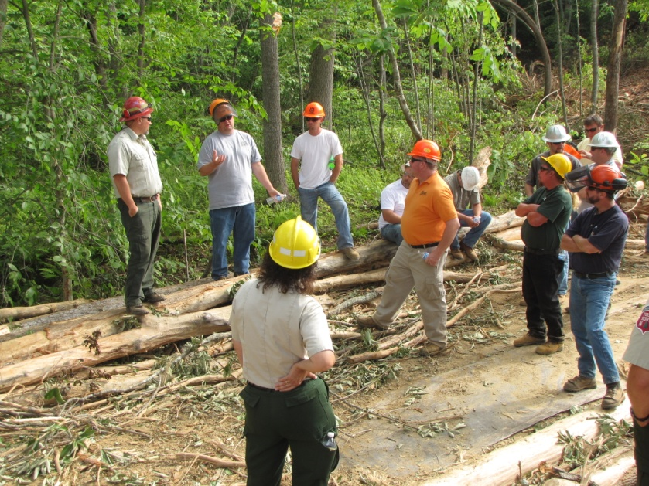
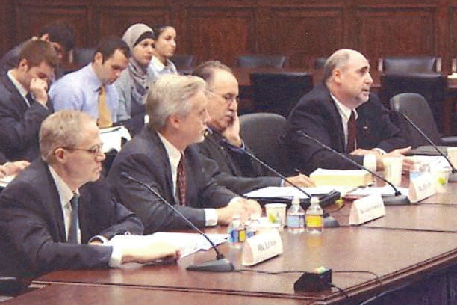
Special Emphasis Program
Health Hazards
FFY 2021—1st Qtr.
HEALTH HAZARDS | Consultative Surveys
 | 1st Qtr. | Total
Silica | 17 | 17
Asbestos | 5 | 5
Isocyanates | 1 | 1
Lead | 5 | 5
Hexavalent Chromium | 4 | 4
Total | 32 | 32
FFY Goal | 125
NCDOL Photo Library
NCDOL Photo Library
SEP ACTIVITY | 1st Qtr. | Total | FFY Goal
OSH Outreach Events | 3 | 3 | 20
People Trained | 50 | 50 | 300

Slide 16
Special Emphasis Program
Food Manufacturing
FFY 2021—1st Qtr.
NAICS 311*—FOOD MANUFACTURING
 | North Carolina |  |  |  | National Average |  |  |  | North Carolina vs. National Average
 | CY 2018 |  | CY 2019 |  | CY 2018 |  | CY 2019 |  | 2019 Comparison
TRC | 2.9 | No Change |  | 2.9 | 4.2 | 5% Decrease |  | 4.0 | 27% Lower
DART | 2.2 | 5% Decrease |  | 2.1 | 2.9 | 3% Decrease |  | 2.8 | 25% Lower
*TRC/DART rate based on the 3-digit NAICS code
SEP ACTIVITY | 1st Qtr. | Total | FFY Goal
Compliance Inspections | 5 | 5 | 20
Consultative Visits | 1 | 1 | 12
OSH Outreach Events | 1 | 1 | 2
People Trained | 9 | 9 | 40

Slide 17
Special Emphasis Program
Grocery and Related Product Wholesalers
FFY 2021—1st Qtr.
NAICS 4244*—GROCERY AND RELATED WHOLESALERS
 | North Carolina |  |  |  | National Average |  |  |  | North Carolina vs. National Average
 | CY 2018 |  | CY 2019 |  | CY 2018 |  | CY 2019 |  | 2019 Comparison
TRC | 4.5 | 2% Increase |  | 4.6 | 5.2 | 8% Decrease |  | 4.8 | 4% Lower
DART | 3.4 | 3% Decrease |  | 3.3 | 4.0 | 7% Decrease |  | 3.7 | 11% Lower
*DART/TRC rate based on the 4-digit NAICS code
SEP ACTIVITY | 1st Qtr. | Total | FFY Goal
Compliance Inspections | 4 | 4 | 24
Consultative Visits | 4 | 4 | 10
OSH Outreach Events | 0 | 0 | 2
People Trained | 0 | 0 | 40

Slide 18
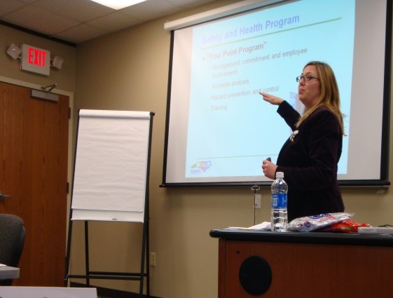
Special Emphasis Program
Amputations
FFY 2021—1st Qtr.
SEP ACTIVITY | 1st Qtr. | Total | FFY Goal
Compliance Inspections | 28 | 28 | 100
Consultative Visits | 49 | 49 | 80
OSH Outreach Events | 7 | 7 | 15
People Trained | 123 | 123 | 400

Slide 19
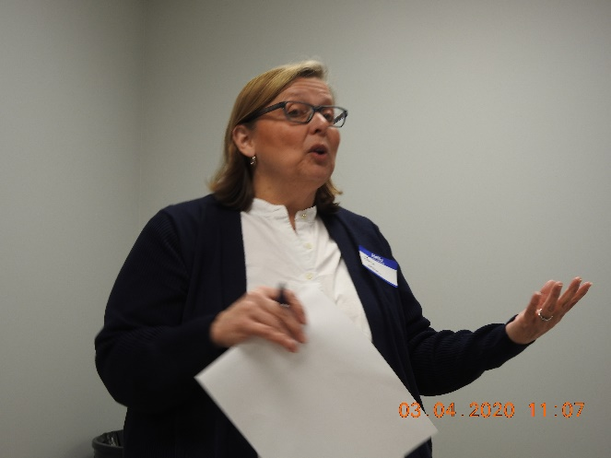
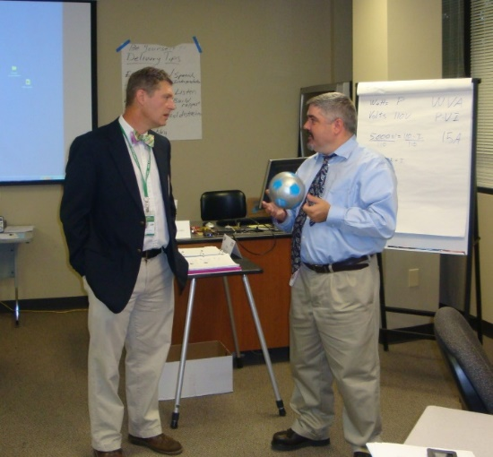
OSH Division
Public Sector
FFY 2021—1st Qtr.
 | CY 2018 |  | CY 2019
TRC | 3.9 | 8% Decrease |  | 3.6
DART | 1.8 | 14% Increase |  | 2.1
ACTIVITY | 1ST Qtr. | Total | FFY Goal
Compliance Inspections | 32 | 32 | 63
Consultative Visits | 67 | 67 | 150
OSH Outreach Events/Booths | 0 | 0 | 22
Trained | 256 | 256 | 2,000

Slide 20
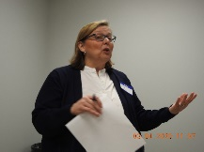
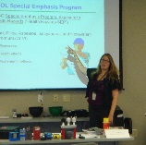
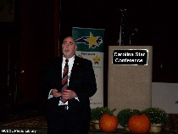
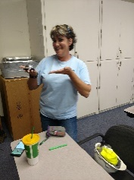
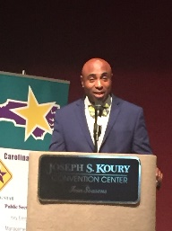
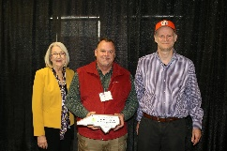
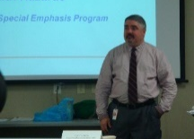

OSH Division
Recognition Programs
FFY 2021—1st Qtr.
STAR SITES—New, Recertification, Promotion | 1st Qtr. | Total | FFY Goal | Approved Star Sites*
Carolina Star | 2 | 2 |  | 103
Building Star | 0 | 0 |  | 23
Rising Star | 0 | 0 |  | 4
Public Sector Star | 1 | 1 |  | 20
Total | 3 | 3 | 20 | 150
NCDOL Photo Library
*Cumulative Total
 | 1st Qtr. | Total | FFY Goal
Star Sites—Termination/Withdrawn | 2 | 2
Star Booths | 0 | 0
Star Presentations | 3 | 3 | 20
Star Program Interventions | 32 | 32 | 100

Slide 21
OSH Division
Recognition Programs
FFY 2021—1st Qtr.
SHARP SITES—New/Renewal | 1st Qtr. | Total | FFY Goal | Approved SHARP Sites*
SHARP—Construction | 1 | 1 |  | 6
SHARP—General Industry | 1 | 1 |  | 121
SHARP—Public Sector | 5 | 5 |  | 40
SHARP—Logging | 0 | 0 |  | 0
SHARP—Renewal | 13 | 13 |  | 167
Totals | 20 | 20 | 55
*Cumulative Total
GOLD STAR GROWERS—NEW | 1st Qtr. | Total
 | 1 | 1
SAFETY AWARDS |  | Total
CY 2020 Safety Awards Season (Silver, Gold, Million Hour) |  | 2,737
 | 1st Qtr. | Total
Million Hour Awards | 8 | 8

Slide 22


OSH Division
Alliances and Partnerships
FFY 2021—1st Qtr.
Alliances
  Carolinas AGC
  Lamar Advertising Company
  Mexican Consulate
  N.C. State – Industry Expansion Solutions
  Safety and Health Council of NC
  NUCA of the Carolinas
  NCALGESO (Being renewed)

Slide 23
OSH Division
Alliances and Partnerships
FFY 2021—1st Qtr.
Partnerships
  Sanders Utility Construction Company, Inc.
    Charlotte – Irwin Creek Tributaries Sanitary Sewer Improvements (2020 – 2022)
  Barringer Construction
    Charlotte - Foundry Building Including Ancillary Buildings (2020 – 2023)
  Holder – Edison Foard – Leeper, A Joint Venture
    Charlotte - Charlotte Convention Center (2020 – 2021)

Slide 24
OSH Division
Complaint Desk*
FFY 2021—1st Qtr.
East Compliance | West Compliance | Agricultural Safety and Health
ACTIVITY | 1st Qtr. | 1st Qtr. | 1st Qtr. | Cumulative* Total | FFY 2020
Complaints | 604 | 744 | 3 | 1,351 | 2,419
Referrals | 65 | 101 | 10 | 176 | 822
Fat/Cat | 20 | 26 | 1 | 47 | 123
Totals | 689 | 871 | 14 | 1,574 | 3,364
*Includes calls that were processed but not necessarily inspected. Fat/Cat includes calls regarding heart attacks and other natural causes.
ACTIVITY | 1st Qtr. | Cumulative Total
Complaints Not in OSH Jurisdiction* | 764 | 764
*Includes complaints related to wage and hour, discrimination, worker's compensation questions, beyond statute of limitation time frame, etc.

Slide 25
OSH Division
Cut-Loose, In-Training, Vacant
FFY 2021—1st Qtr.
West Compliance | Safety | % | Industrial Hygienist | %
Cut Loose | 19 | 61% | 21 | 81%
In-Training | 4 | 13% | 4 | 15%
Vacant | 8 | 26% | 1 | 4%
Total | 31 |  | 26
East Compliance | Safety | % | Industrial Hygienist | %
Cut Loose | 11 | 40% | 8 | 44%
In-Training | 5 | 18% | 4 | 22%
Vacant | 11 | 40% | 6 | 33%
Total | 27 |  | 18
Safety Cut Loose | 52% | Health Cut Loose | 66%
Safety In-Training | 16% | Health in-Training | 18%
Safety Vacant | 33% | Health Vacant | 16%

Slide 26
OSH Division
Cut-Loose, In-Training, Vacant
FFY 2021—1st Qtr.
Consultative Services | Safety | % | Industrial Hygienist | %
Cut Loose | 11 | 100% | 8 | 100%
In-Training | 0 | 0% | 0 | 0%
Vacant | 0 | 0% | 0 | 0%
Total | 11 |  | 8
Education, Training and Technical Assistance | Safety | % | Industrial Hygienist | %
Cut Loose | 8 | 73% | 5 | 83%
In-Training | 3 | 27% | 1 | 17%
Vacant | 0 | 0% | 0 | 0%
Total | 11 |  | 6
Agricultural Safety and Health | Safety | % | Industrial Hygienist
Cut Loose | 4 | 67% | NA
In-Training | 1 | 17% | NA
Vacant | 1 | 17% | NA
Total | 6

Slide 27
OSH Division
Internal Training
FFY 2021—1st Qtr.
1st Qtr.—COURSE
Webinars: | No. | Trained
Fall Protection (3), Steel Erection, Stairways and Ladders (2), Basic COVID-19, COVID-19 for Meat Processing (2), Inspection Process (2), HAZCOM (3), Introduction to OSH, Toxic and Hazardous Substances, Bloodborne Pathogens, Lockout-Tagout (2), Concrete and Masonry, Scaffolds, Walking - Working Surfaces, Electrical Safety (4) Struck By-Caught Between, 1910 Subpart E, Personal Protective Equipment, Hand and Portable Powered Tools (2), Excavation and Trenching (2), Cranes and Derricks, Welding and Cutting, Machine Guarding, Health Hazards SEP. | 37 | 107
Virtual: | No. | Trained
Gravitec Fall Protection—Annual training | 1 | 144
8-Hour HAZWOPER Refresher | 1 | 14
Total Trained |  | 121

Slide 28
OSH Division
Training & Education Outreach
FFY 2021—1st Qtr.
OUTREACH EVENT | 1st Qtr. | Total | FFY Goal
General Industry—10 Hour Course | 1 | 1 | 4
General Industry—30 Hour Course | 0 | 0 | 1
NC #500/502—Construction Train the Trainer Course/ NC #501/503—General Industry Train the Trainer Course | 0 | 0 | 1
Construction—10 Hour Course | 1 | 1 | 5
Construction—30 Hour Course | 0 | 0 | 1
Labor One/Booth Events | 1 | 1 | N/A
Speaker’s Bureau | 9 | 9 | N/A
Webinars | 47 | 47 | N/A
OSH Workshop | 4 | 4 | N/A
Technical Assistance | 0 | 0 | N/A
Spanish Training and Outreach Events | 1 | 1 | N/A
Train the Trainer Program (Construction/General Industry)—Events | 4 | 4 | N/A
Train the Trainer Program (Construction/General Industry)—Trained | 14 | 14 | N/A

Slide 29
OSH Division
Standards Section—Revisions/New
FFY 2021—1st Qtr.
Operational Procedure Notice (OPN)
  OPN 123V—Special Emphasis Program for Construction Activities
    SEP established to decrease fatalities in Construction; changes included updates to SEP counties and statistics.
Memos
  COV 3—Coding to Identify Remote COVID-19 Inspections
    Added coding (N-10-COVID-19 REMOTE) to identify COVID-19 inspections that are conducted completely offsite.
  ASH 4—Temporary Guidance on Migrant Housing for COVID-19 Impacted Workers
    Iterates approval/limitations of emergency housing for COVID-19 suspect/known migrant workers w/o preoccupancy inspection.

Slide 30
OSH Division
Standards Section—Revisions/New
FFY 2021—1st Qtr.
Compliance Directives (CPL)
  CPL 02-02-080—Inspection Procedures for Respirable Crystalline Silica Standards
    Established inspection procedures and enforcement policies for the respirable crystalline silica standards, 29 CFR §§ 1910.1053 and 1926.1153.
Field Operations Manual (FOM)
  FOM Chapter 10—Discrimination Complaints
    Updated guidance related to discrimination complaints. A companion EDB OSH Discrimination Manual is linked from Inspection Resources.

Slide 31
OSH Division
Retaliatory Employment Discrimination
FFY 2021—1st Qtr.
Bureau Staffing
Jay Cronley | Information Officer
Celestine Chestnutt | Administrative Assistant II
James Agosto | Investigator
David Bailey* | Investigator
Dianne Daniels | Investigator
Anitra Nalls | Investigator
Erin Smith | Investigator
Alvin Vocalan | Investigator
Harriet Hopkins | Administrator
*Dave is leaving the agency on 1/29/2021.

Slide 32
OSH Division
Retaliatory Employment Discrimination
FFY 2021—1st Qtr.
OSH Complaint Statistics | 1st Qtr. | Total
Total OSH Complaints Filed | 37 | 37
Total OSH Complaints Closed | 54 | 54
Number of OSH Cases Closed Within 90 Days of File Date | 0 | 0
Percentage of Cases Closed Within 90 Days of File Date | 0% | 0%
Of Cases Closed, Average Number of Elapsed Days Between File Date and Closed Date | 248 | 248
Total Number of OSH Complaints Pending at End of Reporting Period | 111 | 111
Percentage of Pending OSH Complaints Over 90 Days Old (From Filing) | 68% | 68%
Average Number of Elapsed Days Since Filing Date of All OSH Cases Pending at End of the Reporting Period | 191 | 191

Slide 33
OSH Division
Retaliatory Employment Discrimination
FFY 2021—1st Qtr.
OSH Complaint Disposition | 1st Qtr. | Total
Administrative Closure (IMIS: Not Docketed) | 0 | 0
Withdrawn (Includes Requested RTS Letters) | 13 | 13
Merit | 5* | 5*
Total SAMM 15 Merit | 10 | 10
Total SAMM 15 Percent Merit | 19% | 19%
Dismissal Right-to-Sue (Includes No Merit and Unresponsive) | 31 | 31
Settled (External and Internal) | 5* | 5*
Total Cases Closed by Disposition | 54 | 54
TOTAL DAMAGES PAID (Includes Settlements With Aid of the Bureau During Informal Discussions or Mediation.) | $15,000 | $15,000
*Total of Merit and Settled is Total SAMM 15 Merit Finding.

Slide 34
REDA Complaints
COVID-19 Statistics
FFY 2021—1st Qtr.
OSH Complaint COVID-19 Statistics | 1st Quarter FFY 2020 - 2021
OSH Cases Filed this Quarter | 37
COVID-19 Related Complaints Filed | 22
% of Filed OSH Cases that are COVID-19 Related | 59%
% of Filed OSH Cases that are 11(c) Referrals | 13%
COVID-19 Related Complaints Closed | 22
Disposition | DRTS: 7 (31%) Withdrawn:12 (55%) Settled: 3 (14%)
% Change in Filed OSH Complaints Compared to 4th Qtr., 2020 (63) | -40%
% Change in Filed COVID-Related Complaints Compared to 4th Qtr., 2020 (43) | -49%
% of Calls to Helpline that have been COVID-19 Related | 22%

Slide 35
OSH Division
COVID-19 Activities
FFY 2020—2021
Calls/Emails | FFY 2020* | Oct.** | Nov.** | Dec.** | Jan.** | Feb.** | FFY 2021 | FFY 2020 - 2021
Director's Office | 2,143 | 181 | 169 | 193 | 146 | 95 | 784 | 2,927
ETTA | 1,347 | 53 | 42 | 68 | 52 | 17 | 253 | 1,579
ASH*** | 341 | 60 | 42 | 19 | 33 | 9 | 193 | 534
PSIM | 11 | 0 | 0 | 0 | 0 | 0 | 0 | 11
CSB | 1,084 | 51 | 35 | 52 | 49 | 30 | 239 | 1,323
Totals | 4,926 | 345 | 288 | 332 | 341 | 151 | 1,469 | 6,374
*FFY 2020 includes data from March 1 (estimated), 2020 through September 27, 2020.
**Monthly data as follows: October 2020 includes data from October 3-October 30, November 2020 includes data from October 31-November 27, 2020, December 2020 includes data from November 28-January 1, 2021, January 2021 includes data from January 2 – January 29, and February 2021 includes data from January 30 – February 12.
***Includes weekly conference calls with other Agencies.

Slide 36
OSH Division
COVID-19 Activities
FFY 2020—2021
Director's Office | FFY 2020* | Oct.** | Nov.** | Dec.** | Jan.** | Feb.** | FFY 2021 | FFY 2020 - 2021
Meetings | 102 | 15 | 12 | 10 | 4 | 11 | 52 | 154
Compliance | FFY 2020* | Oct.** | Nov.** | Dec.** | Jan.** | Feb.** | FFY 2021 | FFY 2020 - 2021
Valid Complaints | 1,012 | 156 | 122 | 236 | 251 | 83 | 855 | 1,867
Non-Valid Complaints | 1,402 | 136 | 103 | 305 | 193 | 78 | 822 | 2,224
Inspections | 21 | 1 | 3 | 4 | 2 | 0 | 11 | 32
Referrals | 51 | 2 | 1 | 3 | 3 | 0 | 9 | 60
Unprocessed Complaints*** | 1,107 | 60 | 68 | 138 | 83 | 30 | 389 | 1,496
*FFY 2020 includes data from March 1 (estimated), 2020 through September 27, 2020.
**Monthly data as follows: October 2020 includes data from September 29 – November 1, November includes data from November 2 – 29, December 2020 includes data from November 30 – January 3, 2021, January 2021 includes data from January 4 – 31, 2021, and February 2021 includes data from February 1 – February 12.
***This data is preliminary and subject to change as unprocessed complaints are moved to other categories. Many of these unprocessed complaints contain insufficient information to process and/or they cover complaint items that do not fall under OSH jurisdiction. Referrals to other Agencies are made, as appropriate.

Slide 37
OSH Division
COVID-19 Activities
FFY 2020—2021
PSIM | FFY 2020* | Oct.** | Nov.** | Dec.** | Jan.** | Feb.** | FFY 2021 | FFY 2020 - 2021
Disclosure Requests | 1,627 | 1,092 | 73 | 28 | 1 | 2 | 1,196 | 2,823
CSB | FFY 2020* | Oct.** | Nov.** | Dec.** | Jan.** | Feb.** | FFY 2021 | FFY 2020 - 2021
Interventions | 54 | 1 | 0 | 1 | 5 | 3 | 10 | 64
Visits | 157 | 38 | 27 | 25 | 43 | 18 | 151 | 308
ASH | FFY 2020* | Oct.** | Nov.** | Dec.** | Jan.** | Feb.** | FFY 2021 | FFY 2020 - 2021
Guidance Documents | 1 | 0 | 0 | 0 | 0 | 0 | 0 | 1
*FFY 2020 includes data from March 1 (estimated), 2020 through September 27, 2020.
**Monthly data as follows: October 2020 includes data from September 29 – November 1, November includes data from November 2 – 29, December 2020 includes data from November 30 – January 3, 2021, January 2021 includes data from January 4 – 31, 2021, and February 2021 includes data from February 1 – February 12.

Slide 38
OSH Division
COVID-19 Activities
FFY 2020—2021
ETTA | FFY 2020* | Oct.** | Nov.** | Dec.** | Jan.** | Feb.** | FFY 2021 | FFY 2020 - 2021
Live Webinars | 28 | 3 | 4 | 2 | 2 | 0 | 11 | 39
Pre-recorded Webinars | 6 | 0 | 0 | 1 | 0 | 0 | 1 | 7
PowerPoints | 25 | 3 | 1 | 1 | 0 | 0 | 5 | 30
Hazard Alerts | 7 | 2 | 0 | 0 | 0 | 0 | 2 | 9
Streaming Videos | 72 | 10 | 16 | 10 | 3 | 0 | 39 | 111
A-Z Topics Added/Updated | 24 | 3 | 3 | 2 | 2 | 2 | 12 | 36
Fact Sheets | 4 | 1 | 0 | 3 | 0 | 1 | 5 | 9
Example Programs | 1 | 0 | 0 | 0 | 0 | 0 | 0 | 1
Compliance Memos | 10 | 0 | 1 | 0 | 0 | 0 | 1 | 11
Billboards | 0 | 2 | 0 | 0 | 0 | 0 | 2 | 2
*FFY 2020 includes data from March 1 (estimated), 2020 through September 27, 2020.
**Monthly data as follows: October 2020 includes data from September 29 – November 1, November includes data from November 2 – 29, December 2020 includes data from November 30 – January 3, 2021, January 2021 includes data from January 4 – 31, 2021, and February 2021 includes data from February 1 – February 12.

Slide 39
OSH Division
COVID-19 Activities
FFY 2020—2021
COVID-19 Safety and Health Topic Page
FFY 2020
FFY 2020 - 2021 = 28,819
FFY 2021

Slide 40

Thank You For Attending!
FFY 2020—2021
Questions?
1-800-NC-LABOR
(1-800-625-2267)
www.labor.nc.gov
Notes:
40

