Slide 1
North Carolina Department of Labor
Occupational Safety & Health Division
4th Quarter Report
Federal Fiscal Year 2020*
Presented by:
Wanda Lagoe
Bureau Chief
Education, Training and Technical Assistance
Occupational Safety and Health Division of North Carolina
*Preliminary Data
Notes:
The information in this presentation is provided voluntarily by the N.C. Department of Labor, Education Training and Technical Assistance Bureau as a public service and is made available in good faith. This presentation is designed to assist trainers conducting OSHA outreach training for workers. Since workers are the target audience, this presentation emphasizes hazard identification, avoidance, and control – not standards. No attempt has been made to treat the topic exhaustively. It is essential that trainers tailor their presentations to the needs and understanding of their audience.
The information and advice provided on this Site and on Linked Sites is provided solely on the basis that users will be responsible for making their own assessment of the matters discussed herein and are advised to verify all relevant representations, statements, and information.
This presentation is not a substitute for any of the provisions of the Occupational Safety and Health Act of North Carolina or for any standards issued by the N.C. Department of Labor. Mention of trade names, commercial products, or organizations does not imply endorsement by the N.C. Department of Labor.

Slide 2
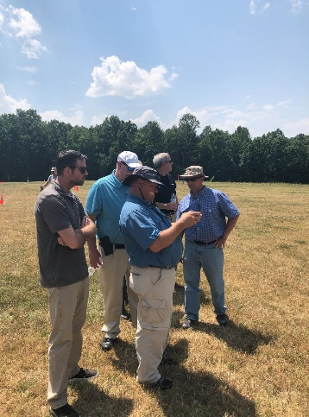
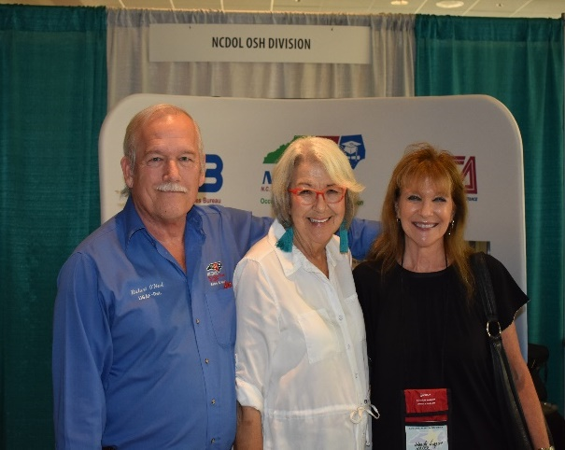


N.C. Workplace Safety and Health
TRC and DART Rate Comparison
FFY 2020—4th Qtr.
CY 2019 | North Carolina |  | National Average |  | Comparison
TRC Rate | 2.3 | 2.5* | 2.8 | 3.0* | 18% Lower/17% Lower*
DART Rate | 1.2 | 1.3* | 1.5 | 1.6* | 20% Lower/19% Lower*
*All industries including state and local government CY = Calendar Year
Notes:
North Carolina’s Total Recordable cases and DART rate continue to be lower that the National Average.
The DART rate stands for "Days Away, Restrictions and Transfers". This number is also based on trending over 200,000 hours but its not based on total injuries. Its based only on those injuries and illnesses severe enough to warrant "Days Away, Restrictions and Transfers".
The Total Recordable Case Rate (TRC) equals the division of all recordable cases by the hours worked, multiplied by 200'000 for standardization.

Slide 3
N.C. Workplace Safety and Health
Total Recordable Cases (TRC)
FFY 2020—4th Qtr.
3% Decrease
4% Decrease
7% Decrease
4% Decrease
4% Increase
All Industries Including State and Local Government
Based on Calendar Year

Slide 4
N.C. Workplace Safety and Health
Days Away, Restricted or Transferred (DART)
FFY 2020—4th Qtr.
7% Decrease
No Change
7% Decrease
7% Decrease
7% Increase
All Industries Including State and Local Government
Based on Calendar Year

Slide 5
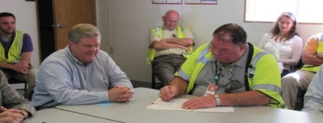
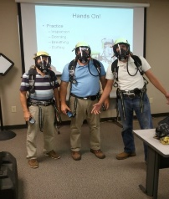
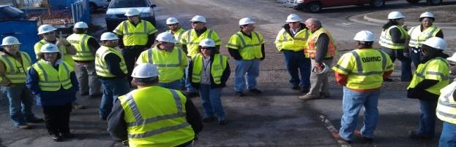
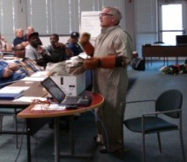
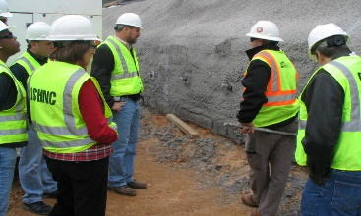
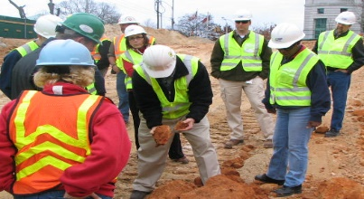
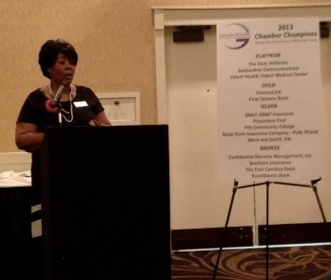
N.C. Workplace Safety and Health
OSH Division—Fatalities Inspected
FFY 2020—4th Qtr.
FATALITY TYPE | 1ST Qtr. | 2nd Qtr. | 3rd Qtr. | 4th Qtr. | Total | FATALITY TYPE | 1ST Qtr. | 2nd Qtr. | 3rd Qtr. | 4th Qtr. | Total
Struck By | 1 | 8 | 5 | 7 | 21 | Inhalation | 0 | 1 | 0 | 0 | 1
Caught In/Between | 3 | 1 | 4 | 2 | 10 | Ingestion | 0 | 0 | 0 | 0 | 0
Bite/Sting/Scratch | 0 | 0 | 0 | 0 | 0 | Absorption | 0 | 0 | 0 | 0 | 0
Fall (Same Level) | 0 | 0 | 1 | 0 | 1 | Repeated Motion/Pressure | 0 | 0 | 0 | 0 | 0
Fall (From Elevation) | 6 | 4 | 2 | 6 | 18 | Cardio/Respiratory | 0 | 0 | 0 | 0 | 0
Struck Against | 0 | 0 | 0 | 0 | 0 | Shock | 0 | 0 | 2 | 0 | 2
Rubbed/Abraded | 0 | 0 | 0 | 0 | 0 | Other | 0 | 1 | 1 | 7 | 9
COVID-19 |  |  |  |  |  |  | 0 | 0 | 6 | 10 | 16
Fatalities Under OSH Division Jurisdiction
FFY 2019 |  | FFY 2020 | 1st Qtr. | 2nd Qtr. | 3rd Qtr. | 4th Qtr. | Total
Total Fatalities | 54 | Fatalities | 10 | 15 | 21 | 32 | 78
NCDOL Photo Library

Slide 6
N.C. Workplace Safety and Health
OSH Division—Strategic Plan Goals
FFY 2020—4th Qtr.
COMPLIANCE | 1ST Qtr. | 2nd Qtr. | 3rd Qtr. | 4th Qtr. | Total | FFY Goal
Safety Inspections | 319 | 455 | 309 | 341 | 1,424 | 1,273
Health Inspections | 159 | 260 | 119 | 233 | 771 | 755
Serious Hazards Eliminated | 634 | 1,814 | 686 | 249 | 3,383 | 4,100
CONSULTATION | 1ST Qtr. | 2nd Qtr. | 3rd Qtr. | 4th Qtr. | Total | FFY Goal
Serious Hazards Eliminated | 1,710 | 1,475 | 355 | 1,279 | 4,819 | 4,800
Private Sector and Public Sector Visits | 394 | 324 | 160 | 393 | 1,271 | 1,012
OSH DIVISION | 1ST Qtr. | 2nd Qtr. | 3rd Qtr. | 4th Qtr. | Total | FFY Goal
Program Improvements | 584 | 578 | 385 | 634 | 2,181 | 2,060
People Trained in Special Emphasis Program Areas | 1,224 | 1,398 | 1,984 | 1,505 | 6,111 | 3,700
People Trained at OSH Division Sponsored Events | 1,729 | 2,406 | 2,653 | 1,784 | 8,572 | 7,350

Slide 7
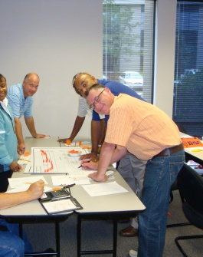
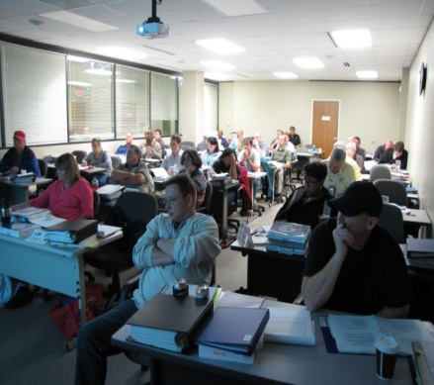
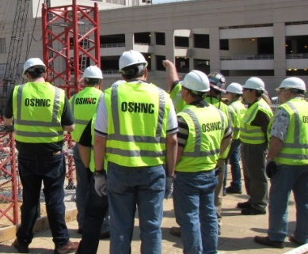
N.C. Workplace Safety and Health
OSH Division—Strategic Plan Goals
FFY 2020—4th Qtr.
Education, Training and Technical Assistance (ETTA) | 1ST Qtr. | 2nd Qtr. | 3rd Qtr. | 4th Qtr. | Total | FFY Goal
Publications Distributed | 6,823 | 9,815 | 688 | 3,352 | 20,678 | 20,000
Standards Interpretations | 723 | 1,009 | 882 | 765 | 3,379 | N/A
Agricultural Safety and Health (ASH) | 1ST Qtr. | 2nd Qtr. | 3rd Qtr. | 4th Qtr. | Total | FFY Goal
Outreach Materials Distributed | 263 | 1,971 | 196 | 42 | 2,472 | 3,500
Compliance Inspections | 13 | 4 | 4 | 19 | 40 | 80
Certificates Issued | 114 | 1,085 | 267 | 81 | 1,547 | 1,500
Preoccupancy Inspections | 212 | 1,134 | 220 | 65 | 1,631 | 1,700
NCDOL Photo Library

Slide 8
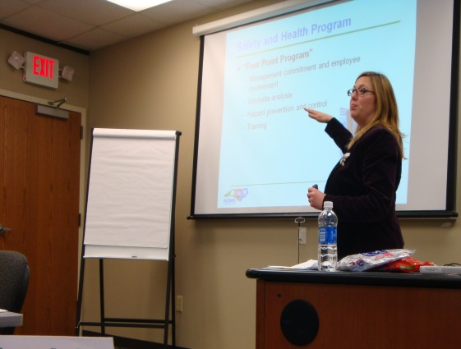
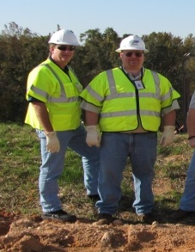
Strategic Plan
Special Emphasis Programs (SEP)
FFY 2020—4th Qtr.
NCDOL Photo Library
Construction
Logging and Arboriculture
Long Term Care Facilities
Health Hazards
Food Manufacturing
Grocery and Related Product Wholesalers
Amputations

Slide 9
Special Emphasis Program
Construction
FFY 2020—4th Qtr.
NAICS 23—CONSTRUCTION | FFY 2019 |  | 1st Qtr. | 2nd Qtr. | 3rd Qtr. | 4th Qtr. | Total
Total Fatalities | 18 |  | 5 | 10 | 3 | 8 | 26
2nd Qtr. Total Fatality Rate | 0.0043 |  | N/A | N/A | N/A | N/A | N/A
Fatality Type | 1st Qtr. | 2nd Qtr. | 3rd Qtr. | 4th Qtr. | Total | Fatality Type | 1st Qtr. | 2nd Qtr. | 3rd Qtr. | 4th Qtr. | Total
Struck By | 1 | 4 | 2 | 2 | 9 | Inhalation | 0 | 1 | 0 | 0 | 1
Caught In/Between | 0 | 0 | 0 | 0 | 0 | Ingestion | 0 | 0 | 0 | 0 | 0
Bite/Sting/Scratch | 0 | 0 | 0 | 0 | 0 | Absorption | 0 | 0 | 0 | 0 | 0
Fall (Same Level) | 0 | 0 | 0 | 0 | 0 | Repeated Motion/Pressure | 0 | 0 | 0 | 0 | 0
Fall (From Elevation) | 4 | 4 | 1 | 5 | 14 | Cardio/Respiratory | 0 | 0 | 0 | 0 | 0
Struck Against | 0 | 0 | 0 | 0 | 0 | Shock | 0 | 0 | 0 | 0 | 0
Rubbed/Abraded | 0 | 0 | 0 | 0 | 0 | Other | 0 | 1 | 0 | 1 | 2
Notes:
ETTA Events Total: 9 (4 Labor One, 4 Webinars, 1 Speaker Bureau )
Total Trained: 305
Consultation Events: 16
Total Trained: 1400
A total of 16 events were served by Rod Wilce. Activities included but are not limited to; event speakers, vendor demonstrations, fall protection training sessions, equipment inspections, distribution of Fed provided resource material, meals i.e. 700 Chic Filet sandwiches, countless doughnuts, full catered lunches. These 16 events provided the intended distribution of information and training to in excess 1400 employees within a 50 mile radius of Raleigh.
Used Billboards for Fall Stand Down, Safe and Sound Week, and Heat Stress.

Slide 10
Special Emphasis Program
Construction
FFY 2020—4th Qtr.
 | North Carolina |  |  |  | National Average |  |  |  | North Carolina vs. National Average
 | CY 2018 |  | CY 2019 |  | CY 2018 |  | CY 2019 |  | 2019 Comparison
TRC | 2.5 | 36% Decrease |  | 1.6 | 3.1 | 10% Decrease |  | 2.8 | 43% Lower
DART | 1.6 | 50% Decrease |  | 0.8 | 1.7 | No Change |  | 1.7 | 53% Lower
SEP ACTIVITY | 1ST Qtr. | 2nd Qtr. | 3rd Qtr. | 4th Qtr. | Total | FFY Goal
Compliance Inspections | 247 | 430 | 251 | 344 | 1,272 | 1,050
Consultative Visits | 119 | 101 | 67 | 122 | 409 | 250
OSH Outreach Events (10- and 30- Hour Construction Courses) | 1 | 2 | 0 | 0 | 3 | 6
People Trained | 493 | 434 | 320 | 99 | 1,346 | 1,750

Slide 11
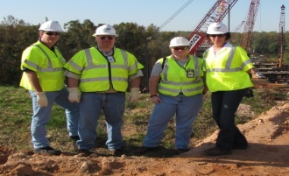
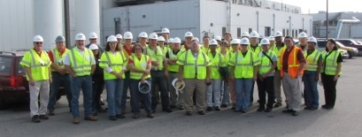
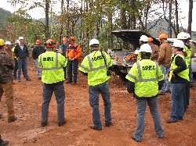
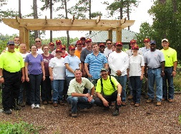
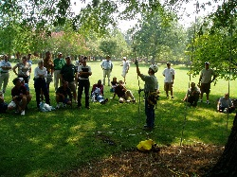
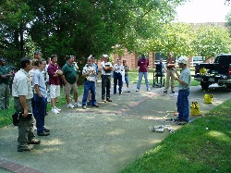
Special Emphasis Program
Logging and Arboriculture
FFY 2020—4th Qtr.
SEP ACTIVITY | 1st Qtr. | 2nd Qtr. | 3rd Qtr. | 4th Qtr. | Total | FFY Goal
Compliance Inspections | 2 | 11 | 5 | 10 | 28 | 30
Consultative Visits | 3 | 6 | 4 | 8 | 21 | 13
OSH Training and Outreach Events | 1 | 1 | 0 | 1 | 3 | 1
People Trained | 30 | 12 | 0 | 23 | 65 | 75
NAICS 11331*—LOGGING | FFY 2019 |  | 1st Qtr. | 2nd Qtr. | 3rd Qtr. | 4th Qtr. | Total
Total Fatalities | 1 |  | 0 | 0 | 1 | 0 | 1
NAICS 56173*—ARBORICULTURE | FFY 2019 |  | 1st Qtr. | 2nd Qtr. | 3rd Qtr. | 4th Qtr. | Total
Total Fatalities | 5 |  | 0 | 1 | 2 | 4 | 7
2nd Qtr. Combined Total Fatality Rate | 0.0027 |  | N/A | N/A | N/A | N/A | N/A

Slide 12
Special Emphasis Program
Long Term Care Facilities
FFY 2020—4th Qtr.
NAICS 623*—LONG TERM CARE
 | North Carolina |  |  |  | National Average |  |  |  | North Carolina vs. National Average
 | CY 2018 |  | CY 2019 |  | CY 2018 |  | CY 2019 |  | 2019 Comparison
TRC | 5.4 | 7% Decrease |  | 5.0 | 6.1 | 3% Decrease |  | 5.9 | 15% Lower
DART | 3.3 | 3% Increase |  | 3.4 | 3.7 | 5% Decrease |  | 3.5 | 3% Lower
SEP ACTIVITY | 1ST Qtr. | 2nd Qtr. | 3rd Qtr. | 4th Qtr. | Total | FFY Goal
Compliance Inspections | 12 | 15 | 0 | 0 | 27 | 29
Consultative Visits | 8 | 9 | 4 | 9 | 30 | 21
OSH Outreach Events | 0 | 1 | 0 | 0 | 1 | 1
People Trained | 0 | 15 | 0 | 0 | 15 | 25

Slide 13
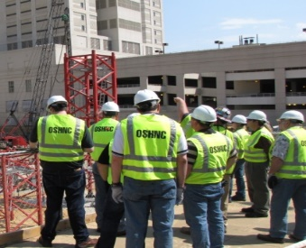
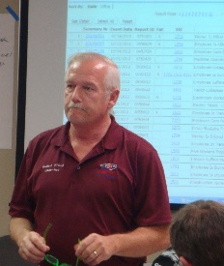
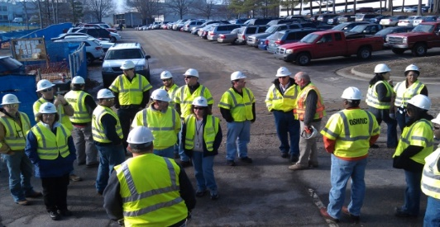
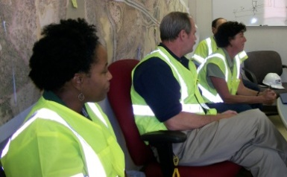
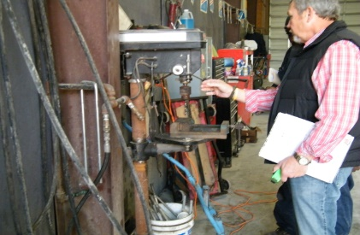
Special Emphasis Program
Health Hazards
FFY 2020—4th Qtr.
COMPLIANCE INSPECTIONS | 1ST Qtr. | 2nd Qtr. | 3rd Qtr. | 4th Qtr. | Total | FFY Goal
Silica | 8 | 19 | 5 | 6 | 38 | 90
Asbestos | 6 | 6 | 2 | 7 | 21
Isocyanates | 5 | 9 | 0 | 3 | 17
Lead | 3 | 5 | 2 | 1 | 11
Hexavalent Chromium | 3 | 3 | 2 | 2 | 10
Total | 24 | 35 | 8 | 19 | 97
Program Improvements | 5 | 11 | 4 | 4 | 24 | 20
*Some inspections involved more than one health hazard and generally included a program improvement
NCDOL Photo Library

Slide 14
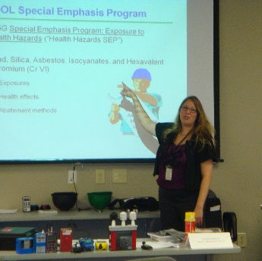
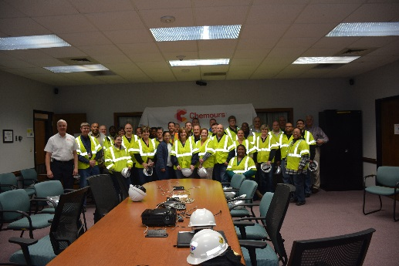
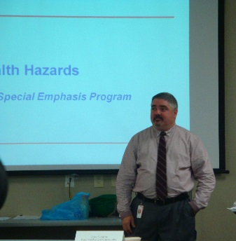
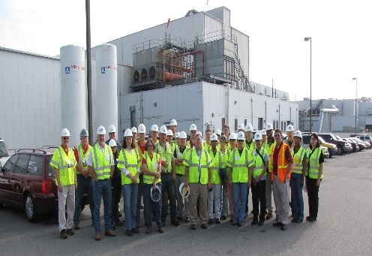
Special Emphasis Program
Health Hazards
FFY 2020—4th Qtr.
COMPLIANCE INSPECTION RESULTS
HEALTH HAZARDS | Number of Samples (Detectable Results) |  |  |  |  | Number With Overexposures |  |  |  |  | Average Severity Rate*
 | 1st Qtr. | 2nd Qtr. | 3rd Qtr. | 4th Qtr. | Total | 1st Qtr. | 2nd Qtr. | 3rd Qtr. | 4th Qtr. | Total | 1st Qtr. | 2nd Qtr. | 3rd Qtr. | 4th Qtr. | Avg.
Silica | 11 | 22 | 7 | 0 | 40 | 6 | 0 | 0 | 0 | 6 | 1.49 | 0.43 | 0.84 | 0 | 0.79
Asbestos | 0 | 0 | 0 | 0 | 0 | 0 | 0 | 0 | 0 | 0 | 0 | 0 | 0 | 0 | 0
Isocyanates | 2 | 1 | 0 | 2 | 5 | 0 | 0 | 0 | 0 | 0 | 0.05 | 0.30 | 0 | 0.01 | 0.08
Lead | 0 | 3 | 1 | 3 | 7 | 0 | 0 | 0 | 0 | 0 | 0 | 1.32 | 0.53 | 0.05 | 0.66
Hexavalent Chromium | 2 | 0 | 0 | 2 | 4 | 0 | 0 | 0 | 0 | 0 | 0.10 | 0 | 0 | 0.01 | 0.06
Total | 13 | 26 | 7 | 7 | 53 | 0 | 0 | 0 | 0 | 6 | N/A | N/A | N/A | N/A | N/A
NCDOL Photo Library
* All Samples

Slide 15

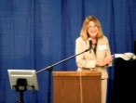
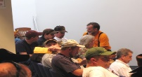
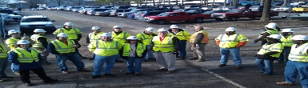
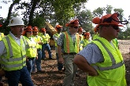
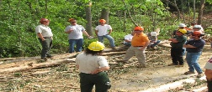
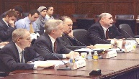


Special Emphasis Program
Health Hazards
FFY 2020—4th Qtr.
HEALTH HAZARDS | Consultative Surveys
 | 1st Qtr. | 2nd Qtr. | 3rd Qtr. | 4th Qtr. | Total
Silica | 48 | 34 | 12 | 32 | 124
Asbestos | 2 | 1 | 1 | 1 | 5
Isocyanates | 3 | 1 | 1 | 2 | 7
Lead | 7 | 7 | 0 | 2 | 16
Hexavalent Chromium | 9 | 7 | 1 | 0 | 17
Total | 67 | 50 | 15 | 37 | 169
FFY Goal | 135
NCDOL Photo Library
NCDOL Photo Library
SEP ACTIVITY | 1st Qtr. | 2nd Qtr. | 3rd Qtr. | 4th Qtr. | Total | FFY Goal
OSH Outreach Events | 2 | 6 | 5 | 3 | 16 | 18
People Trained | 36 | 102 | 60 | 40 | 238 | 280

Slide 16
Special Emphasis Program
Food Manufacturing
FFY 2020—4th Qtr.
NAICS 311*—FOOD MANUFACTURING
 | North Carolina |  |  |  | National Average |  |  |  | North Carolina vs. National Average
 | CY 2018 |  | CY 2019 |  | CY 2018 |  | CY 2019 |  | 2019 Comparison
TRC | 2.9 | No Change |  | 2.9 | 4.2 | 5% Decrease |  | 4.0 | 27% Lower
DART | 2.2 | 5% Decrease |  | 2.1 | 2.9 | 3% Decrease |  | 2.8 | 25% Lower
*DART/TRC rate based on the 3- digit NAICS code
SEP ACTIVITY | 1st Qtr. | 2nd Qtr. | 3rd Qtr. | 4th Qtr. | Total | FFY Goal
Compliance Inspections | 12 | 14 | 8 | 8 | 42 | 40
Consultative Visits | 9 | 6 | 0 | 1 | 16 | 12
OSH Outreach Events | 0 | 0 | 0 | 1 | 1 | 1
People Trained | 0 | 0 | 0 | 23 | 23 | 25

Slide 17
Special Emphasis Program
Grocery and Related Product Wholesalers
FFY 2020—4th Qtr.
NAICS 4244*—GROCERY AND RELATED WHOLESALERS
 | North Carolina |  |  |  | National Average |  |  |  | North Carolina vs. National Average
 | CY 2018 |  | CY 2019 |  | CY 2018 |  | CY 2019 |  | 2019 Comparison
TRC | 4.5 | 2% Increase |  | 4.6 | 5.2 | 8% Decrease |  | 4.8 | 4% Lower
DART | 3.4 | 3% Decrease |  | 3.3 | 4.0 | 7% Decrease |  | 3.7 | 11% Lower
*DART/TRC rate based on the 4- digit NAICS code
SEP ACTIVITY | 1st Qtr. | 2nd Qtr. | 3rd Qtr. | 4th Qtr. | Total | FFY Goal
Compliance Inspections | 6 | 3 | 1 | 5 | 15 | 14
Consultative Visits | 0 | 0 | 0 | 0 | 0 | 0
OSH Outreach Events | 0 | 0 | 0 | 1 | 1 | 1
People Trained | 0 | 0 | 0 | 23 | 23 | 18

Slide 18


Special Emphasis Program
Amputations
FFY 2020—4th Qtr.
SEP ACTIVITY | 1st Qtr. | 2nd Qtr. | 3rd Qtr. | 4th Qtr. | Total | FFY Goal
Compliance Inspections | 36 | 44 | 23 | 33 | 136 | 105
Consultative Visits | 33 | 46 | 7 | 38 | 124 | 100
OSH Outreach Events | 4 | 6 | 6 | 2 | 18 | 15
People Trained | 67 | 138 | 142 | 18 | 365 | 400

Slide 19
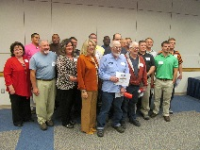
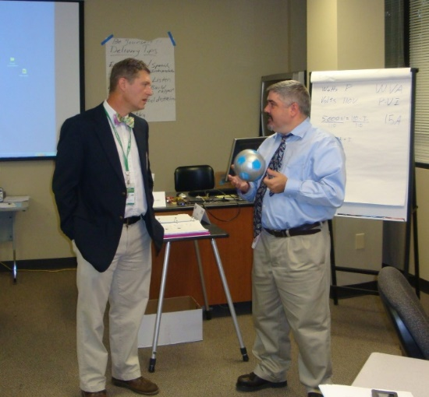
OSH Division
Public Sector
FFY 2020—4th Qtr.
 | CY 2018 |  | CY 2019
TRC | 3.9 | 8% Decrease |  | 3.6
DART | 1.8 | 14% Increase |  | 2.1
ACTIVITY | 1ST Qtr. | 2nd Qtr. | 3rd Qtr. | 4th Qtr. | Total | FFY Goal
Compliance Inspections | 50 | 42 | 3 | 7 | 102 | 93
Consultative Visits | 71 | 48 | 10 | 82 | 211 | 153
OSH Outreach Events/Booths | 5 | 4 | 2 | 1 | 12 | 22
Trained | 198 | 502 | 1,210 | 484 | 2,394 | 2,000

Slide 20
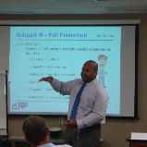

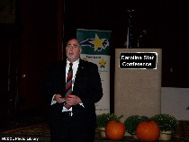
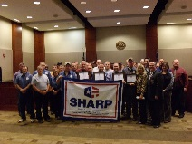
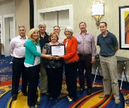

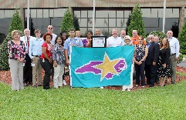
OSH Division
Recognition Programs
FFY 2020—4th Qtr.
STAR SITES—New, Recertification, Promotion | 1st Qtr. | 2nd Qtr. | 3rd Qtr. | 4th Qtr. | Total | FFY Goal | Approved Star Sites*
Carolina Star | 7 | 7 | 3 | 6 | 23 |  | 103
Building Star | 2 | 1 | 0 | 0 | 3 |  | 23
Rising Star | 0 | 0 | 2 | 1 | 3 |  | 4
Public Sector Star | 1 | 0 | 0 | 0 | 1 |  | 21
Total | 10 | 8 | 5 | 7 | 30 | 20 | 151
*Cumulative Total
NCDOL Photo Library
 | 1st Qtr. | 2nd Qtr. | 3rd Qtr. | 4th Qtr. | Total | FFY Goal
Star Sites—Termination/Withdrawn | 4 | 0 | 1 | 0 | 5
Star Booths | 2 | 0 | 0 | 0 | 2
Star Presentations | 4 | 2 | 1 | 2 | 9 | 20
Star Program Interventions | 37 | 28 | 22 | 47 | 134 | 100

Slide 21
OSH Division
Recognition Programs
FFY 2020—4th Qtr.
SHARP SITES—NEW/RENEWALS | 1st Qtr. | 2nd Qtr. | 3rd Qtr. | 4th Qtr. | Total | FFY Goal | Approved SHARP Sites*
SHARP—Construction | 1 | 1 | 0 | 0 | 2 |  | 6
SHARP—General Industry | 0 | 2 | 0 | 1 | 3 |  | 121
SHARP—Public Sector | 0 | 5 | 8 | 5 | 18 |  | 40
SHARP—Logging | 0 | 0 | 0 | 0 | 0 |  | 0
SHARP—Renewals | 10 | 14 | 11 | 14 | 49 |  | 167
Totals | 11 | 22 | 19 | 20 | 72 | 55
*Cumulative Total
GOLD STAR GROWERS—NEW | 1st Qtr. | 2nd Qtr. | 3rd Qtr. | 4th Qtr. | Total
 | 30 | 185 | 51 | 11 | 277
SAFETY AWARDS |  |  |  |  | Total
CY 2020 Safety Awards Season (Silver, Gold, Million Hour) |  |  |  |  | 2,737
 | 1st Qtr. | 2nd Qtr. | 3rd Qtr. | 4th Qtr. | Total
Million Hour Awards | 4 | 83 | 3 | 6 | 96

Slide 22


OSH Division
Alliances and Partnerships
FFY 2020—4th Qtr.
Alliances
  Carolinas AGC
  Lamar Advertising Company
  Mexican Consulate
  N.C. State – Industry Expansion Solutions
  Safety and Health Council of NC
  NUCA of the Carolinas
  NCALGESO

Slide 23
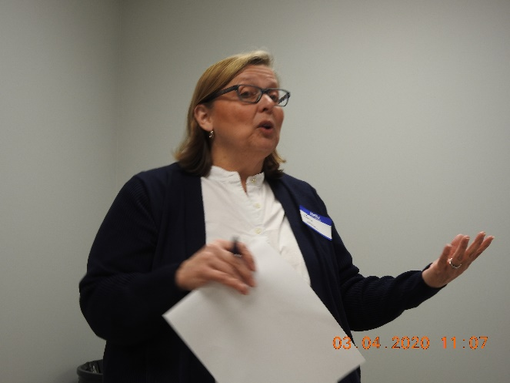
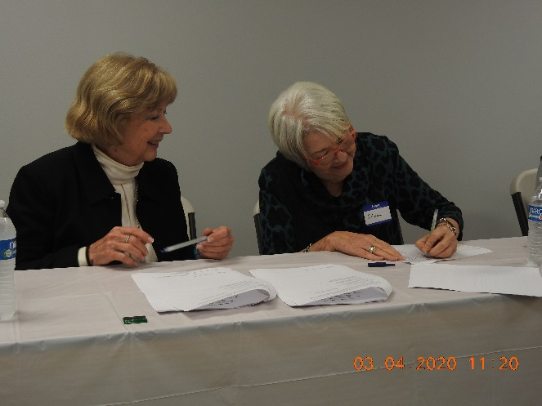
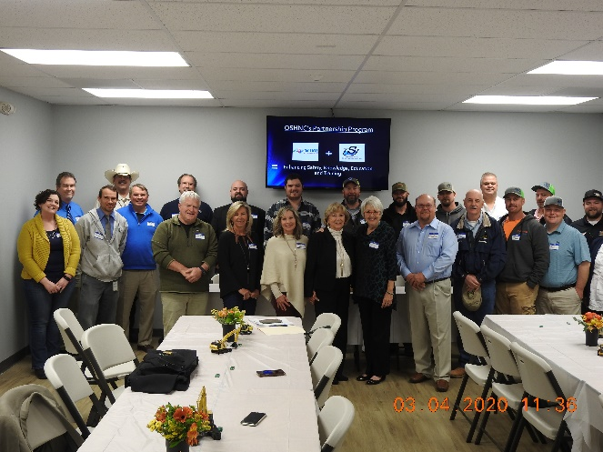
OSH Division
Alliances and Partnerships
FFY 2020—4th Qtr.
Partnerships
  Sanders Utility Construction Company, Inc.
    Design Build Project to improve/up-size/replace sanitary sewer lines along the Irwin Creek Tributary to the Irwin Creek Interceptor
    March 2020 - 2022

Slide 24
OSH Division
Complaint Desk*
FFY 2020—4th Qtr.
East Compliance | West Compliance | Agricultural Safety and Health
ACTIVITY | 1st Qtr. | 2nd Qtr. | 3rd Qtr. | 4th Qtr. | 1st Qtr. | 2nd Qtr. | 3rd Qtr. | 4th Qtr. | 1st Qtr. | 2nd Qtr. | 3rd Qtr. | 4th Qtr. | Cumulative* Total | FFY 2019
Complaints | 223 | 313 | 708 | 709 | 263 | 351 | 801 | 740 | 3 | 3 | 3 | 4 | 4,121 | 2,419
Referrals | 61 | 85 | 68 | 76 | 88 | 98 | 80 | 111 | 4 | 8 | 10 | 18 | 703 | 822
Fat/Cat | 28 | 19 | 21 | 31 | 28 | 32 | 39 | 35 | 1 | 1 | 4 | 7 | 246 | 123
Totals | 312 | 417 | 797 | 816 | 379 | 481 | 920 | 886 | 8 | 8 | 17 | 29 | 5,070 | 3,364
*Includes calls that were processed but not necessarily inspected. Fat/Cat includes calls regarding heart attacks and other natural causes.
ACTIVITY | 1st Qtr. | 2nd Qtr. | 3rd Qtr. | 4th Qtr. | Cumulative Total
Complaints Not in OSH Jurisdiction* | 641 | 916 | 1,108 | 1,105 | 3,770
*Includes complaints related to wage and hour, discrimination, worker's compensation questions, beyond statute of limitation time frame, etc.

Slide 25
OSH Division
Cut-Loose, In-Training, Vacant
FFY 2020—4th Qtr.
West Compliance | Safety | % | Industrial Hygienist | %
Cut Loose | 21 | 68% | 20 | 77%
In-Training | 4 | 13% | 4 | 15%
Vacant | 6 | 19% | 2 | 8%
Total | 31 |  | 26
East Compliance | Safety | % | Industrial Hygienist | %
Cut Loose | 11 | 40% | 8 | 44%
In-Training | 4 | 14% | 5 | 28%
Vacant | 12 | 44% | 5 | 28%
Total | 27 |  | 18
Safety Cut Loose | 55% | Health Cut Loose | 64%
Safety In-Training | 14% | Health in-Training | 20%
Safety Vacant | 31% | Health Vacant | 16%

Slide 26
OSH Division
Cut-Loose, In-Training, Vacant
FFY 2020—4th Qtr.
Consultative Services | Safety | % | Industrial Hygienist | %
Cut Loose | 11 | 100% | 7 | 87%
In-Training | 0 | 0% | 1 | 11%
Vacant | 0 | 0% | 0 | 0%
Total | 11 |  | 8
Education, Training and Technical Assistance | Safety | % | Industrial Hygienist | %
Cut Loose | 5 | 45% | 5 | 83%
In-Training | 6 | 55% | 1 | 17%
Vacant | 0 | 0% | 0 | 0%
Total | 11 |  | 6
Agricultural Safety and Health | Safety | % | Industrial Hygienist
Cut Loose | 4 | 67% | NA
In-Training | 1 | 17% | NA
Vacant | 1 | 17% | NA
Total | 6

Slide 27
OSH Division
Internal Training
FFY 2020—4th Qtr.
1st Qtr.—COURSE |  | Trained
Annual Training—Raleigh:
OCSS Concrete and Masonry OCSS Cranes and Derricks Farm Guarding Safety, Home Inspections ASH Paperless File Management |  | 72 47 10 8 8
OSH 141—Legal Aspects—Raleigh |  | 28
OTI 245—Safety and Health Management Systems—Raleigh |  | 20
OCSS Work Zone Safety/Flagger Safety—Raleigh |  | 21
OCSS Work Zone Safety/Flagger Safety—Charlotte |  | 20
CPR/AED—Raleigh (2) |  | 12
Webinars: | No.
Welding and Cutting, Excavation and Trenching, Personal Protective Equipment (General Industry), Electrical Safety, Machine Guarding | 5 | 6
Total Trained |  | 398

Slide 28
OSH Division
Internal Training
FFY 2020—4th Qtr.
2nd Qtr.—COURSE |  | Trained
OSH 105—Introduction to Safety Standards for Safety Officers—Raleigh |  | 12
OSH 100—Initial Compliance—Charlotte |  | 9
OSH—Technical Writing and OSHA Express—Charlotte |  | 10
Long Term Care Workshop—Webinar |  | 15
Webinars: | No.
Scaffolds, Personal Protective Equipment for Construction, Personal Protective Equipment for General Industry, Inspection Process, Hazard Communication, Ergonomic Awareness, Respiratory Protection, Struck by/Caught in Between, Concrete and Masonry, and 1910 Subpart E - Exit Routes, Emergency Action Plans and Fire Prevention Plans | 11 | 49
Total Trained |  | 95

Slide 29
OSH Division
Internal Training
FFY 2020—4th Qtr.
3rd Qtr.—COURSE |  | Trained
Webinars: | No.
Heat Stress, Excavation and Trenching, Inspection Process, Respiratory Protection, Introduction to OSH, Fall Protection, Bloodborne Pathogens, Hazard Communication, Toxic and Hazardous Substances, Personal Protective Equipment, Scaffolds, Powered Industrial Trucks, Recordkeeping, Health Hazards SEP, Hand and Portable Powered Tools, Lockout/Tagout, Confined Space Entry, Stairways and Ladders, Exit Routes, EAP and FPP, Electrical Safety, Machine Guarding, Struck-by/Caught Between, Walking Working Surfaces, Occupational Noise Exposure, Collateral First Aid, Welding and Cutting, Silica, Concrete and Masonry, Safety and Health Committees, Top Ten in General Industry, Top Ten in Construction Industry, Work Zone Safety, Material Handling, Steel Erection, Ergonomics Awareness, and Cranes and Derricks | 98 | 931
Total Trained |  | 931

Slide 30
OSH Division
Internal Training
FFY 2020—4th Qtr.
4th Qtr.—COURSE
Webinars: | No. | Trained
Health Hazards SEP, Food Manufacturing SEP, Grocery SEP, Chainsaw Safety, Fall Protection (2), Steel Erection, Stairways and Ladders, COVID-Construction | 9 | 35
Virtual: | No. | Trained
OSH 125—Introduction to Health Standards for Industrial Hygienists | 1 | 20
Total Trained |  | 55

Slide 31
OSH Division
Training & Education Outreach
FFY 2020—4th Qtr.
OUTREACH EVENT | 1st Qtr. | 2nd Qtr. | 3rd Qtr. | 4th Qtr. | Total | FFY Goal
General Industry—10 Hour Course | 1 | 1 | 0 | 0 | 2 | 4
General Industry—30 Hour Course | 0 | 1 | 0 | 0 | 1 | 1
NC #500/502—Construction Train the Trainer Course NC #501/503—General Industry Train the Trainer Course | 0 | 0 | 0 | 0 | 0 | 1
Construction—10 Hour Course | 1 | 2 | 0 | 0 | 3 | 5
Construction—30 Hour Course | 0 | 0 | 0 | 0 | 0 | 1
Labor One/Booth Events | 7 | 2 | 0 | 0 | 9 | N/A
Speaker’s Bureau | 20 | 15 | 2 | 4 | 41 | N/A
Webinars | 16 | 25 | 99 | 47 | 187 | N/A
OSH Workshop | 3 | 2 | 0 | 1 | 6 | N/A
Technical Assistance | 7 | 5 | 0 | 0 | 12 | N/A
Spanish Training and Outreach Events | 1 | 2 | 0 | 0 | 3 | N/A
Train the Trainer Program (Construction/ General Industry)—Events | 5 | 4 | 6 | 7 | 22 | N/A
Train the Trainer Program (Construction/ General Industry)—Trained | 0 | 25 | 23 | 0 | 48 | N/A
Total | 61 | 84 | 130 | 59 | 334 | N/A

Slide 32

OSH Division
Training & Education—Stand Downs
FFY 2020—4th Qtr.
Heat Stress
  Seven Webinars, 154 Trained
  Billboard
Falls Prevention
  Four Webinars (Fall Protection (2), Stairways and Ladders, Construction – COVID-19), 56 Trained
  Billboard
Safe + Sound Week
  Webinar on Safety and Health Committees, 55 Trained
Notes:
Safe and Sound Week – Webinar on Recommended Practices for S&H
162 participants Programs; carousel on website; governor proclamation.
Fall Stand-Down Numbers-283 Trained
Trench – NUCA podcast, webinar

Slide 33
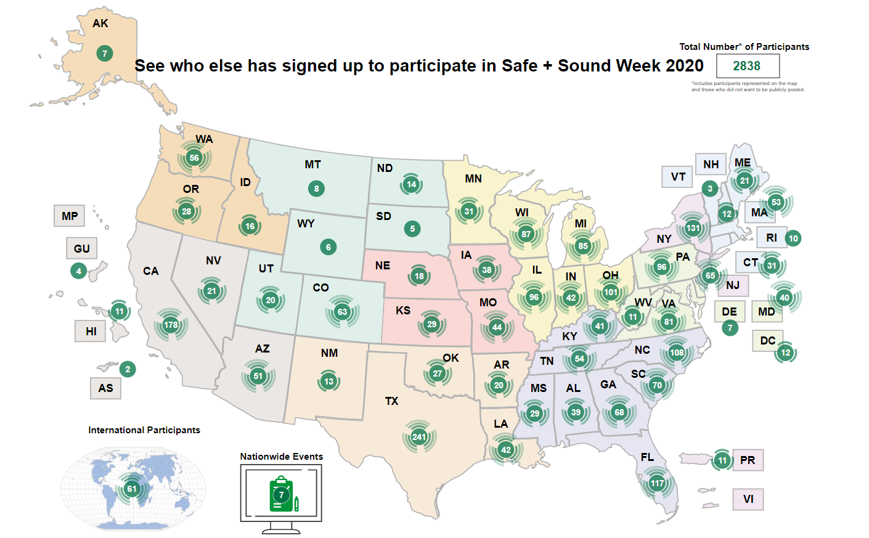
OSH Division
Training & Education—Stand Downs
FFY 2020—4th Qtr.

Slide 34
OSH Division
Standards Section—Revisions
FFY 2020—4th Qtr.
Operational Procedure Notice (OPN)
  OPN 128V—Public Sector Surveys and Inspections
    Changes to reference years for OSHA 300 logs and DART rates
  OPN 135I—Health Hazards Special Emphasis Program
    In lieu of adopting the respirable silica NEP (CPL 03-00-023), applicable portions of the NEP were incorporated into OPN 135 to include updating the list of NAICS codes and coding for OSHA Express.
Standards Notice (SN)
  SN 77—Cyanides Antidotes
    The SN presents updated guidance on appropriate type and administration of antidotes for cyanide poisoning.

Slide 35
OSH Division
Standards Section—Revisions
FFY 2020—4th Qtr.
Code of Federal Register (CFR)
  CFR 188—OSHA Standards and Regulations; Corrections
    Final rule corrects typographical errors, including extraneous or omitted materials and inaccurate graphics, in 27 OSHA standards and regulations.
Memorandums
  MRA 5—Medical Records Administrators
    Memo updating OSH Division Medical Records Administrators list.

Slide 36
OSH Division
Retaliatory Employment Discrimination
FFY 2020—4th Qtr.
OSH Complaint Disposition | 1st Qtr. | 2nd Qtr. | 3rd Qtr. | 4th Qtr. | Total
Administrative Closure (No RTS Letter) | 0 | 0 | 1 | 0 | 1
Withdrawn | 6 | 1 | 7 | 3 | 17
Merit | 0 | 2 | 3 | 1 | 6
Percent SAMM Merit | 0% | 33% | 11% | 12% | 16%
Dismissal Right-to-Sue (Includes No Merit and Unresponsive) | 10 | 14 | 21 | 30 | 75
Settled | 3 | 7 | 1 | 4 | 14
Requested RTS Letter | 2 | 3 | 3 | 4 | 12
Total | 21 | 27 | 36 | 42 | 125

Slide 37
OSH Division
Retaliatory Employment Discrimination
FFY 2020—4th Qtr.
OSH Complaint Statistics | 1st Qtr. | 2nd Qtr. | 3rd Qtr. | 4th Qtr. | Total
Total OSH Complaints Filed | 31 | 26 | 37 | 59 | 153
Total OSH Complaints Closed | 21 | 27 | 36 | 42 | 126
Number of OSH Cases Closed Within 90 Days of File Date | 1 | 1 | 0 | 1 | 3
Percentage of Cases Closed With in 90 Days of File Date | 11% | 4% | 0% | 2% | N/A
Of Cases Closed, Average Number of Elapsed Days Between File Date and Closed Date | 190 | 287 | 288 | 292 | N/A
Total Number of OSH Complaints Pending at End of Reporting Period | 105 | 102 | 105 | 112 | N/A
Percentage of Pending OSH Complaints Over 90 Days Old (From Filing) | 69% | 76% | 65% | 51% | N/A
Average Number of Elapsed Days Since Filing Date of All OSH Cases Pending at End of the Reporting Period | 135 | 148 | 150 | 128 | N/A

Slide 38
REDA Complaints
COVID-19 Statistics
FFY 2020—4th Qtr.
OSH Complaint Statistics | 4th Quarter
OSH Cases Filed this Quarter | 59
COVID-19 Related Complaints Filed | 42
% of Filed OSH Cases that are COVID-19 Related | 71%
% of Filed OSH Cases that are 11(c) Referrals | 7%
COVID-19 Related Complaints Closed | 3
Disposition | 2 No Merit Disposal/ 1 Withdrawal
% Increase in OSH Cases Over Same Quarter Last Year | 34%
% of Calls to Helpline that have been COVID-19 Related | 22%

Slide 39
OSH Division
Retaliatory Employment Discrimination
FFY 2020—4th Qtr.
Bureau Staffing
Jay Cronley | Information Officer
Celestine Chestnutt | Administrative Assistant II
James Agosto | Investigator
David Bailey | Investigator
Dianne Daniels | Investigator
Anitra Nalls | Investigator
Erin Smith | Investigator
Alvin Vocalan | Investigator
Harriet Hopkins | Administrator

Slide 40
OSH Division
COVID-19 Activities
FFY 2020—4th Qtr.
Calls/Emails | Apr* | May* | Jun* | Jul* | Aug* | Sep* | Oct* | Nov* | Total
Director's Office | 217 | 436 | 397 | 390 | 397 | 306 | 181 | 92 | 2,416
ETTA | 687 | 262 | 155 | 108 | 86 | 49 | 53 | 22 | 1,422
ASH** | 45 | 45 | 32 | 56 | 74 | 89 | 60 | 22 | 423
PSIM | 0 | 2 | 2 | 4 | 3 | 0 | 0 | 0 | 11
CSB | 401 | 376 | 101 | 127 | 109 | 70 | 51 | 20 | 1,155
Totals | 1,350 | 1,021 | 687 | 685 | 669 | 514 | 345 | 156 | 5,427
*Monthly data as follows: April 2020 includes data through May 1, May 2020 includes data from May2- June 5, June 2020 includes data from June 6-July 3, July 2020 includes data from July 4-July 31. August 2020 includes data from August 1 – August 28, September 2020 includes data from August 29-October 2, October 2020 includes data from October 3-October 30, November 2020 includes data from October 31-November 13.
**Includes weekly conference calls with other Agencies.

Slide 41
OSH Division
COVID-19 Activities
FFY 2020—4th Qtr.
Director’s Office | Mar/Apr* | May* | Jun* | Jul* | Aug* | Sep* | Oct* | Nov* | Total
Meetings | 10 | 26 | 25 | 16 | 4 | 21 | 15 | 7 | 124
Compliance | Mar/Apr* | May* | Jun* | Jul* | Aug* | Sep* | Oct* | Nov* | Total
Valid Complaints | 180 | 176 | 166 | 217 | 200 | 71 | 156 | 59 | 1,225
Non-Valid Complaints | 435 | 278 | 170 | 249 | 149 | 60 | 133 | 42 | 1,564
Inspections | 0 | 3 | 3 | 5 | 3 | 3 | 1 | 0 | 20
Referrals | 2 | 9 | 9 | 10 | 12 | 4 | 1 | 1 | 53
Unprocessed Complaints** | 505 | 116 | 144 | 180 | 102 | 60 | 60 | 33 | 1,200
*Monthly data as follows: March/April 2020 includes data through May 1, May 2020 includes data from May2- June 5, June 2020 includes data from June 6-July 3, July 2020 includes data from July 4-July 31. August 2020 includes data from August 1 – August 28, September 2020 includes data from August 29-October 2, October 2020 includes data from October 3-November 1, November 2020 includes data from November 2-November 13.
* *This data is preliminary and subject to change as unprocessed complaints are moved to other categories. Many of the unprocessed complaints contain insufficient information to process and/or they cover complaint items that do not fall under OSH jurisdiction. Referrals to other Agencies are made, as appropriate.

Slide 42
OSH Division
COVID-19 Activities
FFY 2020—4th Qtr.
ETTA | Mar/Apr* | May* | Jun* | Jul* | Aug* | Sept* | Oct* | Nov* | Totals
Live Webinars | 13 | 3 | 3 | 2 | 5 | 2 | 3 | 1 | 32
Pre-recorded Webinars | 4 | 0 | 0 | 0 | 2 | 0 | 0 | 0 | 6
PowerPoints | 3 | 1 | 1 | 0 | 0 | 0 | 1 | 0 | 6
Hazard Alerts | 6 | 0 | 0 | 0 | 0 | 1 | 2 | 0 | 9
Streaming Videos | 15 | 16 | 14 | 9 | 12 | 6 | 10 | 4 | 86
A-Z Topics Added/Updated | 4 | 5 | 5 | 3 | 4 | 3 | 3 | 1 | 28
Fact Sheets | 1 | 0 | 2 | 1 | 0 | 0 | 1 | 0 | 5
Example Programs | 0 | 0 | 1 | 0 | 0 | 0 | 1 | 0 | 2
Compliance Memos | 8 | 2 | 0 | 0 | 0 | 0 | 1 | 0 | 11
Billboards | 0 | 0 | 0 | 0 | 0 | 0 | 2 | 0 | 2
*Monthly data as follows: March/April 2020 includes data through May 1, May 2020 includes data from May2- June 5, June 2020 includes data from June 6-July 3, July 2020 includes data from July 4-July 31. August 2020 includes data from August 1 – August 28, September 2020 includes data from August 29-October 2, October 2020 includes data from October 3-November 1, November 2020 includes data from November 2-November 13.

Slide 43
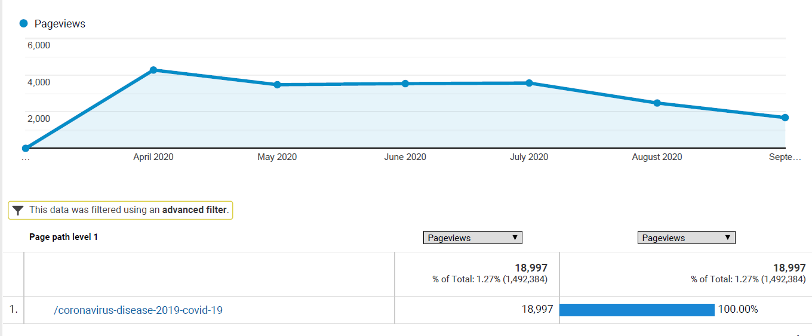
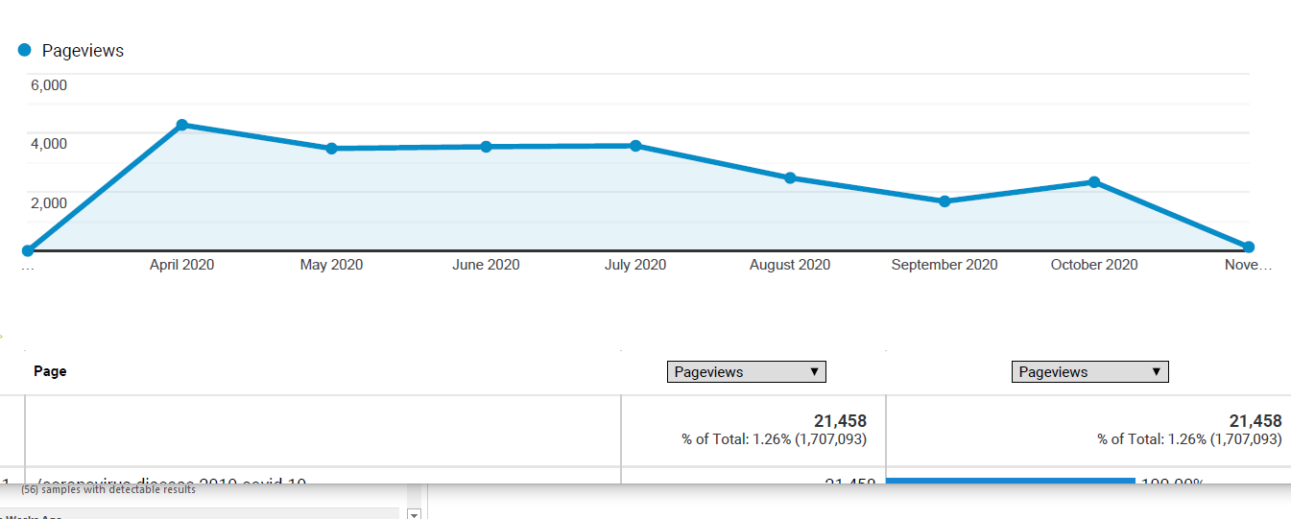
OSH Division
COVID-19 Activities
FFY 2020—4th Qtr.
COVID-19 Safety and Health Topic Page
FFY 2020
Current to November

Slide 44
OSH Division
COVID-19 Activities
FFY 2020—4th Qtr.
PSIM | Mar/Apr* | May* | Jun* | Jul* | Aug* | Sept* | Oct* | Nov* | Totals
Disclosure Requests | 0 | 194 | 8 | 153 | 1,228 | 44 | 1,092 | 63 | 2,782
CSB | Mar/Apr* | May* | June* | July* | Aug* | Sept* | Oct* | Nov* | Totals
Interventions | 28 | 4 | 4 | 1 | 1 | 0 | 1 | 0 | 39
Visits | 2 | 20 | 49 | 41 | 26 | 19 | 38 | 13 | 208
ASH | Mar/Apr* | May* | Jun* | Jul* | Aug* | Sept* | Oct* | Nov* | Totals
Guidance Documents | 1 | 0 | 0 | 0 | 0 | 0 | 0 | 0 | 1
*Monthly data as follows: March/April 2020 includes data through May 1, May 2020 includes data from May2- June 5, June 2020 includes data from June 6-July 3, July 2020 includes data from July 4-July 31. August 2020 includes data from August 1 – August 28, September 2020 includes data from August 29-October 2, October 2020 includes data from October 3-November 1, November 2020 includes data from November 2-November 13.
OSH Division
  Maintaining available PPE supplies for staff including respirators, washable facemasks/coverings, hand sanitizer, Clorox wipes, Lysol spray, face shields, sanitation barriers, cubicle privacy screens, gloves, and goggles.
  Updated OSH COVID-19 Policy for office and field work that includes use of PPE, employee training, posters, marked floors, staggered shifts, teleworking, virtual meetings/training, temporary phones and self health checks.

Slide 45
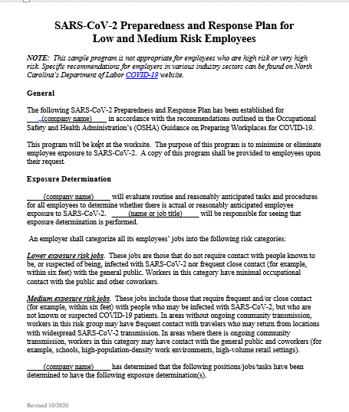
OSH Division
COVID-19 Activities
FFY 2020—4th Qtr.
COVID-19 Guidance PowerPoints (New/Under Review/Development)
  Basic COVID-19 Employee Training
  Construction
  Retail (New)
  Manufacturing (New)
  Universities (New)
  Poultry/Meat Processing (New)
  Schools (Under Development)
  Agriculture (Under Review)
Example COVID-19 Preparedness/Response Plan
  COVID-19 Preparedness and Response Plan for Low and Medium risk employers (Revised)

Slide 46
OSH Division
COVID-19 Activities
FFY 2020—4th Qtr.
Live Webinars Related to COVID-19
  Respiratory Protection
  Bloodborne Pathogens
  Personal Protective Equipment – Construction
  Personal Protective Equipment – General Industry
  Basic COVID -19 Employee Training
  COVID -19 Employee Training – Construction
  COVID -19 Employee Training – Retail
  COVID -19 Employee Training – Manufacturing
  COVID -19 Employee Training – Higher Education
  COVID -19 Employee Training – Poultry/Meat Processing

Slide 47
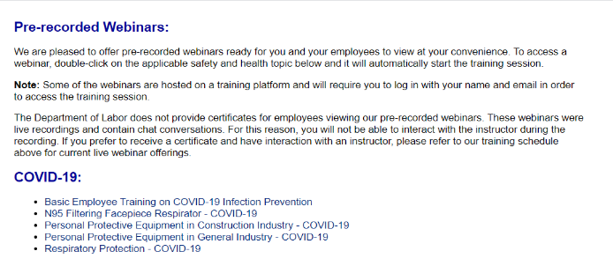
OSH Division
COVID-19 Activities
FFY 2020—4th Qtr.
Pre-recorded Webinars With COVID-19 Focus
  N95 Filtering Facepiece Respirator
  Personal Protective Equipment in Construction Industry
  Personal Protective Equipment in General Industry
  Basic COVID-19 Employee Training
  Respiratory Protection

Slide 48


OSH Division
COVID-19 Activities
FFY 2020—4th Qtr.
A - Z Safety and Health Topics (New/Revised)
  COVID-19 (Continuously Updated)
  Respiratory Protection
  Bloodborne Pathogens
  Personal Protective Equipment
  Reporting and Recording
COVID-19 FAQs
  NCDOL FAQs (English/Spanish)
  OSHA FAQs
  CDC’s FAQs
  NC Government – Phase 3 FAQs

Slide 49

OSH Division
COVID-19 Activities
FFY 2020—4th Qtr.
Fact Sheets
  Facemasks vs. Respirators
  Hazard Considerations for Face Coverings, Masks and Respirator Choices
Hotspot

Slide 50
OSH Division
COVID-19 Activities
FFY 2020—4th Qtr.
Temporary Guidance Memorandums
  Discretion in Enforcement when Considering an Employer's Good Faith Efforts During the Coronavirus Disease 2019 (COVID-19) Pandemic
  Enforcement Guidance on Decontamination of Filtering Facepiece Respirators in Healthcare During the Coronavirus Disease 2019 (COVID-19) Pandemic
  Temporary Enforcement Guidance - Healthcare Respiratory Protection Annual Fit-Testing for N95 Filtering Facepieces During the COVID-19 Outbreak
  Enforcement Guidance for Respiratory Protection and the N95 Shortage Due to COVID-19 Pandemic

Slide 51
OSH Division
COVID-19 Activities
FFY 2020—4th Qtr.
Temporary Guidance Memorandums
  Enforcement Guidance For Use of Respiratory Protection Equipment Certified Under Standards of Other Countries or Jurisdictions During the Coronavirus Disease 2019 Pandemic
  Interim Guidance on COVID-19 Use of Filtering Facepiece Respirators After Their Expiration Date
  Expanded Temporary Enforcement Guidance on Respiratory Protection Fit-Testing for N95 Filtering Facepieces in All Industries During the Coronavirus 2019 Pandemic
  Temporary Guidance on Migrant Housing for COVID-19 Impacted Workers (Revised)

Slide 52
OSH Division
COVID-19 Activities
FFY 2020—4th Qtr.
Temporary Guidance Memorandums
  Updated Interim Enforcement Plan for Coronavirus Disease 2019 (COVID-19) (Complaint, Referral Letters)
  Revised Enforcement Guidance for Recording Cases of Coronavirus 2019 (COVID-19)

Slide 53
OSH Division
COVID-19 Activities
FFY 2020—4th Qtr.
Hazard/Guidance Alerts (Updated/Under Review)
  Farmworkers and COVID-19 (Updated)
  COVID-19 - Health and Safety Guidelines for Retail Workers
  COVID-19 - Health and Safety Guidelines for Food Processing (Updated)
  COVID-19 - Review of the Respiratory Protection for Healthcare Workers
  Controlling Exposures to the 2019 Novel Coronavirus
  Dealing with COVID-19 in Construction (Updated)
  Respiratory Protection for Long-Term Care Workers

Slide 54






OSH Division
COVID-19 Activities
FFY 2020—4th Qtr.
Social Media
  Podcasts
  Facebook Posts
  Twitter
  YouTube
  Instagram
Digital Billboards (2)

Slide 55

Thank You For Attending!
FFY 2020—4th Qtr.
Questions?
1-800-NC-LABOR
(1-800-625-2267)
www.labor.nc.gov
Notes:
55

