Slide 1
North Carolina Department of Labor Occupational Safety & Health Division 3rd Quarter Report Federal Fiscal Year 2020*
Presented by:
Occupational Safety and Health Division of North Carolina
*Preliminary Data
Notes:
The information in this presentation is provided voluntarily by the N.C. Department of Labor, Education Training and Technical Assistance Bureau as a public service and is made available in good faith. This presentation is designed to assist trainers conducting OSHA outreach training for workers. Since workers are the target audience, this presentation emphasizes hazard identification, avoidance, and control – not standards. No attempt has been made to treat the topic exhaustively. It is essential that trainers tailor their presentations to the needs and understanding of their audience.
The information and advice provided on this Site and on Linked Sites is provided solely on the basis that users will be responsible for making their own assessment of the matters discussed herein and are advised to verify all relevant representations, statements, and information.
This presentation is not a substitute for any of the provisions of the Occupational Safety and Health Act of North Carolina or for any standards issued by the N.C. Department of Labor. Mention of trade names, commercial products, or organizations does not imply endorsement by the N.C. Department of Labor.

Slide 2
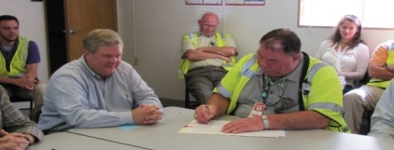
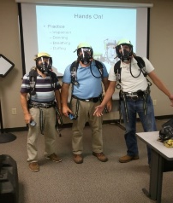
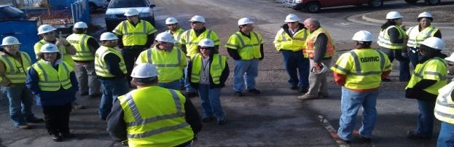
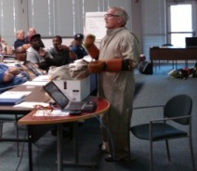
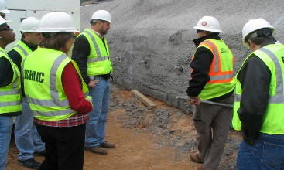
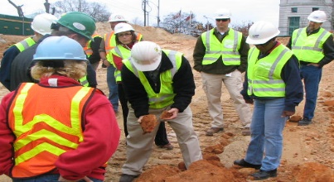
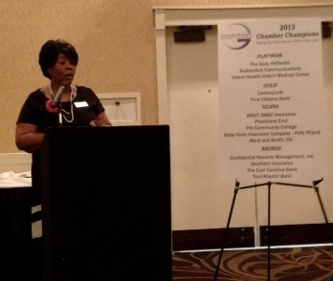
N.C. Workplace Safety and Health
OSH Division—Fatalities Inspected
FFY 2020—3rd Qtr.
FATALITY TYPE | 1ST Qtr. | 2nd Qtr. | 3rd Qtr. | Total | FATALITY TYPE | 1ST Qtr. | 2nd Qtr. | 3rd Qtr. | Total
Struck By | 1 | 7 | 5 | 13 | Inhalation | 0 | 1 | 0 | 1
Caught In/Between | 3 | 1 | 4 | 8 | Ingestion | 0 | 0 | 0 | 0
Bite/Sting/Scratch | 0 | 0 | 0 | 0 | Absorption | 0 | 0 | 0 | 0
Fall (Same Level) | 0 | 0 | 0 | 0 | Repeated Motion/Pressure | 0 | 0 | 0 | 0
Fall (From Elevation) | 6 | 4 | 2 | 12 | Cardio/Respiratory | 0 | 0 | 0 | 0
Struck Against | 0 | 0 | 0 | 0 | Shock | 0 | 0 | 2 | 2
Rubbed/Abraded | 0 | 0 | 0 | 0 | Other | 0 | 1 | 6 | 7
Fatalities Under OSH Division Jurisdiction
FFY 2019 |  | FFY 2020 | 1st Qtr. | 2nd Qtr. | 3rd Qtr. | Total
Total Fatalities | 54 | Fatalities | 10 | 14 | 19 | 43
NCDOL Photo Library

Slide 3
N.C. Workplace Safety and Health
OSH Division—Strategic Plan Goals
FFY 2020—3rd Qtr.
COMPLIANCE | 1ST Qtr. | 2nd Qtr. | 3rd Qtr. | Total | FFY Goal
Safety Inspections | 305 | 442 | 235 | 982 | 1,273
Health Inspections | 189 | 287 | 114 | 590 | 755
Serious Hazards Eliminated | 634 | 1,814 | 686 | 2,500 | 4,100
Training and/or Program Violations | 138 | 165 | 147 | 440 | 1,050
CONSULTATION | 1ST Qtr. | 2nd Qtr. | 3rd Qtr. | Total | FFY Goal
Serious Hazards Eliminated | 1,710 | 1,475 | 351 | 3,536 | 5,250
Private Sector and Public Sector Visits | 394 | 324 | 160 | 878 | 1,012
OSH DIVISION | 1ST Qtr. | 2nd Qtr. | 3rd Qtr. | Total | FFY Goal
Program Improvements | 579 | 564 | 384 | 1,527 | 2,060
People Trained in Special Emphasis Program Areas | 1,224 | 1,398 | 1,984 | 4,606 | 3,700
People Trained at OSH Division Sponsored Events | 1,729 | 2,406 | 2,653 | 6,788 | 7,350

Slide 4
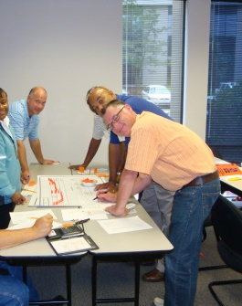
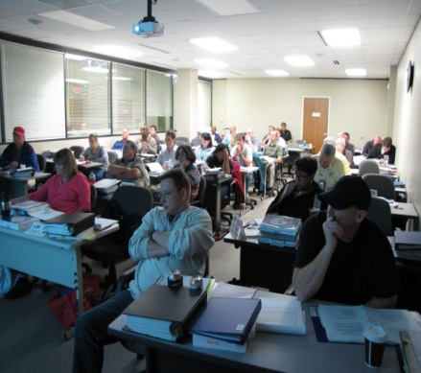
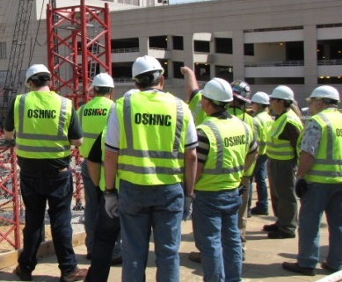
N.C. Workplace Safety and Health
OSH Division—Strategic Plan Goals
FFY 2020—3rd Qtr.
Education, Training and Technical Assistance (ETTA) | 1ST Qtr. | 2nd Qtr. | 3rd Qtr. | Total | FFY Goal
Publications Distributed | 6,823 | 9,815 | 688 | 17,326 | 20,000
Standards Interpretations | 723 | 1,009 | 882 | 2,614 | NA
Agricultural Safety and Health (ASH) | 1ST Qtr. | 2nd Qtr. | 3rd Qtr. | Total | FFY Goal
Outreach Materials Distributed | 263 | 1,971 | 196 | 2,430 | 3,500
Compliance Inspections | 13 | 4 | 4 | 21 | 80
Certificates Issued | 114 | 1,085 | 267 | 1,466 | 1,500
Preoccupancy Inspections | 212 | 1,134 | 220 | 1,566 | 1,700
NCDOL Photo Library

Slide 5
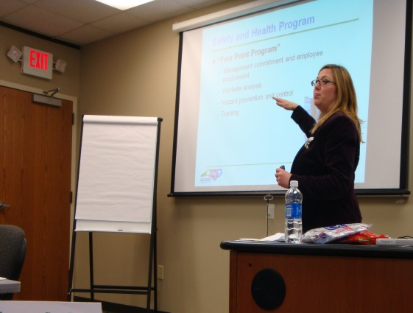
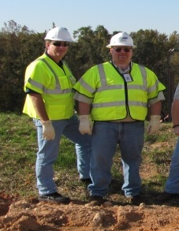
Strategic Plan
Special Emphasis Programs (SEP)
FFY 2020—3rd Qtr.
NCDOL Photo Library
Construction
Logging and Arboriculture
Long Term Care Facilities
Health Hazards
Food Manufacturing
Grocery and Related Product Wholesalers
Amputations

Slide 6
Special Emphasis Program
Construction
FFY 2020—3rd Qtr.
NAICS 23—CONSTRUCTION | FFY 2019 |  | 1st Qtr. | 2nd Qtr. | 3rd Qtr. | Total
Total Fatalities | 18 |  | 5 | 10 | 3 | 18
1st Qtr. Total Fatality Rate | 0.0021 |  | N/A | N/A | N/a | N/A
Fatality Type | 1st Qtr. | 2nd Qtr. | 3rd Qtr. | Total | Fatality Type | 1st Qtr. | 2nd Qtr. | 3rd Qtr. | Total
Struck By | 1 | 4 | 2 | 7 | Inhalation | 0 | 1 | 0 | 1
Caught In/Between | 0 | 0 | 0 | 0 | Ingestion | 0 | 0 | 0 | 0
Bite/Sting/Scratch | 0 | 0 | 0 | 0 | Absorption | 0 | 0 | 0 | 0
Fall (Same Level) | 0 | 0 | 0 | 0 | Repeated Motion/Pressure | 0 | 0 | 0 | 0
Fall (From Elevation) | 4 | 4 | 1 | 9 | Cardio/Respiratory | 0 | 0 | 0 | 0
Struck Against | 0 | 0 | 0 | 0 | Shock | 0 | 0 | 0 | 0
Rubbed/Abraded | 0 | 0 | 0 | 0 | Other | 0 | 1 | 0 | 1
Notes:
ETTA Events Total: 9 (4 Labor One, 4 Webinars, 1 Speaker Bureau )
Total Trained: 305
Consultation Events: 16
Total Trained: 1400
A total of 16 events were served by Rod Wilce. Activities included but are not limited to; event speakers, vendor demonstrations, fall protection training sessions, equipment inspections, distribution of Fed provided resource material, meals i.e. 700 Chic Filet sandwiches, countless doughnuts, full catered lunches. These 16 events provided the intended distribution of information and training to in excess 1400 employees within a 50 mile radius of Raleigh.
Used Billboards for Fall Stand Down, Safe and Sound Week, and Heat Stress.

Slide 7
Special Emphasis Program
Construction
FFY 2020—3rd Qtr.
NAICS 23*—CONSTRUCTION
 | North Carolina |  |  |  | National Average |  |  |  | North Carolina vs. National Average
 | CY 2017 |  | CY 2018 |  | CY 2017 |  | CY 2018 |  | 2018 Comparison
TRC | 1.8 | 28% Increase |  | 2.5 | 3.1 | No Change |  | 3.1 | 19% Lower
DART | 1.1 | 21% Increase |  | 1.6 | 1.8 | 6% Decrease |  | 1.7 | 6% Lower
SEP ACTIVITY | 1ST Qtr. | 2nd Qtr. | 3rd Qtr. | Total | FFY Goal
Compliance Inspections | 239 | 423 | 247 | 909 | 1,050
Consultative Visits | 119 | 101 | 67 | 287 | 250
OSH Outreach Events (10- and 30- Hour Construction Courses) | 1 | 2 | 0 | 3 | 6
People Trained | 493 | 434 | 320 | 1,247 | 1,750

Slide 8
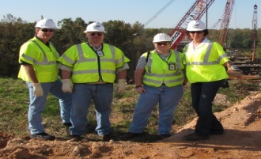
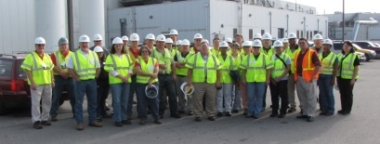
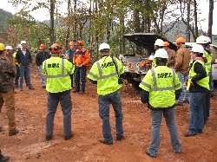
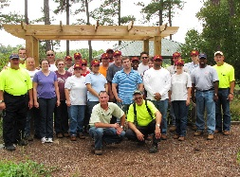
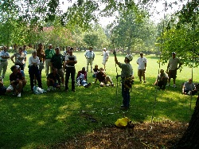
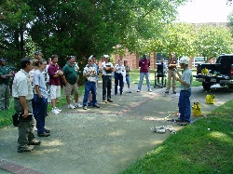
Special Emphasis Program
Logging and Arboriculture
FFY 2020—3rd Qtr.
SEP ACTIVITY | 1st Qtr. | 2nd Qtr. | 3rd Qtr. | Total | FFY Goal
Compliance Inspections | 2 | 11 | 5 | 18 | 30
Consultative Visits | 3 | 6 | 4 | 13 | 13
OSH Training and Outreach Events | 1 | 1 | 0 | 2 | 1
People Trained | 30 | 12 | 0 | 42 | 75
NAICS 11331*—LOGGING | FFY 2019 |  | 1st Qtr. | 2nd Qtr. | 3rd Qtr. | Total
Total Fatalities | 1 |  | 0 | 0 | 1 | 1
NAICS 56173*—ARBORICULTURE | FFY 2019 |  | 1st Qtr. | 2nd Qtr. | 3rd Qtr. | Total
Total Fatalities | 5 |  | 0 | 0 | 1 | 1
1st Qtr. Combined Total Fatality Rate | 0.0000 |  | N/A | N/A | N/A | N/A

Slide 9
Special Emphasis Program
Long Term Care Facilities
FFY 2020—3rd Qtr.
NAICS 623*—LONG TERM CARE
 | North Carolina |  |  |  | National Average |  |  |  | North Carolina vs. National Average
 | CY 2017 |  | CY 2018 |  | CY 2017 |  | CY 2018 |  | 2018 Comparison
TRC | 6.4 | 16% Decrease |  | 5.4 | 6.3 | 3% Decrease |  | 6.1 | 11% Lower
DART | 3.7 | 11% Decrease |  | 3.3 | 3.8 | 3% Decrease |  | 3.7 | 11% Lower
SEP ACTIVITY | 1ST Qtr. | 2nd Qtr. | 3rd Qtr. | Total | FFY Goal
Compliance Inspections | 12 | 15 | 0 | 27 | 29
Consultative Visits | 8 | 9 | 4 | 21 | 21
OSH Outreach Events | 0 | 1 | 0 | 1 | 1
People Trained | 0 | 15 | 0 | 15 | 25

Slide 10
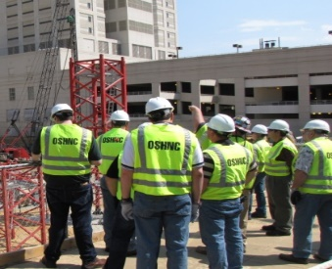
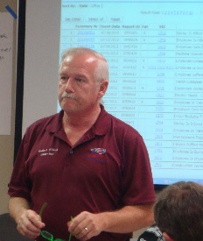
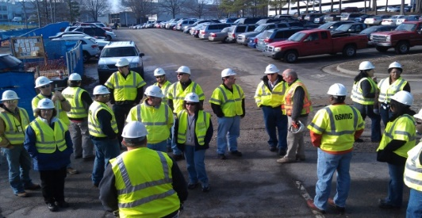
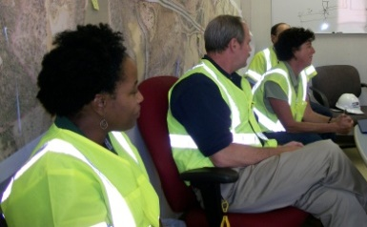
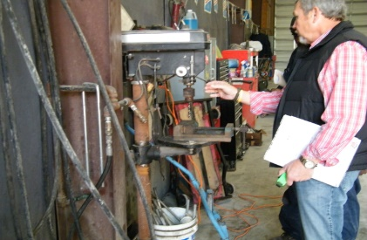
Special Emphasis Program
Health Hazards
FFY 2020—3rd Qtr.
COMPLIANCE INSPECTIONS | 1ST Qtr. | 2nd Qtr. | 3rd Qtr. | Total | FFY Goal
Silica | 8 | 19 | 5 | 32 | 90
Asbestos | 6 | 6 | 1 | 13
Isocyanates | 5 | 9 | 0 | 14
Lead | 3 | 5 | 2 | 10
Hexavalent Chromium | 3 | 3 | 0 | 6
Total | 24 | 35 | 8 | 67
Program Improvements | 5 | 11 | 4 | 20 | 20
*Some inspections involved more than one health hazard and generally included a program improvement
NCDOL Photo Library

Slide 11
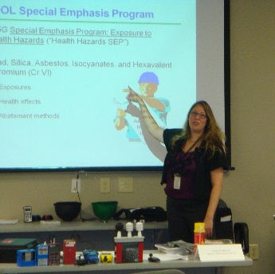
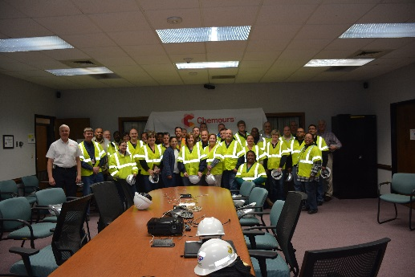
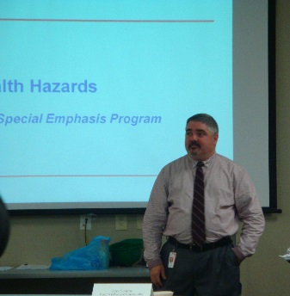
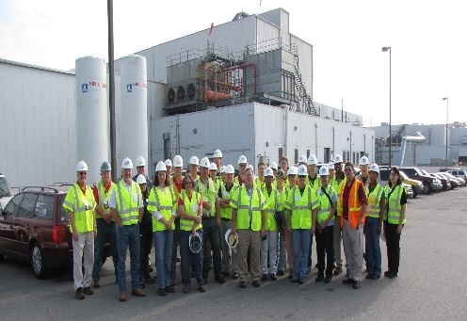
Special Emphasis Program
Health Hazards
FFY 2020—3rd Qtr.
COMPLIANCE INSPECTION RESULTS
HEALTH HAZARDS | Number of Samples (Detectable Results) |  |  |  | Number With Overexposures |  |  |  | Average Severity Rate*
 | 1st Qtr. | 2nd Qtr. | 3rd Qtr. | Total | 1st Qtr. | 2nd Qtr. | 3rd Qtr. | Total | 1st Qtr. | 2nd Qtr. | 3rd Qtr.
Silica | 11 | 22 | 7 | 40 | 6 | 0 | 0 | 6 | 1.49 | 0.43 | 0.84
Asbestos | 0 | 0 | 0 | 0 | 0 | 0 | 0 | 0 | 0 | 0 | 0
Isocyanates | 0 | 1 | 0 | 1 | 0 | 0 | 0 | 0 | 0 | 0.30 | 0
Lead | 0 | 3 | 0 | 3 | 0 | 0 | 0 | 0 | 0 | 1.32 | 0
Hexavalent Chromium | 2 | 0 | 0 | 2 | 0 | 0 | 0 | 0 | 0.10 | 0 | 0
Total | 13 | 26 | 7 | 39 | 0 | 0 | 0 | 6 | N/A | N/A | N/A
NCDOL Photo Library
* All Samples

Slide 12

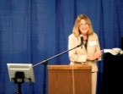
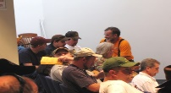
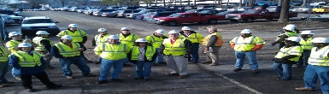
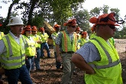
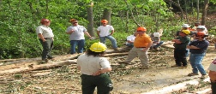
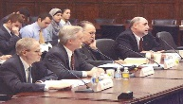


Special Emphasis Program
Health Hazards
FFY 2020—3rd Qtr.
HEALTH HAZARDS | Consultative Surveys
 | 1st Qtr. | 2nd Qtr. | 3rd Qtr. | Total
Silica | 48 | 25 | 11 | 84
Asbestos | 2 | 1 | 1 | 4
Isocyanates | 3 | 1 | 1 | 5
Lead | 7 | 5 | 0 | 12
Hexavalent Chromium | 9 | 7 | 1 | 17
Total | 67 | 37 | 14 | 118
FFY Goal | 135
NCDOL Photo Library
NCDOL Photo Library
SEP ACTIVITY | 1st Qtr. | 2nd Qtr. | 3rd Qtr. | Total | FFY Goal
OSH Outreach Events | 2 | 6 | 5 | 13 | 18
People Trained | 36 | 102 | 60 | 198 | 280

Slide 13
Special Emphasis Program
Food Manufacturing
FFY 2020—3rd Qtr.
NAICS 311*—FOOD MANUFACTURING
 | North Carolina |  |  |  | National Average |  |  |  | North Carolina vs. National Average
 | CY 2017 |  | CY 2018 |  | CY 2017 |  | CY 2018 |  | 2018 Comparison
TRC | 3.6 | 19% Decrease |  | 2.9 | 4.5 | 7% Decrease |  | 4.2 | 31% Lower
DART | 2.5 | 12% Decrease |  | 2.2 | 3.1 | 6% Decrease |  | 2.9 | 24% Lower
*DART/TRC rate based on the 3- digit NAICS code
SEP ACTIVITY | 1st Qtr. | 2nd Qtr. | 3rd Qtr. | Total | FFY Goal
Compliance Inspections | 15 | 14 | 2 | 31 | 40
Consultative Visits | 9 | 6 | 0 | 15 | 12
OSH Outreach Events | 0 | 0 | 0 | 0 | 1
People Trained | 0 | 0 | 0 | 0 | 25

Slide 14
Special Emphasis Program
Grocery and Related Product Wholesalers
FFY 2020—3rd Qtr.
NAICS 4244*—GROCERY AND RELATED WHOLESALERS
 | North Carolina |  |  |  | National Average |  |  |  | North Carolina vs. National Average
 | CY 2017 |  | CY 2018 |  | CY 2017 |  | CY 2018 |  | 2018 Comparison
TRC | 4.1 | 9% Increase |  | 4.5 | 5.1 | 2% Increase |  | 5.2 | 13% Lower
DART | 3.0 | 12% Increase |  | 3.4 | 4.2 | 5% Decrease |  | 4.0 | 15% Lower
*DART/TRC rate based on the 4- digit NAICS code
SEP ACTIVITY | 1st Qtr. | 2nd Qtr. | 3rd Qtr. | Total | FFY Goal
Compliance Inspections | 6 | 3 | 1 | 10 | 14
Consultative Visits | 0 | 0 | 0 | 0 | 0
OSH Outreach Events | 0 | 0 | 0 | 0 | 1
People Trained | 0 | 0 | 0 | 0 | 18

Slide 15


Special Emphasis Program
Amputations
FFY 2020—3rd Qtr.
SEP ACTIVITY | 1st Qtr. | 2nd Qtr. | 3rd Qtr. | Total | FFY Goal
Compliance Inspections | 35 | 43 | 22 | 100 | 105
Consultative Visits | 32 | 43 | 7 | 82 | 100
OSH Outreach Events | 4 | 6 | 6 | 16 | 15
People Trained | 67 | 138 | 142 | 247 | 400

Slide 16
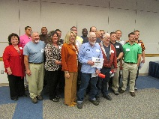
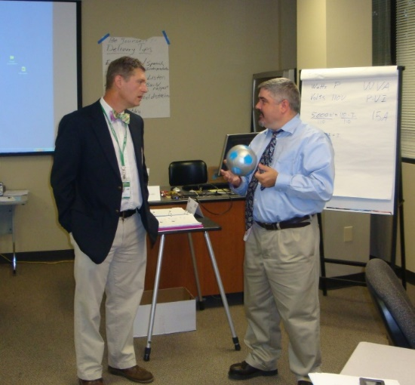
OSH Division
Public Sector
FFY 2020—3rd Qtr.
 | CY 2017 |  | CY 2018
TRC | 3.8 | 3% Increase |  | 3.9
DART | 1.8 | No Change |  | 1.8
ACTIVITY | 1ST Qtr. | 2nd Qtr. | 3rd Qtr. | Total | FFY Goal
Compliance Inspections | 50 | 42 | 3 | 95 | 93
Consultative Visits | 71 | 48 | 7 | 129 | 153
OSH Outreach Events/Booths | 5 | 4 | 2 | 11 | 22
Trained | 198 | 502 | 1,210 | 1,910 | 2,000

Slide 17
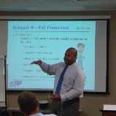

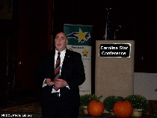
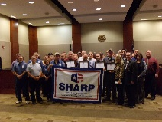
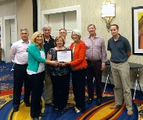

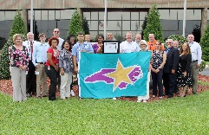
OSH Division
Recognition Programs
FFY 2020—3rd Qtr.
STAR SITES—New, Recertification, Promotion | 1st Qtr. | 2nd Qtr. | 3rd Qtr. | Total | FFY Goal | Approved Star Sites*
Carolina Star | 7 | 7 | 3 | 17 |  | 101
Building Star | 2 | 1 | 0 | 3 |  | 23
Rising Star | 0 | 0 | 2 | 2 |  | 5
Public Sector Star | 1 | 0 | 0 | 1 |  | 21
Total | 10 | 8 | 5 | 23 | 20 | 152
*Cumulative Total
NCDOL Photo Library
 | 1st Qtr. | 2nd Qtr. | 3rd Qtr. | Total | FFY Goal
Star Sites—Termination/Withdrawn | 4 | 0 | 1 | 5
Star Booths | 2 | 0 | 0 | 2
Star Presentations | 4 | 2 | 1 | 7 | 20
Star Program Interventions | 37 | 28 | 22 | 77 | 100

Slide 18
OSH Division
Recognition Programs
FFY 2020—3rd Qtr.
SHARP SITES—NEW/RENEWALS | 1st Qtr. | 2nd Qtr. | 3rd Qtr. | Total | FFY Goal | Approved SHARP Sites*
SHARP—Construction | 1 | 1 | 0 | 2 |  | 6
SHARP—General Industry | 0 | 2 | 0 | 2 |  | 128
SHARP—Public Sector | 0 | 5 | 8 | 13 |  | 46
SHARP—Logging | 0 | 0 | 0 | 0 |  | 0
SHARP—Renewals | 10 | 14 | 11 | 35 |  | 180
Totals | 11 | 22 | 19 | 52 | 55
*Cumulative Total
GOLD STAR GROWERS—NEW | 1st Qtr. | 2nd Qtr. | 3rd Qtr. | Total
 | 30 | 185 | 51 | 266
SAFETY AWARDS |  |  |  | Total
CY 2019 Safety Awards Season (Silver, Gold, Million Hour) |  |  |  | 3,200
 | 1st Qtr. | 2nd Qtr. | 3rd Qtr. | Total
Million Hour Awards | 4 | 83 | 3 | 90

Slide 19


Not in Strategic Plan
Alliances and Partnerships
FFY 2020—3rd Qtr.
Alliances
Carolinas AGC
Lamar Advertising Company
Mexican Consulate
N.C. State – Industry Expansion Solutions
Safety and Health Council of NC
NUCA of the Carolinas
NCALGESO

Slide 20
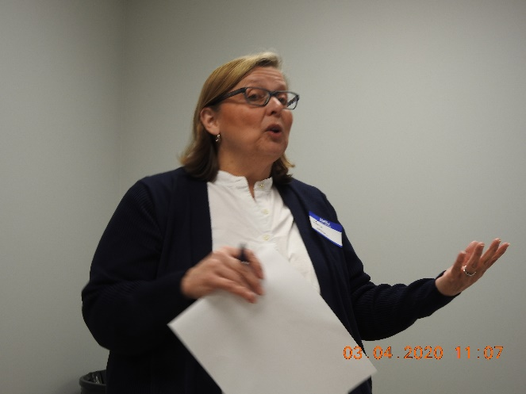
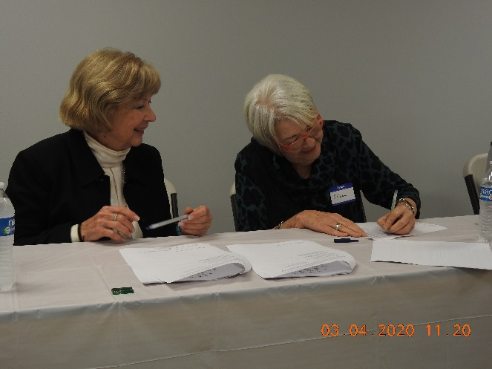
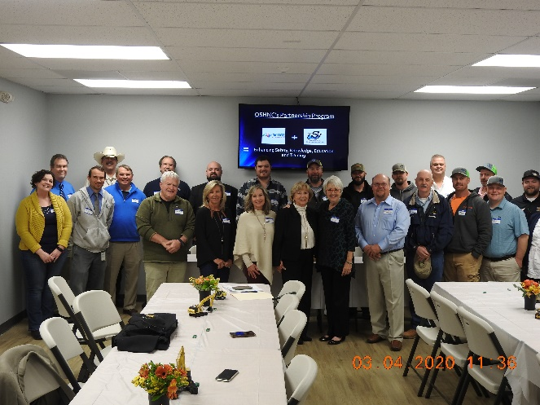
Not in Strategic Plan
Alliances and Partnerships
FFY 2020—3rd Qtr.
Partnerships
Sanders Utility Construction Company, Inc.
Design Build Project to improve/up-size/replace sanitary sewer lines along the Irwin Creek Tributary to the Irwin Creek Interceptor
March 2020 - 2022

Slide 21
OSH Division
Complaint Desk*
FFY 2020—3rd Qtr.
East Compliance | West Compliance | Agricultural Safety and Health
ACTIVITY | 1st Qtr. | 2nd Qtr. | 3rd Qtr. | 1st Qtr. | 2nd Qtr. | 3rd Qtr. | 1st Qtr. | 2nd Qtr. | 3rd Qtr. | Cumulative Total | FFY 2019
Complaints | 223 | 308 | 708 | 263 | 349 | 801 | 3 | 3 | 3 | 2,661 | 2,419
Referrals | 61 | 85 | 67 | 88 | 98 | 80 | 4 | 8 | 10 | 497 | 822
Fat/Cat | 13 | 10 | 10 | 23 | 24 | 67 | 0 | 1 | 3 | 151 | 123
Totals | 297 | 403 | 785 | 374 | 471 | 948 | 7 | 8 | 16 | 3,309 | 3,364
*Includes calls that were processed but not necessarily inspected. Fat/Cat includes calls regarding heart attacks and other natural causes.
ACTIVITY | 1st Qtr. | 2nd Qtr. | 3rd Qtr. | Cumulative Total
Complaints Not in OSH Jurisdiction | 641 | 916 | 1,108 | 2,665
*Includes complaints related to wage and hour, discrimination, worker's compensation questions, beyond statute of limitation time frame, etc.

Slide 22
OSH Division
Cut-Loose, In-Training, Vacant
FFY 2020—3rd Qtr.
West Compliance | Safety | % | Industrial Hygienist | %
Cut Loose | 22 | 71% | 19 | 73%
In-Training | 5 | 16% | 5 | 19%
Vacant | 4 | 13% | 2 | 8%
Total | 31 |  | 26
East Compliance | Safety | % | Industrial Hygienist | %
Cut Loose | 13 | 48% | 7 | 39%
In-Training | 5 | 19% | 5 | 28%
Vacant | 9 | 33% | 6 | 33%
Total | 27 |  | 18
Safety Cut Loose | 60% | Health Cut Loose | 59%
Safety In-Training | 17% | Health in-Training | 23%
Safety Vacant | 22% | Health Vacant | 18%

Slide 23
OSH Division
Cut-Loose, In-Training, Vacant
FFY 2020—3rd Qtr.
Consultative Services | Safety | % | Industrial Hygienist | %
Cut Loose | 11 | 100% | 7 | 87%
In-Training | 0 | 0% | 1 | 11%
Vacant | 0 | 0% | 0 | 0%
Total | 11 |  | 8
Education, Training and Technical Assistance | Safety | % | Industrial Hygienist | %
Cut Loose | 7 | 64% | 5 | 83%
In-Training | 2 | 18% | 1 | 17%
Vacant | 2 | 18% | 0 | 0%
Total | 11 |  | 6
Agricultural Safety and Health | Safety | % | Industrial Hygienist
Cut Loose | 4 | 67% | NA
In-Training | 2 | 33% | NA
Vacant | 0 | 0% | NA
Total | 6

Slide 24
OSH Division
Internal Training
FFY 2020—3rd Qtr.
1st Qtr.—COURSE |  | Trained
Annual Training—Raleigh:
OCSS Concrete and Masonry OCSS Cranes and Derricks Farm Guarding Safety, Home Inspections ASH Paperless File Management |  | 72 47 10 8 8
OSH 141—Legal Aspects—Raleigh |  | 28
OTI 245—Safety and Health Management Systems—Raleigh |  | 20
OCSS Work Zone Safety/Flagger Safety—Raleigh |  | 21
OCSS Work Zone Safety/Flagger Safety—Charlotte |  | 20
CPR/AED—Raleigh (2) |  | 12
Webinars: | No.
Welding and Cutting, Excavation and Trenching, Personal Protective Equipment (General Industry), Electrical Safety, Machine Guarding | 5 | 6

Slide 25
OSH Division
Internal Training
FFY 2020—3rd Qtr.
2nd Qtr.—COURSE |  | Trained
OSH 105—Introduction to Safety Standards for Safety Officers—Raleigh |  | 12
OSH 100—Initial Compliance—Charlotte |  | 9
OSH—Technical Writing and OSHA Express—Charlotte |  | 10
Long Term Care Workshop—Webinar |  | 15
Webinars: | No.
Scaffolds, Personal Protective Equipment for Construction, Personal Protective Equipment for General Industry, Inspection Process, Hazard Communication, Ergonomic Awareness, Respiratory Protection, Struck by/Caught in Between, Concrete and Masonry, and 1910 Subpart E - Exit Routes, Emergency Action Plans and Fire Prevention Plans | 11 | 49

Slide 26
OSH Division
Internal Training
FFY 2020—3rd Qtr.
3rd Qtr.—COURSE |  | Trained
Webinars: | No.
Heat Stress, Excavation and Trenching, Inspection Process, Respiratory Protection, Introduction to OSH, Fall Protection, Bloodborne Pathogens, Hazard Communication, Toxic and Hazardous Substances, Personal Protective Equipment, Scaffolds, Powered Industrial Trucks, Recordkeeping, Health Hazards SEP, Hand and Portable Powered Tools, Lockout/Tagout, Confined Space Entry, Stairways and Ladders, Exit Routes, EAP and FPP, Electrical Safety, Machine Guarding, Struck-by/Caught Between, Walking Working Surfaces, Occupational Noise Exposure, Collateral First Aid, Welding and Cutting, Silica, Concrete and Masonry, Safety and Health Committees, Top Ten in General Industry, Top Ten in Construction Industry, Work Zone Safety, Material Handling, Steel Erection, Ergonomics Awareness, and Cranes and Derricks | 98 | 931

Slide 27
OSH Division
Training & Education Outreach
FFY 2020—3rd Qtr.
OUTREACH EVENT | 1st Qtr. | 2nd Qtr. | 3rd Qtr. | Total | FFY Goal
General Industry—10 Hour Course | 1 | 1 | 0 | 2 | 4
General Industry—30 Hour Course | 0 | 1 | 0 | 1 | 1
NC #500/502—Construction Train the Trainer Course NC #501/503—General Industry Train the Trainer Course | 0 | 0 | 0 | 0 | 1
Construction—10 Hour Course | 1 | 2 | 0 | 3 | 5
Construction—30 Hour Course | 0 | 0 | 0 | 0 | 1
Labor One/Booth Events | 7 | 2 | 0 | 9 | N/A
Speaker’s Bureau | 20 | 15 | 2 | 37 | N/A
Webinars | 16 | 25 | 99 | 140 | N/A
OSH Workshop | 3 | 2 | 0 | 5 | N/A
Technical Assistance | 7 | 5 | 0 | 12 | N/A
Spanish Training and Outreach Events | 1 | 2 | 0 | 3 | N/A
Train the Trainer Program (Construction/General Industry)—Events | 5 | 4 | 6 | 15 | N/A
Train the Trainer Program (Construction/General Industry)—Trained | 0 | 25 | 23 | 48 | N/A

Slide 28

OSH Division
Stand Downs
FFY 2020—3rd Qtr.
Heat Stress
Seven Webinars, 154 Trained
Billboard
Falls Prevention
Conducting webinars on fall protection, scaffolds, stairways and ladders, and steel erection
Billboard
Safe + Sound Week
Webinar on Safety and Health Committees, 55 Trained

Slide 29
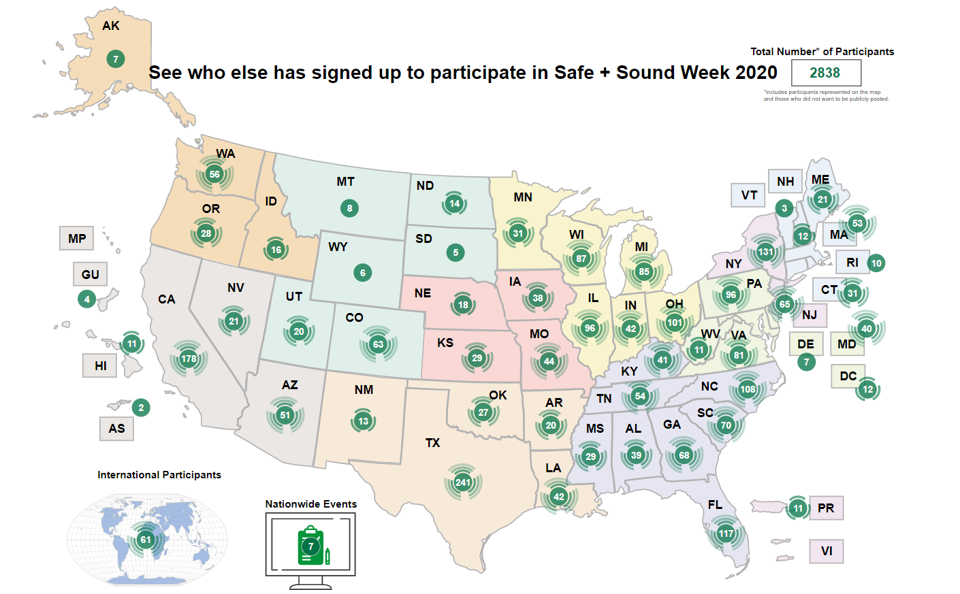
OSH Division
Stand Downs
FFY 2020—3rd Qtr.

Slide 30
OSH Division
Publications—New/Revisions
FFY 2020—3rd Qtr.
Quick Cards (New)
Injury Reporting (Spanish)
Hazardous Animals (Spanish)
Lockout/Tagout (Spanish)
Vehicle Safety (Spanish)
Process Safety Management (Spanish)
Portable Ladders (Spanish)
Industry Guide (Revised)
IG 48—Standards With Special Requirements

Slide 31
OSH Division
Standards Section—Revisions
FFY 2020—3rd Qtr.
Operational Procedure Notice (OPN)
OPN 150—Unmanned Aircraft Systems Operational Policy and Procedures
Sets forth policies, procedures and instructions governing the use of Unmanned Aircraft Systems (UAS) by the OSH Division as well as the Elevator and Amusement Device Bureau.
Field Operations Manual (FOM)
FOM Chapter 16—Administrative File Activities
Corrected hyperlinks to Financial Services forms in Appendix D

Slide 32
OSH Division
Standards Section—Revisions
FFY 2020—3rd Qtr.
Code of Federal Register (CFR)
CFR 188—Walking and Working Surfaces, Personal Protective Equipment, and Special Industries; Corrections
Final rule makes corrections in six general industry standards.
Memorandums
CC 1—Temporary Enforcement Policy – Certification Issued by Crane Institute Certification
Citation policy regarding crane operator certification issued by Crane Institute Certification, which is no longer accredited by a nationally recognized accrediting agency.

Slide 33
OSH Division
Retaliatory Employment Discrimination
FFY 2020—3rd Qtr.
OSH Complaint Disposition | 1st Qtr. | 2nd Qtr. | 3rd Qtr. | Total
Administrative Closure (No RTS Letter) | 0 | 0 | 1 | 1
Withdrawn | 6 | 1 | 7 | 14
Merit | 0 | 2 | 3 | 5
Percent SAMM Merit | 0% | 33% | 11% | N/A
Dismissal Right-to-Sue (Includes No Merit and Unresponsive) | 10 | 14 | 21 | 45
Settled | 3 | 7 | 1* | 11
Requested RTS Letter | 2 | 3 | 3** | 8
Total | 21 | 27 | 36 | 84
*Included in Merit
**Included in Withdrawn

Slide 34
OSH Division
Retaliatory Employment Discrimination
FFY 2020—3rd Qtr.
OSH Complaint Statistics | 1st Qtr. | 2nd Qtr. | 3rd Qtr. | Total
Total OSH Complaints Filed | 31 | 26 | 37 | 94
Total OSH Complaints Closed | 21 | 27 | 36 | 84
Number of OSH Cases Closed Within 90 Days of File Date | 1 | 1 | 0 | 2
Percentage of Cases Closed With in 90 Days of File Date | 11% | 4% | 0% | N/A
Of Cases Closed, Average Number of Elapsed Days Between File Date and Closed Date | 190 | 287 | 288 | 255
Total Number of OSH Complaints Pending at End of Reporting Period | 105 | 102 | 105 | N/A
Percentage of Pending OSH Complaints Over 90 Days Old (From Filing) | 69% | 76% | 65% | N/A
Average Number of Elapsed Days Since Filing Date of All OSH Cases Pending at End of the Reporting Period | 135 | 148 | 150 | 144

Slide 35
OSH Division
Retaliatory Employment Discrimination
FFY 2020—3rd Qtr.
Bureau Staffing
Jay Cronley | Information Officer
Celestine Chestnutt | Administrative Assistant II
James Agosto | Investigator
David Bailey | Investigator
Dianne Daniels | Investigator
Anitra Nalls | Investigator
Erin Smith | Investigator
Alvin Vocalan | Investigator
Harriet Hopkins | Administrator

Slide 36
REDA Complaints
COVID-19 Statistics
FFY 2020—3rd Qtr.
April 1 - August 20, 2020
69% of filed OSH cases are COVID-19 related
44 COVID-19 related complaints have been filed
16% of those are 11(c) complaints
15% increase in OSH cases over same period last year
26% of calls to helpline have been COVID-19 related

Slide 37
REDA Complaints
COVID-19 Protected Activities Alleged
FFY 2020—3rd Qtr.
Filed an OSH complaint
Contacted the press
Lack of PPE/inappropriate safety precautions or lack thereof
Refusal to work due to safety concerns
Refusal to test employees
Employer insistence on no mask wearing
Exposure required quarantine

Slide 38
REDA Complaints
COVID-19 Adverse Action Alleged
FFY 2020—3rd Qtr.
Termination
Demotion
Suspension
Forces leave of absence
Constructive discharge/abandoned the job/quit

Slide 39
REDA Complaints
COVID-19 Respondent’s Asserted Defense
FFY 2020—3rd Qtr.
No knowledge of protected activity
Complainant walked off the job
Violation of attendance policy
Refusal to perform work assignment

Slide 40
OSH Division
COVID-19 Activities
FFY 2020—3rd Qtr.
Calls/Emails | April* | May* | June* | July* | August* | Total
OSH Director's Office | 217 | 436 | 397 | 390 | 298 | 1,738
ETTA | 687 | 262 | 155 | 108 | 70 | 1,282
ASH** | 45 | 45 | 32 | 56 | 64 | 242
PSIM | 0 | 2 | 2 | 4 | 3 | 11
CSB | 330 | 234 | 159 | 129 | 92 | 944
Totals | 1,350 | 1,021 | 687 | 685 | 517 | 4,260
*Monthly data as follows: April 2020 includes data through May 1, May 2020 includes data from May2- June 5,
June 2020 includes data from June 6-July 3, July 2020 includes data from July 4-July 31. August 2020 includes data from August 1 – August 21.
**Includes weekly conference calls with other Agencies.

Slide 41
OSH Division
COVID-19 Activities
FFY 2020—3rd Qtr.
Director’s Office | March/April* | May* | June* | July* | August* | Totals
Meetings | 10 | 26 | 25 | 16 | 9 | 86
Compliance | March/April* | May* | June* | July* | August* | Totals
Valid COVID-19 Complaints | 180 | 176 | 166 | 216 | 171 | 909
Non-Valid COVID-19 Complaints | 435 | 278 | 170 | 249 | 149 | 1,282
Inspections | 0 | 3 | 3 | 5 | 3 | 14
Referrals | 2 | 9 | 9 | 10 | 12 | 42
Unprocessed Complaints** | 511 | 100 | 143 | 150 | 110 | 1,055
*Monthly data as follows: April 2020 includes data through May 1: May 2020 includes data from May 2 - June 5: June 2020 includes data from June 6 - July 3: July 2020 includes data from July 4 - July 31. August 2020 includes data from August 1 – August 23.
* *This data is preliminary and subject to change as unprocessed complaints are moved to other categories. Many of the unprocessed complaints contain insufficient information to process and/or they cover complaint items that do not fall under OSH jurisdiction. Referrals to other Agencies are made, as appropriate.

Slide 42
OSH Division
COVID-19 Activities
FFY 2020—3rd Qtr.
ETTA | March/April* | May* | June* | July* | August* | Totals
Live Webinars | 13 | 3 | 3 | 2 | 4 | 25
Pre-recorded Webinars | 4 | 0 | 0 | 0 | 1 | 5
PowerPoints | 4 | 1 | 2 | 0 | 12 | 19
Hazard Alerts | 6 | 0 | 0 | 0 | 0 | 6
Streaming Videos | 15 | 16 | 14 | 9 | 6 | 60
A-Z Topics Added/Updated | 4 | 5 | 5 | 3 | 3 | 20
Fact Sheets | 1 | 0 | 2 | 1 | 0 | 4
Example Programs | 0 | 0 | 1 | 0 | 0 | 1
Compliance Memos | 6 | 1 | 1 | 0 | 0 | 10
ASH | March/April* | May* | June* | July* | August* | Totals
Guidance Documents | 1 | 0 | 0 | 0 | 0 | 1
*Monthly data as follows: April 2020 includes data through May 1: May 2020 includes data from May 2 - June 5: June 2020 includes data from June 6 - July 3: July 2020 includes data from July 4 - July 31. August 2020 includes data from August 1 – August 23.

Slide 43
OSH Division
COVID-19 Activities
FFY 2020—3rd Qtr.
PSIM | March/April* | May* | June* | July* | August* | Totals
COVID-19 Related Disclosure Requests | 0 | 194 | 8 | 153 | 1,224 | 1,579
Consultation | March/April* | May* | June* | July* | August* | Totals
Interventions | 28 | 6 | 6 | 5 | 3 | 48
Visits | 6 | 31 | 54 | 47 | 18 | 156
*Monthly data as follows: April 2020 includes data through May 1: May 2020 includes data from May 2 - June 5: June 2020 includes data from June 6 - July 3: July 2020 includes data from July 4 - July 31. August 2020 includes data from August 1 – August 23.
OSH Division
PPE supplies available for staff including respirators, washable facemasks, hand sanitizer, Clorox wipes, Lysol spray, face shields, sanitation barriers, cubicle privacy screens, gloves, and goggles.
COVID-19 Policies and Procedures for office and field work that includes use of PPE, employee training, posters, marked floors, staggered shifts, teleworking, and health self-checks.

Slide 44
OSH Division
COVID-19 Activities
FFY 2020—3rd Qtr.
Live Webinar COVID-19 Related Topics
Respiratory Protection
Bloodborne Pathogens
Personal Protective Equipment – Construction
Personal Protective Equipment – General Industry
Pre-recorded Webinars Related to COVID-19
N95 Filtering Facepiece Respirator – COVID-19
Personal Protective Equipment in Construction Industry – COVID-19
Personal Protective Equipment in General Industry – COVID-19
Respiratory Protection – COVID-19
Basic COVID-19 Employee Training (New)

Slide 45
OSH Division
COVID-19 Activities
FFY 2020—3rd Qtr.
COVID-19 Guidance PowerPoints (New/Under Review/Development)
Basic COVID-19 Employee Training (New)
Construction (New)
Retail (Under Review)
Manufacturing (Under Review)
Universities (Under Review)
Schools (Under Development)
Agriculture (Under Review)
Example Program Related to COVID-19
COVID-19 Preparedness and Response Plan for Low and Medium risk employers (New)

Slide 46
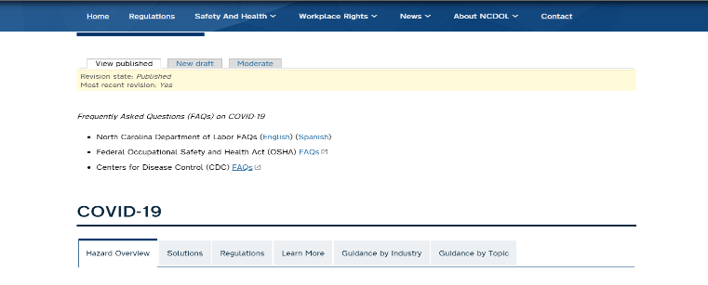
OSH Division
COVID-19 Activities
FFY 2020—3rd Qtr.
A - Z Safety and Health Topics (New/Revised)
COVID-19 (Continuously Updated)
Respiratory Protection
Bloodborne Pathogens
Personal Protective Equipment
COVID-19 FAQs
NCDOL FAQs (English/Spanish)
OSHA FAQs
CDC’s FAQs

Slide 47

OSH Division
COVID-19 Activities
FFY 2020—3rd Qtr.
Fact Sheets
Facemasks vs. Respirators
Hazard Considerations for Face Coverings, Masks and Respirator Choices (New)
Hotspot

Slide 48
OSH Division
COVID-19 Activities
FFY 2020—3rd Qtr.
Temporary Guidance Memorandums
Discretion in Enforcement when Considering an Employer's Good Faith Efforts During the Coronavirus Disease 2019 (COVID-19) Pandemic
Enforcement Guidance on Decontamination of Filtering Facepiece Respirators in Healthcare During the Coronavirus Disease 2019 (COVID-19) Pandemic
Temporary Enforcement Guidance - Healthcare Respiratory Protection Annual Fit-Testing for N95 Filtering Facepieces During the COVID-19 Outbreak
Enforcement Guidance for Respiratory Protection and the N95 Shortage Due to COVID-19 Pandemic

Slide 49
OSH Division
COVID-19 Activities
FFY 2020—3rd Qtr.
Temporary Guidance Memorandums
Enforcement Guidance For Use of Respiratory Protection Equipment Certified Under Standards of Other Countries or Jurisdictions During the Coronavirus Disease 2019 Pandemic
Interim Guidance on COVID-19 Use of Filtering Facepiece Respirators After Their Expiration Date
Expanded Temporary Enforcement Guidance on Respiratory Protection Fit-Testing for N95 Filtering Facepieces in All Industries During the Coronavirus 2019 Pandemic
Temporary Guidance on Migrant Housing for COVID-19 Impacted Workers

Slide 50
OSH Division
COVID-19 Activities
FFY 2020—3rd Qtr.
Temporary Guidance Memorandums
Updated Interim Enforcement Plan for Coronavirus Disease 2019 (COVID-19) (Complaint, Referral Letters)
Revised Enforcement Guidance for Recording Cases of Coronavirus 2019 (COVID-19)

Slide 51
OSH Division
COVID-19 Activities
FFY 2020—3rd Qtr.
Hazard/Guidance Alerts (Updated/Under Review)
Farmworkers and COVID-19 (Updated)
COVID-19 - Health and Safety Guidelines for Retail Workers
COVID-19 - Health and Safety Guidelines for Food Processing
COVID-19 - Review of the Respiratory Protection for Healthcare Workers
Controlling Exposures to the 2019 Novel Coronavirus
Dealing with COVID-19 in Construction
Respiratory Protection for Long-Term Care Workers

Slide 52



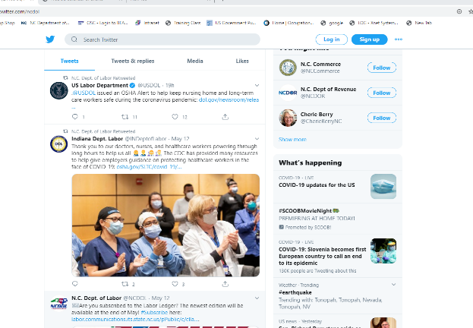
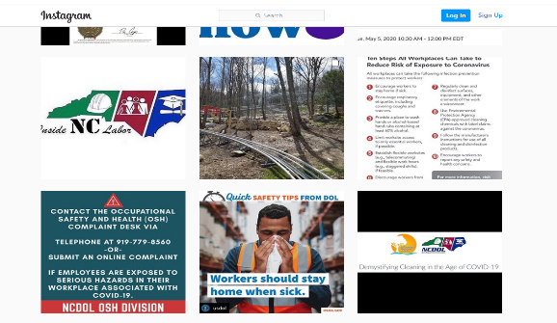
OSH Division
COVID-19 Activities
FFY 2020—3rd Qtr.
Social Media
Podcasts
Facebook Posts
Twitter
YouTube
Instagram

Slide 53

Thank You For Attending!
FFY 2020—3rd Qtr.
Questions?
1-800-NC-LABOR
(1-800-625-2267)
www.labor.nc.gov
Notes:
53

