Slide 1
North Carolina Department of Labor Occupational Safety & Health Division 2nd Quarter Report Federal Fiscal Year 2020*
Presented by:
Wanda Lagoe CSP CPM ARM
Bureau Chief
Education, Training and Technical Assistance
Occupational Safety and Health Division of North Carolina
*Preliminary Data
Notes:
The information in this presentation is provided voluntarily by the N.C. Department of Labor, Education Training and Technical Assistance Bureau as a public service and is made available in good faith. This presentation is designed to assist trainers conducting OSHA outreach training for workers. Since workers are the target audience, this presentation emphasizes hazard identification, avoidance, and control – not standards. No attempt has been made to treat the topic exhaustively. It is essential that trainers tailor their presentations to the needs and understanding of their audience.
The information and advice provided on this Site and on Linked Sites is provided solely on the basis that users will be responsible for making their own assessment of the matters discussed herein and are advised to verify all relevant representations, statements, and information.
This presentation is not a substitute for any of the provisions of the Occupational Safety and Health Act of North Carolina or for any standards issued by the N.C. Department of Labor. Mention of trade names, commercial products, or organizations does not imply endorsement by the N.C. Department of Labor.

Slide 2
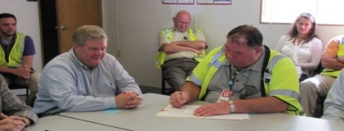
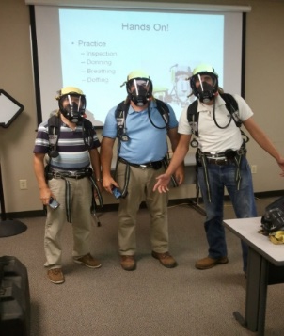
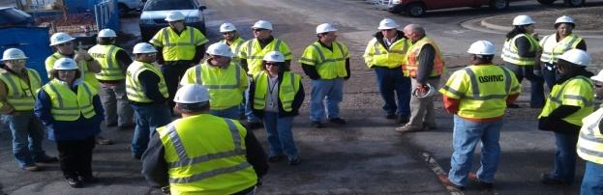
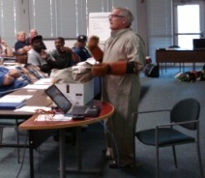
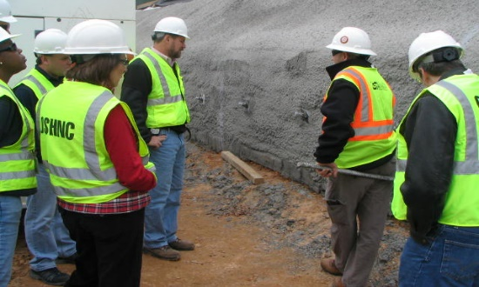
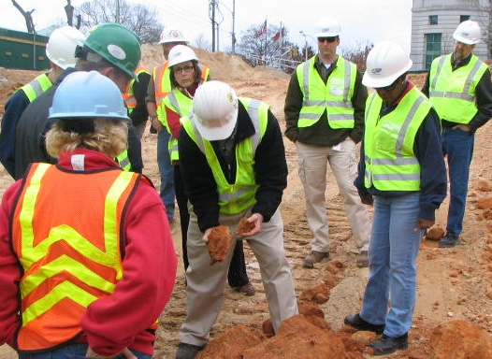
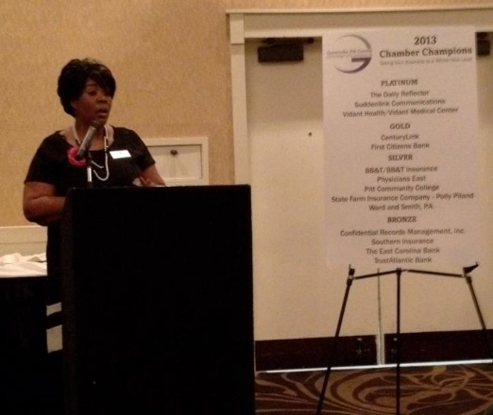
N.C. Workplace Safety and Health
OSH Division—Fatalities Inspected
FFY 2020—2nd Qtr.
FATALITY TYPE | 1ST Qtr. | 2nd Qtr. | Total | FATALITY TYPE | 1ST Qtr. | 2nd Qtr. | Total
Struck By | 1 | 7 | 8 | Inhalation | 0 | 1 | 1
Caught In/Between | 3 | 1 | 4 | Ingestion | 0 | 0 | 0
Bite/Sting/Scratch | 0 | 0 | 0 | Absorption | 0 | 0 | 0
Fall (Same Level) | 0 | 0 | 0 | Repeated Motion/Pressure | 0 | 0 | 0
Fall (From Elevation) | 6 | 3 | 9 | Cardio/Respiratory | 0 | 0 | 0
Struck Against | 0 | 0 | 0 | Shock | 0 | 0 | 0
Rubbed/Abraded | 0 | 0 | 0 | Other | 0 | 1 | 1
Fatalities Under OSH Division Jurisdiction
FFY 2019 |  | FFY 2020 | 1st Qtr. | 2nd Qtr. | Total
Total Fatalities | 54 | Fatalities | 10 | 13 | 23
NCDOL Photo Library

Slide 3
N.C. Workplace Safety and Health
OSH Division—Strategic Plan Goals
FFY 2020—2nd Qtr.
COMPLIANCE | 1ST Qtr. | 2nd Qtr. | Total | FFY Goal
Safety Inspections | 294 | 435 | 729 | 1,735
Health Inspections | 190 | 282 | 472 | 1,000
Serious Hazards Eliminated | 634 | 1,180 | 1,814 | 4,100
Training and/or Program Violations | 138 | 165 | 303 | 1,050
CONSULTATION | 1ST Qtr. | 2nd Qtr. | Total | FFY Goal
Serious Hazards Eliminated | 1,704 | 1,422 | 3,126 | 5,250
Private Sector and Public Sector Visits | 392 | 321 | 713 | 1,370
OSH DIVISION | 1ST Qtr. | 2nd Qtr. | Total | FFY Goal
Program Improvements | 581 | 572 | 1,153 | 2,060
People Trained in Special Emphasis Program Areas | 1,224 | 1,398 | 2,622 | 3,700
People Trained at OSH Division Sponsored Events | 1,729 | 2,406 | 4,135 | 9,600

Slide 4
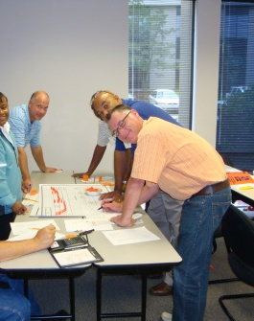
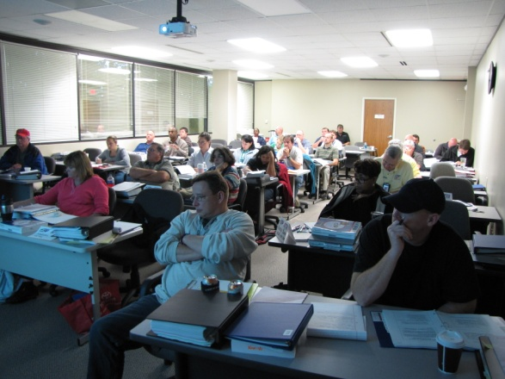
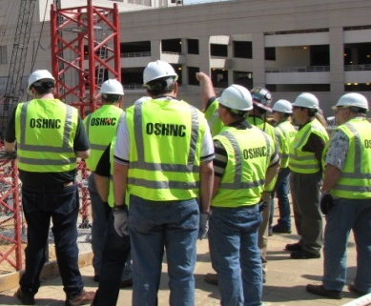
N.C. Workplace Safety and Health
OSH Division—Strategic Plan Goals
FFY 2020—2nd Qtr.
Education, Training and Technical Assistance (ETTA) | 1ST Qtr. | 2nd Qtr. | Total | FFY Goal
Publications Distributed | 6,823 | 9,815 | 16,638 | 45,000
Standards Interpretations | 723 | 1,009 | 1,732 | NA
Agricultural Safety and Health (ASH) | 1ST Qtr. | 2nd Qtr. | Total | FFY Goal
Outreach Materials Distributed | 263 | 1,971 | 2,234 | 3,500
Compliance Inspections | 13 | 4 | 17 | 80
Certificates Issued | 114 | 1,085 | 1,199 | 1,500
Preoccupancy Inspections | 212 | 1,134 | 1,346 | 1,700
NCDOL Photo Library

Slide 5
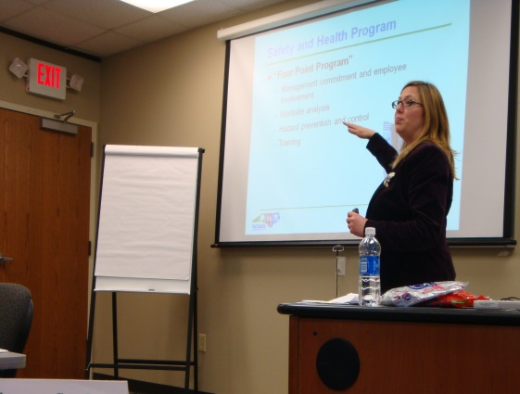
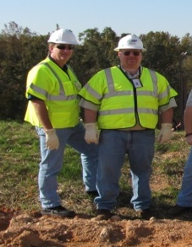
Strategic Plan
Special Emphasis Programs (SEP)
FFY 2020—2nd Qtr.
NCDOL Photo Library
Construction
Logging and Arboriculture
Long Term Care Facilities
Health Hazards
Food Manufacturing
Grocery and Related Product Wholesalers
Amputations

Slide 6
Special Emphasis Program
Construction
FFY 2020—2nd Qtr.
NAICS 23—CONSTRUCTION | FFY 2019 |  | 1st Qtr. | 2nd Qtr. | Total
Total Fatalities | 18 |  | 5 | 8 | 13
4th Qtr. Total Fatality Rate | 0.0017 |  | N/A | N/A | N/A
Fatality Type | 1st Qtr. | 2nd Qtr. | Total | Fatality Type | 1st Qtr. | 2nd Qtr. | Total
Struck By | 1 | 3 | 4 | Inhalation | 0 | 1 | 1
Caught In/Between | 0 | 0 | 0 | Ingestion | 0 | 0 | 0
Bite/Sting/Scratch | 0 | 0 | 0 | Absorption | 0 | 0 | 0
Fall (Same Level) | 0 | 0 | 0 | Repeated Motion/Pressure | 0 | 0 | 0
Fall (From Elevation) | 4 | 3 | 7 | Cardio/Respiratory | 0 | 0 | 0
Struck Against | 0 | 0 | 0 | Shock | 0 | 0 | 0
Rubbed/Abraded | 0 | 0 | 0 | Other | 0 | 1 | 1
Notes:
ETTA Events Total: 9 (4 Labor One, 4 Webinars, 1 Speaker Bureau )
Total Trained: 305
Consultation Events: 16
Total Trained: 1400
A total of 16 events were served by Rod Wilce. Activities included but are not limited to; event speakers, vendor demonstrations, fall protection training sessions, equipment inspections, distribution of Fed provided resource material, meals i.e. 700 Chic Filet sandwiches, countless doughnuts, full catered lunches. These 16 events provided the intended distribution of information and training to in excess 1400 employees within a 50 mile radius of Raleigh.
Used Billboards for Fall Stand Down, Safe and Sound Week, and Heat Stress.

Slide 7
Special Emphasis Program
Construction
FFY 2020—2nd Qtr.
NAICS 23*—CONSTRUCTION
 | North Carolina |  |  |  | National Average |  |  |  | North Carolina vs. National Average
 | CY 2017 |  | CY 2018 |  | CY 2017 |  | CY 2018 |  | 2018 Comparison
TRC | 1.8 | 28% Increase |  | 2.5 | 3.1 | No Change |  | 3.1 | 19% Lower
DART | 1.1 | 21% Increase |  | 1.6 | 1.8 | 6% Decrease |  | 1.7 | 6% Lower
SEP ACTIVITY | 1ST Qtr. | 2nd Qtr. | Total | FFY Goal
Compliance Inspections | 247 | 431 | 678 | 1,050
Consultative Visits | 119 | 96 | 215 | 200
OSH Outreach Events (10- and 30- Hour Construction Courses) | 1 | 2 | 3 | 8
People Trained | 493 | 434 | 927 | 2,500

Slide 8
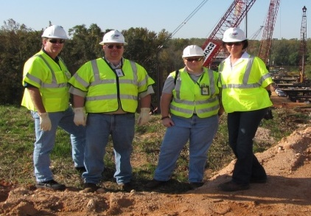
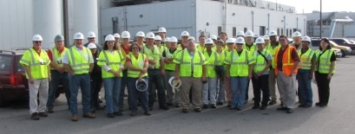
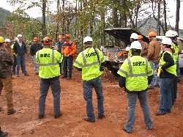
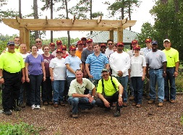
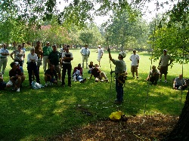
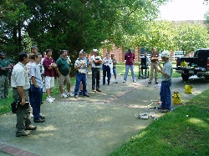
Special Emphasis Program
Logging and Arboriculture
FFY 2020—2nd Qtr.
SEP ACTIVITY | 1st Qtr. | 2nd Qtr. | Total | FFY Goal
Compliance Inspections | 2 | 12 | 14 | 60
Consultative Visits | 3 | 6 | 9 | 13
OSH Training and Outreach Events | 1 | 1 | 2 | 1
People Trained | 30 | 12 | 42 | 150
NAICS 11331*—LOGGING | FFY 2019 |  | 1st Qtr. | 2nd Qtr. | Total
Total Fatalities | 1 |  | 0 | 0 | 0
NAICS 56173*—ARBORICULTURE | FFY 2019 |  | 1st Qtr. | 2nd Qtr. | Total
Total Fatalities | 5 |  | 0 | 0 | 0
4th Qtr. Combined Total Fatality Rate | 0.0025 |  | N/A | N/A | N/A

Slide 9
Special Emphasis Program
Long Term Care Facilities
FFY 2020—2nd Qtr.
NAICS 623*—LONG TERM CARE
 | North Carolina |  |  |  | National Average |  |  |  | North Carolina vs. National Average
 | CY 2017 |  | CY 2018 |  | CY 2017 |  | CY 2018 |  | 2018 Comparison
TRC | 6.4 | 16% Decrease |  | 5.4 | 6.3 | 3% Decrease |  | 6.1 | 11% Lower
DART | 3.7 | 11% Decrease |  | 3.3 | 3.8 | 3% Decrease |  | 3.7 | 11% Lower
SEP ACTIVITY | 1ST Qtr. | 2nd Qtr. | Total | FFY Goal
Compliance Inspections | 15 | 12 | 27 | 48
Consultative Visits | 8 | 9 | 17 | 40
OSH Outreach Events | 0 | 1 | 1 | 2
People Trained | 0 | 15 | 15 | 50

Slide 10
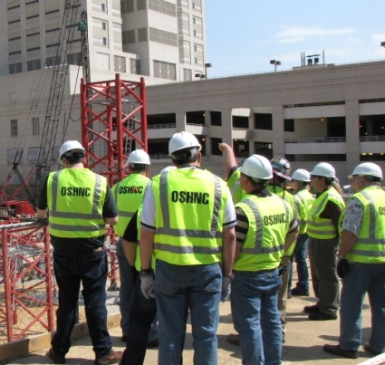
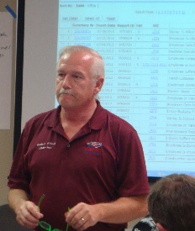
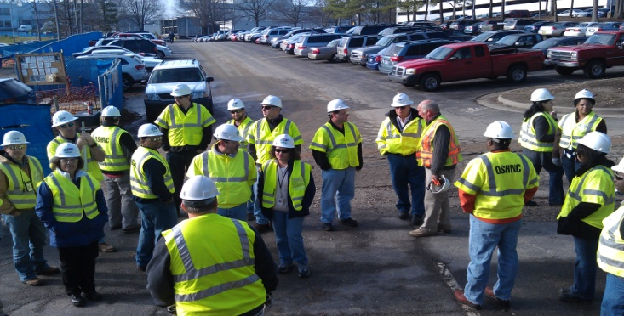
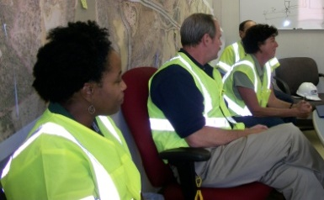
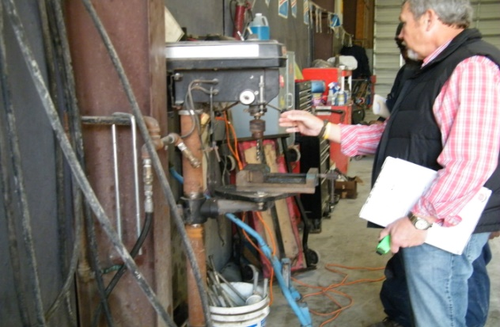
Special Emphasis Program
Health Hazards
FFY 2020—2nd Qtr.
COMPLIANCE INSPECTIONS | 1ST Qtr. | 2nd Qtr. | Total | FFY Goal
Silica | 8 | 24 | 32 | 100
Asbestos | 6 | 9 | 15
Isocyanates | 5 | 11 | 16
Lead | 3 | 7 | 10
Hexavalent Chromium | 3 | 5 | 8
Total | 25 | 56 | 81
Program Improvements | 3 | 9 | 12 | 20
*Some inspections involved more than one health hazard and generally included a program improvement
NCDOL Photo Library

Slide 11
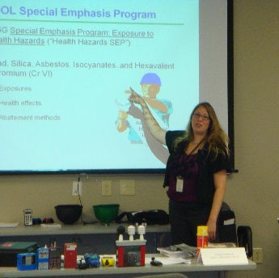
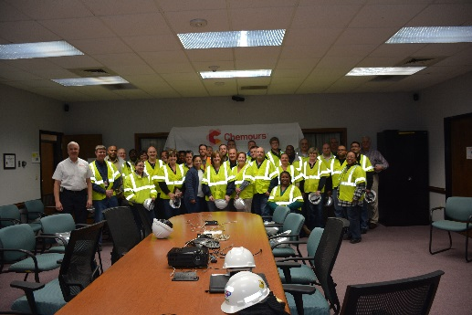
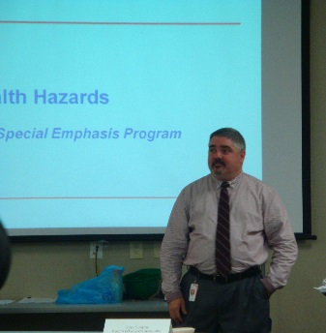
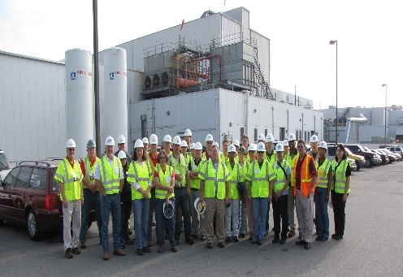
Special Emphasis Program
Health Hazards
FFY 2020—2nd Qtr.
COMPLIANCE INSPECTION RESULTS
HEALTH HAZARDS | Number of Samples (Detectable Results) |  |  | Number With Overexposures |  |  | Average Severity Rate*
 | 1st Qtr. | 2nd Qtr. | Total | 1st Qtr. | 2nd Qtr. | Total | 1st Qtr. | 2nd Qtr.
Silica | 11 | 22 | 33 | 6 | 0 | 6 | 1.49 | 0.43
Asbestos | 0 | 0 | 0 | 0 | 0 | 0 | 0 | 0
Isocyanates | 0 | 1 | 1 | 0 | 0 | 0 | 0 | 0.30
Lead | 0 | 3 | 3 | 0 | 0 | 0 | 0 | 1.32
Hexavalent Chromium | 2 | 0 | 2 | 0 | 0 | 0 | 0.10 | 0
Total | 13 | 26 | 39 | 0 | 0 | 6 | N/A | N/A
NCDOL Photo Library
* All Samples

Slide 12

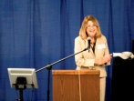
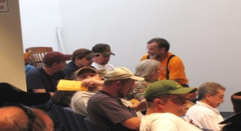
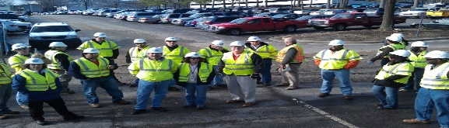
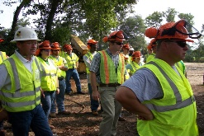
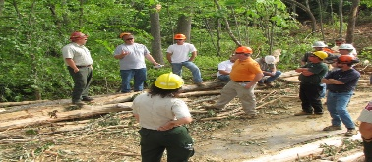
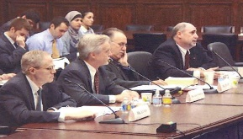


Special Emphasis Program
Health Hazards
FFY 2020—2nd Qtr.
HEALTH HAZARDS | Consultative Surveys
 | 1st Qtr. | 2nd Qtr. | Total
Silica | 48 | 25 | 73
Asbestos | 2 | 1 | 3
Isocyanates | 3 | 1 | 4
Lead | 7 | 5 | 12
Hexavalent Chromium | 9 | 7 | 16
Total | 67 | 37 | 104
FFY Goal | 200
NCDOL Photo Library
NCDOL Photo Library
SEP ACTIVITY | 1st Qtr. | 2nd Qtr. | Total | FFY Goal
OSH Outreach Events | 2 | 6 | 8 | 18
People Trained | 36 | 102 | 138 | 400

Slide 13
Special Emphasis Program
Food Manufacturing
FFY 2020—2nd Qtr.
NAICS 311*—FOOD MANUFACTURING
 | North Carolina |  |  |  | National Average |  |  |  | North Carolina vs. National Average
 | CY 2017 |  | CY 2018 |  | CY 2017 |  | CY 2018 |  | 2018 Comparison
TRC | 3.6 | 19% Decrease |  | 2.9 | 4.5 | 7% Decrease |  | 4.2 | 31% Lower
DART | 2.5 | 12% Decrease |  | 2.2 | 3.1 | 6% Decrease |  | 2.9 | 24% Lower
*TRC/DART rate based on the 3 digit NAICS code
SEP ACTIVITY | 1st Qtr. | 2nd Qtr. | Total | FFY Goal
Compliance Inspections | 12 | 14 | 26 | 40
Consultative Visits | 9 | 6 | 15 | 12
OSH Outreach Events | 0 | 0 | 0 | 1
People Trained | 0 | 0 | 0 | 25

Slide 14
Special Emphasis Program
Grocery and Related Product Wholesalers
FFY 2020—2nd Qtr.
NAICS 4244*—GROCERY AND RELATED WHOLESALERS
 | North Carolina |  |  |  | National Average |  |  |  | North Carolina vs. National Average
 | CY 2017 |  | CY 2018 |  | CY 2017 |  | CY 2018 |  | 2018 Comparison
TRC | 4.1 | 9% Increase |  | 4.5 | 5.1 | 2% Increase |  | 5.2 | 13% Lower
DART | 3.0 | 12% Increase |  | 3.4 | 4.2 | 5% Decrease |  | 4.0 | 15% Lower
*DART/TRC rate based on the 4 digit NAICS code
SEP ACTIVITY | 1st Qtr. | 2nd Qtr. | Total | FFY Goal
Compliance Inspections | 6 | 3 | 9 | 20
Consultative Visits | 0 | 0 | 0 | 3
OSH Outreach Events | 0 | 0 | 0 | 1
People Trained | 0 | 0 | 0 | 25

Slide 15
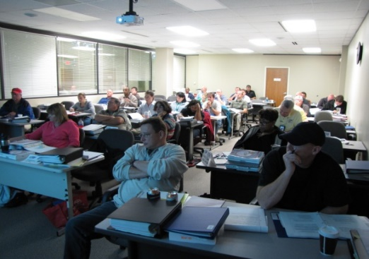

Special Emphasis Program
Amputations
FFY 2020—2nd Qtr.
SEP ACTIVITY | 1st Qtr. | 2nd Qtr. | Total | FFY Goal
Compliance Inspections | 35 | 34 | 69 | 150
Consultative Visits | 9 | 33 | 42 | 100
OSH Outreach Events | 4 | 6 | 10 | 15
People Trained | 67 | 138 | 205 | 500

Slide 16
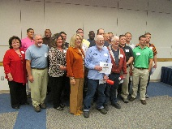
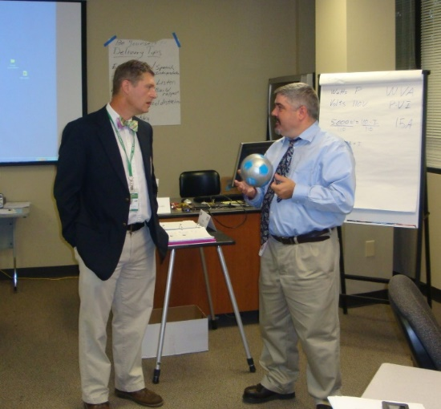
OSH Division
Public Sector
FFY 2020—2nd Qtr.
 | CY 2017 |  | CY 2018
TRC | 3.8 | 3% Increase |  | 3.9
DART | 1.8 | No Change |  | 1.8
ACTIVITY | 1ST Qtr. | 2nd Qtr. | Total | FFY Goal
Compliance Inspections | 50 | 42 | 92 | 151
Consultative Visits | 71 | 47 | 118 | 205
OSH Outreach Events/Booths | 5 | 4 | 9 | 22
Trained | 198 | 502 | 700 | 1,500

Slide 17
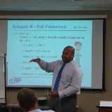

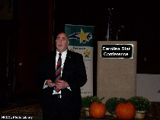
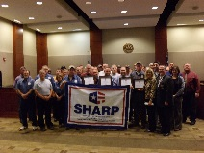
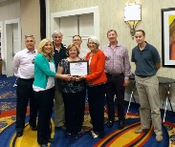

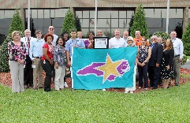
OSH Division
Recognition Programs
FFY 2020—2nd Qtr.
STAR SITES—New, Recertification, Promotion | 1st Qtr. | 2nd Qtr. | Total | FFY Goal | Approved Star Sites*
Carolina Star | 7 | 7 | 14 |  | 103
Building Star | 2 | 1 | 3 |  | 24
Rising Star | 0 | 0 | 0 |  | 4
Public Sector Star | 1 | 0 | 1 |  | 21
Total | 10 | 8 | 18 | 20 | 152
*Cumulative Total
NCDOL Photo Library
 | 1st Qtr. | 2nd Qtr. | Total | FFY Goal
Star Sites—Termination/Withdrawn | 4 | 0 | 4
Star Booths | 2 | 0 | 2
Star Presentations | 5 | 2 | 7 | 30
Star Program Interventions | 36 | 29 | 65 | 150

Slide 18
OSH Division
Recognition Programs
FFY 2020—2nd Qtr.
SHARP SITES—NEW | 1st Qtr. | 2nd Qtr. | Total | FFY Goal | Approved SHARP Sites*
SHARP—Construction | 1 | 1 | 2 |  | 7
SHARP—General Industry | 0 | 2 | 2 |  | 135
SHARP—Public Sector | 0 | 5 | 5 |  | 48
SHARP—Logging | 0 | 0 | 0 |  | 0
Total | 1 | 8 | 9 |  | 190
SHARP—Renewals | 10 | 14 | 24
*Cumulative Total
GOLD STAR GROWERS—NEW | 1st Qtr. | 2nd Qtr. | Total
 | 30 | 185 | 215
SAFETY AWARDS |  |  | Total
CY 2019 Safety Awards Season (Silver, Gold, Million Hour) |  |  | 3,200
 | 1st Qtr. | 2nd Qtr. | Total
Million Hour Awards | 4 | 83 | 87

Slide 19


Not in Strategic Plan
Alliances and Partnerships
FFY 2020—2nd Qtr.
Alliances
Carolinas AGC
Lamar Advertising Company
Mexican Consulate
N.C. State – Industry Expansion Solutions
Safety and Health Council of NC
NUCA of the Carolinas
NCALGESO

Slide 20
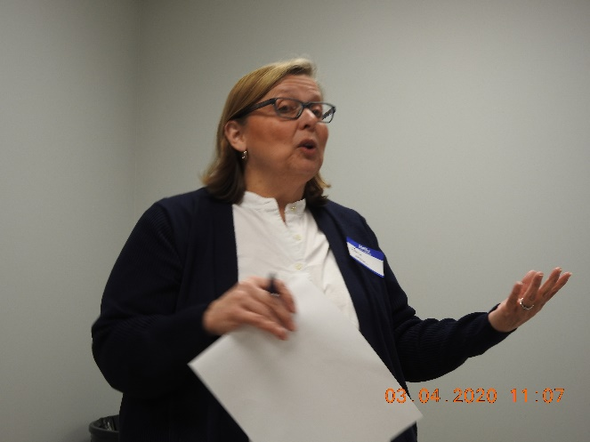
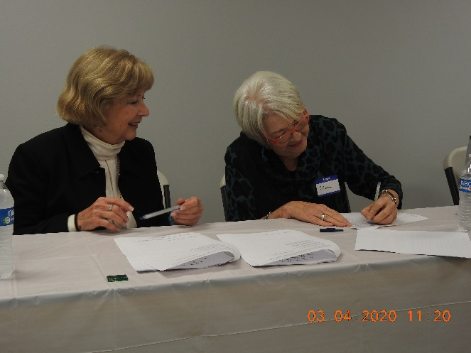
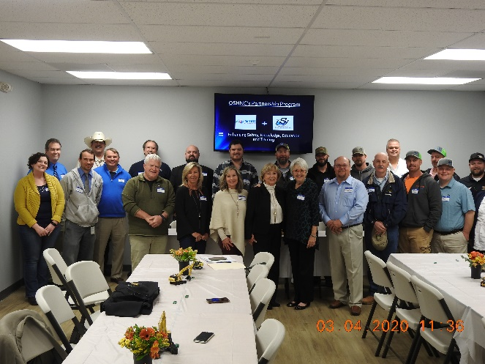
Not in Strategic Plan
Alliances and Partnerships
FFY 2020—2nd Qtr.
Partnerships
Sanders Utility Construction Company, Inc.
Design Build Project to improve/up-size/replace sanitary sewer lines along the Irwin Creek Tributary to the Irwin Creek Interceptor
March 2020 - 2022

Slide 21
OSH Division
Complaint Desk*
FFY 2020—2nd Qtr.
East Compliance | West Compliance | Agricultural Safety and Health
ACTIVITY | 1st Qtr. | 2nd Qtr. | 1st Qtr. | 2nd Qtr. | 1st Qtr. | 2nd Qtr. | Cumulative Total | FFY 2019
Complaints | 223 | 308 | 263 | 349 | 3 | 3 | 1,149 | 2,419
Referrals | 61 | 85 | 88 | 98 | 4 | 8 | 340 | 822
Fat/Cat | 13 | 10 | 23 | 24 | 0 | 1 | 71 | 123
Totals | 297 | 403 | 374 | 471 | 7 | 8 | 1,560 | 3,364
*Includes calls that were processed but not necessarily inspected. Fat/Cat includes calls regarding heart attacks and other natural causes.
ACTIVITY | 1st Qtr. | 2nd Qtr. | Cumulative Total
Complaints Not in OSH Jurisdiction | 641 | 916 | 1,557
*Includes complaints related to wage and hour, discrimination, worker's compensation questions, beyond statute of limitation time frame, etc.

Slide 22
OSH Division
Cut-Loose, In-Training, Vacant
FFY 2020—2nd Qtr.
West Compliance | Safety | % | Industrial Hygienist | %
Cut Loose | 22 | 71% | 19 | 73%
In-Training | 4 | 13% | 4 | 15%
Vacant | 5 | 16% | 3 | 12%
Total | 31 |  | 26
East Compliance | Safety | % | Industrial Hygienist | %
Cut Loose | 12 | 44% | 8 | 44%
In-Training | 6 | 22% | 6 | 33%
Vacant | 9 | 33% | 4 | 22%
Total | 27 |  | 18
Safety Cut Loose | 59% | Health Cut Loose | 61%
Safety In-Training | 17% | Health in-Training | 23%
Safety Vacant | 24% | Health Vacant | 16%

Slide 23
OSH Division
Cut-Loose, In-Training, Vacant
FFY 2020—2nd Qtr.
Consultative Services | Safety | % | Industrial Hygienist | %
Cut Loose | 11 | 100% | 7 | 87%
In-Training | 0 | 0% | 1 | 11%
Vacant | 0 | 0% | 0 | 0%
Total | 11 |  | 8
Education, Training and Technical Assistance | Safety | % | Industrial Hygienist | %
Cut Loose | 7 | 64% | 5 | 83%
In-Training | 2 | 18% | 1 | 17%
Vacant | 2 | 18% | 0 | 0%
Total | 11 |  | 6
Agricultural Safety and Health | Safety | % | Industrial Hygienist
Cut Loose | 4 | 67% | NA
In-Training | 2 | 33% | NA
Vacant | 0 | 0% | NA
Total | 6

Slide 24
OSH Division
Internal Training
FFY 2020—2nd Qtr.
1st Qtr.—COURSE | Trained
Annual Training—Raleigh:
OCSS Concrete and Masonry OCSS Cranes and Derricks Farm Guarding Safety, Home Inspections ASH Paperless File Management | 72 47 10 8 8
OSH 141—Legal Aspects—Raleigh | 28
OTI 245—Safety and Health Management Systems—Raleigh | 20
OCSS Work Zone Safety/Flagger Safety—Raleigh | 21
OCSS Work Zone Safety/Flagger Safety—Charlotte | 20
CPR/AED—Raleigh (2) | 12
Webinars:
Welding and Cutting, Excavation and Trenching, Personal Protective Equipment (General Industry), Electrical Safety, Machine Guarding | 6

Slide 25
OSH Division
Internal Training
FFY 2020—2nd Qtr.
2nd Qtr.—COURSE | Trained
OSH 105—Introduction to Safety Standards for Safety Officers—Raleigh | 12
OSH 100—Initial Compliance—Charlotte | 9
OSH—Technical Writing and OSHA Express—Charlotte | 10
Long Term Care Workshop—Webinar | 15
Webinars:
Scaffolds, Personal Protective Equipment for Construction, Personal Protective Equipment for General Industry, Inspection Process, Hazard Communication, Ergonomic Awareness, Respiratory Protection, Struck by/Caught in Between, Concrete and Masonry, and 1910 Subpart E - Exit Routes, Emergency Action Plans and Fire Prevention Plans | 49

Slide 26
OSH Division
Retaliatory Employment Discrimination
FFY 2020—2nd Qtr.
OSH Complaint Statistics | 1st Qtr. | 2nd Qtr. | Total
Total OSH Complaints Filed | 31 | 26 | 57
Total OSH Complaints Closed | 21 | 27 | 48
Number of OSH Cases Closed Within 90 Days of File Date | 1 | 1 | 2
Percentage of Cases Closed With in 90 Days of File Date | 11% | 4% | N/A
Of Cases Closed, Average Number of Elapsed Days Between File Date and Closed Date | 190 | 287 | 477
Total Number of OSH Complaints Pending at End of Reporting Period | 105 | 102 | 207
Percentage of Pending OSH Complaints Over 90 Days Old (From Filing) | 69% | 76% | N/A
Average Number of Elapsed Days Since Filing Date of All OSH Cases Pending at End of the Reporting Period | 135 | 148 | 283

Slide 27
OSH Division
Retaliatory Employment Discrimination
FFY 2020—2nd Qtr.
OSH Complaint Disposition | 1st Qtr. | 2nd Qtr. | Total
Administrative Closure (No RTS Letter) | 0 | 0 | 0
Withdrawn | 6 | 1 | 7
Merit | 0 | 2 | 2
Percent SAMM Merit | 0% | 33% | N/A
Dismissal Right-to-Sue (Includes No Merit and Unresponsive) | 10 | 14 | 24
Settled | 3 | 7 | 10
Requested RTS Letter | 2 | 3 | 5
Total | 21 | 27 | 48

Slide 28
OSH Division
Retaliatory Employment Discrimination
FFY 2020—2nd Qtr.
Bureau Staffing
Jay Cronley | Information Officer
Celestine Chestnutt | Administrative Assistant II
James Agosto | Investigator
David Bailey | Investigator
Dianne Daniels | Investigator
Anitra Nalls | Investigator
Erin Smith | Investigator
Alvin Vocalan | Investigator
Harriet Hopkins | Administrator

Slide 29
OSH Division
Training & Education Outreach
FFY 2020—2nd Qtr.
OUTREACH EVENT | 1st Qtr. | 2nd Qtr. | Total | FFY Goal
General Industry—10 Hour Course | 1 | 1 | 2 | 5
General Industry—30 Hour Course | 0 | 1 | 1 | 2
NC #500/502—Construction Train the Trainer Course NC #501/503—General Industry Train the Trainer Course | 0 | 0 | 0 | 1
Construction—10 Hour Course | 1 | 2 | 3 | 6
Construction—30 Hour Course | 0 | 0 | 0 | 2
Labor One/Booth Events | 7 | 2 | 9 | N/A
Speaker’s Bureau | 20 | 15 | 35 | N/A
Webinars | 16 | 25 | 41 | N/A
OSH Workshop | 3 | 2 | 5 | N/A
Technical Assistance | 7 | 5 | 12 | N/A
Spanish Training and Outreach Events | 1 | 2 | 3 | N/A
Train the Trainer Program (Construction/General Industry)—Events | 5 | 4 | 9 | N/A
Train the Trainer Program (Construction/General Industry)—Trained | 0 | 25 | 25 | N/A

Slide 30
OSH Division
Standards Section—Revisions
FFY 2020—2nd Qtr.
Brochures
Public Sector Injury and Illness Survey
Top Ten Frequently Cited Serious Violations in 2019

Slide 31
OSH Division
Standards Section—Revisions
FFY 2020—2nd Qtr.
Compliance Directives (CPL)
CPL 01-00-004—NRTL Program Policies, Procedures and Guidelines
Replaces CPL 01-00-003 and includes updates to policies, procedures, and instructions that supplement and clarify 1910.7 and Appendix A to that section.
CPL 02-00-051—Enforcement Exemptions and Limitations Under the Appropriations Act
Attached the most recent listing of the North American Industry Classification System (NAICS) codes for industries with a Days Away, Restricted, or Transferred (DART) occupational injury and illness rate below the national private sector rate of 1.6 for 2018.

Slide 32
OSH Division
Standards Section—Revisions
FFY 2020—2nd Qtr.
Operational Procedure Notice (OPN)
OPN 64G—Mandatory Training Program for OSH Compliance Personnel
Edited to reflect the requirement in the CSHO Progression Notebook to send a copy of the Excel spreadsheet(s) to ETTA for inclusion in their training records.

Slide 33
OSH Division
Standards Section—Revisions
FFY 2020—2nd Qtr.
Field Operations Manual (FOM)
FOM Chapter 6—Penalties
Includes additional information on certain administrative violations that would not warrant penalty reductions for good faith and added information which describes situations when the OSH Director can exercise discretion to depart from the penalty policy.
FOM Chapter 8—Fatality and Catastrophe Investigations
Information was added to clarify expanding the scope of a partial scope inspection based on information found in OSHA 300 log.
FOM Chapter 9—Complaints, Referrals and Accidents
This revision adds information to clarify expanding the scope of a partial scope inspection based on information found in OSHA 300 logs.

Slide 34
OSH Division
Standards Section—Revisions
FFY 2020—2nd Qtr.
Code of Federal Register (CFR)
CFR 146F—Respiratory Protection Standard: Additional Ambient Aerosol CNC QNFT Protocols
OSHA approved and added two additional condensation nuclei counting (CNC) quantitative fit test protocols in Appendix A of 29 CFR 1910.134: one for elastomeric full-face and half-mask respirators, and the other for filtering facepiece respirators.
CFR 187C—Occupational Exposure to Beryllium and Beryllium Compounds in Construction and Shipyard Sectors
OSHA delayed the compliance deadlines for almost all provisions of the beryllium standards for shipyards and construction until 9/30/2020 with the exception of the PEL and STEL.

Slide 35
OSH Division
Standards Section
FFY 2020—2nd Qtr.
Forms
ADM 1—Good Faith Reductions for Administrative Violations
Table lists the applicability of good faith reductions for administrative violations.
PAR 2—Receipt of Public Agency Records
Release form to be used when requesting or receiving records from public agencies.
WST 2—Warrant/Subpoena Tracking Form
Referenced in FOM Chapter III, Appendix C.
ERR 2—Equipment Repair Request
Form to request IH Technical Equipment Repair from Lab.

Slide 36
OSH Division
Standards Section
FFY 2020—2nd Qtr.
Forms
PMA 2—Petition for Modification of Abatement Checklist
Checklist used when an employer petitions for modification of abatement.
MR 2—Medical Records Chain of Custody
Form referenced in FOM Chapter 111.
CIL 3—Confidential Information Log
Form referenced in FOM Chapter 111.
FUA 1—Follow-up Assignment
Form to be completed for all follow-up assignments.
ROS 2—Return of Service
Form used when citations are delivered by hand.

Slide 37
OSH Division
COVID-19 Activities
FFY 2020—2nd Qtr.
Calls/Emails | 3/1-4/17 | 4/18-24 | 4/25-5/1 | 5/2-5/8 | 5/9-5/15 | Total
Director's Office | 122 | 44 | 51 | 52 | 47 | 316
ETTA | 615 | 46 | 26 | 67 | 74 | 828
ASH* | 0 | 26 | 19 | 10 | 7 | 62
PSIM | 0 | 0 | 0 | 0 | 0 | 0
CSB | 255 | 71 | 75 | 74 | 64 | 539
Totals | 992 | 187 | 171 | 203 | 192 | 1,745
* Includes a weekly conference call with other agencies

Slide 38
OSH Division
COVID-19 Activities
FFY 2020—2nd Qtr.
Director’s Office | Through 4/19 | 4/20-4/26 | 4/27-5/3 | 5/4-5/10 | 5/11-5/17 | Totals
Meetings | 2 | 4 | 4 | 6 | 9 | 25
Compliance | Through 4/19 | 4/20-4/26 | 4/27-5/3 | 5/4-5/10 | 5/11-5/17 | Totals
Valid COVID-19 Complaints | 97 | 33 | 27 | 50 | 50 | 257
Non-Valid COVID-19 Complaints | 117 | 115 | 102 | 111 | 138 | 583
Inspections | 0 | 0 | 0 | 0 | 1 | 1
Referrals | 2 | 0 | 1 | 1 | 7 | 11
Unprocessed Complaints* | 513 | 27 | 26 | 17 | 20 | 603
* This data is preliminary and subject to change as unprocessed complaints are moved to other categories. Many of the unprocessed complaints contain insufficient information to process and/or they cover complaint items that do not fall under OSH jurisdiction. Referrals to other Agencies are made, as appropriate.

Slide 39
OSH Division
COVID-19 Activities
FFY 2020—2nd Qtr.
ETTA | Through 4/19 | 4/20-4/26 | 4/27-5/3 | 5/4-5/10 | 5/11-5/17 | Totals
Live Webinars | 8 | 0 | 5 | 1* | 0 | 14**
Pre-recorded Webinars | 4 | 0 | 0 | 0 | 0 | 4
PowerPoints | 4 | 0 | 0 | 1 | 0 | 5
Hazard Alerts | 3 | 1 | 2 | 0 | 0 | 6
Streaming Videos | 12 | 2 | 1 | 5 | 6 | 26
A-Z Topics Added/Updated | 1 | 0 | 3 | 3 | 0 | 7
Fact Sheets | 1 | 0 | 0 | 0 | 0 | 1
Compliance Memos | 6 | 1 | 1 | 0 | 0 | 8
*Joint with DEQ on cleaning/disinfecting – 354 in attendance
** Webinar attendance (COVID-19 and Non-COVID 19) for April was 1,394
ASH | Through 4/19 | 4/20-4/26 | 4/27-5/3 | 5/4-5/10 | 5/11-5/17 | Totals
Guidance Documents | 1 | 0 | 0 | 0 | 0 | 1

Slide 40
OSH Division
COVID-19 Activities
FFY 2020—2nd Qtr.
PSIM | Through 4/19 | 4/20-4/26 | 4/27-5/3 | 5/4-5/10 | 5/11-5/17 | Totals
COVID-19 Related Disclosure Requests | 0 | 0 | 0 | 10 | 164 | 174
Consultation | Through 4/19 | 4/20-4/26 | 4/27-5/3 | 5/4-5/10 | 5/11-5/17 | Totals
Interventions | 19 | 7 | 2 | 1 | 2 | 31
Visits | 1 | 1 | 0 | 3 | 3 | 8
OSH Division
PPE supplies available for staff including respirators, washable facemasks, hand sanitizer, Clorox wipes, Lysol spray, face shields, sanitation barriers, gloves, and goggles.
COVID-19 Policies and Procedures for office and field work that includes use of PPE, employee training, posters, marked floors, staggered shifts, teleworking, and health self-checks.

Slide 41
OSH Division
COVID-19 Activities
FFY 2020—2nd Qtr.
Webinar COVID-19 Related Topics
Respiratory Protection
Bloodborne Pathogens
Personal Protective Equipment – Construction
Personal Protective Equipment – General Industry
Pre-recorded Webinars Related to COVID-19
N95 Filtering Facepiece Respirator – COVID-19
Personal Protective Equipment in Construction Industry – COVID-19
Personal Protective Equipment in General Industry – COVID-19
Respiratory Protection – COVID-19

Slide 42
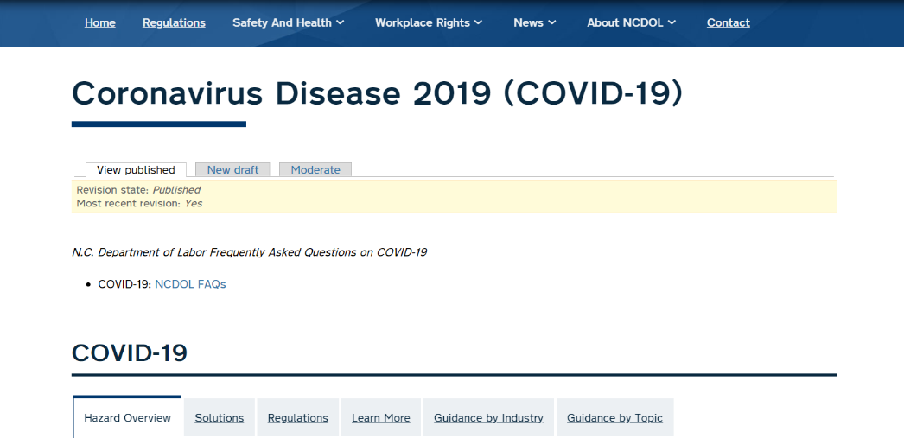

OSH Division
COVID-19 Activities
FFY 2020—2nd Qtr.
A - Z Safety and Health Topics (new/revised)
COVID-19
Respiratory Protection
Bloodborne Pathogens
Personal Protective Equipment
COVID-19: NCDOL FAQs
Fact Sheet
Facemasks vs. Respirators
Hotspot

Slide 43
OSH Division
COVID-19 Activities
FFY 2020—2nd Qtr.
Temporary Guidance Memorandums
Discretion in Enforcement when Considering an Employer's Good Faith Efforts During the Coronavirus Disease 2019 (COVID-19) Pandemic
Enforcement Guidance on Decontamination of Filtering Facepiece Respirators in Healthcare During the Coronavirus Disease 2019 (COVID-19) Pandemic
Temporary Enforcement Guidance - Healthcare Respiratory Protection Annual Fit-Testing for N95 Filtering Facepieces During the COVID-19 Outbreak
Enforcement Guidance for Respiratory Protection and the N95 Shortage Due to COVID-19 Pandemic

Slide 44
OSH Division
COVID-19 Activities
FFY 2020—2nd Qtr.
Temporary Guidance Memorandums
Enforcement Guidance For Use of Respiratory Protection Equipment Certified Under Standards of Other Countries or Jurisdictions During the Coronavirus Disease 2019 Pandemic
Interim Guidance on COVID-19 Use of Filtering Facepiece Respirators After Their Expiration Date
Expanded Temporary Enforcement Guidance on Respiratory Protection Fit-Testing for N95 Filtering Facepieces in All Industries During the Coronavirus 2019 Pandemic
Enforcement Guidance for Recording Cases of Coronavirus Disease 2019
Temporary Guidance on Migrant Housing for COVID-19 Impacted Workers

Slide 45
OSH Division
COVID-19 Activities
FFY 2020—2nd Qtr.
Hazard/Guidance Alerts
Farmworkers and COVID-19
COVID-19 - Health and Safety Guidelines for Retail Workers
COVID-19 - Health and Safety Guidelines for Food Processing
COVID-19 - Review of the Respiratory Protection for Healthcare Workers
Controlling Exposures to the 2019 Novel Coronavirus
Dealing with COVID-19 in Construction
Respiratory Protection for Long-Term Care Workers

Slide 46



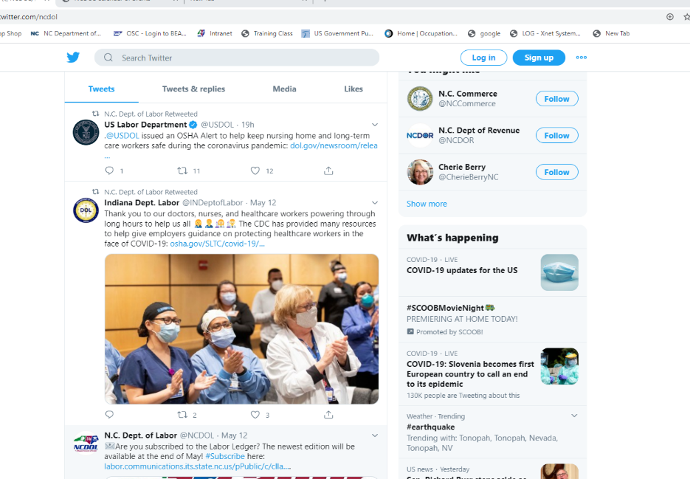
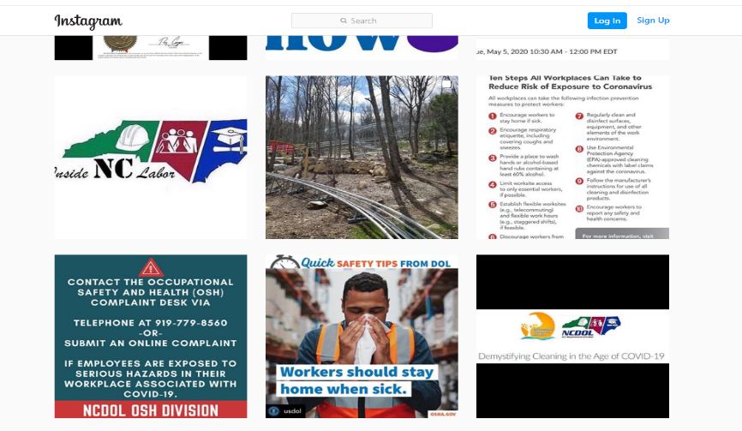
OSH Division
COVID-19 Activities
FFY 2020—2nd Qtr.
Social Media
Podcasts
Facebook Posts
Twitter
YouTube
Instagram

Slide 47

Thank You For Attending!
FFY 2020—2nd Qtr.
Questions?
1-800-NC-LABOR
(1-800-625-2267)
www.labor.nc.gov
Notes:
47

