Slide 1
North Carolina Department of Labor
Occupational Safety & Health Division
4th Quarter Report
Federal Fiscal Year 2019*
Presented by:
Wanda Lagoe CSP CPM ARM
Bureau Chief
Education, Training and Technical Assistance
Occupational Safety and Health Division of North Carolina
*Preliminary Data
Notes:
The information in this presentation is provided voluntarily by the N.C. Department of Labor, Education Training and Technical Assistance Bureau as a public service and is made available in good faith. This presentation is designed to assist trainers conducting OSHA outreach training for workers. Since workers are the target audience, this presentation emphasizes hazard identification, avoidance, and control – not standards. No attempt has been made to treat the topic exhaustively. It is essential that trainers tailor their presentations to the needs and understanding of their audience.
The information and advice provided on this Site and on Linked Sites is provided solely on the basis that users will be responsible for making their own assessment of the matters discussed herein and are advised to verify all relevant representations, statements, and information.
This presentation is not a substitute for any of the provisions of the Occupational Safety and Health Act of North Carolina or for any standards issued by the N.C. Department of Labor. Mention of trade names, commercial products, or organizations does not imply endorsement by the N.C. Department of Labor.

Slide 2
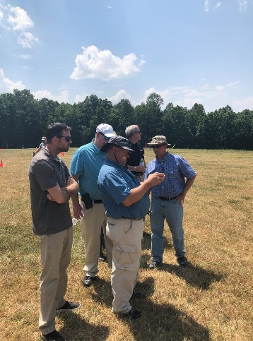
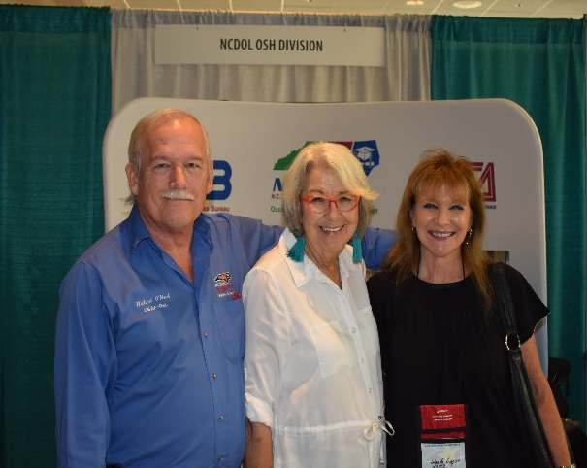


N.C. Workplace Safety and Health
TRC and DART Rate Comparison
FFY 2019—4th Qtr.
CY 2018 | North Carolina |  | National Average |  | Comparison
TRC Rate | 2.4 | 2.6* | 2.8 | 3.1* | 14% Lower/16% Lower*
DART Rate | 1.3 | 1.4* | 1.6 | 1.7* | 19% Lower/18% Lower*
*All industries including state and local government CY = Calendar Year
Notes:
North Carolina’s Total Recordable cases and DART rate continue to be lower that the National Average.
The DART rate stands for "Days Away, Restrictions and Transfers". This number is also based on trending over 200,000 hours but its not based on total injuries. Its based only on those injuries and illnesses severe enough to warrant "Days Away, Restrictions and Transfers".
The Total Recordable Case Rate (TRC) equals the division of all recordable cases by the hours worked, multiplied by 200'000 for standardization.

Slide 3
N.C. Workplace Safety and Health
Total Recordable Cases (TRC)
FFY 2019—4th Qtr.
No Change
3% Decrease
4% Decrease
7% Decrease
4% Increase
All Industries Including State and Local Government
Based on Calendar Year

Slide 4
N.C. Workplace Safety and Health
Days Away, Restricted or Transferred (DART)
FFY 2019—4th Qtr.
7% Increase
7% Decrease
No Change
7% Decrease
7% Increase
All Industries Including State and Local Government
Based on Calendar Year

Slide 5
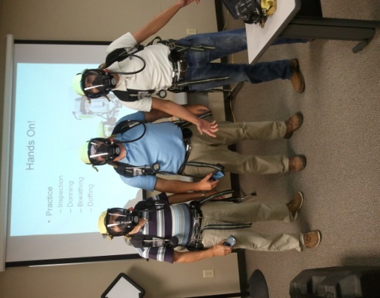
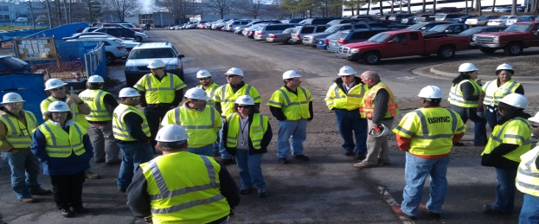

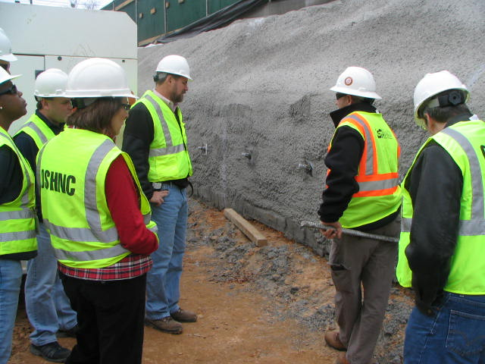
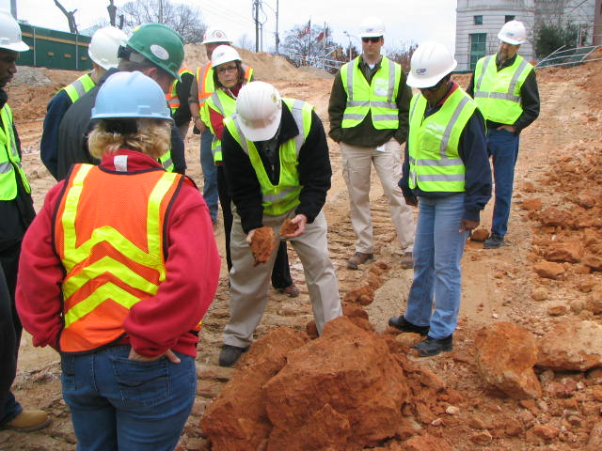

N.C. Workplace Safety and Health
OSH Division—Fatalities Inspected
FFY 2019—4th Qtr.
FATALITY TYPE | 1st Qtr. | 2nd Qtr. | 3rd Qtr. | 4th Qtr. | Total | FATALITY TYPE | 1st Qtr. | 2nd Qtr. | 3rd Qtr. | 4th Qtr. | Total
Struck By | 3 | 3 | 7 | 5 | 18 | Inhalation | 1 | 0 | 0 | 0 | 1
Caught In/Between | 1 | 2 | 3 | 3 | 9 | Ingestion | 0 | 0 | 0 | 0 | 0
Bite/Sting/Scratch | 0 | 0 | 0 | 0 | 0 | Absorption | 0 | 0 | 0 | 0 | 0
Fall (Same Level) | 0 | 1 | 0 | 0 | 1 | Repeated Motion/Pressure | 0 | 0 | 0 | 0 | 0
Fall (From Elevation) | 1 | 4 | 4 | 4 | 13 | Cardio/Respiratory | 0 | 0 | 0 | 0 | 0
Struck Against | 0 | 0 | 0 | 1 | 1 | Shock | 0 | 0 | 1 | 0 | 1
Rubbed/Abraded | 0 | 0 | 0 | 0 | 0 | Other | 2 | 3 | 3 | 1 | 9
Fatalities Under OSH Division Jurisdiction
FFY 2018 |  | FFY 2019 | 1st Qtr. | 2nd Qtr. | 3rd Qtr. | 4th Qtr. | Total
Total Fatalities | 48 | Fatalities | 8 | 13 | 18 | 14 | 53
NCDOL Photo Library

Slide 6
N.C. Workplace Safety and Health
OSH Division—Strategic Plan Goals
FFY 2019—4th Qtr.
COMPLIANCE | 1st Qtr. | 2nd Qtr. | 3rd Qtr. | 4th Qtr. | Total | FFY Goal
Safety Inspections | 294 | 525 | 598 | 453 | 1,870 | 1,907
Health Inspections | 146 | 282 | 291 | 266 | 985 | 1,087
Serious Hazards Eliminated | 669 | 1,565 | 1,278 | 1,468 | 4,980 | 4,100
Training and/or Program Violations | 138 | 227 | 253 | 202 | 820 | 1,050
CONSULTATION | 1st Qtr. | 2nd Qtr. | 3rd Qtr. | 4th Qtr. | Total | FFY Goal
Serious Hazards Eliminated | 1,603 | 2,233 | 1,713 | 1,831 | 7,380 | 5,250
Private Sector Visits | 331 | 386 | 365 | 366 | 1,448 | 1,165
Public Sector Visits | 71 | 75 | 71 | 27 | 244 | 205
OSH DIVISION | 1st Qtr. | 2nd Qtr. | 3rd Qtr. | 4th Qtr. | Total | FFY Goal
Program Improvements | 581 | 746 | 738 | 623 | 2,688 | 2,060
People Trained in Special Emphasis Program Areas | 1,689 | 2,602 | 1,246 | 1,661 | 7,198 | 3,700
People Trained at OSH Division Sponsored Events | 3,649 | 4,172 | 3,722 | 2,153 | 13,696 | 9,600

Slide 7

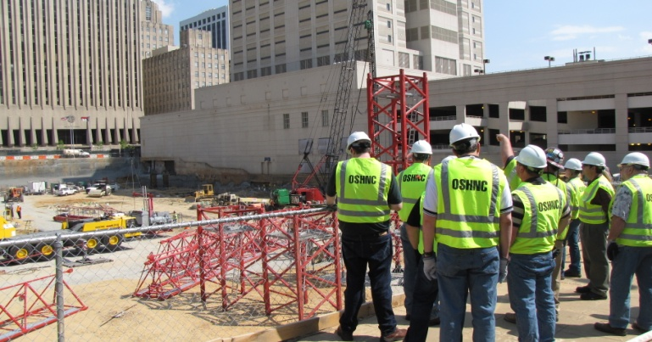
N.C. Workplace Safety and Health
OSH Division—Strategic Plan Goals
FFY 2019—4th Qtr.
EDUCATION, TRAINING AND TECHNICAL ASSISTANCE | 1st Qtr. | 2nd Qtr. | 3rd Qtr. | 4th Qtr. | Total | FFY Goal
Publications Distributed | 35,521 | 10,188 | 14,174 | 11,009 | 70,892 | 45,000
Standards Interpretations | 635 | 931 | 795 | 798 | 3,159 | NA
AGRICULTURAL SAFETY AND HEALTH | 1st Qtr. | 2nd Qtr. | 3rd Qtr. | 4th Qtr. | Total | FFY Goal
Outreach Materials Distributed | 227 | 2,465 | 2,118 | 333 | 5,143 | 3,500
Compliance Inspections | 24 | 7 | 12 | 31 | 74 | 80
Certificates Issued | 88 | 1,152 | 457 | 73 | 1,770 | 1,500
Preoccupancy Inspections | 146 | 1,311 | 353 | 77 | 1,887 | 1,700
NCDOL Photo Library

Slide 8

Strategic Plan
Special Emphasis Programs (SEP)
FFY 2019—4th Qtr.
Construction
Logging and Arboriculture
Long Term Care Facilities
Health Hazards
Food Manufacturing
Grocery and Related Product Wholesalers
Amputations
2019 – 2023 Strategic Management Plan
Goal #1 – Reduce fatalities by 2%
Goal #2 – Reduce injuries and illnesses by 5%
Notes:
FFY 2019 - 2023
OSHNC Outcome Goal #1 By the end of FY 2023, reduce the rate of workplace fatalities by 2% OSHNC Outcome Goal #2 By the end of FY 2023, reduce the rate of workplace injuries and illnesses by 5%

Slide 9
Special Emphasis Program
Construction
FFY 2019—4th Qtr.
NAICS 23—CONSTRUCTION | FFY 2018 |  | 1st Qtr. | 2nd Qtr. | 3rd Qtr. | 4th Qtr. | Total
Total Fatalities | 24 |  | 2 | 6 | 6 | 4 | 18
Fatality Rate | 0.0110 |  | 0.0009 | 0.0026 | *0. | *0. | *0.
* Data not available
Fatality Type | 1st Qtr. | 2nd Qtr. | 3rd Qtr. | 4th Qtr. | Total | Fatality Type | 1st Qtr. | 2nd Qtr. | 3rd Qtr. | 4th Qtr. | Total
Struck By | 1 | 0 | 1 | 2 | 4 | Inhalation | 1 | 0 | 0 | 0 | 1
Caught In/Between | 0 | 0 | 0 | 1 | 1 | Ingestion | 0 | 0 | 0 | 0 | 0
Bite/Sting/Scratch | 0 | 0 | 0 | 0 | 0 | Absorption | 0 | 0 | 0 | 0 | 0
Fall (Same Level) | 0 | 0 | 0 | 0 | 0 | Repeated Motion/Pressure | 0 | 0 | 0 | 0 | 0
Fall (From Elevation) | 0 | 4 | 3 | 0 | 7 | Cardio/Respiratory | 0 | 0 | 0 | 0 | 0
Struck Against | 0 | 0 | 0 | 1 | 1 | Shock | 0 | 0 | 1 | 0 | 1
Rubbed/Abraded | 0 | 0 | 0 | 0 | 0 | Other | 0 | 2 | 1 | 0 | 3

Slide 10
Special Emphasis Program
Construction
FFY 2019—4th Qtr.
NAICS 23*—CONSTRUCTION
 | North Carolina |  |  |  | National Average |  |  |  | North Carolina vs. National Average
 | CY 2017 |  | CY 2018 |  | CY 2017 |  | CY 2018 |  | 2018 Comparison
TRC | 1.8 | 28% Increase |  | 2.5 | 3.1 | No Change |  | 3.1 | 19% Lower
DART | 1.1 | 21% Increase |  | 1.6 | 1.8 | 6% Decrease |  | 1.7 | 6% Lower
SEP ACTIVITY | 1st Qtr. | 2nd Qtr. | 3rd Qtr. | 4th Qtr. | Total | FFY Goal
Compliance Inspections | 218 | 437 | 544 | 442 | 1,641 | 1,050
Consultative Visits | 104 | 120 | 150 | 129 | 503 | 200
OSH Outreach Events (10 and 30 Hour Construction Courses) | 0 | 2 | 4 | 3 | 9 | 8
People Trained | 288 | 1,194 | 608 | 203 | 2,293 | 2,500

Slide 11
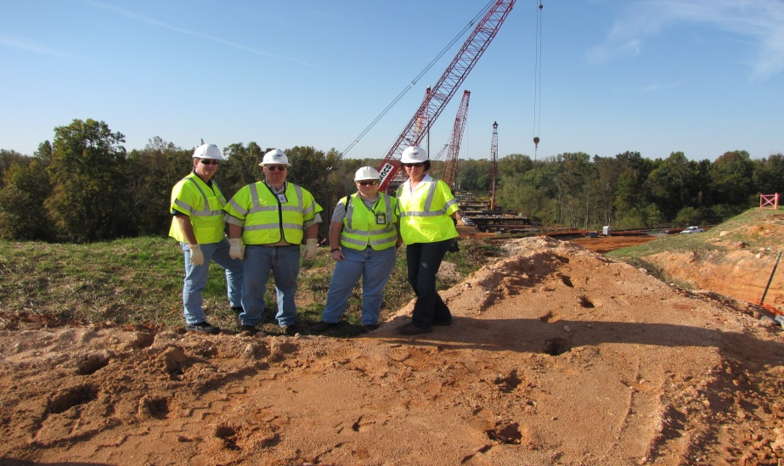
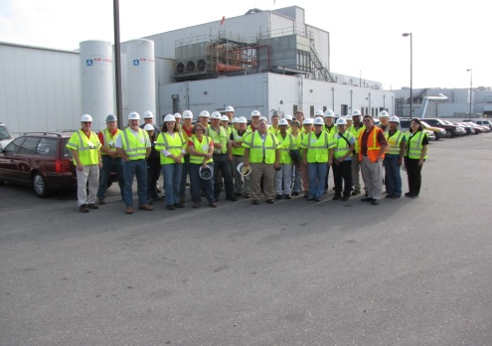
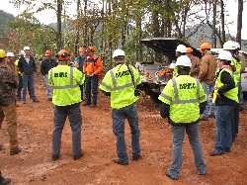
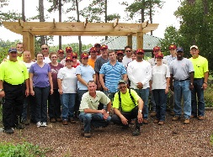
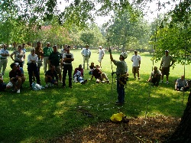
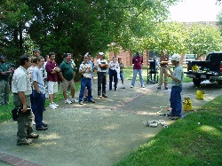
Special Emphasis Program
Logging and Arboriculture
FFY 2019—4th Qtr.
SEP ACTIVITY | 1st Qtr. | 2nd Qtr. | 3rd Qtr. | 4th Qtr. | Total | FFY Goal
Compliance Inspections | 10 | 15 | 9 | 5 | 39 | 60
Consultative Visits | 10 | 12 | 4 | 2 | 28 | 13
OSH Training and Outreach Events | 1 | 3 | 3 | 5 | 12 | 1
People Trained | 21 | 174 | 28 | 159 | 382 | 150
NAICS 11331*—LOGGING | FFY 2018 |  | 1st Qtr. | 2nd Qtr. | 3rd Qtr. | 4th Qtr. | Total
Total Fatalities | 0 |  | 0 | 1 | 0 | 0 | 1
NAICS 56173*—ARBORICULTURE | FFY 2018 |  | 1st Qtr. | 2nd Qtr. | 3rd Qtr. | 4th Qtr. | Total
Total Fatalities | 6 |  | 1 | 1 | 2 | 1 | 5
Combined Fatality Rate | 0.0166 |  | 0.0027 | 0.0056 | *0. | *0. | *0.
* Data not available

Slide 12
Special Emphasis Program
Long Term Care Facilities
FFY 2019—4th Qtr.
NAICS 623*—LONG TERM CARE
 | North Carolina |  |  |  | National Average |  |  |  | North Carolina vs. National Average
 | CY 2017 |  | CY 2018 |  | CY 2017 |  | CY 2018 |  | 2018 Comparison
TRC | 6.4 | 16% Decrease |  | 5.4 | 6.3 | 3% Decrease |  | 6.1 | 11% Lower
DART | 3.7 | 11% Decrease |  | 3.3 | 3.8 | 3% Decrease |  | 3.7 | 11% Lower
SEP ACTIVITY | 1st Qtr. | 2nd Qtr. | 3rd Qtr. | 4th Qtr. | Total | FFY Goal
Compliance Inspections | 5 | 19 | 20 | 14 | 58 | 48
Consultative Visits | 9 | 31 | 10 | 16 | 66 | 40
OSH Outreach Events | 1 | 0 | 2 | 0 | 3 | 2
People Trained | 400 | 0 | 42 | 0 | 442 | 50

Slide 13
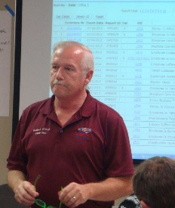


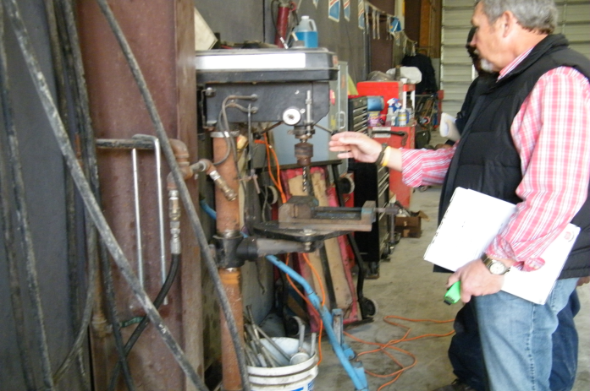
Special Emphasis Program
Health Hazards
FFY 2019—4th Qtr.
COMPLIANCE INSPECTIONS | 1st Qtr. | 2nd Qtr. | 3rd Qtr. | 4th Qtr. | Total | FFY Goal
Silica | 11 | 20 | 21 | 20 | 72 | 100
Asbestos | 7 | 5 | 7 | 6 | 25
Isocyanates | 2 | 6 | 10 | 7 | 25
Lead | 9 | 5 | 8 | 9 | 31
Hexavalent Chromium | 2 | 5 | 1 | 4 | 12
Total | 31 | 41 | 47 | 46 | 165*
Program Improvements | 10 | 13 | 10 | 6 | 39 | 20
*Some inspections involved more than one health hazard and generally included a program improvement
NCDOL Photo Library

Slide 14

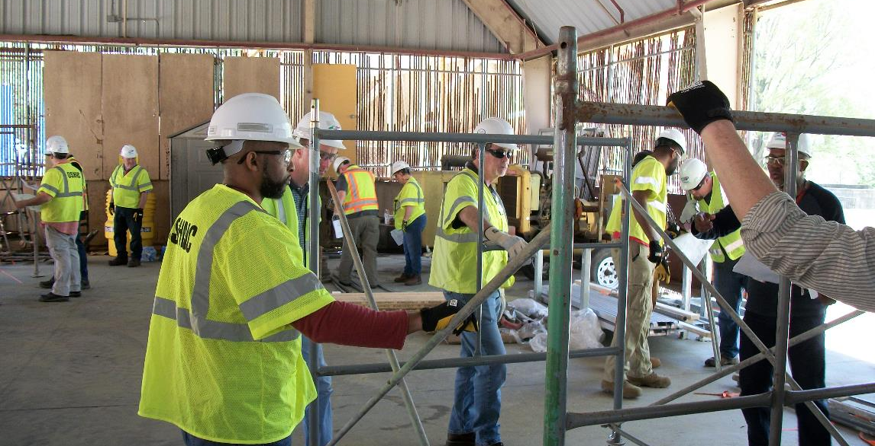
Special Emphasis Program
Health Hazards
FFY 2019—4th Qtr.
COMPLIANCE INSPECTION RESULTS
HEALTH HAZARDS | Number of Samples (Detectable Results) |  |  |  |  | Number With Overexposures |  |  |  |  | Average Severity Rate*
 | 1st Qtr. | 2nd Qtr. | 3rd Qtr. | 4th Qtr. | Total | 1st Qtr. | 2nd Qtr. | 3rd Qtr. | 4th Qtr. | Total | 1st Qtr. | 2nd Qtr. | 3rd Qtr. | 4th Qtr. | Aver.
Silica | 14 | 20 | 23 | 9 | 66 | 9 | 6 | 4 | 3 | 22 | 22.57 | 0.87 | 1.20 | 2.59 | 42.12
Asbestos | 5 | 0 | 4 | 0 | 9 | 0 | 0 | 0 | 0 | 0 | 0.08 | 0.0 | 0.05 | 0.0 | 0.12
Isocyanates | 3 | 6 | 0 | 0 | 9 | 0 | 0 | 0 | 0 | 0 | 0.04 | 0.039 | 0.0 | 0.0 | 0.07
Lead | 8 | 5 | 5 | 8 | 26 | 2 | 0 | 0 | 2 | 4 | 2.41 | 0.29 | 0.12 | 0.71 | 0.60
Hexavalent Chromium | 0 | 4 | 1 | 2 | 7 | 0 | 0 | 0 | 0 | 0 | 0.0 | 0.02 | 0.02 | 0.24 | 0.15
Total | 30 | 35 | 33 | 19 | 117 | 3 | 6 | 7 | 9 | 26 | N/A | N/A | N/A | N/A | N/A
NCDOL Photo Library
* All Samples

Slide 15
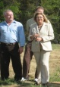

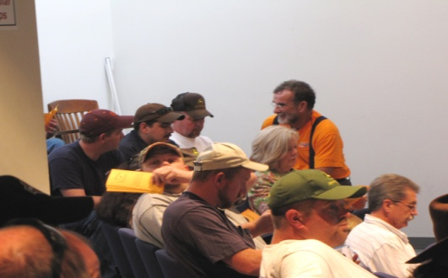
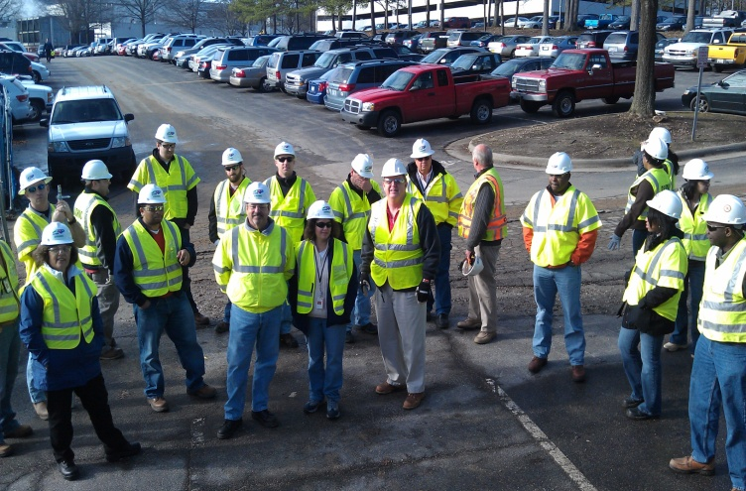
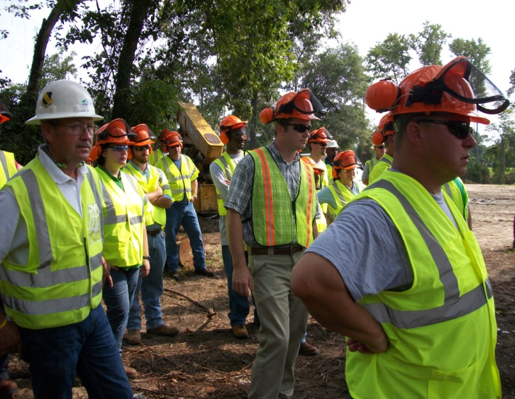
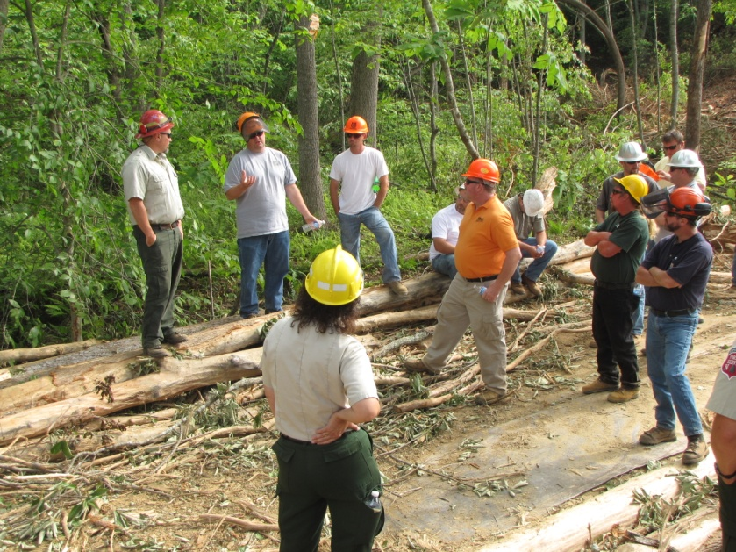
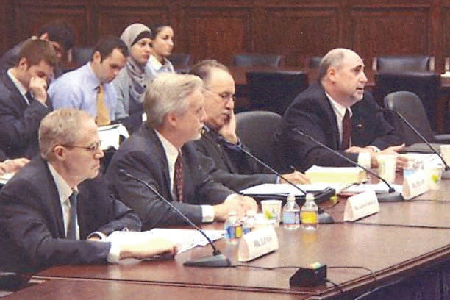
Special Emphasis Program
Health Hazards
FFY 2019—4th Qtr.
HEALTH HAZARDS | CONSULTATIVE SURVEYS
 | 1st Qtr. | 2nd Qtr. | 3rd Qtr. | 4th Qtr. | Total
Silica | 43 | 40 | 47 | 40 | 170
Asbestos | 3 | 5 | 3 | 3 | 14
Isocyanates | 2 | 1 | 1 | 9 | 13
Lead | 8 | 4 | 9 | 10 | 31
Hexavalent Chromium | 4 | 6 | 8 | 9 | 27
Total | 60 | 56 | 68 | 71 | 255
FFY Goal | 200
NCDOL Photo Library
NCDOL Photo Library
SEP ACTIVITY | 1st Qtr. | 2nd Qtr. | 3rd Qtr. | 4th Qtr. | Total | FFY Goal
OSH Outreach Events | 5 | 8 | 22 | 6 | 41 | 18
People Trained | 117 | 284 | 210 | 184 | 795 | 400

Slide 16
Special Emphasis Program
Food Manufacturing
FFY 2019—4th Qtr.
NAICS 311*—FOOD MANUFACTURING
 | North Carolina |  |  |  | National Average |  |  |  | North Carolina vs. National Average
 | CY 2017 |  | CY 2018 |  | CY 2017 |  | CY 2018 |  | 2018 Comparison
TRC | 3.6 | 19% Decrease |  | 2.9 | 4.5 | 7% Decrease |  | 4.2 | 31% Lower
DART | 2.5 | 12% Decrease |  | 2.2 | 3.1 | 6% Decrease |  | 2.9 | 24% Lower
*TRC/DART rate based on the 3 digit NAICS code
SEP ACTIVITY | 1st Qtr. | 2nd Qtr. | 3rd Qtr. | 4th Qtr. | Total | FFY Goal
Compliance Inspections | 10 | 12 | 12 | 8 | 42 | 40
Consultative Visits | 3 | 7 | 9 | 9 | 28 | 12
OSH Outreach Events | 0 | 0 | 0 | 1 | 1 | 1
People Trained | 0 | 0 | 0 | 14 | 14 | 25

Slide 17
Special Emphasis Program
Grocery and Related Product Wholesalers
FFY 2019—4th Qtr.
NAICS 4244*—GROCERY AND RELATED WHOLESALERS
 | North Carolina |  |  |  | National Average |  |  |  | North Carolina vs. National Average
 | CY 2017 |  | CY 2018 |  | CY 2017 |  | CY 2018 |  | 2018 Comparison
TRC | 4.1 | 9% Increase |  | 4.5 | 5.1 | 2% Increase |  | 5.2 | 13% Lower
DART | 3.0 | 12% Increase |  | 3.4 | 4.2 | 5% Decrease |  | 4.0 | 15% Lower
*DART/TRC rate based on the 4 digit NAICS code
SEP ACTIVITY | 1st Qtr. | 2nd Qtr. | 3rd Qtr. | 4th Qtr. | Total | FFY Goal
Compliance Inspections | 2 | 10 | 8 | 3 | 23 | 20
Consultative Visits | 2 | 0 | 0 | 2 | 4 | 3
OSH Outreach Events | 0 | 1 | 0 | 0 | 1 | 1
People Trained | 0 | 7 | 0 | 0 | 7 | 25

Slide 18
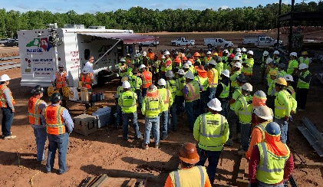
Special Emphasis Program
Amputations—New for FFY 2019
FFY 2019—4th Qtr.
FFY 2019 Planning Year
  Setting and Monitoring Goals
    Training Events (Internal and external)
    Compliance Inspections
    Consultation Visits
    Publications
  Finalized Operational Procedure Notice
    Mailed approximately 1,675 SEP letters
Notes:
Added Amputations for our new 5 year SMP, and removed Accommodations.

Slide 19
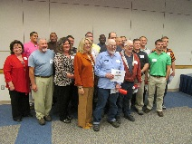
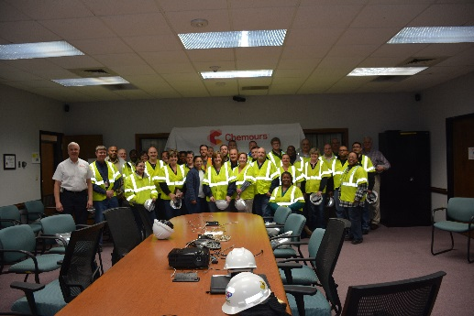
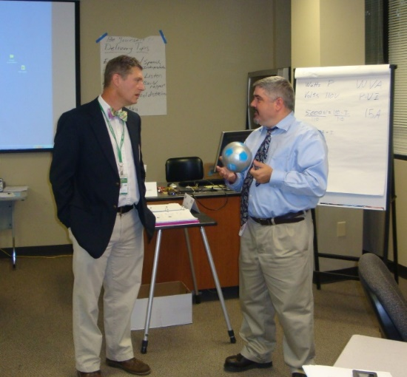
OSH Division
Public Sector
FFY 2019—4th Qtr.
 | CY 2017 |  | CY 2018
TRC | 3.8 | 3% Increase |  | 3.9
DART | 1.8 | No Change |  | 1.8
ACTIVITY | 1st Qtr. | 2nd Qtr. | 3rd Qtr. | 4th Qtr. | Total | FFY Goal
Compliance Inspections | 43 | 64 | 41 | 40 | 188 | 151
Consultative Visits | 71 | 75 | 71 | 27 | 244 | 205
OSH Outreach Events/Booths | 11 | 8 | 7 | 10 | 36 | 22
Trained | 351 | 473 | 255 | 427 | 1,506 | 1,500

Slide 20
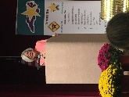
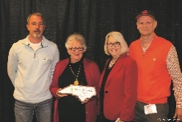
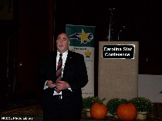
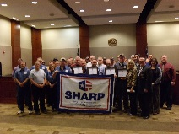
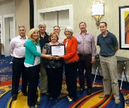
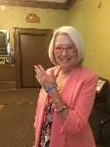
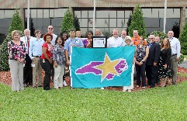
OSH Division
Recognition Programs
FFY 2019—4th Qtr.
STAR SITES—NEW, RECERTIFICATION, PROMOTION | 1st Qtr. | 2nd Qtr. | 3rd Qtr. | 4th Qtr. | Total | FFY Goal | APPROVED STAR SITES*
Carolina Star | 1 | 10 | 12 | 5 | 28 |  | 103
Building Star | 0 | 2 | 1 | 2 | 5 |  | 22
Rising Star | 0 | 0 | 0 | 0 | 0 |  | 5
Public Sector Star | 1 | 0 | 2 | 0 | 3 |  | 23
Total | 2 | 12 | 15 | 7 | 36 | 30 | 153
*Cumulative Total
NCDOL Photo Library
 | 1st Qtr. | 2nd Qtr. | 3rd Qtr. | 4th Qtr. | Total | FFY Goal
Star Sites—Termination/Withdrawn | 0 | 0 | 3 | 0 | 3
Star Booths | 2 | 0 | 5 | 4 | 11
Star Presentations | 11 | 7 | 3 | 10 | 31 | 30
Star Program Interventions | 40 | 44 | 40 | 42 | 166 | 150
Notes:
The Carolina Star Program is designed to recognize employers and employees who have implemented effective safety and health management systems and maintain injury and illness rates that meet the criteria for participation. Any size employer.
The SSTM Program is North Carolina’s version of federal OSHA’s Special Government Employee (SGE) Program. The SSTM Program allows industry employees and qualified independent private sector safety and health professionals the opportunity to work together in partnership with the NCDOL Carolina Star Program during onsite Star Program evaluations.
General industry, private sector participants must meet the following criteria: The most recent three-year average for both the total recordable case (TRC) rates and cases with days away from work, job transfer, or restriction (DART) rates must be at or below 50 percent of the most recent published federal BLS rates for the appropriate North American Industrial Classification System (NAICS) industry, preferably using a 6-digit NAICS rate, or highest digit available.
Building Star - The contractor participant must meet the following criteria: All injuries and illness rates for each worksite in North Carolina must be summarized on the OSHA 300 log each year, for the past three years. The most recent three-year average for both the total recordable case (TRC) rates and cases with days away from work, job transfer, or restriction (DART) rates must be at or below 50 percent of the most recent published Federal BLS rate for the appropriate North American Industrial Classification System (NAICS) preferably using a 6-digit NAICS rate, or highest digit available.

Slide 21
OSH Division
Recognition Programs
FFY 2019—4th Qtr.
SHARP SITES—NEW | 1st Qtr. | 2nd Qtr. | 3rd Qtr. | 4th Qtr. | Total | FFY Goal | Approved SHARP Sites*
SHARP—Construction | 1 | 0 | 1 | 0 | 2 |  | 6
SHARP—General Industry | 1 | 2 | 1 | 2 | 6 |  | 137
SHARP—Public Sector | 3 | 4 | 0 | 0 | 7 |  | 48
SHARP—Logging | 0 | 0 | 0 | 0 | 0 |  | 0
Total | 5 | 6 | 2 | 2 | 15 | 6 | 191
SHARP—Renewals | 20 | 16 | 11 | 14 | 61* | 55
*Cumulative Total
*Includes both general industry and public sector renewals
GOLD STAR GROWERS—NEW | 1st Qtr. | 2nd Qtr. | 3rd Qtr. | 4th Qtr. | Total
 | 16 | 209 | 50 | 11 | 286
SAFETY AWARDS |  |  |  |  | Total
CY 2019 Safety Awards Season |  |  |  |  | 3,201
 | 1st Qtr. | 2nd Qtr. | 3rd Qtr. | 4th Qtr. | Total
Million Hour Awards | 2 | 62 | 84 | 4 | 152
Notes:
The SHARP (Safety and Health Achievement and Recognition Programs) Program is designed for small and mid-size employers that have established, implemented and maintained exceptional workplace safety standards.
The Gold Star Grower Housing Program recognizes growers who provide farmworker housing that meets and exceeds all of the requirements of the Migrant Housing Act of North Carolina.
The Gold Star Flag recognizes agricultural employers who have devised ways to continuously promote a culture of safety on their farms. Gold Star Flag recipients have identified hazards, trained their employees and completed farm safety inspections. They follow and exceed the regulations pertaining to the agricultural work place.
Safety Awards Program - In operation since 1946, the program now extends to more than 5,000 firms, and about 3,000 awards are presented annually. Two types of awards are administered through the program: Annual Safety Awards and Million-Hour Awards.
To qualify for an annual safety award, a firm must:
Have no fatalities during the calendar year at the site or location for which the award was given; and
Have maintained an incidence rate at least 50 percent below the average for its particular industry group.
Two Safety Award Levels - Gold and Silver
The Gold Award is based on the days away, restricted, transferred (DART) rate, which includes cases of days away from work, restricted activity or job transfer.
The Silver Award is based only on cases with days away from work. They are recorded when the worker misses at least one full day of work, not including the day of the injury.

Slide 22



OSH Division
Alliances and Partnerships
FFY 2019—4th Qtr.
ALLIANCES
  Carolinas AGC
  Lamar Advertising Company
  Mexican Consulate
  N.C. State – Industry Expansion Solutions
  Safety and Health Council of NC
  NUCA of the Carolinas
  NCALGESO
  Forestry Mutual Insurance Company, NC Forestry Association, Carolina Loggers Association*
NCDOL Photo Library
*Expired the end of September
Notes:
Our alliances are organizations based toward our SEPs to promote education and training. Logging alliance expired in Sept – no renewal scheduled.
Kimmel School of Construction terminated in July – POC took job in MI and WCU don’t have staff to support alliance.
Looking at AIHA.
MESH alliances: NCSU and SHCNC – introducing emergency preparedness MESH in August. Working on Environmental MESH for the Fall/Winter time frame

Slide 23
OSH Division
Alliances and Partnerships
FFY 2019—4th Qtr.
PARTNERSHIPS
  Flatiron Blythe, a Joint Venture
    Charlotte-Douglas Airport Improvements—Charlotte
    Estimated Completion: November 2019
  Fluor Enterprises
    DAPI US Project, Novo Nordisk Facility—Clayton
    Estimated Completion: October 2019
Notes:
We try to keep it around 3 partnerships due to limited manpower.
Yes. Fluor has closed out as of Oct 2, 2019 and Flatiron is set to close out in early November 2019.
All partnerships will close out this winter.

Slide 24
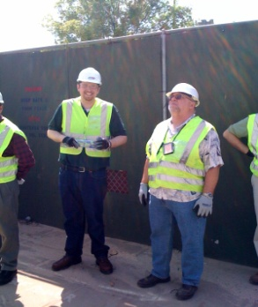
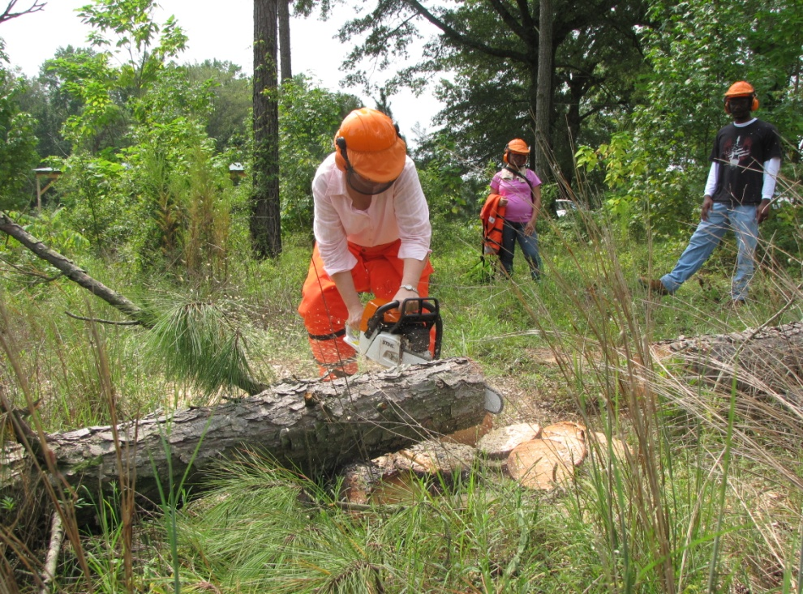

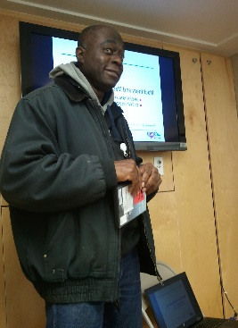
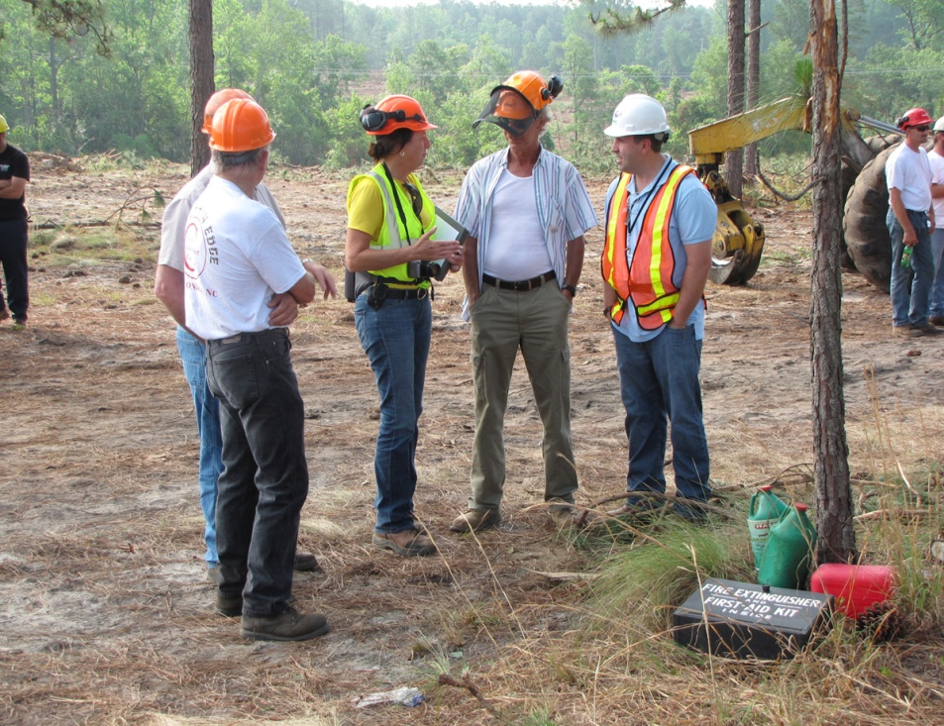
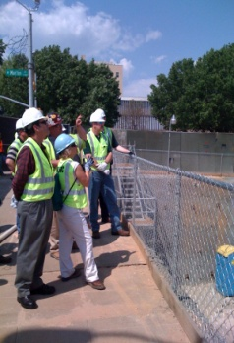
OSH Division
Complaint Desk*
FFY 2019—4th Qtr.
EAST COMPLIANCE | WEST COMPLIANCE | AGRICULTURAL SAFETY AND HEALTH
ACTIVITY | 1st Qtr. | 2nd Qtr. | 3rd Qtr. | 4th Qtr. | 1st Qtr. | 2nd Qtr. | 3rd Qtr. | 4th Qtr. | 1st Qtr. | 2nd Qtr. | 3rd Qtr. | 4th Qtr. | Cumulative Total | FFY 2018
Complaints | 282 | 251 | 276 | 362 | 265 | 353 | 344 | 438 | 3 | 1 | 2 | 2 | 2,579 | 2,419
Referrals | 88 | 92 | 114 | 104 | 104 | 91 | 116 | 132 | 23 | 4 | 14 | 23 | 905 | 822
Fat/Cat | 19 | 23 | 28 | 21 | 19 | 19 | 21 | 22 | 0 | 0 | 0 | 1 | 173 | 123
Totals | 389 | 366 | 418 | 487 | 388 | 463 | 481 | 592 | 26 | 5 | 16 | 26 | 3,657 | 3,364
*Includes calls that were processed but not necessarily inspected. Fat/Cat includes calls regarding heart attacks and other natural causes.
NCDOL Photo Library
Notes:
Complaints, referrals, fatality and catastrophe inspections account for a significant amount of inspections that compliance does every year. This slide puts that into perspective.

Slide 25
OSH Division
Cut-Loose, In-Training, Vacant
FFY 2019—4th Qtr.
WEST COMPLIANCE | Safety | % | Industrial Hygienist | %
Cut Loose | 22 | 71% | 21 | 81%
In-Training | 2 | 6% | 3 | 11%
Vacant | 7 | 23% | 2 | 8%
Total | 31 |  | 26
EAST COMPLIANCE | Safety | % | Industrial Hygienist | %
Cut Loose | 14 | 52% | 7 | 39%
In-Training | 7 | 26% | 7 | 39%
Vacant | 6 | 22% | 4 | 22%
Total | 27 |  | 18
Safety Cut Loose | 62% | Health Cut Loose | 64%
Safety In-Training | 16% | Health in-Training | 23%
Safety Vacant | 22% | Health Vacant | 14%

Slide 26
OSH Division
Cut-Loose, In-Training, Vacant
FFY 2019—4th Qtr.
CONSULTATIVE SERVICES | Safety | % | Industrial Hygienist | %
Cut Loose | 10 | 91% | 8 | 100%
In-Training | 1 | 9% | 0 | 0%
Vacant | 0 | 0% | 0 | 0%
Total | 11 |  | 8
EDUCATION, TRAINING AND TECHNICAL ASSISTANCE | Safety | % | Industrial Hygienist | %
Cut Loose | 8 | 73% | 5 | 83%
In-Training | 3 | 27% | 0 | 0%
Vacant | 0 | 0% | 1 | 17%
Total | 11 |  | 6
AGRICULTURAL SAFETY AND HEALTH | Safety | % | Industrial Hygienist
Cut Loose | 4 | 67% | NA
In-Training | 2 | 33% | NA
Vacant | 0 | 0% | NA
Total | 6

Slide 27
OSH Division
Internal Training
FFY 2019—4th Qtr.
1st Qtr.—COURSE | Number Trained
OSH 105: Introduction to Safety Standards—Raleigh | 21
OCSS: Confined Spaces—Raleigh | 22
OCSS: Confined Spaces—Charlotte | 23
OTI 2450: Safety and Health Management Systems—Raleigh | 25
OSH 100: Initial Compliance—Raleigh | 14
Fall Protection—Charlotte | 13
Technical Writing—Raleigh | 14
OSHA Express—Raleigh | 14
CPR-First Aid—Raleigh | 3
11 Webinars (Inspection Process, Ergonomics, Confined Spaces, Noise, Health Hazards, Recordkeeping, Hazard Communication, Machine Guarding, Hand and Portable Powered Tools, Bloodborne Pathogens | 23

Slide 28
OSH Division
Internal Training
FFY 2019—4th Qtr.
2nd Qtr.—COURSE | Number Trained
OSH 125: Health Standards—Raleigh | 13
HAZWOPER – 8 Hour Refresher—Charlotte | 7
HAZWOPER – 8 Hour Refresher—Raleigh | 5
Drone Pilot Training—Raleigh | 4
10 Hour Online Portion of Principles of Scaffolding | 36
13 Webinars (personal protective equipment, fall protection, walking and working surfaces, lockout/tagout, machine guarding, scaffolding, concrete and masonry, confined space, steel erection, inspection process) | 22

Slide 29
OSH Division
Internal Training
FFY 2019—4th Qtr.
3rd Qtr.—COURSE | Number Trained
OTI 3080: Introduction to Scaffolding—Raleigh | 38
Construction Forums—Raleigh and Charlotte | 13
Long Term Care Workshops—Raleigh and Charlotte | 4
OSH 123/141: Accident Investigation and Interviewing Techniques—Raleigh and Charlotte | 28
Drone Pilot/Visual Observer Training—Raleigh | 18
Machine Guarding—Raleigh and Charlotte | 38
Lockout/Tagout—Raleigh and Charlotte | 35
8 Webinars (heat stress, exit routes, electrical safety, scaffolds, concrete and masonry, introduction to OSH, fall protection, personal protective equipment, work zone safety) | 9

Slide 30
OSH Division
Internal Training
FFY 2019—4th Qtr.
4th Qtr.—COURSE | Number Trained
OSH #100: Initial Compliance—Raleigh | 6
Technical Writing—Raleigh | 16
OTI #3095: Electrical Standards—Raleigh | 27
Amputations SEP—Raleigh (2) | 57
Amputations SEP—Charlotte (2) | 42
Amputations SEP—Winston-Salem | 23
CPR/AED—Charlotte | 3
8 Webinars (lockout/tagout, powered industrial trucks, hazard communication, scaffolds, inspection process, bloodborne pathogens, subpart E, health hazards SEP) | 9

Slide 31
OSH Division
Retaliatory Employment Discrimination
FFY 2019—4th Qtr.
OSH COMPLAINT STATISTICS | 1st Qtr. | 2nd Qtr. | 3rd Qtr. | 4th Qtr. | Total
Total OSH Complaints Filed/Assigned (IMIS: Docketed) | 6 | 22 | 32 | 43 | *
Total OSH Complaints Closed (IMIS: Cases completed) | 20 | 14 | 21 | 15 | 70
Number of OSH Cases Closed Within 90 Days of File Date | 8 | 0 | 2 | 2 | 12
Percentage of Cases Closed With in 90 Days of File Date | 40% | 0% | 10% | 13% | 17%
Of Cases Closed, Average Number of Elapsed Days Between File Date and Closed Date | 116 | 170 | 194 | 197 | 169
Total Number of OSH Complaints Pending at End of Reporting Period | 17 | 44 | 60 | 95 | 95
Percentage of Pending OSH Complaints Over 90 Days Old (From Filing) | 100% | 45% | 29% | 53% | 53%
Average Number of Elapsed Days Since Filing Date of All OSH Cases Pending at End of the Reporting Period | 158 | 150 | 185 | 120 | 120
* 130 cases were opened. 1st and 2nd quarter numbers were pulled from assigned date.
Notes:
Let Harriet expand on this slide.

Slide 32
OSH Division
Retaliatory Employment Discrimination
FFY 2019—4th Qtr.
OSH COMPLAINT DISPOSITION | 1st Qtr. | 2nd Qtr. | 3rd Qtr. | 4th Qtr. | Total
Administrative Closure (No RTS Letter) | 2 | 0 | 0 | 0 | 2
Withdrawn | 3 | 1 | 3 | 3 | 1-
Merit | 1 | 1 | 2 | 3 | 7
Percent Merit | 5% | 1% | 25% | 20% | 10%
No Merit | 6 | 2 | 7 | 5 | 21
Settled | 3 | 1 | 2 | 2 | 8
Uncooperative - RTS | 1 | 1 | 0 | 0 | 2
Requested RTS Letter | 4 | 8 | 6 | 2 | 20
Total | 20 | 14 | 21 | 15 | 70
Notes:
Let Harriet expand on this slide.

Slide 33
OSH Division
Retaliatory Employment Discrimination
FFY 2019—4th Qtr.
Notes:
Let Harriet expand on this slide.

Slide 34
OSH Division
Training & Education Outreach
FFY 2019—4th Qtr.
OUTREACH EVENT | 1st Qtr. | 2nd Qtr. | 3rd Qtr. | 4th Qtr. | Total | FFY Goal
General Industry—10 Hour Course | 0 | 2 | 2 | 1 | 5 | 5
General Industry—30 Hour Course | 0 | 1 | 1 | 0 | 2 | 2
Construction—10 Hour Course | 0 | 2 | 3 | 2 | 7 | 6
Construction—30 Hour Course | 0 | 0 | 1 | 1 | 2 | 2
Labor One/Booth Events | 10 | 6 | 10 | 9 | 35 | N/A
Speaker’s Bureau | 28 | 26 | 28 | 19 | 101 | N/A
Webinars | 28 | 23 | 15 | 18 | 84 | N/A
OSH Workshop | 1 | 3 | 1 | 0 | 5 | N/A
Technical Assistance | 5 | 7 | 4 | 3 | 19 | N/A
Spanish Training and Outreach Events | 0 | 1 | 1 | 1 | 3 | N/A
Train the Trainer Program (Construction/General Industry)—Events | 8 | 7 | 6 | 7 | 28 | N/A
Train the Trainer Program (Construction/General Industry)—Trained | 51 | 55 | 62 | 60 | 228 | N/A

Slide 35
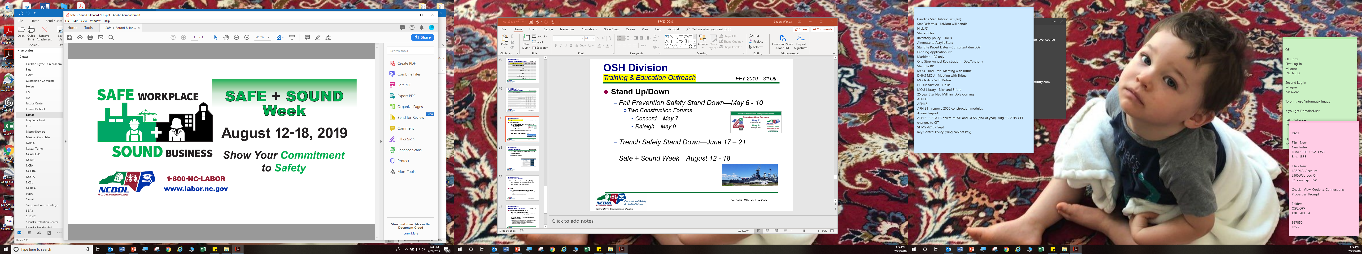
OSH Division
Training & Education Outreach
FFY 2019—4th Qtr.
Safe + Sound Week—August 12 – 18
  Governor’s proclamation
  Webinars on recommended practices for safety and health programs
  Social media venues
  Billboard
  Carousel on NCDOL website
Notes:
Safe and Sound Week – Webinar on Recommended Practices for S&H Programs; carousel on website; governor proclamation

Slide 36
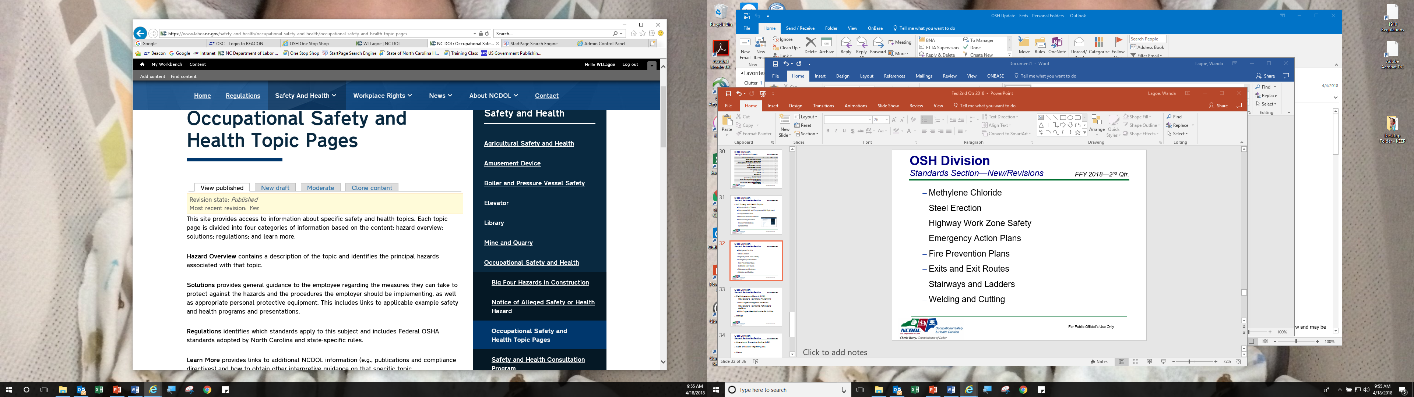
OSH Division
Standards Section—New
FFY 2019—4th Qtr.
A - Z SAFETY AND HEALTH TOPICS
(>100 TOPICS)
  Hand and Portable Powered Tools
  Benzene
  Carbon Monoxide
  Amputations
  Zoonotic Diseases

Slide 37
OSH Division
Standards Section—Revisions
FFY 2019—4th Qtr.
PUBLICATIONS
  MESH Brochure
  Alliance Brochure
  Medical and Dental Offices Brochure
  ETTA Brochure
  Industry Guide #53—Special Requirements for Shipyard Employment

Slide 38
OSH Division
Standards Section—New/Revisions
FFY 2019—4th Qtr.
OPERATIONAL PROCEDURE NOTICES (OPN)
  OPN 88—SEP: Logging and Arboriculture
    Updated NAICS Codes
  OPN 128—Public Sector Surveys and Inspections
    Changed reference years for OSHA 300 Logs and DART rates
  OPN 141—Enforcement Guidance for Heat-related Inspections and Citations
    Updated statistics, added OSHA’s 2019 heat memo (as resource), added paragraph for documenting signs/symptoms
  OPN 149—SEP: Amputations
    Establishes the SEP for inspections where employees may be exposed to amputation hazards on machinery due to lack of guarding/failure to utilize energy control procedures

Slide 39
OSH Division
Standards Section—New/Revisions
FFY 2019—4th Qtr.
MEMORANDUM OF UNDERSTANDINGS (MOU)
  MOU—NCDA & CS
    MOU between the OSH Division and the NC Department of Agriculture and Consumer Service, Meat and Poultry Inspection Division regarding training, inspections and jurisdiction
ALERTS
  3M 2a—3M DBI-SALA Self-Retracting Lifelines
    Recall of Twin-Leg Nano-Lok Edge and Twin-Leg Nano-Lok Wrap Back Self-Retracting Lifeline
  3M 2b—3M DBI-SALA Self-Retracting Lifelines – Affected Product Numbers

Slide 40
OSH Division
Standards Section—Revisions
FFY 2019—4th Qtr.
FIELD OPERATIONS MANUAL (FOM)
  FOM Chapter 2—Compliance Programming
    ASH programmed inspections updated
  FOM Chapter 3—Inspection Procedures
    Terminology changes, circumstances not considered advance notice following reporting procedures required by 1904.39
  FOM Chapter 13—Informal Conferences, Contested Cases and Disclosures
    Updated statutory references
  FOM Chapter 16—Administrative File Activities
    Removed requirement for establishment search page

Slide 41
OSH Division
Standards Section—New/Revisions
FFY 2019—4th Qtr.
FORMS
  HMR 3a—HIPAA Employee Medical Release (Word)
    Letter signed by bureau chief and provided to employer/medical facility when OSH has right to access medical records w/o employee consent
  HMR 3b—HIPAA Employee Medical Release (pdf)
    Letter signed by bureau chief and provided to employer/medical facility when OSH has right to access medical records w/o employee consent
  FNF 2—Fatality Notification From
    Revised to reflect new PSIM phone number
  ANF 1c—Accident Notification Form
    Revised to reflect new PSIM phone number

Slide 42

Thank You For Attending!
FFY 2019—4th Qtr.
Questions?
1-800-NC-LABOR
(1-800-625-2267)
www.labor.nc.gov
Notes:
42

