Slide 1
North Carolina Department of Labor Occupational Safety & Health Division 3rd Quarter Report Federal Fiscal Year 2019*
Presented by:
Wanda Lagoe CSP CPM ARM
Bureau Chief
Education, Training and Technical Assistance
Occupational Safety and Health Division of North Carolina
*Preliminary Data
Notes:
The information in this presentation is provided voluntarily by the N.C. Department of Labor, Education Training and Technical Assistance Bureau as a public service and is made available in good faith. This presentation is designed to assist trainers conducting OSHA outreach training for workers. Since workers are the target audience, this presentation emphasizes hazard identification, avoidance, and control – not standards. No attempt has been made to treat the topic exhaustively. It is essential that trainers tailor their presentations to the needs and understanding of their audience.
The information and advice provided on this Site and on Linked Sites is provided solely on the basis that users will be responsible for making their own assessment of the matters discussed herein and are advised to verify all relevant representations, statements, and information.
This presentation is not a substitute for any of the provisions of the Occupational Safety and Health Act of North Carolina or for any standards issued by the N.C. Department of Labor. Mention of trade names, commercial products, or organizations does not imply endorsement by the N.C. Department of Labor.

Slide 2
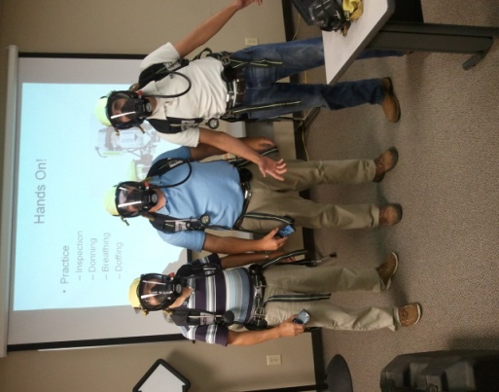
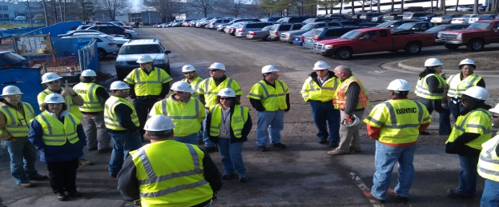

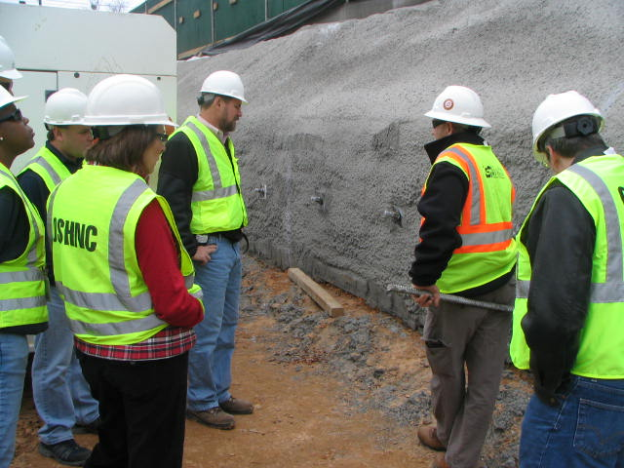
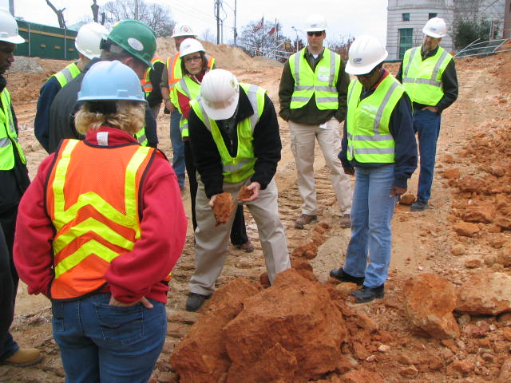
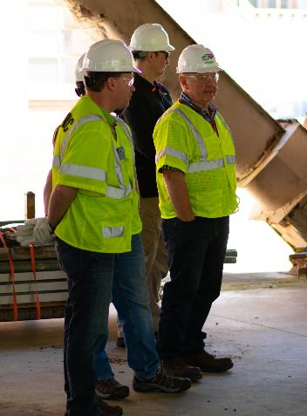
N.C. Workplace Safety and Health
OSH Division—Fatalities Inspected
FFY 2019—3rd Qtr.
FATALITY TYPE | 1st Qtr. | 2nd Qtr. | 3rd Qtr. | Total | FATALITY TYPE | 1st Qtr. | 2nd Qtr. | 3rd Qtr. | Total
Struck By | 3 | 3 | 7 | 13 | Inhalation | 1 | 0 | 0 | 1
Caught In/Between | 1 | 2 | 3 | 6 | Ingestion | 0 | 0 | 0 | 0
Bite/Sting/Scratch | 0 | 0 | 0 | 0 | Absorption | 0 | 0 | 0 | 0
Fall (Same Level) | 0 | 1 | 0 | 1 | Repeated Motion/Pressure | 0 | 0 | 0 | 0
Fall (From Elevation) | 1 | 4 | 4 | 9 | Cardio/Respiratory | 0 | 0 | 0 | 0
Struck Against | 0 | 0 | 0 | 0 | Shock | 0 | 0 | 1 | 1
Rubbed/Abraded | 0 | 0 | 0 | 0 | Other | 2 | 3 | 3 | 8
Fatalities Under OSH Division Jurisdiction
FFY 2018 |  | FFY 2019 | 1st Qtr. | 2nd Qtr. | 3rd Qtr. | Total
Total Fatalities | 48 | Fatalities | 8 | 13 | 18 | 39
NCDOL Photo Library

Slide 3
N.C. Workplace Safety and Health
OSH Division—Strategic Plan Goals
FFY 2019—3rd Qtr.
COMPLIANCE | 1stQtr. | 2nd Qtr. | 3rd Qtr. | Total | FFY Goal
Safety Inspections | 294 | 527 | 586 | 1,407 | 1,907
Health Inspections | 146 | 284 | 285 | 715 | 1,087
Serious Hazards Eliminated | 669 | 2,234 | 1,278 | 3,512 | 4,100
CONSULTATION | 1st Qtr. | 2nd Qtr. | 3rd Qtr. | Total | FFY Goal
Serious Hazards Eliminated | 1,603 | 2,233 | 1,713 | 5,549 | 5,250
Private Sector Visits | 331 | 386 | 365 | 1,082 | 1,165
Public Sector Visits | 71 | 75 | 71 | 217 | 205
OSH DIVISION | 1st Qtr. | 2nd Qtr. | 3rd Qtr. | Total | FFY Goal
Program Improvements | 581 | 746 | 738 | 2,065 | 2,060
People Trained in Special Emphasis Program Areas | 1,689 | 2,601 | 1,235 | 5,525 | 3,700
People Trained at OSH Division Sponsored Events | 3,649 | 4,171 | 3,711 | 11,531 | 9,600

Slide 4


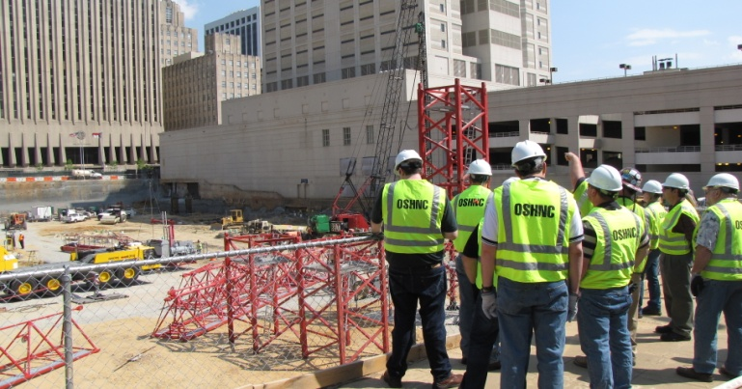
N.C. Workplace Safety and Health
OSH Division—Strategic Plan Goals
FFY 2019—3rd Qtr.
EDUCATION, TRAINING AND TECHNICAL ASSISTANCE | 1st Qtr. | 2nd Qtr. | 3rd Qtr. | Total | FFY Goal
Publications Distributed | 35,521 | 10,188 | 14,174 | 59,883 | 45,000
Standards Interpretations | 635 | 931 | 795 | 2,361 | NA
AGRICULTURAL SAFETY AND HEALTH | 1st Qtr. | 2nd Qtr. | 3rd Qtr. | Total | FFY Goal
Outreach Materials Distributed | 227 | 2,465 | 2,118 | 4,810 | 3,500
Compliance Inspections | 24 | 7 | 13 | 44 | 80
Certificates Issued | 88 | 1,152 | 457 | 1,697 | 1,500
Preoccupancy Inspections | 146 | 1,311 | 353 | 1,810 | 1,700
NCDOL Photo Library

Slide 5

Strategic Plan
Special Emphasis Programs (SEP)
FFY 2019—3rd Qtr.
Construction
Logging and Arboriculture
Long Term Care Facilities
Health Hazards
Food Manufacturing
Grocery and Related Product Wholesalers
Amputations
2019 – 2023 Strategic Management Plan
Goal #1 – Reduce fatalities by 2%
Goal #2 – Reduce injuries and illnesses by 5%
Notes:
FFY 2019 - 2023
OSHNC Outcome Goal #1 By the end of FY 2023, reduce the rate of workplace fatalities by 2% OSHNC Outcome Goal #2 By the end of FY 2023, reduce the rate of workplace injuries and illnesses by 5%

Slide 6
Special Emphasis Program
Construction
FFY 2019—3rd Qtr.
NAICS 23—CONSTRUCTION | FFY 2018 |  | 1st Qtr. | 2nd Qtr. | 3rd Qtr. | Total
Total Fatalities | 24 |  | 2 | 6 | 6 | 14
Fatality Rate | 0.0118 |  | 0.0005 | 0.0004 | 0.0017 | 0.0017
Fatality Type | 1st Qtr. | 2nd Qtr. | 3rd Qtr. | Total | Fatality Type | 1st Qtr. | 2nd Qtr. | 3rd Qtr. | Total
Struck By | 1 | 0 | 1 | 2 | Inhalation | 1 | 0 | 0 | 1
Caught In/Between | 0 | 0 | 0 | 0 | Ingestion | 0 | 0 | 0 | 0
Bite/Sting/Scratch | 0 | 0 | 0 | 0 | Absorption | 0 | 0 | 0 | 0
Fall (Same Level) | 0 | 0 | 0 | 0 | Repeated Motion/Pressure | 0 | 0 | 0 | 0
Fall (From Elevation) | 0 | 4 | 3 | 7 | Cardio/Respiratory | 0 | 0 | 0 | 0
Struck Against | 0 | 0 | 0 | 0 | Shock | 0 | 0 | 1 | 1
Rubbed/Abraded | 0 | 0 | 0 | 0 | Other | 0 | 2 | 1 | 3

Slide 7
Special Emphasis Program
Construction
FFY 2019—3rd Qtr.
NAICS 23*—CONSTRUCTION
 | North Carolina |  |  |  | National Average |  |  |  | North Carolina vs. National Average
 | CY 2016 |  | CY 2017 |  | CY 2016 |  | CY 2017 |  | 2017 Comparison
TRC | 2.2 | 18% Decrease |  | 1.8 | 3.2 | 3% Decrease |  | 3.1 | 42% Lower
DART | 1.5 | 27% Decrease |  | 1.1 | 1.9 | 5% Decrease |  | 1.8 | 39% Lower
SEP ACTIVITY | 1st Qtr. | 2nd Qtr. | 3rd Qtr. | Total | FFY Goal
Compliance Inspections | 208 | 427 | 520 | 1,155 | 1,050
Consultative Visits | 104 | 120 | 150 | 374 | 200
OSH Outreach Events (10 and 30 Hour Construction Courses) | 0 | 2 | 4 | 6 | 8
People Trained | 288 | 1,193 | 597 | 2,078 | 2,500

Slide 8
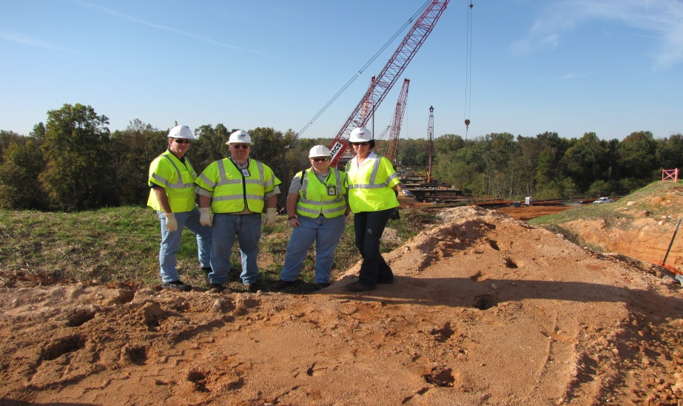
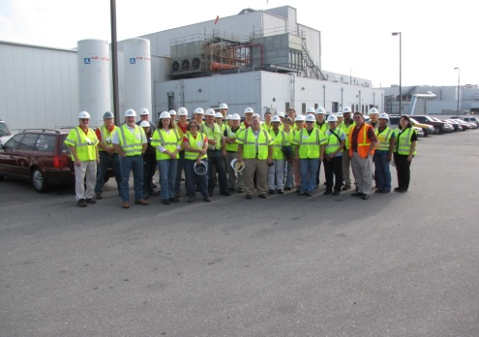
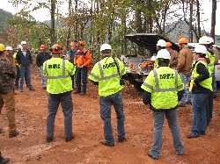
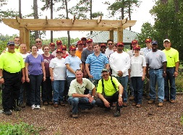
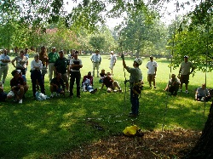
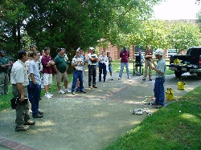
Special Emphasis Program
Logging and Arboriculture
FFY 2019—3rd Qtr.
SEP ACTIVITY | 1st Qtr. | 2nd Qtr. | 3rd Qtr. | Total | FFY Goal
Compliance Inspections | 10 | 16 | 11 | 37 | 60
Consultative Visits | 10 | 12 | 4 | 26 | 13
OSH Training and Outreach Events | 0 | 3 | 3 | 6 | 1
People Trained | 21 | 174 | 17 | 212 | 150
NAICS 11331*—LOGGING | FFY 2018 |  | 1st Qtr. | 2nd Qtr. | 3rd Qtr. | Total
Total Fatalities | 0 |  | 0 | 1 | 0 | 1
NAICS 56173*—ARBORICULTURE | FFY 2017 |  | 1st Qtr. | 2nd Qtr. | 3rd Qtr. | Total
Total Fatalities | 6 |  | 1 | 1 | 2 | 4
 |  |  | 0.0032 | 0.0078 | 0.0127 | 0.0127
Combined Fatality Rate | 0.017

Slide 9
Special Emphasis Program
Long Term Care Facilities
FFY 2019—3rd Qtr.
NAICS 623*—LONG TERM CARE
 | North Carolina |  |  |  | National Average |  |  |  | North Carolina vs. National Average
 | CY 2016 |  | CY 2017 |  | CY 2016 |  | CY 2017 |  | 2017 Comparison
TRC | 5.7 | 11% Increase |  | 6.4 | 6.4 | 2% Decrease |  | 6.3 | 2% Higher
DART | 3.3 | 11% Increase |  | 3.7 | 3.9 | 3% Decrease |  | 3.8 | 3% Lower
SEP ACTIVITY | 1st Qtr. | 2nd Qtr. | 3rd Qtr. | Total | FFY Goal
Compliance Inspections | 4 | 21 | 18 | 43 | 48
Consultative Visits | 9 | 31 | 10 | 50 | 40
OSH Outreach Events | 1 | 0 | 2 | 3 | 2
People Trained | 400 | 0 | 42 | 442 | 50

Slide 10
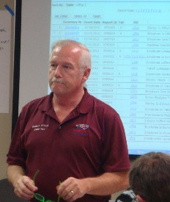

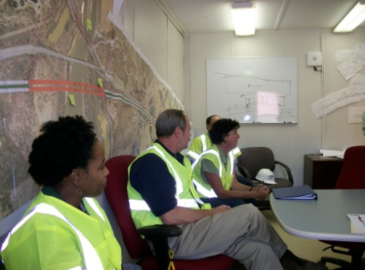
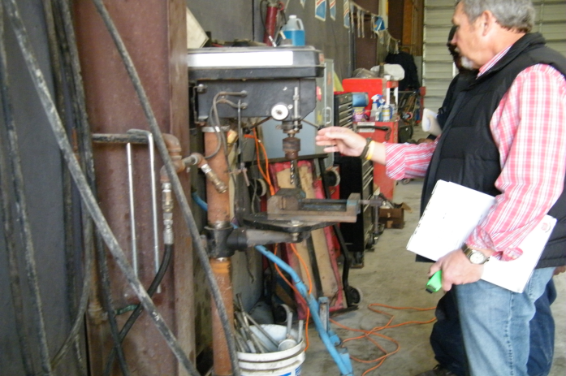
Special Emphasis Program
Health Hazards
FFY 2019—3rd Qtr.
COMPLIANCE INSPECTIONS | 1st Qtr. | 2nd Qtr. | 3rd Qtr. | Total | FFY Goal
Silica | 11 | 20 | 19 | 50 | 100
Asbestos | 6 | 5 | 7 | 18
Isocyanates | 2 | 6 | 9 | 17
Lead | 9 | 4 | 6 | 19
Hexavalent Chromium | 1 | 4 | 0 | 5
Total | 29 | 39 | 41 | 109*
Program Improvements | 10 | 13 | 10 | 33 | 20
*Some inspections involved more than one health hazard and generally included a program improvement
NCDOL Photo Library

Slide 11
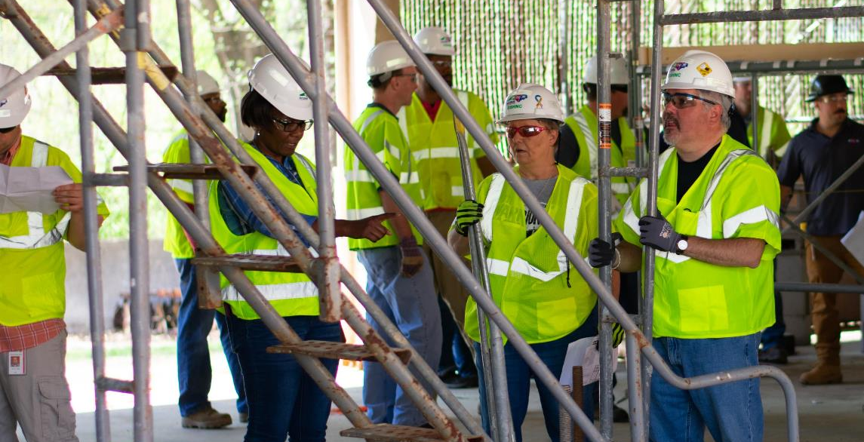
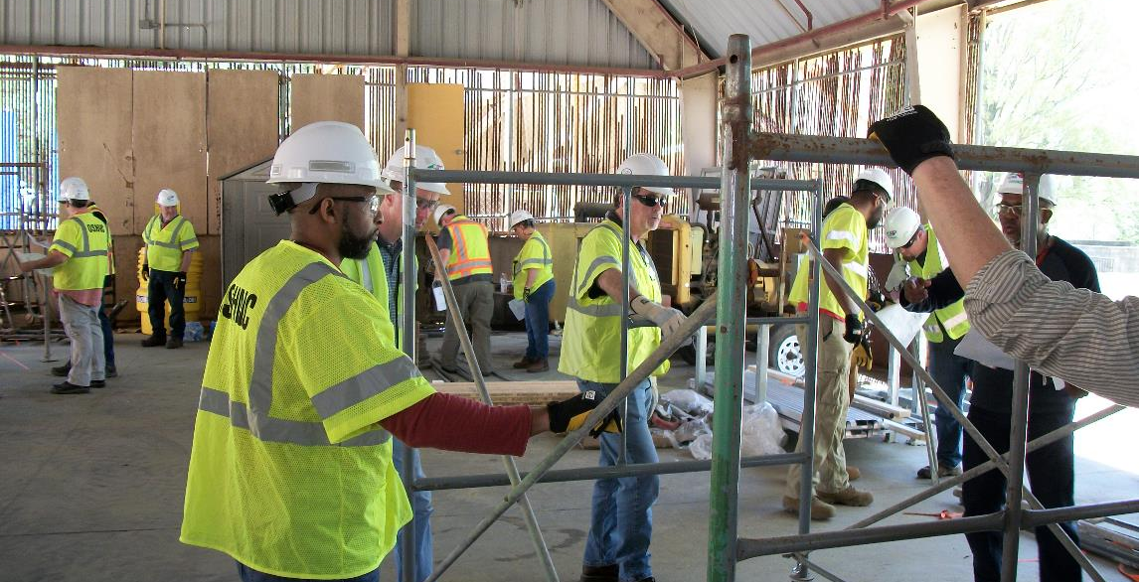
Special Emphasis Program
Health Hazards
FFY 2019—3rd Qtr.
COMPLIANCE INSPECTION RESULTS
HEALTH HAZARDS | Number of Samples (Detectable Results) |  |  |  | Number With Overexposures |  |  |  | Average Severity Rate*
 | 1st Qtr. | 2nd Qtr. | 3rd Qtr. | Total | 1st Qtr. | 2nd Qtr. | 3rd Qtr. | Total | 1st Qtr. | 2nd Qtr. | 3rd Qtr. | Aver.
Silica | 16 | 21 | 23 | 60 | 3 | 6 | 7 | 16 | 22.57 | 0.83 | 1.20 | 22.57
Asbestos | 5 | 0 | 0 | 5 | 0 | 0 | 0 | 0 | 0.08 | 0.0 | 0.0 | 0.08
Isocyanates | 4 | 6 | 0 | 10 | 0 | 0 | 0 | 0 | 0.04 | 0.039 | 0.0 | 0.04
Lead | 17 | 5 | 6 | 28 | 0 | 0 | 0 | 0 | 2.41 | 0.29 | 0.12 | 2.41
Hexavalent Chromium | 0 | 4 | 1 | 5 | 0 | 0 | 0 | 0 | 0.0 | 0.02 | 0.02 | 0.0
Total | 42 | 36 | 30 | 108 | 3 | 6 | 7 | 16 | N/A | N/A | N/A | N/A
NCDOL Photo Library
* All Samples

Slide 12
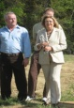

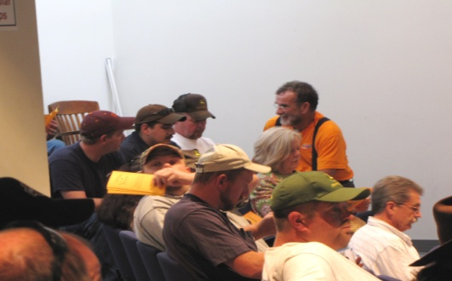
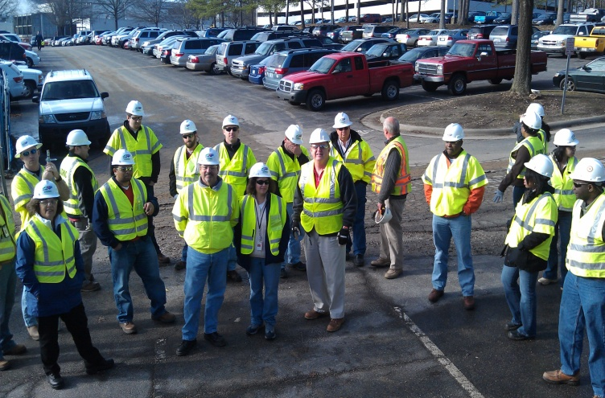
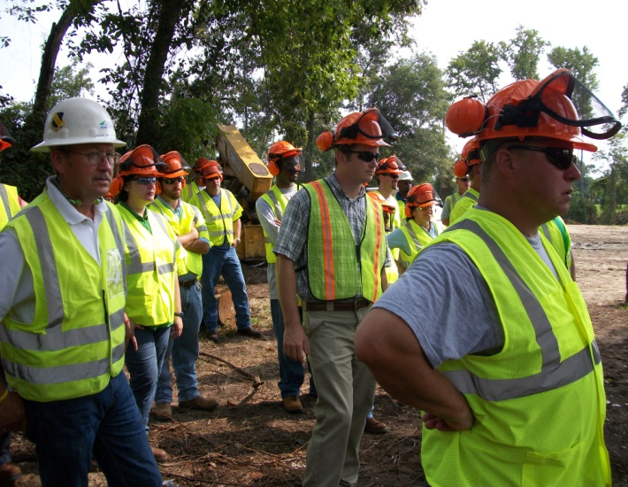
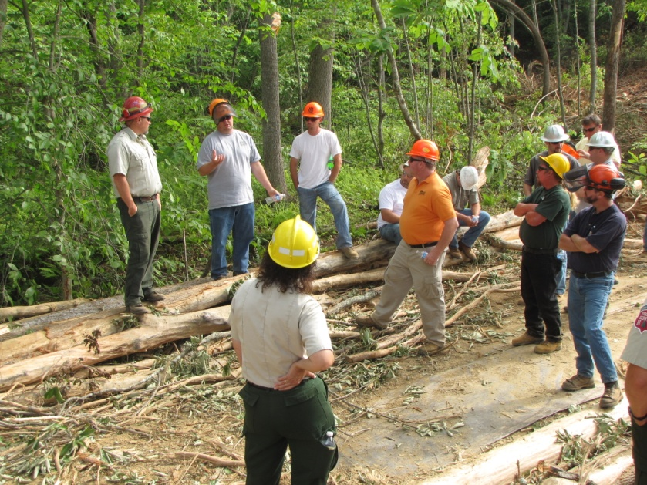
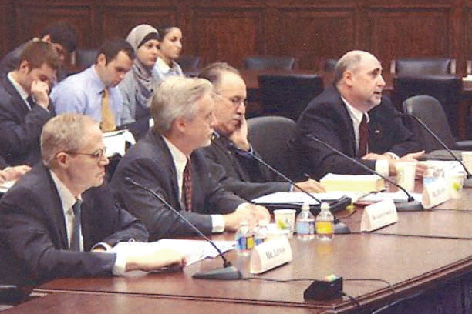
Special Emphasis Program
Health Hazards
FFY 2019—3rd Qtr.
HEALTH HAZARDS | CONSULTATIVE SURVEYS
 | 1st Qtr. | 2nd Qtr. | 3rd Qtr. | Total
Silica | 36 | 38 | 45 | 119
Asbestos | 3 | 6 | 3 | 12
Isocyanates | 3 | 1 | 2 | 6
Lead | 6 | 1 | 10 | 17
Hexavalent Chromium | 4 | 7 | 8 | 19
Total | 52 | 53 | 68 | 173
FFY Goal | 200
NCDOL Photo Library
NCDOL Photo Library
SEP ACTIVITY | 1st Qtr. | 2nd Qtr. | 3rd Qtr. | Total | FFY Goal
OSH Outreach Events | 5 | 8 | 22 | 35 | 18
People Trained | 117 | 284 | 210 | 611 | 400

Slide 13
Special Emphasis Program
Food Manufacturing
FFY 2019—3rd Qtr.
NAICS 311*—FOOD MANUFACTURING
 | North Carolina |  |  |  | National Average |  |  |  | North Carolina vs. National Average
 | CY 2016 |  | CY 2017 |  | CY 2016 |  | CY 2017 |  | 2017 Comparison
TRC | 3.7 | 3% Decrease |  | 3.6 | 4.7 | 4% Decrease |  | 4.5 | 20% Lower
DART | 2.7 | 7% Decrease |  | 2.5 | 3.2 | 3% Decrease |  | 3.1 | 19% Lower
*TRC/DART rate based on the 3 digit NAICS code
SEP ACTIVITY | 1st Qtr. | 2nd Qtr. | 3rd Qtr. | Total | FFY Goal
Compliance Inspections | 13 | 12 | 13 | 38 | 40
Consultative Visits | 3 | 7 | 8 | 18 | 12
OSH Outreach Events | 0 | 0 | 0 | 0 | 1
People Trained | 0 | 0 | 0 | 0 | 25

Slide 14
Special Emphasis Program
Grocery and Related Product Wholesalers
FFY 2019—3rd Qtr.
NAICS 4244*—GROCERY AND RELATED WHOLESALERS
 | North Carolina |  |  |  | National Average |  |  |  | North Carolina vs. National Average
 | CY 2016 |  | CY 2017 |  | CY 2016 |  | CY 2017 |  | 2017 Comparison
TRC | 4.5 | 8% Decrease |  | 4.1 | 4.7 | 8% Increase |  | 5.1 | 20% Lower
DART | 3.7 | 19% Decrease |  | 3.0 | 3.6 | 14% Increase |  | 4.2 | 29% Lower
*DART/TRC rate based on the 4 digit NAICS code
SEP ACTIVITY | 1st Qtr. | 2nd Qtr. | 3rd Qtr. | Total | FFY Goal
Compliance Inspections | 2 | 10 | 8 | 20 | 20
Consultative Visits | 2 | 0 | 0 | 2 | 3
OSH Outreach Events | 0 | 1 | 0 | 1 | 1
People Trained | 0 | 7 | 0 | 7 | 25

Slide 15
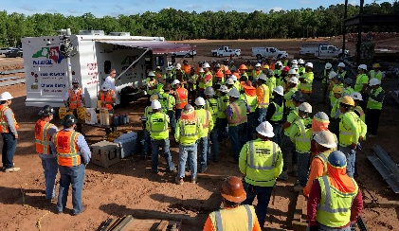
Special Emphasis Program
Amputations—New for FFY 2019
FFY 2019—3rd Qtr.
FFY 2019 Planning Year
Setting and Monitoring Goals
Training Events (Internal and external)
Compliance Inspections
Consultation Visits
Publications
Finalizing Operational Procedure Notice
Notes:
Added Amputations for our new 5 year SMP, and removed Accommodations.

Slide 16
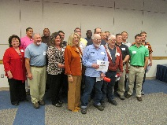
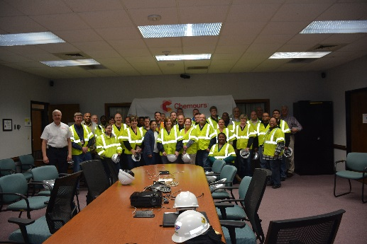
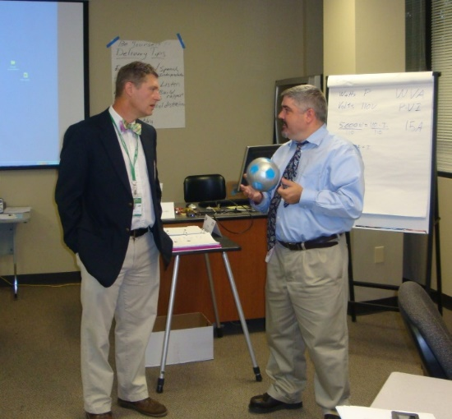
OSH Division
Public Sector
FFY 2019—3rd Qtr.
ACTIVITY | 1st Qtr. | 2nd Qtr. | 3rd Qtr. | Total | FFY Goal
Compliance Inspections | 43 | 64 | 41 | 148 | 151
Consultative Visits | 71 | 75 | 71 | 217 | 205
OSH Outreach Events/Booths | 11 | 8 | 7 | 26 | 22
Trained | 351 | 473 | 255 | 1,079 | 1,500

Slide 17
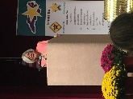
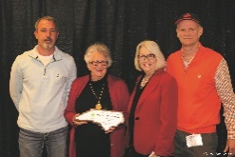
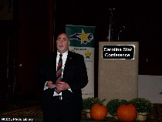
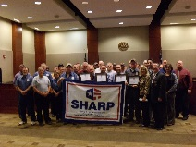
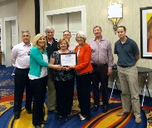
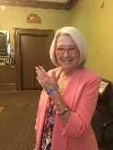
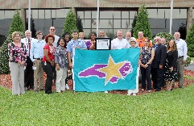
OSH Division
Recognition Programs
FFY 2019—3rd Qtr.
STAR SITES—NEW, RECERTIFICATION, PROMOTION | 1st Qtr. | 2nd Qtr. | 3rd Qtr. | Total | FFY Goal | APPROVED STAR SITES*
Carolina Star | 1 | 12 | 12 | 25 |  | 100
Building Star | 0 | 2 | 1 | 3 |  | 23
Rising Star | 0 | 0 | 0 | 0 |  | 5
Public Sector Star | 1 | 0 | 2 | 3 |  | 22
Total | 2 | 14 | 15 | 31 | 30 | 150
*Cumulative Total
NCDOL Photo Library
 | 1st Qtr. | 2nd Qtr. | 3rd Qtr. | Total | FFY Goal
Star Sites—Termination/Withdrawn | 0 | 0 | 3 | 3
Star Booths | 2 | 0 | 5 | 7
Star Presentations | 11 | 7 | 3 | 21 | 30
Star Program Interventions | 40 | 44 | 40 | 124 | 150
Notes:
The Carolina Star Program is designed to recognize employers and employees who have implemented effective safety and health management systems and maintain injury and illness rates that meet the criteria for participation. Any size employer.
The SSTM Program is North Carolina’s version of federal OSHA’s Special Government Employee (SGE) Program. The SSTM Program allows industry employees and qualified independent private sector safety and health professionals the opportunity to work together in partnership with the NCDOL Carolina Star Program during onsite Star Program evaluations.
General industry, private sector participants must meet the following criteria: The most recent three-year average for both the total recordable case (TRC) rates and cases with days away from work, job transfer, or restriction (DART) rates must be at or below 50 percent of the most recent published federal BLS rates for the appropriate North American Industrial Classification System (NAICS) industry, preferably using a 6-digit NAICS rate, or highest digit available.
Building Star - The contractor participant must meet the following criteria: All injuries and illness rates for each worksite in North Carolina must be summarized on the OSHA 300 log each year, for the past three years. The most recent three-year average for both the total recordable case (TRC) rates and cases with days away from work, job transfer, or restriction (DART) rates must be at or below 50 percent of the most recent published Federal BLS rate for the appropriate North American Industrial Classification System (NAICS) preferably using a 6-digit NAICS rate, or highest digit available.

Slide 18
OSH Division
Recognition Programs
FFY 2019—3rd Qtr.
SHARP SITES—NEW | 1st Qtr. | 2nd Qtr. | 3rd Qtr. | Total | FFY Goal | Approved SHARP Sites*
SHARP—Construction | 1 | 0 | 1 | 2 |  | 7
SHARP—General Industry | 1 | 2 | 1 | 4 |  | 142
SHARP—Public Sector | 3 | 4 | 0 | 7 |  | 49
SHARP—Logging | 0 | 0 | 0 | 0 |  | 0
Total | 5 | 6 | 2 | 13 | 6 | 198
SHARP—Renewals | 16 | 16 | 11 | 43* | 55 | 175
*Cumulative Total
*Includes both general industry and public sector renewals
GOLD STAR GROWERS—NEW | 1st Qtr. | 2nd Qtr. | 3rd Qtr. | Total
 | 16 | 209 | 50 | 275
SAFETY AWARDS |  |  |  | Total
CY 2019 Safety Awards Season |  |  |  | 3,201
 | 1st Qtr. | 2nd Qtr. | 3rd Qtr. | Total
Million Hour Awards | 2 | 62 | 84 | 148
Notes:
The SHARP (Safety and Health Achievement and Recognition Programs) Program is designed for small and mid-size employers that have established, implemented and maintained exceptional workplace safety standards.
The Gold Star Grower Housing Program recognizes growers who provide farmworker housing that meets and exceeds all of the requirements of the Migrant Housing Act of North Carolina.
The Gold Star Flag recognizes agricultural employers who have devised ways to continuously promote a culture of safety on their farms. Gold Star Flag recipients have identified hazards, trained their employees and completed farm safety inspections. They follow and exceed the regulations pertaining to the agricultural work place.
Safety Awards Program - In operation since 1946, the program now extends to more than 5,000 firms, and about 3,000 awards are presented annually. Two types of awards are administered through the program: Annual Safety Awards and Million-Hour Awards.
To qualify for an annual safety award, a firm must:
Have no fatalities during the calendar year at the site or location for which the award was given; and
Have maintained an incidence rate at least 50 percent below the average for its particular industry group.
Two Safety Award Levels - Gold and Silver
The Gold Award is based on the days away, restricted, transferred (DART) rate, which includes cases of days away from work, restricted activity or job transfer.
The Silver Award is based only on cases with days away from work. They are recorded when the worker misses at least one full day of work, not including the day of the injury.

Slide 19


OSH Division
Alliances and Partnerships
FFY 2019—3rd Qtr.
ALLIANCES
Carolinas AGC
Forestry Mutual Insurance Company, NC Forestry Association, Carolina Loggers Association
Lamar Advertising Company
Mexican Consulate*
NCSU – Industry Expansion Solutions
Safety and Health Council of NC
NUCA of the Carolinas
NCALGESO
Western Carolina University – Kimmel School of Construction*
NCDOL Photo Library
Notes:
Our alliances are organizations based toward our SEPs to promote education and training.
Kimmel School of Construction terminated in July – POC took job in MI and WCU don’t have staff to support alliance.
Looking at AIHA.
MESH alliances: NCSU and SHCNC – introducing emergency preparedness MESH in August. Working on Environmental MESH for the Fall/Winter time frame

Slide 20
OSH Division
Alliances and Partnerships
FFY 2019—3rd Qtr.
PARTNERSHIPS
Flatiron Blythe, a Joint Venture
Charlotte-Douglas Airport Improvements—Charlotte
Estimated Completion: November 2019
Fluor Enterprises
DAPI US Project, Novo Nordisk Facility—Clayton
Estimated Completion: October 2019
Notes:
We try to keep it around 3 partnerships due to limited manpower.
All partnerships will close out this winter.

Slide 21
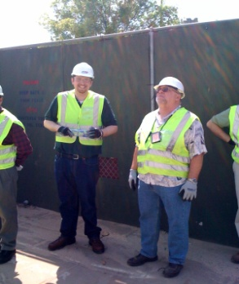
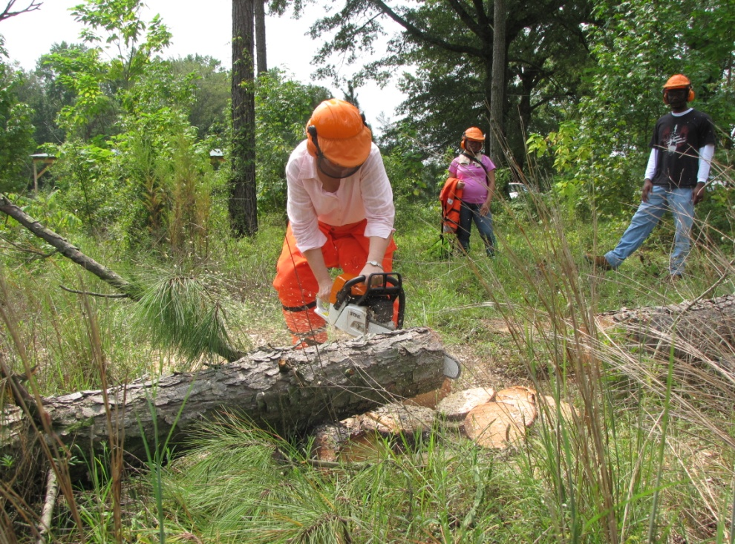
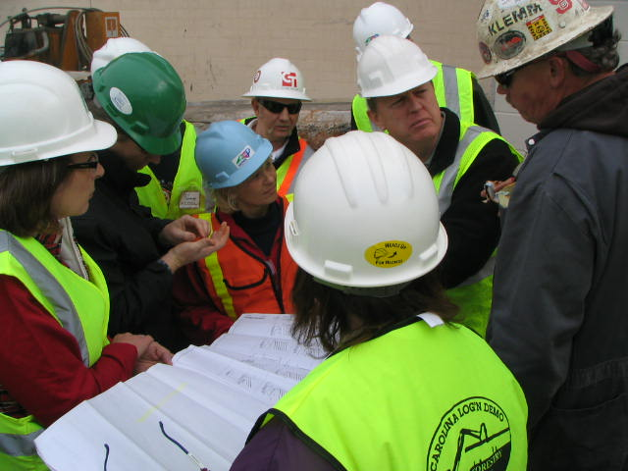
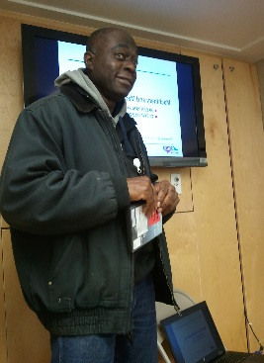
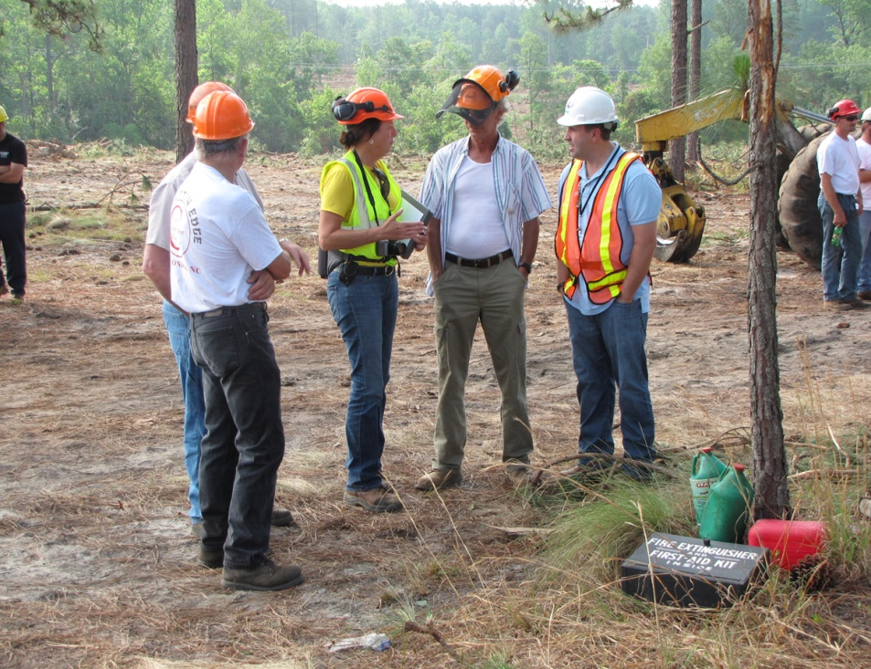
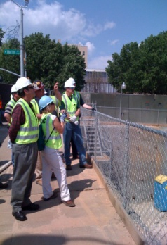
OSH Division
Complaint Desk*
FFY 2019—3rd Qtr.
EAST COMPLIANCE | WEST COMPLIANCE | AGRICULTURAL SAFETY AND HEALTH
ACTIVITY | 1st Qtr. | 2nd Qtr. | 3rd Qtr. | 1st Qtr. | 2nd Qtr. | 3rd Qtr. | 1st Qtr. | 2nd Qtr. | 3rd Qtr. | Cumulative Total | FFY 2018
Complaints | 282 | 251 | 276 | 265 | 353 | 344 | 3 | 1 | 2 | 1,777 | 2,419
Referrals | 88 | 92 | 114 | 104 | 91 | 116 | 23 | 4 | 14 | 646 | 822
Fat/Cat | 19 | 23 | 28 | 19 | 19 | 21 | 0 | 0 | 0 | 129 | 123
Totals | 389 | 366 | 418 | 388 | 463 | 481 | 26 | 5 | 16 | 2,552 | 3,364
*Includes calls that were processed but not necessarily inspected. Fat/Cat includes calls regarding heart attacks and other natural causes.
NCDOL Photo Library
Notes:
Complaints, referrals, fatality and catastrophe inspections account for a significant amount of inspections that compliance does every year. This slide puts that into perspective.

Slide 22
OSH Division
Cut-Loose, In-Training, Vacant
FFY 2019—3rd Qtr.
WEST COMPLIANCE | Safety | % | Industrial Hygienist | %
Cut Loose | 25 | 81% | 21 | 81%
In-Training | 2 | 6% | 1 | 4%
Vacant | 4 | 13% | 4 | 15%
Total | 31 |  | 26
EAST COMPLIANCE | Safety | % | Industrial Hygienist | %
Cut Loose | 15 | 55% | 6 | 33%
In-Training | 6 | 22% | 7 | 39%
Vacant | 6 | 22% | 5 | 28%
Total | 27 |  | 18
Safety Cut Loose | 69% | Health Cut Loose | 61%
Safety In-Training | 14% | Health in-Training | 18%
Safety Vacant | 17% | Health Vacant | 20%

Slide 23
OSH Division
Cut-Loose, In-Training, Vacant
FFY 2019—3rd Qtr.
CONSULTATIVE SERVICES | Safety | % | Industrial Hygienist | %
Cut Loose | 10 | 91% | 8 | 100%
In-Training | 1 | 9% | 0 | 0%
Vacant | 0 | 0% | 0 | 0%
Total | 11 |  | 8
EDUCATION, TRAINING AND TECHNICAL ASSISTANCE | Safety | % | Industrial Hygienist | %
Cut Loose | 8 | 73% | 5 | 83%
In-Training | 2 | 18% | 0 | 0%
Vacant | 1 | 9% | 1 | 17%
Total | 11 |  | 6
AGRICULTURAL SAFETY AND HEALTH | Safety | % | Industrial Hygienist
Cut Loose | 4 | 67% | NA
In-Training | 2 | 33% | NA
Vacant | 0 | 0% | NA
Total | 6

Slide 24
OSH Division
Internal Training
FFY 2019—3rd Qtr.
1st Qtr.—COURSE | Number Trained
OSH 105: Introduction to Safety Standards—Raleigh | 21
OCSS: Confined Spaces—Raleigh | 22
OCSS: Confined Spaces—Charlotte | 23
OTI 2450: Safety and Health Management Systems—Raleigh | 25
OSH 100: Initial Compliance—Raleigh | 14
Fall Protection—Charlotte | 13
Technical Writing—Raleigh | 14
OSHA Express—Raleigh | 14
CPR-First Aid—Raleigh | 3
11 Webinars (Inspection Process, Ergonomics, Confined Spaces, Noise, Health Hazards, Recordkeeping, Hazard Communication, Machine Guarding, Hand and Portable Powered Tools, Bloodborne Pathogens | 23

Slide 25
OSH Division
Internal Training
FFY 2019—3rd Qtr.
2nd Qtr.—COURSE | Number Trained
OSH 125: Health Standards—Raleigh | 13
HAZWOPER – 8 Hour Refresher—Charlotte | 7
HAZWOPER – 8 Hour Refresher—Raleigh | 5
Drone Pilot Training—Raleigh | 4
10 Hour Online Portion of Principles of Scaffolding | 36
13 Webinars (personal protective equipment, fall protection, walking and working surfaces, lockout/tagout, machine guarding, scaffolding, concrete and masonry, confined space, steel erection, inspection process) | 22

Slide 26
OSH Division
Internal Training
FFY 2019—3rd Qtr.
3rd Qtr.—COURSE | Number Trained
OTI 3080: Introduction to Scaffolding—Raleigh | 38
Construction Forums—Raleigh and Charlotte | 13
Long Term Care Workshops—Raleigh and Charlotte | 4
OSH 123/141: Accident Investigation and Interviewing Techniques—Raleigh and Charlotte | 28
Drone Pilot/Visual Observer Training—Raleigh | 18
Machine Guarding—Raleigh and Charlotte | 38
Lockout/Tagout—Raleigh and Charlotte | 35
8 Webinars (heat stress, exit routes, electrical safety, scaffolds, concrete and masonry, introduction to OSH, fall protection, personal protective equipment, work zone safety) | 9

Slide 27
OSH Division
Retaliatory Employment Discrimination
FFY 2019—3rd Qtr.
OSH COMPLAINT STATISTICS | 1st Qtr. | 2nd Qtr. | 3rd Qtr. | Total
Total OSH Complaints Filed/Assigned (IMIS: Docketed) | 6 | 22 | 32 | 60
Total OSH Complaints Closed (IMIS: Cases completed) | 20 | 14 | 20 | 54
Number of OSH Cases Closed Within 90 Days of File Date | 8 | 0 | 2 | 10
Percentage of Cases Closed With in 90 Days of File Date | 40% | 0% | 10% | N/A
Of Cases Closed, Average Number of Elapsed Days Between File Date and Closed Date | 116 | 170 | 194 | 160
Total Number of OSH Complaints Pending at End of Reporting Period | 17 | 44 | 60 | 121
Percentage of Pending OSH Complaints Over 90 Days Old (From Filing) | 100% | 45% | 29% | N/A
Average Number of Elapsed Days Since Filing Date of All OSH Cases Pending at End of the Reporting Period | 158 | 150 | 185 | 164
Notes:
Let Harriet expand on this slide.

Slide 28
OSH Division
Retaliatory Employment Discrimination
FFY 2019—3rd Qtr.
OSH COMPLAINT DISPOSITION | 1st Qtr. | 2nd Qtr. | 3rd Qtr. | Total
Administrative Closure (No RTS Letter) | 2 | 0 | 0 | 2
Withdrawn | 3 | 1 | 3 | 7
Merit | 1 | 1 | 2 | 4
Percent Merit | 5% | 1% | 25% | N/A
No Merit | 6 | 2 | 7 | 15
Settled | 3 | 1 | 2 | 6
Uncooperative - RTS | 1 | 1 | 0 | 2
Requested RTS Letter | 4 | 8 | 6 | 18
Total | 20 | 14 | 20 | 54
Notes:
Let Harriet expand on this slide.

Slide 29
OSH Division
Training & Education Outreach
FFY 2019—3rd Qtr.
OUTREACH EVENT | 1st Qtr. | 2nd Qtr. | 3rd Qtr. | Total | FFY Goal
General Industry—10 Hour Course | 0 | 2 | 2 | 4 | 5
General Industry—30 Hour Course | 0 | 1 | 1 | 2 | 2
NC #500/502—Construction Train the Trainer Course/ NC #501/503—General Industry Train the Trainer Course | 0 | 0 | 0 | 0 | 1
Construction—10 Hour Course | 0 | 2 | 3 | 5 | 6
Construction—30 Hour Course | 0 | 0 | 1 | 1 | 2
Labor One/Booth Events | 10 | 6 | 10 | 26 | NA
Speaker’s Bureau | 28 | 26 | 28 | 82 | NA
Webinars | 28 | 23 | 15 | 66 | NA
OSH Workshop | 1 | 3 | 1 | 5 | NA
Technical Assistance | 5 | 7 | 4 | 16 | NA
Spanish Training and Outreach Events | 0 | 1 | 1 | 2 | NA
Train the Trainer Program (Construction/General Industry)—Events | 8 | 7 | 6 | 21 | NA
Train the Trainer Program (Construction/General Industry)—Trained | 51 | 55 | 62 | 168 | NA

Slide 30
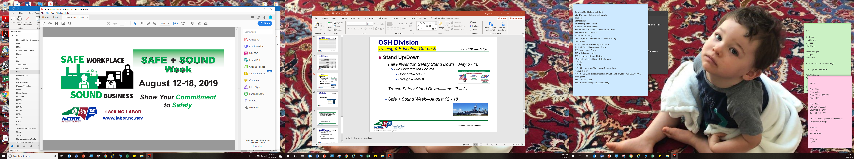
OSH Division
Training & Education Outreach
FFY 2019—3rd Qtr.
STAND UP/DOWN
Fall Prevention Safety Stand Down—May 6 - 10
Two Construction Forums
Concord – May 7
Raleigh – May 9
Trench Safety Stand Down—June 17 - 21
Safe + Sound Week—August 12 - 18
Notes:
Fall Stand-Down Numbers-283 Trained
Trench – NUCA podcast, webinar
Safe and Sound Week – Webinar on Recommended Practices for S&H Programs; carousel on website; governor proclamation

Slide 31
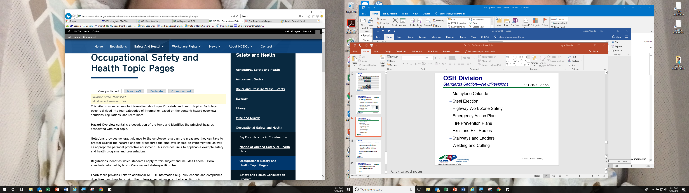
OSH Division
Standards Section—New
FFY 2019—3rd Qtr.
A - Z SAFETY AND HEALTH TOPICS
(>90 TOPICS)
Boat Manufacturing
Concrete and Masonry
Notes:
We have almost 100 safety and health topics currently on our website. More to come!

Slide 32
OSH Division
Standards Section—Revisions
FFY 2019—3rd Qtr.
MEMORANDUM OF UNDERSTANDING (MOU)
MOU—NCDHHS – Radiation Protection Section
MOU—NCDEQ – Air Quality Division
ALERTS
3M 1—3M DBI – SALA ExoFit NEX Harnesses
Safety notice pertains to a possible defect in the dorsal D-ring on ExoFit NEX harnesses manufactured between January 2016 and December 2018
Notes:
NCDHHS - Radiation Protection Section
Memorandum of Agreement between the NCDOL, OSH Division and the NCDHHS, Division of Health Service Regulation, Radiation Protection Section (formerly part of NCDENR) .
NCDEQ - Air Quality Division
Memorandum of Understanding between the NCDOL, OSH Division and the NCDEQ (formerly NCDENR), Air Quality Division.

Slide 33
OSH Division
Standards Section—New/Revisions
FFY 2019—3rd Qtr.
CODE OF FEDERAL REGISTER (CFR)
CFR 176A—Technical Amendments
Corrects CAS number for methyl vinyl ketone in 1910.119 App A and restores two figures to 1910.184
CFR 178E—Cranes and Derricks in Construction: Operator Qualification
New final rule alters a provision that required different levels of certification based on the rated lifting capacity of equipment and establishes minimum requirements for determining operator competency
Notes:
CFR 176A Technical amendments
84 FR 4/15/2019 29 CFR §§ 1910.119 & 1910.184 - final rule; technical amendments
Corrects CAS number for methyl vinyl ketone in 1910.119 App A and restores two figures to 1910.184.
CFR 178E Cranes and Derricks in Construction: Operator Qualification
83 FR 11/9/2018 29 CFR 1926.1427 - final rule.
New final rule alters a provision that required different levels of certification based on the rated lifting capacity of equipment and establishes minimum requirements for determining operator competency.

Slide 34
OSH Division
Standards Section—New/Revisions
FFY 2019—3rd Qtr.
FIELD OPERATIONS MANUAL (FOM)
FOM Chapter 15—Industrial Hygiene Compliance
COMPLIANCE DIRECTIVE (CPL)
CPL 02-00-161—National Emphasis Program on Trenching and Excavation
MEMOS
FED 1—Entering Federally-Owned Buildings or Federally-Leased Facilities/REAL ID
BE 4—Updated Interim Enforcement Guidance for the Beryllium Standards
Notes:
FOM Chapter 15 Industrial Hygiene Compliance
Chapter updated to reflect the new silica standard(s) and reference to the new memo regarding air contaminants for which there is no PEL (Memo AC 1).
CPL 02-00-161 National Emphasis Program on Trenching and Excavation
This directive implements a National Emphasis Program (NEP) in North Carolina for identifying, reducing and/or eliminating safety hazards associated with trenching and excavation. This NEP supplements the Special Emphasis Program (SEP) for construction activity, which include trenching and excavation.
Memos FED 1 Entering Federally-Owned Buildings or Federally-Leased Facilities/REAL ID
This memo addresses recent issues regarding increased security measures encountered by NCDOL S&I inspectors entering into Federally-owned buildings or Federally leased facilities. Also discussed is the process to obtain a REAL ID.
Memos BE 4 Updated Interim Enforcement Guidance for the Beryllium Standards
This memorandum supersedes the May 9, 2018 Interim Enforcement Memorandum and Notice of Delay in Enforcement for Certain Provisions of the Beryllium Standard and continues previous guidance for those provisions of the beryllium standards that OSHA began enforcing on May 11, 2018.

Slide 35

Thank You For Attending!
FFY 2019—3rd Qtr.
Questions?
1-800-NC-LABOR
(1-800-625-2267)
www.labor.nc.gov
Notes:
35

