Slide 1
North Carolina Department of Labor Occupational Safety & Health Division 2nd Quarter Report Federal Fiscal Year 2019*
Presented by:
Wanda Lagoe CSP CPM ARM
Bureau Chief
Education, Training and Technical Assistance
Occupational Safety and Health Division of North Carolina
*Preliminary Data
Notes:
The information in this presentation is provided voluntarily by the N.C. Department of Labor, Education Training and Technical Assistance Bureau as a public service and is made available in good faith. This presentation is designed to assist trainers conducting OSHA outreach training for workers. Since workers are the target audience, this presentation emphasizes hazard identification, avoidance, and control – not standards. No attempt has been made to treat the topic exhaustively. It is essential that trainers tailor their presentations to the needs and understanding of their audience.
The information and advice provided on this Site and on Linked Sites is provided solely on the basis that users will be responsible for making their own assessment of the matters discussed herein and are advised to verify all relevant representations, statements, and information.
This presentation is not a substitute for any of the provisions of the Occupational Safety and Health Act of North Carolina or for any standards issued by the N.C. Department of Labor. Mention of trade names, commercial products, or organizations does not imply endorsement by the N.C. Department of Labor.

Slide 2
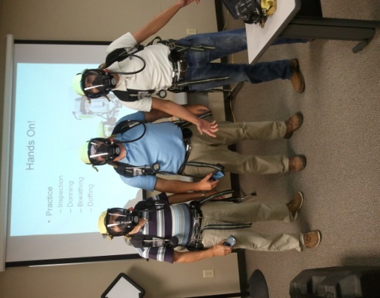
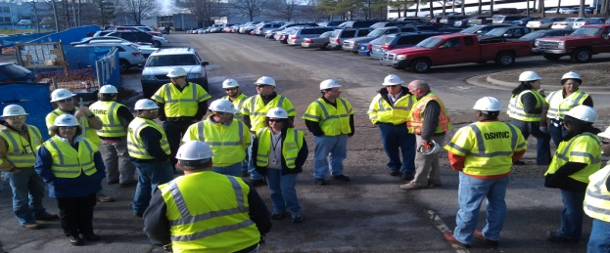

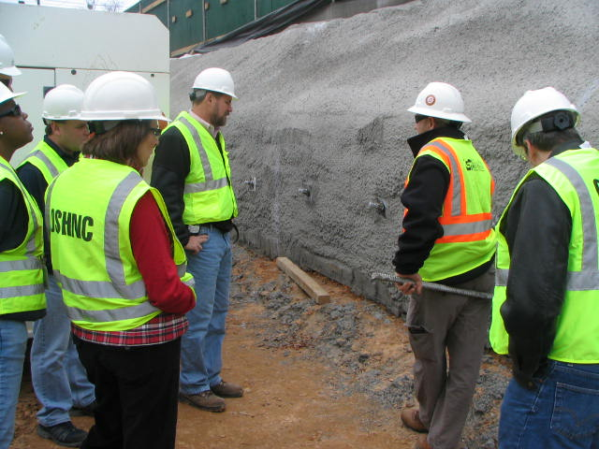
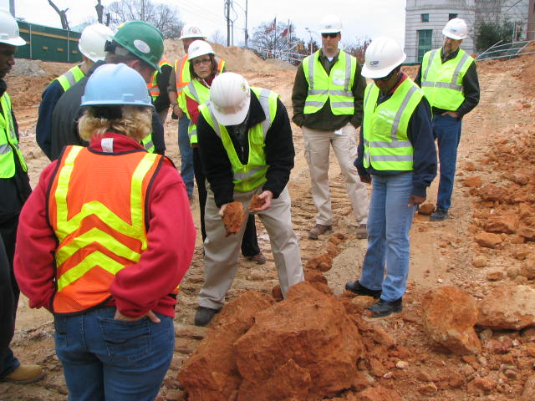
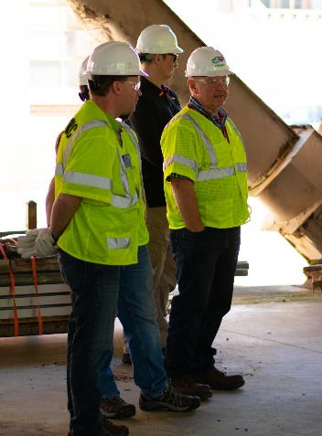
N.C. Workplace Safety and Health
OSH Division—Fatalities Inspected
FFY 2019—2nd Qtr.
FATALITY TYPE | 1st Qtr. | 2nd Qtr. | Total | FATALITY TYPE | 1st Qtr. | 2nd Qtr. | Total
Struck By | 3 | 3 | 6 | Inhalation | 1 | 0 | 1
Caught In/Between | 1 | 2 | 3 | Ingestion | 0 | 0 | 0
Bite/Sting/Scratch | 0 | 0 | 0 | Absorption | 0 | 0 | 0
Fall (Same Level) | 0 | 1 | 1 | Repeated Motion/Pressure | 0 | 0 | 0
Fall (From Elevation) | 1 | 5 | 6 | Cardio/Respiratory | 0 | 0 | 0
Struck Against | 0 | 0 | 0 | Shock | 0 | 0 | 0
Rubbed/Abraded | 0 | 0 | 0 | Other | 3 | 2 | 5
Fatalities Under OSH Division Jurisdiction
FFY 2018 |  | FFY 2019 | 1st Qtr. | 2nd Qtr. | Total
Total Fatalities | 48 | Fatalities | 9 | 13 | 22
NCDOL Photo Library

Slide 3
N.C. Workplace Safety and Health
OSH Division—Strategic Plan Goals
FFY 2019—2nd Qtr.
COMPLIANCE | 1stQtr. | 2nd Qtr. | Total | FFY Goal
Safety Inspections | 294 | 527 | 821 | 1,907
Health Inspections | 146 | 284 | 430 | 1,087
Serious Hazards Eliminated | 1,056 | 1,782 | 2,838 | 4,100
CONSULTATION | 1st Qtr. | 2nd Qtr. | Total | FFY Goal
Serious Hazards Eliminated | 1,603 | 2,233 | 3,836 | 5,250
Private Sector Visits | 331 | 386 | 717 | 1,165
Public Sector Visits | 71 | 75 | 146 | 205
OSH DIVISION | 1st Qtr. | 2nd Qtr. | Total | FFY Goal
Program Improvements | 581 | 746 | 1,327 | 2,060
People Trained in Special Emphasis Program Areas | 1,689 | 2,601 | 4,290 | 3,700
People Trained at OSH Division Sponsored Events | 3,649 | 4,171 | 7,820 | 9,600

Slide 4


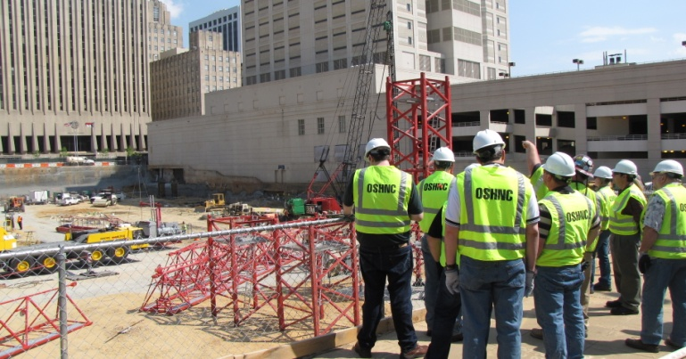
N.C. Workplace Safety and Health
OSH Division—Strategic Plan Goals
FFY 2019—2nd Qtr.
Education, Training and Technical Assistance (ETTA) | 1st Qtr. | 2nd Qtr. | Total | FFY Goal
Publications Distributed | 35,521 | 10,188 | 45,709 | 45,000
Standards Interpretations | 635 | 931 | 1,566 | NA
Agricultural Safety and Health (ASH) | 1st Qtr. | 2nd Qtr. | Total | FFY Goal
Outreach Materials Distributed | 227 | 2,465 | 2,692 | 3,500
Compliance Inspections | 24 | 7 | 31 | 80
Certificates Issued | 88 | 1,152 | 1,240 | 1,500
Preoccupancy Inspections | 146 | 1,311 | 1,457 | 1,700
NCDOL Photo Library

Slide 5

Strategic Plan
Special Emphasis Programs (SEP)
FFY 2019—2nd Qtr.
Construction
Logging and Arboriculture
Long Term Care Facilities
Health Hazards
Food Manufacturing
Grocery and Related Product Wholesalers
Amputations
2019 – 2023 Strategic Management Plan
Goal #1 – Reduce fatalities by 2%
Goal #2 – Reduce injuries and illnesses by 5%
Notes:
FFY 2019 - 2023
OSHNC Outcome Goal #1 By the end of FY 2023, reduce the rate of workplace fatalities by 2% OSHNC Outcome Goal #2 By the end of FY 2023, reduce the rate of workplace injuries and illnesses by 5%

Slide 6
Special Emphasis Program
Construction
FFY 2019—2nd Qtr.
NAICS 23—CONSTRUCTION | FFY 2018 |  | 1st Qtr. | 2nd Qtr. | Total
Total Fatalities | 24 |  | 2 | 6 | 8
Fatality Rate | 0.0118 |  | 0.0005 | 0.0004 | 0.0004
Fatality Type | 1st Qtr. | 2nd Qtr. | Total | Fatality Type | 1st Qtr. | 2nd Qtr. | Total
Struck By | 1 | 0 | 1 | Inhalation | 1 | 0 | 1
Caught In/Between | 0 | 0 | 0 | Ingestion | 0 | 0 | 0
Bite/Sting/Scratch | 0 | 0 | 0 | Absorption | 0 | 0 | 0
Fall (Same Level) | 0 | 0 | 0 | Repeated Motion/Pressure | 0 | 0 | 0
Fall (From Elevation) | 0 | 4 | 4 | Cardio/Respiratory | 0 | 0 | 0
Struck Against | 0 | 0 | 0 | Shock | 0 | 0 | 0
Rubbed/Abraded | 0 | 0 | 0 | Other | 0 | 2 | 2

Slide 7
Special Emphasis Program
Construction
FFY 2019—2nd Qtr.
NAICS 23*—CONSTRUCTION
 | North Carolina |  |  |  | National Average |  |  |  | North Carolina vs. National Average
 | CY 2016 |  | CY 2017 |  | CY 2016 |  | CY 2017 |  | 2017 Comparison
TRC | 2.2 | 18% Decrease |  | 1.8 | 3.2 | 3% Decrease |  | 3.1 | 42% Lower
DART | 1.5 | 27% Decrease |  | 1.1 | 1.9 | 5% Decrease |  | 1.8 | 39% Lower
SEP ACTIVITY | 1st Qtr. | 2nd Qtr. | Total | FFY Goal
Compliance Inspections | 208 | 420 | 628 | 1,050
Consultative Visits | 104 | 119 | 223 | 200
OSH Outreach Events (10 and 30 Hour Construction Courses) | 0 | 2 | 2 | 8
People Trained | 288 | 1,193 | 1,481 | 2,500

Slide 8
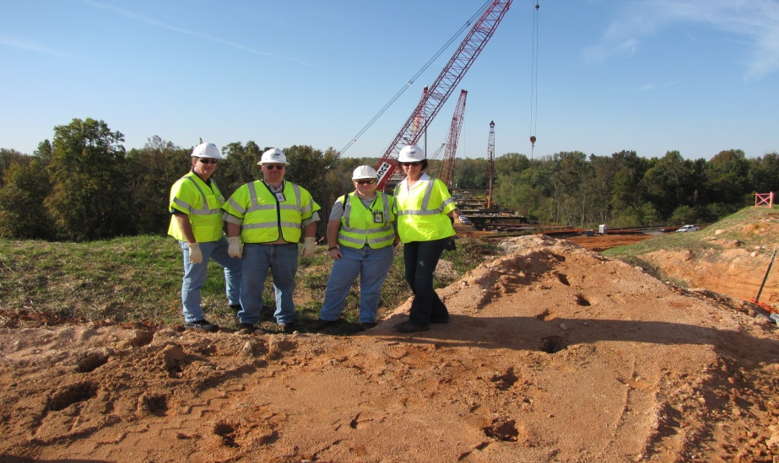
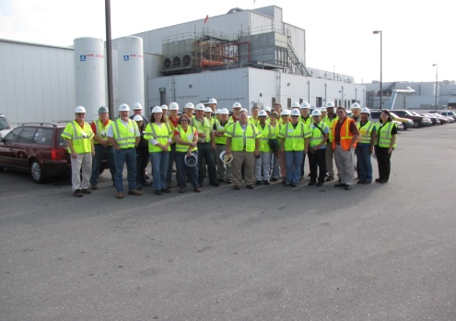
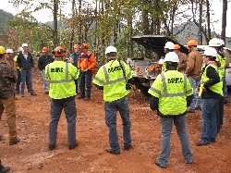
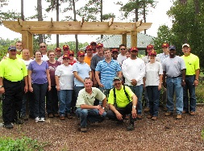
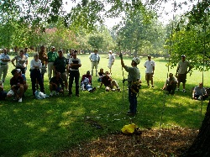
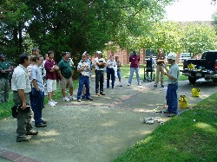
Special Emphasis Program
Logging and Arboriculture
FFY 2019—2nd Qtr.
SEP ACTIVITY | 1st Qtr. | 2nd Qtr. | Total | FFY Goal
Compliance Inspections | 10 | 13 | 23 | 60
Consultative Visits | 10 | 12 | 22 | 13
OSH Training and Outreach Events | 0 | 3 | 3 | 1
People Trained | 0 | 127 | 127 | 150
NAICS 11331*—LOGGING | FFY 2018 |  | 1st Qtr. | 2nd Qtr. | Total
Total Fatalities | 0 |  | 0 | 1 | 1
NAICS 56173*—ARBORICULTURE | FFY 2017 |  | 1st Qtr. | 2nd Qtr. | Total
Total Fatalities | 6 |  | 1 | 1 | 2
 |  |  | 0.0032 | 0.0078 | 0.0078
Combined Fatality Rate | 0.017

Slide 9
Special Emphasis Program
Long Term Care Facilities
FFY 2019—2nd Qtr.
NAICS 623*—LONG TERM CARE
 | North Carolina |  |  |  | National Average |  |  |  | North Carolina vs. National Average
 | CY 2016 |  | CY 2017 |  | CY 2016 |  | CY 2017 |  | 2017 Comparison
TRC | 5.7 | 11% Increase |  | 6.4 | 6.4 | 2% Decrease |  | 6.3 | 2% Higher
DART | 3.3 | 11% Increase |  | 3.7 | 3.9 | 3% Decrease |  | 3.8 | 3% Lower
SEP ACTIVITY | 1st Qtr. | 2nd Qtr. | Total | FFY Goal
Compliance Inspections | 4 | 21 | 25 | 48
Consultative Visits | 9 | 31 | 40 | 40
OSH Outreach Events | 1 | 0 | 1 | 2
People Trained | 400 | 0 | 400 | 50

Slide 10
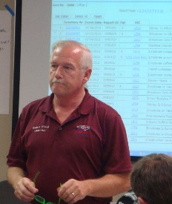

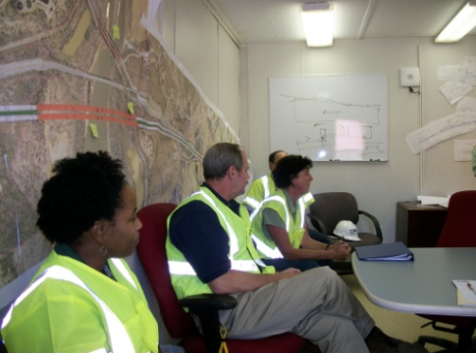
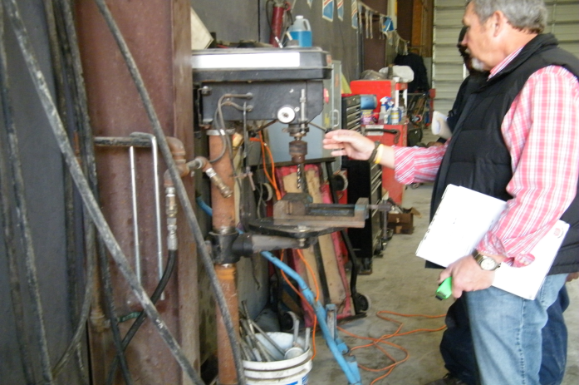
Special Emphasis Program
Health Hazards
FFY 2019—2nd Qtr.
COMPLIANCE INSPECTIONS | 1st Qtr. | 2nd Qtr. | Total | FFY Goal
Silica | 10 | 17 | 27 | 100
Asbestos | 6 | 5 | 11
Isocyanates | 2 | 6 | 8
Lead | 9 | 4 | 13
Hexavalent Chromium | 1 | 4 | 5
Total | 28 | 36 | 64*
Program Improvements | 6 | 15 | 21 | 20
*Some inspections involved more than one health hazard and generally included a program improvement
NCDOL Photo Library

Slide 11
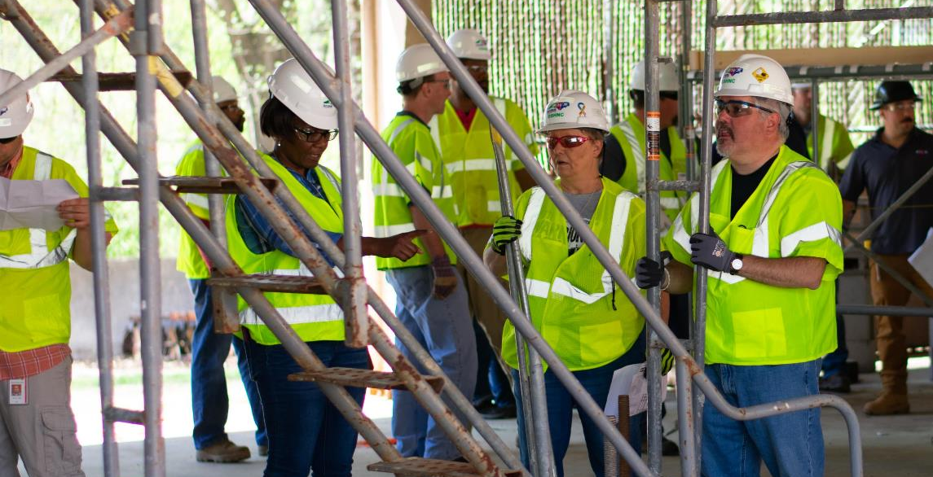
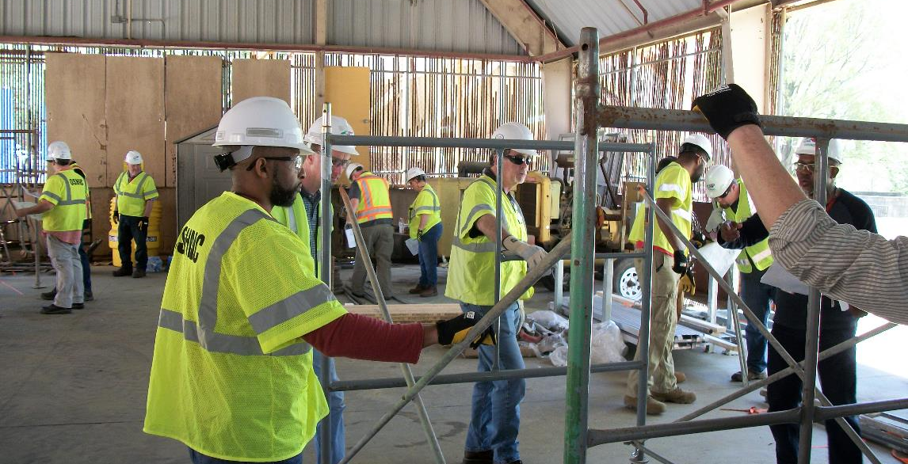
Special Emphasis Program
Health Hazards
FFY 2019—2nd Qtr.
COMPLIANCE INSPECTION RESULTS
HEALTH HAZARDS | Number of Samples (Detectable Results) |  |  | Number With Overexposures |  |  | Average Severity Rate*
 | 1st Qtr. | 2nd Qtr. | Total | 1st Qtr. | 2nd Qtr. | Total | 1st Qtr. | 2nd Qtr. | Aver.
Silica | 16 | 21 | 37 | 3 | 6 | 9 | 22.57 | 0.83 | 22.57
Asbestos | 5 | 0 | 5 | 0 | 0 | 0 | 0.08 | 0 | 0.08
Isocyanates | 4 | 6 | 10 | 0 | 0 | 0 | 0.04 | 0.039 | 0.04
Lead | 17 | 5 | 22 | 0 | 0 | 0 | 2.41 | 0.29 | 2.41
Hexavalent Chromium | 0 | 4 | 4 | 0 | 0 | 0 | 0.0 | 0.02 | 0.0
Total | 42 | 36 | 78 | 3 | 6 | 9 | N/A | N/A | N/A
NCDOL Photo Library
* All Samples

Slide 12
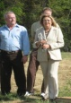
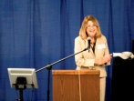
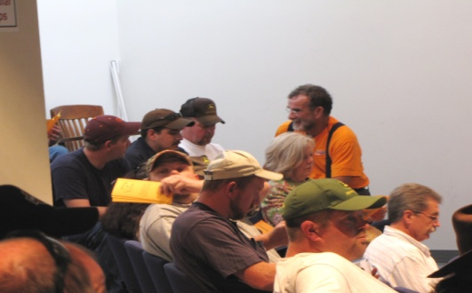
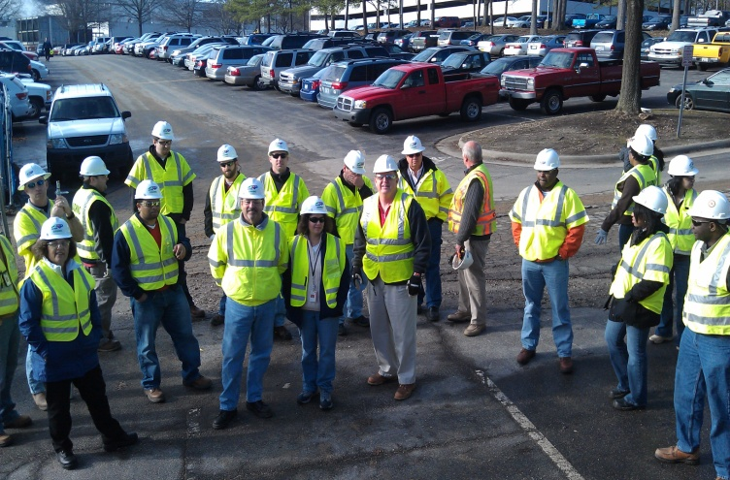
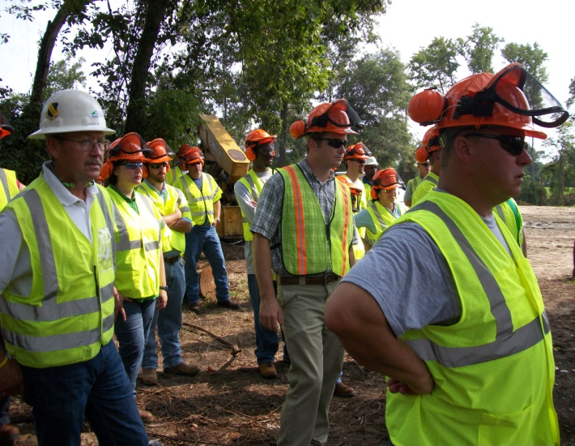
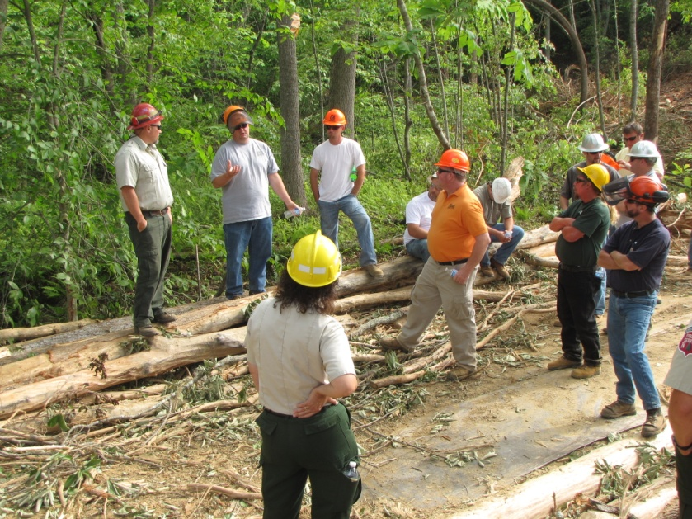
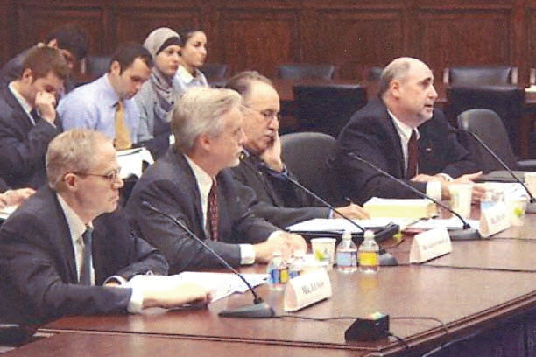
Special Emphasis Program
Health Hazards
FFY 2019—2nd Qtr.
HEALTH HAZARDS | Consultative Surveys
 | 1st Qtr. | 2nd Qtr. | Total
Silica | 38 | 41 | 79
Asbestos | 3 | 5 | 8
Isocyanates | 2 | 1 | 3
Lead | 8 | 4 | 12
Hexavalent Chromium | 4 | 6 | 10
Total | 55 | 57 | 112
FFY Goal | 200
NCDOL Photo Library
NCDOL Photo Library
SEP ACTIVITY | 1st Qtr. | 2nd Qtr. | Total | FFY Goal
OSH Outreach Events | 5 | 8 | 13 | 18
People Trained | 117 | 284 | 401 | 400

Slide 13
Special Emphasis Program
Food Manufacturing
FFY 2019—2nd Qtr.
NAICS 311*—FOOD MANUFACTURING
 | North Carolina |  |  |  | National Average |  |  |  | North Carolina vs. National Average
 | CY 2016 |  | CY 2017 |  | CY 2016 |  | CY 2017 |  | 2017 Comparison
TRC | 3.7 | 3% Decrease |  | 3.6 | 4.7 | 4% Decrease |  | 4.5 | 20% Lower
DART | 2.7 | 7% Decrease |  | 2.5 | 3.2 | 3% Decrease |  | 3.1 | 19% Lower
*TRC/DART rate based on the 3 digit NAICS code
SEP ACTIVITY | 1st Qtr. | 2nd Qtr. | Total | FFY Goal
Compliance Inspections | 12 | 6 | 18 | 40
Consultative Visits | 3 | 7 | 10 | 12
OSH Outreach Events | 0 | 0 | 0 | 1
People Trained | 0 | 0 | 0 | 25

Slide 14
Special Emphasis Program
Grocery and Related Product Wholesalers
FFY 2019—2nd Qtr.
NAICS 4244*—GROCERY AND RELATED WHOLESALERS
 | North Carolina |  |  |  | National Average |  |  |  | North Carolina vs. National Average
 | CY 2016 |  | CY 2017 |  | CY 2016 |  | CY 2017 |  | 2017 Comparison
TRC | 4.5 | 8% Decrease |  | 4.1 | 4.7 | 8% Increase |  | 5.1 | 20% Lower
DART | 3.7 | 19% Decrease |  | 3.0 | 3.6 | 14% Increase |  | 4.2 | 29% Lower
*DART/TRC rate based on the 4 digit NAICS code
SEP ACTIVITY | 1st Qtr. | 2nd Qtr. | Total | FFY Goal
Compliance Inspections | 2 | 10 | 12 | 20
Consultative Visits | 2 | 0 | 2 | 3
OSH Outreach Events | 0 | 1 | 1 | 1
People Trained | 0 | 7 | 7 | 25

Slide 15
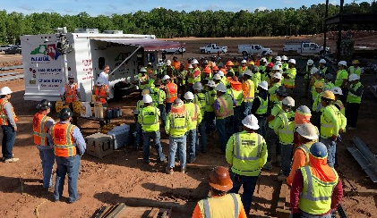
Special Emphasis Program
Amputations—New for FFY 2019
FFY 2019—2nd Qtr.
FFY 2019 Planning Year
Setting and Monitoring Goals
Training Events (Internal and external)
Compliance Inspections
Consultation Visits
Publications
Developing an Operational Procedure Notice
Notes:
Added Amputations for our new 5 year SMP, and removed Accommodations.

Slide 16
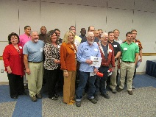
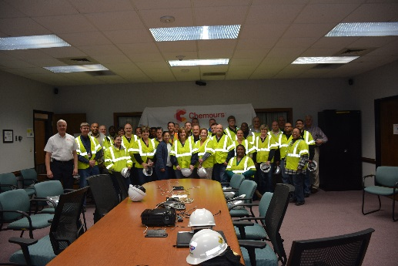
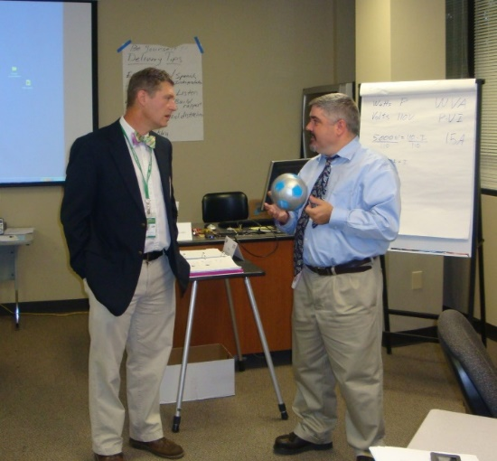
OSH Division
Public Sector
FFY 2019—2nd Qtr.
ACTIVITY | 1st Qtr. | 2nd Qtr. | Total | FFY Goal
Compliance Inspections | 43 | 65 | 108 | 151
Consultative Visits | 71 | 75 | 146 | 205
OSH Outreach Events/Booths | 11 | 8 | 19 | 22
Trained | 351 | 473 | 824 | 1,500

Slide 17
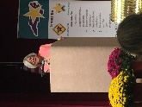
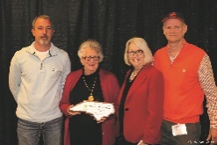
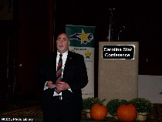
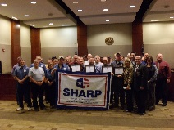
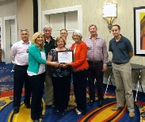
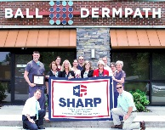
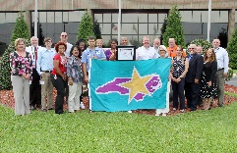
OSH Division
Recognition Programs
FFY 2019—2nd Qtr.
STAR SITES—New, Recertification, Promotion | 1st Qtr. | 2nd Qtr. | Total | FFY Goal | Approved Star Sites*
Carolina Star | 1 | 12 | 13 |  | 101
Building Star | 0 | 2 | 2 |  | 23
Rising Star | 0 | 0 | 0 |  | 6
Public Sector Star | 1 | 0 | 1 |  | 23
Total | 2 | 14 | 16 | 30 | 153
*Cumulative Total
NCDOL Photo Library
 | 1st Qtr. | 2nd Qtr. | Total | FFY Goal
Star Sites—Termination/Withdrawn | 0 | 0 | 0
Star Booths | 2 | 0 | 2
Star Presentations | 11 | 7 | 18 | 30
Star Program Interventions | 40 | 44 | 84 | 150
Notes:
The Carolina Star Program is designed to recognize employers and employees who have implemented effective safety and health management systems and maintain injury and illness rates that meet the criteria for participation. Any size employer.
The SSTM Program is North Carolina’s version of federal OSHA’s Special Government Employee (SGE) Program. The SSTM Program allows industry employees and qualified independent private sector safety and health professionals the opportunity to work together in partnership with the NCDOL Carolina Star Program during onsite Star Program evaluations.
General industry, private sector participants must meet the following criteria: The most recent three-year average for both the total recordable case (TRC) rates and cases with days away from work, job transfer, or restriction (DART) rates must be at or below 50 percent of the most recent published federal BLS rates for the appropriate North American Industrial Classification System (NAICS) industry, preferably using a 6-digit NAICS rate, or highest digit available.
Building Star - The contractor participant must meet the following criteria: All injuries and illness rates for each worksite in North Carolina must be summarized on the OSHA 300 log each year, for the past three years. The most recent three-year average for both the total recordable case (TRC) rates and cases with days away from work, job transfer, or restriction (DART) rates must be at or below 50 percent of the most recent published Federal BLS rate for the appropriate North American Industrial Classification System (NAICS) preferably using a 6-digit NAICS rate, or highest digit available.

Slide 18
OSH Division
Recognition Programs
FFY 2019—2nd Qtr.
SHARP SITES—NEW | 1st Qtr. | 2nd Qtr. | Total | FFY Goal | Approved SHARP Sites*
SHARP—Construction | 1 | 0 | 1 |  | 7
SHARP—General Industry | 1 | 2 | 3 |  | 140
SHARP—Public Sector | 3 | 4 | 7 |  | 49
SHARP—Logging | 0 | 0 | 0 |  | 0
Total | 5 | 6 | 11 | 6 | 196
SHARP—Renewals | 16 | 16 | 32* | 55
*Cumulative Total
*Includes both general industry and public sector renewals
GOLD STAR GROWERS—NEW | 1st Qtr. | 2nd Qtr. | Total
 | 16 | 209 | 225
SAFETY AWARDS |  |  | Total
CY 2018 Safety Awards Season |  |  | 3,327
 | 1st Qtr. | 2nd Qtr. | Total
Million Hour Awards | 2 | 62 | 64
Notes:
The SHARP (Safety and Health Achievement and Recognition Programs) Program is designed for small and mid-size employers that have established, implemented and maintained exceptional workplace safety standards.
The Gold Star Grower Housing Program recognizes growers who provide farmworker housing that meets and exceeds all of the requirements of the Migrant Housing Act of North Carolina.
The Gold Star Flag recognizes agricultural employers who have devised ways to continuously promote a culture of safety on their farms. Gold Star Flag recipients have identified hazards, trained their employees and completed farm safety inspections. They follow and exceed the regulations pertaining to the agricultural work place.
Safety Awards Program - In operation since 1946, the program now extends to more than 5,000 firms, and about 3,000 awards are presented annually. Two types of awards are administered through the program: Annual Safety Awards and Million-Hour Awards.
To qualify for an annual safety award, a firm must:
Have no fatalities during the calendar year at the site or location for which the award was given; and
Have maintained an incidence rate at least 50 percent below the average for its particular industry group.
Two Safety Award Levels - Gold and Silver
The Gold Award is based on the days away, restricted, transferred (DART) rate, which includes cases of days away from work, restricted activity or job transfer.
The Silver Award is based only on cases with days away from work. They are recorded when the worker misses at least one full day of work, not including the day of the injury.

Slide 19


Not in Strategic Plan
Alliances and Partnerships
FFY 2019—2nd Qtr.
Alliances
Carolinas AGC
Forestry Mutual Insurance Company, NC Forestry Association, Carolina Loggers Association
Lamar Advertising Company
Mexican Consulate
NCSU – Industry Expansion Solutions
Safety and Health Council of NC
NUCA of the Carolinas
NCALGESO
NCDOL Photo Library
Notes:
Our alliances are organizations based toward our SEPs to promote education and training.

Slide 20
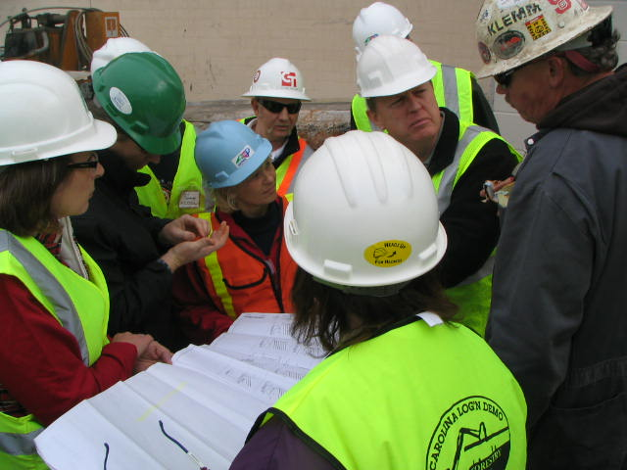
Not in Strategic Plan
Alliances and Partnerships
FFY 2019—2nd Qtr.
Partnerships
Flatiron/Blythe Development Company
Charlotte-Douglas Airport Improvements—Charlotte
Fluor Enterprises
DAPI US Project, Novo Nordisk Facility—Clayton
Notes:
We try to keep it around 3 partnerships due to limited manpower.
Turner Rodgers is no longer an active site. According to the team leader, they want to wait to do their closing ceremony with Flatiron Blythe.
Thanks, Laura

Slide 21
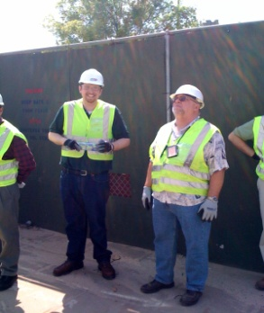
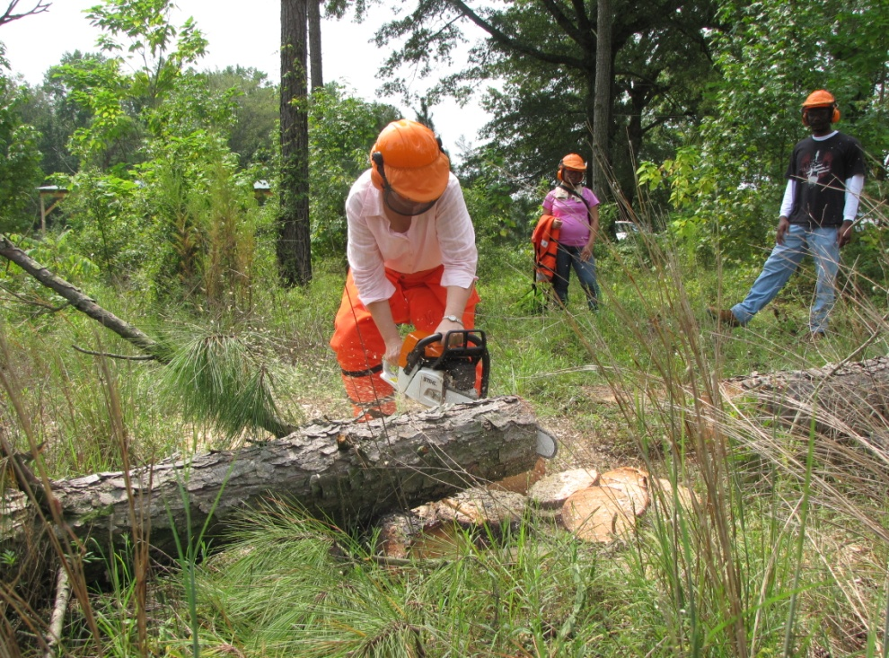
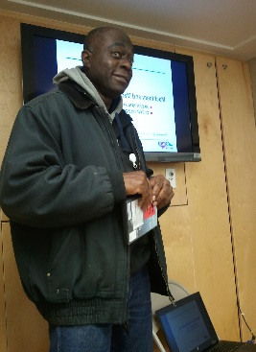
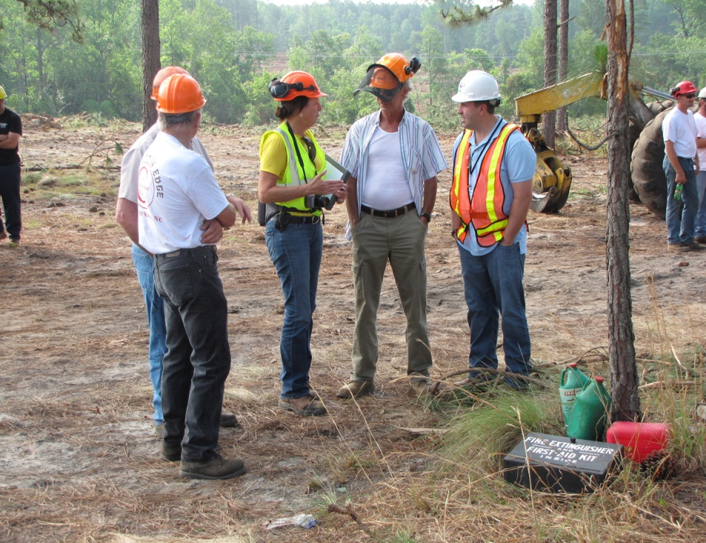
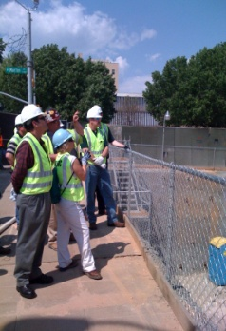
OSH Division
Complaint Desk*
FFY 2019—2nd Qtr.
East Compliance | West Compliance | Agricultural Safety and Health
ACTIVITY | 1st Qtr. | 2nd Qtr. | 1st Qtr. | 2nd Qtr. | 1st Qtr. | 2nd Qtr. | Cumulative Total | FFY 2018
Complaints | 282 | 251 | 265 | 353 | 3 | 1 | 1,155 | 2,419
Referrals | 88 | 92 | 104 | 91 | 23 | 4 | 402 | 822
Fat/Cat | 19 | 23 | 19 | 19 | 0 | 0 | 80 | 123
Totals | 389 | 366 | 388 | 463 | 26 | 5 | 1,637 | 3,364
*Includes calls that were processed but not necessarily inspected. Fat/Cat includes calls regarding heart attacks and other natural causes.
NCDOL Photo Library
Notes:
Complaints, referrals, fatality and catastrophe inspections account for a significant amount of inspections that compliance does every year. This slide puts that into perspective.

Slide 22
OSH Division
Cut-Loose, In-Training, Vacant
FFY 2019—2nd Qtr.
West Compliance | Safety | % | Industrial Hygienist | %
Cut Loose | 26 | 84% | 21 | 81%
In-Training | 4 | 13% | 2 | 8%
Vacant | 1 | 3% | 3 | 11%
Total | 31 |  | 26
East Compliance | Safety | % | Industrial Hygienist | %
Cut Loose | 14 | 52% | 5 | 28%
In-Training | 9 | 33% | 7 | 39%
Vacant | 4 | 15% | 6 | 33%
Total | 27 |  | 18
Safety Cut Loose | 69% | Health Cut Loose | 59%
Safety In-Training | 22% | Health in-Training | 20%
Safety Vacant | 9% | Health Vacant | 20%

Slide 23
OSH Division
Cut-Loose, In-Training, Vacant
FFY 2019—2nd Qtr.
Consultative Services | Safety | % | Industrial Hygienist | %
Cut Loose | 10 | 91% | 8 | 100%
In-Training | 0 | 0% | 0 | 0%
Vacant | 1 | 9% | 0 | 0%
Total | 11 |  | 8
Education, Training and Technical Assistance | Safety | % | Industrial Hygienist | %
Cut Loose | 8 | 73% | 6 | 100%
In-Training | 2 | 18% | 0 | 0%
Vacant | 1 | 9% | 0 | 0%
Total | 11 |  | 6
Agricultural Safety and Health | Safety | % | Industrial Hygienist
Cut Loose | 4 | 67% | NA
In-Training | 2 | 33% | NA
Vacant | 0 | 0% | NA
Total | 6

Slide 24
OSH Division
Internal Training
FFY 2019—2nd Qtr.
1st Qtr.—COURSE | Number Trained
OSH 105: Introduction to Safety Standards—Raleigh | 21
OCSS: Confined Spaces—Raleigh | 22
OCSS: Confined Spaces—Charlotte | 23
OTI 2450: Safety and Health Management Systems—Raleigh | 25
OSH 100: Initial Compliance—Raleigh | 14
Fall Protection—Charlotte | 13
Technical Writing—Raleigh | 14
OSHA Express—Raleigh | 14
CPR-First Aid—Raleigh | 3
Various Webinars (Inspection Process, Ergonomics, Confined Spaces, Noise, Health Hazards, Recordkeeping, Hazard Communication, Machine Guarding, Hand and Portable Powered Tools, and Bloodborne Pathogens | 23

Slide 25
OSH Division
Internal Training
FFY 2019—2nd Qtr.
2nd Qtr.—COURSE | Number Trained
OSH 125: Health Standards—Raleigh | 13
HAZWOPER – 8 Hour Refresher—Charlotte | 7
HAZWOPER – 8 Hour Refresher—Raleigh | 5
Drone Pilot Training—Raleigh | 4
10 Hour Online Portion of Principles of Scaffolding | 36
13 Webinars (e.g., personal protective equipment, fall protection, walking and working surfaces, lockout/tagout, machine guarding, scaffolding, concrete and masonry, confined space, steel erection, inspection process) | 22

Slide 26
OSH Division
Retaliatory Employment Discrimination
FFY 2019—2nd Qtr.
OSH Complaint Statistics | 1st Qtr. | 2nd Qtr. | Total
Total OSH Complaints Filed/Assigned (IMIS: Docketed) | 6 | 22 | 28
Total OSH Complaints Closed (IMIS: Cases completed) | 20 | 16 | 36
Number of OSH Cases Closed Within 90 Days of File Date | 8 | 0 | 8
Percentage of Cases Closed With in 90 Days of File Date | 40% | 0% | N/A
Of Cases Closed, Average Number of Elapsed Days Between File Date and Closed Date | 116 | 170 | 286
Total Number of OSH Complaints Pending at End of Reporting Period | 17 | 44 | 61
Percentage of Pending OSH Complaints Over 90 Days Old (From Filing) | 100% | 45% | N/A
Average Number of Elapsed Days Since Filing Date of All OSH Cases Pending at End of the Reporting Period | 158 | 150 | 308
Notes:
Let Harriet expand on this slide.

Slide 27
OSH Division
Retaliatory Employment Discrimination
FFY 2019—2nd Qtr.
OSH Complaint Disposition | 1st Qtr. | 2nd Qtr. | Total
Administrative Closure (No RTS Letter) | 2 | 0 | 2
Withdrawn | 3 | 1 | 4
Merit | 1 | 1 | 2
Percent Merit | 5% | 1% | N/A
No Merit | 6 | 2 | 8
Settled | 3 | 1 | 4
Uncooperative - RTS | 1 | 1 | 2
Requested RTS Letter | 4 | 8 | 12
Total | 20 | 14 | 34
Notes:
Let Harriet expand on this slide.

Slide 28
OSH Division
Training & Education Outreach
FFY 2019—2nd Qtr.
OUTREACH EVENT | 1st Qtr. | 2nd Qtr. | Total | FFY Goal
General Industry—10 Hour Course | 0 | 2 | 2 | 5
General Industry—30 Hour Course | 0 | 1 | 1 | 2
NC #500/502—Construction Train the Trainer Course/ NC #501/503—General Industry Train the Trainer Course | 0 | 0 | 0 | 1
Construction—10 Hour Course | 0 | 2 | 2 | 6
Construction—30 Hour Course | 0 | 0 | 0 | 2
Labor One/Booth Events | 10 | 6 | 16 | NA
Speaker’s Bureau | 28 | 26 | 54 | NA
Webinars | 28 | 23 | 51 | NA
OSH Workshop | 1 | 3 | 4 | NA
Technical Assistance | 5 | 7 | 12 | NA
Spanish Training and Outreach Events | 0 | 1 | 1 | NA
Train the Trainer Program (Construction/General Industry)—Events | 8 | 7 | 15 | NA
Train the Trainer Program (Construction/General Industry)—Trained | 51 | 55 | 106 | NA

Slide 29
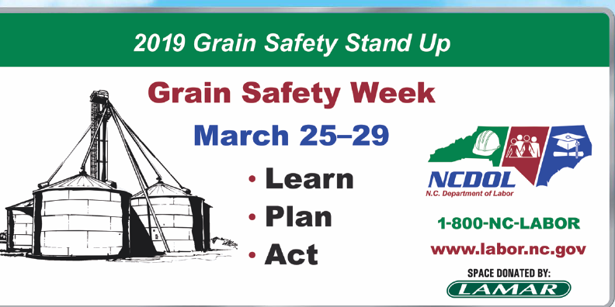
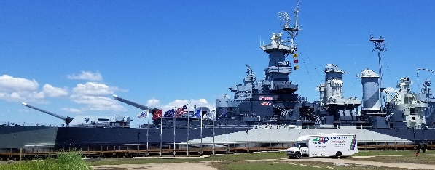
OSH Division
Training & Education Outreach
FFY 2019—2nd Qtr.
Stand Up/Down
Grain Safety Stand Up – March 25 - 29
Fall Prevention Safety Stand Down – May 6 - 10
Two Construction Forums
Concord – May 7
Raleigh – May 9
Safe + Sound Week – August 12 - 18

Slide 30
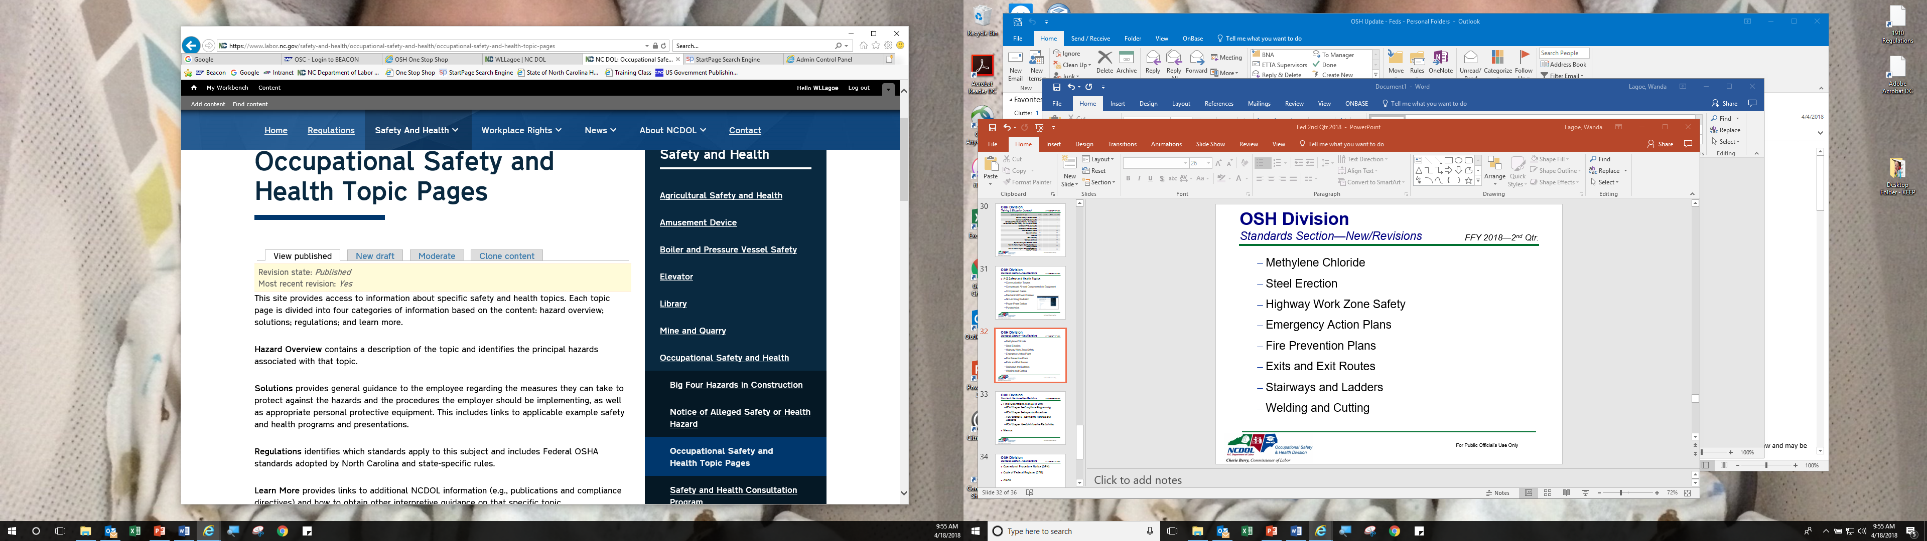
OSH Division
Standards Section—New/Revised
FFY 2019—2nd Qtr.
A - Z Safety and Health Topics (>90 Topics)
Excavations and Trenching
Acids and Bases
Abrasive Blasting
Publications
General Industry Safety Briefings
MESH Brochure
ETTA Brochure
Library Brochure
Top Ten Brochure
Library Bookmark
Notes:
We have almost 100 safety and health topics currently on our website. More to come!

Slide 31
OSH Division
Standards Section—Revisions
FFY 2019—2nd Qtr.
Operational Procedure Notice (OPN)
OPN 64F—Mandatory Training Program for OSH Compliance Personnel
Standards Notice (SN)
19C—Class 1, Division 2; Class 1, Zone 2; and Class II, Division 2 Hazardous Locations for Spray Finishing
Code of Federal Register (CFR)
CFR 127M—Recording and Reporting Requirements
Notes:
Recording and Reporting Requirements 84 FR 380 (1/25/2019) 29 CFR1904.41 - final rule. Removes requirement for establishments with 250 or more employees to electronically submit information from OSHA Forms 300 and 301. Also requires covered employers to submit their Employer Identification Number (EIN) electronically along with their injury and illness data submission.
Class I, Division 2; Class I, Zone 2; and Class II, Division 2 Hazardous Locations for Spray Finishing
This SN was revised to include the most recent requirements from NFPA related to clarifying Class I, Division 2; Class I, Zone2; and Class II, Division 2 hazardous locations surrounding spray finishing operations.

Slide 32
OSH Division
Standards Section—Revisions
FFY 2019—2nd Qtr.
Field Operations Manual (FOM)
Chapter 2—Compliance Programming
Chapter 16—Administrative File Activities
Compliance Directive (CPL)
CPL 02-18-01—Site-Specific Targeting 2016
CPL 02-00-051—Enforcement Exemptions and Limitations under the Appropriations Act
Memos
AC 1—Enforcement Policy for Respiratory Hazards Not Covered by OSHA Permissible Exposure Limits
Notes:
Enforcement Policy for Respiratory Hazards Not Covered by OSHA Permissible Exposure Limits
This memo clarifies the existing agency enforcement policy for citing general duty violations for air contaminants not covered by OSHA permissible exposure limits.
Administrative File Activities
This chapter provides guidance to OSH Division personnel in conducting administrative file activities for OSH inspections and investigations.
Clarification added regarding where to find the Establishment Search page.
Compliance Programming
The purpose of this chapter is to provide guidance to Division personnel in planning compliance operations and related activities and instructions for their implementation.
Site-specific targeting added into chart of inspection priorities.
Site-Specific Targeting 2016 (SST 2016)
This directive implements a site-specific targeting (SST) inspection program using employer-submitted calendar year 2016 Form 300A data.
Enforcement Exemptions and Limitations under the Appropriations Act
Attached is the most recent listing of the North American Industry Classification System (NAICS) codes for industries with a Days Away, Restricted, or Transferred (DART) occupational injury and illness rate below the national private sector rate of 1.5 for 2017.
Appendix A will be effective on the date of this memorandum for any inspection opened on this date or thereafter, until the next revision.

Slide 33

Thank You For Attending!
FFY 2019—2nd Qtr.
Questions?
1-800-NC-LABOR
(1-800-625-2267)
www.labor.nc.gov
Notes:
33

