Slide 1

North Carolina Department of Labor Occupational Safety & Health Division OSH Advisory Council OSH COVID-19 Resources and Activities November 12, 2020
Illustration: CDC / Alissa Eckert & Dan Higgins
Presented by:
Kevin Beauregard, Deputy Commissioner of Labor
Occupational Safety and Health Division of North Carolina
Notes:
The information in this presentation is provided voluntarily by the N.C. Department of Labor, Education Training and Technical Assistance Bureau as a public service and is made available in good faith. This presentation is designed to assist trainers conducting OSHA outreach training for workers. Since workers are the target audience, this presentation emphasizes hazard identification, avoidance, and control – not standards. No attempt has been made to treat the topic exhaustively. It is essential that trainers tailor their presentations to the needs and understanding of their audience.
The information and advice provided on this Site and on Linked Sites is provided solely on the basis that users will be responsible for making their own assessment of the matters discussed herein and are advised to verify all relevant representations, statements, and information.
This presentation is not a substitute for any of the provisions of the Occupational Safety and Health Act of North Carolina or for any standards issued by the N.C. Department of Labor. Mention of trade names, commercial products, or organizations does not imply endorsement by the N.C. Department of Labor.

Slide 2

OSH COVID-19 Overview
Applicable OSH Standards
OSH Enforcement Guidance
NC Executive Orders
Guidance Materials
PowerPoints
FAQs
Hazard Alerts
Sample Programs
OSH Webinars
OSH Pre-Recorded Webinars
OSH COVID-19 Activities

Slide 3
Applicable OSH Standards
Relevant OSHA requirements
Personal Protective Equipment (1910 subpart I, 1926 Subpart E), including:
PPE General Requirements (1910.132, 1926.28)
Eye and Face Protection (1910.133)
Respiratory Protection (1910.134, 1926.103)
Hand Protection (1910.138, 1926.95(a))
Safety Instruction Signs (1910.145, 1926.200)
Bloodborne Pathogens (1910.1030)
Hazard Communication (1910.1200)
Recordkeeping & Reporting (1904)
Sanitation 1910.141, 1928.110
Temporary Labor Camps- 1910.142
OSH guidance was developed to help protect workers from exposure to SARS-CoV-2 and infection with COVID-19.
Applicable OSH Standards (see list)
The General Duty Clause, NCGS §95-129(1), of the Occupational Safety and Health Act of NC may also be applicable to ensure that workers are protected from recognized safety and health hazards that may cause serious harm.

Slide 4
OSH COVID-19 Recordkeeping Requirements
COVID-19 can be a recordable illness if a worker is infected as a result of performing their work-related duties. However, employers are only responsible for recording cases of COVID-19 if all of the following are met:
The case is a confirmed case of COVID-19;
The case is work-related, as defined by 29 CFR 1904.5; and
The case involves one or more of the general recording criteria set forth in 29 CFR 1904.7 (e.g. medical treatment beyond first-aid, days away from work).
Work-related COVID-19 Fatalities must be reported to OSH
Work-related COVID -19 Hospitalizations may be reportable to OSH
OSH is providing enforcement discretion around recordkeeping for most sectors (see OSH temporary enforcement memos).
Notes:
Under OSHA’s recordkeeping requirements, COVID-19 is a recordable illness, and employers are responsible for recording cases of COVID-19, if:
the case is a confirmed case of COVID-19, as defined by Centers for Disease Control and Prevention (CDC);
the case is work-related as defined by 29 CFR § 1904.5; and
the case involves one or more of the general recording criteria set forth in 29 CFR § 1904.7.
On March 11, the World Health Organization (WHO) declared COVID-19 a global pandemic, and the extent of transmission is a rapidly evolving issue.
In areas where there is ongoing community transmission, employers other than those in the healthcare industry, emergency response organizations (e.g., emergency medical, firefighting, and law enforcement services), and correctional institutions may have difficulty making determinations about whether workers who contracted COVID-19 did so due to exposures at work. In light of those difficulties, OSHA is exercising its enforcement discretion in order to provide certainty to the regulated community.
Employers of workers in the healthcare industry, emergency response organizations (e.g., emergency medical, firefighting, and law enforcement services), and correctional institutions must continue to make work-relatedness determinations pursuant to 29 CFR § 1904. Until further notice, however, OSHA will not enforce 29 CFR § 1904 to require other employers to make the same work-relatedness determinations, except where:
There is objective evidence that a COVID-19 case may be work-related. This could include, for example, a number of cases developing among workers who work closely together without an alternative explanation; and
The evidence was reasonably available to the employer. For purposes of this memorandum, examples of reasonably available evidence include information given to the employer by employees, as well as information that an employer learns regarding its employees’ health and safety in the ordinary course of managing its business and employees.
This enforcement policy will help employers focus their response efforts on implementing good hygiene practices in their workplaces, and otherwise mitigating COVID-19’s effects, rather than on making difficult work-relatedness decisions in circumstances where there is community transmission.

Slide 5
OSH COVID-19 Enforcement
Guidance
Temporary Guidance Memorandums
Discretion in Enforcement when Considering an Employer's Good Faith Efforts During the Coronavirus Disease 2019 (COVID-19) Pandemic
Enforcement Guidance on Decontamination of Filtering Facepiece Respirators in Healthcare During the Coronavirus Disease 2019 (COVID-19) Pandemic
Temporary Enforcement Guidance - Healthcare Respiratory Protection Annual Fit-Testing for N95 Filtering Facepieces During the COVID-19 Outbreak
Enforcement Guidance for Respiratory Protection and the N95 Shortage Due to COVID-19 Pandemic

Slide 6
OSH COVID-19 Enforcement
Guidance
Temporary Guidance Memorandums
Enforcement Guidance For Use of Respiratory Protection Equipment Certified Under Standards of Other Countries or Jurisdictions During the Coronavirus Disease 2019 Pandemic
Interim Guidance on COVID-19 Use of Filtering Facepiece Respirators After Their Expiration Date
Expanded Temporary Enforcement Guidance on Respiratory Protection Fit-Testing for N95 Filtering Facepieces in All Industries During the Coronavirus 2019 Pandemic
Temporary Guidance on Migrant Housing for COVID-19 Impacted Workers

Slide 7
OSH COVID-19 Enforcement
Guidance
Temporary Guidance Memorandums
Updated Interim Enforcement Plan for Coronavirus Disease 2019 (COVID-19) (Complaint, Referral Letters)
Revised Enforcement Guidance for Recording Cases of Coronavirus Disease 2019 (COVID-19)
Tight-Fitting Powered Air Purifying Respirators
(PAPRs) Used During the Coronavirus Disease
2019 (COVID-19) Pandemic

Slide 8
Executive Orders via Emergency Management Act
EO #170 went into effect at 5pm on 10/23. It will remain in effect until at least 11/13/20. It extended Phase 3 of the Governor’s COVID-19 Response Plan which is designed to slow COVID spread by restricting contact between people. Provisions include:
Face coverings required to be worn in most public places and buildings (exceptions for health)
Social distancing of at least 6’
Signage in places of business (retail, restaurants, etc.)
Gatherings limited to 25 indoors, 50 outdoors
Some businesses have reduced capacity with additional restrictions (i.e. bars – no indoor seating, movie theaters, amusement parks, sporting venues)
State and local law enforcement has EO enforcement authority (Class 2 misdemeanor, NCGS §14-288.20A)

Slide 9
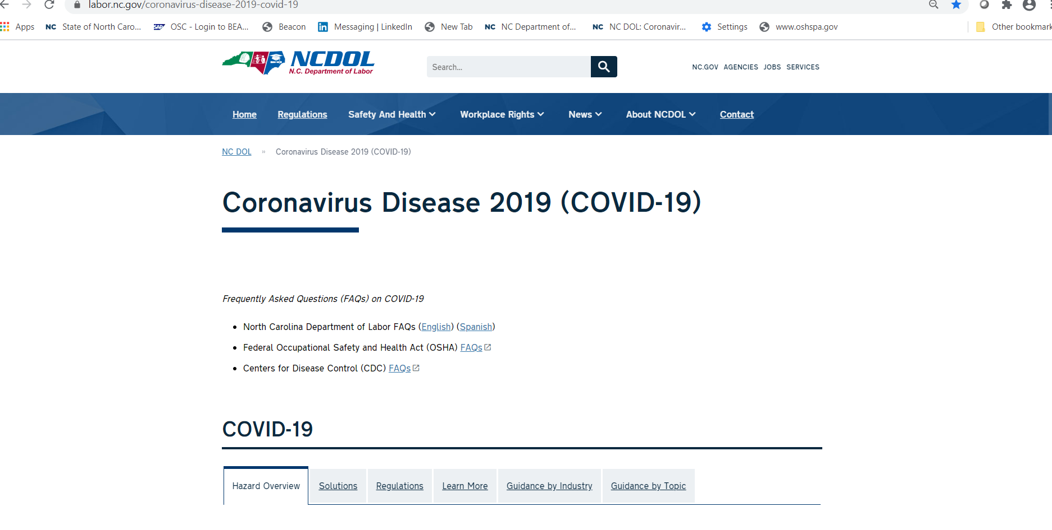
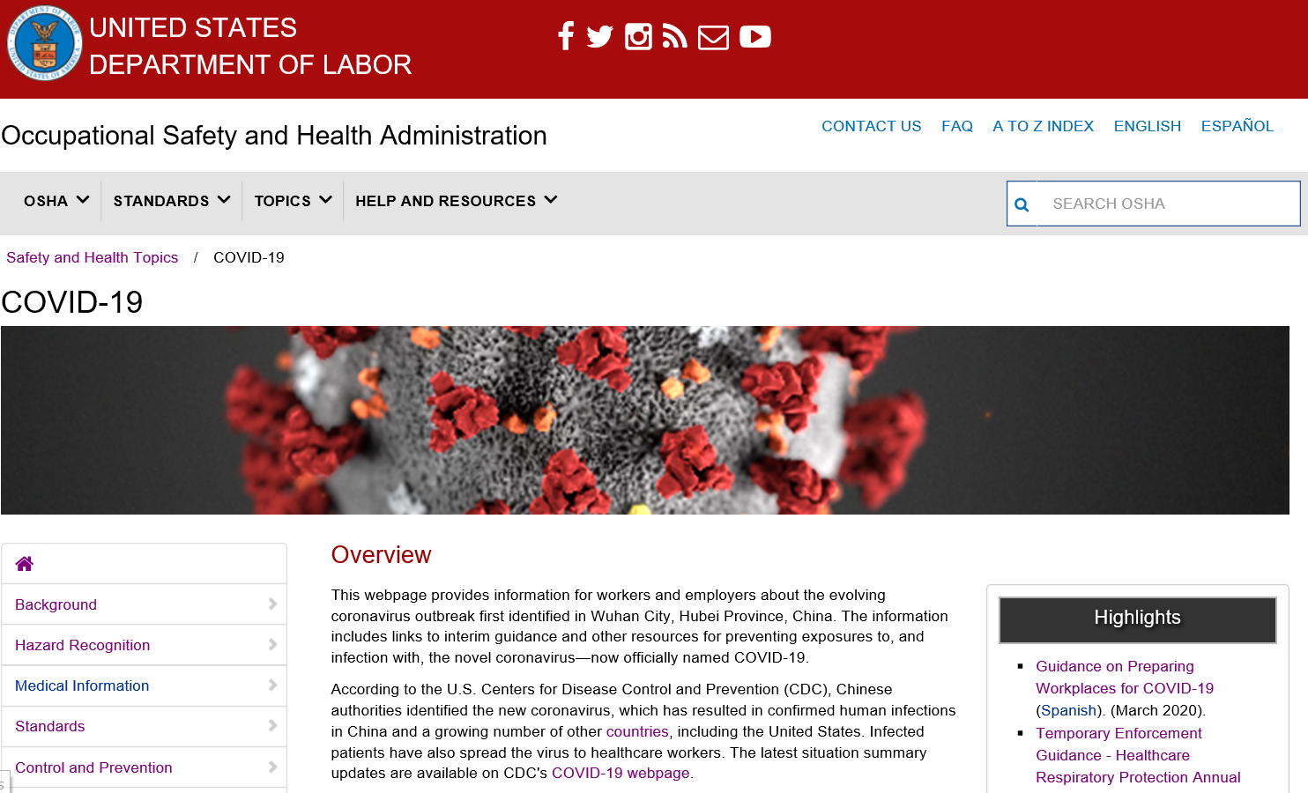
OSH COVID-19 Guidance
OSHNC and OSHA have both developed a variety of guidance materials for workers and employers on how to stay healthy during the pandemic.
Guidance includes information on implementing the hierarchy of controls when workers have specific exposure risks.
https://www.labor.nc.gov/coronavirus
Notes:
In addition to the COVID-19 Safety and Health Topics page, OSHA is also providing a number of alerts, a booklet produced jointly with the U.S. Department of Health and Human services, and other materials to help workers and employers, including in the sectors where exposure to the virus may be most likely. These materials are all available from the OSHA.gov/coronavirus page.
You can find additional resources from the Coronavirus Task Force at coronavirus.gov and the U.S. Department of Labor at dol.gov/coronavirus.

Slide 10
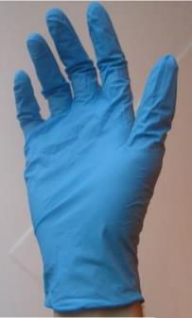
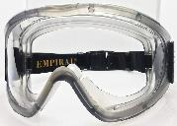
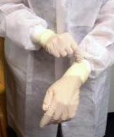
OSH COVID-19 Guidance
Guidance developed to help employers reduce exposure risks and comply with OSHA standards and CDC recommendations.
Guidance includes best practices and recommendations for elimination and/or reducing exposures.
Guidance varies based on each employer’s hazard assessment and workers’ tasks.
Clockwise from L: public domain; WikimediaCommons; CDC/Kimberly Smith & Christine Ford
Notes:
List N: Disinfectants for Use Against SARS-CoV-2 – https://www.epa.gov/pesticide-registration/list-n-disinfectants-use-against-sars-cov-2
List N includes products that meet EPA’s criteria for use against SARS-CoV-2, the cause of COVID-19.
This list includes products with emerging viral pathogen claims and those with human coronavirus claims. If a product with an emerging viral pathogen claim is not available, use a product with a coronavirus claim. If the product is listed as “N” under the Emerging Viral Pathogen Claim column, then it has a human coronavirus claim.

Slide 11

DHHS COVID-19 Guidance
All workers should follow the 3 W’s (Wear, Wait, Wash)
WEAR a cloth face covering over nose and mouth
WAIT at least 6’ apart. Avoid close contact with people who are sick.
WASH your hands or use hand sanitizer often. Avoid touching the eyes, nose, or mouth with unwashed hands.
Photo: U.S. Department of Defense
Notes:
For all workers, regardless of specific exposure risks, it is always a good practice to:
Frequently wash your hands with soap and water for at least 20 seconds. When soap and running water are unavailable, use an alcohol-based hand rub with at least 60% alcohol. Always wash hands that are visibly soiled.
Follow good cough etiquette by covering your mouth when coughing and sneezing, such as by using disposable tissues or coughing/sneezing into the elbow.
Avoid touching your eyes, nose, or mouth with unwashed hands.
Avoid close contact with people who are sick.

Slide 12
OSH COVID-19 Guidance
Employers should implement protocols for regularly cleaning and disinfecting high-touch surfaces in the work environment.
Surfaces such as door push bars, shopping carts, points of sale, chairs in waiting areas, and other areas that customers, visitors, or workers frequently touch should be cleaned and disinfected regularly.
Employers/employees should follow manufacturer’s instructions for use of all EPA-approved cleaning and disinfection products.
CDC provides detailed guidance for environmental cleaning and disinfection.

Slide 13
OSH COVID-19 Guidance
Employers should train all workers about their risk of occupational exposure to COVID-19 as well as on what to do if they have been exposed to possible cases.
For workers at particular risk of exposure (e.g. in healthcare, congregate living facilities, processing facilities), discuss:
Sources of exposure to the virus and hazards associated with that exposure.
Appropriate ways to prevent or reduce the likelihood of exposure, including use of engineering and administrative controls, safe work practices, and PPE.
Some OSHA standards (e.g., BBP, PPE) require worker training.
Notes:
Workers required to use PPE must be trained. This training includes when to use PPE; what PPE is necessary; how to properly don (put on), use, take off PPE; how to properly dispose of or disinfect, inspect for damage and maintain PPE; and the limitations of PPE. Applicable standards include the PPE (29 CFR 1910.132), Eye and Face Protection (29 CFR 1910.133), Hand Protection (29 CFR 1910.138), and Respiratory Protection (29 CFR 1910.134) standards. The OSHA website offers a variety of training videos on respiratory protection.
When the potential exists for exposure to human blood, certain body fluids, or other potentially infectious materials, workers must receive training required by the Bloodborne Pathogens (BBP) standard (29 CFR 1910.1030), including information about how to recognize tasks that may involve exposure and the methods, such as engineering controls, work practices, and PPE, to reduce exposure. Further information on OSHA's BBP training regulations and policies is available for employers and workers on the OSHA Bloodborne Pathogens and Needlestick Prevention Safety and Health Topics page.

Slide 14
OSH COVID-19 Guidance
Eliminate source, if feasible (teleworking, no carpools)
Engineering controls, such as isolation rooms and other physical barriers, can limit most workers’ exposures.
Administrative controls and safe work practices include measures such as limiting access to patient care areas, staggered work shifts and lunch breaks, and worker training.
PPE may include gloves, gowns, goggles, face shields, and respirators.
Face coverings and social distancing for source control
Notes:
OSHA and CDC recommend respiratory protection for certain workers who have close contact with potentially infectious people, including healthcare, border protection, and screening workers tending to persons under investigation (PUI) for COVID-19 and those providing care for suspected or confirmed patients. Standard biosafety practices in BSL-2 and BSL-3 microbiological laboratories—including clinical labs—also call for respiratory protection for certain activities, including any tasks that may generate aerosols.
Whenever needed, use respiratory protection, including NIOSH-certified disposal N95 filtering facepiece or better (e.g., elastomeric APRs with N95 particulate cartridges, PAPRs with N100/HEPA filters) respirators, as part of a comprehensive, written respiratory protection program that meets the requirements of OSHA’s Respiratory Protection standard (29 CFR 1910.134) and includes medical exams, fit testing, and training.
OSHA has released enforcement memoranda detailing enforcement discretion around the Respiratory Protection standard, including cases in which employers may consider re-use or extended use of N95 filtering facepiece respirators (FFRs), other NIOSH-certified FFRS, elastomeric APRs, PAPRs, respiratory protection equipment that was previously NIOSH-certified by that has exceeded its manufacturer’s recommended shelf-life, and respiratory protection equipment certified in accordance with the standards from other countries or jurisdictions. See www.osha.gov/enforcementmemos for complete details.

Slide 15
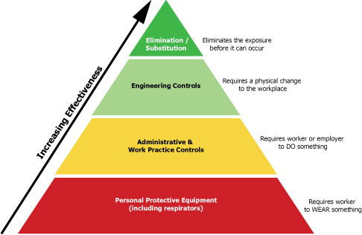
OSH COVID-19 Guidance
Increasing effectiveness in order: PPE, administrative controls, engineering controls, eliminate source
Notes:
In all workplaces where exposure to the SARS-CoV-2 may occur, prompt identification and isolation of potentially infectious individuals is a critical first step in protecting workers, visitors, and others at the worksite.
Immediately isolate the person. For example, move potentially infectious people to isolation rooms and close the door. On an aircraft, move potentially infectious people to a seat away from passengers and crew, if possible and without compromising aviation safety. In other worksites, move potentially infectious people to a location away from workers, customers, and other visitors.
Take steps to limit spread of the person’s infectious respiratory secretions, including by providing them a facemask and asking them to wear it, if they can tolerate doing so. Note: A surgical mask on a patient or other sick person should not be confused with PPE for a worker; the mask acts to contain potentially infectious respiratory secretions at the source (i.e., the person’s nose and mouth).
If possible, isolate people suspected of having COVID-19 separately from those with confirmed cases of the virus to prevent further transmission in screening, triage, or healthcare facilities.
Restrict the number of personnel entering the room of a patient with suspected/confirmed COVID-19.
Protect workers in close contact* with the sick person by using additional engineering and administrative control, safe work practices and PPE.

Slide 16
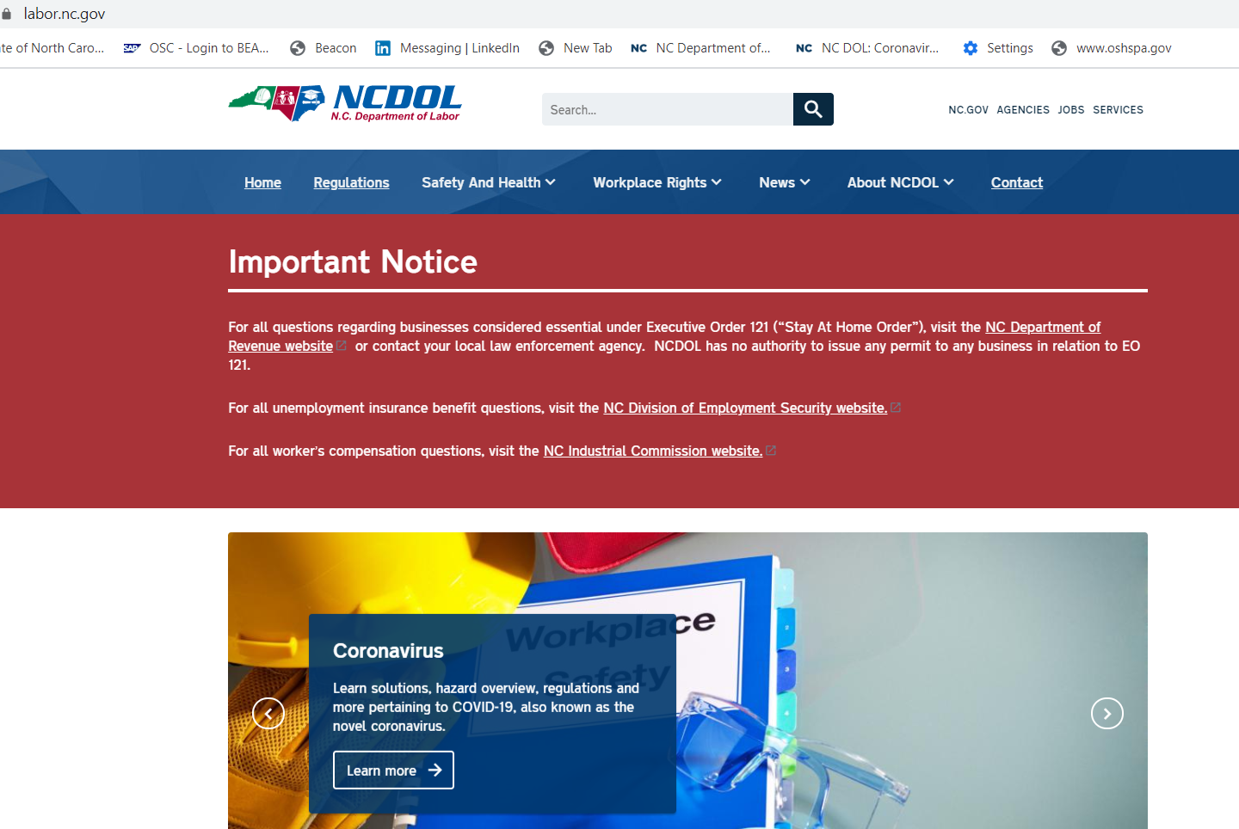
NCDOL Website: www.labor.nc.gov

Slide 17
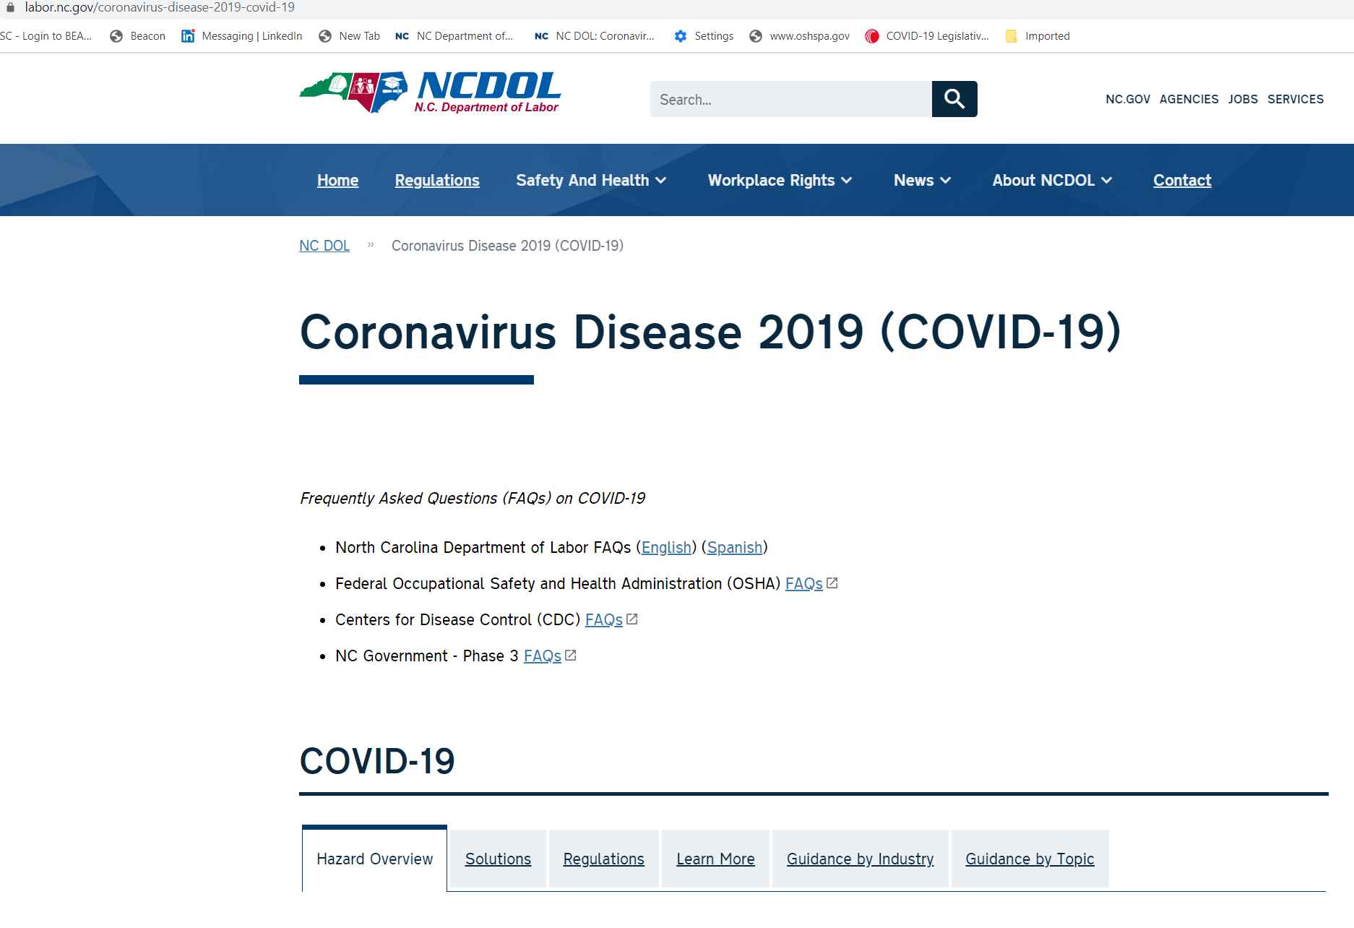
FAQ’s and Guidance Information

Slide 18
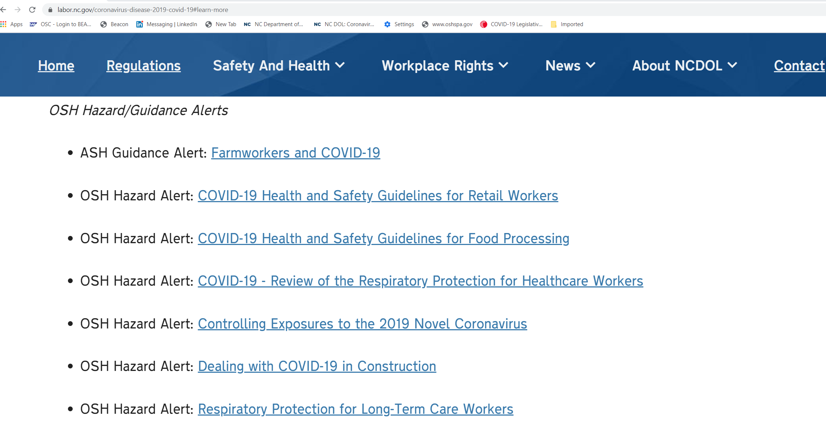
OSH COVID-19 Hazard Alerts

Slide 19

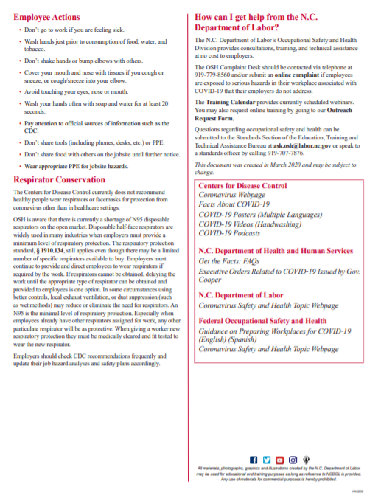
Hazard Alert Construction

Slide 20

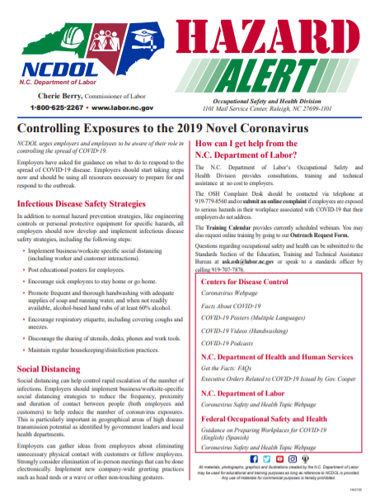
Guidance For All Employers

Slide 21
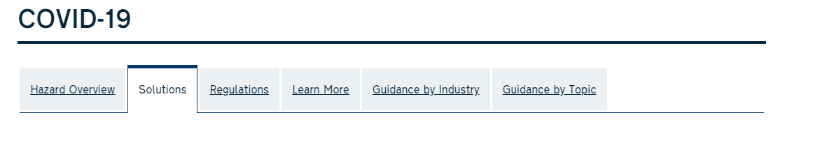
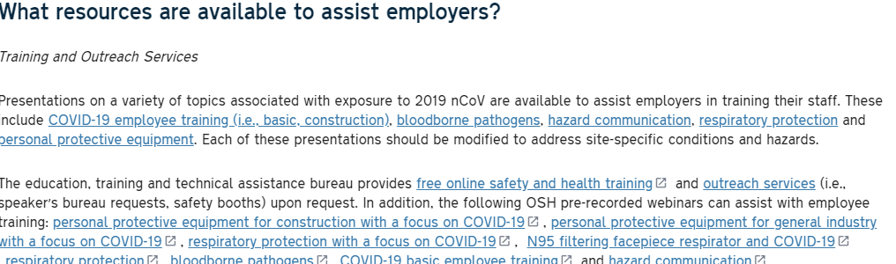
PPTs and Webinars

Slide 22
PPTs and Sample Program
COVID-19 Guidance PowerPoints (New/Under Review/Development)
Basic COVID-19 Employee Training
Construction
Respiratory Protection
PPE
Retail
Manufacturing
Universities
Schools (Under Development)
Agriculture (Under Review)
Example Program Related to COVID-19
COVID-19 Preparedness and Response Plan for Low and Medium risk employers

Slide 23
Basic Employee Training on COVID-19 Infection Prevention
Presented by:
Notes:
Revised: 6/2020
This presentation was originally developed by the Washington State Department of Labor & Industries and was provided to the North Carolina Department of Labor’s Occupational Safety and Health Division (OSH). Links and references were changed to represent documents from NC OSH and its website (www.labor.nc.gov). Photos were removed or replaced with ones that have been approved for use by the NC Department of Labor.
The information in this presentation is provided voluntarily by the N.C. Department of Labor, Education Training and Technical Assistance Bureau as a public service and is made available in good faith. This presentation is designed to assist trainers conducting OSHA outreach training for workers. Since workers are the target audience, this presentation emphasizes hazard identification, avoidance, and control – not standards. No attempt has been made to treat the topic exhaustively. It is essential that trainers tailor their presentations to the needs and understanding of their audience.
The information and advice provided on this Site and on Linked Sites is provided solely on the basis that users will be responsible for making their own assessment of the matters discussed herein and are advised to verify all relevant representations, statements, and information.
This presentation is not a substitute for any of the provisions of the Occupational Safety and Health Act of North Carolina or for any standards issued by the N.C. Department of Labor. Mention of trade names, commercial products, or organizations does not imply endorsement by the N.C. Department of Labor.

Slide 24
Objectives
In this course, we will discuss the following:
What COVID-19 is, the symptoms, how it’s spread and what to do if you feel sick.
Different exposure risk levels based on the type of work.
Ways to protect yourself and employees.
Additional assistance and resources.

Slide 25
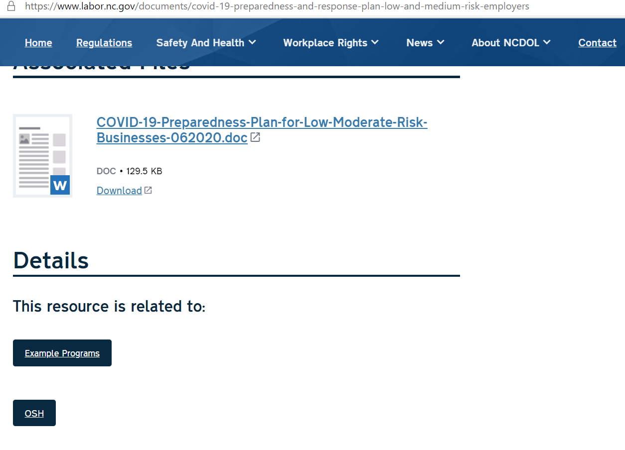
Sample COVID Program

Slide 26

Fact Sheets
Fact Sheets
Facemasks vs. Respirators
Hazard Considerations for Face Coverings, Masks and Respirator Choices (New)
Hotspot

Slide 27
OSH Division
COVID-19 Activities
Webinar COVID-19 Related Topics
Respiratory Protection
Bloodborne Pathogens
Personal Protective Equipment – Construction
Personal Protective Equipment – General Industry
Pre-recorded Webinars Related to COVID-19
N95 Filtering Facepiece Respirator – COVID-19
Personal Protective Equipment in Construction Industry – COVID-19
Personal Protective Equipment in General Industry – COVID-19
Respiratory Protection – COVID-19

Slide 28
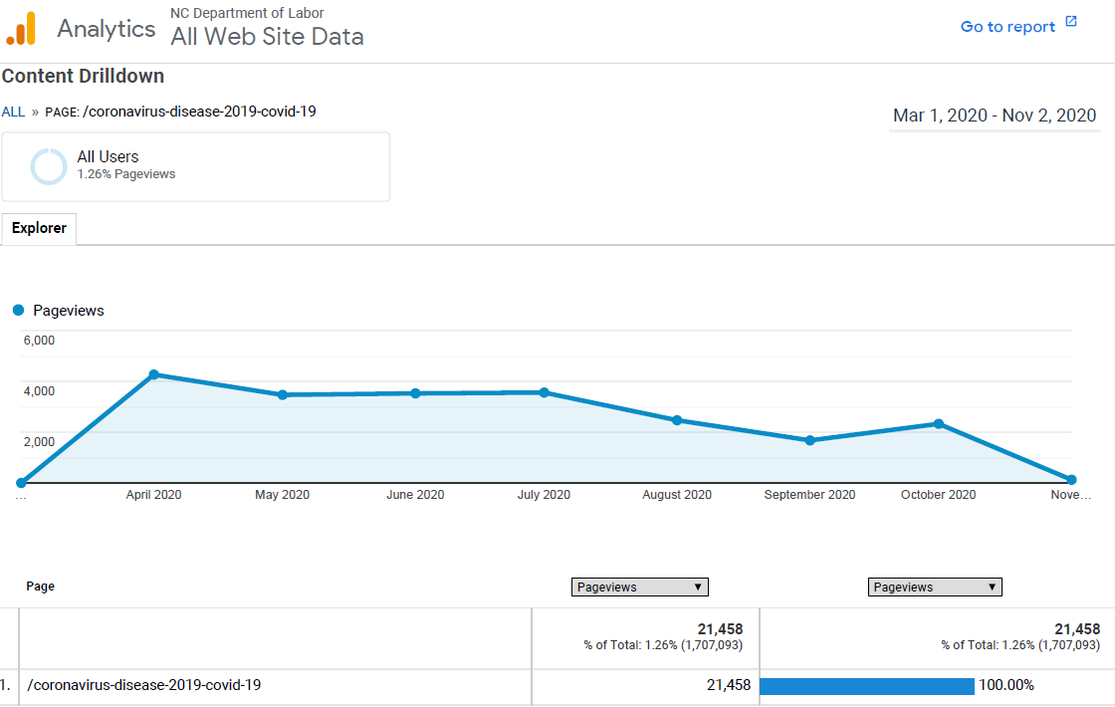
NCDOL COVID-19 Web Page Views

Slide 29
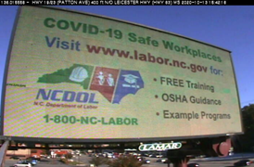
Digital Billboards

Slide 30
OSH Division
COVID-19 Activities FFY20*
Calls/Emails | April* | May* | June* | July* | August* | September* | Total
OSH Director's Office | 217 | 436 | 397 | 390 | 397 | 306 | 2143
ETTA | 687 | 262 | 155 | 108 | 86 | 49 | 1347
ASH** | 45 | 45 | 32 | 56 | 74 | 89 | 705
PSIM | 0 | 2 | 2 | 4 | 3 | 0 | 22
CSB | 401 | 376 | 101 | 127 | 109 | 70 | 2177
Totals | 1350 | 1021 | 687 | 685 | 669 | 514 | 4926
*Monthly data as follows: April 2020 includes data through May 1, May 2020 includes data from May2- June 5,
June 2020 includes data from June 6-July 3, July 2020 includes data from July 4-July 31. August 2020 includes data from August 1 – August 28, September 2020 includes data from August 29-October 2
**Includes weekly conference calls with other Agencies.

Slide 31
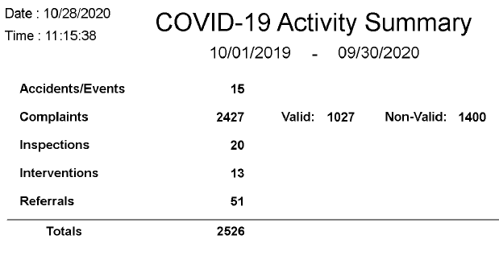
OSH Division
COVID-19 Compliance Activities FFY20*

Slide 32
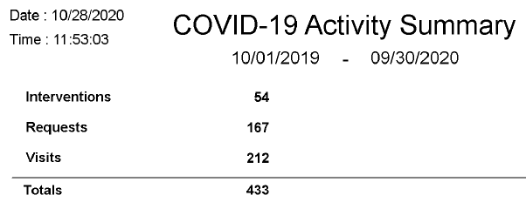
OSH Division
COVID-19 Consultation Activities FFY20*

Slide 33
Top 10 NAICS OSHNC FY20 COVID-19 Related Complaints:
147 - NAICS 722310, Food Service Contractors
130 - NAICS 722511, Restaurants
66 - NAICS 445110, Supermarkets
62 - NAICS 621111, Physician Offices
57 - NAICS 311615, Poultry Processing
53 - NAICS 623110, Nursing Care Facilities
52 - NAICS 622110, Hospitals
49 - NAICS 452210, Department Stores
34 - NAICS 561422, Telemarketing Centers
33 - NAICS 713940, Fitness Centers

Slide 34
OSH Division
COVID-19 Activities FFY20*
ETTA | March/April* | May* | June* | July* | August* | September* | Totals
Live Webinars | 13 | 3 | 3 | 2 | 5 | 2 | 28
Pre-recorded Webinars | 4 | 0 | 0 | 0 | 2 | 0 | 6
PowerPoints | 4 | 1 | 2 | 0 | 14 | 4 | 25
Hazard Alerts | 6 | 0 | 0 | 0 | 0 | 1 | 7
Streaming Videos | 15 | 16 | 14 | 9 | 12 | 6 | 72
A-Z Topics Added/Updated | 4 | 5 | 5 | 3 | 4 | 3 | 24
Fact Sheets | 1 | 0 | 2 | 1 | 0 | 0 | 4
Example Programs | 0 | 0 | 1 | 0 | 0 | 0 | 1
Compliance Memos | 8 | 2 |  | 0 | 0 | 0 | 10
*Monthly data as follows: April 2020 includes data through May 1: May 2020 includes data from May 2 - June 5: June 2020 includes data from June 6 - July 3: July 2020 includes data from July 4 - July 31. August 2020 includes data from August 1 – August 30 and September 2020 includes data from August 31-September 27. .

Slide 35
OSH Division
COVID-19 Activities FFY20*
PSIM | March/April* | May* | June* | July* | August* | September* | Totals
COVID-19 Related Disclosure Requests | 0 | 194 | 8 | 153 | 1,228 | 44 | 1,627
ASH | March/April* | May* | June* | July* | August* | September* | Totals
Guidance Documents | 1 | 0 | 0 | 0 | 0 | 0 | 1
Director’s Office | March/April* | May* | June* | July* | August* | September* | Totals
Meetings | 10 | 26 | 25 | 16 | 4 | 21 | 102
*Monthly data as follows: April 2020 includes data through May 1: May 2020 includes data from May 2 - June 5: June 2020 includes data from June 6 - July 3: July 2020 includes data from July 4 - July 31. August 2020 includes data from August 1 – August 23.

Slide 36

Thank You For Attending!
.
Questions?
1-800-NC-LABOR
(1-800-625-2267)
www.labor.nc.gov
Notes:
36

