Slide 1

The New Amputations Special Emphasis Program
Cherie Berry, Commissioner of Labor
OSHNC Training
September 2019
Presented by:
Paul Sullivan and Ted Hendrix
NC Dept. of Labor/Occupational Safety & Health Division
Notes:
Created: March 2017
The information in this presentation is provided voluntarily by the N.C. Department of Labor, Education Training and Technical Assistance Bureau as a public service and is made available in good faith. This presentation is designed to assist trainers conducting OSHA outreach training for workers. Since workers are the target audience, this presentation emphasizes hazard identification, avoidance, and control – not standards. No attempt has been made to treat the topic exhaustively. It is essential that trainers tailor their presentations to the needs and understanding of their audience.
The information and advice provided on this Site and on Linked Sites is provided solely on the basis that users will be responsible for making their own assessment of the matters discussed herein and are advised to verify all relevant representations, statements, and information.
This presentation is not a substitute for any of the provisions of the Occupational Safety and Health Act of North Carolina or for any standards issued by the N.C. Department of Labor. Mention of trade names, commercial products, or organizations does not imply endorsement by the N.C. Department of Labor.

Slide 2
What will we cover?
The OPN for the new Amputations SEP
How/why we can develop an SEP
Baseline data & how it was obtained
Determination of high-hazard NAICS codes and programmed planned assignments
Inspection procedures (including possible expansions)
Proper coding on the OSHA-1
Machine guarding
Amputation hazards during normal production operations.
Control of hazardous energy (LOTO)
Amputation hazards during servicing & maintenance activities.

Slide 3
OPN 149
OPN 149 has been completed and will be signed and uploaded to the FIS system prior to October 1, 2019.
Thanks to Tara Payne and James Cook for serving as the committee co-chairs during the development year. District 3 supervisor Jennie Cagle will assume those duties for year 2 of the five-year OSHNC Strategic Plan period.

Slide 4
How did we get here?

Slide 5
OSH Act of North Carolina

Slide 6
OSH Act – Special Emphasis Programs

Slide 7
Targeting Employers Who…
What program is already in place for item #2?

Slide 8
Site Specific Targeting Program

Slide 9
OSH Act – Special Emphasis Programs
Most of our SEPs fall under item #3

Slide 10
How do we do this?
Further guidance from NCGS 95-136.1:
“To identify an employer for a special emphasis inspection, the Department shall use the most current data available from its own database and from other sources, including State departments, divisions, boards, commissions, and other State entities.”

Slide 11
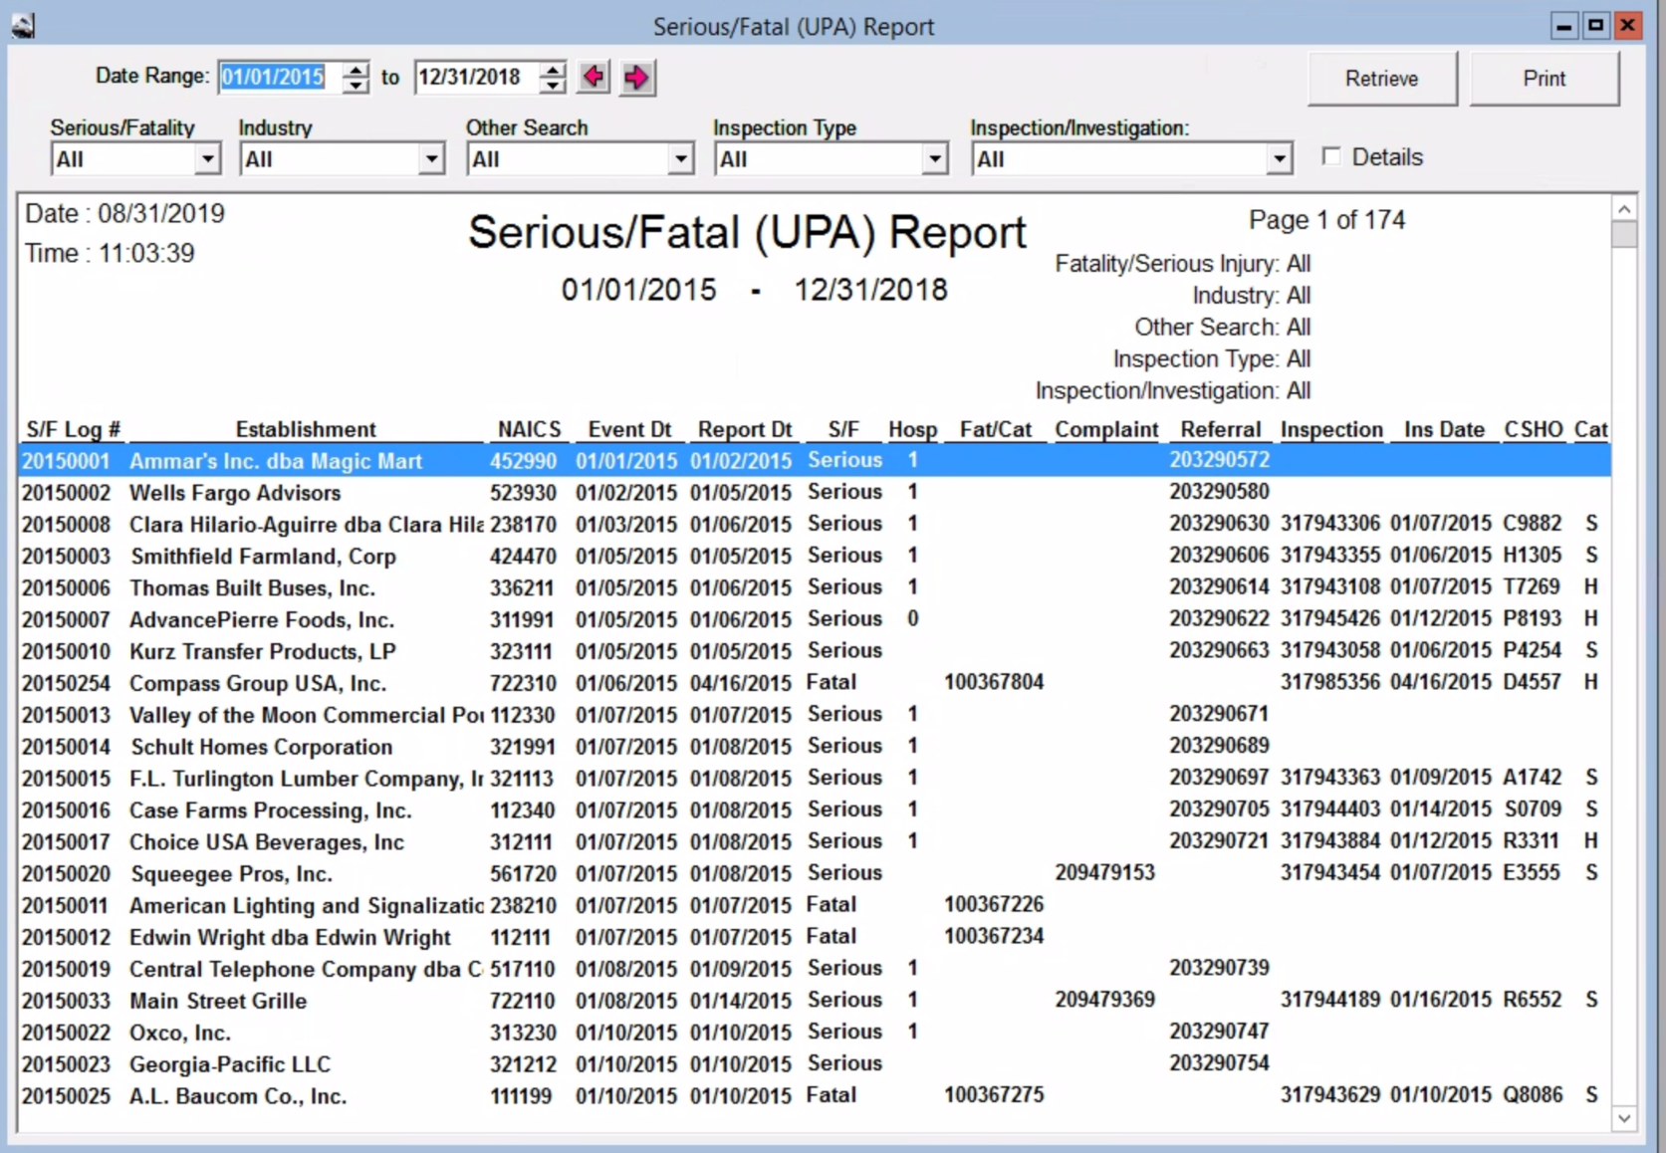
OSHA Express Data

Slide 12
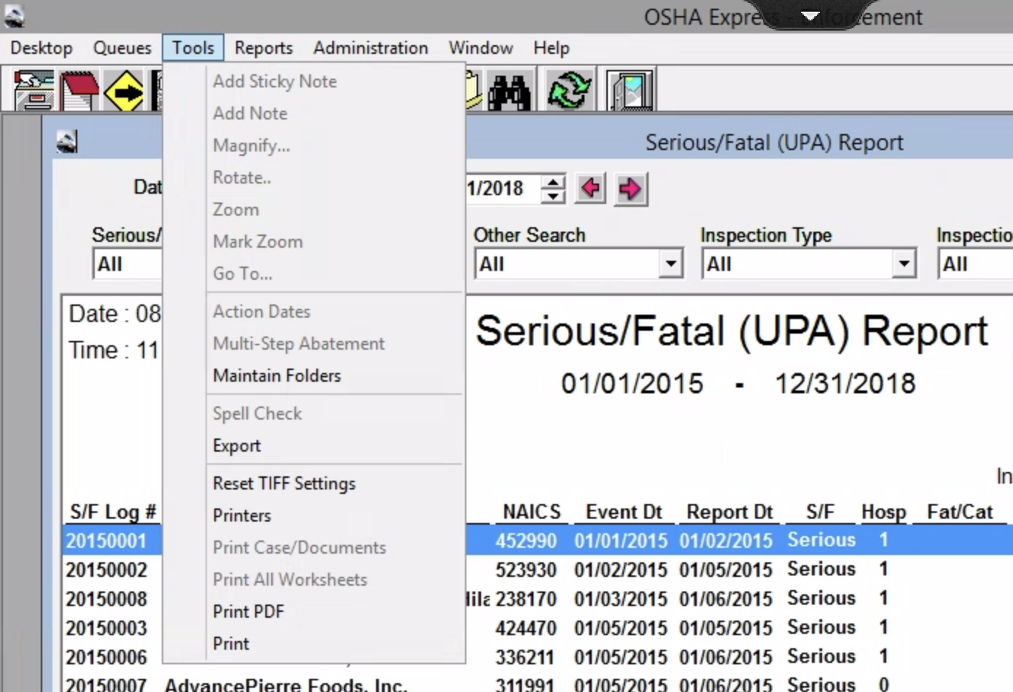
OSHA Express Data

Slide 13
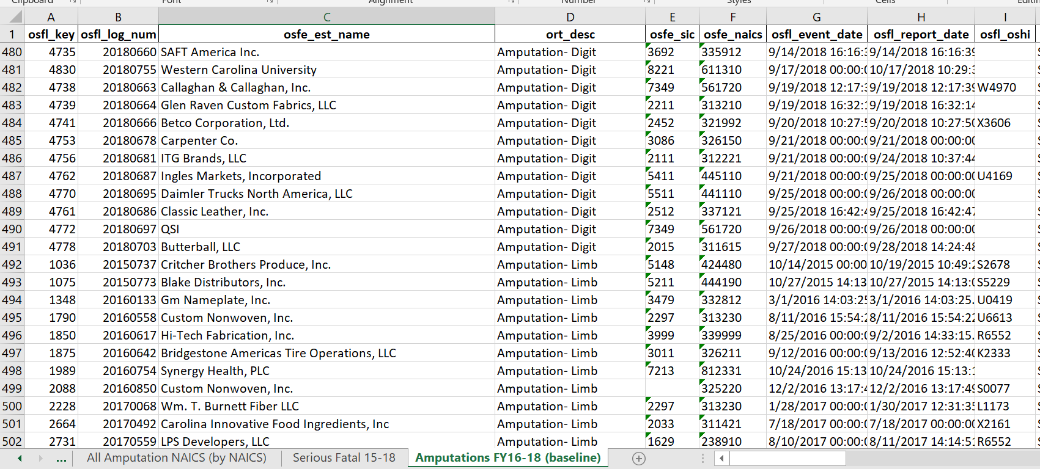
Data Exported to Excel
“Amputation-Digit” and “Amputation-Limb” are two of the injury categories.

Slide 14
What did the data show?
576 amputations over the almost 3 ½ year period.

Slide 15
Amputations SEP Baseline & Goal

Slide 16

How do we reach/exceed our goal?
As with all special emphasis programs, it will involve a combined effort from all OSHNC bureaus:
Compliance inspections
Consultative Services surveys
Training & outreach (both internal and external)
Data analysis and assignment generation

Slide 17
Compliance Inspections
Unprogrammed inspections
These will primarily include employer-reported amputation referrals and complaints alleging either an actual amputation or a potential amputation hazard (such as the lack of machine guarding or LOTO deficiencies).
Handled in accordance with FOM Chapter IX (Complaints, Referrals, and Accidents) and other established OSHNC procedures.

Slide 18
Compliance Inspections
Programmed-planned Inspections
As with any targeting program, the difficulty is identifying the industries where intervention is necessary while ensuring the selection process is legally defensible.
How did we select the NAICS codes for targeting under this SEP? It is very important that the CSHOs and supervisors understand that full process for when entry is denied by an employer.

Slide 19
Programmed Planned Inspections
In developing our targeting program, we had a couple choices:
Use the NAICS codes in the Federal OSHA Amputations Emphasis Program.
Utilize NC-specific data to identify the NAICS codes for targeting.
We chose door #2.

Slide 20
Targeting Program
The data from the “Serious/Fatal (UPA) Report” in OE was exported and analyzed.
Used calendar years 2015 through 2018.
Identified injuries categorized as one of the following:
Amputation-Digit
Amputation-Limb
Pulled into Machinery
Sorted data to get the number of events per NAICS code.
Calculated an event rate per 1000 North Carolina employees based on employment data provided by PSIM.

Slide 21
Targeting Program
All the data is presented in Appendix A of OPN 149. The following NAICS codes were included in the table:
All NAICS codes listed in the Federal OSHA Amputations emphasis program. These are labeled “Fed” in the “Fed/NC” column.
All NAICS codes not included in the Federal OSHA emphasis program where the data shows two (2) or more “amputation” or “pulled into machinery” events. These are labeled “NC” in the “Fed/NC” column.

Slide 22
Targeting Program
The selection criteria is outlined in section E.2.a of the OPN:
The NAICS codes selected for targeting are shown in italics in Appendix A.

Slide 23
Appendix A of OPN 149
NAICS codes with 3 or more amputation events AND an event rate greater than or equal to 1.5 are included in the targeting program

Slide 24
Appendix A of OPN 149
The NAICS codes meeting those criteria are shown in italics in Appendix A.

Slide 25
Appendix A of OPN 149
The importance of using event rate in the targeting criteria is demonstrated with NAICS 445110 for Supermarkets and Grocery Stores. They had 24 amputations, but due to the large # of employees, they have an event rate of only 0.2 per 1000 employees. As a result, that NAICS code is NOT part of the targeting program.

Slide 26
Appendix A of OPN 149
There were many NAICS codes from the Federal Amputations emphasis program where North Carolina experienced zero (0) amputations. That demonstrates the importance of using NC-specific data. Those were also not included in the targeting program.

Slide 27
Targeting Program
A total of 181 NAICS codes are listed in Appendix A, but only 35 met the criteria for selection.
Based on the employment data from PSIM, these 35 NAICS codes include 1787 North Carolina employers and 58,247 employees.
There is no one NAICS code that dominates the list. Metal Service Centers (322220) and Retail Bakeries (311811) are the highest with 385 (21.5%) and 230 (12.9%) respectively. Metal Service Centers had six (6) amputations and Retail Bakeries had four (4).
The remaining 32 NAICS codes constitute 65.6% of the list.
PSIM and IT will randomly pull 25 assignments per district.

Slide 28
Targeting Program

Slide 29
Targeting Program
Special note: Supervisors and/or CSHOs should cross-reference the NAICS code with Appendix A of CPL 02-00-051, Enforcement Exemptions and Limitations under the Appropriations Act.
If the NAICS code is listed on the current Appendix A, an inspection should still be attempted until it has been determined the employer has controlled 10 or fewer employees nationwide at all times over the past year.

Slide 30
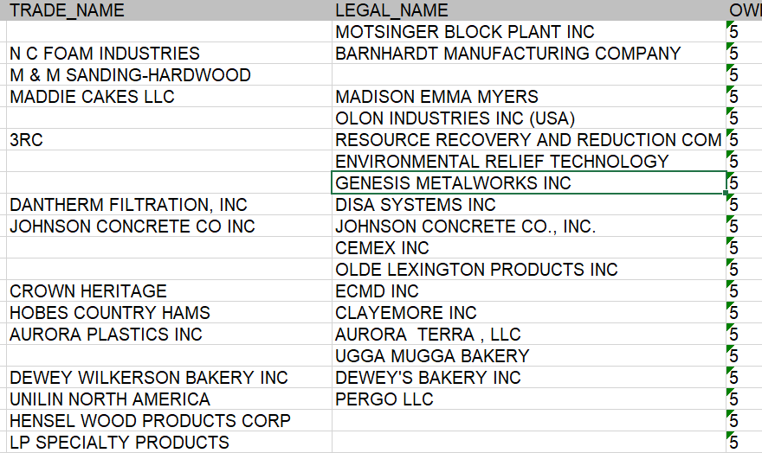
Targeting Program
A couple test lists were run. Here is an example. The actual assignments will be posted by October 1, 2019.

Slide 31
Pre-inspection Procedures
Unprogrammed Inspections
Handled in accordance with FOM Chapter IX, Complaints, Referrals, and Accidents or Chapter VIII, Fatality and Catastrophe Investigations.
CSHOs should be familiar with the applicable standards (e.g. 1910.212 and 1910.147) and compliance directives (e.g. LOTO, Press Brakes, etc.)
CSHOs should know the NAICS code and cross reference with Appendix A prior to the inspection.

Slide 32
Pre-inspection Procedures
Programmed Inspections
CSHOs should be familiar with the applicable standards (e.g. 1910.212 and 1910.147) and compliance directives (e.g. LOTO, Press Brakes, etc.)
Review the amputation data on the F:\ drive to read through the details of previous amputation injuries within that NAICS code.
File name is “Amputations Data Jan15-Jul19”
Available under F:\BUREAUS\Compliance\Amputations SEP

Slide 33
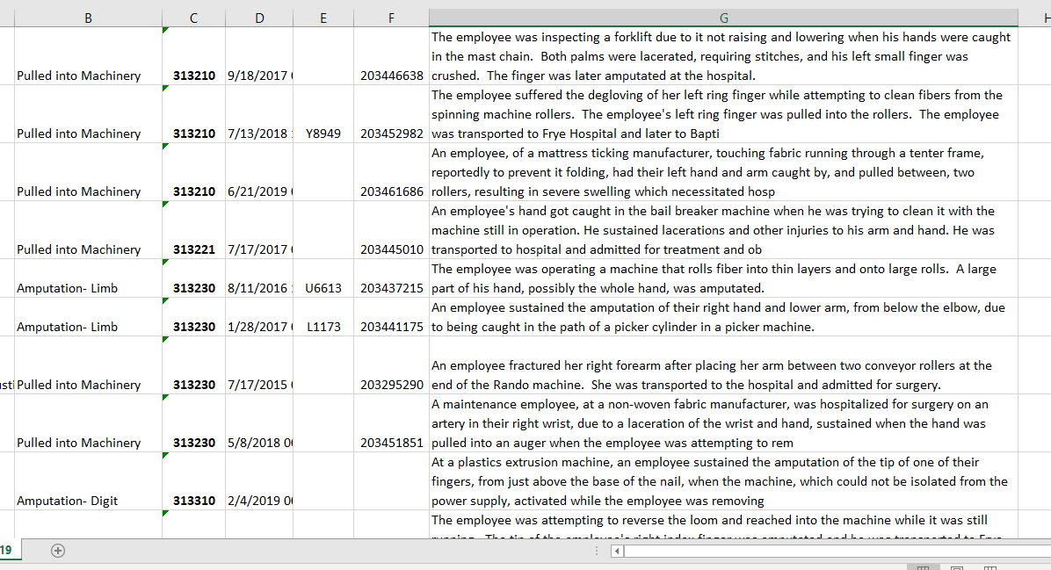
F:\ Drive Amputation Data

Slide 34
Inspection Scope
Unprogrammed inspections (e.g. complaints, referrals, and accidents)
Partial scope, limited to the allegations in the complaint or the accident events & equipment.
Programmed inspections
These are also partial scope inspections, limited to the evaluation of onsite machinery & equipment (throughout the facility) for possible guarding hazards and the employer’s lockout/tagout program.

Slide 35
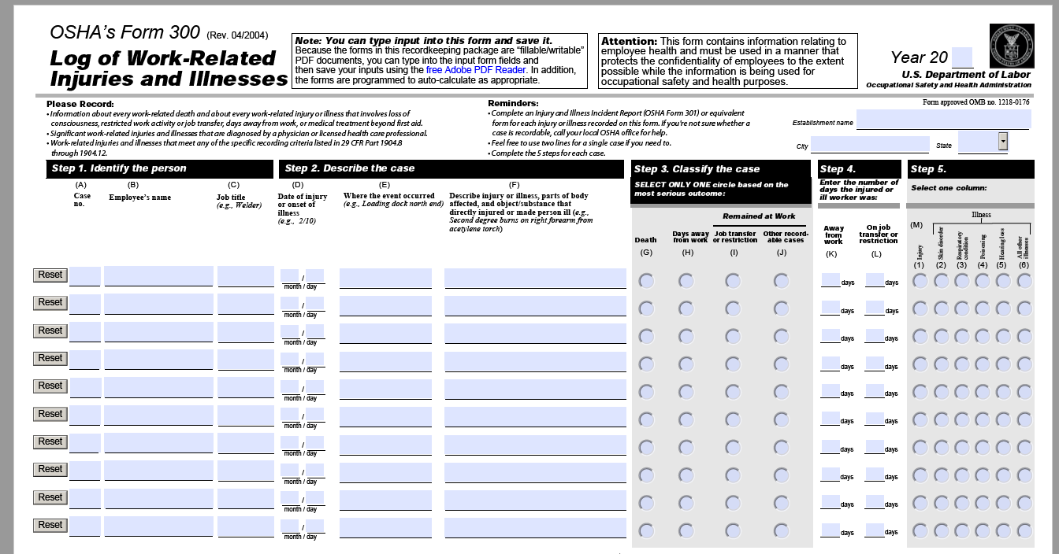
Inspection Process – All Inspections
OSHA 300 logs and 301 incident reports will be reviewed. Any amputations, severe lacerations, and/or crush injuries caused by machinery and equipment will be thoroughly evaluated during the walk-through portion of the inspection.

Slide 36
Inspection Process – Programmed Planned
General Procedures:

Slide 37
Inspection Process – Programmed Planned
Evaluation of machine guarding:

Slide 38
Appendix B – Example Machinery

Slide 39
Inspection Process – Programmed Planned
Evaluation of LOTO program

Slide 40
Expansions?
Unprogrammed Inspections (e.g. complaints, referrals, and accidents).
Handled in accordance with FOM Chapter IX, Complaints, Referrals, and Accidents or Chapter VIII, Fatality and Catastrophe Investigations.
CSHOs should specifically review paragraph A.9. of Chapter IX regarding the inspection scope (partial) and the circumstances when it may be expanded to machinery or equipment not included in the original complaint or referral.
Paragraph A.9.e.ii of Chapter IX applies for industries within a NAICS code that is targeted in accordance with this OPN.

Slide 41
Expansions?
Unprogrammed & Programmed Inspections
Is the assignment also on the general schedule list? If so, it would be a comprehensive inspection.
Are there items brought to the attention of the CSHO? If so, the CSHO has the authority to evaluate those without it being an expansion of the scope.

Slide 42
Items Brought to the CSHO’s Attention

Slide 43
Expanding from Partial to Comprehensive
As with any unprogrammed inspection, one possible reason to expand would be observation of multiple plain view hazards. Discuss with supervisor.

Slide 44
Expansion on an Unprogrammed Inspection
The same thing applies for a referral.
This would apply for inspections of employers in one of the 35 NAICS codes being targeted in this OPN.

Slide 45
Expansion on an Unprogrammed Inspection

Slide 46
Recording and Tracking

Slide 47
Questions?

