Slide 1
Control of Hazardous Energy (Lockout/Tagout) – Part 2
Amputations SEP Training
September 2019
Notes:
Rev 3: 7/09/2015
The information in this presentation is provided voluntarily by the N.C. Department of Labor, Education, Training and Technical Assistance Bureau as a public service and is made available in good faith. This presentation is designed to assist trainers conducting OSHA outreach training for workers. Since workers are the target audience, this presentation emphasizes hazard identification, avoidance, and control – not standards. No attempt has been made to treat the topic exhaustively. It is essential that trainers tailor their presentations to the needs and understanding of their audience.
The information and advice provided on this Site and on Linked Sites is provided solely on the basis that users will be responsible for making their own assessment of the matters discussed herein and are advised to verify all relevant representations, statements, and information.
This presentation is not a substitute for any of the provisions of the Occupational Safety and Health Act of North Carolina or for any standards issued by the N.C. Department of Labor. Mention of trade names, commercial products, or organizations does not imply endorsement by the N.C. Department of Labor.
NCDOL References:
HAZARDOUS ENERGY CONTROL (Lockout/Tagout)
CPL 02-00-147 Control of Hazardous Energy
CPL 02-01-043 Slide-locks-Control of Hazardous Energy
CFR 106 Lockout/Tagout
CFR 106A Lockout/Tagout

Slide 2
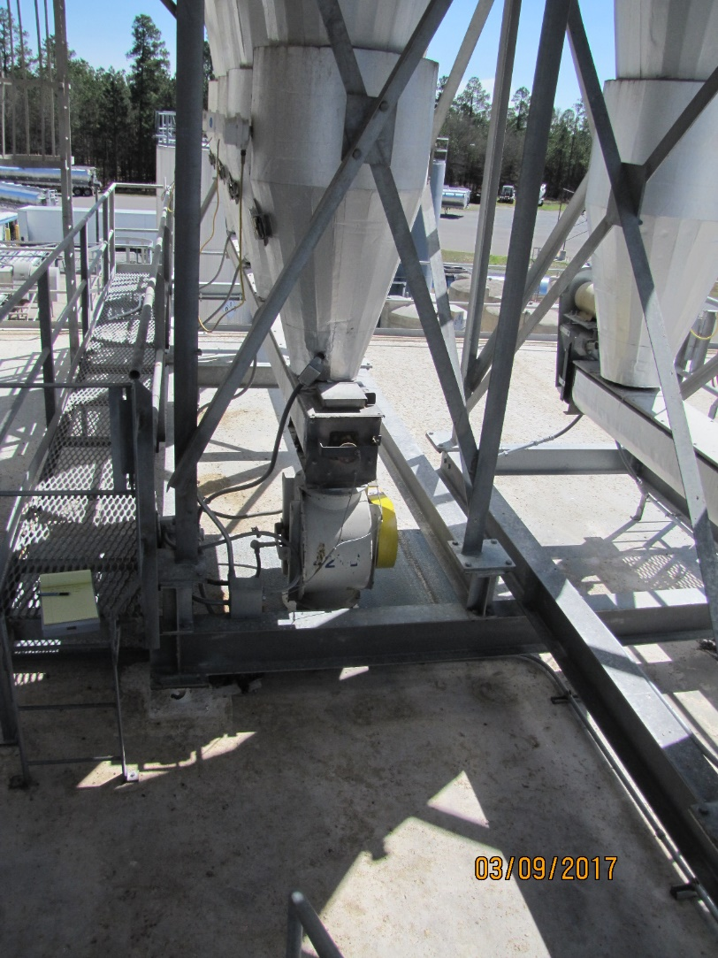
Case Study #1 – Mountaire Farms
Let’s begin with a straight-forward LOTO example.
A maintenance employee went to the roof to address a clogged screw conveyor.
Inspection 318100922
NCDOL Photo Library

Slide 3
Case Study #1 – Mountaire Farms
At just before midnight, an alarm signaled in the control room that the Goodman screw conveyor was plugged. It moves “fines” for the feed mill.
Operator took it offline and radioed a maintenance mechanic to investigate. He found the exit lid had popped-up due to the clog.
The mechanic spent 90 minutes attempting to unclog the plugged conveyor using a 4’ PVC pipe (1/2-inch diameter).

Slide 4
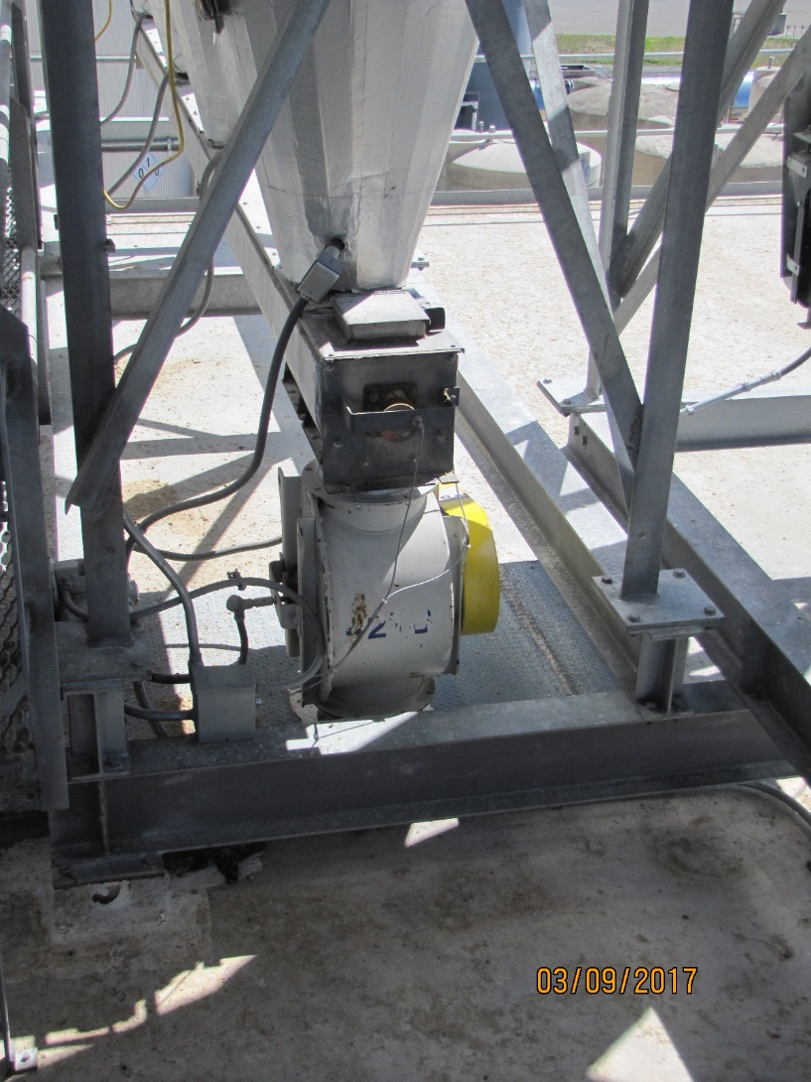
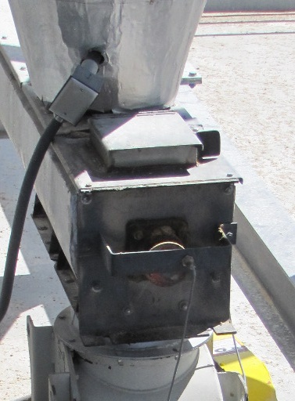
Case Study #1 – Mountaire Farms
NCDOL Photo Library
The maintenance mechanic spent 90 minutes attempting to unclog the conveyor through this opening with a 4’ long PVC pipe.
NCDOL Photo Library

Slide 5
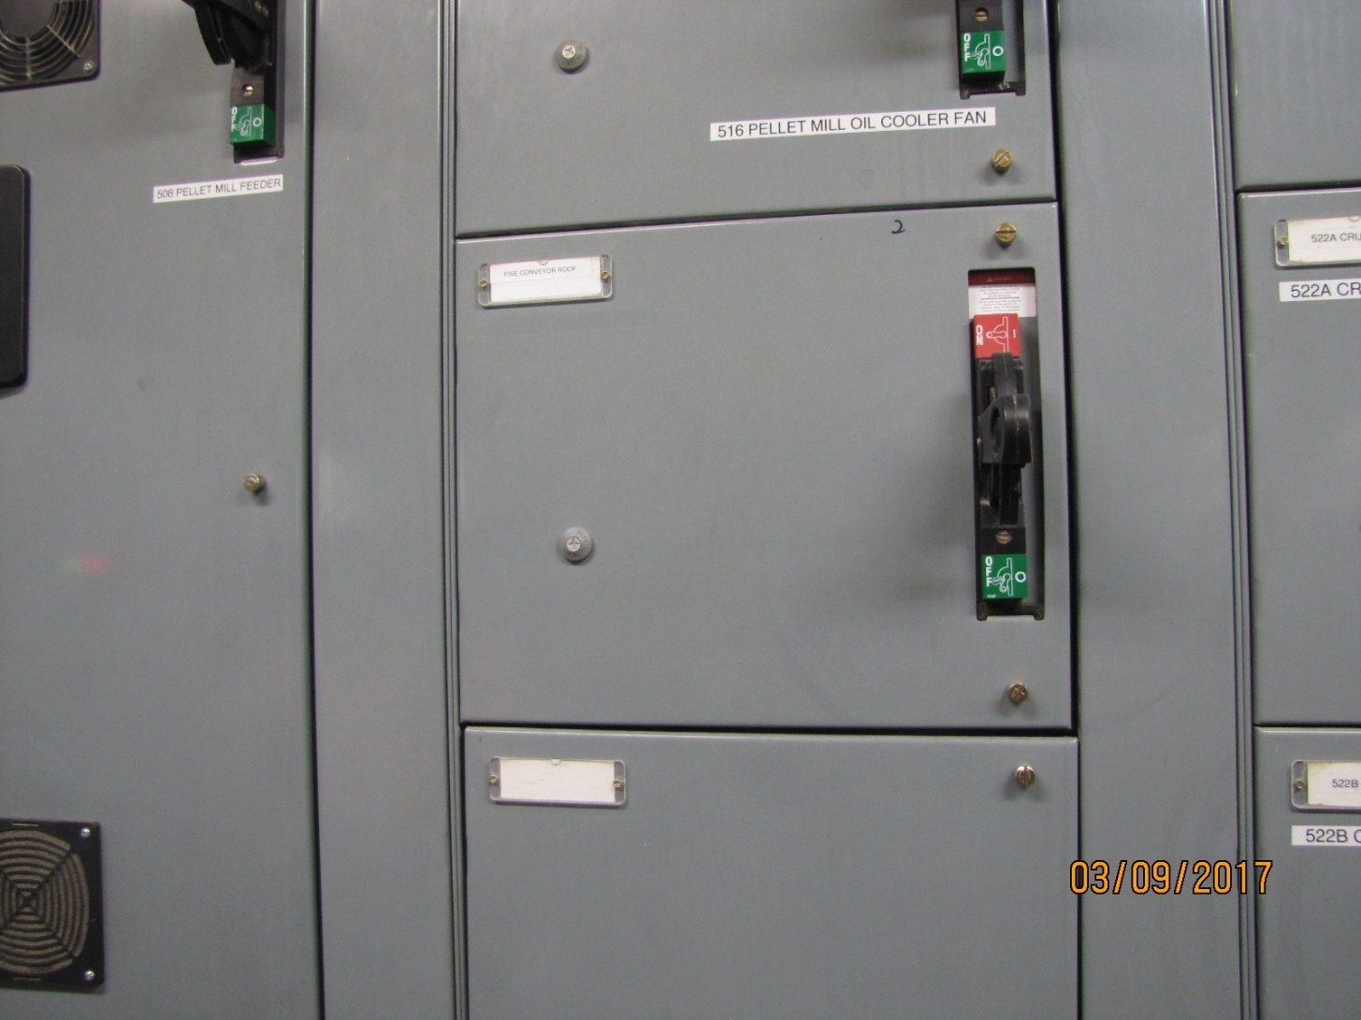
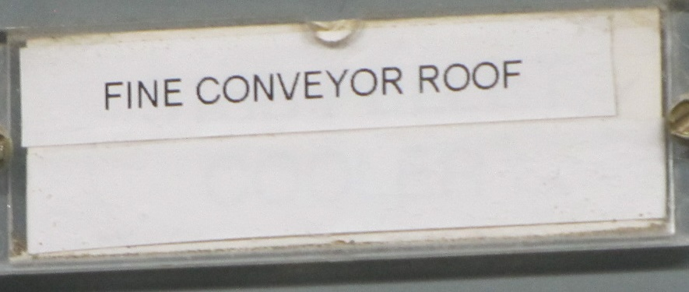
Case Study #1 – Mountaire Farms
NCDOL Photo Library
After each attempt, he would radio the control room operator to turn on the conveyor to see if material would flow. There were 20+ attempts in 90 minutes.
NCDOL Photo Library

Slide 6
Case Study #1 – Mountaire Farms
At 1:45 am, the mechanic reached into the opening with his left hand to feel for any build-up on the screw when it suddenly started turning.
He suffered the degloving of his lower left arm from the elbow to the wrist and fractured left thumb.
NCDOL Photo Library

Slide 7
Case Study #1 – Mountaire Farms
The employer had a LOTO policy, but had not developed a written energy control procedure for this equipment because the activity fell under the minor servicing exemption. Other elements of the program were in place.
The employer’s counsel stated there was no employee exposure because the policy required the use of the PVC pipe to clear the jam.
What should be cited in this situation?

Slide 8
Case Study #1 – Mountaire Farms
Does the minor serving exemption apply?

Slide 9
Case Study #1 – Mountaire Farms
Does the use of the PVC pipe prevent exposure to the hazard?

Slide 10
Case Study #1 – Effective Guarding?
CPL 02-00-147, page 2-26

Slide 11
Case Study #1 – Effective Guarding?
CPL 02-00-147, page 2-27

Slide 12
Citation

Slide 13
The Final Result

Slide 14
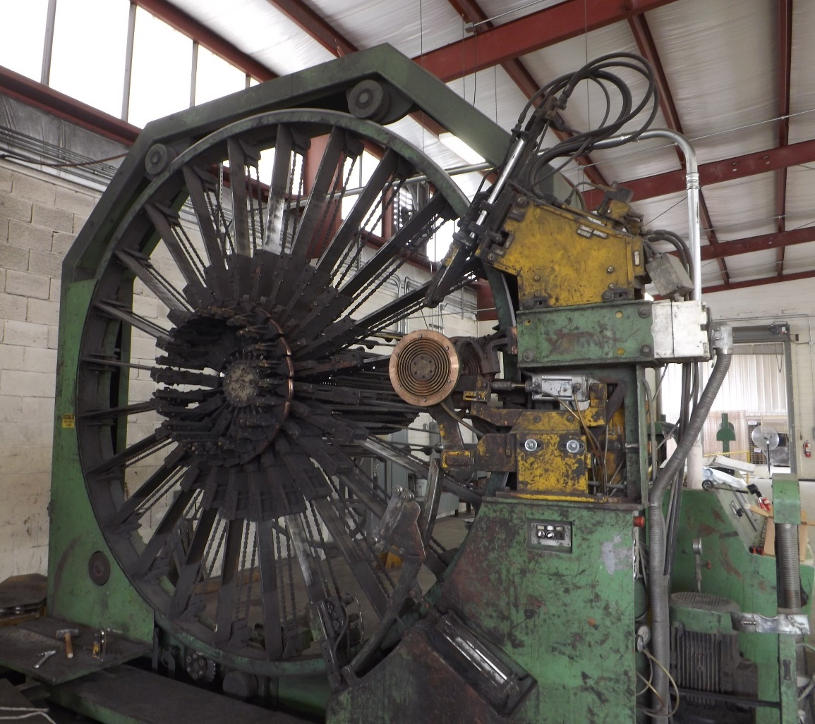
Case Study #2 – Johnson Concrete
Now we’re getting a bit more complicated.
This case involves an accident involving machine operators, including two that are temporary employees.
NCDOL Photo Library

Slide 15
Case Study #2 – Johnson Concrete
Initial referral hazard description:
  The employee, a temporary worker, was working with one or more other employees on an MBK 450 cage welder machine, which makes the wire support that the concrete is poured around. Metal rods are fed into the machine where they are welded to form the cage. The cage got hung up/caught and the employees climbed past the railing system and tried to pull it out. While they were doing this, one of the wheels that rotates the wire moved and rolled on and fractured the employee's ankle.
  The employee was transported from Salisbury to Baptist Hospital in Winston-Salem.

Slide 16
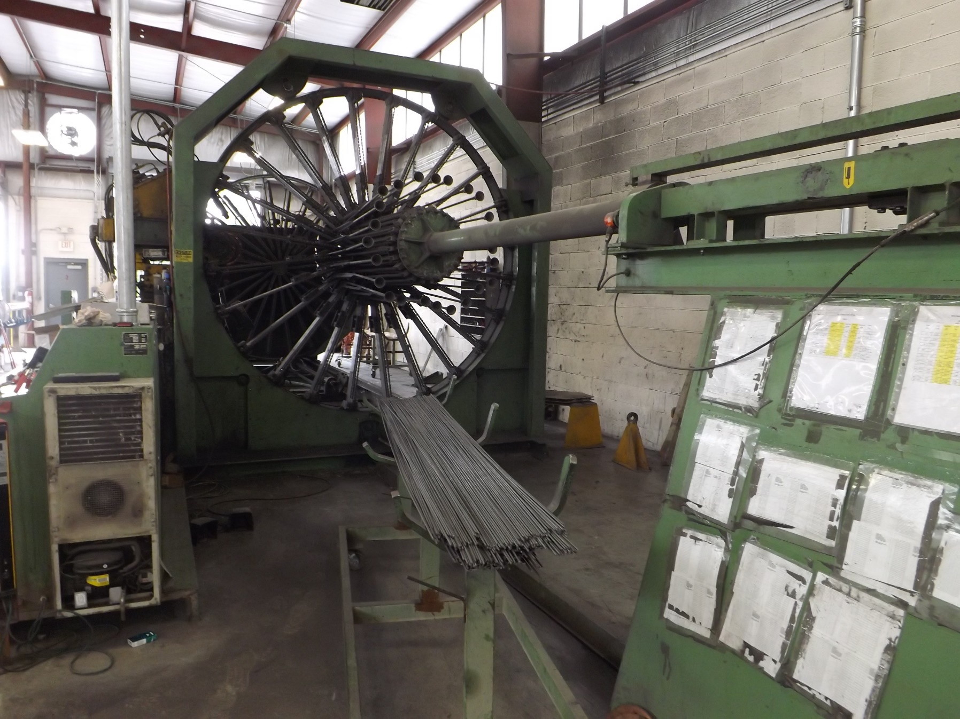
Case Study #2 – Johnson Concrete
NCDOL Photo Library

Slide 17
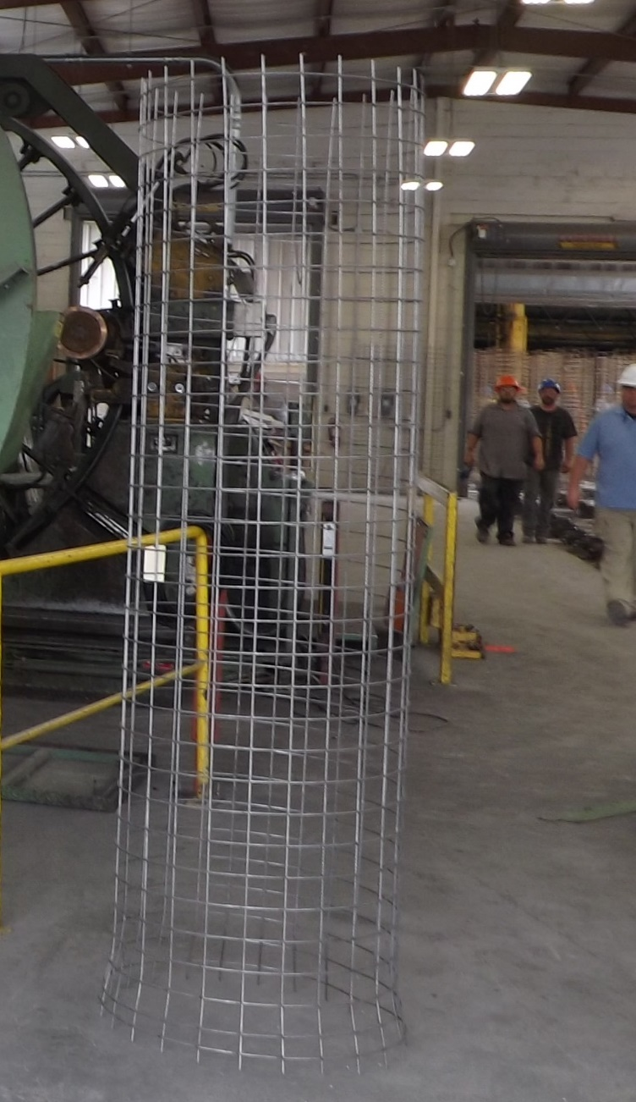
Final product from the MBK 450 wire cage welding machine
NCDOL Photo Library

Slide 18
Case Study #2 – Johnson Concrete
A temporary employee was working with two other employees on the MBK 50 cage welder machine. The cage got hung-up/caught and the employees climbed past the railing system and tried to pull it out.
When all three employees were standing on, or between the base frame railing, the machine unexpectedly became operational. It moved and caught the victim’s foot between the stationary support I-beam and the moving feed wheel support console.
The 24-year old victim suffered a severely fractured ankle. After multiple surgeries, his lower right leg was amputated, just below the knee.

Slide 19
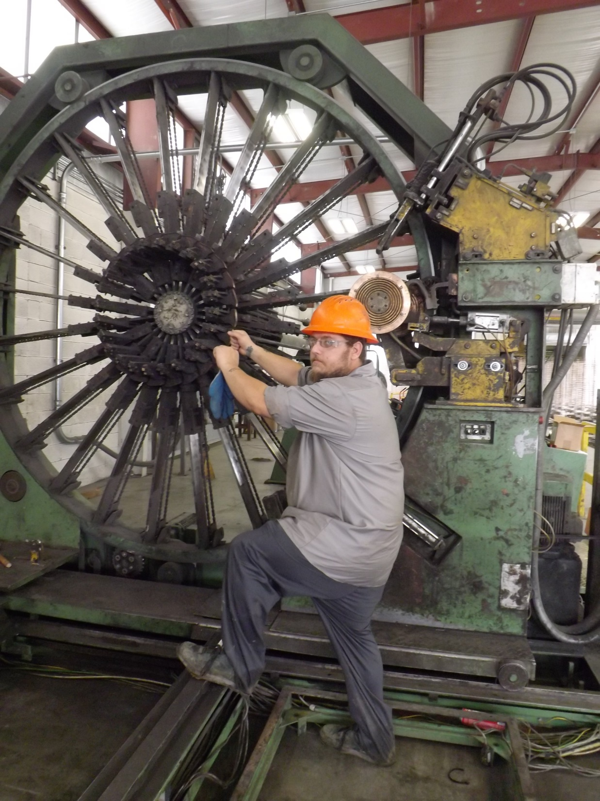
Employee demonstrating where they stand to remove the cage.
The equipment was completely locked out during this demonstration.
NCDOL Photo Library

Slide 20
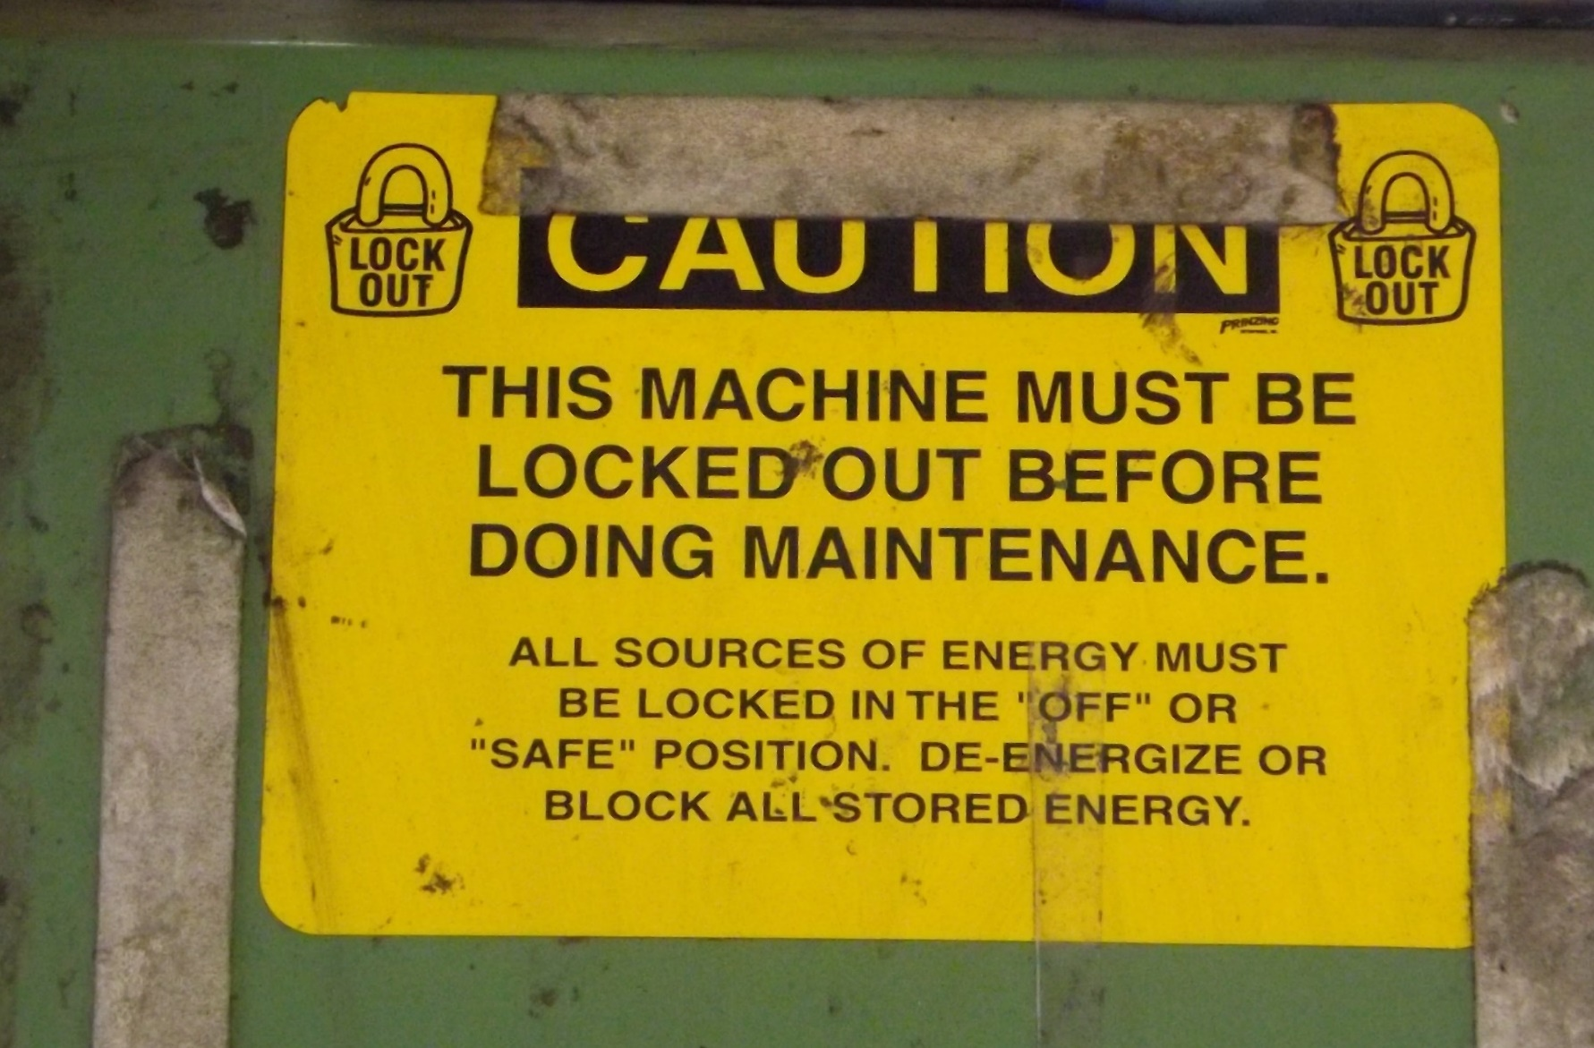
Case Study #2 – Johnson Concrete
NCDOL Photo Library

Slide 21
Case Study #2 – Johnson Concrete
The employer had a general LOTO program in place, but they didn’t have specific procedures for the MBK 450.
  Machine is not cord and plug, and has electrical, hydraulic, and pneumatic energy.
The employer had a LOTO training program in place, but neither of the temp employees had received training.
What citations would you recommend in this case?

Slide 22
Case Study #2 – Johnson Concrete

Slide 23
Case Study #2 – Johnson Concrete

Slide 24
Case Study #2 – Johnson Concrete
The employer was also cited for the failure to guard a pinch point hazard on the machine during normal operation.
The employer requested an informal conference, where no changes were made. They paid the full penalty of $22,400 without contesting.
What should be done about the temporary staffing company?

Slide 25
Case Study #2(a) - Staffmasters
Inspection 318120979
Should they be cited for the failure to develop. Document, and utilize energy control procedures?
Should they be cited for not training their two employees as authorized employees?
What would you recommend and why?

Slide 26
Case Study #2(a) - Staffmasters

Slide 27
Case Study #2(a) - Staffmasters
Staffmasters requested an informal conference in this case. They explained all employees receive general S&H training prior to being assigned – and requested the citation be deleted.
Part of the evidence in this case was the Staffmasters Client Evaluation form, which noted employees would be “making cages from steel pipe.” That was done with the MBK 450.
The employer signed an ISA keeping the serious violation and reducing the penalty by 35%. The also agreed to some additional stipulations.

Slide 28
Case Study #3 – Hanwha Adv. Materials
This is another case involving machine operators.
This was a glass-mat-reinforced thermoplastic process where polypropylene is combined with glass in an extrusion process to form sheets of material. The process on the accident machine involved slitting and cutting of the material.

Slide 29
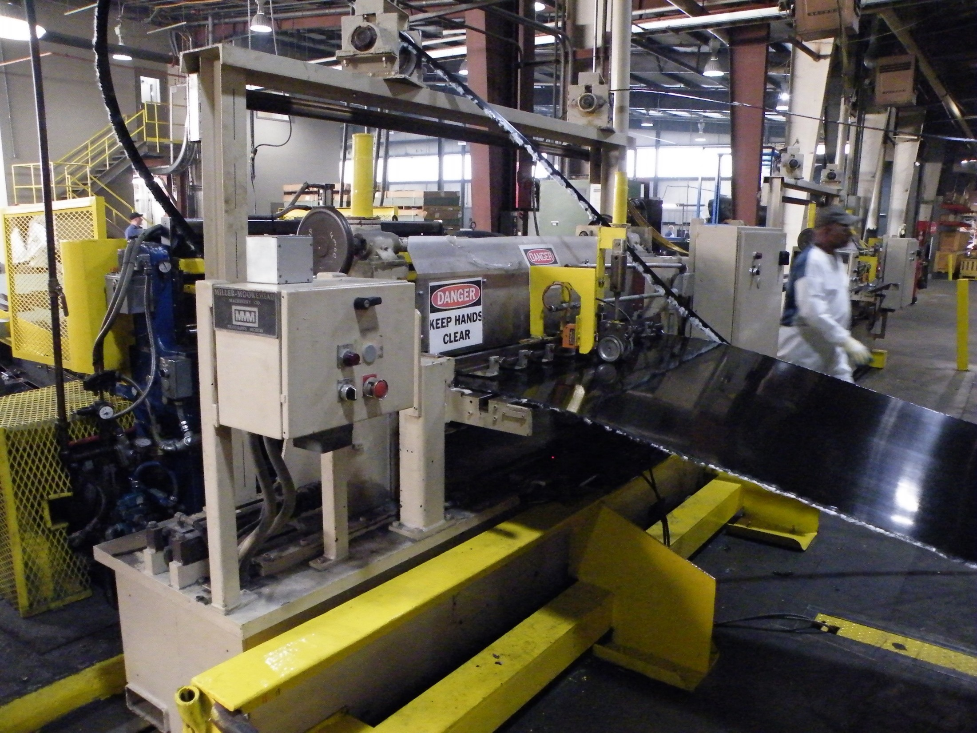
Thermoplastic material coming into the slitter is cut it into specified widths. It then goes to the vertical shear. A “bow-up” occurs at this location when there is a break in the material in the slitter or a mis-feed from the slitter to the shear.
NCDOL Photo Library

Slide 30
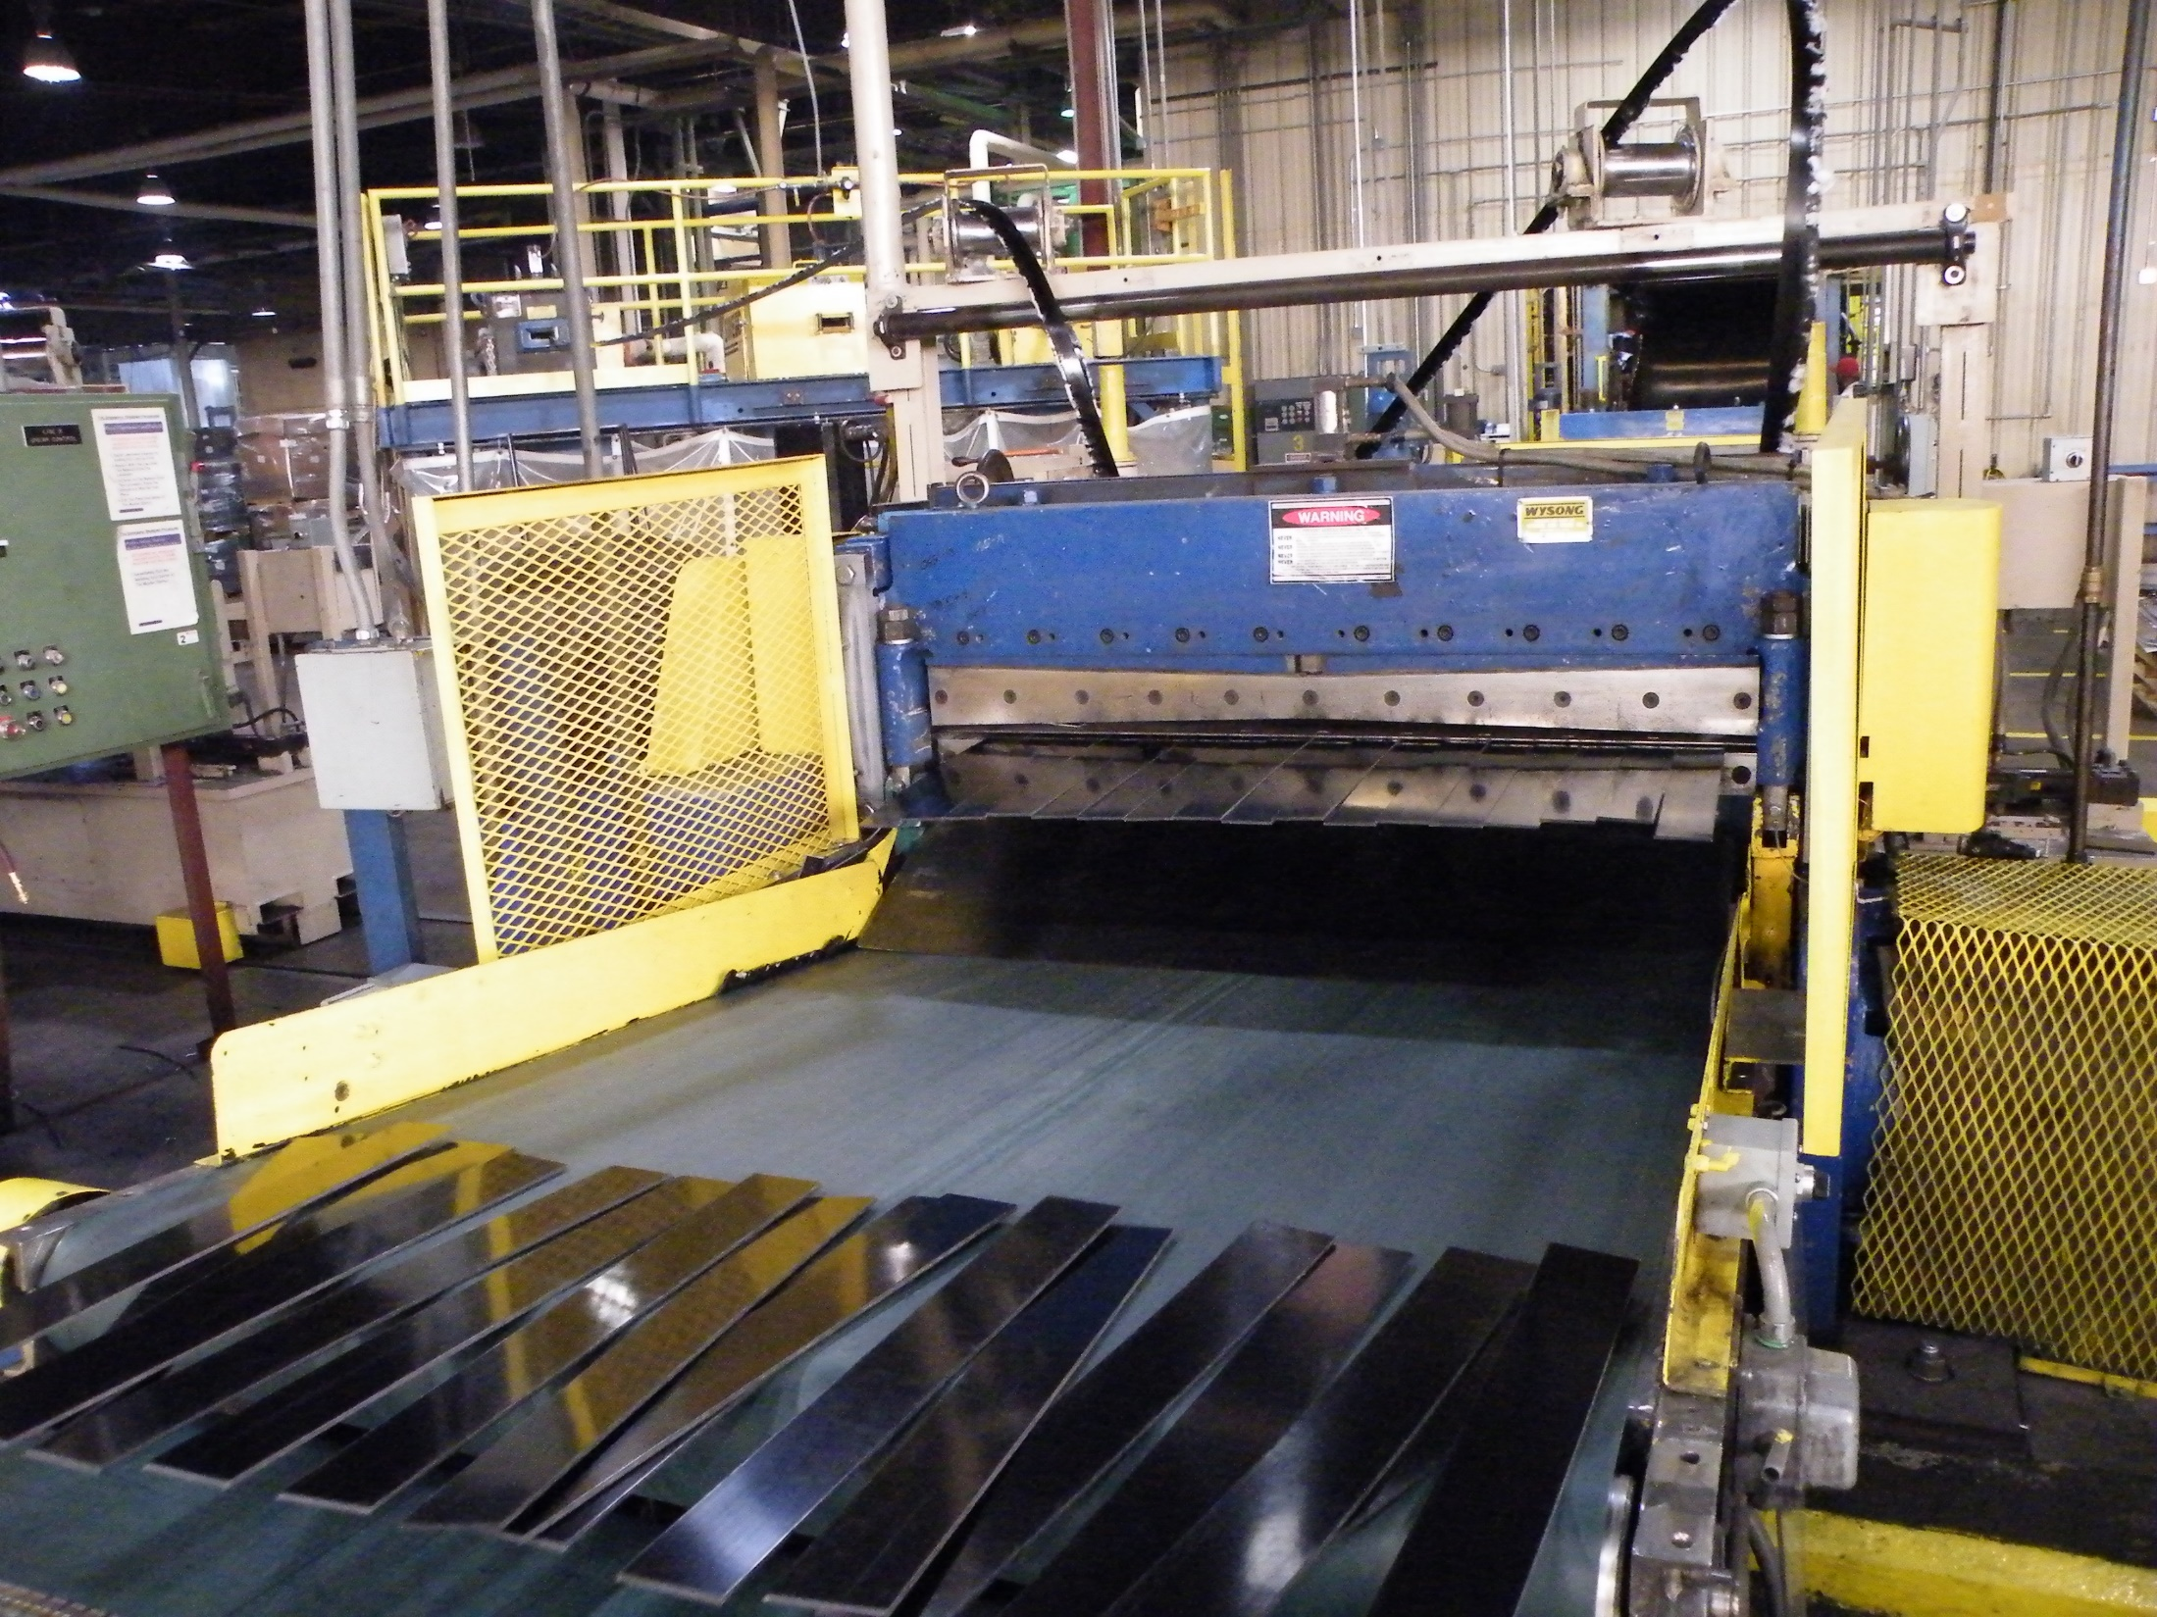
Thermoplastic material after going through the slitter and shear.
NCDOL Photo Library

Slide 31
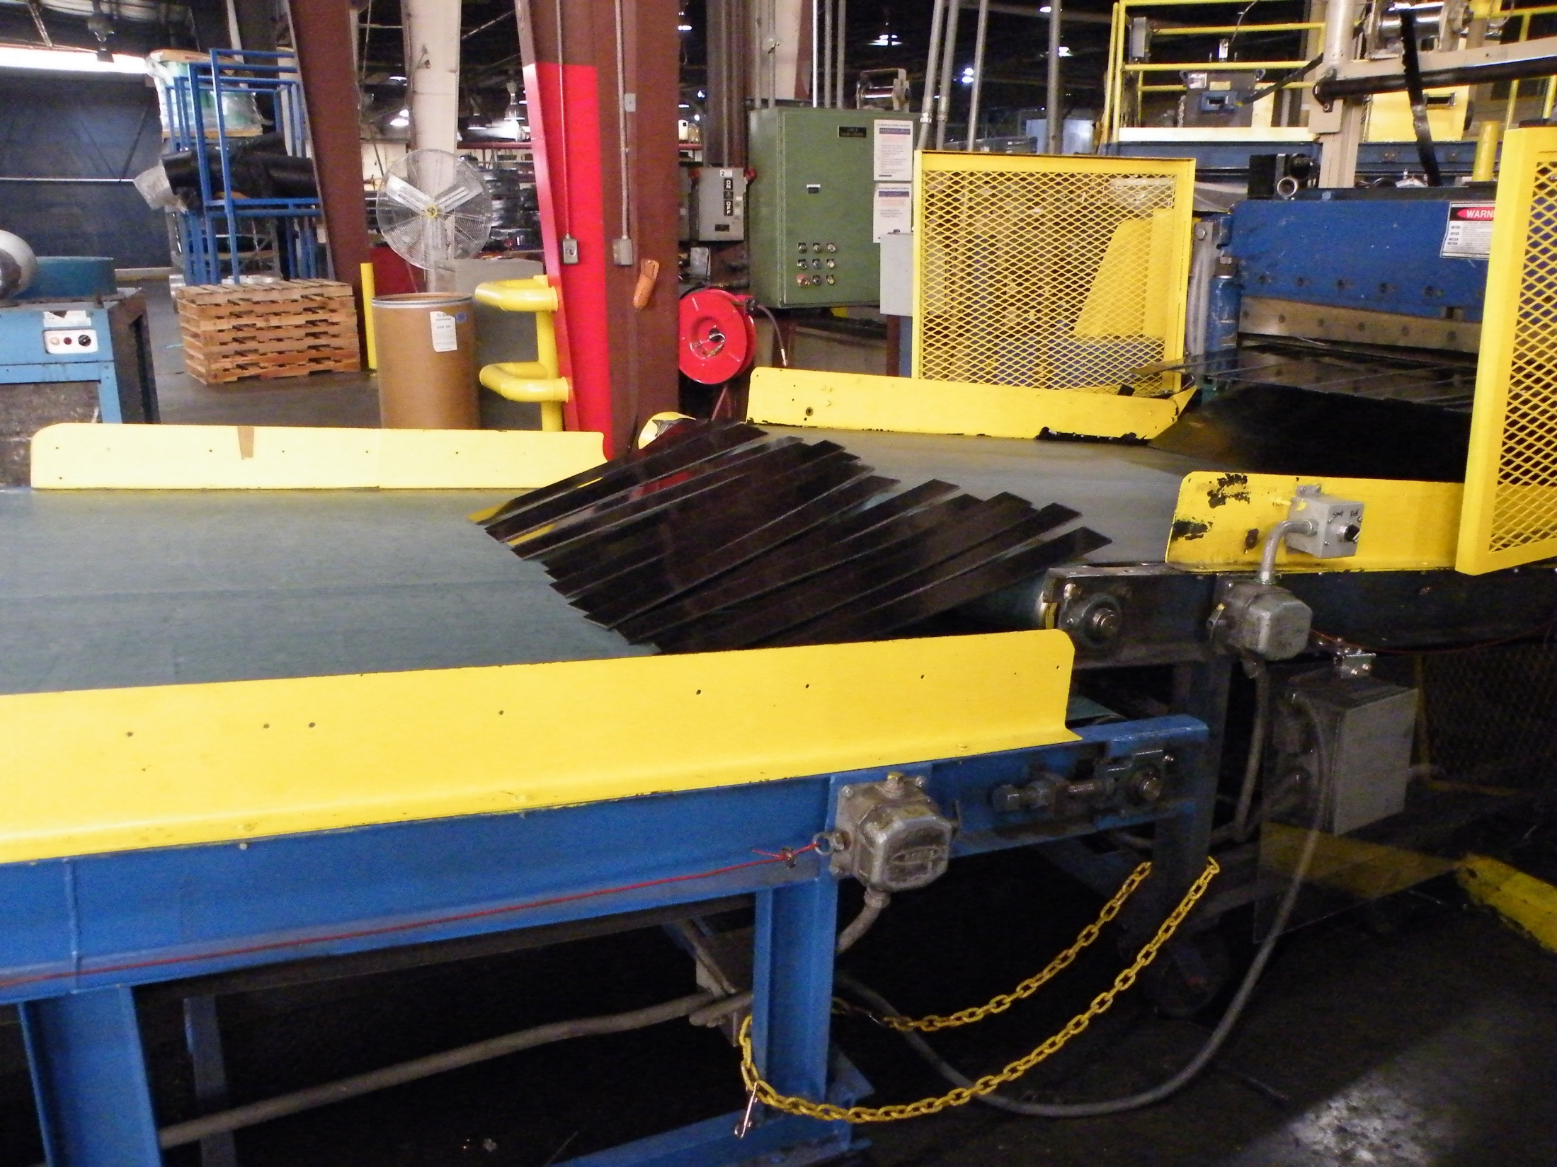
Thermoplastic material after going through the slitter and shear.
NCDOL Photo Library

Slide 32
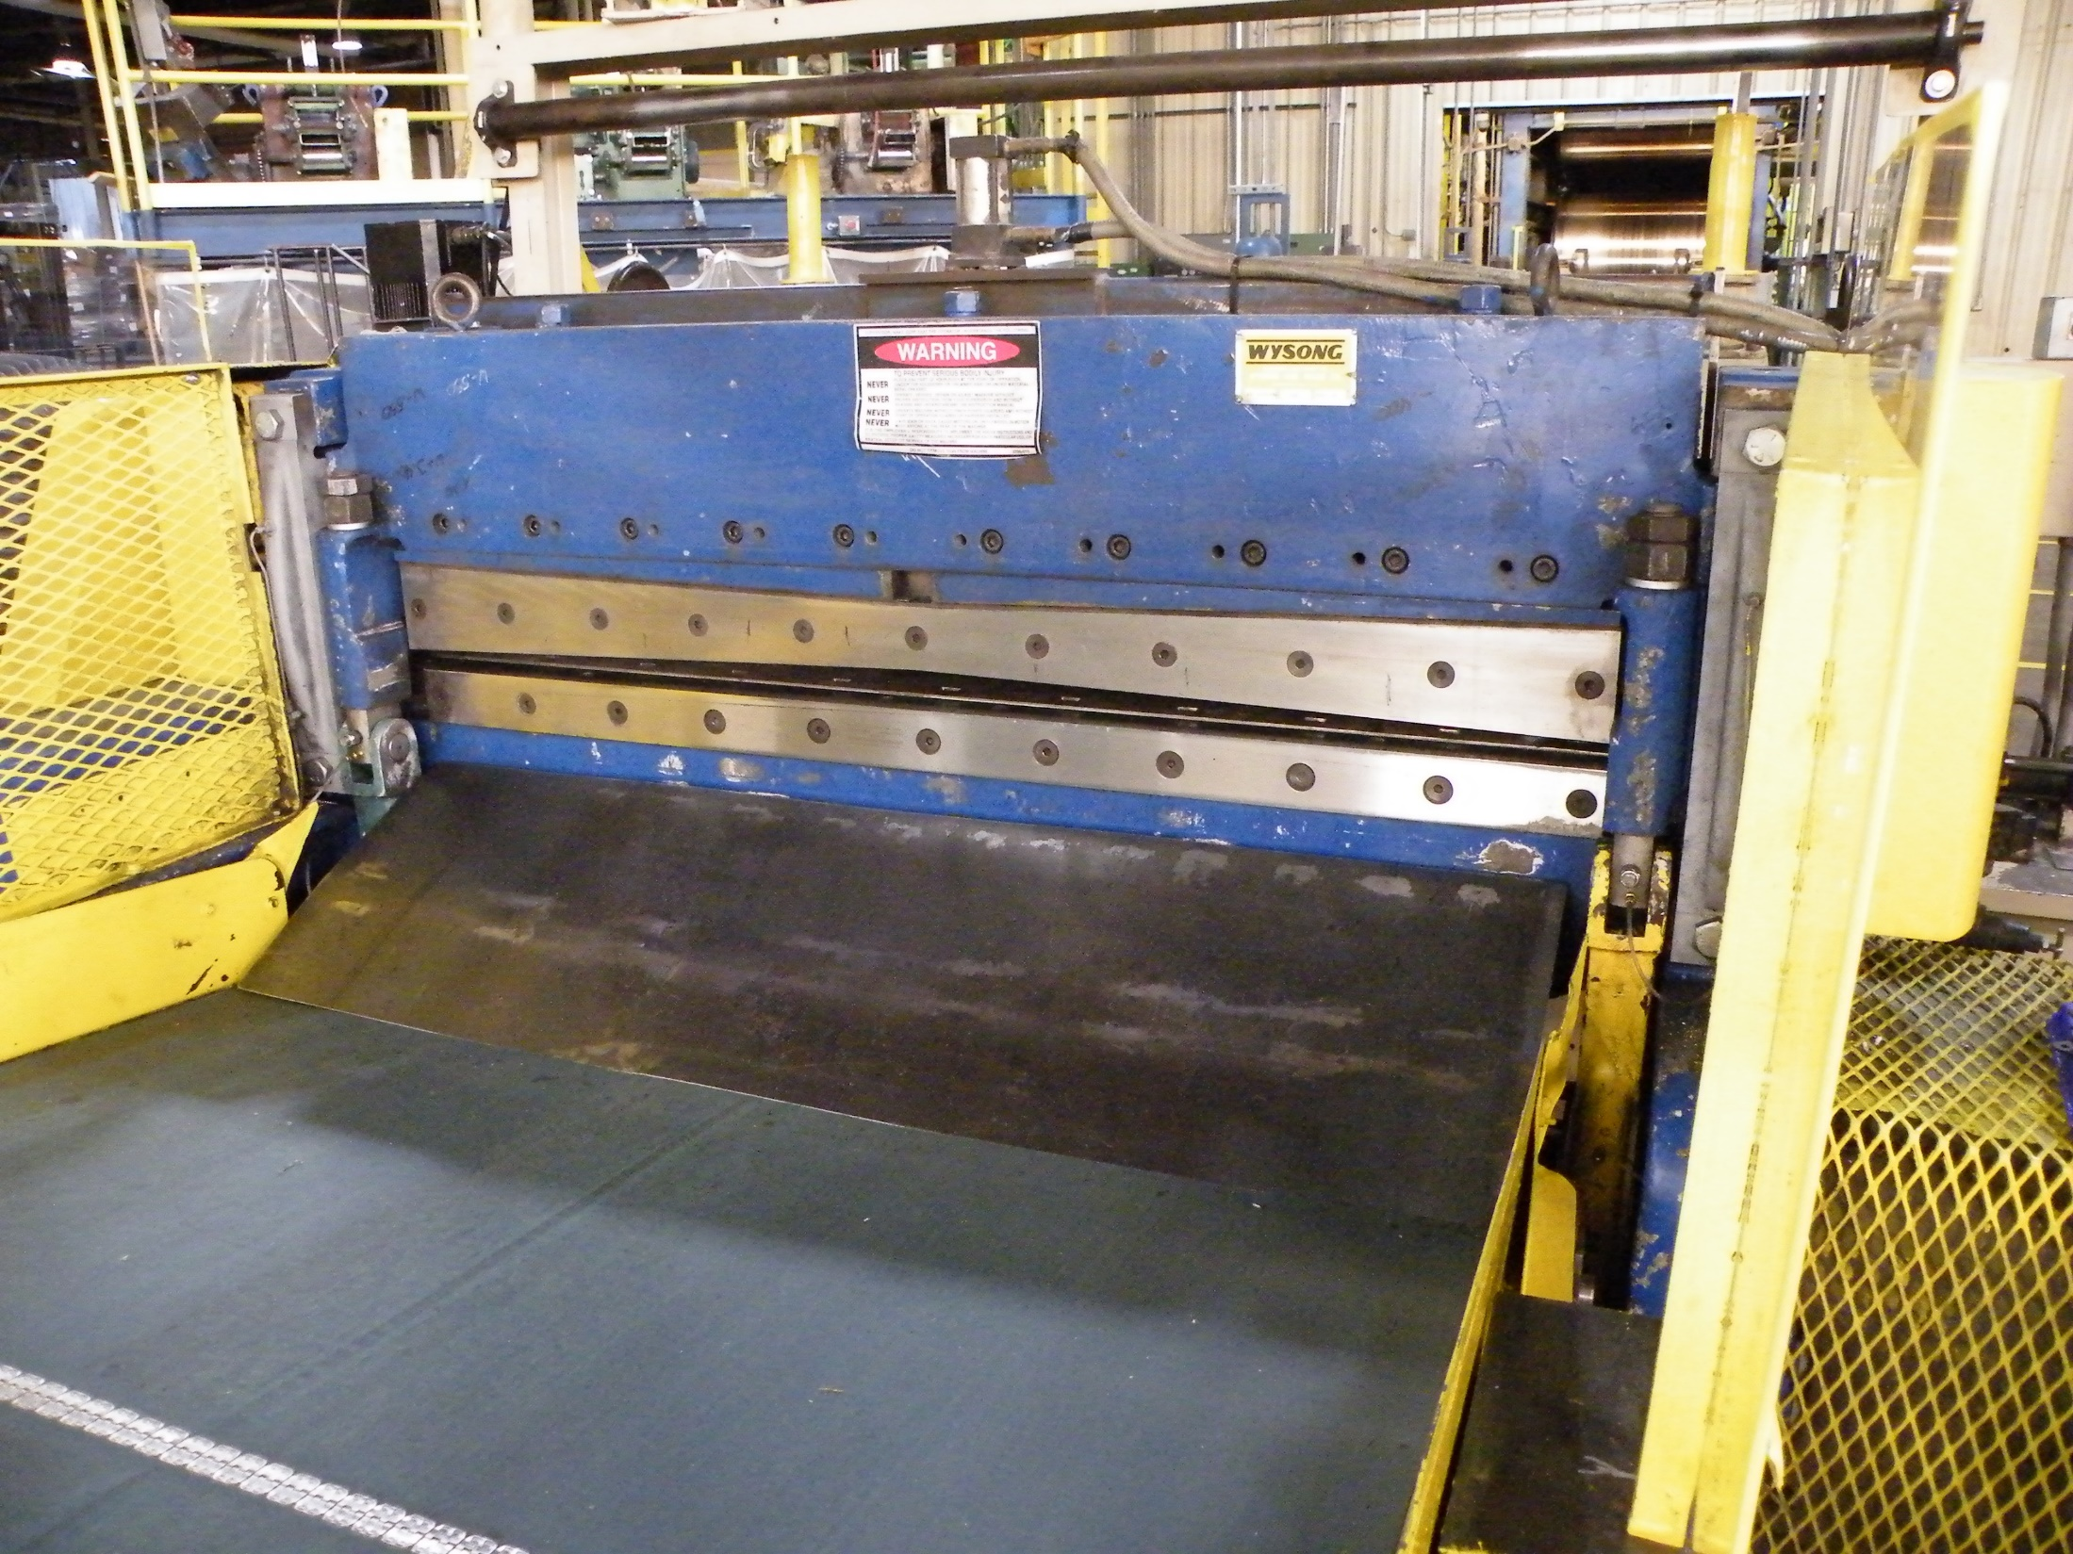
Shear – accident location
NCDOL Photo Library

Slide 33
Case Study #3 – Hanwha Adv. Materials
One of the operators suffered an amputation of the tip of their thumb.
CSHO determined that written LOTO procedures were in place for jobs identified as service and maintenance activities. Training had been conducted for affected and authorized employees.
What citation(s) would you recommend in this situation?

Slide 35
Case Study #3 – Hanwha Adv. Materials
The employer also cited for three instances of 1910.212(a)(1) for the lack of guarding on the line during normal production operations.
The employer requested an informal conference and ultimately agreed to both the LOTO and machine guarding items. The serious classification remained and the penalty was reduced by 25%.

Slide 36
Case Study #4 – Genpak LLC
One final case study is Genpak LLC (inspection 318137759) where a press operator suffered the partial amputation of the right hand and four fingers.
This is a thermoforming process that uses plastic sheeting or film. It is on a roll and fed through the thermoformer. At the time of the accident, it was manufacturing plastic cup lids for a major food chain.

Slide 37
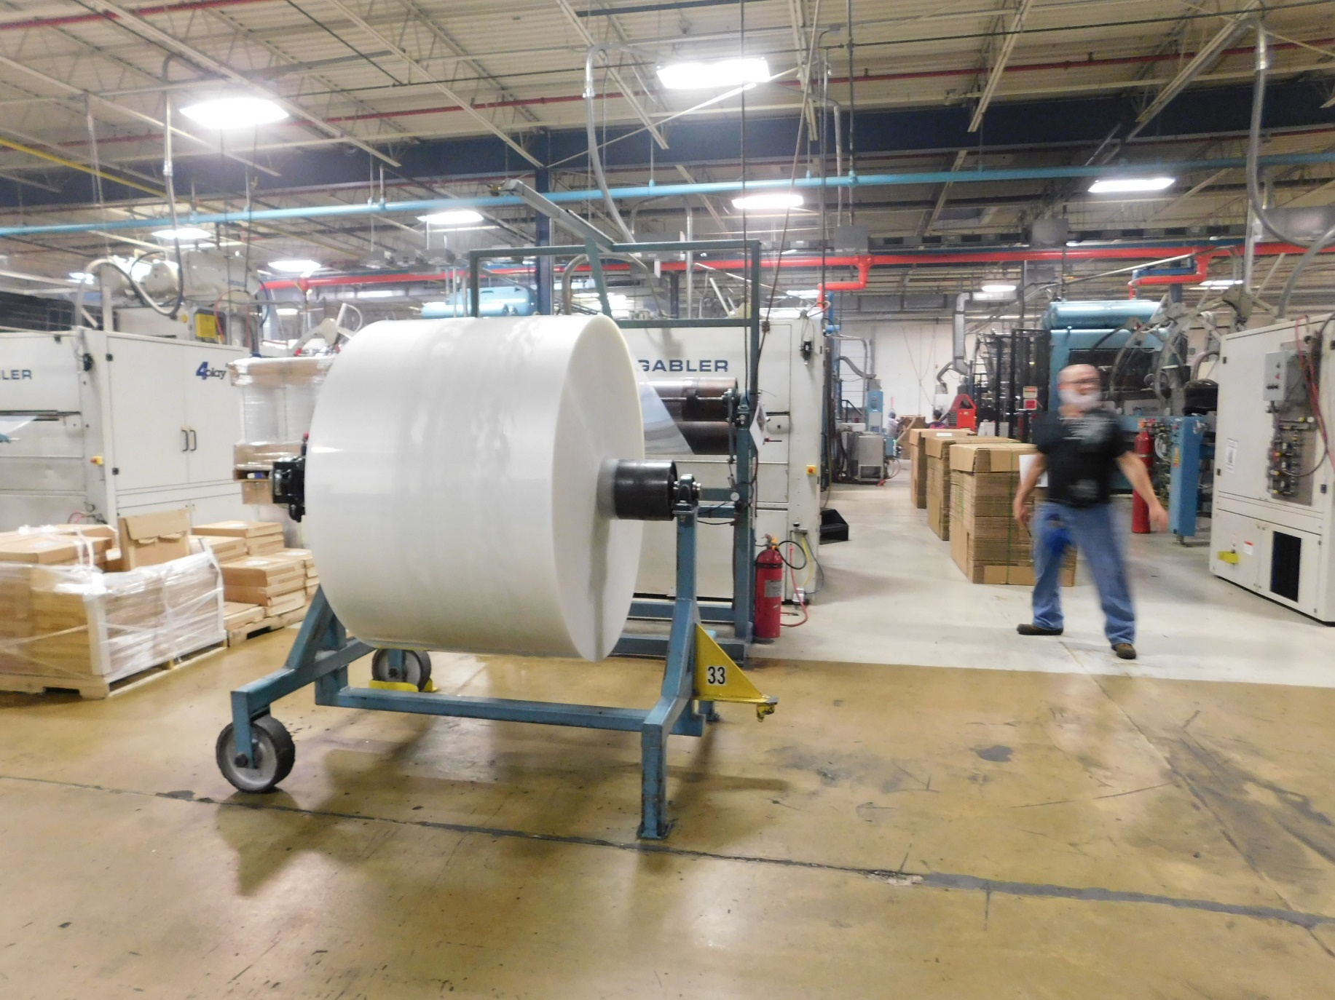
Case Study #4 – Genpak LLC
NCDOL Photo Library

Slide 38
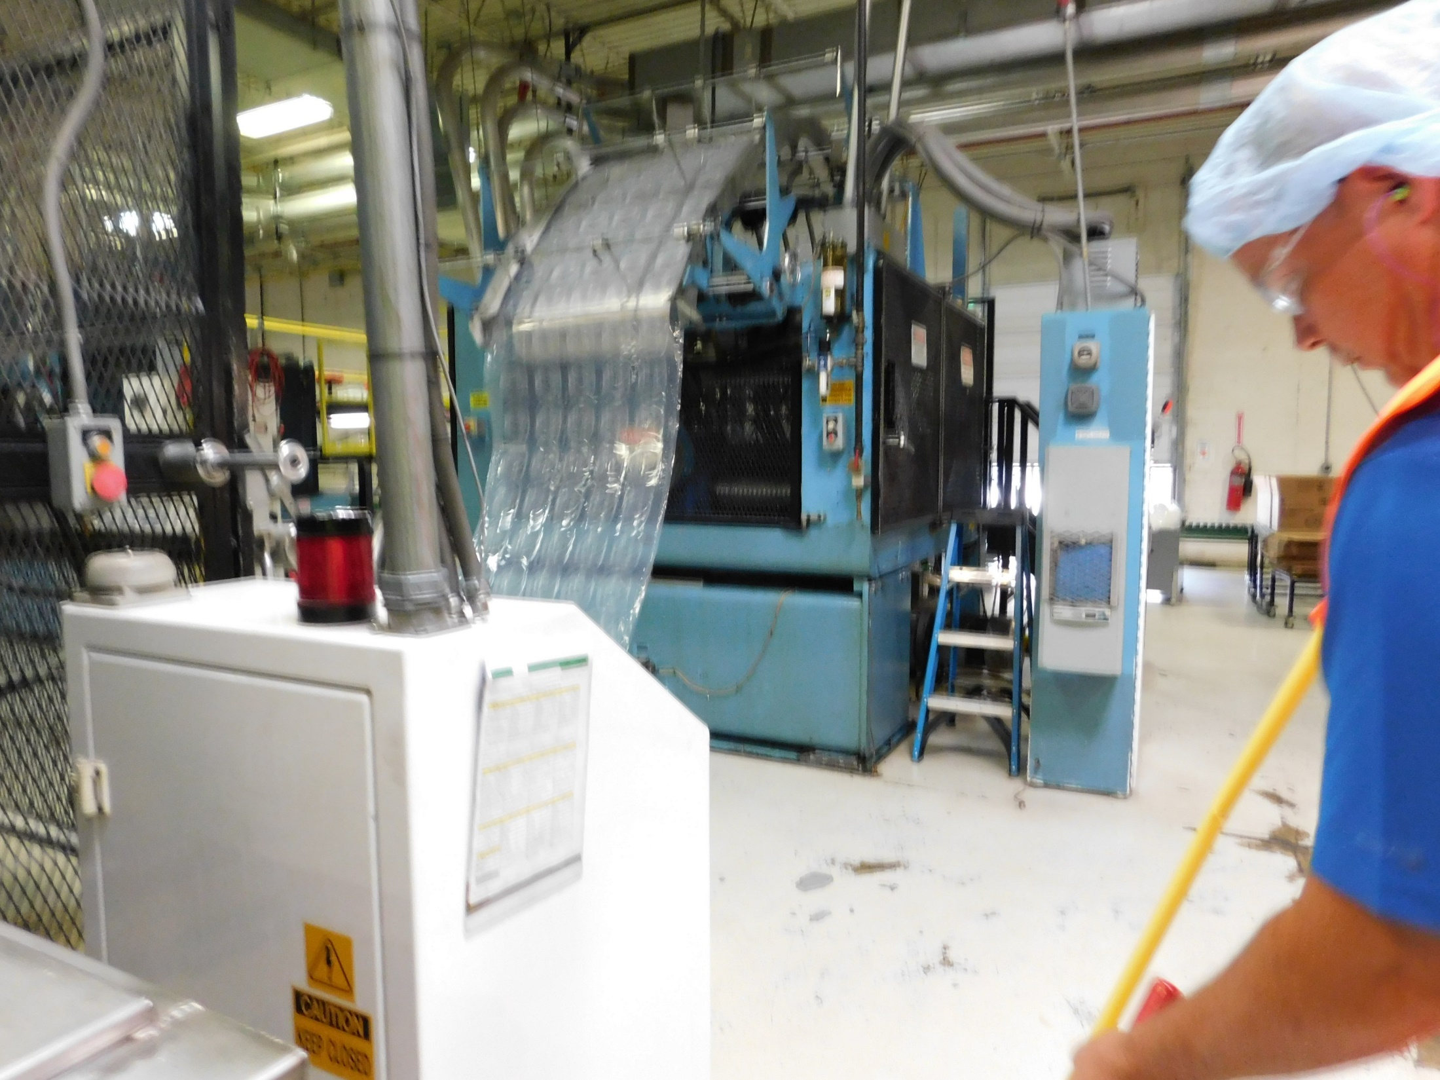
NCDOL Photo Library

Slide 39
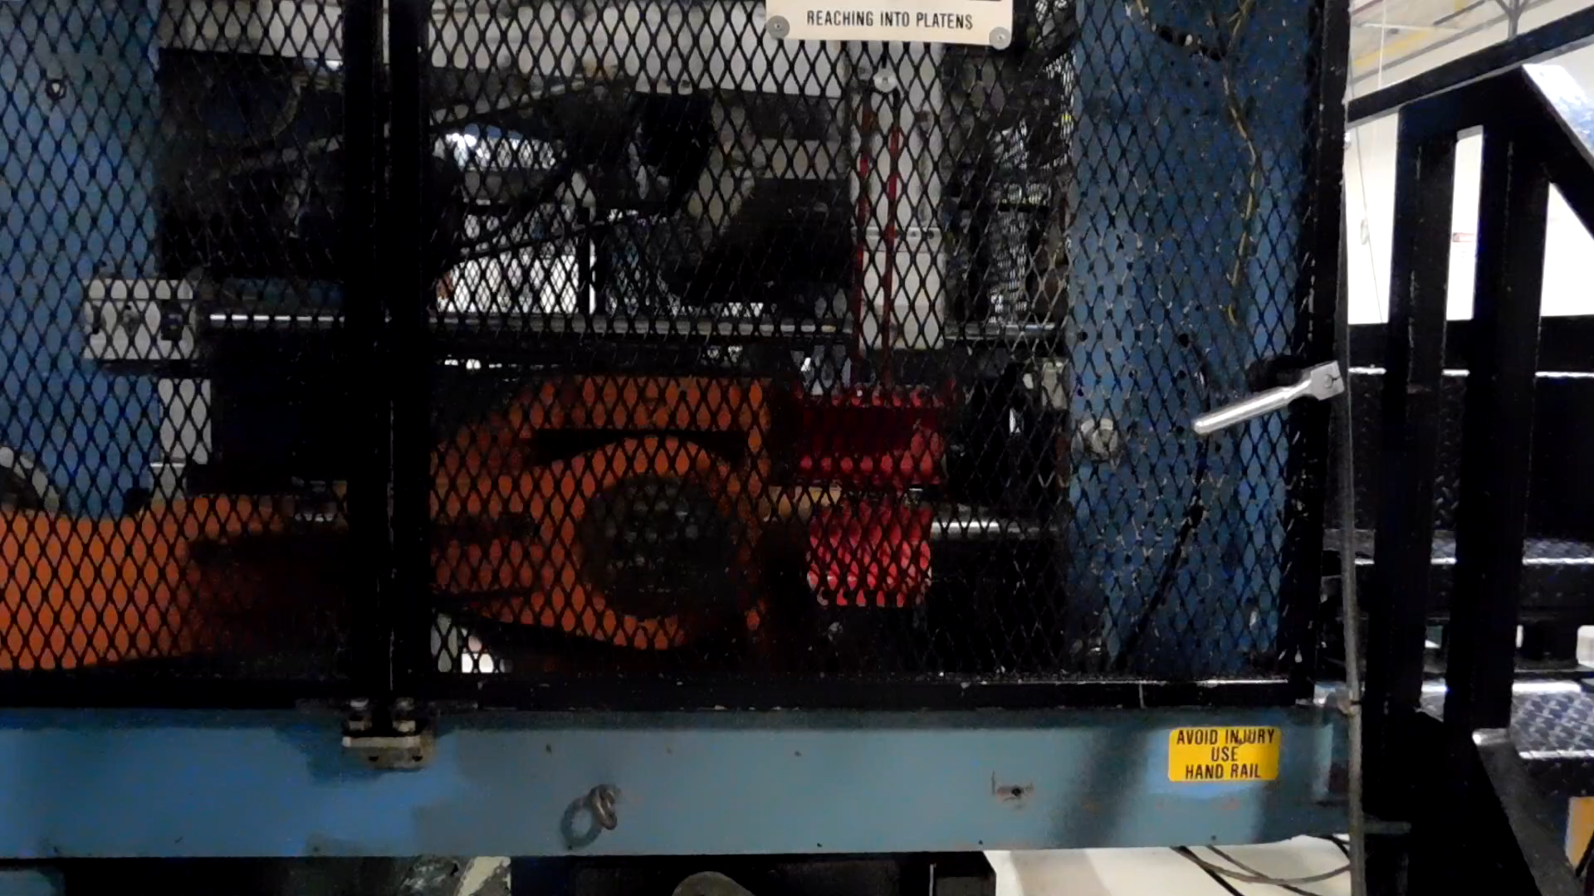


Slide 40
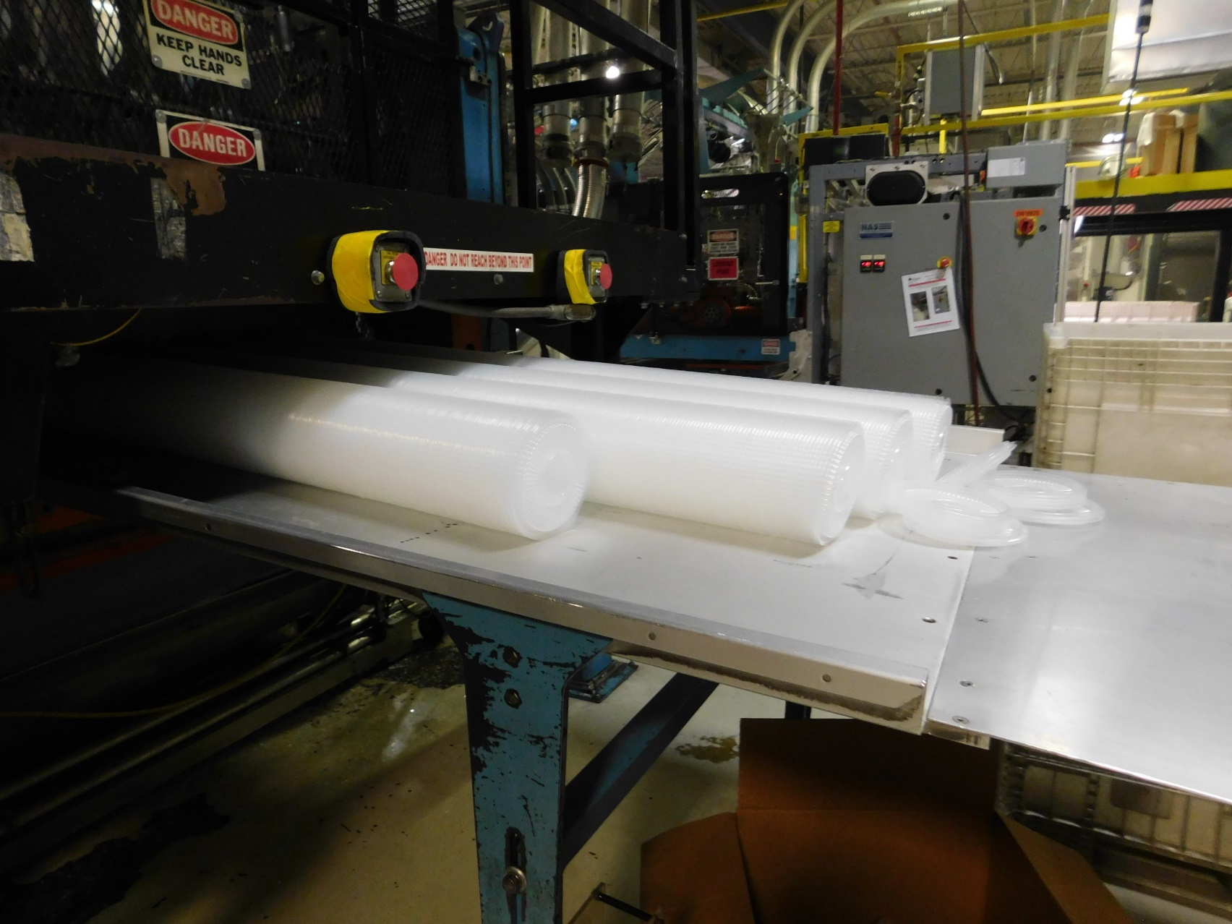
Case Study #4 – Genpak LLC
NCDOL Photo Library

Slide 41
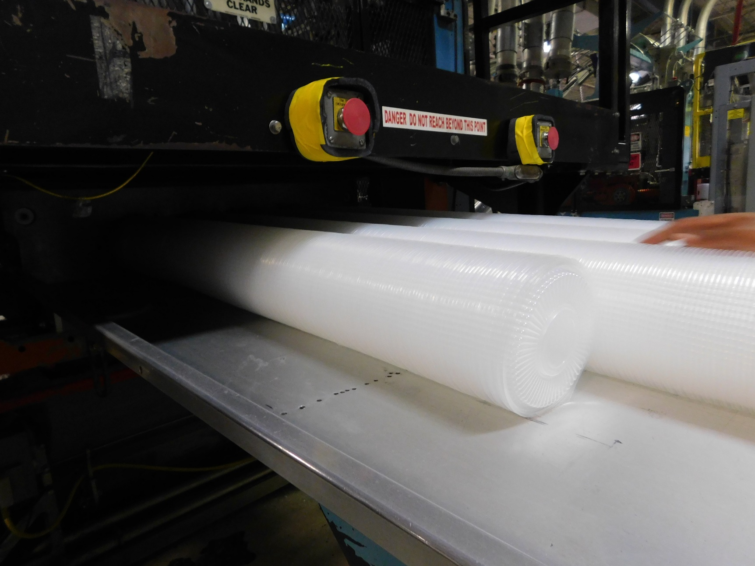
Case Study #4 – Genpak LLC
NCDOL Photo Library

Slide 42
Case Study #4 – Genpak LLC
Employee was an operator on the Magnum thermo forming line and had worked only five days following his orientation before the accident. He was trained for one day and then allowed to work independently.
The plastic roll was being changed at the time of the accident. When this is occurring, the machine “idles.” During this time, the machine operates at 24 cycles/minute. Employees are instructed to “clean” the packing table and surrounding areas of extra lids during this time.

Slide 43
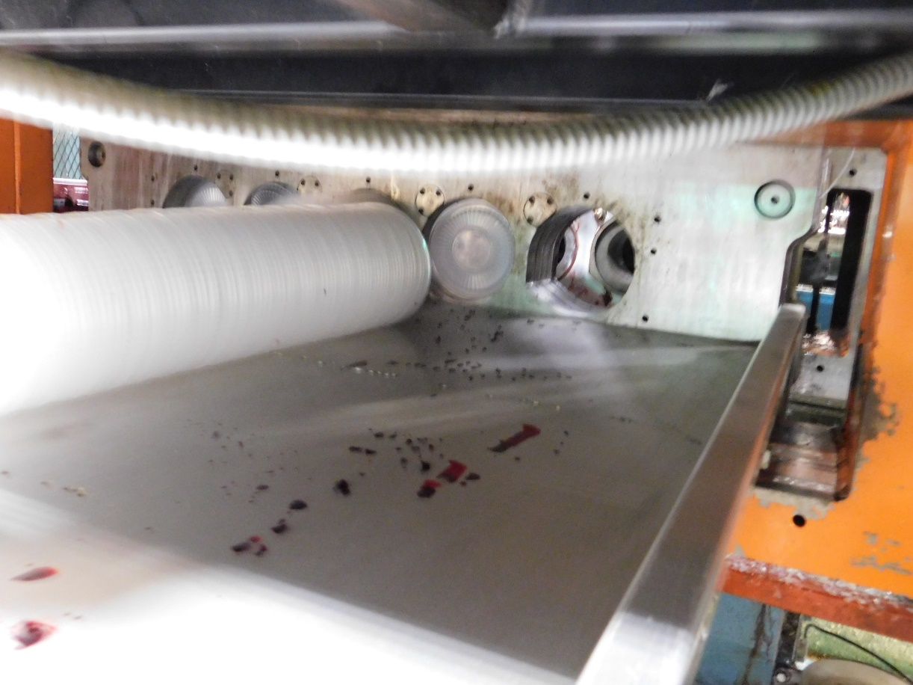
Case Study #4 – Genpak LLC
The victim noted he had observed co-workers reaching in to get loose lids while cleaning during the idle mode. He reached in and allegedly his right foot slipped on a lid and his hand went into the die.
NCDOL Photo Library

Slide 44
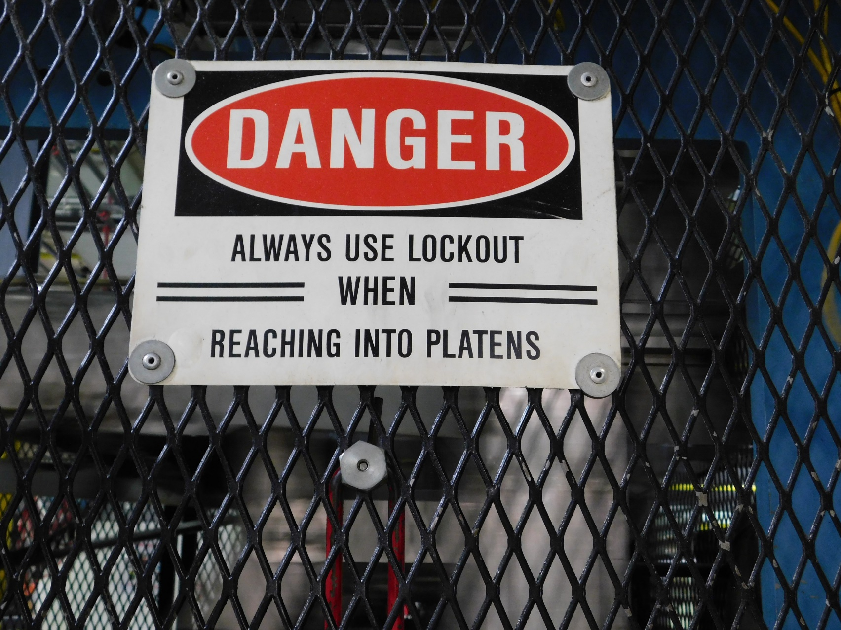
Case Study #4 – Genpak LLC
NCDOL Photo Library

Slide 45
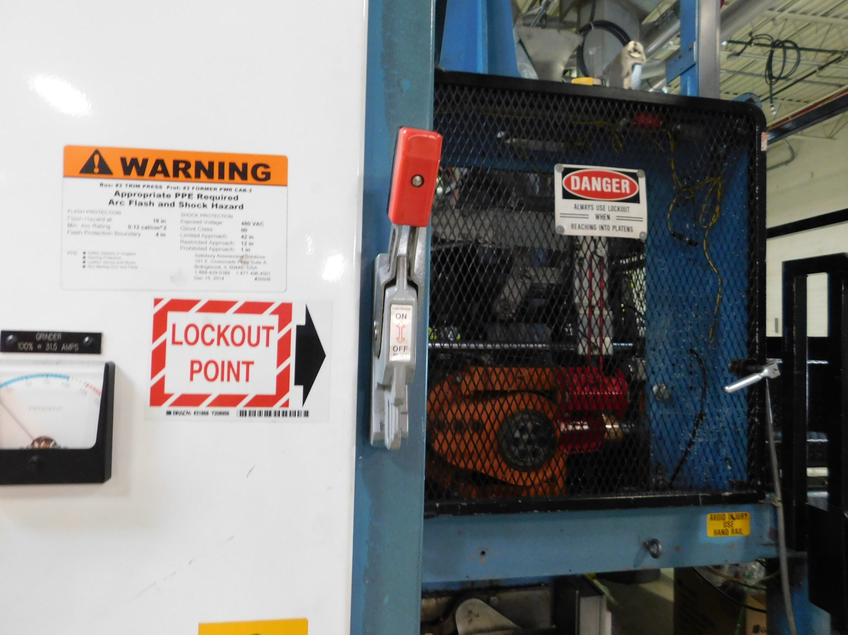
Case Study #4 – Genpak LLC
NCDOL Photo Library

Slide 46
Case Study #4 – Genpak LLC
The employer had a LOTO program but was aware employees were trained to clean without utilizing energy control procedures during the “idle” mode when the roll was being changed.
The employer’s LOTO program had blank periodic inspection forms in Appendix A and B, but the employer hadn’t completed any of those inspections.
The victim had not received any LOTO training since being hired.
What citations will you recommend?

Slide 47
Case Study #4 – Genpak LLC

Slide 48
Case Study #4 – Genpak LLC

Slide 49
Case Study #4 – Genpak LLC

Slide 50
Machine Operators – What have we learned?
We need to understand the operation, the machinery & equipment, and the operators’ duties.
CSHOs need to specifically ask the operators about how they handle product jams and other upset conditions, as well as other “servicing and/or maintenance” activities, such as:
  Cleaning
  Lubricating
  Setting-up
  Inspections/trouble-shooting
Are the operators utilizing LOTO procedures during these activities? If not, does it fall under the minor servicing exemption? Are alternative measures (such an interlocked guard) in place?

Slide 51
Machine Operators – What have we learned?
Remember to look closely at LOTO training for these operators.
  Training and other program violations are established almost completely through interviews.
If they are conducting servicing and/or maintenance activities, they must be trained as an Authorized Employee.
Don’t forget to ask about periodic inspections of the energy control procedures. Have them walk you through an example inspection. Are they having an authorized employee actually observe another authorized employee implement the procedure during the audit?

Slide 52

Questions?

