Slide 1
Control of Hazardous Energy (Lockout/Tagout) – Part 1
Amputations SEP Training
September 2019
Notes:
Rev 3: 7/09/2015
The information in this presentation is provided voluntarily by the N.C. Department of Labor, Education, Training and Technical Assistance Bureau as a public service and is made available in good faith. This presentation is designed to assist trainers conducting OSHA outreach training for workers. Since workers are the target audience, this presentation emphasizes hazard identification, avoidance, and control – not standards. No attempt has been made to treat the topic exhaustively. It is essential that trainers tailor their presentations to the needs and understanding of their audience.
The information and advice provided on this Site and on Linked Sites is provided solely on the basis that users will be responsible for making their own assessment of the matters discussed herein and are advised to verify all relevant representations, statements, and information.
This presentation is not a substitute for any of the provisions of the Occupational Safety and Health Act of North Carolina or for any standards issued by the N.C. Department of Labor. Mention of trade names, commercial products, or organizations does not imply endorsement by the N.C. Department of Labor.
NCDOL References:
HAZARDOUS ENERGY CONTROL (Lockout/Tagout)
CPL 02-00-147 Control of Hazardous Energy
CPL 02-01-043 Slide-locks-Control of Hazardous Energy
CFR 106 Lockout/Tagout
CFR 106A Lockout/Tagout

Slide 2
Objectives
Develop a strong & working knowledge the LOTO standard (1910.147) and the documentation needed to support a citation.
Become familiar with the Federal OSHA LOTO CPL and understand how it can be used to support possible citations.
Discuss several accident case studies including those that involve maintenance employees and others where machine operators are involved.

Slide 3
OSHA LOTO CPL

Slide 4
OSHA LOTO CPL
CPL 02-00-147, Abstract-3

Slide 5
If you don’t learn anything else….
CPL 02-00-147, page 3-7

Slide 6
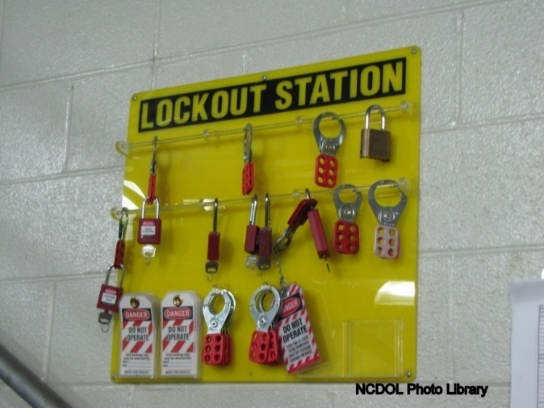
Lockout/Tagout
1910.147
Technically known as the Control of Hazardous Energy
Control of unexpected energization or start-up of machines or equipment, or release of stored energy that could cause injury to employees

Slide 7
Scope – Important Points
This standard protects employees from caught-in or struck-by hazards associated with the unexpected start-up of machinery during servicing and maintenance activities.
It generally does NOT apply to electricians working on the wiring of machinery or the building. That is covered under Subpart S of 29 CFR 1910.
As a result, you should not have an injury of “electrocution” for any 1910.147 citation.

Slide 8
Subpart S – Electrical Work Practices
1910.333(a)(1) "Deenergized parts." Live parts to which an employee may be exposed shall be deenergized before the employee works on or near them, unless the employer can demonstrate that deenergizing introduces additional or increased hazards or is infeasible due to equipment design or operational limitations. Live parts that operate at less than 50 volts to ground need not be deenergized if there will be no increased exposure to electrical burns or to explosion due to electric arcs.

Slide 9
Subpart S – Electrical Work Practices
1910.333(b)(2) "Lockout and Tagging." While any employee is exposed to contact with parts of fixed electric equipment or circuits which have been deenergized, the circuits energizing the parts shall be locked out or tagged or both in accordance with the requirements of this paragraph. The requirements shall be followed in the order in which they are presented (i.e., paragraph (b)(2)(i) first, then paragraph (b)(2)(ii), etc.).
Note 1: As used in this section, fixed equipment refers to equipment fastened in place or connected by permanent wiring methods.
Note 2: Lockout and tagging procedures that comply with paragraphs (c) through (f) of 1910.147 will also be deemed to comply with paragraph (b)(2) of this section provided that:
[1] The procedures address the electrical safety hazards covered by this Subpart; and
[2] The procedures also incorporate the requirements of paragraphs (b)(2)(iii)(D) and (b)(2)(iv)(B) of this section.

Slide 10
Subpart S – Electrical Work Practices
1910.333(b)(2)(i) "Procedures." The employer shall maintain a written copy of the procedures outlined in paragraph (b)(2) and shall make it available for inspection by employees and by the Assistant Secretary of Labor and his or her authorized representatives.
Bottom Line – Exposures to electrical current need to be addressed under Subpart S and not 1910.147.

Slide 11
Scope of 1910.147
1910.147(a)(1)
Covers the servicing and/or maintenance of machines or equipment where the unexpected start-up or release of stored energy could cause injury.
Servicing and/or maintenance. Workplace activities such as constructing, installing, setting up, adjusting, inspecting, modifying, and maintaining and/or servicing machines or equipment. These activities include lubrication, cleaning or unjamming of machines or equipment and making adjustments or tool changes, where the employee may be exposed to the unexpected energization or startup of the equipment or release of hazardous energy.

Slide 12
Scope – 1910.147
1910.147(a)(1)
Does not cover
Construction, agriculture, maritime
Installations under exclusive control of the electric utilities for power generation, transmission and distribution
Exposure to electrical hazards from work on, near, or with conductors or equipment in electric-utilization installations
Oil and gas drilling and servicing

Slide 13
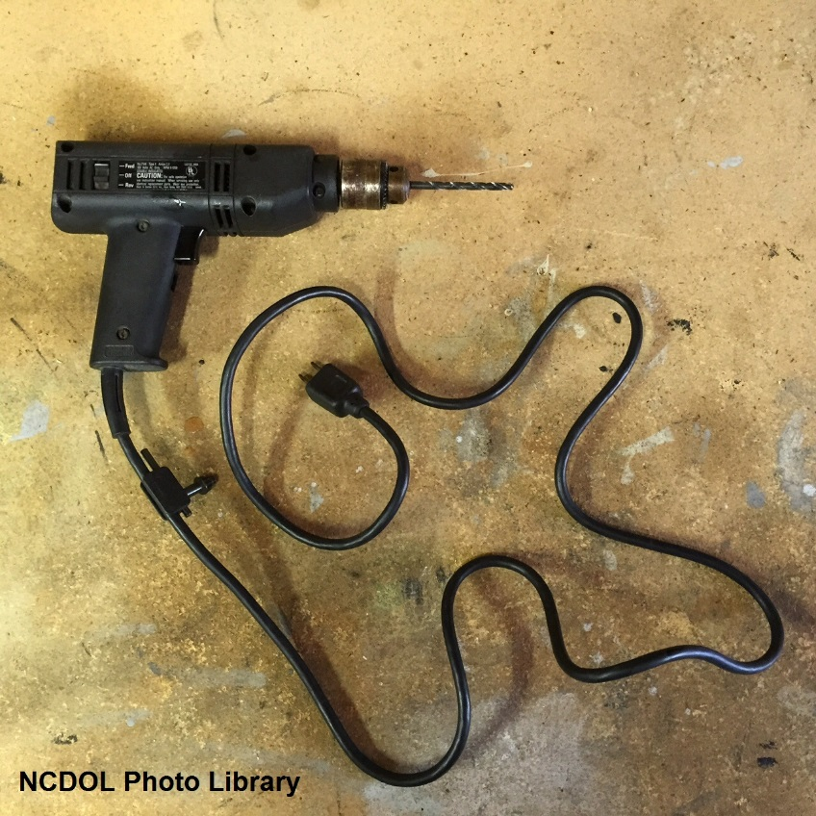
Application
1910.147(a)(2)
Does not cover:
Work on cord and plug connected equipment where plug is under exclusive control of employee performing servicing/maintenance
Hot tap operations, under special conditions
Normal production operations

Slide 14
CPL Tidbits on Scope/Application
CPL 02-00-147, page 3-17

Slide 15
CPL Tidbits on Scope/Application
CPL 02-00-147, page 3-3

Slide 16
CPL Tidbits on Scope/Application
CPL 02-00-147, page 3-3

Slide 17
CPL Tidbits on Scope/Application
CPL 02-00-147, page 3-4

Slide 18
Application
1910.147(a)(2)
Servicing and/or maintenance which takes place during normal production operations is covered by 1910.147 only if:
Employee is required to remove or bypass a guard or other safety device; or
Employee is required to place any part of his/her body into the point of operation or where an associated danger zone exists during a machine operation.

Slide 19
What does the CPL say about this?
CPL 02-00-147, page 3-7

Slide 20
Production or Servicing?
CPL 02-00-147, page 3-7

Slide 21
Application
1910.147(a)(2)
Exception
Minor tool changes and adjustments, and other minor servicing activities, which take place during normal production operations, are not covered if they are:
Routine,
Repetitive, and
Integral to the use of the equipment for production
…provided that the work is performed using alternative measures which provide effective protection.

Slide 22
Minor Servicing Exemption
CPL 02-00-147, page 3-26

Slide 23
Minor Servicing Exemption
CPL 02-00-147, page 3-27

Slide 24
What are Alternative Measures?
CPL 02-00-147, page 3-27

Slide 25
What are Alternative Measures?
CPL 02-00-147, page 3-28

Slide 26
Alternative Measures – Example #1
CPL 02-00-147, page 3-29

Slide 27
Alternative Measures – Example #2
CPL 02-00-147, page 3-30

Slide 28
Alternative Measures – Example #3
CPL 02-00-147, page 3-30

Slide 29
Alternative Measures - IMPORTANT
CPL 02-00-147, page 3-31

Slide 30
Summary of Applicability

Slide 31
Definitions
1910.147(b)
Authorized employee
An employee who locks out or tags out machines or equipment to perform servicing or maintenance on that machine or equipment
Lockout or tagout is used by these employees for their own protection
Authorized

Slide 32
Definitions
1910.147(b)
Affected employee
An employee who performs the duties of his or her job on equipment or in an area in which the energy control procedure is implemented and servicing or maintenance operations are performed
Affected

Slide 33
Other Employees
1910.147(c)(7)
Other employees
Other employees whose work operations are, or may be, in an area where energy control procedures may be utilized
Other

Slide 34
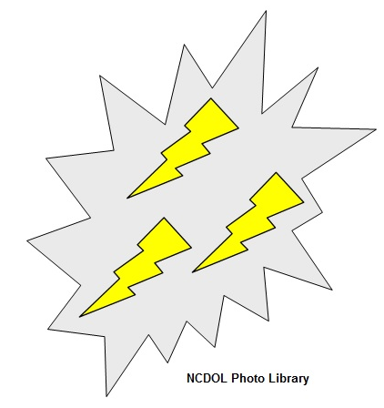
Definitions
1910.147(b)
Energy source
Mechanical
Hydraulic
Pneumatic
Electrical
Kinetic
Gravity

Slide 35
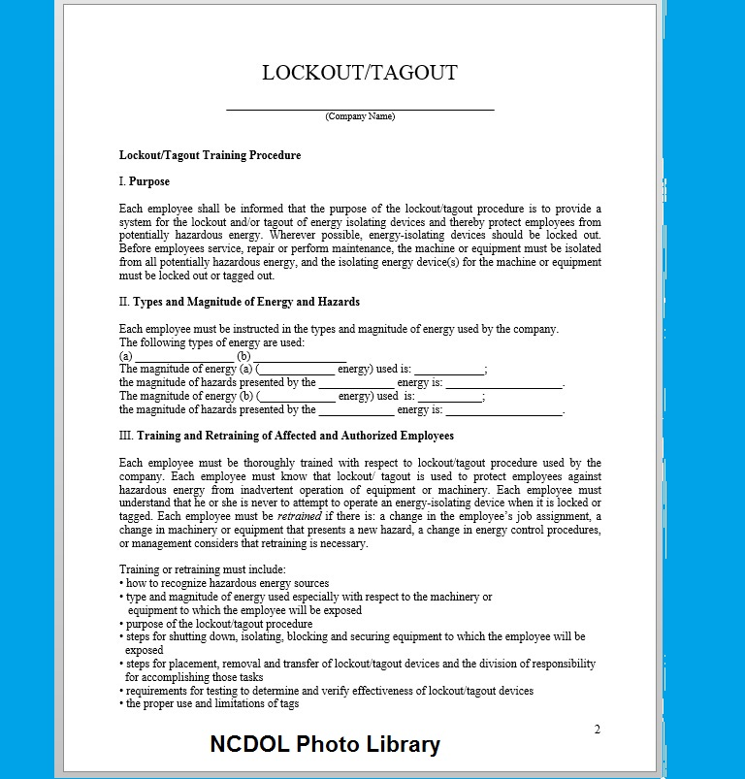
Energy Control Program
1910.147(c)(1)
The employer shall establish a program consisting of:
Energy control procedures
Employee training
Periodic inspections

Slide 36
Energy Control Program
Important point – there is no requirement for a written LOTO “program.”
Many employers have a generic written LOTO procedure that doesn’t comply with the requirements of 1910.147(c)(4)(ii).
There are requirements for written LOTO components, including:
Documented energy control procedures (if multiple energy sources or stored energy)
Certification of periodic inspections
Certification of employee training

Slide 37
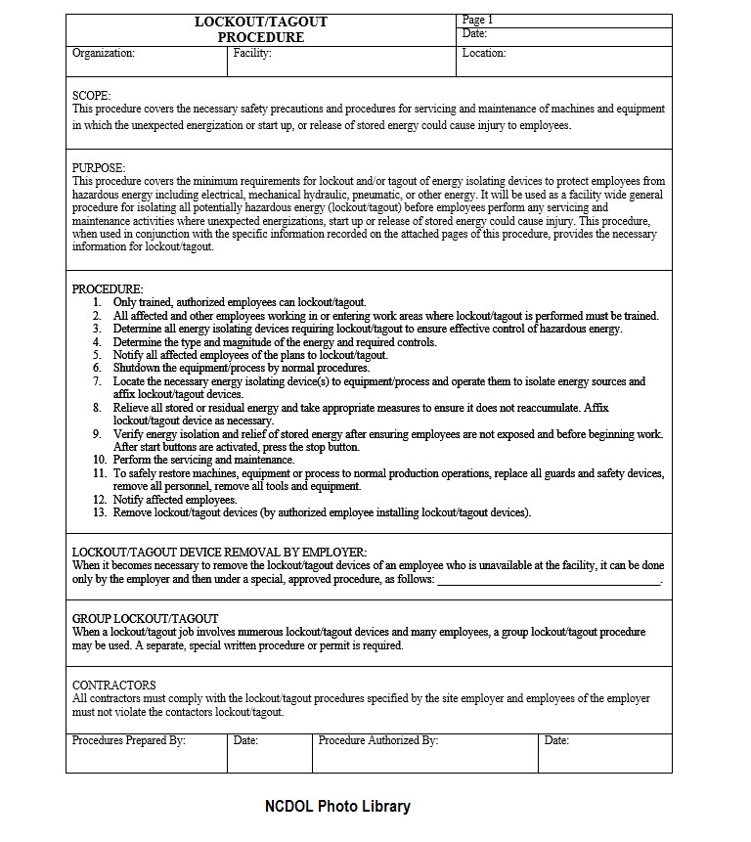
Energy Control Procedure
1910.147(c)(4)
Procedures
Shall be developed, documented and utilized for the control of potentially hazardous energy
Shall clearly and specifically outline techniques to be utilized to control hazardous energy

Slide 38
Energy Control Procedure
1910.147(c)(4)
Energy control (LOTO) procedure
Statement of intended use of procedure
Steps for shutting down, isolating, blocking and securing machines or equipment to control hazardous energy
Steps for the placement, removal and transfer of lockout devices or tagout devices and the responsibility for them, and
Requirements for testing machine/equipment to determine and verify effectiveness of LOTO devices and other energy control measures

Slide 39
Control Sequence
1910.147(d)
Application of control
Preparation for shutdown
Machine or equipment shutdown
Machine or equipment isolation
LOTO device application
Release of stored energy
Verification of isolation

Slide 40
Written Procedure Exception
1910.147(c)(4)
When conducting servicing and/or maintenance on machinery or equipment, an energy control procedure must be developed and utilized, but doesn’t need to be documented if all of the following exceptions apply:
Machine/equipment has no potential for stored or residual energy after shut down
Machine/equipment has a single energy source (readily identified and isolated)
The isolation and locking out of energy source will completely de-energize/deactivate the machine/equipment
Machine/equipment is isolated from that energy source and locked out during servicing or maintenance

Slide 41
Written Procedure Exception
1910.147(c)(4)
Lockout device is under the exclusive control of the authorized employee performing the servicing or maintenance
Servicing/maintenance does not create hazards for other employees; and
Employer has had no accidents involving the unexpected activation/re-energization of the machine/equipment during servicing/maintenance

Slide 42
Periodic Inspection
1910.147(c)(6)
Conducted at least annually to ensure procedure and requirements are followed
Performed by authorized employee other than the one(s) using the procedure
Designed to correct identified deficiencies or inadequacies
Must review each authorized employee’s responsibilities under the energy control procedure

Slide 43
Periodic Inspection
CPL 02-00-147, page 3-65

Slide 44
Periodic Inspection
CPL 02-00-147, page 3-65

Slide 45
Periodic Inspection
1910.147(c)(6)(i)
The employer shall certify that the periodic inspections have been performed. The certification shall identify:
The machine or equipment on which the energy control procedure was being utilized;
The date of the inspection;
The employees included in the inspection; and
The person performing the inspection.

Slide 46
Training and Communication
1910.147(c)(7)
Authorized employee
Recognition of hazardous energy sources
Type and magnitude of energy in workplace
Methods and means for energy isolation and control
Affected employee
Purpose and use of the energy control procedure

Slide 47
Authorized Employee Training
CPL 02-00-147, page 3-61

Slide 48
Affected Employee Training
CPL 02-00-147, page 3-61

Slide 49
Affected Employee Training
Affected Employees must be able to:
This is the training that machine operators who do NOT conduct servicing & maintenance must receive. Your interviews with these employees should focus on these items.
Please note that this is more than “LOTO Awareness” training.
If the operators are unjamming equipment or doing other servicing and /or maintenance work, they must be trained as AUTHORIZED EMPLOYEES.
CPL 02-00-147, page 3-61

Slide 50
Training and Communication
1910.147(c)(7)
All other employees
Procedures for energy control
Prohibition of restarting or reenergizing machines that are locked or tagged out
All other employees

Slide 51
Testing/Positioning Machines
1910.147(f)
When LOTO devices must temporarily be removed for testing/positioning:
Clear machine or equipment of tools and materials
Remove employees from area
Remove lockout/tagout device
Energize and proceed with testing or positioning
Deenergize and reapply energy control measures

Slide 52
Group Lockout/Tagout
1910.147(f)(3)
When servicing and/or maintenance is performed by a group, they shall utilize a procedure which affords employee protection equivalent to a personal LOTO device

Slide 53
Group Lockout/Tagout
1910.147(f)(3)
Primary responsibility is vested in an authorized employee
Authorized employee must ascertain exposure status of group members
If more than one crew is involved, a coordinator shall be designated
Each authorized employee shall use a personal LOTO device and remove device when they stop working on machine/equipment

Slide 54
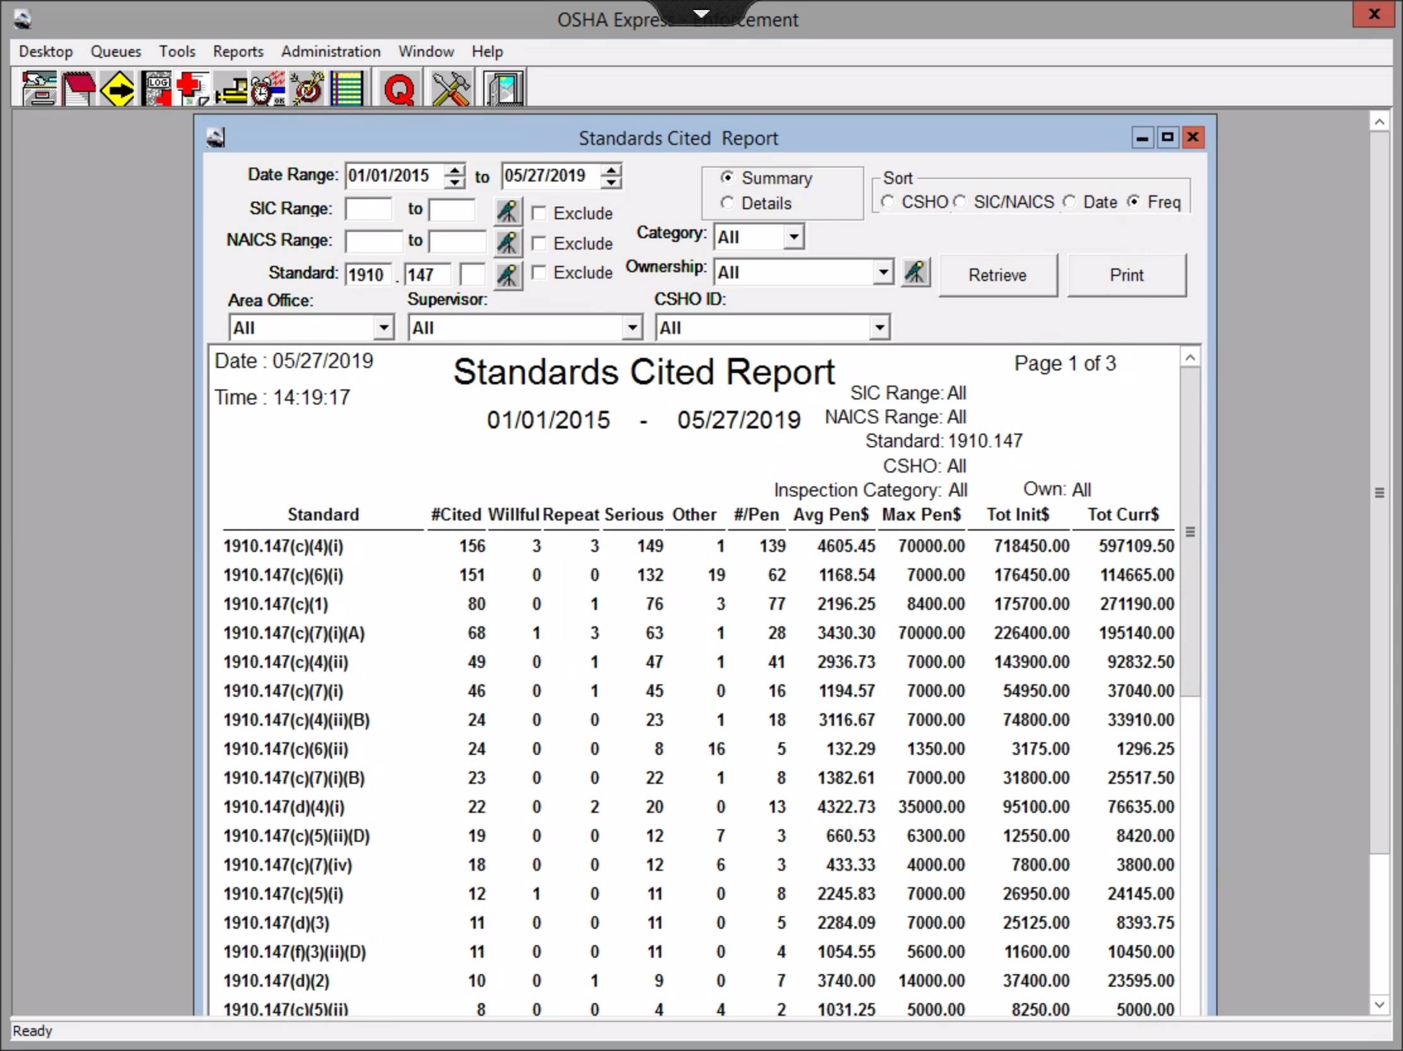
1910.147 Citations by Frequency (since 2015)

Slide 55
Keeping it Simple…
The LOTO standard is relatively complicated, but we typically only cite a few main issues:
Failure to develop, document, and/or utilize energy control procedures.
Incomplete energy control procedures.
Inadequate training of authorized or affected employees
Failure to conduct periodic inspections of the procedures and/or authorized employees.
Failure to use group lockout when there are multiple employees doing servicing & maintenance work.

Slide 56
29 CFR 1910.147(c)(4)(i): Procedures were not developed, documented and utilized for the control of potentially hazardous energy when employees were engaged in the activities covered by this section:

Slide 57
1910.147(c)(4)(i) – Lack of ECP
It’s important to first determine which element(s) of this standard have been violated.
Have energy control procedures been developed? Keep in mind, these procedures could be verbal.
Have the procedures been documented in writing? Remember, if the machinery and the employer meets all the exceptions (e.g. single energy source, no stored energy, etc.), the procedures don’t have to be documented.
Are the procedures being utilized by employees during servicing and/or maintenance activities.
Your AVD should outline the specific details – as well as the type of servicing and/or maintenance work that was occurring.

Slide 58
29 CFR 1910.147(c)(4)(i): Procedures were not developed, documented and utilized for the control of potentially hazardous energy when employees were engaged in the activities covered by this section:
a) Facility – in the Finishing Department where the employer did not develop and utilize machine specific energy control procedures when employees perform servicing and/or maintenance activities on equipment having multiple sources of energy such as but not limited to, the tenter frame SR-1 machine. On or about November 20, 2018, an operator was seriously injured while fixing a machine jam.

Slide 59
29 CFR 1910.147(c)(4)(i): Procedures were not developed, documented and utilized for the control of potentially hazardous energy when employees were engaged in the activities covered by this section:
b) Laminator Line 3, Horizontal Slitter - where energy control procedures to protect employees from exposure to the Miller Moore slitter 1 (serial number 96238162-004) or slitter 2 (serial number 96238162-003) while performing servicing and maintenance activities, including but not limited to, removing or clearing a jam caused by a material build up, had been developed but were not utilized to clear material jams during production operations.

Slide 60
Violation Section (B1) – Required Elements
Evidence that must be documented for this citation (and all 1910.147 citations):
How/why this standard (1910.147) applies. Exactly what servicing and/or maintenance activities were being conducted?
If during normal production, explain how they had to remove a guard or reach into an associated danger zone.
Explain how/why the minor servicing exemption does not apply. Is it routine and repetitive? Is the work conducting using alternative measures that provide effective protection?

Slide 61
Violation Section (B1) – Required Elements
After establishing the standard applies, you need to document how the employer violated its requirements.
How/why we know procedures were not developed.
Were the procedures documented in writing? Be sure to explain how the machinery did not meet the exceptions (e.g. multiple energy sources), so the ECP must be in writing.
Explain how the procedures were not utilized. Be sure to discuss what employees said how they typically handle that servicing and/or maintenance activity.

Slide 62
29 CFR 1910.147(c)(6)(i): The employer did not conduct a periodic inspection of the energy control procedure at least annually to ensure that the procedure and the requirement of this standard were being followed:
a) facility, routing department - where periodic inspections of the energy control procedures were not conducted for employees performing servicing and/or maintenance activities on equipment such as the C.R. Onsrud Single Table C.N.C. Machine that has multiple sources of energy, to include electrical, hydraulic, and mechanical.

Slide 63
29 CFR 1910.147(c)(1): The employer did not establish a program consisting of energy control procedures, employee training and periodic inspections to ensure that before any employee performs any servicing or maintenance on a machine or equipment where the unexpected energizing, startup or release of stored energy could occur and cause injury, the machine or equipment was isolated from the energy source and rendered inoperative:
a) facility, where the employer did not implement a lockout/tagout program, including energy control procedures, employee training, and periodic inspections for employees performing servicing and/or maintenance on vertical balers.

Slide 64
29 CFR 1910.147(c)(7)(i)(A): Authorized employee(s) did not receive training in the recognition of applicable hazardous energy sources, the type and magnitude of the energy available in the workplace, and the methods and means necessary for energy isolation and control:
a) facility, where employees who performed servicing and maintenance on food processing machines, a robotic palletizer and automated shrink wrapper, a case packer, and related equipment had not been trained on the specific procedures for controlling hazardous energy.

Slide 65
29 CFR 1910.147(c)(4)(ii): Procedures did not clearly and specifically outline the scope, purpose, authorization, rules, and techniques to be utilized for the control of hazardous energy, and the means to enforce compliance including, but not limited to, 29 CFR 1910.147(c)(4)(ii)(A), (c)(4)(ii)(B), (c)(4)(ii)(C) and (c)(4)(ii)(D):
a) within the facility, the employer did not implement lock and tag procedures that outlined specific procedural steps for shutting down, isolating, blocking and securing machines or equipment, placement of lockout devices and verifying the effectiveness of the lock and tag devices for equipment and machinery, such as but not limited to, conveyors, Model 752 packing machine and mixers, which operate at 480 volts.

Slide 66
Energy Control Procedure
1910.147(c)(4)
Energy control (LOTO) procedure
Statement of intended use of procedure
Steps for shutting down, isolating, blocking and securing machines or equipment to control hazardous energy
Steps for the placement, removal and transfer of lockout devices or tagout devices and the responsibility for them, and
Requirements for testing machine/equipment to determine and verify effectiveness of LOTO devices and other energy control measures

Slide 67
29 CFR 1910.147(c)(4)(ii)(B): The energy control procedures did not clearly and specifically outline the specific procedural steps for shutting down, isolating, blocking and securing machines or equipment to control hazardous energy:
a) Dock #23 – where the energy control procedures did not include specific procedural steps to control the hazardous energy associated with gravity on the Kelley dock leveler, Model Number H7X8P, Serial Number 10012121. On July 13, 2016 an employee was crushed beneath the ramp of the dock leveler.

Slide 68
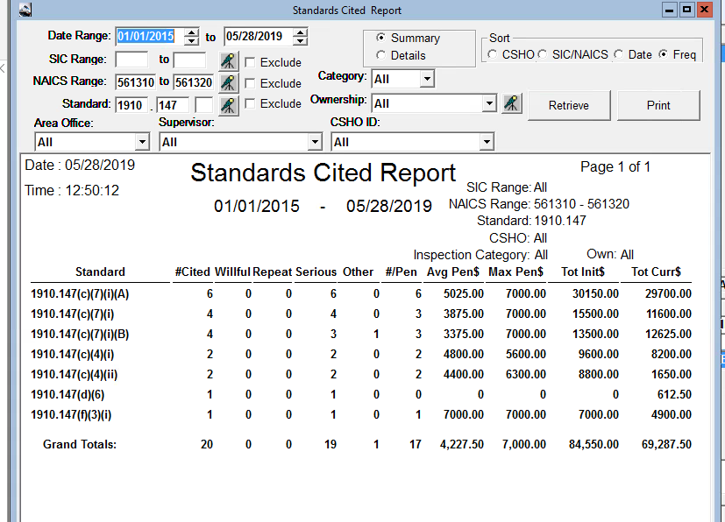
1910.147 Citations – Temp Agencies

Slide 69

Course Continues in Part 2

