Slide 1
N.C. Department of Labor
OSHA 125 Course
Industrial Ventilation
Paul M. Sullivan, CIH, CSP
West Compliance Bureau Chief
September 2020
Notes:
Rev 0: 6/24/2013

Slide 2
Ventilation Objectives
Understand the basics of industrial (local exhaust) ventilation
Discuss applicable standards and how ventilation is typically cited by CSHOs

Slide 3
Example Local Exhaust Ventilation System
A
G
B
Hoods
F
2
C
1
D
E

Slide 4
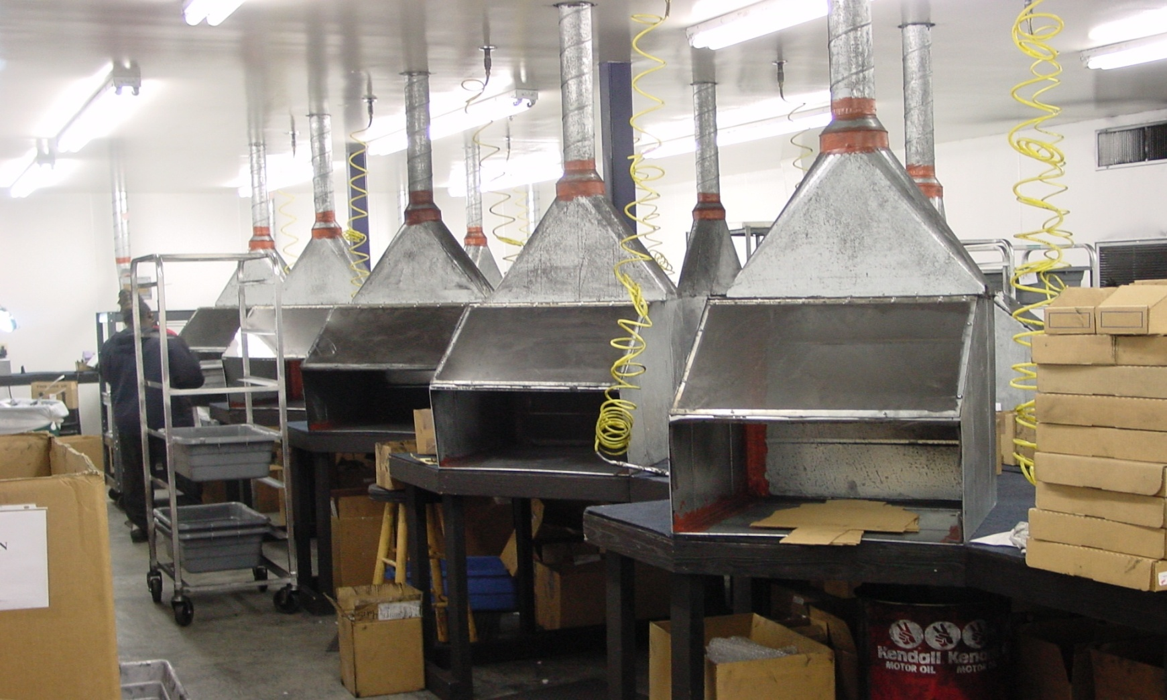
Introduction to Hoods
Hoods are the single most important component in the establishment of a system’s flow requirement (Q) and control of the emission source.
Toner Cartridge Blowout Hoods
Notes:
4

Slide 5
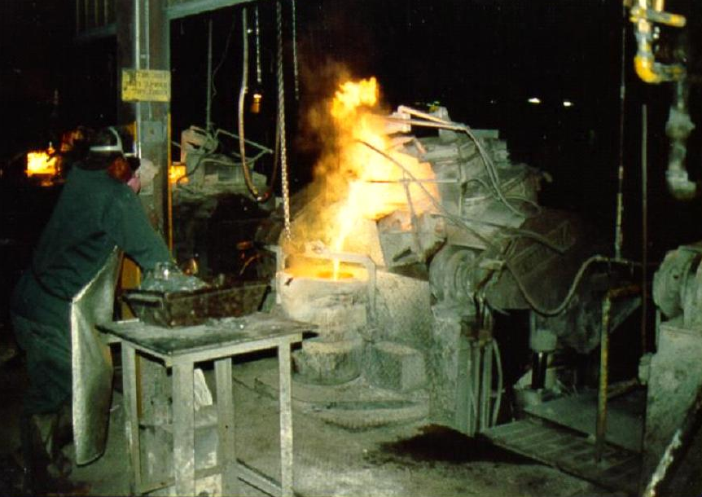
There are numerous examples of poor hood design…
Notes:
5
Photo: This is a hood located in a closed brass foundry. The employee is tossing lead ingots into the molten metal to achieve desired characteristics. Lead exposures in the area of the foundry were measured at 4X the PEL…but “ventilation” was provided. An undersized canopy-style hood was initially installed in this area. (Source: Gregg Grubb)

Slide 6
…poor due to hood location…
Air
Monitoring
PAPR
Notes:
Poor location of the hood in relation to the source results in poor contaminant control and the need for the employee to wear a respirator (PAPR).

Slide 7
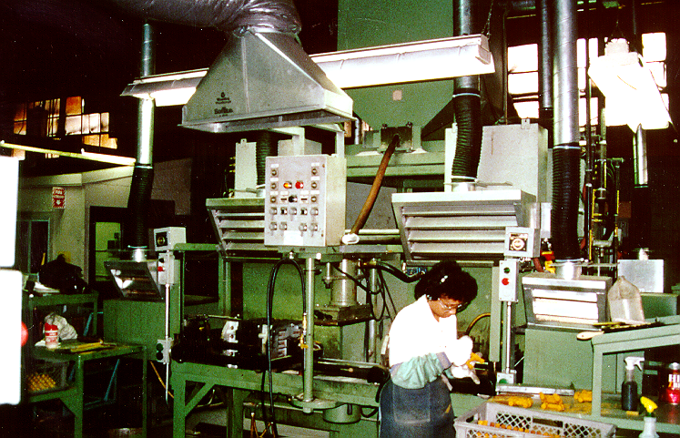
…poor due to air currents…
Notes:
107
Well-designed slotted hoods (4) used to control warm gaseous contaminants from a core-making operation in a foundry. No excessive exposures were determined in this area where $100’s of thousands were spent on ventilation to control an odor issue while lead exposures were 2-4 times the PEL in the foundry area of the facility. Note the location of the replacement air discharge which is located directly above two of the slotted hoods. This will likely result in poor control at these two hoods due to competing air currents.

Slide 8
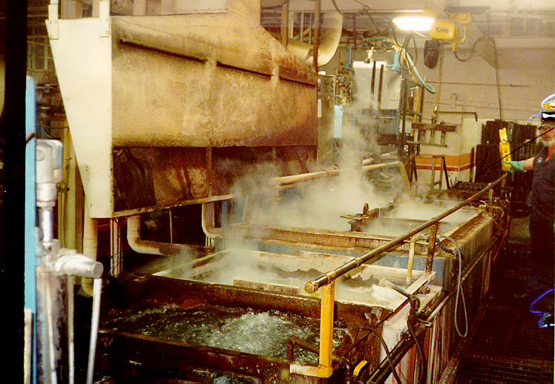
…poor due to lack of knowledge of design principles…
Notes:
Employee thought that by increasing the slot width on the lower slot, better control would be obtained. Guess not! Note storage of shovel in the hood and “cloud” near the ceiling.

Slide 9
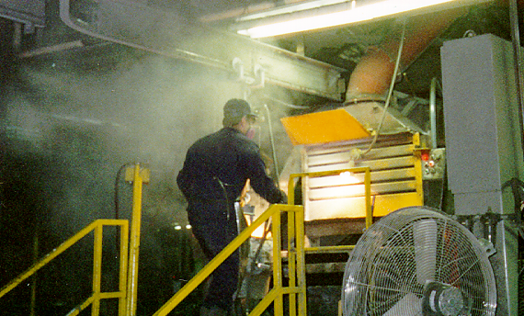
…poor due to use of personnel fans…
Notes:
75
Pouring deck at a brass foundry (now out of business) that made plumbing fixtures. Note employee modification to baffle at top of hood and interaction of cooling fan with contaminant capture. Lead exposures in this area were two-to-four times the TWA (time-weighted average) permissible exposure limit.

Slide 10
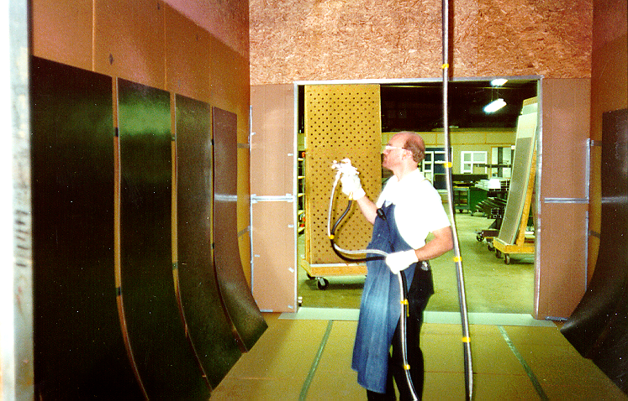

…poor due to materials of construction…
Notes:
Spray applying glue to door laminates in a booth – no excessive exposures. However, glue is flammable and booth is made from particle board and lined with cardboard for cleaning purposes – not a good idea and a violation of the spray finishing standards regarding design of booths when using flammable substances.
1910.94(c)(4) Design and construction of spray rooms.
1910.94(c)(4)(i) Spray rooms, including floors, shall be constructed of masonry, concrete, or other noncombustible material.
1910.94(c)(4)(ii) Spray rooms shall have noncombustible fire doors and shutters.
1910.94(c)(4)(iii) Spray rooms shall be adequately ventilated so that the atmosphere in the breathing zone of the operator shall be maintained in accordance with the requirements of paragraph (c)(6)(ii) of this section.
1910.94(c)(4)(iv) Spray rooms used for production spray-finishing operations shall conform to the requirements for spray booths.

Slide 11
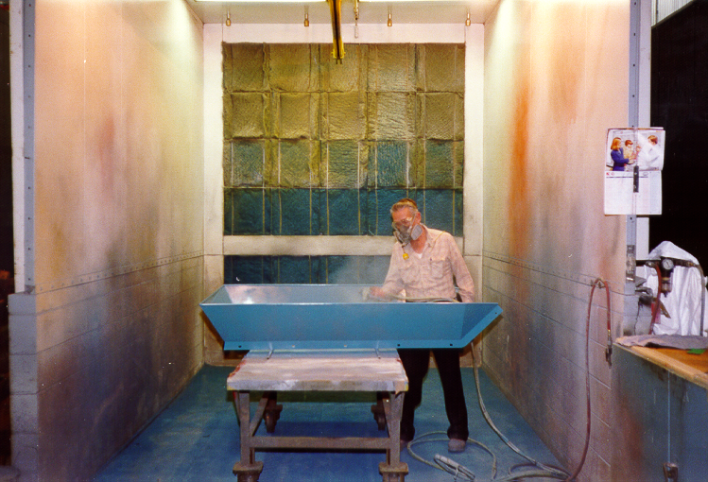
…poor due to improper work practices…
Notes:
Well designed spray booth but poor work operations (spraying in the wrong direction).

Slide 12
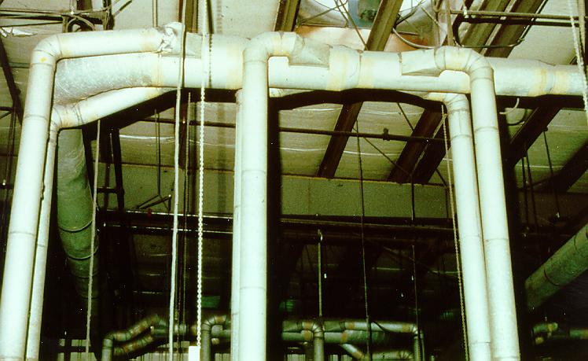
…and pretty…but just plain poor.
Notes:
Example of a slotted hood with plenum. Note use of single slot – no control when basket lifted out of tanks; poor take-off from the plenum – unbalanced velocity across the slot likely resulting in poorer control at end farthest from the take-off; slot length does not exceed length of the tank.

Slide 13
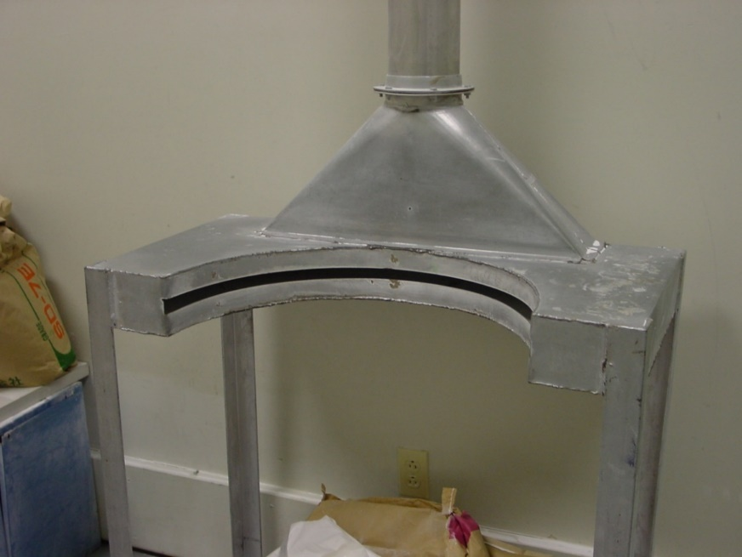
Definition: “Hood”
A shaped inlet designed to capture contaminated air and conduct away from the worker’s breathing zone and into the duct system.
Notes:
Example of a close-capturing slotted hood used at a barrel filling operation.

Slide 14
Remember this fact regarding blowing air…
30 D
FAN
Pressure Jet Outlet Opening
Diameter = D
The face velocity decreases to about 10% at 30 diameters (D) from the pressure jet opening.
Notes:
This slide shows the principle of blowing air. A rule of thumb is the face velocity decreases to about 10% at 30 diameters down stream from the pressure jet opening. For example, typical face velocity for a pressure blower is around 50 mph. If the diameter of the fan outlet is 6 inches, then 15’ downstream of the blower the velocity of blower will be approximately 5 mph.

Slide 15
…and this fact regarding exhausting air…
Key Fundamental
Local exhaust hoods must be placed close to the source of generation to effectively capture the air contaminant and direct it into the ductwork system
FAN
D
The capture velocity decreases to about 10% at one diameter (D) from the pressure jet opening.
Inlet opening diameter, D
Notes:
When exhausting air, the capture velocity decreases to 10% at one diameter from the pressure jet opening. For a typical duct velocity of 3500 fpm, the capture velocity drops to 350 fpm 6” away from the duct opening. This is the basic fundamental of local exhaust hoods. Because local exhaust hoods are placed upstream of the exhaust fan they must be placed close to the source of generation for the airflow to effectively capture the contaminant and direct it into the ductwork system.

Slide 16
Hood Classifications
Enclosing Hoods
Contaminant to be controlled is generated within the hood.
Build a box around the source
Most efficient hood type
Access for workers could pose problems
Capturing Hoods
Contaminant to be controlled is generated outside the hood.
Located adjacent to the source; does not enclose the source
Work practices and air currents are critical to the successful operation of this hood type
Push-Pull Hoods
Used when source is located about four feet or more from hood face (large, open-surface vessels)
Combines pushing and receiving of air to control the emission source
Notes:
Definition of a hood: A shaped inlet designed to capture contaminated air and conduct it into the duct system.
Hoods can be classified into different types based upon their design…
Enclosing hoods are preferred over other types as they are the least impacted by disturbing air currents and require lower volumes of air to control the contaminant.

Slide 17
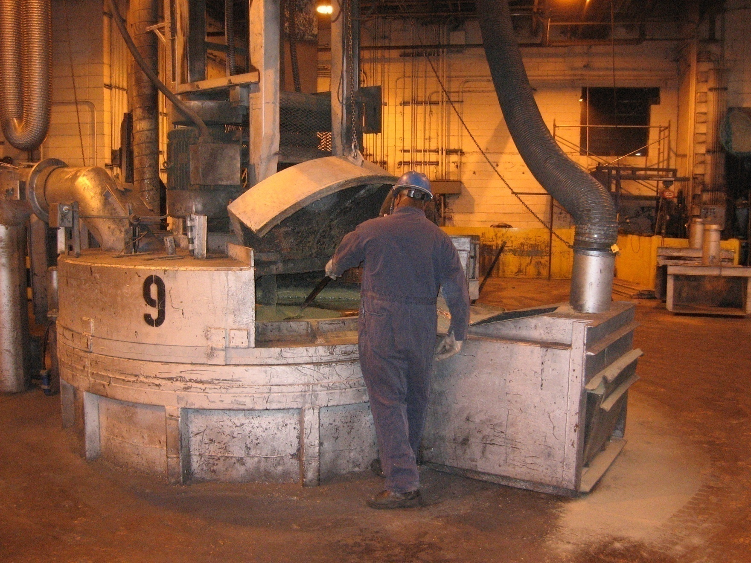
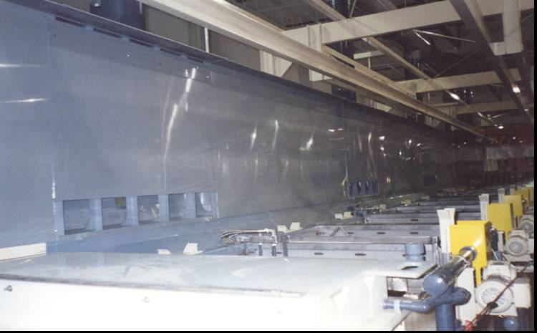
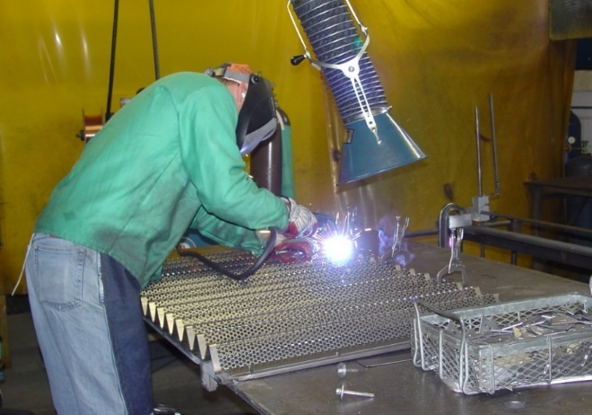
Hood Classification Examples
Capturing Hood
Air Flow
Push-Pull Hood
Enclosing Hood
Notes:
17

Slide 18
Hood Terminology
Simple Hood
Remember: Q = VA
Included Angle
Face Velocity, V_{f}
Duct Velocity, V_{d}
Source
Taper Angle (a)
Flange
Flange Width:
W_{f} = (A_{f})^{0.5}
Capture
Velocity, V_{X}
X
Notes:
Capture velocity is a major factor in determining whether or not a capturing hood works properly. The capture velocity must be high enough to capture the contaminants at the location where the initial contaminant velocity dissipates.

Slide 19
System Design
What values are needed to size your fan?
  Total air volume per minute (Q).
  System Static Pressure – a measure of the total static pressure “losses” throughout the ventilation system.
Your goal is to minimize losses while providing enough air volume to control the hazard (i.e. maintaining the required capture velocity at each hood).

Slide 20
Local Exhaust Components
We know Q needed to control the hazard. What else is needed to select our fan?

Slide 21
Local Exhaust Components
We need to calculate the static pressure “losses” across the system.

Slide 22
Hood Static Pressure
If we know shape of the hood and the amount of flow required, we can then determine the energy required to overcome the resistance to flow into the hood.
It is a function of the hood entry coefficient and the air velocity in the duct.
SP_{h} = F_{h}VP_{d} + VP_{d}

Slide 23
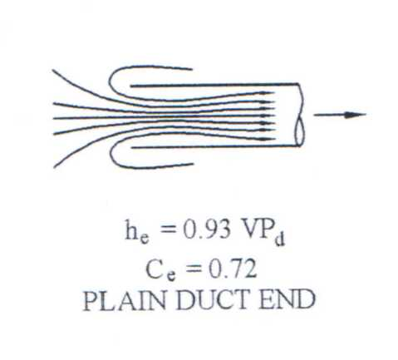
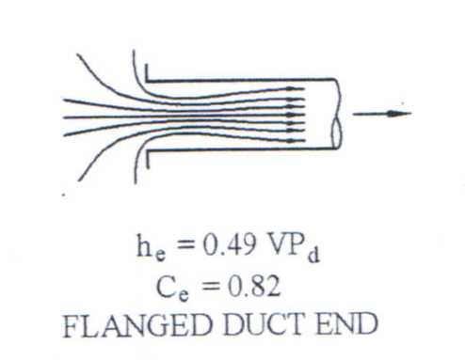
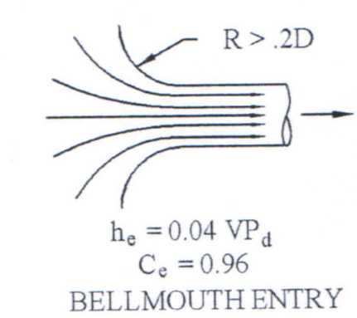
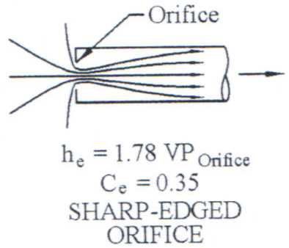
Hood Static Pressure

Slide 24
Minimum Duct Velocity
Vapors, Gasses, Smoke
Fumes, Metal Smokes
Dry Dust and Powder
Average Industrial Dust
Heavy Dust
Heavy and/or Moist Dusts
1000 - 1200 fpm
2000 - 2500 fpm
3000 - 3500 fpm
3500 – 4000 fpm
4000 - 4500 fpm
4500 fpm +
Notes:
Minimum duct velocity is the lowest velocity which will insure that all dust will be transported through the duct segments. The use of a minimum velocity results in smaller system designs and less expense. Remember, one must design a system to always maintain at least the minimum velocity in all ducts. Some common minimum duct velocities:
Vapors 1000-1200 fpm (5.1-6.1 M/S)
Fine Dust 2500-3000 fpm (12.7-15.3 M/S)
General Dust 3500-4000 fpm (17.8-20.4 M/S)
Very Heavy Dust 4500+fpm (22.9+M/S).

Slide 25
Straight Duct F_{duct} = (F_{d})(L)
Losses are a function of:
  Length of duct
  Diameter of duct (smaller duct has more friction)
  Speed of air through the duct

Slide 26
Elbow Design
Recommended: R/D ≥ 2
R
D
Notes:
To minimize the turbulence generated in any elbow, the design of the bend should maintain the largest turn radius possible.
Practice indicates a radius of two times (2X) the diameter of the duct reduces turbulence and resulting pressure losses to reasonable levels without adding dramatically to the cost of the fitting.

Slide 27
Branch Entries
F_{en} is a function of Angle of Entry
30° and 45° are most common

Slide 28
Branch Entry Design ‘F_{en}’
Notes:
To minimize the turbulence at a branch entry, the angle of entry for the airstream is critical. Practice indicates that an entry angle of 15 to 45 degrees reduces pressure loss to a reasonable level.
Entries should be made into the side of the main, not the bottom, to avoid material built up. The diameter of the main duct may need to increase after an entry to maintain the minimum conveying velocity.
Elbows and entries are also often referred to as fittings. Fitting static pressure can be described as the energy necessary to overcome the turbulence and friction in a fitting while maintaining the minimum conveying velocity.

Slide 29
System Losses
How do we use these static pressure loss calculations?
System Static Pressure (SP_{sys}).
  Provides the fan SP for fan selection.

Slide 30
System Static Pressure
SP_{sys}= SP_{out} - SP_{in}- VP_{in}

Slide 31
Ventilation Standards
Most CSHO dealings with ventilation are related to the PELs
  1910.1000
  1926.55
  Expanded health standards
Subparts G (Occupational Health and Environmental Controls) and H (Hazardous Materials) also have ventilation-related standards

Slide 32
PEL Compliance
Employers must achieve compliance with PELs by using engineering or administrative controls:
  Elimination/substitution
  Local exhaust ventilation
  General exhaust ventilation
  Work practice controls, job rotation, or other administrative controls

Slide 33
PEL Compliance
Typically enforced through:
  29 CFR 1910.1000(e)
    General industry (most chemicals)
  29 CFR 1910.1xxx
    Expanded health standards
  29 CFR 1926.55(b)
    Construction industry
  29 CFR 1926.1xxx
    Expanded health standards

Slide 34
Ventilation
29 CFR 1910.94
An eight-page standard that deals with three specific operations:
  (a) Abrasive blasting
  (b) Grinding, polishing, and buffing operations
  (c) Spray finishing operations

Slide 35
Abrasive Blasting
1910.94(a)(3)(i)
Blast-cleaning enclosures shall be exhaust ventilated in such a way that a continuous inward flow of air will be maintained at all openings in the enclosure during the blasting operation.

Slide 36
Abrasive Blasting
1910.94(a)(5)(ii)(a) – (c)
Abrasive-blasting respirators shall be worn by all abrasive-blasting operators:
  When working inside of blast-cleaning rooms, or
  When using silica sand in manual blasting operations where the nozzle and blast are not physically separated from the operator in an exhaust ventilated enclosure, or
  Where concentrations of toxic dust dispersed by the abrasive blasting may exceed the limits set in 1910.1000 and the nozzle and blast are not physically separated from the operator in an exhaust-ventilated enclosure.
Notes:
Abrasive-blasting respirators shall be worn by all abrasive-blasting operators:
1910.94(a)(5)(ii)(a) When working inside of blast-cleaning rooms, or
1910.94(a)(5)(ii)(b) When using silica sand in manual blasting operations where the nozzle and blast are not physically separated from the operator in an exhaust ventilated enclosure, or
1910.94(a)(5)(ii)(c) Where concentrations of toxic dust dispersed by the abrasive blasting may exceed the limits set in 1910.1000 and the nozzle and blast are not physically separated from the operator in an exhaust-ventilated enclosure.

Slide 37
Grinding, Polishing, and Buffing Operations
1910.94(b)(2)
"Application"
  Wherever dry grinding, dry polishing or buffing is performed, and employee exposure, without regard to the use of respirators, exceeds the permissible exposure limits prescribed in 1910.1000 or other sections of this part, a local exhaust ventilation system shall be provided and used to maintain employee exposures within the prescribed limits.

Slide 38
Spray Finishing Operations
1910.94(c)(3)(i)
Spray booths shall be designed and constructed in accordance with 1910.107(b)(1) through (4) and (6) through (10).
  (a) Lights, motors, electrical equipment, and other sources of ignition shall conform to the requirements of 1910.107 (b)(10) and (c).

Slide 39
Spray Finishing Operations
1910.94(c)(6)(i) –(ii)
Except where a spray booth has an adequate air replacement system, the velocity of air into all openings of a spray booth shall be not less than that specified in Table G-10 for the operating conditions specified.
In addition to the requirements in paragraph (c)(6)(i) of this section, the total air volume exhausted through a spray booth shall be such as to dilute solvent vapor to at least 25 percent of the lower explosive limit of the solvent being sprayed.

Slide 40
Ventilation Requirements
What other OSHA standards have ventilation requirements?

Slide 41
Flammable and Combustible Liquids
1910.94(d)(4)(iv)
"Ventilation"
  Every inside storage room shall be provided with either a gravity or a mechanical exhaust ventilation system. Such system shall be designed to provide for a complete change of air within the room at least six times per hour. If a mechanical exhaust system is used, it shall be controlled by a switch located outside of the door.

Slide 42
Spray Finishing
1910.94(b)(5)(i)
The spraying operations except electrostatic spraying operations shall be so designed, installed and maintained that the average air velocity over the open face of the booth (or booth cross section during spraying operations) shall be not less than 100 linear feet per minute.
Electrostatic spraying operations may be conducted with an air velocity over the open face of the booth of not less than 60 linear feet per minute, or more, depending on the volume of the finishing material being applied and its flammability and explosion characteristics. Visible gauges or audible alarm or pressure activated devices shall be installed to indicate or insure that the required air velocity is maintained.

Slide 43
Spray Finishing
1910.107(d)(2)
"General"
  All spraying areas shall be provided with mechanical ventilation adequate to remove flammable vapors, mists, or powders to a safe location and to confine and control combustible residues so that life is not endangered. Mechanical ventilation shall be kept in operation at all times while spraying operations are being conducted and for a sufficient time thereafter to allow vapors from drying coated articles and drying finishing material residue to be exhausted.

Slide 44
Permit Required Confined Spaces
1910.146(c)(5)(ii)(E)
Alternate procedures
  An employee may not enter the space until the forced air ventilation has eliminated any hazardous atmosphere;
  The forced air ventilation shall be so directed as to ventilate the immediate areas where an employee is or will be present within the space and shall continue until all employees have left the space;
  The air supply for the forced air ventilation shall be from a clean source and may not increase the hazards in the space.
Notes:
1910.146(c)(5)(ii)(E)(1) An employee may not enter the space until the forced air ventilation has eliminated any hazardous atmosphere;
1910.146(c)(5)(ii)(E)(2) The forced air ventilation shall be so directed as to ventilate the immediate areas where an employee is or will be present within the space and shall continue until all employees have left the space;
1910.146(c)(5)(ii)(E)(3) The air supply for the forced air ventilation shall be from a clean source and may not increase the hazards in the space.

Slide 45
Cotton Dust
1910.1043(e)(4)
Mechanical ventilation
  When mechanical ventilation is used to control exposure, measurements which demonstrate the effectiveness of the system to control exposure, such as capture velocity, duct velocity, or static pressure shall be made at reasonable intervals.

Slide 46
Lead
1910.1025(e)(4)(i)
Mechanical ventilation
  When ventilation is used to control exposure, measurements which demonstrate the effectiveness of the system in controlling exposure, such as capture velocity, duct velocity, or static pressure shall be made at least every 3 months.
  Measurements of the system's effectiveness in controlling exposure shall be made within 5 days of any change in production, process, or control which might result in a change in employee exposure to lead.
Notes:
1910.1025(e)(4) Mechanical ventilation.
1910.1025(e)(4)(i) When ventilation is used to control exposure, measurements which demonstrate the effectiveness of the system in controlling exposure, such as capture velocity, duct velocity, or static pressure shall be made at least every 3 months. Measurements of the system's effectiveness in controlling exposure shall be made within 5 days of any change in production, process, or control which might result in a change in employee exposure to lead.

Slide 47
Summary
Discussed applicable standards and how ventilation is typically cited by CSHOs
Covered the basics of industrial (local exhaust) ventilation
Overview of information required to work through some ventilation calculations and design problems

Slide 48
Thank You For Attending!
Final Questions?
1-800-NC-LABOR
(1-800-625-2267)
www.nclabor.com

