Slide 1
N.C. Department of Labor OSH Division
Applied Industrial Toxicology

Slide 2
Objectives
Identify hazards associated with specific chemical exposures
Identify where to find toxicological information
Discuss Severity and Probability
assessments when dealing with
chemical exposures

Slide 3

Objectives
Discuss the HCO’s role when NC PEL’s differ from Federal OSHA PEL’s
Identify situations where there may be combined effects from chemicals
Discuss BEI’s and their use in
compliance

Slide 4
The HCO’s Role
Recognize Hazards
Evaluate
Identify OSH
Violations
Recommend
Controls
Ensure
Implementation

Slide 5
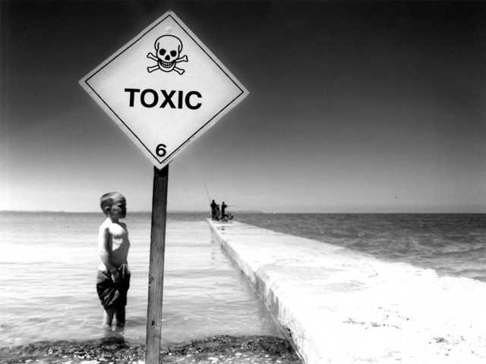
Hazard Recognition
Toxicity
  Capacity of a substance to produce harmful effects.
Toxicity + Exposure = Hazard
OSH compliance activity is based on hazard, not toxicity.

Slide 6
Classes of Toxic Substances
Asphyxiants
Metals
Organic solvents
Pesticides
Particulates: dusts/fibers
Other chemicals

Slide 7

Asphyxiants
Simple
  The presence of a contaminant causes the displacement of oxygen
    Methane, carbon dioxide, inert gases
    OSHA minimum is 19.5% O₂
Chemical
  Cause hypoxia through some sort of a chemical reaction
    Carbon monoxide, cyanide, hydrogen sulfide

Slide 8
Metals
Exposures found during welding, grinding, soldering, blasting, etc.
  Absorption through the lung from exposure to dust and fumes
  Absorption through GI tract based on solubility, oxidation state
  Acute effects include metal fume fever
  Chronic effects include cumulative systemic illness, cancers

Slide 9
Organic Solvents
Found in a number of operations, including application of paint and adhesives, and chemical formulation.
Exposure via the lungs (vapors) or the skin (liquid). Dermal exposure may lead to local or systemic effects.
The greater the vapor pressure (volatility),
the higher the vapor concentration in air.

Slide 10
Organic Solvents
Acute effects
  Include CNS depression, membrane irritation (primary – defatting)
Chronic effects
  Involve cumulative systemic illnesses (liver, kidney) and cancers.
Toxicological properties are similar within groups
  Liver toxicity from chlorinated HC’s
  Irritation from aldehydes
Dermal absorption may contribute to overall exposure (shown as a “Skin” designation)

Slide 11

Pesticides
Seen primarily in agricultural operations
  Exposure via inhalation, ingestion, and skin
Classes include:
  Organophosphate
    Inactivation of acetylcholinesterase (AchE) enzyme
  Carbamate
    AChE inactivation
      Muddles/sludge
  Organochlorine
    Such as DDT
      CNS Effects

Slide 12
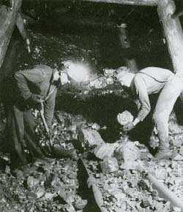

Particulates: Dusts/Fibers
Minerals
  Silica, asbestos, coal dust
Bio-organics
  Cotton dust, Western Red Cedar

Slide 13
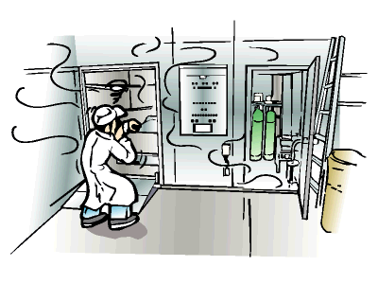
Other Chemicals
Acids/alkalies
  Low volatility, causes tissue damage
Ethylene oxide
  High odor threshold
  Binds to DNA, may cause mutations
  Toxic to reproductive function
Formaldehyde
  Causes direct irritation
Styrene
  High fire and health hazard

Slide 14
Occupational Hematology
May affect blood cell formation, survival, morphology and function, or coagulation
Anilines, nitrobenzenes may cause Methemoglobinemia (Fe²⁺ to Fe³⁺)
Heavy metals may cause hemolytic anemia
Porphyrias (heme biosynthesis problems) seen with lead, Al, Vinyl Chloride, others
Carboxyhemoglobin

Slide 15

Occupational Infections
These involve contact with a biologically active organism (e.g. bacteria, virus)
  Tuberculosis – mycobacterial infection of the lungs
    Usually remains subclinical
  Brucellosis – from contact with infected animal tissues
  Hepatitis B/C – caused by viral agent
  Legionnaire’s Disease – can be fatal if not recognized early

Slide 16
Occupational Lung Diseases
Lungs are the most common route of occupational exposure.
  Chemicals have rapid access to the blood stream.
    Large surface area
    Nasal hair, cough reflex and mucocilliary ladder prevents large particles from reaching the deeper parts.

Slide 17
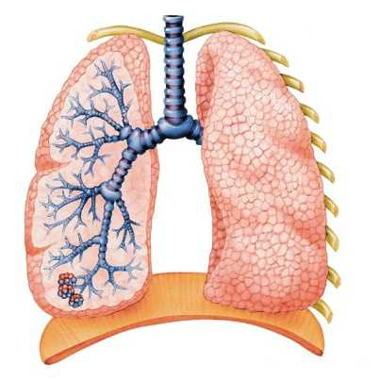
Occupational Lung Diseases
Deposition in lungs is based on water solubility for gases and particle sizes for solids.
  Ammonia and SO₂ are water soluble and are almost entirely removed by aqueous layer in the nose and upper airways
  Nitrogen dioxide and phosgene are water insoluble and reach the distal airways and alveoli.

Slide 18
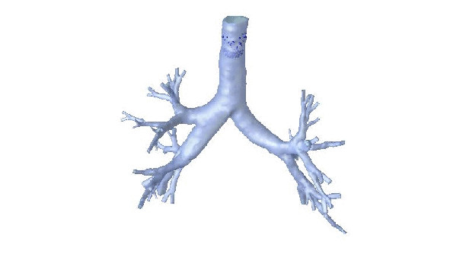
Occupational Lung Diseases
Particle deposition
  Aerodynamic diameter >10 um deposited in nasal mucosa
  Particles between 3 and 10 um deposited throughout tracheobronchial tree
  Particles 0.1 to 3 um are deposited in and around the alveoli.

Slide 19
Occupational Lung Diseases
Common problems include:
  Asthma
    From wood dust or isocyanates
  Pneumoconiosis
    Such as seen with asbestos, silica, coal dust
  Cancer
    Includes both lung cancer and mesothelioma from exposure to asbestos, radon, chloromethyl ethers

Slide 20

Other Toxic Effects
Hepatoxins
  Liver damage
Nephrotoxins
  Renal (kidney) damage
Neurotoxins
  Affects the central and/or peripheral nervous system

Slide 21
Using employee
exposure level
Contaminant
Form (gas, particle
fume)
Respiratory
Protection & PPE
Exposure route/
Uptake level
Estimate employee
dose
Non-work
factors
Physiological
Makeup of
employee
Frequency of
Exposure
Duration of
Exposure

Slide 22
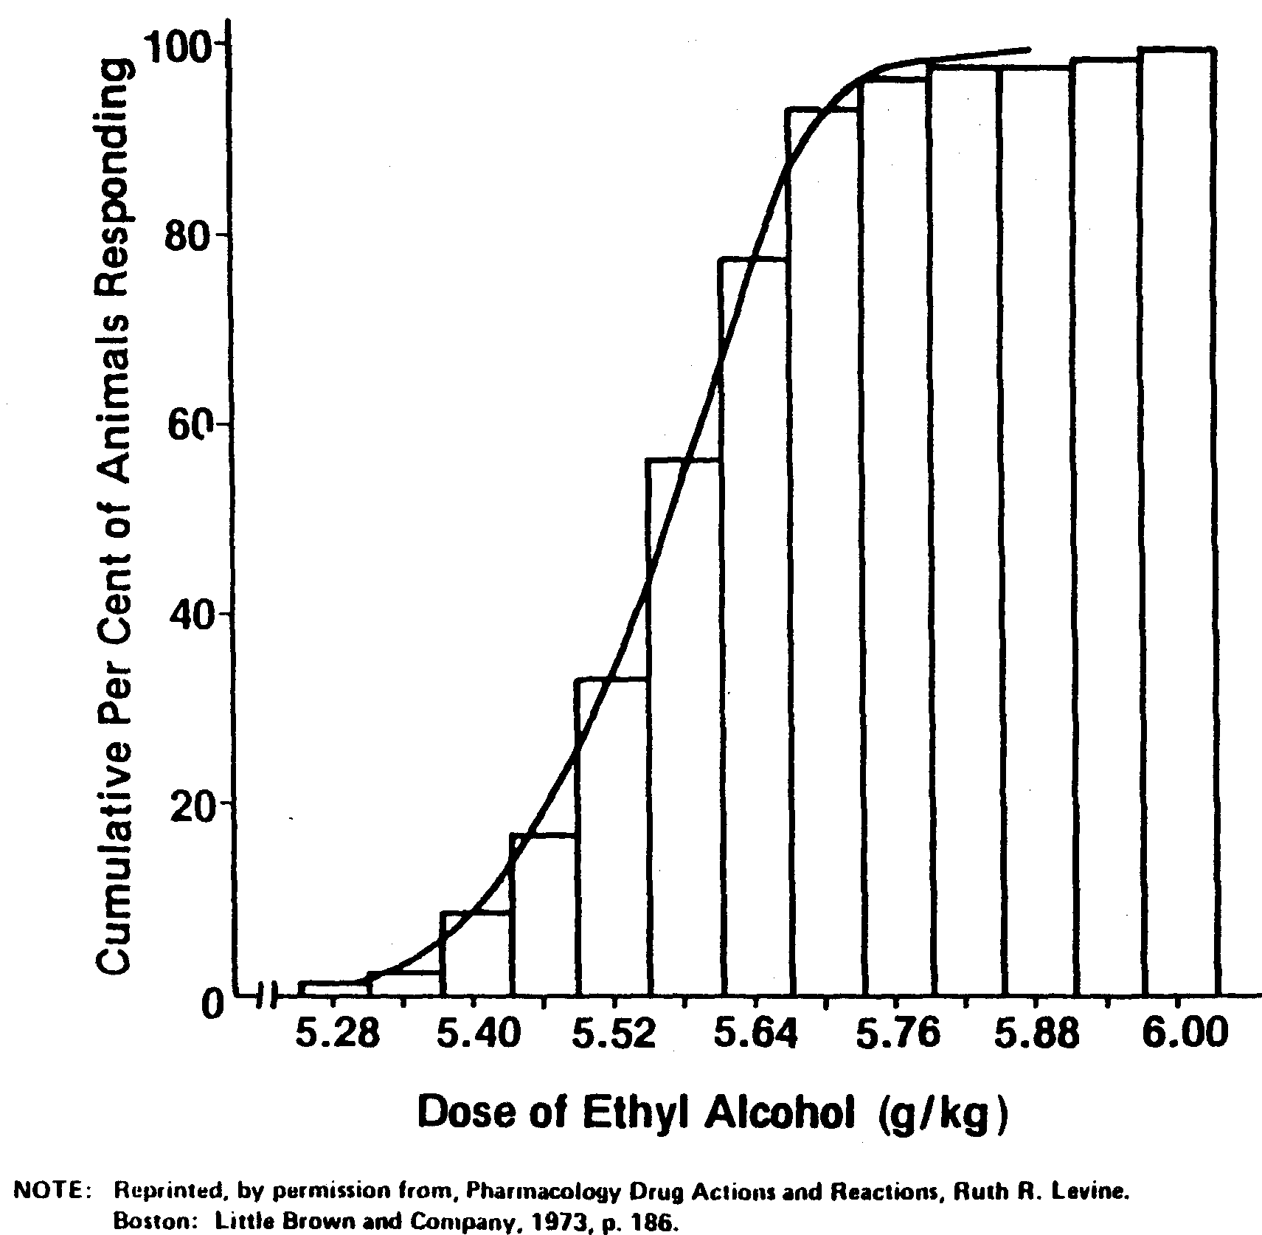

Slide 23
Estimated Dose
Skin irritation
Liver damage
Determine Likely
Health effects
Lung fibrosis
Respiratory
irritation
Cancer
Loss of
Consciousness
CNS
Depression
Severity/Probability Assessment

Slide 24
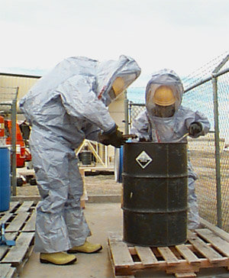
Severity Assessment
What is the definition of serious?
  Likely to cause death or serious physical harm
Examples:
  High
    Death/permanent disability
  Medium
    Hospitalization, partial disability, lost worktime
  Low
    Requires minor supportive treatment (such as an emergency room visit)

Slide 25
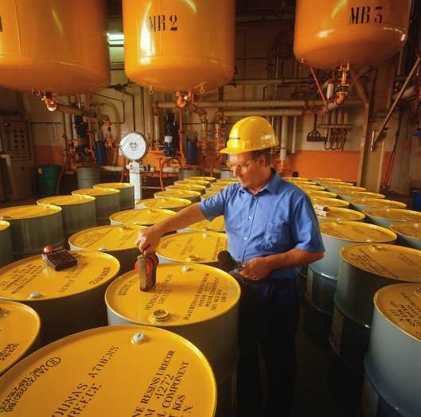
Probability Assessment
CSHO must determine the probability that an accident or health hazard exposure will result from the hazard.
  Comes into play only for penalty calculation
Factors affecting probability include:
  # of workers exposed, frequency/duration
  Proximity to the hazard, use of PPE
All classifications begin at medium

Slide 26
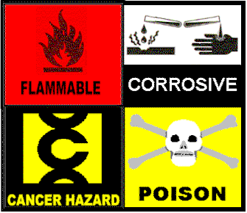
Overexposures
What is the definition of an overexposure?
How does the injury/illness differ based on the specific PEL exceeded?
  TWA?
  STEL?
  Ceiling?

Slide 27

Overexposures
Are all overexposures serious?
Are all non-overexposures non-serious (if violations are found)?
Can you have a hazard when airborne levels of a specific chemical are non-detectable?

Slide 28

Additive Effects
Chemicals with identical or very similar mechanisms and target organs can be treated as one when evaluating employee exposures
  (Exposure 1/PEL 1) + (Exposure 2/PEL 2)
    If result exceeds unity (1.0), then the employee is overexposed

Slide 29
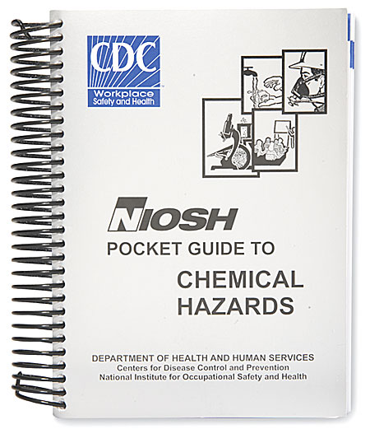
Hazard Information
NIOSH Databases (www.cdc.gov/niosh/database.html)
  Pocket Guide to Chemical Hazards
  IDLH Viewer
  OSH Guidelines for Chemical Hazards
  Chemical Safety Cards
Federal OSHA web site
(www.osha.gov)

Slide 30
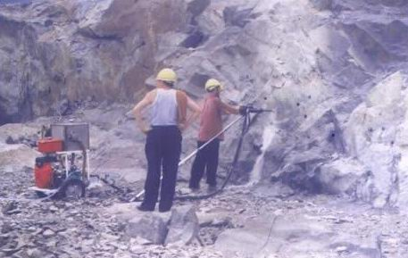
Silica
Found in rockdrilling, sandblasting, cutting brick, cement or concrete industries or any application dealing with earthen materials.
  Crystalline vs. amorphous
  How do we evaluate exposure?
    Total vs. Respirable dust
    Use of mini-ram?
    Bulk samples?

Slide 31
Silica
Silicosis is the resultant illness
  Toxic interaction between silica crystals and alveolar macrophages
  Three forms – chronic, accelerated, and acute
    Acute silicosis is usually fatal.
    Chronic silicosis may be stable with little reduction in lung function.
    Accelerated silicosis occurs after exposure to larger amounts of silica over a shorter period of time
  Progressive massive fibrosis may be characterized by lung restriction or by restriction/obstruction
  At risk for tuberculosis infection
Notes:
Three types of silicosis exist:
Simple chronic silicosis -- results from long-term exposure (more than 20 years) to low amounts of silica dust. Swellings caused by the silica dust form in the lungs and chest lymph nodes. This disease may cause people to have trouble breathing.
Accelerated silicosis -- occurs after exposure to larger amounts of silica over a shorter period of time (5 - 15 years). Swelling in the lungs and symptoms occur faster than in simple silicosis.
Acute silicosis -- results from short-term exposure to very large amounts of silica. The lungs become very inflamed and can fill with fluid, causing severe shortness of breath and low blood oxygen levels.

Slide 32
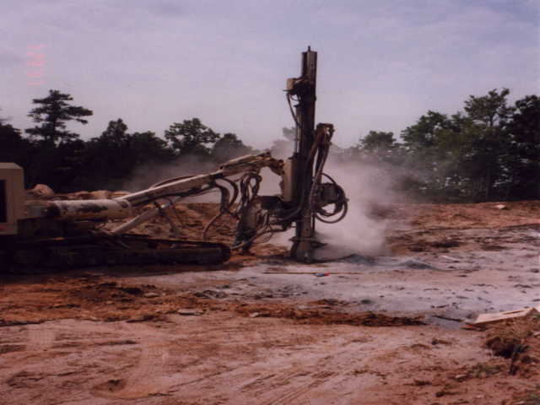


Slide 33
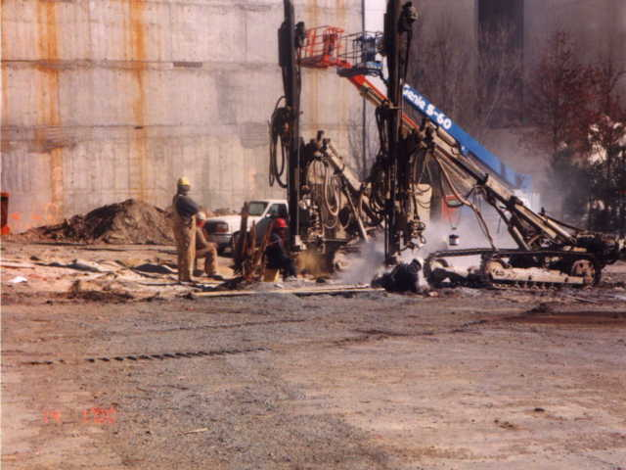

Slide 34
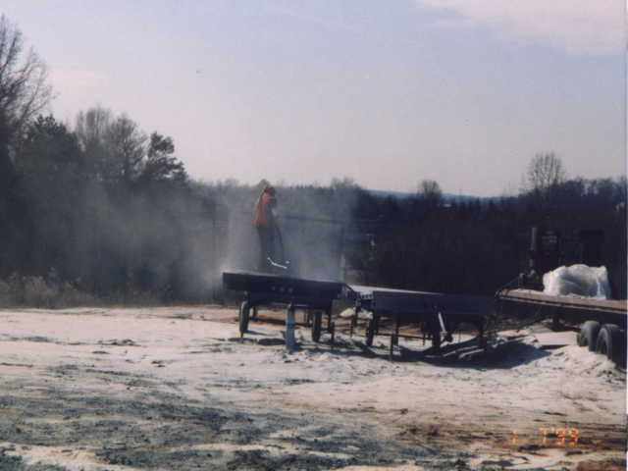

Slide 35
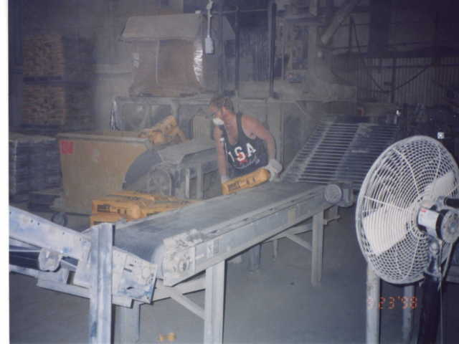

Slide 36
Lead
Serves no biological function in humans
Uses include:
  Manufacture of storage batteries
  Solder
  Paints and plastics
  Glazes
Absorbed via respiratory system (40%) and GI tract (10%). GI absorption is greater is children.

Slide 37
Lead
In bloodstream, Lead is bound to RBC’s.
  Distributed to soft tissue (liver, kidney, brain, muscle) where it is readily exchangeable.
  Eventually deposits in the bone
  Half-life of 5-10 years

Slide 38
Lead – Health Effects
Acute
  Abdominal pains, encephalopathy, hemolysis, and acute renal failure
Chronic
  Altered heme synthesis at BLL > 40 ug/dL
  Central and peripheral nervous system damage and effects at BLL’s between 40 and 80 ug/dL.
  Reproductive effects at levels >30 ug/dL.

Slide 39
Lead - Treatment
First step is always to remove the individual from exposure (standard requires this at >50 ug/dL)
Chelation therapy may be used as well
  Toxic
  Bounce-back effects – why?

Slide 40
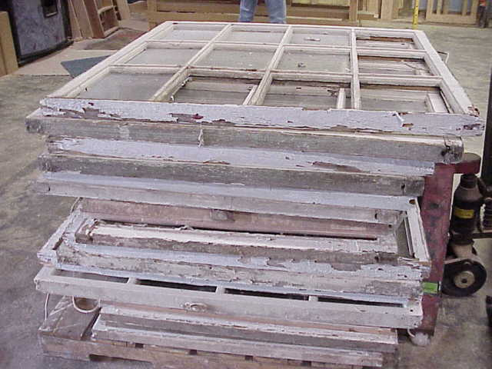

Slide 41
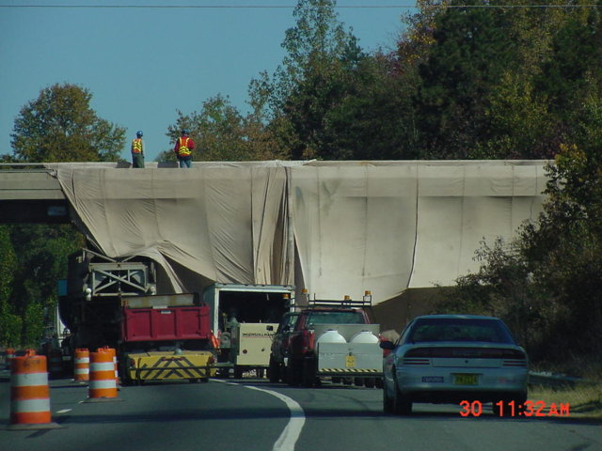

Slide 42
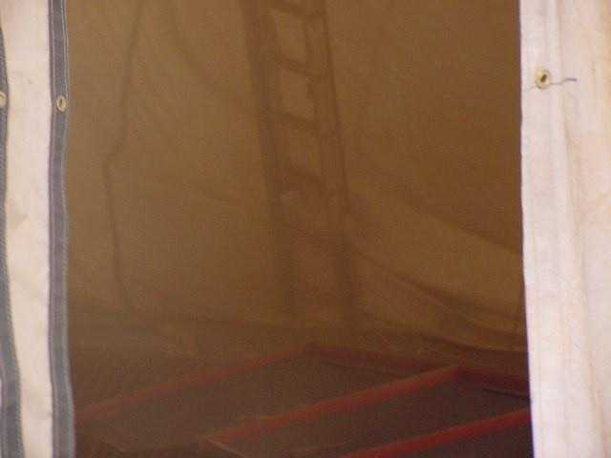

Slide 43
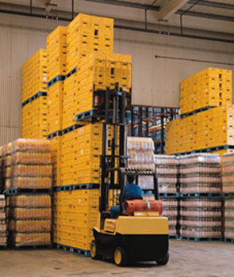
Carbon Monoxide
Product of incomplete combustion, from the burning of a variety of fuels.
  Gasoline – vehicles
  Propane – forklifts, portable heater
  Natural gas – heating systems

Slide 44
Carbon Monoxide
Chemical asphyxiant
  CO binds to hemoglobin forming carboxyhemoglobin (COHb).
  Hemoglobin has affinity for CO 240X greater than that for oxygen.
  COHb decreases oxygen saturation and shifts the O₂ hemoglobin dissociation curve to the left.
  COHb levels of 6% may cause impairment
  At 40-60%, alterations in mental status and death may be seen.

Slide 45
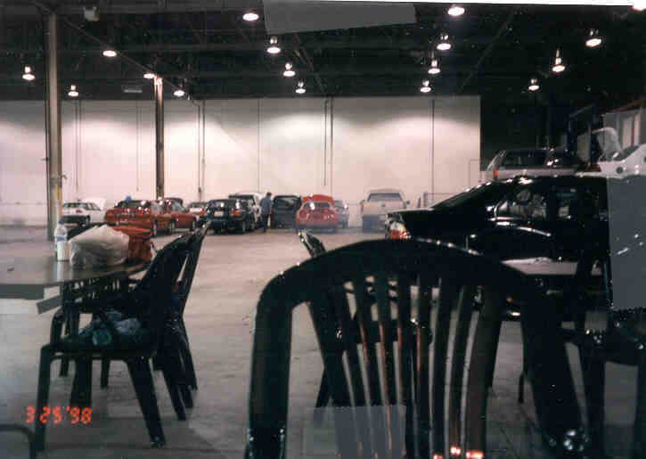

Slide 46
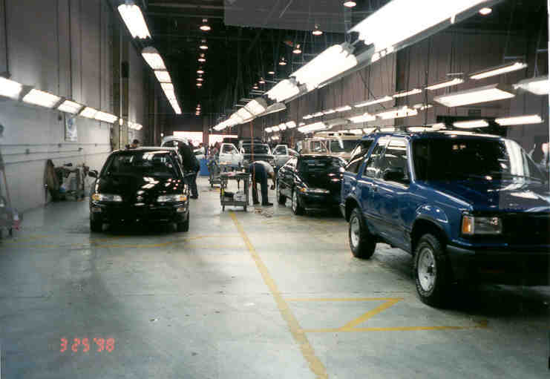

Slide 47
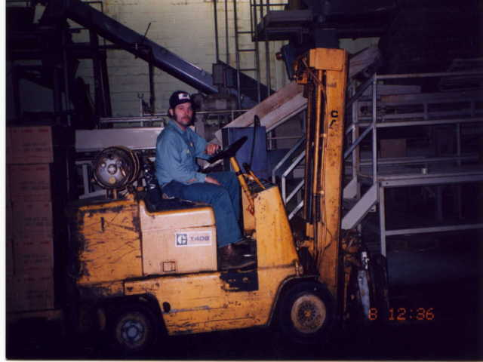

Slide 48
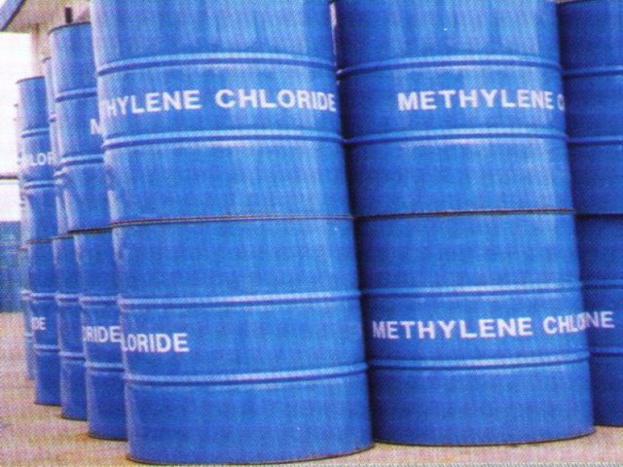
Methylene Chloride
Organic solvent often used in furniture stripping and spray adhesives.
Metabolized to carbon monoxide in the body.
  Therefore, concerned about hypoxia in addition to normal CNS solvent effects
  Possible carcinogen

Slide 49
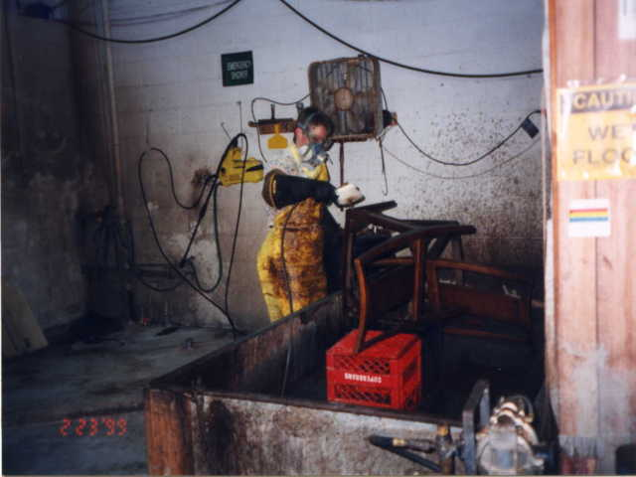

Slide 50
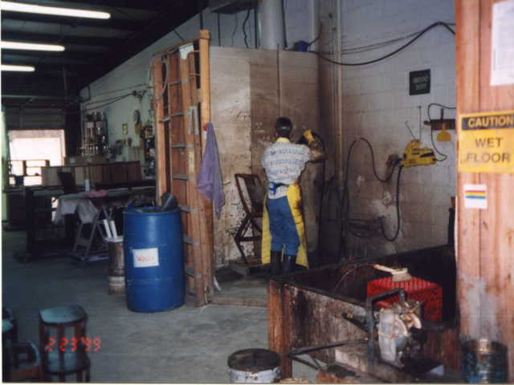

Slide 51
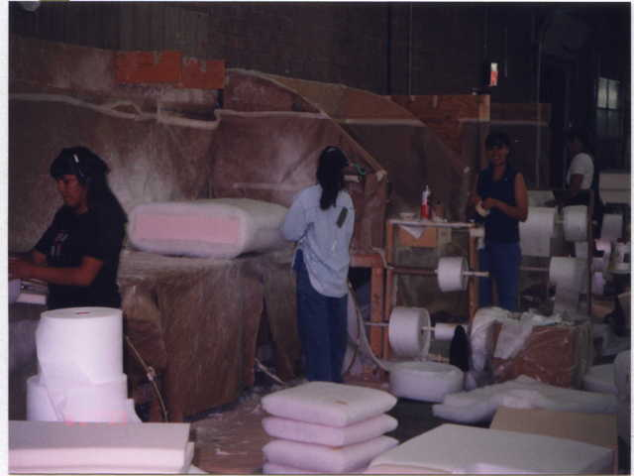

Slide 52
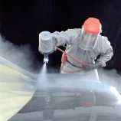
Isocyanates
Intermediaries in the production of polyurethane
  Seen in paints and coatings, foams, and other “two-part” chemicals mixes
  TDI, MDI, HDI
Primary effect is eye, nose, and throat irritation
5-10% of employees may become
sensitized and experience asthma at
very low levels.

Slide 53
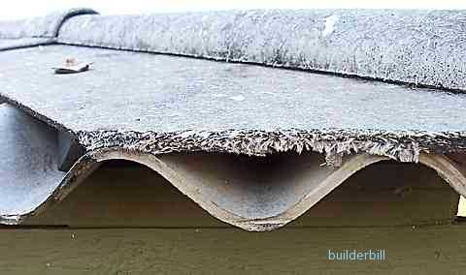
Asbestos
Mineral silicates that are fibrous in nature and can be woven
Fibers are very aerodynamic and tend to deposit in the lower respiratory tract
Health effects:
  Asbestosis (progressive restrictive lung disease)
  Cancer (lung cancer and mesothelioma)
  Synergistic effects between asbestos exposure and cigarette smoke

Slide 54
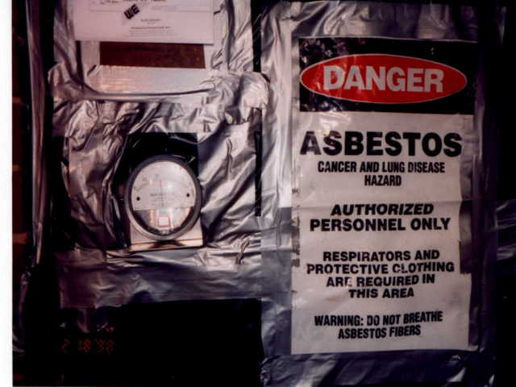

Slide 55
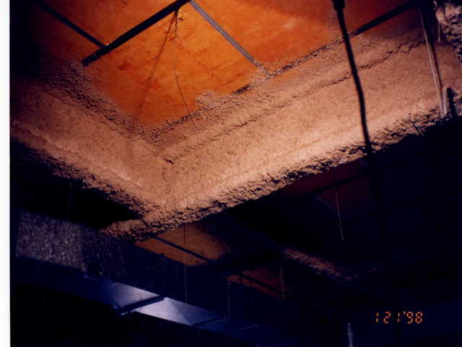

Slide 56
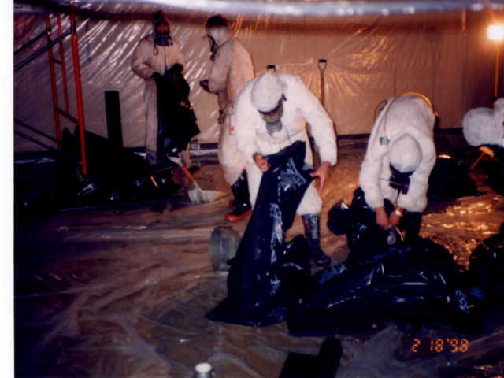

Slide 57

Cotton Dust
Employees exposed to excessive cotton dust or other natural dusts (flax, hemp) may develop Byssinosis.
  Causes chest tightness, cough, and difficulty breathing among the textile workers.
  Dust causes the release of histamine and contains endotoxins that activates the complement system, causing broncho-constriction.
  Symptoms are worse on the first day
  back at work following the weekend
  “Monday fever.”

Slide 58
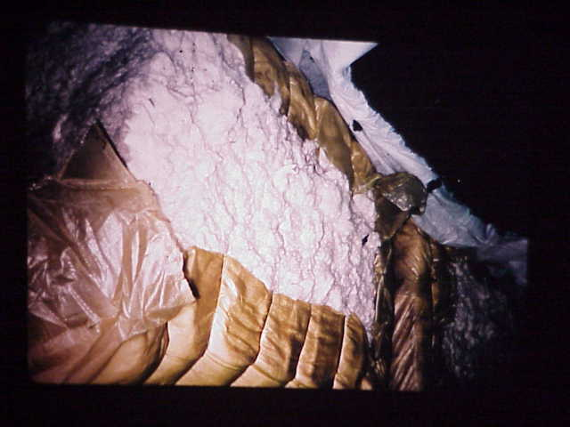

Slide 59
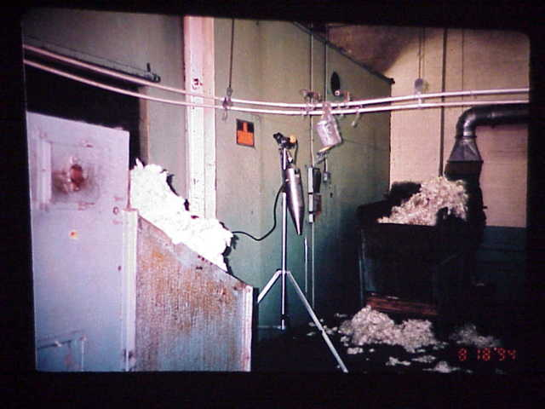

Slide 60
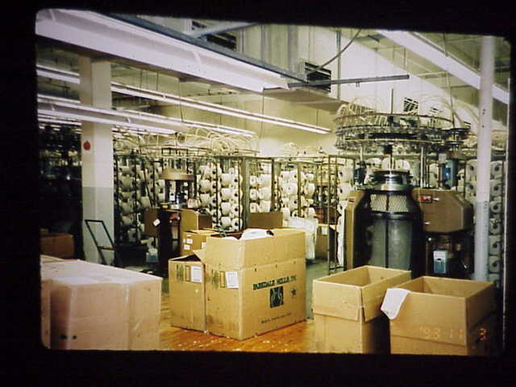

Slide 61

Biological Exposure Indices (BEI)
Published by ACGIH, they are guidance values for assessing biological monitoring results.
Some commonly used BEI’s:
  Pesticides – Acetylcholinesterase activity in RBC’s.
  CO – COHb in blood
  Lead – lead in blood/ZPP in blood
  Mercury – inorganic mercury in blood or urine

Slide 62

BEI for Carbon Monoxide
Can use formulas for estimating the CO exposure given a particular COHb measurement.
  Must know the following parameters:
    COHb concentration in blood
    Time delay between last exposure and biological sample
    Number of hours worked (exposed)

Slide 63

Case Studies
Evaluate each case study and answer the following questions:
  What’s the hazard?
  What the mechanism of action and the resulting injuries or illnesses?
  Which OSH standards have likely been
  violated?

Slide 64
Case Study #1
Employees of a synthetic fiber manufacturing plant use toluene during the extrusion process.
The toluene is reclaimed in a room twenty feet below ground.
One of the reclaim tanks overflows, spilling approximately 100 gallons on to the floor.
Two workers go down to clean-up the spill and lose consciousness.
They are rescued by the local Fire Department
and released following treatment at the local
hospital.

Slide 65
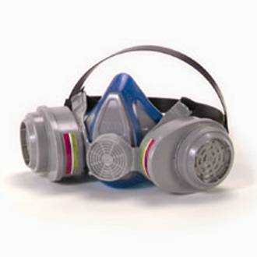
Case Study #2
Two employees at a mobile home manufacturing plant spend most of their day arc welding on steel support beams.
The facility has general exhaust ventilation. Air monitoring shows one employee exposed to total welding fumes at 17.4 mg/m³ (8 hour TWA) and the other exposed at 15.25 mg/m³.
No respiratory protection is used.

Slide 66
Case Study #3
A subcontractor is hired to pressure wash the inside of a newly constructed public storage facility.
They use gasoline-powered washers.
After six hours of work, three employees begin to feel sick.
After one loses consciousness, they call 911 and all three are transported to the hospital.
Blood tests show the three to have carboxyhemoglobin levels of 27.2%, 24.1% and 18.0%.
Two employees are transported for hyperbaric O₂ treatments and released the next day.

Slide 67
Case Study #4
Employees at a cement plant routinely (once each week) climb into the back of transport trucks to remove cement that has hardened.
This is done using pneumatic hammers and chippers.
A double strapped dust mask is used, but the company has no respirator program.
Air sampling for one worker shows the following results:
  1200 liters collected, 2.54 mg total dust
  0.42 mg quartz, other forms of SiO₂ were ND

Slide 68
Case Study #5
Employees at a small furniture plant are responsible for stripping the stain from old church pews.
The pew is placed in a large tub, coated with methylene chloride, and hand stripped.
Air sampling showed employee exposure to be 1223 ppm.
Employees use gloves, an apron, and a half-mask respirator with organic vapor cartridges.
The company has not developed a respirator program.

Slide 69
Case Study #1 - Answers
Hazard – Exposure to excessive concentrations of toluene vapors due to not ………(doing what the standard requires).
Mechanism – As with other solvents, aromatic hydrocarbons will primarily cause CNS depression.
Injury/Illness – headache, nausea, dizziness, light-headedness, slurred speech, vertigo, disorientation, loss of consciousness, death.
Standards Violated – 1910.1000, 1910.134, 1910.120, 1910.119, 1910.1200, others?

Slide 70
Case Study #2 - Answers
Hazard – Exposure to excessive concentrations of metal fumes due to not … ………(doing what the standard requires).
Mechanism – Deposition of small metal particles in the alveoli and lower portion of bronchiole tree.
Injury/Illness – Metal fume fever, respiratory irritation
Standards Violated – 1910.1000, 1910.134, 1910.132, others?

Slide 71
Case Study #3 - Answers
Hazard – Exposure to excessive concentrations of carbon monoxide due to not ………(doing what the standard requires).
Mechanism – Chemical asphyxiation. CO combines with hemoglobin to reduce the oxygen-carrying capacity of the blood. Organs with greatest need for oxygen (heart, brain) are affected first.
Injury/Illness – Hypoxia, loss of consciousness
Standards Violated – 1910.1000, 1910.134, 1910.1200, others?

Slide 72
Case Study #4 - Answers
16.5% Silica. PEL = 0.54 mg/m³. Exposure = 2.12 mg/m³
Hazard – Exposure to excessive concentrations of respirable dust containing crystalline silica due to not ………(doing what the standard requires).
Mechanism – Deposition of silica crystals in the lung. Interaction between crystals and alveolar macrophages may eventually lead to fibrosis and other pathophysiology of the lung.
Injury/Illness – Silicosis – characterized by coughing, difficulty breathing, scarring of the lungs, and a limited disability.
Standards Violated – 1910.1000, 1910.134, others?

Slide 73
Case Study #5 - Answers
Hazard – Exposure to excessive concentrations of methylene chloride vapors due to not ………(doing what the standard requires).
Mechanism – CNS depression, chemical asphyxiation (MC metabolized to CO).
Injury/Illness – Hypoxia, nausea, dizziness, loss of consciousness.
Standards Violated – 1910.1052, 1910.134, others?

Slide 74

Thank You For Attending!
Final Questions?
1-800-NC-LABOR
(1-800-625-2267)
www.nclabor.com

