Slide 1
OSH 125: Tuberculosis
Presented by: Cory Dunphy, ETTA
Notes:
Revised 8/2020
The information in this presentation is provided voluntarily by the N.C. Department of Labor, Education Training and Technical Assistance Bureau as a public service and is made available in good faith. This presentation is designed to assist trainers conducting OSHA outreach training for workers. Since workers are the target audience, this presentation emphasizes hazard identification, avoidance, and control – not standards. No attempt has been made to treat the topic exhaustively. It is essential that trainers tailor their presentations to the needs and understanding of their audience.
The information and advice provided on this Site and on Linked Sites is provided solely on the basis that users will be responsible for making their own assessment of the matters discussed herein and are advised to verify all relevant representations, statements, and information.
This presentation is not a substitute for any of the provisions of the Occupational Safety and Health Act of North Carolina or for any standards issued by the N.C. Department of Labor. Mention of trade names, commercial products, or organizations does not imply endorsement by the N.C. Department of Labor.

Slide 2
Objectives
Provide a basic understanding regarding the transmission and pathogenesis of M. tuberculosis
Discuss the epidemiology of TB in the US and NC
Provide an overview regarding the enforcement procedures for occupational exposure to TB

Slide 3
Reported TB Cases United States, 1990-2017
Cases
Year
NCDOL Photo Library
*Updated as of January 28, 2019
Notes:
Chart Updated by NCDOL Tom Wilder 01-28-19
Stewart RJ, Tsang CA, Pratt RH, Price SF, Langer AJ. Tuberculosis — United States, 2017. MMWR Morb Mortal Wkly Rep 2018;67:317–323. DOI: http://dx.doi.org/10.15585/mmwr.mm6711a2

Slide 4
TB Morbidity - United States, 2009 - 2017
Year | Number | Rate*
2009 | 11,519 | 3.8
2010 | 11,164 | 3.6
2011 | 10,509 | 3.4
2012 | 9,940 | 3.2
2013 | 9,582 | 3.0
2014 | 9,412 | 3.0
2015 | 9,547 | 3.0
2016 | 9,272 | 2.9
2017 | 9,105 | 2.8
*Cases per 100,000. Updated as of January 28, 2019
NCDOL Photo Library
Notes:
Table updated by NCDOL Tom Wilder 01-28-1
TB Morbidity, United States, 2009-2017. This slide provides the total number of reported U.S. TB cases and the associated rates for 6 years. Rate is defined as cases per 100,000 population.
https://www.cdc.gov/tb/statistics/tbcases.htm

Slide 5
Case Rate per 100,000 Population
DATA SOURCE: epi.publichealth.nc.gov
NCDOL Photo Library
Notes:
Chart Created by NCDOL Tom Wilder 08-05-15 using data from https://epi.publichealth.nc.gov/cd/tb/figures/rank1980_2017.pdf
This slide demonstrates that NC has experienced a similar overall decline in the number of new TB cases as is seen on the national level.

Slide 6
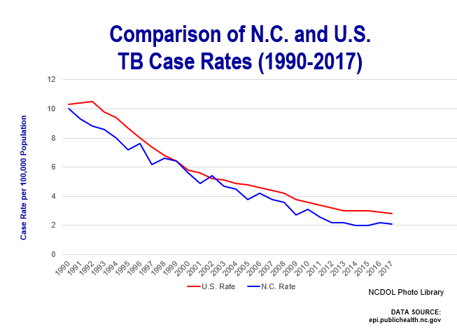
North Carolina 2017 TB Cases
North Carolina’s Tuberculosis Case Rate decreased from 3.8 to 2.1 from 2007 through 2017
  During the same time frame, Tuberculosis Case Rate in the United States decreased from 4.4 to 2.8
Notes:
https://epi.publichealth.nc.gov/cd/tb/figures/rank1980_2017.pdf
Chart Created by NCDOL Tom Wilder 01-28-19

Slide 7
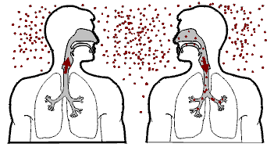
Transmission and Pathogenesis
Notes:
Graphic from CDC

Slide 8
Transmission of M. Tuberculosis
Spread by droplet nuclei (1-5 µm)
Expelled when person with infectious TB coughs, sneezes, speaks, or sings
Close contacts at highest risk of becoming infected
Transmission occurs from person with infectious TB disease (not latent TB infection)
Notes:
Not spread through shaking someone’s hand, sharing food or drink, touching bed linens or toilet seats, sharing toothbrushes or kissing.

Slide 9
Probability of TB Transmission
Infectiousness of person with TB
Environment in which exposure occurred
Duration of exposure
Virulence of the organism
Notes:
Environments characterized by overcrowding or close confinement in areas with little or no ventilation favor the transmission of TB to others.
Photo from MS Clipart

Slide 10
TB Pathogenesis - Latent TB Infection
Once inhaled, bacteria travel to lung alveoli and establish infection
  Can travel through blood to other body parts
2–12 wks after infection, immune response limits activity; infection is detectable
Some bacteria survive and remain dormant but viable for years (latent TB infection, or LTBI)
Notes:
Other body parts that can be infected are the kidneys, spinal column and brain.
TST (tuberculin skin testing) prior to 2 wks following exposure can produce a false negative result, meaning the individual may be infected but has not developed an antibody response. An antibody response gives rise to a positive skin test.
If a newly hired employee in tested within the first 2 weeks of employment and has a positive skin test, this means the TB infection occurred prior to working at that workplace. Therefore, the new employer does not have to enter this onto their OSHA 300 log. However, if tested after 2 weeks and the result if positive, the infection is assumed to have occurred at the new work location. The case may be lined out if an investigation shows the transmission occurred elsewhere.

Slide 11
TB Pathogenesis - Latent TB Infection
Persons with LTBI are:
  Asymptomatic
  Not infectious
LTBI formerly diagnosed only with TST
Now QFT-G can be used
Notes:
TBT: Tuberculin skin test. A liquid called tuberculin is injected under the skin on the lower part of your arm. If you have a positive reaction to this test, you probably have a TB infection. Other tests will be needed to determine if the infection is latent or actual TB disease.
QFT-G: QuantiFeron®-TB Gold Test. It is a whole-blood test for use as an aid in diagnosing Mycobacterium tuberculosis infection, including latent tuberculosis infection (LTBI) and tuberculosis (TB) disease. This test was approved by the U.S. Food and Drug Administration (FDA) in 2005.
MS Clip Art

Slide 12
TB Pathogenesis - Active TB Disease
LTBI progresses to TB disease in:
  Small number of persons soon after infection
  5%–10% of persons with untreated LTBI sometime during lifetime
  About 10% of persons with HIV and untreated LTBI per year
Notes:
A small number of persons who become infected with TB will progress to TB disease soon after they become infected.
5%-10% of persons with untreated LTBI will develop active TB disease during their lifetime.
By contrast, 10% of persons who have untreated LTBI and are also infected with HIV develop active TB disease per year.

Slide 13
Pathogenesis
10% of infected persons with normal immune systems develop TB at some point in life
HIV strongest risk factor for development of TB if infected
  Risk of developing TB disease 7% to 10% each year
Certain medical conditions increase risk that TB infection will progress to TB disease
Notes:
The medical conditions referenced in the last bullet are detailed on the next slide.

Slide 14
Conditions That Increase Risk…
….of progression to TB disease
HIV infection
Substance abuse
Recent infection
Chest radiograph findings suggestive of previous TB
Diabetes mellitus
Silicosis
Cancer of the head and neck
(cont…)
Notes:
he bullets in the slide identify conditions that increase risk of progression to TB disease.
Mellitus (‘me-lə-təs) Diabetes mellitus is a variable disorder of carbohydrate metabolism caused by a combination of hereditary and environmental factors and usually characterized by inadequate secretion or utilization of insulin, by excessive urine production, by excessive amounts of sugar in the blood and urine, and by thirst, hunger, and loss of weight.
Corticosteroid: (kôr'tĭ-kō-stîr'oid‘) Corticosteroids are a class of steroid hormones that are produced in the adrenal cortex. Corticosteroids are involved in a wide range of physiologic systems such as stress response, immune response and regulation of inflammation, carbohydrate metabolism, protein catabolism, blood electrolyte levels, and behavior.
MS Clip Art

Slide 15
Conditions That Increase Risk…
….of progression to TB disease
Hematologic and reticuloendothelial diseases
End-stage renal disease
Intestinal bypass or gastrectomy
Chronic malabsorption syndromes
Low body weight (10% or more below the ideal)
Prolonged corticosteroid therapy
Other immunosuppressive therapy
Notes:
reticuloendothelial system: a diffuse system of cells of varying lineage that include especially the macrophages and the phagocytic endothelial cells lining blood sinuses and that were originally grouped together because of their supposed phagocytic properties based on their ability to take up the vital dye trypan blue.
Corticosteroid: (kôr'tĭ-kō-stîr'oid‘) Corticosteroids are a class of steroid hormones that are produced in the adrenal cortex. Corticosteroids are involved in a wide range of physiologic systems such as stress response, immune response and regulation of inflammation, carbohydrate metabolism, protein catabolism, blood electrolyte levels, and behavior.

Slide 16
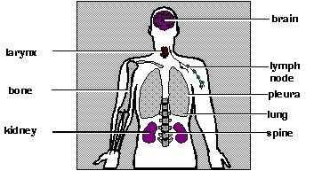
Common Sites of TB Disease
Lungs
Pleura
Central nervous system
Lymphatic system
Genitourinary systems
Bones and joints
Disseminated (miliary TB)
Notes:
Pulmonary TB is TB that occurs in the lungs. About 85% of TB cases are pulmonary. Most patients with pulmonary TB have a cough and an abnormal chest x-ray, and they should be considered infectious until they meet certain criteria.
Extrapulmonary TB occurs in places other than the lungs, such as the larynx, the lymph nodes, the pleura (the membrane surrounding each lung), the brain, the kidneys, or the bones and joints. Extrapulmonary TB occurs more often in people who are infected with HIV than in people who are not infected with HIV. In HIV-infected people, extrapulmonary TB is often accompanied by pulmonary TB. Most types of extrapulmonary TB are not considered infectious.
Miliary TB occurs when tubercle bacilli enter the bloodstream and are carried to all parts of the body, where they grow and cause disease in multiple sites. This condition, which is rare but serious, is called miliary TB because the chest x-ray has the appearance of millet seeds scattered throughout the lung.
Clipart courtesy of CDC

Slide 17
Classification System for TB
Class | Type | Description
0 | No TB exposure Not infected | No history of exposure Negative reaction to tuberculin skin test
1 | TB exposure No evidence of infection | History of exposure Negative reaction to tuberculin skin test
2 | TB infection No disease | Positive reaction to tuberculin skin test Negative bacteriologic studies (if done) No clinical, bacteriological, or radiographic evidence of active TB
3 | TB, clinically active | M. tuberculosis cultured (if done) Clinical, bacteriological, or radiographic evidence of current disease
4 | TB, not clinically active | History of episode(s) of TB or Abnormal but stable radiographic findings Positive reaction to the tuberculin skin test Negative bacteriologic studies (if done) and No clinical or radiographic evidence of current disease
5 | TB suspected | Diagnosis is pending
Notes:
The current clinical classification system for TB used in the United States is based on the pathogenesis of the disease. This classification system provides clinicians the opportunity to track the development of TB in their patients. Health care providers should comply with state and local laws and regulations requiring the reporting of TB disease. All persons with Class 3 or Class 5 TB should be reported promptly to the local or state health department. A patient should not have a Class 5 classification for more than 3 months.

Slide 18
Drug-Resistant TB
Drug-resistant TB transmitted same way as drug-susceptible TB
Drug resistance is divided into two types:
  Primary resistance develops in persons initially infected with resistant organisms
  Secondary resistance (acquired resistance) develops during TB therapy
Notes:
Multi drug-resistant tuberculosis (MDR TB) is TB that is resistant to at least two of the best anti-TB drugs, isoniazid and rifampicin. These drugs are considered first-line drugs and are used to treat all persons with TB disease.
Extensively drug-resistant tuberculosis (XDR TB) is a relatively rare type of multidrug-resistant tuberculosis (MDR TB). It is resistant to almost all drugs used to treat TB, including the two best first-line drugs: isoniazid and rifampin. XDR TB is also resistant to the best second-line medications: fluoroquinolones and at least one of three injectable drugs (i.e., amikacin, kanamycin, or capreomycin).

Slide 19
First-Line Anti-TB Drugs
Isoniazid (INH)
Rifampin (RIF)
Pyrazinamide (PZA)
Ethambutol (EMB) or Streptomycin (SM)*
Notes:
First line Anti-TB Drugs form the core treatment regimen for the treatment of TB and are usually chosen due to less side effects and high clinical effectiveness.
Isoniazid is also the primary drug used to treat TB infection to prevent it developing into TB disease.
* Streptomycin is given by injection; the others are administered as pills

Slide 20
Second-Line Anti-TB Drugs
Capreomycin
Kanamycin
Amikacin
Ethionamide
Para-aminosalicylic acid
Cycloserine
Ciprofloxacin*
Ofloxacin*
Levofloxacin*
Clofazamine
Notes:
Second Line Anti-TB drugs are used when first line drugs show no effect for the disease, or when it is difficult to continue the treatment owing to the side effect. These drugs are usually associated with worse side effects and possibly less effectiveness that first line drugs.
*Broad-spectrum antibiotics belonging to class of drugs called fluoroquinolones. These drugs have been associated with tendinitis and tendon rupture in patients taking this drug.
(See http://www.fda.gov/cder/drug/infopage/fluoroquinolones/default.htm for FDA warning.)

Slide 21
Chronology
May 1992, Region II OSHA issues “Enforcement Guidelines for Occupational Exposure to Tuberculosis” in response to increasing complaints
October 8, 1993 - Memorandum from Roger A. Clark, Directorate of Compliance Programs
  Based on 1990 CDC TB guidelines
  Utilizes General Duty Clause (GDC) to enforce CDC guidelines
February 9, 1996 -- OSHA Instruction CPL 2.106, “Enforcement Procedures and Scheduling for Occupational Exposure to Tuberculosis”
  Based on 1994 CDC revised guidelines
Notes:
Federal OSHA’s involvement in occupational exposure to TB

Slide 22
Chronology
October 17, 1997 -- Proposed standard (NPRM) on occupational exposure to tuberculosis.
December 31, 2003 -- OSHA terminates rulemaking and revokes 29 CFR 1910.139 (respiratory protection against tuberculosis)
March 2, 2004 – NCDOL adopts revocation of 1910.139, effective 6/30/04.
Notes:
(Continuation of previous slide)

Slide 23
Chronology
June 30, 2015 – OSHA introduces CPL 02-02-078: Inspection Procedures for Occupational Exposure to Tuberculosis which replaces CPL 02.106.
September 9, 2015 – NCDOL adopts CPL 02-02-078, which provides guidance to the CSHO for Tuberculosis inspections.
Notes:
(Chronology continued)
Congress added an rider to the 2005 Appropriations Act which prohibited OSHA from enforcing annual fit-testing (1910.134(f)(2)) for respirators worn to protect against TB only.
This prohibition against enforcement of annual fit-testing was lifted in the FY 2008 Appropriations Act.

Slide 24
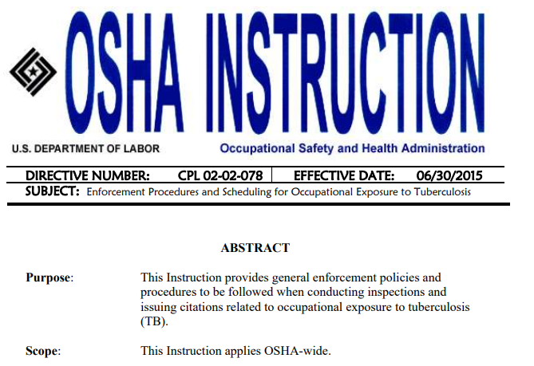
OSHA Instruction CPL 02-02-078
Inspection Procedures for Occupational Exposure to Tuberculosis
NCDOL Photo Library
Notes:
NCDOL Photo Library – This is a screenshot of the cover page of CPL 02-02-078: Enforcement Procedures and Scheduling for Occupational Exposure to Tuberculosis and was taken by NCDOL Cory Dunphy.
OSHA Instruction CPL 02-02-078: Inspection Procedures for Occupational Exposure to Tuberculosis (9/9/2015)
SUBJECT: Enforcement Procedures and Scheduling for Occupational Exposure to Tuberculosis
A. Purpose. This instruction provides uniform inspection procedures and guidelines to be followed when conducting inspections and issuing citations under Section 5(a)(1) of the OSH Act and pertinent standards for employees who are occupationally exposed to tuberculosis.
B. Scope. This instruction applies OSHA-wide.
Citation Policy. Relevant chapters of the FIRM shall be followed when preparing and issuing citations for hazards related to TB. 1. The following requirements apply when citing hazards found in target workplaces. Employers must comply with the provisions of these requirements whenever an employee may be occupationally exposed to TB:
Section 5(a)(1) --General Duty Clause and Executive Order 12196, Section 1-201(a) for Federal facilities.
For North Carolina - NCGS 95-129(1)
29 CFR 1910.134 -- Respiratory Protection
29 CFR 1910.145 -- Accident Prevention Signs and Tags
29 CFR 1910.20 -- Access to Employee Exposure and Medical Records
29 CFR 1904 --Recording and Reporting Occupational Injuries & Illness

Slide 25
Inspection Scheduling and Scope
Inspections conducted in response to:
  Valid employee complaints or referrals
  Related fatality/catastrophes
  Part of all industrial hygiene inspections in covered facilities
  Part of all inspections covered by OPN 132: SEP for Log Term Care Facilities
Notes:
OPN 132: Tuberculosis is part of the primary focal points for LTC inspections under this SEP. The other focal points are ergonomics, exposure to BBP, slips/trips/falls and workplace violence.

Slide 26
Covered Facilities
Health care facilities
  Include hospitals where patients w/ confirmed or suspect TB are treated or transported
  Non-hospital health care settings
    Applies only to personnel present during performance of high-hazard procedures
    Dental personnel covered only if treat suspect or confirmed active TB patients in hospital or correctional facility
Notes:
Inpatient settings may include: Patient rooms, emergency departments, intensive care units, surgical suites, laboratories, laboratory procedure areas, bronchoscopy suites, sputum induction or inhalation/respiratory therapy rooms, autopsy suites, and embalming rooms.
Outpatient settings may include: TB treatment facilities, medical offices, ambulatory-care settings, dialysis units, and dental-care settings.
Nontraditional facility-based settings may include: Emergency medical service (EMS) facilities, medical settings in correctional facilities (e.g., prisons, jails, and detention centers), long-term care settings (e.g., hospices and skilled nursing facilities), drug treatment centers, and homeless shelters.
Home Healthcare: TB inspections of employers with employees who work in home healthcare settings should be limited to employer program evaluations and off-site employee interviews.

Slide 27
Covered Facilities
Correctional institutions
Long-term care facilities for the elderly
Homeless shelters
  Present unique problems for protection of workers
  Must establish protocols for rapid early identification followed by immediate transfer if shelter not treating patients
Drug treatment centers
Notes:
Current enforcement directive, CPL 2.106, is based on the 1994 CDC guidelines. This document identifies four other occupational settings in addition to healthcare settings, where (1) the incident of TB infection and disease is higher than the general population and (2) where employees may be exposed to and become infected with TB.
Inspection Scheduling and Scope 1. The evaluation of occupational exposure to TB shall be conducted in response to employee complaints, related fatality/catastrophes, or as part of all industrial hygiene inspections conducted in workplaces where the CDC has identified workers as having a greater incidence of TB infection than in the general population. The degree of risk of occupational exposure of a worker to TB will vary based on a number of factors discussed in detail by the CDC (Appendix A, pg. 4-5). These workplaces have been the subject of reports issued by the CDC which provide recommendations for the control of tuberculosis. Specifically, these workplaces are as follows:
a. health care facilities b. correctional institutions c. long-term care facilities for the elderly d. homeless shelters e. drug treatment centers
Note: Health-care facilities include hospitals where patients with confirmed or suspect TB are treated or to which they are transported. Coverage of non-hospital health care settings (i.e., doctors' offices, clinics, etc.) includes only personnel present during the performance of high hazard procedures on suspect or active TB patients. Dental health care personnel are covered by the directive only if they treat suspect or active patients in a hospital or correctional facility.
Homeless shelters - due to a variety of circumstances, the control of TB in homeless shelters presents unique problems for the protection of workers. Shelters must establish protocols that provide for rapid early identification followed by immediate transfer of suspect cases if the shelters have elected not to treat these patients.

Slide 28
Inspection Procedures
Has the facility had a suspect or confirmed active case within previous 6 months?
  No, TB enforcement procedures do not apply
  Yes, CSHO to proceed with TB portion of inspection
Notes:
Six months is the statute of limitations for the issuance of a citation for violation of statutes and rules under the OSH Act of NC.
This determination shall be made using employee interviews, a review of available infection control data, and a review of the OSHA 300 logs.
This could also include contacting the appropriate local health department to see if any TB cases have been reported at the facility

Slide 29
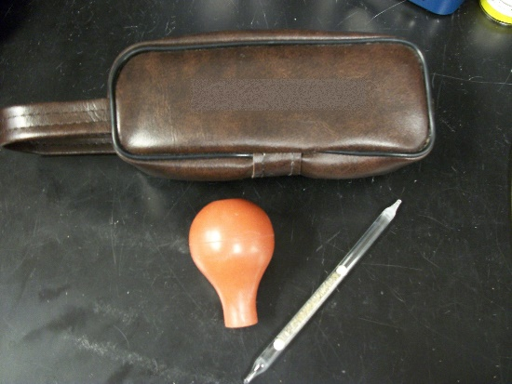
Inspection Procedures
Employer’s TB plan will be verified through employee interviews and direct observation where feasible
CSHO shall use professional judgement to determine what areas shall be inspected
When smoke-trail visualization tests are used
  Be prepared to present
  SDS for smoke
NCDOL Photo Library
Notes:
Smoke tubes used by CSHOs to verify the existence and direction of ventilation for TB isolation rooms and treatment areas contain stannic chloride (SnCl4) which generates a white “cloud” on contact with moisture in the air. This “cloud” consists of hydrochloric acid (HCl) and tin compounds and can be irritating to the nose and eyes.
NCDOL Photo Library – taken by NCDOL Employee Cory Dunphy of a Sensidyne Smoke Tube test kit.

Slide 30
CSHO Protection
Use professional judgement and extreme caution to avoid potential exposure
Generally should not enter airborne infection isolation rooms (AIIRs)
If you must enter, comply with facility-imposed PPE
  With at least a half-mask negative pressure respirator with an N95 filter
  Wash hands afterwards with soap & water
Notes:
Typically employers should require at least a face mask, disposable gloves, eye protection, disposable gown and disposable shoe coverings as required PPE for entering AIIRs. They may use N95 FFRs but CPL 02-02-078 requires that CSHOs were half-mask respirators.
If handwashing facilities are not immediately available, CSHOs may use hand sanitizer or antiseptic towelettes as an initial cleaning until handwashing facilities are available.

Slide 31
Citation Policy
Employers who have employees occupationally exposed to TB must comply with the following provisions:
  NCGS 95-129(1) -- General Duty Clause
  29 CFR 1910.132 – Personal Protective Equipment
  29 CFR 1910.139 -- Respiratory Protection
  29 CFR 1910.145 -- Accident Prevention Signs and Tags
  29 CFR 1910.1020 -- Access to Employee Exposure
  and Medical Records
  29 CFR 1904 -- Recording & Reporting Occupational
  Injuries & Illnesses
Notes:
OSHA regulations that apply to occupational exposure to TB in the five occupational settings previously discussed.

Slide 32

General Duty Clause
NCGS: 95-129(1)
  Each employer shall furnish to each of his employees conditions of employment and a place of employment which are free from recognized hazards that are causing or are likely to cause death or serious physical harm to his employees.
Notes:
When comparing General Statute 95-129 with the federal OSH ACT (Section 5) there is a slight difference in the wording.
North Carolina added (conditions of) to the OSH Act. This subtle divergence does not change the intention, meaning or purpose on the OSH Act.
This is the General Duty Claus which can be cited when no other standard applies to an observed hazard but only under certain conditions, discussed in the next slide.
NCDOL Photo Library – This is a photo of NCDOL OSH Standards books, courtesy of Mancomm.

Slide 33
General Duty Clause Violation
Four Required Elements
  The employer failed to keep the workplace free of a hazard to which employees of that employer were exposed;
  The hazard was recognized in the industry;
  The hazard was causing or likely to cause death or serious physical harm; and
  There was a feasible and useful abatement method to correct (abate) the hazard.
Notes:
ALL four criteria must be met in order for a citation to be issued for violation of the General Duty Clause

Slide 34
Invoking the General Duty Clause
The basis of a General Duty Clause violation is exposure to the hazard, not the absence of a particular abatement method.
Notes:
NCDOL Photo Library – This is a screenshot of the cover of the NC Labor Laws.

Slide 35
Recognizing Exposure to a Serious Hazard
Employers with employees working in one of the high risk occupational settings,
When employees not provided with appropriate protection, and
Who have occupational exposure to TB
Notes:
Recognition of occupational exposure to TB as a serious hazard has been established through the CDC guidelines.

Slide 36
Occupational Exposure to Tuberculosis
Exposure to exhaled air of an individual with suspected or confirmed pulmonary TB disease, or
Employee exposure without appropriate protection to a high hazard procedure performed on individual with suspected or confirmed infectious TB disease and which has potential to generate infectious airborne droplet nuclei.
Notes:
Either of these conditions is considered occupational exposure to TB in the five occupational settings.

Slide 37
High Hazard Procedures
Aerosolized medication treatment
Bronchoscopy
Sputum induction
Endotracheal intubation and suctioning procedures
Emergency dental procedures
Endoscopic procedures
Autopsies conducted in hospitals
Notes:
This slide identifies the high hazard procedures which can result in occupational exposure to TB.

Slide 38
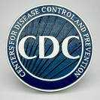
Feasible and Useful Abatement Methods
Early identification of patient/client
  Employer must implement a protocol for early identification of individuals with active TB
  Program must identify and characterize each area within the facility
  Characteristics of effective TB IC program (see Table 3, CDC Guidelines)
Notes:
CDC.Gov
TB IC – Tuberculosis Infection Control

Slide 39

Inspection Procedures
CSHOs should evaluate the following
  TB Infection Control Program
  TB Risk Assessment for incoming patients
  Medical Surveillance of Employees
    Initial testing
    Periodic evaluations
  Case Management for infected employees
  Education and Training
  Engineering Controls
NCDOL Photo Library
Notes:
TB Infection Control Program should outline how to identify infected individuals and how to handle infections. Should be updated annually
Medical Surveillance for employees who have direct contact with TB patients, work with aerosol generating procedures, or installing, maintaining or replacing environmental controls in areas where TB patients are/have been present. Initial exams shall be baseline BAMT or TST for all new healthcare employees. Periodic testing shall be conducted, especially for moderate to high risk employees, Use CDC guidelines for frequency of periodic testing, and handling employees who test positive or have LTBI.
Case Management is how the company will handle employees with either a positive test or LTBI. This should include return to work protocols, and restricted duties after return.
Engineering Controls include AIIR with negative pressure ventilation, HEPA filters and emergency power in the event of a power outage.

Slide 40
Respiratory Protection
1910.134(a)(2)
“Respirators shall be provided by the employer when such equipment is necessary to protect the health of the employee.
The employer shall provide the respirators which are applicable and suitable for the purpose intended.
The employer shall be responsible for the establishment and maintenance of a respiratory protection program which shall include the requirements outlined in paragraph (c) of this section.”

Slide 41
Respiratory Protection
HEPA respirators or respirators certified under 42 CFR Part 84 Subpart K are required:
  When workers enter rooms housing individuals with suspected or confirmed infectious TB
  When workers present during performance of high hazard procedures on individuals with suspected or confirmed infectious TB
  When emergency-medical-response personnel or others transport, in a closed a vehicle, an individual with suspected or confirmed infectious TB
Notes:
Circumstances when appropriate respirators are required to be worn for protection against TB.

Slide 42
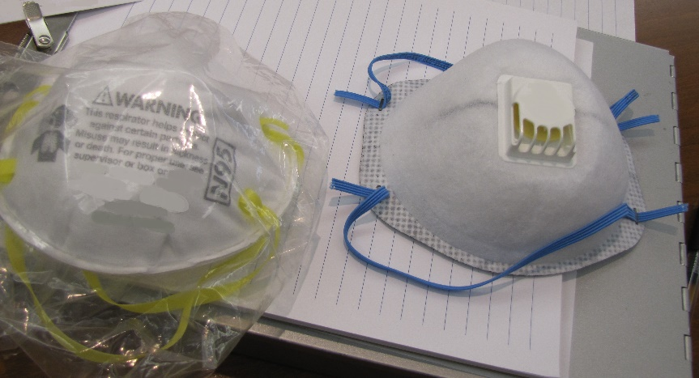
Respirator Program Requirements
1910.134(c)
Inspection and maintenance
Work area surveillance
Inspection/evaluation of
program
Approved respirators
Written operating
procedures
Proper selection
Training and fitting
Cleaning and disinfecting
Storage
NCDOL Photo Library
NCDOL Photo Library
Notes:
29 CFR 1910.134(c)(1)
In any workplace where respirators are necessary to protect the health of the employee or whenever respirators are required by the employer, the employer shall establish and implement a written respiratory protection program with worksite-specific procedures. The program shall be updated as necessary to reflect those changes in workplace conditions that affect respirator use. The employer shall include in the program the following provisions of this section (On slide).
NCDOL Photo Library – Closed Case File #316971654

Slide 43
Employee Medical/Exposure Records
1910.1020
Employee access to records
  A record concerning employee exposure to TB is an employee exposure record.
  A record of TB skin test results and medical evaluations and treatment are employee medical records.
Notes:
This slide identifies the types of information that constitute an “exposure record” and “medical record” for occupational exposure to TB.
Employee access to records
A record concerning employee exposure to TB is an employee exposure record within the meaning of 29 CFR 1910.1020
A record of TB skin test results and medical evaluations and treatment are employee medical records within the meaning of 29 CFR 1910.1020

Slide 44
Accident Prevention Signs and Tags
1910.145(f)(8)
A warning shall be posted outside the respiratory isolation or treatment room or a message referring one to the nursing station for instruction may be posted.
Notes:
Definitions. As used in this section, the word "sign" refers to a surface on prepared for the warning of, or safety instructions of, industrial workers or members of the public who may be exposed to hazards. Excluded from this definition, however, are news releases, displays commonly known as safety posters, and bulletins used for employee education.
1910.145(f)(8)(i)
Biological hazard tags shall be used to identify the actual or potential presence of a biological hazard and to identify equipment, containers, rooms, experimental animals, or combinations thereof, that contain or are contaminated with hazardous biological agents.

Slide 45

Accident Prevention Signs and Tags
1910.145(f)(4)
A signal word/phrase (“STOP”, “HALT”, “NO ADMITTANCE”), or
Biohazard symbol and major message (“RESPIRATORY ISOLATION” or “AFB ISOLATION”) along with necessary precautions.
Biological hazard tags are also required on air transport components (e.g., fans, ducts, filters) that transport contaminated air.
Notes:
Communication of Hazards: Warning Signs and Tags
Enforcement Procedures and Scheduling for Occupational Exposure to Tuberculosis [OSHA Directive CPL CPL 02-00-106, L.4.].
Employees must receive adequate information about the hazards of TB through the use of labels and signs, as indicated in 1910.145 Accident Prevention Signs and Tags. OSHA requires that signs must be posted at the entrance to:
Rooms or areas used to isolate an individual with suspected or confirmed infectious TB (TB isolation rooms for example).
Rooms or areas where procedures or services are being performed on an individual with suspected/confirmed TB.
Warning signs shall be posted outside the Respiratory isolation or treatment room. The sign must include a signal word (e.g. "STOP", HALT", or "NO ADMITTANCE") or biological hazard symbol and a descriptive message (e.g., "Respiratory Isolation, No Admittance Without Wearing a Type N95 or More Protective Respirator", or "See nurses' station before entering this room") [1910.145(f)(4)].
The precaution sign must remain posted at the entrance to the room after the room has been vacated by someone who was infectious at the time they left the room, and respirators must be used if entering the room, until the area is ventilated for the time necessary to obtain 99.9% removal efficiency [CDC Guidelines.

Slide 46
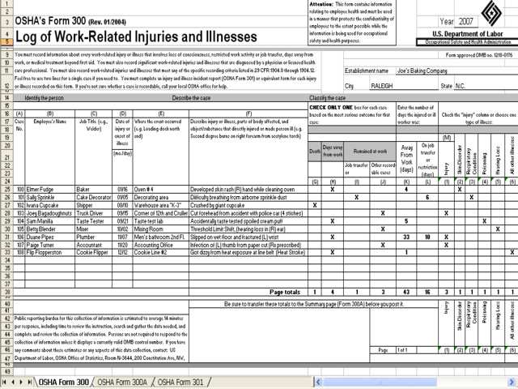
OSHA 300 Log
1904.11
Both TB infections (positive skin test) and TB disease are recordable
Original entry must be updated if TB infection progresses to TB disease during 5 year maintenance period
Positive skin test within first 2 weeks of employment does not have to be recorded on the OSHA 300 form
Notes:
1904.11(a) Basic requirement. If any of your employees has been occupationally exposed to anyone with a known case of active tuberculosis (TB), and that employee subsequently develops a tuberculosis infection, as evidenced by a positive skin test or diagnosis by a physician or other licensed health care professional, you must record the case on the OSHA 300 Log by checking the "respiratory condition" column.

Slide 47
Outreach and Assistance
NC Department of Labor
1-800-NCLABOR
http://www.labor.nc.gov
Consultative Services
1-800-NCLABOR or (919) 707-7846
Education, Training & Technical Assistance
  1-800-NCLABOR or (919) 707-7874
NIOSH
1-800-232-4636
http://www.cdc.gov/niosh/homepage.html

Slide 48
Summary
Provided a basic understanding regarding the transmission and pathogenesis of M. tuberculosis
Discussed the epidemiology of TB in the US and NC
Provided an overview regarding the enforcement procedures for occupational exposure to TB

Slide 49
Thank You For Attending!
Final Questions?
1-800-NC-LABOR
(1-800-625-2267)
www.nclabor.com

