Slide 1
N.C Department of Labor OSH Division
Sampling and Analysis
Presented by: ETTA Bureau, (919) 707-7876

Slide 2
Resources
FOM Chapter XV – Industrial Hygiene Compliance
OneStopShop
OSHA Technical Manual
https://www.osha.gov/dts/osta/otm/otm_toc.html
Chemical Sampling Information – OSHA website
https://www.osha.gov/dts/chemicalsampling/toc/toc_chemsamp.html
NIOSH – Occupational Exposure Sampling Strategy Manual
http://www.cdc.gov/niosh/docs/77-173/
Patty’s Industrial Hygiene and Toxicology

Slide 3
Objectives
Discuss Sampling Equipment
Describe Analytical Techniques
Reasons for Sampling
Develop Sampling Strategy
Evaluation of Sampling Results
Carbon Monoxide – Coburn Equation
Common Citations

Slide 4
Brief Review

Slide 5
Hazard Categories for IHs
Contaminant
Chemical
CO
Biological
Mold
Radiation
Ionizing
Non-ionizing
Reactive (explosive)
Combustible dust
Condition
Thermal
Hot
Cold
Ergonomic
Vibration
Repetitive tasks
Noise
Continuous

Slide 6
Classification of Airborne Contaminants
Physical State
Solids
Fumes
Particles formed by condensation of vapor, generally after volatilization from the molten state and can be accompanied by a chemical reaction.
Size range: 0.01µm – 10.0µm
Dusts
Particles generated by mechanical action.
Size range: 1µm – 100µm
Fibers
Particulate with an aspect ratio (length to width) of 3:1

Slide 7
Classification of Airborne Contaminants
Physical State
Liquids
Mists
Suspended liquid droplets generated by condensation (from gas to liquid).
Size range: 0.01µm – 10µm
Gases
Vapors
A gaseous form of a substance that is normally a solid or liquid at room temperature

Slide 8
Classification of Airborne Contaminant
Multiple Physical States
Aerosol
Liquid droplets or solid particles dispersed in air.
Size range: 0.001µm – 50µm
Particulate matter
Fine solid or liquid particles dispersed in air.
Smoke
Contains liquid droplets, solid particles, and gases originating from incomplete combustion.
Size range: 0.01µm – 1.0µm

Slide 9
Routes of Entry
Inhalation
Material enters the body by breathing.
Ingestion
Material enters the body by swallowing.
Absorption
Material enters the body by diffusing across tissue/membranes.
Injection
Material enters the body when tissue/membranes are punctured or broken.

Slide 10
Toxicological Classification
Different criteria used throughout the world
Examples:
Acute Toxicity
Asphyxiants
Carcinogens
Chronic Toxicity
Corrosive
Irritation
Mutagens
Reproductive Toxicity
Sensitization
Systemic Poisons
Teratogens

Slide 11
Physiological Effects
Acute Toxicity
Refers to those adverse effects occurring following oral or dermal administration of a single dose of a substance, or multiple doses given within 24 hours, or an inhalation exposure of 4 hours.
e.g., phenol – [C₆H₆O]; nickel carbonyl – [Ni(CO)₄]
Chronic Toxicity
Refers to the ability of a chemical to do systemic damage as a result of many repeated exposures, during a prolonged period of time, to relatively low levels of the chemical.
e.g., phenol – [C₆H₆O]; nickel carbonyl – [Ni(CO)₄]

Slide 12
Physiological Effects
Systemic Poisons
Toxic substance whose effect is not localized in one spot but spreads to all body organs and systems in varying degrees, the major effects being manifested in one or two organs.
e.g., tetraethyl lead – [(CH₃CH₂)₄Pb]

Slide 13
Physiological Effects
Asphyxiants
A vapor or gas that can cause unconsciousness or death by suffocation due to lack or depletion of oxygen.
Simple asphyxiants
Are inert gases or vapors which are harmful to the body when they become so concentrated that they reduce oxygen in the air to dangerous levels
e.g., carbon dioxide – [CO₂]; nitrogen – [N]; methane – [CH₄]; hydrogen – [H]
Chemical asphyxiants
Cause suffocation by either preventing the uptake of oxygen in the blood or by preventing the normal oxygen transfer from the blood to the tissues or within the cell itself.
e.g., carbon monoxide – [CO]; hydrogen cyanide – [HCN]; hydrogen sulfide – [H₂S]

Slide 14
Physiological Effects
Corrosive
Chemical at the site of contact that causes visible destruction or irreversible alterations of the skin, eyes, lining of the respiratory tract, or gastrointestinal tract.
e.g., hydrochloric acid – [HCl]; sulfuric acid – [H₂SO₄]
Irritation
Chemical at the site of contact may cause inflammation of the skin, eyes, lining of the respiratory tract, or gastrointestinal tract.
e.g., ammonia – [NH₃]; nitrogen dioxide – [NO₂]

Slide 15
Physiological Effects
Mutagens
Chemicals to modify the genetic material in the nucleus of cells in ways that allow the changes to be transmitted during cell division and potentially causing heritable effects.
e.g., bromine – [Br]; benzene – [C₆H₆]
Carcinogens
A substance or a mixture of substances which induces cancer or increases its incidence.
e.g., Beta-naphthylamine – [C₁₀H₉N]; Bis-chloromethyl either (BCME) – [C₂H₄Cl₂O]

Slide 16
Physiological Effects
Reproductive Toxicity
Adverse effects induced by a chemical on any aspect of mammalian reproduction.
Reproductive Toxicity
Adverse effects that interfere with the ability of males or females to reproduce.
e.g., lead – [Pb]; ethylene oxide – [C₂H₄O]; 1,2-dibromo-3-chloropropane (DBCP) – [C₃H₅Br₂Cl]
Developmental Toxicity
Adverse effects manifested in the embryonic or fetal periods or postnatally, associated with exposure during pregnancy.
e.g., ethylene oxide – [C₂H₄O]; thalidomide – [C₁₃H₁₀N₂O₄]

Slide 17
Physiological Effects
Teratogens
Agents that cause irreversible deleterious structural malformations in an embryo as a consequence of exposure of the mother during pregnancy.
e.g., ethylene oxide – [C₂H₄O]; thalidomide – [C₁₃H₁₀N₂O₄]
Sensitization
Agent that can cause an allergic response in susceptible individuals.
e.g., methylene bisphenyl isocyanate (MDI) – [C₁₅H₁₀N₂O₂]; trichloroethylene – [C₂HCl₃]

Slide 18
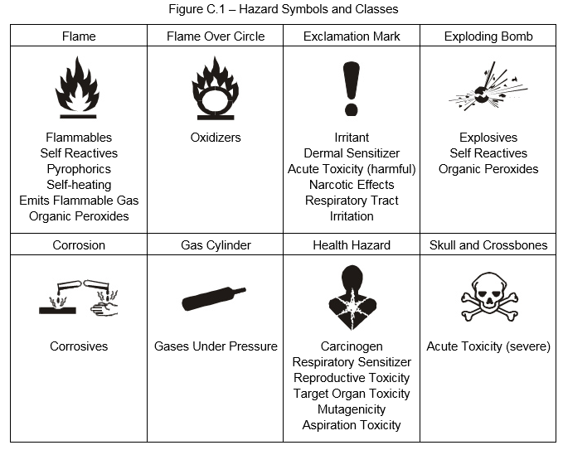
Hazard Classification
1910.1200
Hazard Communication Standard (HCS) 2012

Slide 19
Reasons for Sampling

Slide 20
Sampling Reasons
Characterization of contaminant(s) and/or condition(s) present in the work environment through identification and quantification.
Estimation of employee exposure
Assess compliance
Evaluation of the effectiveness of work place controls (i.e., engineering controls, PPE)

Slide 21
Types of Sampling

Slide 22
Types of Sampling
Grab / Spot
Environmental concentrations at a specific point in time
Can analysis multiple contaminants
Sampling collected over a short period of time
Usually less than 5 minutes
Can be used to estimate time-weighted average (TWA)
Integrated
Averages concentration over long periods of time
Can consist of one sample or multiple samples
Known volume of air passed through a collection device to remove a specific contaminant(s)
Used to determine TWA
Typically, 15 minutes – 8 hours

Slide 23
Types of Sampling
Area
Specific area / fixed locations
TWA
Full-shift
Partial-shift
Ceiling / Excursion / Short Term Exposure Limit (STEL)
Typically 15 minutes
Variations
Equipment
Processes
Personal
Breathing Zone
TWA
Full-shift
Partial-shift
Ceiling / Excursion / STEL
Typically 15 minutes
Variations
Tasks performed
Biological
Biological exposure indices (BEIs)
Full-shift

Slide 24
Types of Sampling
Passive
Passive diffusion
Fick’s first law of diffusion
TWA
Area
Personal
Ceiling / Excursion / STEL
Area
Personal
Active
Physically/forcibly moving air.
through media
Into a collection device
Across membranes
TWA
Area
Personal
Ceiling / Excursion / STEL
Area
Personal

Slide 25
Types of Sampling
Screenings (Grab / Spot)
Provide proof of the existence of the contaminant
Wipe samples
Establish presence of contaminant
Can determine concentration within a defined area
Difficult to interpret results
Bulk samples
Establish and identify contaminant
Sometimes necessary to support analysis
Direct read instruments
Instantaneous
Can provide quantification
Can be used to determine TWA

Slide 26
Full-shift Sampling
FOM Chapter XV
Defined to be a minimum of the total time of the shift minus 1 hour.
e.g., 7 hours of an 8-hour work shift or 9 hours of a 10-hour work shift.
Make every attempt to sample as much of the work shift as possible, including segments of the greatest exposure.

Slide 27
Full-shift Sampling
Monitoring may be accomplished with a full shift single sample or continuous multiple samples taken to determine any 8 hours of exposure for comparison with the permissible exposure level (PEL).
A separate sample should be used to determine any additional exposure beyond 8 hours.

Slide 28
Partial-shift Sampling
Less than 7 hours of an 8-hour shift
Professional judgment is necessary for making any conclusions or assumptions regarding the un-sampled period
i.e. the set-up and/or take-down time which is not to exceed 1 hour.
The CSHO should carefully document the rationale for any professional judgment regarding un-sampled exposure periods.
A determination that any employer is in compliance will not be made in any case unless the sampled period is representative of the employee's normal exposure.

Slide 29
Ceiling Sampling
Typically a 15 minute sample
Monitoring may be accomplished with a single sample to determine the exposure for comparison with the ceiling limits.
Select time period of greatest concern and potential for exposure.

Slide 30
Biological Monitoring
Indirectly reflects the dose to a worker from exposure to the chemical of interest.
Sampling time
Prior to shift
During shift
End of shift
End of the workweek
Discretionary
Examples
Urine Analysis
Blood Analysis
Expired Breath Analysis

Slide 31
Sampling Equipment

Slide 32
Sampling for Gases and Vapors
Grab / Spot Sampling
Evacuated Containers
Displacement Collectors
Flexible Plastic Bags
Integrated Sampling
Absorbers
Adsorption Media
Flexible Plastic Bags

Slide 33
Grab Sampling for Gases/Vapors
Evacuated Containers
Flasks are heavy-walled containers of glass or other suitable material, where air has been removed, created a vacuum.
Usually 200-1000ml in volume
Open container
Air is drawn in
Seal flask
Ship for analysis

Slide 34
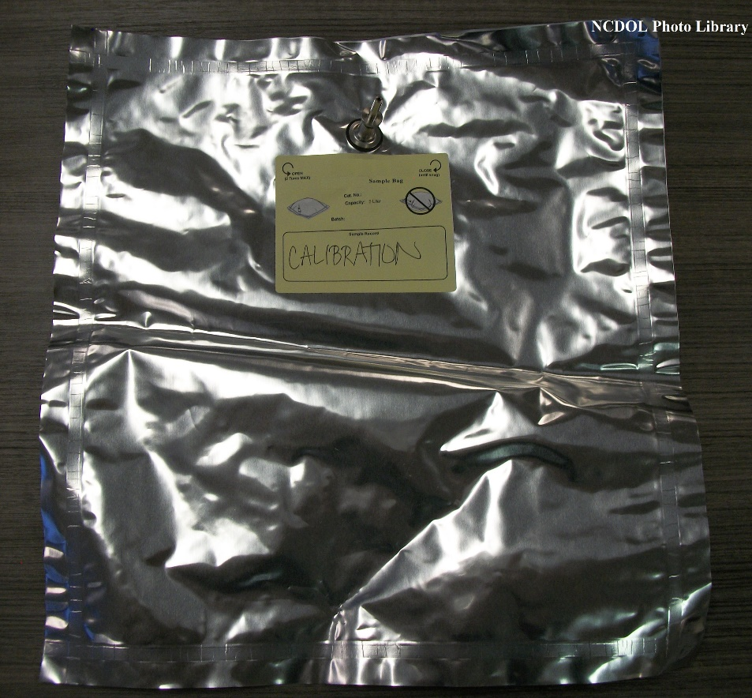
Sampling for Gases/Vapors
Flexible Plastic Bags
Variety of sizes
Common materials used for bags;
Polyester
Polyvinylidene chloride
Teflon
Fluorocarbons
Air drawn into bag by hand pump or battery operated pump
Can be used for either grab or integrated sampling

Slide 35
Commonly used to collect
Evacuated containers
e.g., oxygen – [O]; carbon dioxide – [CO₂]; carbon monoxide – [CO]; nitrogen – [N]; methane – [CH₄]
Flexible Plastic Bags
e.g., organic and inorganic vapors and gases

Slide 36
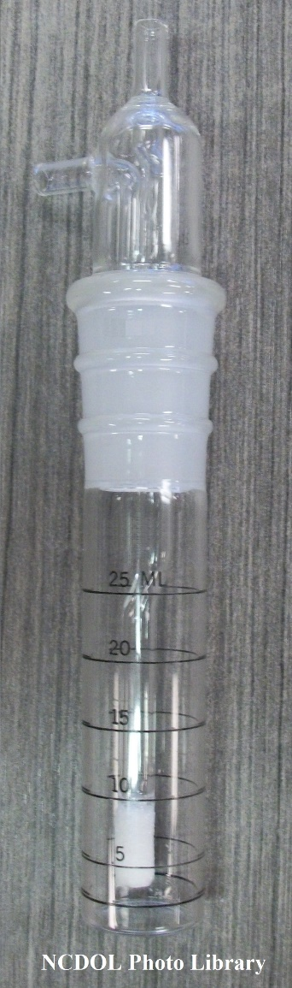
Integrated Sampling for Gas/Vapors
Absorbers
Impinger
Air is passed through liquid, the contaminant is captured by the liquid.
Types
Gas-wash
Spiral absorbers
Fritted bubblers

Slide 37
Integrated Sampling for Gas/Vapors
Adsorption Media
Solid-sorbent tubes
Air is passed through the tube and binds to the media
Types
Activated charcoal based
Most common
Organic vapors
Silica gel based
Polar molecules
Impregnated solid sorbent
Specific contaminant

Slide 38
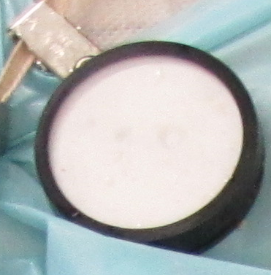
Integrated Sampling for Gas/Vapors
Passive monitors
Utilize Brownian motion to control the sampling process into a collection medium
Follows Fick’s Law
Very easy to use

Slide 39
Commonly used to collect
Absorbers
Impingers
e.g., formaldehyde – [CH₂O]; iodine – [I]
Adsorption Media
Solid-sorbent tubes
Activated charcoal based
e.g., aliphatic, aromatic, halogenated hydrocarbons, alcohols, ethers, acetates, carbon disulfide – [CS₂]
Silica gel based
e.g., Amines, acids, methanol – [CH₃OH]
Impregnated solid sorbent
e.g., 1,3-Butadiene – [C₄H₆], ethylene oxide – [C₂H₄O]
Passive monitors
e.g., formaldehyde – [CH₂O], mercury – [Hg],

Slide 40
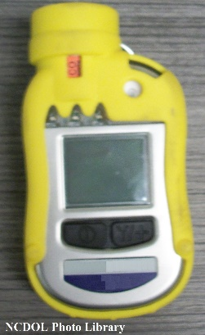
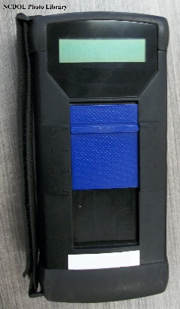
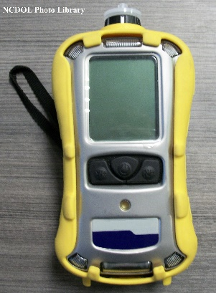
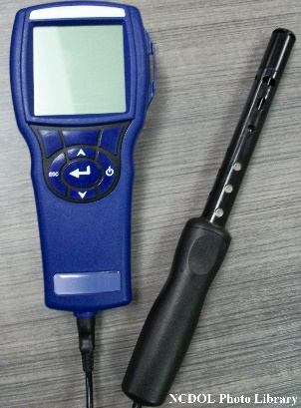
Sampling for Gases and Vapors
Direct-Reading Instruments
Typically used to rapidly detect
flammable or explosive atmospheres
oxygen deficiency
specific gases and vapors
Typically Not designed to measure or detect below 1 ppm
Only for specific classes of chemicals; or
Only for one particular substance or chemical

Slide 41
Sampling for Particulates
Grab / Spot Sampling
Bulk
Wipe
Integrated Sampling
Filtration
Impaction and Impingement
Elutriation
Centrifugal Collection
Electrostatic Precipitation

Slide 42
Sampling for Particulates
Bulk
Physical collection of suspect material
Necessary to support analysis of air samples and presence of hazard
Collected in plastic bad, glass container, or plastic container.
Commonly used to collect
e.g., asbestos; combustible dust; silica – [SiO₂]

Slide 43
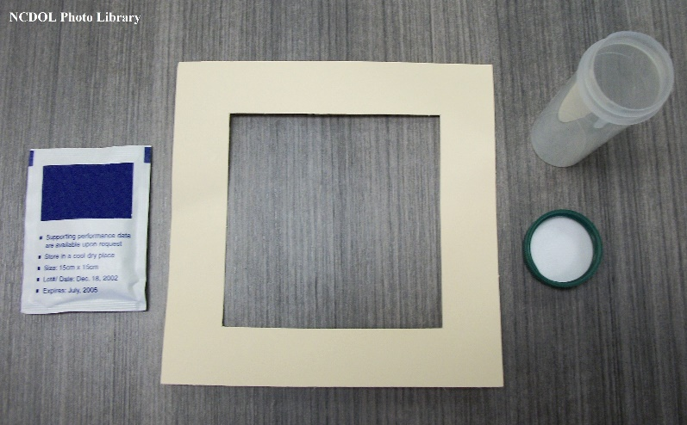
Sampling for Particulates
Wipe
Wiping a predetermined area
Establish presence of contaminant
Can determine concentration within a defined area
Difficult to interpret results
Used to support effectiveness of PPE, housekeeping, and personal hygiene
Commonly used to collect
e.g., Lead – [Pb]; chromium (VI) – [Cr]; isocyanates

Slide 44
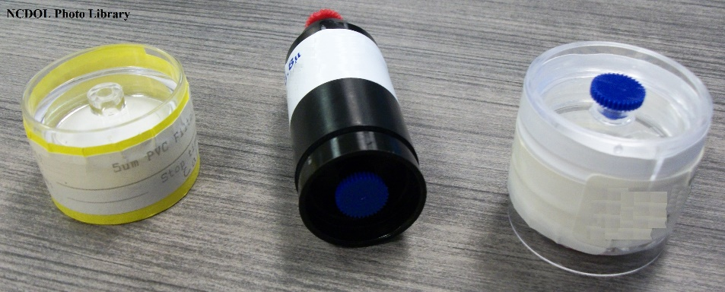
Sampling for Particulates
Filtration
Most common method
Air passes through the filter, particles impact onto the filter
Types
Glass fiber
e.g., oil mist
Mixed Cellulose ester
e.g., asbestos
PVC
e.g., chromium (VI) – [Cr]
PTFE (Teflon) with XAD-2 tube
e.g., coal tar pitch

Slide 45
Sampling for Particulates
Impaction Impingement
Cascade impactors
Constructed with several stages to separate dust by size fractions
Causing a sudden change in direction in airflow
Particle’s momentum causes it to impact on the stage
Collects viable or non-viable samples
Commonly used to collect
e.g., mold

Slide 46
Sampling for Particulates
Impingement
Impinger
Air is passed through liquid, the contaminant is captured by the liquid.
Commonly used to collect
e.g., dust
Not really used much anymore for collecting particulates

Slide 47
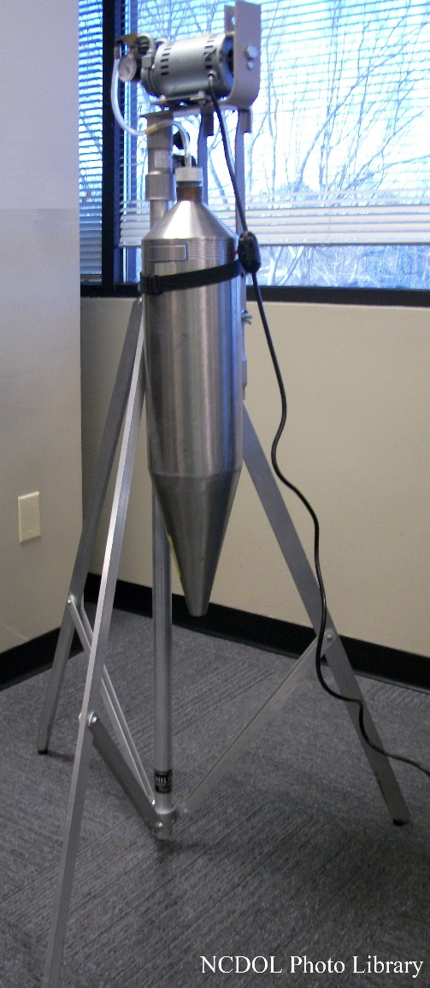
Sampling for Particulates
Elutriation
Used to remove unwanted materials and/or to remove larger size particles
Types
Vertical elutriator
e.g., cotton dust
Horizontal elutriator
e.g., mineral dust

Slide 48
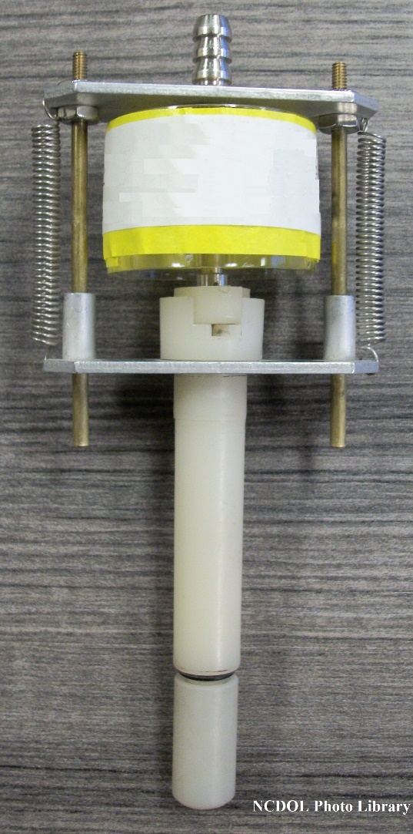
Sampling for Particulates
Centrifugal Collection
Used to determine the respirable fraction
Air stream enters the device and through centripetal force, eliminates particles larger than 10 microns.
Types
Aluminum
Nylon
Commonly used to collect
e.g., silica – [SiO₂]

Slide 49
Sampling for Particulates
Electrostatic Precipitation
High airflow, where particulates pass through a high-voltage electrical field
Particulates are attracted to the cylinder wall where they are collected
Commonly used to collect
e.g., nanoparticles, metal fumes

Slide 50
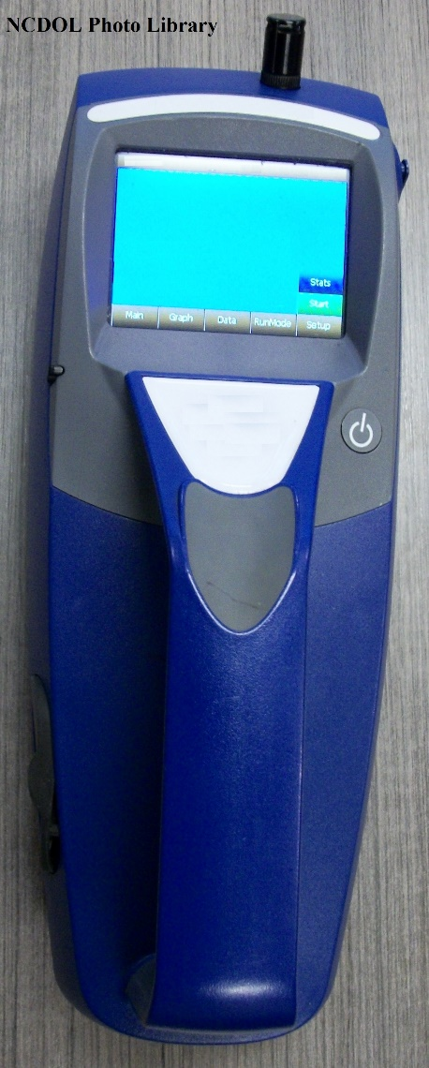
Sampling for Particulates
Direct-Reading Instruments
Typically used to rapidly detect
Particulate size distribution
Respirable dust
Total dust
Results are non-specific

Slide 51
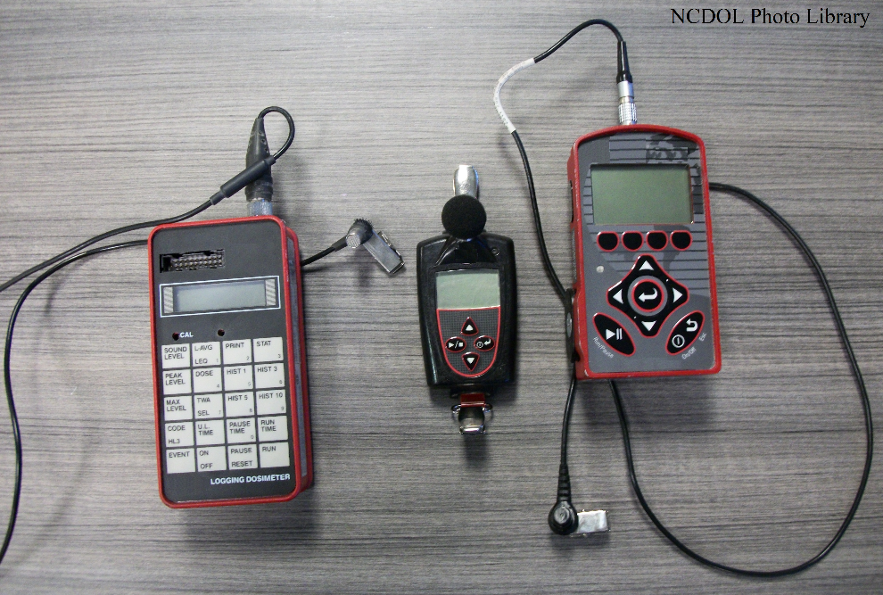
Sampling for Noise
Grab / Spot Sampling
Sound level meters (SLMs)
Octave Band Analyzer (OBA)
Integrated Sampling
Noise Dosimeters

Slide 52
Sampling for Noise
Sound level meters (SLM)
Microphones change energy from sound waves to mechanical energy
Types of Microphones
Dynamic: mylar; vibrates with sound
Ceramic: crystals; distorted by sound; sends out piezoelectric signal.
Condenser: capacitor; measures voltage difference across gap (best type)
Type II
Intended for general field use
Typically ± 2 dB

Slide 53
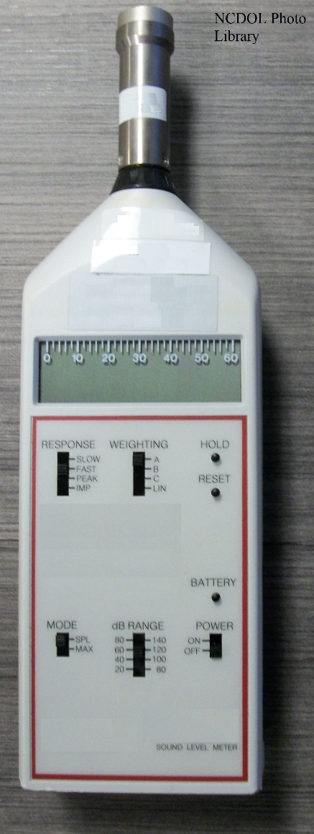
Sampling for Noise
Sound level meters
Measures
Slow
Averages the response out so the SLM can be read more easily
Fast
Used for intermittent noise (i.e., allows you to measure peaks)
Impact
Transient acoustical event less than half second in duration separated by greater than one second between peaks

Slide 54
Sampling for Noise
Octave Band Analyzer
Provides frequency analysis
Useful to select the proper controls to reduce dB

Slide 55
Sampling for Noise
Noise Dosimeters
Measures noise levels and compares them to the 8-hour PEL and AL
Read-out expressed as dose percentage.
Settings used to determine dose percentage
Criterion level – compared level (90 dB and 80 dB), read-out will be expressed as a percentage
Threshold level – level below which noise will not be registered by the meter
Exchange rate – amount of increase in sound pressure level that reduces the exposure time in half (e.g., OSHA uses 5 dB)

Slide 56
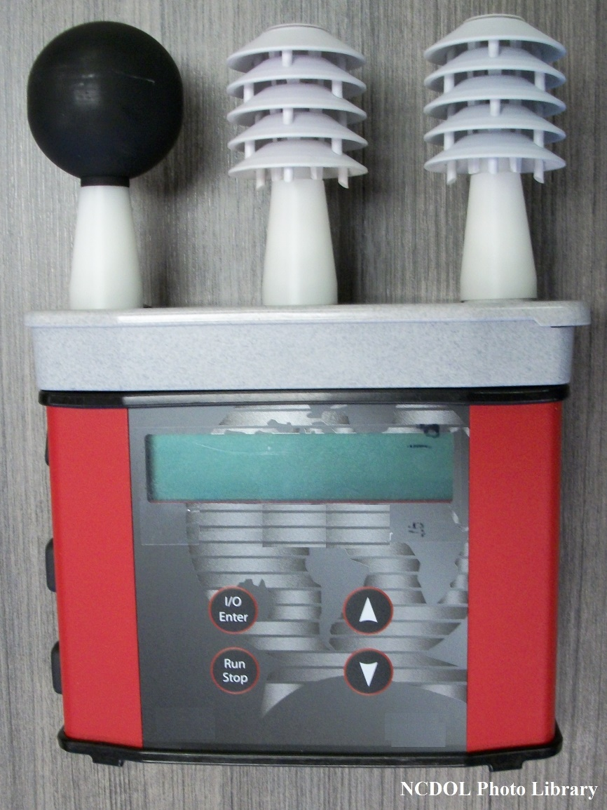
Sampling for Heat
Grab / Spot Sampling
Thermometers (temperature)
Anemometers (air flow)
Psychrometry (humidity)
Wet-bulb, Globe, Thermometer (WBGT)

Slide 57
Sampling for Ergo
Grab / Spot Sampling
Camera
Photographs
Movies
Spot watch
Scale

Slide 58
Sampling for Ergo - Vibration
Grab / Spot Sampling
Accelerometers
Common systems use a vibration transducer which transforms the mechanical motion into an electrical signal.

Slide 59
Radiation
Ionizing vs non-ionizing
Ionizing
Alpha
Beta
Gamma
Neutrons
Non-ionizing
Light
Lasers
Ultraviolet radiation
Radiofrequency

Slide 60
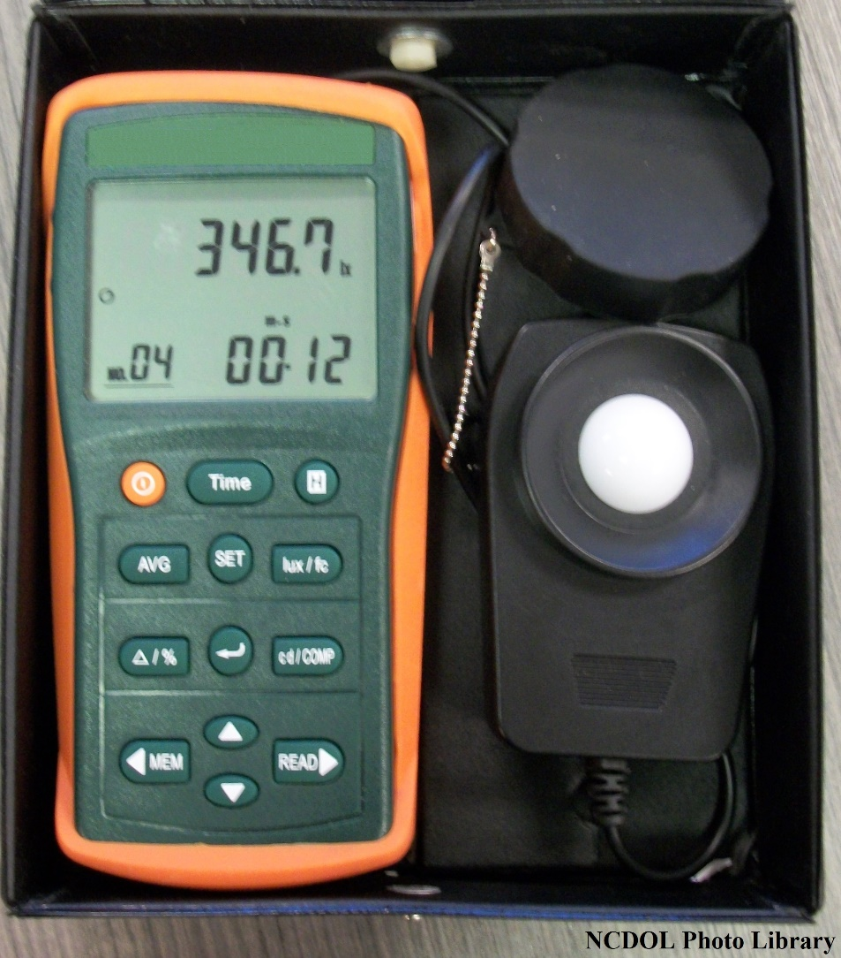
Sampling for Radiation
Ionizing
Grab / Spot Sampling
Geiger Counter
Integrated Sampling
Dosimeters
Non-Ionizing
Grab / Spot Sampling
Light Meter
RF Meter

Slide 61
Analytical Techniques

Slide 62
Analysis Techniques
Gravimetric Techniques
Most frequently used
Calculate based on weight gain
Titrimetric Methods
Using a known concentration to determine an unknown concentration volumetrically
Acid-base
Oxidation-reduction
Optical Methods
Use of a microscope to count particles and fibers
Colorimetric Procedures
Change of color intensity or tone

Slide 63
Analysis Techniques
Spectrophotometric Methods
Use infrared radiation spectra to the ultraviolet, measuring fractions transmitted or scattered
Spectrographic Techniques
Vaporize sample, disperse it and photograph resulting spectrum for analysis
Chromatographic Methods
Quantified by run times, when sample is passed through columns
Atomic Absorption Spectrophotometry
Measures adsorption of radiation to determine concentration

Slide 64
Sampling Strategy

Slide 65
Methods of sampling
There are multiple types of sampling methods and the method(s) selected comes from professional judgement and evaluation being conducted.
Time-weighted average (TWA)
Determining exposure during the entire shift
Typically 8 hours
Ceiling/excursion limits/shot term exposure limits
Determining short term exposures
Typically 15 minutes
Screenings
Provide the existence of the contaminant
Can provide quantification

Slide 66
Sampling Strategy
General Considerations
Preliminary Survey
Worst case vs Typical day
Whom/where/when to sample
Analytical Method
Sampling Equipment
Sampling Necessary?

Slide 67
General Considerations
Preliminary Survey
Materials used/present
Employee complaints or symptoms
Process operations
Workplace observations

Slide 68
Materials/Products
Identify the raw material/products being used in production
Review SDS/MSDS
Review purchasing records
Determine the chemical composition of the product(s)
Do chemicals pose or potentially pose a hazard?
Determination amount of raw material/products
Identify any by-products produced during the production
e.g., dust, carbon monoxide – [CO]

Slide 69
Symptoms/Complaints
Interviews
Management
Employee complaints
Sick employees
Employees
Experience any symptoms
Co-workers
Illnesses
Concerns/Issues
Documentation
OSHA 300 logs
Form 19s
Medical Records
Workers Compensation Claims
Form WC-14

Slide 70
Process/Operation
Become familiar with the entire process operation.
Start to finish
Describe how raw materials/products are transformed into the sales/final product.
Identify equipment used
Identify engineering controls in place.
Identify specific tasks/operational procedures
Identify any task/operational hazards
Noise
Repetitive tasks
Air contaminants

Slide 71
Process/Operation
There are many processes and operations within the working environment that could expose employees to concentrations above the action level or permissible exposure limit.
Examples
Welding | Dipping
Soldering | Plating
Painting | Mixing
Etching | Milling
Spraying | Drilling

Slide 72
Workplace observation
Workplace Conditions
Temperature
Hot / cold
Water damage
Mold
Visible contamination
Dust clouds
Fumes
Dust piles
Fog
PPE
Respirators
Dust Masks vs Full Face
Ventilation
Mechanical vs Natural
Habits

Slide 73
Worst Case vs Typical Day
Worst case
Representative of the highest potential exposures during process operations
Typical Day
Representative of normal process operations
Goal for compliance is to sample worst case.

Slide 74
Whom/Where/When
Where
Sample location
Operation
Department
Sampling
Area
Workplace
Specific operation
Personal
Breathing zone

Slide 75
Whom/Where/When
Whom
Select the maximum risk employee(s)
Employee(s) location to operation/area
Employees who perform similar tasks
When
Differences between shifts
Ventilation changes
Weather conditions
Process change(s)
Unusual situation(s)
Worst case scenario(s)
Specific task(s)

Slide 76
Sample Analysis
Sample Analysis
Accreditation
Analytics
OSHA’s Salt Lake Technical Center (SLTC)
Analytical Methods
Validation
OSHA method or NIOSH method
Few exceptions
Interferences
Positive
Gravimetric analysis
Negative
Depletion of contaminant
Combustible Dust
Moisture

Slide 77
Sampling Strategy
8-hours TWA
Full period single sample
Full period consecutive samples
Partial period consecutive samples
Grab samples measurement(s)
Ceiling
Full period single sample
Grab samples measurement(s)

Slide 78
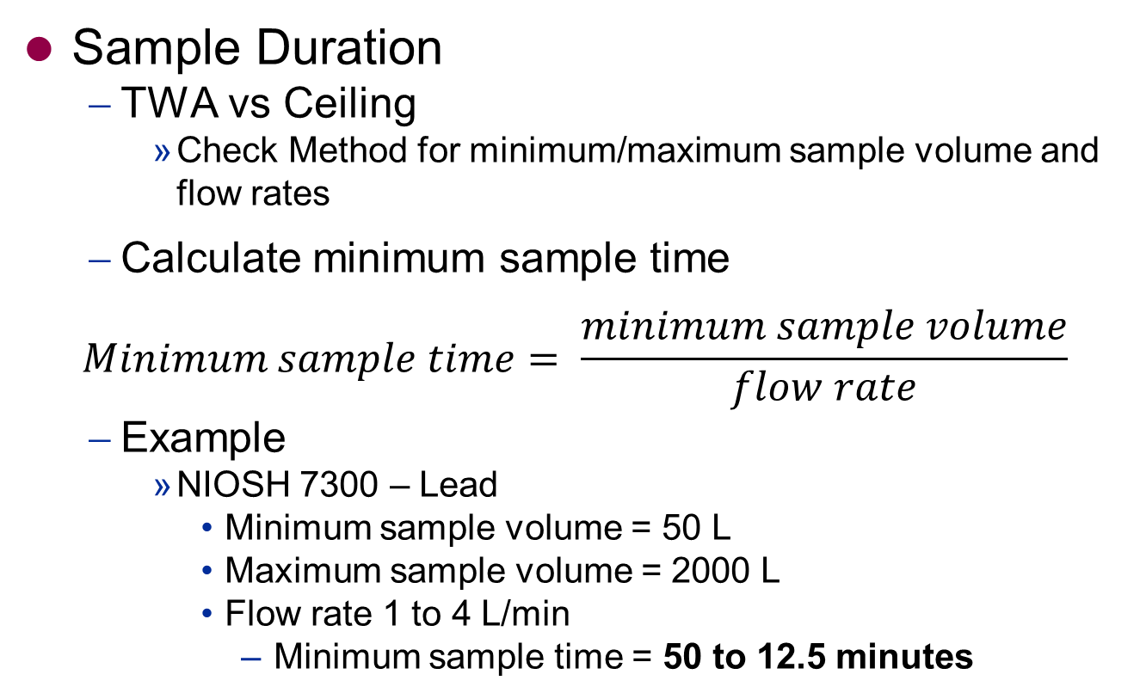
Considerations
Tech Man: Sec II Ch 1
Sample Duration
TWA vs Ceiling
Check Method for minimum/maximum sample volume and flow rates
Calculate minimum sample time
$$Minimum sample time= \frac{minimum sample volume}{flow rate}$$
Example
NIOSH 7300 – Lead
Minimum sample volume = 50 L
Maximum sample volume = 2000 L
Flow rate 1 to 4 L/min
Minimum sample time = 50 to 12.5 minutes

Slide 79
Considerations
Media
Availability
Overnight shipping
Number of Samples
Includes field blanks
Cost
Method
Media

Slide 80
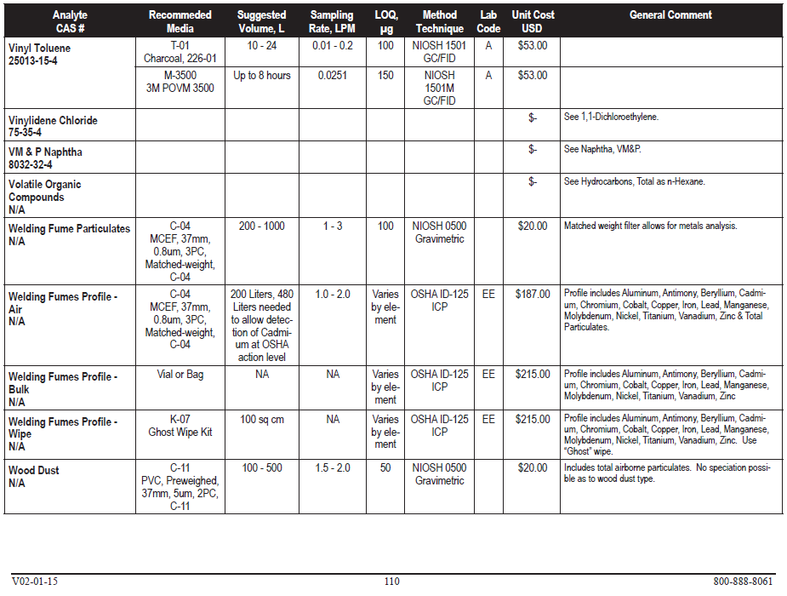
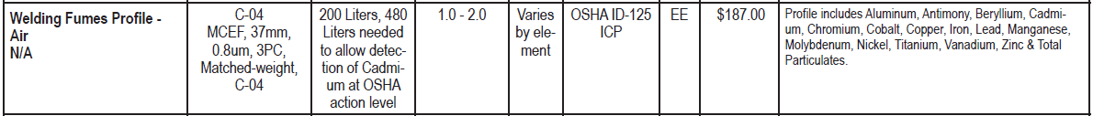
Analytics - Book

Slide 81
Sampling Equipment
Good working order
Availability
Plus additional back ups
Charged

Slide 82
Sampling Necessary?
Potential exposure?
Related symptoms present?
Contaminant / Condition present?
Employer’s exposure assessment?
Previous sampling conducted by NCDOL?

Slide 83
Sampling Necessary?
Employer’s exposure assessment
Who conducted the sampling?
Credentials?
Third-party?
Sampling Method Used?
Sample Time?
Employee(s) Sampled?
Representative?
Operation(s)
Number of samples?
Meets requirements of standard where applicable?
e.g., ethylene oxide – [C₂H₄O]

Slide 84
Sampling Necessary?
OSHA’s additional monitoring requirement
Whenever there has been a change in the production, process, control equipment, personal or work practices that may result in new or additional exposures or when the employer has any reason to suspect that a change may result in new or additional exposures.

Slide 85
Includes Personal
Asbestos
1910.1001(d)(5)
1926.1101(f)(4)(ii)
Inorganic Arsenic
1910.1018(e)(4)
1926.1118
Beryllium
1910.1024(d)(4)
1926.1124(d)(4)
Lead
1910.1025(d)(7)
1926.62(d)(7)
Chromium (VI)
1910.1026(d)(2)(vi)
1910.1126(d)(2)(vi)
Cadmium
1910.1027(d)(4)
1910.1126(d)(4)
DBCP
1910.1044(f)(4)
1926.1144
Acrylonitrile
1910.1045(e)(4)
1910.1145
Ethylene Oxide
1910.1047(d)(5)
19126.147
MDA
1910.1050(e)(5)
1926.60(f)(5)
1,3-Butadiene
1910.1051(d)(5)(i)
Silica
1910.1053(d)(4)
1926.1153(d)(2)(iv)

Slide 86
Differences
Doesn’t include personal
Vinyl Chloride
1910.1017(d)(3)
1926.1117
Coke Oven Emissions
1910.1029(e)(2)
1926.1129
Cotton Dust
1910.1043(d)(3)(iii)
Methylene Chloride
1910.1052(d)(4)(i)
1926.1152
Unique
Formaldehyde
1910.1048
1926.1148
13 Carcinogens
1910.1003 – 1910.1016
1926.1103 – 1926.1116

Slide 87
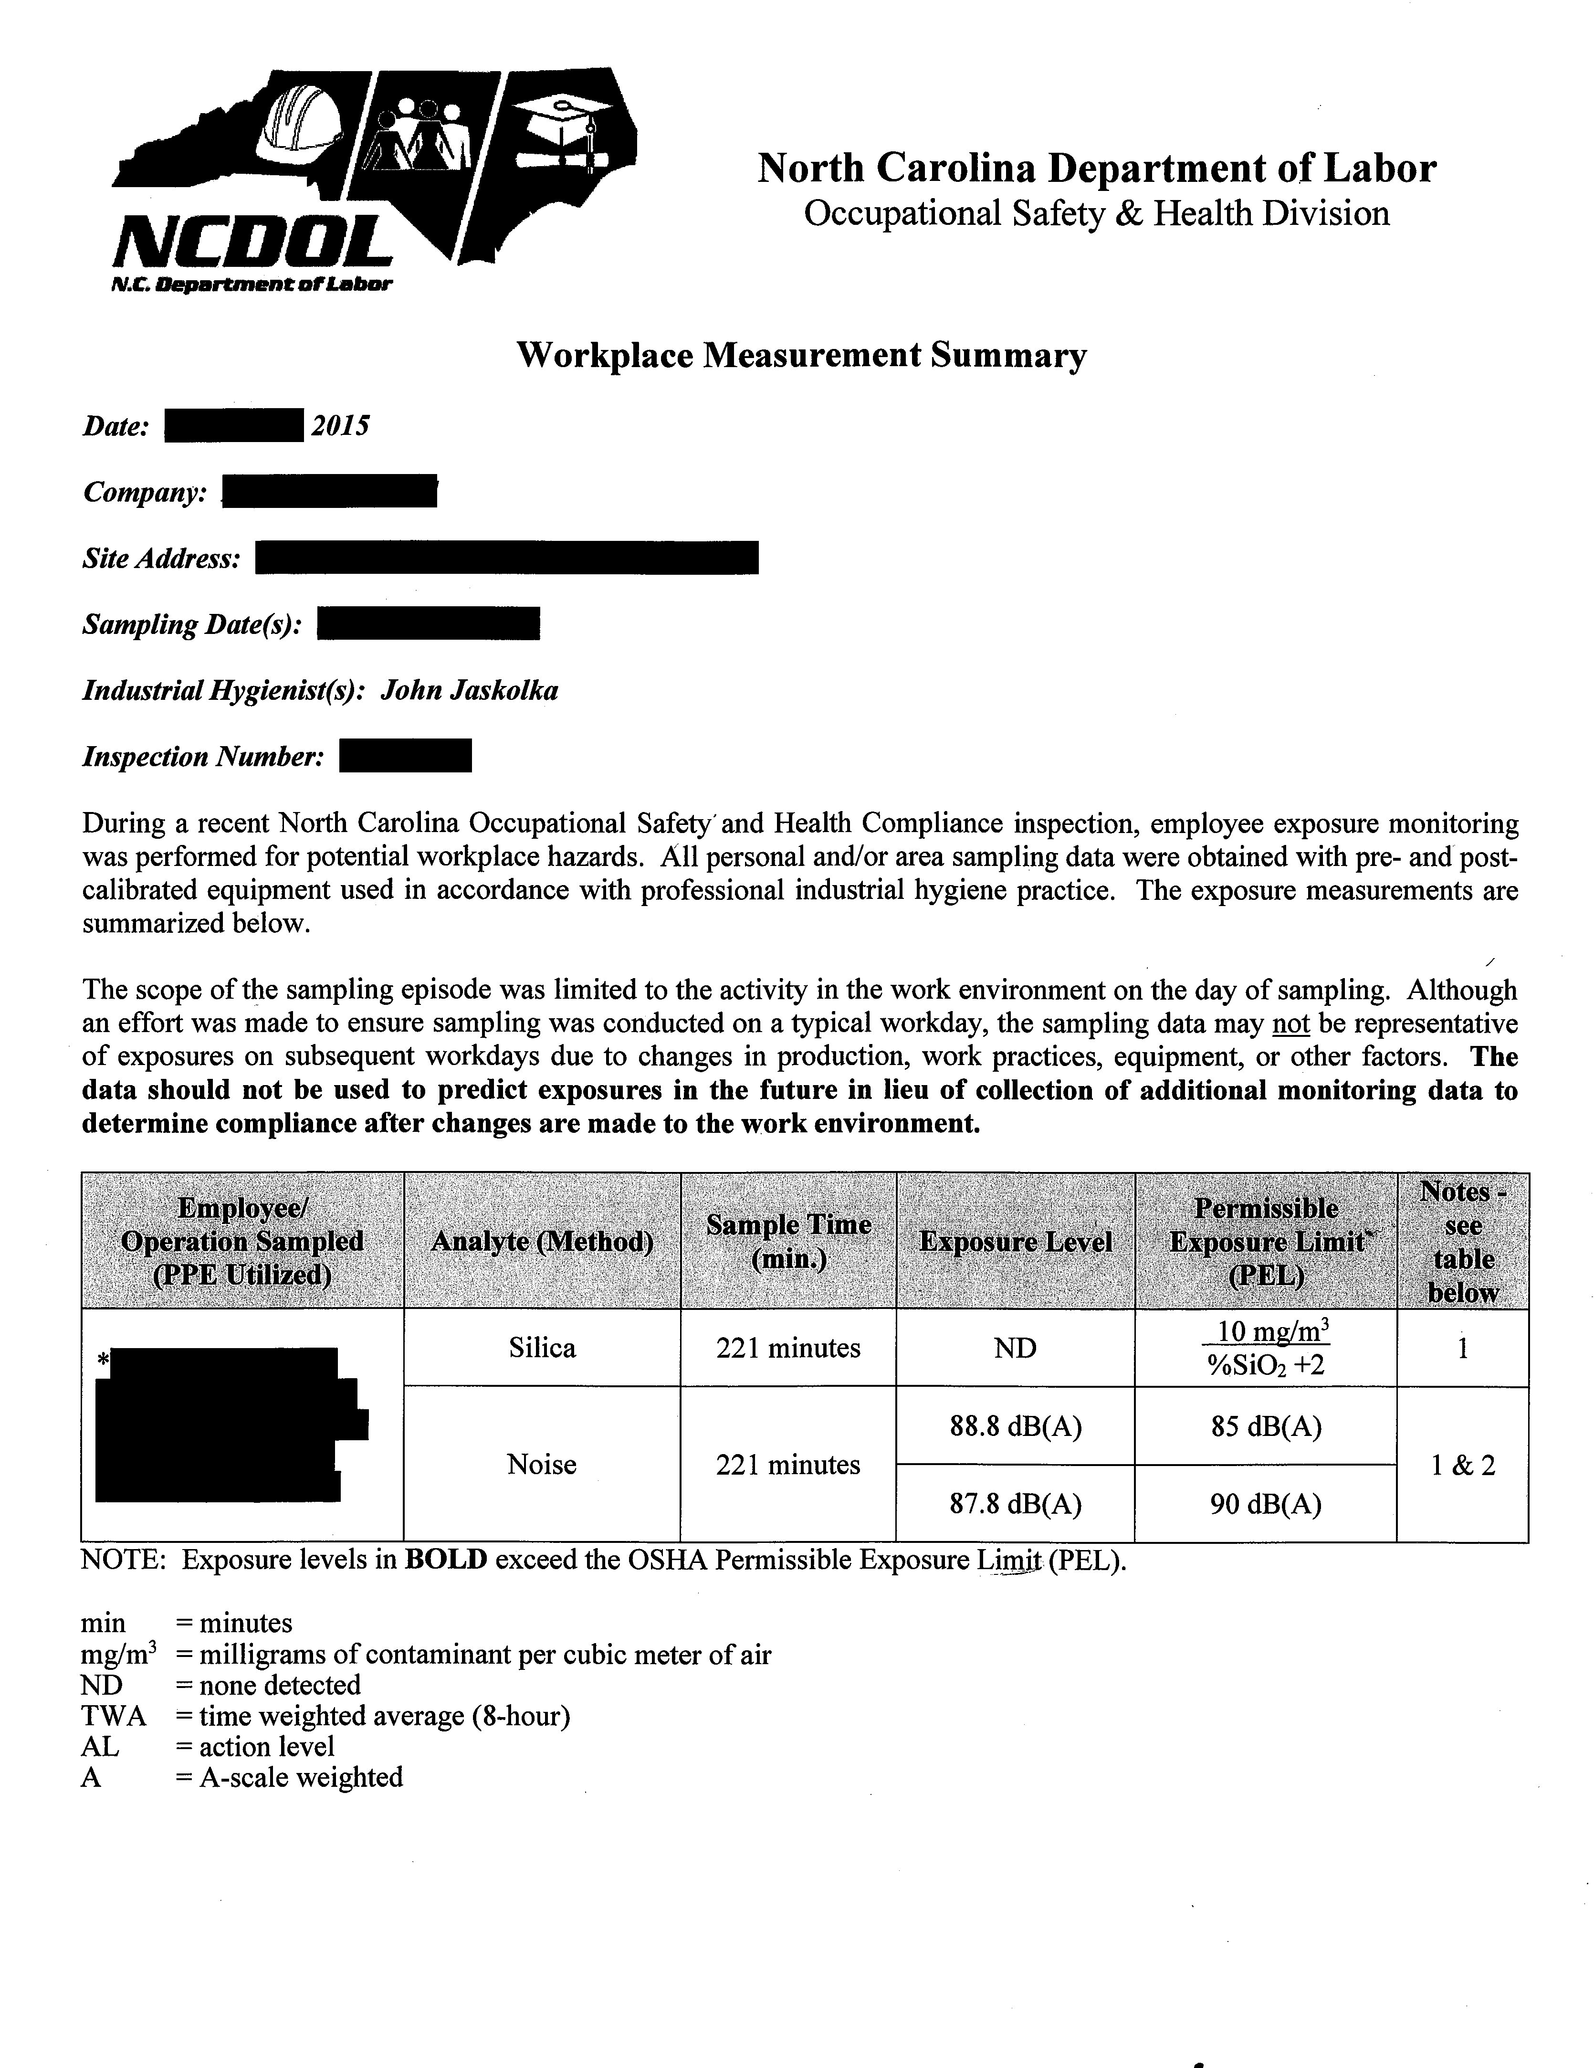
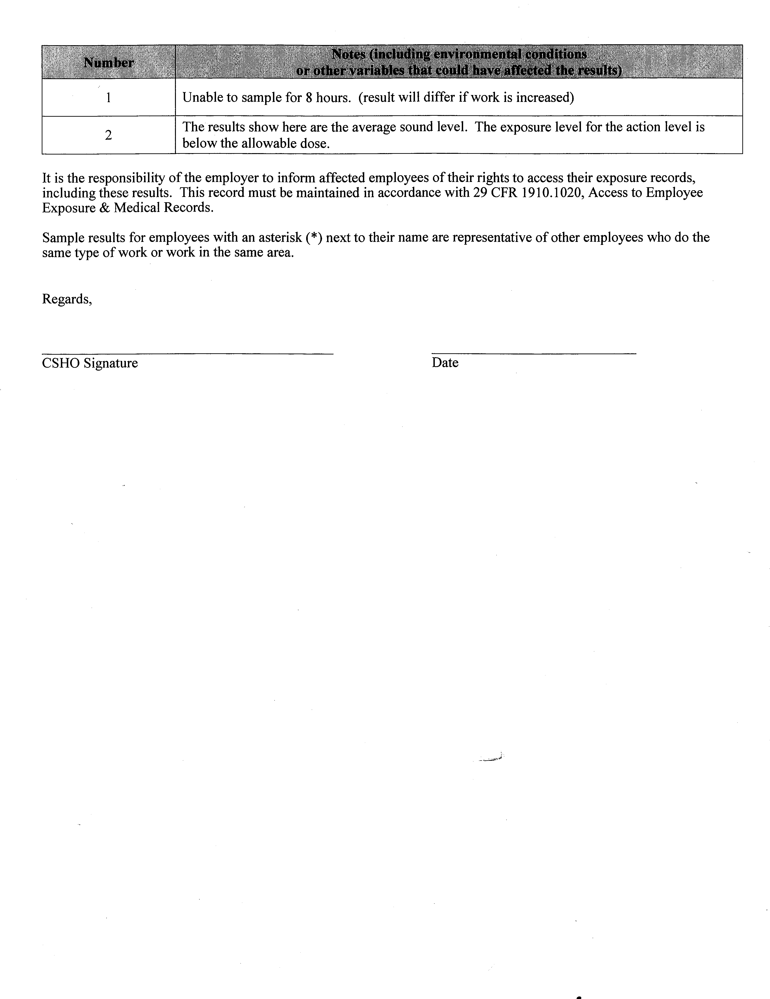
NCDOL Sampling

Slide 88
NCDOL Sampling
The scope of the sampling episode was limited to the activity in the work environment on the day of sampling. Although an effort was made to ensure sampling was conducted on a typical workday, the sampling data may not be representative of exposures on subsequent workdays due to changes in production, work practices, equipment, or other factors.
The data should not be used to predict exposures in the future in lieu of collection of additional monitoring data to determine compliance after changes are made to the work environment.

Slide 89
Sampling Necessary?
FOM Chapter – XV.C.2.
Sampling procedures should be conducted for all complaints and referrals alleging exposure to substances.
If the CSHO determines that sampling is not necessary, the CSHO will discuss this with their supervisor.
If sampling is not conducted, the CSHO will document the reasons in the case file.

Slide 90
Sample Collection
Air and Noise Samples

Slide 91
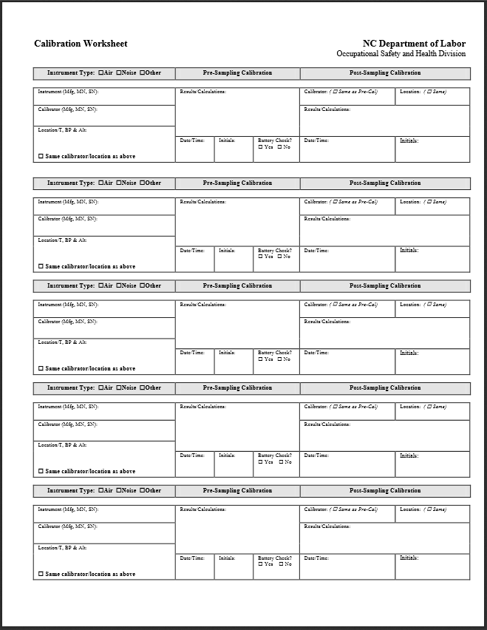
Calibration Worksheet
NCDOL Photo Library

Slide 92
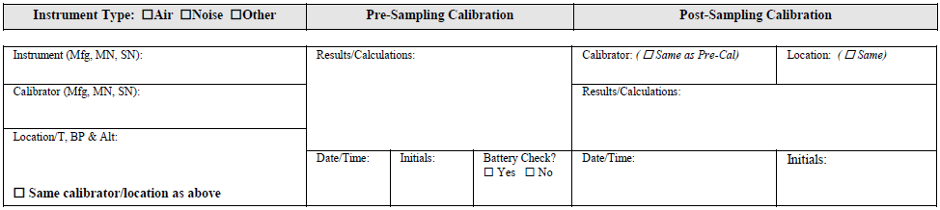
Calibration
Sampling equipment checked out, inspected and calibrated before use (on-site if possible).
Pre and Post calibration must be recorded on the Calibration Worksheet for each piece of sampling equipment.

Slide 93
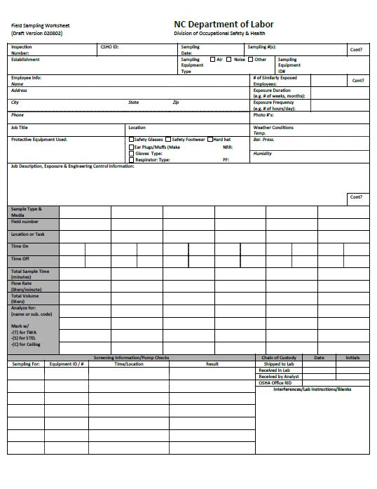
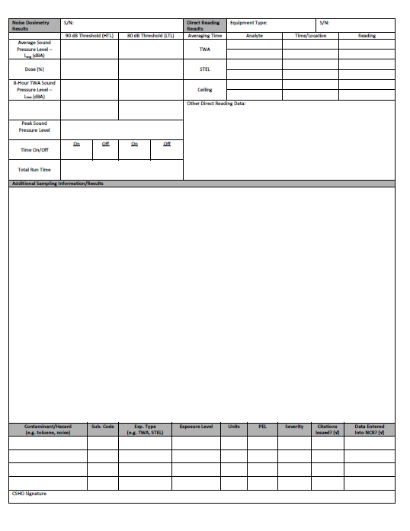
Field Sampling Worksheet
NCDOL Photo Library
NCDOL Photo Library

Slide 94
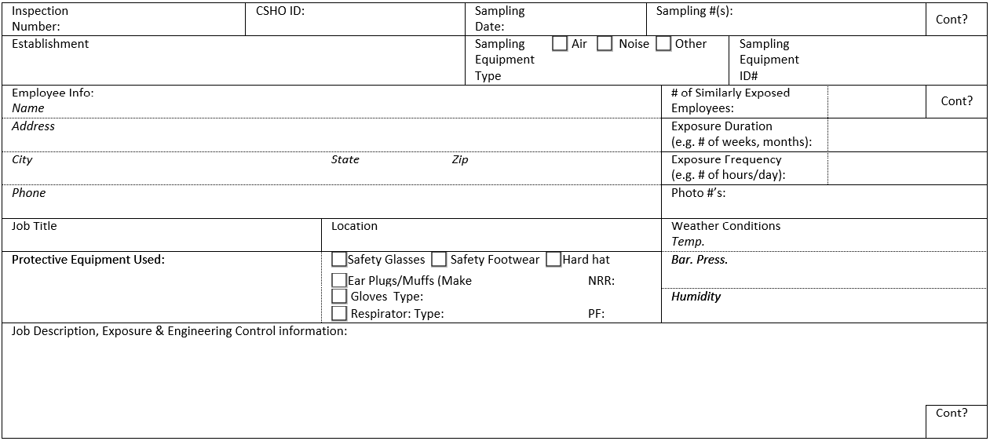
Day of Sampling
Field Sampling Worksheet

Slide 95
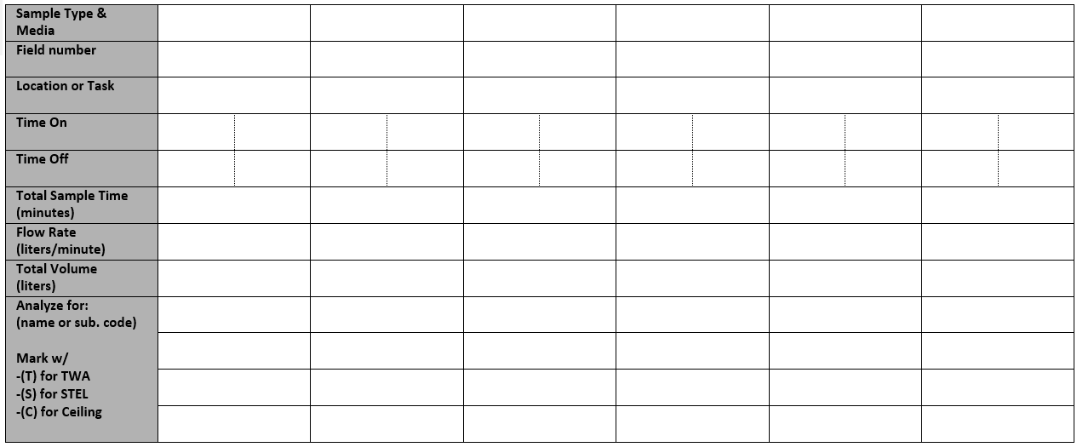
Day of Sampling
Field Sampling Worksheet

Slide 96
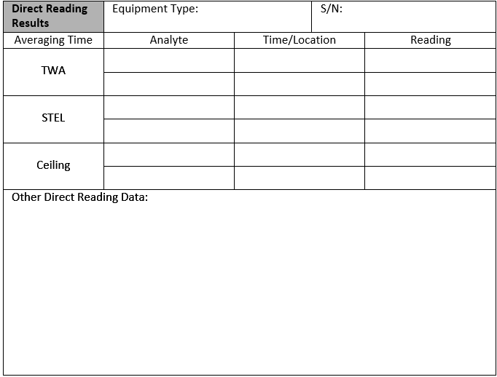
Day of Sampling
Field Sampling Worksheet

Slide 97
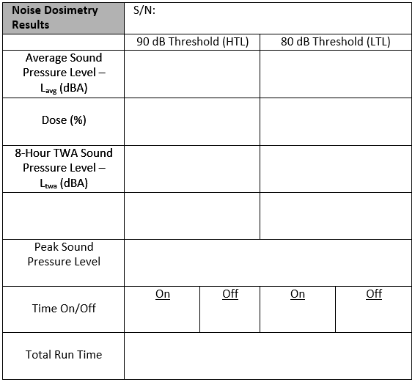
Day of Sampling
Field Sampling Worksheet

Slide 98
Breaks and Sampling
Lunch breaks
Not advisable to sample during lunch breaks
Employee may leave the company premises
Unless employees eat in areas where potential exposure exists.
Bathroom breaks
Not advisable to sample during bathroom breaks.
Depends on the sampling equipment (e.g., Edge 5s)
Regular breaks
Continue to sample during regular breaks.
Unless employees leave the company premises
Unless employees go for a smoke break

Slide 99
Breaks and Sampling
Removal of equipment
Turn off device prior to break and turn on again after returning from break.
Care taken to assure that contamination of collection medium does not occur.
Ensure sample media and equipment go back on the same person.
The time it is off should not be counted as sample time for calculation of TWA.

Slide 100
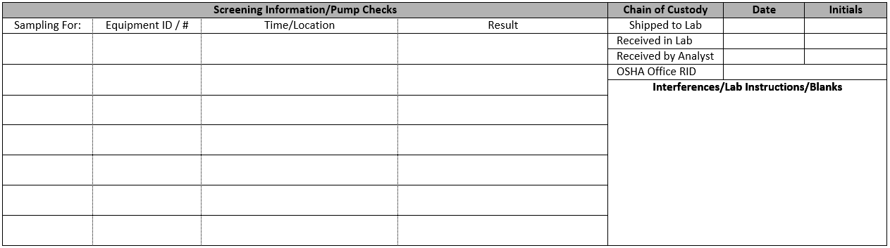
Day of Sampling – Equipment Checks
Field Sampling Worksheet

Slide 101
Equipment Checks
FOM XV.C.2.c
Once sampling equipment is placed on employee or area
Check on sampling equipment
First 30 minutes
1-hour after the 30 minutes
2 hours after the first hour
CSHO must remain at workplace while samples are being collected.

Slide 102
Observation
Observe employee(s) during sampling
Note any deviation(s) from procedure
Non-routine tasks
Additional protections
New engineering controls
Rotation
PPE usage
Shorten duration
Anything else of importance

Slide 103

Day of Sampling - Observation
Field Sampling Worksheet
Record any and all observations here

Slide 104
After Sample Collection
Post Calibrate sampling equipment, immediately after sampling.
Document on Calibration Worksheet for each piece of sampling equipment.
Difference between pre and post flow rates as a general rule should not be greater than 5%

Slide 105
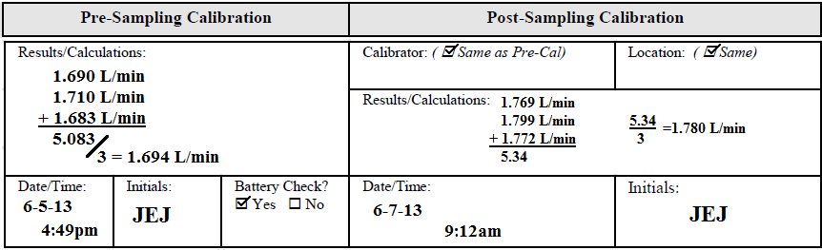
Example 1
Not calibrated on-site
Not immediately post calibrated

Slide 106
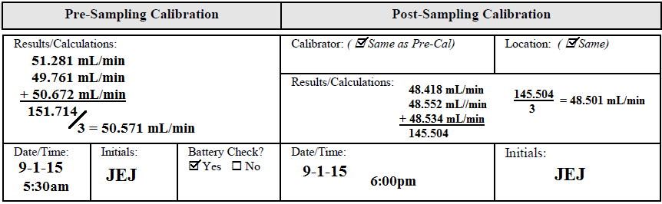
Example 2

Slide 107
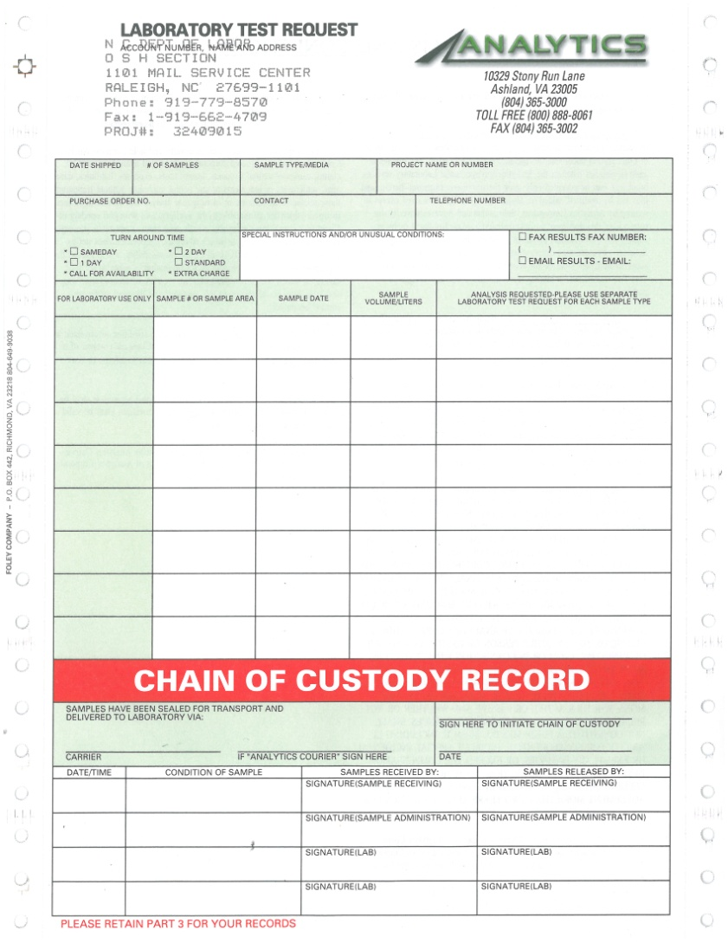
Analytics Lab Test Request Form
Photo Source: NCDOL Photo Library

Slide 108
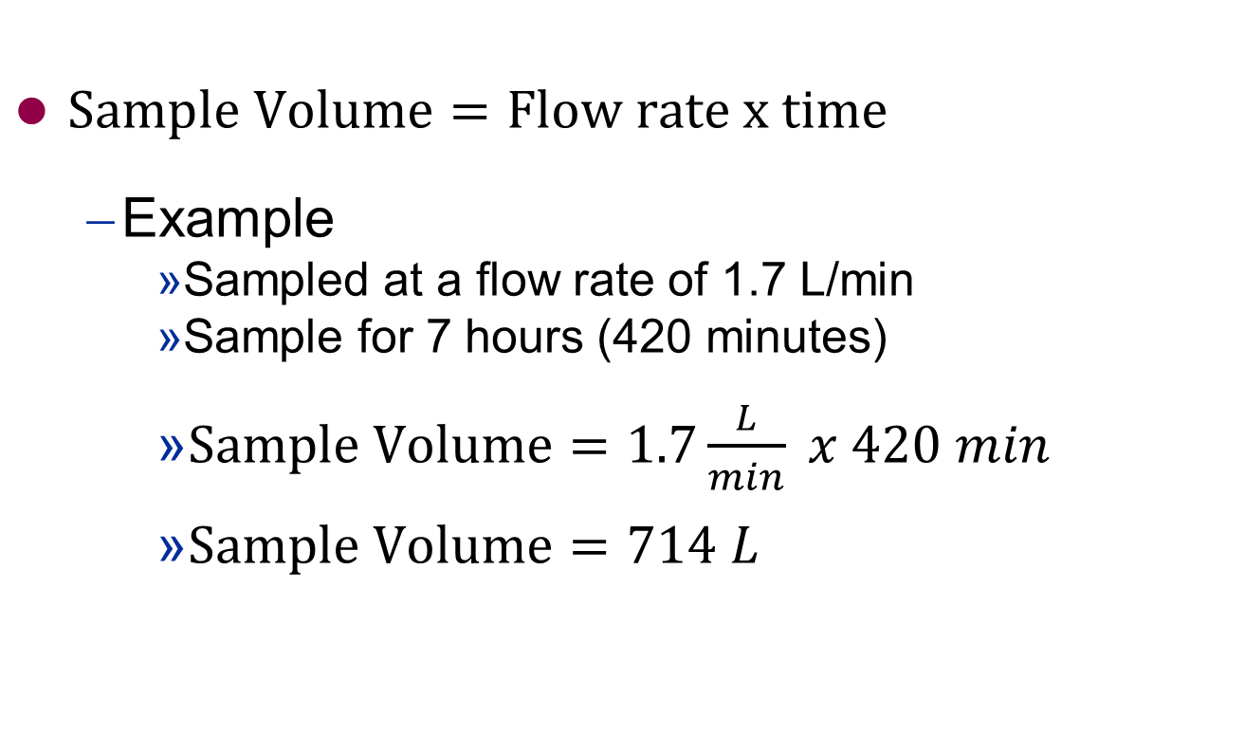
Calculating Sample Volume
$Sample Volume=Flow rate x time$
Example
Sampled at a flow rate of 1.7 L/min
Sample for 7 hours (420 minutes)
$Sample Volume=1.7\frac{L}{min} x 420 min$
$Sample Volume=714 L$

Slide 109
Calculating Sample Volume
What is the sampling flow rate and sample volume for Example 2?
Pre-cal = 50.571 mL/min
Post-cal = 48.501 mL/min
Average of pre and post = 49.536 mL/min
Pre-Calibration | Post-Calibration
50.571 mL/min | 48.501 mL/min

Slide 110
Answer
Pre-cal = 50.571 mL/min
Post-cal = 48.501 mL/min
Average = 49.536 mL/min

Slide 111
Reason
Example – PEL 1ppm
43µg was detected on one sample collected over 480 minutes.
Typical reports
mg/m³ and/or ppm
43µg = 0.043mg
Pre-cal = 50.571 mL/min
Post-cal = 48.501 mL/min
Average of pre and post = 49.536 mL/min

Slide 112
Conversions
Pre-cal
50.571 mL/min x 480 min = 24274.08 mL
24274.08 ml = 24.27408 L = 0.02427408 m³
Post-cal
48.501 mL/min x 480 min = 23280.48 mL
23280.48 mL = 23.28048 L = 0.02328048 m³
Average
49.536 mL/min x 480 min = 23777.28 mL
23777.28 mL = 23.77728 L = 0.02377728 m³

Slide 113
Concentrations
Pre-Cal
0.043mg / 0.02427408 m³ = 1.77 mg/m³
1.77 mg/m³ = 0.98 ppm
Post-Cal
0.043mg / 0.02328078 m³ = 1.85 mg/m³
1.85 mg/m³ = 1.03 ppm
Average
0.043mg / 0.02377728 m³ = 1.81 mg/m³
1.81 mg/m³ = 1.00 ppm

Slide 114

Form 21 Tape

Slide 115

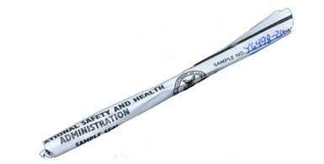
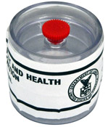
Form 21 Tape

Slide 116
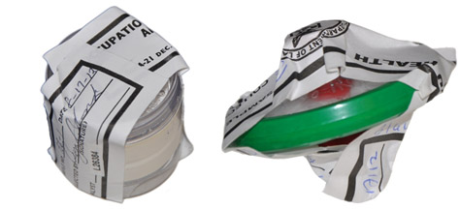
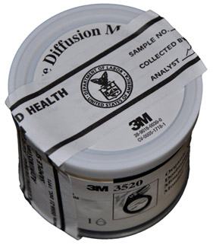
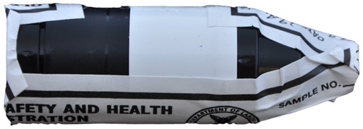
Form 21 Tape

Slide 117
Sample Collection
Wipe Samples

Slide 118
Wipe Sampling
Wipe Sampling Procedures
FOM Chapter XV
Refer to the OSHA Technical Manual
Prior determination of wipe sample locations
Surfaces
e.g., Floor, desks, tables, door knobs, etc.
Employees’ skin
e.g., hands, face.
Each wipe sample
A new set of clean, disposable, powder-free gloves must be used for each sample.
prevents false positives

Slide 119
Day of Sampling
Record each location with a unique identifier.
Photograph each location and specify each location within the facility.
If photographs cannot be taken, sketches, diagrams, and other means of identifying locations are acceptable.
Don gloves
Remove media (e.g., filter) from packaging / cassette / vial with tweezers or fingers.
If a damp wipe sample is desired, moisten the filter with distilled water or other solvent as recommended.
Note: For skin sampling use only distilled water.

Slide 120
Day of Sampling
Place single-use 10cm x 10cm templates at desired location
Using the media, wipe an area about 100 cm², rubbing the entire area side to side, then up and down.
When wiping, apply firm pressure
In many cases (such as knobs and levers) it may not be possible to wipe 100 cm².
Sample cannot be quantified
Place media in a sample vial, cap and label it with the same unique identifier as the location.

Slide 121
Day of Sampling
Remove and dispose gloves.
Include additional relevant details regarding the nature of the sample
e.g., inside Fred’s respirator, “x” distance from contaminant generating process
At least one blank media treated in the same fashion, but without wiping, should be submitted for each sampled area.

Slide 122
Day of Sampling
Some substances (e.g., benzidine, hexavalent chromium, and 4,4’-methylenedianiline) are unstable and may require a solution to be added to the vial as soon as the wipe sample is placed in the vial or may require other special sample handling.

Slide 123
After Sampling Collection
Submit the samples, each sealed with a Form OSHA-21, and in accordance with any special procedures located in OTM Section II Chapter 4 (Sample Shipping and Handling).

Slide 124
Sample Collection
Bulk Samples

Slide 125
Bulk Sampling
Bulk Sampling Procedures
FOM Chapter XV
Refer to the OSHA Technical Manual
Locations
Prior determination after walk-around
Immediate during walk-around
Equipment
Plastic container, natural bristle brush and non-sparking dust pans
e.g., combustible dust
Plastic bag and gloves
e.g., paint chips

Slide 126
Dust – Day of Sampling
Each type of dust must be collected as a separate sample
Collect at least 1 liter of dust per sample
If grain dust collect two samples
Suggested locations
“High spaces” such as roof beams, open web beams, and other ceiling supports; tops of pipes, railing, ductwork, conduit, electrical boxes/panels and other horizontal surfaces located as high in the overhead as possible.
Samples from floor level present a significantly reduced potential for dust cloud generation

Slide 127
Dust – Day of Sampling
Record each location where sample was collected.
Document each location within the facility.
Do not take photographs
Use sketches, diagrams, and other means of identifying locations were samples were taken from.
Document where, when, and how dust is used and/or generated.
Don gloves
Use natural bristle hand brush to sweep accumulated dust into non-sparking dust pans.

Slide 128
Dust – Day of Sampling
Transfer dust from dust pans to plastic container.
Upon completion
Affix an OSHA-21 sample identification seal to the container.
To seal the container, apply one end of the seal to the center of the lid, and run the seal down the edge of the lid and as far down the side of the container as it will reach
Complete the Receipt of Evidence or Property Form
If available collect MSDS/SDS of dust or raw materials

Slide 129
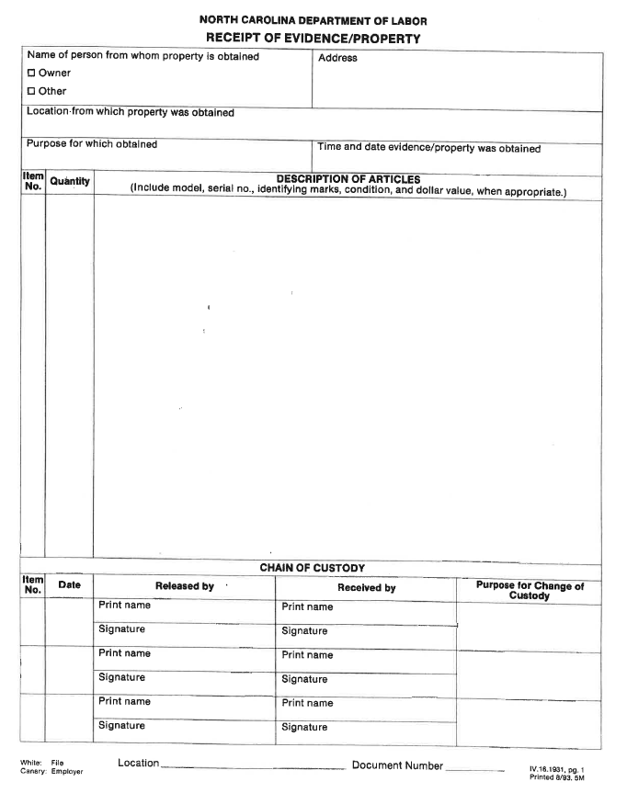
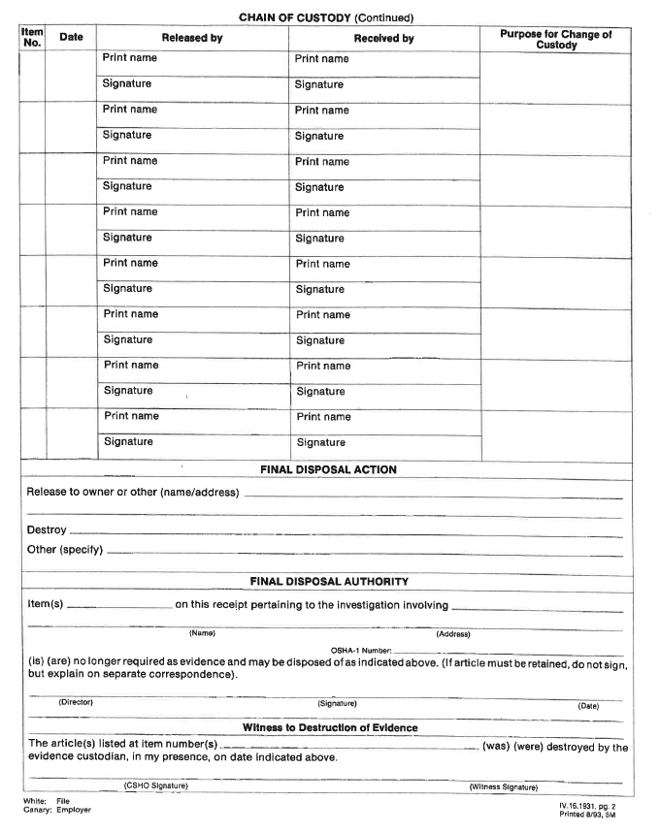
Receipt of Evidence/Property Form

Slide 130
Dust – Day of Sampling
Storage
Secure sample(s)
Approval must be received prior to sending sample for analysis
Typically after file is contested
Fill out form 91 to submit to SLTC
Must specify test to be done
Request “Potential Class II Dust” to support electrical violations
e.g., 29 CFR 1910.307
Request “Kst” to support fire or explosion hazards that may result from housekeeping or 95-129(1).

Slide 131
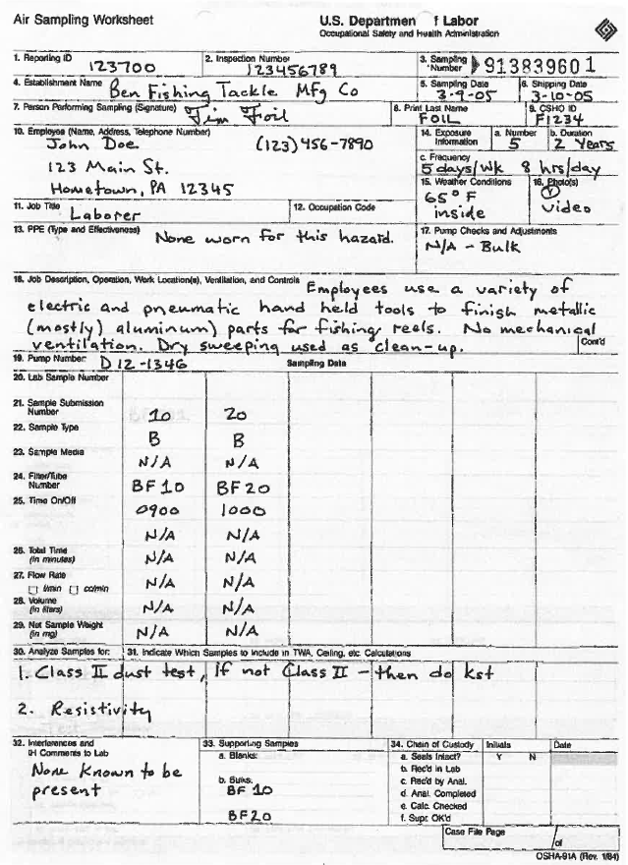
Dust - Submission

Slide 132
Evaluation of Sampling Results
Air and Noise Samples

Slide 133
Understanding Results
Direct Reading Results
Directly displayed on screen
Print outs
In-House Results
Equipment software
Print outs
Laboratory Results
Mailed results
Amount detected

Slide 134
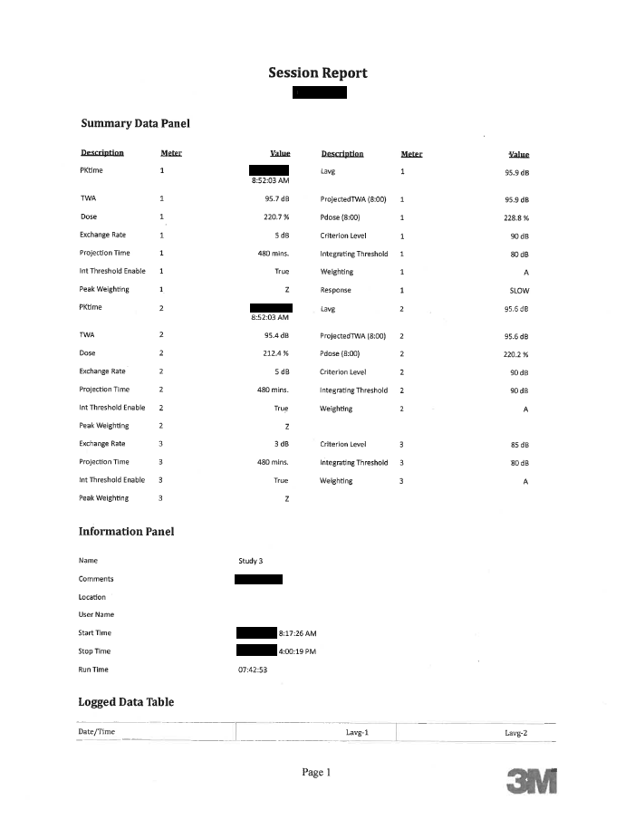
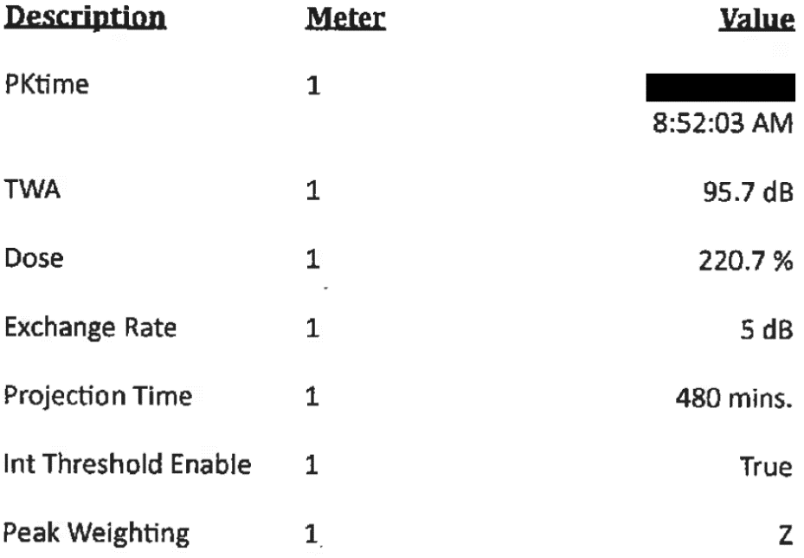
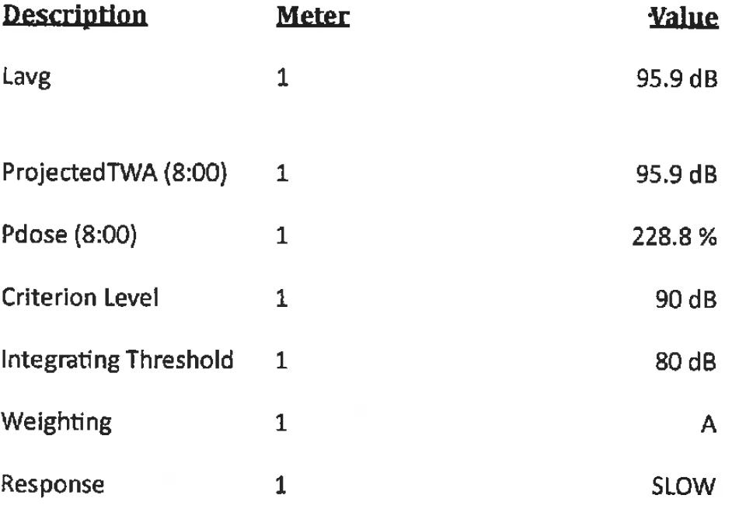
Direct Print Out – Sound Results: Edge 5s

Slide 135
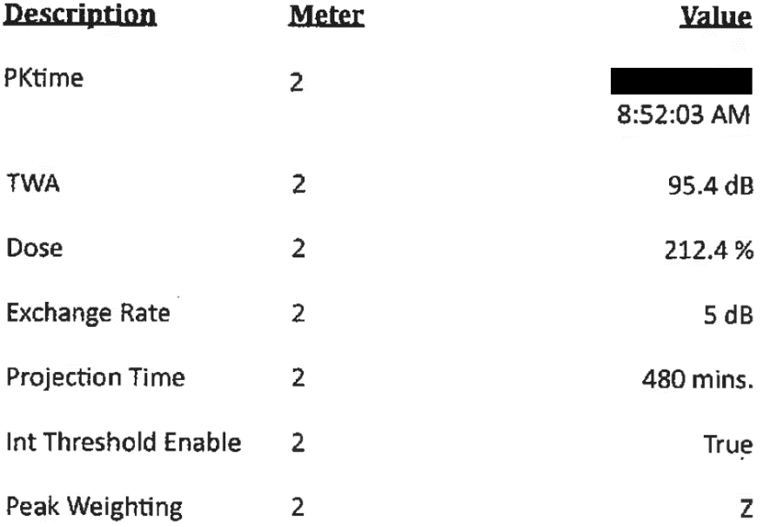
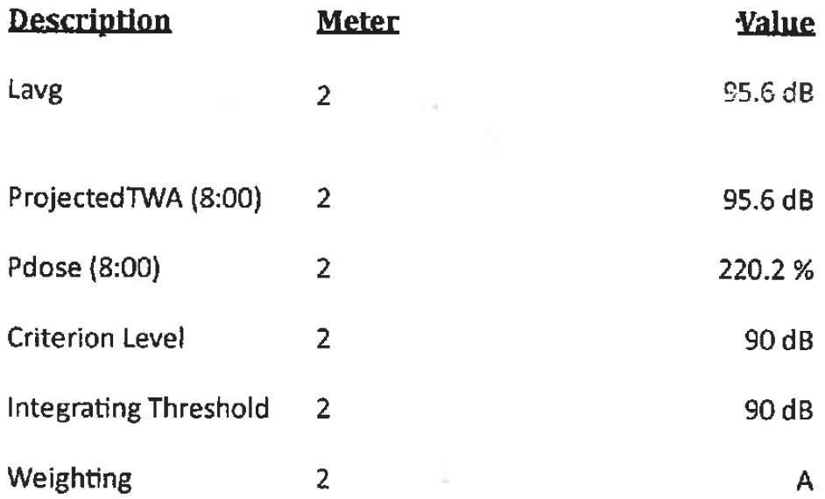
Direct Print Out – Sound Results: Edge 5s

Slide 136
Direct Print Out – Sound Results: Edge 5s
Threshold – 80 dB(A)
AL 85 dB(A)
TWA – 95.7 dB
Projected – 95.9 dB
Dose – 220.7%
Projected – 228.8%
Lavg – 95.9 dB
Peak – 104.8 dB
Threshold – 90 dB(A)
PEL 90 dB(A)
TWA – 95.4 dB
Projected – 95.6 dB
Dose – 212.4%
Projected – 220.2%
Lavg – 95.6 dB
Peak – 104.8 dB

Slide 137
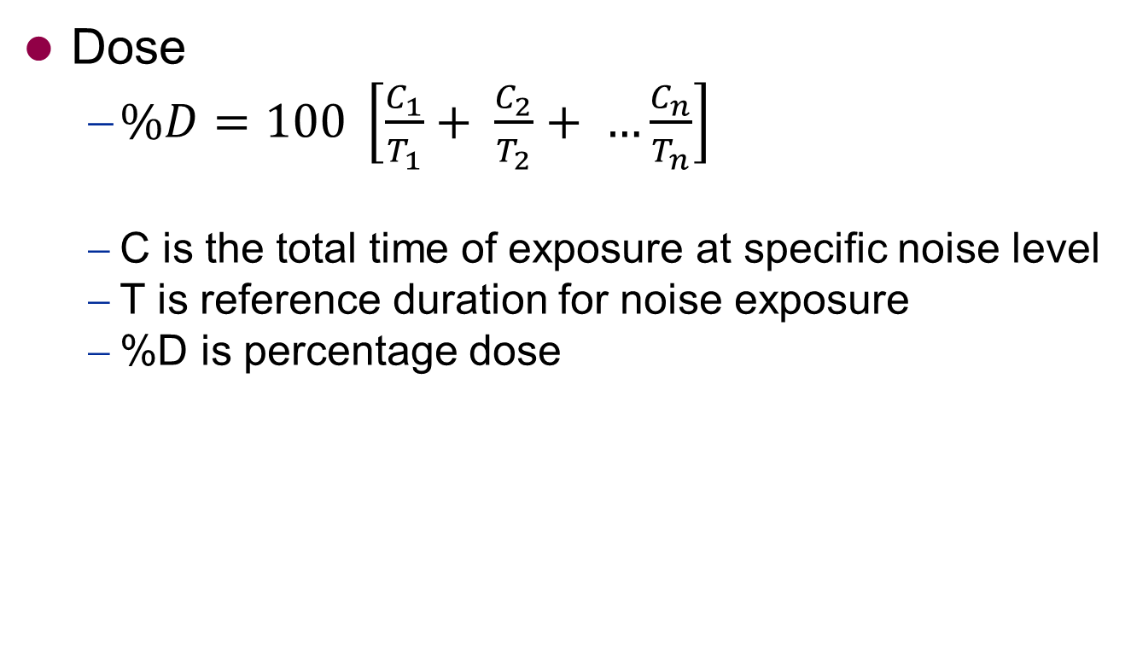
Noise Equations
Dose
$\%D=100 \left[\frac{C_{1}}{T_{1}}+ \frac{C_{2}}{T_{2}}+ …\frac{C_{n}}{T_{n}}\right]$
C is the total time of exposure at specific noise level
T is reference duration for noise exposure
%D is percentage dose

Slide 138
Dose Example
Calculate the dose for an employee who is exposed to the follow noise levels:
95 dB(A) for 1 hour
90 dB(A) for 3 hours
105 dB(A) for 10 minutes
93 dB(A) for 2 hours
86 dB(A) for 1 hour
Answer:

Slide 139

Noise Equations
TWA
$TWA=16.61\log\left(\frac{\%D}{100}\right)+90 dBA$
%D is percentage dose

Slide 140
TWA Noise Example
Calculate the TWA in dB(A) for an employee was exposed to noise at a dose of 140.7%
Answer:

Slide 141

Noise Equations
Distance
${SPL}_{2}= {SPL}_{1}+20\log\left(\frac{d_{1}}{d_{2}}\right)$
SPL is sound pressure level in dB(A)
d is distance in feet or meters

Slide 142
Distance Noise Example
You measure the sound pressure level of 95 dB(A) from 5 feet away from the noise source, what is the sound pressure level the employee is exposed to at 1 foot away?
Answer:

Slide 143


Laboratory Results

Slide 144

Sample Break-Through
Sample break-through
If the back-up section of the sampling media contains >25% of the contaminant then the sample should be considered invalid.

Slide 145
Equations
Calculation of potential exposure concentrations
However, no more than eight hours of sampling can be used in the 8-hour TWA calculation

Slide 146
Equations
A zero exposure will be assumed unless the CSHO can defend a professional judgment on the magnitude of the exposure for the unsampled period. Thus, a TWA should generally be calculated by dividing the sample results by 8 hours (or 480 minutes) rather than the actual time sampled

Slide 147

TWA Equations
Actual
$TWA= \frac{C_{1}T_{1}+C_{2}T_{2}{+C}_{3}T_{3}+{….C}_{n}T_{n}}{T_{1}+T_{2}+T_{3}+{….T}_{n}}$
8-hour
$TWA= \frac{C_{1}T_{1}+C_{2}T_{2}{+C}_{3}T_{3}+{….C}_{n}T_{n}}{480 minutes or 8 hours}$
C is concentration
T is actual duration of time sampled

Slide 148
TWA Example 1
Sampling for Sulfuric Acid.
PEL is 1 mg/m³
Take one sample
The sampling pump ran for 7 hours or 420 minutes.
The laboratory reported a concentration of 1.1 mg/m³.
8-hour TWA

Slide 149
TWA Example 2
Sampling for Sulfuric Acid.
Take two samples
Sample 1
The sampling pump ran for 4 hours or 240 minutes.
The laboratory reported a concentration of 1.12 mg/m³ .
Sample 2
The sampling pump ran for 4 hours or 240 minutes.
The laboratory reported a concentration of 1.13 mg/m³
Actual & 8-hour TWA

Slide 150
Sulfuric Acid Sampling
Example 1
1 sample taken
7 hours sampled
8-hour TWA
0.9625 mg/m³
Actual TWA
1.1 mg/m³
Example 2
2 samples taken
8 hours sampled
Actual & 8-hour TWA
1.125 mg/m³

Slide 151

Equations
Severity / hazard ratio
$Y= \frac{C}{OEL}$
Y is the severity or hazard ratio
C is the concentration or employee exposure
OEL is the Occupational Exposure Limit

Slide 152


Severity / Hazard Ratio
Example 1
8-hour TWA
0.9625 mg/m³
$Y= \frac{0.9625}{1}$
$Y=0.9625$
96.25% of the PEL
Example 2
8-hour TWA
1.125 mg/m³
$Y= \frac{1.125}{1}$
$Y=1.125$
112.5% of the PEL

Slide 153

TWA Mixture Equation
For substances with occupational exposure limits (OELs) established for similar toxicological pathways and target organs.
Compare results to unity (1)
< 1 – below combined OEL
> 1 – exceeds combined OEL
$= \frac{C_{1}}{{OEL}_{1}}+ \frac{C_{2}}{{OEL}_{2}}+ …\frac{C_{n}}{{OEL}_{n}}$
C is 8-hour TWA concentration
OEL is Occupational Exposure Limit

Slide 154
Mixture Example
Sampling conducted
carbon tetrachloride
Sample 1 reported 2.9 ppm collected over 4 hours
Sample 2 reported 3.5 ppm collected over 4 hours
PEL is 10 ppm
trichloroethylene
Sample 1 reported 30 ppm collected over 4 hours
Sample 2 reported 60 ppm collected over 4 hours
PEL is 100 ppm
vinyl chloride
Sample 1 reported 0.39 ppm collected over 4 hours
Sample 2 reported 0.23 ppm collected over 4 hours
PEL is 1 ppm

Slide 155

Mixture Example
carbon tetrachloride
TWA is 3.2 ppm
trichloroethylene
TWA is 45 ppm
vinyl chloride
TWA is 0.31 ppm
Now we can do the mixture equation (E_{m})
$E_{m}= \frac{3.2}{10}+ \frac{45}{100}+ \frac{0.31}{1}$
$E_{m}=1.08$
$E_{m}$ > 1, exceeds

Slide 156
Statistical Analysis

Slide 157
Accuracy of air sampling
Air sampling accuracy is ± 25% of the true value (given the errors during calibration, sampling, and analytical methods).

Slide 158

Statistical Equations
Sampling and Analytical Error (SAE)
$SAE=1.645 x S_{rT}$
1.645 is a statistical constant
S_{rT} is the Overall Precision
OSHA Methods: SAE can be read directly
NIOSH Methods: Must be calculated
Not listed: Contact the laboratory to get the SAE

Slide 159

Statistical Equations
Confidence Limits: Full-Period, Single Sample
Upper Confidence Limit (UCL)
$UCL=Y+SAE$
Lower Confidence Limit (LCL)
$LCL=Y −SAE$
Y is severity / hazard ratio.
SAE is sampling and analytical error.
If LCL is ≥ 1, then a violation exists with a 95% confidence

Slide 160

TWA Examples
Sampling for Sulfuric Acid.
NIOSH Method 7903
The SrT is 0.087
Sampling and Analytical Error
$SAE=1.645 x 0.087$
$SAE=0.143115$

Slide 161


TWA Example 1
Example 1
Lower Confidence Limit (LCL)
$LCL=0.8194$
Upper Confidence Limit (UCL)
$UCL=1.1056$
LCL_{95%} < 1 & UCL_{95%} > 1
the results are in the possible overexposure region.
Example 2
Lower Confidence Limit (LCL)
$LCL=0.981885$
Upper Confidence Limit (UCL)
$UCL=1.268115$
LCL_{95%} < 1 & UCL_{95%} > 1
the results are in the possible overexposure region.

Slide 162

Statistical Equations
Confidence Limits: Full-Period, Consecutive Sampling
Upper Confidence Limit (UCL)
$UCL=Y+\frac{\left\{SAE \sqrt{\left[{\left(T_{1}X_{1}\right)}^{2}+{\left(T_{2}X_{2}\right)}^{2}+ …{\left(T_{n}X_{n}\right)}^{2}\right]}\right\}}{\left[PEL\left(T_{1}+T_{2}+ …T_{n}\right)\right]}$
Lower Confidence Limit (LCL)
$LCL=Y − \frac{\left\{SAE \sqrt{\left[{\left(T_{1}X_{1}\right)}^{2}+{\left(T_{2}X_{2}\right)}^{2}+ …{\left(T_{n}X_{n}\right)}^{2}\right]}\right\}}{\left[PEL\left(T_{1}+T_{2}+ …T_{n}\right)\right]}$
Y is severity / hazard ratio
SAE is sampling and analytical error
T is actual duration of time sampled
X is concentration

Slide 163

TWA Example 2
Calculated
TWA = 1.125 mg/m3
Severity / hazard ratio = 1.125
Lower Confidence Limit (LCL)
$LCL=1.125 − \frac{\left\{0.143115\sqrt{\left[{\left(4 hours x 1.13 {mg}/{m^{3}}\right)}^{2}+{\left(4 hours x 1.12 {mg}/{m^{3}}\right)}^{2}\right]}\right\}}{\left[1 {mg}/{m^{3}}\left(4 hours +4 hours\right)\right]}$
$LCL=1.011152$

Slide 164

Statistical Equation
Confidence Limits: Mixtures
$CL=1+ R_{St}$
$R_{St}= {\left[{\left(R_{1}{SAE}_{1}\right)}^{2}+{\left(R_{2}{SAE}_{2}\right)}^{2}+ …{\left(R_{n}{SAE}_{n}\right)}^{2}\right]}^{0.5}$
$R_{1}= \frac{Y_{1}}{E_{m}}$
CL is mixture control limit
E_{m} is the equivalent exposure for the mixture
Y is the exposure ratio
R is the ratio to total exposure
SAE is the sampling and analytical error
If E_{m} > 1 and E_{m} > CL = an overexposure

Slide 165

Mixture Example
TWA
carbon tetrachloride
$TWA=3.2 ppm$
trichloroethylene
$TWA=45 ppm$
vinyl chloride
$TWA=0.31 ppm$
$E_{m}=1.08$

Slide 166

Mixture Example
$E_{m}=1.08$
carbon tetrachloride
$TWA=3.2 ppm$
$Y=0.32$
$SAE=0.15134$
trichloroethylene
$TWA=45 ppm$
$Y=0.45$
$SAE=0.13489$
vinyl chloride
$TWA=0.31 ppm$
$Y=0.31$
$SAE=0.0987$

Slide 167

Mixture Example
Ratio to total exposure
carbon tetrachloride
$R_{C}=\frac{0.32}{1.08}$
$R_{C}=0.2963$
trichloroethylene
$R_{T}=\frac{0.45}{1.08}$
$R_{T}=0.4167$
vinyl chloride
$R_{V} =\frac{0.3}{1.08}$
$R_{V}=0.2870$

Slide 168

Mixture Example
$E_{m}=1.08$
carbon tetrachloride
$TWA=3.2 ppm$
$Y=0.32$
$SAE=0.15134$
$R_{C}=0.2963$
trichloroethylene
$TWA=45 ppm$
$Y=0.45$
$SAE=0.13489$
$R_{T}=0.4167$
vinyl chloride
$TWA=0.31 ppm$
$Y=0.3$1
$SAE =0.0987$
$R_{V}=0.2870$

Slide 169

Mixture Example
Total Ratio
$R_{St}= {\left[{\left(0.2963 x 0.15134\right)}^{2}+{\left(0.4167 x 0.13489\right)}^{2}+ {\left(0.287 x 0.0987\right)}^{2}\right]}^{0.5}$
$R_{St}=0.07728057$
Mixture Control limit
$CL=1+0.07728057$
$CL=1.07728057$
Em = 1.08
CL = 1.077
E_{m} > 1 & E_{m} > CL.
Therefore, an violation has been established.

Slide 170

Equations
Field Sampling Worksheet
Recorded observations
Recommended to include your calculations in this area as well
TWA
$$TWA= \frac{\left(2.9 ppm x 4 hours\right)+(3.5 ppm x 4 hours}{8 hours}$$
$$TWA=3.2 ppm$$
Severity
$$Y= \frac{3.2}{10}$$
$$Y=0.32$$

Slide 171
Evaluation of Sampling Results
Wipe Samples

Slide 172
Wipe Results
OSHA does not have standards setting limits for surface contamination.
Standard with housekeeping sections
Inorganic arsenic – §1910.1018
Beryllium – §1910.1024
Lead – §1910.1025 & §1926.62
Chromium (VI) – §1910.1026 & §1926.1126
Cadmium – §1910.1027 & §1926.1127
Etc.
All use that same language “as free as practicable”.

Slide 173


Wipe Results

Slide 174
Understanding Wipe Results
Lead Wipe
Concentration
0.0273 µg/cm²
Does this concentration constitute a violation of the standard?

Slide 175
Evaluation of Sampling Results
Bulk Samples

Slide 176

Bulk Sample - Identification

Slide 177


Bulk Sample - Dust Results

Slide 178
Understanding Results
Reports may contain the following:
Percent through 40 mesh
Percent moisture content
Percent combustible material
Percent combustible dust
Metal dusts will include resistivity
Minimum explosive concentration (MEC)
Minimum ignition energy (MIE)
Class II test
Sample weight
Maximum normalized rate of pressure rise (dP/dt) – Kst Test
Minimum ignition temperature

Slide 179

Understanding Results

Slide 180
Understanding Results
Kst
The maximum rate of pressure rise generated when dust is tested in a confined enclosure.
Dust Explosion Class | Kst (bar.m/s) | Characteristic
St 0 | 0 | No Explosion
St 1 | >0 and ≤200 | Weak explosion
St 2 | >200 and ≤300 | Strong explosion
St 3 | >300 | Very strong explosion

Slide 181
Understanding Results
Moisture
Moisture in dust particles raises the ignition temperature of the dust because of the heat absorbed during heating and vaporization of the moisture.
Ignition temperature of cornstarch may increase as must as 122F, with an increase of moisture content from 1.6% to 12.5%.
The moisture in the air surrounding a dust particle has no significant effect on the course of deflagration once ignition has occurred.
In order for moisture to prevent ignition of dust by common source, the dust would have to be so damp that a cloud could not be formed

Slide 182
Recording Sampling Data
Air and Noise Samples

Slide 183
Recording Sampling Data
All sampling data must be recorded
OE
Field Sampling Worksheet

Slide 184

Entering Sampling Data in OE
Photo Source: NCDOL Photo Library

Slide 185

Entering Sampling Data in OE
Photo Source: NCDOL Photo Library

Slide 186

Entering Sampling Data in OE
Photo Source: NCDOL Photo Library

Slide 187

Entering Sampling Data in OE
Photo Source: NCDOL Photo Library

Slide 188

Entering Sampling Data in OE
Photo Source: NCDOL Photo Library

Slide 189

Entering Sampling Data in OE
Photo Source: NCDOL Photo Library

Slide 190

Entering Sampling Data in OE
Photo Source: NCDOL Photo Library

Slide 191

Entering Sampling Data in OE
Photo Source: NCDOL Photo Library

Slide 192

Entering Sampling Data in OE
Photo Source: NCDOL Photo Library

Slide 193

Entering Sampling Data in OE
Photo Source: NCDOL Photo Library

Slide 194

Entering Sampling Data in OE
Photo Source: NCDOL Photo Library

Slide 195

Entering Sampling Data in OE
Photo Source: NCDOL Photo Library

Slide 196

Entering Sampling Data in OE
Photo Source: NCDOL Photo Library

Slide 197

Entering Sampling Data in OE
Photo Source: NCDOL Photo Library

Slide 198

Entering Sampling Data in OE
Photo Source: NCDOL Photo Library

Slide 199

Entering Sampling Data in OE
Photo Source: NCDOL Photo Library

Slide 200

Entering Noise Results
Photo Source: NCDOL Photo Library

Slide 201

Entering Noise Results
Photo Source: NCDOL Photo Library

Slide 202

Entering Noise Results
Photo Source: NCDOL Photo Library

Slide 203

Entering Noise Results
Photo Source: NCDOL Photo Library

Slide 204

Entering Noise Results
Photo Source: NCDOL Photo Library

Slide 205

Entering Noise Results
Photo Source: NCDOL Photo Library

Slide 206

Entering Noise Results
Photo Source: NCDOL Photo Library

Slide 207

Entering Results
Field Sampling Worksheet
All sampling data must be record
Noise AL
8111
TWA
49
%
50
0.98
No
Yes
Noise PEL
8110
TWA
97
%
100
0.97
No
Yes
Carbon Monoxide
0560
TWA
5
PPM
50
0.10
No
Yes
Your Signature

Slide 208
Recording Sampling Data
Bulk and Wipe Samples

Slide 209

Entering Bulk & Wipe Data

Slide 210

Entering Bulk Data

Slide 211

Entering Bulk Data

Slide 212

Enter Wipe Data

Slide 213

Enter Wipe Data

Slide 214
Recording Sampling Data
Direct Read Samples

Slide 215

Entering Direct Read Data

Slide 216

Entering Direct Read Data

Slide 217

Entering Direct Read Data

Slide 218

Entering Direct Read Data

Slide 219

Entering Direct Read Data

Slide 220

Entering Direct Read Data

Slide 221

Entering Direct Read Data

Slide 222

Entering Direct Read Data

Slide 223
Recording Sampling Data
Screening Samples

Slide 224

Entering Screening Data

Slide 225

Entering Screening Data

Slide 226

Entering Screening Data

Slide 227

Entering Screening Data

Slide 228
Carbon Monoxide
OPN 148

Slide 229
OPN-148
For situations where significant exposure(s) to CO occurred, resulting in medical intervention and/or hospitalization.
Theoretically derive an employee’s exposure to CO
Coburn Equation
Coburn-Forster-Kane Model

Slide 230
OPN-148
Appendix B
Must request medical records of suspected employees.
% carboxyhemoglobin (COHb or HbCO)
Smoker or non-smoker
Assess individual’s physical activity level for assigned job task(s).
Description of work activity for assigned job task(s).
Determine the entire time period (in minutes) to which the individual(s) were occupational exposed to CO.

Slide 231
Con’t
Appendix B
Determine time period between the end of CO exposure and blood sample taken (in minutes).
Recovery Time (air, oxygen, hyperbaric or mixture)
Mixture
Include time for each type of treatment

Slide 232

Coburn Equation
$CO= \frac{1316\left\{\left[\left(0.0046\right)\left(2^{θ/T}\right)(C)\right]−\left[\left(0.007\right)\left(B\right)\right]+\left[\left(0.007∗B\right)−2.3(D)\left(e^{{−2.3(t)}/{5500(b)}}\right)\right]\right\}}{1−\left(e^{{−2.3(t)}/{5500(b)}}\right)}$
CO = theoretical concentration of CO in air (ppm)
C = Blood COHb in % at the time of blood sample
B = Activity Factor (sedentary = 0.152, light work = 0.065, heavy work = 0.040)
D = background COHb level (non-smoker = 0.0015, smoker = 0.0100)
t = time of exposure to CO (in minutes)
𝜃 = time between end of CO exposure and blood sampling (in minutes)
T = half-life recovery factor of CO removal from blood (in minutes)

Slide 233
Coburn Equation
FIS
Forms
10 Forms COB 1: Coburn Equation CO Calculator

Slide 234
Reference
OSHA
CO PEL = 50 ppm
NIOSH
CO REL = 35 ppm
Ceiling = 200 ppm
ACGIH (2014)
CO TLV = 25 ppm
CO BEI
Blood (end of shift) = 3.5% of hemoglobin
Exhaled air (end of shift) = 20 ppm

Slide 235
Example 1
Employee #1
COHb % at time of blood sample = 4.5%
Activity Factor = Sedentary
Background COHb = non-smoker
Exposure time to CO = 8 hours
Time between end of CO exposure and collection of blood sample = 1 hour
Recovery method = Air

Slide 236
Example 2
Employee #1
COHb % at time of blood sample = 6.5%
Activity Factor = Heavy Work
Background COHb = Smoker
Exposure time to CO = 30 minutes
Time between end of CO exposure and collection of blood sample = 45 minutes
Recovery method = Mixture
Air recovery time = 15 minutes
Oxygen recovery time = 30 minutes

Slide 237
Carbon Monoxide
OPN 148
If Coburn Equation results in > 50 ppm
Get supervisor’s approval to initiate the Coburn-Forster-Kane Model.
Done by Salt Lake Technical Center (SLTC)
Model has been extensively tested for reliability.
Download SLTC Application
Directions in Appendix C
Requires a OSHA Extranet account

Slide 238

SLTC Application

Slide 239
SLTC Application
Detailed questions
25 numbered questions
Any sampling information taking during event (e.g., emergency responders)
Symptoms or signs employees exhibited.
Refer to the catalog of activity levels
Recommendation
Download this form prior to conducting inspection to ensure the gathering of all necessary information.

Slide 240
Common Citations

Slide 241
Noise Citations
When the 8-hour TWA is ≥ 92 dB(A) (a dose of 132%)
Exceeds the permissible noise exposure
Cite 29 CFR 1910.95(b)(1) or 29 CFR 1926.52(b)
Serious
Hearing protection not provided or properly utilized; and/or
Hearing conservation program is deficient or nonexistent
Non-Serious
Effective hearing protection provided and utilized; and
Hearing conservation program is effective
Employer has an effective training program.

Slide 242
Noise Citations
When the 8-hour TWA is ≥ 87 dB(A) (a dose of 66%)
Cite for Hearing Conservation Program if non-existent
29 CFR 1910.95(c)(1) or 29 CFR 1926.52(d)(1)
Serious
8-hour TWA ≥ 92 dB(A) (a dose of 132%)
Non-Serious
8-hours TWA ≥ 87 dB(A) but < 92 dB(A)

Slide 243
Air Contaminant Citations
FOM ch XV F.4.d-e
Limits for air contaminants are exceeded
Air contaminant concentration ≥ acceptable levels
Table Z-1
Cite 29 CFR 1910.1000(a)(1) or (2)
Table Z-2
Cite 29 CFR 1910.1000(b)(1) or (2)
Table Z-3
Cite 29 CFR 1910.1000(c)
Threshold Limit Values of Airborne Contaminants for Construction
Cite 29 CFR 1926.55(a)
Lack of engineering controls and/or administrative and work practice controls
Cite 29 CFR 1910.1000(e) or 29 CFR 1926.55(b)

Slide 244
General Duty Clause §95-129(1)
Substance with no OSHA PEL
If the substance’s dose (exposure) and toxicity could result in a serious illness or injury; and
The substance has an OEL set by other entities
TLV published by ACGIH
REL recommendation by NIOSH
10 hour TWA
Exceptions (further discussion needed with supervisor and bureau chief)
Substance concentration below established PEL, but in excess of a TLV or REL
Substance has a PEL with no established ceiling limit, but a ceiling from either ACGIH or NIOSH

Slide 245
General Duty Clause §95-129(1)
Heat Stress
OPN 141 – Enforcement Guidance for Conducting Heat-Related Illness Inspections and Issuing Citations
Ergonomics
FOM Chapter 17 – Ergonomics Inspection Procedures
Combustible Dust
NEP: Combustible Dust Explosion Prevention Program

Slide 246
Air Contaminant Citations
Grouping
Situations where an overexposure is documented, feasible engineering and/or administrative controls have not been implemented, and respiratory protection has not been provided or is insufficient or ineffective
Overexposure for regulated contaminants
29 CFR 1910.1000(a), (b), (c), (d) or 29 CFR 1926.55(a)
Engineering/administrative controls
29 CFR 1910.1000(e) or 29 CFR 1926.55(b)
Respirator
29 CFR 1910.134(a)(2)

Slide 247
Citation Classification
Guidance
Based on Health Codes from the Chemical Sampling Information page on the OSHA website
Substances with a health code of 13 or less
Serious
Substances with a health code of 6, 8, and 12
Non-serious
mild to temporary effects
Substances with a health code of 14 and 15
Non-serious
Mild to moderate irritation
Multiple health codes
Non-serious
Until the concentration reaches a level which a serious effect could occur

Slide 248
Air Contaminant Citations
Documented overexposure
No violation or citation
Engineering and/or administrative controls are in place, utilized and effective; and
Personal protective equipment is provided, utilized and maintained properly
Example;
Process evaluated by Professional Engineer (PE) and/or Certified Industrial Hygienist (CIH), documented that engineering controls reduce the contaminant level to lowest possible levels (not below the PEL), and with proper PPE eliminated the hazard to employees.

Slide 249
Related Citations
General Industry
29 CFR 1910.94 – Ventilation
29 CFR 1910.106 – Flammable Liquids
29 CFR 1910.119 – Process Safety Management of Highly Hazardous Chemicals
29 CFR 1910.120 – Hazardous Waste Operations and Emergency Response
29 CFR 1910.123 – 126 – Dipping and Coating Operations
Subpart I – Personal Protective Equipment
29 CFR 1910.151 – Medical Services and First Aid
Subpart Q – Welding, Cutting and Brazing
Subpart Z – Toxic and Hazardous Substances

Slide 250
Related Citations
Construction
29 CFR 1926.20 – General Safety and Health Provisions
Subpart D – Occupational Health and Environmental Controls
Subpart E – Personal Protective and Life Saving Equipment
Subpart J – Welding and Cutting
Subpart Z – Toxic and Hazardous Substances
Subpart AA – Confined Spaces in Construction

Slide 251
Summary
In this course, we discussed
Sampling Equipment
Analytical Techniques
Reasons for Sampling
Sampling Strategies
Evaluation of Sampling Results
The Coburn Equation
Common Citations

Slide 252
Thank You For Attending!
Final Questions?
1-800-NC-LABOR
(1-800-625-2267)
www.nclabor.com

