Slide 1
N.C. Department of Labor OSHA 125 Course
Process Safety Management / Risk Management Program / EPCRA
29 CFR 1910.119/1926.64
Notes:
Rev 0: 6/24/2013
The information in this presentation is provided voluntarily by the N.C. Department of Labor, Education Training and Technical Assistance Bureau as a public service and is made available in good faith. This presentation is designed to assist trainers conducting OSHA outreach training for workers. Since workers are the target audience, this presentation emphasizes hazard identification, avoidance, and control – not standards. No attempt has been made to treat the topic exhaustively. It is essential that trainers tailor their presentations to the needs and understanding of their audience.
The information and advice provided on this Site and on Linked Sites is provided solely on the basis that users will be responsible for making their own assessment of the matters discussed herein and are advised to verify all relevant representations, statements, and information.
This presentation is not a substitute for any of the provisions of the Occupational Safety and Health Act of North Carolina or for any standards issued by the N.C. Department of Labor. Mention of trade names, commercial products, or organizations does not imply endorsement by the N.C. Department of Labor.

Slide 2

Objectives
Attain an overall understanding of Process Safety Management and Risk Management Program
Have an overall understanding of the Emergency Planning and Community Right-to-Know Act (EPCRA) of 1986
Describe how to request and obtain Tier II reports
State Emergency Response Commission (SERC)
Local County Emergency Manager

Slide 3
Catastrophic Events
Catastrophic Events in the United States which led to the development of the PSM standard
1985 - Institute, WV; 135 injured.
1988 - Norco, LA; 7 dead/42 injured.
1988 - Henderson, NV; 2 dead/350 injured.
1989 – Richmond, CA; 9 injured.
1989 - Pasadena, TX; 23 dead/232 injured.
1990 - Channelview, TX; 17 dead.
Notes:
Speaker’s Notes: After the 1984 Bhopal, India incident involving a release of methyl isocyanate, OSHA determined that it was necessary to immediately investigate U.S. producers and users of the chemical. This investigation indicated that while the chemical industry is subject to OSHA's general industry standards, these standards did not contain specific coverage for chemical industry process hazards, nor did they specifically address employee protection from large releases of highly hazardous chemicals.
In 1985 a serious release of chemicals occurred at a plant in Institute, West Virginia, injuring 135 persons.
The experience of investigating this release indicated to OSHA that there was a need to look beyond existing standards and led OSHA to develop a demonstration program of special inspections. The purpose of the program was to examine industry practices for the prevention of disastrous releases and the mitigation of the effects of releases that do occur, and to consider ways in which OSHA could best protect employees from these hazards. Based on the results of the program, OSHA determined that chemical plant inspections needed a comprehensive inspection approach which includes plant physical conditions and management systems.

Slide 4

Emergency Planning and Community Right-to-Know Act
October 17, 1986
President signed Superfund
Amendments and
Reauthorization Act (SARA)
into law
Emergency Planning and
Community Right-to-Know
Act (EPCRA) included under
Title III of SARA

Slide 5
Emergency Planning and Community Right-to-Know Act
Subtitle A Emergency Planning and Notification
Section 301: Establishes State Emergency Response Commission (SERC) and Local Emergency Planning Committee (LEPC)
LEPC: Fire, law enforcement, first aid, industry, hospital, elected officials, health, transportation, and emergency management

Slide 6

Emergency Planning and Community Right-to-Know Act
Subtitle B Reporting Requirements
312 Chemical Inventory Report (Tier II)
LEPC
SERC
Fire department with jurisdiction
over the facility

Slide 7
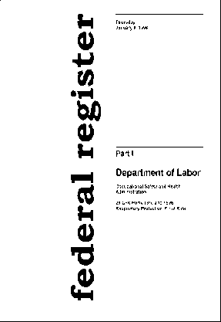
Clean Air Act
Clean Air Act Amendments of November 1990 - Section 304
Required OSHA to develop chemical safety standard.
Required standard to contain a list of chemicals.
Required standard to contain certain elements.

Slide 8
PSM vs. 112r Applicability
CERCLA
HS
EHS
Toxics
OSHA Hazardous
Chemicals
RMP

Slide 9
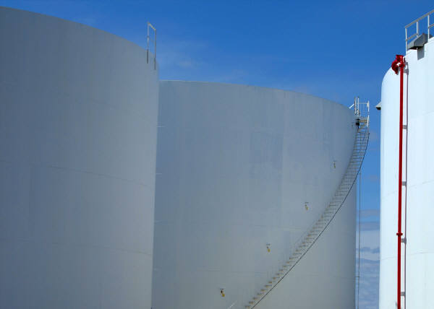
PSM/RMP Listed Chemical Differences
RMP… 147 listed
…….…77 Toxics/ 67 Flammables
PSM…137 Chemicals + Flammables
Inside fence vs. Outside fence

Slide 10
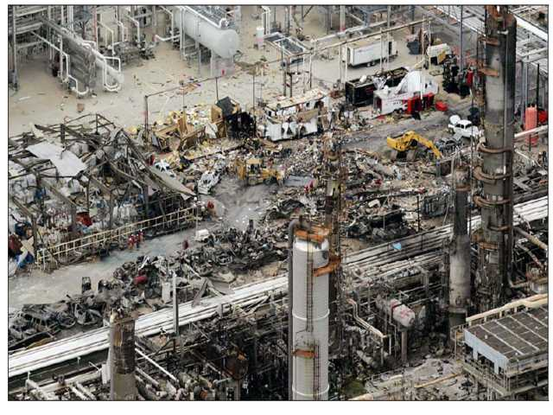
Purpose of Process Safety Management
To Prevent Catastrophic Releases of Highly Hazardous Chemicals
(Containment)
Notes:
The process safety management standard was published in the FEDERAL REGISTER on February 24, 1992. The final rule reflects OSHA's conclusion that employees have been and continue to be exposed to the hazards of toxicity, fires and explosions resulting from catastrophic releases of highly hazardous chemicals in the workplace. The catastrophic hazard potential is evidenced by the releases and resulting deaths and injuries that have occurred at a variety of plants handling a variety of highly hazardous chemicals. OSHA believes that the requirements in this new standard establish procedures for process safety management that will protect employees by preventing or minimizing the consequences of chemical accidents involving highly hazardous chemicals.
As we are all aware, devastating incidents involving highly hazardous chemicals have occurred worldwide. Incidents including Bhopal, India; Norco, Louisiana; Henderson, Nevada; Pasadena, Texas; and Sterlington, Louisiana, have led to an increased public concern and scrutiny of plants handling significant quantities of highly hazardous chemicals.
This program is not intended as a substitute for the Process Safety Management Standard. The program provides a broad overview of the standard and is intended as. only an educational tool.
The picture on the slide is from the refinery explosion of BP in Texas on March 23, 2005.
Photo source: http://www.csb.gov

Slide 11
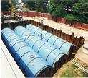
Program Quality Verification
PQV Team
Team inspection method used to evaluate an employer’s PSM Program
Notes:
Photo fedcenter.gov

Slide 12

Implementation of the PSM Standard
Must have top management support to succeed
May involve added personnel and capital investments
“Giving another hat” to the plant
engineer and/or safety manager
generally does not work

Slide 13
Implementation of the PSM Standard
Company may need the help of outside consultants for parts of the program
Company must be involved in the development and have ownership of the PSM program
“Canned programs” generally do not meet the requirements of the standard

Slide 14
1910.119 - Process Safety of Highly Hazardous Chemicals
Effective as of May 26, 1992
Has 16 paragraphs (a-p)
Time intensive program to implement and maintain
Can also be time intensive to inspect
Performance Based Standard

Slide 15
Performance Based Standard
Employer decides HOW to be safe based on GOOD ENGINEERING PRACTICES
(accepted practices)
ANSI, ASME, NEC, NFPA, IIAR, Chlorine Institute, Owners Manual, etc., etc., etc.
ANY documented procedures or instructions that MAKE SENSE to use.
You decide what “makes sense”

Slide 16
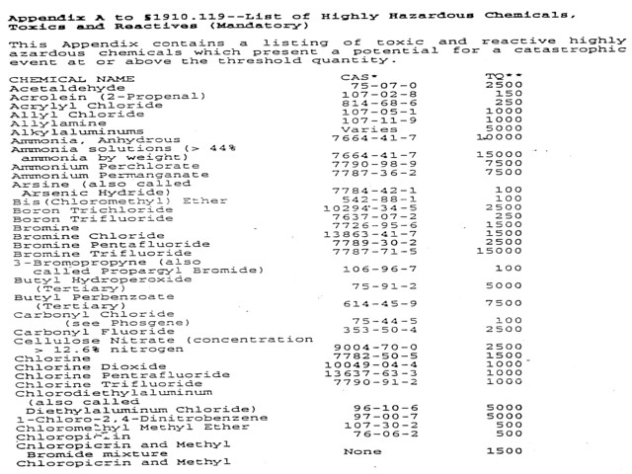
Process Safety Chemicals
1910.119 Appendix A
Appendix A

Slide 17
Key P.O.C.s in Chemical Plant
Chemical Manufacturing…...PhD Chemistry
Engineering………………..….P.E.
Maintenance…………………..P.E.
SHE………………………….….CSP/CIH

Slide 18

How People “Really” Speak
PhD Chemistry………..Proper Chemical name
Chemical Engineer…...MEBS
Mechanical Engineer…Junk
Wrench Turners……….Crap

Slide 19

2 Things to Remember…
Not all Chemists and Engineers finished in the top 10% of their class.
A PSM site is just a regular manufacturer using the same chemicals, just larger amounts.

Slide 20
Useful Terminology
PSM Covered Chemicals = JUNK
All other chemicals = STUFF
Proper name gets you the MSDS, other than that, you don’t need or care what the name is.

Slide 21
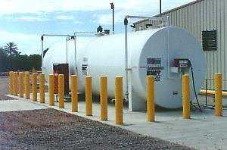
ONLY 2 Things to Care About
JUNK stays inside the pipes = GOOD
JUNK gets outside of pipes = BAD
Notes:
Photo: Fedcenter.gov (US Government)

Slide 22
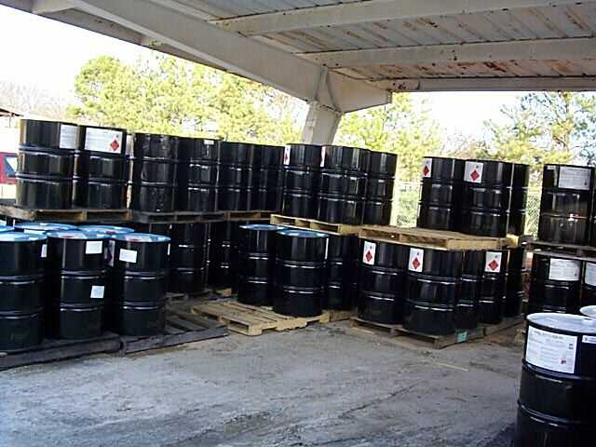
Junk
ANY PSM covered chemical
Think of it as a wild animal. It EATS PEOPLE. Who cares what the name of it is?

Slide 23
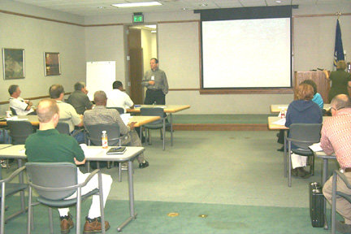
Remember
They might be making rocket fuel.
You are not.
You are inspecting the cage to make sure the wild animal stays inside.

Slide 24
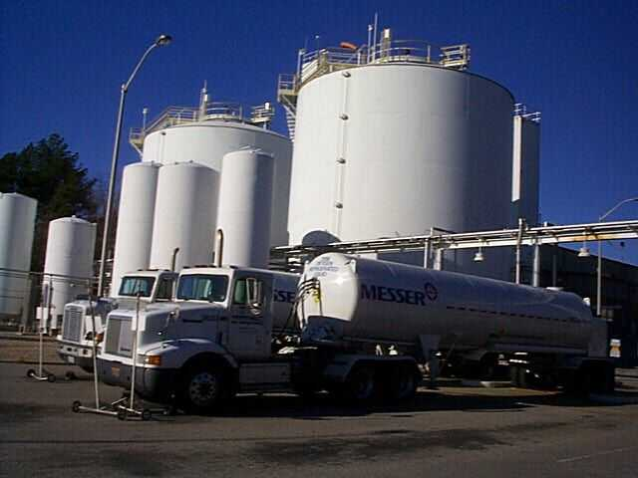
Definitions - Paragraph (b)
Atmospheric tank
Catastrophic release
Facility
Highly Hazardous Chemical (HHC)
Hot work
Normally unoccupied remote facility
Process
Replacement in kind
Trade secret
Covered process
Notes:
Speaker’s Notes:

Slide 25
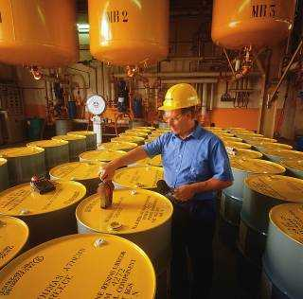
Important Terminology/Concepts
Atmospheric tank
Energy transfer system
Venting
Pressure relief system
Alarm system

Slide 26
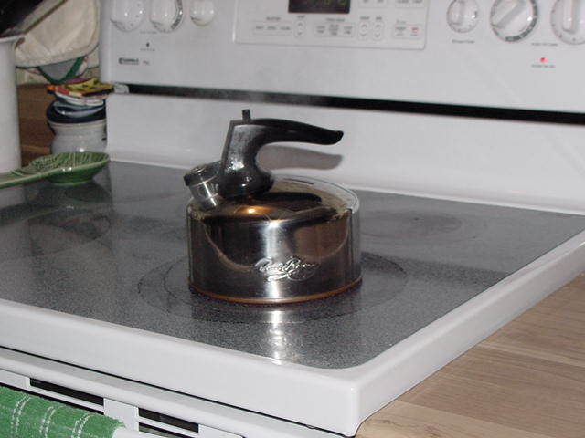
Example of each of these

Slide 27
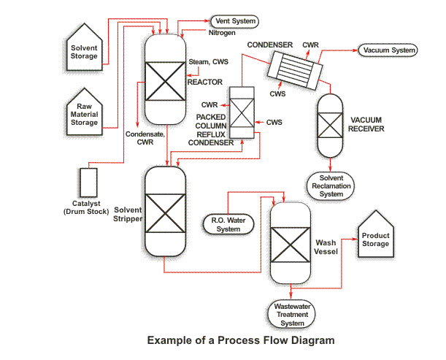
Important 119(d) PSI Documents
P&IDs (roadmap of Equipment, not to scale)
Block Diagrams / Process Flow Diagrams (roadmap of Operations performed)

Slide 28
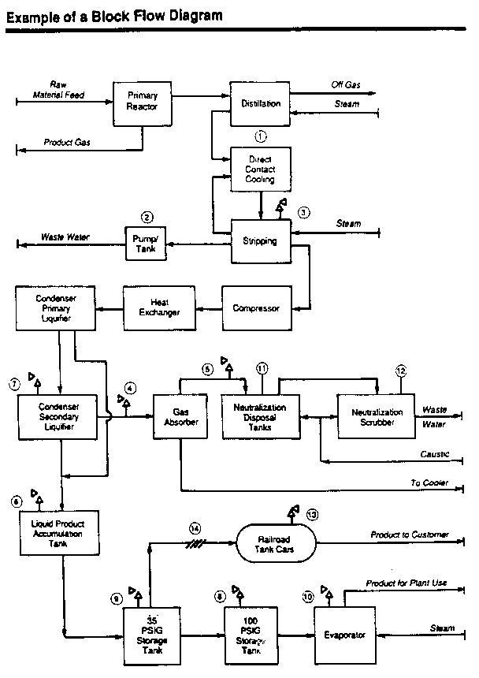

Slide 29
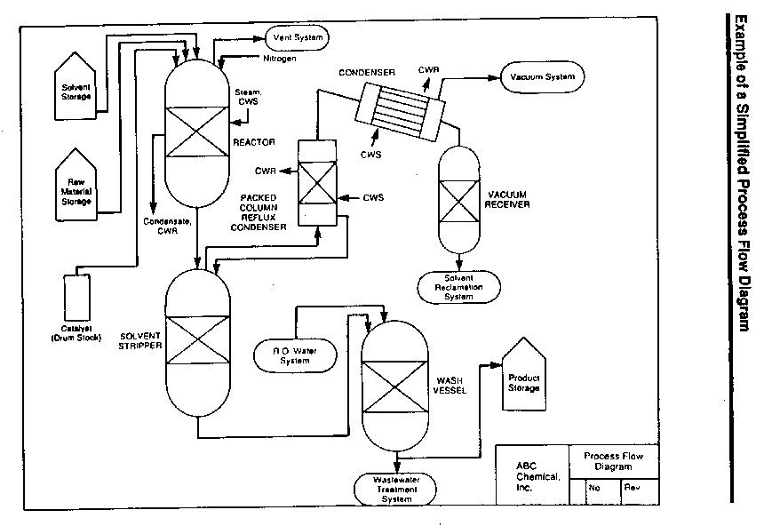

Slide 30
PSM Covered PROCESS
HHC in use, storage, manufacturing, handling, or on-site movement

Slide 31
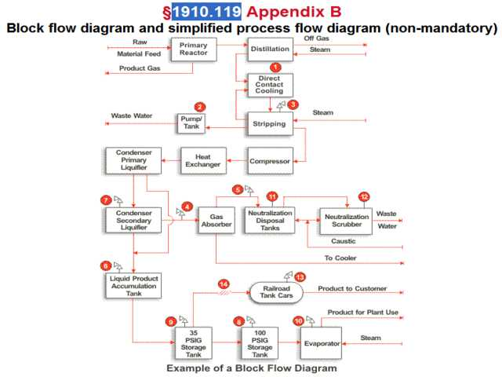
Process Boundary Lines
Use Block or Process Flow Diagrams to show where HHC is in “use, storage, etc” to define the “initial” PSM Covered Process.
Then evaluate “Adjacency Issues” to see if they need to be expanded.

Slide 32

Application - Paragraph (a)
Covers plants which have toxic or reactive chemical(s) in processes at or above a listed Threshold Quantity (TQ):
Chemicals covered are listed in Appendix A.
TQ for ammonia is 10,000 Lbs.
TQ for chlorine is 1,500 Lbs.
TQ for flammable liquids and gasses is 10,000 Lbs.
Notes:
The standard applies generally to processes involving:
A chemical at or above the specified threshold quantities listed in Appendix A to the standard.
A flammable liquid or gas on site in one location, in a quantity of 10,000 pounds or more.
The manufacture of explosives and pyrotechnics.

Slide 33
What’s NOT Covered
Retail facilities
Oil or gas well drilling or servicing operations
Normally unoccupied remote facilities
Hydrocarbons USED AS FUEL
Flammable liquids in atmospheric tanks

Slide 34
The Meer Decision
Federal OSHA court decision from New Jersey (Meer Decision) states that language used in PSM standard for storage of flammable liquids in atmospheric tanks is “unconstitutionally vague”.
RESULT: Flammable liquids stored in Atmospheric Tanks are not counted in the quantity used to determine the TQ (for right now)

Slide 35
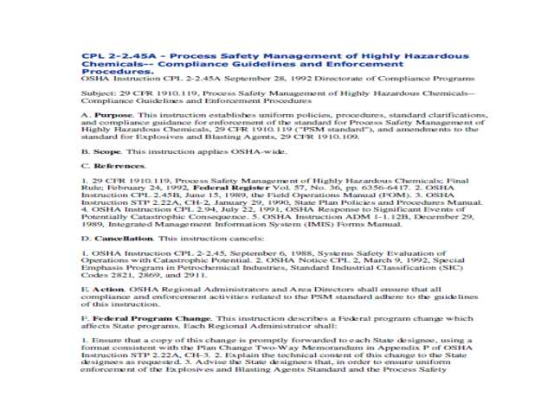
CPL 2-2.45A - PSM of HHC
PQV Team Leader
PSM330 & 340 or PSM 345
Chemical plant experience
Evals .119 D, E, F, I, J, L, O, P
**1910.119 Paragraphs C, G, H, K, M, and N may be evaluated by ANY CSHO. ALL Other .119 MUST be evaluated by PQV Trained CSHO

Slide 36
CPL 2-2.45A - Appendix A
Questions arranged by .119 Paragraph (C-P)
All set up for Yes or No answers.
YES = Good
NO = BAD = Citation
USE THESE TO DOCUMENT EVERY PSM INSPECTION

Slide 37
Interrelationship of Paragraphs
CPL 2-2.45A gives example of 1 valve impacting 11 paragraphs
1910.119 PSM Standard Paragraph arrangement is “clunky”
HANDOUT ….“How to Conduct PQV”
Wheel/Paragraph Arrangement
USE this guidance for this class AND on every PQV Inspection
CPL

Slide 38
How to Conduct PQV Inspection
Basic (non-PQV trained) CSHO
**Initiates ANY Inspection Activity through normal channels (FATCAT, Complaint, Referral, Follow-Up, General Schedule)
**Screens for possible PSM coverage (asks for types/amounts of chemicals)
**ANY possible PSM coverage, contacts Supervisor or any PQV Team member

Slide 39
Who are PQV Team Leaders/Members?
See Hand Out

Slide 40

Key portions of the PSM Standard
N Emergency Response (ANY CSHO)
E PHA’s (PQV Trained CSHO)
J Mechanical Integrity (PQV Trained CSHO)
F SOP’s / Training (PQV Trained CSHO)
***All other paragraphs can be evaluated in conjunction with these

Slide 41
Employee Participation - Paragraph (c)
Consult with employees on all stages of development of the process safety program
Must develop a written employee participation plan
Provide employees with access to all elements of the process safety program
Notes:
Speaker’s Notes:

Slide 42

Process Safety Information - Paragraph (d) - Chemical Information
Toxicity information
Permissible exposure limits (PEL)
Physical data
Reactivity data
Corrosively data
Thermal and chemical stability data
Hazardous effects of inadvertent mixing
Notes:
Speaker’s Notes: This information is necessary for determining the extent of the hazards involved. Material Safety Data Sheets (MSDS) would contain most of this information.

Slide 43
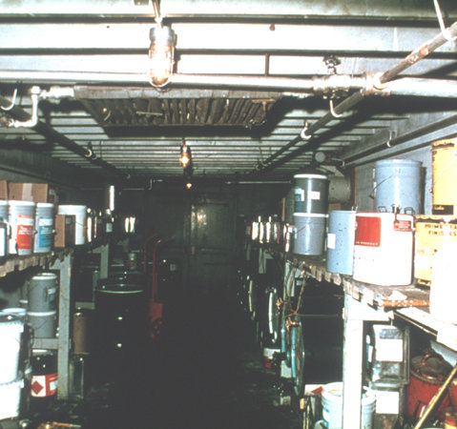
Process Safety Information - Paragraph (d) - Technology Information
Process chemistry
Maximum inventory
Safe upper and lower limits
Consequences of deviation
Block flow diagram
Notes:
For the technology of the process:
1.A block flow diagram or simplified process flow diagram;
2. Process chemistry;
3.Maximum intended inventory;
4.Safe upper and lower limits for such items as temperatures, pressures, flows and/or compositions; and,
5.The consequences of deviations, including those affecting the safety and health of employees.

Slide 44
Process Safety Information – Paragraph (d) - Equipment Information
Materials of construction
Piping and instrument diagrams (P&ID’s)
Electrical classification
Material and energy balances
Notes:
For the equipment used in the process:
1.Materials of construction;
2Piping and instrument diagrams (P&ID's);
3.Electrical classification;
4.Relief systems design and design basis;
5.Ventilation system design;
6.Design codes employed;
7.Material and energy balances; and
8.Safety systems (such as interlocks, detection and suppression systems, etc.).
This information is critical for evaluating the integrity, compatibility and safety considerations for the equipment in the process, and may be obtained from design specifications, existing process hazards analyses and physical inspection of the process.

Slide 45
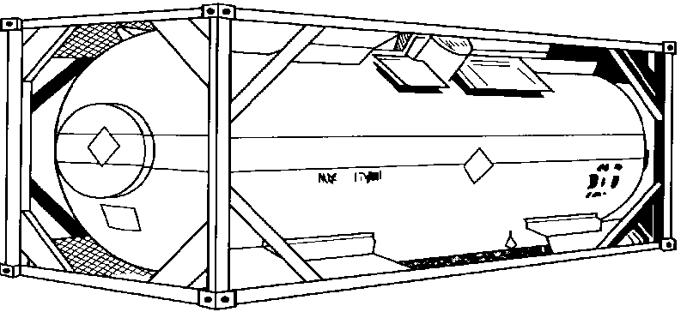
Process Safety Information - Paragraph (d) - Equipment Information
Safety systems
Relief systems design and design basis
Ventilation systems design
Design codes employed
Notes:
For the equipment used in the process:
1.Materials of construction;
2Piping and instrument diagrams (P&ID's);
3.Electrical classification;
4.Relief systems design and design basis;
5.Ventilation system design;
6.Design codes employed;
7.Material and energy balances; and
8.Safety systems (such as interlocks, detection and suppression systems, etc.).
This information is critical for evaluating the integrity, compatibility and safety considerations for the equipment in the process, and may be obtained from design specifications, existing process hazards analyses and physical inspection of the process.

Slide 46
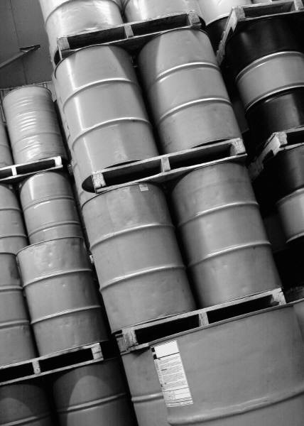
Process Hazard Analysis Paragraph (e)
The process hazard analysis is the cornerstone of the PSM regulation.
It is a formal, systematic means of identifying, evaluating and controlling process hazards involving highly hazardous chemicals.
Notes:
This information is necessary for understanding the process itself, its design parameters and critical operating limits. The information could be obtained from design specifications, existing process hazards analyses and operating manuals.

Slide 47
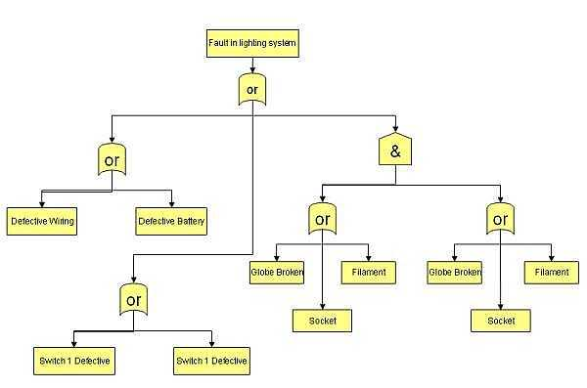
Process Hazard Analysis - Paragraph (e)
Methodologies must be appropriate to complexity of process:
What-if Analysis
Checklist Analysis
What-if/Checklist
Hazard and Operability Study (HAZOP)
Failure Modes and Effects (FEMA)
Fault Trees
Notes:
The PHA serves to identify, evaluate and control process hazards. This is where the information collected about a process will be systematically evaluated, reevaluated, changes recommended and evaluated, and the confidence in the safety of a process established. Due to the significance of the hazards in processes covered by this standard, a thorough and aggressive process hazard analysis is essential. The employer is required to select a method which is appropriate to the complexity of the process being analyzed. The priority order for conducting process hazard analyses must be based on such considerations as the extent of the process hazards, number of potentially affected employees, age of the process, and operating history of the process.
The standard sets forth six process hazard analysis methodologies:
1.What If?;
2.Checklist;
3The employer has the responsibility of choosing a methodology which will properly evaluate the processes.

Slide 48

Process Hazard Analysis - Paragraph (e)
Assemble team to conduct PHA:
Someone who is knowledgeable with the of PHA methodology to be used
Someone with engineering experience
Someone who is familiar with the specific system
Notes:
The significance of the requirement for process safety information is that the safety of the process cannot be properly evaluated without good and detailed data. Some of the information may not be readily available, but can be obtained and incorporated as other sections of the standard are addressed by the employer.
The process safety information package which is required to be compiled by the standard, addresses process chemicals, technology and equipment, provides the foundation for identifying and understanding the hazards involved in the process and is necessary in the development of a complete and thorough process hazard analysis.
Although all of the elements of the process safety management system are necessary to establish and to maintain a safe operation, OSHA believes that the process hazard analysis (PHA) is the cornerstone of the regulation since it is a thorough, orderly, systematic approach for identifying, evaluating and controlling processes involving highly hazardous chemicals and improvements in a plant's process safety management system result from a rigorous scrutiny of processes.

Slide 49
Process Hazard Analysis - Paragraph (e)
Hazards of the process
Identification of previous incidents
Engineering and administrative controls
Consequences of failures of engineering and administrative controls
Facility sitting
Human factors
Qualitative evaluation of failure of controls on employees
Notes:
The hazard analysis must address:
1.The hazards of the process; 2. Identification of previous incidents; 3. Engineering and administrative controls for the hazards; 4. Consequences of failures of controls; 5. Facility siting; 6. Human factors; and 7. Consequences (qualitative) of effects on workers within the facility of potential failures. The standard requires that the process hazard analysis be conducted by a team knowledgeable in the process including at least one worker. In addition, findings and recommendations of the analysis must be promptly addressed by the employer, and the process hazard analysis must be updated and revalidated every five years & address the safe operation of the process. Although OSHA requires that process hazard analyses be conducted as soon as possible, based on considerations discussed during the rulemaking such as multiple processes, resources, and limited availability of expertise in conducting process hazard analyses, OSHA has set out a schedule of when process hazard analyses must be completed. 25% of the analyses must be completed by May 26,1994, with an additional 25% each year until May 26, 1997, when all are required to be completed. Also in recognition of efforts that have already been devoted to conducting process hazard analyses, OSHA has included a five year grandfather of process hazard analyses which meet the specified criteria.

Slide 50
Operating Procedures - Paragraph (f)
Operating phases: Initial startup, normal operations. temporary operations, emergency shutdown and operations, normal shutdowns, startup following shutdown.
Operating limits
Safety and health considerations
Safety systems and their functions
Notes:
The standard requires that written operating procedures be developed, implemented and readily accessible. Written operating procedures provide employees with clear and consistent instructions for safely conducting all activities involved in each process. Written operating procedures comprise the employer's policy on how to operate the process.
The employer is required to provide written operating procedures for operations:1. Initial startup, normal operation,normal shutdown;2.Temporary operations, emergency operations including emergency shutdown;3.Startup following a turnaround, or after an emergency shutdown.
For operating limits:1.Consequences of deviation;2.Steps to take to correct or avoid deviation from operating limits;3.Safety systems related to operating limits.The operating procedures are also required to address: the hazards and properties of the chemicals used in the process; the precautions to take to prevent employee exposure; the control measures to take if physical contact or airborne exposure occurs; the safety procedures for opening process equipment; control of raw materials and inventory amounts; and any special hazards unique to the process.These written procedures must be available to process employees and they are to be reviewed. regularly to assure that they are up-to-date and reflect any changes made to the process.

Slide 51
Operating Procedures - Paragraph (f)
Safe work practices for: Lockout/Tagout, confined space entry, operating process equipment, control over entrance into facility
Quality control for raw materials
Accessible to those who work on an/or maintain the process
Reviewed on a regular basis to make sure that they consistent with the actual procedures
Notes:
The standard requires that written operating procedures be developed, implemented and readily accessible. Written operating procedures provide employees with clear and consistent instructions for safely conducting all activities involved in each process. Written operating procedures comprise the employer's policy on how to operate the process.
The employer is required to provide written operating procedures for operations:1. Initial startup, normal operation,normal shutdown;2.Temporary operations, emergency operations including emergency shutdown;3.Startup following a turnaround, or after an emergency shutdown.
For operating limits:1.Consequences of deviation;2.Steps to take to correct or avoid deviation from operating limits;3.Safety systems related to operating limits.The operating procedures are also required to address: the hazards and properties of the chemicals used in the process; the precautions to take to prevent employee exposure; the control measures to take if physical contact or airborne exposure occurs; the safety procedures for opening process equipment; control of raw materials and inventory amounts; and any special hazards unique to the process.These written procedures must be available to process employees and they are to be reviewed. regularly to assure that they are up-to-date and reflect any changes made to the process.

Slide 52

Training - Paragraph (g)
Process overview
Process hazards
Operating procedures
Emergency procedures
Means used to verify/document training
Refresher training
Notes:
Finally, OSHA is -requiring that employers develop and implement safe work practices to provide for the control of hazards during operations such as lockout/tagout, confined space entry, opening process equipment or piping and control over the entrance into a facility by support personnel.
OSHA believes that an effective training program will enhance the safe operation of processes covered by this standard and that it is an essential component of a process safety management system. Each employee working with a process must be trained in an overview of the process and in the operating procedures developed as outlined above. The training should be job task specific and is to cover specific safety and health hazards, procedures and safe practices.
Refresher training must be provided no less than every three years, but more often if necessary. The employer must consult with the employees to determine the frequency of refresher training. Finally, OSHA wants to see that employees receive and understand training and is therefore requiring that the employer prepare a record.

Slide 53

Contractors - Paragraph (h)
Employer responsibilities:
Evaluate safety of contractor before hire
Inform of hazards of process
Explain emergency evacuation plan
Develop and implement safe work practices
Evaluate contractors are fulfilling obligations
Maintain a contract employee injury and illness log
Notes:
Speaker’s Notes:

Slide 54
Contractors - Paragraph (h)
Assure employees are trained in work practices
Assure employees are instructed in emergency action plan
Document employee receipt and understanding
Assure employees follow safe work practices
Advise facility employer or unique hazards presented or discovered
Notes:
Speaker’s Notes:

Slide 55
Pre-Startup Safety Review - Paragraph (i)
Confirm that:
Construction and equipment meet design specifications
Operating procedures are in place before startup
New facilities: process hazard analysis
Modified facility: meets management of change
Training has occurred before startup
Notes:
The standard requires the employer to perform a pre-startup safety review for each new process or for a process that has been modified.
The safety review must determine that:
1.Construction is in accordance with design specifications;
2.Safety, operating, maintenance, and emergency procedures are in place and are adequate;
3.Process hazard analysis recommendations have been addressed for any new or modified process and actions necessary for startup have been completed in accordance with the management of change provisions; and,
4.Operating procedures are in place and training of each operating employee has been completed.
The reason for this provision is to provide for a formalized double check to verify that all process safety considerations are addressed and in place before a hazardous material is introduced into the process.
Sirnply put, "Are the process and workers ready to safely begin operation?"

Slide 56
Mechanical Integrity - Paragraph (j)
Employer must establish and implement written mechanical integrity program
Employer must establish a list of all equipment to be covered by mechanical integrity program
Training for maintenance activities including standard operating procedures
Notes:
The standard requires written procedures to be established and implemented to maintain the integrity of process equipment. This would require inspection and testing at proper intervals, and maintaining a record of inspections on equipment such as pressure vessels, piping systems, relief valves, emergency shutdown systems, controls, alarms, and interlocks.
In addition, equipment deficiencies must be corrected, and a quality assurance program implemented to assure that replacement equipment meets design specifications and is property installed.

Slide 57
Mechanical Integrity - Paragraph (j)
Inspection and testing of equipment to determine if the equipment is designed and being used according to recognized good engineering practices
Document inspection results
Correct equipment deficiencies
Establish quality assurance of equipment used in process (spare parts, equipment used according to manufacturers specifications….)

Slide 58
Hot Work Permit - Paragraph (k)
Requires written permit
Authorization of hot work: welding, cutting, brazing, flame or spark producing operations
For work done on or near the covered process
Fire prevention precautions.
Refers to 29 CFR 1910.252(a) for safe requirement to be implemented prior to hot work operations
Notes:
The final rule includes a requirement for issuing hot work permits. Before flame or spark- producing operations, such as welding, cutting or brazing, can be performed on or near a process, a permit must be issued authorizing the work. The permit must identify the specific location or equipment on which hot work will be performed, the date authorized and other safe conditions, such as fire prevention precautions, line blocking/purging, etc., which must be verified before work is conducted. The purpose of this requirement is to be certain,
through management control and responsibility, that sources of ignition and their potential effect on the process and process environment are strictly controlled.

Slide 59

Management of Change Paragraph (l)
Employer must establish written procedures to address the management of change.
Replacement in kind
Program must consider:
Technical basis
Impact of change on the process
Modification of operating procedures and,
Time period for the change
Notes:
The employer is required to establish and implement written procedures to evaluate the safety of any changes to process chemicals, technology, equipment, and the facility.
These procedures must address:
1.The technical basis for the proposed change;
2.Impact of change on safety and health;
3.Modifications to operating procedures;
4.Necessary time period for the change;and,
5.Authorization requirements for the proposed change.
In addition, employees must be informed of the - change and receive any necessary training as the result of the change before operation is resumed. Safety information and operating procedures must also be updated to reflect the change.

Slide 60
Management of Change - Paragraph (l)
Who must authorize the change
Training for employee operating or maintaining the process affected by the change prior to start up of the process
Update process safety information

Slide 61
Incident Investigations - Paragraph (m)
Incidents which did or could result in a catastrophic release of hazardous chemicals
Near misses
Investigation conducted within 48 hours
Report and recommendations
System to address recommendations
Review with affected personnel
Notes:
The standard requires that every incident that results in, or could have resulted in a major accident, be investigated by the employer. This would include "near misses" as well as process deviations or events, which, at the time, appear harmless, but after closer scrutiny, are identified as being a significant compromise to the safety of a process unit.
Any incident which could have resulted in, or could reasonably have resulted in a catastrophic release of a highly hazardous chemical in the workplace must be investigated. The investigation must be started within 48 hours of the incident and be conducted by a- knowledgeable investigation team. A report is to be prepared and the findings and recommendations addressed in a timely manner. The results of the investigation must be reviewed with all employees whose job tasks are relevant to the incident findings.

Slide 62
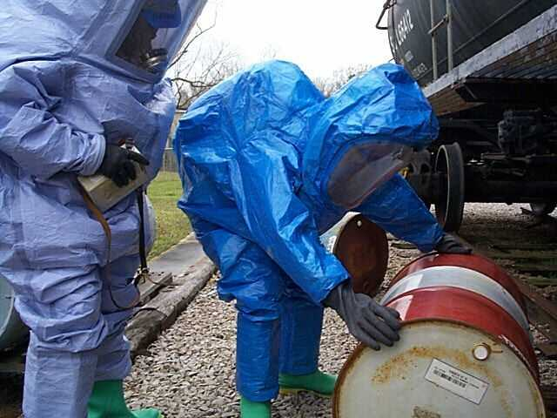
Emergency Planning & Response - Paragraph (n)
Implement emergency action plan meeting (1910.38):
Preplanning
Escape procedures
Notification procedures
Alarm system
Training
Handling of small releases:
May be subject to 1910.120, Hazardous Waste and Emergency Response
Notes:
The next element of the standard concerns emergency planning and response. The requirements in this element help to assure that employers pre-plan for emergencies.
Employers are required to develop an emergency action plan for the plant which meets the requirements of §1910.38(a). Emergency action plans must include escape procedures and route assignments; procedures to be followed by employees who remain to operate critical equipment; procedures to account for employees after an emergency; rescue and medical duties; preferred means of reporting fires and other emergencies; an employee alarm system; and the types of evacuation and training.

Slide 63
Compliance Audits - Paragraph (o)
Certify that the program is in compliance with the paragraphs of 29 CFR 1910.119
Verify that the program is effective
Develop report and recommendations
Conduct at least every three years
Notes:
The employer is required to certify that compliance with all of the sections of the .standard have been evaluated at least every three years. A team knowledgeable in the processes must be used for the audit, and a report of their findings developed.
Employees must promptly address all findings and recommendations reported by the audit team. 'A The purpose of these requirements for compliance safety audits is to double check, on a continuing basis, that all safety issues are continuing to be addressed and that unsafe changes in the process, or operating and maintenance procedures have not inadvertently occurred over time.

Slide 64

Trade Secrets - Paragraph (p)
For the protection of process trade secrets involved with the highly hazardous chemical(s) involved in the process
Enter in confidentiality agreements (if applicable)
Make information available to affected employees
Notes:
The last element in the process safety management standard concerns the protection of trade secrets.
The employer would be required to provide all information to the persons responsible for compiling the process safety information, the process hazard analysis, the operating procedures, incident investigations, emergency planning and response, and compliance audits.The employer could require the persons to whom the information is made available toenter into confidentially agreements not to disclose the information, as set forth in 29 CFR 1910.1200.
Under rules and procedures contained in 29 CFR 1910.1200, employees and their designated representatives would have access to trade secret information contained in the process hazard analysis and other required documents.
The proposed standard contains fourappendices:Appendix A is mandatory and provides the list of toxic and reactive chemicals covered by the standard.Appendix B is nonmandatory and provides a sample block flow diagram and a simplified process flow diagram.Appendix C is non-mandatory and provides helpful informationfor using the standard. A discussion of process hazard analyses methods, and . recommendations regarding incident investigations and emergency control centers are included. Appendix D lists sources of assistance.

Slide 65

Thank You For Attending!
Final Questions?
1-800-NC-LABOR
(1-800-625-2267)
www.nclabor.com
Notes:
65

