Slide 1
N.C. Department of Labor OSH Division
Practical Industrial Hygiene
Compliance

Slide 2
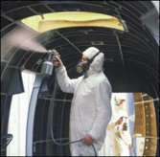
Objectives
Present practical methods for conducting IH inspections
Noise
Air Sampling
Expanded Health Standards
Bloodborne Pathogens
General Industry vs. Construction
IH Fat/Cats
Discuss IH case studies
Become familiar with procedures and techniques used by HCO during IH inspections

Slide 3

Case Studies
Background information
Hazard anticipation and recognition
File photos
Determine which standards may be involved
Hazard evaluation
Sampling methodology, forms, results
Equipment needed

Slide 4

Case Studies
Hazard documentation
List of possible violations
Information needed to substantiate each violation
Hazard assessment – What is the hazard and the most probable injury/illness?
Severity/probability assessment
Putting it all together in an OSHA 1b

Slide 5
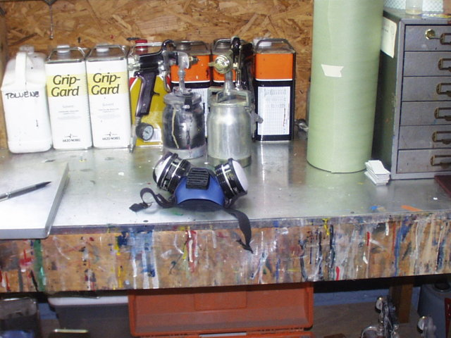
Case Studies

Slide 6
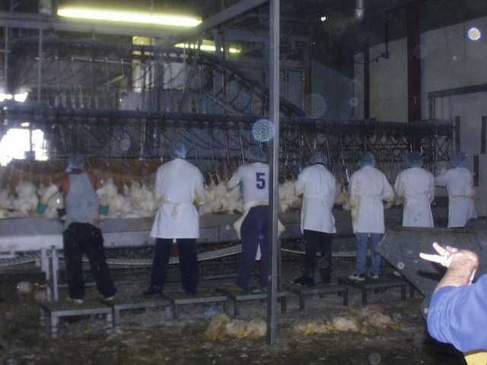
Case Studies

Slide 7
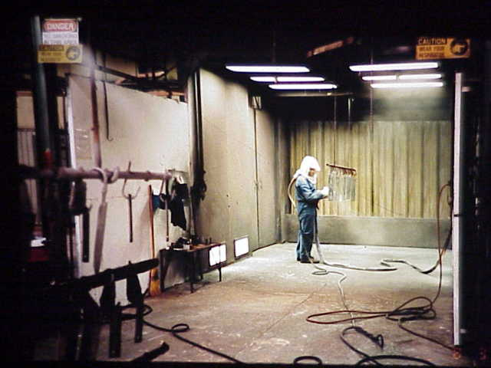
Case Studies

Slide 8
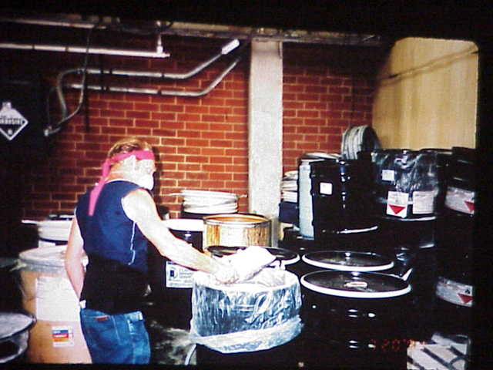
Case Studies

Slide 9
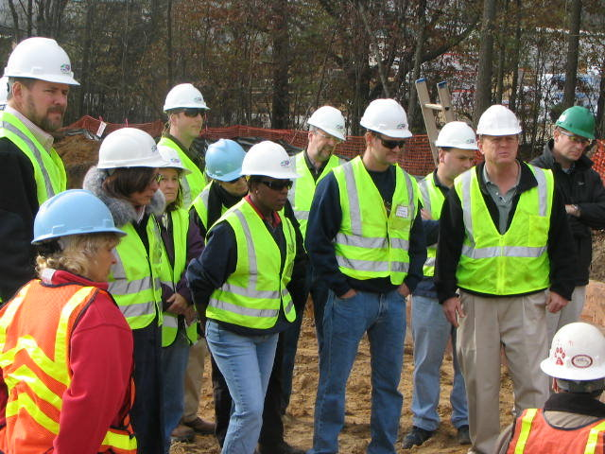
Air Sampling
When is air sampling necessary?
Complaints?
General Schedule?
SST Inspections?
Special Emphasis Programs (e.g. Lead, Silica)?
Can you do screen sampling?
What equipment is available for
screening?

Slide 10
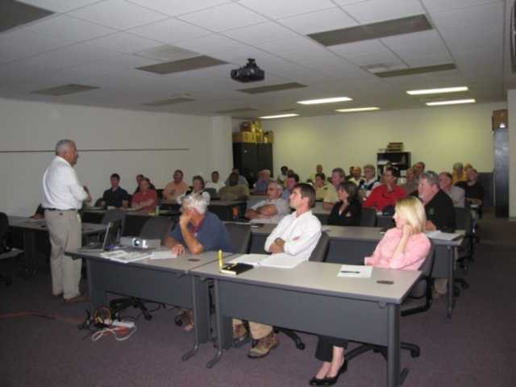
Air Sampling
Which contaminants do you sample for?
MSDS’s
Use of “profile” sampling
What type of media?
Sampling flow rates
Total sampling volume

Slide 11

Air Sampling
Sampling procedures
Which employees will you sample?
Pump placement/securing
Tubing
Welding helmets
Supplied air respirators
How do you handle lunches/breaks?
How do you handle pump faults?

Slide 12
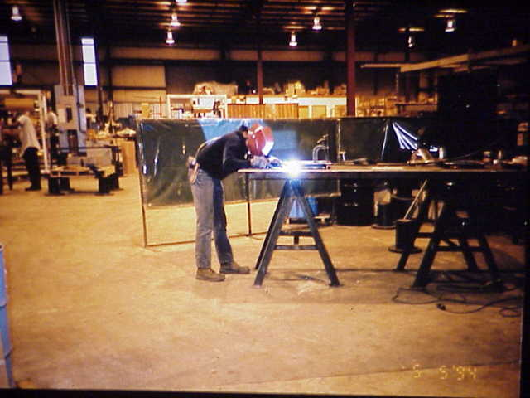
Case Studies

Slide 13
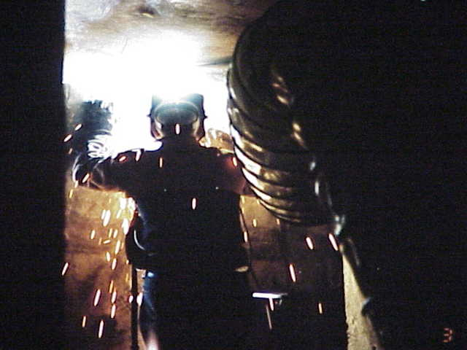
Case Studies

Slide 14
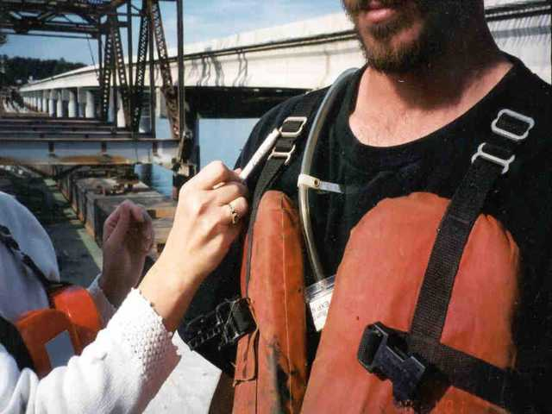
Case Studies

Slide 15
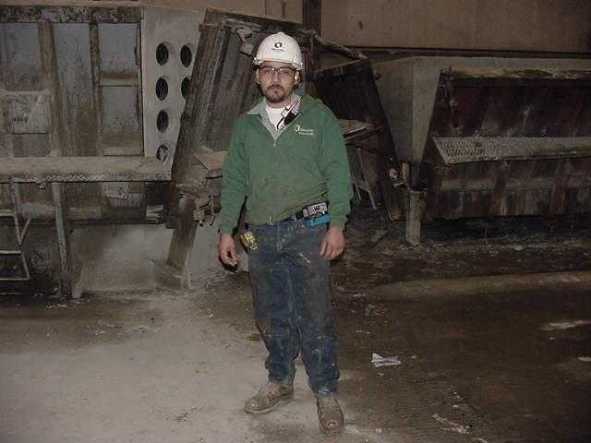
Case Studies

Slide 16


Expanded Health Standards
Standards promulgated by 6(b) rulemaking, including:
Asbestos
Lead
Formaldehyde
Methylene Chloride
Cotton dust
A number of carcinogens

Slide 17
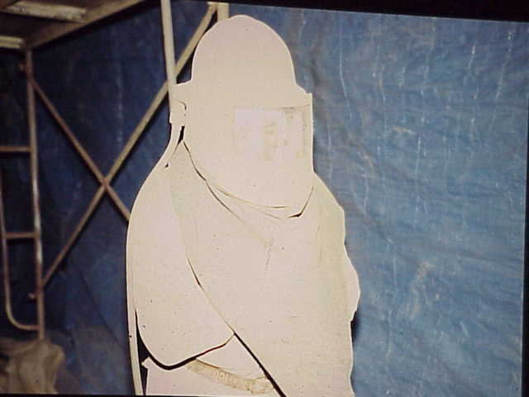
Case Studies

Slide 18

Expanded Health Standards
The OSH Act under paragraph 6(b)(7) specifies what must be included in these standards:
Exposure monitoring or measurements
Appropriate PPE
Labeling and employee training
Medical surveillance

Slide 19
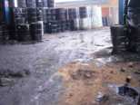
Expanded Health Standards
What procedures will you follow when a regulated contaminant is identified?
Monitoring results
Written compliance program
Medical records
Training records
Will you need to sample?
How will this info be confirmed?

Slide 20

Bloodborne Pathogens
29 CFR 1910.1030
Who is covered by this standard?
How about First Aid providers?
Collateral duty
Post exposure HBV Vaccinations
How can training and HBV Vaccinations be confirmed?

Slide 21
Program Evaluation
“Program” vs. “Written program”
1910.38 – Emergency action
1910.95 – Noise
1910.146 – Permit-Required Confined Spaces
1910.147 – LO/TO
1910.1000 – PELs
1910.1030 – BBP
1910.1xxx – Expanded Health Standards

Slide 22

Thank You For Attending!
Final Questions?
1-800-NC-LABOR
(1-800-625-2267)
www.nclabor.com
Notes:
Tell students that now is time they log out of the session, if they have no further questions.

