Slide 1
N.C. Department of Labor OSHA 125 Course
29 CFR 1910.1025 Lead Standard
29 CFR 1926.62 Lead Standard
Notes:
Rev 0: 6/24/2013

Slide 2
Lead Stuff
We don’t eat lead paint chips!
We consume lead dust, its easier to swallow
Same with children
Lead interacts with our bodies
Word

Slide 3
What Industries?
Battery manufacturing Chemical industry Construction workers Demolition workers Firing-range instructors Foundry workers Gas-station attendants Gasoline additives production Jewelers Lead miners Lead smelters and refiners
Pigment manufacturing Pipe fitters Plastics industry Pottery workers Printers Radiator repair Rubber industry Soldering of lead products Solid waste production Stained-glass makers Welders

Slide 4
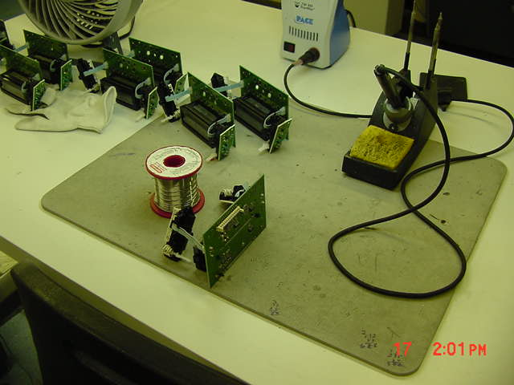
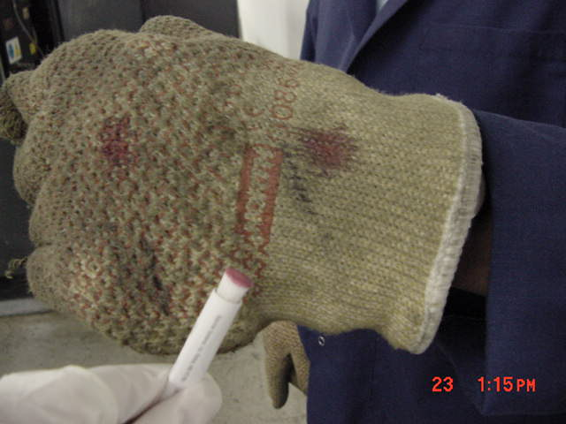
With Pictures!
Radiator repair shops
Storage batteries
Paints, dyes, ceramics
Foundries
Manufacturing of ammunition
Firearm ranges
Electronics
Weights
Notes:
Highly toxic heavy metal.

Slide 5
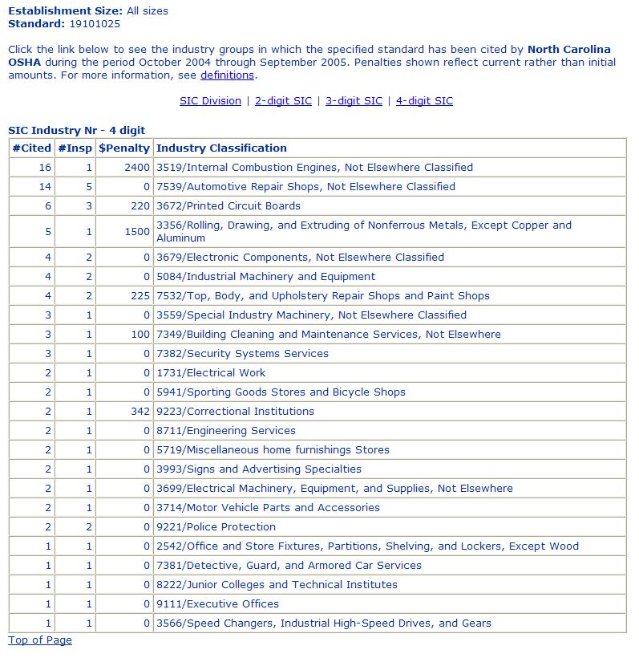

Slide 6


Lead Standard
29 CFR 1910.1025
29 CFR 1926.62
Objectives
To list the general requirements of the lead standard
To apply the lead standard to data obtained during inspection activity
To identify the differences between the general industry and construction lead standards
Gain the tools necessary for an inspection with lead.
Notes:
NOTE: Tech Manual sect V, chap 3 about controlling lead in construction
Objectives:
-to list the general requirements of the lead standard.
-to apply the lead standard to data obtained during inspection activity
-to identify the differences between the General Industry and Construction lead standards.

Slide 7
Why the Fuss?
The list below shows many of the key lead-induced health effects.
Neurological Effects
Peripheral neuropathy
Fatigue / Irritability
Impaired concentration
Hearing loss
Wrist / Foot drop
Seizures
Encephalopathy
Gastrointestinal Effects
Nausea
Dyspepsia
Constipation
Colic
Lead line on gingival tissue
Reproductive Effects
Miscarriages/Stillbirths
Reduced sperm count & motility
Abnormal sperm
Heme Synthesis
Anemia
Erythrocyte protoporphyrin elevation
Renal Effects
Chronic nephropathy with proximal tubular damage
Hypertension
Other
Arthralgia
Myalgia

Slide 8
Illness
Encephalopathy - means disorder or disease of the brain
Dyspepsia – upset stomach
Anemia – is a condition in which the body does not have enough healthy red blood cells.
Nephropathy – refers to damage to or disease of the kidney.

Slide 9
General Industry
1910.1025
Flip in your books to this section.
Reviewing the basics of the standard.

Slide 10
Construction
1926.62 – Lead
Flip in your books to this section.
Reviewing the basics of the standard.

Slide 11
Lots of information
Good news: 95% is the same
Bad news: still have to carry two books
Bad news: still have to know both
Good news: We have till 5:00 to get it done

Slide 12
Breakdown: 1910.1025
(a) Scope
(b) Definitions
(c) Permissible Exposure Limits (PEL’s)
(d) Exposure Monitoring
(e) Methods of Compliance
(f) Respiratory Protection
(g) Protective Work Clothing

Slide 13
Breakdown: 1910.1025 cont.
(h) Housekeeping
(i) Hygiene Facilities and Practices
(j) Medical Surveillance
(k) Medical Removal Protection
(l) Employee Information and Training
(m) Signs
(n) Recordkeeping
(o) Observation and Monitoring

Slide 14
Breakdown: 1926.62
(a) Scope
(b) Definitions
(c) Permissible Exposure Limits (PEL’s)
(d) Exposure Assessment
(e) Methods of Compliance
(f) Respiratory Protection
(g) Protective Work Clothing

Slide 15
Breakdown: 1926.62 cont.
(h) Housekeeping
(i) Hygiene Facilities and Practices
(j) Medical Surveillance
(k) Medical Removal Protection
(l) Employee Information and Training
(m) Signs
(n) Recordkeeping
(o) Observation and Monitoring

Slide 16
Appendices
Appendix – A (read I)
Appendix B – (In a nut shell)
Appendix C – Medical Surveillance (Pb 101 in the body)

Slide 17


Slide 18
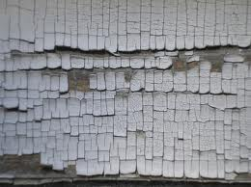
The Quick look – is it lead?

Slide 19
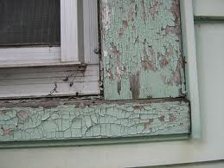

Slide 20
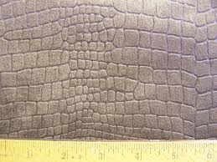

Slide 21
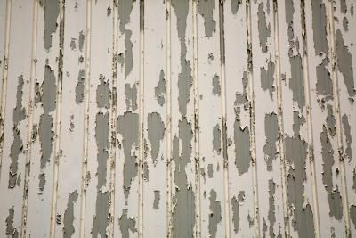

Slide 22
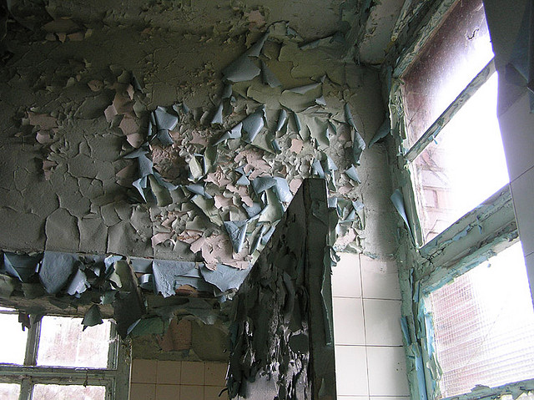

Slide 23
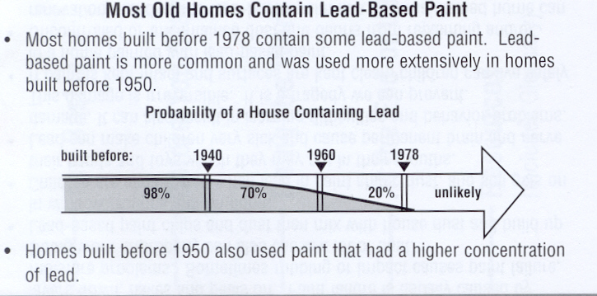

Slide 24
The Scenario
We will be discussing a scenario throughout the training. Provided 2 case files at the end.
Pull the information we have learned
Create a guideline for future inspections
Questions – ask as we go!

Slide 25
Inspection Time
You are given an inspection. Employees are removing pain from a water tower.
Media reports that the project will take approximately 8 weeks in total.
First thoughts?

Slide 26
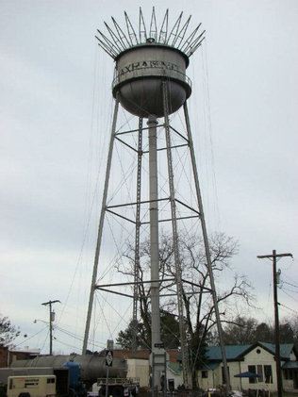
Inspection Time
Lets start with Construction
What are our questions:
1) has lead been identified?
2) are we generating air borne dust?
what does this?
Why is this important?
If both are true what’s first?

Slide 27
Lead – 1926.62
Exposure Assessment:
1926.62(d)
The A’s and the B’s
Make a note! (d) – is where it all begins.

Slide 28
Inspection
After interviewing our Contractor we know:
Sandblasting occurred on the legs and shell
3 people inside,
All three with a hood
All 3 wear a half mask respirator when exiting the containment
Based on our activities what do we expect to see?
Where do we begin?

Slide 29
Exposure Assessment
Tasks?
Respirators?
Blasting employee needs what?
Clean up employees need what?
So many questions!

Slide 30
Methods of Compliance??
For construction you have to review section 62.d first, and is mostly where you will cite.
For industry you have to review 62.e, and is mostly where you will cite.
The rest of the standard supports these two areas.

Slide 31
1926.62(v) – The project
A – respirators (f)
B – PPE (g)
C – Change areas (i2)
D – Hand washing (i5)
E – Biological Monitoring (j)(1)(ii)
F – training (l)(1)(i)

Slide 32
But we are sampling right now!
Now that we have that covered – lets move on to the rest of the standard!
Following our (d)(2)(v)
PPE

Slide 33
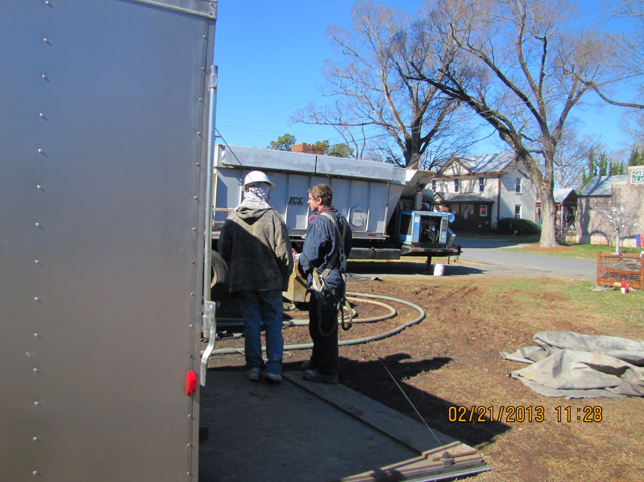

Slide 34
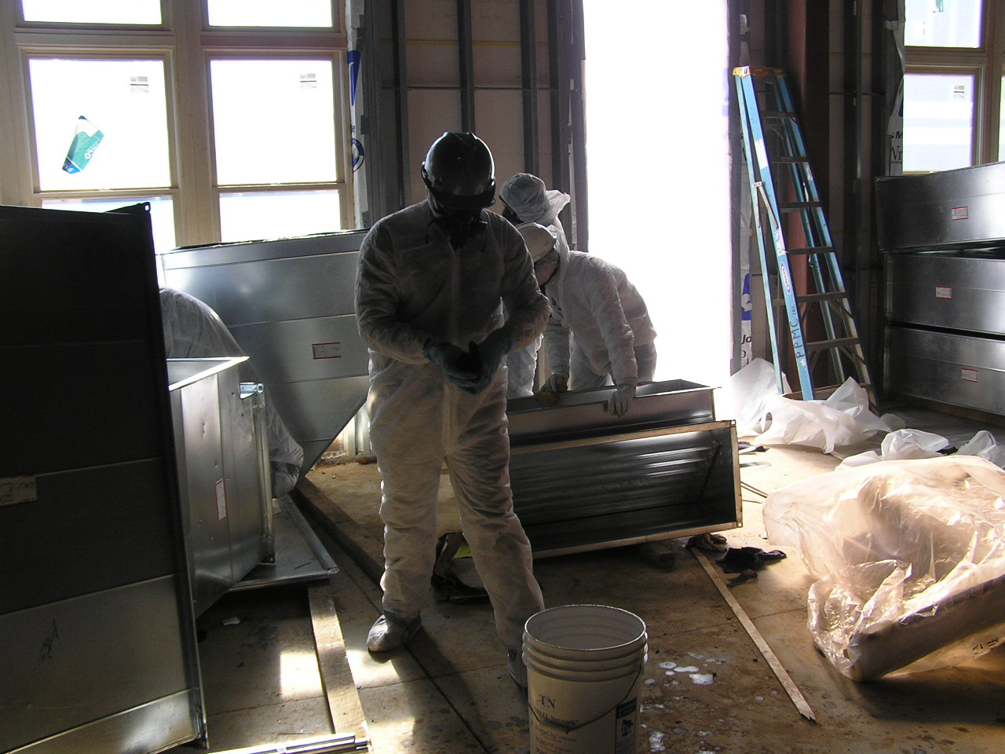

Slide 35

Lead PPE 1926.62(g)
Full body work clothing
Protect the rest
So what did our workers have?
Full body work suits
Respirators
Gloves
Shoes (work boots)
Contamination?

Slide 36
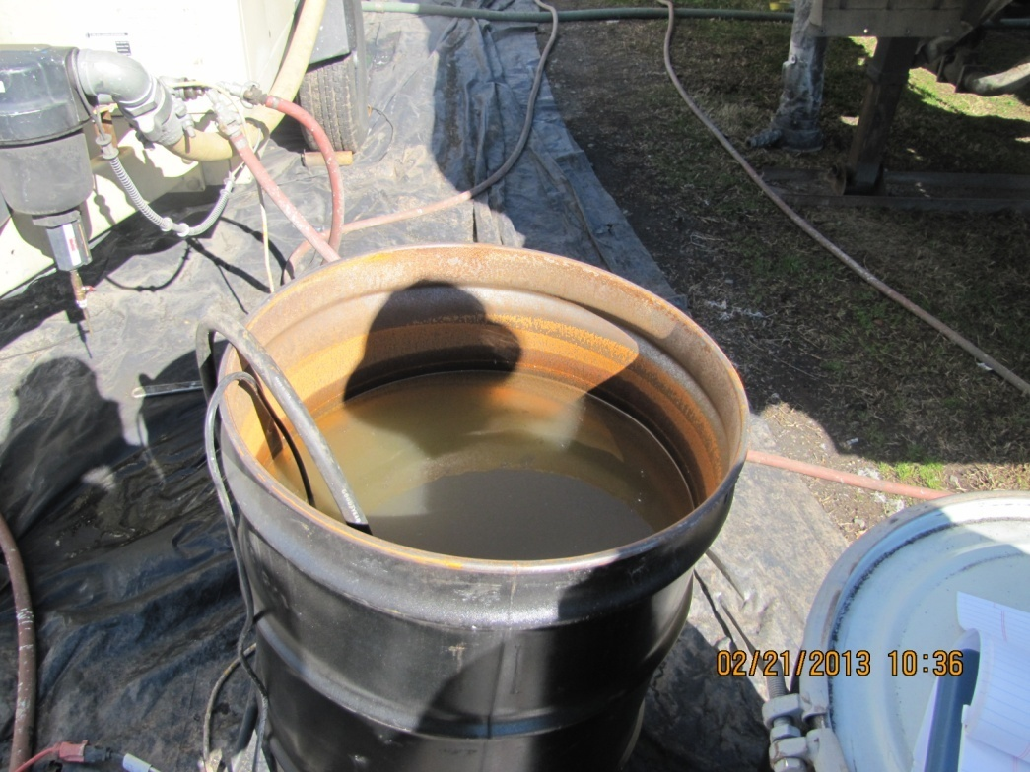
Hygiene Concerns
Potable water?
Wash station, shower?
No eating, drinking, no tobacco (including chew!!) or cosmetics
Cosmetics?

Slide 37
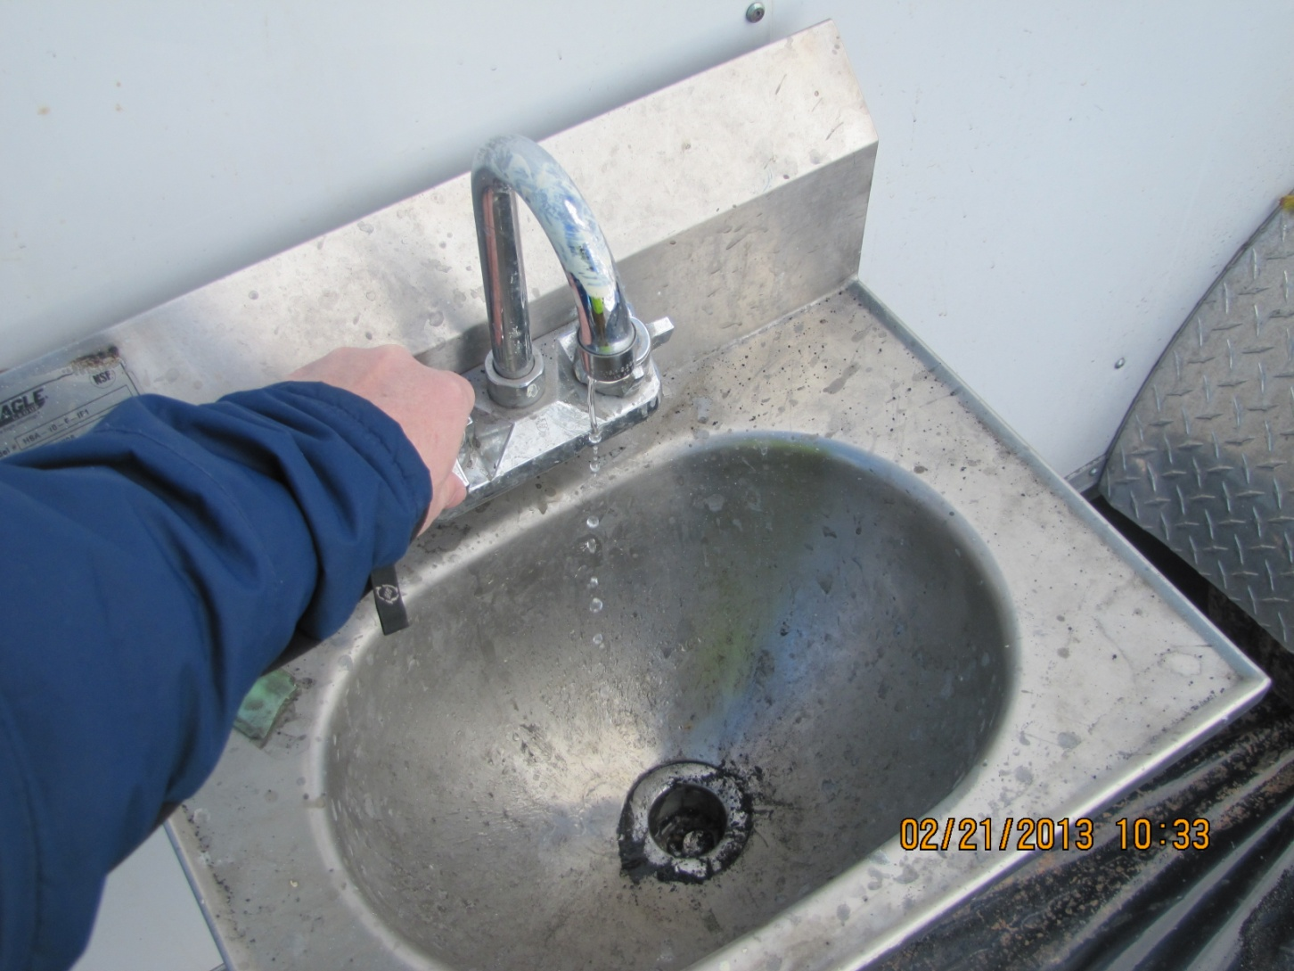
Water?

Slide 38
Hygiene Continued 1926.62(i)
Change Areas
Showers
Shower facilities actually no garden hose for you!
Where feasible?
Supply cleaning agents and towels!
Clorox wipes a good idea?

Slide 39
Washing Hands
A whole slide on washing hands?
The other lead case!
Wash your hands.
Remember Routes of Entry

Slide 40
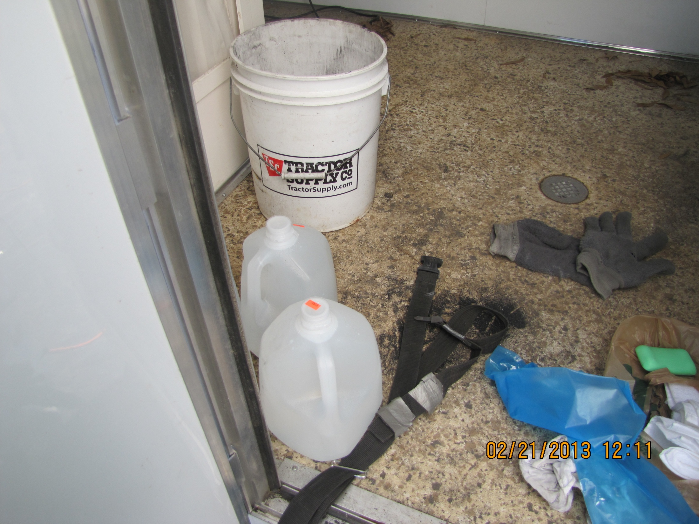

Slide 41
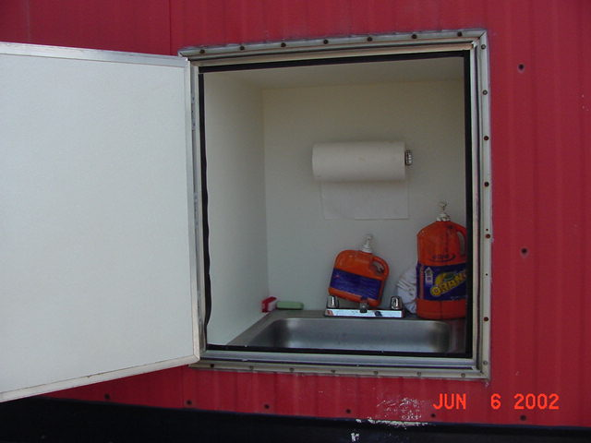
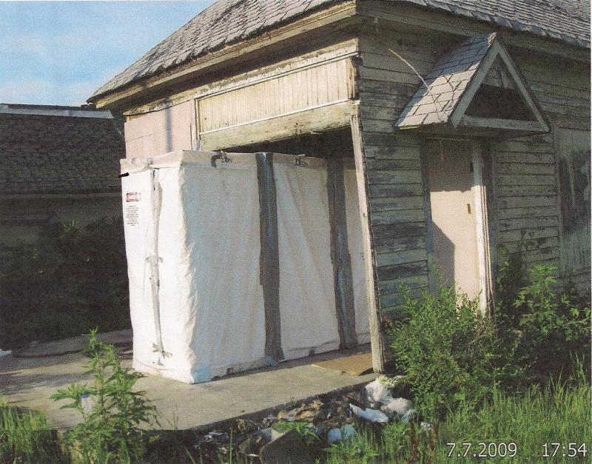
Notes:
Hand washing facility.

Slide 42

Lead Standard
All medical exams and procedures provided at no cost to employees at a reasonable time and place.
Basics of medical Surveillance
Read the details
What's the difference between (1)(i) and (1)(ii)
J(2) – That’s specific
Need records, dates, work history
Notes:
(j)(1)(iii) Q: Do employees get paid while they are going for medical exams? A: Yes.

Slide 43
Medical Surveillance 1926.62(j)
Not your vitals, your lead and zinc protoporphyrin levels!
Biological monitoring
Blood Pb sampling and analysis
Every 6 mo. when over the AL 30 days/year
Every 2 mo. when blood Pb is 40 μg/100g
Every month when on removal for blood Pb

Slide 44
ZPP at a glance
Why Get Tested?
To screen for and monitor chronic exposure to lead; to detect iron deficiency in children
When to Get Tested?
When you have been chronically exposed to lead, as part of a program to monitor lead exposure, and/or when your doctor suspects lead poisoning; as part of a screening program for iron deficiency in children and adolescents
Sample Required?
A blood sample drawn from a vein in your arm or from a fingerstick

Slide 45

Lead Standard -Medical
Follow-up blood sampling tests when the criterion for removal is reached 50 μg for construction (60 μg once or 50 μg as 6 month average for General Industry)
Employee notification
Notes:
45

Slide 46

Lead Standard -Medical
Medical exams prior to a Pb assignment
Medical exams will include detailed work and medical histories and a thorough physical examination.
Notes:
46

Slide 47

Lead Standard -Medical
Multiple physician review allowed
Information about the job (airborne levels, PPE, employee duties) and blood Pb levels must be provided to the physician
Notes:
47

Slide 48

Lead Standard -Medical
The physician must provide a written medical opinion for the employee.
Chelation is permitted only in a clinical setting with physician supervision.
Notes:
48

Slide 49

Lead Standard -Medical
Temporary medical removal from jobs over the AL for:
Construction EE at 50 μg/dl
Employees with blood Pb at 60 μg/dl
Employees with 6 month average blood Pb at 50 μg/dl.
Temporary medical removal from jobs over the AL due to medical determination.
Notes:
49

Slide 50

Lead Standard -Medical
Return to former job when:
Two consecutive blood Pb are below 40 μg/dl (for both standards)
With physician determination of improved health
Notes:
50

Slide 51

Lead Standard -Medical
Removal benefits are specified
Follow up medicals specified
Worker compensation applies
Notes:
51

Slide 52
Training 1926.62(l)
Have to train each employee who is subject to exposure to lead at or above the AL
Has to be provided prior to employment
And annually to all employees who are subject to lead exposure at or above the AL on any day.
Example of an employee that would not be trained?

Slide 53
Training Cont.
Training Programmed spelled out:
1926.62(l)(2)
What does 1926.62(l)(3)(ii) mean?

Slide 54
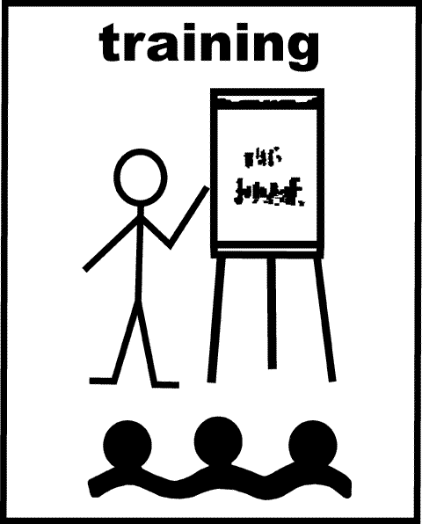
Training cont
All employees exposed to Pb to be trained on Appendices A and B
Appendix A
Substance data sheet for occupational exposure to lead
Appendix B
Employee standard summary

Slide 55
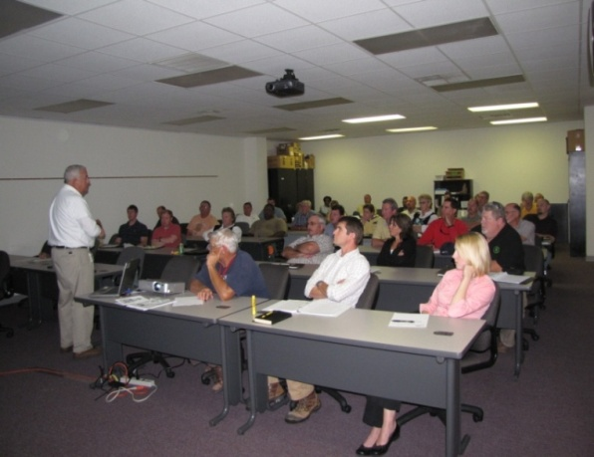
Lead Standard
All employees exposed over the AL to have in depth training on an annual basis and prior to initial assignment
Contents of standard and appendices
Jobs with exposures over the AL
Medical surveillance
Engineering and other controls
Compliance plan

Slide 56
Signs 1926.62(m)
Your right, not part of the list
But – it goes along with training
1926.62(m)(2)(i)
That’s the sign.
Check out 2(ii) – Illuminated and Cleaned!

Slide 57
The sign
WARNING LEAD WORK AREA POISON NO SMOKING OR EATING

Slide 58
Recordkeeping 1926.62(n)
This is in that list.. Where else are you going to find all that information?
What does (1)(i) say?
How long to keep?
1926.62(n)(1)(iii)
Hint- 1910.1020(d)

Slide 59
A Note
Objective Data and Previously monitored in 12 months!
Be extra critical, be extra cautious.
1926.62(d)(4) – Positive initial monitoring
1926.62(d)(5) – Negative initial determination

Slide 60
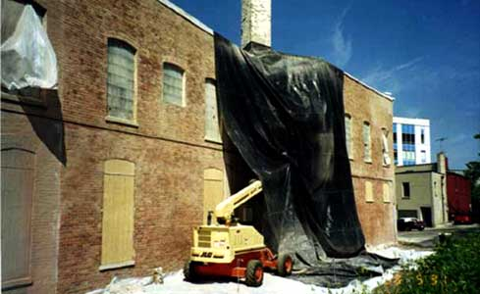
Lead Standard
29 CFR 1910.1025
Air Monitoring Data Review

Slide 61
Are we done?
Nope, but ½ way I think – onto the evaluation of their controls.
We are BACK to that pesky (e)!
The down and dirty.
Methods of Compliance.. Its all spelled out.

Slide 62
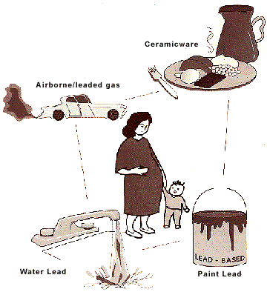
Lead Standard Still at e
Engineering and work practice control requirements:
Over PEL 31 or more days, reduce exposure to below the PEL OR as low as feasible and use APPROPRIATE respirators.
Over PEL 30 or fewer days, reduce
exposure to 200 μ g/m³ and use
respirators to maintain exposures
to below the PEL
Notes:
Feasibility discussion (look at Ch 15 of FOM):
Technical feasibility: similar situations observed, methods documented in journals or at conferences, studies from a qualified professional (consultant), equipment catalogs or suppliers.
Economic feasibility: cost is not usually considered (except in contestment), however, if it places an undue burden on the employer and would “shut the doors”, an extended abatement date can be set. The BC must approve abatements longer than 1 year. It is recommended that the employer provide periodic updates on work done during these longer abatements.

Slide 63
What respirator?
At minimum what should you expect an employee to be wearing?
Table 1 (1910.134)
Cartridges?
What about the respirator standard?
One more list to follow!

Slide 64
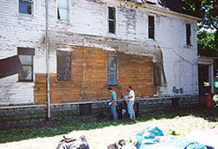
Lead Standard Still at e
When engineering and work practices controls do not reduce exposure below the PEL, use respirators per paragraph (f)
Establish / implement a written plan to comply with PEL
Revise every 6 months
Seriously! Take a look.
A through I
Notes:
These are to be made available to the Asst Sec, the Director, and any affected employees or authorized employee reps for examination and copying.
Asst Sec is anyone from OSHA, Director is anyone from NIOSH
EE reps are union reps or stewards, spouses, parents, children, lawyers, MDs, etc.

Slide 65

This is mostly identical in both standards
Describe each operation
Describe specific means of compliance
Report the technology considered
Document emission sources with IH data
Detail time schedule for implementation
List work practices required in (g), (h), (i)
Describe administrative control schedules
Document other relevant information

Slide 66
Guess where?
1926.62(e)(2)(ii)(H) – for all the multi-contractor sites.
Check out 1926.62(e)(2)(iii)
Required!
Moving right along…. Jumping around…

Slide 67

Lead Standard
Mechanical ventilation
Effectiveness checks required every 3 months and after any change in process that might alter employee exposures.
Any recirculated air must be HEPA filtered and monitored.
Pb in the return air must cause automatic bypass of the system
Notes:
Ventilation checks: capture velocity, duct velocity, static pressure.

Slide 68
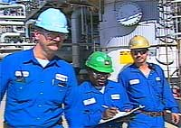
Lead Standard
Administrative control documentation for employee rotation
Name or ID number of each affected employee
Duration and exposure levels at each job
Any information useful for assessing that these controls reliably reduce employee exposure

Slide 69
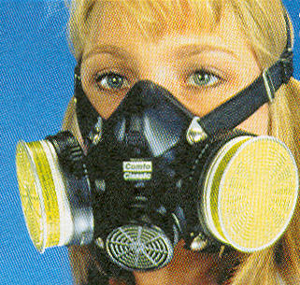
Lead Standard
Respirators must be worn when necessary to install and/or implement engineering/ work practice controls or when those controls are not sufficient to reduce exposures to below PEL.
The employer must implement a respiratory protection program in accordance with 29 CFR 1910.134.

Slide 70
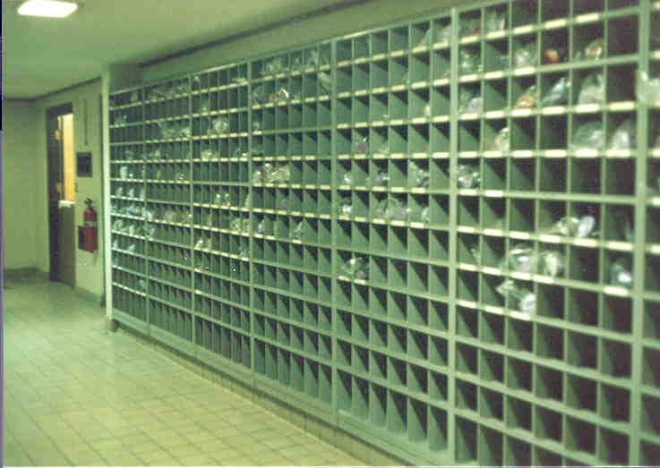
Lead Standard
29 CFR 1910.1025
Notes:
respirator storage, Company J

Slide 71
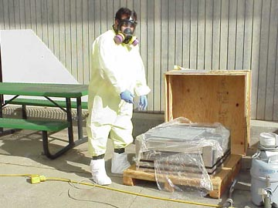
Lead Standard
The employer provides for cleaning or disposal of protective clothing and equipment
The employer is to repair and replace equipment as needed

Slide 72
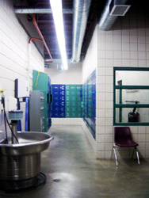
Lead Standard
Back to General industry:
Can you eat in your lead clothes?
Placed in closed container to
prevent spread of lead dust.
Remember the Indoor lead case?

Slide 73
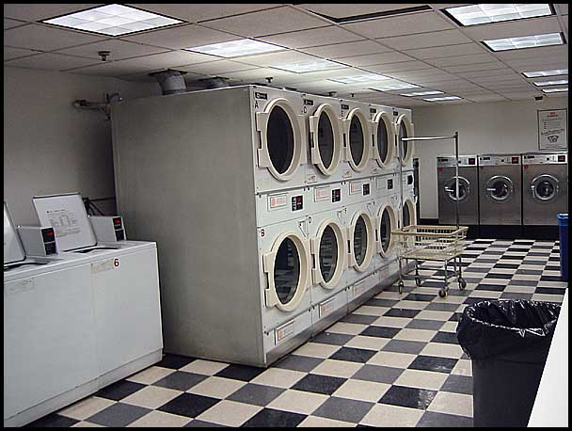
Lead Standard
Notify the laundry in writing re: Pb contamination and potential health effects.
Containers must be labeled.
Shaking or blowing off with compressed air to clean PPE is prohibited.
Notes:
Pb overexposures have been documented in the laundry areas of uniform service companies.

Slide 74
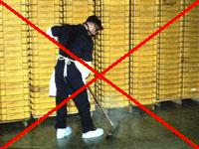
Lead Standard
Surfaces free of Pb accumulations.
Use 200 μg/ft² per CPL 2-2.58 (1926.62)
Do not used compressed air to clean floors. Shoveling and dry sweeping to be used only where vacuuming not effective.
Vacuums to be used and emptied to keep recontamination to a minimum.

Slide 75
Lead Standard
29 CFR 1910.1025
Notes:
lead oxide is leaking from ball mill, Company J

Slide 76
Lead Standard
29 CFR 1910.1025
Notes:
company using a dust reducing compound in house keeping, Company V

Slide 77
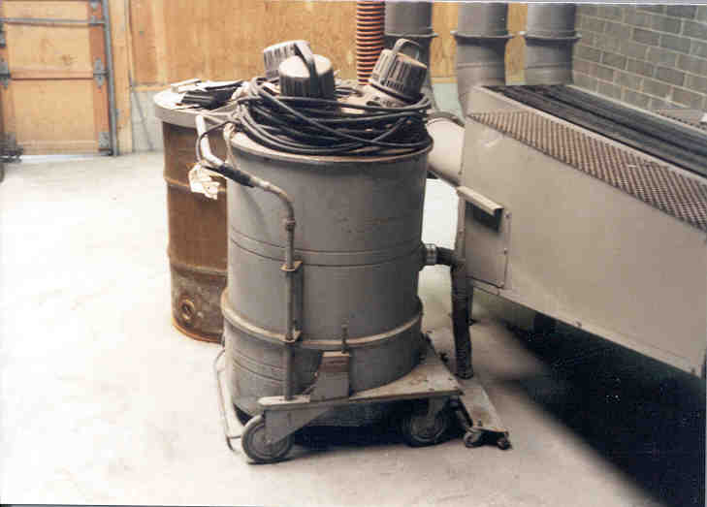
Lead Standard
29 CFR 1910.1025
Notes:
Vacuum, Company V

Slide 78
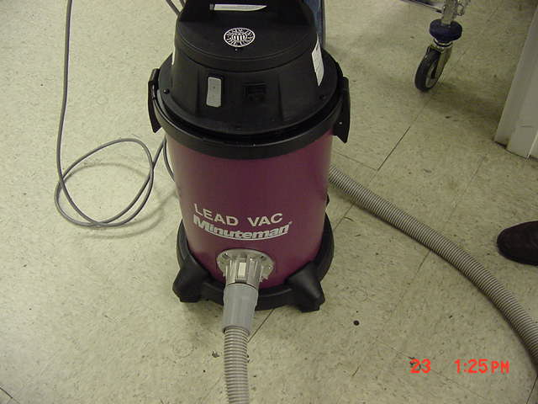
Lead Standard
29 CFR 1910.1025

Slide 79
Lead Standard
29 CFR 1910.1025
Notes:
Vacuum, Company J

Slide 80
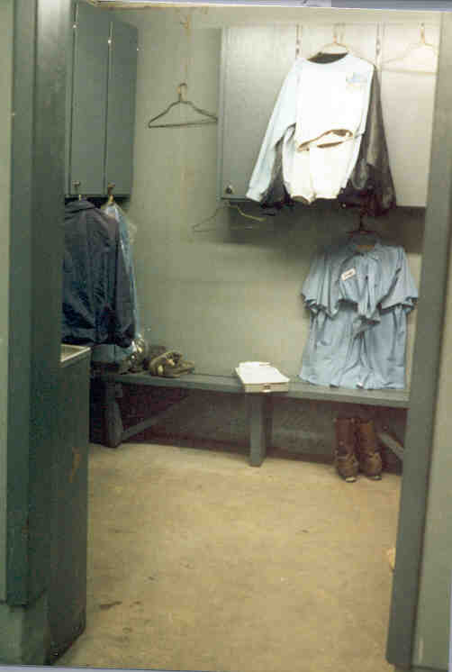
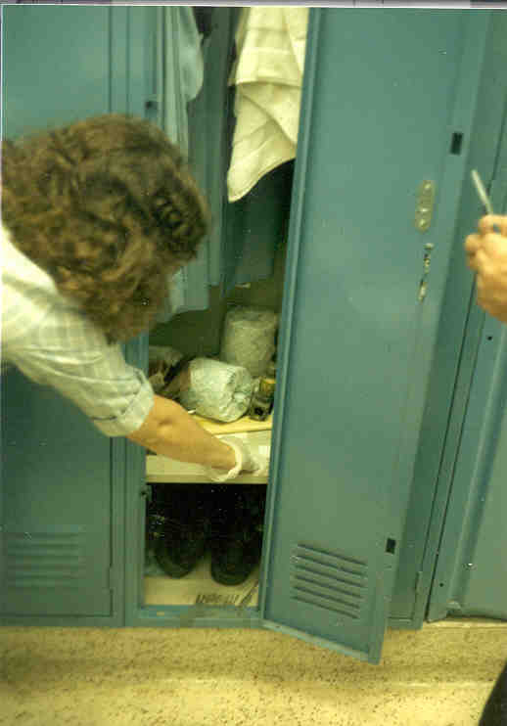
Lead Standard
29 CFR 1910.1025
Notes:
uniform storage, Company V

Slide 81
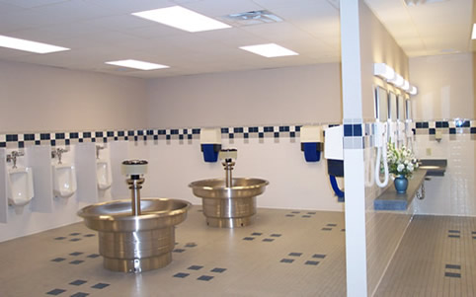
Lead Standard
Shower facilities (per 1910.141(d)(3)) provided with Pb over PEL. Must shower at end of shift, can’t leave wearing Pb contaminated work clothes.

Slide 82

Lead Standard
Lunchrooms provided when over PEL
Must have a temperature controlled, positive pressure, filtered air supply.
Must wash prior to eating, drinking, smoking.
Must remove surface dust from PPE by vacuum or downdraft booth.
Restrooms must be provided per 29
CFR 1910.141

Slide 83
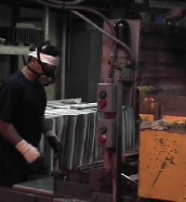
Lead Standard
Employees can observe monitoring
Effective date – March 1, 1979
Appendices to supplement standard

Slide 84
Back to our Job
Handout of 1A
Lets do the inspection:
You lead the questions!

Slide 85
Show Case Pictures
Gun Manufacturing - GI
Review case pictures
Review case file
Water Tank – Con.
Review case pictures
Review case file

Slide 86
What Else but CPL’s
CPL 2-2.46 – Medical Records review
CPL 2-2.33 – OSHA Access to Employee Medical records
CPL 2-2.58 Lead In Construction
CPL 2-2.67 lead Brass & Bronze Ingot Manufacturing
CPL 03-00-009 NEP Lead

Slide 87

Thank You For Attending!
Final Questions?

