Slide 1
Confined Spaces in Construction/General Industry - Internal 105 Training
1926.1200 Subpart AA
29 CFR 1910.146
Presented by: ETTA, OSH Division, (919) 707-7876
Notes:
Revised 06/2021
The information in this presentation is provided voluntarily by the N.C. Department of Labor, Education Training and Technical Assistance Bureau as a public service and is made available in good faith. This presentation is designed to assist trainers conducting OSHA outreach training for workers. Since workers are the target audience, this presentation emphasizes hazard identification, avoidance, and control – not standards. No attempt has been made to treat the topic exhaustively. It is essential that trainers tailor their presentations to the needs and understanding of their audience.
The information and advice provided on this Site and on Linked Sites is provided solely on the basis that users will be responsible for making their own assessment of the matters discussed herein and are advised to verify all relevant representations, statements, and information.
This presentation is not a substitute for any of the provisions of the Occupational Safety and Health Act of North Carolina or for any standards issued by the N.C. Department of Labor. Mention of trade names, commercial products, or organizations does not imply endorsement by the N.C. Department of Labor.

Slide 2
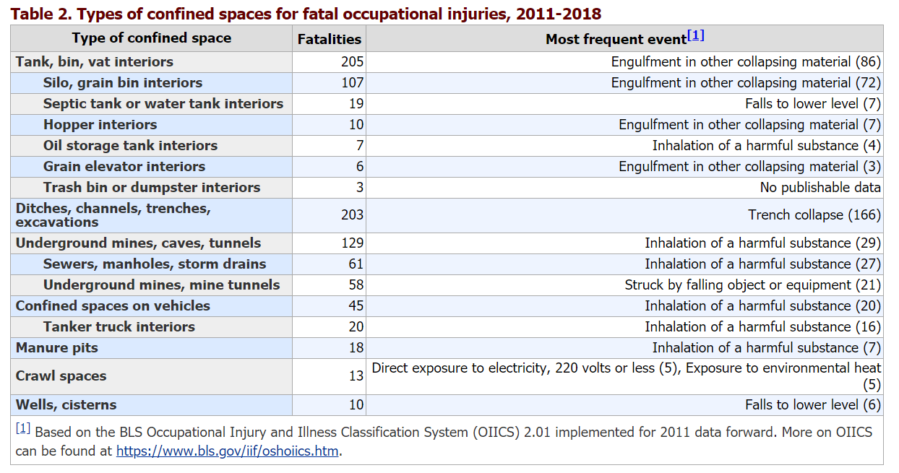
Total : 914 deaths (2011-2018)
Notes:
Two leading Areas
Tanks bin vat interiors
Ditches, channels, trenches, excavations
Total Fatalities: 914

Slide 3
Objectives
Subpart AA / Subpart J
At the end of this course, students will be able to:
Discuss and recognize the differences/similarities in Confined Spaces in General Industry and Construction
Use and understand the Terms and Definitions used within CSE application
Understand the components of PRCS and employer responsibilities

Slide 4
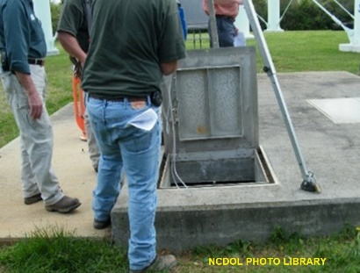
Objectives
Subpart AA / Subpart J
Recognize and define a Confined Space and/or Permitted Space and incorporate that knowledge in your investigations
Understand the required components of a PRCS such as Written Program, Alternate Entry, and Air Monitoring
Notes:
NCDOL Photo Library: City of Apex, 4/12/2011 Partnership Site, Permission Letter Obtained. An employee is testing the atmosphere inside the space prior to entry

Slide 5
Scope
1926.1201a / 1910.146
Construction Standard
Standard contains practices and procedures to protect workers engaged in construction activities at a worksite with one or more confined spaces
General Industry Standard
Standard contains practices and procedures to protect workers engaged in general industry from the hazards of entry into permit-required confined spaces.

Slide 6
Enforcement
NC adopted the OSHA Confined Spaces in Construction standard verbatim
Effective date of October 2, 2015
Delayed enforcement of some sections until January 8, 2016
Now in full effect under Subpart AA 1926.
In comparison,1910.146 became effective on Nov 4, 1994.
CPL 02-00-100 Confined Spaces-PRCS space inspection instructions for CSHO’s.
NO CSHO is to enter a CS/ PRCS.
Notes:
CPL 02-00-100 instruction which establishes the enforcement policy and provides explanation of the standard to ensure uniform enforcement.
At no time are CSHO’s to enter a confined space/Permit Required Space without DS/BC permission.

Slide 7
Exceptions
1910.146(a)
1910.146(a), excludes the General Industry Standard from agriculture, construction, and shipyard employment.
Notes:
Read the different exceptions to the standard as noted above.

Slide 8
Exceptions
1926.1201(b)
1926.1201(b) this standard does not apply to construction work in the following standards which have their own parts:
1926 Subpart P –Excavations
1926 Subpart S -Underground Construction, Caissons, Cofferdams and Compressed Air
1926 Subpart Y -Diving
Notes:
Read the different exceptions to the standard as noted above. However, as we will see in the next two slides, the following situations can exist.

Slide 9
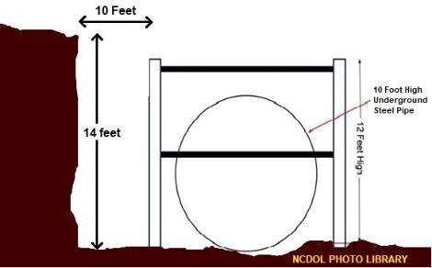
Exception example
1926.1201(b)
1926 Subpart P - Excavations
If there is a confined space within an excavation, such as a sewer pipe, and a worker enters the pipe to perform work, it is covered by both 1926 Subpart AA and P above.
NO CHSO entry
allowed in the
pipe.
Notes:
NCDOL Photo Library: Illustrations by NCDOL Employee Andy Sterlen using his NCDOL Licensed Microsoft Paint Program on his NCDOL Laptop. (10/30/20). Illustration shows an excavation with a sewer pipe.
Where this standard applies, AND there is a provision that addresses a confined space hazard in another applicable OSHA standard, the employer must comply with BOTH requirements and the applicable provisions of this standard.
For example,
the Excavation standard (Subpart P) above protects workers in an excavation (a type of confined space) against the hazards associated with the excavation itself. However, the Excavation standard would not protect workers inside a pipeline that is installed in an open excavation from confined space hazards associated with the pipeline. The employer must comply with the Excavation standard to protect workers in the excavation and with the Confined Spaces standard to protect workers in the pipeline.
Note: if work is done underground and no construction is involved then 1926 Subpart AA would only apply.

Slide 10
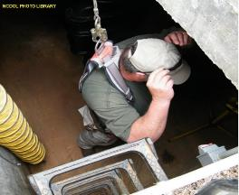
Exception example
1926.1201(b)
1926 Subpart S - Underground Construction, Caissons, Cofferdams and Compressed Air (construction)
Work done in an underground space that does not involve altering the “structure” of the space is covered by 1926 Subpart AA (such as installing equipment)
Notes:
NCDOL Photo Library: City of Apex, 4/12/2011 Partnership Site, Permission Letter Obtained. An employee entering a confined space water well.
So, in this exception, underground work involving construction of the structure DOES NOT fall under 1926 Subpart AA Confined Space
Caisson – sunken pier construction ie, bridge piers
Cofferdam – sheet piles driven into the water/sand

Slide 11
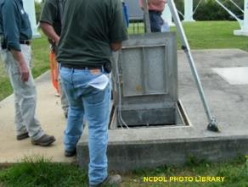
Definitions
1910.146(b),1926.1202
Confined Space - a space that:
Is large enough and so configured that an employee can bodily enter and perform assigned work
Has limited or restricted means for entry or exit; and
Is not designed for continuous
employee occupancy
* www.osha.gov/laws-regs/
standardinterpretation/1995-10-27
NCDOL Photo Library
Notes:
NCDOL Photo Library: City of Apex, 4/12/2011 Partnership Site, Permission Letter Obtained. An employee is testing the atmosphere inside the space prior to entry.
Ask the following questions:
Has anybody had any experience in Industrial maintenance?
What were the hazards? Were there any other hazards?
What is the person doing in the picture? They are testing the atmosphere prior to entry.
* If anyone would like to read about Residential confined spaces read this letter of interpretation:
https://www.osha.gov/laws-regs/standardinterpretations/1995-10-27
Applying Permit-Required Confined Spaces (PRCS) standard to a workplace that is a multi-family residential commercial building

Slide 12
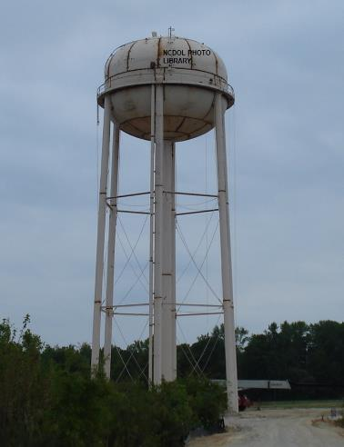
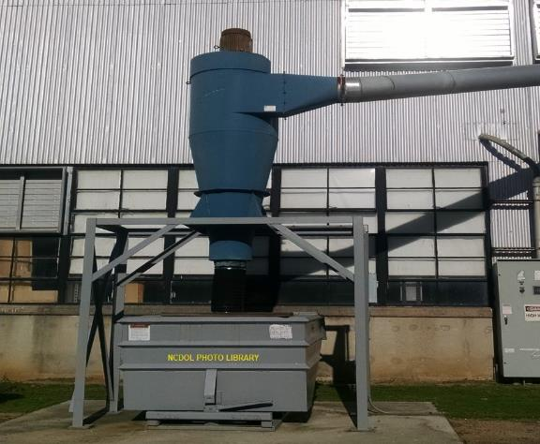
Would these meet the CS definition?
Notes:
Definition points: lets talk about these spaces……. Do they have the following?
Hazardous atmosphere
Internal configuration (inwardly converging walls, sloping floors)
Engulfment hazard
Recognized serious safety or health hazard

Slide 13
Definitions (continued):
“Permit-required confined space (permit space)” is a confined space that has one or more of the following characteristics:
Hazardous atmosphere
Internal configuration (inwardly converging walls, sloping floors)
Engulfment hazard
Recognized serious safety or health hazard
Notes:
Describe the hazards:
HAZARDOUS ATMOSPHERE – any atmosphere that may expose employees to the risk of death, incapacitation, impairment of ability to self rescue, injury or acute illness from flammable gas, airborne dust, atmospheric oxygen concentration below 19.5% or above 23.5%.
INWARDLY CONVERGING WALLS- sloped walls or floors that taper downward to a smaller cross section.
ENGULFMENT HAZARD- material that is “flowable or fluid” that cannot hold the weight of a person. Imagine an hourglass with sand.
RECOGNIZED SERIOUS SAFETY/HEALTH HAZARD- could be any other recognized hazard.
Theses are EXTREMELY DANGEROUS environments. To reduce the risk of engulfment and suffocation, employers should not allow workers to enter a storage bin unless it is necessary and with proper PPE.
Confined space conditions can change quickly from no hazards to life-threatening hazards. Some confined spaces are so hazardous, a written permit system is necessary for entry. But the hazards of confined spaces can often be controlled or engineered out before an employee enters the space.

Slide 14
Definitions
1926.1202 / 1910.146(c)
Competent person
One who is capable of identifying existing and predictable hazards in the surroundings or working conditions which are unsanitary, hazardous, or dangerous to employees, and who has the authorization to take prompt corrective measures to eliminate them.
In the 1910’s the employer shall evaluate using Appendix A.
Notes:
1926.1202 defines a competent person as the person responsible for determining conditions.
1910. 146(c) states that the employer shall evaluate the workplace to determine if any spaces are PRCS.

Slide 15
Definitions
1910.146(b)
Entry Supervisor (employer)
Means the person(such as the employer, foreman, or crew chief) responsible for determining if acceptable entry conditions are present at a permit space where entry is planned for, for authorizing entry and overseeing entry operations, and for terminating entry as required by this section.
Notes:
So back to our definitions…..

Slide 16
Definitions
1910.146(b) / 1926.1202
Entry
Action by which any part of a person passes through an opening into a permit-required confined space
Entry includes ensuing work activities in that space and is considered to have occurred as soon as any part of entrant’s body breaks the plane of an opening into the space, whether or not such action is intentional or any work activities are actually performed in the space
Notes:
Question for you: Is it deemed Entry if you stick your hand in the hole to do maintenance work? What must take place first?
Determine if it is confined space:
Is large enough and so configured that an employee can bodily enter and perform assigned work
Has limited or restricted means for entry or exit; and
Is not designed for continuous
employee occupancy
and then Permit required confined space.

Slide 17
Definitions
1926.1202
Control
Action taken to reduce level of any hazard inside a confined space using engineering methods (for example, by ventilation), and then using these methods to maintain the reduced hazard level
Note: Personal protective equipment is not considered a control.
Controlling contractor
Employer that has overall responsibility for construction at worksite.
Notes:
Controlling contractor in construction – similar to the Entry Supervisor in the General Industry. Both have the overall responsibility of auditing and approving entry at the facility or worksite.
Personal protective equipment is not considered a control

Slide 18
Definitions
1926.1202
Host employer
Employer that owns or manages the property where construction work is taking place
Monitor or monitoring
Process used to identify and evaluate hazards after an authorized entrant enters space
Early-warning system*
Method used to alert authorized entrants and attendants that an engulfment hazard may be developing
Notes:
So we have been talking about mostly 1910 CSE which has limited definitions and components that are mostly static and don’t change
But, in the 1926’s there are multiple parties and environments that change frequently. Here are some of the definitions you need to know for 1926.1200
Host employer
Monitoring
Early warning system
Early warning system would be four gas monitors and personal monitors.

Slide 19
Definitions
1926.1202
Physical hazard
An existing or potential hazard that can cause death or serious physical damage
Examples include, but are not limited to:
Explosives (as defined by 1926.914(n));
Mechanical, electrical, hydraulic and pneumatic energy; radiation; temperature extremes; engulfment; noise; and inwardly converging surfaces
Includes chemicals that can cause death or serious physical damage through skin or eye contact (rather than through inhalation)
Notes:
PRCS = Hazardous atmosphere
Internal configuration (inwardly converging walls, sloping floors)
Engulfment hazard
Recognized serious safety or health hazard

Slide 20
Responsible persons
General Industry 1910.146
The qualified person normally determines CS/PRCS locations
A management team member (Supervisor, Maintenance Lead, Safety person) would be responsible for any entries into the PRCS.
All spaces that are Confined or Permit Required must be marked and categorized and are typically static without change in location.
Notes:
NOW WHO IS RESPONSIBLE FOR THE SITE
General Industry will normally have a supervisor or management team member responsible for the Confined Space List determination and an Entrant Supervisor for any entry.
Normally the responsible person is a shift supervisor, maintenance supervisor, or safety person.

Slide 21
Responsible persons
Construction 1926.1200
The General Contractor or Host Employer, Competent Person, and Subcontractors are all involved in performing and responsible for PRCS entry on a construction site.
The competent person, however, is the key lead person responsible at the worksite.
Notes:
Mention differences in Construction Industry:
Now Construction, unlike General Industry, will have a General Contractor and Subs as the responsible parties. A competent person for PRCS must be well versed in the written program as well as the standard and be on the site at all times of entry.

Slide 22
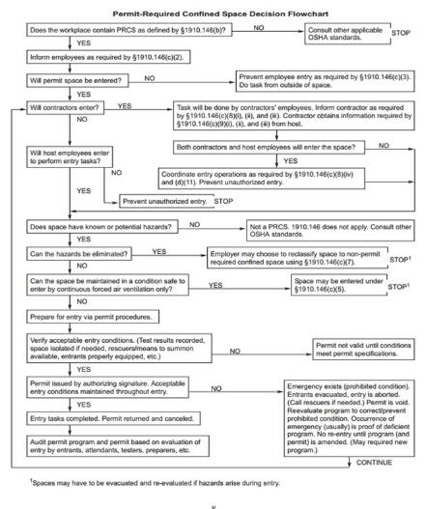
Permit Space Decision Making Tool
NCDOL Photo Library
Notes:
Appendix A
Discuss the decision-making tool above and pass out to the class. It follows an if/then and yes/no logic process. It applies to the 1910 and 1926 standards as referenced in the flowchart steps.

Slide 23
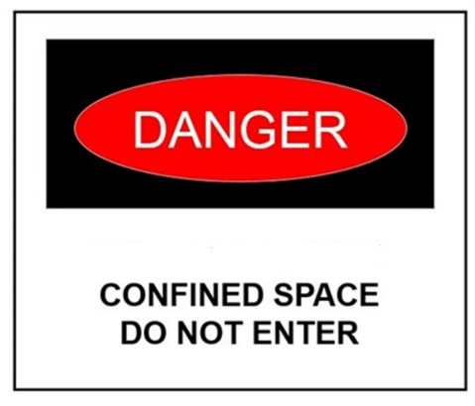
General Requirements
1926.1203(a)
Prior to work starting, a competent person must evaluate the worksite
Identify confined spaces, including permit spaces
When there are changes in use or configuration to the non-permit space
Competent person must reevaluate the space and reclassify it, if necessary
NCDOL Photo Library

Slide 24
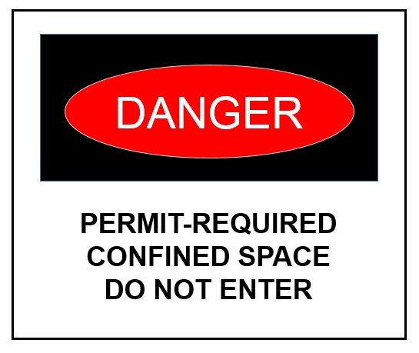
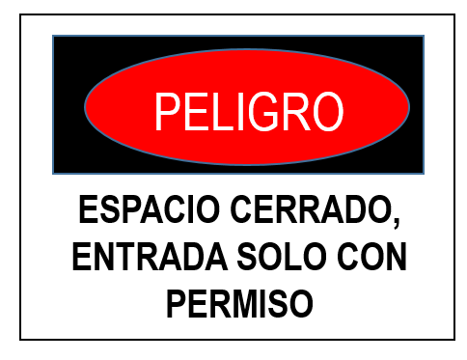
General Requirements
1926.1203(b)
Competent person must identify all permit spaces - those workers will enter, and those they will not enter
All permit spaces must be posted/identified in some way
NCDOL Photo Library
Notes:
Posting must be provided in all languages that would be found in the workspace.
NOTICE: The second sign is in Spanish

Slide 25
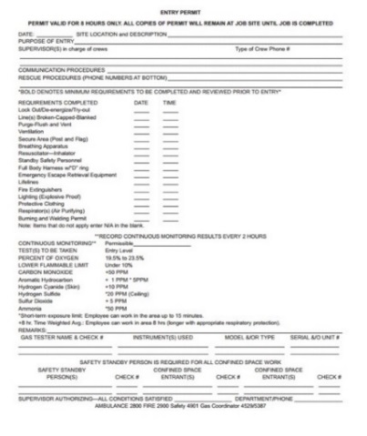
General Requirements
1926.1203(c)-(d)
If workers will not perform work in permit spaces
Employer must ensure that workers are prevented from entering permit spaces
Employers who have determined that workers will perform work in permit spaces must develop a permit space program
NCDOL Photo Library
Notes:
How could you prevent someone from entering a PRCS? LOCKS, physically welding shut …..any others ways you may know about?

Slide 26
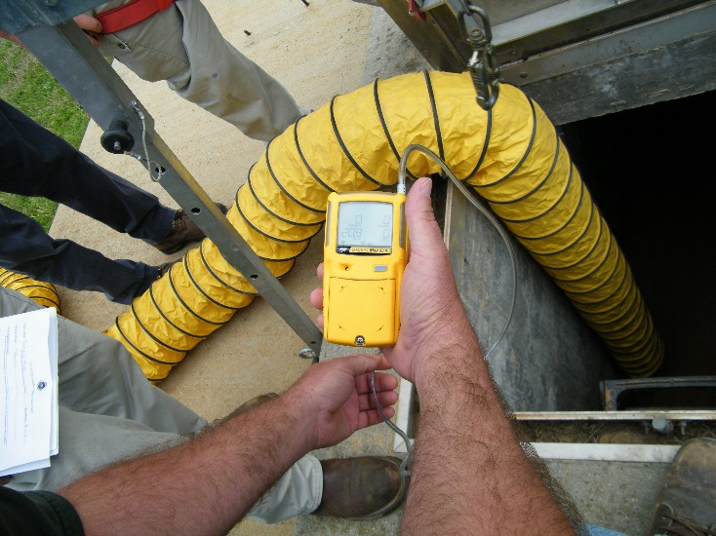
General Requirements
1926.1203(e)(1)(i)
Employers may use alternate procedures for entering a permit space when only hazard is actual or potential atmosphere
Must demonstrate that all physical hazards in the space are eliminated or isolated through engineering controls
NCDOL Photo Library
Notes:
The picture shows ventilation being used as an alternate method. Engineering controls must be implemented and monitoring must be continuous.

Slide 27
General Requirements
1926.1203(e)(1)(ii)-(vi)
Employers must:
Demonstrate that continuous forced air ventilation alone is sufficient to maintain that permit space safe for entry
Develop monitoring and inspection data
Document the determinations and supporting data and make them available to each employee who enters the permit space
Permit space can be reclassified after all hazards within the space have been eliminated. 1926.1203(g)/1910.146(c)(7)
Notes:
In 1910.146 (c)(7)
In 1926.1203(g)

Slide 28
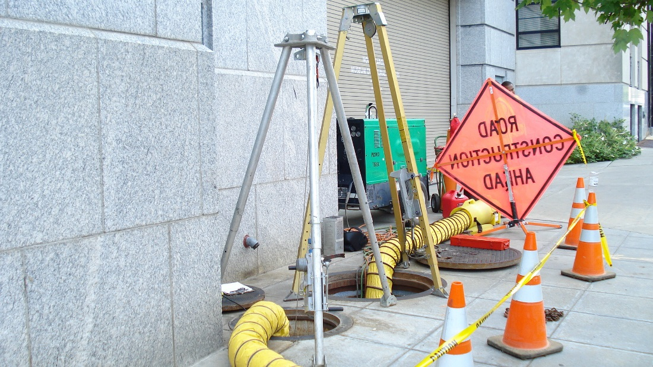
General Requirements
1926.1203(e)(2)(ii)
If entrance covers are removed, the opening must:
Be immediately guarded by a railing or temporary cover or barrier to prevent an accidental fall through the opening
Protect each employee working in the space from foreign objects entering the space
NCDOL Photo Library
Notes:
See the picture where the tripods are covering the entry holes. If the hole is open you must barricade and place the attendant on watch for unauthorized personnel in the area.

Slide 29
General Requirements
1926.1203(e)(2)(v)(A)-(C)
Continuous forced air ventilation
Employees must not enter the space until forced air ventilation has eliminated any hazardous atmosphere
Be so directed as to ventilate immediate areas where an employee is/will be present within the space and continue until all employees have left space
Air supply for forced air ventilation must be from a clean source and must not increase hazards in space
Notes:
All three of these statements are very important….number 3 is mostly overlooked on roadside municipality entries. Remember Carbon Dioxide and car fumes can drift and enter confined spaces at any time.

Slide 30
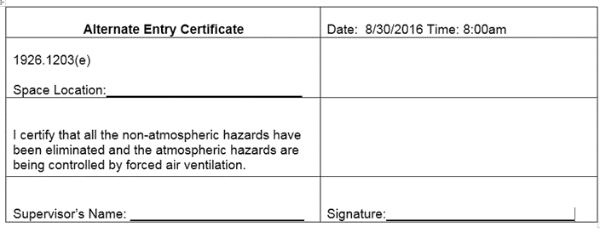
General Requirements
1926.1203(e)(2)(ix)
Employers who allow workers to enter a permit space using alternate entry procedures
Must verify that space is safe for entry with the following:
Written certification that contains date
Location of space and
Signature of the person providing certification
NCDOL Photo Library
Notes:
If you are inspecting a site then all of these must be documented and records obtained from the employer

Slide 31
General Requirements
1926.1203(f)
When there are changes in use or configuration of a non-permit confined space that might increase hazards to entrants, or:
Some indication that initial evaluation of space may not have been adequate
Each entry employer must have a competent person reevaluate that space and, if necessary, reclassify it as a permit-required confined space
NCDOL Photo Library
Notes:
Re evaluate as atmospheres change

Slide 32
General Requirements
1926.1203(g)
1926.1203(g) A space classified by an employer as a permit-required confined space may only be reclassified as a non-permit confined space when a competent person determines that all applicable requirements have been met
1910.146(c)(7)
NCDOL Photo Library
Notes:
1926.1203 g
1910.146 C 7

Slide 33
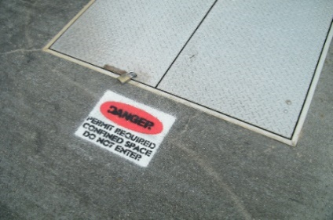
General Requirements
1926.1203(h)(1)
Permit space entry communication and coordination
Before entry operations begin, host employer must provide the following information:
Location of each known permit space
Hazards or potential hazards in each space or reason it is a permit space
Precautions that host employer or any previous controlling contractor or entry employer implemented for protection of employees in permit space
NCDOL Photo Library
Notes:
Bullet 1 is required for 1926.1203 h 1. There is an alternate communication method found in the standards that allows rapping or tapping from inside a tank. This method is limited in application and specifically states “a tank” etc. Do not apply this to structural entries such as manholes and similar locations.

Slide 34

General Requirements
1926.1203(h)(2)(i)-(ii)
Before entry operations begin, controlling contractor must:
Obtain host employer’s information about permit space hazards and previous entry operations, and
Provide the following information to each entity entering a permit space and any other entity at worksite whose activities could foreseeably result in a hazard in permit space
NCDOL Photo Library

Slide 35
General Requirements
1926.1203(h)(2)(ii)(A)-(C)
Information received from host employer
Any additional information the controlling contractor has about subjects (permit space location, hazards)
Precautions host employer, controlling contractor, or other entry employers implemented for protection of employees in permit spaces

Slide 36
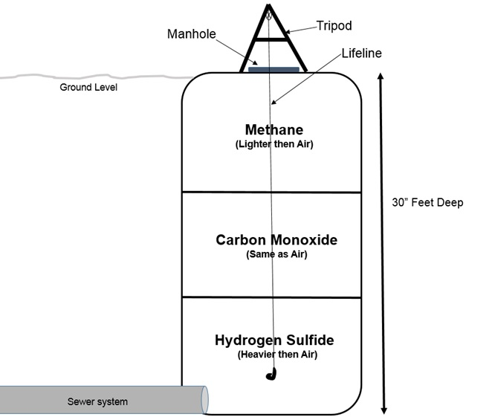
General Requirements
1926.1203(h)(3)(i)-(ii)
Before entry operations begin, each entry employer must:
Obtain all controlling contractor’s information regarding permit space hazards and entry operations, and
Inform controlling contractor of permit space program that entry employer will follow, including any hazards likely to be
confronted or created in each permit
space
NCDOL Photo Library

Slide 37
General Requirements
1926.1203(h)(4)(i)-(ii)
Controlling contractor and entry employer(s) must coordinate entry operations when:
More than one entity performs permit space entry at same time, or
Permit space entry is performed at same time that any activities that could foreseeably result in a hazard in permit space are performed

Slide 38
General Requirements
1926.1203(h)(5)
After entry operations, controlling contractor must debrief each entity that entered a permit space regarding the permit space program and any hazards confronted or created in permit space(s) during entry operations
Entry employer must inform controlling contractor in a timely manner of the permit space program and of any hazards confronted or created in permit space(s) during entry operations, and
Controlling contractor must apprise host employer of information exchanged with entry entities

Slide 39
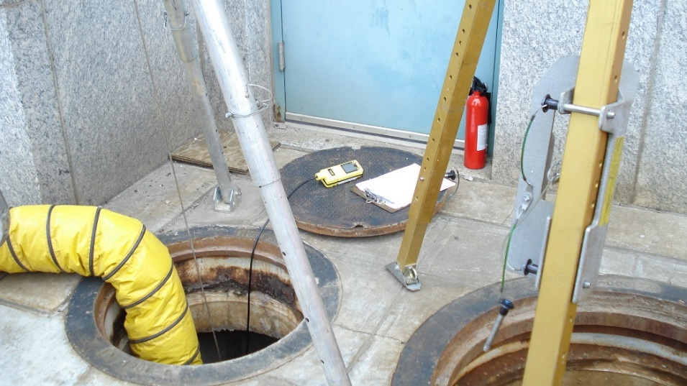
General Requirements
1926.1203(i)
If there is no controlling contractor present at worksite, requirements for, and role of, controlling contactors must be fulfilled by host employer or other employer who arranges to have employees of another employer perform work that involves permit space entry
NCDOL Photo Library

Slide 40
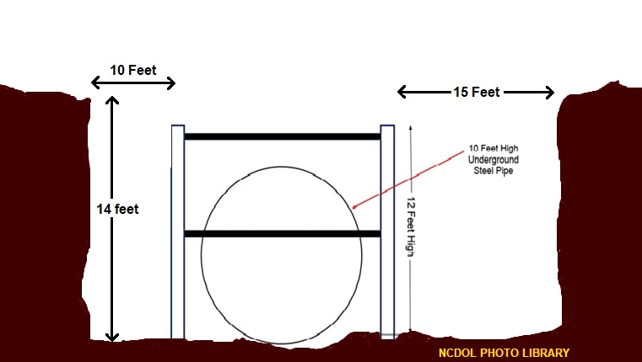
Discussion (Trench or Excavation)
Notes:
NCDOL Photo Library: Illustrations by NCDOL Employee Andy Sterlen using his NCDOL Licensed Microsoft Paint Program on his NCDOL Laptop. (10/26/20)
Discuss the scenario shown above: trench or excavation?
First, Let’s think about the difference between a trench and an excavation? If an excavation is wider than it is deep, and a trench is deeper than it is wide, which of the two are we looking at? What hazards are possibly present?
So here, in this slide, is an excavation, with a pipe, large enough to walk into upright. It is covered under 1926.1200 AA?
Once an employee enters the steel pipe to perform a work activity, it now becomes a confined space as identified by this standard and falls under 1926.1200 Subpart AA. However, the activity of the employee would determine if it was a permit-required space or not.
Example above:
Contains or has the potential to contain a hazardous atmosphere. In this type of scenario the employer must have a competent person identify all confined spaces in which its employees may work. Therefore a competent person for both the confined spaces and trenching/excavations operations is required at this work site.
However, this employee can be the same person, provided they have received training as a competent person for both standards.
Back in the 80’s builder’s used gypsum rope and tar to patch and splice box culverts….today they use silicone seals. When curing it can off-gas with a toxic gas. For example, some off-gas MEKs. (methyl ethyl ketones) This could be an inhalation hazard depending on concentration.
Another example in the speaker notes might be performing a welding operation inside the pipe to produce welding fumes, potentially above the applicable PEL(s).

Slide 41
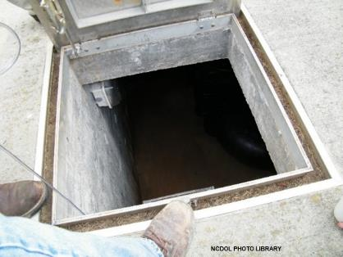
Confined Spaces Examples
Storage tanks
Manholes and sewers
Grain storage bins
Boilers
Ducts
Tank cars
Notes:
NCDOL Photo Library: City of Apex, 4/12/2011 Partnership Site, Permission Letter Obtained. Employee still testing the atmosphere.
Read the examples of Confined Spaces above and discuss how they are Confined Spaces. Then ask the class if there are other examples that they have on their sites.
Tell the class it is the employer’s responsibility to locate and identify confined spaces and/or permit-required confined spaces within the workplace and to train their workforce in Confined Space Standards.

Slide 42
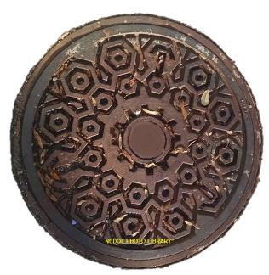
Confined Spaces Examples
Sewers
Utility vaults
Pipelines
Equipment and machinery
Tunnels
Notes:
NCDOL Photo Library: Photo by NCDOL employee Robert O’Neal from a public street
Continued from the precious slide:
Confined or enclosed spaces include, but are not limited to, storage tanks, process vessels, bins, boilers, ventilation or exhaust ducts, sewers, underground utility vaults, tunnels, pipelines, and open top spaces more than 4 feet in depth such as pits, tubs, vaults, and vessels.
***Four feet is the listed as the minimum because it’s assumed a person can self rescue by standing up.

Slide 43
Confined Space – PRCS Hazards
An Oxygen level of 19.5% - 21% is ideal
A deficient or enriched oxygen atmosphere can create additional hazards
> 23.5% results in an explosion
17% results in accelerated heart rate
14-16% results in rapid fatigue/respiration
6% results in loss of consciousness/death
Flammable atmospheres (>10% of LFL)
Toxic atmospheres (> PEL and/or STEL or IDLH)
Notes:
Discuss the bullets starting with testing for Oxygen first then follow up with physical hazards, a safety audit, use of the SDS, and finally keeping equipment certified and bump tested before use.
Oxygen
- Above 23.5% is a fire and/or explosive hazard. NEVER use pure oxygen to ventilate a confined space.
- Below 17% cause increased breathing volume, accelerated heartbeat, and deterioration of night vision.
- Levels at 14-16% contribute to poor muscular coordination, rapid fatigue and intermittent respiration.
- Levels at 6% there is a rapid loss of consciousness and death in minutes.
Flammable gas, vapor or mist in excess of 10% of its lower flammable limits (LFL).
Gasoline is 1.4%
Isopropyl Alcohol 2%
Airborne combustible dust at a concentration that meets or exceeds its LFL AND obscures vision at 5 ft.
A toxic product stored in the space, type of work being performed in or adjacent to the confined space. At high levels toxic chemicals can cause death or permanent bodily harm. Even at low level and non-toxic substances can replace O2, thus becoming dangerous.

Slide 44
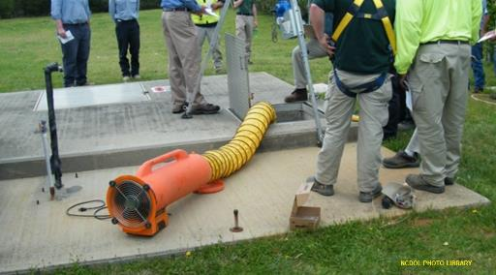
Confined Space – PRCS Hazards
General/physical (noise, entrapment, engulfment, temperature)
Mechanical (moving parts)
Electrical
Notes:
NCDOL Photo Library: City of Apex, 4/12/2011 Partnership Site, Permission Letter Obtained. Ventilation of confined space using a fresh air blower.
General/physical hazards immediately dangerous to life or health such as;
- Temperature extremes, slick/wet surfaces, falling objects.
- Noise
- Steam lines, hydraulic lines.
- Entrapment, engulfment materials can include liquids (e.g., water) or loose solids (e.g., grain or sand).
- Mechanical (moving) parts of equipment located in the confined space.
Electrical lines and electricity from tools and equipment for work within the confined space.
WHAT TOXIC ATMOSPHERES WOULD YOU FIND IN SANITARY SEWERS?
Most common toxic chemicals in confined spaces fatalities are hydrogen sulfide (sewers) and carbon monoxide. Carbon monoxide comes from operating internal combustion engines in or near confined space. Propane-powered engines also emit carbon monoxide.

Slide 45
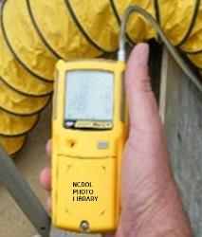
Controlling Confined Space Hazards
Locking out moving parts
De-energizing electrical parts or wiring
Blocking (blanking) steam pipes and product
in-feeding pipes must meet ASME B31.3, paragraph 304.5.2b
Draining or pumping out liquid contents
Air monitoring and ventilating
Notes:
NCDOL PHOTO LIBRARY: City of Apex, 4/12/2011 Partnership Site, Permission Letter Obtained
Some of the ways to keep a safe environment in the Confined Space:
Locking out moving parts or valves.
De-energizing electrical parts using Lock Out/ Tag Out.
Blanking/Blinding- the mechanical means to stop material or gases from moving downstream into a work area.
A pipe flange “bolted” between the flanges makes a hard stop for any material trying to move past the flange.
A BLANK is designed as a flat plate between two flanges typically inside the flange bolt pattern (ASME B31.3 : Paragraph 304.5.3). The blank must be sized for full design pressure (maximum non-shock pressure rating) of the line.
A BLIND is designed as a bolted flat plate, which can be used to terminate a pipeline (ASME B31.3 Paragraph 304.5.2b). When a blind is required, use the geometry specified in ASME/ANSI B16.5.
-Drain or pump any liquid contents from the work area.
-Use a four-gas monitor and ventilate with non-sparking fans.

Slide 46
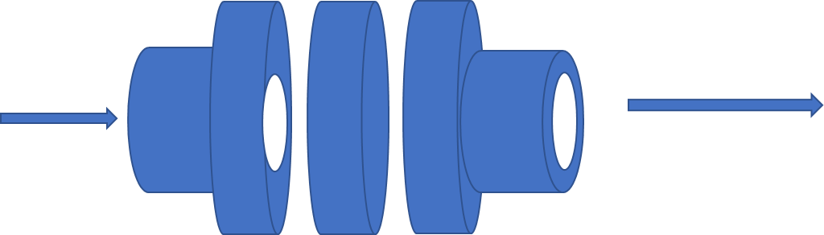
Blind/Blanked Steam Pipe Dwg
Solid Blank
Material flow
Notes:
Picture drawn by Ed Hardy using Microsoft Word and shapes 4/7/21.

Slide 47
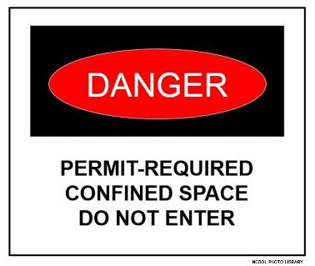
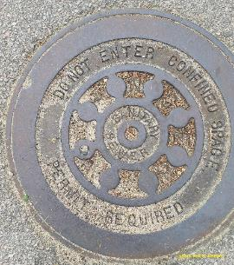
Permit Space Signs
1910.146(c)(2) / 1926.1203(b)1
In Gen. Ind. the employer shall inform exposed employees by posting signs or other equally effective means.
In Construction the competent person identifies, evaluates, and tests and informs.
Notes:
NCDOL Photo Library: Illustration developed by NCDOL Employee Robert O’Neal. Illustration identifies an example of acceptable signage for identifying permit-required confined space.
NCDOL Photo Library: Photo by NCDOL Employee Andy Sterlen from a public street March 25th, 2016
Explain the responsibility of the employer:
If the workplace contains permit spaces, the employer shall inform exposed employees, by posting danger signs or by any other equally effective means of the existence and location of and the danger posed by the permit spaces.
A sign reading DANGER: PERMIT-REQUIRED CONFINED SPACE, DO NOT ENTER or using other similar language would satisfy the requirement for a sign.
The standard states the employer shall inform its employees. It does not say you have to use signs. If the employer has an effective training program that lets the employee know this information, then that is adequate.
It is the employer's obligation to assure that an alternative method is at least as effective as a sign. In some cases, employers may have to provide training in addition to signs, to protect employees who do not speak English or who would have difficulty understanding or interpreting signs. (One method by which OSHA can gauge an employer's effectiveness is through random interviews of affected employees.)
If a space has a locked entry cover or panel, or an access door that can only be opened with special tools, the use of signs may be unnecessary if the employer ensures that all affected employees are informed about such spaces and know that they are not to be opened without taking proper precautions, including temporary signs, to restrict unexpected or unknowing entry.

Slide 48
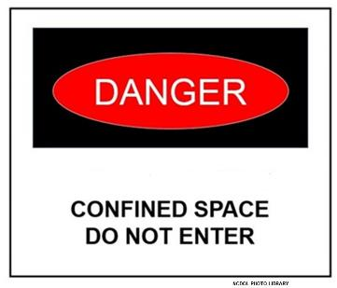
Permit Space Non-Entry
1910.146(c)(2)/1926.1203(b)1
If employer decides its employees will not enter permit spaces, employer shall take effective measures to prevent employees from entering permit spaces
Both Const. / Gen Ind.
Notes:
NCDOL Photo Library: Illustration developed by NCDOL Employee Robert O’Neal. Illustration identifies an example of acceptable signage for identifying confined space.
Use this question as a knowledge test:
Question: If an employer forbids employee entry into one of its several permit-required confined spaces, is it sufficient to notify its employees of the identity and location of the entry prohibited space via a safety manual and training, or must the employer still post a danger sign at the entry prohibited permit-required confined space? Answer- Employers who are providing sufficient training to protect their employees effectively need not post dangers signs at permit-spaces.
Regardless of whether signs are used, the standard requires that the employer inform employees exposed to the hazards posed by permit spaces of the existence, location, and danger of those spaces.
CSHOs: In enforcing §1910.146(c)(2), CSHO’s will check to ensure that methods other than warning signs are truly effective in imparting the required information to employees. General training in the permit-required confined space standard, for example, cannot be expected to adequately inform employees of the location of permit spaces in the workplace. The standard places the burdens of identifying the spaces and of controlling the resultant hazards on the employer not on the employees. (https://www.osha.gov/laws-regs/standardinterpretations/2006-09-21 )

Slide 49
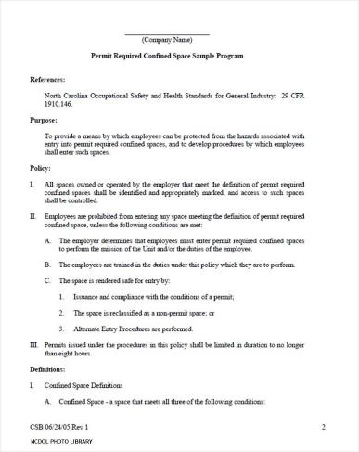
Written Permit Space Program
1910.146(c)(4)
If employees enter permit spaces, the employer shall develop and implement a written permit space program
Notes:
NCDOL Photo Library: Sample Permit shown above from NCDOL library.
Describe employer’s responsibility:
GENERAL INDUSTRY 1910.146(c)(4) paraphrased:
Prior to permitting employees to enter a permit space, employers must develop and implement a written Program. A permit-required confined space program is the employer’s plan for controlling and protecting employees from permit-space hazards and regulating employee entry.
CONSTRUCTION 1926.1203(h)(2) -1926.1203(h)(5) paraphrased:
On construction sites, before work begins, the controlling contractor must obtain all the host employer’s information about the hazards.
1926.1203 (a)
Before work begins at a worksite, each employer must ensure that a competent person identifies all confined spaces in which one or more of the employees it directs may work, and identifies each space that is a permit space, through consideration and evaluation of the elements of that space, including testing, as necessary.
Before any entry begins the Entry Supervisor must obtain the information from the host employer.

Slide 50
Written Permit Space Program
1926.1204/1910.146(d)
Provide measures and procedures:
Prevent unauthorized entry
Identify permit space hazards
Ensure implementation for safe entry
Provide, maintain and ensure proper use of equipment
Evaluate permit space conditions
Provide for at least one attendant
Monitoring multiple spaces
Notes:
Note: This slide references the 1926.1204 and 1910.146(d)
Written program elements:
Fixed industrial sites- the employer’s program must include the location of all permit spaces.
Construction sites need to review and create permit space site list as the jobs progress toward completion. The employer will need to develop a way for employees to identify the space as a permit space and signs, labels, or tags can be used to accomplish this.
The program must include:
A procedure for issuing an entry permit.
Provisions for training employees about the written program and entry permits.
Measures taken to prohibit unauthorized employees from entering permit spaces.
The roles of entrants, attendants, entry supervisors, rescuers, and those who test or monitor the atmosphere in the space.
Provisions for training employees about their roles.
Duties of designated employees.
Instructions for identifying and evaluating hazards.
Methods for eliminating or controlling hazards.
Instructions for using and maintaining equipment.
Instructions for coordinating entry with another employer.
Procedures for concluding entry and canceling the entry permit.

Slide 51
Written Permit Space Program
1910.146(d)
Designate active the roles:
Attendants
Entry supervisors
Entrants
Summoning rescue and other emergency operations
System for preparation, issuance, use and cancellation entry permit
Notes:
Program components continued:
Employees must understand their roles for training effectiveness and techniques.
Written, as well as practical testing is recommended.
Personnel should be questioned or asked to demonstrate their practical knowledge of confined space hazards that are in their work areas, to identify locations of confined spaces, their role is exercising proper permit procedures, use and donning of personal protective equipment, such as respirators, and their role in response to emergency situations.

Slide 52
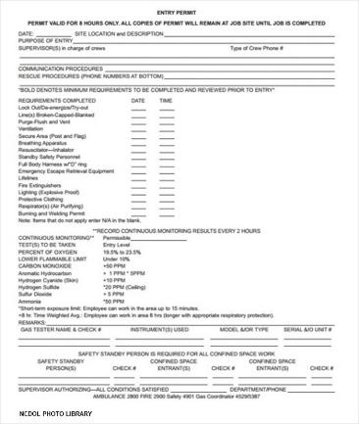
Written Permit Space Program
1910.146(d)
System for concluding entry after entry completion
Coordination with multiple employers
System to review entry operations and permit space program
Notes:
NCDOL Photo Library: Sample Permit shown above from NCDOL library.
When estimating a repair, make sure not to under-estimate the time needed as permits are written for a specific amount of time. A permit can be terminated early but cannot be extended.
Even if the repair has not been completed, you must leave the space and write a new permit to re-enter if the time has expired.

Slide 53
Confined Space Entry Hierarchy
No “permit” space
Entry permitted only if no hazards exist or all hazards are eliminated without entry
Alternate entry procedures
Only in spaces with controlled atmospheric hazards
Written permit system
Required for any high hazard space
Notes:
NO PERMIT ENTRY:
As discussed in an earlier slide there are employers that have “no entry permitted” spaces. There must be quantitative measurements and determination that hazards have been removed to allow reassignment as a “permitted entry” space.
CONCERNS:
Listed below are issues to consider and/or questions ask in order to determine the options for entry
Can the atmosphere be controlled?
Are there ‘other’ uncontrollable hazards? (An assessment must be made prior to entry).
If there is any uncertainty about the risk; assume highest hazard is present.
Only when 100% positive there is not a hazardous atmosphere(s) or ‘other’ hazard(s) can an employer avoid a required permit confined space entry.
ALTERNATE ENTRY:
Alternate Entry procedures allow employees to enter a permit space if:
The employer can demonstrate that the only hazard posed by the permit space is an actual or potential hazardous atmosphere
The employer can demonstrate that continuous forced air ventilation alone is sufficient to maintain that permit space safe for entry
The employer develops monitoring and inspection data that supports the demonstrations required by paragraph c(5)(i)(A) and c(5)(i)(B).
If an initial entry of the permit space is necessary to obtain the data required by paragraphs c(5)(i)(C) of this section and the entry is performed in compliance with paragraphs (d) through (k)
The determinations and supporting data required by c(5)(i)(A), c(5)(i)(B), and c(5)(i)(C) are documented by the employer and are available to each employee who enters the space
Entry into the permit space under the terms of paragraph c(5)(i) of this section are performed in accordance with the requirements of c(5)(i)(I).
Once all the above is performed then an employer can remove an entry cover when guarding is in place and conduct atmospheric testing with a calibrated direct reading instrument. Test for oxygen, flammables, gases and vapors, and for potential toxic air contamination. In that order.

Slide 54
Alternate Entry
1910.146(c)(5)/1926.1203(e)(2)
Employers may use alternate procedures for entering a permit space when only hazard is actual or potential atmosphere
Must demonstrate that all physical hazards in the space are eliminated or isolated through engineering controls
Must verify that space is safe for entry with the following:
Written certification that contains date
Location of space and
Signature of the person providing certification

Slide 55

Alternate Entry
1910.146(c)(5)/1926.1203(e)(2)
Employees must be trained
Atmosphere tested before and during entry
Continuous forced air ventilation
If a hazardous atmosphere is detected, or ventilation stops, the space must be promptly exited
Notes:
NCDOL PHOTO LIBRARY: City of Apex, 4/12/2011 Partnership Site, Permission Letter Obtained
ALTERNATE ENTRY
As stated in the previous slide:
The alternate entry procedures at 1910.146(c)(5) can be used when the only hazard in a permit-required confined space is an atmospheric hazard that can be controlled through continuous forced air ventilation. If the entry operation is done using the alternate entry procedures, the employer does not need to meet 1910.146(d) through (f) and (h) through (k).
RECLASSIFICATION OF PERMIT SPACE:
Discuss the 1910.146.(c)(7), 1926.1203(e)(2) entry standard as an alternative entry after the permitted space is reclassified to non-permit Confined Space with no actual or potential atmospheric hazards.
If the conditions change and the it becomes hazardous the space then immediately becomes a Permitted Space and evacuation must take place.
Other issues to consider:
Don’t assume that the only hazard is atmospheric without investigative and reliable information.
These procedures have fewer requirements – no written permit system is required.
If the only hazard is atmospheric (toxic gas or oxygen deficiency) and it is controlled by ventilation, then you may use less restrictive alternate entry procedures.

Slide 56
General Requirements
1926.1203(e)(2)(v)(A)-(C)
Continuous forced air ventilation
Employees must not enter the space until forced air ventilation has eliminated any hazardous atmosphere
Be so directed as to ventilate immediate areas where an employee is/will be present within the space and continue until all employees have left space
Air supply for forced air ventilation must be from a clean source and must not increase hazards in space

Slide 57
Permit System
1910.146(e), 1926.1206
Written procedure for preparing and issuing permits for entry and returning permit space to service
Requirements:
Document completion of required measures
Permit availability
Supervisor signature
Activity (job) duration
Permit termination/cancellation (1 year)
Notes:
Describe the requirements listed above and the reason for having that information.
For example, the supervisor signature and start / stop time of entry.
After 1 year any permits at 12 months duration should be reviewed for improvements and corrections then terminated and filed.

Slide 58
Entry Permit
1910.146(f), 1926.1206
Entry permit shall identify:
Space to be entered
Purpose of entry
Date and duration
Authorized entrants
Personnel (attendant and supervisor)
Hazards within the space
Isolation of space
Acceptable entry conditions
Notes:
Inform the class Appendix D of the standard has an example of an entry permit and read the slide sections above.
Also, Consultative Services has a sample program with sample permits available for download at LABOR.COM online.
NOTE: The list on the slide does not include all the requirements\ requirements of the standard.

Slide 59

Entry Permit
1910.146(f)/1926.1206
Additional requirements
Air monitoring test results
Specifies safety equipment/PPE
Methods used to control the hazards
Communication procedures
Rescue and emergency services
Name and telephone number of the rescue service
Notes:
NCDOL PHOTO LIBRARY: City of Apex, 4/12/2011 Partnership Site, Permission Letter Obtained
ONE IMPORTANT POINT: if you use 4 gas monitors they are required to be calibrated annually and they should be bump tested before use!
Discuss the following and involve the class with the questions.
What other standards may an employer need to comply with? Why? (Discuss the programs listed below)
Is the employer responsible for any addition training?
Some example are:
Rescue techniques
Respirator Protection Program
Presence of flammable liquids or gases.
Employees working close to machinery components and power-driven equipment, such as augers.
Heat, noise, vibration.

Slide 60
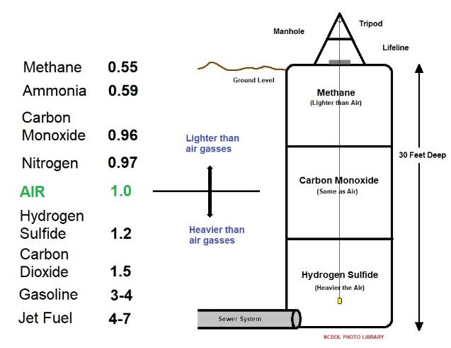
Air Monitoring and Ventilation
Notes:
NCDOL Photo Library: Illustrations by NCDOL Employee Andy Sterlen using his NCDOL Licensed Microsoft Paint Program on his NCDOL Laptop. (11/02/20)
Discuss the effects of gases within the Confined Space and compare it to the weight of breathing air to explain stratification and layering in confined spaces. (The slide depicts how important it is to take multiple layered air gas readings).
Discuss the following:
How atmospheric conditions can change rapidly, hence air monitoring is required whenever there is a possibility of a hazardous atmosphere from slugs of material, sudden release of H2S, engulfment from released fluids, welding fumes, etc.

Slide 61
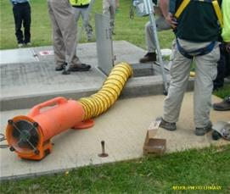
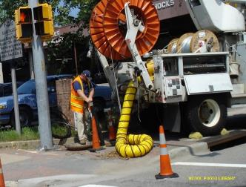
Air Monitoring and Ventilation
Notes:
NCDOL Photo Library:
Left Photo: Photo taken by NCDOL Employee Robert O’Neal, Public Access
Right Bottom Photo: Photo taken by NCDOL Employee Robert O’Neal, Public Access
Right Top Photo: City of Apex, 4/12/2011 Partnership Site, Permission Letter Obtained
Best practice: A portable personal gas monitor with an alarm should be used by a person entering the confined space and checked frequently.
Ventilation of confined spaces can be accomplished by using fresh air blowers or exhaust fans. Blowers and/or fans need to be the correct size to ensure adequate results. The blower intake must be in an area of clean air. Exhaust ventilation is mandatory for welding work or if atmospheric hazards are present.
Initially determine:
Number and size of openings.
Volume and configuration of the space to be entered.
Capacity and positioning of the ventilation equipment to be used.
Existing and potential atmospheric hazards.
After beginning ventilation:
Routinely test the confined space until levels stabilize at acceptable entry conditions.
Once entry and work start:
Continue ventilation and frequent atmospheric testing for the entire duration of entry.
Consider atmospheric hazards created by work in the space.
.

Slide 62
Training
1910.146(g), 1926.1207
Employees must acquire the understanding, knowledge and skills necessary for the safe performance of duties assigned
Before first assigned to duties
Before change in assigned duties
When change in operations
Employee proficiency
Certification of training
Notes:
Discuss when training must take place.
You can expand on the standard and discuss the confined space training requirements and needed information.
1) The employer shall certify that the training required by paragraphs (g)(1) through (g)(3) of the standard has been accomplished.
2) The certification shall contain each employee's name, the signatures or initials of the trainers, and the dates of training.
3) The certification shall be available for inspection by employees and their authorized representatives.

Slide 63

Assigned Duties
1910.146(h)-(j)/1926.1208
Authorized entrant: Employee(s) who enter the permit space
Attendant: Individual stationed outside space who monitors entrant(s)
Entry supervisor: Person responsible for planning, authorizing, and terminating entry
Notes:
NCDOL Photo Library: City of Apex, 4/12/2011 Partnership Site, Permission Letter Obtained. Ventilation of confined space using a fresh air blower.
Discuss the definitions:
"Authorized entrant" means an employee who is authorized by the employer to enter a permit space.
"Attendant" means an individual stationed outside one or more permit spaces who monitors the authorized entrants and who performs all attendant's duties assigned in the employer's permit space program.
"Entry supervisor" means the person (such as the employer, foreman, or crew chief) responsible for determining if acceptable entry conditions are present at a permit space where entry is planned, for authorizing entry and overseeing entry operations, and for terminating entry as required by this section.

Slide 64
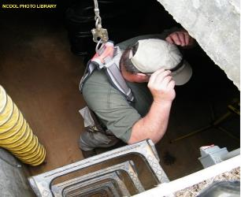
Authorized Entrant
1910.146(h), 1926.1208
Knowledge of hazards in permit space
Proper use of equipment
Communication methods
When to alert attendant
When to exit
NCDOL Photo Library
Notes:
NCDOL Photo Library: City of Apex, 4/12/2011 Partnership Site, Permission Letter Obtained. An employee entering a confined space water well.
Discuss the duties and responsibility of the employer to train the Authorized Entrant.
Authorized Entrant:
-Must know space hazards, including information on the mode of exposure (e.g., inhalation or dermal absorption), signs or symptoms, and consequences of exposure.
-Use appropriate personal protective equipment properly (e.g., face and eye protection, and other forms of barrier protection such as gloves, aprons and coveralls).
-Maintain communication with attendants to enable the attendant to monitor the entrant’s status as well as to alert the entrant to evacuate.
-Exit from permit space as soon as possible when ordered by an authorized person, when the entrant recognizes the warning signs or symptoms of exposure exist, when a prohibited condition exists, or when an automatic alarm is activated.
Alert the attendant when a prohibited condition exists or when warning signs or symptoms of exposure exist.

Slide 65
Attendants
1910.146(i) vs. 1926.1209
Knowledge of hazards in permit space
Aware of behavioral effects of exposure
Maintains an accurate count of entrants
Remains outside permit space during operations
Communicates with entrants
Monitors activities inside and outside space
Summons rescue and emergency services
Notes:
Discuss the above (attendant duties) and responsibility of the employer to deliver the training and knowledge.

Slide 66

Attendants
1910.146(i)/1926.1209
Prevents unauthorized persons from approaching permit space
Performs non-entry rescues
Performs no other duties that might interfere with primary duty
To monitor and protect entrants
Notes:
NCDOL Photo Library: Photo taken by NCDOL Employee Robert O’Neal, Public Access
Discuss these other duties of the attendant:
When unauthorized persons approach the entry way, what should the attendant do?
What and what not to do when the attendant performs a non-entry rescue.
State that the attendant does not perform any other duties.
Entry by an attendant for rescue may only be accomplished if the attendant has been trained in rescue procedures, is properly equipped, and only if the attendant is relieved by another trained attendant.
Discuss what properly equipped should involve.

Slide 67
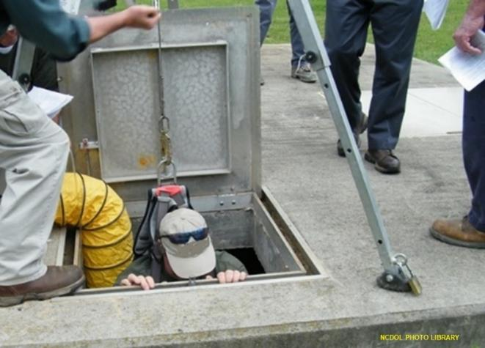
Attendants and Non-entry Rescue
Notes:
NCDOL Photo Library: City of Apex, 4/12/2011 Partnership Site, Permission Letter Obtained. Non-entry rescue.
Ask the class the following question. “Letter of Interpretation”
https://www.osha.gov/pls/oshaweb/owadisp.show_document?p_table=INTERPRETATIONS&p_id=23735
Question: Assuming the attendant meets all the training requirements of a member of the rescue service as outlined in section 29 CFR 1910.146(k), may the attendant participate as a part of the rescue service in a non-entry capacity once entry rescue procedures have been initiated and the rescue duties to which the attendant is assigned do not interfere with the attendant's primary duty to monitor and protect the authorized entrant? Response: Under the conditions described, an attendant may participate as part of the rescue service in a non-entry capacity once entry rescue procedures have been initiated, provided that the attendant performs no duties that might interfere with the attendant's primary duty to effectively monitor and protect all the authorized entrants for all the permit-spaces he/she is attending and for whom he/she is responsible. However, you don’t elaborate on the extent of the duties that your attendant would be participating in as a rescue service member in a non-entry capacity. If the attendant will be performing the same non-entry rescue duties as specified in the employer's rescue procedures in which the attendant has been trained, then those duties may be acceptable. However, duties additional to those that this employee already has as an attendant have a high chance of distracting an attendant from adequately monitoring or protecting authorized entrants; this type of distraction from the monitoring and protecting of authorized entrants would be prohibited. In addition, if your attendant should have to tend to his/her primary duties as an attendant while participating in the rescue as you described, this type of rescue interference would have to be considered in evaluating the rescue service's ability to function appropriately as required under §1910.146(k)(1)(ii).

Slide 68
Entry Supervisors
1910.146(j) & 1926.1210
Knowledge of hazards in permit space
Verifies completion of all tests; procedures and equipment in place as specified by permit
Terminates and cancels permit as required
Verifies rescue services availability and operable summons capability
Removes unauthorized individuals
Ensures entry operations remain intact
Notes:
Discuss the Entry Supervisors responsibilities and duties:
-Know the requirements of the confined space entry program, including proper execution of duties of entrants, attendants and rescue personnel.
-Verify that all required actions have been taken prior to endorsing the permit and allowing entry to begin and ensure that acceptable conditions are maintained for the duration of the entry.
-Verify that rescue services are available prior to and throughout the entry and that the means for summoning them are operable.
-Communicate the status and requirements of the entry to other Entry Supervisor/Leader(s) whenever the Entry Supervisor/Leader is changed.
-Terminate entry, assure removal of personnel and equipment, and revoke or cancel the permit when required.

Slide 69
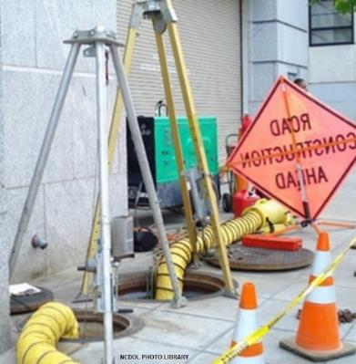
Rescue & Emergency Services
1910.146(k) & 1926.1211
Entry rescue
Use rescue and emergency services
Use own employees
Non-entry rescue
Entrants use retrieval systems or methods
Notes:
NCDOL Photo Library: Photo taken by NCDOL Employee Robert O’Neal, Public Access. Photo identifies a confined space site.
Photo identifies a confined space site that was found to be without a perimeter barricade to warn others of the confined space opening.
Discuss training for other personnel on the site, especially those there to rescue and stand by.
Rescuers often enter a confined space with limited knowledge and without thinking of the hazards.
Rescues cannot be done without proper equipment and training.
See link below to article on confined space fatalities. “A total of 458 fatal occupational injuries meeting the research definition were recorded in the period 1997-2001. Fatal injuries in confined spaces fluctuated from a low of 81 in 1998 to a high of 100 in 2000 during the five-year period, averaging 92 fatalities per year.” 3% of the fatalities during rescue operations.
https://ohsonline.com/articles/2003/11/fatal-occupational-injuries-involving-confined-spaces-19972001.aspx

Slide 70
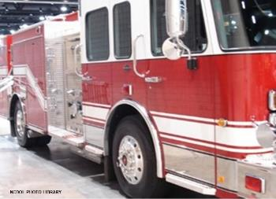
Rescue & Emergency Services
1910.146(k) & 1926.1211
Using rescue and emergency services(
Evaluate prospective services ability to perform the summons in a timely and proficient manner
Identify the hazards in the space
Practice mock rescues
Notes:
Photo taken by NCDOL Employee Robert O’Neal, Public Access inside Raleigh Civic Center. Photo shows a standard fire truck as emergency services.
Discuss the employer’s duties to respond in a timely manner (4 mins per Fed OSHA) and to evaluate the capability of outside services to meet the requirements.
While the standard does not prescribe a number of minutes, OSHA has long interpreted the term "near proximity" to mean that emergency care must be available within no more than 3-4 minutes from the workplace for medical assistance. Or someone on site needs to be trained.
https://www.osha.gov/laws-regs/standardinterpretations/2007-02-05
Employers are required to review the permit program annually, and there is a requirement that employee rescue service personnel must make practice rescues at least once every 12 months.
Not all fire departments can do confined space rescuing, it is imperative as an employer to inform the local fire rescue to the hazards within the facility. This will better prepare the fireman in case of an accident or emergency.
It is the employer’s responsibility to ensure that a company contracted to provide rescue service is able to perform the necessary duties to execute a successful confined space rescue.
Emergency response personnel should simulate actual rescue conditions by conducting practice drills. Typical potential rescue problems which should be addressed are egress restrictions, ability to lift without injury, problems in using rescue equipment, and fall hazards. Such training should not be limited to internal emergency response personnel. When possible, outside response agencies should receive the same type of training to ensure their effectiveness in a rescue situation.

Slide 71
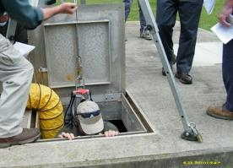
Rescue & Emergency Services
1910.146(k) & 1926.1211
Rescue using in-house employees
Trained to perform assigned rescue duties
Trained in basic first aid and CPR
Practice rescue at least annually
Note: If using air-supplying respirators, additional training is required per 29 CFR 1910.134 (Respiratory Protection)
Notes:
NCDOL Photo Library: City of Apex, 4/12/2011 Partnership Site, Permission Letter Obtained. Ventilation of confined space using a fresh air blower.
Photo identifies employees performing a confined space rescue exercise at one of there locations.
Discuss the employer’s responsibility for training and knowledge for using inhouse employees for PRCS rescue.
A new non-mandatory Appendix F, Rescue Team or Rescue Service Evaluation Criteria, was added to 29 CFR 1910.146 to assist in the selection of a rescue team or emergency service.
At a minimum, if an off-site rescue service is being considered, the employer must contact the service to plan and coordinate the evaluations required by the standard. Merely posting the service's number or planning to rely on the 911 emergency phone number to obtain these services at the time of a permit space emergency would not comply with paragraph (k)(1) of the standard.
Also if using air supplying respirators additional training is required per 29 CFR 1910.134 Respiratory Protection

Slide 72
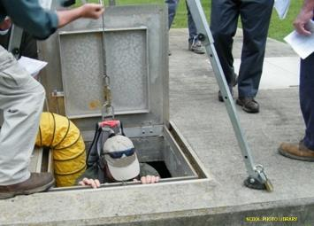
Rescue & Emergency Services
1910.146(k) & 1926.1211
Non-entry rescue
Retrieving an entrant from a confined space without going into the space
Entrants must wear a chest or full body harness with retrieval line attached
If non-entry rescue is
not successful then the
rescue team must be given
full rescue equipment to
enter the site.
1926.1211(c)
Notes:
NCDOL Photo Library: City of Apex, 4/12/2011 Partnership Site, Permission Letter Obtained. Ventilation of confined space using a fresh air blower.
It can be extremely difficult or nearly impossible to pull a person out of this situation unassisted.
The equipment that is used in non-permit rescue are wristlets/rope instead of body harness.
These types of harness rescue is best suited for manholes and tanks and cannot be used in every situation.
A retrieval line is attached to a mechanical device or a fixed anchor point outside the space.
The mechanical device must be capable of lifting a person from a 5-foot-deep space.
Special rescue tripods are available and must be man rated.
Employees cannot enter the site to rescue without appropriate PPE.

Slide 73
Additional Information
Appendices
A: Permit-required Confined Space Decision Flow Chart
B: Procedures for Atmospheric Testing
C: Examples of Permit-required Confined Space Programs
D: Sample Permits
E: Sewer System Entry
F: Non-Mandatory: Rescue Team or Rescue Service Evaluation Criteria
Notes:
Appendices A through F serve to provide information and non-mandatory guidelines to assist employers and employees in complying with the appropriate requirements of this section.

Slide 74
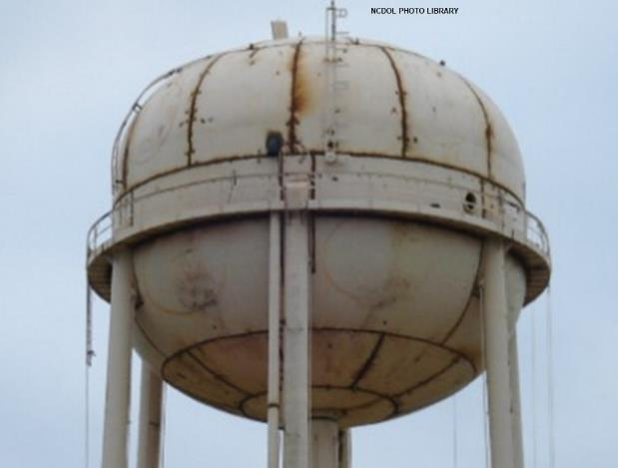
Is this a Confined Space?
Notes:
NCDOL PHOTO LIBRARY: Photo taken by NCDOL Employee Robert O’Neal, Public Access
This photo shows a water tower under construction.
What could be introduced to the interior of this tank to make it PRCS? Discuss.
By definition, a confined space:
Is large enough that an employee can bodily enter and perform assigned work.
Is not designed for continuous occupancy by the employee; and
Has a limited or restricted means of entry or exit.
Does the picture meet the criteria of a confined space? Yes!
Is it a permit required confined space under the General Industry Standard? No! The construction of this water tower would now fall under the Construction Standard 29 CFR 1926, Subpart AA.
Can you recognize serious safety or health hazard?
For a class activity the instructor can write the three (3) questions above on a board and for each picture that follows, have the class work together to determine if it meets the criteria of the definition. May include asking if it is a permit space and what are methods to control the hazard as applicable.

Slide 75

Is this a Confined Space?
Notes:
NCDOL Photo Library: Photo by NCDOL Employee Andy Sterlen from a public street March 25th, 2016. Photo identifies a manhole identified as a permit-required confined space.
This photo shows a manhole that has been identified as a permit required confined space.
By definition, a confined space:
Is large enough that an employee can bodily enter and perform assigned work.
Is not designed for continuous occupancy by the employee; and
Has a limited or restricted means of entry or exit.
Ask the class?
Does the picture meet the criteria of a confined space? Yes!
Is it a permit required confined space under the General Industry Standard? Yes!

Slide 76
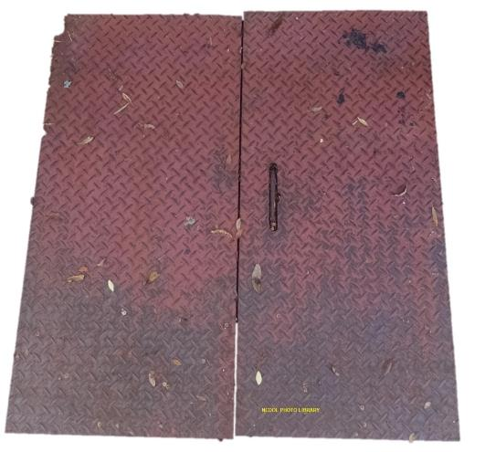
Is this a Confined Space?
Notes:
NCDOL Photo Library: Photo by NCDOL Employee Robert O’Neal from a public street
This photo shows another type of manhole/vault for electrical or utilities lines for utility workers. It was only 3 ft deep and self rescue could take place.
Remember, open top spaces more than 4 feet in depth such as pits, tubs, vaults, and vessels are confined spaces.
Does the picture meet the criteria of a confined space? No!
Is it a permit required confined space under the General Industry Standard? No!

Slide 77
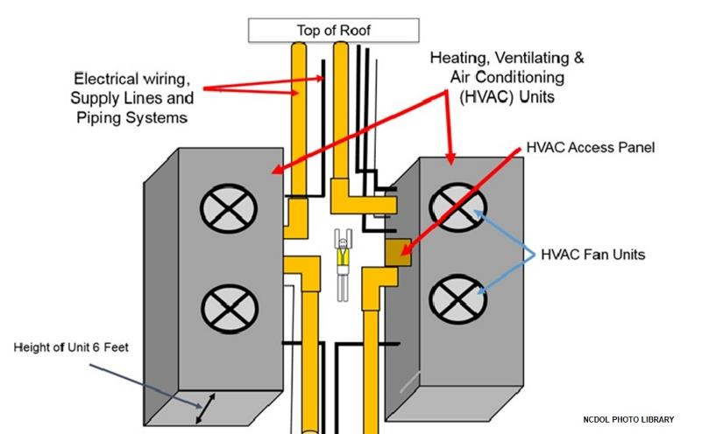
Is this a Confined Space?
Worker
Notes:
NCDOL Photo Library: Illustration developed by NCDOL Employees Robert O’Neal and Andy Sterlen.
Discuss the scenario below:
The illustration description is as follows: two large HVAC units on a roof. Workers must access one unit from the inside space between the two units. Workers are also required to climb over the electrical wiring, supply lines and piping systems, shown in yellow and black lines. The HVAC units are 6 feet tall in height, 20 feet long and 5 feet wide.
Would you consider this a confined space or permit required confined space?
Refrigerant gas leaks may pose a risk of suffocation in these type of areas. Although, Freon refrigerants have low toxicity, at very high concentrations they can displace oxygen. Without oxygen to breathe, workers can be injured or die.
In most units of this type you will find R410 refrigerant which is used because the US Environmental Protection Agency recognizes it as an acceptable substitute for R-22 refrigerant in households and light commercial air conditioning systems.
Larger HVAC system may use refrigerants such as ammonia (R717), carbon dioxide and non-halogenated hydrocarbons do not deplete the ozone layer and have no (ammonia) or only a low (carbon dioxide, hydrocarbons) global warming potential. They are used in air-conditioning systems for buildings, in sport and leisure facilities, in the chemical/pharmaceutical industry, in the automotive industry and above all in the food industry (production, storage, retailing).
Does the illustration meet the criteria of a confined space? Yes!
Is it a permit required confined space under the General Industry Standard? Maybe!

Slide 78
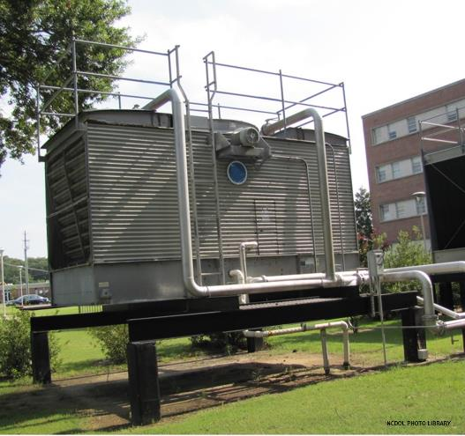
Is this a Confined Space?
Notes:
NCDOL Photo Library: Photo by NCDOL Employees Robert O’Neal, public access
Discuss this scenario:
This photo shows a water-cooling tower where employees were required to enter it annual for maintenance.
Industrial cooling towers can be used to remove heat from various sources such as machinery or heated process material. The primary use of large, industrial cooling towers is to remove the heat absorbed in the circulating cooling water systems.
The door opening in the middle of the tower is used for maintenance access. It’s a bolted-on type of door to prevent authorized workers from entering.
Are workers exposed to an increased risk for health hazards during maintenance and repairs. Yes, cooling towers are because of their mode of operation, can create ideal conditions for microbial growth such as legionella bacteria, electrical hazards, and spinning fans. LOTO must be used to de-energize before entering these type of spaces.
Does the picture meet the criteria of a confined space? Yes!
Is it a permit required confined space under the General Industry Standard? Yes!

Slide 79
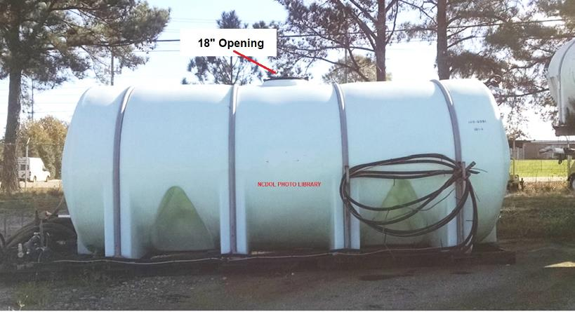
Is this a Confined Space?
Notes:
NCDOL Photo Library: Department of Transportation, 7/13/2015 Partnership Site, Permission Letter Obtained This photo shows a 20,000-gallon industrial elliptical leg tank. Employees are required to enter it for cleaning of mold. Workers enter from the top through an 18 inches opening.
Can you recognize serious safety or health hazard?
Ventilation, chemicals and a rescue issue.
Is it large enough that an employee can bodily enter and perform assigned work?
Yes!
Does it have limited or restricted means of entry or exit?
Yes!
Is not designed for continuous occupancy?
Yes!
Is it a permit required confined space under the General Industry Standard?
Yes!
Are employers required to mark this type of tank with confined space permit signs?
No!
Letter of Interpretation: https://www.osha.gov/pls/oshaweb/owadisp.show_document?p_table=INTERPRETATIONS&p_id=22549
Question: Is it necessary to physically place a sign on the entryway to a given confined space? Or, would it be acceptable to ensure that all personnel are fully aware, through documented training, of the various confined spaces at a facility and the proper procedures that must be followed prior to entry? Response: Ordinarily, information about permit spaces is most effectively and economically communicated through the use of signs. Consequently, signs would be the principal method of warning under the standard. Alternative methods, such as additional training, may be used where they are truly effective in warning all employees who could reasonably be expected to enter the space. It is the employer's obligation to assure that an alternative method is at least as effective as a sign. In some cases, employers may have to provide training in addition to signs, to protect employees who do not speak English or who would have difficulty understanding or interpreting signs. (One method by which OSHA can gauge an employer's effectiveness is through random interviews of affected employees.) If a space has a locked entry cover or panel, or an access door that can only be opened with special tools, the use of signs may be unnecessary if the employer ensures that all affected employees are informed about such spaces and know that they are not to be opened without taking proper precautions, including temporary signs, to restrict unexpected or unknowing entry.

Slide 80
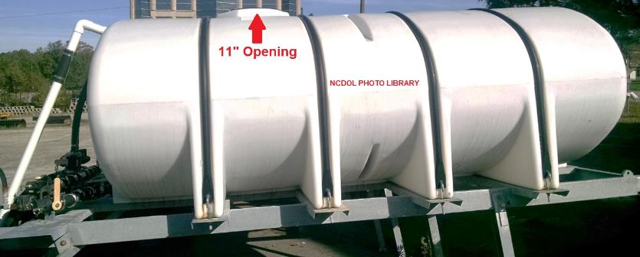
Is this a Confined Space?
Notes:
NCDOL Photo Library: Department of Transportation, 7/13/2015 Partnership Site, Permission Letter Obtained
Discuss this scenario with the emphasis on the cylinder opening size.
This photo shows a 15,000-gallon industrial elliptical leg tank with an opening at the top. Employees were not required to enter it for cleaning. However, workers were required to reach inside the tank from the top for cleaning the inside. The opening on top of the tank is only 11 inches wide.
Is the tank large enough that an employee can bodily enter and perform assigned work? No!
Is the tank designed for continuous occupancy by the employee? No!
Does it have limited or restricted means of entry or exit? Yes!
Does the picture meet the criteria of a confined space? No!
It does not meet all three of the criteria. However, please keep in mind that a worker may be able to enter this type of space, so training is very important. Plus, some smaller employees may be able to fit through the 11 inches opening. Again, training is the key to prevention.

Slide 81
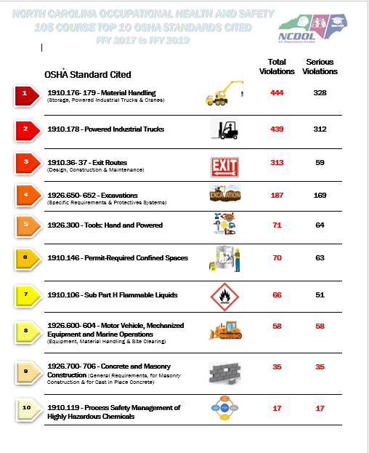
Notes:
According to BLS these are the top ten citations for Confined Space up to 2019.

Slide 82
Top Citations for 1910/1926:
PROGRAM related:
1910.146(c)(1) to evaluate the space for hazards
1910.146(c)(2) to inform employees of hazards
1910.146(g)(1) to provide training to the employees
1910.146(d)(5)(i) to test atmosphere conditions
PERMIT related:
1926.1205(a) to have a entry permit completed
1926.1205(b) to have a signed entry permit
1926.1206(h) to have hazards entered and identified
1926.1206(j) to have acceptable entry conditions
1926.1206(k) to have results of tests and monitoring
Notes:
Some of the top citations from OE:
1910.146 c 1 the employer must evaluate the space for hazards.
By testing, obtaining owner knowledge. Did the competent or qualified person gather this information. Document through interviews with employees and from the competent/qualified person.
1910.146 c 2 inform the employees.
During interview gather statements from the employees
1910.146 g 1 training.
Any records found at the site or are available?
1910.146 d 5 i test the atmospheres.
Can the employer provide the testing equipment and records
1926.1205a entry permit completed
Requires that a permit be completed and on site during the entry
1926.1205b signed permit
the competent person/supervisor must sign the permit – not just any employee
1926.1206h hazards entered and identified
1926.1206j to have acceptable entry conditions
1926.1206k to have results of tests and monitoring
These are just some of the top citations that have been written by NCDOL. Other possible citations would be for inadequate equipment, not allowing employees or representation review the entry conditions and testing, a lack of training for first aid, improper or inadequate response to an emergency by fire and rescue (4 min response). Read the standard thoroughly and be prepared when you arrive on site.

Slide 83
Summary
In this course, we covered:
Confined spaces in general industry/construction
The difference between a confined space and a permit-required confined space
How to determine if a hazard exists within the confined space
Responsibilities for the entrant, attendant and entry supervisor, and host employer
Rescue options and timing
Notes:
In Summary we discussed the following:
Discussed the difference between a CS and PRCS
What techniques to use to determine PRCS
Participant responsibilities
Rescue responsibilities and requirements with training and different options for rescue

Slide 84
KNOWLEDGE CHECK
What is the first thing to check before an employee enters a Confined Space?
a) flammables(LFL)
b) oxygen

Slide 85
KNOWLEDGE CHECK
b) oxygen

Slide 86
KNOWLEDGE CHECK
What is the Ideal range for Oxygen in the space?
19.5% to 21%
10% to 15%
5% to 10%

Slide 87
KNOWLEDGE CHECK
a) 19.5% to 21% oxygen

Slide 88
KNOWLEDGE CHECK
What is the response time required by Fed OSHA to respond to an incident?

Slide 89
KNOWLEDGE CHECK
4 minutes
While the standard does not prescribe a number of minutes, OSHA has long interpreted the term "near proximity" to mean that emergency care must be available within no more than 3-4 minutes from the time workplace entry or rescue begins.
https://www.osha.gov/laws-regs/standardinterpretations/2007-02-05

Slide 90
KNOWLEDGE CHECK
What should be some of the things a CSHO asks for when speaking to the competent person/entry supervisor about a Confined Space entry?
a) atmosphere testing, permit, training records
b) competent person in charge, supervisor(host)
c) bump test / test gas results, equipment calibration
d) ALL the above

Slide 91
KNOWLEDGE CHECK
d) ALL the above.

Slide 92
Thank You For Attending!
Final Questions?

