Slide 1
OSH 125 Introduction to Health Standards
OSHA’s Technical Manual
Presented by: Cory Dunphy, Health Standards Officer ETTA
Notes:
Updated January 2021

Slide 2
Objectives
In this course, we will look at:
What is the OSHA Technical Manual
The sections of the OSHA Technical Manual
More in-depth look at 6 of the 10 sections
How to use the OSHA Technical Manual

Slide 3

OSHA Technical Manual (OTM)
Content is based on currently available research publications, OSHA standards, and consensus standards
Notes:
The OSHA Technical Manual cancels the OSHA Instruction TED 1.15, which is now a historical reference document. The OSHA Technical Manual is on the NCDOL Intranet under OSH Compliance Administrative Policies and Procedures.
This directive may be used as resource reference for compliance officers, in addition to OSHA Instruction CPL 2.103, Field Inspection Reference Manual (FIRM), which serves as the primary resource.
NCDOL Photo Library – This graphic is a screenshot of the Table of Contents of TED 01-00-015: OSHA Technical Manual and was captured by NCDOL Employee Cory Dunphy from the federal OSHA Website

Slide 4
What is the purpose of the OTM?
Provides technical information and guidance on occupational safety and health topics
To assist OSHA Compliance Safety and Health Officers (CSHO’s) in hazard recognition
Provide guidance in accident prevention
To serve as a source of advice for CSHO’s on safety and health issues

Slide 5
OTM is NOT …
A substitute for OSHA standards
Intended to be used for establishing Agency compliance policies
Note: If OTM conflicts with OSH Act and the standards and regulations, the latter are controlling.

Slide 6
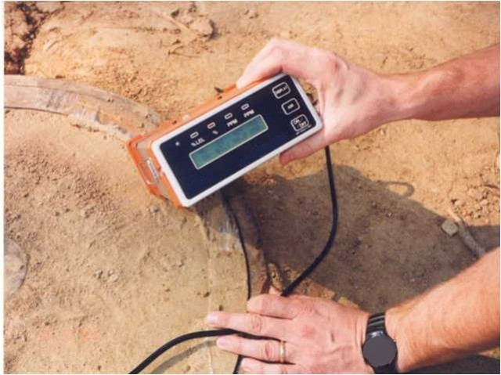
Ten OTM Sections
General Information
Sampling and Measurement Methods
Health Hazards
Safety Hazards
Construction Operations
Health Care Facilities
Ergonomics
Personal Protective Equipment
Safety and Health Management
Miscellaneous Issues
NCDOL Photo Library
Notes:
The sections reviewed in the 125 class are highlighted in red.
NCDOL Photo Library – Closed Case File #303139166. This is a picture of a four gas meter and the photo is used a filler.

Slide 7
Section II: Sampling, Measurement Methods and Instruments
Chapter 1: Personal Sampling for Air Contaminants
Chapter 2: Sampling for Surface Contamination
Chapter 3: Technical Equipment
Chapter 4: Sample Shipping and Handling
Notes:
In this section I will primarily review Chapter 1 & 2;
Technical equipment will be reviewed later in the course

Slide 8
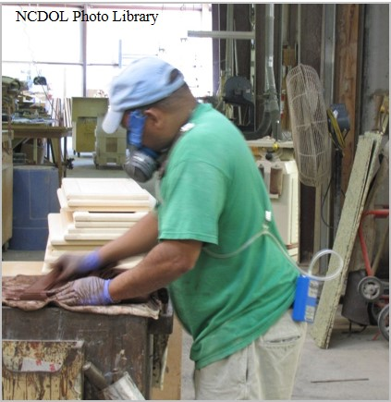
Section II: Chapter 1
Personal Sampling for Air Contaminants
General Sampling Procedures
Sampling Media
Special Sampling Procedures
Sampling for Welding Fumes
Equipment Preparation and
Calibration
Filter Weighing
Appendices
Notes:
Sampling and Measurement Methods will be covered in greater detail later in another segment. For informational purposes I will highlight some of the contents of the OSH Technical Manual.
NCDOL Photo Library – Closed Case File #316593284. This photo shows an employee manually applying stain to some wood while wearing a respirator and a pump for air monitoring.

Slide 9
Appendices
Appendix II:1-1
Detector Tubes and Pumps
Appendix II:1-2
Electronic Flow Calibrators
Appendix II:1-3
Manual Buret Bubble Meter Technique
Appendix II:1-4
Shelf Life of Sampling Media Provided by SLTC

Slide 10
Appendices (cont…)
Appendix II:1-5
Sampling for Special Analyses
Appendix II:1-6
Sampling and Analytical Errors (SAE’s)
Appendix II:1-7
Partial List of Substances for Auto-weighing Submission

Slide 11
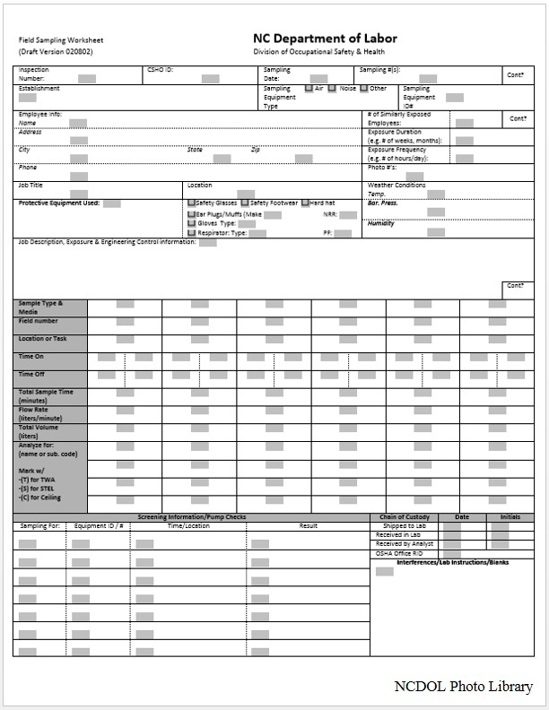
General Sampling Procedures
A review of the basic IH sampling requirements when evaluating employee exposures to chemical and physical hazards in the workplace.
Notes:
Setting up a sampling strategy
Use of screening equipment (i.e, Detector tubes) to determine the presence of contaminants and to identify the sampling area; Also used to determine the sampling technique that should be used
Determine what to sample and who to sample; Check for likely sources of interferences with IH instruments, such as the presence of radio frequency electromagnetic fields. (e.g., walkie-talkies, RF heat sealers, vehicles equipped with mobile radio transimitters)
NCDOL Photo Library – This is a screenshot of the NC Department of Labor’s Field Sampling Worksheet. This graphic was captured by NCDOL Employee Cory Dunphy from the NCDOL OSH One-Stop-Shop.

Slide 12
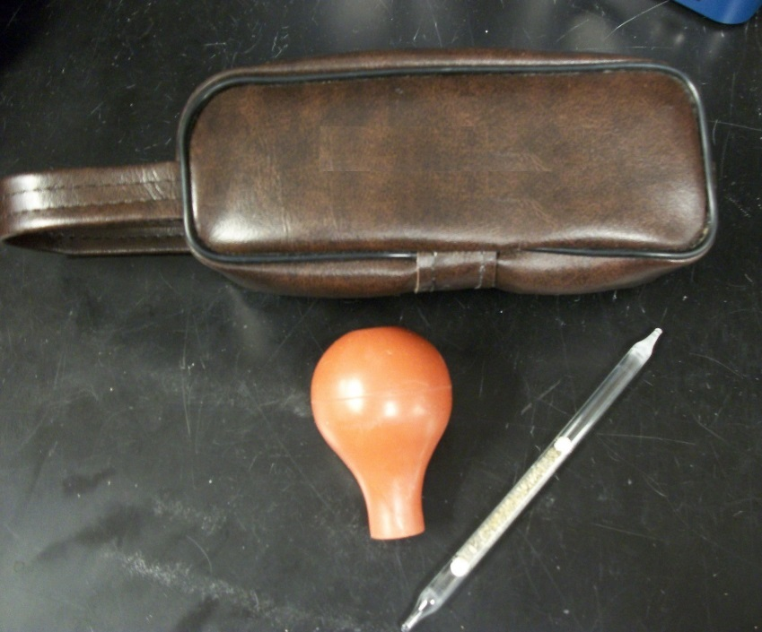
Sampling Media
Detector tubes
Aerosol Samplers
Respirable Dust
Samplers
Solid Sorbent Tubes
Midget Impingers and Bubblers
Vapor Badges
NCDOL Photo Library
Notes:
Refer to the OTM for guidance on the use of midget impingers and bubblers and vapor badges; this may be discussed later in another section.
NCDOL Photo Library – This photo was taken by NCDOL Employee Cory Dunphy during his time of employment with NCDOL. This photo shows a detector tube, bulb and carrying case.

Slide 13
Detector Tubes
Screening media that may be used to measure more than 200 organic and inorganic gases and vapors or for leak detection.
Concentration is determined by a colorimetric change of an indicator which is present in the tube contents
Detector tubes of a given brand may only be used with a pump of the same brand

Slide 14
Aerosol Samplers
Total Dust and Metal Fume
Air Sampling Pumps
Total Dust
Pre-weighed, low-ash polyvinyl chloride (PVC) filter
Open-face filter cassette
Metal Fume
0.8 micron mixed cellulose ester (MCE) filter
Notes:
Be sure to calibrate pumps at the recommended flow rates. Refer to Analytics Directory of Services binder.

Slide 15
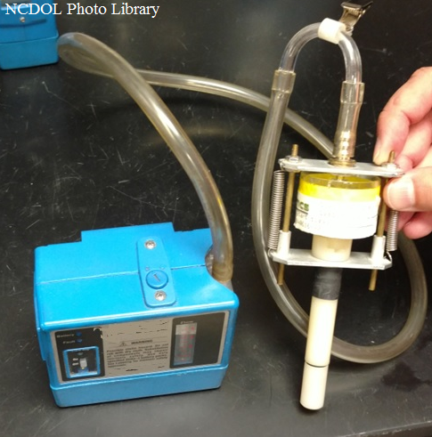
Respirable Dust Samplers
Cyclone with a pre-weighed low-ash polyvinyl chloride filter
Silica
Nylon cyclone vs. Aluminum cyclone
Submit a bulk sample if possible.
Notes:
Photo: Photo taken by Robert O’Neal on 7/11/16: Staged
Clean cyclones after each use.

Slide 16
Solid Sorbent Tubes
Activated charcoal, silica gel, or other adsorption tubes
For organic and vapor gases, low flow pumps are required
Lower flow rates when there is high humidity (above 90%) in the sampling area or high concentrations of other organic vapors present
Notes:
“air flow” directional arrow on the sorbent tube should point in the direction of the sampling pump.

Slide 17
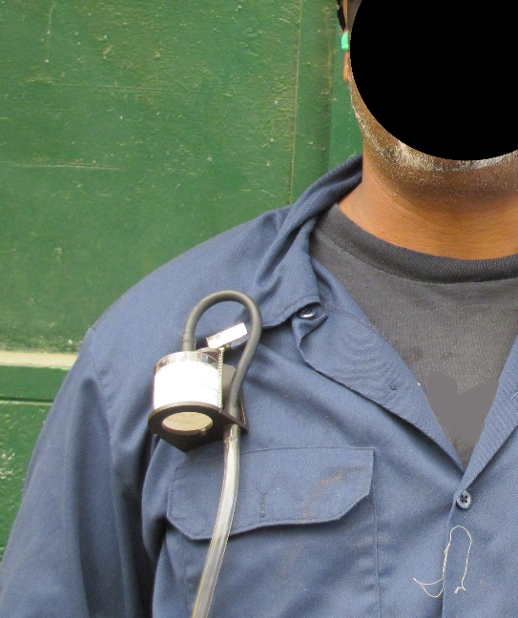
Special Sampling Procedures
Asbestos
Use a 0.8 micrometer pore size, 25-mm diameter mixed cellulose ester filter with a back up pad. Use a fully conductive cassette with conductive extension cowl
Sample open face
Flow rate in the range of
0.5 to 5 L/mi
NCDOL Photo Library
Notes:
NCDOL Photo Library – Closed Case File # 316971712. This is a close-up of an employee wearing a cartridge attached to an air pump for sampling purposes.

Slide 18
Special Sampling Procedures (cont…)
Welding Fumes
Filter must be placed inside welders helmet
Use 37-mm filters and cassettes
Note: The 25-mm filters and cassettes may be used if the 37-mm filters and cassettes will not fit inside the welding helmet.
Notes:
Is there a situation when you would place the filter on the outside of the welder’s helmet? If the helmet has supplied air from an outside, clean source then you would want to put the filter on the outside of the helmet. Otherwise you would be testing the clean air and not reading the contaminated air being produced by the welding activities.

Slide 19
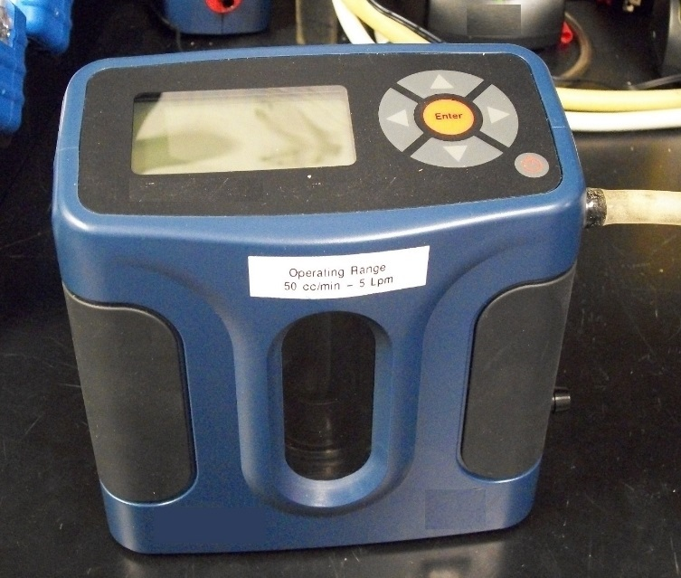
Equipment Preparation & Calibration
Primary Devices
Electronic Flow Calibrators
Drycal
Bubble flow meter
Manual Buret Bubble Meter Calibrator
Secondary Device
Rotameter
NCDOL Photo Library
Notes:
These will be further discussed in the Equipment Day segment of the OSH 125 course.
NCDOL Photo Library – This photo was taken by NCDOL Employee Cory Dunphy during his time of employment with NCDOL. This photo shows a Dry Cal Calibrator that is used to calibrate pumps prior to and after sampling.

Slide 20
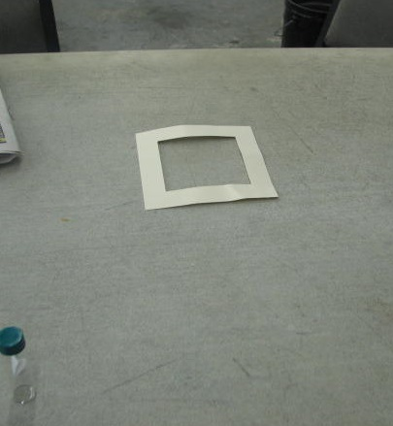
Section II: Chapter 2
Sampling for Surface Contamination
Wipe Sampling, Swipe Sampling, and Smear Sampling
Techniques used to assess surface contamination on the skin, work surfaces, and PPE surfaces (e.g., gloves, respirators, aprons, etc.)
NCDOL Photo Library
Notes:
NCDOL Photo Library – Closed Case File #315445874. This photo shows a template used when collecting area samples on a surface (table).
Wipe sampling is an important tool of worksite analysis for both identifying hazardous conditions, and in evaluating the effectiveness of personal protective equipment, housekeeping, and decontamination programs.

Slide 21
Generalized Work Areas
Where Wipe Sampling is Used
Controlled Work Areas Requiring PPE
PPE is necessary to prevent dermal exposures to surface contamination
Controlled Work Areas Requiring Special Cleaning
Quality control test of the specialized cleaning (or decontamination) regimen
Non-controlled Work Areas
Assumed to have no significant contamination

Slide 22
Examples
Media used for Wipe Sampling
Glass fiber filters
Paper filters – Mixed Cellulose Ester discs or smear tabs
Polyvinyl filters
Charcoal impregnated pads
Other media available, refer to OTM Manual for more specialized cases
Notes:
Glass fiber filters – used for chemicals analyzed by gas chromatography, or high performance liquid chromatography; wet or dry
Paper filters – collection of metals
Polyvinyl filters – unstable on paper type filters
Charcoal impregnated pads – volatile solvents from surfaces

Slide 23
Appendices
Appendix II:2-1
Substances with a Skin Notation
Appendix II:2-2
Example Procedures for Isocyanates
Appendix II:2-3
Example Procedures for Aromatic Amines

Slide 24
Section III: Health Hazards
Chapter 1: Polymer Matrix Materials
Chapter 2: Indoor Air Quality Investigation
Chapter 3: Ventilation
Chapter 4: Heat Stress
Chapter 5: Noise and Hearing Conservation
Chapter 6: Laser Hazards
Chapter 7: Legionnaire’s Disease
Notes:
Only the highlighted Chapters will be discussed during this section. Chapters 2, 3, 4 & 5 will be discussed later in the course.
Say: You may want to review those Chapters prior to attending that portion of the class.

Slide 25
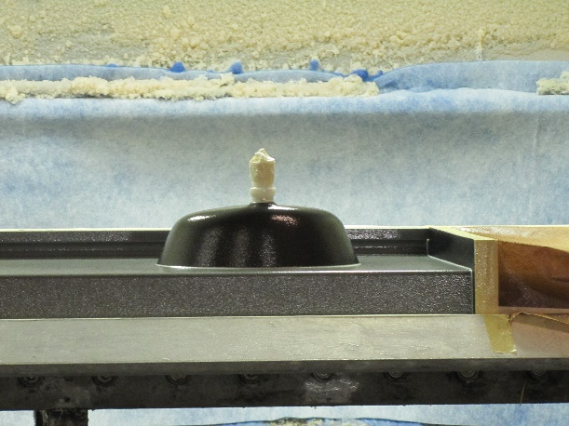
Section III: Chapter 1
Polymer Matrix Materials: Advanced Composites
Composites industry in the U.S include three manufacturing areas:
Polymer Matrix Composites (PMCs)
Ceramic Matrix Composites (CMCs)
Metal Matrix Composites (MMCs)
NCDOL Photo Library
Notes:
NCDOL Photo Library - Closed Case File #316593300. This is a picture of a composite marble casting of a sink. The material that coats the bottom of the sink, as well as the artificial marble materials that the sink is made out of are examples of matrix composites.
Composites are classified according to their matrix phase.

Slide 26
Advanced Composites Health Hazards
Epoxy Resins
Dermal exposure
Polyurethane Resins
Reaction products of polyols and isocyanates (TDI, MDI and HDI)
Isocyanates present a respiratory and dermal hazard
Phenol-Formaldehyde Resins
Traces of free formaldehyde and phenol
Skin absorption of phenol
Adequate ventilation; Components may give off during curing process
Notes:
Say: The basic epoxy molecule is a reaction product of epichlorhydrin (ECH) and bisphenol-A (BPA). Most monitoring has shown no detectable levels of ECH in the air.
Uncured epoxy resins can present a significant dermal exposure hazard.
Say: Health Hazards Special Emphasis Program that target Isocyanates exposure, as well as Silica, Lead, Styrene, and Asbestos
Other Composite Health Hazards can also be found in this Chapter.

Slide 27
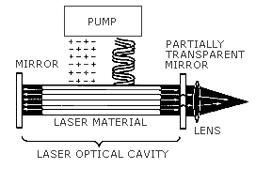
Section III: Chapter 6
Laser Hazards
Light Amplification by Stimulated Emission of Radiation
Notes:
Probably will see LASERs mostly in construction activity.
LASER is an acronym for Light Amplification by Stimulated Emission of Radiation.
The photo shows the components of a laser. A Laser consists of an optical cavity, a pump system, and an appropriate lasing medium.

Slide 28
Types of Laser Hazards
Non beam laser hazards
Industrial Hygiene
Explosion
Non-beam optical radiation
Collateral radiation
Electrical hazards
Flammability of Laser Beam Enclosures
Biological effects of laser beam
Eye Injury
Thermal Injury
Notes:
Table with basic biological effects of light with the spectral range, and the eye and skin effects most common within that wavelength.
NC has a construction standard in the NCAC for properly maintained Class I LASERS.
Contact DENR radiation protection to discuss whether they regulate LASERS at all.
Investigation guidelines – refer to some OSHA standards, other consensus stds. and FDA, ANSI exposure limits, LASER hazard computations.
Control Measures – beam path controls (enclosed beam paths, limited open beam paths, totally unenclosed beam paths. LASER-controlled area – warning signs, qualified personnel. Specific Class IV controls. Protective clothing and engineering controls. Measure for LASER use without protective housing.
Appendices – Glossary of Terms, Signage, FDA requirements for LASER products.

Slide 29
Laser Hazard Classifications
Class I - Low power; lowest hazard
Class IA – (Subclass “not intended for viewing” – supermarket scanners)
Class II – Low power
Class IIIA – Intermediate power – limited controls recommended
Class IIIB – Moderate power – specific controls recommended
Class IV – High power – specific controls recommended
Notes:
Summary table included with class, wavelength typical for each class and the typical hazard found in each class (direct ocular, diffuse ocular and fire)
Information on identification of LASERS during inspection (Class I LASERS do not require labeling)

Slide 30
Investigational Guidelines
American National Standards Institute (ANSI)
Center for Devices and Radiological Health (CDRH)
Food and Drug Administration (FDA)
Occupational Safety and Health Administration (OSHA)
Council of Radiation Control Program Directors (CRCPD)

Slide 31
OSHA Regulatory Practice
29 CFR 1926.54
Non-ionizing Radiation
29 CFR 1926.102(b)(2)
Laser Eye & Face Protection
Note: OSHA citations are issued by invoking
General Duty Clause
Notes:
Other pertinent information such as Laser Exposure Limits; Laser Hazard Computations; and Control Measures and Safety Programs;

Slide 32
Section III: Chapter 7
Legionnaires’ Disease
Disease recognition
Source identification
Investigation protocol
Controls
Notes:
Discussed briefly as part of IAQ. More than likely the NC DHHS epidemiology division will investigate any report of Legionnaires disease as this is a reportable public health disease. Diagnosis is difficult and detailed and luckily relatively rare.
Diagnosis information/description. Transmission information – hot water sources, typically aerosolized.
Source identification – conditions that promote growth – stagnation, temp 68-112, pH 5-8.5, sediment and certain microorganisms.
Common sources of contaminated water – cooling towers, evaporative condensers, fluid coolers. Domestic hot water systems, humidifiers and decorative fountains, spas and whirlpools, dental water lines, other stagnant water sources (fire sprinkler systems, and warm water for eye washes and safety showers.)
Monitoring – air and water sampling.
Investigative Controls – some OSHNC could conduct, most (including medical surveillance would more than likely be conducted by the NC DHHS. OSHNC could work in cooperation with NCDHHS if necessary)
Controls – Inspection and Maintenance of equipment with potential to promote, use of appropriate biocides to kill/control bacterial growth, design, cleaning.
Provides information on domestic hot and cold water systems – good reading for anyone who owns a home!
Appendices –
Employee Awareness Program – for workplace with a diagnosis. Interview questionnaire, FAQ’as, letter to employees if diagnosis made at workplace.
Physical Survey and Water Sampling Protocol – how to obtain and transport water samples from the various “sources” of Legionella.
Water Sampling Guidelines – to determine effectiveness of general water system treatment
Water Treatment protocols for facilities that have had a Legionnaires outbreak.

Slide 33
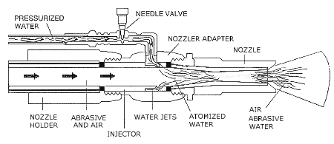
Section V: Chapter 3
Controlling Lead Exposures in the Construction Industry:
Engineering and Work Practice Controls

Slide 34
Types of Construction Activities
Abrasive blasting
Bridges, tanks, towers, etc.
Welding, Burning and Torch Cutting
Highway/Railroad Bridge Rehabilitation
Spray painting with Lead- Based Paint
Red lead primers
Manual Scraping and Sanding of Lead-Based Paints
Demolition
Other

Slide 35
Engineering &Work Practice Controls
Engineering Control
Ventilation
Isolation
Work Practice Control
Housekeeping
Change Areas
Other
Substitution
Personal Hygiene
Showers
Notes:
Engineering Controls are first line of defense.
Examples of substitution:
Use of less hazardous material
Change in process equipment
Change in process
Isolation: limiting lead exposure to those employees working directly with it; erect a sealed containment structure around open abrasive blasting operations (may increase exposure of the blasters)
Ventilation: Local or dilution (general)

Slide 36
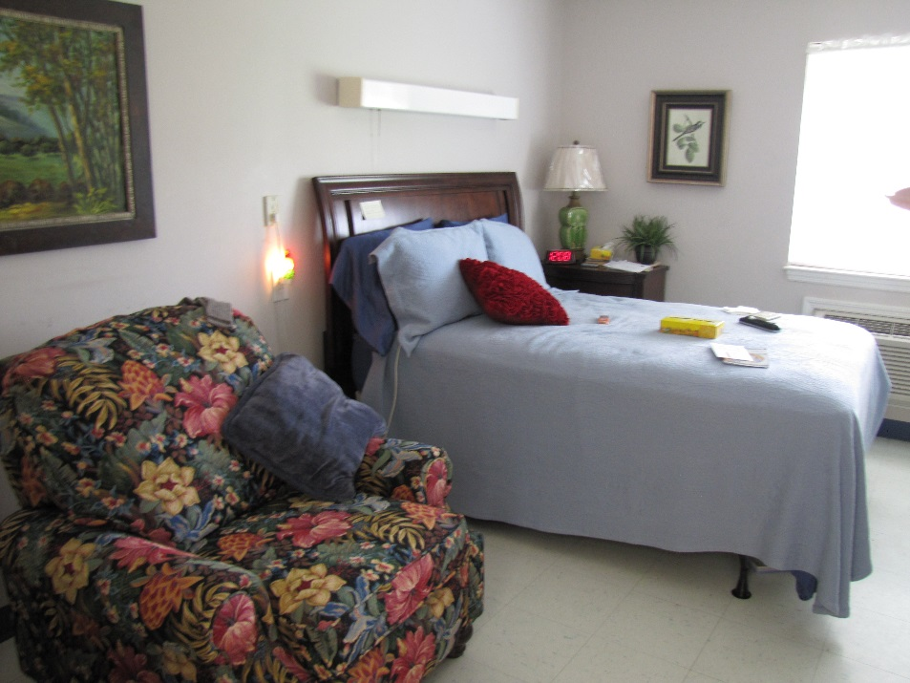
Section VI
Health Care Facilities
Chapter 1: Hospital Investigations
Chapter 2: Controlling Occupational Exposure to Hazardous Drugs
NCDOL Photo Library
Notes:
NCDOL Photo Library – Closed Case File #316971704. This photo shows a typical long term care room.

Slide 37
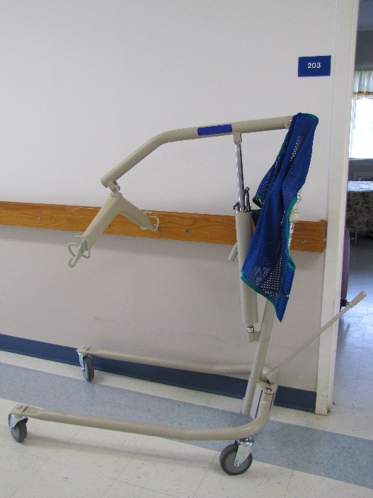
Hospital Investigations
Typical hazards and health effects
Biological, Chemical & Physical Agents
Investigation guidelines
OSHA 300 logs
Hospital Safety Program
Walkaround/Informal Interviews
Screening/ IH Sampling
Controls and prevention
Engineering (eg.,Ventilation)
Workpractices
Personal Protective Equipment (PPE)
NCDOL Photo Library
Notes:
1. Biological, chemical & physical agents are reviewed in the appendices to the chapter.
Biological – Blood and body fluid - (reference to CPL is incorrect).
Chemical - EtO, Waste Anesthetic Gases (nitrous oxide, Halothane, Enfluorane),
Physical – Lasers, Ionizing Radiation, Magnetic Radiation (MRI), Electrical hazards, UV, compressed gases.
Engineering – general and local ventilation, biosafety cabinets, ventilation information for EtO, morgues, storage of radioactive materials, LASERS.
NCDOL Photo Library – Closed Case File #316971704. This photo shows a Hoyer Lift, which is common in long term care facilities and is used to help lift patients/residents.

Slide 38
Controlling Occupational Exposure to Drugs
Categorization of drugs as hazardous drugs
Hazardous drugs as occupational risks
Work areas
Prevention of employee exposure
Medical surveillance
Hazard communication
Training and information dissemination
Recordkeeping
Notes:
Focused area of concern which will not be encountered as often as other OSH hazards. However, the potential risks to employees are great. Generally in clinics or hospitals which provide cancer treatment.
American Society of Hospital Pharmacists (ASHP) describes 4 drugs charateristics: genotoxicity, carcinogenicity, teratogenicity or fertility impairment, serious organ or other toxic manifestation at low doses in experimental animals or treated patients.
Work Areas – provides information on drug preparation areas and tasks which may cause exposure. Drug administration and disposal. (In NC, DENR - solid waste section will have jurisdiction over disposal requirements).
Preventing exposure – guidance on developing a Hazardous Drug Safety and Health Plan. Drug preparation precautions, types of Biological Safety Cabinets, Decontamination considerations, service and certification requirements for BSC’s, PPE (especially NIOSH approved HEPA respirators, preferably PAPR). Work Equipment and work practices used to handle HD’s – including drug administration, handling excreta from patients whop have received HD’s with previous 48 hours, disposal of linens, vials, equipment, PPE, etc. contaminated with HD’s. Spill control and clean up procedures and storing and transporting.
Pre-employment, Periodic, Episodic, and Post-employment. Records kept about types of drugs employees have exposure to. Biological monitoring where appropriate. Retention of medical records as required in 1910.1020.

Slide 39
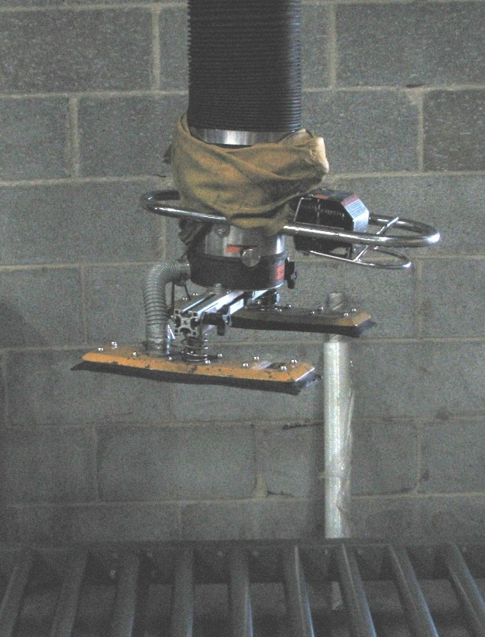
Section VII: Chapter 1 Ergonomics
Back Disorders and Injuries
Back disorders
Reports of back injuries
Investigation guidelines
Prevention and control
NCDOL Photo Library
Notes:
OSHNC FOM Chapter 17 was written to address Ergonomics Inspections in NC.
Factors associate with back disorders – tasks, postures, etc.
Contributing factors, manual material handling
Records Review, eE and eR interviews.
Engineering Controls – general and manual handling tasks; Work Practices - training, work hardening, job and task rotation to work different muscle groups, breaks; Other – seating selection, anti-fatique mats
Appendices – NIOSH work practice guide for manual lifting, Video guidelines and analysis
NCDOL Photo Library – Closed Case File #315453928. This is an assistive lifting device that uses a vacuum to pick up larger or awkward boxes from the conveyor and then placed on pallets.

Slide 40
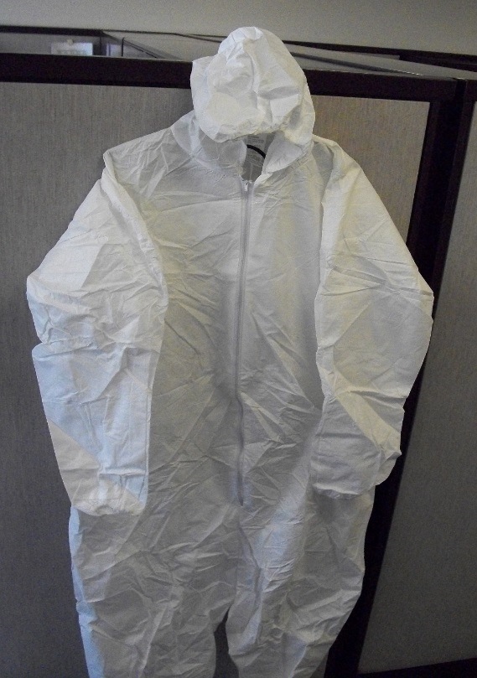
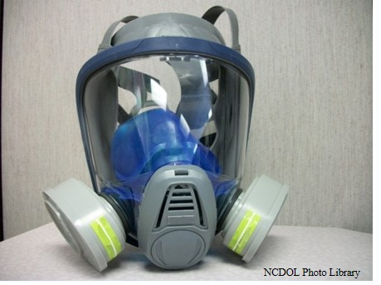
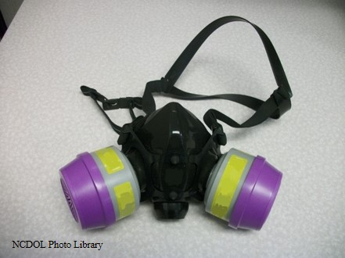
Section VIII: Personal Protective Equipment
Chapter 1: Chemical Protective Clothing
Chapter 2: Respiratory Protection
NCDOL Photo Library
Notes:
NCDOL Photo Library – The photos of the respirators were taken by NCDOL Employee Sara Steward during her time of employment with NCDOL. The photo of the Tyvek suit was taken by NCDOL Employee Cory Dunphy during his time of employment with NCDOL.

Slide 41
Chemical Protective Clothing
Description
Protective clothing selection factors
General guidelines
Management program
Clothing donning, doffing and use
Decontamination procedures
Inspection, storage and
maintenance
Training
Risks
NCDOL Photo Library
Notes:
Wide variety of information about CPC’s in general. Especially important for emergency responders, HAZMAT teams, fire fighters, HAZWOPER clean up sites, CBRN events, etc.
Activities requiring CPC’s. Description of Levels (A-D) of protection. Table with the types of protective clothing for full body protection. Classification by Design, Performance or Service-Life. (Some of this information is redundant)
Selection Factors –
Clothing design considerations - sizes, ease of use.
Material chemical resistance – permeation, penetration, degradation
Physical properties – strength and tear resistance, repeated use and decon, hot and cold conditions, seams provide same integrity, flame-resistant or self-extinguishing.
Determine use/purpose of clothing, full body protection needed?, evaluate manufacturer chemcial resistance data, examine mfr’s instructions or tech manual, obtain and inspect sample clothing garments, field selection.
Management Program should include:
Written program
Program review and evaluation
Types of SOP’s
Selection of CPC components
Donning and Doffing – inspection prior to use, how to use properly, conditions of use, how to remove properly
Decontamination – definitions and types of contamination, prevention of contamination, decontamination procedures – physically remove, inactivate chemicals by detoxification or disinfection/sterilization, combination of both. Testing effectiveness of decontamination – visual exam, wipe sampling. Decontamination Plan – number and layout of decon stations, appropriate methods, prevent contamination of clean areas, disposal/handling of contaminated clothing
5 elements of an effective CPC inspection program. Also, sample PPE inspection checklists, inspection records, visual inspection, appropriate storage (heat/cold, corrosives)
Heat Stress – measure using guidance in heat stress chapter of Tech Manual.
NCDOL Photo Library – The photo was taken by NCDOL Employee Cory Dunphy during his time of employment with NCDOL. The photo is of a Tyvek suit, which is one of the lowest class suits permissible.

Slide 42
Respiratory Protection
History of development of respiratory protection
General information
Respiratory protection program
Respiratory selection
Medical evaluation
Fit testing
Use, maintenance and care of respirators
Breathing air quality and use
Program Logistics
Notes:
Respirators and CPL’s for respirators should have already been discussed in 100 course. This chapter may provide a review of the standard in a more readable format.
NCDOL Photo Library – The photo was taken by NCDOL Sara Steward during her time of employment with NCDOL. This photo shows a half-mask respirator.

Slide 43
Summary
In this course, we examined:
What is the OSHA Technical Manual
The sections of the OSHA Technical Manual
More in-depth look at 6 of the 10 sections
How to use the OSHA Technical Manual

Slide 44
Thank You For Attending!
Final Questions?

