Slide 1
N.C. Department of Labor OSH Division
Fundamentals of Noise
Paul M. Sullivan, CIH, CSP
West Compliance Bureau Chief
September 2020
Notes:
Rev 0: 6/24/2013

Slide 2
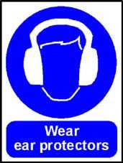
Objectives
Fundamentals of noise
Anatomy of the ear
Noise measurement instrumentation
Requirements of OSHA’s noise regulation
Enforcement guidelines
Types of hearing loss
Evaluating an audiogram
Proper methods of noise control

Slide 3
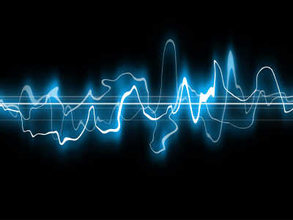
What is Sound?
Defined as a vibratory disturbance in pressure (above and below atmospheric pressure) of a medium which is detectable by the human ear.

Slide 4
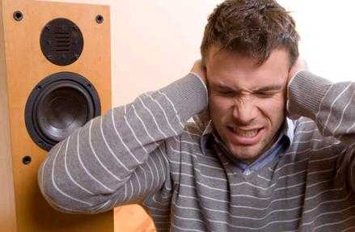
What is Noise?
Defined as sound that carries no information and whose intensity generally varies randomly over time.
Noise is also described as “undesirable / unwanted sound”.

Slide 5
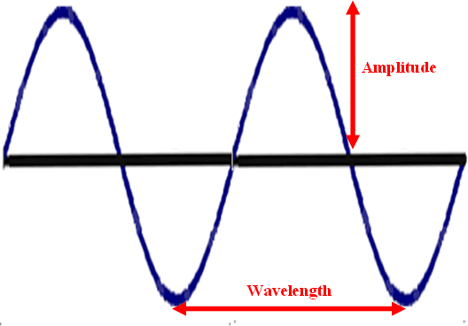
Wavelength
Measured distance (feet or meters) between two analogous points on two successive parts of a wave.
Greek letter lambda (λ) used to express wavelength.
Number of wavelengths per second equals frequency.

Slide 6
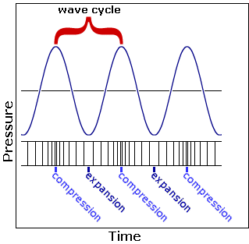
Frequency
Rate at which variation in normal atmospheric pressure occurs.
Expressed as Hertz (HZ) - synonymous with cycles or waves per second.
Number of waves per second is frequency.

Slide 7
Human Hearing
Frequency range for young adults with good hearing is usually between 20 - 20,0000 Hz

Slide 8
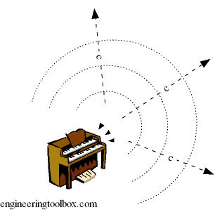
Velocity
Velocity at which analogous points on successive parts of a sound wave pass a given point is called the speed of sound (c)
Speed of sound is always equal to the product of the frequency wavelength (c=fλ)
Speed of sound increases as the medium becomes more dense and less compressible;
In air at 72° F, c is about 1130 ft/sec
e.g., c of steel = 16,500ft/sec

Slide 9
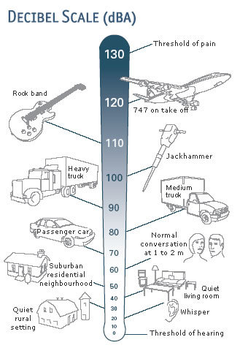
Decibel (dB)
The decibel scale is a logarithmic function named after Alexander Graham Bell.
A dimensionless unit used to express the logarithm of the ratio of a measured quantity to a reference quantity.
Decibels are referenced to 20 micro Newtons/m² (threshold of hearing at a reference tone of 1000 Hz).

Slide 10
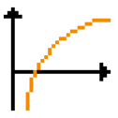
Why Logarithms???
The ratio between the threshold of pain and the threshold of hearing in humans is 10,000,000.
Therefore a relative scale is more practical than an absolute scale
Using the same ratio on the dB scale is
0 - 140 dB.

Slide 11
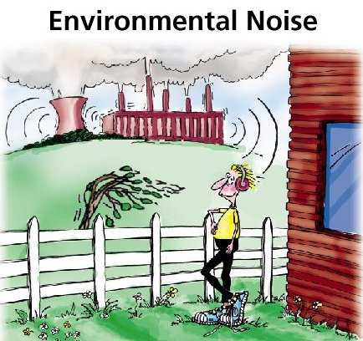
Types of Noise
Continuous noise
Variations in noise levels are at intervals of 1 second or less.
Impulse/Impact noise
Less than ½ second in
duration and do not repeat
more often than once per
second.

Slide 12
Combining Decibels
Difference in dB Values | Add to Higher Value
0 or 1 dB | 3 dB
2 or 3 dB | 2 dB
4 to 9 dB | 1 dB
10 dB or more | 0 dB

Slide 13
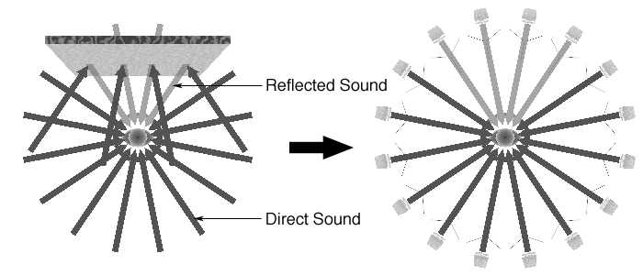
Sound Fields
Free Field
Uniform sound propagation from a point source with no sound-reflecting obstacles in the sound field.
Sound pressure level decreases 6 dB for each doubling of distance from the point source (inverse square law)

Slide 14
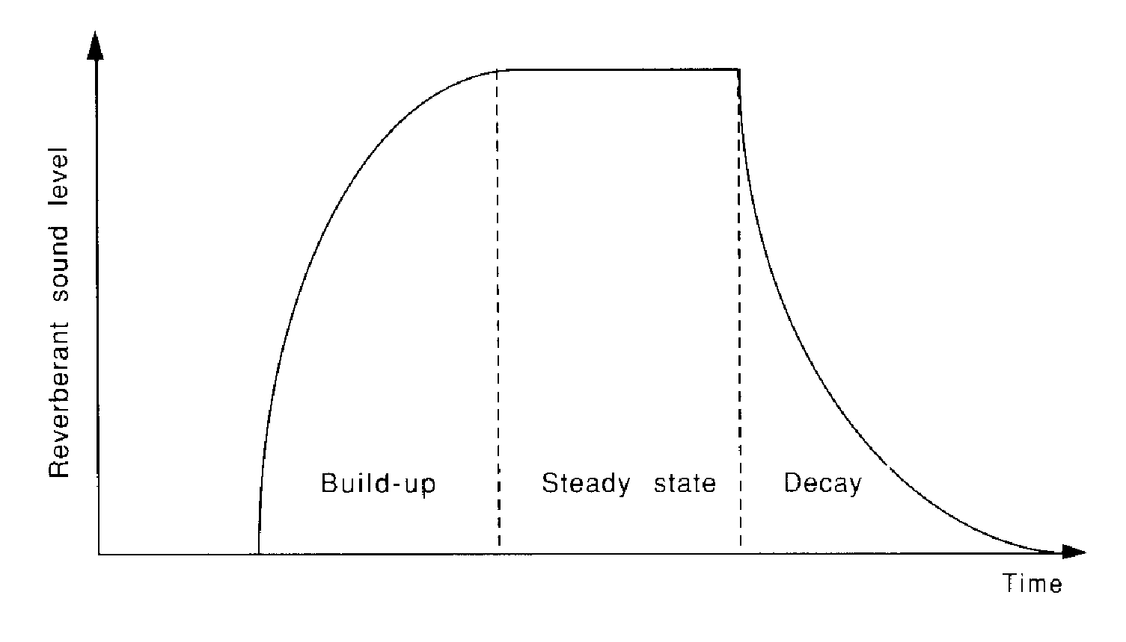
Sound Fields
Reverberant Field
Sound is repeatedly reflected in a room by the walls, floor, and ceiling
Sound at a given position is made up of direct sound and reflected sound
Far from the source, the reflected sound dominates, and this region is called the reverberant field

Slide 15
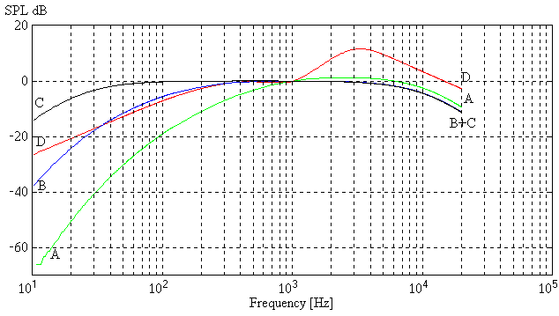
Sound Pressure Weighting

Slide 16
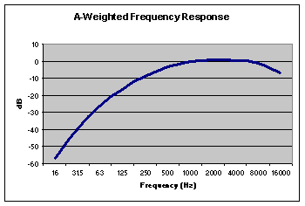
A-Weighting
Reduces low frequency noise reception and increases high frequency noise reception.

Slide 17
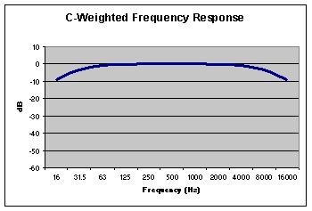
C-Weighting
Attempts to measure actual noise levels.

Slide 18
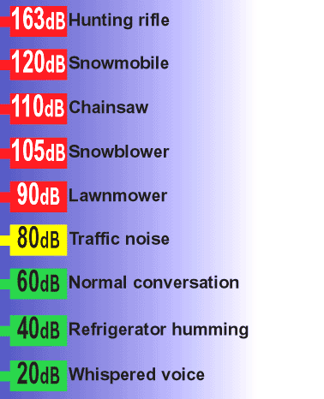
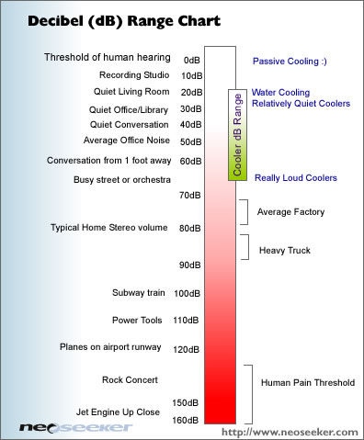
Typical “A” Measured Sound Levels

Slide 19
Sound Levels Effects
190 dB | Death
170 dB | Blow out ear drums
160 dB | Deaf in 100 microseconds
120 dB | Pain occurs
115 dB | For 20 min, threshold drop
100 dB | Permanent hearing loss
80 dB | Okay

Slide 20
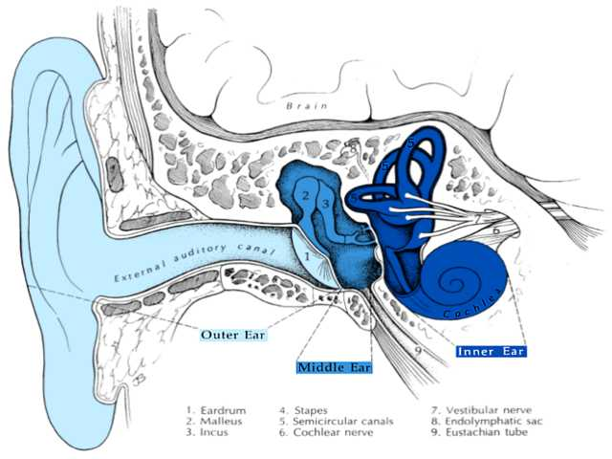
Anatomy of the Ear

Slide 21
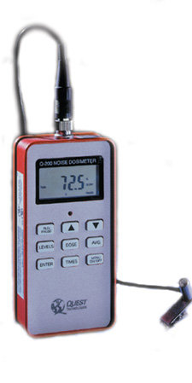
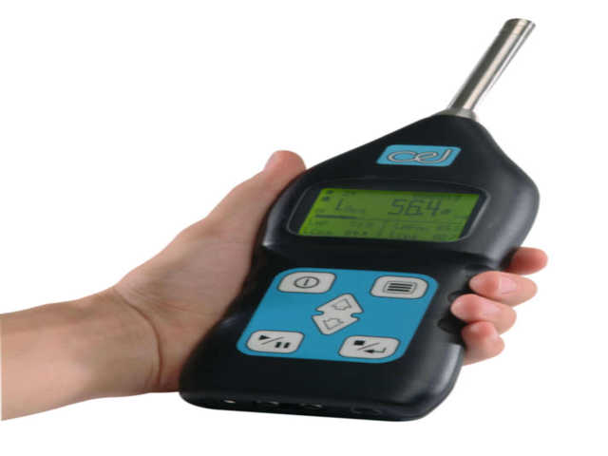
Measuring Noise

Slide 22
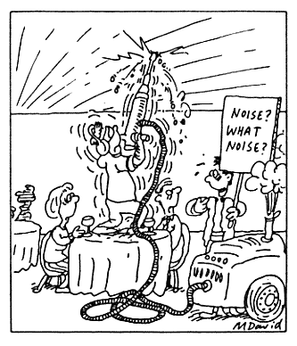
Definitions
Criteria Level - Continuous sound level at which the dosimeter will read 100 percent
Exchange Rate - Increment of decibels that requires the halving of exposure time
Threshold - Sound level above which the dosimeter turns on and integrates noise into the measured exposure

Slide 23
OSHA Exchange Rate
As you increase noise by 5 dB, you must cut exposure in half.

Slide 24
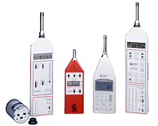
Noise Instrumentation
Sound level meter
Octave band analyzer
Dosimeter

Slide 25
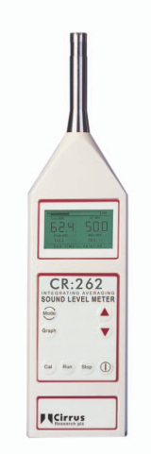
Noise Equipment
Sound Level Meter
Basic instrument to measure sound pressure variations in air.
Simply a microphone mounted on an amplifier with a meter to indicate the level of sound pressure at the microphone
ANSI S1.4-1983 Type 2, “Specifications for
Sound Level Meters”.
Set at “A” weighting scale, slow response

Slide 26
SLM Response
TIME CONSTANTS
Slow | 1000 milliseconds
Fast | 125 milliseconds
Impulse | 35 milliseconds
Peak | 50 microseconds
NOTE: Human ear averaging time is approximately 30-100 milliseconds

Slide 27
Noise Equipment
Noise Dosimeter
Instrument which integrates sound pressure over time and directly indicates a noise dose. Used for personal exposure monitoring.
ANSI S1.25-1978 “Specifications for Noise Dosimeters”.
90 dBA criterion level, 5 dB exchange rate,
80 dBA or 90 dBA threshold gate

Slide 28
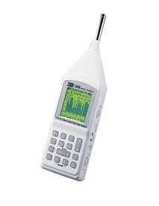
Noise Equipment
Octave Band Analyzer
Instrument used to determine where the noise energy lies in a frequency spectrum. Generally used as a diagnostic tool to help find appropriate engineering controls to reduce noise levels.
Can be used to evaluate hearing protectors
ANSI S1.11- 1986

Slide 29
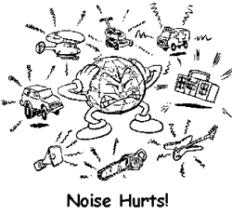
To Sample or Not?
SLM readings
Duration of exposure (How many hours does equipment run?)
Employee proximity to equipment
Multiple noise sources?
Hearing conservation program?
Complaint?

Slide 30
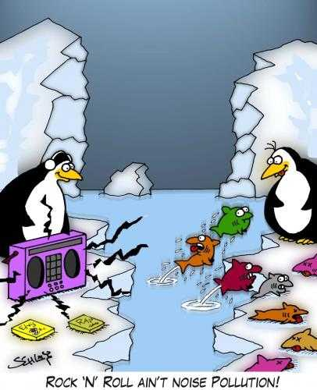
Sampling Protocol
Follow the manufacturer’s instruction booklet for proper sampling technique, microphone placement, calibration, charging, etc.
Make sure equipment is properly calibrated and battery function is adequate
Make sure microphone is in employee’s hearing zone

Slide 31
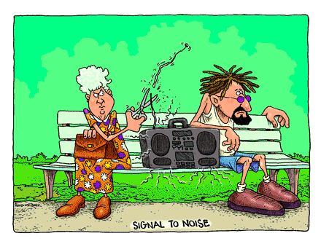
Sampling Protocol
When noise levels are different for two ears, the higher level must be used
Note situations which can interfere with equipment operation
Obtain at least 5 random SLM readings noting time and job function during reading
Record information as required
on OSHA-92

Slide 32

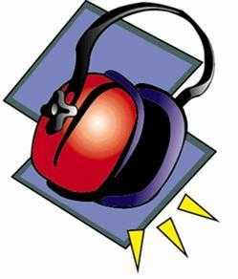
Requirements - OSHA’s Noise Regulation
29 CFR 1910.95 – General Industry
29 CFR 1926.52 – Construction Industry

Slide 33
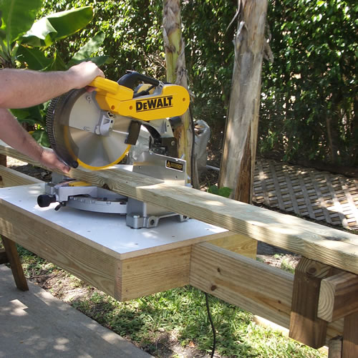
General Industry
29 CFR 1910.95
Woodworking
Textiles
Food processing
Machining operations

Slide 34
Hearing Conservation Program
29 CFR 1910.95(a)-(b)
PEL - 90 dBA 8-hour TWA
AL - 85 dBA 8-hour TWA
Maximum exposure (for example) - 115 dBA for 15 min
Maximum impact or impulse noise - 140 dBA
How can this be measured?
When would you cite it?

Slide 35
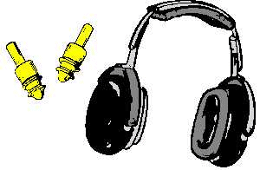
Hearing Conservation Program
29 CFR 1910.95(b)
If exposures exceed 90 dBA as an 8-hour TWA
Feasible administrative or engineering controls shall be utilized.
If such controls fail to reduce sound levels to below the PEL, PPE shall be provided and used.

Slide 36

Hearing Conservation Program
29 CFR 1910.95(c)
Employer shall administer a continuing effective hearing conservation program when noise exposures equal or exceed an 8 hour TWA of 85 dBA.
Does this program have to be in writing?
In determining exposure, no regard is given to hearing protector attenuation.
Where does hearing protection attenuation
come into play?

Slide 37
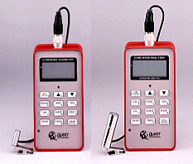
Monitoring
29 CFR 1910.95(d)
Develop a monitoring program
Develop a sampling strategy

Slide 38
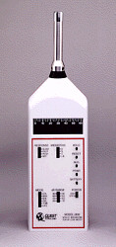
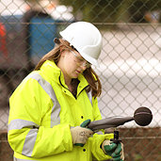
Monitoring
29 CFR 1910.95(d)
Is dosimetry required?
Can an employer comply with (d) by using an SLM?
How?

Slide 39

Employee Notification
29 CFR 1910.95(e)
Employer shall notify each employee exposed at or above 85 dBA of the monitoring results.
How would you recommend this be accomplished?

Slide 40
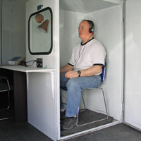
Audiometric Testing Program
29 CFR 1910.95(g)
Establish and maintain an audiometric testing program.
Baseline audiogram
Mobile test van exception
NOTE: Audiograms should be preceded
by 14 hours without workplace noise
exposure

Slide 41
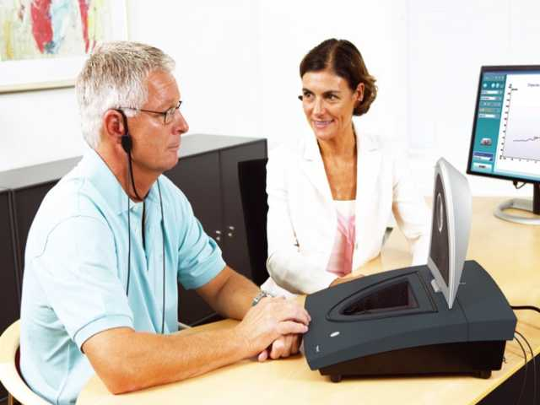
Audiometric Testing Program
29 CFR 1910.95(g)
Follow-up procedures
Revised baseline
Standard threshold shift

Slide 42
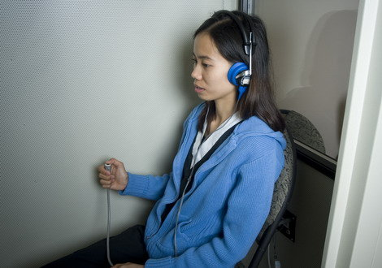
Audiometric Test Requirements
29 CFR 1910.95(h)
This section sets the criteria for how the tests should be conducted and what standards audiometric test equipment shall meet.

Slide 43
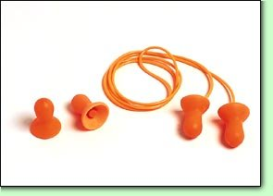
Hearing Protectors
29 CFR 1910.95(i)
Shall be available to employees exposed at or above 85 dBA
Shall be required for those employees:
Exposed at or above 90 dBA
Exposed at or above 85 dBA (no baseline)
Who have an STS

Slide 44
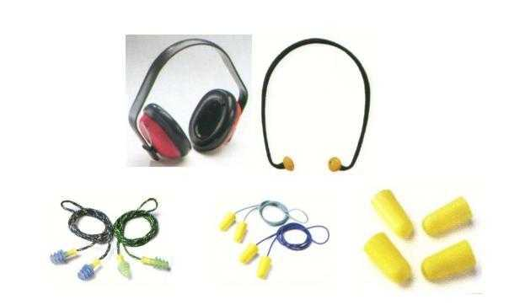
Hearing Protector Attenuation
29 CFR 1910.95(j)
Hearing protectors shall:
Attenuate to an 8 hour TWA PEL of 90 dBA
Attenuate to an 8 hour TWA PEL of 85 dBA, for those with a STS
Be reevaluated whenever noise exposures increase to determine adequacy.

Slide 45
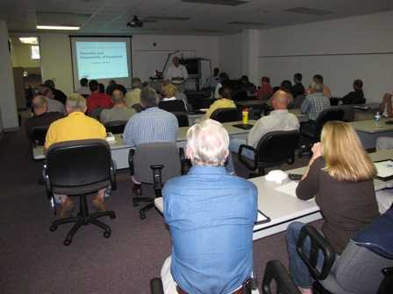
Training
29 CFR 1910.95(k)
Shall be instituted for employees exposed at or above 85 dBA
Shall be repeated at least annually, or as needed and include:
Effects of noise on hearing
Purpose of hearing protectors
Instruction and proper selection, fitting,
use, and care
Purpose of audiometric test and
explanation of the procedures and
results.

Slide 46

Construction Noise Sources
29 CFR 1926
Earth moving equipment
Power tools (nail guns, etc.)
Abrasive blasting
Jack hammers
Air compressors
Pneumatic nail guns, staple guns
Confined space

Slide 47
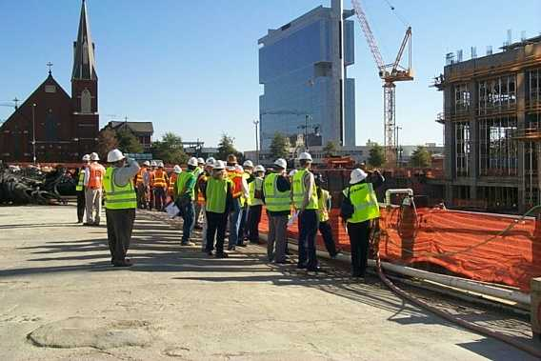
Construction Industry
29 CFR 1926
Hearing Conservation Program required at 90 dBA
What is required in a construction hearing conservation program?

Slide 48
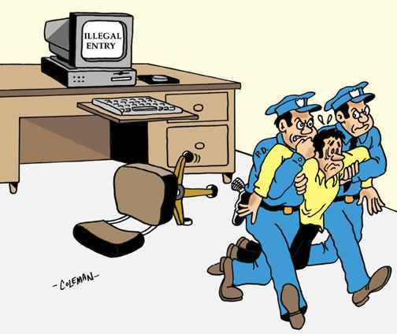
Enforcement Guidelines

Slide 49
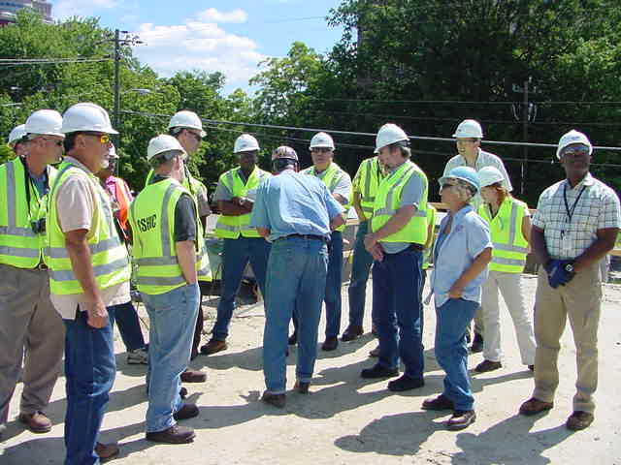
Noise Enforcement
Refer to Technical Manual Section II: Chapter 5
Use 80 dBA threshold for Hearing Conservation
Use 90 dBA threshold for PEL
Use SLM for impact noise

Slide 50
Interpreting Dosimeter Readings Using 80dBA Threshold Level
Dosimeter Reading | Compliance with PEL | Compliance with AL
<50% | Within PEL | Within Al
50% - 66% | Within PEL | Inconclusive
>66% | Within PEL | Over AL

Slide 51
Interpreting Dosimeter Readings Using 90dBA Threshold Level
Dosimeter Reading | Compliance with PEL | Compliance with AL
<50% | Within PEL | Inconclusive
50% - 66% | Within PEL | Inconclusive
66% - 100% | Within PEL | Over AL
100% - 132% | Inconclusive | Over AL
>132% | Over PEL | Over AL

Slide 52
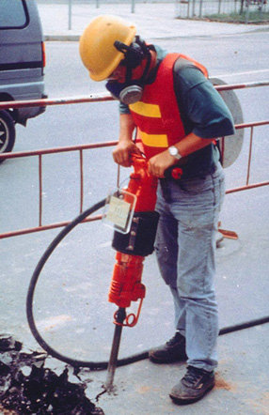
Noise Enforcement
Pre and post- calibrate equipment
Take at least 5 random SLM readings
Obtain information for OSHA-92
Take appropriate photographs
Note types and NRR of hearing
protection used; is it being used
properly?

Slide 53
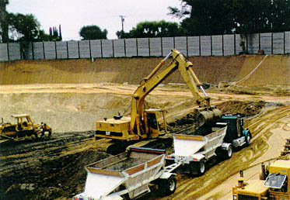
Noise Enforcement
Note type and location of noise sources adjacent to employee sampled
Copy data before you leave site
Note breaks, lunch hours, machine down time
Typical work day?

Slide 54
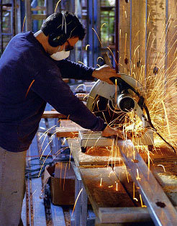
Noise Enforcement
Hearing Protector Attenuation - Compliance:
NRR-7 (for spectral uncertainty)
Approximately Field Attenuation - Recommend
NRR-7 X 50%
Dual protection: (NRR -7) + 5
Note: NRR is for higher-rated protector

Slide 55

Noise Enforcement
Serious Citation - Exposure Dose 132% and:
HP not provided or utilized correctly and/or
HCP is deficient or non-existent
“Other” Citation - Exposure Dose 66% and:
HCP is non-existent or deficient in some element
Note: If effective HP, HCP and no feasible administrative or engineering controls exist, then no citation will be issued.

Slide 56
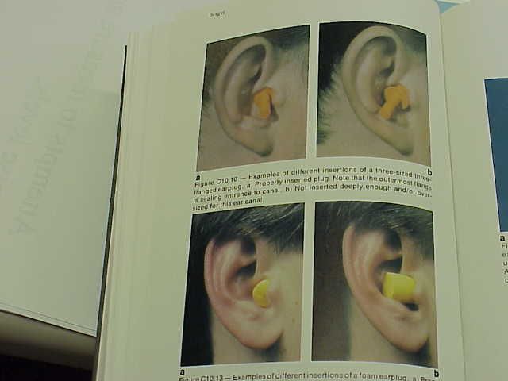
Insertion of Ear Plugs

Slide 57

Types of Hearing Loss

Slide 58
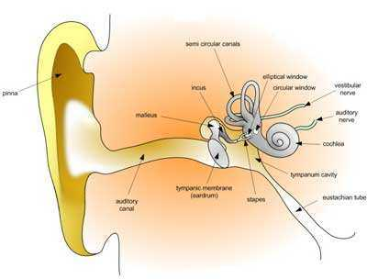
Types of Hearing Loss
Conductive hearing losses
Wax build-up
Foreign objects
Infections
Rupture of ear drum
Accidents with sharp blow to head
Some medical conditions

Slide 59
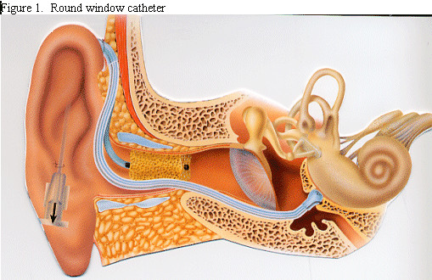
Types of Hearing Loss
Sensori-neural hearing loss
Presbycusis
Disease
Ototoxic drugs
Noise-induced hearing loss

Slide 60
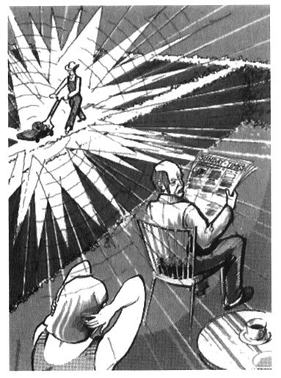
Noise-Induced Hearing Loss
Immediate acoustic trauma
Cochlear structures are mechanically broken apart by the pressure wave
Extremely intense sound levels
Gradually progressive
Temporary threshold shift
Permanent threshold shift

Slide 61
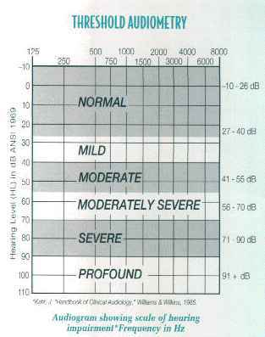
Degree of Hearing Loss

Slide 62
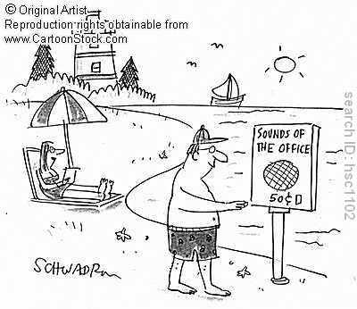
Auditory Effects of Noise
Temporary effects
Interference with communication and perception of warnings
Permanent effects
Tinnitus, recruitment
Safety concerns
Social isolation

Slide 63

Evaluating an Audiogram

Slide 64

Evaluating an Audiogram
Check for baseline audiogram
Evaluate for threshold shift in the 2,000/3,000/4,000 Hz range
If average of shift in above range is ≥10dBA then a STS has occurred (apply age correction if necessary).
Check 200 Logs for STS.

Slide 65

Audiometric Examination Report

Slide 66

Normal Hearing

Slide 67

Sensorineural Hearing Loss

Slide 68

Conductive Hearing Loss

Slide 69


Proper Methods of Noise Control

Slide 70

Noise Control
Noise engineering controls
Replacement
Source modification
Path modification

Slide 71

Noise Control
Replacement
Quieter equipment
Quieter processes
Quieter materials
Notes:
Professional noise control and ventilation for turbines Professional noise control and ventilation for turbines Professional noise control and ventilation for turbines

Slide 72

Noise Control
Source modification
Reduce driving force
Reduce response of vibrating surface
Reduce area of vibrating surface
Use directivity of source
Reduce velocity of fluid flow
Notes:
Vibration switches and monitors minimize production shut down time and repair costs by measuring the total accelerated force (shock) present on a machine. Individual acceleration measurements are summed to yield the total destructive force acting on a machine.

Slide 73

Noise Control
Path modification
Enclosures
Shields of barriers
Room absorption
Lined ducts and mufflers

Slide 74

Air Noise
Approximately 50% of all high noise sources are due to compressed air
Generally in the 2000 Hz to 8000 Hz bands
Can be controlled below 90
dB in nearly all cases
Most common sources are
blow-offs and pneumatic
valves

Slide 75


Duct Silencers

Slide 76

Compressed Air Silencer

Slide 77

Pneumatic Muffler

Slide 78


Air Silencers and Vibration Mounts

Slide 79

Noise Curtains

Slide 80




Expansion Joints/Fan Connector

Slide 81


Sound Absorption Baffles and Wall Panels

Slide 82

Resources
OSHA Technical Manual
FIS (search DOL intranet)
Internet (USDOL, NIOSH, etc.)
Library (check DOL intranet)

Slide 83

Resources
NIOSH Technical Report - Compendium of Materials for Noise Control (80-116)
NIOSH Criteria for a Recommended Standard (98-126)
Noise and Hearing Conservation Manual
(Berger,Ward, Morrill, Royster; 4th edition)

Slide 84

Case Studies

Slide 85

Case Studies
For each of the following case studies:
What OSH violations are present?
What is the hazard?
Which employees are exposed?
How many?
What is the assessed severity
and probability?
What are some abatement recommendations?

Slide 86
Case Study #1 – Groups 1 & 2
Employees at a yarn manufacturing facility are exposed to noise in various departments including carding, drawing, roving, and spinning.
The facility operates three 8-hour shifts each day.
Employees operate the textile machinery and wear EAR foam ear plugs as shown in the following photos.
Audiograms were conducted for a few employees three years ago, but none since.
The company has a written hearing conservation program.
Noise monitoring was conducted with Type-2 Quest Dosimeters

Slide 87
Case Study #1
Dose | Employee #1 Carding | Employee #2 Maintenance | Employee #3 Roving | Employee #4 Ring Spinning
Dose – LTL | 120.75 | 53.24 | 75.8 | 199.12
Dose – HTL | 99.6 | 39.15 | 59.2 | 172.31
Lavg – LTL | 91.64 | 87.07 | 88.2 | 94.84
Lavg – HTL | 90.3 | 84.84 | 86.4 | 93.78
Ltwa – LTL | 91.4 | 85.52 | 88.0 | 95.03
Ltwa – HTL | 90.03 | 83.3 | 86.2 | 93.98
Peak | 143 | 128.6 | 118.2 | 123.0
Run Time | 7:41 | 6:25 | 7:44 | 8:09

Slide 88

Case Study #1

Slide 89

Case Study #1

Slide 90

Case Study #1

Slide 91

Case Study #1

Slide 92

Case Study #1

Slide 93

Case Study #2 – Groups 1 & 2
Three employees operate a corrugating machine at a cardboard manufacturing plant.
One 8-hour shift is utilized, and the company has a full hearing conservation program.
The company says they are aware of the noise problem, but that it will cost about $600,000 to enclose the corrugating machine.

Slide 94
Case Study #2
Dose | Machine Operator
Dose – LTL | 376.45
Dose – HTL | 374.24
Lavg – LTL | 99.56
Lavg – HTL | 99.52
Ltwa – LTL | 99.56
Ltwa – HTL | 99.52
Peak | 115.4
Run Time | 8:00

Slide 95
Case Study #3 – Groups 1 & 2
Employees at a small woodworking shop operate a variety of machines in the manufacture of table legs.
The company has no hearing conservation program.
Employees work four ten-hour shifts each week.

Slide 96
Case Study #3
Dose | Lathe Operator | Sander
Dose – LTL | 169.24 | 138.94
Dose – HTL | 137.20 | 112.42
Lavg – LTL | 92.25 | 90.97
Lavg – HTL | 90.73 | 89.44
Ltwa – LTL | 93.80 | 92.37
Ltwa – HTL | 92.28 | 91.45
Peak | 114.7 | 120.8
Run Time | 9:55 | 9:43

Slide 97

Case Study #3

Slide 98

Case Study #3

Slide 99

Case Study #3

Slide 100

Case Study #3

Slide 101
Case Study #4 – Groups 3 & 4
Employees operating jet and atmospheric dye machines at a textile dyeing and finishing plant are exposed to noise throughout their 8-hour shifts.
The company has a partial hearing conservation program.
Ear plugs are provided, but generally not used by employees (and not required).
Audiograms are conducted annually when the test van comes to the plant.
The OSHA 300 logs showed 3 STS’s (out of 40 Dye Room employees tested).
Monitoring by the HCO was shorted by about 90 minutes when the employee sampled went home sick.

Slide 102
Case Study #4
Dose | Jet Dye Machine Operator | ATM Dye Machine Operator
Dose – LTL | 56.45 | 64.84
Dose – HTL | 12.41 | 9.54
Lavg – LTL | 87.37 | 86.92
Lavg – HTL | 76.44 | 73.10
Ltwa – LTL | 85.88 | 86.87
Ltwa – HTL | 74.95 | 73.05
Peak | 109.8 | 112.4
Run Time | 6:30 | 7:57

Slide 103

Case Study #5 – Groups 3 & 4
Employees at a paper recycling plant shred and re-bale cardboard and wastepaper for sale to other companies.
The workers feed paper onto the conveyor and it is dumped into the shredder.
Hearing protection was not worn on the first day of the inspection but was used during the noise monitoring.
No other elements of a hearing conservation program were in place.
Some of the laborers in this area were working for a temp company and had been there for about a 1 ½ months.

Slide 104
Case Study #5
Dose | Baler | Laborer | Laborer
Dose – LTL | 91.0 | 157.8 | 161.8
Dose – HTL | 62.9 | 144.3 | 147.6
Lavg – LTL | 89.4 | 93.5 | 93.6
Lavg – HTL | 86.7 | 92.8 | 92.9
Ltwa – LTL | 89.3 | 93.3 | 93.5
Ltwa – HTL | 86.7 | 92.6 | 92.8
Peak | 126.7 | 135.0 | 132.7
Run Time | 7:57 | 7:55 | 7:59

Slide 105

Case Study #5

Slide 106

Case Study #5

Slide 107


Case Study #5

Slide 108


Case Study #5

Slide 109

Following Abatement

Slide 110

Following Abatement

Slide 111

Following Abatement

Slide 112

Following Abatement

Slide 113

Case Study #6 – Groups 3 & 4
Employees at a road construction site are operating a rock drill.
They utilize ear plugs properly (NRR=24) and receive baseline audiograms.
However, annual audiograms, initial monitoring, and training are not conducted.
Exposure monitoring showed a Dose-HTL of 627% as measured over 8 hours.

Slide 114

Case Study #6

Slide 115

Thank You For Attending!
Final Questions?
1-800-NC-LABOR
(1-800-625-2267)
www.nclabor.com

