Slide 1
N.C. Department of Labor OSH Division
Laboratory Safety and Health
29 CFR 1910.1450
Notes:
Rev 0: 6/24/2013

Slide 2
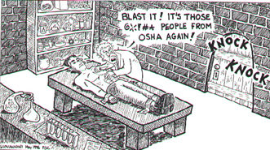
Frankenstein’s Lab, SIC 8731…
Notes:
I also want to add that:
I am not a chemist
I am not a lab expert
I do not know it all, BUT
I love to learn and it is my hope that I can teach you something and that you can teach me something.
I have 2 hours to cover this material, and most of you in here will have heard much of this before. I don’t want this to be a lecture in industrial hygiene/chemistry, nor do I want to ignore it for the sake of those in this class that do not have that knowledge by way of education or experience. I want everyone to get something from this class. I can tell you honestly that putting this presentation together has been a great review for myself!

Slide 3
Course Objectives
29 CFR 1910.1450
Provide overview of the “Occupational exposure to hazardous chemicals in laboratories” (a.k.a. “The Lab Standard”)
Enable CSHO to correctly cite lab standard by:
Defining laboratory use
Identifying the types of laboratories covered by the standard
Identifying exceptions (when to cite the other health standards in Subpart Z or the lab standard)
Know what to look for in a lab by understanding the employer’s Chemical Hygiene Plan.
Identify other “shall’s” of the lab standard
Notes:
A few of the pictures, stories, slides are taken from the OSHA TI Course in Salt Lake City Utah.
The course lasted for 3.5 days, and one day was spent at the Salt Lake Technical Center where Federal OSHA and some state plan states sent their field samples (air, soil, bulk, etc.) to be analyzed.
The class walked through the laboratory to evaluate it for safety and health hazards (for violations of the lab standard and other applicable standards).
We were also provided a copy of their Chemical Hygiene Plan.
The first few days of the class we covered the lab standard, chemical hazards, flammables, compressed gases, emergency response, and bio-safety.
I learned a lot just from the first day of class when we covered the scope and application of the lab standard. The scope is vital to the correct application of this standard. There are many compliance officers that incorrectly cite the lab standard, based solely on the scope.
Other aspects of the OSHA TI course on lab safety that was beneficial was
The class participation (hint, hint)…there were a variety of questions representing the many different backgrounds in the classroom. There were compliance officers, consultants, and people from private industry. Many state plan states were represented as well.
2. The presenter (chair person, Jim Miller) was very professional, and knowledgeable in the subject manner.
The field trip to the SLTC was interesting (getting to see where/how samples are analyzed), and getting to apply some of what we learned in class.
4. It was good to hear stories, pictures, accidents, and fatalities from various locations throughout the country.
The OSHA TI course really taught me a lot about the lab standard, but I am finding that Laboratory Safety and Health goes well beyond the standard.
For this presentation, I have borrowed information and pictures from Duke (where I worked before coming to OSHA), from the HazMat team (RRT-4) for which I am a member of, from the internet, NCOSH intranet, and Fed OSHA website, from the course information presented in Utah, and a little from my job at East Carolina School of Medicine as a Radiation Safety Technician, and many other resources. I have also referred to several Chemical Hygiene Plans from different companies.
I will cover every paragraph of the Lab Standard, spending time on the more pertinent parts of it.
I will cover other safety and health items/issues that may be encountered in the laboratory, but covered by a different standard. This may help you answer the question “what am I looking for in here?”
There are Appendices attached to your presentation package including a glove selection guide and resources, chemical incompatibility charts, example inspection checklist, and an expanded health standard chart.
If there is time, I have a really good 30 minute video that may help put some of this information into perspective.

Slide 4
Objective 1 Correctly Cite the Lab Standard
29 CFR 1910.1450(a)(1)
Scope and application
This section shall apply to all employers engaged in the laboratory use of hazardous chemicals.

Slide 5

Scope and Application
29 CFR 1910.1450(a)
Exceptions to citing the lab standard
Supersedes all OSHA health standards in 29CFR 1910, Subpart Z, except:
Employee exposure shall not exceed PEL’s already set by other standards
Prohibition of skin and eye contact set by other standards shall be observed
Where an action level is routinely exceeded for an OSHA regulated substance, the exposure monitoring and medical surveillance requirements paragraphs (d) and (g)(1)(ii) of this section shall apply.
Notes:
Where this section applies, it shall supersede, for laboratories, the requirements of all other OSHA health standards in 29 CFR part 1910, subpart Z, except as follows:1910.1450(a)(2)(i) For any OSHA health standard, only the requirement to limit employee exposure to the specific permissible exposure limit shall apply for laboratories, unless that particular standard states otherwise or unless the conditions of paragraph (a)(2)(iii) of this section apply.1910.1450(a)(2)(ii) Prohibition of eye and skin contact where specified by any OSHA health standard shall be observed.1910.1450(a)(2)(iii) Where the action level (or in the absence of an action level, the permissible exposure limit) is routinely exceeded for an OSHA regulated substance with exposure monitoring and medical surveillance requirements paragraphs (d) and (g)(1)(ii) of this section shall apply.
MS Clip Art

Slide 6

Scope and Application
29 CFR 1910.1450(a)
Does not apply to:
Use of hazardous chemicals which do not meet the definition of laboratory use
Lab use of hazardous chemicals having no potential for exposure, such as:
Chemically-impregnated test media
Commercially prepared kits such as those used to perform pregnancy testing
Notes:
1910.1450(a)(3) This section shall not apply to:1910.1450(a)(3)(i) Uses of hazardous chemicals which do not meet the definition of laboratory use, and in such cases, the employer shall comply with the relevant standard in 29 CFR part 1910, subpart Z, even if such use occurs in a laboratory.1910.1450(a)(3)(ii) Laboratory uses of hazardous chemicals which provide no potential for employee exposure. Examples of such conditions might include:1910.1450(a)(3)(ii)(A) Procedures using chemically-impregnated test media such as Dip-and-Read tests where a reagent strip is dipped into the specimen to be tested and the results are interpreted by comparing the color reaction to a color chart supplied by the manufacturer of the test strip; and1910.1450(a)(3)(ii)(B) Commercially prepared kits such as those used in performing pregnancy tests in which all of the reagents needed to conduct the test are contained in the kit.
MS Clip Art

Slide 7

Definitions
29 CFR 1910.1450(b)
Laboratory use
Handling or use of such chemicals in which ALL the following conditions are met:
Chemical manipulations are carried out on a “laboratory scale”
Multiple chemical procedures or chemicals are used
The procedures involved are NOT part of a production process
“Protective laboratory practices and equipment” are available and in common use
Notes:
Chemical manipulations simply means the use of chemicals.
3.Production simply means operation where a product is produced such as, refineries, utility-generating companies, manufacturing plants.
4.”Protective laboratory practices and equipment” means those laboratory procedures, practices and equipment accepted by laboratory health and safety experts as effective, or that the employer can show to be effective, in minimizing the potential for employee exposure to hazardous chemicals. ***The intent refers that a body of information, accepted by safety and health experts is AVAILABLE. Not to exclude those labs from coverage if they did not have these practices and equipment.
Private sector QC labs are not covered: (“I’m doing it to prove my product is okay”)… Testing incoming product and outgoing product. These labs will fall under HazCom. If they do ANYTHING else, then they are covered. **QC exemption only for private sector manufacturing a product. Quality Control Labs generally not covered because they are usually adjuncts of production operations.
Municipalities – potable water – production is QC OR electrical power generation water treatment labs.
Photography labs are QC
Dental Labs are production/QC
Production pharmacies are QC
No and Yes to Small Medical Labs drawing blood (No if just drawing blood and no other activities are involved—biohazards are not w/in the scope. YES if use chemicals to analyze the blood.
YES: Any EPA compliance work (testing wastewater effluent, air quality, etc.) simply for determining compliance with EPA discharge criteria is covered . This would only be considered QC if the results of the monitoring are used as a source of info. for process control adjustment.
Yes to I.H. labs doing asbestos analysis all day long.
Yes to bench scale operations that look @ substitutes for processes. (It is considered research).
Yes/No to soil & water analysis of unknowns (yes, so long as not assuring product liability).
Yes/No to Labs that use toxic materials just for calibration (Yes, if calibration is for purposes other that QC, AND assuming ee’s are exposed to toxic materials.)
SIC codes are not used as a criteria for scope of coverage.
Repetitive nature is not criteria used in determining coverage. This was mentioned in the preamble as one of the characteristics that labs generally have.

Slide 8
Definitions
29 CFR 1910.1450(b)
Laboratory scale
Containers used for reactions, transfers, and other handling of substances are designed to be easily and safely manipulated by one person.
(Excludes those workplaces whose function is to produce commercial quantities of materials.)
Notes:
Mention PSM
OSHA developed definitions for “laboratory scale” and “laboratory use” so as to focus on the CONDITIONS of the workplace rather than on the word “laboratory” itself.
Quantity limits is not a criteria for laboratory scale. So, instead it is defined in relation to the size of containers

Slide 9
Definitions
29 CFR 1910.1450(b)
Laboratory
A facility where the “laboratory use of hazardous chemicals” occurs.
It is a workplace where relatively small quantities of hazardous chemicals are used on a non-production basis.
Notes:
Laboratory as defined is not subject to the PSM stds (“relatively small quantities” is less than the threshold quantities of hazardous chemicals listed in the PSM std.)

Slide 10
Definitions
29 CFR 1910.1450(b)
Chemical hygiene officer
Employee designated by employer that has the training or experience to provide technical guidance in the development and implementation of the Chemical Hygiene Plan.
Definition not intended to place
limitations on the position description
or job classification that the designated
individual holds within the employer's
organizational structure.
Notes:
Chemical Hygiene Officer means an employee who is designated by the employer, and who is qualified by training or experience, to provide technical guidance in the development and implementation of the provisions of the Chemical Hygiene Plan. This definition is not intended to place limitations on the position description or job classification that the designated individual shall hold within the employer's organizational structure.
MS Clip Art

Slide 11

Definitions
29 CFR 1910.1450(b)
Chemical hygiene plan
Written program developed and implemented that sets forth procedures, equipment, personal protective equipment and work practices that protect employees from health hazards presented by hazardous chemicals used in the workplace
Notes:
Chemical Hygiene Plan means a written program developed and implemented by the employer which sets forth procedures, equipment, personal protective equipment and work practices that (i) are capable of protecting employees from the health hazards presented by hazardous chemicals used in that particular workplace and (ii) meets the requirements of paragraph (e) of this section.
MS Clip Art

Slide 12
Definitions
29 CFR 1910.1450(b)
Hazardous chemical
Chemical that has statistically significant evidence that acute or chronic health effects may occur in exposed employees.
“Health hazard" includes carcinogens, toxic agents, reproductive toxins, irritants, corrosives, sensitizers, hepatotoxins, nephrotoxins, neurotoxins, agents which act on the
hematopoietic systems, those that damage
the lungs, skin, eyes, or mucous membranes.
Notes:
Hazardous chemical means a chemical for which there is statistically significant evidence based on at least one study conducted in accordance with established scientific principles that acute or chronic health effects may occur in exposed employees. The term "health hazard" includes chemicals which are carcinogens, toxic or highly toxic agents, reproductive toxins, irritants, corrosives, sensitizers, hepatotoxins, nephrotoxins, neurotoxins, agents which act on the hematopoietic systems, and agents which damage the lungs, skin, eyes, or mucous membranes. Appendices A and B of the Hazard Communication Standard (29 CFR 1910.1200) provide further guidance in defining the scope of health hazards and determining whether or not a chemical is to be considered hazardous for purposes of this standard.
MS Clip Art

Slide 13

When are employees covered?
At least one employee doing analysis
Laboratory use
At least one chemical
Must be a potential for employee exposure
Examples of conditions of no exposure
Dip and read tests
Commercially prepared kits
Notes:
All employers engaged in the laboratory use of hazardous chemicals.
Define laboratory use: on next slide
(2)
Can be any employee, any where **There is no size requirements (can be 1 person in a mobile unit, tent, etc.) **ALSO, maintenance and custodial may be included. But not visitors or sales people.
There has to be at least ONE Chemical (no physical testing labs)
Chemicals ONLY– does not apply to biohazard (go general duty or bloodborne standard) until extracted and manipulated.
Ex. Dog bite with rabies = biohazard
But if you extract the rabies and research on = chemical
All human samples (blood, etc.) will apply because using other chemicals to research it.
No potential for employee exposure examples:
Procedures using chemically-impregnated test media such as Dip-and-read tests where a reagent strip is dipped into the specimen to be tested and the results are interpreted by comparing the color reaction to a color chart supplied by the manufacturer of the test strip.
Ex. The tests used at the doctors office for checking urine for level of glucose, protein, etc.
Commercially prepared kits in which all of the reagents needed to conduct the test are contained in the kit.
Ex. pregnancy test
Automated tests

Slide 14
The Formaldehyde Exception
The use of formaldehyde in histology, pathology and anatomy labs will remain under the formaldehyde standard, as directed by that standard.
All other uses of formaldehyde will be covered by the lab standard.
Found in the Federal Register, Vol. 55, No. 21 Supplementary Information, Summary of Issues and Explanations of Provisions of the Final Standard, Paragraph (a) Scope and Application, Preemption by Other OSHA Health Standards.

Slide 15
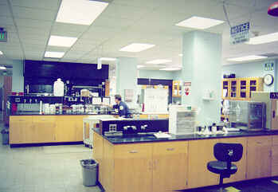
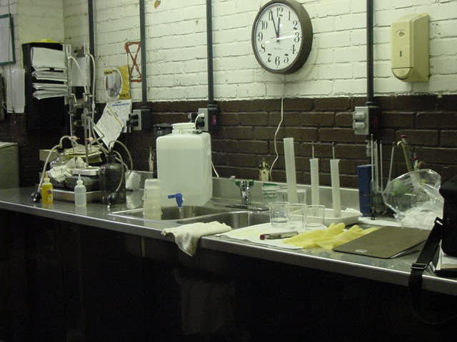
Does the lab standard apply?
Wastewater Lab
Yes
QC Lab
No
Notes:
EPA discharge criteria!
QC is usually an adjunct of a production process

Slide 16
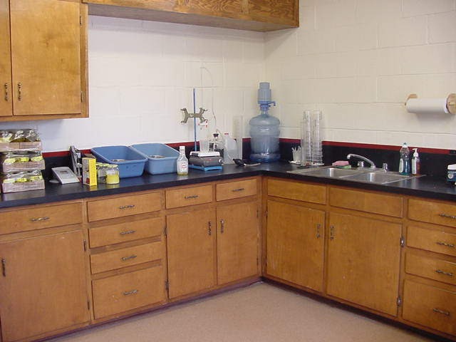
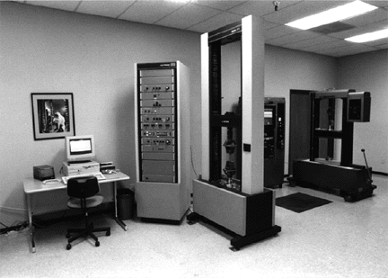
Does the lab standard apply?
R & D
Yes
Physical Testing Lab
No
Notes:
Mount Olive Pickle
Remember, there must be at least one chemical!

Slide 17


Does the lab standard apply?
Computer Lab
No
NASA Bio-Technology Lab
Yes
Notes:
Ha Ha
Biotechnology is an upcoming thing in the world with the space station. It would be great work as an IH

Slide 18
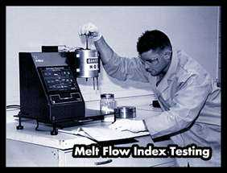
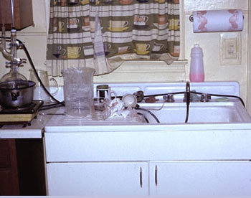
Does the lab standard apply?
Physical Testing Lab
No
Clandestine Lab
Yes
Notes:
Clandestine labs are illicit operations consisting of chemicals and equipment necessary to manufacture controlled substances. They can be in mountain cabins, rural farms, single and multifamily residences, in urban and suburban neighborhoods.
Drugs like methamphetamine, PCP, MDMA, methcathinone, require little knowledge or equipment. LSD requires much higher levels of expertise.

Slide 19
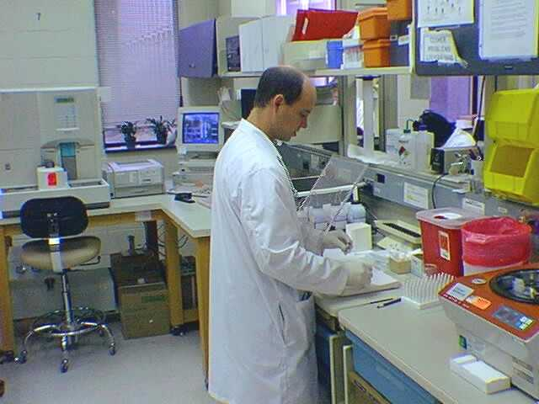
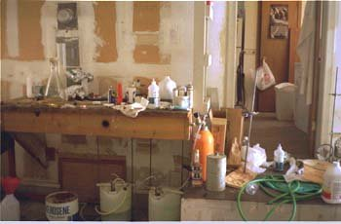
Does the lab standard apply?
Medical Research
Yes
Clandestine Methamphetamine Lab
Yes
Notes:
Research, so long as all conditions are met. Lab std does not apply to biologicals or radiologicals

Slide 20
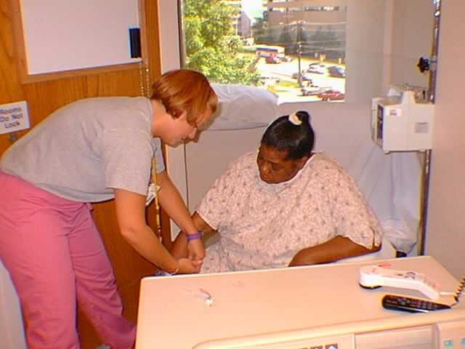
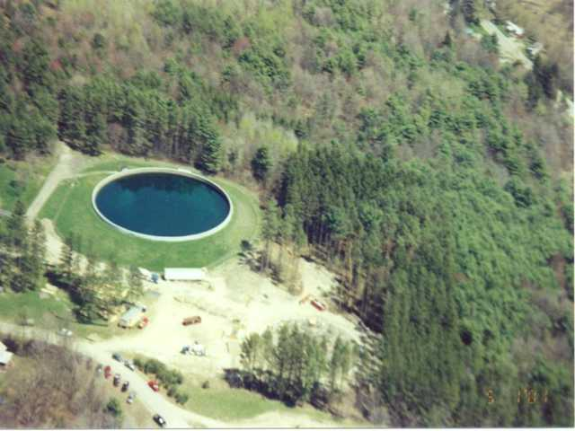
Does the lab standard apply?
Physician’s Clinic Lab
No? Maybe Yes
Water Treatment Labs
No
Notes:
No, and yes, really depends on what is being done. If just drawing blood and no other activities are performed then no (as biohazards are not within the scope). If used chemicals to analyze blood, then yes it is covered.
Water treatment is production (water is the product). And may be analyzing the water for quality control purposes.

Slide 21
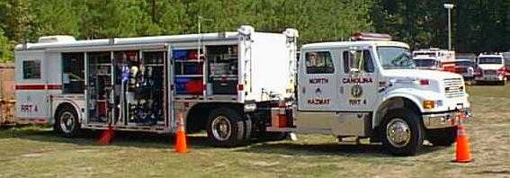
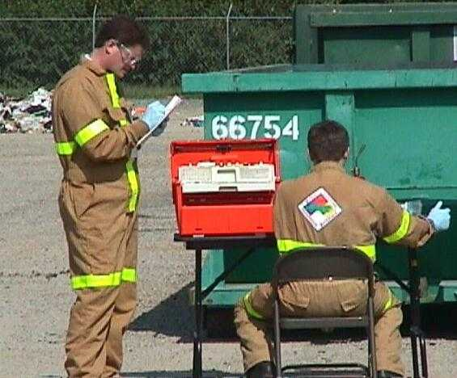
Does the lab standard apply?
NC Regional Response HazMat Team 4 (RRT 4)
Yes!
Notes:
Yes. Research. Mobile unit. Analyzing unknowns

Slide 22
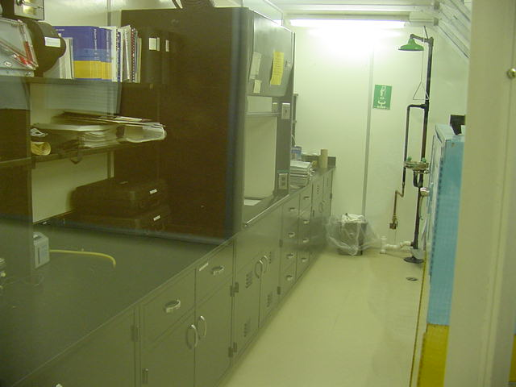
Does the lab standard apply?
Notes:
Do we need a chemical hygiene plan???
Remember: Failure to fit within the scope and application section of the lab std. Merely shifts the employer’s obligation to compliance with the appropriate general industry standards. Moreover, it should be noted that the general duty clause, section 5 (a)(1) of the OSH Act, continues to be applicable to all employers

Slide 23

PELs
29 CFR 1910.1450(c)
For laboratory uses of OSHA regulated substances, the employer shall assure the employees’ exposures to such substances do not exceed the permissible exposure limits specified in 29 CFR 1910, Subpart Z.

Slide 24
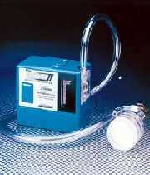
Employee Exposure Determination
29 CFR 1910.1450(d)
Initial monitoring
Employer shall measure exposure for any chemical with a standard if there is reason to believe that exposure exceed, routinely, the action level or PEL
Periodic monitoring
If the initial monitoring show exposure over the action level or PEL, the employer shall comply with monitoring requirements of the relevant standard
Notes:
First meet the definition of lab use (if doesn’t, then must comply with relevant std. even though it occurs in a lab.
Second, there must be a potential for employee exposure.
Keep in mind… Workers are often exposed to a mixture of hazardous substances which may produce a variety of toxic reactions. Such reactions may be synergistic or additive. Mixed exposures would be more common in labs than in general industry…(lab std. History)

Slide 25
Employee Exposure Determination
29 CFR 1910.1450(d)
Termination of monitoring
Per the applicable standard
Employee notification of monitoring
Within 15 working days of getting results, notify employees in writing individually or by posting in appropriate, accessible location

Slide 26
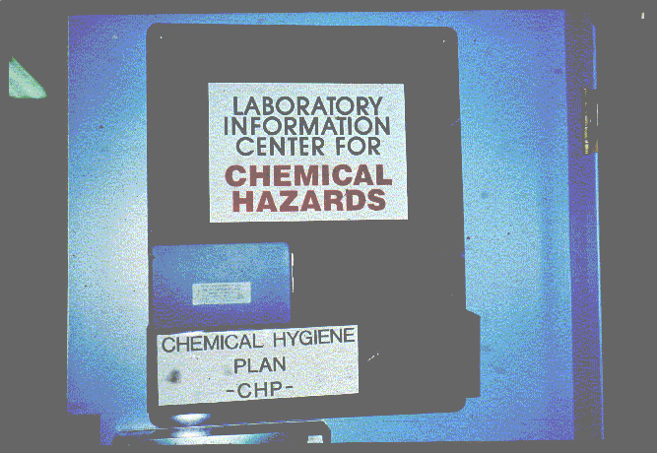
Objective 2 Chemical Hygiene Plan
29 CFR 1910.1450(e)
Notes:
The chemical hygiene plan is the heart of the lab standard. It is the employer’s policy, procedure, approach to handling safety and health in a laboratory setting.
The plan shall:
1) Be capable of protecting employees from health hazards associated with hazardous chemicals and
2) Be capable of keeping exposures below the specific exposure limits specified in paragraph ( c) and as stated earlier.
The question as to whether a CHP would be required for each individual laboratory in establishments with many separate laboratory operations or whether a single facility-specific plan would suffice, should be decided locally by the facilities covered. Ideally, the plan should be specific enough to a particular workplace that it does not require employees to familiarize themselves with extraneous material that is not relevant.
(3) The plan shall include the following elements and shall indicate specific measures to ensure employee protection..
SOPs

Slide 27
Chemical Hygiene Plan
29 CFR 1910.1450(e)(1)-(2)
The employer shall develop and carry out provisions of a plan where hazardous chemicals are used in the workplace to:
Protect employees from health hazards, and
Keep exposures below PELs
The Plan must be readily accessible to employees and others as defined
Please note: Non-mandatory Appendix A of the Lab Standard 1910.1450 provides guidance to assist employers in plan development.

Slide 28
Chemical Hygiene Plan
29 CFR 1910.1450(e)(3)(i)
The plan shall include the following elements and and shall indicate specific measures to ensure employee protection:
Standard Operating Procedures (SOPs) , Safe Work Practices (SWPs), or Standard Operating Guidelines (SOGs)
Developed to ensure employees are
protected from all potentially hazardous
chemicals in use in their work area
Notes:
The CHP must include necessary work practices, procedures, and policies to ensure employee’s are protected from all potentially hazardous chemicals in use in their work area.
Written safe work practices are often the most important component of a good safety program, esp. when used for training and education.

Slide 29
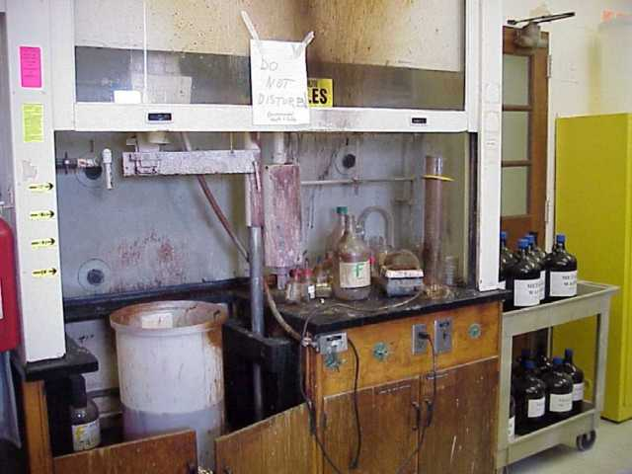
NCSU’s Chemistry Department Chemical explosion
Notes:
Reagent being prepared on the day of the incident was for a general chemistry lab titration that involved adding potassium permanganate powder to concentrated sulfuric acid. The reaction that took place resulted in an explosion. The chemical mixture splashed on the employee resulting in second and third degree burns.
The eyewash safety shower was 70+ feet from the lab and the path to get to it involved going through two doors and maneuvering around lab benches. Sometimes the lab with the eyewash/safety shower is closed and locked. Safety glasses and nitrile gloves were worn. No lab coat. No face shield. She had safety/haz com training (inc. MSDSs). The PPE required to be worn while working with conc. Acids was not provided by the employer. She had done this procedure several times but usually only made half the volume. The procedure was not in writing, but was shown to her by a previous lab technician.
Rule of thumb:
Never add anything to a concentrated acid unless the final solution is a conc. Acid. Dilute the acid first.
Oxidizers (such as KMnO4) are incompatible with strong acids
Check your MSDSs AND other chemistry resources.
“Do what you outta add acid to wata”
How/ What would you cite?

Slide 30
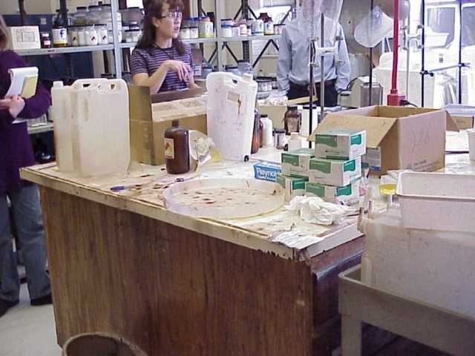
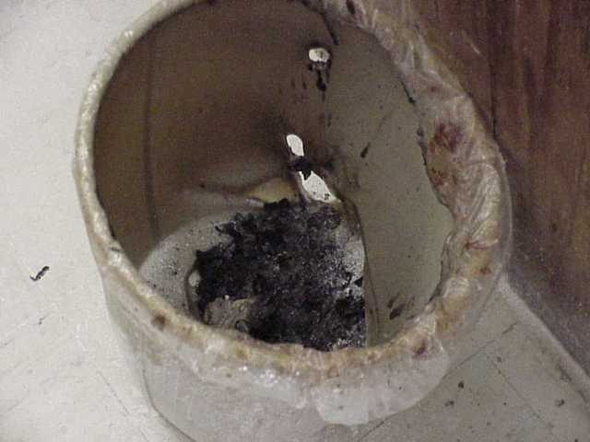
SOP’s = Chemical Explosion
Notes:
The splatter from the explosion reached the ceiling and all sides of the room.
Here you can see the melted trash can directly across from the fume hood where the explosion occurred.

Slide 31
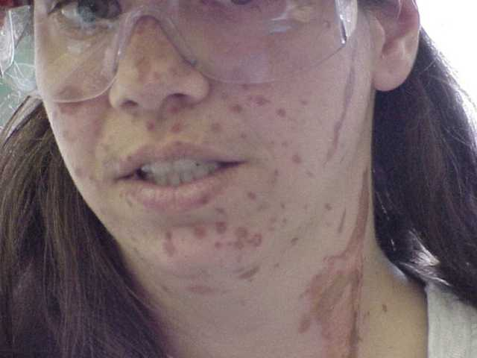
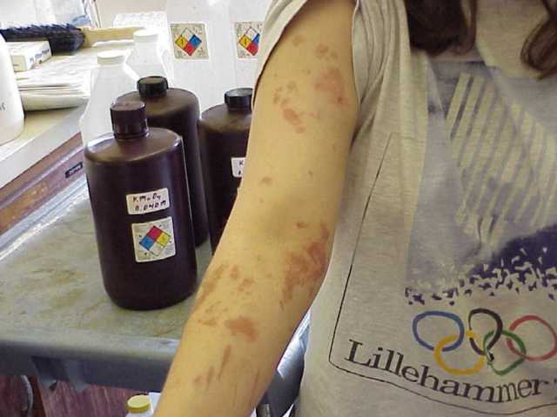
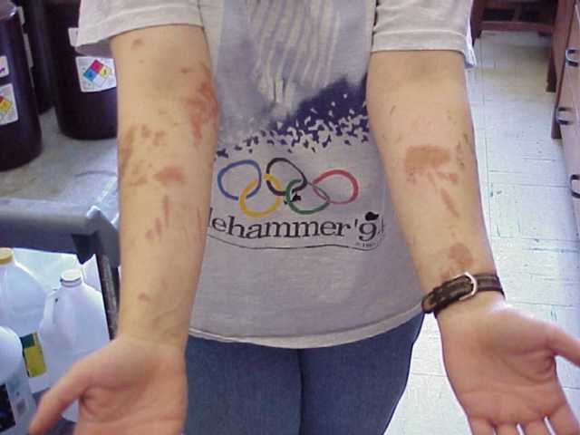
Chemical Explosion
Notes:
In the absence of safe work practices, exposure to hazardous chemicals in the laboratory presents a significant risk of material health impairment (remember the discussion of significant risk?)

Slide 32
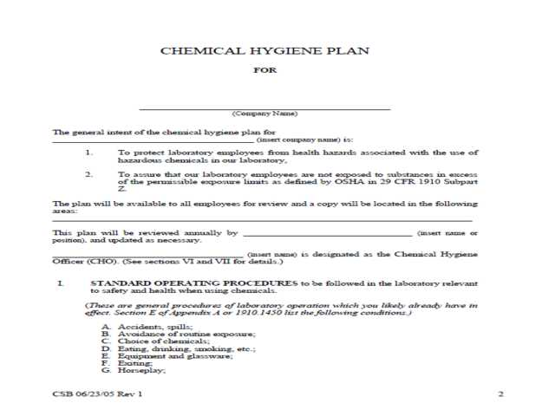
How can the employer ensure safety and health through SOPs?
The employer must write in the SOP/SWP what the procedure is, how to perform the procedure (what materials are needed), what reagents are used, what reactions will take place, (all from a safety perspective)
What PPE is required
How to order the chemical
How to store and dispose of the chemicals

Slide 33
Chemical Hygiene Plan Control Measures
29 CFR 1910.1450(e)(3)(ii)
Criteria that will be used to determine and implement control measures to reduce employee exposure to hazardous chemicals including:
Engineering controls
PPE and hygiene practices
Control measures for chemicals that are known to be extremely hazardous
Notes:
We will talk about each of these as we move along through the presentation

Slide 34
Chemical Hygiene Plan Control Measures
29 CFR 1910.1450(e)(3)(ii)
Criteria that will be used to determine and implement control measures to reduce employee exposure to hazardous chemicals including:
Engineering controls
PPE and hygiene practices
Control measures for chemicals that are known to be extremely hazardous

Slide 35
Examples of Engineering Controls
How often are fume hoods inspected?
Who certifies the hoods?
What if the hood doesn’t pass inspection?
Are there BSC’s (biological safety cabinets)?
Eyewash and safety shower inspections?
Fire extinguisher inspections?
Chemical stockrooms/ storerooms?
Ventilated storage cabinets?
Power failure controls?
What happens to the exhausted air from BSC’s, isolation rooms, stockrooms, etc?….

Slide 36
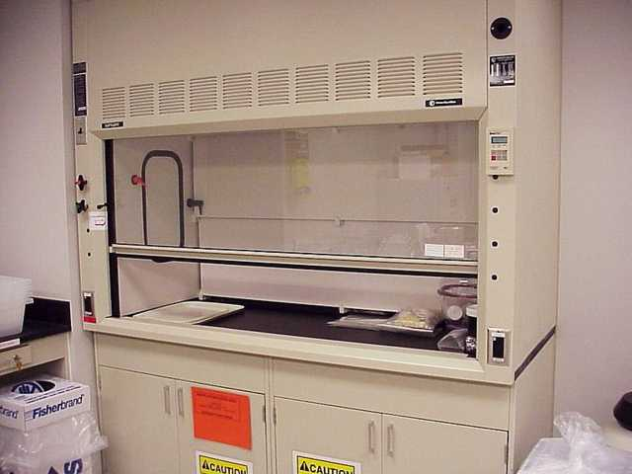
Examples of Engineering Controls
Laboratory ventilation
Facility’s heating and air conditioning system
Fume hoods (are NOT biological safety cabinets!!)
Transport of chemicals
Flammable storage
Sharps use?
Notes:
Laboratory ventilation is a key factor in controlling employee exposure to hazardous substances. Ventilation is provided in two ways:
Through the facility’s heating and air conditioning system
And through fume hoods utilized in the laboratory
* Fume hoods are not be used as a substitute for Biological Safety Cabinets (BSC) which are laminar flow hoods. Or vice versa.

Slide 37
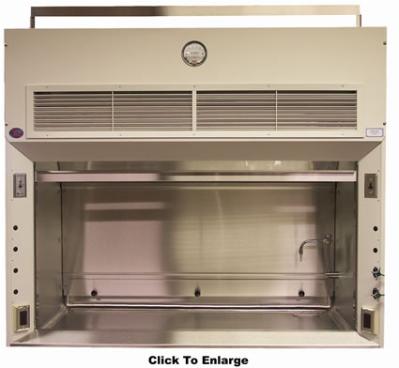
Engineering Controls Laboratory Ventilation
Types of laboratory hoods
Enclosure hoods
Exhaust hoods with HEPA filters (ex. For use with asbestos)
Perchloric acid hoods
Walk-in hoods
Capturing type hoods
Slot vents
Flex ducts
Glove box
Notes:
NIOSH was requested on several occasions to evaluate employee exposures to xylene, formaldehyde, chloroform, toluene, and methyl methacrylate in histology, cytology, and surgical pathology labs following employee complaints of respiratory and behavioral problems. The investigations did show in some instances, a health hazard did exist. Major contributors to the hazardous conditions included ineffective exhaust ventilation and poor work practices.
OSHA’s definition of a fume hood is a “device located in the laboratory which is enclosed on five sides with a movable sash or fixed particle enclosure on the remaining side; constructed and maintained to draw air from the laboratory and to prevent or minimize the escape of air contaminants into the lab; and allows chemical manipulations to be conducted in the enclosure without insertion of any portion of the employee’s body other than hands and arms.
Fume hoods are used for the safe handling of noxious, corrosive, or volatile chemicals. They reduce worker exposure to chemical vapors, gases, fumes and dusts generated in the laboratory and reduces the possibility of fire and explosion hazards inherent in chemical research and development.

Slide 38
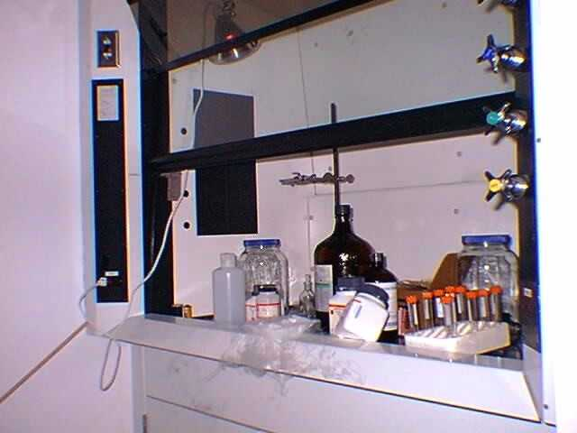
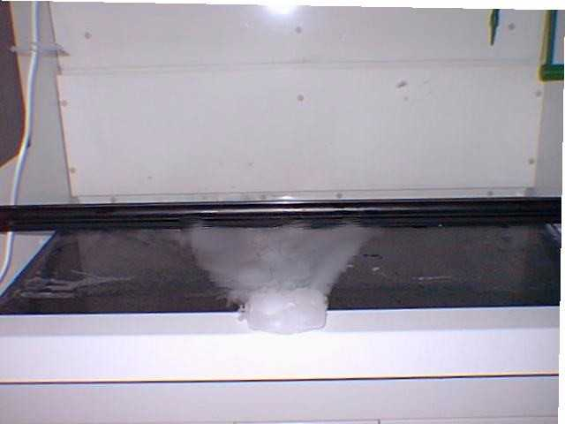
Engineering Controls Laboratory Ventilation
Bad Flow
Good Flow
Notes:
When large obstructions are placed in the hood, the air flow is disrupted. This creates a dead air space in front of the obstruction and may create eddy currents sending chemical vapors out of the hood into the breathing zone of an employee.
Lowering the sash will increase the air velocity and offer greater protection from toxic fumes. Normally the sash opening should be less than 18”, and marked. This will help to keep the air flow within the minimum acceptable levels established for that hood.
Placing equipment no less than six inches in the hood will also reduce the possibility of fumes escaping into the laboratory.
Hoods should not be installed beside doors. The current from opening and closing doors can disturb the flow and create eddies.

Slide 39
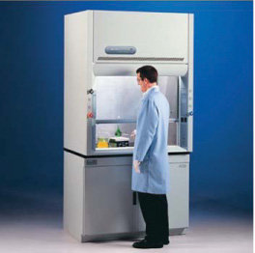
Engineering Controls Laboratory Ventilation
Perchloric acid hoods
Constructed of stainless steel
Have water rinse-down (wash-down) capabilities plumbed into them to remove perchloric acid or perchlorates from the duct work.
Exhaust passes through a water-scrubber on the roof to remove acid vapors
Notes:
Perchloric acid forms highly explosive and unstable compounds with many combustible materials and even with metals. Wood or asphalt tile on which perchloric acid has been spilled may spontaneously ignite.
Perchloric acid should be used with extreme caution and only in a fume hood specifically designed for this use.
Perchloric acid and sulfuric acid, when mixed, produce anhydrous perchloric acid which will ignite any organic material (like wood) and /or explode spontaneously.
All perchlorates should be considered as very explosive, especially on contact with organic materials. They are extremely shock sensitive.
Explosive crystals may form in perchloric acid bottles stored over long periods. For this reason, bottles should not be store for more than one year.

Slide 40
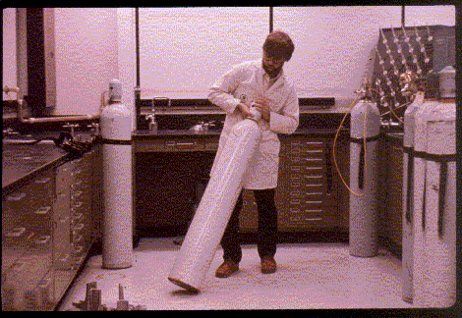
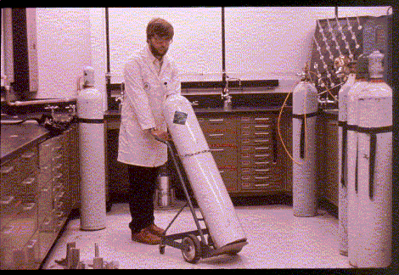
Engineering Controls Transport of Chemicals
Move without a cart
Move with a cart
Notes:
Moving compressed gas cylinders can be awkward (trust me, I know from experience in HazMat). There are several different types of carts designed to move different types/size cylinders.
Two people should move the liquid nitrogen dewars (they are very bulky and heavy).

Slide 41
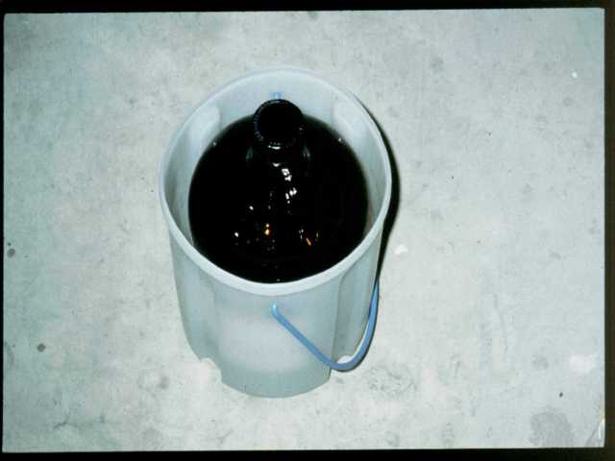
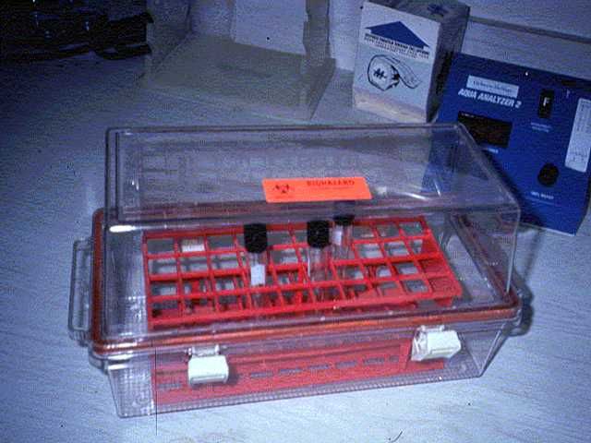
Engineering Controls Transport of Chemicals
Transport in hallways, etc.
Notes:
Never transport open containers of chemicals through the hallways, stairs or in the elevator. All chemicals should be transported in rubber buckets, solvent jug carriers, pails, chemical transport carts (with special dividers to hold glass bottles), or some type of secondary containment device.
This is for containment of the chemical, should the original container be broken.

Slide 42
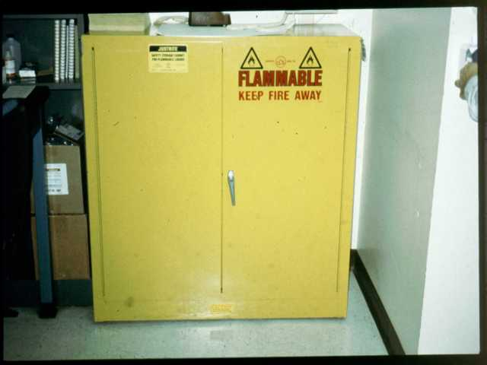
Engineering Controls Flammable Storage
Notes:
Flammable liquids should be stored in approved Safety Storage Cabinets.
They should never be stored with oxidizing agents, ex. Nitric, perchloric and sulfuric acids.

Slide 43
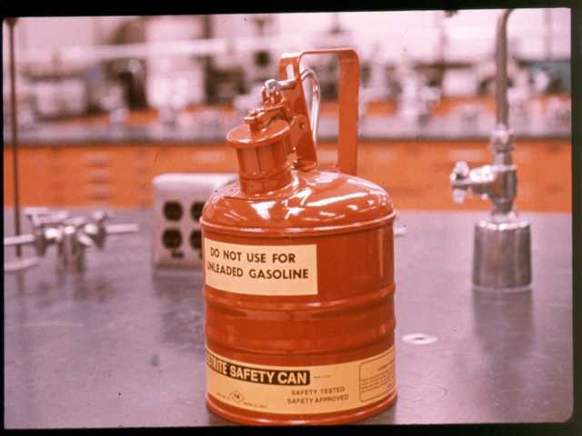
Engineering Controls Flammable Storage
Notes:
Safety cans should be used whenever possible, but should not be subjected to extreme changes in temperature or pressure.
Safety cans should have spring loaded caps with:
Pressure relief valve (allows the release of flammable vapors, which can accumulate—so beware);
A mechanism to prevent leakage or spillage if the can is dropped;
A mechanism to minimize vapor escape;
A flame arrestor to prevent fire from entering a safety can; and
“ “ to smother a fire inside the safety can.

Slide 44
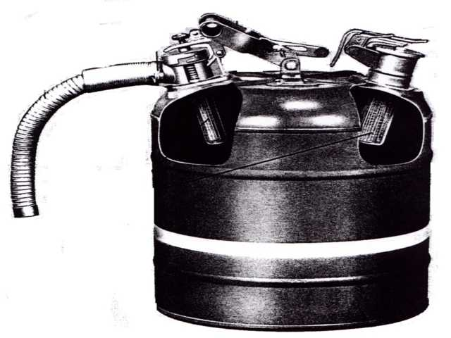
Engineering Controls Flammable Storage
Wire mesh flame arrester
Carrying handle is pulled back to open pouring valve and rear cap
Flexible dispensing hose
Combination fill opening and relief vent
Wire mesh flame arrester

Slide 45
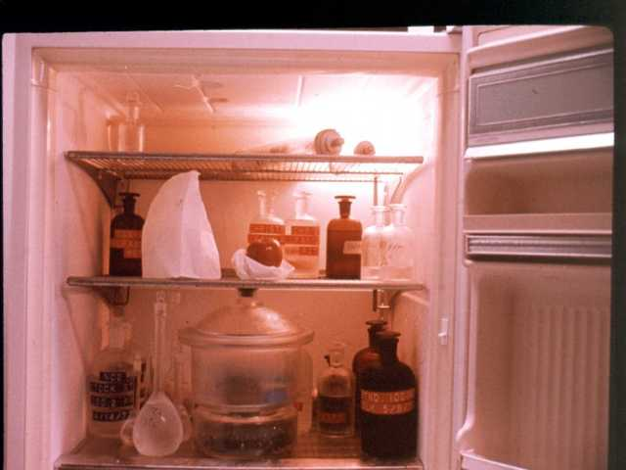
Engineering Controls Flammable Storage
Flammable/explosion proof refrigerators

Slide 46
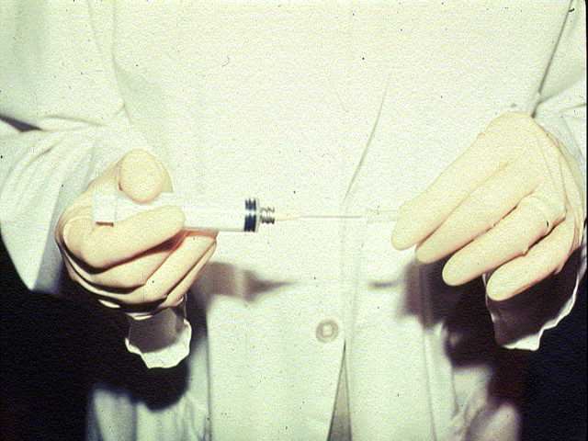
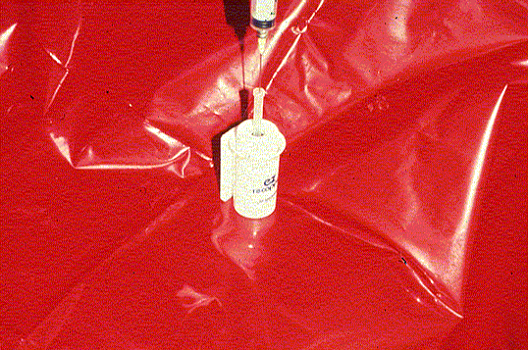

Engineering Controls Sharps Use
Notes:
Various uses of sharps in labs…in analysis (GC’s and in liquid chromatography)…Think of or mention the use of CS2 (acts on central nervous system and has been implicated in some abortions).

Slide 47

Chemical Hygiene Plan Control Measures
29 CFR 1910.1450(e)(3)(ii)
Criteria that will be used to determine and implement control measures to reduce employee exposure to hazardous chemicals including:
Engineering controls
PPE and hygiene practices
Control measures for chemicals that are known to be extremely hazardous

Slide 48
PPE and Hygiene Practices
What is the employer’s position on providing PPE at no cost?
What are the employer’s requirements for PPE?
What PPE is required (eye protection, hand protection, etc.)?
What type of PPE (goggles vs. face shield, nitrile vs. butyl gloves, etc.)?
Where is it required?
When is it required?
Contamination and laundering considerations

Slide 49

PPE and Hygiene Practices
PPE
Hand protection
Eye/face protection
Skin protection
Foot protection
Hygiene
Wash hands
Never eat, drink, … in lab

Slide 50

Why we need the right glove…
Dartmouth Researcher
Karen Wetterhahn
1948-1997
Notes:
Skin contact is a very common route of chemical exposure. Usually, skin contact with chemicals will cause only local irritation or damage. Occasionally, however, skin contact with a chemical can be deadly.
Karen Wetterhahn, professor of chemistry at Dartmouth University, died at the age of 48 in 1997 from exposure to dimethylmercury. She had worked with this organo-metallic compound for years. However, she was wearing gloves that were not resistant to the chemical. One day, while preparing the mercury NMR standard, she spilled “one to several drops” of the dimethylmercury on the back of her gloved hand. The compound permeated the latex gloves she was wearing and was absorbed through her skin into the bloodstream. She said she had removed the glove promptly and did not think any more about the incident, and as a result, no medical monitoring or other follow-up was done. Mercury attacks the central nervous system well before the victim shows symptoms. It wasn’t until five months later that she began losing her balance and having trouble speaking. Tests showed that she had 80 times the lethal dose of mercury in her blood. Despite aggressive chelation treatment, Karen Wetterhahn went into a coma and died 10 months after exposure.
She was wearing disposable latex gloves.
Dimethylmercury is a rare compound, which can pass quickly through latex gloves, and usually without damaging them. It looks like water, but is three times as dense. The compound is attracted to the oil in human skin and is readily absorbed by the body.
Subsequent tests show that this compound permeates latex, PVC, and neoprene almost instantaneously (dimethylmercury migrates through plastics and rubber).
Lessons learned:
SOP’s
PPE selection
Hygiene practices
Training in hazards (inc. MSDS **but remember MSDS may not provide adequate guidance on glove selection)
Emergency Procedures/Equipment/spill response (cmpd has high vapor pressure)
Medical exams/consultation/surveillance
Selection criteria for chemicals with a high degree of acute toxicity, substitution?
“This tragedy highlights the need for research laboratories to develop a protective chemical hygiene plan which includes adequate guidance on the appropriate selection of PPE and engineering controls.
**Highly placed or very well qualified researchers should not be assumed to have adequate health and safety information. Research facilities should recognize that the nature of their work leads to diverse and often severe health hazards, and occupational health and safety must be proportionately pro-active.” -- The directorate of technical support.

Slide 51
PPE Hand Protection
What material is best in glove selection?
Low permeation rate
High breakthrough time
The amount of a chemical
(steady state flow or
highest flow) which is
passed through a
given area of glove
material per unit time
(mg/m2/sec)
The elapsed time from
initial contact of the
chemical to the outside of
the glove to the first
detection of the chemical
on the inside glove
surface
Notes:
Our hands are the body parts most likely to be exposed to chemical contact under normal situations. Even though careful technique may help an employee avoid direct contact with a chemical; the potential for exposure still demands the use of protective gloves.
1. There is no such thing as an impermeable glove. All chemicals will permeate through all glove materials. Gloves are considered protective if the permeation rate is slow enough that the chemical does not break through to the inside.
The objective in choosing a glove should be to seek a low permeation rate and a high breakthrough time, keep in mind:

Slide 52
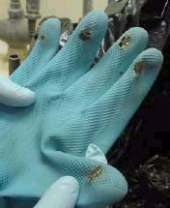
PPE Hand Protection
Keep in mind…
Temperature need greater protection
Double glove = quadruple duration of protection
Solubility of chemical in the glove material
Remember…
No “impermeable glove”
No one glove material works for all
chemicals
For certain chemicals, no glove available
which will provide > 1 hour protection
Notes:
Permeation rates increase and breakthrough times decrease with increasing temperatures. You need greater protection if your chemical processes involve heat.
Thickness – Permeation is inversely proportional to thickness. Breakthrough time is directly proportional to the square of the thickness. Double gloving can quadruple the duration of protection.
Solubility – Permeation is a direct function of the solubility of the chemical in the glove material.

Slide 53
PPE Hand Protection
What other factors are important?
Resistance to physical damage
Flexibility
Heat resistance
Incompatibilities
Notes:
Many other factors must be considered when selecting the glove that best suits the task. Some of these factors include:
Resistance to Physical Damage—Do you need a glove that resists abrasions, cuts, punctures, or tears? A torn glove made of the perfect material is less protective than an intact glove made of another reasonably adequate material.
Flexibility – Is the ability to feel or manipulate small objects important or can you use a thicker more protective glove? Ex. HazMat and Firefighting
Heat Resistance – Do you have a hot operation? As stated in the previous slide, heat increases permeation rates. In addition, heat can lead to the breakdown of the glove material.

Slide 54
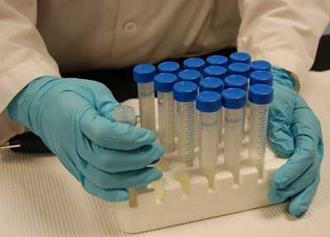
PPE Hand Protection
Resources for glove selection
Glove manufacturer
MSDS’s
“Prudent Practices in the Laboratory”
Web sites
www.bestglove.com
www.superiorglove.com/product.review/index.htm
http://www.ansellpro.com/specware/index.asp
Notes:
The intent of have so much discussion of hand protection is because of it’s importance for life and wellness, and
to present an overview of the complex nature of selecting the correct glove for adequate protection.
Users should consult their Chemical Hygiene Officer and/or Safety Officer, their Standard Operating Procedures or Safe Work Practices, the MSDS, glove manufacturer’s literature and various other resources list here. Also I have attached an appendix which contains additional guidance on glove selection for specific chemicals.

Slide 55
PPE Eye and Face Protection
Various types of eye protection in order of increasing effectiveness:
Ordinary spectacles
Safety glasses with side shields
Protective goggles
Face shields
Head shields, which protect all of the head and throat
What is the company’s policy on
contact lenses?
Notes:
Where there is potential of a corrosive chemical being splashed into the eyes, safety glasses or goggles AND a face shield should be worn. In situations where there is potential for an explosion to occur, head shields are required to safety glasses or goggles.
What is the company’s policy on Contact lenses?

Slide 56
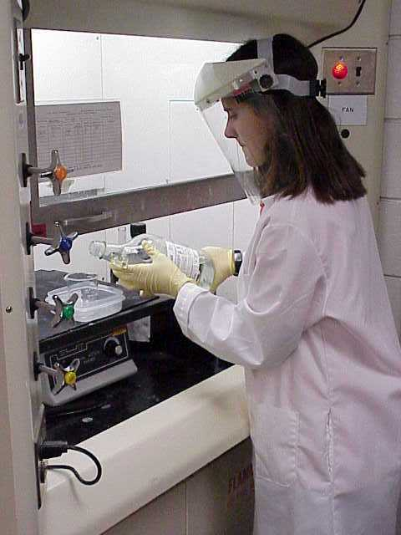

PPE Skin Protection
Notes:
Lab coats should be worn when working with chemicals. Buttons and closures shall be used.
Always wear clothing that minimizes the amount of skin that can be exposed to potentially harmful chemicals. Never wear shorts in the lab.
??Wear an apron when working with acids or bases.

Slide 57
PPE Foot Protection
Notes:
No bare feet,
Shoe must cover top of foot, toe and heel
No pumps (doesn’t cover top of foot, slippery, and trip hazard b/c of high heel)
Cowboy boots are good because most likely leather, but may have a heel that is unacceptable.
Sneakers may be adequate (depending on whether canvas is appropriate or not).
Yes to a shoe that completely covers the foot, toe, and heel, flat sole, rubber sole? Leather shoe?

Slide 58
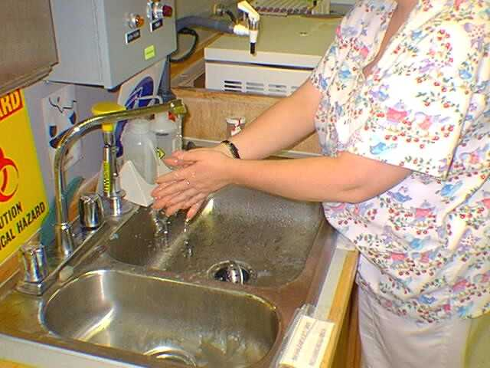
Hygiene Practices
Notes:
Wash hands often –
always before eating, smoking, drinking, applying cosmetics, and handling contact lenses
AND before leaving the laboratory…refer to accident described by Jim Miller in Utah about the man working with a chemical, wore gloves, handled a pen to take notes, intercom announces he has a phone call, he takes off gloves, answers the phone, takes the message using same pen, figures gloves are off he might as well go use the bathroom. Goes to the restroom, we are taught to wash hands afterwards, and he did.. But that didn’t help the subsequent burning of his leg and penis.

Slide 59
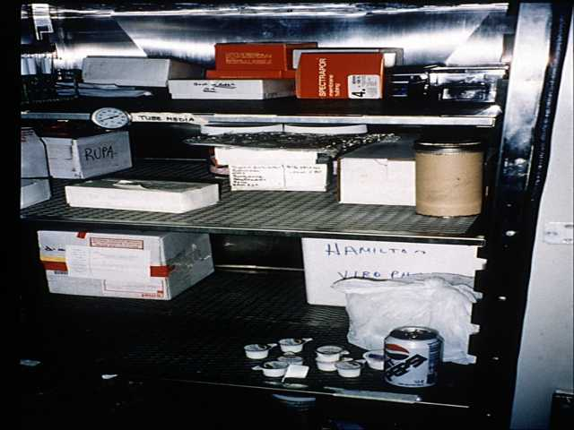

Hygiene Practices
Ingestion
Contamination
Notes:
Ingestion of chemicals occurs mostly through carelessness in the workplace. This might happen if a person puts their lunch or drink in a chemical refrigerator and someone spills a chemical on it.
Do not put objects (pencils, fingers, swabs, etc. in your mouth, ears or nose)

Slide 60
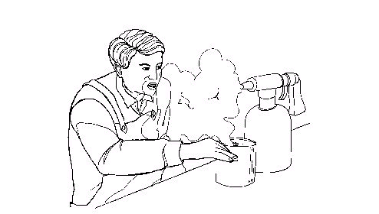
Chemical Hygiene Plan Control Measures
29 CFR 1910.1450(e)(3)(ii)
Criteria that will be used to determine and implement control measures to reduce employee exposure to hazardous chemicals including:
Engineering controls,
PPE and hygiene practices,
Control measures for chemicals that are known to be extremely hazardous

Slide 61


Extremely Hazardous Chemicals
What is an extremely hazardous chemical?
Resources for finding what is an extremely hazardous chemical:
ACGIH TLVs, NIOSH, etc.
Genium “Right to Know Pocket Guide for Laboratory Employees”
Van Nostrand & Reinhold “ Condensed Chemical Dictionary”

Slide 62
Extremely Hazardous Chemicals
What are the specific control measures in place for these chemicals?
Chemical procurement
Safe handling practices
Description of PPE
Air monitoring
Emergency eyewash/shower facilities
Working alone
Notes:
Mention Johnston County Schools
Resources for finding what is a extremely hazardous chemical:
ACGIH, TLVs
Genium “Right to Know Pocket Guide for Laboratory Employees”
Van Nostrand & Reinhold “ Condensed Chemical Dictionary”

Slide 63
Chemical Hygiene Plan Fume Hoods/Other Protective Equipment
29 CFR 1910.1450(e)(3)(iii)
Specific measures to ensure that fume hoods and other protective equipment are functioning properly and are maintained
How often do you test / inspect to verify flow rate and other parameters?
Notes:
Fume hoods should be used in all operations involving toxic or flammable materials

Slide 64
Chemical Hygiene Plan Information and Training
29 CFR 1910.1450(e)(3)(iv)
Provisions for employee information and training refer to paragraph (f) of the lab standard
For example:
When will training be provided?
Who will provide the training?
How will the training be implemented (format)?
What will the training include?
Notes:
Safe operation of the laboratory is largely contingent upon personnel awareness and knowledge. It applies to the familiarity with procedures as well as the hazards of chemicals and equipment in the laboratory.

Slide 65

Chemical Hygiene Plan Prior Approval
29 CFR 1910.1450(e)(3)(v)
Circumstances under which a particular lab operation, procedure, or activity requires prior approval from the employer
Describe when a particular laboratory operation requires prior approval
Non-routine tasks that may introduce additional hazards into the workplace?
New methods, analysis?
Notes:
Are chemicals procured by the individual or is there a chemical store room?
Mention BASF with the perchloric acid.

Slide 66
Chemical Hygiene Plan Medical Consultation
29 CFR 1910.1450(e)(3)(vi)
Provisions for medical consultation and medical examinations in accordance with paragraph (g) of the lab standard
Each employee entitled, Why/for what reasons?
At no cost
Without loss of pay
At a reasonable time and place
Where? When? Who?

Slide 67

Chemical Hygiene Plan Chemical Hygiene Officer
29 CFR 1910.1450(e)(3)(vii)
Designate who is responsible to implement plan
May use a committee
A Chemical Hygiene Officer must be qualified by training or experience, and
To provide technical guidance in the development and implementation of the provisions of the CHP.
Notes:
The CHO must of have knowledge of chemical health and safety that differentiates the CHO from other safety & health professionals.
Good working knowledge of chemistry and have lab experience.
Still will have a lab manager who has responsibility for their employee’s safety (the CHO facilitates). Also needs good communication skills, and supervisory experience.

Slide 68

Chemical Hygiene Plan Particularly Hazardous Substances
29 CFR 1910.1450(e)(3)(viii)
Provisions for additional employee protection for “select carcinogens”, reproductive toxins, and substances with a high degree of acute toxicity.
Establish designated area
Use of containment devices
Disposal/removal of waste
Decontamination procedures
Note: This section with (e)(3)(ii) regarding extremely hazardous substances, and (e)(3)(iv) regarding prior approval may all be combined in the CHP.
Notes:
“Select carcinogen” covers a narrower range of substances—any substances regulated as a carcinogen by OSHA, those identified by IARC or NTP, also “potential carc”
Reproductive toxins may manifest themselves as lethal effects on the fertilized egg, developing embryo, or fetus, or teratogenic (malformation) effects in the fetus. Also, some toxins may cause infertility in females AND males.
Acute toxicity examples are: hydrogen cyanide, hydrogen sulfide, and nitrogen dioxide.
1. Designated area is less restrictive and more appropriate for lab operations than the regulated area (which refers to an actual demarcation) as defined in other OSHA standards. It’s purpose is to focus attention on the fact that a particularly hazardous substance is being used and to ensure, where appropriate protective measures are observed by employees working in or near. NOT to restrict large areas of lab space. It may be the entire lab, an area of the lab, or a device such as a hood.

Slide 69
Chemical Hygiene Plan Review
29 CFR 1910.1450(e)(4)
Review AND evaluate the effectiveness of the Chemical Hygiene Plan at least annually and update as necessary

Slide 70
Objective 3 Information and Training
29 CFR 1910.1450(f)
Purpose
To ensure employees are apprised of the hazards of chemicals in their work area
When
Initial assignment
Prior to assignments involving new exposure situations
Frequency of refresher training TBD by the employer
Notes:
OSHA proposed that the training and info. Provisions supersede those of the HazCom Std.

Slide 71
Employee Information
29 CFR 1910.1450(f)(3)
Contents of standard and appendices; shall be made available
Location and availability of Chemical Hygiene Plan
The PELs or RELs (NIOSH) for substances with no OSHA PEL
Informed of What?

Slide 72

Employee Information
29 CFR 1910.1450(f)(3)(iv)-(v)
Signs and symptoms associated with exposures to chemicals used in the laboratory
Location and availability of reference materials on hazards, safe handling, storage and disposal, BUT not limited to MSDSs!!
Notes:
The required training does not necessarily involve training for each specific chemical that the employee will use, but rather the approach may be directed to classes or groups of hazardous chemicals.
** Pertinent reference materials concerning hazards, safe handling, storage and disposal of hazardous chemicals are an essential part of an effective employee protection program. With HazCom, such hazard id is to be provided by the MSDS that accompanies the shipment of the chemical. However, in the event that such info is not received, or is incomplete, or the chemical is generated in the lab, additional reference material is necessary.
***Initially, the proposed lab std only included training on available resources. However, after several groups contested this proposal, OSHA agreed they may have relied too heavily on information which suggested that most lab personnel were already knowledgeable about the hazards related to the chemicals with which they work and the precautions necessary to protect themselves. Even those with advanced degrees are not necessarily trained in the safety and health aspects assoc. with chemical exposures.
There is no restriction on the form in which reference material may be kept, and some er’s may wish to utilize computer technology. This is acceptable as long as employees are aware of procedures necessary to access the information from this source.

Slide 73
Employee Training
29 CFR 1910.1450(f)(4)
Methods and observations to detect presence or release of hazardous chemical
BOTH physical and health hazards of chemicals used
Methods to protect from hazards inc. specific procedures, work practice, emergency procedures, and PPE
Training shall include WHAT?
Notes:
**Although many lab personnel have advanced degrees and are highly competent in their fields of study, that does not make them expert in the hazards associated with chemicals. ***Those with advanced degrees sometimes demonstrate a cavalier attitude towards the potential hazards, and it is important that lab employees receive training to recognize the hazards.
Such as monitoring conducted by the employer, continuous monitoring devices, visual appearance or odor when being released, etc.
Although the proposed standard originally left out training in physical hazards, OSHA realized lab personnel could benefit from this training. Physical hazards are often responsible for subsequent adverse health effects, like explosions and fire could release toxic fumes and vapors. ALSO, failure to provide training on the physical hazards could lead to a false sense of security concerning the range of hazards present.

Slide 74
Employee Training
29 CFR 1910.1450(f)(4)(ii)
The applicable details of the employer’s written chemical hygiene plan, which includes:
Standard operating procedures
Prior approval protocols, and procedures for handling select carcinogens, reproductive toxins, and substances with a high degree of acute toxicity (particularly hazardous substances).
Notes:
This differs from the HazCom standard
**For the most part, the training provisions of the lab std are identical to the HazCom Std. There are several additional elements which are specific to the lab std and the chemical hygiene plan in particular.
**Wherever there may be duplication of any requirement, there is no need to perform the function twice. If an employer is complying with the HazCom std, either by choice or necessity, his activities will automatically satisfy any identical requirement of this std.

Slide 75
Medical Consultation and Medical Examinations
29 CFR 1910.1450(g)(1)
All employees must be provided with an opportunity to receive medical attention, including any follow-up examinations, under the following circumstances:
Notes:
The medical consultation is provided for the purpose of determining the need for a medical examination.
Irritation or worse is covered, and medical evaluation needs to be offered.
Stinky odors, discoloration of the skin, etc. are not covered.
Given the multiple chemicals used and the unpredictable exposure situations typical of most lab operations, exposure monitoring was not practical. Additionally, routine medical surveillance was indicated to be prohibitively expensive and have little value because of the wide variety of substances to which workers were exposed, and the difficulty in identifying indicators of adverse health effects.
However, the potential for overexposure still existed, so…

Slide 76
Medical Consultation and Medical Examinations
29 CFR 1910.1450(g)(1)(i)-(ii)
An employee develops signs or symptoms associated with chemical
Exposure monitoring reveals an exposure level routinely above the AL or PEL
For an OSHA regulated substance for which there are exposure monitoring and medical surveillance requirements
Follow the procedure as prescribed by the particular standard
Notes:
The proposed standard required employers to provide employees with an exposure evaluation in cases where there was reason to believe an overexposure had taken place. This was not adequate enough for one it relied on the subjective opinion of someone other than the employee that they had been overexposed. It also did not take into account the fact that the employee may feel like they have been exposed, and that they should be allowed to seek medical attention if they had been.
So the final standard incorporates signs or symptoms as a reason for an evaluation.
AND if there appears to be an identifiable condition in terms of overexposure (I.e. exposure levels above the action level (or in case of the absence of an action level, the PEL)

Slide 77
Medical Consultation and Medical Examinations
29 CFR 1910.1450(g)(1)(iii)
Whenever an event such as a spill, leak, explosion, or other occurrence resulting in exposure
Also when...
Notes:
These situations described in these slides should be covered as a minimum in any medical program designed for laboratory workers.

Slide 78
Medical Consultation and Medical Examinations
29 CFR 1910.1450(g)(3)(i)-(iii)
Identity of chemical
Description of conditions (inc. quantitative exposure data, if available)
Description of signs and symptoms
Information provided to the physician
Notes:
All medical exams and consultations shall be provided by or under the direct supervision of a licensed physician, and at a reasonable time and place without cost to the employee.
Problem with trade secrets

Slide 79
Medical Consultation and Medical Examinations
29 CFR 1910.1450(g)(4)(i)-(ii)
Physician’s written opinion shall include:
Any recommendation for medical follow-up
Results of exams/tests
Any medical condition revealed that may increase risk as result of exposure to chemical
A statement that the employee has been notified of findings
Shall NOT reveal any specific findings
unrelated to occupational exposure
Notes:
**Employer must provide all protective measures to that employee, unless physicians deems employee MUST be medically removed.
Existing health impairment may increase health risk, physician should indicate general nature and not specific illness
Written opinion must not reveal specific findings unrelated to occupational exposure.

Slide 80
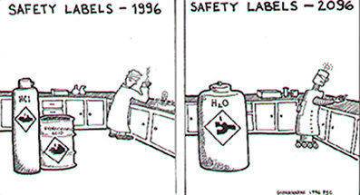
Hazard Identification
29 CFR 1910.1450(h)

Slide 81
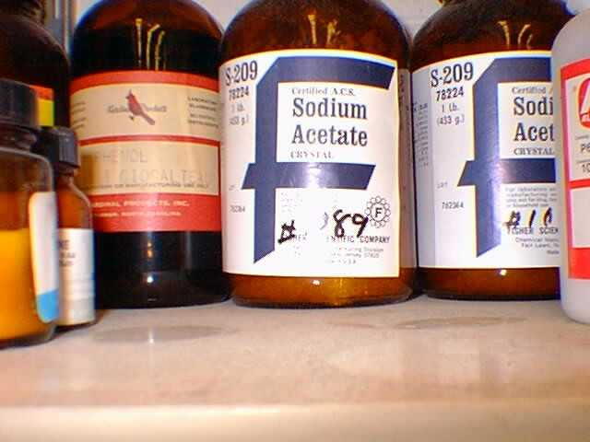
Hazard Identification
29 CFR 1910.1450(h)(1)
With respect to labels and MSDSs
Employers shall ensure that labels on incoming containers are not removed or defaced
Employers shall maintain any MSDSs received on incoming chemicals and ensure that they are readily accessible
Notes:
This action does not represent an increased obligation on employers. They are just to ensure that labels on incoming containers are not removed or defaced. And to retain the MSDSs.

Slide 82

Hazard Identification
29 CFR 1910.1450(h)(2)(i)
For chemicals developed in the lab
If chemical is produced exclusively for the lab’s use, and the composition is known, the employer shall provide appropriate training as required by paragraph (f)
Notes:
First, if a chemical substance whose chemical composition is known is produced in the lab, for its own use, the available hazard information must be provided to the employee.

Slide 83
Hazard Identification
29 CFR 1910.1450(h)(2)(ii)
For chemical developed in the lab
Chemical produced is a byproduct whose composition is not known, assume hazardous, and implement paragraph (e) (Chemical Hygiene Plan)
? ? ? ? ?
Notes:
Second, employers who produce a chemical by byproduct whose composition is unknown shall make the assumption that the substance is hazardous, and require it to be handled according to the chemical hygiene plan which provides for appropriate employee protection of chemicals. By following this approach, the employer will not be required to conduct literature searches or perform actual tests to evaluate the hazard.

Slide 84
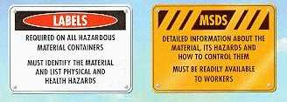
Hazard Identification
29 CFR 1910.1450(h)(2)(iii)
For chemical developed in the lab
If chemical is produced for another user outside of the laboratory, the employer shall comply with the Haz Com standard (1910.1200), including the preparation of MSDSs and labeling
Notes:
Finally, with respect with to the substance produced, the employer has become a manufacturer and therefore is subject to all of the relevant provisions of the HazCom std. However, if manu. Is not the lab’s principal concern, the lab std remains in effect for those activities unrelated to the manu. operations

Slide 85
Use of Respirators
29 CFR 1910.1450(i)
Where the use of respirators is necessary to maintain exposures below the PELs, the employer must comply with the requirements in the respiratory protection standard, 29 CFR 1910.134
Notes:
These provisions do not impose any new requirements on laboratory employers, but are included here to remind the employer of the existing compliance duty.

Slide 86
Recordkeeping
29 CFR 1910.1450(j)(1)-(2)
The employer shall establish and maintain an accurate record of any exposure monitoring and medical consultation/ examination
Employer shall ensure records are kept per 1910.1020
Employment plus 30 years
Notes:
Keep records for duration of employment plus 30 years.

Slide 87

What else do we look for, and Why?

Slide 88

What else do we look for, and Why?
Please ask for additional information, if interested.
I only included a few extra slides due to the limited time of the presentation.

Slide 89
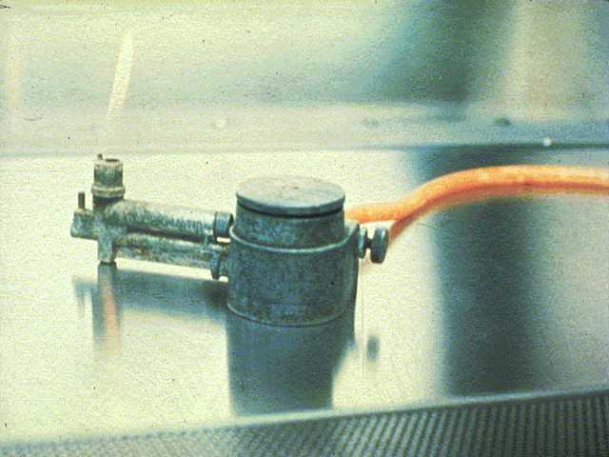
General Handling and Storage of Flammable Chemicals
Never heat with an open flame
Do not expose to sources of ignition (electric motors, bunsen burner flames, etc)
All containers must be labeled
Beware of static electricity…
Notes:
The one fire we were told about at BASF was due to flammable liquid (ethanol) being heated over an open flame
Static electricity is generated when liquids, esp flammable liquids, move and make contact with other materials, like during pouring, pumping etc. If the static electric charge becomes sufficient enough, a spark can occur from one metal container to the other container and ignite the vapor air mixture.

Slide 90
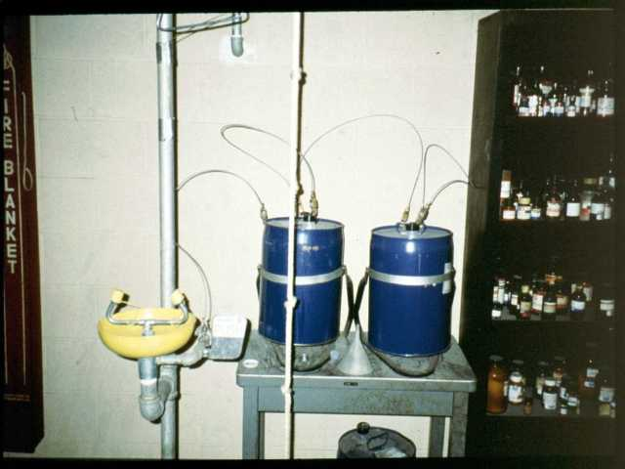
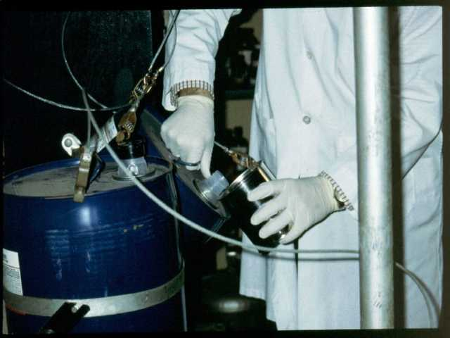
General Handling and Storage of Flammable Chemicals
When dispensing flammable liquids (metal to metal), the dispensing container and safety can must be well grounded and bonded

Slide 91

Specific Hazards of Organic Peroxides
Explosive chemicals
Some types of peroxides can be handled with relative safety, an insidious and treacherous hazard concerning peroxides is their formation from certain classes of compounds AFTER exposure to air
Examples:
1,4-dioxane, ethyl ether, isopropyl
ether, THF, tetralin, cylcohexane,
decalin

Slide 92

Specific Hazards of Ethers…
Explosive chemicals
Ethyl Ether preferably stored in metal cans
Inhibited grades can be used longer - no more than 6 months
Pure, non-inhibited - dispose w/in a few weeks of exposure to air

Slide 93


Other Hazards: Compressed Gases
Protective caps should be kept on cylinders when not in use
Secured by straps, chains, or stand (more than halfway up the cylinder)

Slide 94


Other Hazards: Electrical Safety
Grounding
Protect from static electricity
High voltage equipment caged or completely insulated

Slide 95

Other Hazards: Radiation Safety and Lasers

Slide 96

Other Hazards: Biological Safety

Slide 97


Other Hazards: Biological Safety
Containment
Biosafety Levels (1,2,3,4)
Who’s on First?
Notes:
Biosafety level 1
This level is suitable for work involving well-characterized agents not known to consistently cause disease in healthy adult humans, and of minimal potential hazard to laboratory personnel and the environment (CDC,1997).^{[7]}
It includes several kinds of bacteria and viruses including canine hepatitis, non-pathogenic Escherichia coli, as well as some cell cultures and non-infectious bacteria. At this level precautions against the biohazardous materials in question are minimal, most likely involving gloves and some sort of facial protection.
Biosafety level 2
This level is similar to Biosafety Level 1 and is suitable for work involving agents of moderate potential hazard to personnel and the environment.^{[7]} It includes various bacteria and viruses that cause only mild disease to humans, or are difficult to contract via aerosol in a lab setting, such as C. difficile, hepatitis A, B, and C, influenza A, Lyme disease, dengue fever, Salmonella, mumps, measles, HIV,^{[8]} scrapie, MRSA, and VRSA. Genetically modified organisms have also been classified as level 2 organisms, even if they pose no direct threat to humans. This designation is used to limit the release of modified organisms into the environment.
Biosafety level 3
This level is applicable to clinical, diagnostic, teaching, research, or production facilities in which work is done with indigenous or exotic agents which may cause serious or potentially lethal disease after inhalation.^{[7]} It includes various bacteria and viruses that can cause severe to fatal disease in humans, but for which vaccines or other treatment exist, such as Mycobacterium tuberculosis, Bacillus anthracis, West Nile virus, Venezuelan equine encephalitis virus, Eastern equine encephalitis virus, Hendra virus, SARS coronavirus, Salmonella typhi, Coxiella burnetii, Rift Valley fever virus, Rickettsia rickettsii, and yellow fever virus.
Biosafety level 4
This level is required for work with dangerous and exotic agents that pose a high individual risk of aerosol-transmitted laboratory infections, agents which cause severe to fatal disease in humans for which vaccines or other treatments are not available, such as Bolivian and Argentine hemorrhagic fevers, Marburg virus, Ebola virus, Lassa fever, Crimean-Congo hemorrhagic fever, and other various hemorrhagic diseases

Slide 98


Other Hazards: Biological Safety, cont’d
Pipetting safety
Biosafety cabinet

Slide 99




Other Hazards: Centrifuge Safety

Slide 100

Thank You For Attending!
Final Questions?
1-800-NC-LABOR
(1-800-625-2267)
www.nclabor.com
Notes:
100

